Slide 1
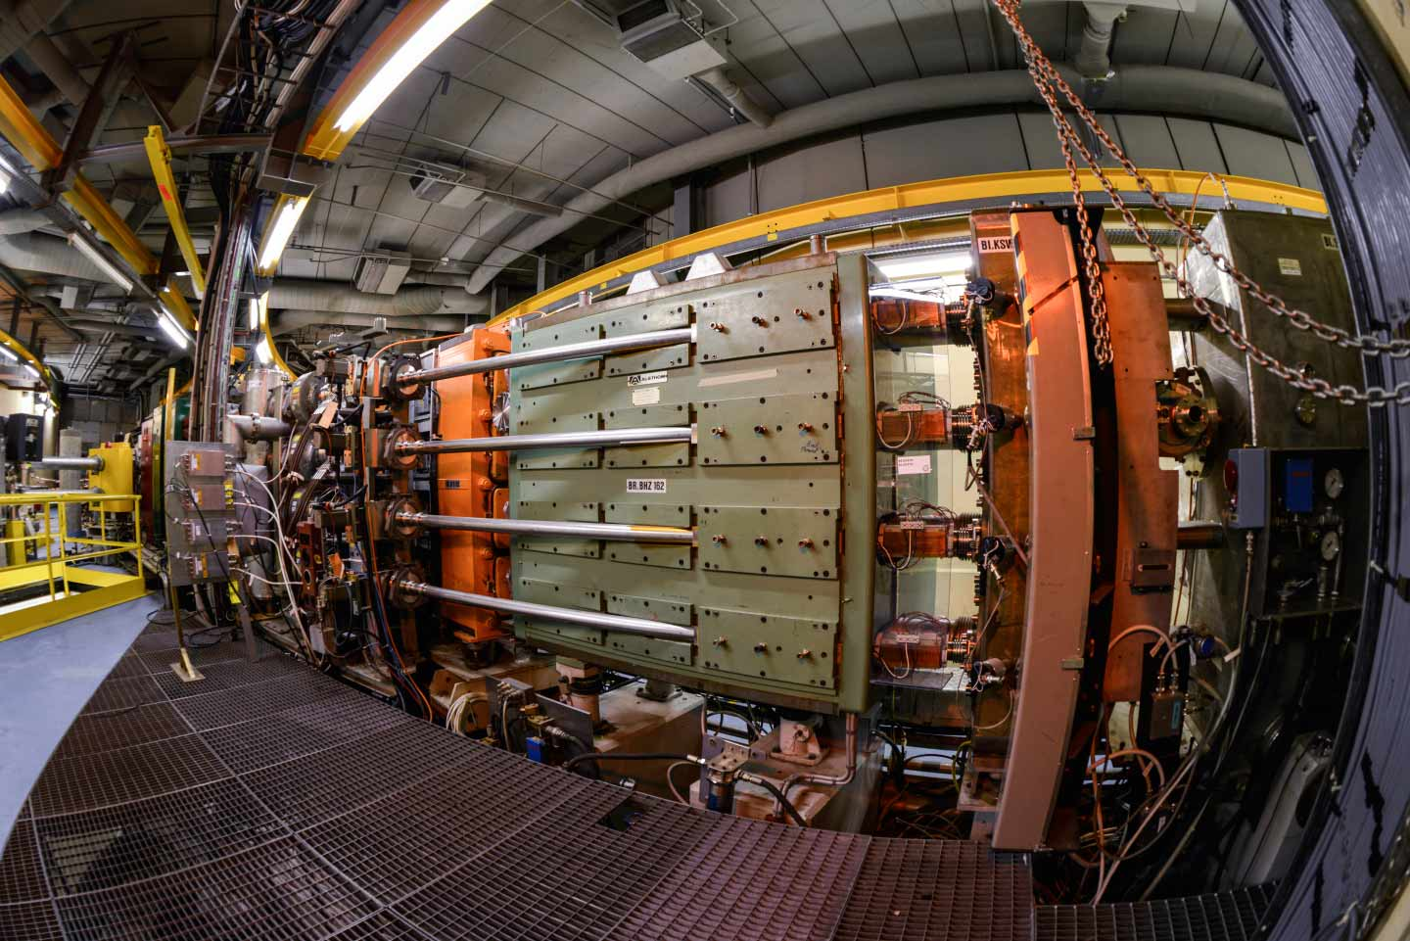
Experimental Investigations on the High-Intensity Effects near the Half-Integer Resonance in the PSB
T. Prebibaj, F. Antoniou, F. Asvesta, H. Bartosik, G. Franchetti
HB2023 Flash Presentation Seminar
16/11/2023

Slide 2
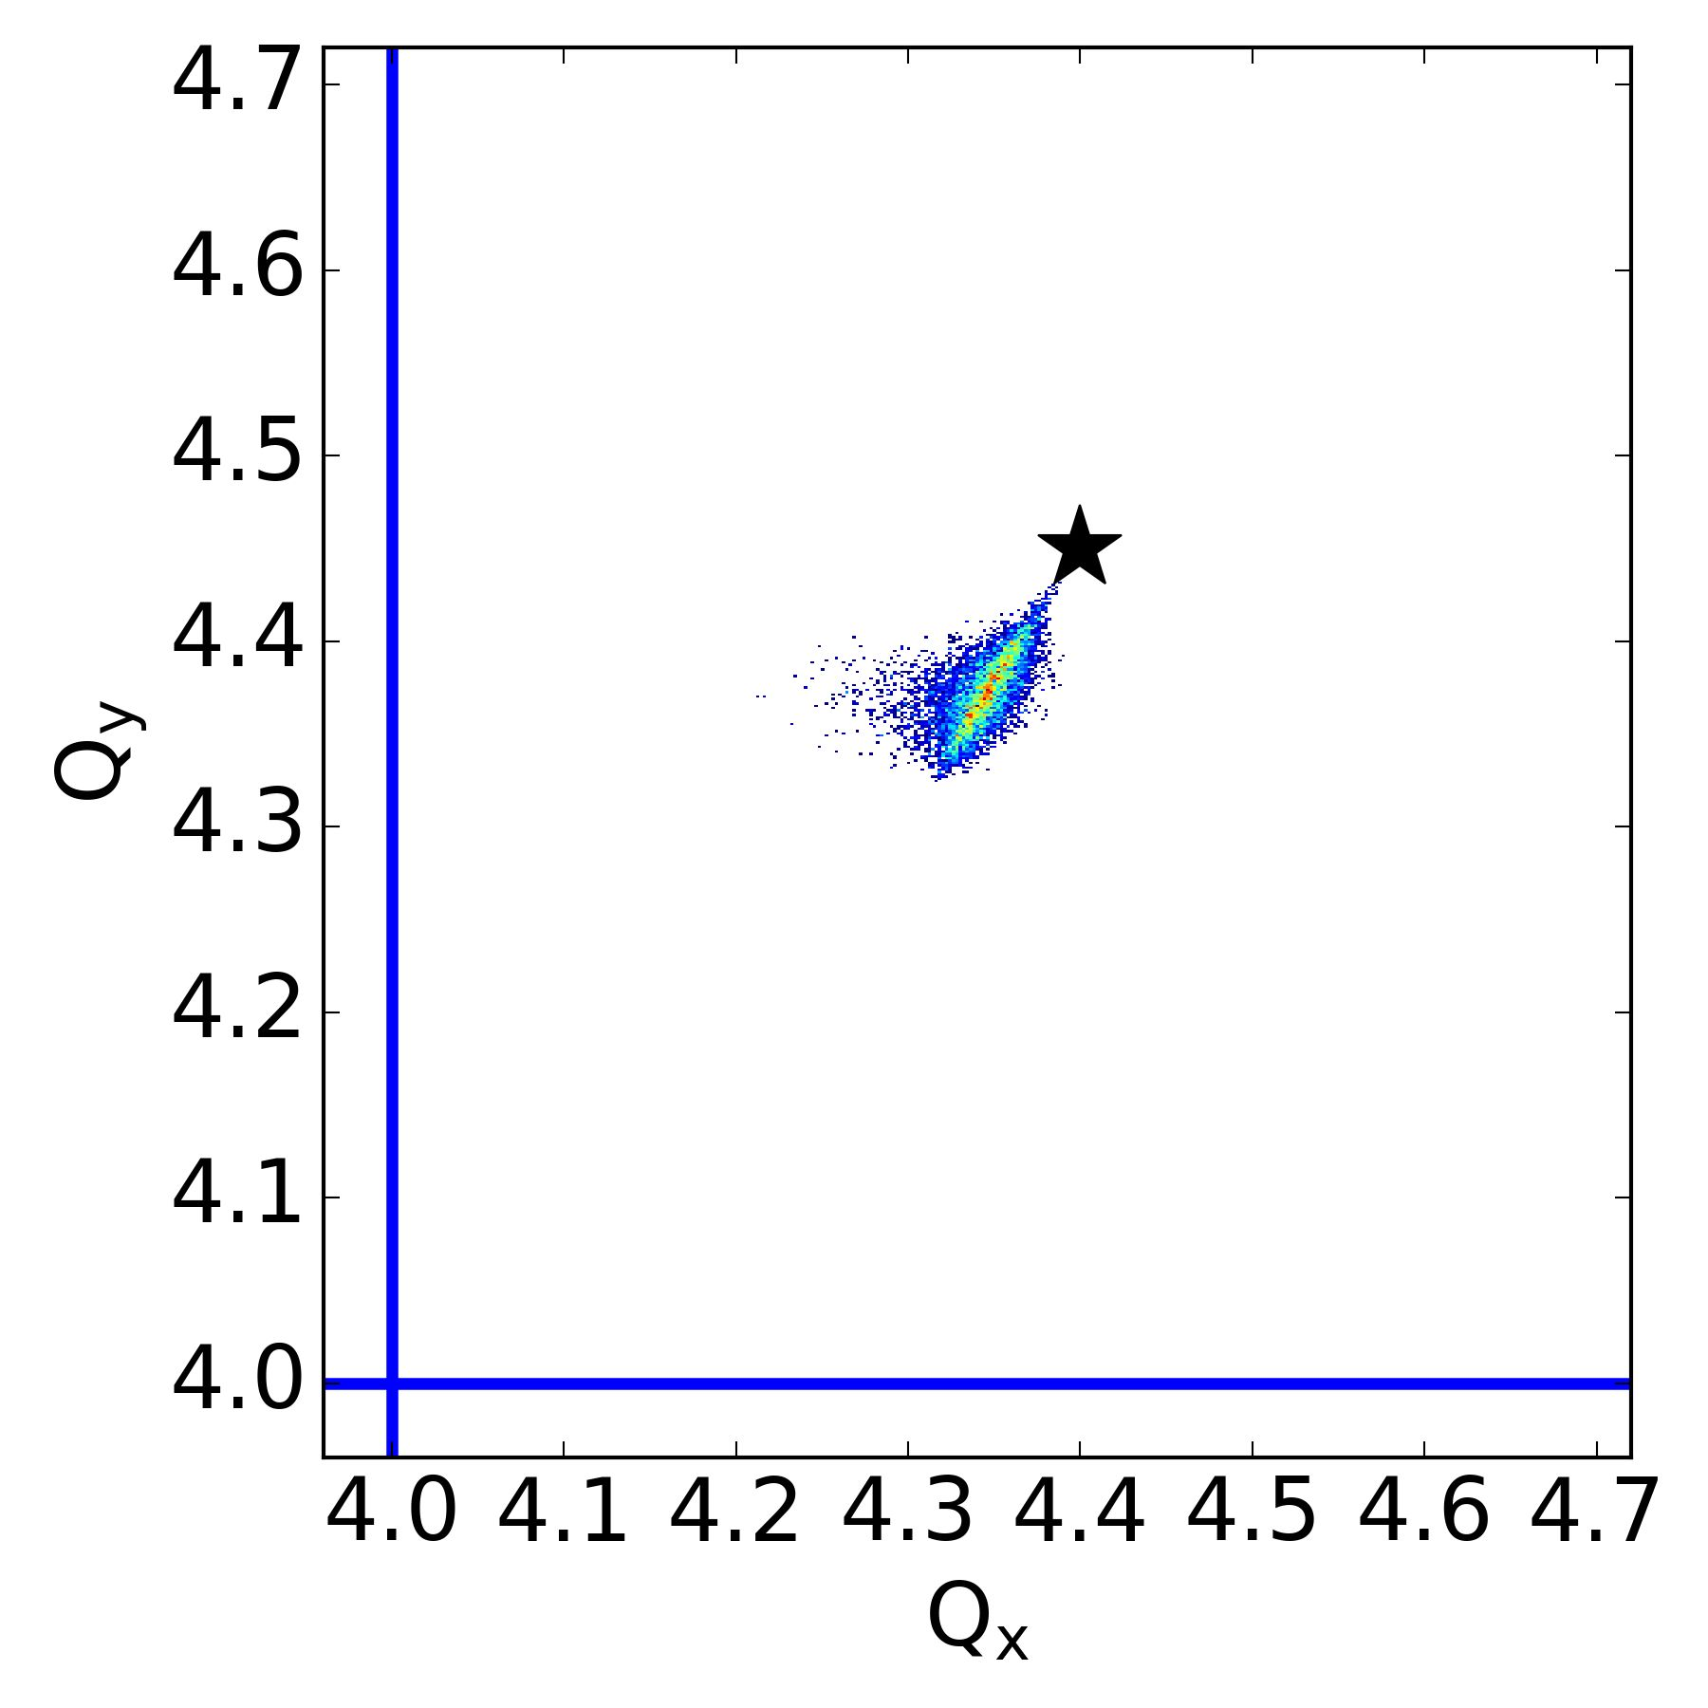
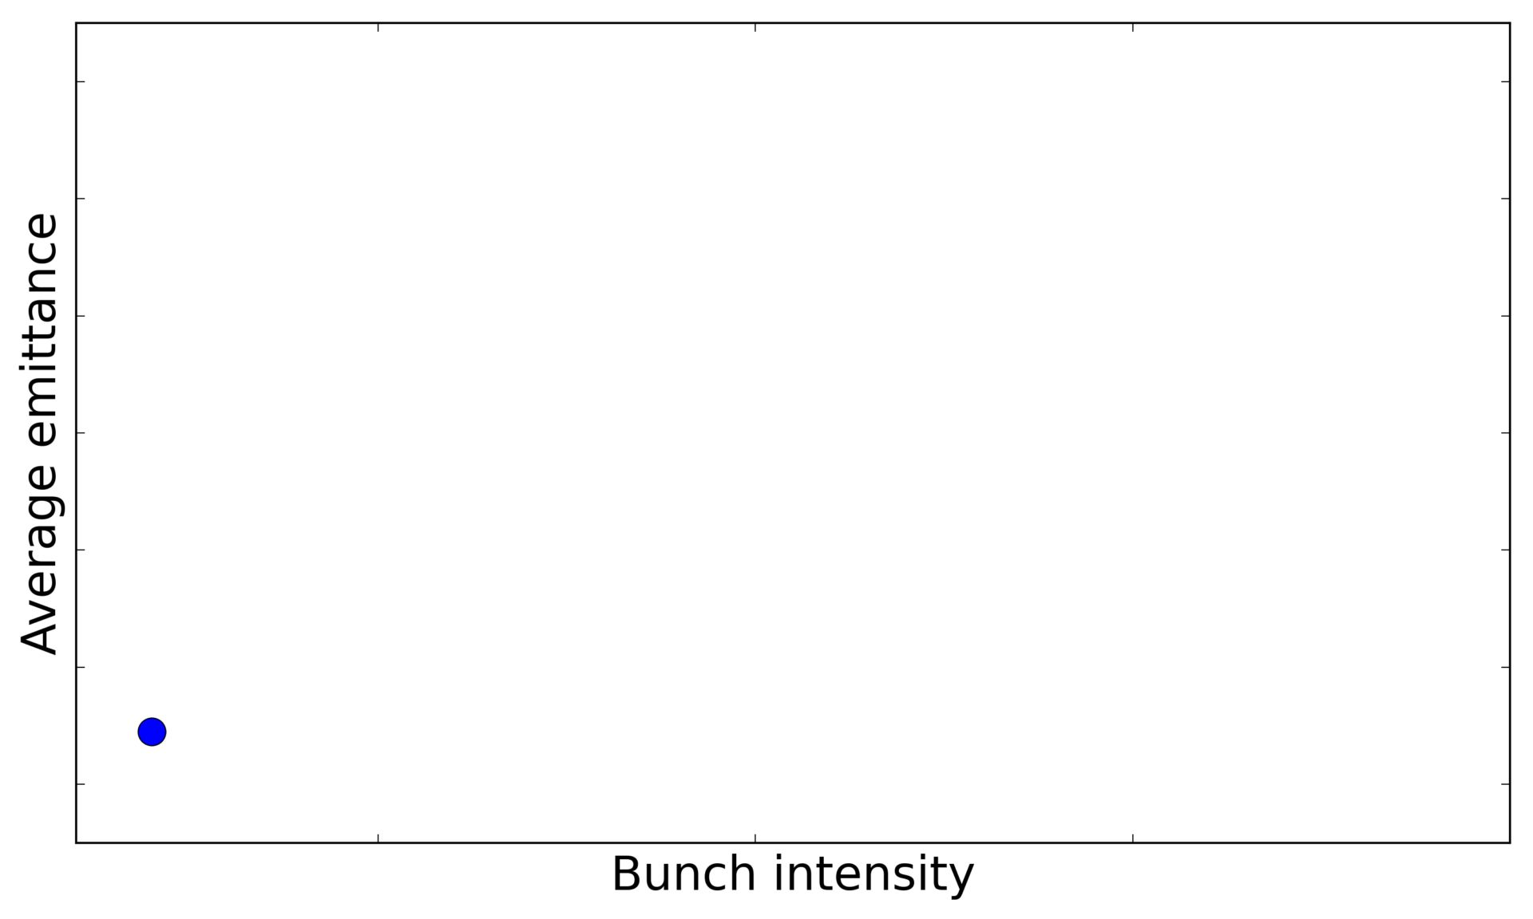

Slide 3
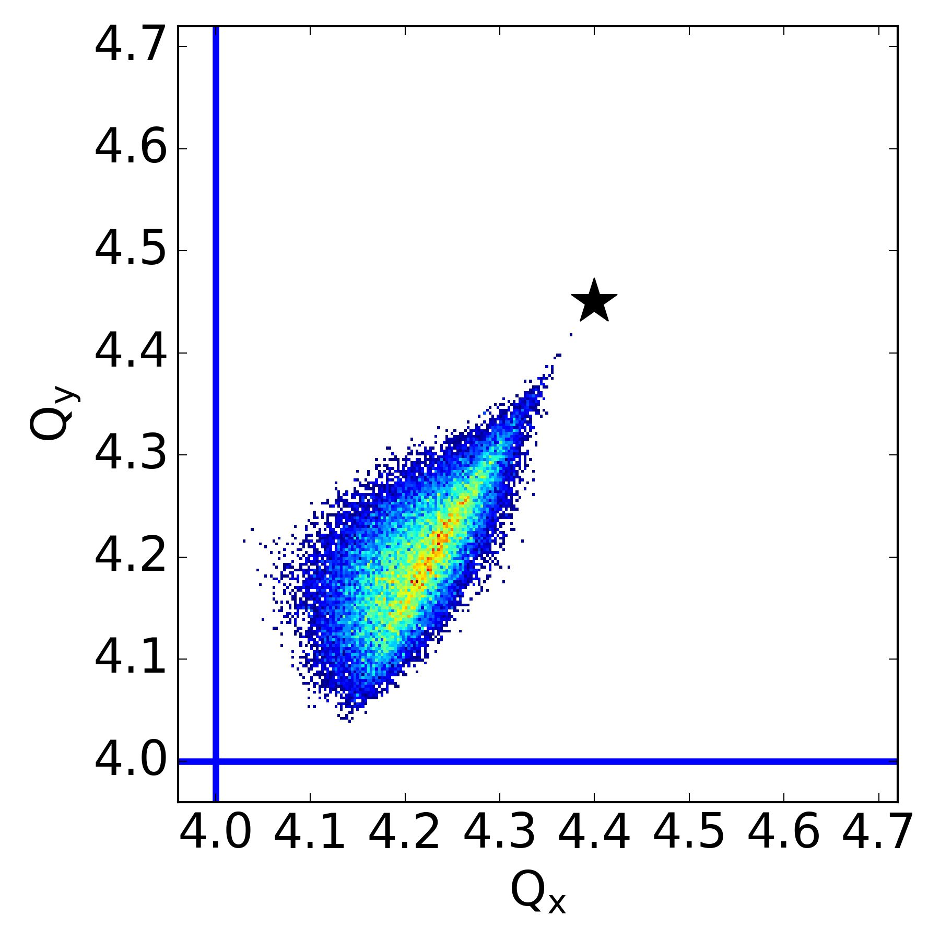
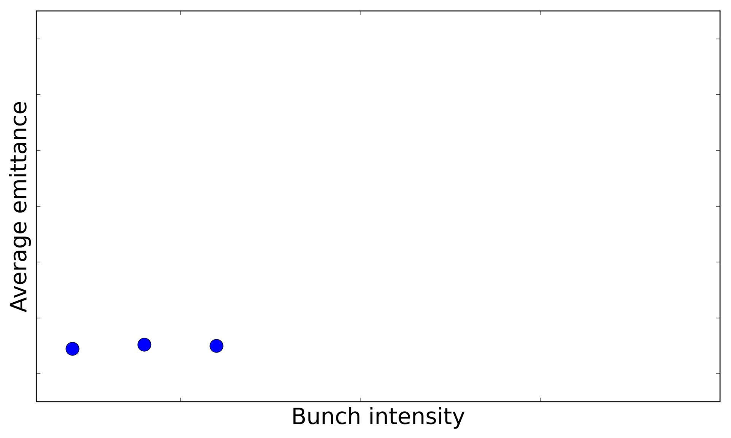

Slide 4
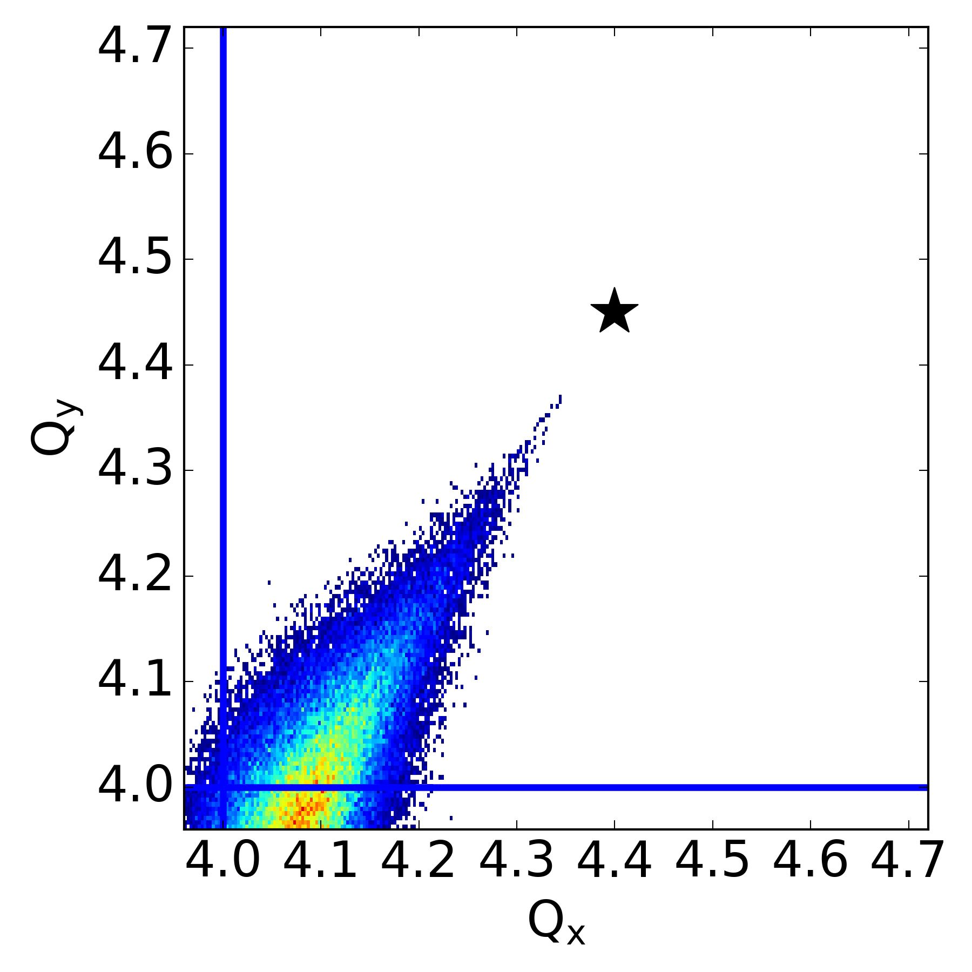
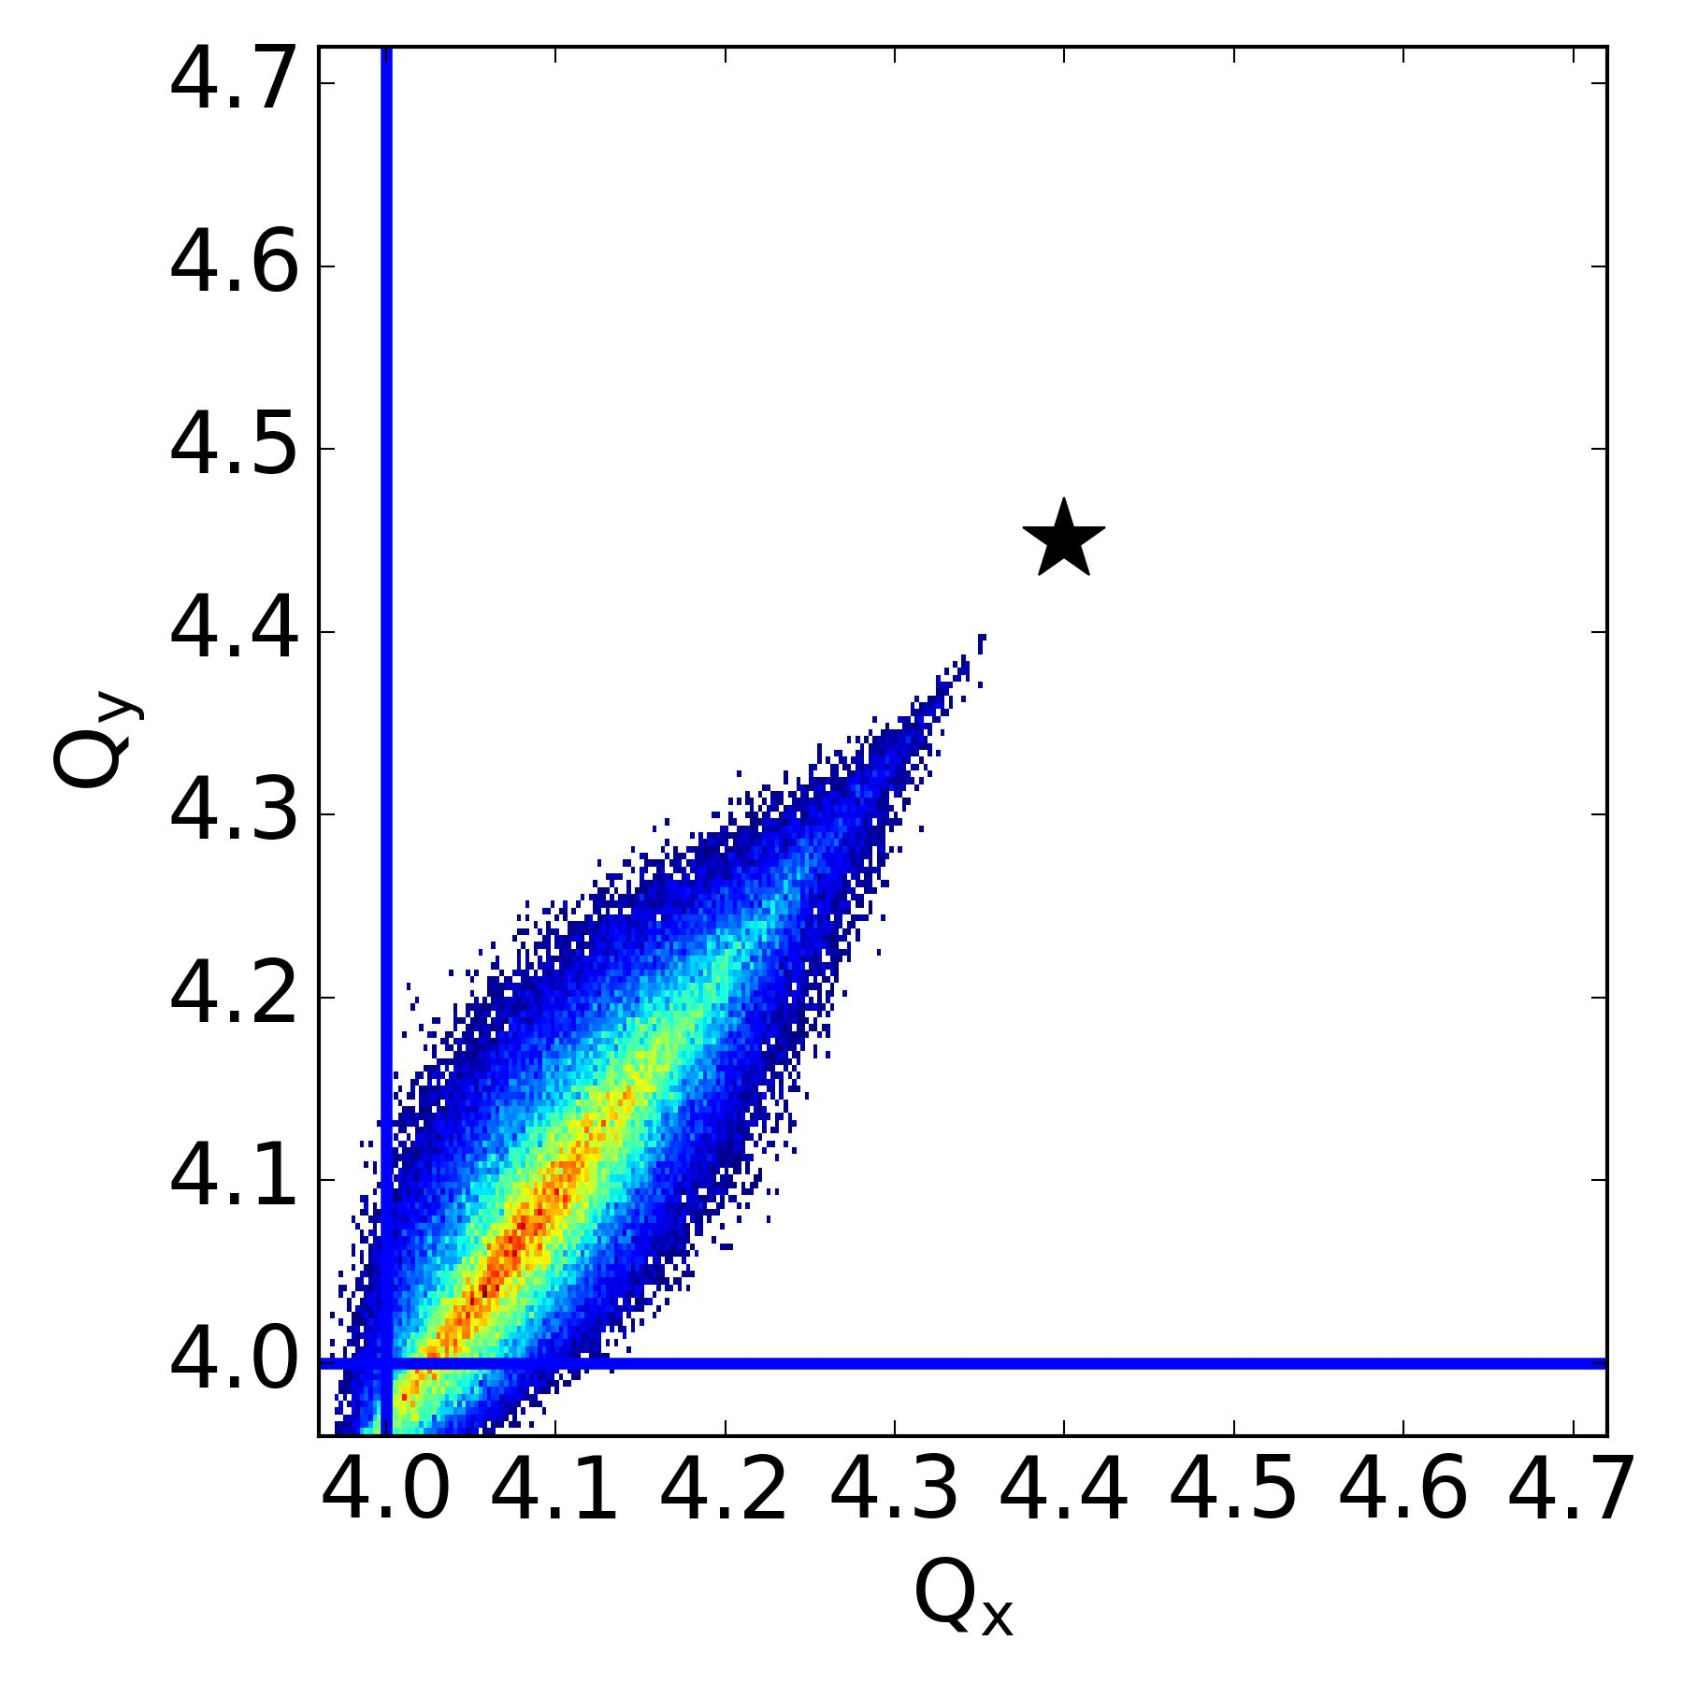
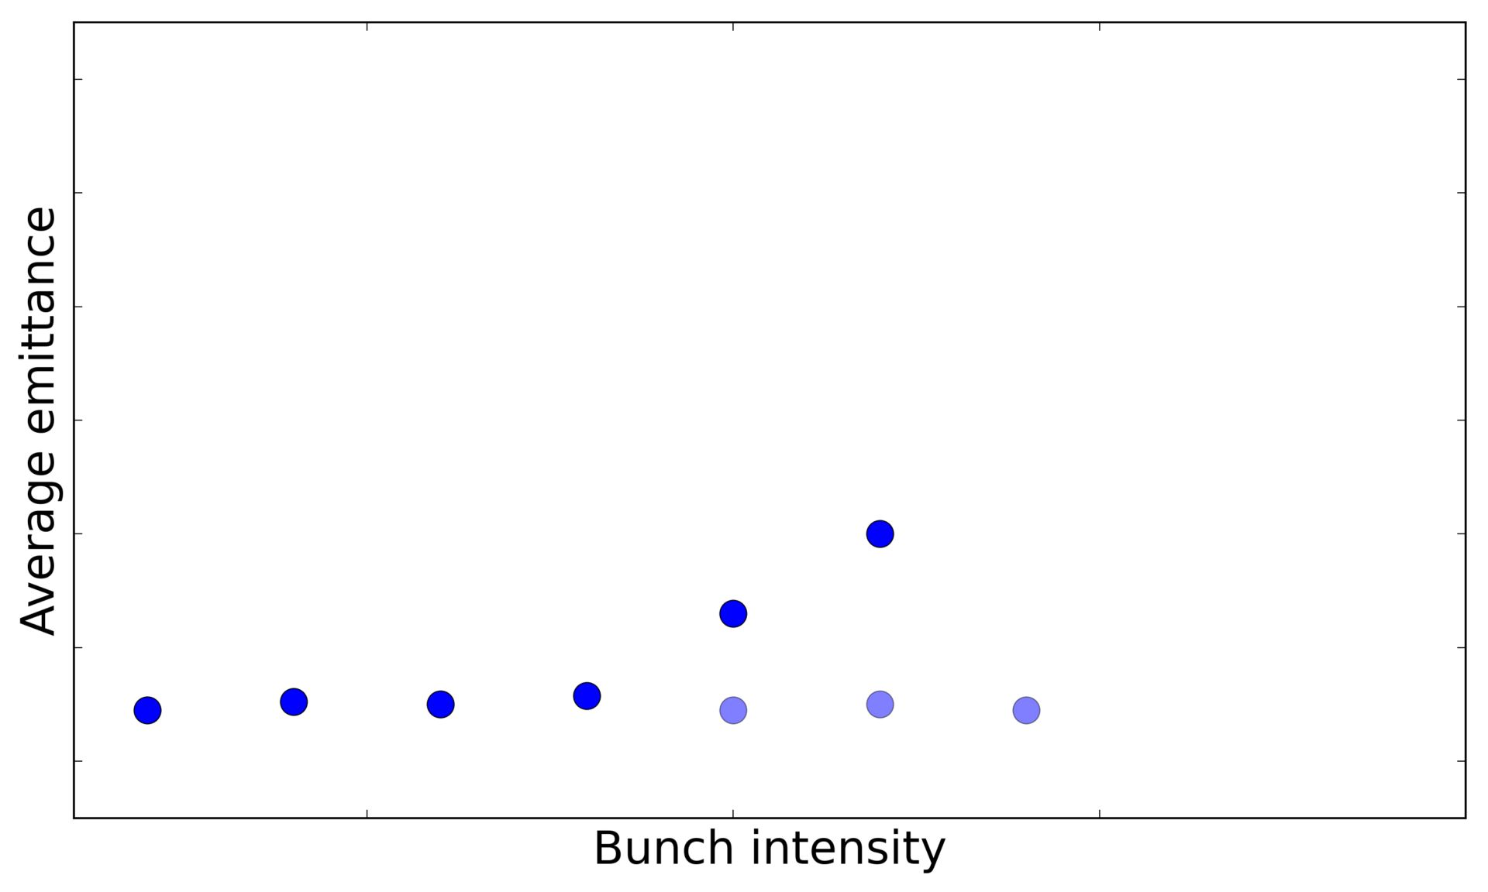
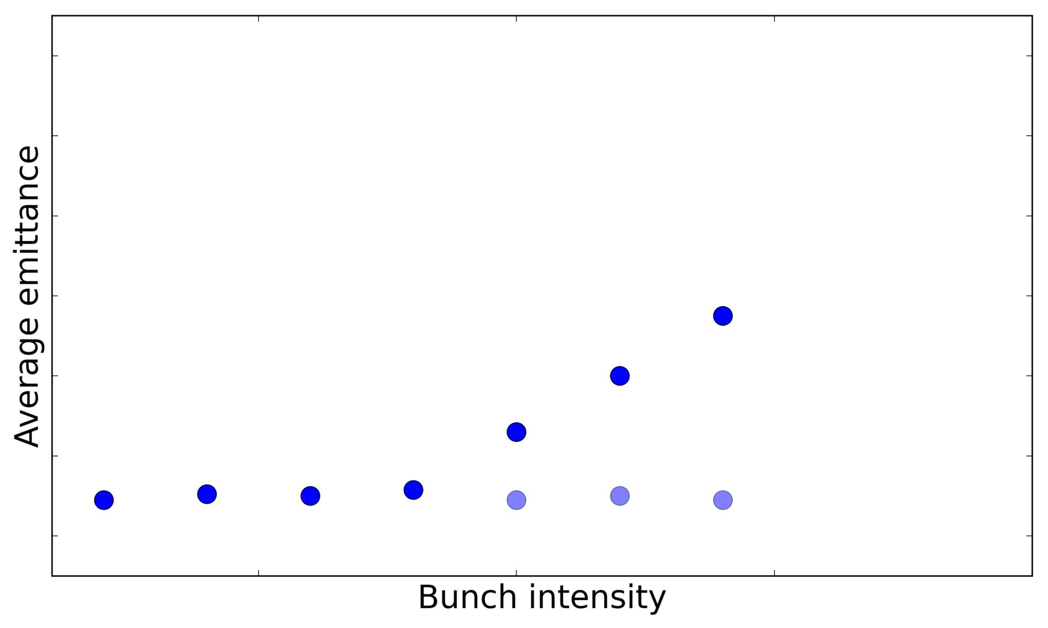

Slide 5
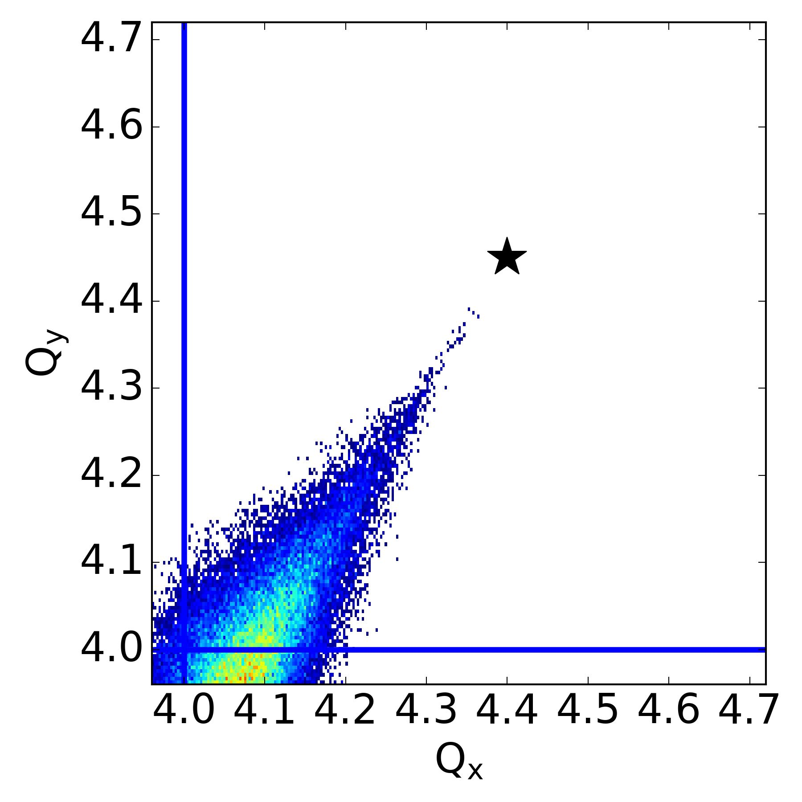
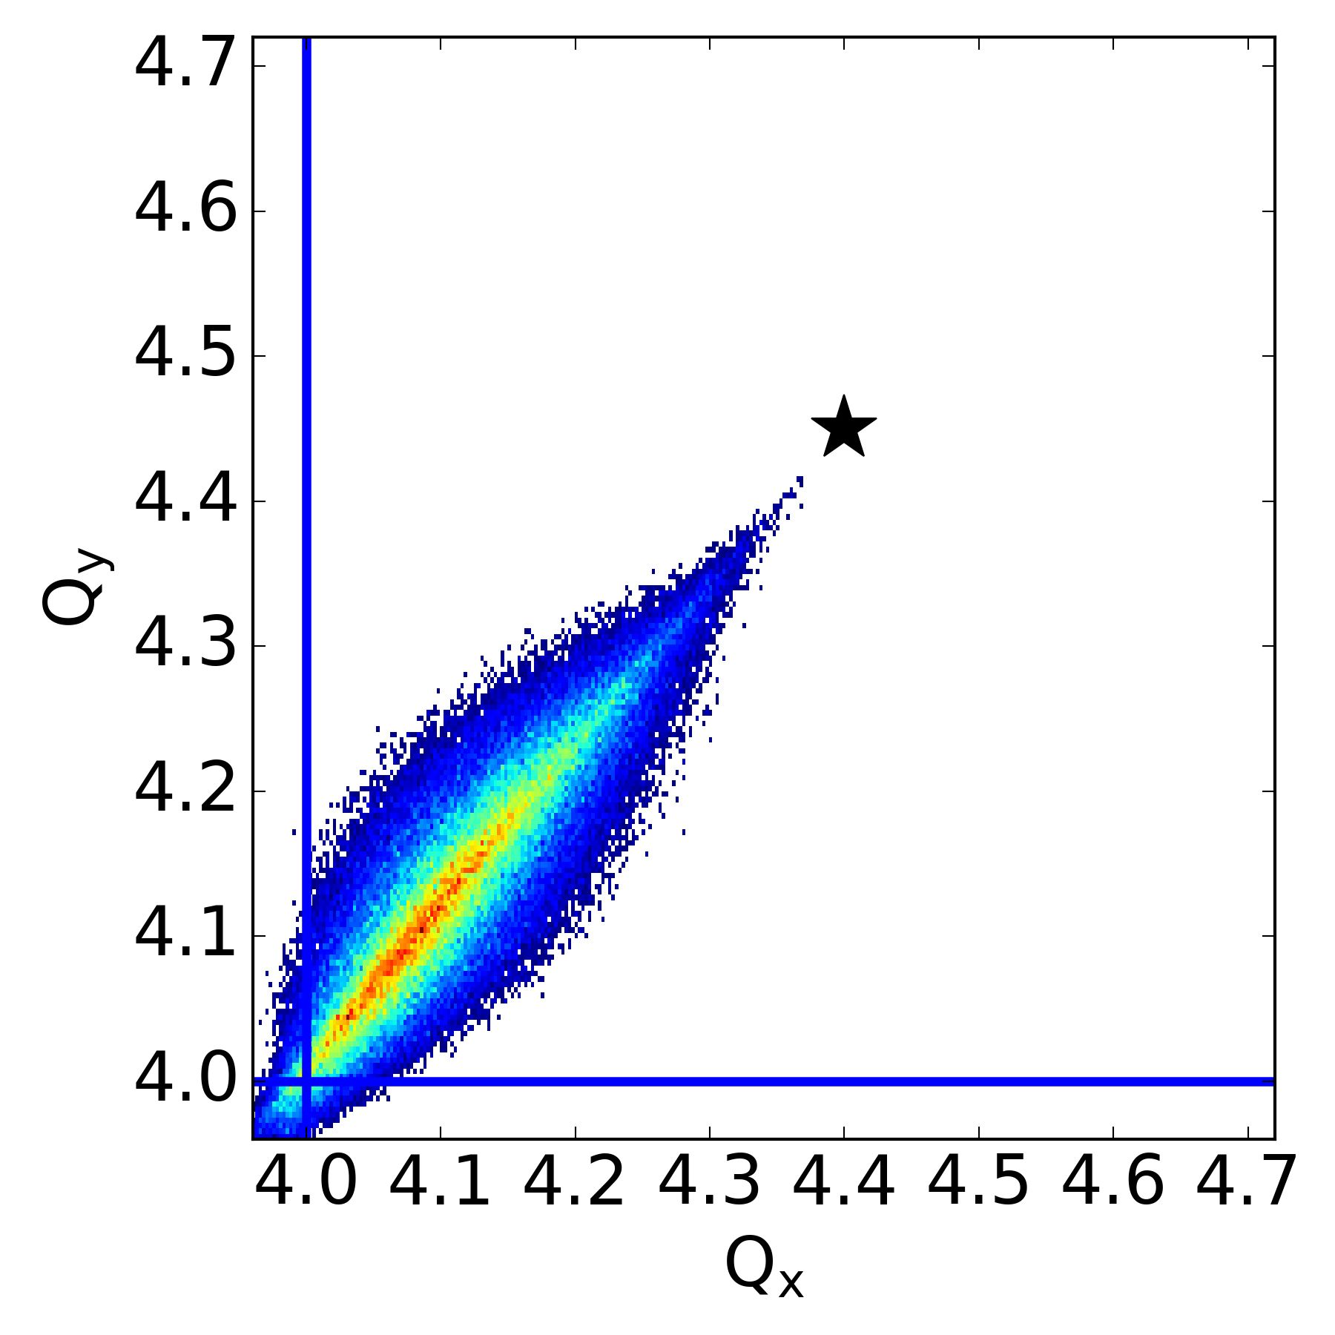
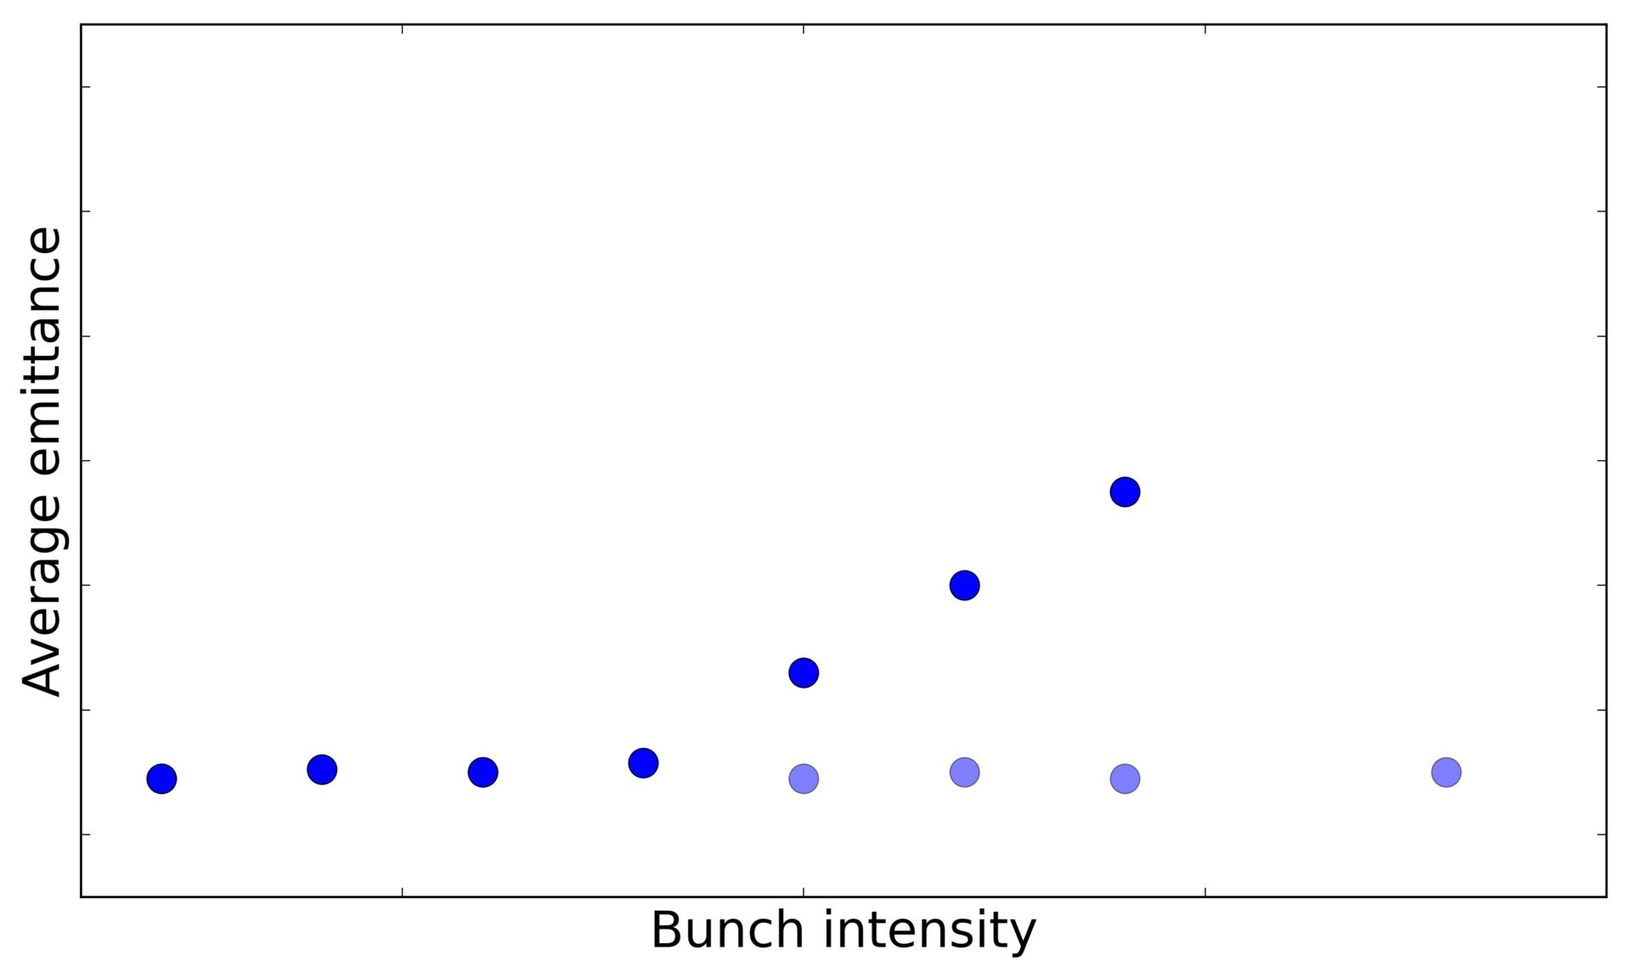
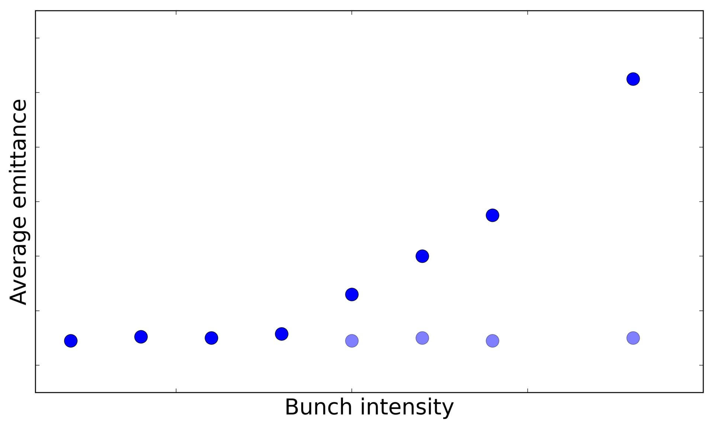

Slide 6
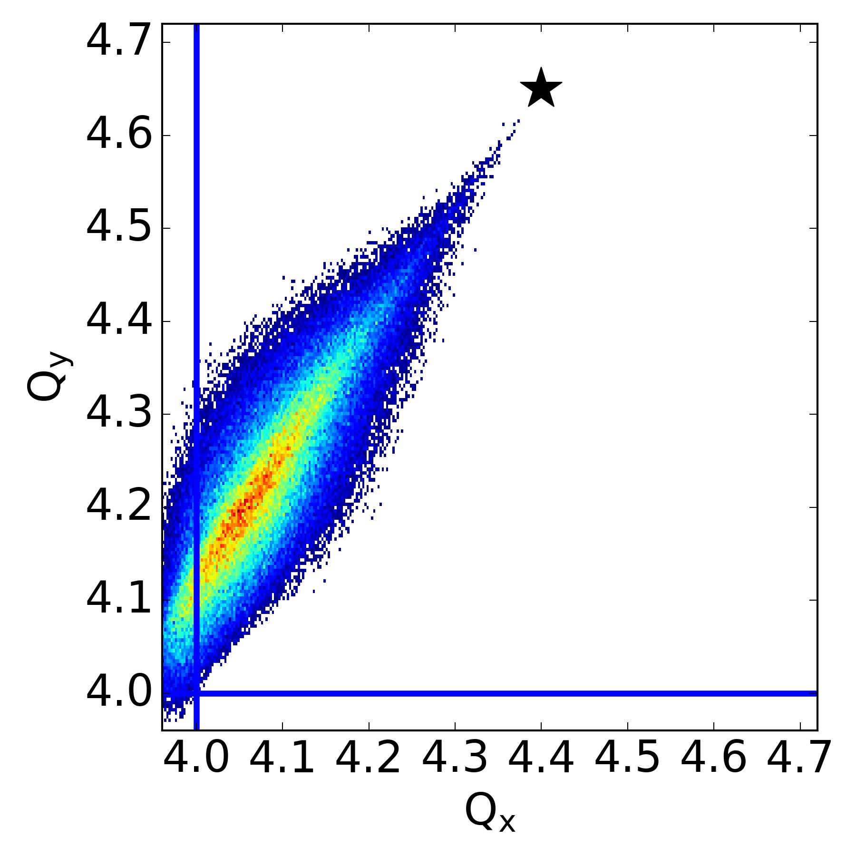
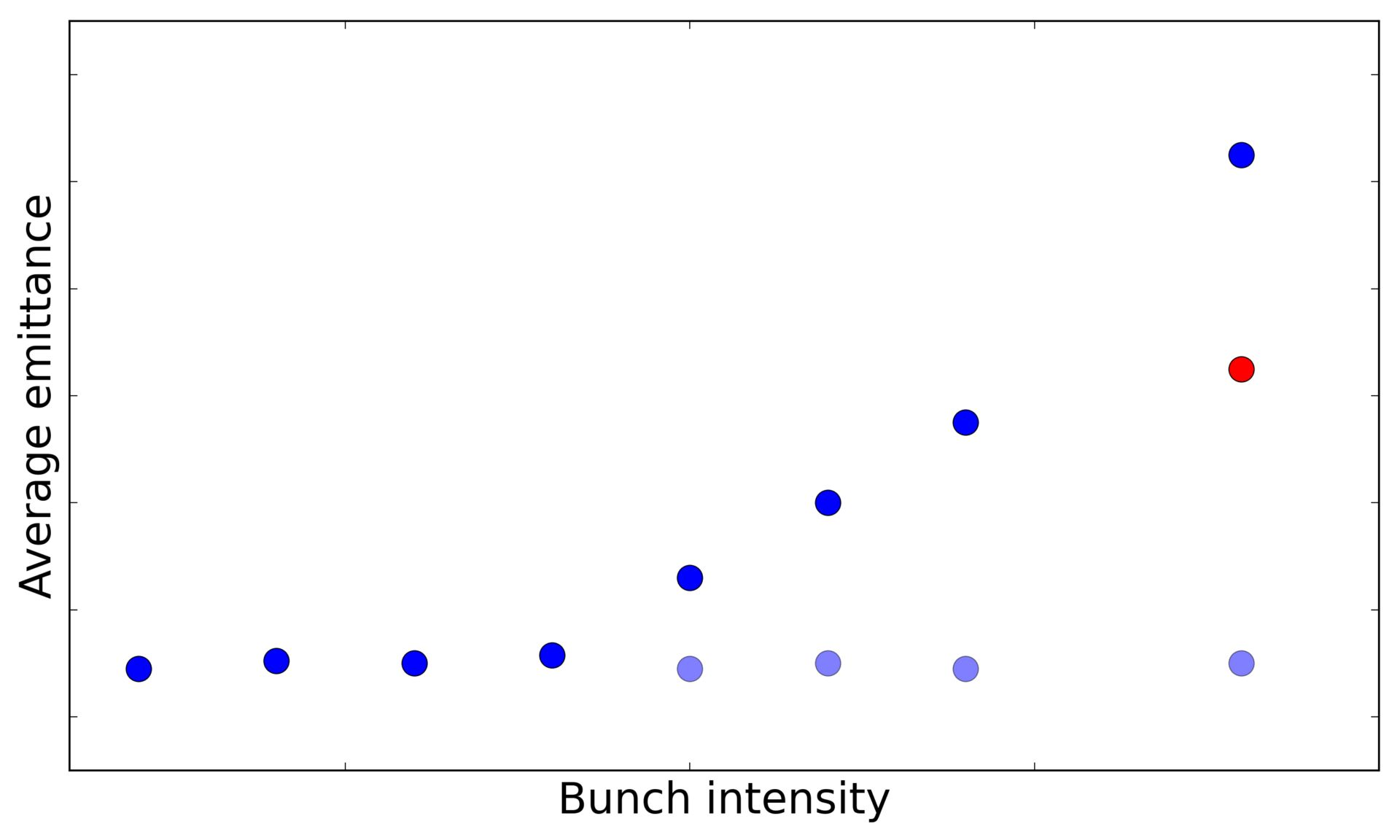
?

Slide 7

Half-integer resonance
Goal:
study space charge effects near half-integer resonance

Slide 8
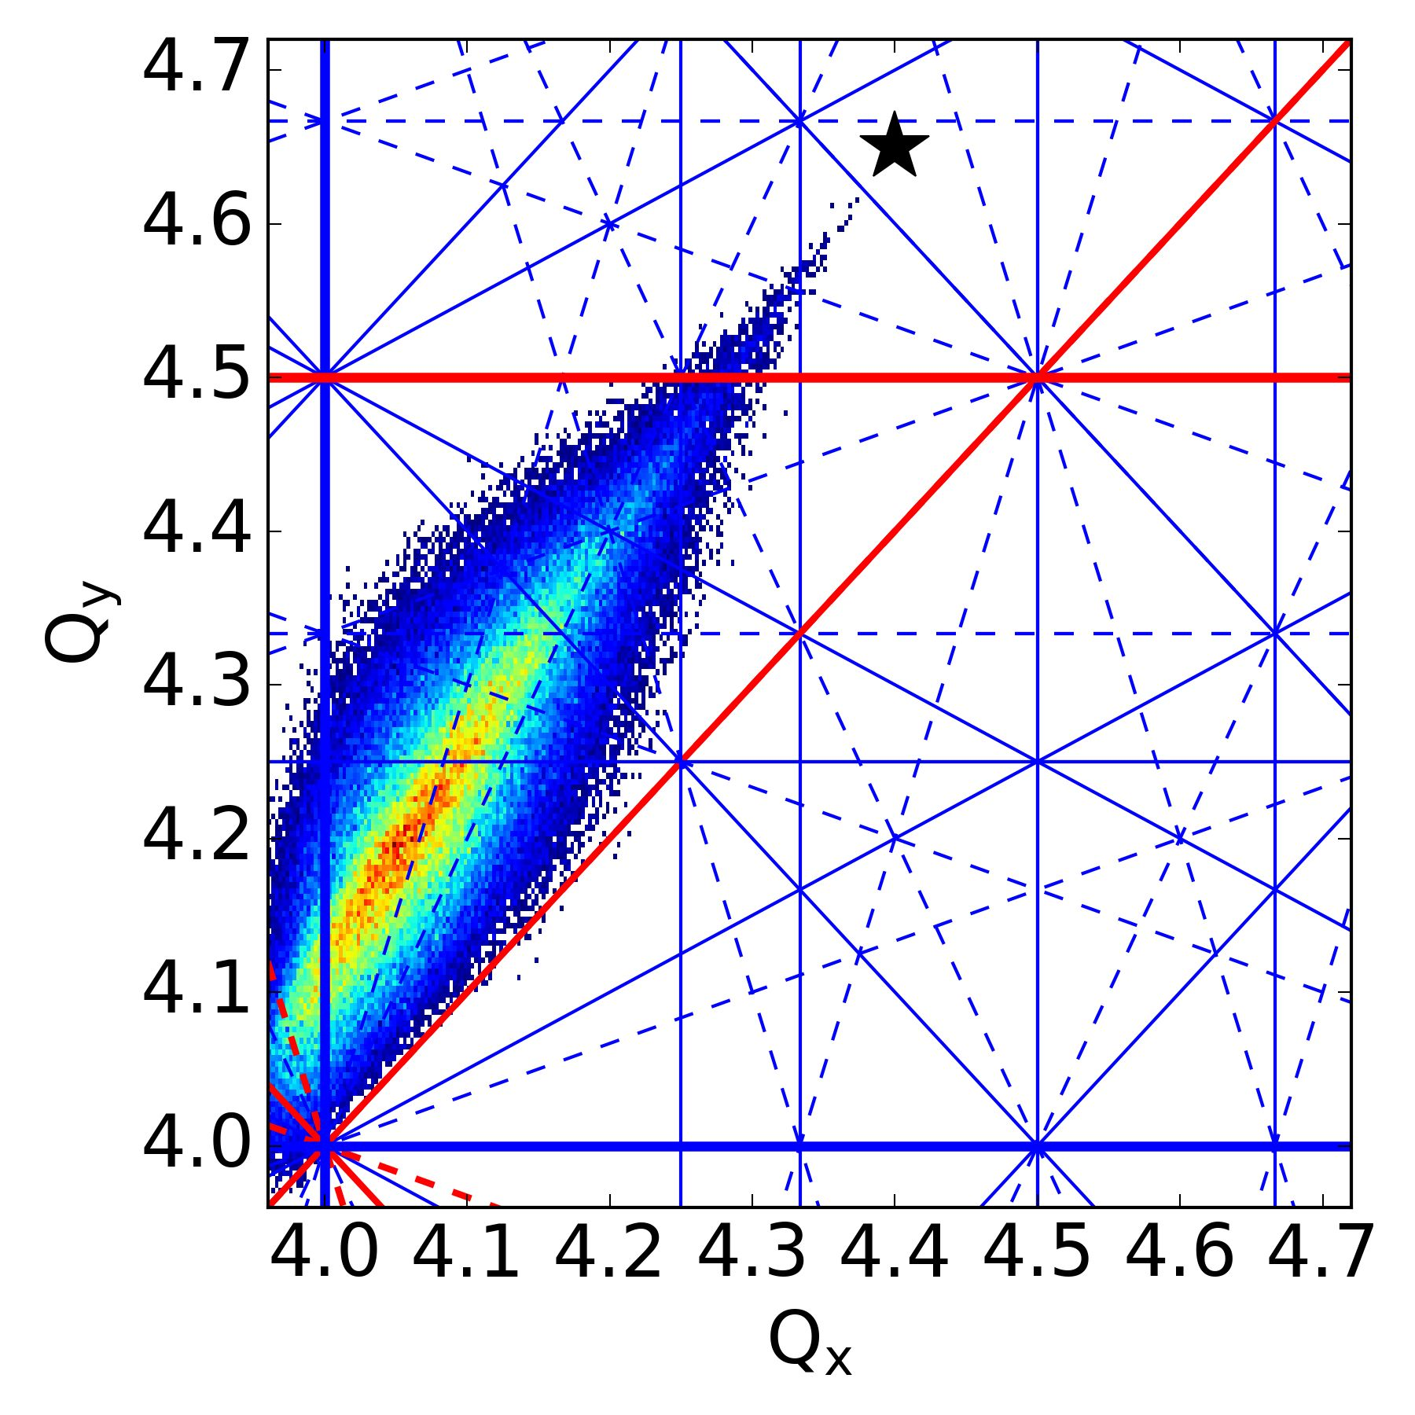
Operational complications:
Large space charge: multiple higher order resonances.

Slide 9
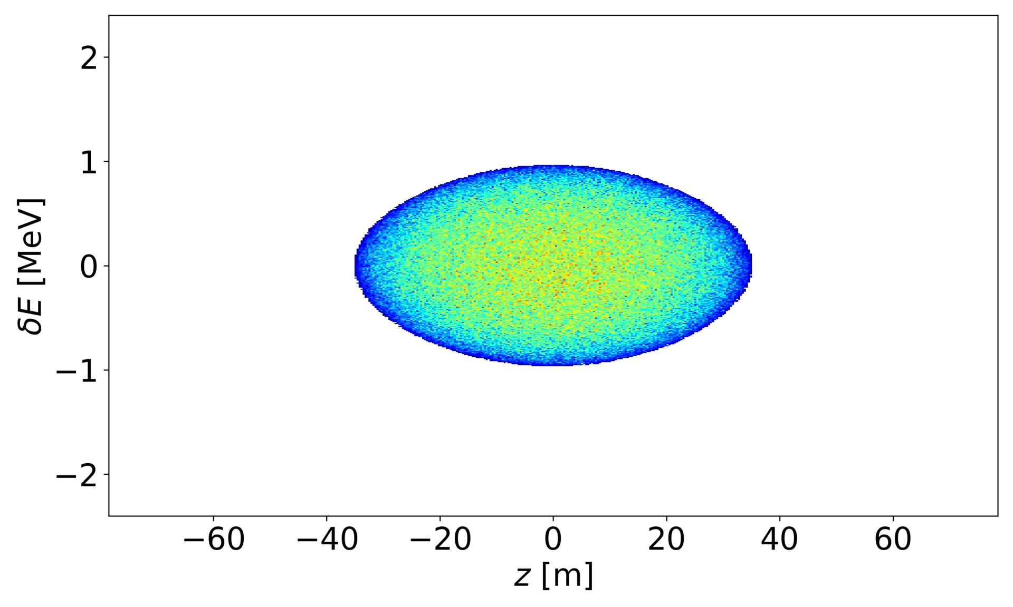
Operational complications:
Large space charge: multiple higher order resonances.
Synchrotron motion: periodic resonance crossing.

Slide 10
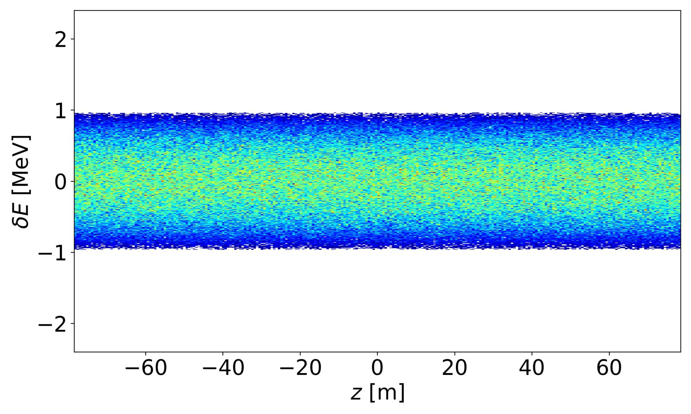
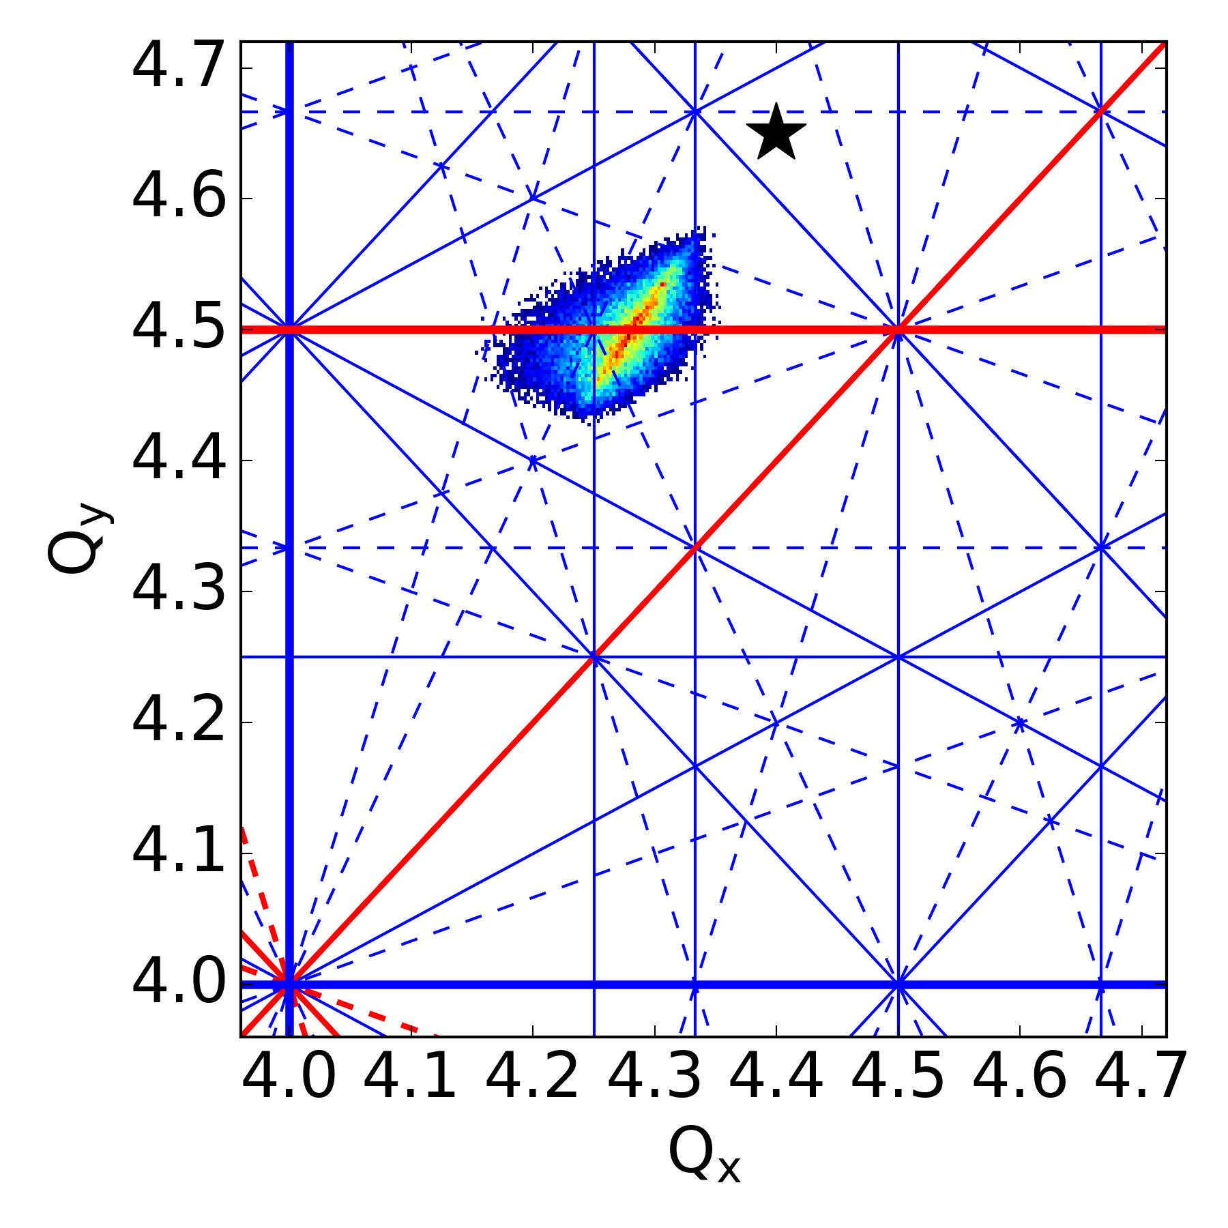
Operational complications:
Large space charge: multiple higher order resonances.
Synchrotron motion: periodic resonance crossing. Start with coasting beam

Slide 11
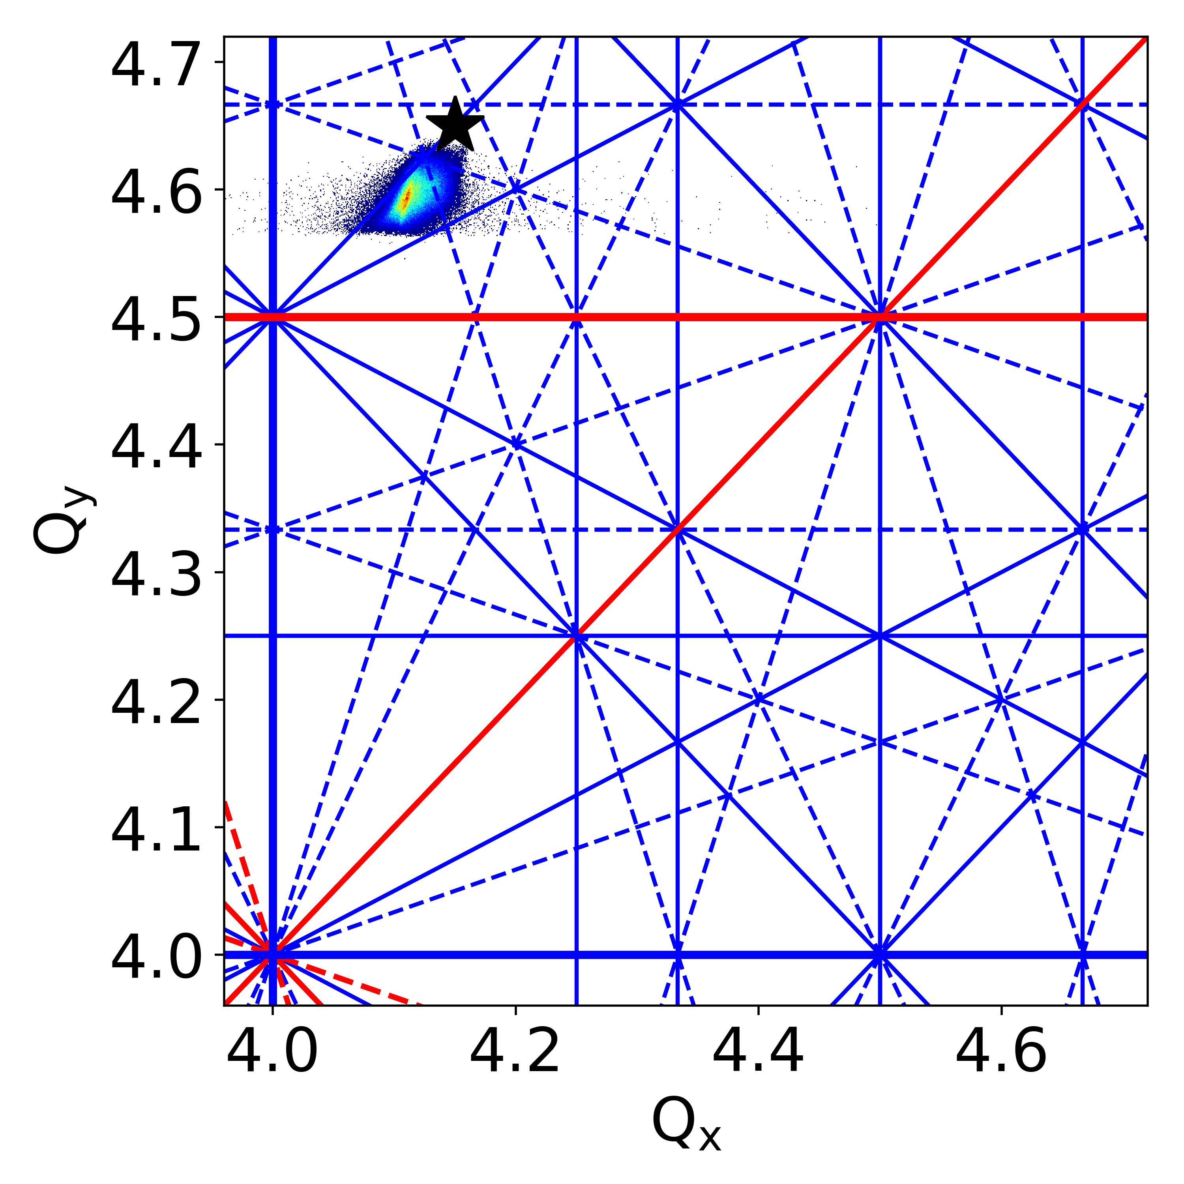
Operational complications:
Large space charge: multiple higher order resonances. Start with lower intensity at different working point
Synchrotron motion: periodic resonance crossing. Start with coasting beam

Slide 12
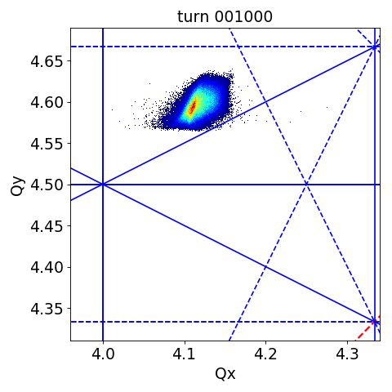

Slide 13

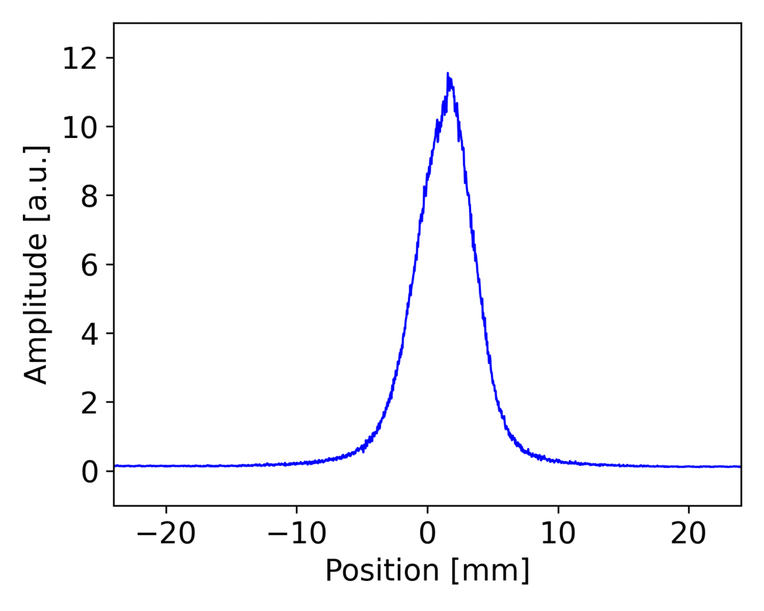
Measurement
Simulation

Slide 14
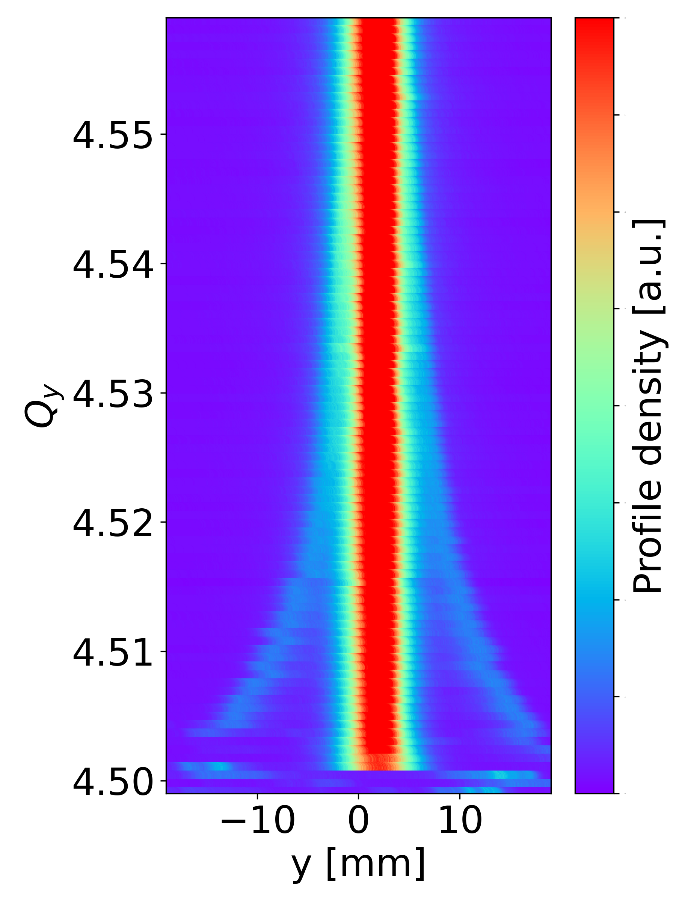
Particle trapping in the half-integer due to the incoherent space charge tune spread.

Slide 15
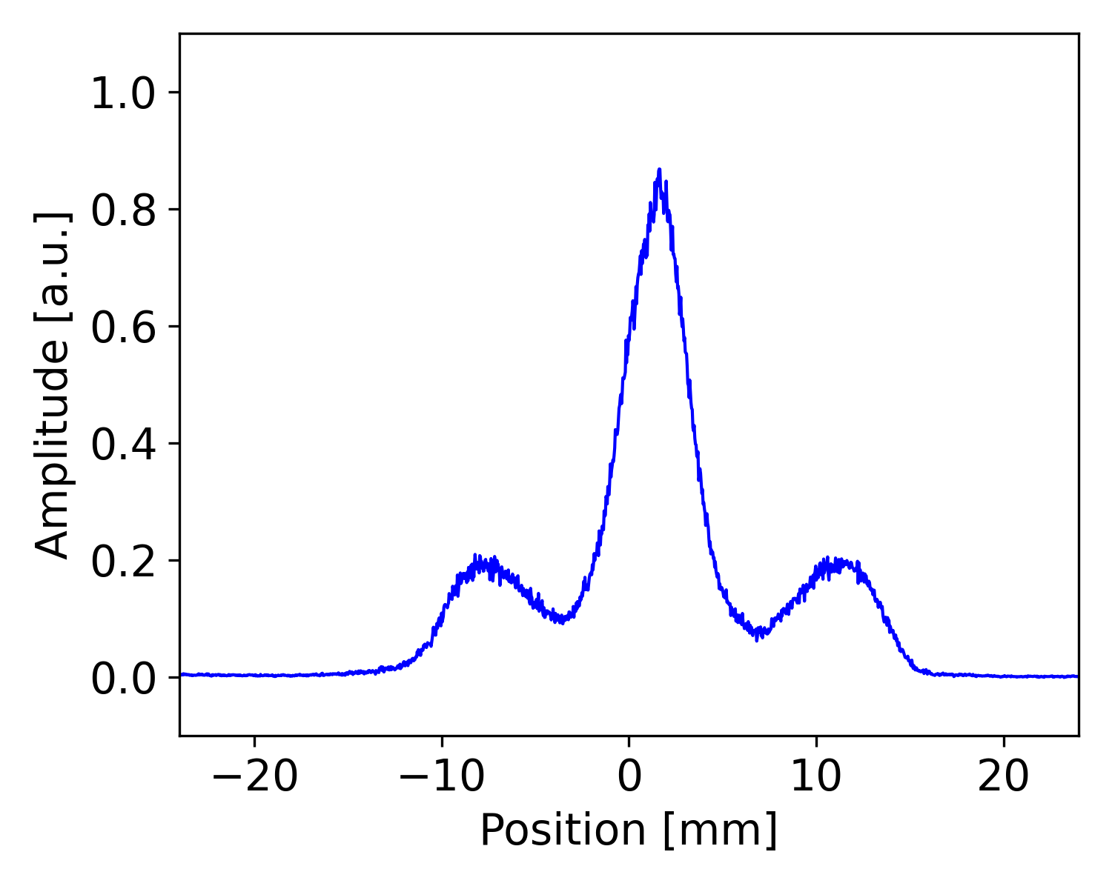

Slide 16
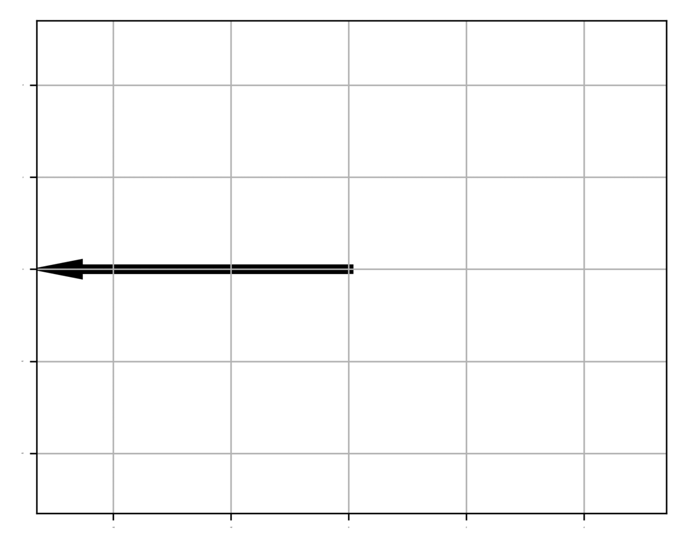

Half-integer resonance driving term phase and amplitude

Slide 17
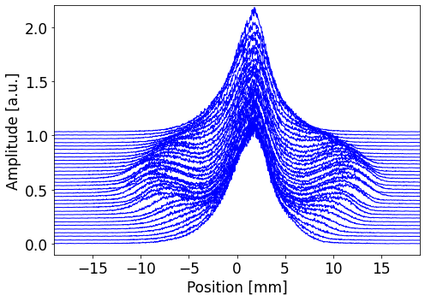
Rotation of the phase space

Slide 18
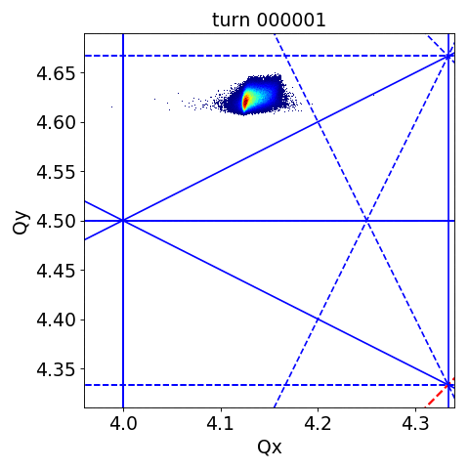
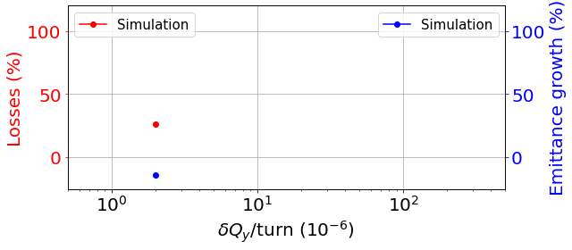
Adiabatic crossing: losses

Slide 19

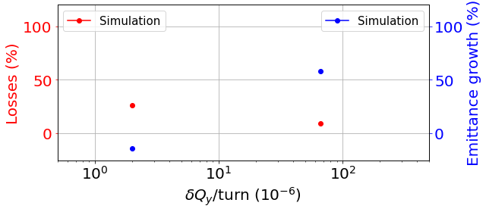
Non-adiabatic crossing:
emittance growth

Slide 20
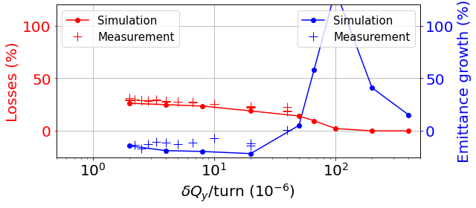
Emittance blow-up domination
Losses domination
Systematic measurements on the effect of the crossing speed

Slide 21
Experimental Investigations on the High-Intensity Effects near the Half-Integer Resonance in the PSB
Particle trapping in the half-integer due to the incoherent space charge tune spread.
Rotation of the phase space.
Systematic measurements on the effect of the crossing speed.
Study of actual operational beams near half-integer is ongoing.

Slide 22
PSB has reached its brightness targets.
But, has it reached its brightness limits?

Slide 23
Thank you for your attention

