Slide 1
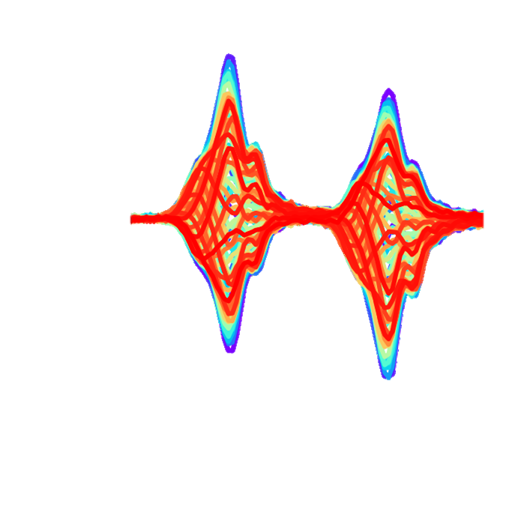



Probing Transverse Impedances in the High Frequency Range at the CERN-SPS
HB conference, 9-13 Oct. 2023, Flash presentation
Elena de la Fuente García*, Ingrid Mases Sole**, Hannes Bartosik**, Giovanni Rumolo*, Carlo Zannini*
* BE-ABP-CEI
** BE-ABP-INC

Slide 2

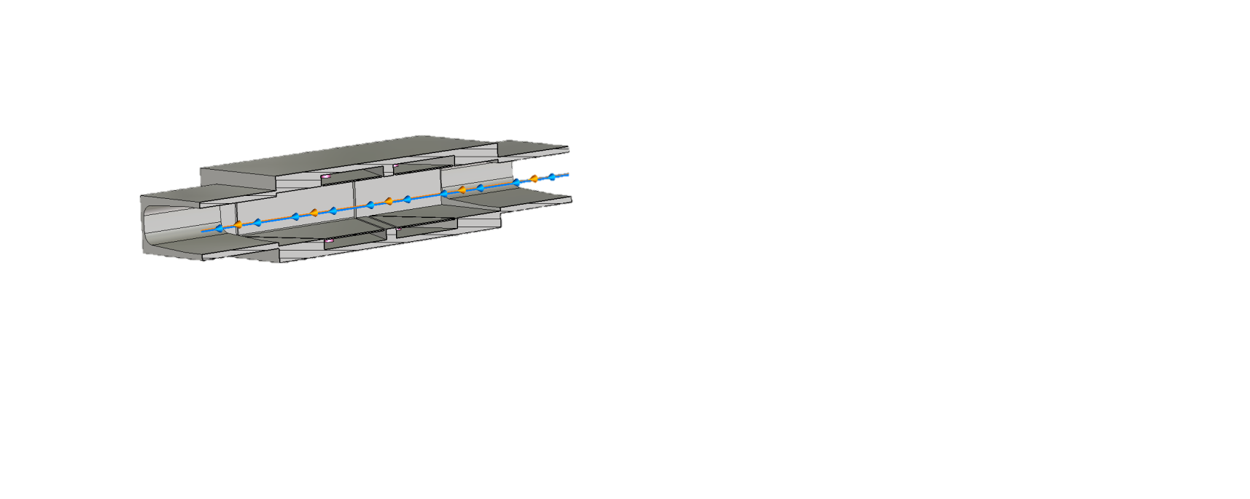
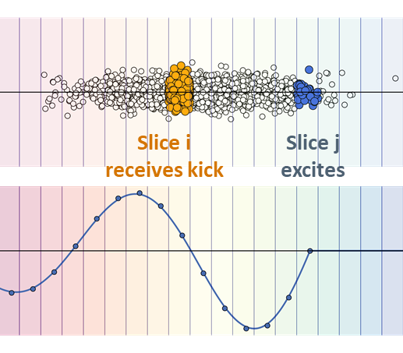
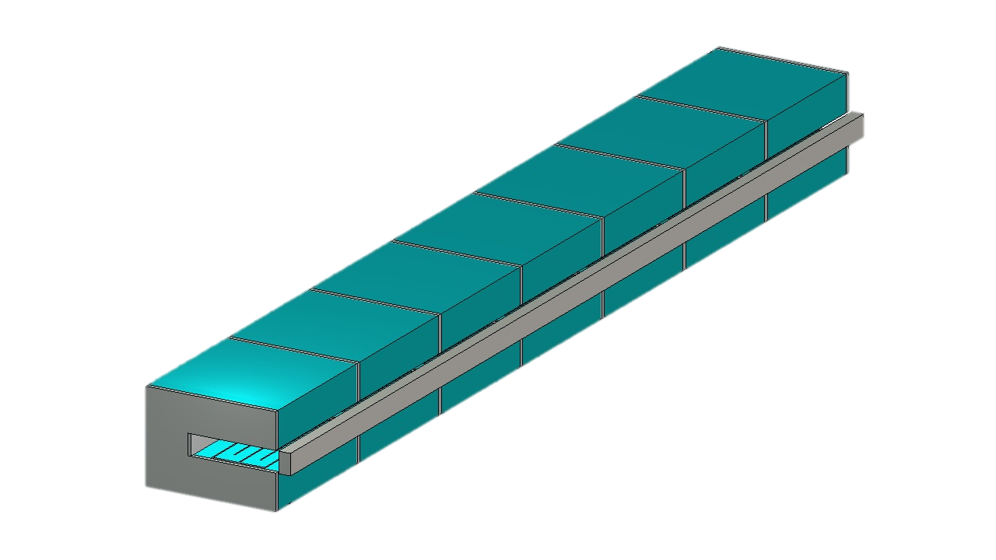
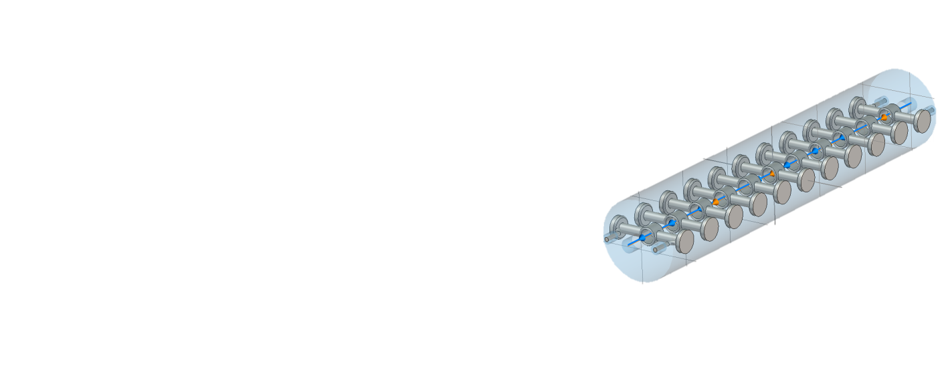
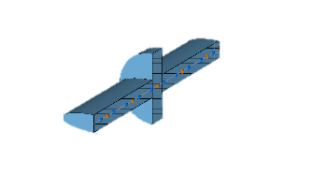
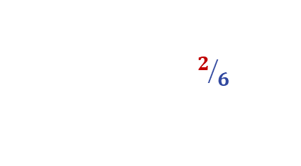
Motivation of the studies
We construct the SPS beam-coupling impedance model from simulations and/or bench measurements
We use the impedance model in PyHEADTAIL simulations to predict beam behavior
SPS
Wakefield
Need to benchmark the model!
*Images from K. Li and G. Rumolo “Beam Instabilities III”, CAS 2022, Sevrier, France [link]

Slide 3

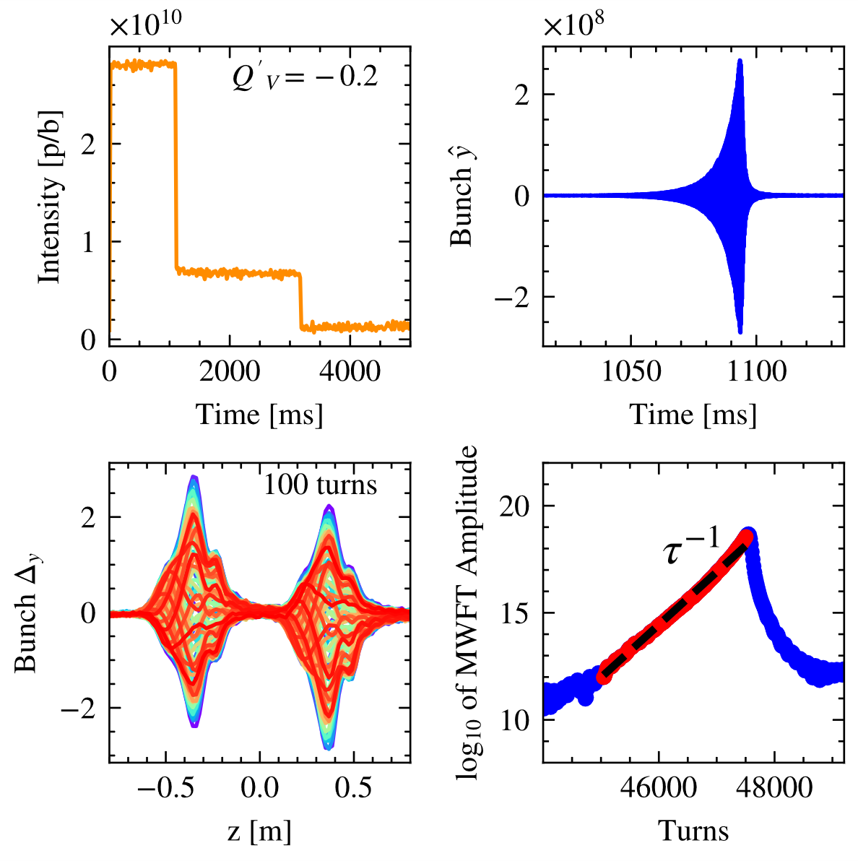
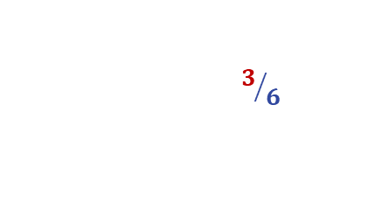
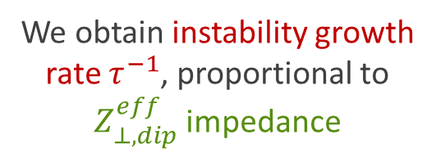


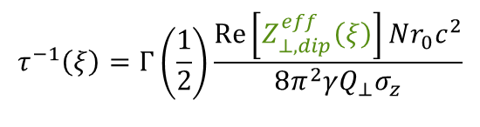
Growth rate measurements
Head-Tail mode zero
Q’ trim
Beam-based measurements benchmark:
Intensity losses
We apply Q’<0 trim and observe Head-Tail mode Zero instability
We obtain instability growth rate $τ^{−1}$, proportional to $Z_{⊥,dip}^{eff}$impedance
Exponential $\hat{y}$ growth
$$τ^{−1}\left(ξ\right)=Γ\left(\frac{1}{2}\right)\frac{\operatorname{Re}\left[Z_{⊥,dip}^{eff}\left(ξ\right)\right]Nr_{0}c^{2}}{8π^{2}γQ_{⊥}σ_{z}}$$
MWFT post-processing
$$ξ=Q^{′}/Q$$

Slide 4

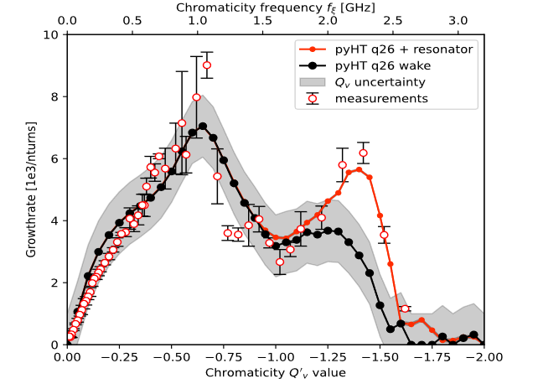
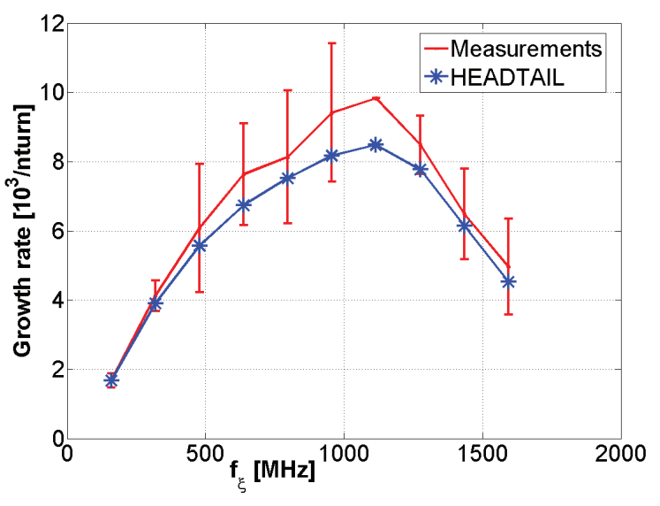

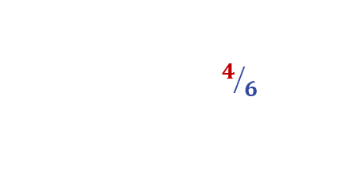
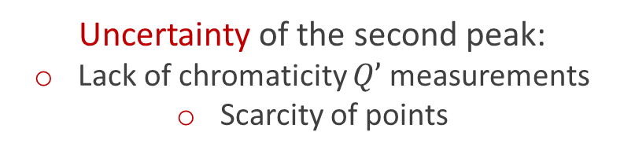
Previous findings
2013 measurements*
Pre-LS2
2022 measurements**
New region explored
Vertical plane
Vertical plane
Uncertainty of the second peak:
Lack of chromaticity $Q’$ measurements
Scarcity of points
*C. Zannini, MOPJE049, IPAC 15
**E. de la Fuente, WEPL155, IPAC 23

Slide 5

Chromaticity measurements
2023 measurements: Measuring Q’ from Head-Tail phase shift* data using 2D Fourier Transform
*R. Jones, ROAB006, PAC01

Slide 6
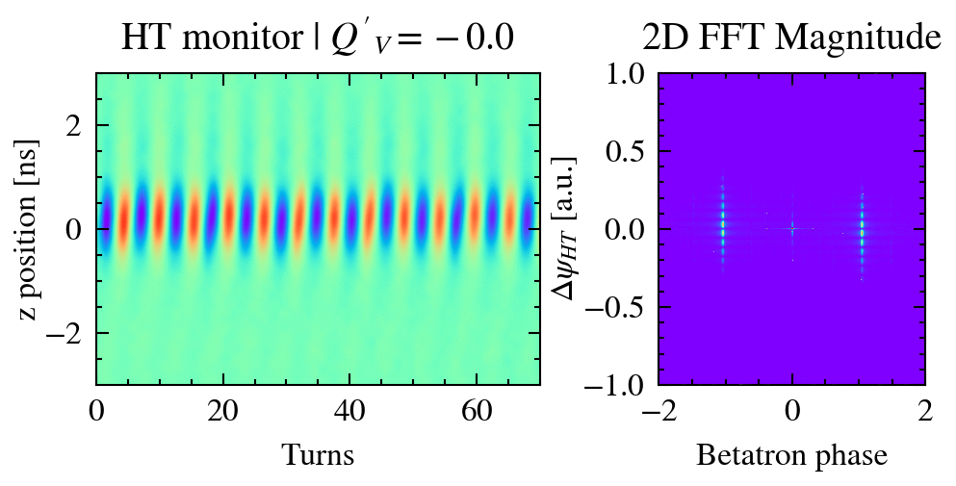
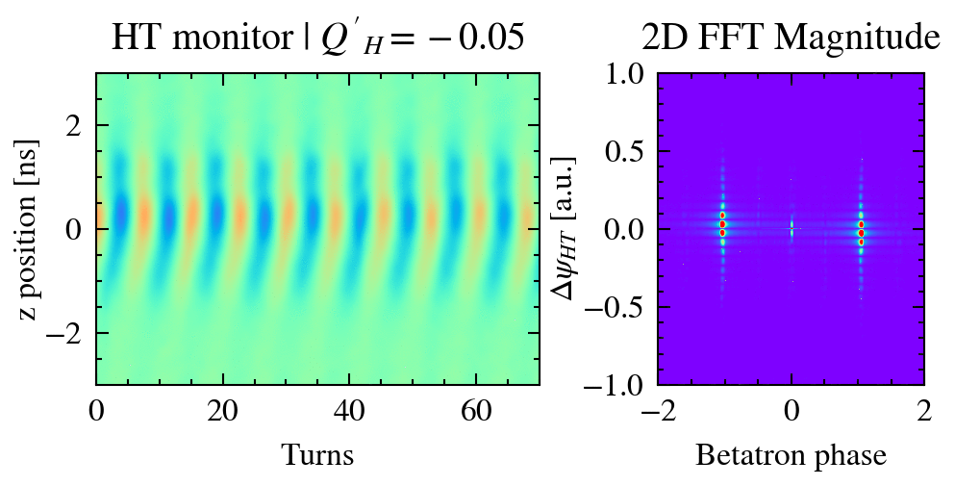
Chromaticity measurements
2023 measurements: Measuring Q’ from Head-Tail phase shift* data using 2D Fourier Transform
Measurements
*R. Jones, ROAB006, PAC01

Slide 7
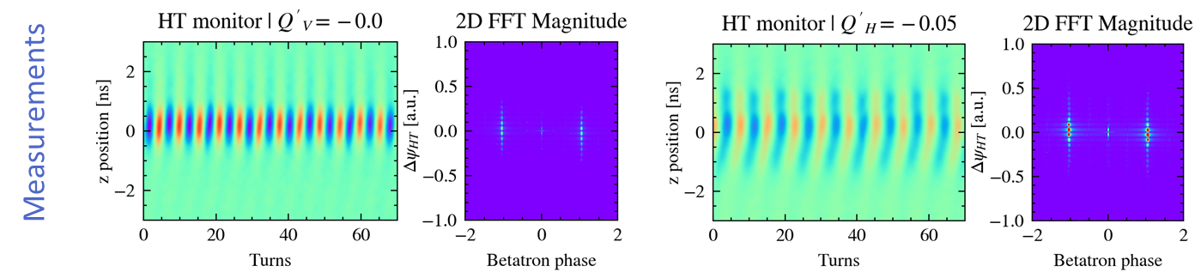
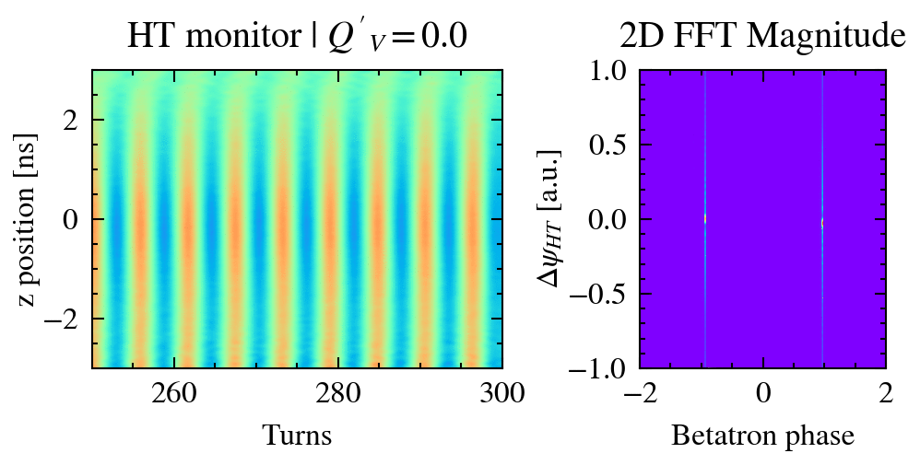
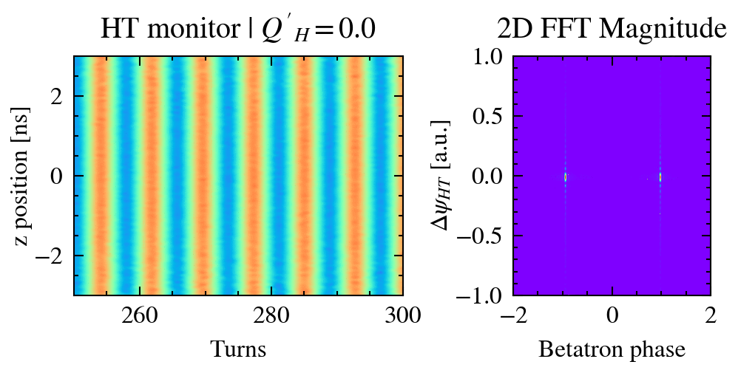
Chromaticity measurements
2023 measurements: Measuring Q’ from Head-Tail phase shift* data using 2D Fourier Transform
PyHEADTAIL
*R. Jones, ROAB006, PAC01

Slide 8
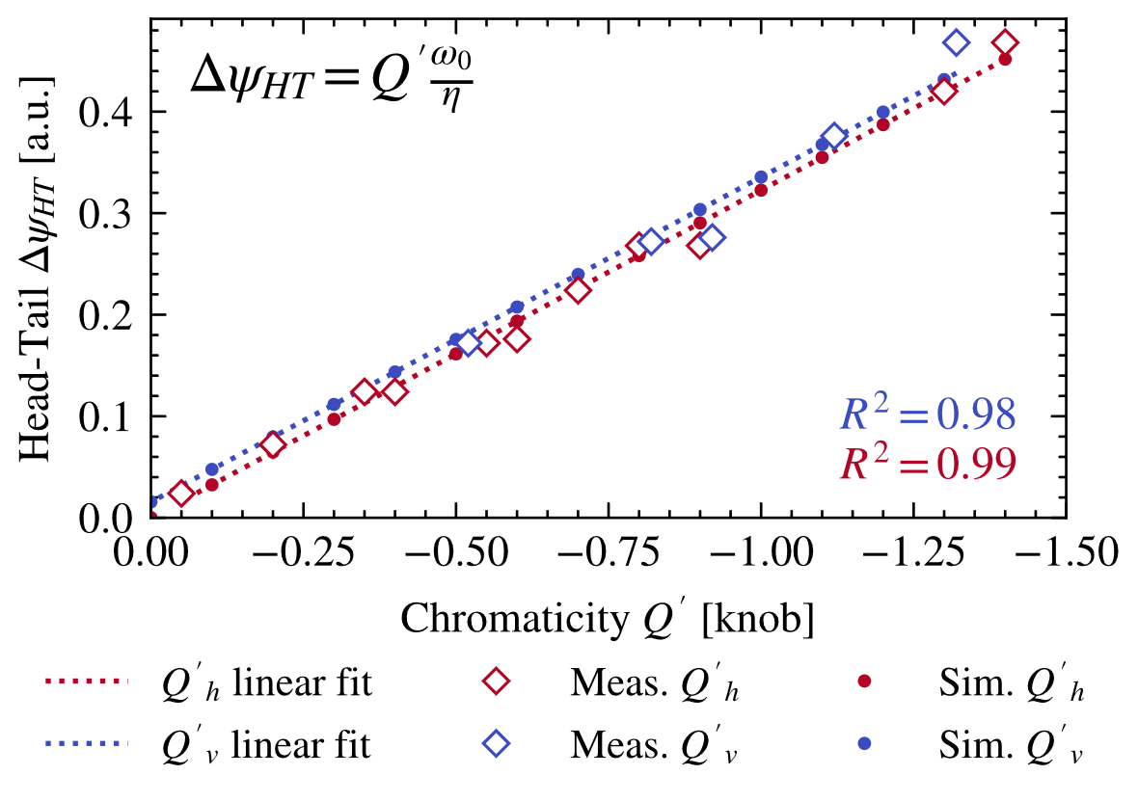
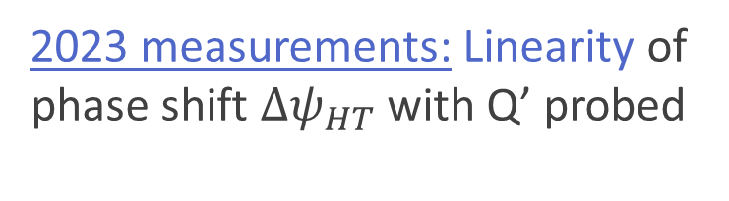
Chromaticity measurements
2023 measurements: Linearity of phase shift ${Δψ}_{HT}$ with Q’ probed

Slide 9

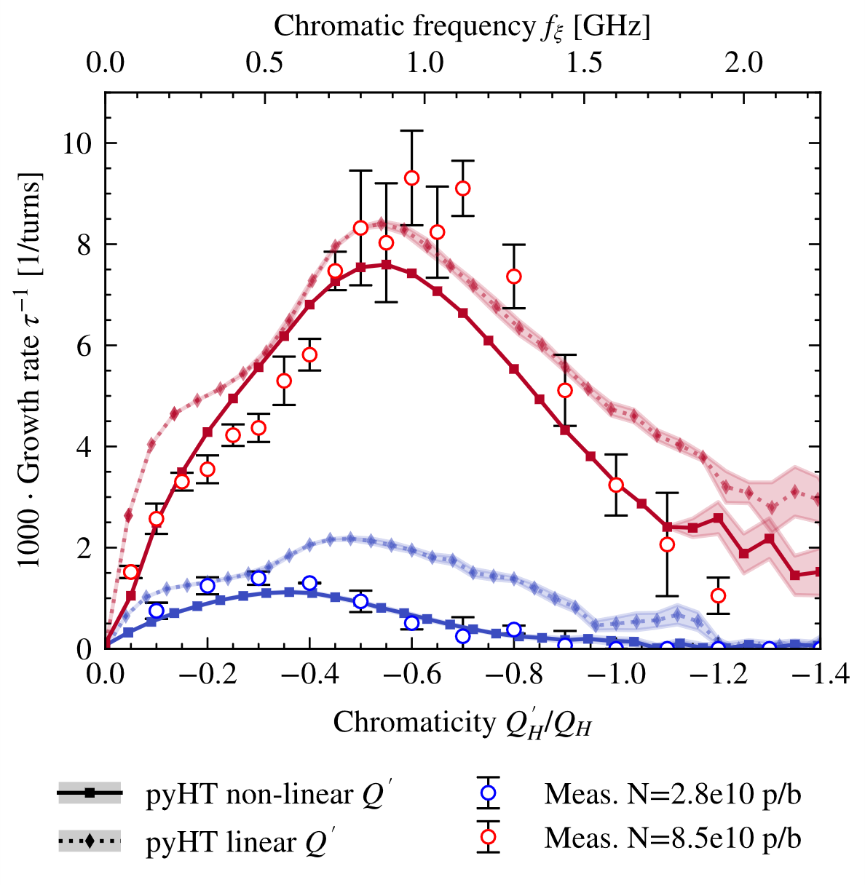
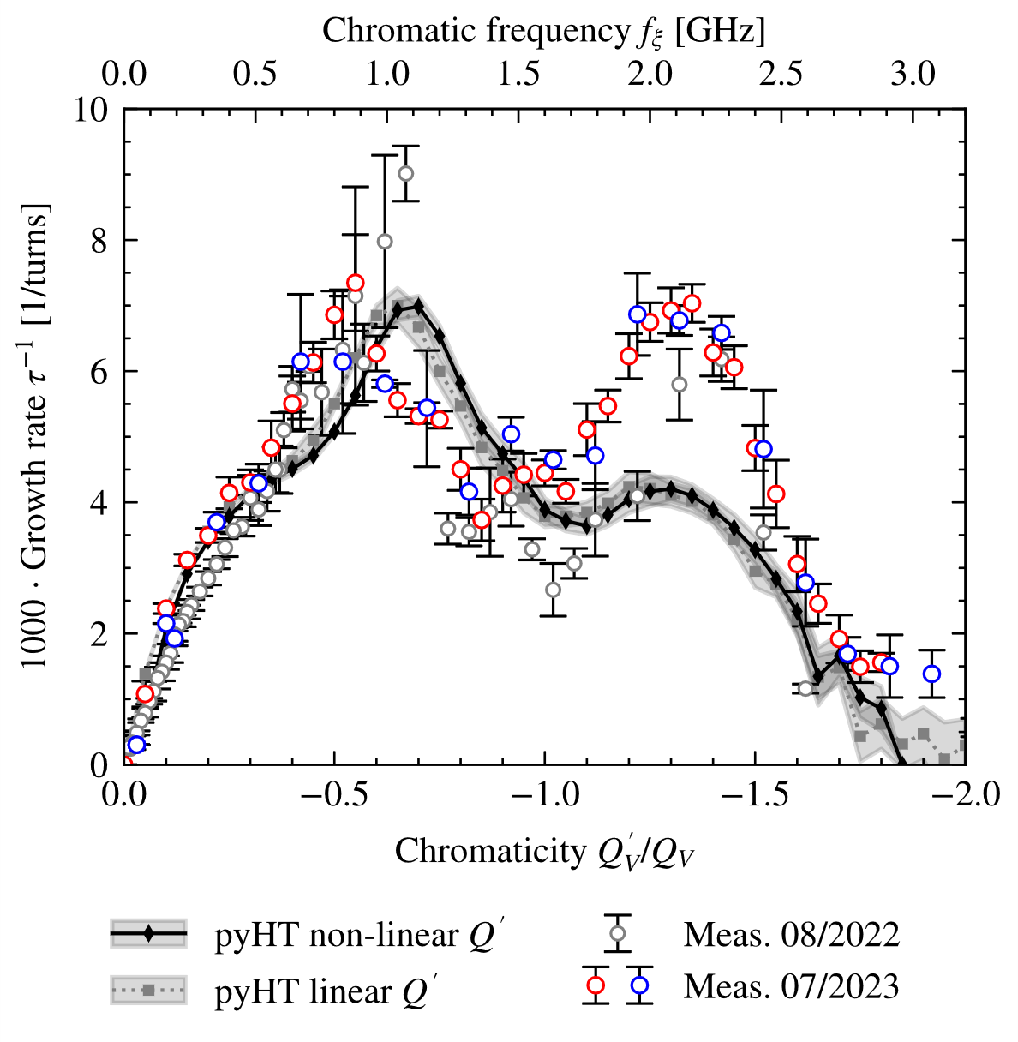

Key results
2023 measurements
Horizontal plane
Vertical plane
Future work aims to clarify the origin of this impedance contribution

Slide 10
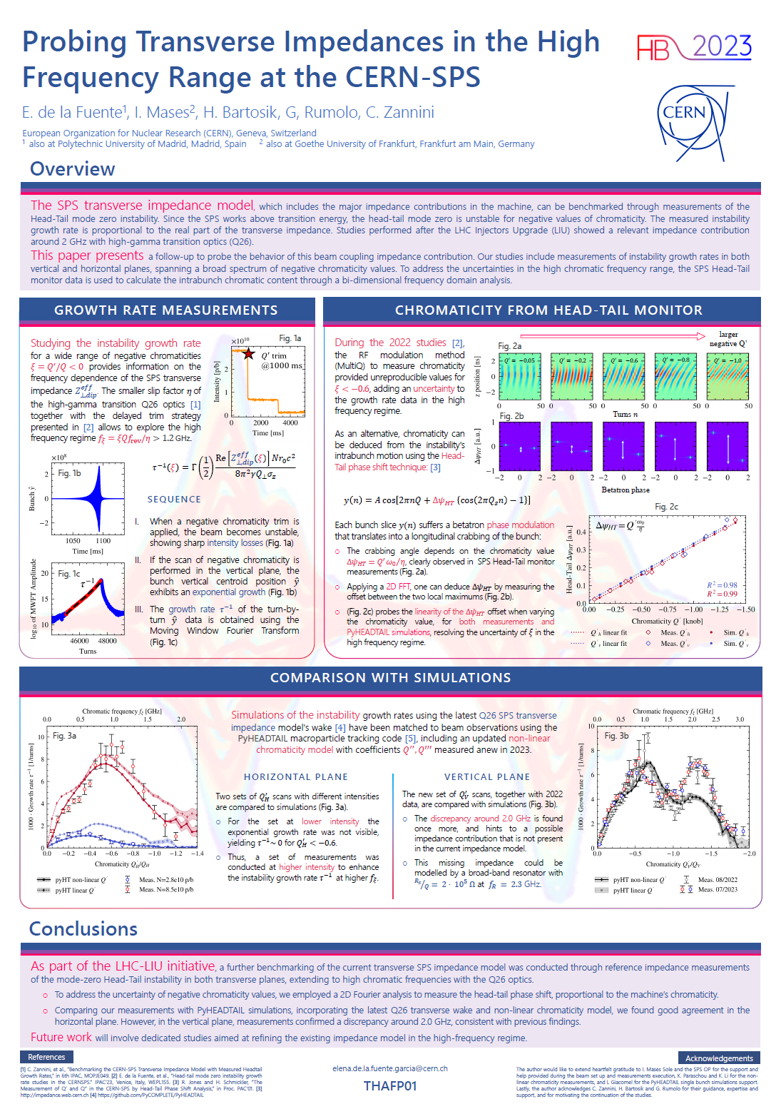
Thank you ☺ !!!
Probing Transverse Impedances in the High Frequency Range at the CERN-SPS
Elena de la Fuente García (BE–ABP–CEI)

