Slide 1

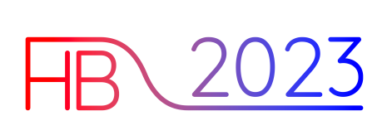
New understanding of longitudinal (bunched) beam instabilities and comparison with measurements
Ivan Karpov
Acknowledgments:
Elena Shaposhnikova, Theodoros Argyropoulos, Alexandre Lasheen, Heiko Damerau (CERN)
Alexey Burov (FNAL), Maxime Gadioux (UCD), Sigurd Nese (UiB)
HB Flash Seminar, 16.11.2023

Slide 2
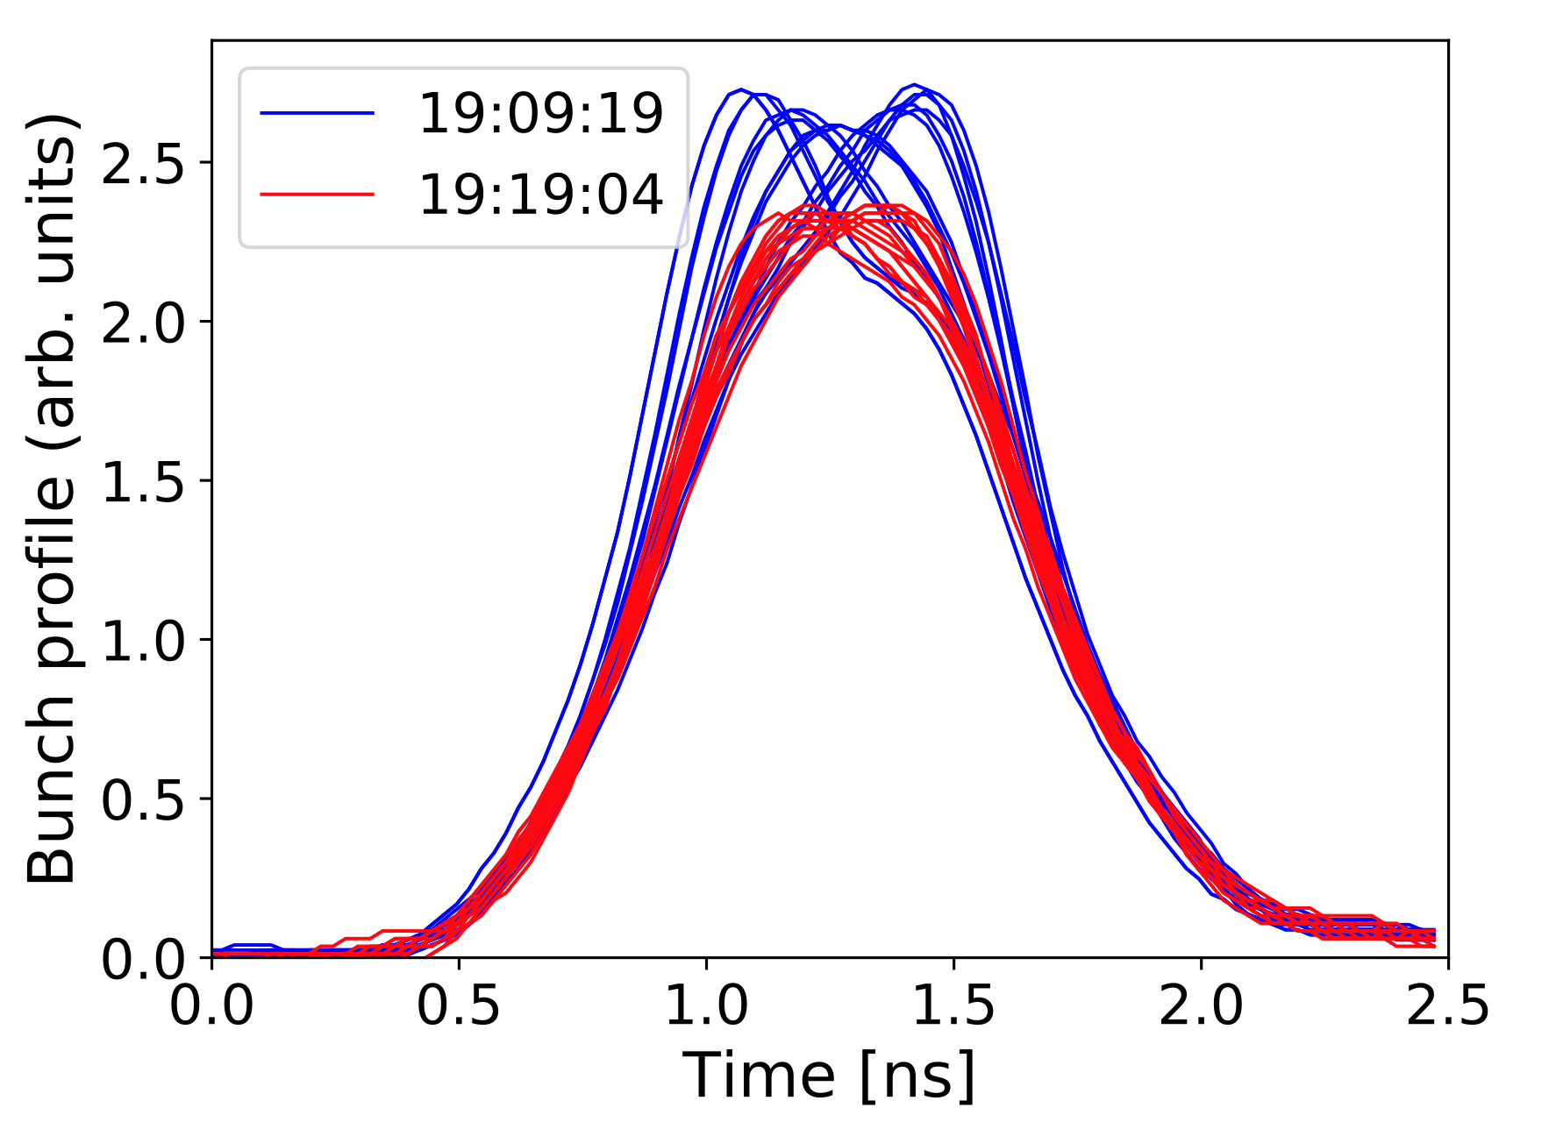
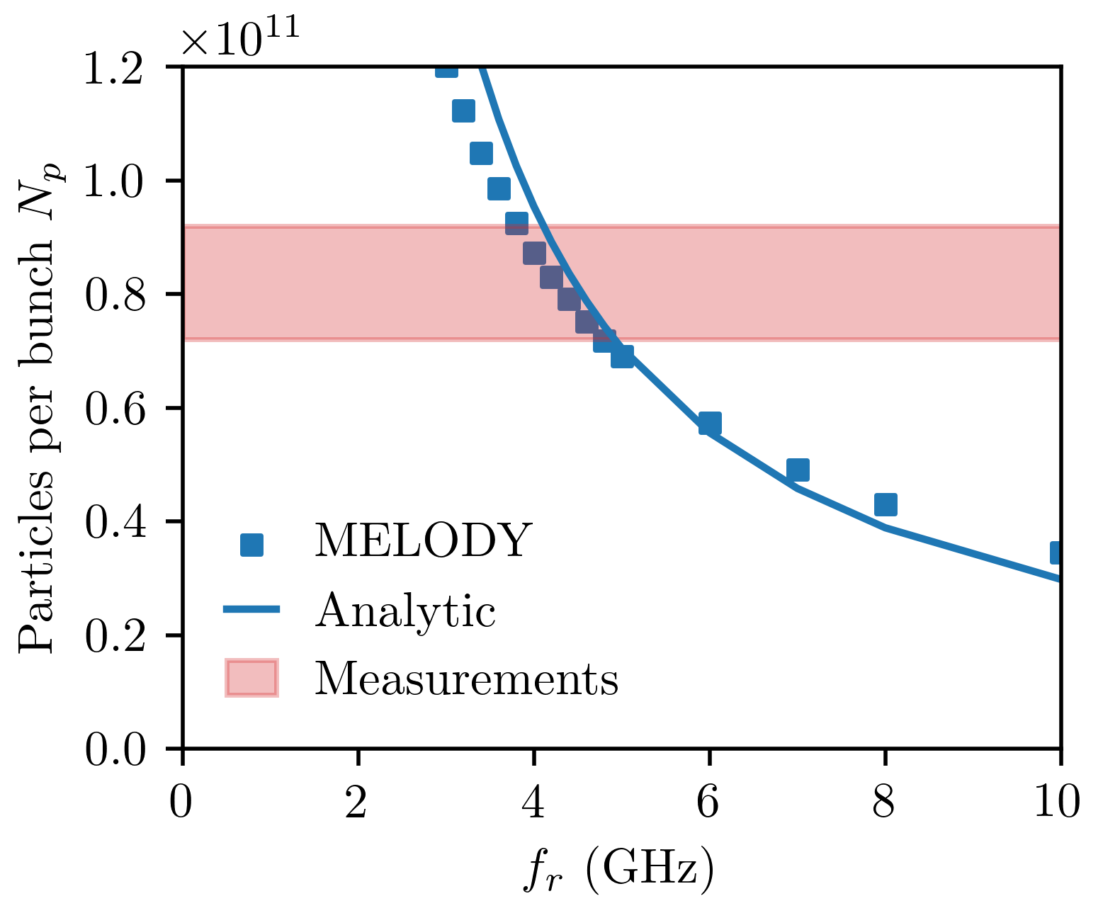
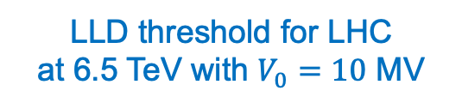
Loss of Landau damping (LLD)
Long-lasting oscillations were observed in SPS, RHIC, Tevatron, LHC, …
van Kampen modes* for broadband impedance above transition energy
LLD threshold for LHC
at 6.5 TeV with $V_{0}=10$ MV
Undamped mode
Synchrotron frequency spread
LLD threshold
H. Timko et al, Beam instabilities after injection to the LHC, 2018
J.F. Esteban Müller, PhD thesis, 2016
$→$ LLD threshold depends not only on impedance strength but also on cut-off frequency $f_{c}$**
$$→\text{Calculations} \text{are} \text{consistent} \text{with} \text{observations} \text{for} f_{c}≈5 \text{GHz}\text{ (}\text{cutoff} \text{of} \text{LHC} \text{beam} \text{pipe}\text{)}$$
*Y. H. Chin, K. Satoh, and K. Yokoya, Instability of a bunched beam with synchrotron frequency spread, 1983
and A. Burov, Van Kampen modes for bunch longitudinal motion, 2010
**IK, T. Argyropoulos, E. Shaposhnikova, Thresholds for loss of Landau damping in longitudinal plane, 2021

Slide 3
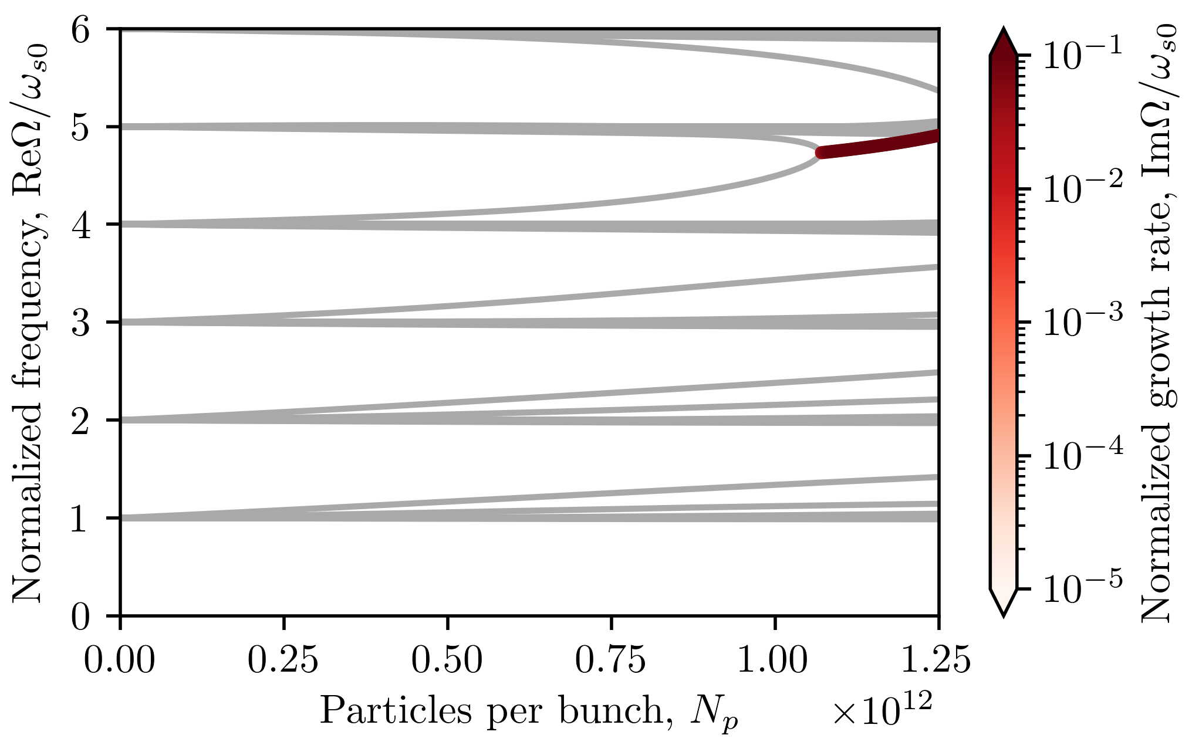
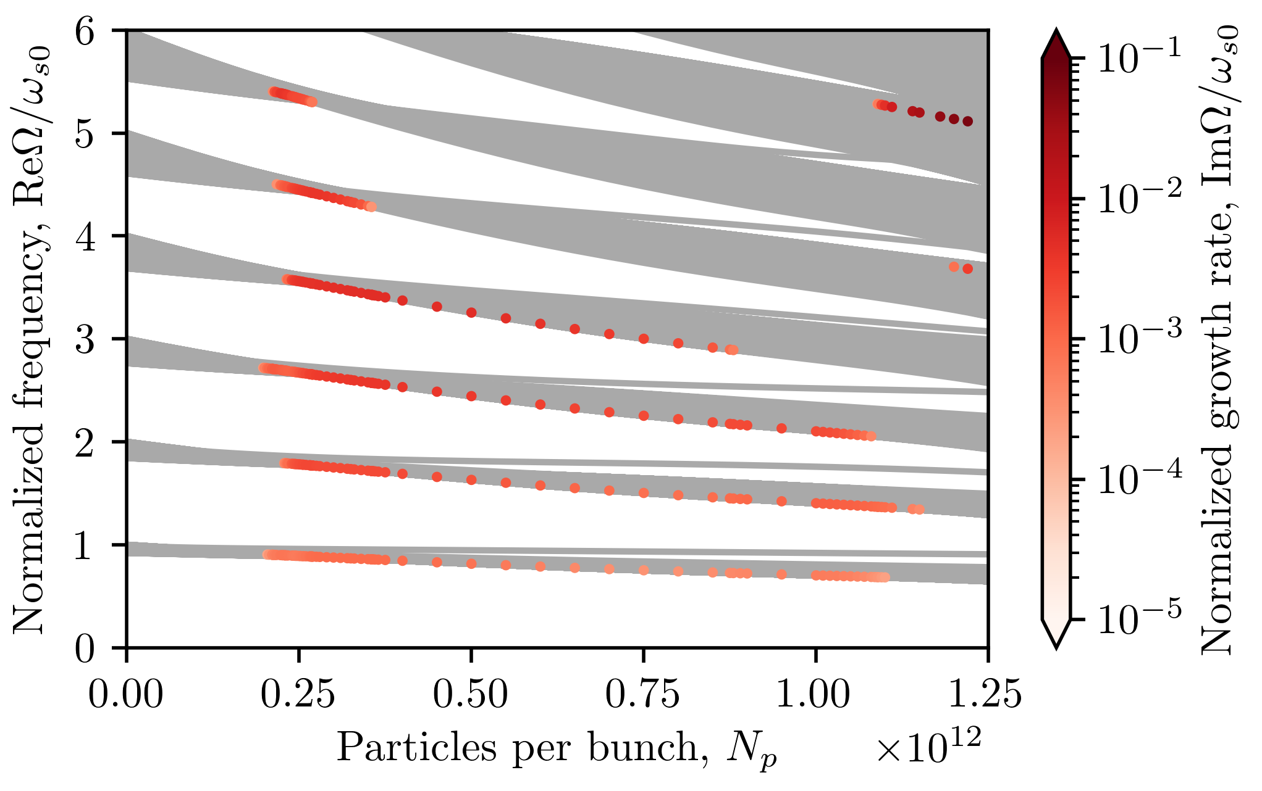
Single-bunch instability in SPS (long bunches)
Classical approach*
(no frequency spread)
Self-consistent approach** (frequency spread with potential-well distortion + RF nonlinearity)
Mode coupling
$→$ Classical azimuthal mode-coupling instability* is predicted at extremely high intensity
$→$ RF nonlinearities reduce the threshold by a factor of 5 (consistent with SPS measurements)***
$→$ Coupling of radial modes** is actual mechanism of instability
*F. J. Sacherer, Bunch lengthening and microwave instability, 1977
**K. Oide and K. Yokoya, Longitudinal single bunch instability in electron storage rings, 1990
***IK, Longitudinal mode-coupling instabilities of proton bunches in the CERN Super Proton Synchrotron, 2023

Slide 4
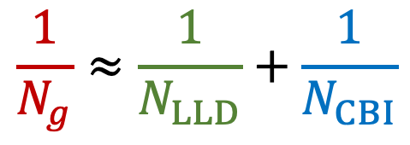
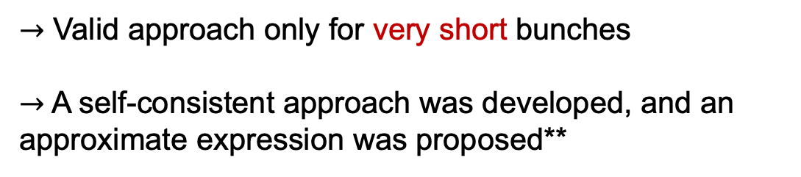
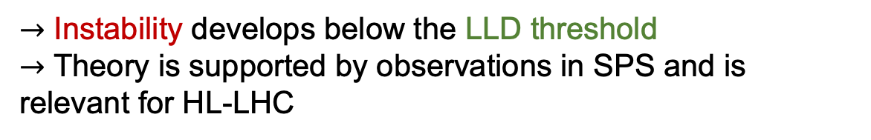
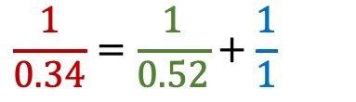
Generalized multi-bunch instability threshold
Growth rates of most unstable modes for 9 bunches
(MELODY - lines, BLonD - crosses)
Threshold coupled-bunch instability (CBI) for a combination of narrowband (nb) and broadband (bb) impedance can be evaluated using stability diagrams*
$→$ Valid approach only for very short bunches
$→$ A self-consistent approach was developed, and an approximate expression was proposed**
$$\frac{1}{0.34}=\frac{1}{0.52}+\frac{1}{1}$$
$$\frac{1}{N_{g}}≈\frac{1}{N_{LLD}}+\frac{1}{N_{CBI}}$$
$→$ Instability develops below the LLD threshold
$→$ Theory is supported by observations in SPS and is relevant for HL-LHC
*F. J. Sacherer, A longitudinal stability criterion for bunched beams, 1973
**IK and E. Shaposhnikova, Generalized threshold of longitudinal multi-bunch instability in synchrotrons, 2023

