Slide 1
Shower simulations for the CERN Proton Synchrotron internal dumps and comparison with beam loss monitor data
16th November 2023
SY & BE Flash Presentation Seminar
S. Niang, D. Domange, L. S. Esposito, M. Giovannozzi, C. Hernalsteens, A. Huschauer, T. Pugnat

Slide 2
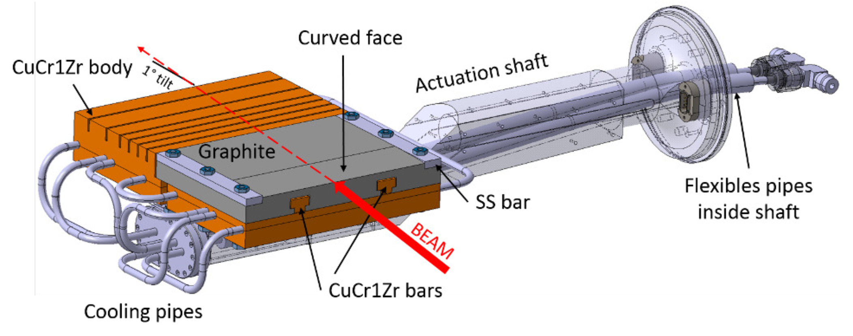
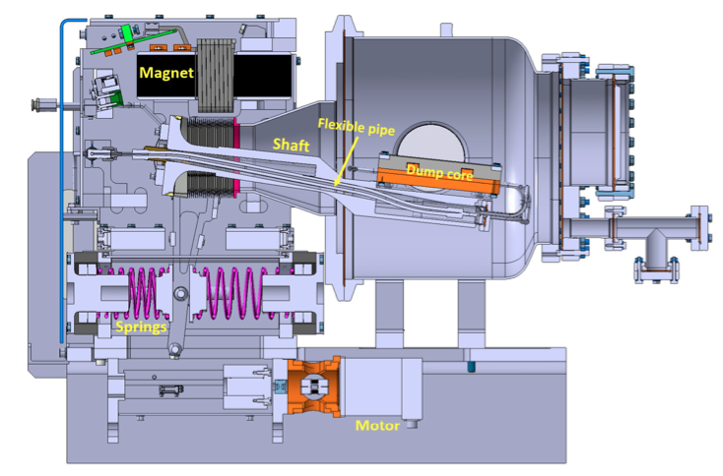
The PS internal dumps
BEAM
Two internal dumps
TDI 47 and TDI 48 in section 47 and 48, respectively
Installed in 2020 during LS2, for LIU beam
2.4 x 10¹⁷ protons / year, spread over the two dumps [1]
200 000 dump cycles per year for 20 years [2]
Not sufficiently long to fully contain the proton beam
Movable dumps with pneumatic
  [1] PS Ring Internal Dumps Functional Specifications, EMDS PS-TDI-ES-001
  [2] Engineering design and prototyping of the new LIU PS internal beam dumps, 10.18429/JACoW-IPAC2018-WEPMG001

Slide 3
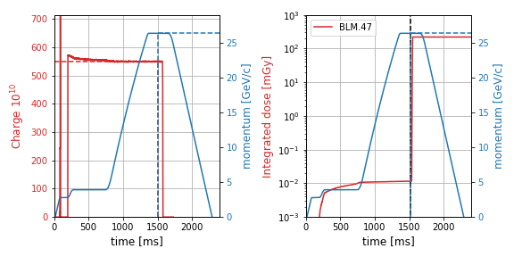
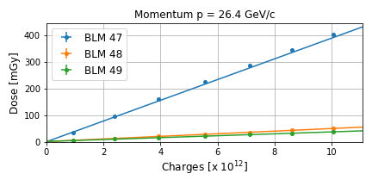
Data from MD tests
Beam optics | Momentum [GeV/c] | Dump used | Simulation done | Experiment done
LHC | 26.4 | 47 | Yes | Yes
LHC | 26.4 | 48 | Yes | Yes
LHC | 3.9 | 47 | No | Yes
SFTPRO | 14.0 | 47 | Yes | Yes
BLM, current, energy when the dump is activated
The dumps have been activated on purpose
We check the value of the variables when the dump is activated
Charge, magnetic field, Beam Loss Monitor
The dose increase with the energy.
Increase close to the extraction line in section 63-65.
Several measurements at different intensities
To obtain the dose per primary for each BLM
To compare with the FLUKA simulations
We assume a linear response of the BLMs
LHC 26.4 GeV (dump 47)
Maximum in section 47 when TDI 47 is used and in section 48 for TDI 48 but in the other sections, the dose is similar.

Slide 4

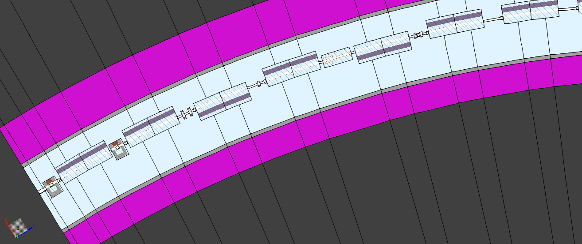
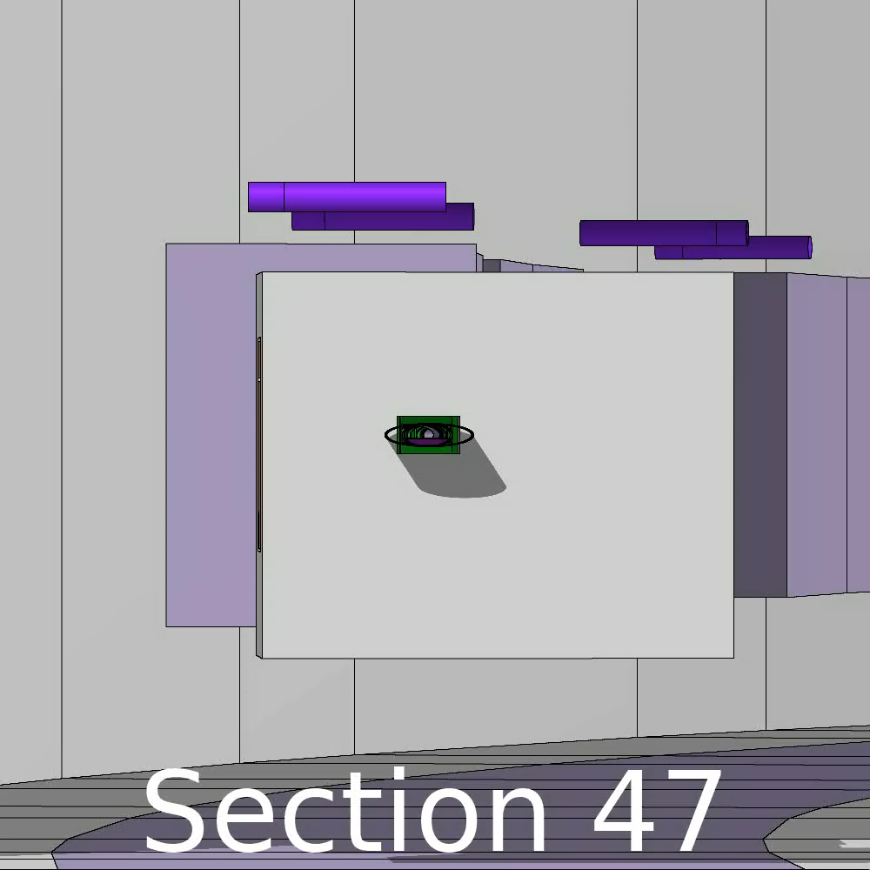
simulations
section 53
section 52
TDI 47
section 51
section 50
section 49
section 48
section 47
TDI 48
From section 47 to 69 (included)
Detailed implementation of mechanical magnet model.
Analytical function to describe the magnetic field in the main magnets

Slide 5
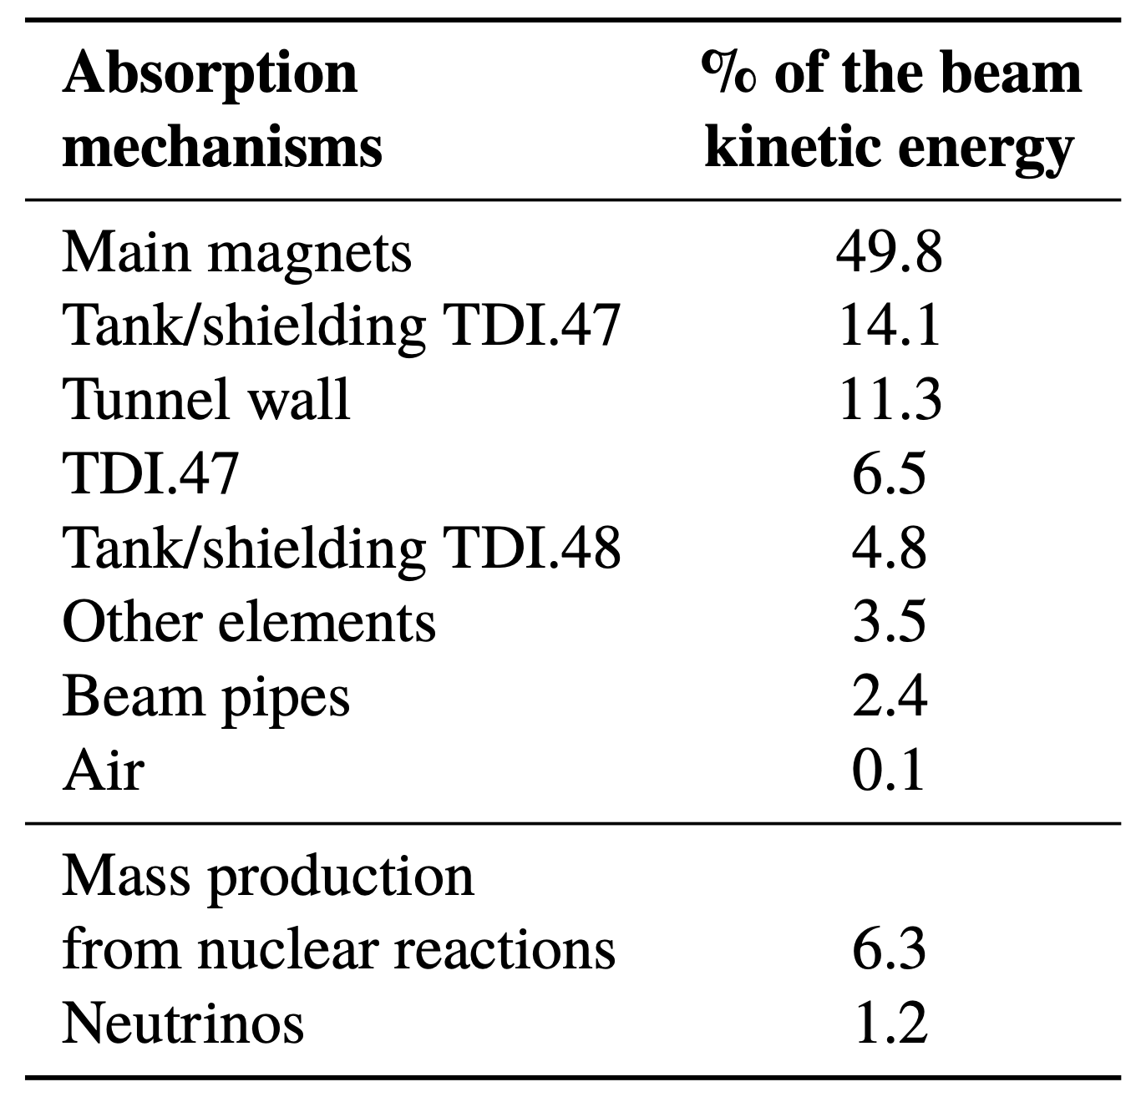
Results
Conservative assumptions
All protons of one year sent on TDI 47
With p = 26.4 GeV/c
LHC flat top optics
the energy deposition will be evaluated with the real beam energy breakdown
LHC beam on TDI 47 at 26.4 GeV/c
We observe a discrepancy along the extraction region (62 to 65), see next slides for hypothesis
  Conclusion
  Good agreement between data and simulations
  Around 7% of the energy captured, rest of the energy is absorbed in the beam elements, walls and escaping the region (mainly neutrinos)
  Evaluation of the hot-spots in the magnets

Slide 6
Thank you for your attention.

