Slide 2
Beam performance with the
LHC Injectors Upgrade (LIU)
Giovanni Rumolo
S. Albright, R. Alemany, M.E. Angoletta, C. Antuono, T. Argyropoulos, F. Asvesta, M. Barnes, H. Bartosik, P. Baudrenghien, G. Bellodi, N. Biancacci, C. Bracco, N. Bruchon, E. Carlier, J. Coupard, H. Damerau, G.P. Di Giovanni, E. de la Fuente Garcia, A. Findlay, M. Fraser, A. Funken, R. Garoby, S. Gilardoni, B. Goddard, G. Hagmann, K. Hanke, A. Huschauer, G. Iadarola, V. Kain, I. Karpov, J.B. Lallement, A. Lasheen, T. Levens, K. Li, A. Lombardi, E. Maclean, D. Manglunki, I. Mases Sole, M. Meddahi, L. Mether, B. Mikulec, E. Montesinos, Y. Papaphilippou, G. Papotti, K. Paraschou, C. Pasquino, F. Pedrosa, T. Prebibaj, S. Prodon, D. Quartullo, F. Roncarolo, B. Salvant, M. Schenk, R. Scrivens, E. Shaposhnikova, L.Sito, P. Skowronski, A. Spierer, R. Steerenberg, M. Sullivan, F. Velotti, R. Veness, C. Vollinger, R. Wegner, C. Zannini, LIU teams, OP crews & all equipment experts

Slide 3
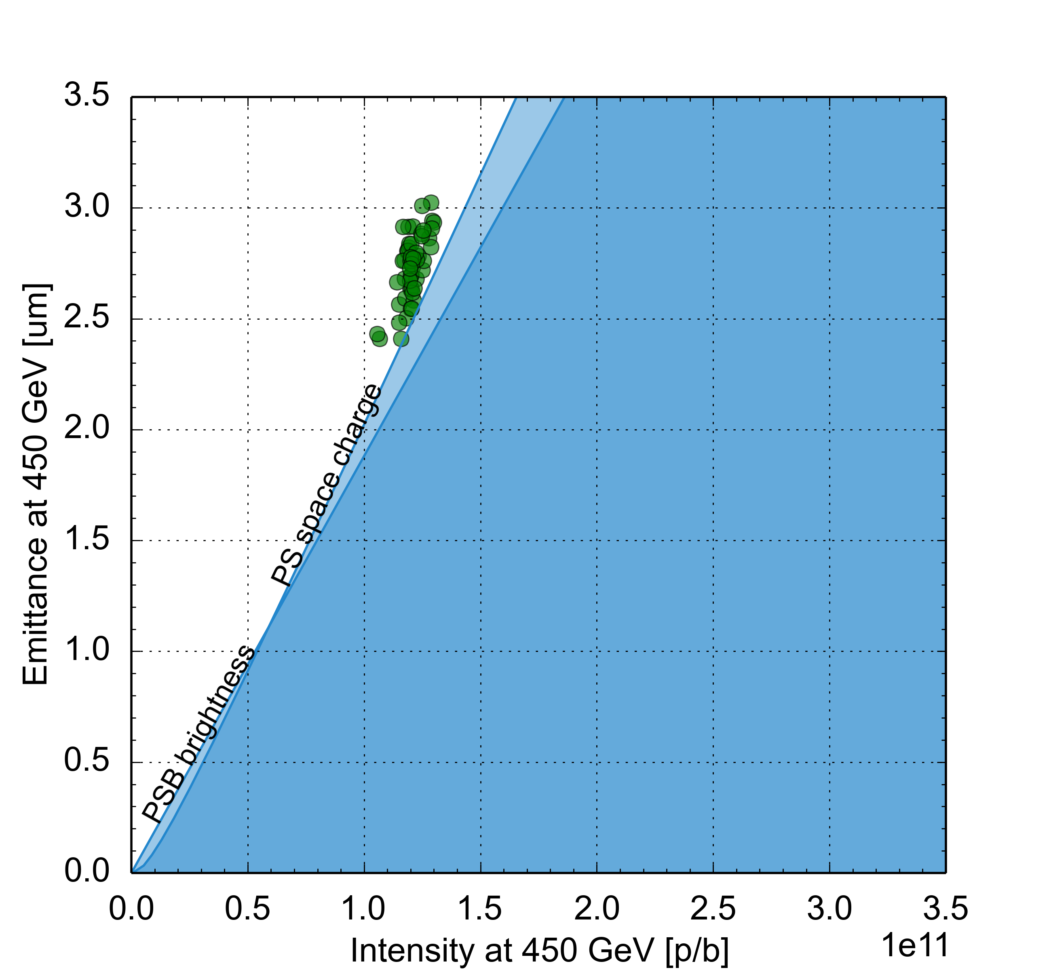
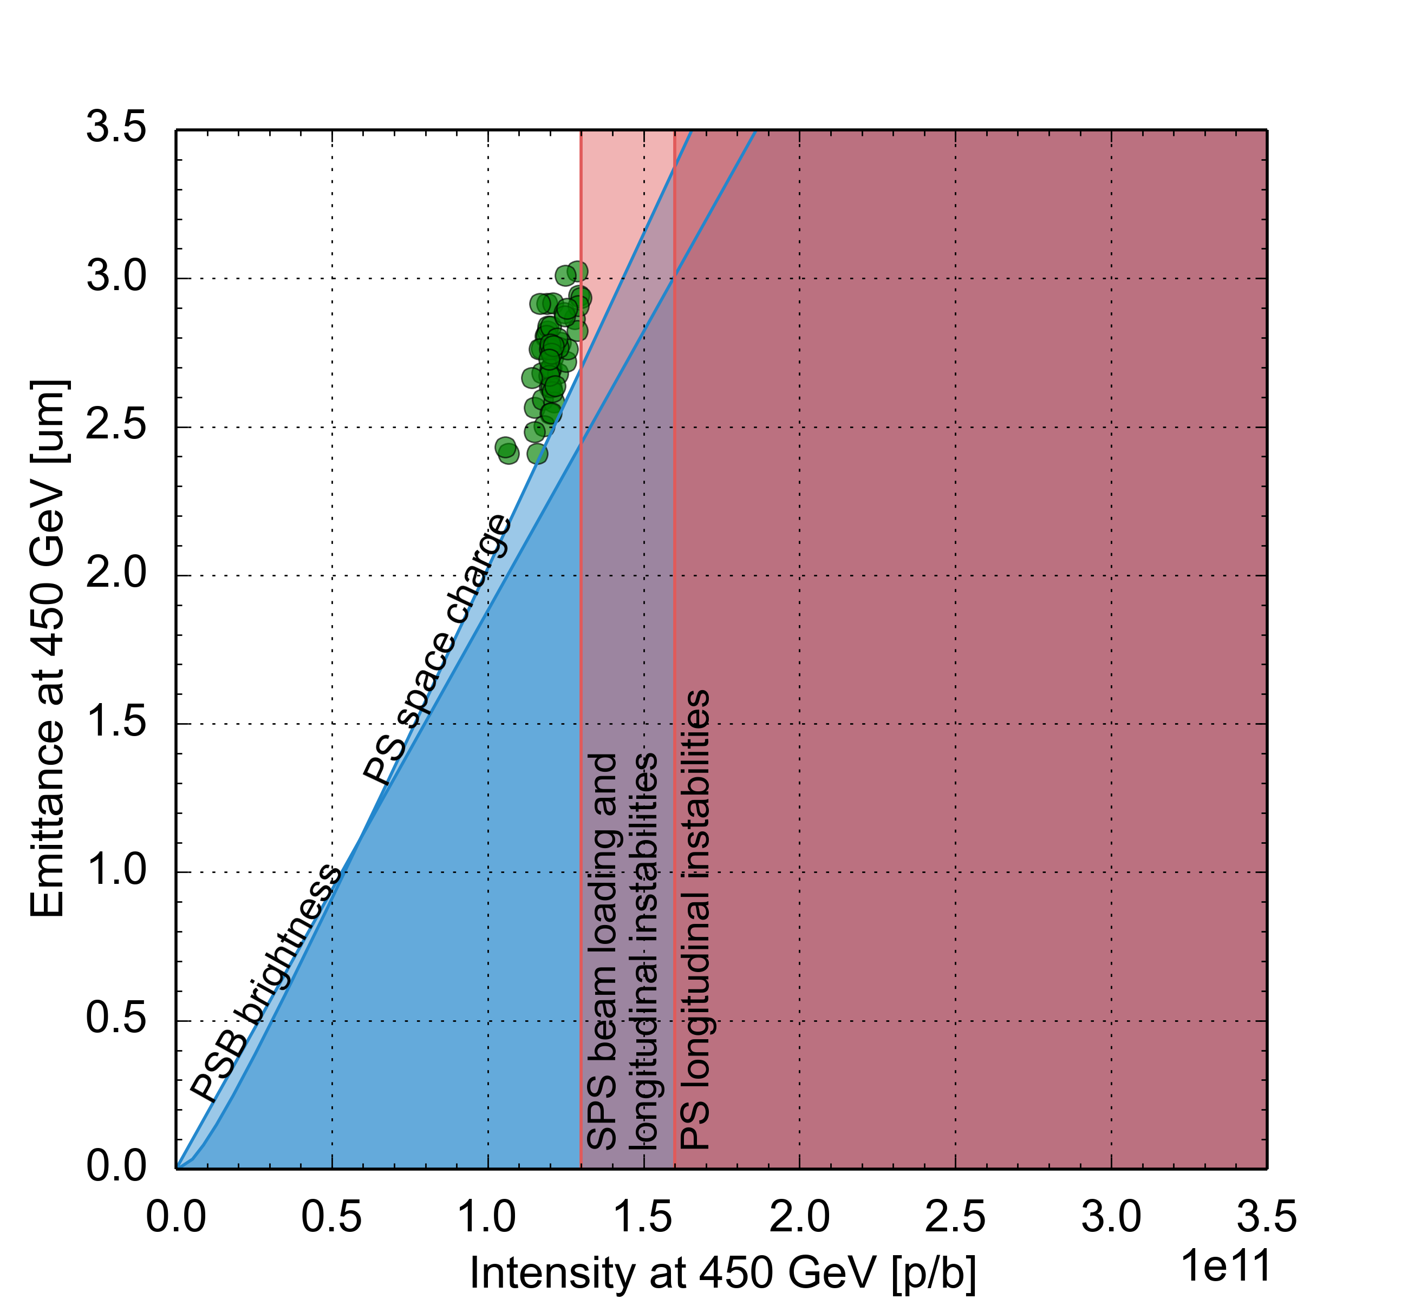
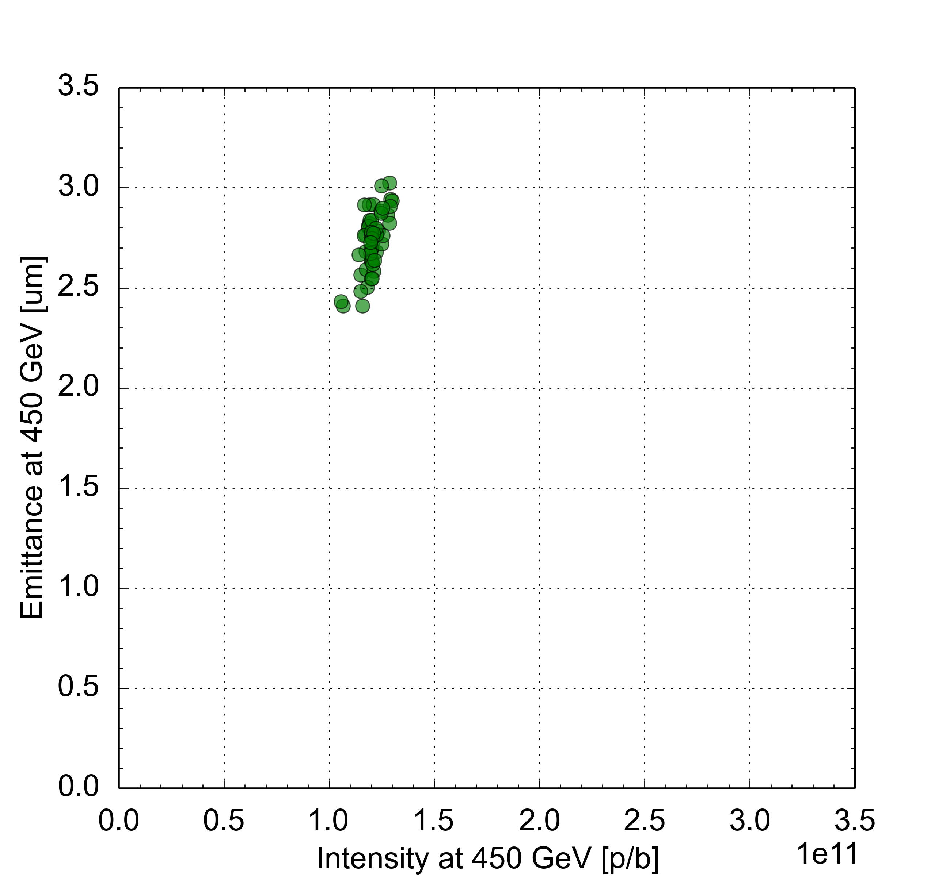
The LHC Injectors Upgrade (LIU) goal
Run 1
Long Shutdown 1
Run 2
Long Shutdown 2
Run 3
Long Shutdown 3
Run 4
2009
2010
2011
2012
2013
2014
2015
2016
2017
2018
2019
2020
2021
2022
2023
2024
2025
2026
2027
2028
2029
2030
Only injectors
Only injectors
HL-LHC installation
(+ ATLAS & CMS upgrade, NA cons, ECN3, …)
Pre-LIU performance:
N_{b}=1.1 – 1.3 x 10¹¹ p/b
ε_{x,y}=2.5 – 3.0 μm
HL-LHC target
N_{b}=2.3 x 10¹¹ p/b
ε_{x,y}=2.1 μm
A gap by a factor 2 in intensity and brightness to be filled

Slide 4

The LHC Injectors Upgrade (LIU) goal
Run 1
Long Shutdown 1
Run 2
Long Shutdown 2
Run 3
Long Shutdown 3
Run 4
2009
2010
2011
2012
2013
2014
2015
2016
2017
2018
2019
2020
2021
2022
2023
2024
2025
2026
2027
2028
2029
2030
Only injectors
Only injectors
HL-LHC installation
(+ ATLAS & CMS upgrade, NA cons, ECN3, …)
(2010 – 2021)
Peak installation phase in Long Shutdown 2 (LS2)
Project closure with performance ramp-up plan and back-up items

Slide 5
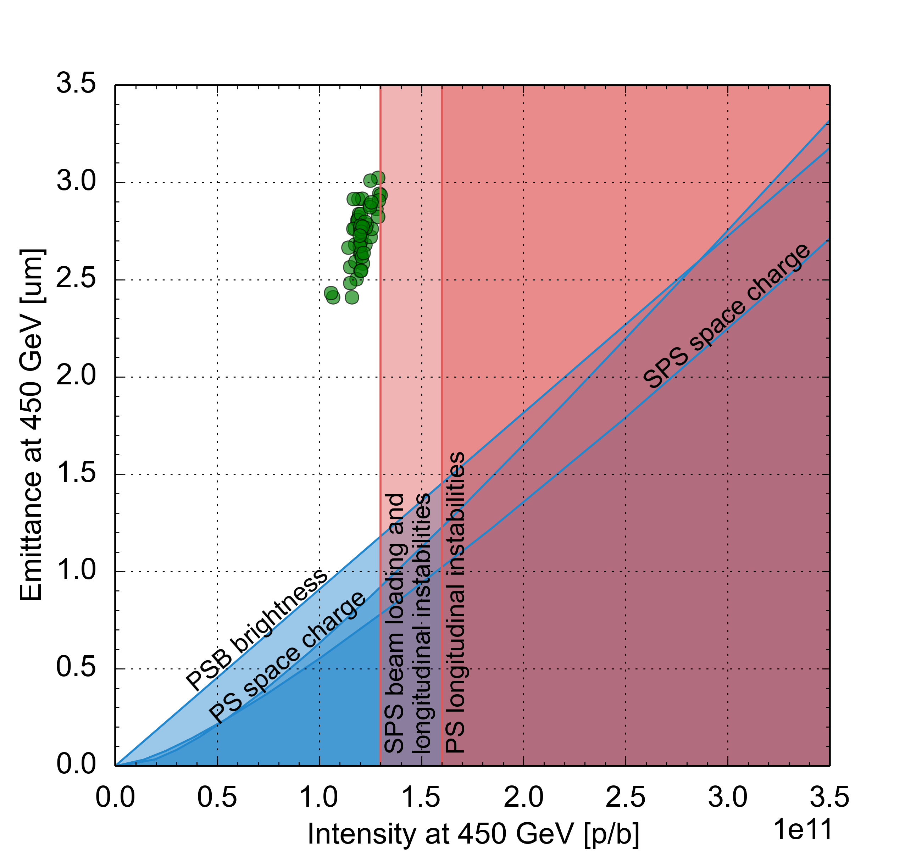
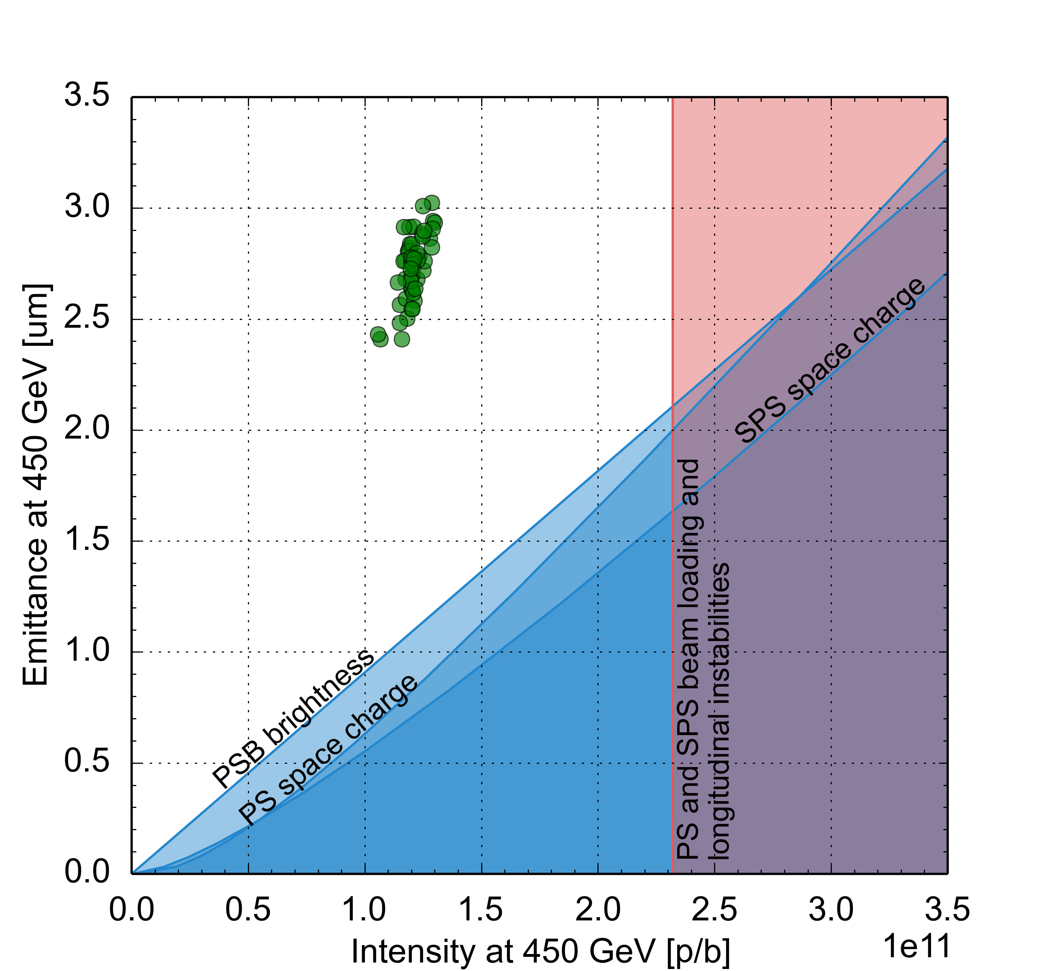
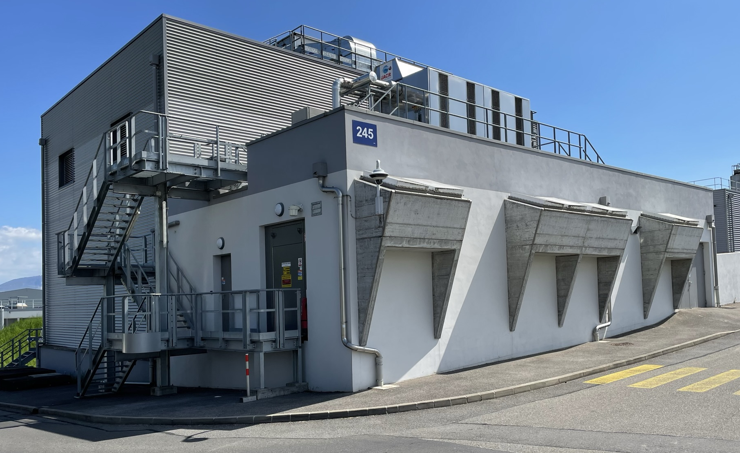
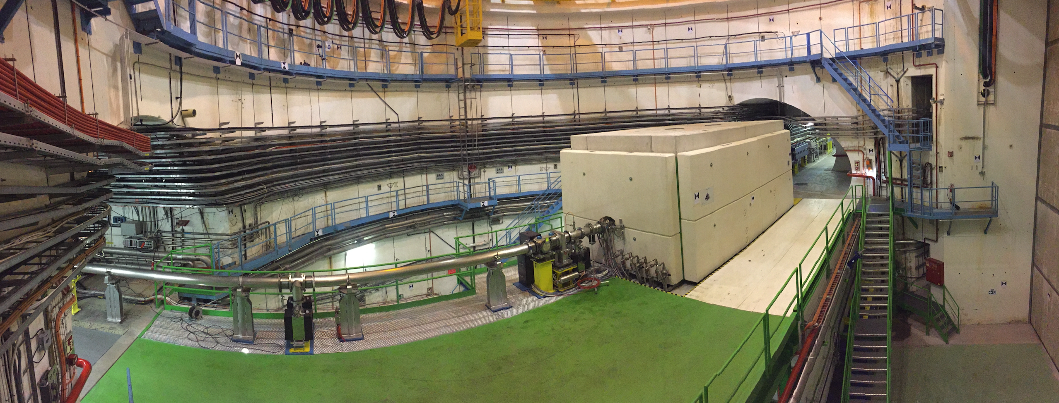
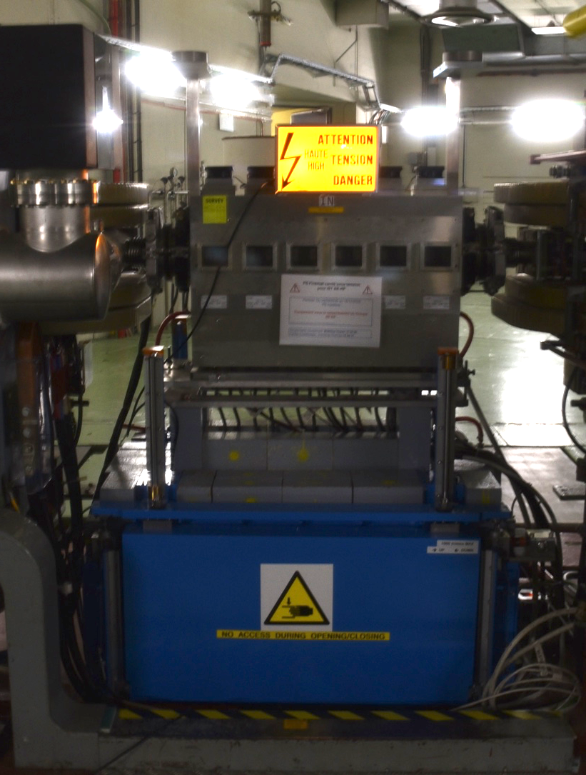
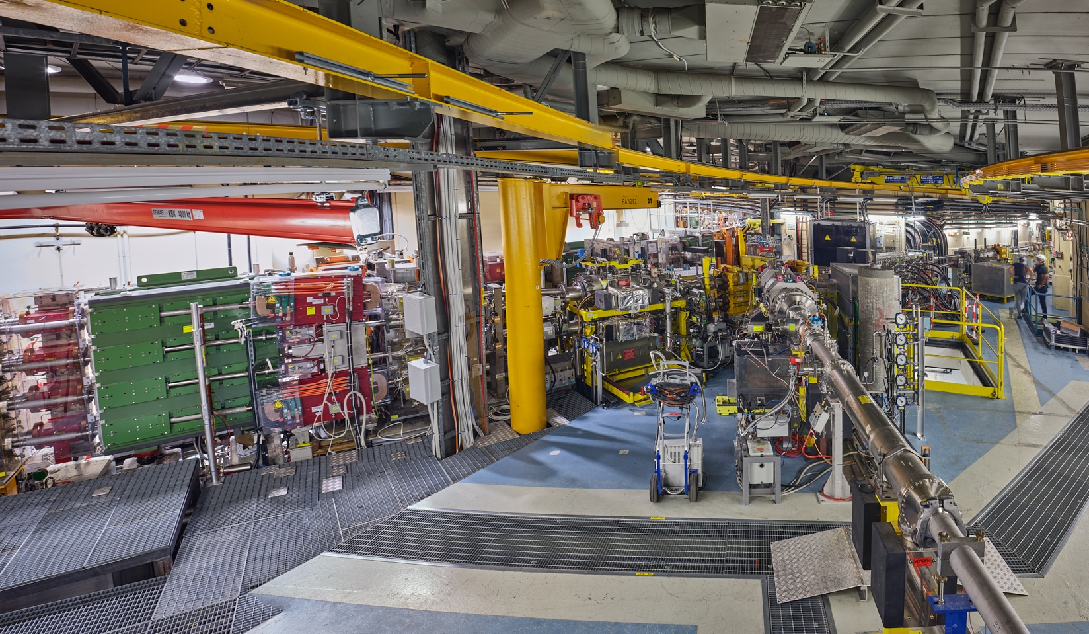
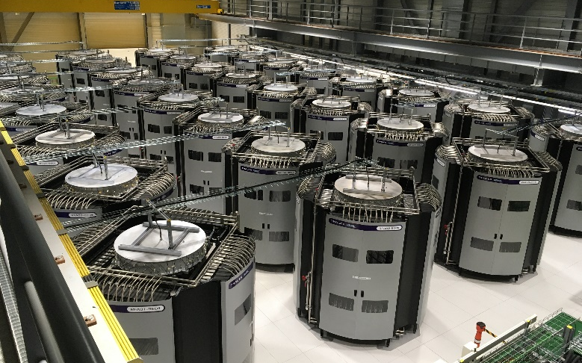
The LIU installation
Connection of PSB to Linac4 and acceleration to 2 GeV in PSB
PS & SPS RF upgrades + e-cloud & impedance reduction, new SPS optics, new dumps & stoppers, etc.
New SPS beam dump
PSB new power supply building
PS longitudinal damper
PSB injection Line from Linac4
New SPS RF amplifier towers

Slide 6
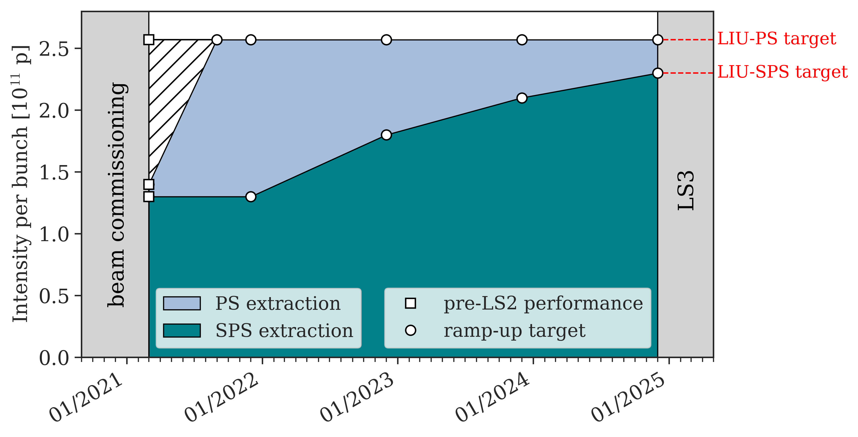
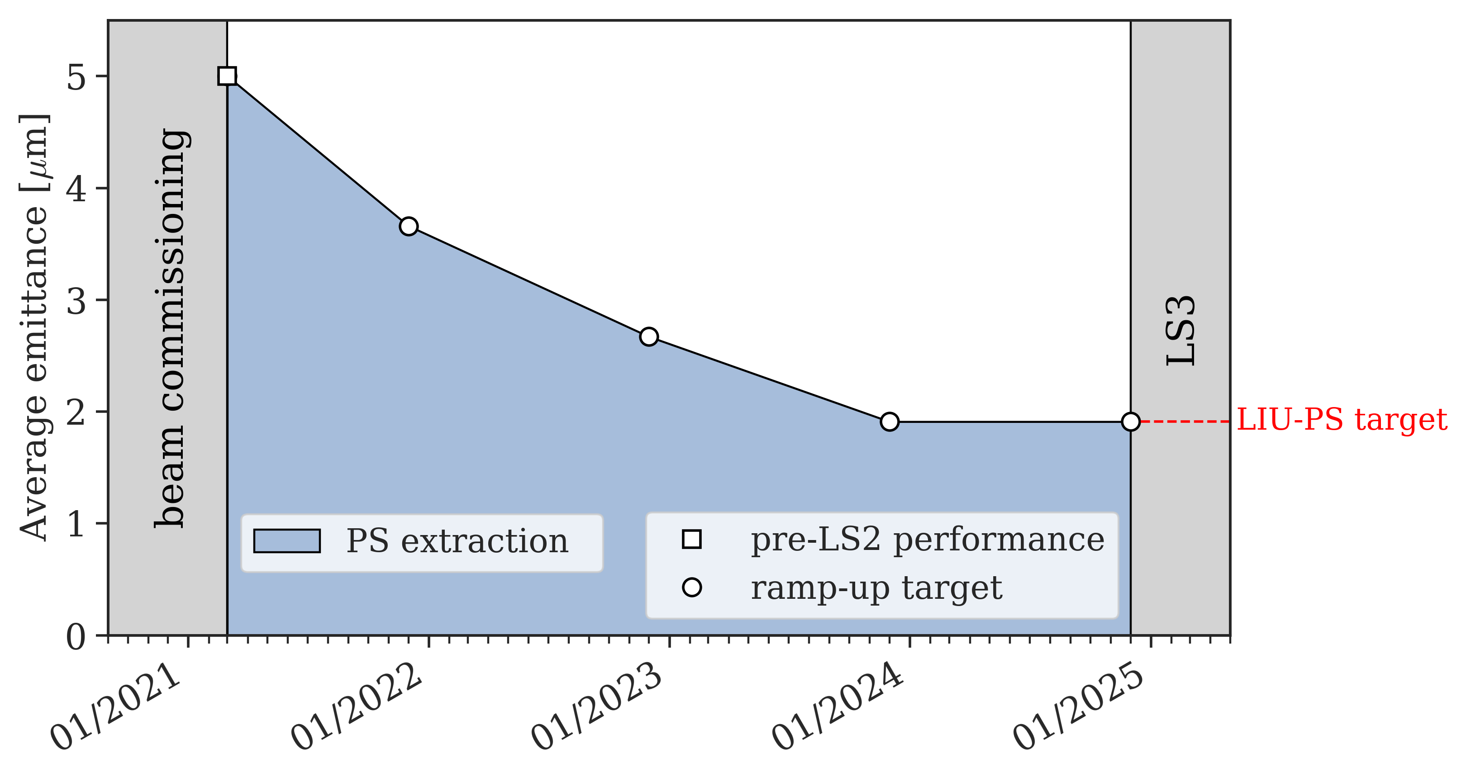

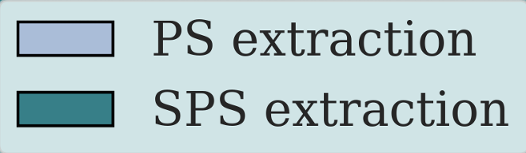
LIU beam commissioning in Run 3: ramp-up plan
Year-by-year intensity goals of the ramp-up at SPS extraction
  Pre-LS2 beam parameters recovered by the end of 2021 – 1.3e11 p/b
  1.8e11 p/b in MD by the end of 2022 – to be ready for LHC in 2023 (operation)
  2.1e11 p/b in MD by the end of 2023 – to be ready for LHC in 2024 (MD)
  2.3e11 p/b in MD by the end of 2024 – to be ready for HL post-LS3
A. Huschauer et al.,
LIU workshop 2020

Slide 7
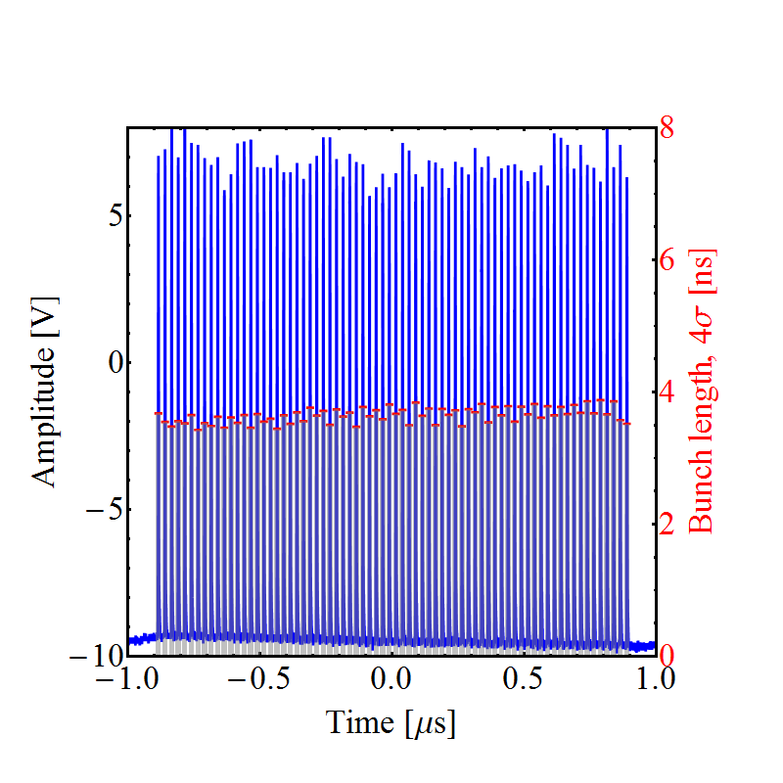
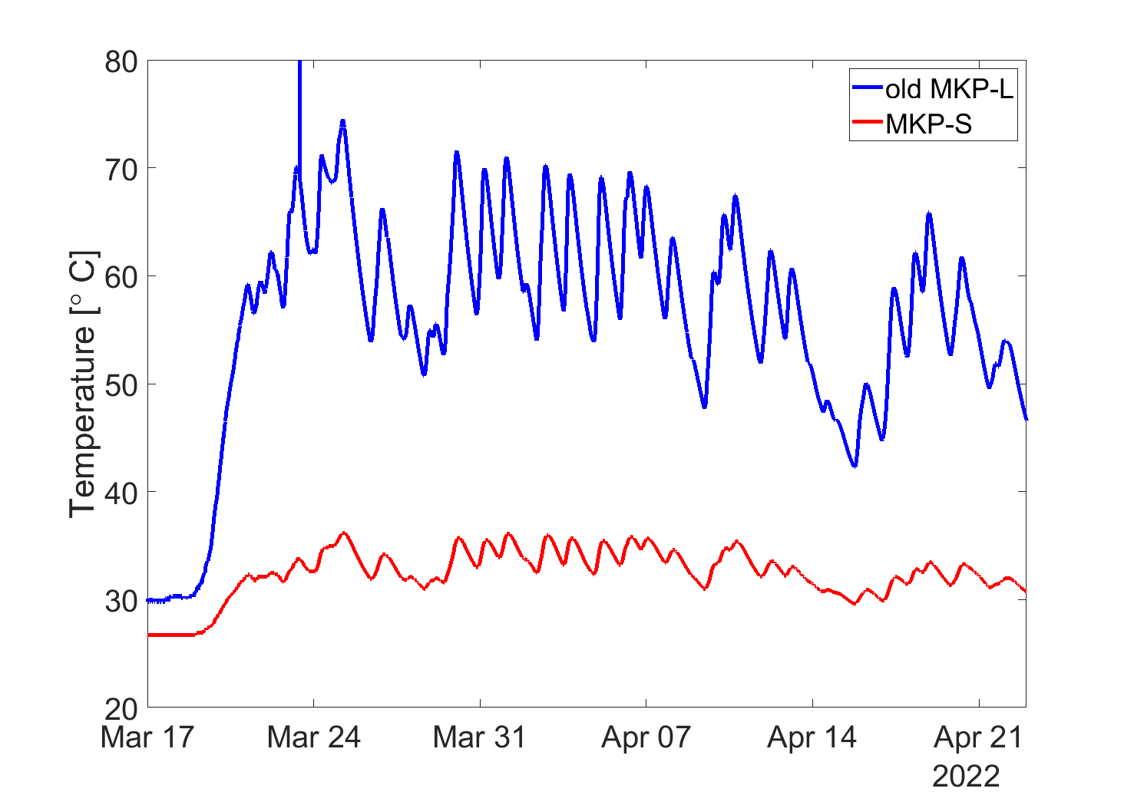
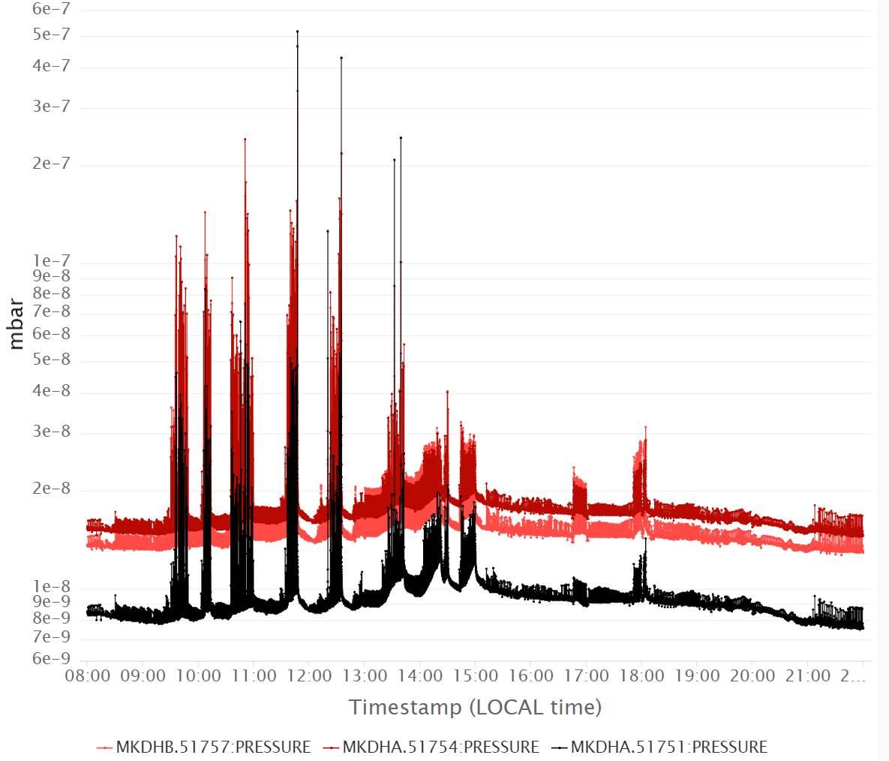
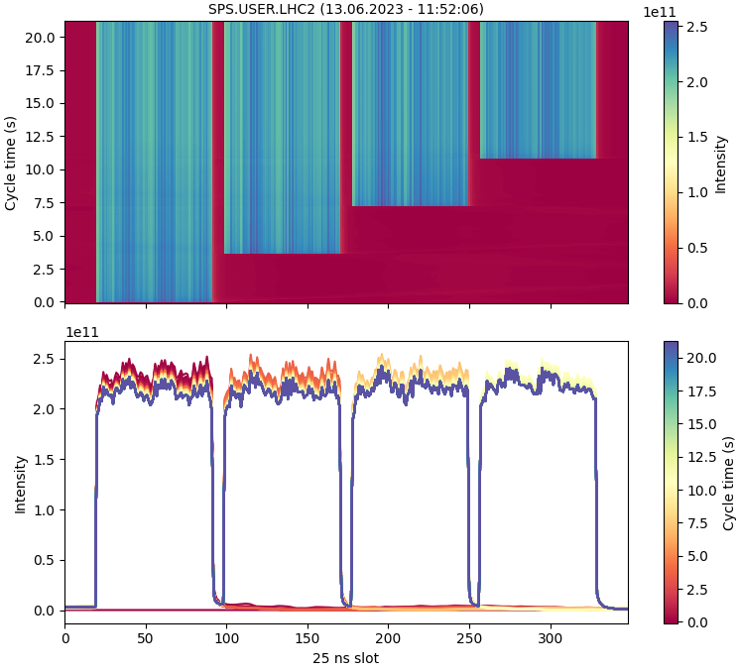
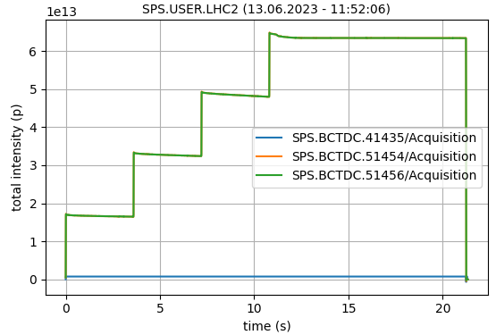
Actual progress in Run 3
N_{b} = 2.6 ∙ 10¹¹ p/b 4σ_{z}<4 ns
LIU-PS achieved
LIU-SPS achieved
MKP-L heating
Pressure spikes in MKP-L and MKDH
Thanks to new MKP-L + efficient scrubbing

Slide 8
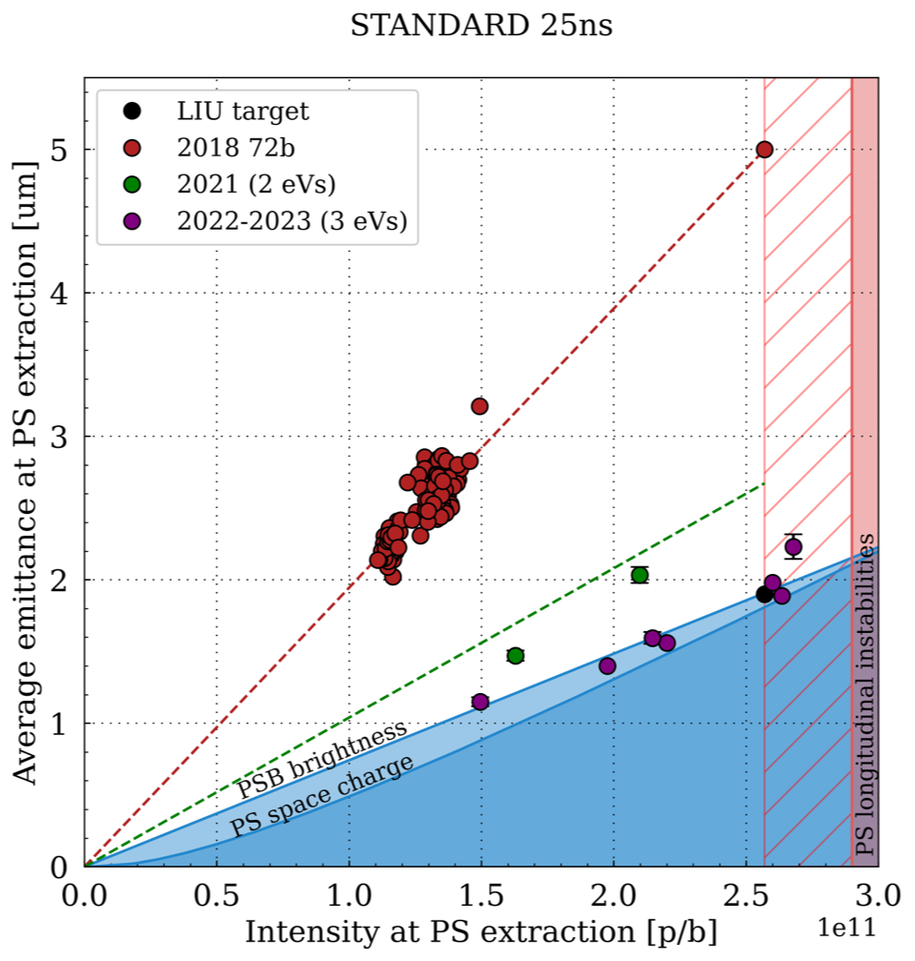
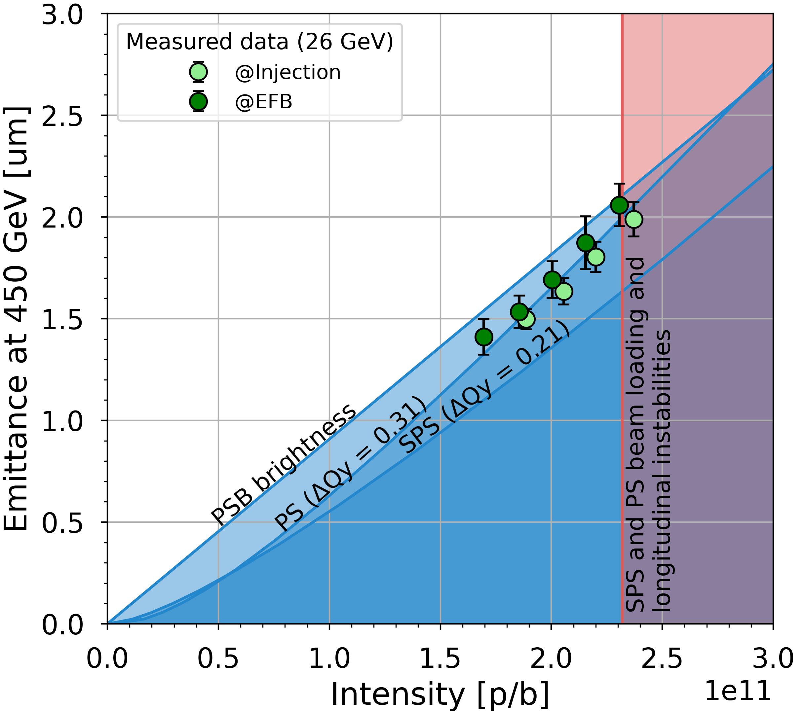
Actual progress in Run 3
2 eVs
LIU-SPS achieved
3 eVs
LIU-PS achieved

Slide 9
Summary & outlook
LIU project ended on time & budget
LIU beam commissioning is advancing well and is currently ahead of schedule both in terms of achieved beam intensity and brightness
Some surprises encountered on the way but no major showstoppers!

