Slide 1
High Intensity Beam Dynamics Challenges for HL-LHC
N. Mounet, R. Tomás, H. Bartosik, P. Baudrenghien, R. Bruce, X. Buffat, R. Calaga, R. De Maria, C. Droin, L. Giacomel, M. Giovannozzi, G. Iadarola, S. Kostoglou, B. Lindström, L. Mether, E. Métral, Y. Papaphilippou, K. Paraschou, S. Redaelli, G. Rumolo, B. Salvant, G. Sterbini
Acknowledgements: C. Antuono, C. Accettura, D. Amorim, V. Baglin, N. Biancacci, G. Bregliozzi, F. Carra, L. Gentini, A. Kurtulus, C. Lannoy, F.‑X. Nuiry, V. Petit, M. Rognlien, L. Sito, E. Vik, W. Vollenberg, C. Zannini
HB Flash Seminar, CERN, Geneva, Switzerland – 16/11/2023

Slide 2

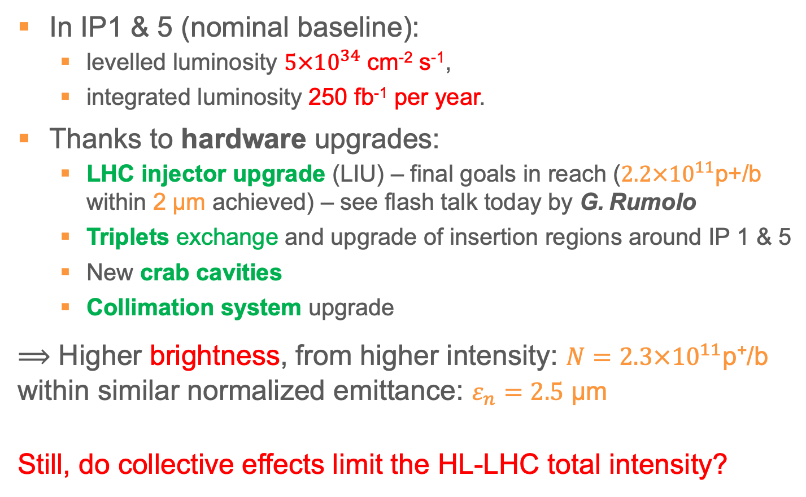
HL-LHC goals
In IP1 & 5 (nominal baseline):
  levelled luminosity $5×{10}^{34}$ cm⁻² s⁻¹,
  integrated luminosity 250 fb⁻¹ per year.
Thanks to hardware upgrades:
  LHC injector upgrade (LIU) – final goals in reach ($2.2×{10}^{11}$p+/b within 2 μm achieved) – see flash talk today by G. Rumolo
  Triplets exchange and upgrade of insertion regions around IP 1 & 5
  New crab cavities
  Collimation system upgrade
⟹ Higher brightness, from higher intensity: $N=2.3×{10}^{11}$p⁺/b
within similar normalized emittance: $ε_{n}=2.5$ μm
Still, do collective effects limit the HL-LHC total intensity?

Slide 3
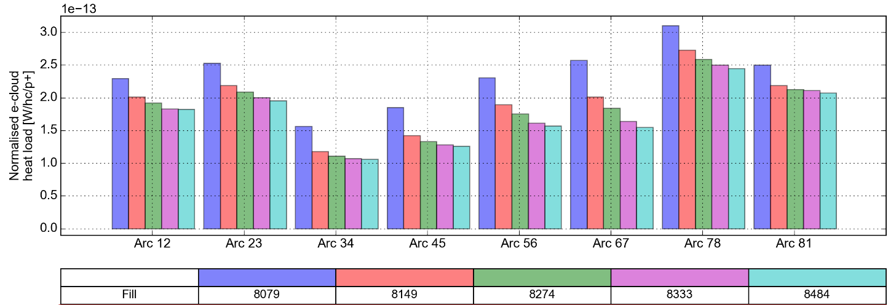
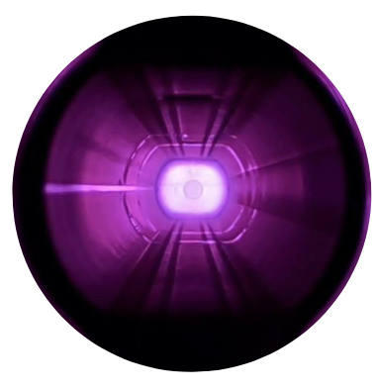
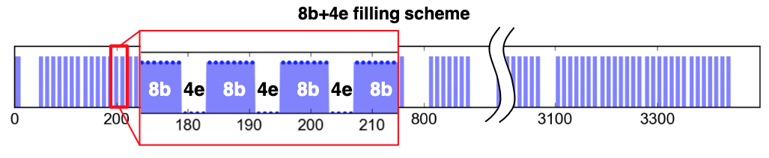
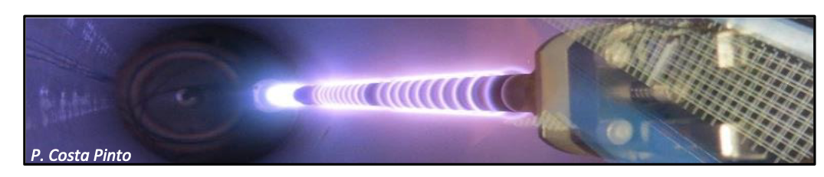
The e-cloud challenge
Degraded situation after LS2, and scrubbing levelling off in all sectors – e.g. sector 78
Mitigations: surface treatment and / or 8b+4e scheme (or hybrid)
L. Mether, 13th HL-LHC Collaboration Meeting, 27/09/2022
See L. Mether’s proceedings, THBP31, HB’23

Slide 4
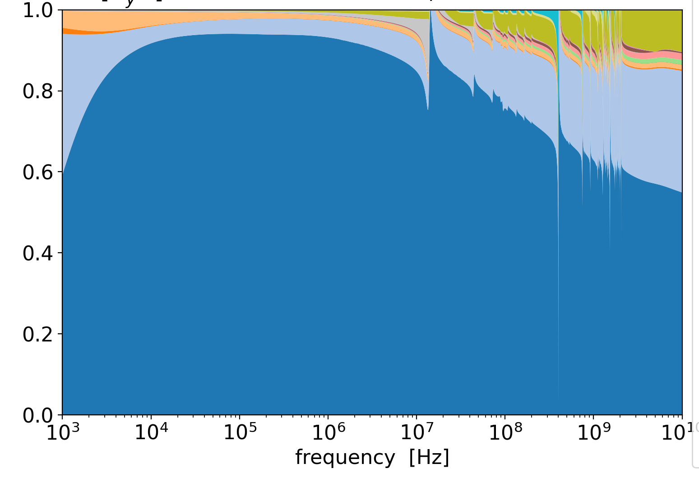
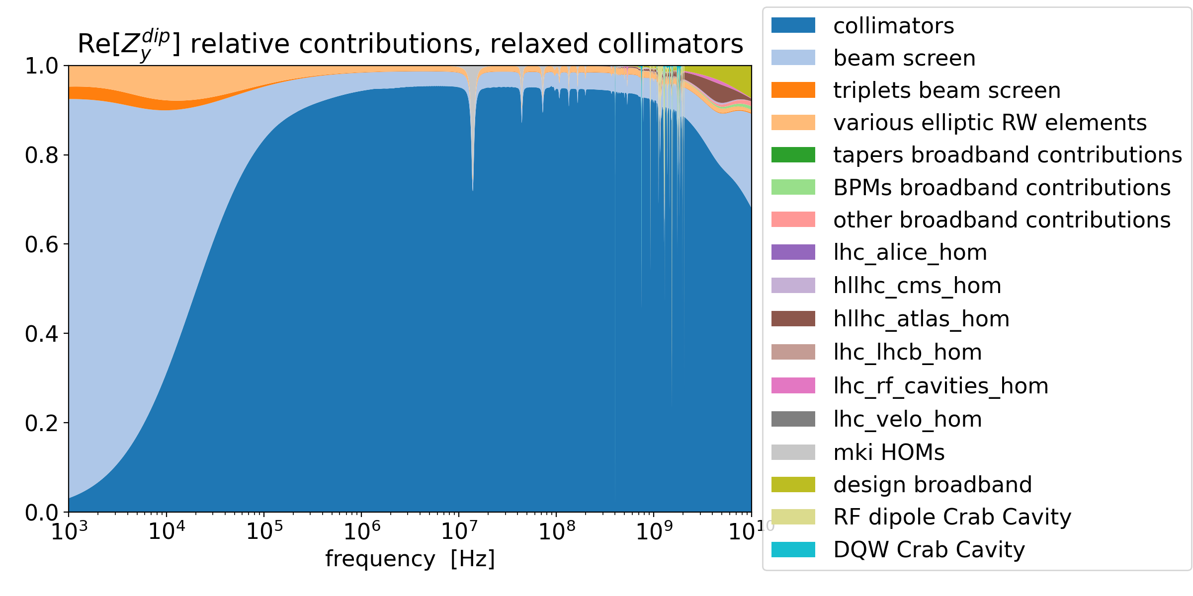
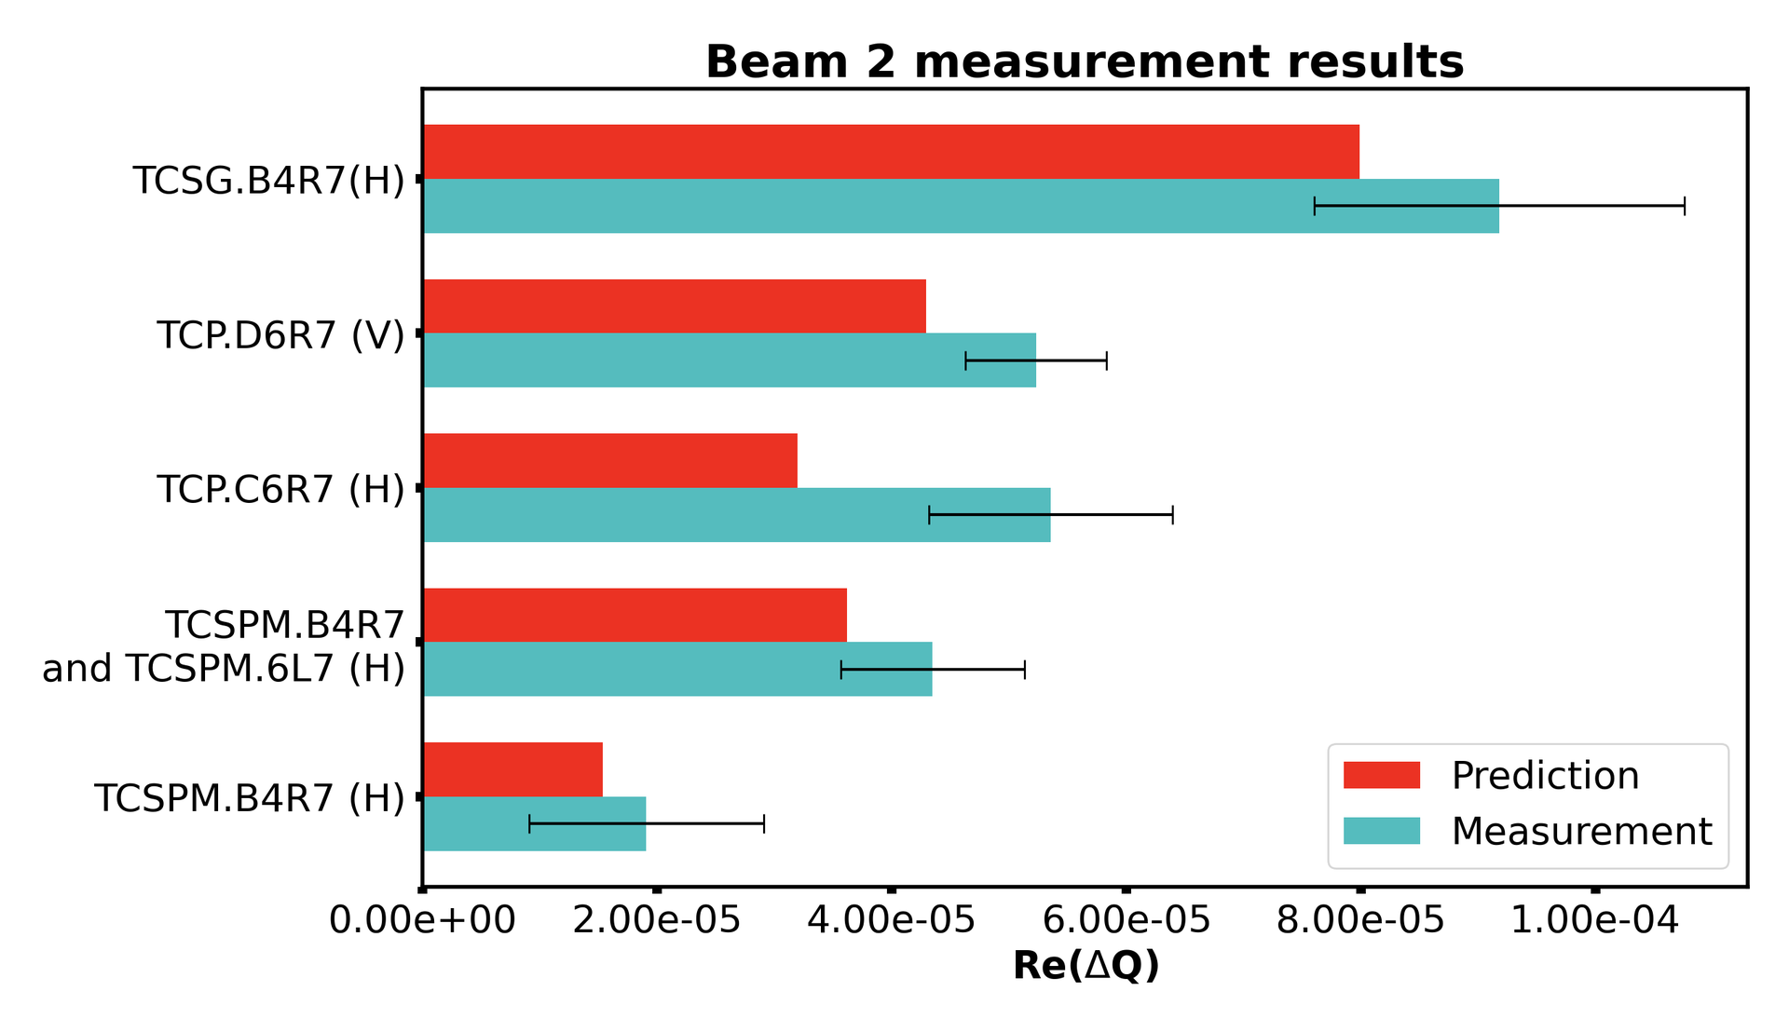

Transverse impedance: collimators
Transverse impedance at flat top dominated by collimators:
⟹ Collimator upgrade (using higher conductivity materials in jaws):
Beam screens
$Im\left(Z_{y}^{dip}\right)$ contributions
Collimators
Impedance decrease confirmed by tune shift measurements:
Impact of
LS2 upgrade
Adnan Kurtulus, ABP-CEI meeting 15/12/2022

Slide 5
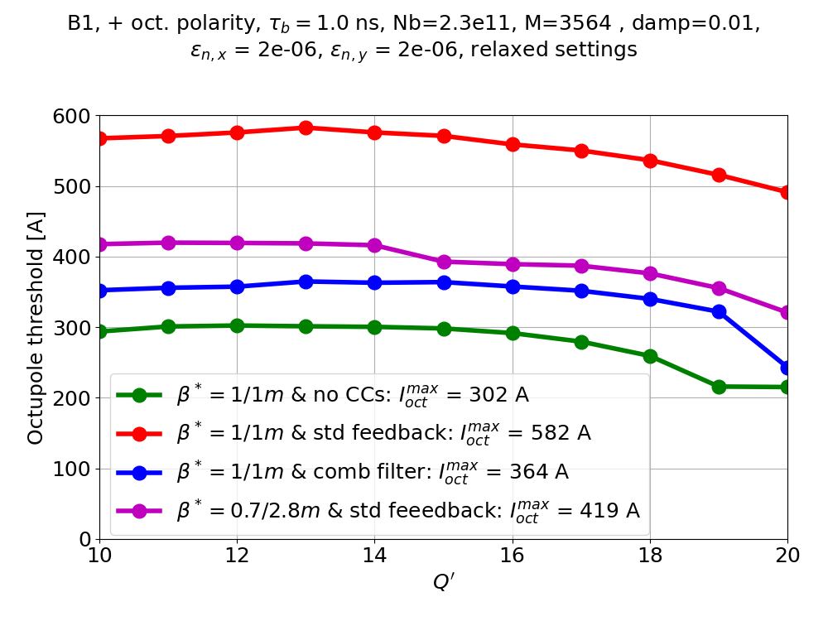
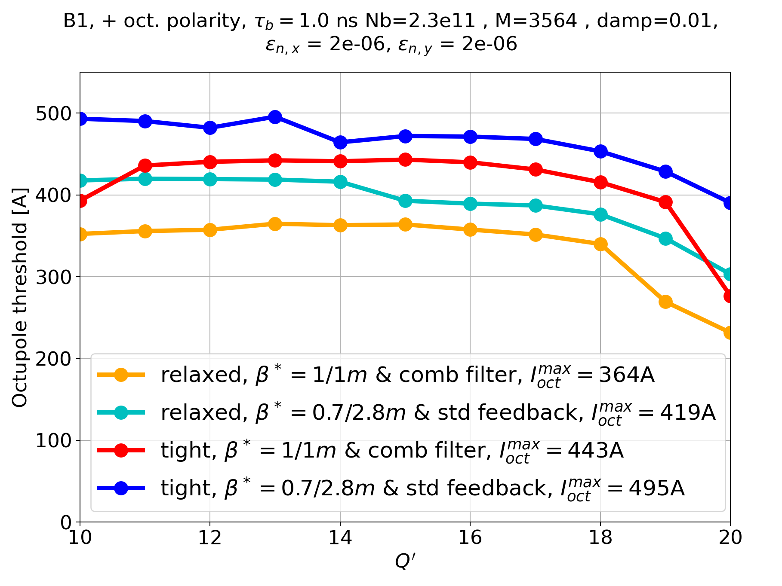
Overall stability
Strong impact of fundamental mode of crab cavities on stability:
Impact of fund. mode
Comb filter mitigation
See flash talk of L. Giacomel today (THBP40)
BUT good news for stability: transverse tails in LIU beams
⟹ more Landau damping
⟹ tight collimators option back on table
(but higher octupoles needed ⟶ impact on dynamic aperture – THBP21 & THBP20, HB’23)

