Slide 1
Emittance growth from electron clouds forming in
the LHC arc quadrupoles
https://hb2023.vrws.de/papers/thbp16.pdf
K. Paraschou, H. Bartosik, L. Deniau, G. Iadarola, E. H. Maclean,
L. Mether, Y. Papaphilippou, G. Rumolo, R. Tomás,
CERN, Geneva, Switzerland,
T. Pieloni, J. Potdevin,
EPFL, Lausanne, Switzerland
HB2023 Flash Seminar
CERN, Geneva, Switzerland
16th November 2023

Slide 2
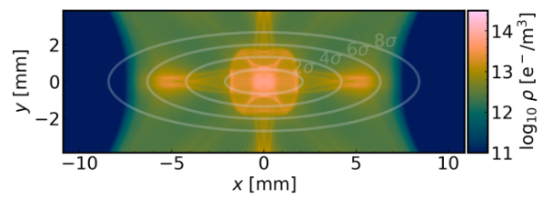
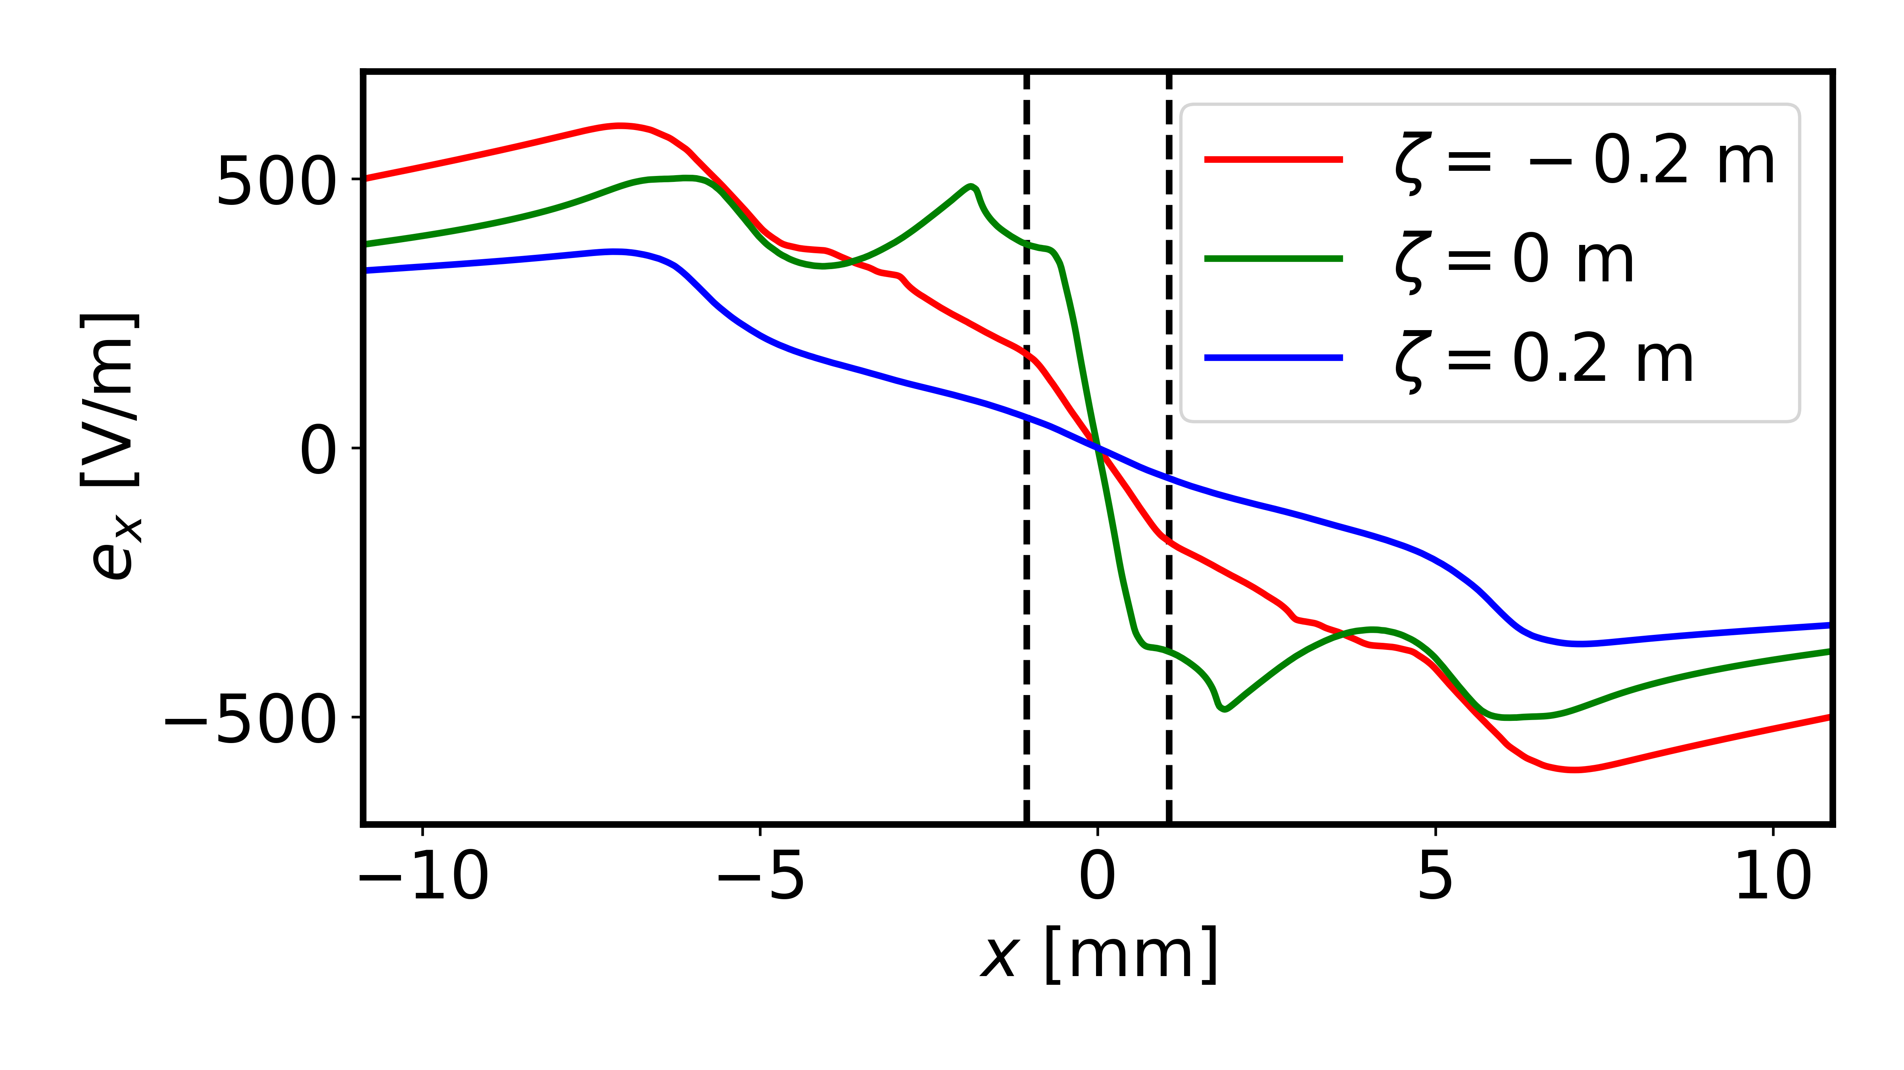
The electron cloud in the arc quadrupole
Electron cloud in quadrupoles exhibit large densities at the beam location.
Protons oscillate in a complex clouds of electrons.
→ Time-dependent non-linear forces → Emittance growth and reduced beam lifetime.
On top of that, strong
non-linearities:
High linear chromaticity
(Q’ = 25).
Strong octupolar magnetic fields (40 A).

Slide 3
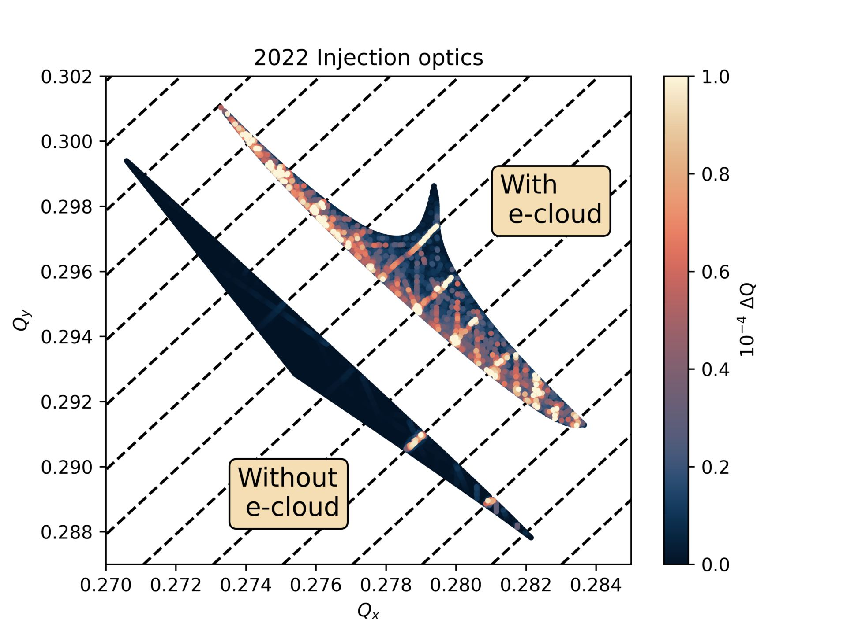
Frequency Map Analysis
2 Q_{x} – 2 Q_{y} + m Q_{ζ}
2 Q_{x} – 2 Q_{y} + m Q_{ζ} synchro-betatron resonances are strongly excited.
Attempted to make small changes in (injection) optics to correct the resonances.
*Figure plotted differently than in paper for compatibility with projector

Slide 4
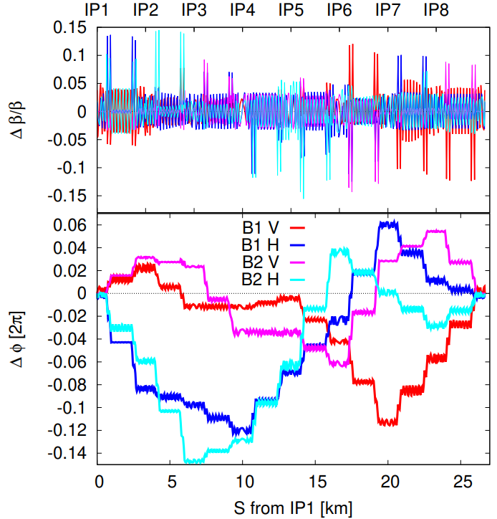
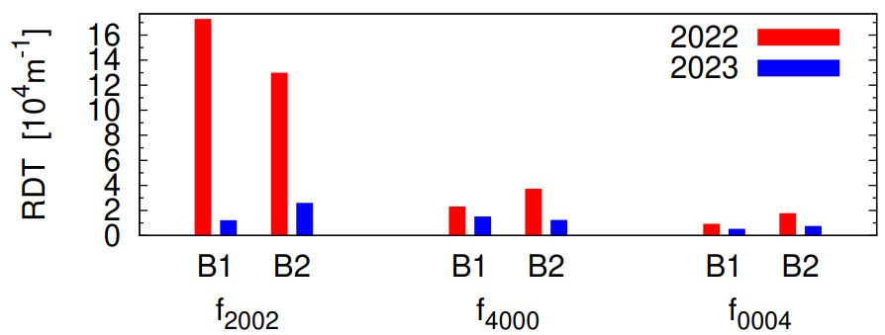
R. Tomas et al, “Optics for Landau damping with minimized octupolar resonances in the LHC”, HB2023 https://hb2023.vrws.de/papers/thbp20.pdf
2023 Injection Optics
2Qx - 2Qx 4Qx 4Qy
Reduction of main octupolar resonances by large factors, with beta-beating generally below 5% and phase shifts below 50°.
Strong impact on lifetime (Dynamic aperture) even without electron cloud effects.
More details in next talk:
L. Deniau et al, “Optimizing resonance driving terms using MAD-NG parameteric maps”, HB2023 https://hb2023.vrws.de/papers/thbp15.pdf

Slide 5
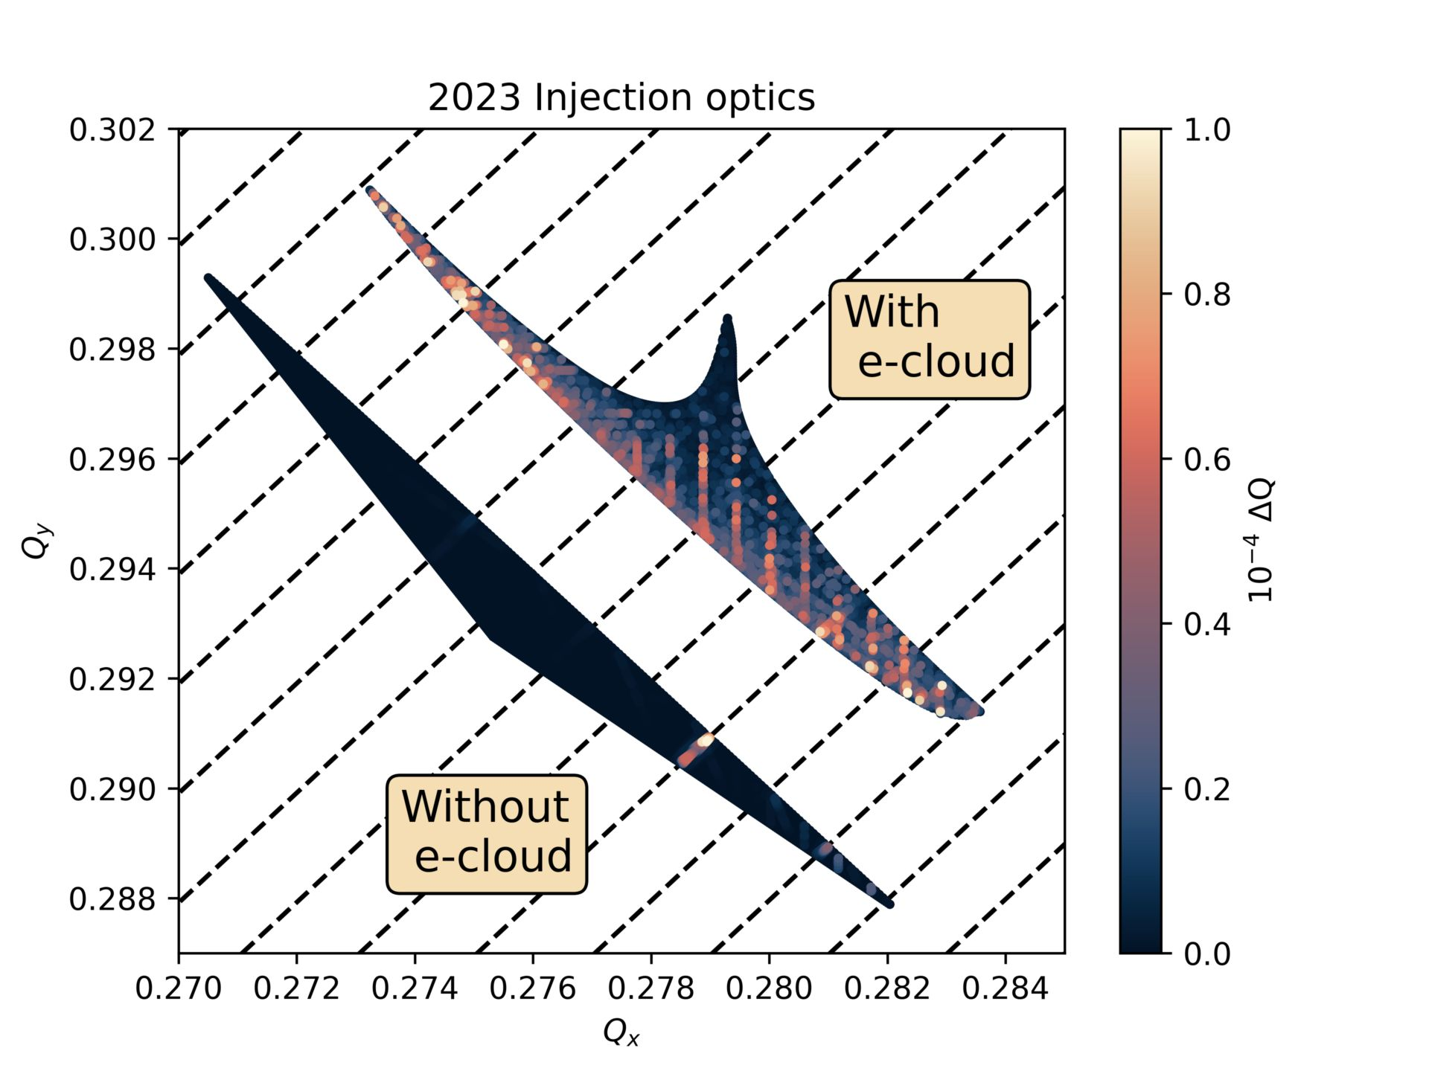
Frequency Map Analysis
2 Q_{x} – 2 Q_{y} + m Q_{ζ}
2022 optics: 2 Q_{x} – 2 Q_{y} + m Q_{ζ} resonances are strongly excited.
2023 optics: 2 Q_{x} – 2 Q_{y} + m Q_{ζ} resonances are not excited.
Higher order synchro-betatron resonances remain.
*Figures plotted differently than in paper for compatibility with projector

Slide 6
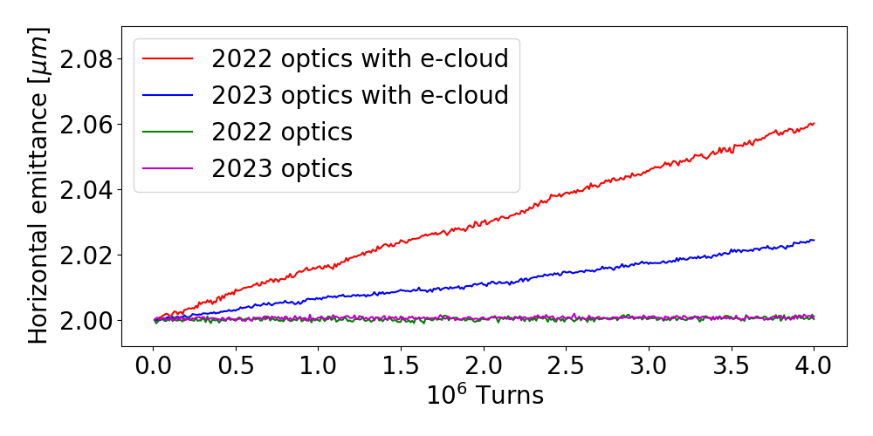
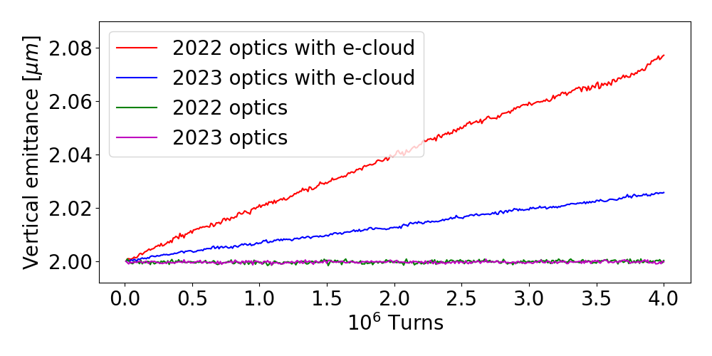
Emittance growth
Without e-cloud there is no emittance growth.
Emittance growth from e-cloud improves when going from 2022 to 2023 optics.
First sign that incoherent electron cloud effects can be mitigated with an optimization of optics!
Experimental measurements are pending.
Electron cloud (Secondary Emission Yield) will change in
HL-LHC era:
Intentional SEY treatment
Unintentional SEY degradation.
Thank you for your attention!
Konstantinos Paraschou

