Slide 1
EAST Availability Statistics 2023
Notes:
Also involved
JC, Thibaud, Jan, Raffaello, Daniel

Slide 2
„Information“ I
These slides are a template to summarize the availability of your machine in 2023. Please correct and complement the slides considering following questions:
What are the main events & reasons impacting availability?
  Does the data show them and is it matching your expectations?
  Is any crucial aspect not visible in the data that we should have a closer look at?
What is the outlook for next year?
  Are you expecting some interventions over the YETS that might improve availability next year?
  Could certain circumstances lead to an availability degradation?

Slide 3
„Information“ II
There will be additonal questions on each slide.
All charts can be regenerated from AFT – Dashboard (cern.ch)
For further inspiration what to put in the slides, please have a look at https://indico.cern.ch/event/1104980/

Slide 4
Considered Times
From start of EAST physics to end of run
  → 03-04-2023 00:00:00 - 30-10-2023 06:00:00
Ded. L4 MD & TS excluded
  10-05-2023 08:00:00 - 10-05-2023 18:00:00
  20-06-2023 08:00:00 – 21-06-2023 14:00:00
(Should these times be wrong, please correct the times above or add additional excluded time periods and let us know – we can update your template)

Slide 5
Weekly Availability by Destination
PS Vacuum leak

Slide 6
Weekly Availability by Destination – w.o. injector faults
PC failure (<4hrs downtime)
What are the main events & reasons impacting availability? Please mark them.

Slide 7
Global Destination Availability
Main downtime due to injector complex.

Slide 8
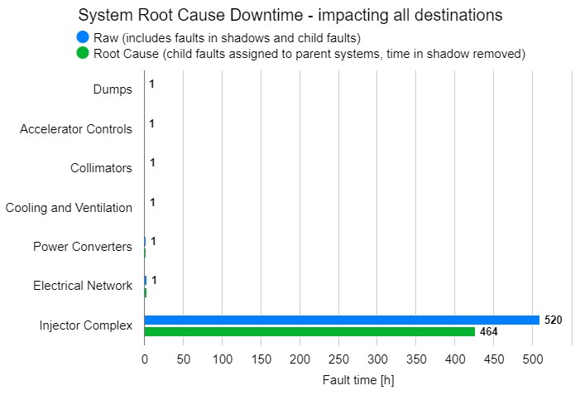
System Downtime
Not relevant for EAST and NORTH
For Cardiogram :
  Most fault coming from injector, beam instrumentation XCET (non-blocking).
  XCET have been heavily study and upgraded during the run and has seen in the cardiogram the situation is really better now.

Slide 9
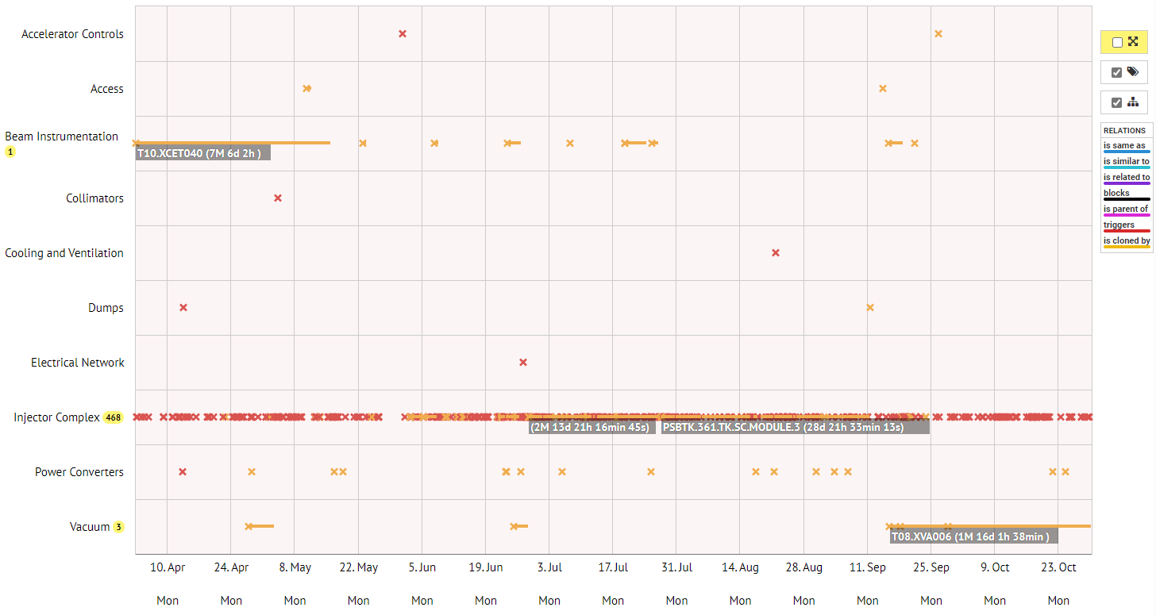
System Downtime

Slide 10
Summary & Conclusion Slides
Good year for the EAST that still profiting from the renovation
Desiderata for fault tracking and AFT tool?
  Be able to filter faults by destination (e.g. is the “search faults” page)

