Slide 1
PS Availability Statistics 2023
Notes:
Also involved
JC, Thibaud, Jan, Raffaello, Daniel

Slide 2
Considered Times
Availability counting starts once beam has to be delivered for downstream machine
  → 17-03-2023 09:00:00 – 13-11-2023 06:00:00
Dedicated MDs and TS excluded
  MD
    10-05-2023 08:00 – 12:00
  TS + Recovery
    20-06-023 08:00 – 21-06-2023 14:00
    21-06-2023 14:00-20:00

Slide 3
Weekly Availability by Destination
MTE kicker KFA13 generator failure
Mainly injector faults
Meyrin power cut 27/06, nTOF Semgrid FE restart, barrier-bucket h16LI beam control issue
PSB BSW and Linac4 CCDTL issues, PS orbit drifts → radiation alarms
PSB inj. bumper exchange, SS03 vacuum leak (RF bypass), 10 MHz gap relay + BB issue
Burnt transformer KFA28
+ emergency button,
KFA45 fault (DS PTU)

Slide 4
2023 in Context
Destination availability between ~92% (SPS) - 94% (AD)
Clear improvement since LS2
Availability above pre-LS2 value (90.7% in 2018)

Slide 5
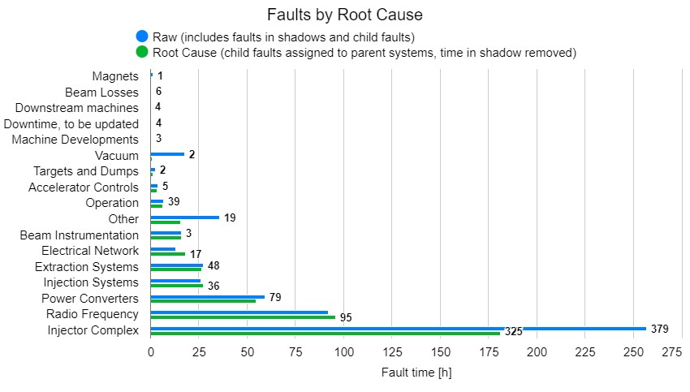
System Downtime
Besides injector faults, longest root downtime due to
Radio-frequency
Power converters
Injection/extraction systems

Slide 6
Unavailability by System
2022 issues with POPS solved*, relative percentage of RF faults increased
* Main controller power supply exchanged (mitigate ripple).

Slide 7
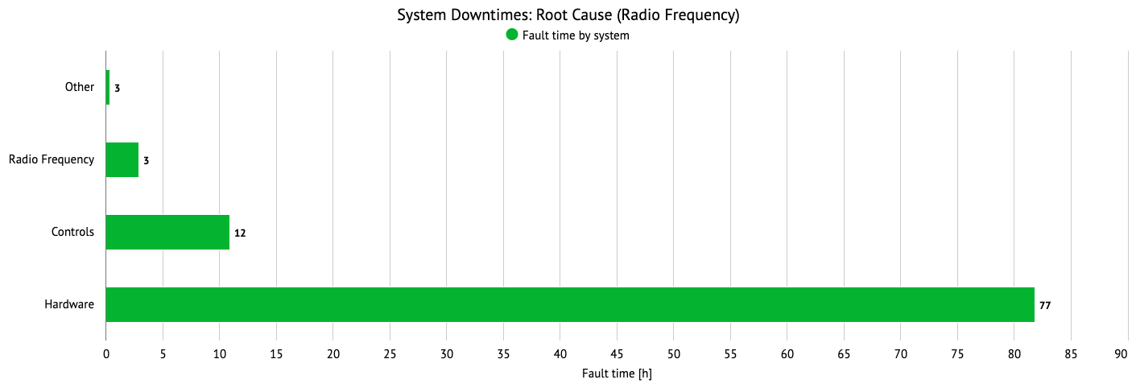
System Downtime – RF Controls
Controls faults:
Main downtime related to new barrier-bucket operation for North Area fixed-target beams
  H16 barrier bucket controller was put into operation at the beginning of the year
  Several settings are written in ppm mode via USB to the custom H16 Barrier bucket controller hardware
  An intermittent issue caused the custom controller to crash approximately every 1-2 weeks
  H16 barrier bucket controller is part of the clock distribution chain → revolution frequency is not distributed correctly to the RF systems
  On 21st of August, the FESA class was modified to only transfer data on SFTPRO cycles
    Since this intervention, the issue has not recurred and can be considered as fixed.

Slide 8
System Downtime – RF Hardware
Hardware faults:
Gap relay faults: usually short, if spare cavity available
  Limited number of spare parts → might run out in LS3 → prepare test of replacement, but do not expect availability increase
RF tube of the 10 MHz driver amplifiers are obsolete and not on the market anymore neither
  Tests planned with a replacement amplifier for next year
  Renovation during LS3 must go ahead (CONS), otherwise PS will stop shortly after
Major issue on a 10 MHz power converter this year (old, must be replaced).
  Consolidation by EPC is being prepared for LS3
Issue on a 40/80 MHz power converter; EPC solved the issue and provides support, but PC should be consolidated (preparations for request started)
Tuning power converters for the 10 MHz cavities are also obsolete and will be replaced by EPC during LS3
  Course and fine tuning by the same power converter then → some operational improvement and better reliability can be expected

Slide 9
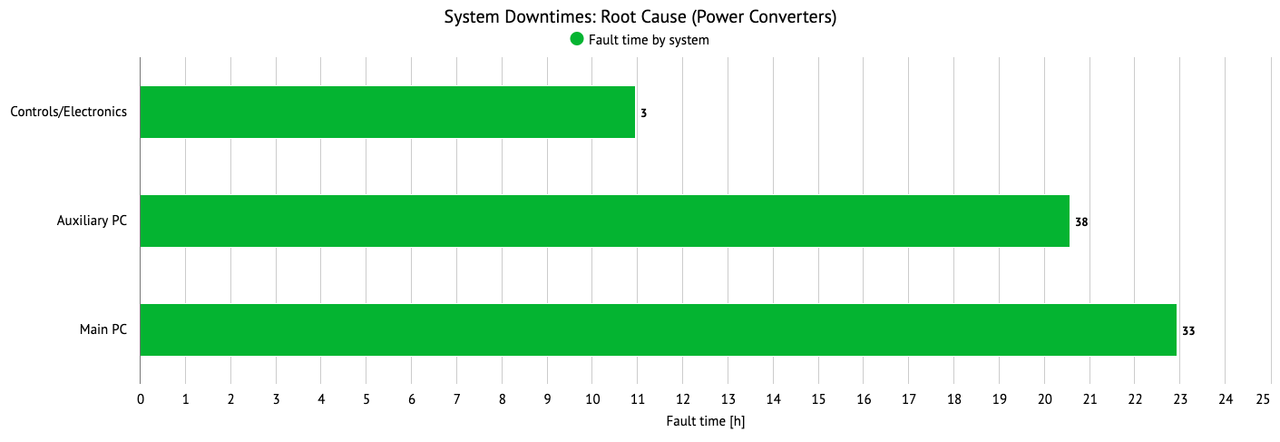
System Downtime – Power Converters
POPS:
Much improved uptime since last year
Several water leaks – known issue, will be repaired during YETS
Some POPS trips due to new demanding cycles
  TOF double-extraction, special low-energy cycles, degaussing of pole-face windings etc.
  Minor SW modifications planned for YETS
  With POPS+ (LS3) better diagnostics to avoid sending functions that lead to trips
No systematic issues of auxiliary power converters except for extraction septum (erratic pulses with wrong cycle value → will be exchanged in YETS24/25).

Slide 10
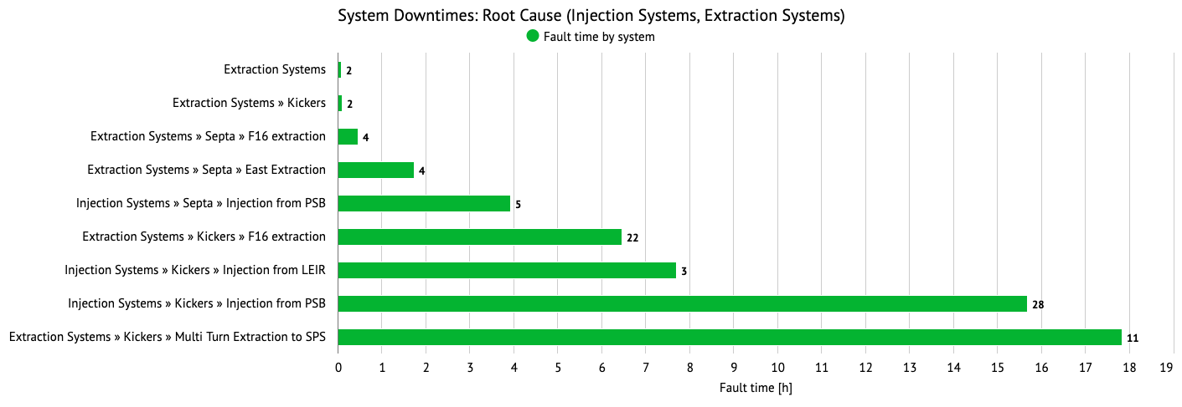
System Downtime – Injection/Extraction
Injection kickers:
  Longest fault (7h20m) of ion injection kicker KFA28 burnt transformer on 13/10
    Child faults due to emergency stop pushed
  Second-longest fault of proton injection kicker KFA45 in same week (w41)
Extraction/MTE kickers:
  A few faults this year on MTE kicker KFA13 (only affecting SPS), including the longest fault (7h) on 03/08 (diode fault?) and 6h on 05/08
  Difficult year for extraction kicker KFA71/79, which does not really show up in AFT
    Recurrently, missing pulses leading to radiation alarms (beam lost at FT), but quick resets
    Consolidation of generators was planned for LS3, but due to ABT workload and equipment ageing, advanced refurbishment of 3 generators every YETS until LS3
      3 KFA79 generators renovated during YETS22/23
      Difficult restart, several issues closely followed up by specialists along the year (e.g. synchronisation issues between the 12 independent magnets)
      YETS 23/24 next 3 generators to be renovated → counting on 2023 lessons learned

Slide 11
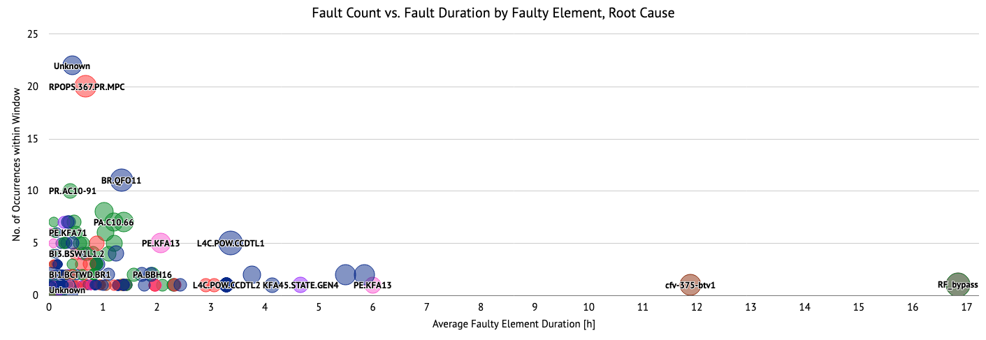
Fault Count vs. Duration (Root)
nTOF Semgrid FE
down (night; best effort)
SS03 vacuum leak
(faulty RF bypass)
Many ’Unknown‘ elements → needs to be improved such that statistics becomes more useful for equipment groups → work on automation of fault declaration

Slide 12
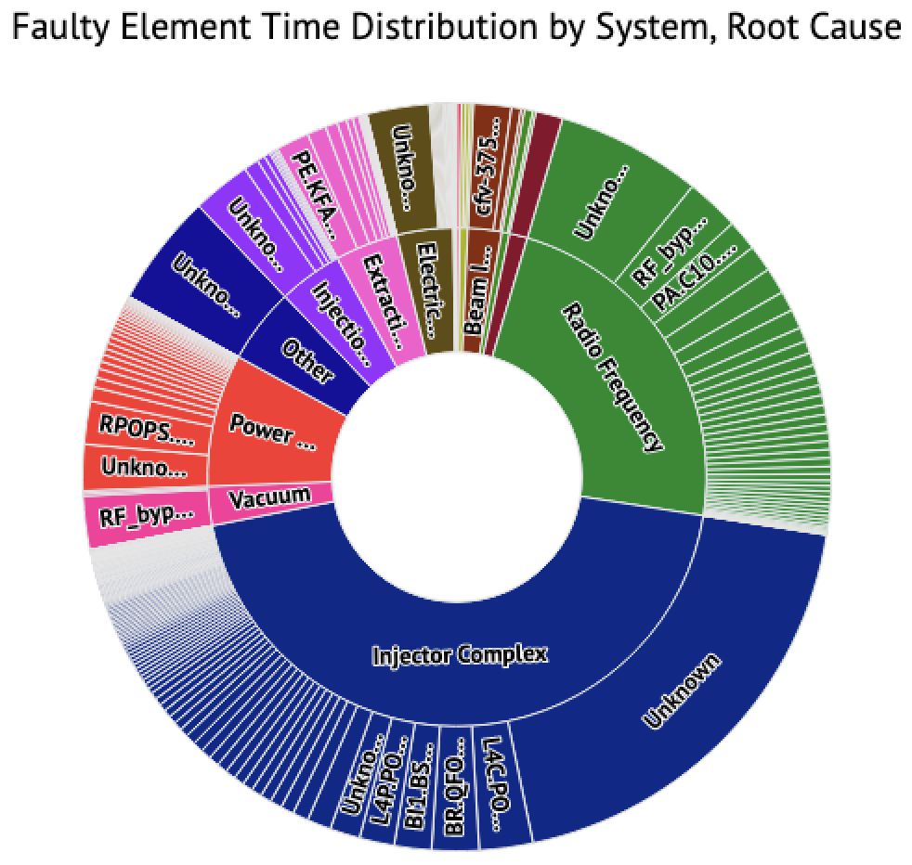
Fault Count vs. Duration (Root)
nTOF Semgrid FE
down (night; best effort)
SS03 vacuum leak
(faulty RF bypass)
Many ’Unknown‘ elements → needs to be improved such that statistics becomes more useful for equipment groups → work on automation of fault declaration

Slide 13
Summary & Conclusions for PS
Very respectable and increased destination availability of 92%-94% for the PS this year
  Certain issues solved since LS2, e.g. exchange of POPS main controller power supply
During YETS23/24 mostly standard maintenance → no high expectations to improve availability in 2024
  HL-RF focus on medium-term consolidation should bear fruits after LS3
  ABT: continuation of proton extraction kicker upgrade (for another 3 generators); might go smoother next year
  POPS: mitigation of water leaks during this YETS
Several improvements planned for LS3 (POPS+, HL+LL RF, PCs…)

Slide 14
Summary & Conclusions for PS
Short recurrent faults do not show up in AFT
  E.g. missing extraction kicker module pulses, extraction septum pulsing with value of wrong cycle... → beam loss at flat top
  Requires close follow-up triggered by OP or specialists, not through fault tracking
Working on more automatic fault registration, hand-in-hand with PS equipment monitoring effort
  Improved fault statistics; if element entered correctly, better usage for equipment groups
  Plan to implement together with equipment groups certain automatic equipment resets → expect benefits for PS uptime

