Slide 1
AD Availability Statistics 2023
Notes:
Also involved
JC, Thibaud, Jan, Raffaello, Daniel

Slide 2
Considered Times
Availability counting starts on physics start of ELENA
  from 30-06-2023 00:00:00 to 13-11-2023 06:00:00
  Delay of the start of physics due to water leak in quadrupole before beam commissioning not taken into account
  Faults happening during beam commissioning also not taken into account
LINAC4 dedicated MD (30/31-10-2023 ) excluded, no injector TS during physics period

Slide 3
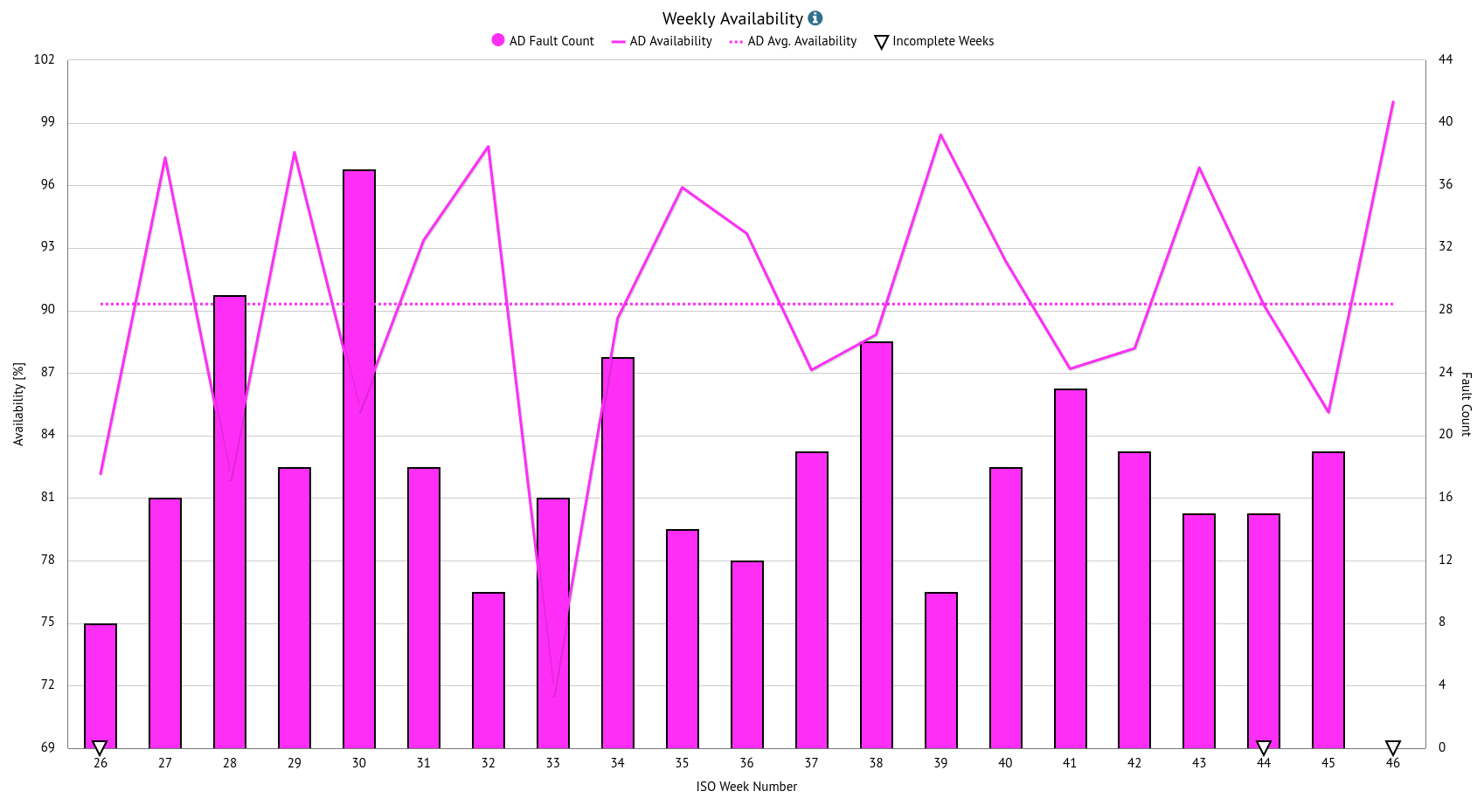
Weekly Availability
Setting-up after power cut
Magnetic noise on water interlock sensor of RF cavity
C10 water leak
Setting-up after power cut
DR.QUAD.TRIM3 not following reference
No beam from injectors

Slide 4
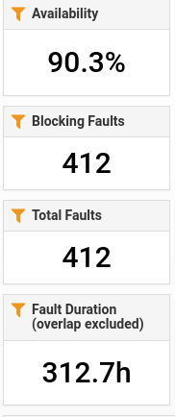
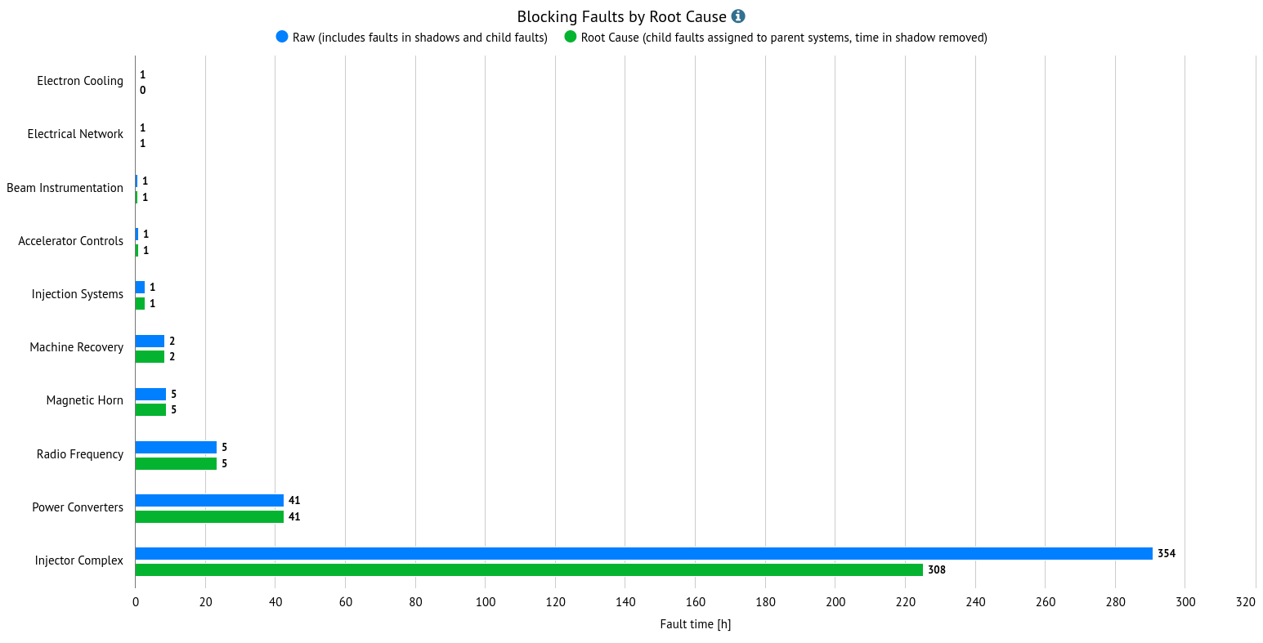
System Downtime – Global picture

Slide 5
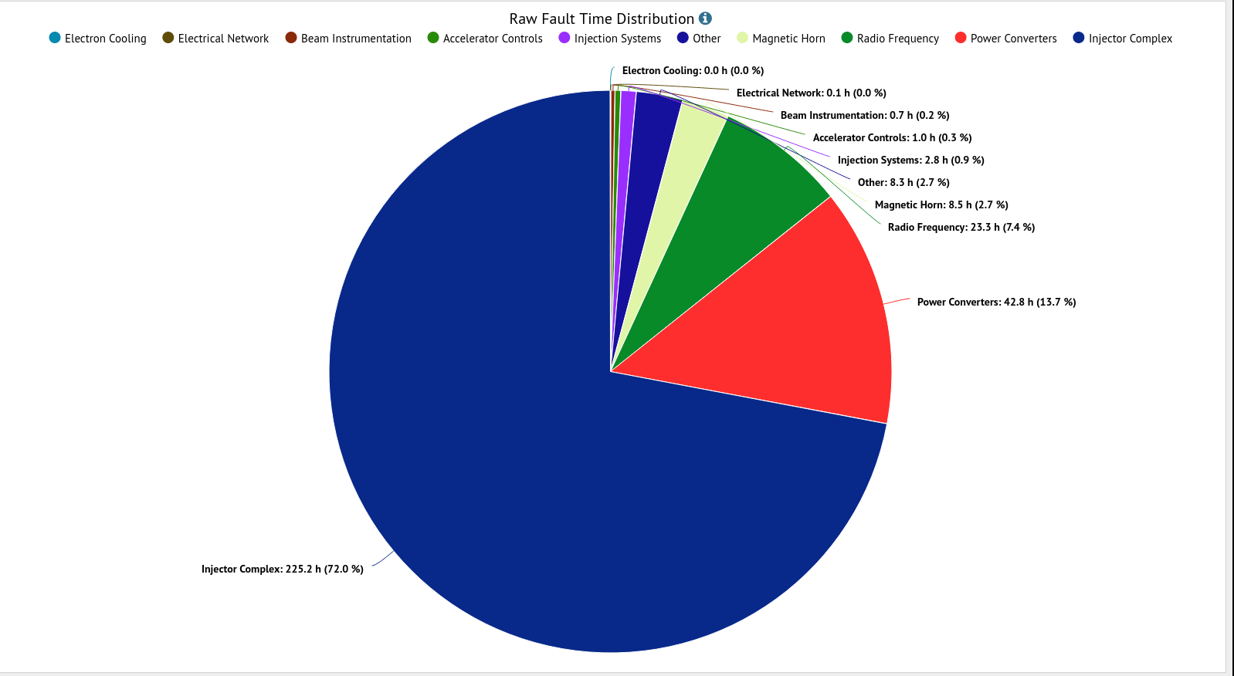
System Downtime
Top 3 faulty systems without Injector Complex:
  Power converter
  RF
  Magnetic Horn
Injector Complex/PSB | 46.55 h
Injector Complex/L4 | 55.93 h
Injector Complex/PS | 122.74 h

Slide 6
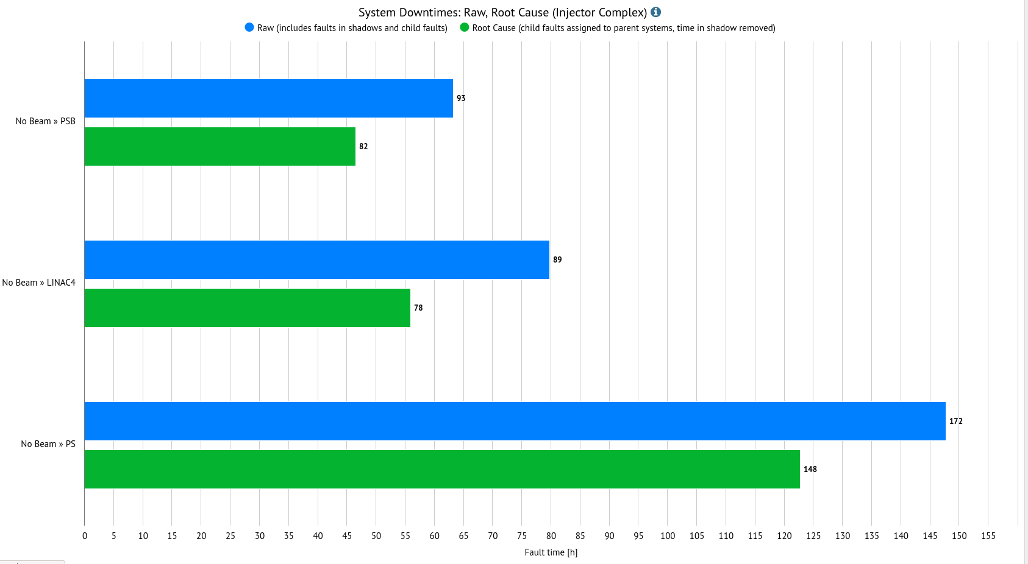
System Downtime - Injectors faults
Faults automatically propagated from injectors
Detailed analysis in each machine report

Slide 7
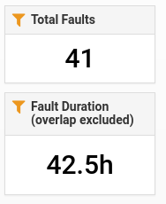
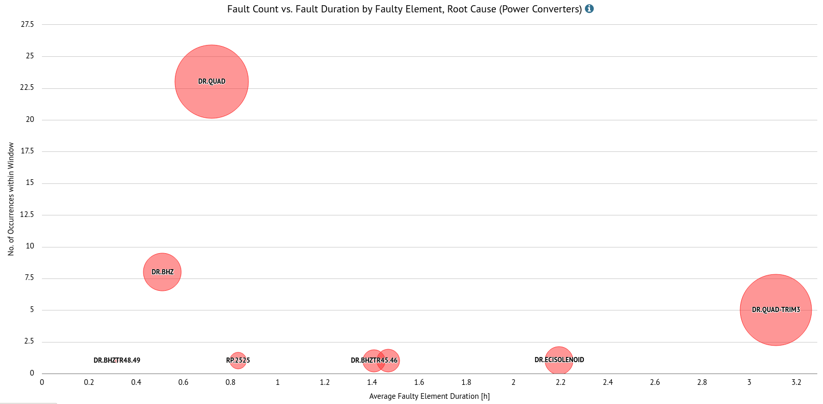
System Downtime – Power converters
recurrent trips of DR.QUAD:
  20 min needed to restart after the reset
  Only couple of piquet intervention on site
  Long restarting procedure causing a total of 16.6 hours
DR.QUAD-TRIM3 regulation problem:
  3 events of the same type
  Long diagnostic time

Slide 8
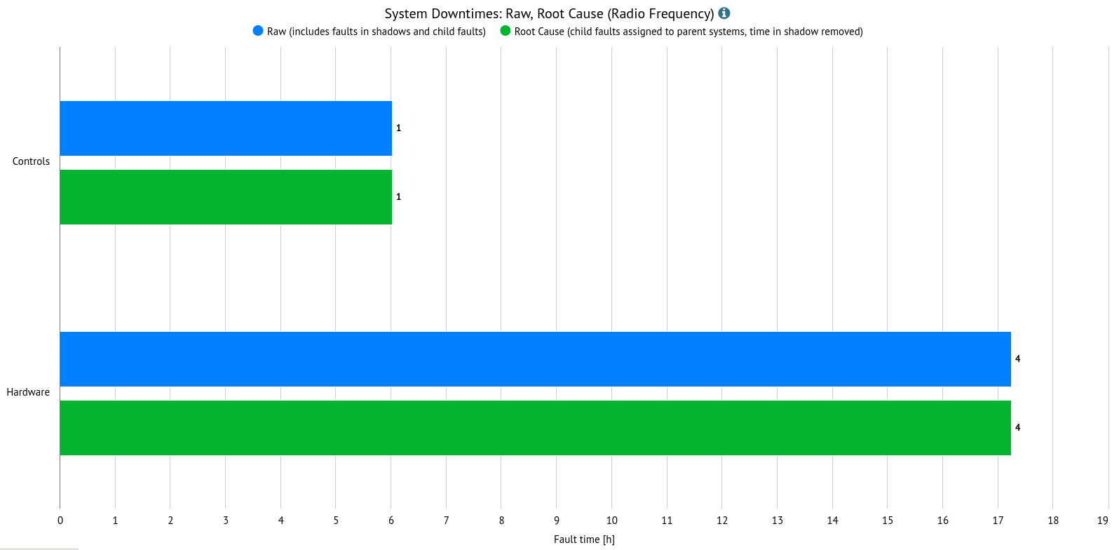
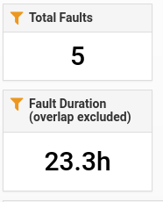
System Downtime – Radio Frequency
No recurrent faults
Couple of big impact faults:
  Long diagnostic time: wrong experts settings, magnetic sensor of water interlock activated by straigh field from orbit corrector, several accesses needed for diagnostics
  Long repair time: water leak on C10 cavity amplifier

Slide 9
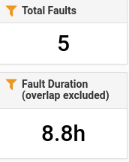
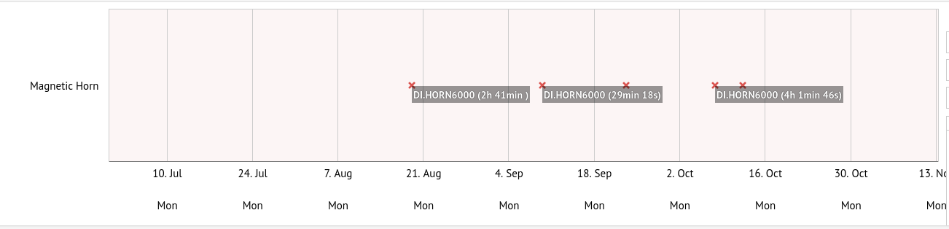
System Downtime – Magnetic Horn
4 events of the same type: anomalous pulsing of the horn due to flashover in the horn
  Untighten and missing screws on the inner conductor horn
Exchange of the horn during the YETS
  Degraded performance (20% less intensity in AD) for the last 4 weeks of run

Slide 10
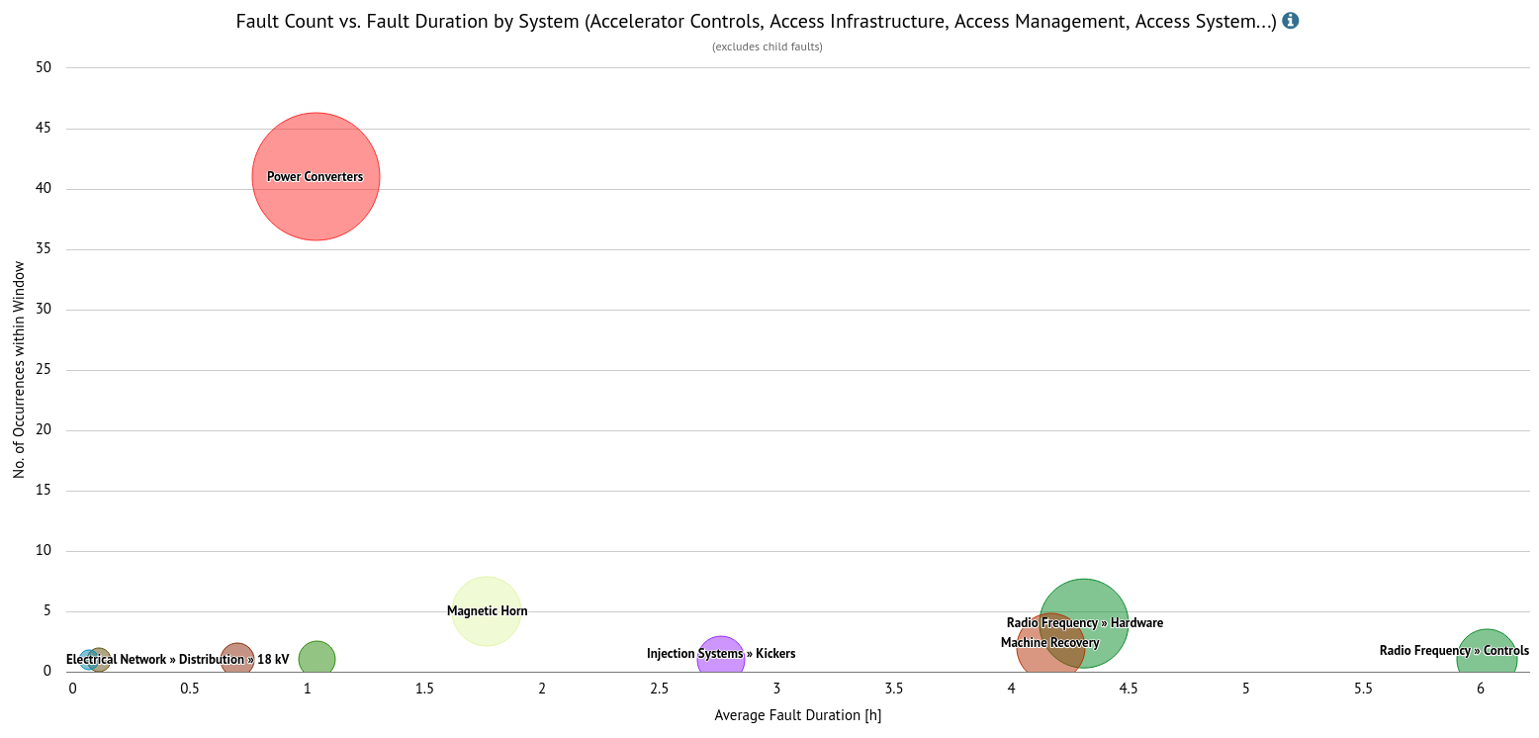
Unavailability Analysis
AD average availability without injectors fault is 97.5%
  This is where we can gain more
Many occurences of the same fault on DR.QUAD circuit
Single big impact faults, no trend
Big impact faults due to:
  long intervention time (water leak)
  Long diagnostic time (RF experts settings, QUAD-TRIM3 wrong reference, water interlock on RF)
  Long recovery time (beam setting-up after electrical glitch)
Note: big impact faults are different every year, no trend except aging of equipement

Slide 11
Summary & Conclusion
Unvailability similar to previous year, dominated by unavailability from injectors complex:
  AD average availability is 97% without injectors faults
Downtime from AD equally distributed between 1 „short“ recurrent fault and couple of big impact faults
No recurrent big impact faults : each time a new system affected
  Due to aging of material → to be adressed by consolidation
  Due to difficulty of diagnostics of faulty equipment → to be adressed by consolidation?
  Due to difficult recovery → need better references
Maintenance intervention during the YETS following the HW failure and problem with the DR.QUAD difficult restart has been fixed at the end of the run

Slide 12
Desiderata for AFT:
In order to be more efficent in the downtime capture, we need to have an automatic by default propagation of AD downtime to ELENA :
  ELENA is the only user of AD beam
Outside working hours, fault recording is made only in case of call from the experiments
  We may have lost some downtime
  We have to think about automatic entry taking into account the low repetiton rate of AD (1 shot every 2 min)
How to deal with degraded mode from previous machine:
  i.e. C10 cavities problem in PS giving not nominal intensity in AD?

