Slide 1
R2E fault tracking workflow and overview of the machine performance
Ygor Aguiar and Rubén García Alía (SY-STI-BMI)
on behalf of the R2E project

Slide 2
Radiation effects in electronic systems
Stochastic Effects
Single-Event Upset (SEU)
Single-Event Transient (SET)
Single-Event Lachup (SEL)
…
Cumulative Effects
Total Ionizing Dose (TID)
Displacement Damage (DD)
R2E stands for Radiation to Electronics…
to Equipment…
More background material available in the R2E training Indico page: https://indico.cern.ch/event/1287100/

Slide 3
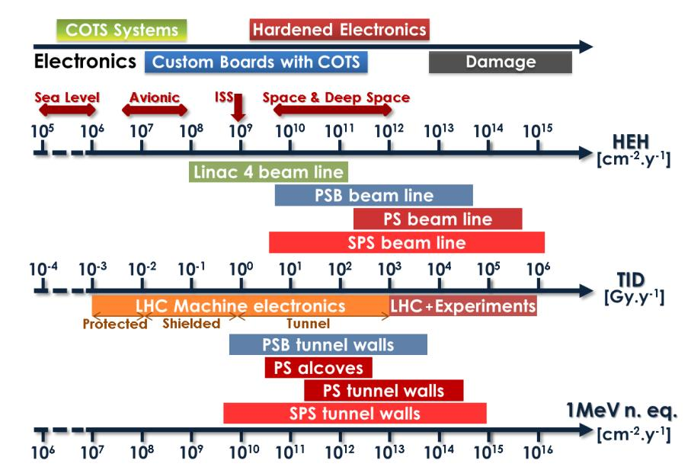
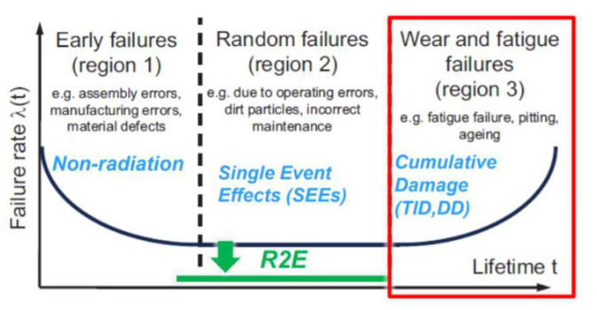
CERN radiation environment
Accelerator complex presents a mixed radiation field in the tunnels and adjacent caverns
Radiation damage
Impact on the lifetime of the equipment and it can lead to machine downtime
CERN-ACC-NOTE-2015-0042

Slide 4
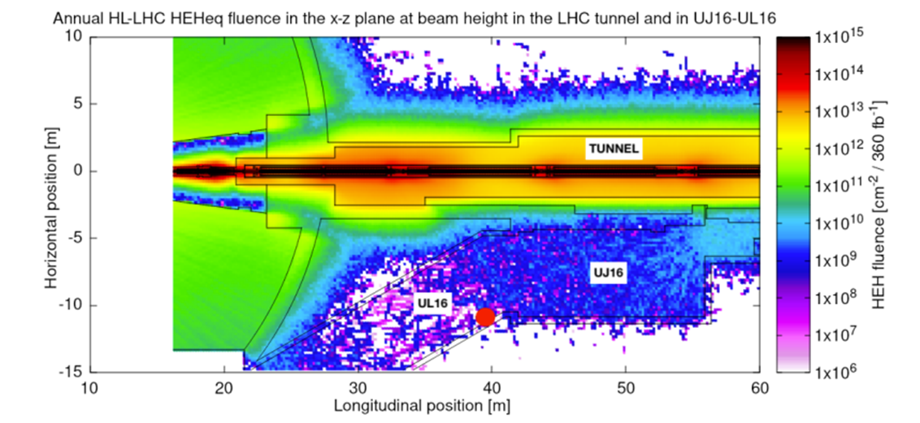
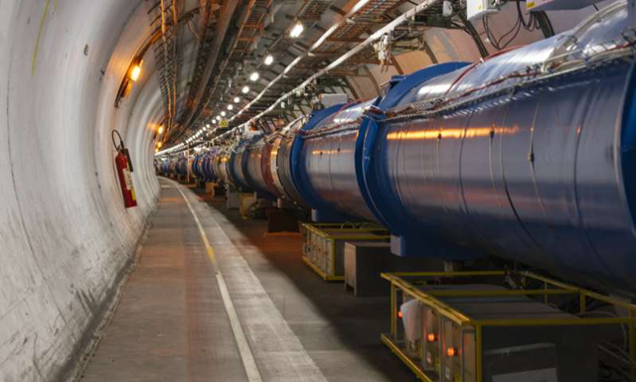
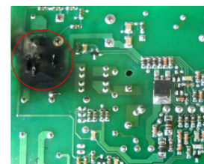
Why R2E is a challenge for CERN?
High-energy accelerators, such as the LHC complex, are subject to beam losses and hence generate radiation in their vicinity
Part of the accelerator equipment needs to be installed near the machine itself, and is hence subject to such radiation environment
Many critical equipment for the successful operation of the accelerator uses microelectronic components which can be sensitive to radiation.
Radiation levels in the LHC tunnel
Photo of the LHC tunnel
Destructive effect induced by radiation

Slide 5
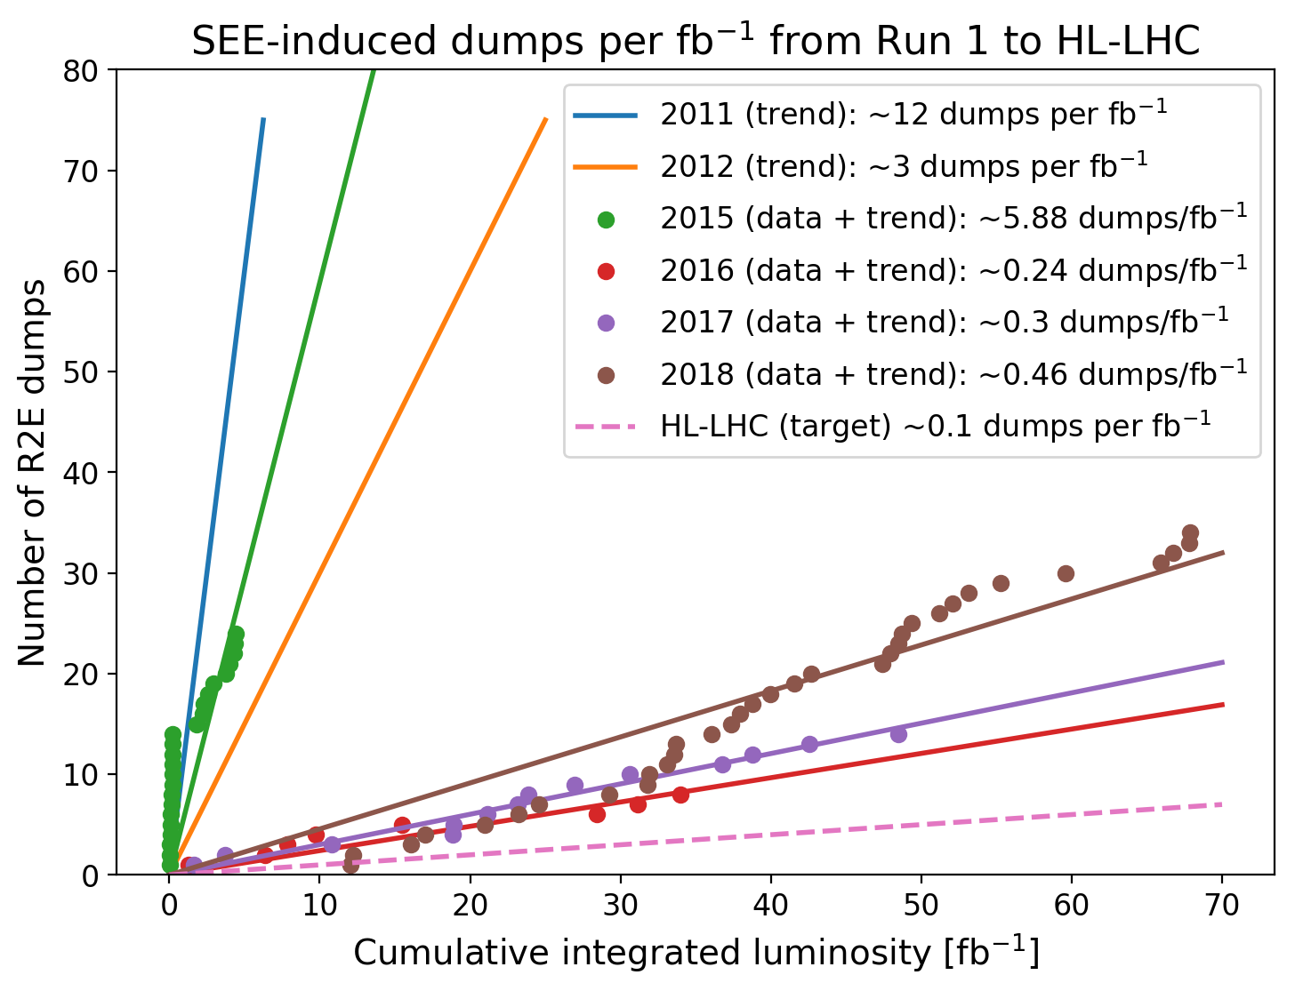
Why R2E is a challenge for CERN?
The LHC performance can be measured as the integrated luminosity (fb⁻¹) delivered in its interaction points (IPs).
The target for the High-Luminosity LHC era is to reach only 0.1 dumps/fb⁻¹.
  Through dedicated Radiation Hardness Assurance procedure including the radiation environment monitoring*.
For the LHC, a significant improvement was achieved between 2011 and 2015 → mitigation (shielding, relocation…)
During Run 2 (2015-2018), it was achieved a substantial improvement in the LHC availability → Less than 0.5 dumps per fb⁻¹ from 2016 onwards.
Mitigation
Prevention
Further improvement for HL-LHC requires more than mitigation:
→ Prevention, i.e. radiation tolerance considered from a very early design phase
Failures expressed per unit integrated luminosity, measured in units of fb⁻¹ ~ 10¹⁴ proton-proton collisions at TeV energies.
Y.Q. Aguiar et al., Radiation to Electronics Impact on CERN LHC Operation: Run 2 Overview and HL-LHC Outlook, IPAC2021,
http://dx.doi.org/10.18429/JACoW-IPAC2021-MOPAB013
* G. Lerner et al. HL-LHC Radiation level specification document, Technical Report, https://edms.cern.ch/document/2302154/

Slide 6
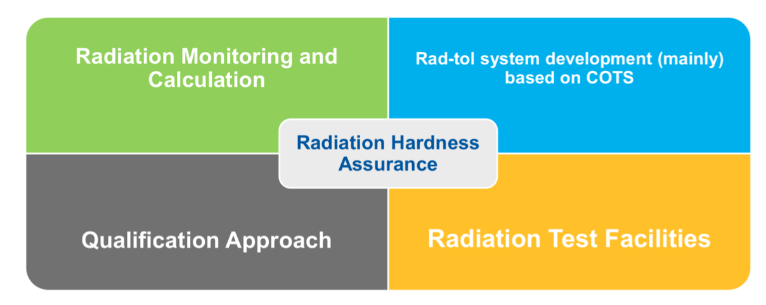
Radiation Hardness Assurance (RHA)
Systematic application of RHA methodologies to prevent radiation damages and meet expected equipment lifetime constraints.
Radiation Monitoring and Calculation:
  Classification of R2E-safe areas (EDMS 2389056) and radiation tolerance requirements for system developments (EDMS 2066950)
  Crucial during operation for mitigation measures
Radiation Testing and Qualification:
  Support equipment groups to design and qualify radiation tolerant systems

Slide 7

R2E activity at CERN
Radiation to Electronics (R2E) activity at CERN is responsible for providing the necessary support to ensure an adequate performance of its accelerator infrastructure, with regards to radiation exposed electronics.
R2E activities (mainly within BE-CEM and SY-STI)
radiation monitoring and calculation of radiation levels
assessment of radiation tolerance of electronic equipment to be installed in radiation exposed areas
radiation effects mitigation at circuit and system level → R2E developments
Strong collaboration with equipment groups
MCWG
Monitoring and Calculation Working Group
RADWG
Radiation Working Group
Equipment Groups

Slide 8
R2E fault tracking – AFT classification
A system failure is attributed to R2E based on:
    the radiation environment in the equipment position;
    the impossibility of reproducing the failure in laboratory conditions, or;
    the similarity of the failure signature to those observed during irradiation test.
Not automatic and it demands a lot of effort !
R2E Status
NOT_R2E_RELATED
R2E_CANDIDATE
R2E_REJECTED
R2E_CONFIRMED

Slide 9
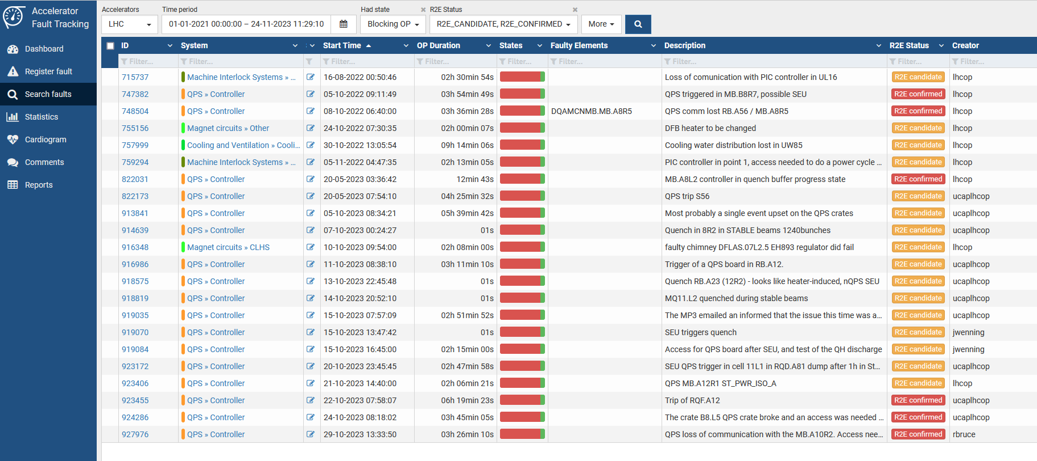
R2E fault tracking – AFT classification
Link to AFT database

Slide 10
R2E impact in the LHC
Run 2 and HL-LHC outlook

Slide 11
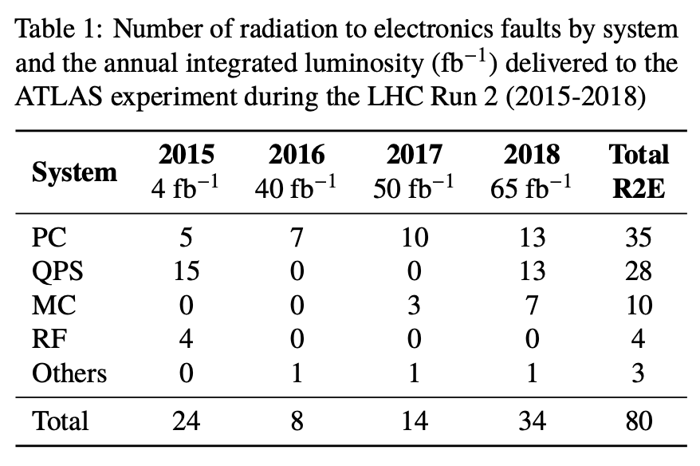
R2E failure analysis in Run 2
Power Converters (PC) and Quench Protection System (QPS) represent over 75% of the total R2E-induced beam dumps.
Link to AFT database for Run 2

Slide 12
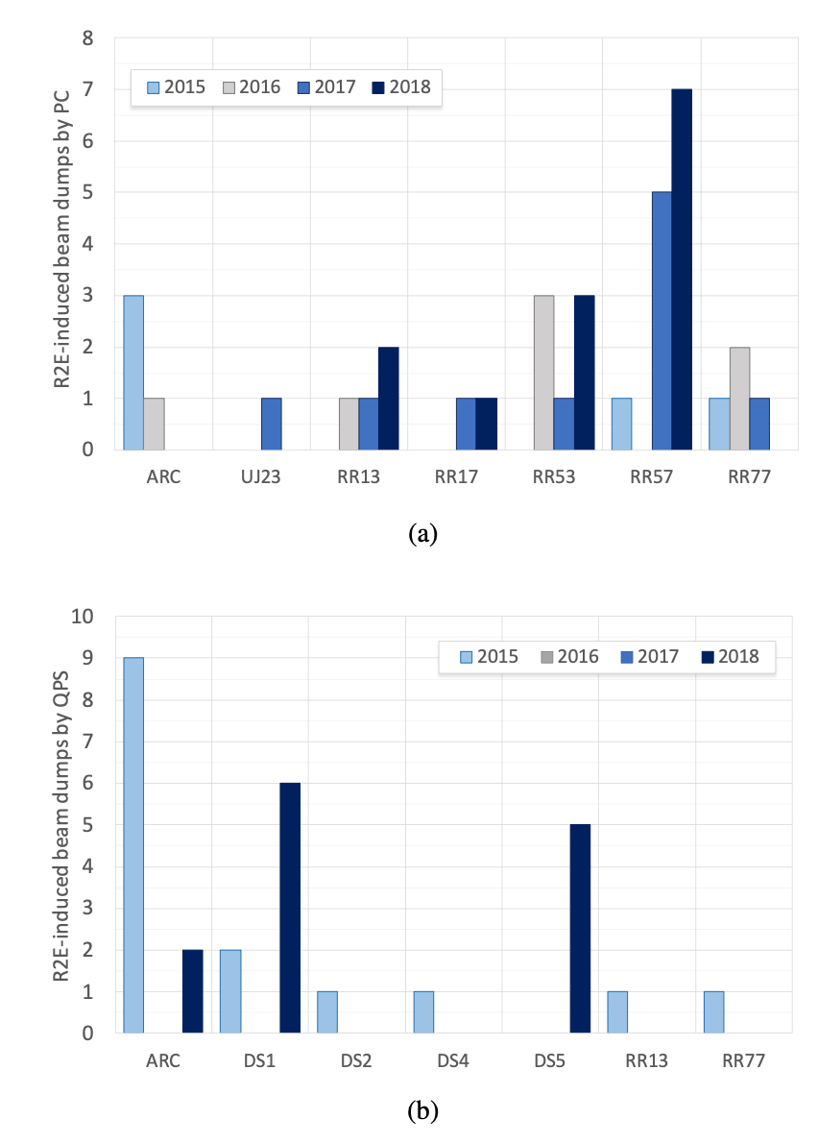
R2E failure analysis in Run 2 – Power Converters
During LS1, many mitigation measures took place to improve the availability of the system:
  Rack relocation to safer areas (lower radiation levels);
  Improvement of shielding in the alcove areas;
  Radiation-tolerant power MOSFET to prevent Single-Event Burnout (SEB).
Radiation-tolerant Function Generator/Controller (FGC)
  Deployed in the PC units located in the arcs by the end of 2016 → no events observed since the deployment;
  Deployed in the PC units located in the RRs during LS2.
Link to AFT database for Run 2
Increased radiation levels

Slide 13
R2E failure analysis in Run 2 – Quench Protection
A high number of failures in the QPS modules in 2015.
  SRAM memory highly sensitive to SEEs
  A radiation-tolerant board was deployed during the TS2, leading to a remarkable improvement in the QPS performance.
A special quench detection board (DQQBS) designed specifically for a commissioning campaign was used in the first physics run of the LHC after the LS1.
Link to AFT database for Run 2

Slide 14
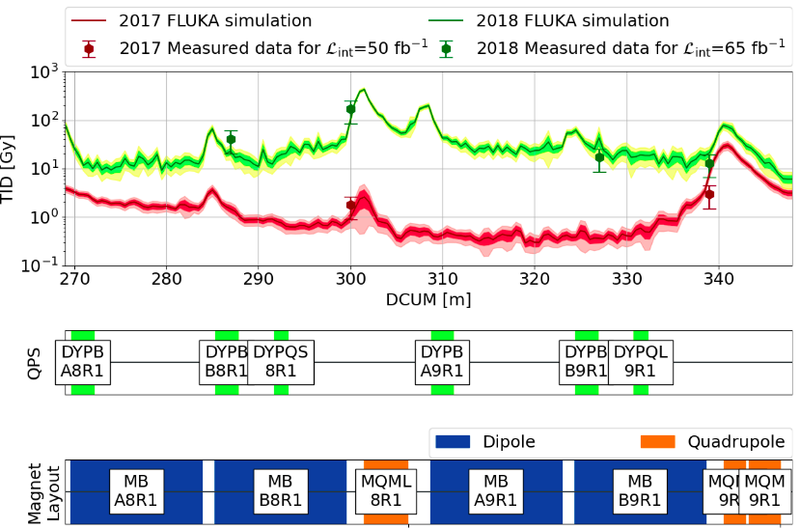
Radiation Environment in the LHC tunnel, IP1
A larger number of QPS failures leading to beam dumps were observed in 2018 in the the Dispersion Suppressor (DS) region of IP1 and IP5
Clear example of how the LHC settings can have a major impact on the beam losses and the R2E-induced failures.
FLUKA simulations and RadMon measurements provide the dose distribution below the beamline in 2017 and 2018
Increased radiation levels caused by a change in the nominal operational setting of the upstream TCL6 collimator.

Slide 15
R2E failure analysis in Run 3 - Availability
 | 2022 | 2023
LHC availability | 75.3% | 70.6%
LHC blocking-OP faults | 190 | 243
LHC downtime | 434.1h | 482.3h
R2E blocking-OP faults | 6 | 3
R2E downtime | 23.5h | 5.9h
No R2E failures in the power converter system → radiation tolerant designs adopted during LS2
  FGClite units installed in the RRs along with the radiation tolerant versions of the 600A and 4-6-8kA power converters
Few failures in the QPS, current lead regulators and PLCs.

Slide 16
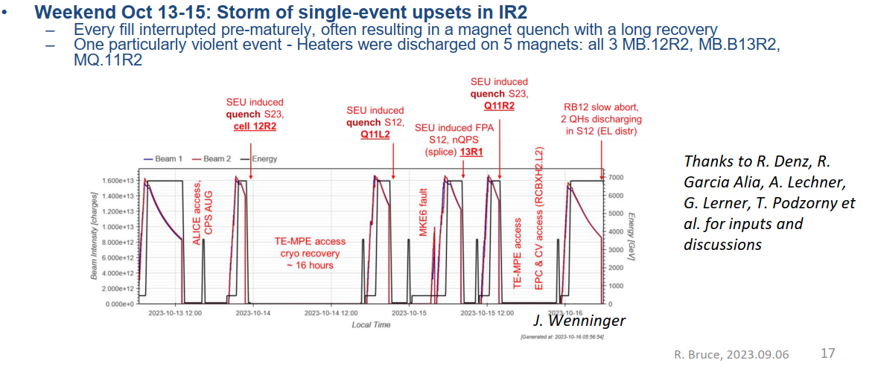

Is R2E solved?

Slide 17
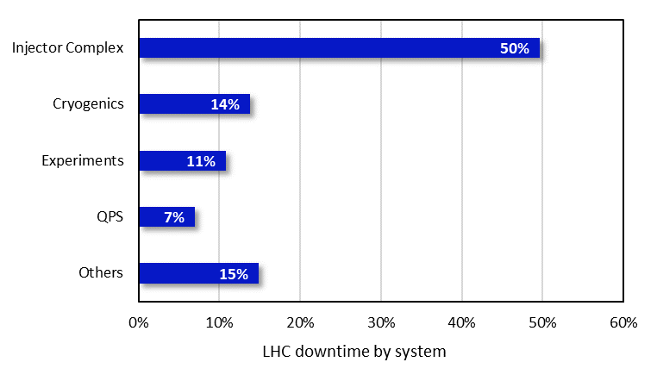
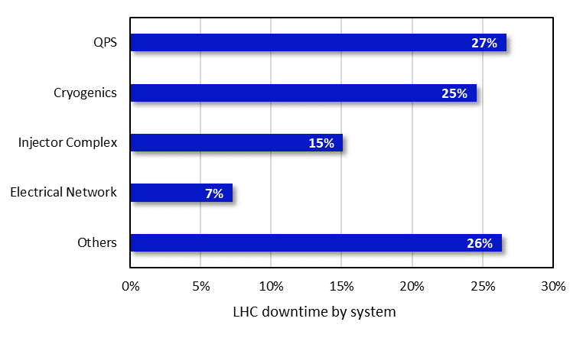
Is R2E solved?
Ion Run 2018 vs. 2023
R2E dominated
*Root cause downtime from AFT: 2018 and 2023

Slide 18
Is R2E solved?
Ion Run 2018 vs. 2023
 | 2018 | 2023
LHC availability | 84.2% | 69.0%
LHC blocking-OP faults | 94 | 136
LHC downtime | 90.1h | 232.4h
QPS availability | 98.9% | 95.0%
QPS blocking-OP faults | 8 | 15
QPS downtime | 6.3h | 37.8h
R2E QPS blocking-OP faults | 7 | 13
R2E QPS downtime | 6.3h | 32.4h

Slide 19
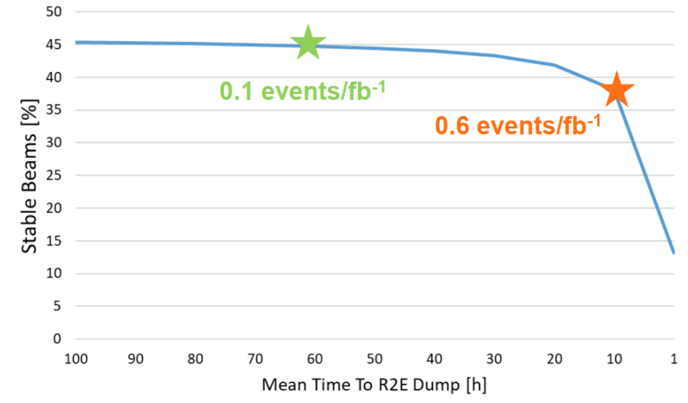
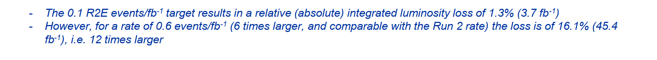
HL-LHC projection

Slide 20
R2E impact in the injector chain
SPS performance in 2021

Slide 21
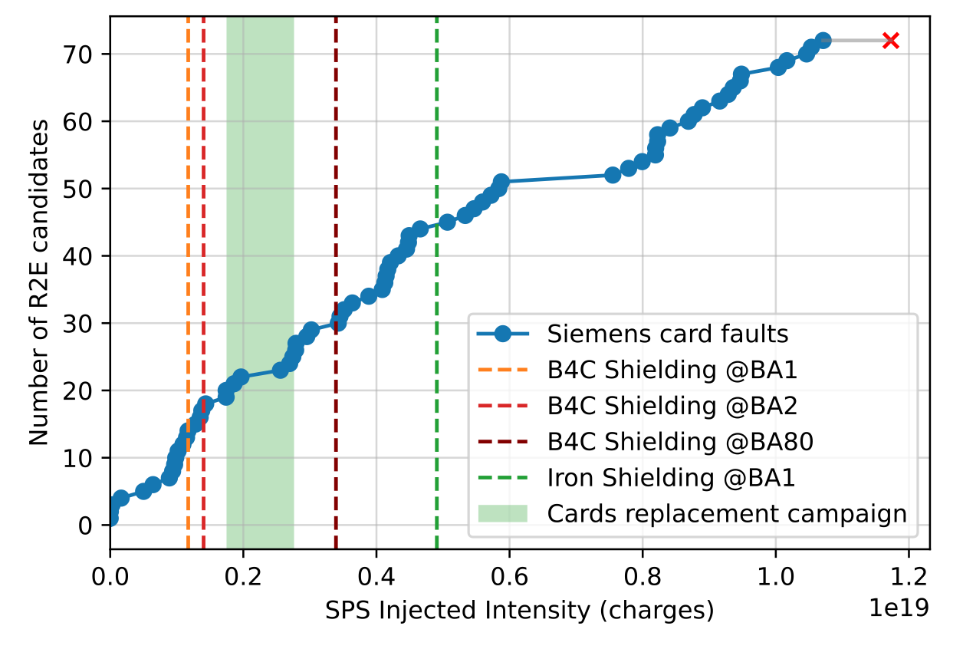
Failure rate vs. SPS injected Intensity
Access system is a safety-interlock architecture that controls the access to the machine.
    sensitive component = Siemens I/O modules
    recovery of the system requires manual reset of the modules.
    underground “intermediate” racks.
Failure signature indicates data corruption by Single-Event Upsets (SEU)
    Diagnosis provided by Siemens.
    Plus: old cards provided to CERN were not ULA (Ultra-Low Alpha) compliant
Y.Q. Aguiar et al., Implications and Mitigation of Radiation Effects on the CERN SPS Operation During the Machine Commissioning of Run 3, IPAC2022

Slide 22
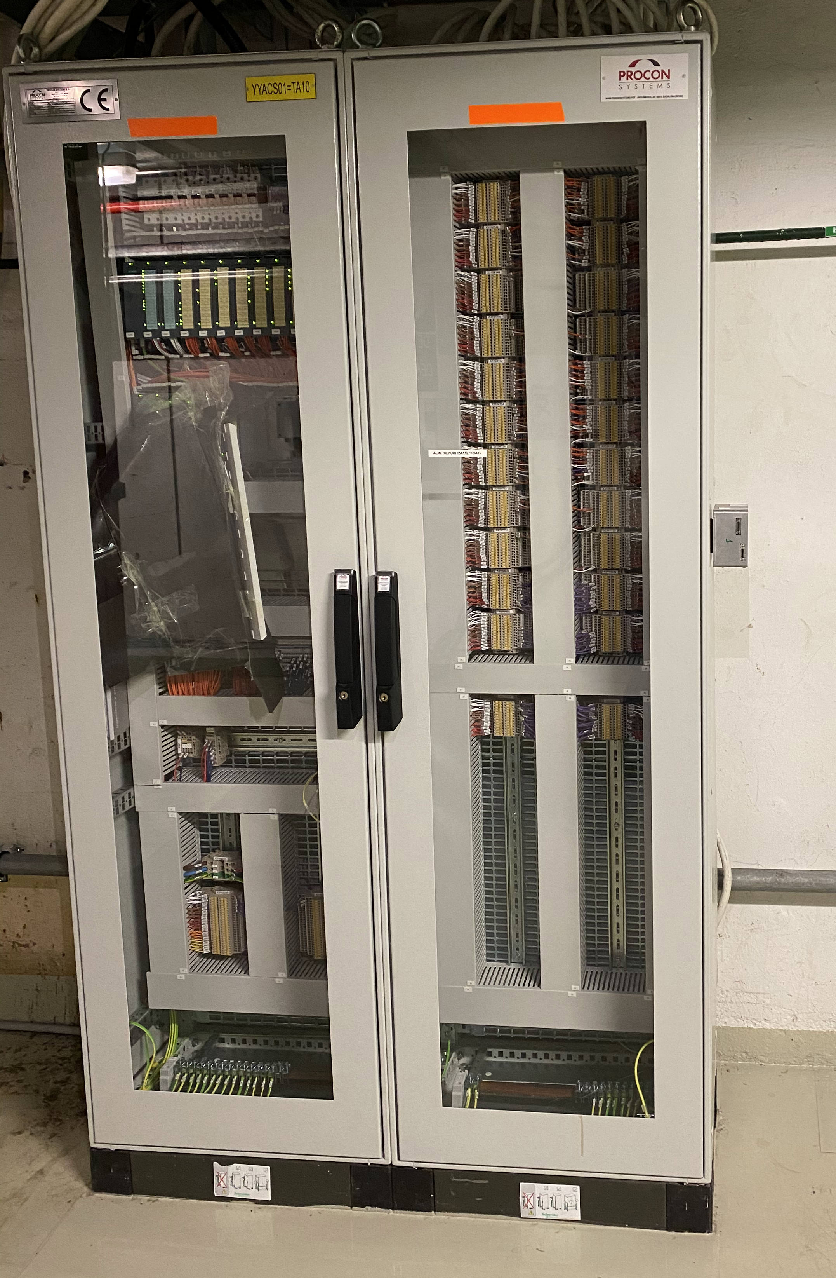
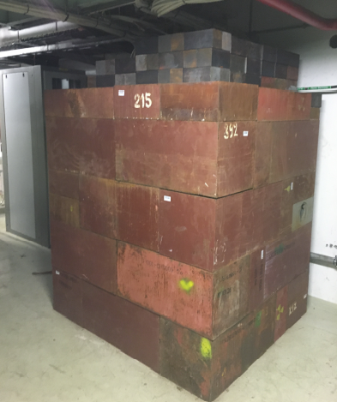
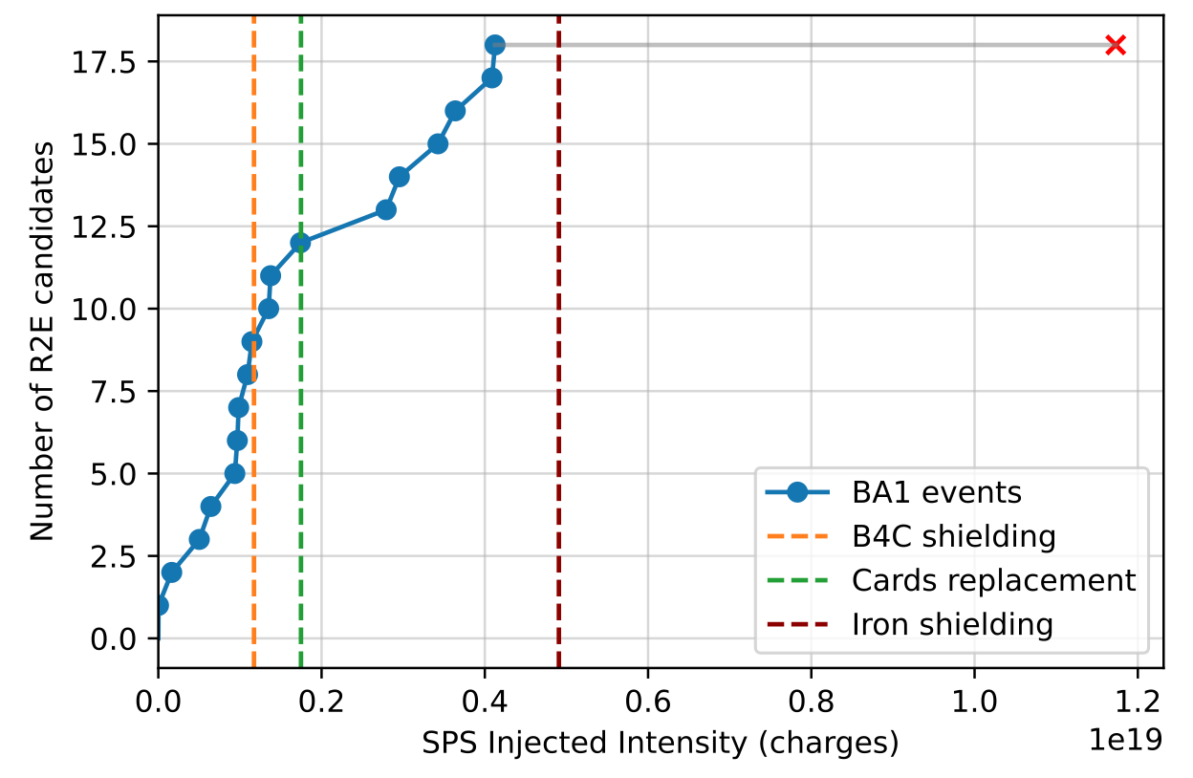
Impact of Heavy Shielding
Some accelerator system can afford heavy solutions against radiation effects.
  40 cm Iron shielding installation (~ 17 T) on the 15th of September. More info on the installation can be found in T. Ladzinski’s presentation at 292nd IEFC meeting.
Y.Q. Aguiar et al., Implications and Mitigation of Radiation Effects on the CERN SPS Operation During the Machine Commissioning of Run 3, IPAC2022,
Electronics rack
Shielding wall

Slide 23
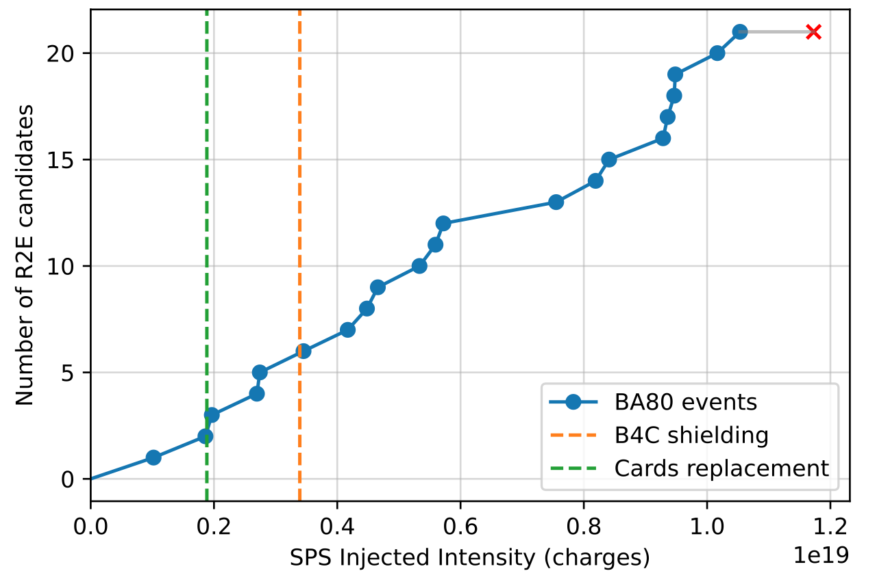
Alternatives to heavy shielding
Relocation of racks during technical stops of the machine.
Before the relocation campaign, it was investigated alternatives to prevent the direct beam dump and to reduce the recovery time.
Remote reset of cards
    Full system recovery through a Hardware Loop (HL) relay logic where an input card requires resetting, the patrol is re-established based on the HL Patrol Memory.
Y.Q. Aguiar et al., Implications and Mitigation of Radiation Effects on the CERN SPS Operation During the Machine Commissioning of Run 3, IPAC2022,

Slide 24
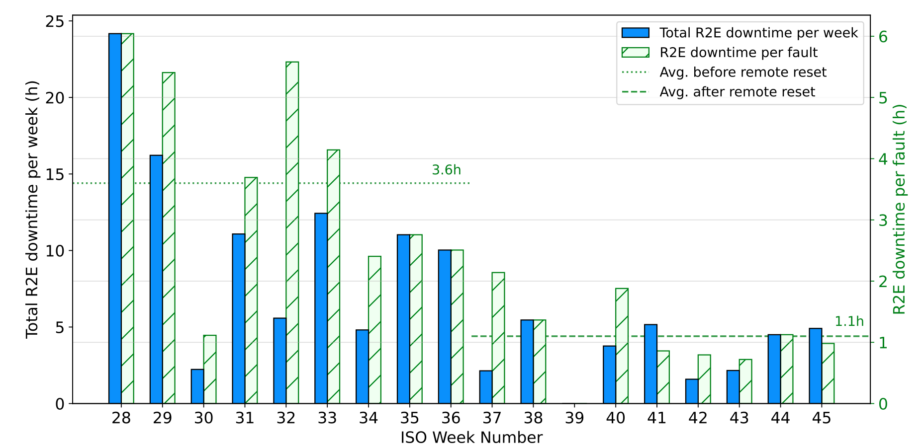
Impact on the recovery time
Remote reset started from the Week 37:
  → reduction from 3.6h to 1.1h average downtime per fault (about 70% reduction).
Fault recovery time was reduced due to the suppression of the cool-down time previously required for the manual reset of modules, e.g. from 4 hours cool-down time in BA80 to tens of min of intervention.
Y.Q. Aguiar et al., Implications and Mitigation of Radiation Effects on the CERN SPS Operation During the Machine Commissioning of Run 3, IPAC2022,

Slide 25
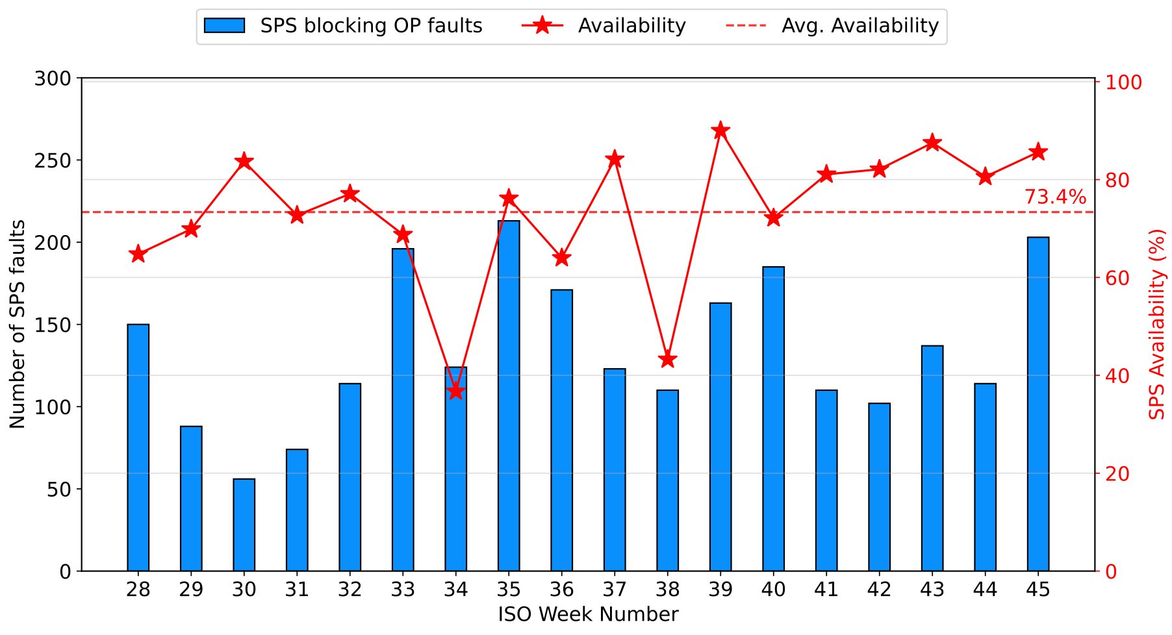
SPS Availability
Using the Accelerator Fault Tracking (AFT) tool, the beam availability is calculated since the week of start of SPS North Area Physics [Week 28].
Data accessible on AFT tool though the link:
  START DATE: 12/07/21 00:00 [Week 28]
  END DATE: 15/11/21 00:00 [Week 45]
Global availability of 73.4%
  2641 faults
  2426 faulty periods
  806 h downtime

Slide 26
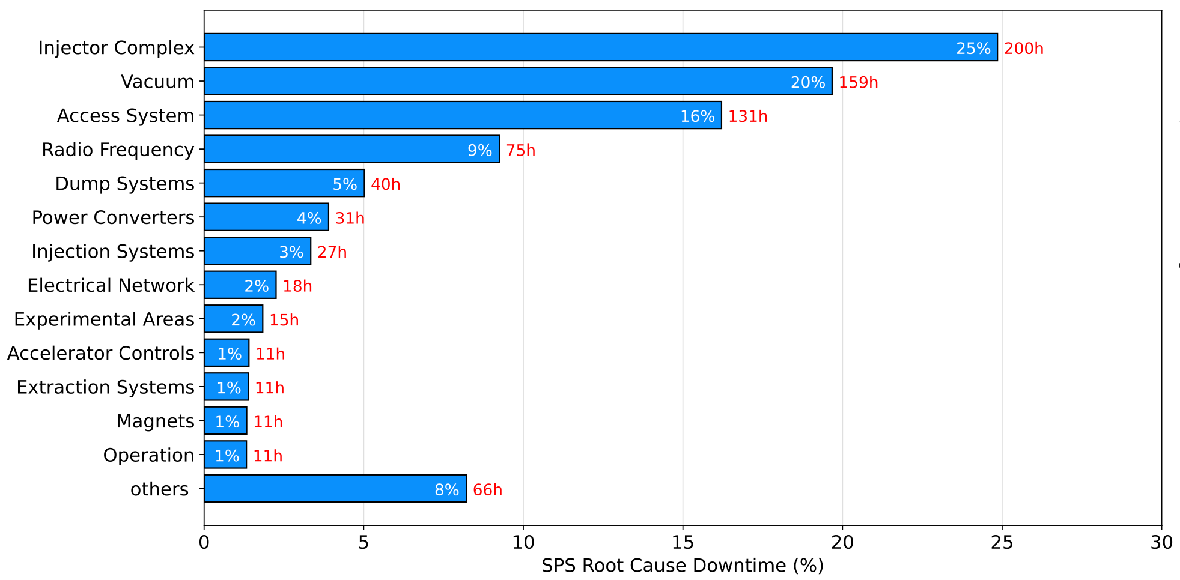
SPS Root Cause Downtime by System
SPS Unavailability of 26.6% (806h)
Top 3 root cause:
  Injector Complex: 25% (200h)
  Vacuum: 20% (159h)
  Access System: 16% (131h)
*Raw data accessible through AFT by clicking here.

Slide 27
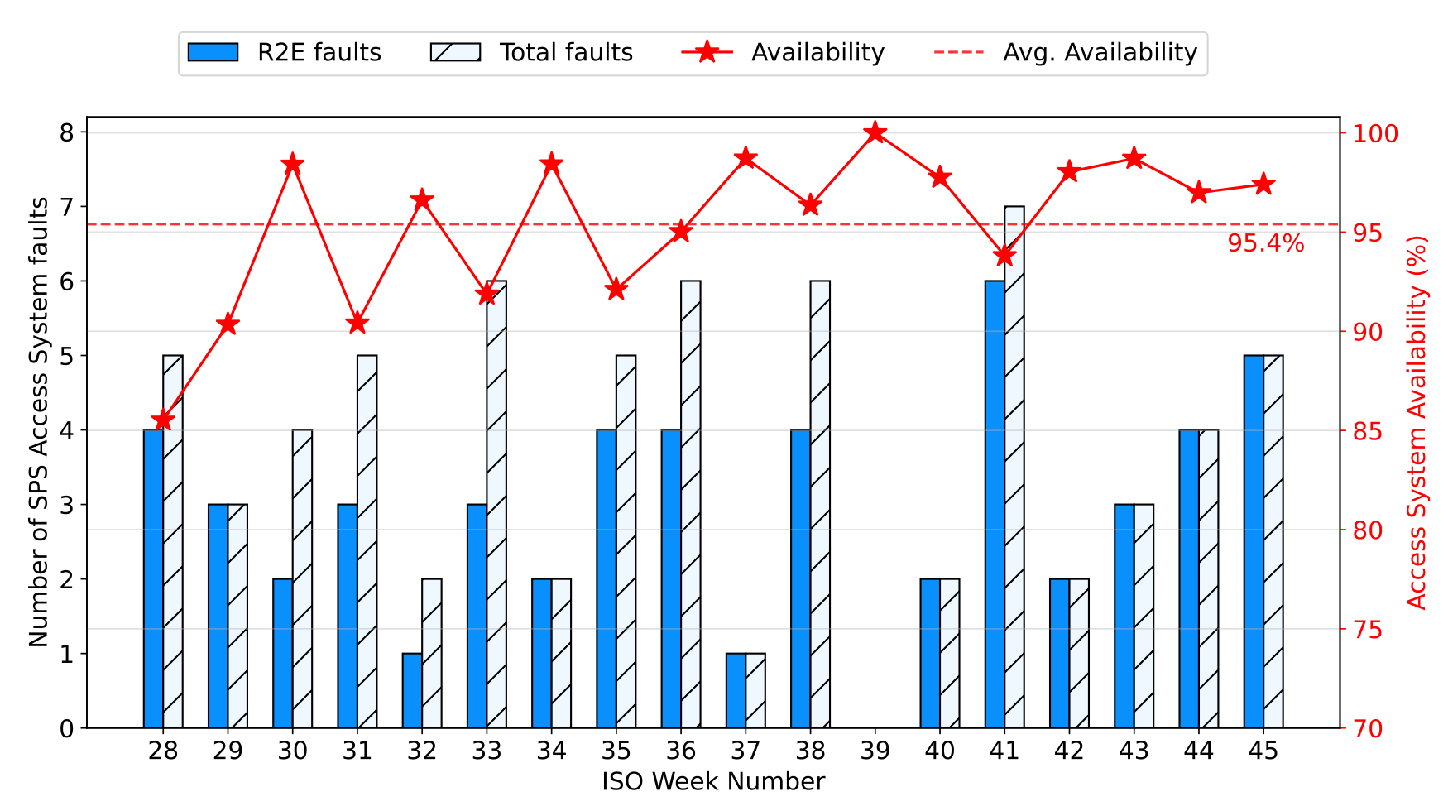
SPS Access System Downtime
SPS Access System availability of 95.4%.
  The system unavailability of only 4.6% contributed to 16% of the SPS downtime, which leads to 4.3% of SPS unavailability in 2021.
78% of R2E faults and 97% of R2E downtime (127h)
  Average downtime of 2.4h per fault

Slide 28
Main takeaways
Electronic systems are subject to stochastic and cumulative radiation effects
  inducing beam dumps and reducing the machine availability and equipment lifetime
Change from mitigation to prevention of radiation-induced events
  systematic application of a dedicated Radiation Hardness Assurance (RHA) procedure
  constant monitoring of the radiation levels
Strong collaboration among the equipment groups and the R2E team

Slide 29
ygor.aguiar@cern.ch

Slide 30
LHC R2E Performance – Run 2 overview
2015:
- Start of the year: nQPS SEEs (introduced in LS1)
- Rest of the year: mainly FGC2 in the arc
2016:
- SEE rate reduction mainly due to lower arc radiation levels (vacuum conditioning)
2017:
- Further improvement thanks to FGClite deployment in ARC; most R2E events in power converters in RR (upgraded in LS2 with radiation tolerant versions)
2018:
- Increased radiation levels in DS of IP1 and IP5 due to TCL6
opening → impact on QPS equipment (possibly lifetime related, i.e. no longer linear versus integrated luminosity)
Y.Q. Aguiar et al., Radiation to Electronics Impact on CERN LHC Operation: Run 2 Overview and HL-LHC Outlook, IPAC2021,
http://dx.doi.org/10.18429/JACoW-IPAC2021-MOPAB013

Slide 31
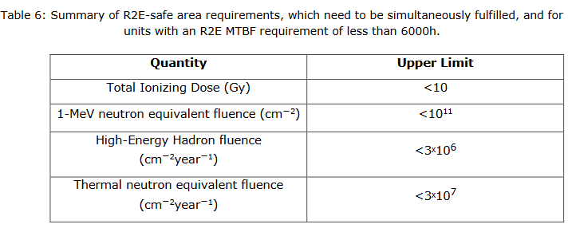
R2E safe area requirements
EDMS 2389056

Slide 32
Failure rate vs. SPS injected Intensity
The first mitigation actions (B4C shielding and cards replacement) had a slight impact on the failure rate.
  BA1 events dominating the number of failures.
Improved failure rate obtained with the suppression of events in BA1 after the installation of heavy shielding.
Y.Q. Aguiar et al., Implications and Mitigation of Radiation Effects on the CERN SPS Operation During the Machine Commissioning of Run 3, IPAC2022,

