Slide 1




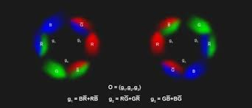
Detailing the Odderon effect with numerical examples at 8 TeV
T. Csörgő^{1,2}, T. Novák¹, R. Pasechnik³,
A. Ster², I. Szanyi^{2,4}
¹MATE KRC, Gyöngyös, Hungary
²Wigner RCP, Budapest, Hungary
³Lund Univ., Lund, Sweden
⁴Eötvös Univ., Budapest, Hungary

Slide 2
Outline
Strategy of Odderon search
Difficulties of Odderon discovery
Odderon-signal at 8 TeV
Comparing (and combining) 7 és 8 TeV data
Optimalaizing the Odderon-signal
Summary

Slide 3

Odderon: A 48-year-old problem solved
L. Lukaszuk, B. Nicolescu,
Lett. Nuovo Cim. 8, 405 (1973)
Received: 31 July 1973
Abstract
It is shown that the assumption that the rise of pp total cross sections at ISR energies can be understood by the existence of a contribution proportional to In/sup 2/s is nut necessarily within the existing knowledge of experimental data. Also by assuming that asymptotically Re F ~- s ln/sup 2/s together with sigma T~ ln/sup 2/s it is possible to propose a parametrization which seems interesting both from the experimental and theoretical points of view. (JFP)
Basarab Nicolescu

Slide 4
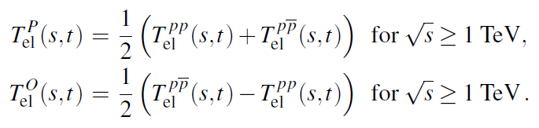

Strategy of Odderon Search
The contribution of Odderon in proton-proton and proton-antiproton collisions
Consequencies
Differential cross-sections → measureable

Slide 5
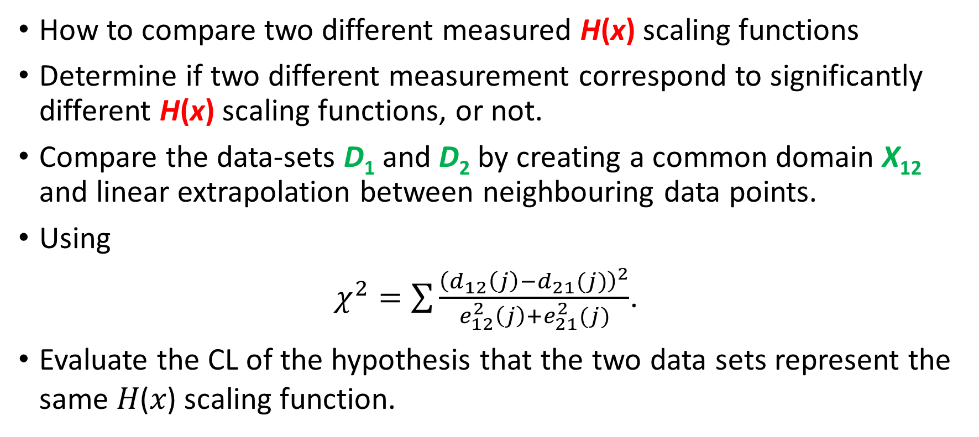
Quantification / Extrapolation
How to compare two different measured H(x) scaling functions
Determine if two different measurement correspond to significantly different H(x) scaling functions, or not.
Compare the data-sets D₁ and D₂ by creating a common domain X₁₂ and linear extrapolation between neighbouring data points.
Using
$χ^{2}=\sum{\frac{{\left(d_{12}\left(j\right)−d_{21}(j)\right)}^{2}}{e_{12}^{2}\left(j\right)+e_{21}^{2}(j)}}$.
Evaluate the CL of the hypothesis that the two data sets represent the same 𝐻(𝑥) scaling function.

Slide 6
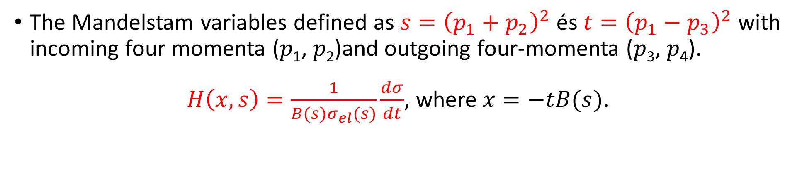
Difficulties I.: H(x,s) scaling function
The Mandelstam variables defined as $s={\left(p_{1}+p_{2}\right)}^{2}$ és $t={\left(p_{1}−p_{3}\right)}^{2}$ with incoming four momenta (𝑝₁, 𝑝₂)and outgoing four-momenta (𝑝₃, 𝑝₄).
$H\left(x,s\right)=\frac{1}{B(s)σ_{el}(s)}\frac{dσ}{dt}$, where$x=−tB(s)$.

Slide 7
Difficulties II. -> need a projection
Illustrate the model independent nature of the interpolations

Slide 8

Difficulties III. -> different types of errors
where $k∈\left\{1, 21\right\}$ and $M∈\left\{A, B\right\}$ type error
Type A: point-to-point fluctuating (uncorrelated) systematic and statistical errors
Type B: point-to-point dependent, but 100% correlated systematic errors

Slide 9
Significant Odderon-signal (7 TeV)

Slide 10
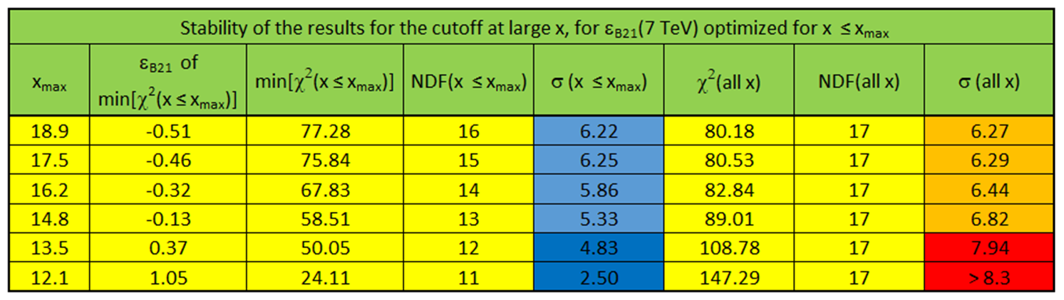
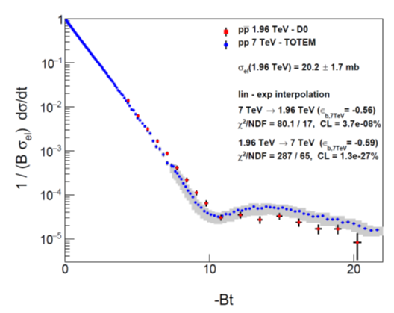
Stability of Odderon-signal
Optimized for the range of investigation
For all the datapoints
Greater than 5 σ

Slide 11
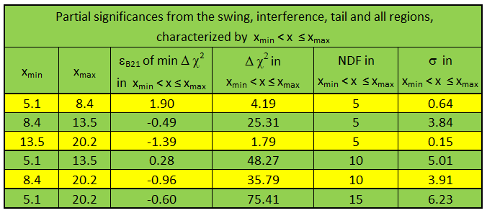
Stability of Odderon-signal
The 10 D0 points in the swing and diffractive interference region provide a significant Odderon effect
0.
I.
II.
III.

Slide 12

Optimizing Odderon signal at 7 TeV
Left door excludes the first n, right door excludes the last m D0 points
n\m | 0 | 1 | 2 | 3 | 4 | 5 | 6 | 7
0 | eps=-0.56 chi2=80.074 sigma=6.26 left=2.26 right=2.69 | eps=-0.51 chi2=77.278 sigma=6.21 left=2.17 right=1.34 | eps=-0.46 chi2=75.842 sigma=6.25 left=2.08 right=7.23 | eps=-0.32 chi2=67.834 sigma=5.85 left=1.83 right=8.09 | eps=-0.13 chi2=58.513 sigma=5.33 left=1.52 right=5.94 | eps=0.35 chi2=50.046 sigma=4.83 left=0.87 right=21.2
1 | eps=-0.57 chi2=77.8 sigma=6.25 left=2.01 right=2.65 | eps=-0.53 chi2=75.082 sigma=6.20 left=1.95 right=1.25 | eps=-0.48 chi2=73.740 sigma=6.25 left=1.86 right=7.00 | eps=-0.34 chi2=65.983 sigma=5.86 left=1.63 right=7.83 | eps=-0.15 chi2=56.974 sigma=5.36 left=1.35 right=5.71 | eps=0.3 chi2=49.150 sigma=4.91 left=0.79 right=20.6
2 | eps=-0.59 chi2=75.763 sigma=6.25 left=1.34 right=2.57 | eps=-0.55 chi2=73.115 sigma=6.21 left=1.28 right=1.16 | eps=-0.50 chi2=71.858 sigma=6.26 left=1.2 right=6.78 | eps=-0.36 chi2=64.330 sigma=5.9 left=0.98 right=7.57 | eps=-0.17 chi2=55.605 sigma=5.42 left=0.73 right=5.49 | eps=0.25 chi2=48.339 sigma=5.01 left=0.30 right=19.9 | eps=0.98 chi2=23.631 sigma=2.81 left=0.001 right=7.36
3 | eps=-0.61 chi2=74.4 sigma=6.29 left=5.83 right=2.50 | eps=-0.57 chi2=71.823 sigma=6.26 left=5.71 right=1.07 | eps=-0.52 chi2=70.644 sigma=6.33 left=5.57 right=6.56 | eps=-0.38 chi2=63.331 sigma=5.98 left=5.18 right=7.32 | eps=-0.19 chi2=54.859 sigma=5.52 left=4.68 right=5.27 | eps=0.22 chi2=48.024 sigma=5.15 left=3.69 right=19.5 | eps=0.97 chi2=23.630 sigma=3.00 left=2.20 right=7.30
4 | eps=-0.64 chi2=68.538 sigma=6.04 left=8.14 right=2.38 | eps=-0.60 chi2=66.074 sigma=6.02 left=8.03 right=0.95 | eps=-0.55 chi2=65.028 sigma=6.09 left=7.89 right=6.24 | eps=-0.42 chi2=58.101 sigma=5.76 left=7.53 right=6.83 | eps=-0.23 chi2=50.123 sigma=5.15 left=7.03 right=4.84 | eps=0.11 chi2=44.210 sigma=5.02 left=3.69 right=19.5 | eps=0.87 chi2=21.344 sigma=2.94 left=4.48 right=6.66
5 | eps=-0.67 chi2=60.359 sigma=5.61 left=8.34 right=2.27 | eps=-0.63 chi2=58.006 sigma=5.59 left=7.93 right=0.84 | eps=-0.58 chi2=57.084 sigma=5.68 left=7.52 right=5.82 | eps=-0.45 chi2=50.529 sigma=5.35 left=6.18 right=6.47 | eps=-0.27 chi2=53.034 sigma=4.74 left=4.66 right=4.43 | eps=-0.09 chi2=37.706 sigma=4.64 left=3.36 right=14.8
6 | eps=-0.78 chi2=51.452 sigma=5.09 left=13.7 right=1.88 | eps=-0.74 chi2=49.510 sigma=5.10 left=13.1 right=0.48 | eps=-0.71 chi2=48.99 sigma=5.23 left=12.7 right=4.64 | eps=-0.58 chi2=43.744 sigma=4.98 left=11.1 right=5.03
7 | eps=-0.94 chi2=36.690 sigma=3.99 left=14.7 right=1.38 | eps=-0.9 chi2=35.255 sigma=4.03 left=14.3 right=0.13 | eps=-0.88 chi2=35.114 sigma=4.21 left=14.1 right=3.2
$$σ=6.33$$
10/29/2023

Slide 13
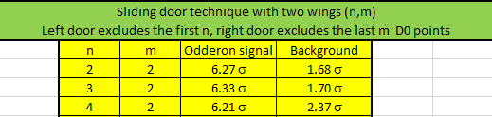
7 TeV results, closing gates
Two sliding gates of size n and size m:
(n,m): Leaving out the first n and last m D0 point
MODEL INDEPENT RESULT:
Outside the best window: H(x|pp) = H(x,pbarp)
pp and pbarp backgrounds agree within 1.7 sigma

Slide 14
No difference between 7 and 8 TeV data

Slide 15
8 TeV data also confirm the Odderon signal
Projection 1.96--->8
eps_b1_7tev | -1.17
eps_b12_1.96tev | 0
chi2 1--->2 | 88.382 | CL (%) | 1.7E-04
ndf 1--->2 | 35 | Significance | 4.7919
Projection 8--->1.96
eps_b2_1.96tev | -1.45
eps_b21_7tev | 0
chi2 2--->1 | 46.817 | CL (%) | 1.3E-02
ndf 2--->1 | 17 | Significance | 3.8266

Slide 16

Optimizing Odderon signal at 8 TeV
Left door excludes the first n, right door excludes the last m D0 points
 | Previous TOTEM slope value: 20.14+-0.15 |  |  |  |  |  | Optimized TOTEM slope value: 19.9+-0.3
 | n=left m=right |  |  |  |  |  | n=left m=right
 | n\m | 0 | 1 | 2 | 3 |  | n\m | 0 | 1 | 2 | 3
Colours | 0 | eps=-1.57 chi2=46.792 sigma=3.82 left=0.0653 right=1.80 | eps=-1.52 chi2=44.988 sigma=3.81 left=0.0587 right=4.55 | eps=-1.35 chi2=40.381 sigma=3.54 left=0.0391 right=7.01 | eps=-1.01 chi2=33.172 sigma=3.00 left=0.0120 right=5.42 | Colours | 0 | eps=-1.26 chi2=45.854 sigma=3.74 left=0.1384 right=1.31 | eps=-1.20 chi2=44.541 sigma=3.77 left=0.1275 right=3.5 | eps=-1.05 chi2=41.006 sigma=3.60 left=0.1023 right=6.44
Greatest σ in the row | 1 | eps=-1.61 chi2=46.724 sigma=3.96 left=0.255 right=1.79 | eps=-1.54 chi2=44.928 sigma=3.95 left=0.273 right=4.53 | eps=-1.36 chi2=40.341 sigma=3.69 left=0.322 right=7.00 | eps=-1.02 chi2=33.160 sigma=3.15 left=0.423 right=5.41 | Greatest σ in the row | 1 | eps=-1.33 chi2=45.709 sigma=3.87 left=0.073 right=1.29 | eps=-1.26 chi2=44.408 sigma=3.90 left=0.082 right=3.47 | eps=-1.11 chi2=40.898 sigma=3.74 left=0.103 right=6.38
Greatest σ in the column | 2 | eps=-1.53 chi2=46.459 sigma=4.08 left=0.373 right=1.81 | eps=-1.46 chi2=44.644 sigma=4.07 left=0.395 right=4.58 | eps=-1.26 chi2=40.007 sigma=3.81 left=0.463 right=7.11 | eps=-0.92 chi2=32.721 sigma=3.27 left=0.588 right=5.49 | Greatest σ in the column | 2 | eps=-1.29 chi2=45.633 sigma=4.01 left=0.115 right=1.30 | eps=-1.21 chi2=44.323 sigma=4.04 left=0.128 right=3.50 | eps=-1.07 chi2=40.792 sigma=3.88 left=0.153 right=6.42
Greatest σ in the table | 3 | eps=-1.43 chi2=46.070 sigma=4.20 left=0.016 right=1.83 | eps=-1.35 chi2=44.230 sigma=4.19 left=0.0221 right=4.65 | eps=-1.16 chi2=39.528 sigma=3.93 left=0.0398 right=7.22 | eps=-0.79 chi2=32.108 sigma=3.38 left=0.088 right=5.60 | Greatest σ in the table | 3 | eps=-1.22 chi2=45.512 sigma=4.15 left=0.018 right=1.32 | eps=-1.15 chi2=44.191 sigma=4.19 left=0.014 right=3.53 | eps=-0.99 chi2=40.631 sigma=4.03 left=0.006 right=6.50
 | 4 | eps=-1.39 chi2=46.053 sigma=4.35 left=0.099 right=1.84 | eps=-1.32 chi2=44.207 sigma=4.34 left=0.089 right=4.66 | eps=-1.12 chi2=39.486 sigma=4.09 left=0.065 right=7.26 | eps=-0.74 chi2=32.015 sigma=3.54 left=0.030 right=5.64 |  | 4 | eps=-1.26 chi2=45.492 sigma=4.30 left=0.436 right=1.31 | eps=-1.18 chi2=44.175 sigma=4.34 left=0.415 right=3.51 | eps=-1.02 chi2=40.624 sigma=4.19 left=0.374 right=6.47
 | 5 | eps=-1.45 chi2=45.949 sigma=4.49 left=0.357 right=1.83 | eps=-1.36 chi2=44.115 sigma=4.50 left=0.332 right=4.64 | eps=-1.16 chi2=39.419 sigma=4.25 left=0.280 right=7.22 | eps=-0.76 chi2=31.984 sigma=3.72 left=0.192 right=5.62 |  | 5 | eps=-1.36 chi2=45.044 sigma=4.42 left=0.899 right=1.29 | eps=-1.28 chi2=43.748 sigma=4.46 left=0.866 right=3.46 | eps=-1.10 chi2=40.241 sigma=4.32 left=0.794 right=6.39
 | 6 | eps=-1.55 chi2=45.577 sigma=4.62 left=1.58 right=1.80 | eps=-1.46 chi2=43.767 sigma=4.63 left=1.53 right=4.58 | eps=-1.26 chi2=39.128 sigma=4.40 left=1.41 right=7.11 | eps=-0.83 chi2=31.785 sigma=3.89 left=1.19 right=5.56 |  | 6 | eps=-1.52 chi2=44.113 sigma=4.50 left=2.29 right=1.26 | eps=-1.40 chi2=42.850 sigma=4.55 left=2.24 right=3.39 | eps=-1.26 chi2=39.416 sigma=4.42 left=2.13 right=6.23
 | 7 | eps=-1.78 chi2=43.923 sigma=4.65 left=5.48 right=1.75 | eps=-1.68 chi2=42.167 sigma=4.67 left=5.37 right=4.45 | eps=-1.47 chi2=37.658 sigma=4.45 left=5.15 right=6.88 | eps=-1.03 chi2=30.544 sigma=3.96 left=4.71 right=5.41 |  | 7 | eps=-1.78 chi2=41.738 sigma=4.46 left=6.08 right=1.20 | eps=-1.68 chi2=40.527 sigma=4.52 left=5.97 right=3.28 | eps=-1.51 chi2=37.211 sigma=4.41 left=5.80 right=5.98
 | 8 | eps=-2.21 chi2=38.205 sigma=4.31 left=4.47 right=1.65 | eps=-2.13 chi2=36.550 sigma=4.35 left=4.41 right=4.19 | eps=-1.88 chi2=32.290 sigma=4.13 left=4.24 right=6.43 | eps=-1.45 chi2=25.631 sigma=3.65 left=3.94 right=5.08
$$σ=4.55$$

Slide 17
Combining the 7 and 8 TeV data
Itt a chi2-ek és az NDF-ek össze lettek adva, majd kiszámoltam a konfidenciákat, abból pedig a szignifikanciákat.
Itt a szignifikanciák összegét osztottam \sqrt{2}-vel.

Slide 18
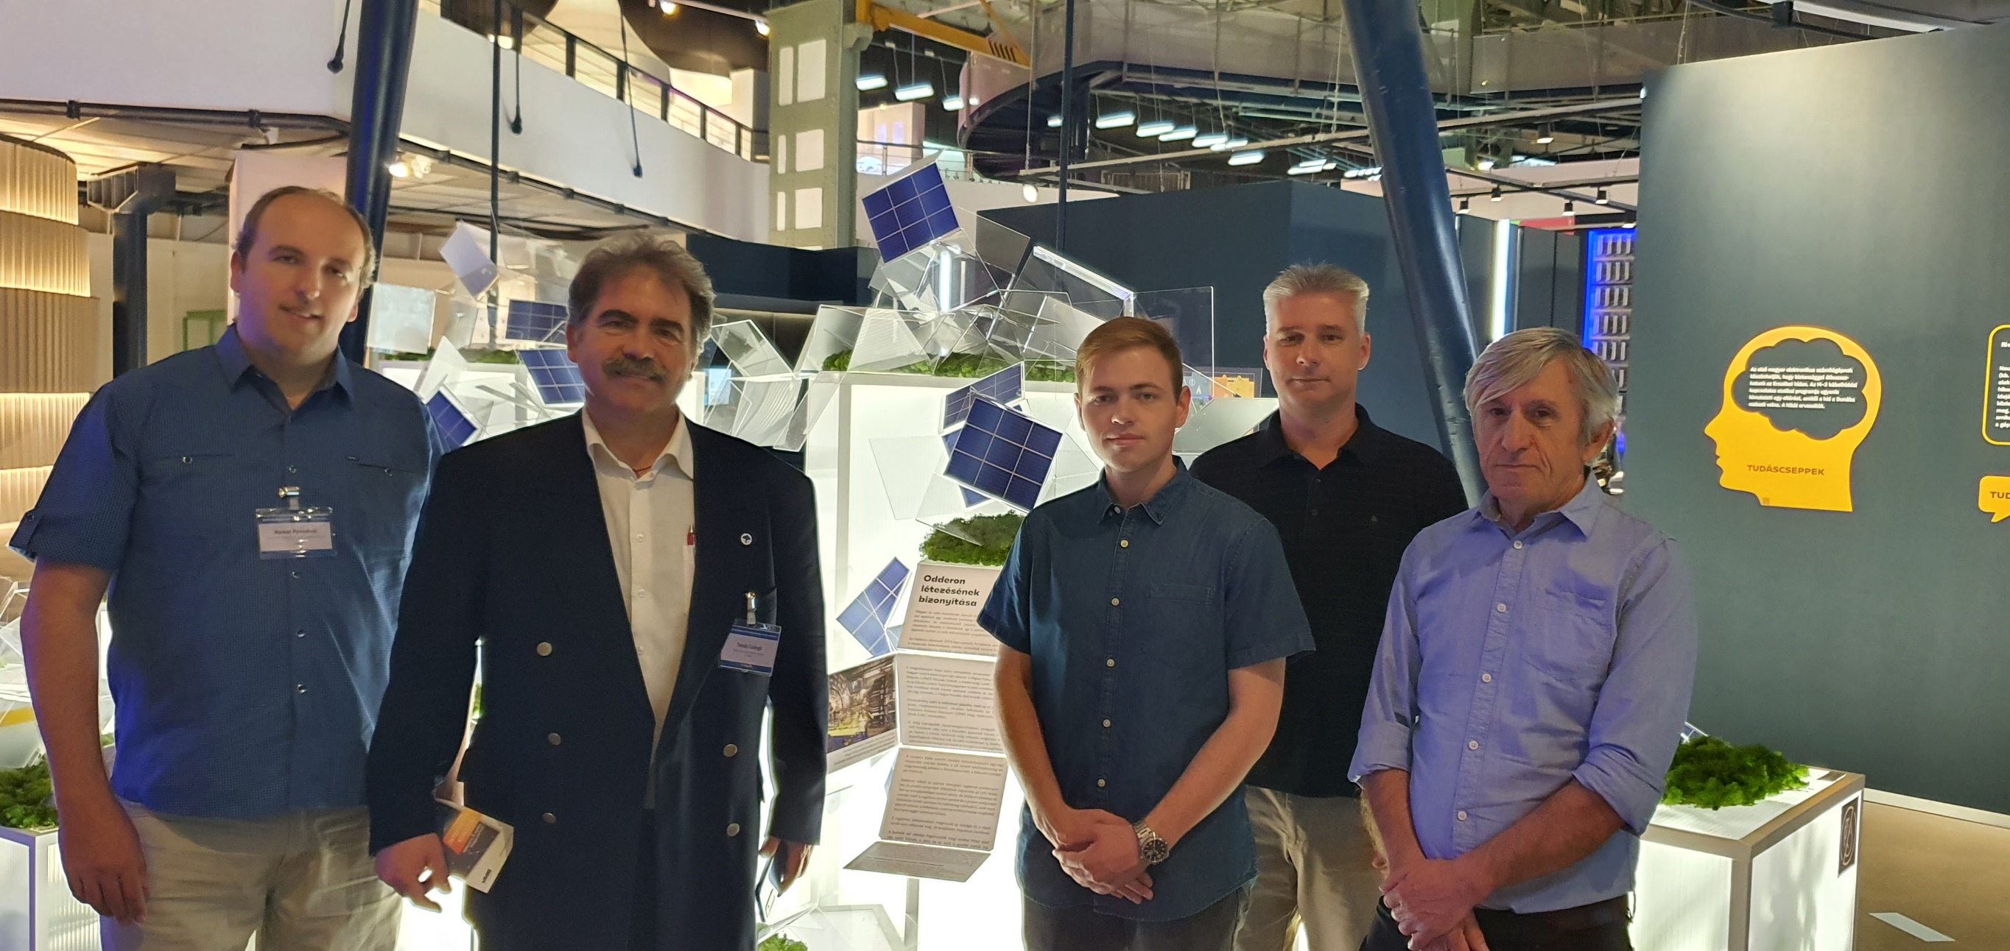

Slide 19
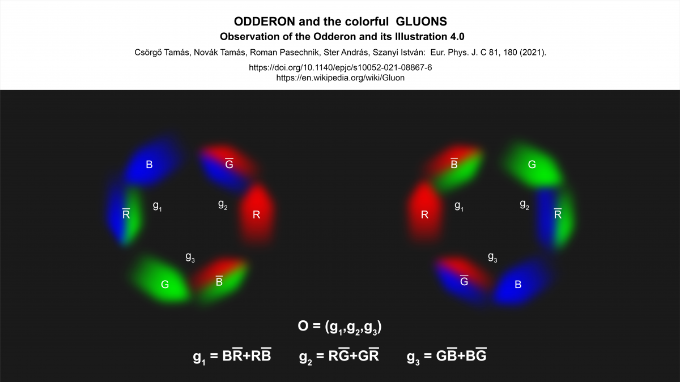
Summary
Strategy of Odderon search
Difficulties of Odderon discovery
Odderon-signal at 8 TeV
No significant difference between 7 és 8 TeV data
Optimalaizing the Odderon-signal
Thank you for your attention!

