Slide 1


MODEL INDEPENDENT FEMTOSCOPIC METHODS
with possible applications
T. Csörgő^{1,2}
¹ Wigner RCP, Budapest, Hungary
² MATE KRC, Gyöngyös, Hungary
Statistical analysis of large amount of data
Laguerre expansions
Gaussian expansions
Levy expansions
Predictions from trends
Possible areas of applications

Slide 2
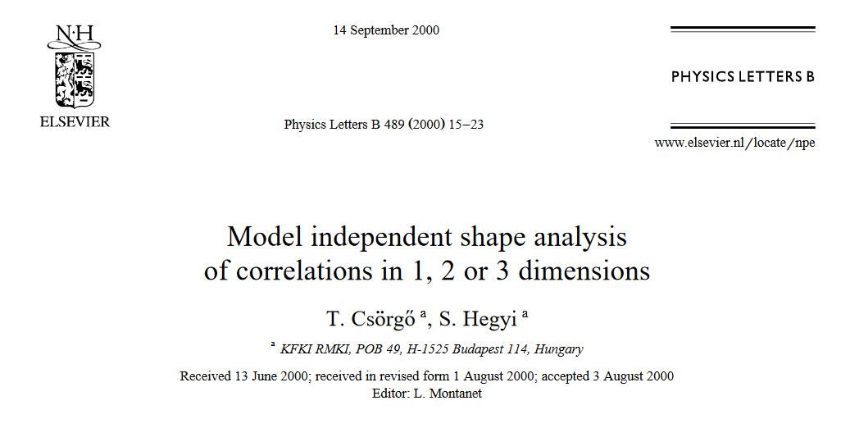
Motivation: details
2
Basic problem: first approximations usually Gaussian or exponential.
When data improve, they frequently become unsatisfactory.
Parameter estimates may become unreliable, need for precision.

Slide 3
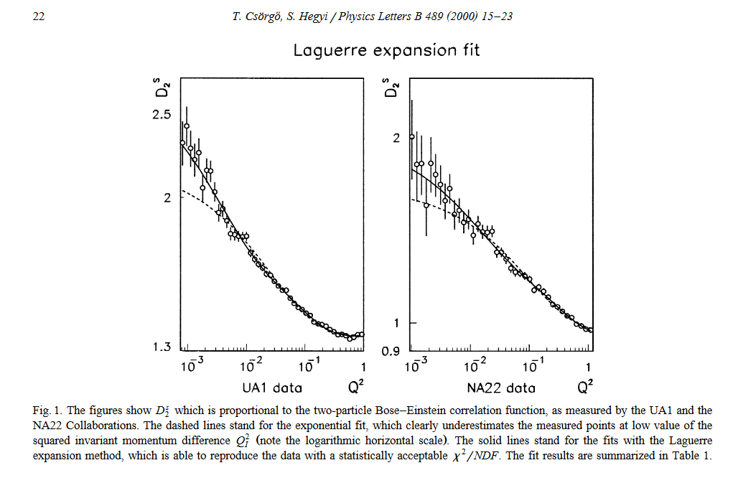
Examples: Laguerre expansions
3
For describing nearly exponential data

Slide 4
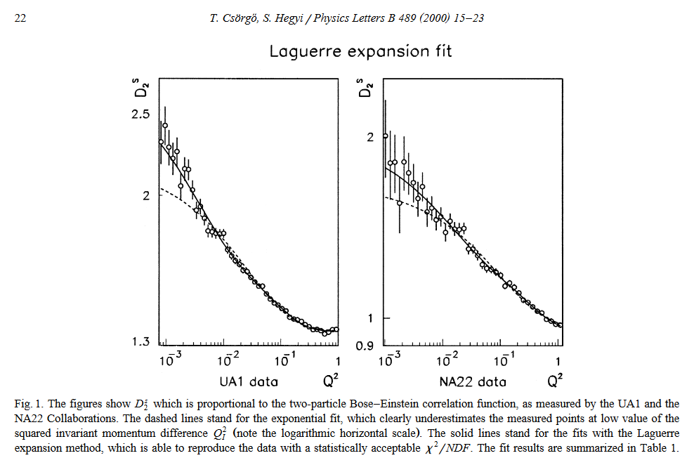
Motivation: details
4
Basic problem: first approximations usually Gaussian or exponential.
When data improve, they frequently become unsatisfactory.
Parameter estimates may become unreliable, need for precision.

Slide 5
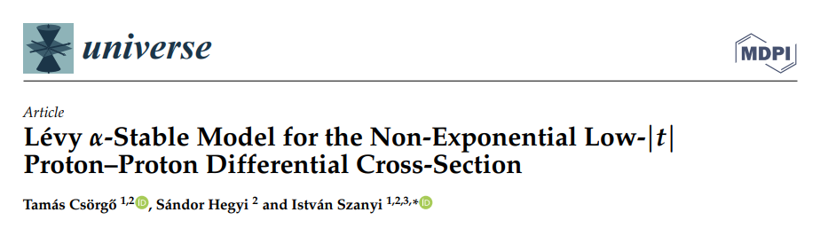
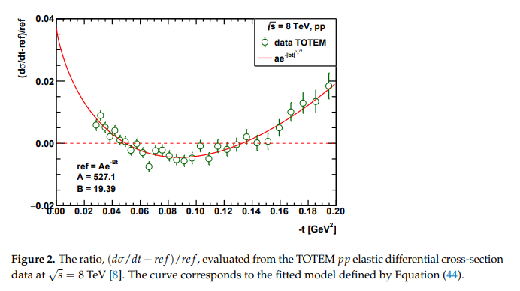
Example 2: strong non-exponential behavior
5
Deviation from a reference exponential indicates a strong non-exponential behaviour of data. How to characterize this well?

Slide 6
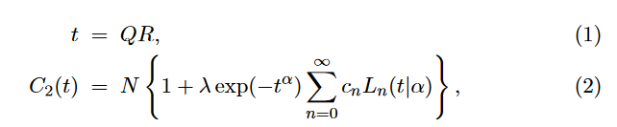
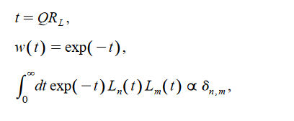
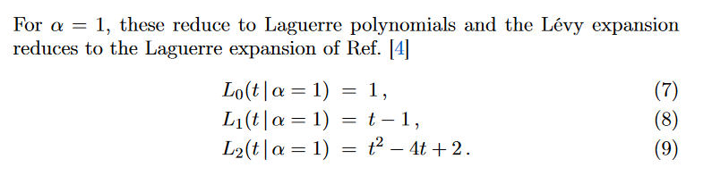
Model-independent Levy expansions
6
For describing nearly exponential data

Slide 7
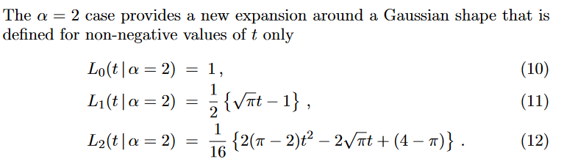
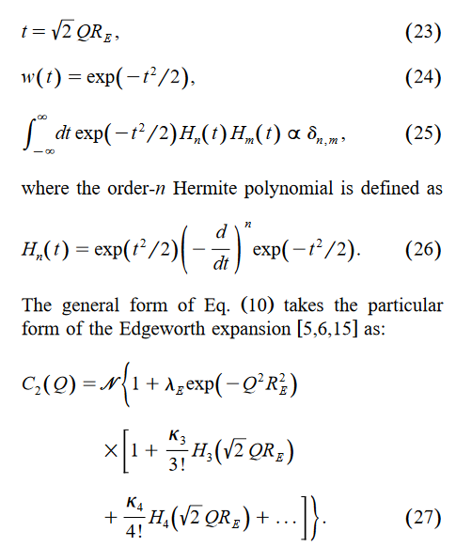
Model-indep. Gauss/Edgeworth expansions
7
Two different Gaussian expansion (t>0, or not)

Slide 8
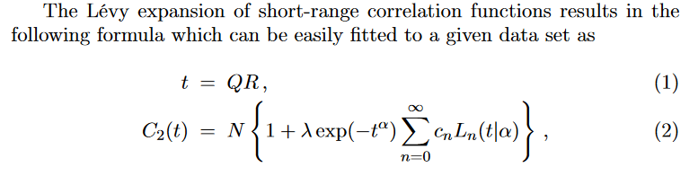
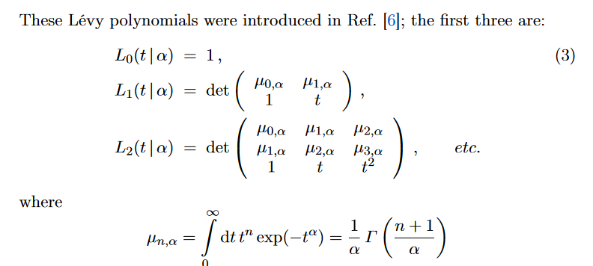
Model-independent Levy expansions
8
For describing nearly Levy data

Slide 9
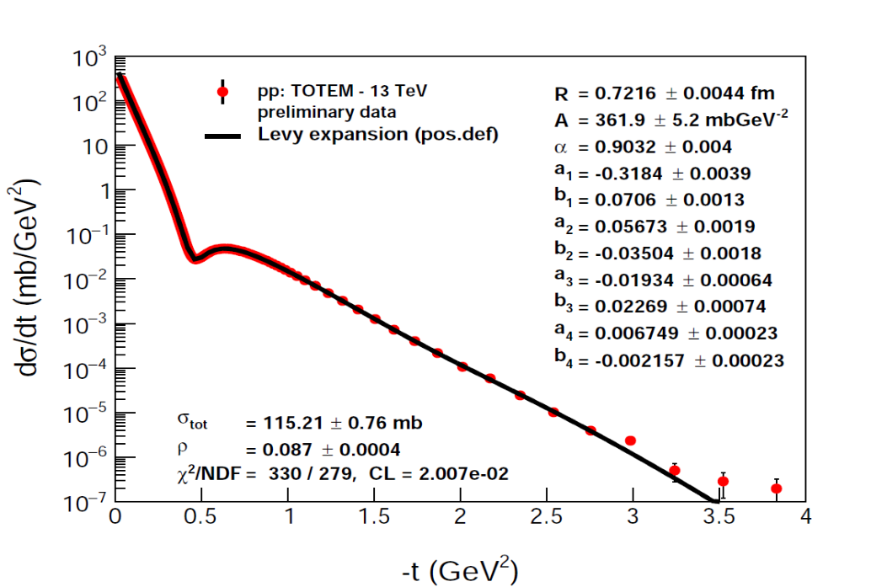
Examples: Levy expansions
9
For describing data over 10 orders of magnitude

