Slide 1
Machine Learning applied to BGI Profile Measurements
Javier Martínez Samblas, Manuel Gonzalez-Berges (BI-SW)
Contributions by:
Glenn Anta, Clara Marie Fleisig, Verena Kain, Mark Mclean, Hampus Sandberg, James Storey
BI DAY (14/12/2023)

Slide 2

Outline
Introduction
Background Removal
Extra Data Processing
Preliminary Results
Conclusions & Outlook

Slide 3
Introduction

Slide 4
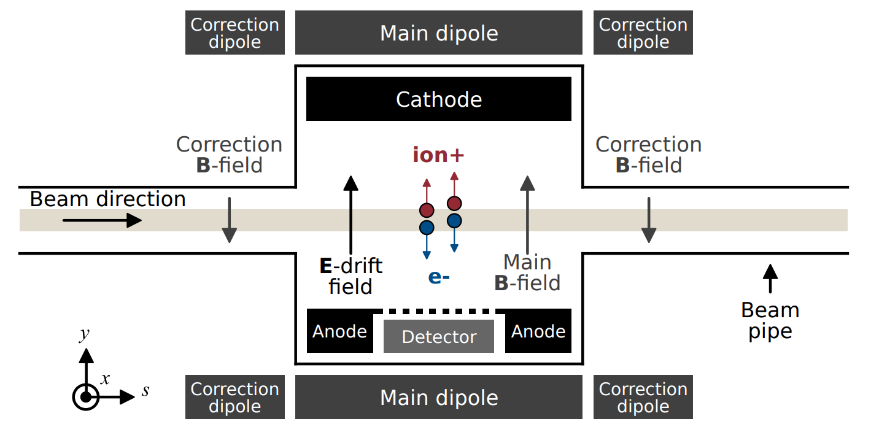
BGI: Beam Gas Ionization
Motivation: “To obtain non-invasive beam profile measurements.”
Source: Commissioning of Timepix3 Based Beam Gas Ionisation Profile Monitors for the CERN Proton Synchrotron (Swann Levasseur)
Notes:
The beam passes. There is a gas. The beam ionizes the gas, the gas loses electrons and the gas atoms convert into positive charged atoms. The electrical field collects the resulting free electrons (ionization electrons).

Slide 5
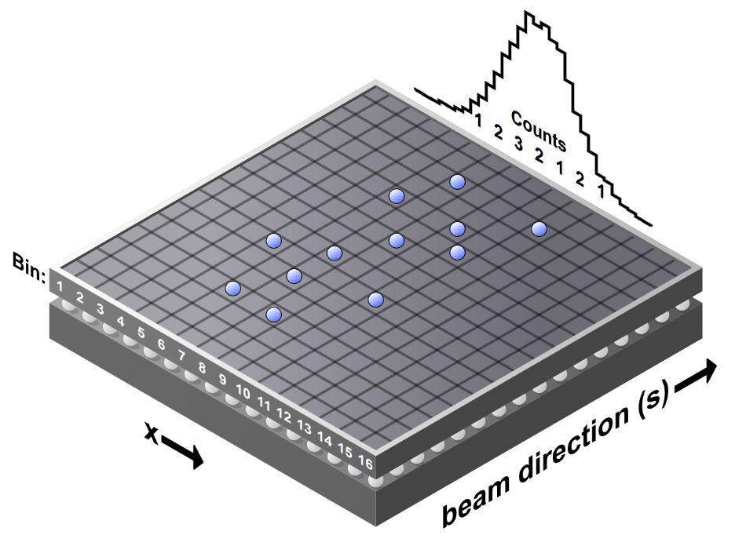
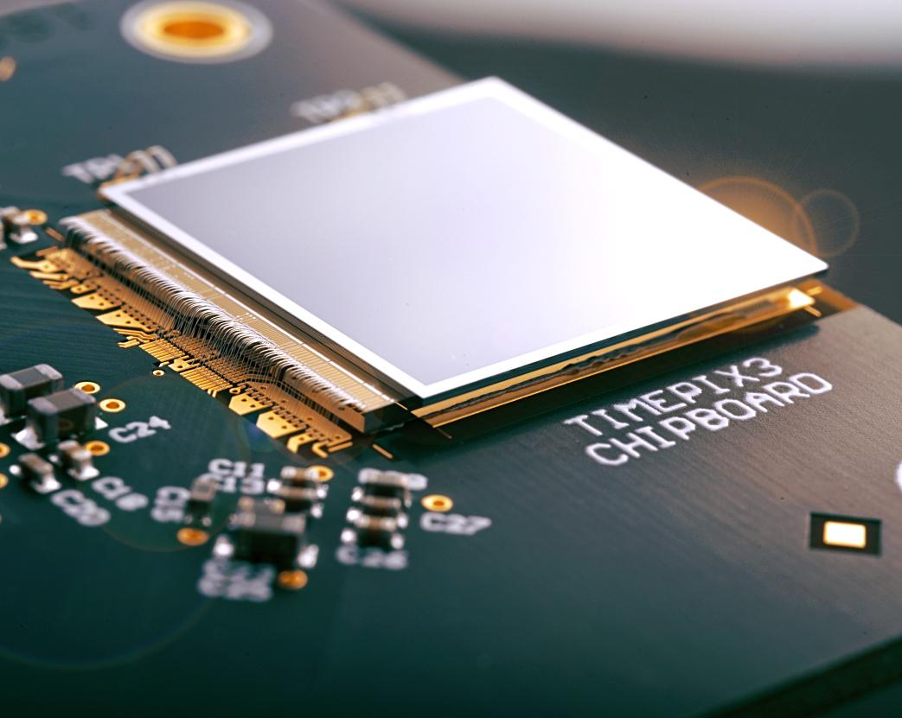
The Detector
ionization
electrons
Timepix3
256x256 px
14x14 mm
Source: Measuring the Beam Profile by Counting Ionization Electrons (Hampus Sandberg)
Notes:
The timepix3 (general purpose integrated circuit) is used in many other applications at CERN (Particle track reconstruction, X-rays imaging).

Slide 6
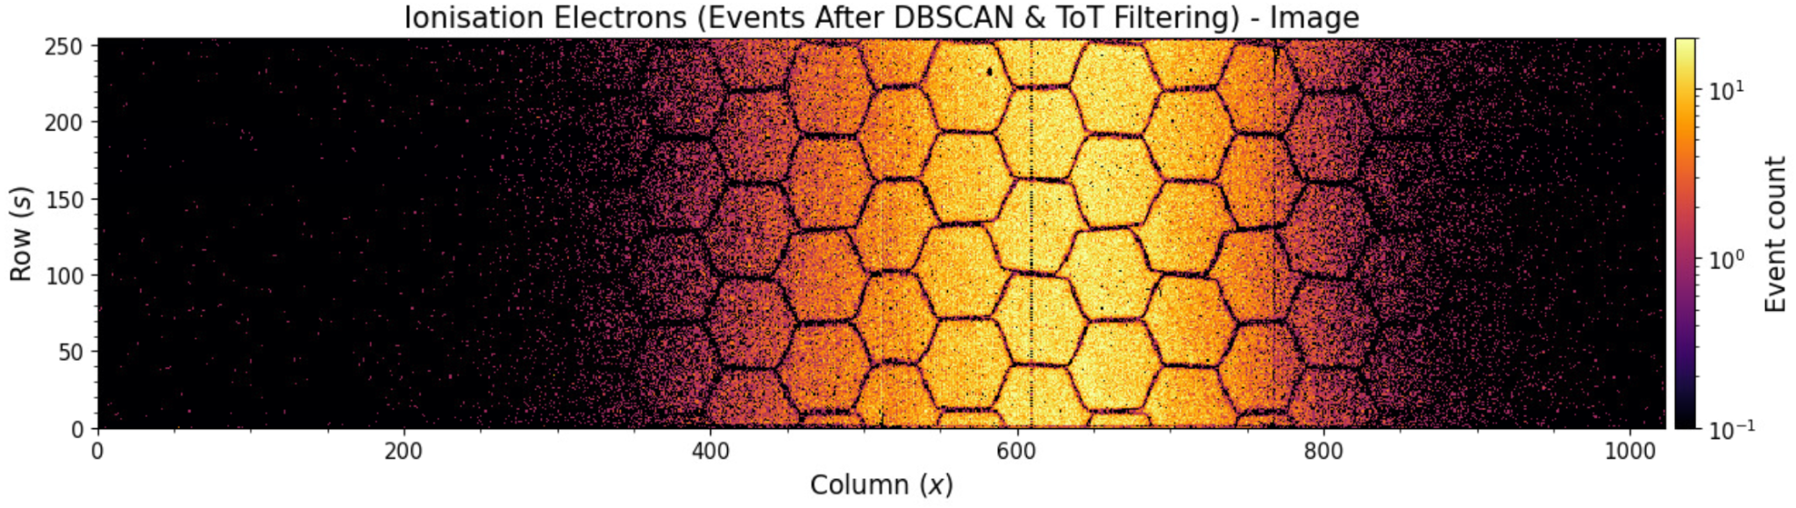
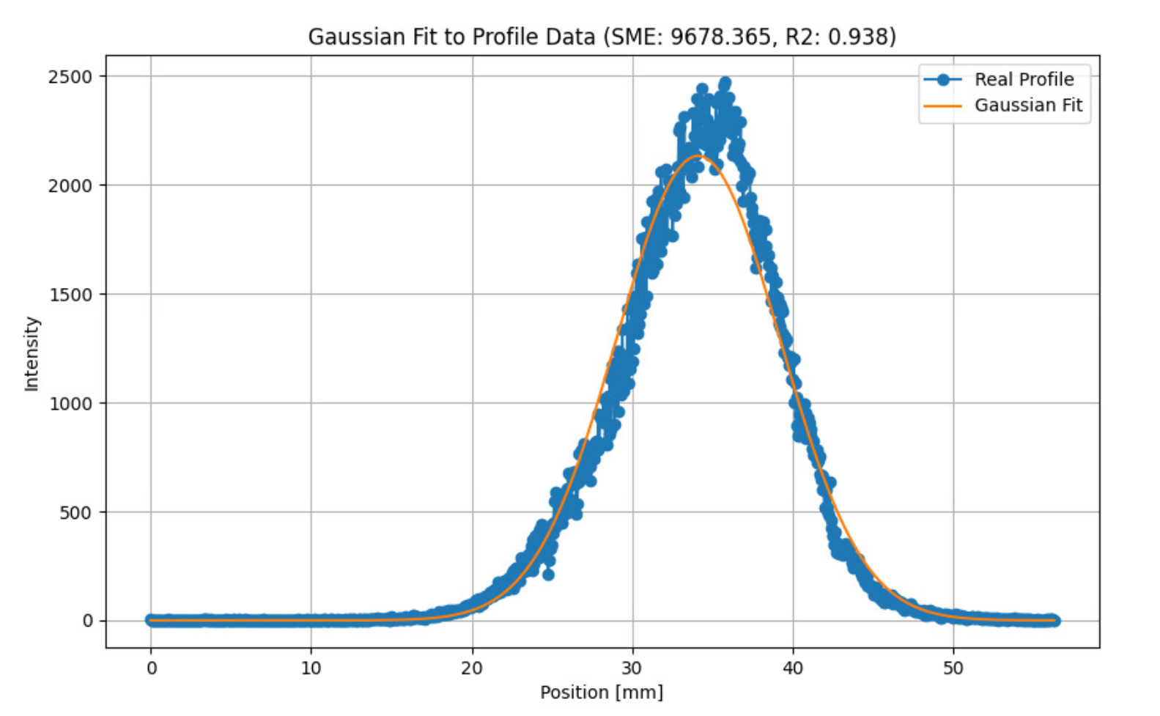
Beam Profile
All Events
Sum (project) columns to obtain the beam profile
Notes:
Honeycomb. No bees were harmed.

Slide 7
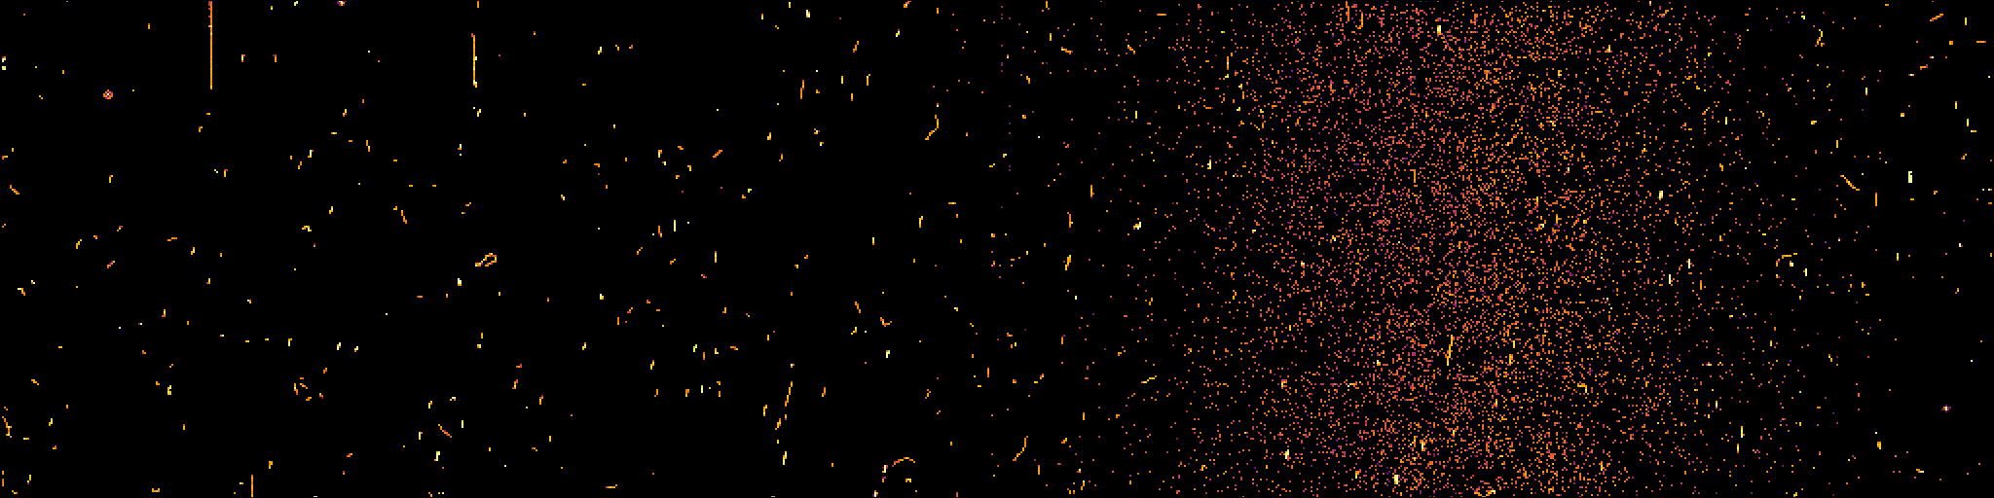
Acquisition Over Time
Acquisitions can actually be considered as a sequence of events that can be merged based on some predefined integration time 🎥
All Events Video Sequence
Source: https://bgi.web.cern.ch/

Slide 8

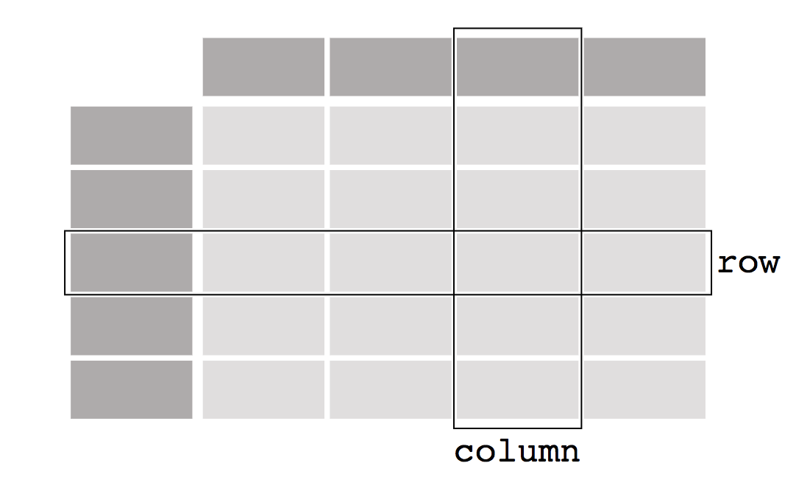
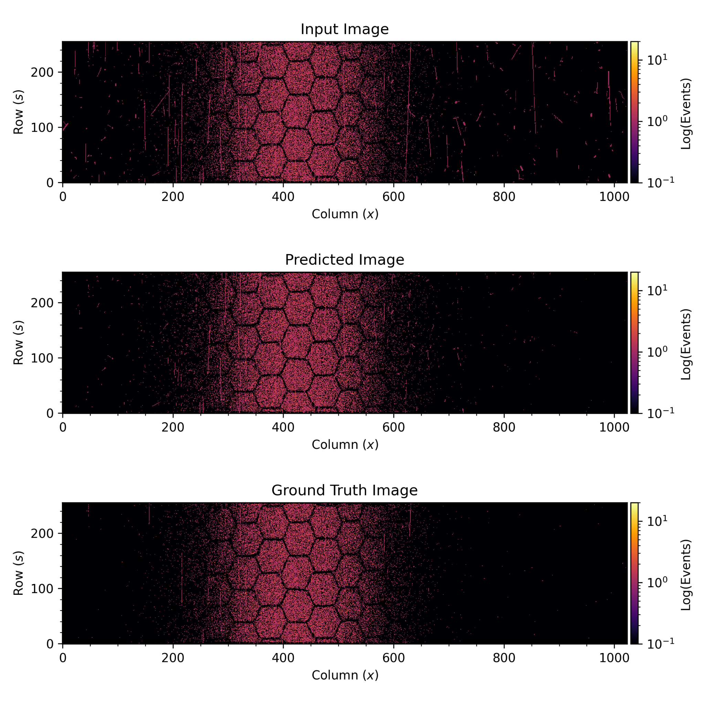
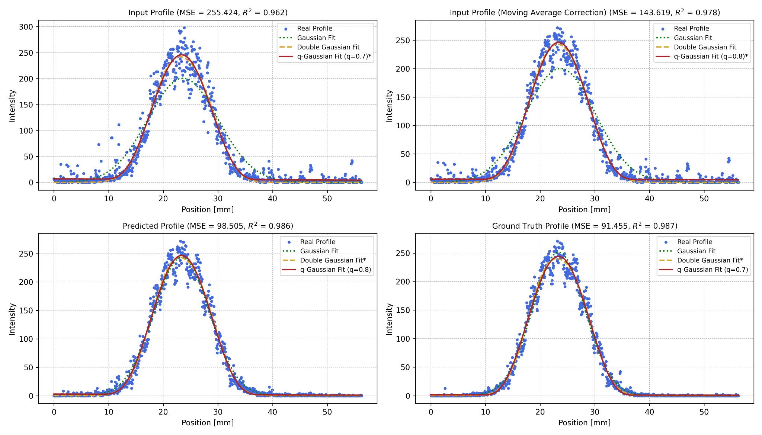
Data Pipeline
Current implementation is slow
Clean Image
Beam
timepix3
Events
Events Processing
Image
Background Removal
Aggregation
2D Dataframe
2D Array
2D Array
Ideally, Machine Learning would allow us to bypass most of the data processing
Beam Profile
Wire Scanners
1D Array

Slide 9
2. Background Removal

Slide 10
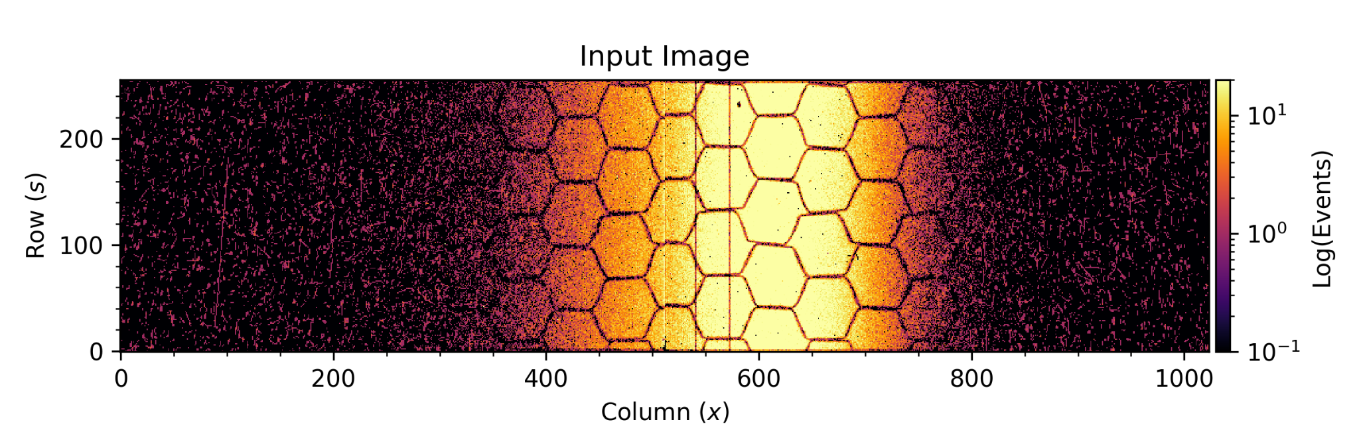
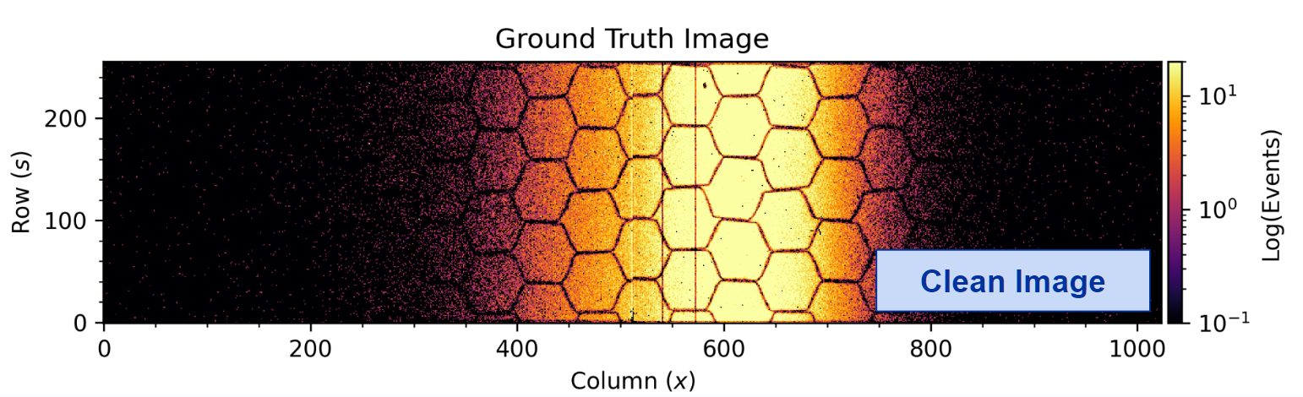
Example Images (Noisy vs Clean)
Ionization Electrons (Signal)
Beam Loss (Background)
Noisy Image

Slide 11
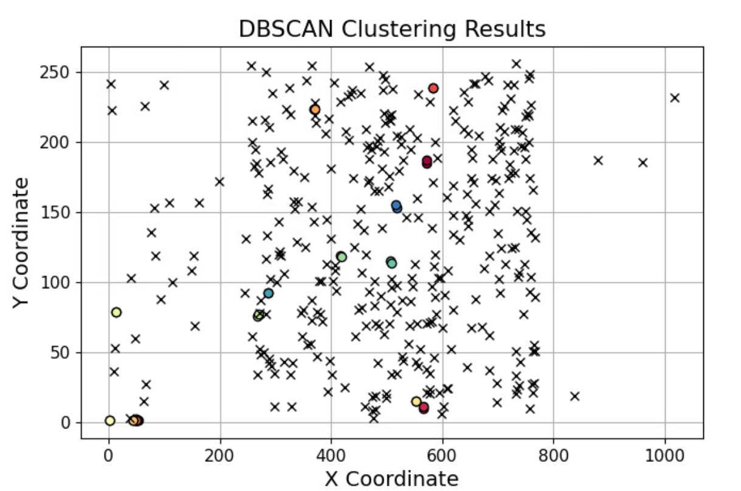
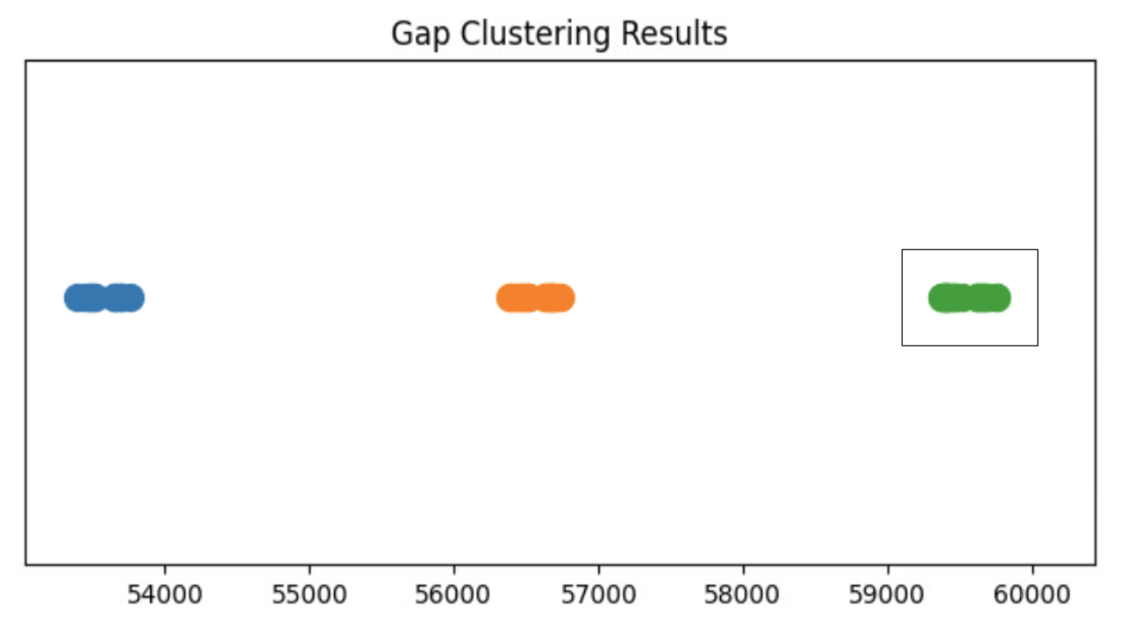

Previous Work: DBSCAN [1] Clustering
Expert knowledge: “Beam losses refer to clusters of points that are sufficiently close together at a given time; everything else is signal (ionization electrons).”
[1] A Density-Based Algorithm for Discovering Clusters in Large Spatial Databases with Noise (1996)
SPATIAL CLUSTERING
TIME CLUSTERING
apply spatial clustering to every time cluster found
C1
C2
C3
C3
nanoseconds
Notes:
Add DBSCAN Reference. “Finding groups”.

Slide 12
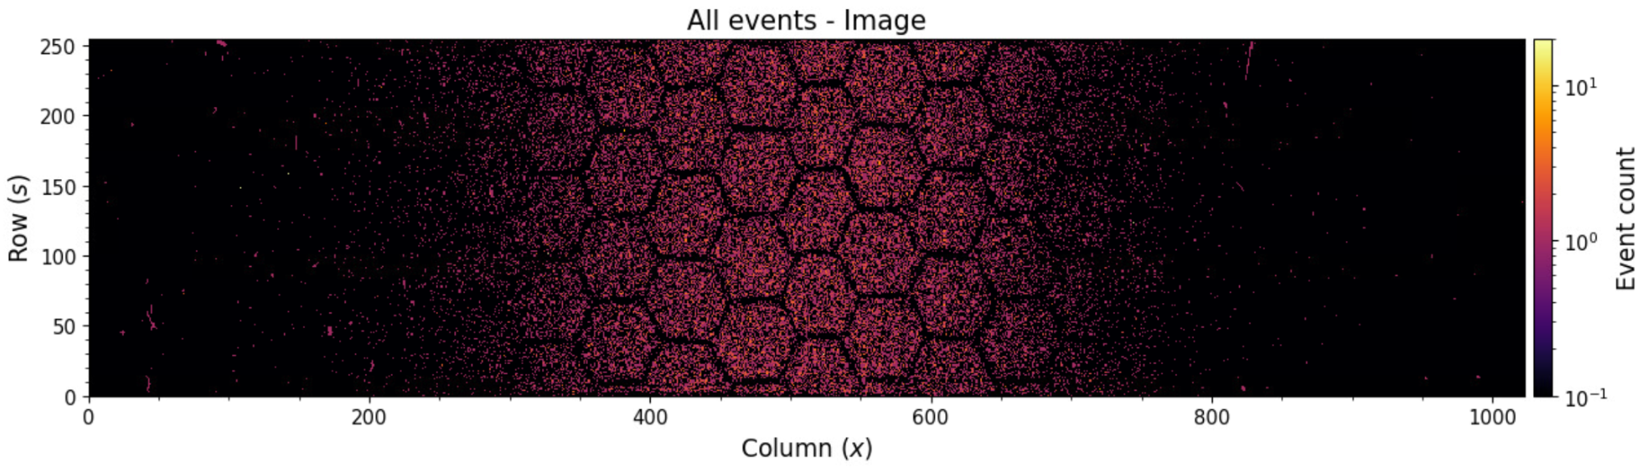
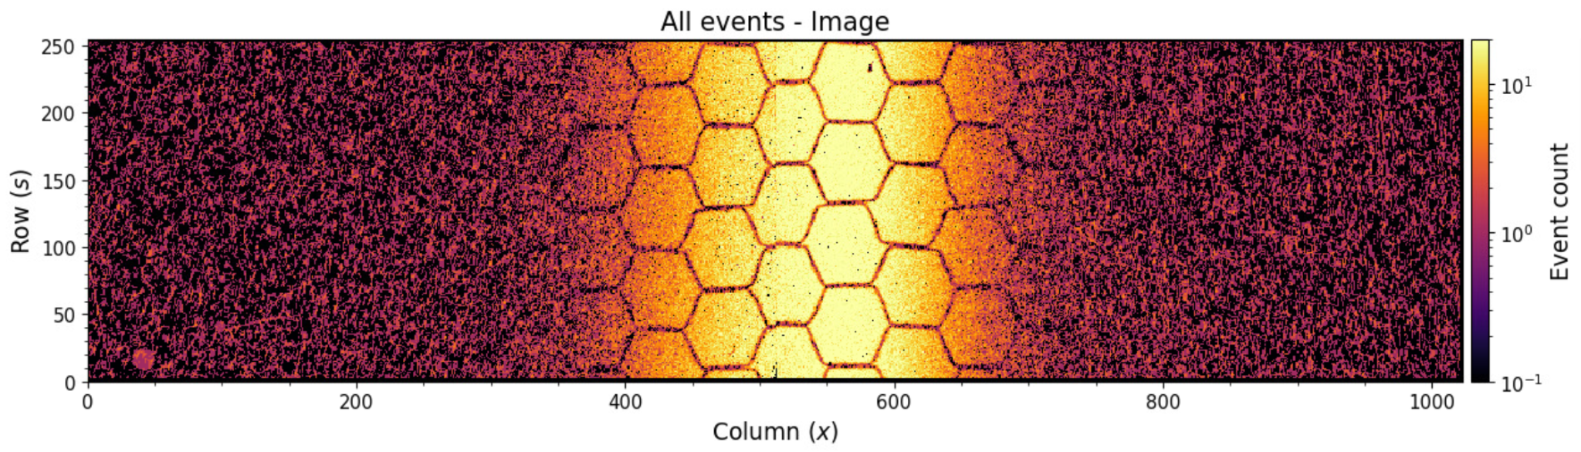
It works but it is too slow for operational use…
Takes too much time to analyze each acquisition, depending on the number of events…
Requirement: 1 measurement / cycle in the PS
40k Events
7 seconds
900k Events
24 minutes
Notes:
Not operational times. requirement: at least 1 measurement per cycle in the PS.

Slide 13
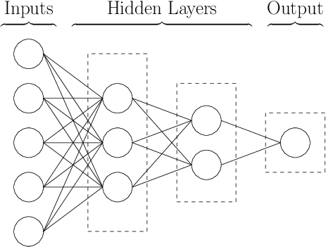
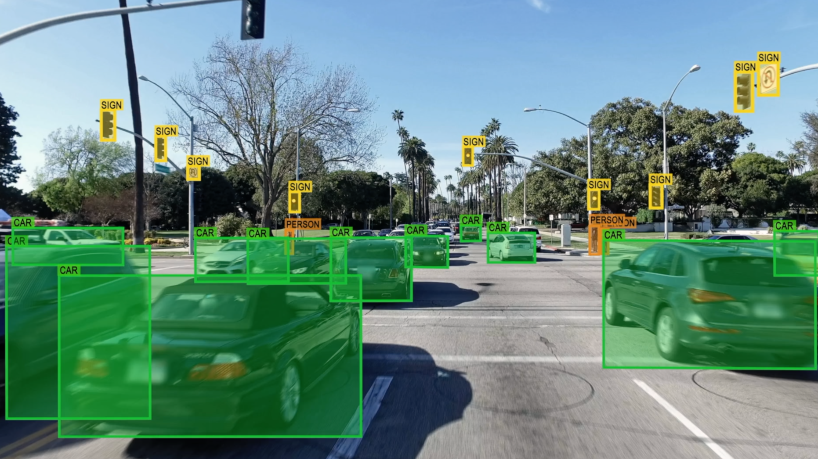

What is ML and how can it help us?
“Machine Learning (ML) is a field within AI, by which we let computers learn patterns from our data, in order to make decisions or predictions without giving them explicit instructions for each specific task.”
What is a Neural Network?
ML model consisting of interconnected nodes (neurons) that can learn complex non-linear patterns in our data through iterative training:
  Costly training - a lot of data and time!
  Super fast during inference (once it has been trained)
Usage: Autonom. Driving, Language Models (ChatGPT), etc.
[1] A new way to give driving lessons for autonomous vehicles
[2] https://chat.openai.com/
[3] Simple neural network diagram
[3]
[1]
[2]
Notes:
Neural networks are costly to train but super fast once they have been trained.

Slide 14
ML Approaches
Unsupervised learning. Trying to directly detect the losses without labeled data (DBSCAN).
Self-supervised learning. Training a model using noisy synthetic images as labels. We would need to know the background distribution.
Supervised learning. Assume DBSCAN works and use its output as the ground truth to train the model.
Algorithms:
  Traditional methods (e.g. wavelet denoising)
  Generative Adversarial Networks (GANs)
  Vision Transformers (ViT)
  Autoencoders (our selection / baseline)
  etc.

Slide 15
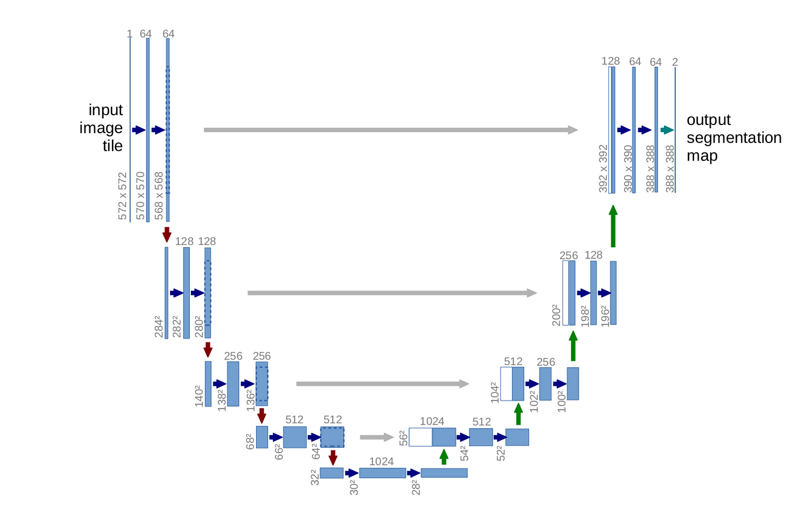
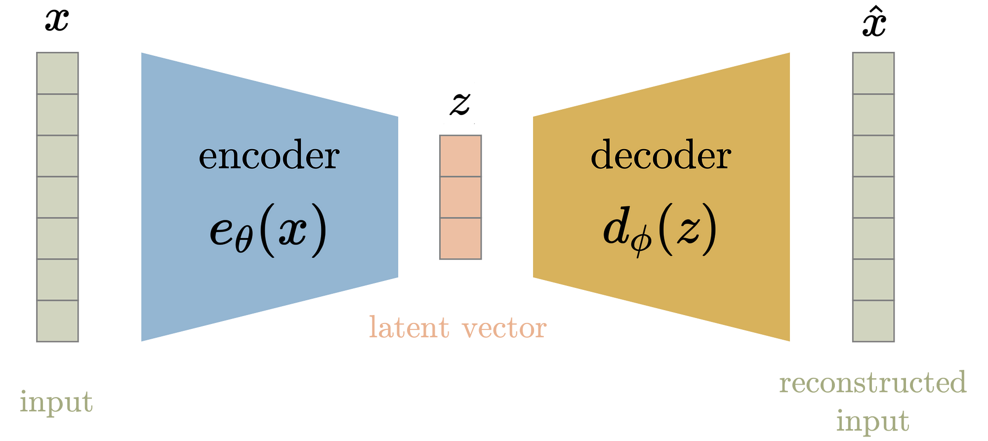
Selected Architecture
Autoencoder
U-NET
U-NET was originally made for medical image segmentation
  It has been proven to work well in many other domains [1]
Fairly simple network - good starting point / baseline for our problem!
Source: Difference between AutoEncoder (AE) and Variational AutoEncoder (VAE) (Aqee Anwar) (https://towardsdatascience.com)
Source: U-Net: Convolutional Networks for Biomedical Image Segmentation
[1] A Unified Framework for U-NET Design and Analysis
Notes:
You can learn any transformation: image denoising, image shifting, rotations, translations, etc.

Slide 16
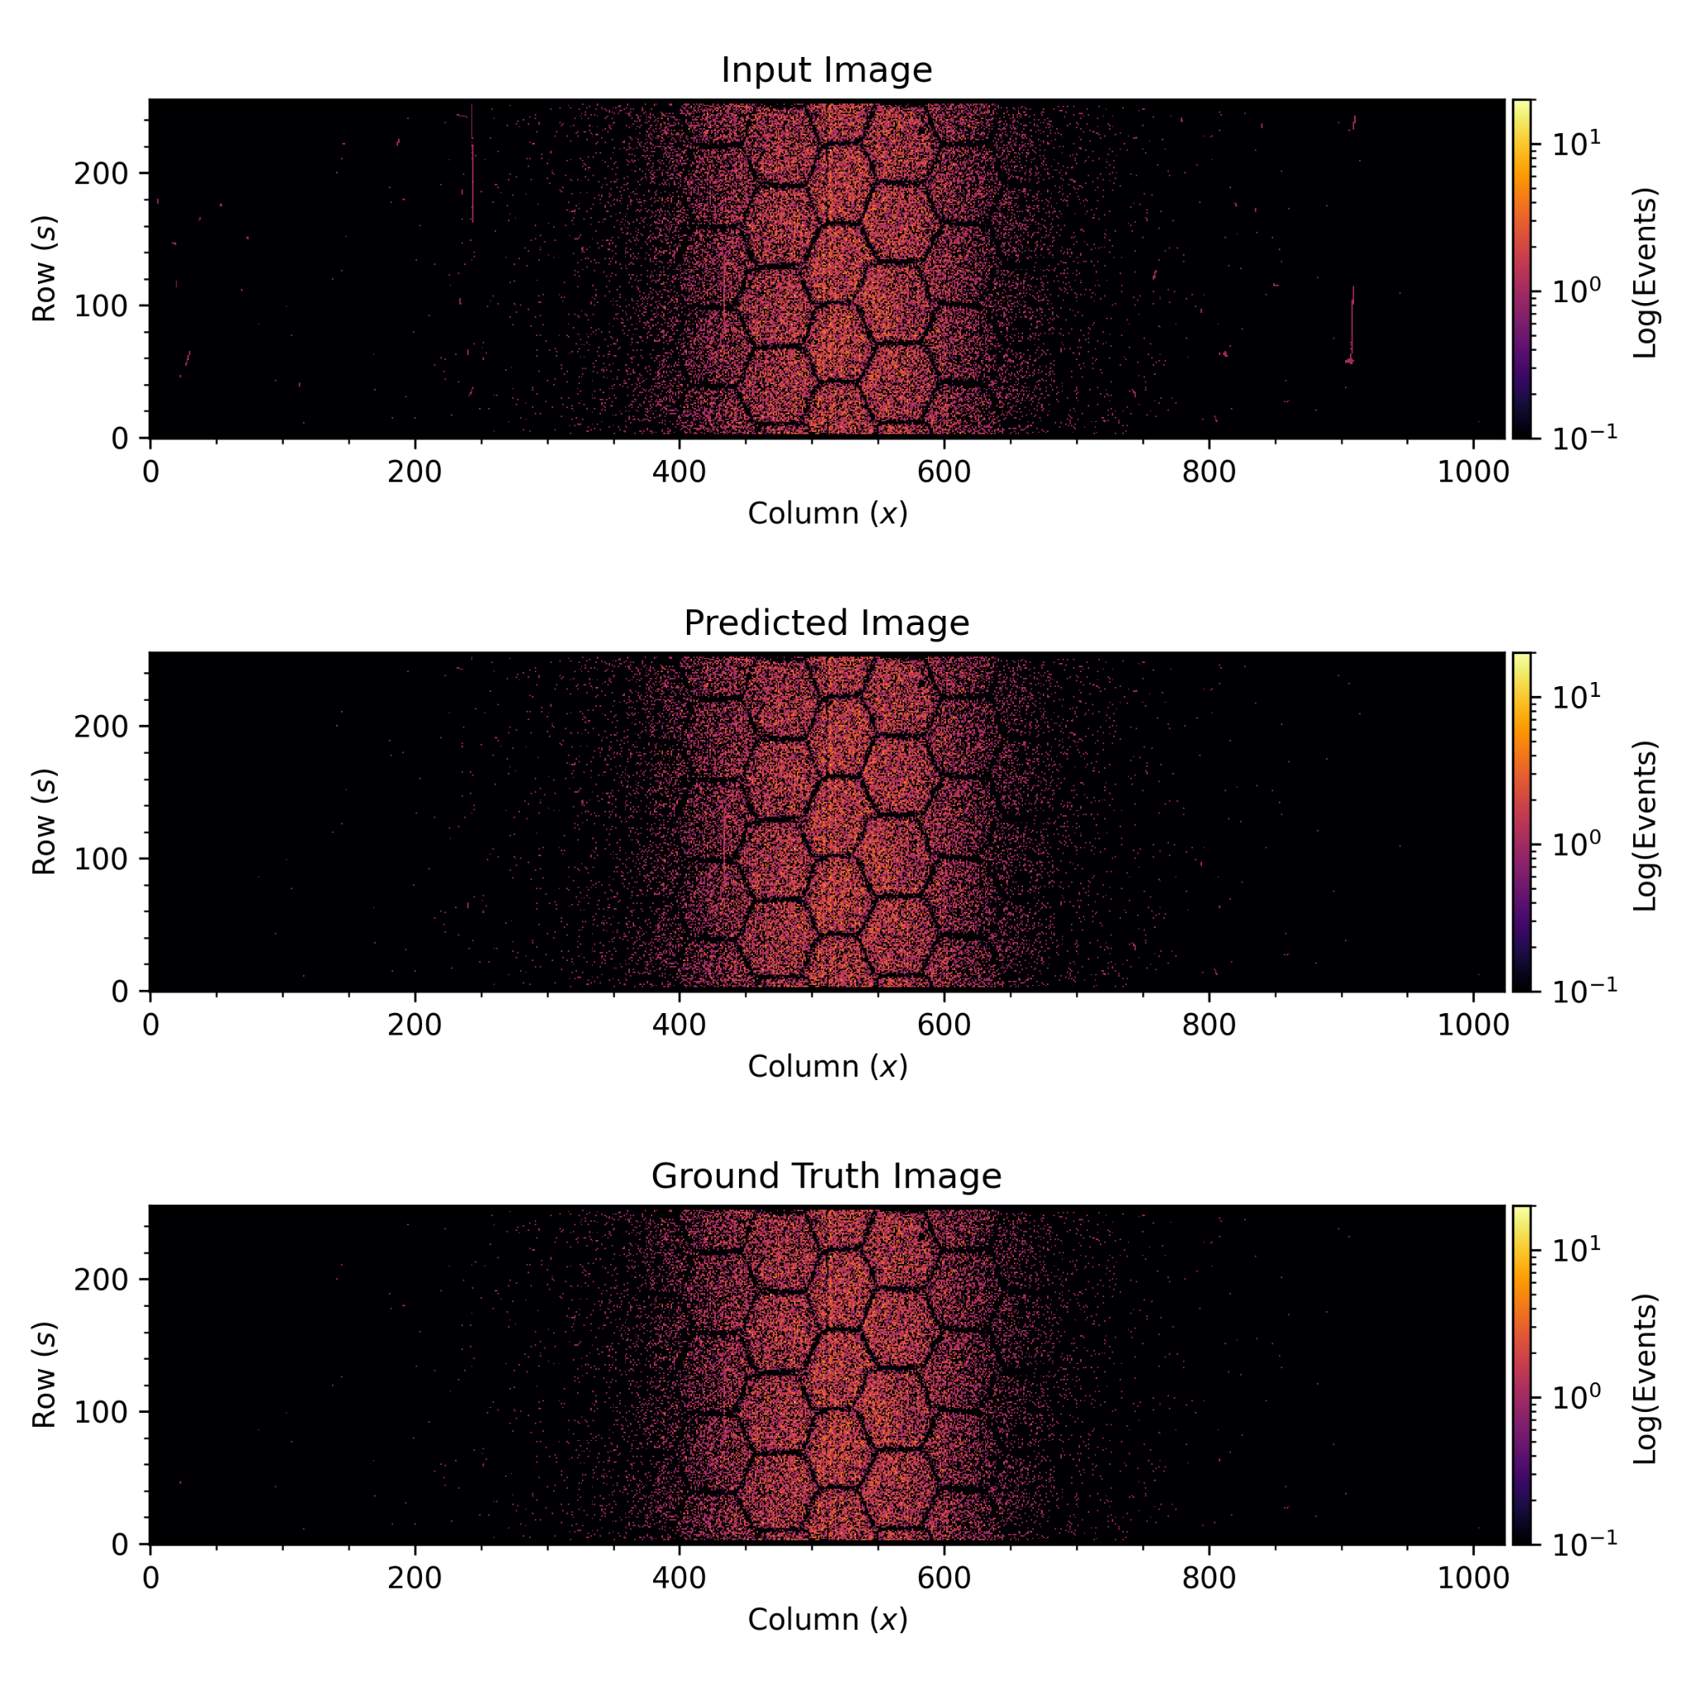
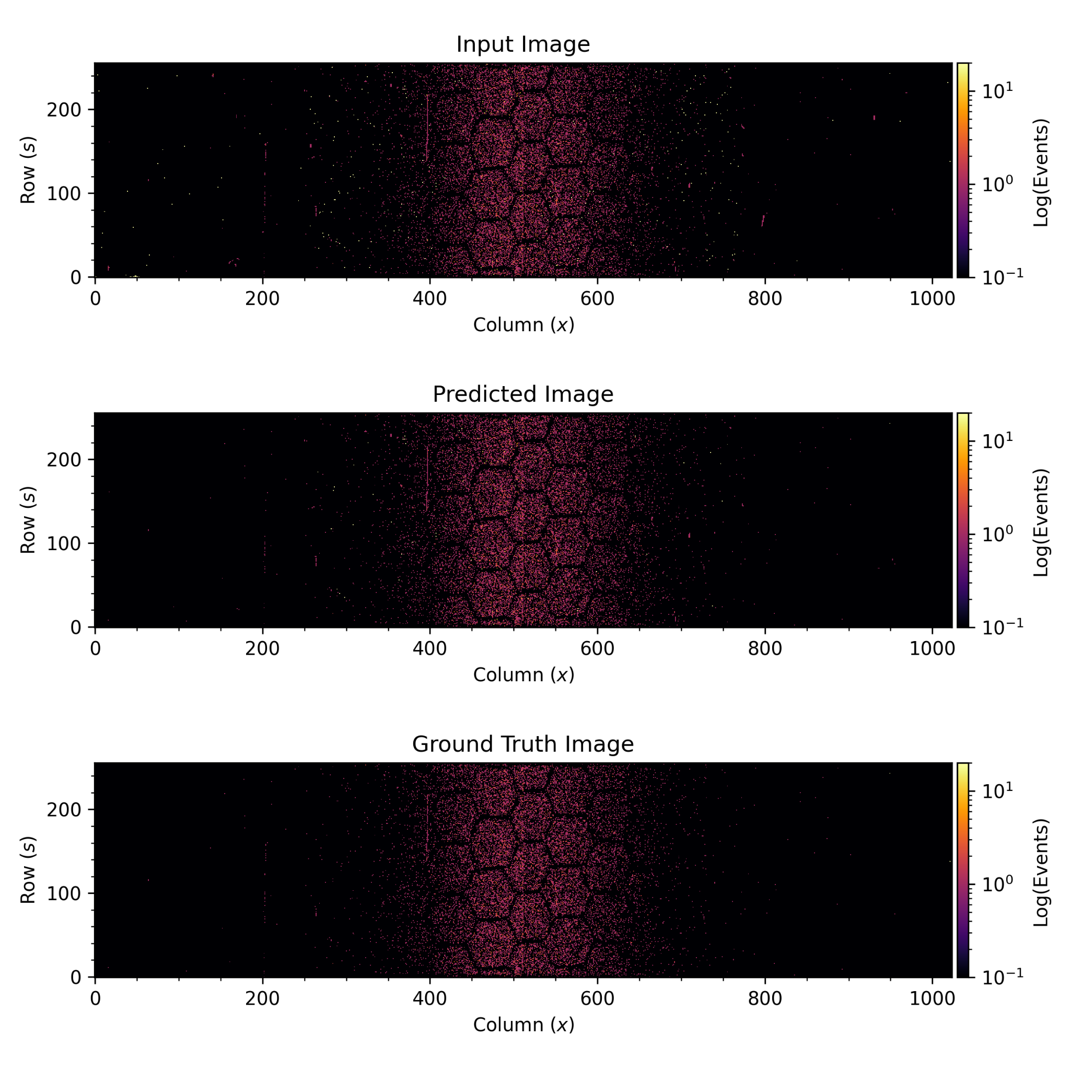
Training & Inference
DBSCAN
NOISY IMAGES
OUR U-NET ARCHITECTURE
CLEAN IMAGES
Untrained Model
img1
img1*
Untrained Model
img2
img2*
Training
Phase
Untrained Model
img3
img3*
Untrained Model
imgN
imgN*
Inference
Phase
Trained Model
new image
model’s prediction

Slide 17
Dataset Details
We have analyzed about 1500 image pairs from PS BGIH 2021 and 2022 data.
Not all of the data is actually valid (e.g. images with detectors OFF, not enough beam or recorded events, bad fits, etc.)
2 DETECTORS WERE OFF

Slide 18
Dataset Details
We have analyzed about 1500 image pairs from PS BGIH 2021 and 2022 data.
Not all of the data is actually valid (e.g. images with detectors OFF, not enough beam or recorded events, bad fits, etc.)
Trained one model on low integration time (LIT) images (~350 imgs)
Trained another on high integration time (HIT) images (~100 imgs)
LOW INTEGRATION TIME (LIT)
HIGH INTEGRATION TIME (HIT)

Slide 19
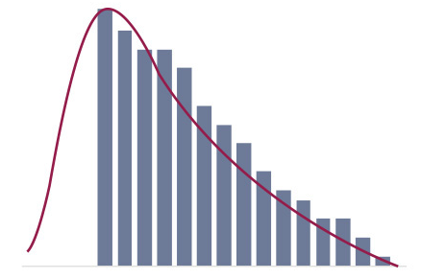
Dataset Details
We have analyzed about 1500 image pairs from PS BGIH 2021 and 2022 data.
Not all of the data is actually valid (e.g. images with detectors OFF, not enough beam or recorded events, bad fits, etc.)
Trained one model on low integration time (LIT) images (~350 imgs)
Trained another on high integration time (HIT) images (~100 imgs)
75% train set (263 imgs LIT, 75 imgs HIT) and 25% test set (87 imgs LIT, 25 imgs HIT)
Preprocessing: Min-Max Normalization and Log Transformation
SKEWED PIXEL DISTRIBUTION
HISTOGRAM

Slide 20
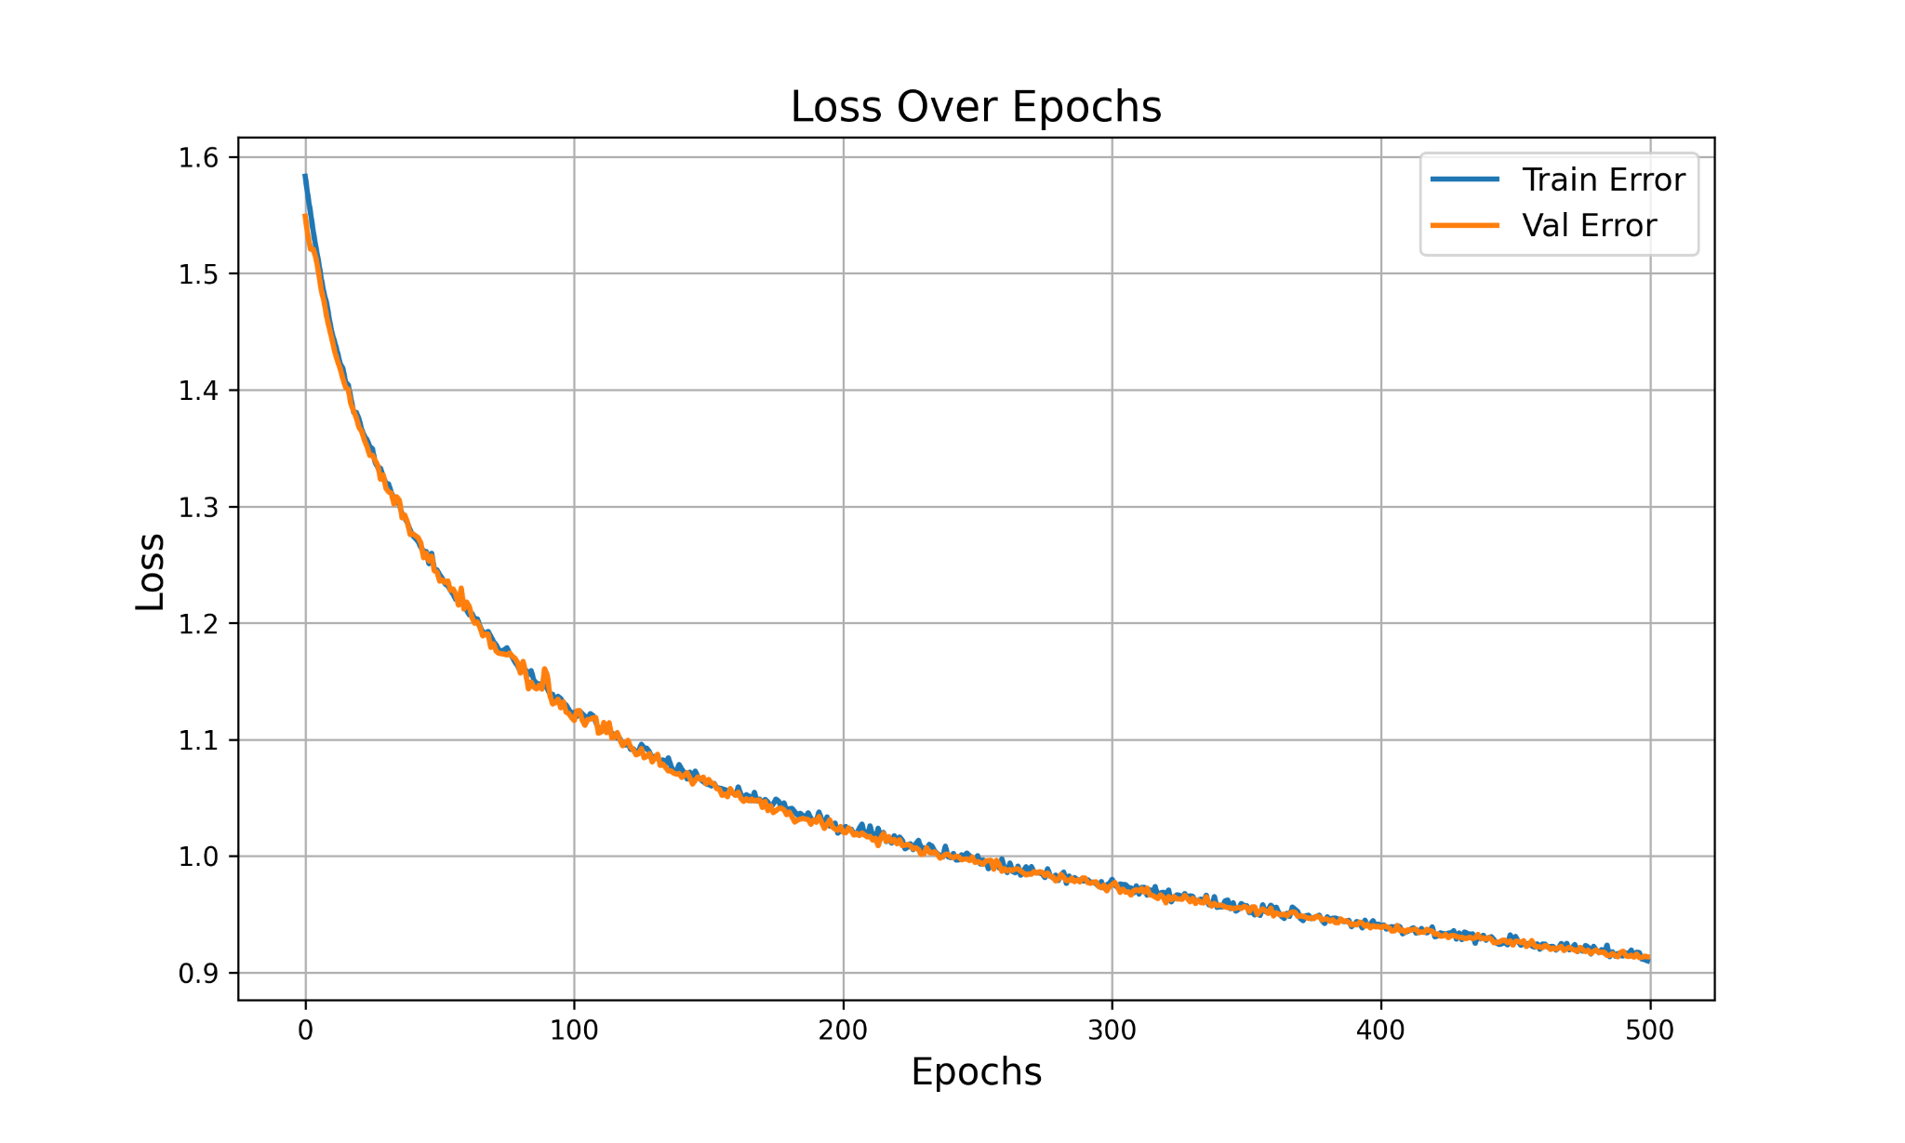
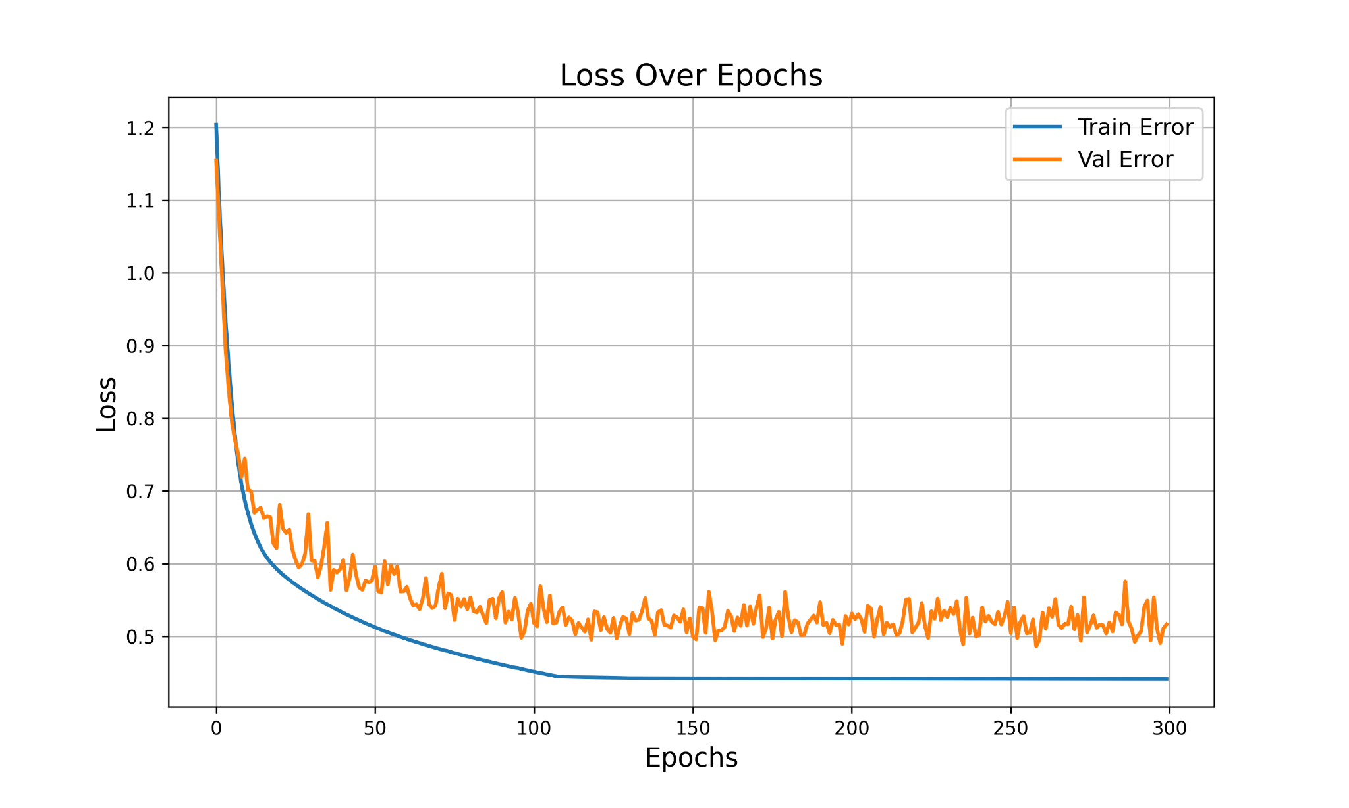
Training Configuration
Training Parameters
batch size = 1-8 imgs
lr = 1e-6 to 1e-8 (lr_scheduler)
weight decay = 1e-8
optimizer = AdamW
Loss = Binary Cross Entropy (BCE)
+ Dice Loss (It is a Sum Loss)
Loss converges to a small amount as we iterate 😊
  No underfitting
  Overfitting still possible due to limitations in dataset size
U-NET seems to be complex enough to learn DBSCAN’s mapping

Slide 21
3. Extra Data Processing
Notes:
Auxiliary methods to ML, still super useful.

Slide 22
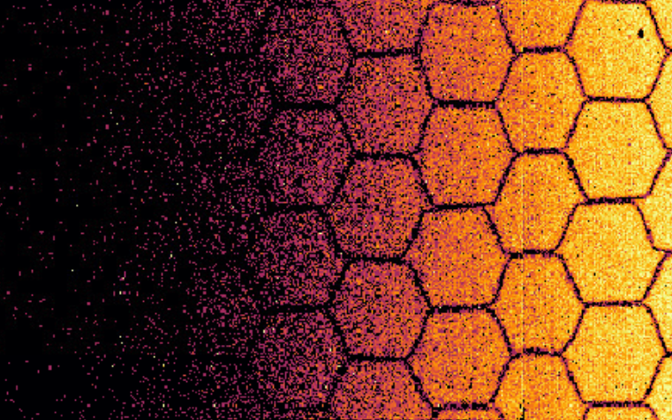
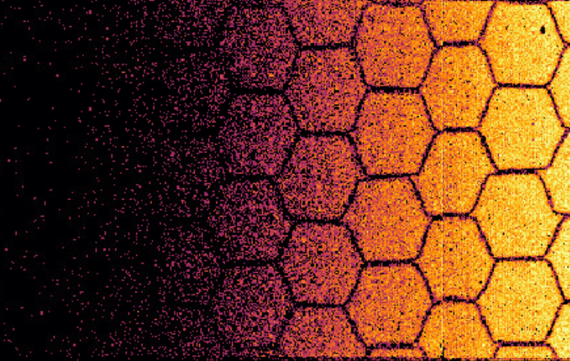
Extra #1: Time Over Threshold (ToT) Filtering
Assumption: "Events with ToT > 20 are likely to be beam loss.”
Already existing and running on the BGI System
After DBSCAN
After DBSCAN + ToT Filtering
Highly saturated pixels!
Saturation is gone 😊
Notes:
Already existing.

Slide 23
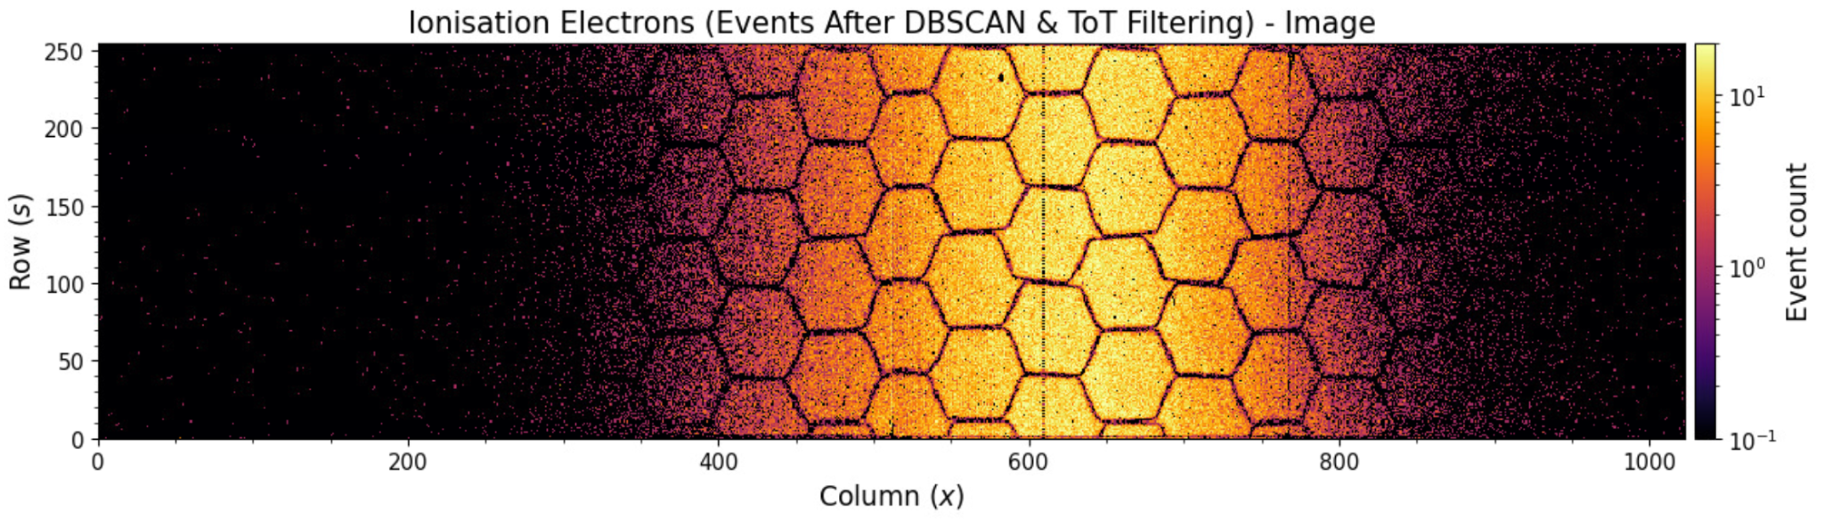
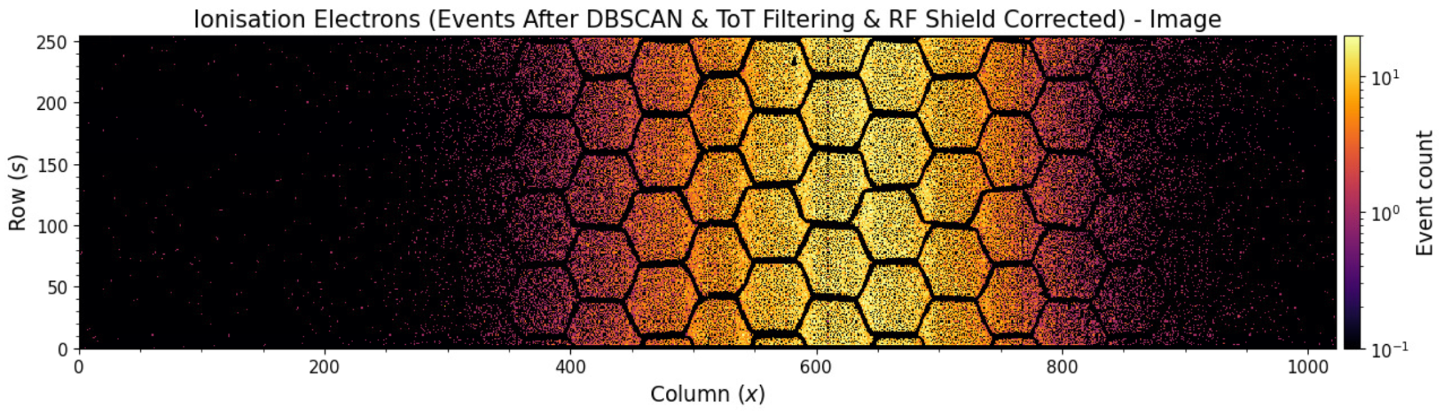
Extra #2: RF Shield Correction
The RF Shield helps to remove any kind of electromagnetic interference 🐝
Already existing and running on the BGI System
Randomly drop pixels to equalize the column distribution
Notes:
Already existing.

Slide 24
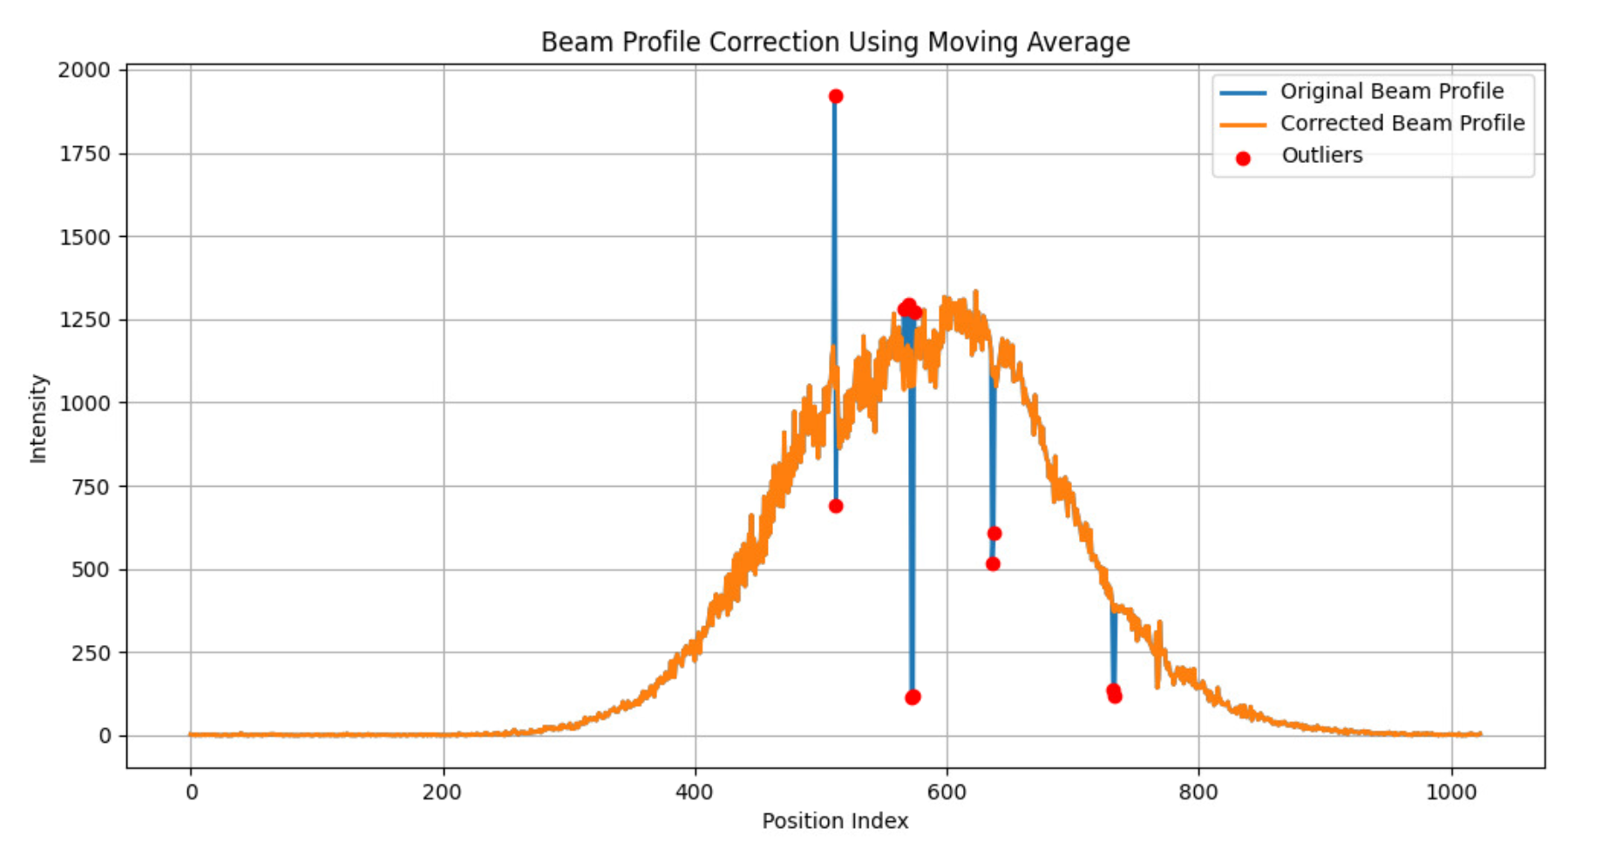
Extra #3: Moving Average Thresholding
Improve the final beam profile by detecting noisy-pixel outliers in a very safe way 😁
NEW! To be added in next updates!

Slide 25
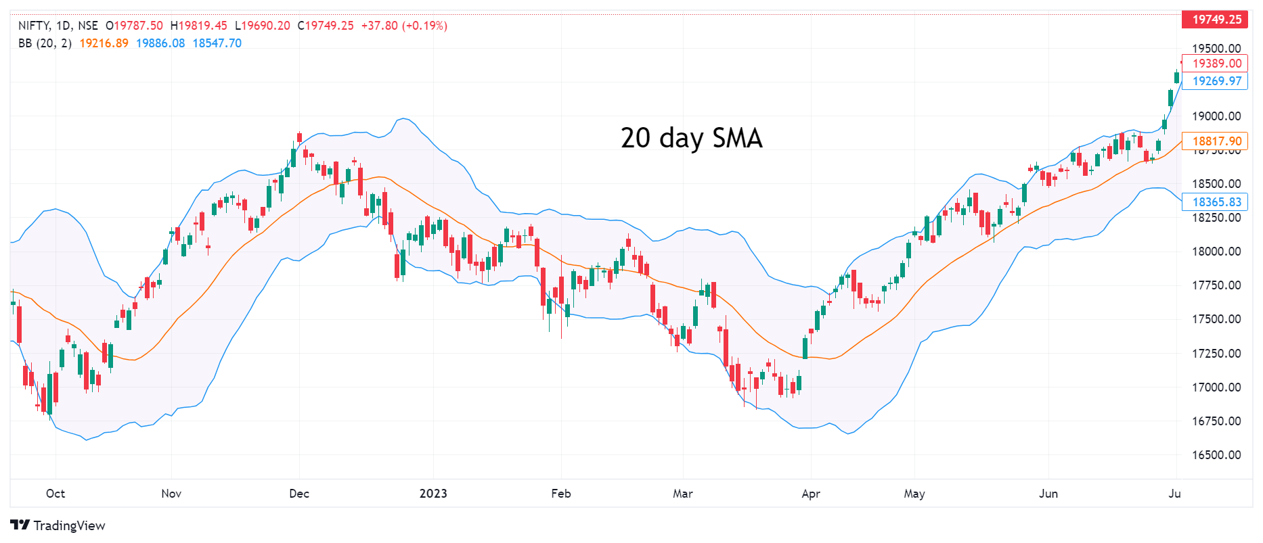
Similar concept to Bollinger Bands in economy…
Source: https://tradingview.com

Slide 26
4. Preliminary Results

Slide 27
Example Images (LIT)
Trained Model (U-NET)
DBSCAN
Notes:
Zooming.

Slide 28
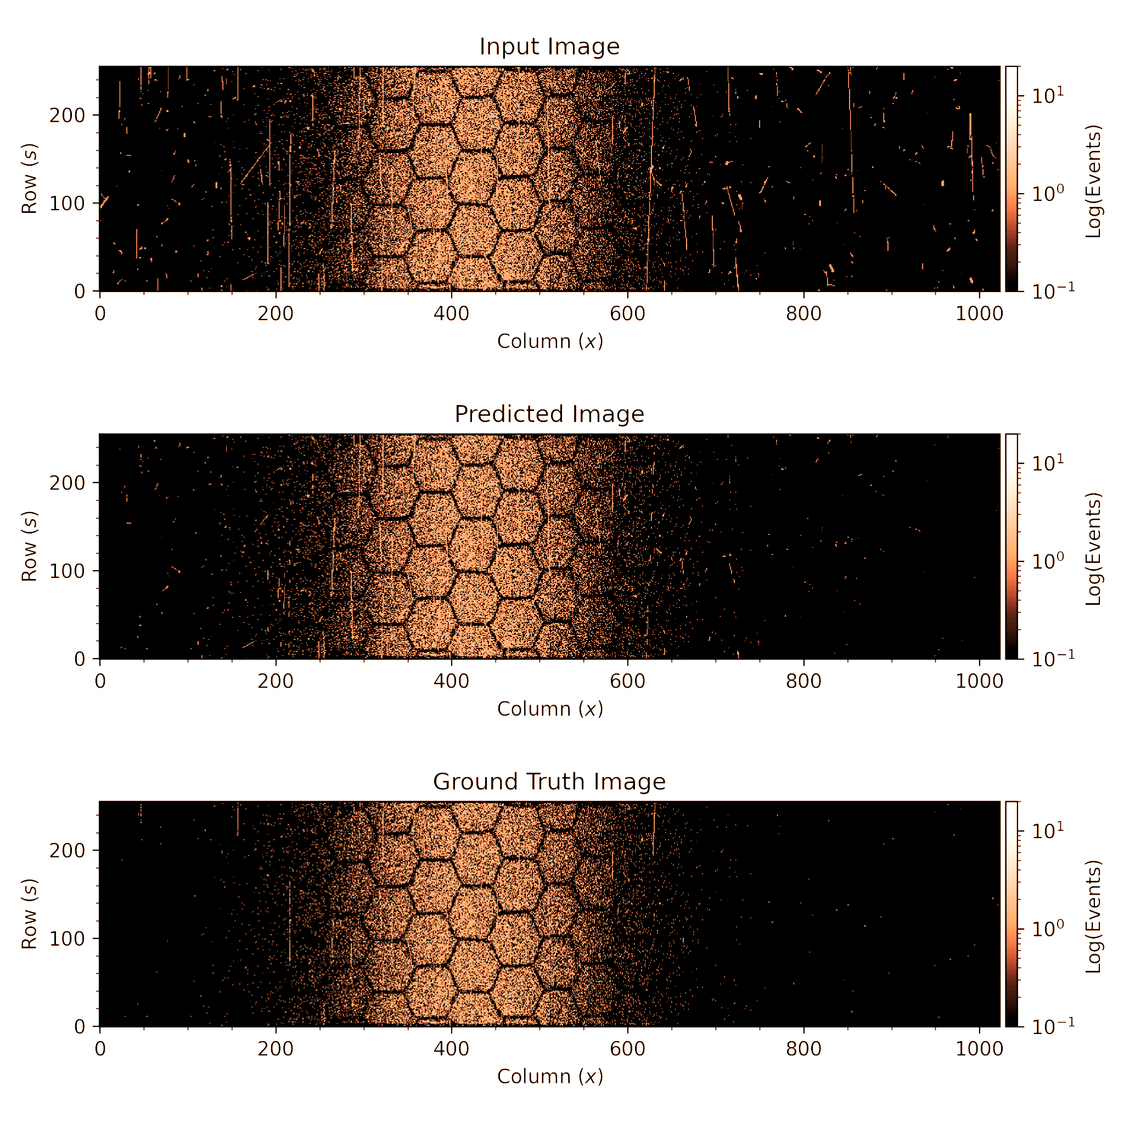

Example Images (LIT)
INPUT
PREDICTED
GROUND TRUTH
Notes:
Link this image with the next profiles.

Slide 29

Profiles
P1
P2
P3
GT
Notes:
Link with the slide before. When showing P3, just say that, by eye, the beam profile of the prediction and the ground truth are very similar, even though the error for the prediction is still a bit higher.

Slide 30
Average Fit Error Metrics (Test Set on LHC3, MD5, MD6 & MD7)
CAUTION! SMALL DATASET! (just ~ 50 imgs in test set )
MSE (Mean Squared Error)
FIT TYPE | P1 (UNPROCESSED) | P2 (MA CORRECTION) | P3 (PREDICTED) | GT (GROUND TRUTH)
Gaussian | 1078.89 | 639.56 | 157.81 | 103.37
Double-Gaussian | 832.30 | 426.24 | 108.82 | 67.31
q-Gaussian | 979.66 | 594.53 | 132.71 | 90.89
R² (Coefficient of Determination)
FIT TYPE | P1 (UNPROCESSED) | P2 (MA CORRECTION) | P3 (PREDICTED) | GT (GROUND TRUTH)
Gaussian | 0.768 | 0.826 | 0.936 | 0.961
Double-Gaussian | 0.821 | 0.878 | 0.948 | 0.969
q-Gaussian | 0.795 | 0.826 | 0.942 | 0.964
σ (mm) (Beam Size)
FIT TYPE | P1 (UNPROCESSED) | P2 (MA CORRECTION) | P3 (PREDICTED) | GT (GROUND TRUTH)
Gaussian | 6.33 | 6.05 | 4.34 | 4.16
Double-Gaussian | 5.19 | 4.62 | 3.22 | 3.09
q-Gaussian | 3.38 | 4.47 | 3.97 | 3.84
< 5%

Slide 31
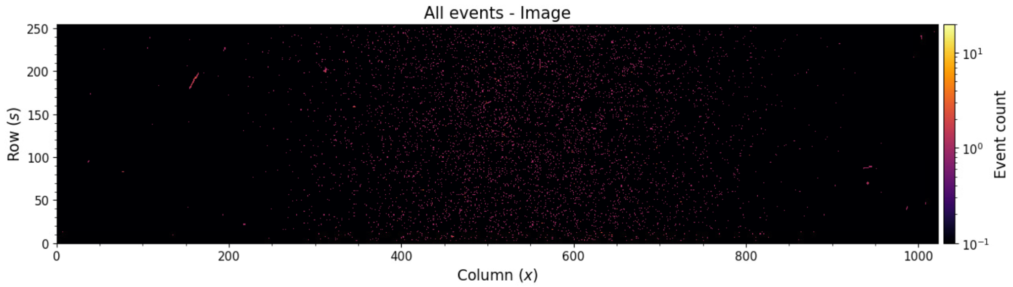
Processing Time
Processing Time for cs-ccr-abbi4
IMAGE | ALGORITHM | NUMBER OF EVENTS | No. TIME CLUSTERS | PROCESSING TIME (s)
IMG1 | DBSCAN | 6.000 | 68 | 1.1
IMG2 | DBSCAN | 44.000 | 661 | 7.3
IMG3 | DBSCAN | 915.000 | 211.000 | 1449 (24min)
Average (50 Images) | U-NET (19 Layers) (CPU) | - | - | 0.66
Time Complexity
A) For Time Clustering, the Processing Time is negligible!
B) For Spatial DBSCAN, the Processing Time varies a lot…
C) For UNET, the Inference Time is fixed!
IMG1
O( T ⋅ N⋅LOG(N) )
N = number of points of each time cluster
IMG2
T = number of time clusters
O( S ⋅ D )
S = size of the architecture (filters, layers, etc.)
IMG3
D = image dimensions (height and width)
Notes:
Spend more time.

Slide 32
5. Conclusions & Outlook

Slide 33

Conclusions & Outlook
First attempt to use ML for BGI background removal proves to be viable ✔️
We need much more raw data - especially, data representative of the different operation conditions (e.g. beam types) 📖
  Accordingly, we will need a capable infrastructure to train our models!
We could apply ML to the full processing chain 🔗
  This requires training data cross-checked with wire scanners…
More advanced techniques can be used in order to exploit time information such as Transformers 🤖

Slide 34
Thanks!

Slide 35
6. Backup Slides

Slide 36
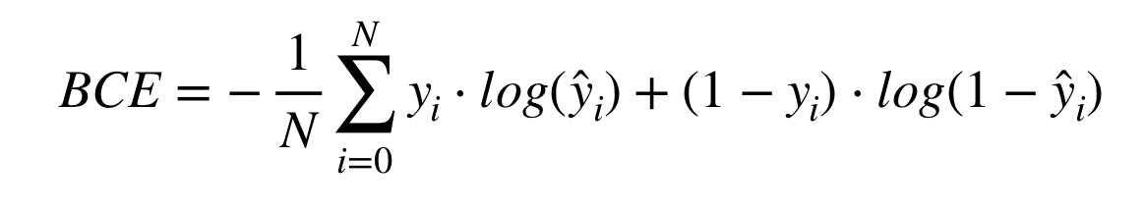
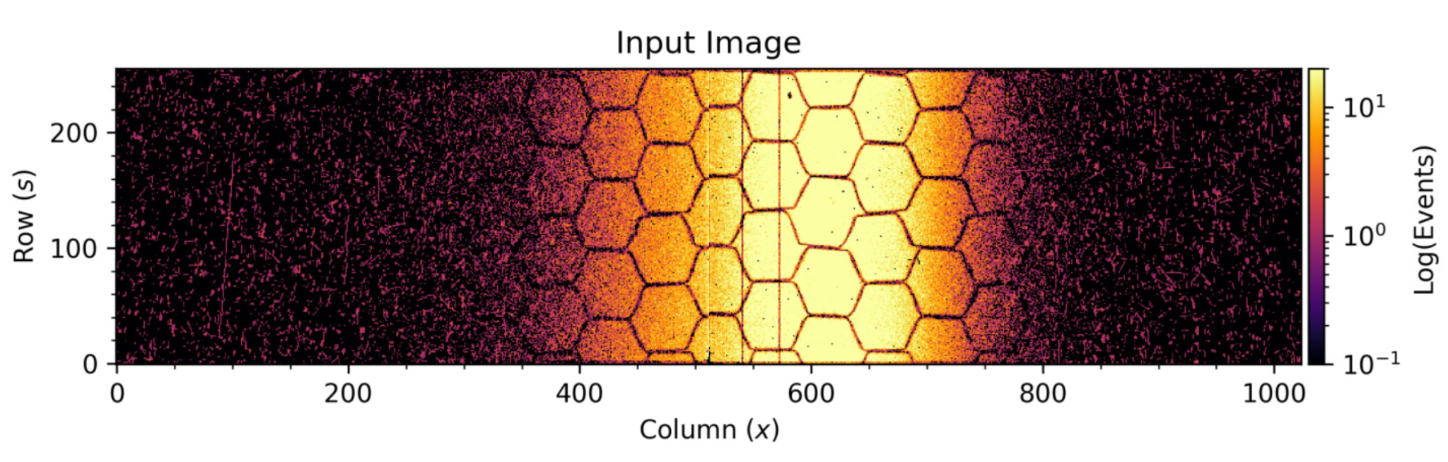
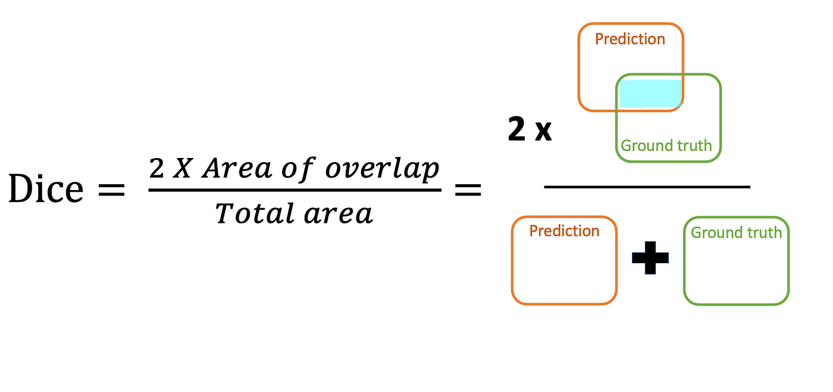
Sum Loss = BCE + Dice Loss
Binary Cross Entropy for pixel-wise accuracy
DL = (1 - Dice Coefficient) for contextual spatial features
Notes:
y_hat is the probability of a pixel belonging to the class (being inside the mask). if y=1 (the pixel belongs to the mask), p = y_hat, loss = -log(p), the loss is small if p is close to 1.

Slide 37
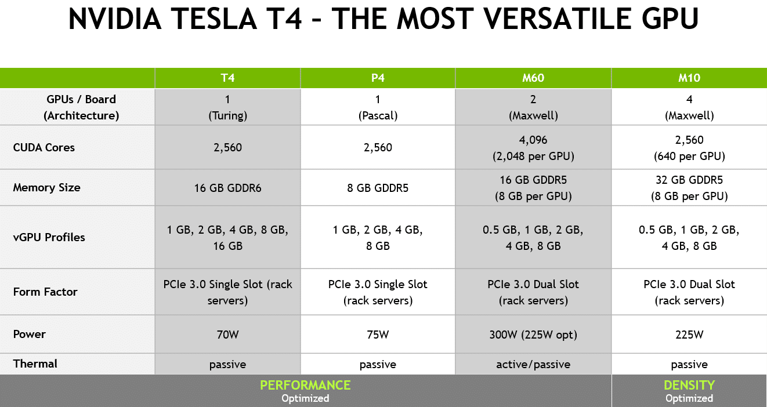
Hardware and GPU Information
The model was trained using CERN’s infrastructure: https://ml.cern.ch
Source: NVIDIA Tesla T4 Powers Next Generation of Virtual Workstations (NVIDIA Blog)

Slide 38
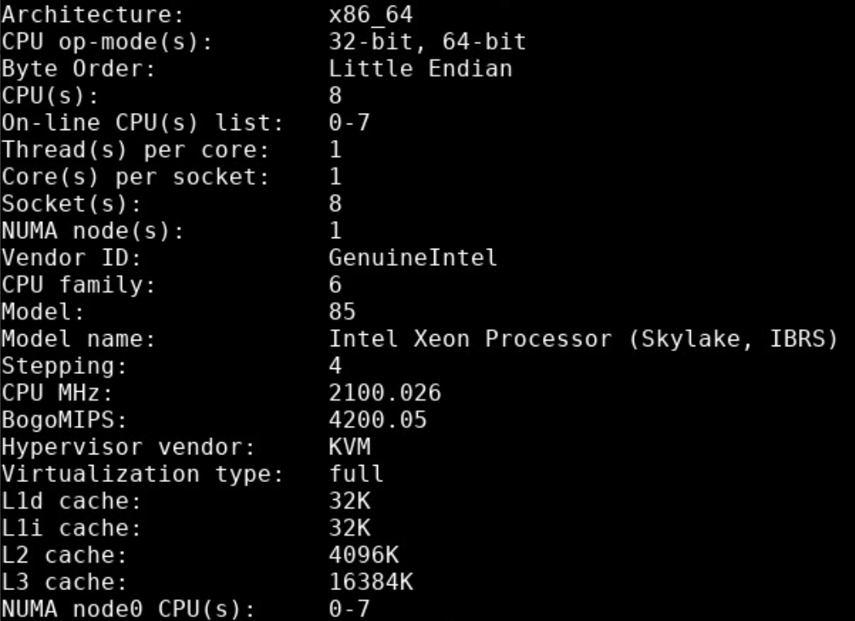
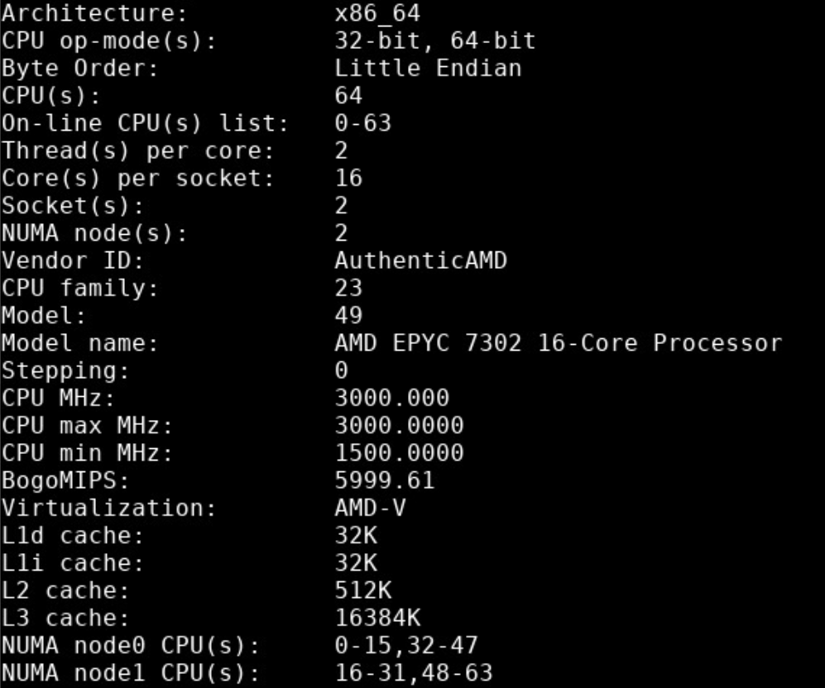
Machine Specs
VM (CPU)
cs-ccr-abbi4 (CPU)
Inference Time = 1.75s
Inference Time = 0.66s
U-NET Inference Time is independent of the number of events of the image

Slide 39
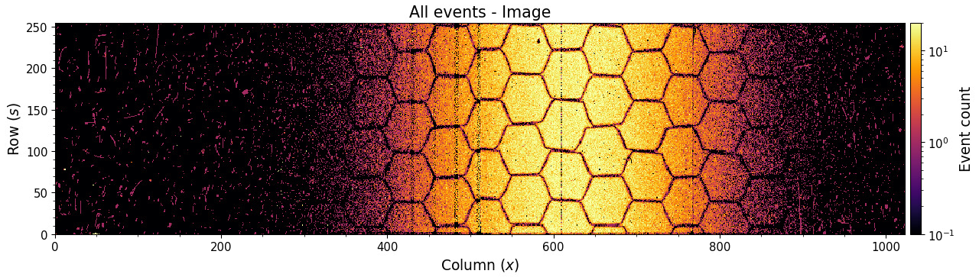
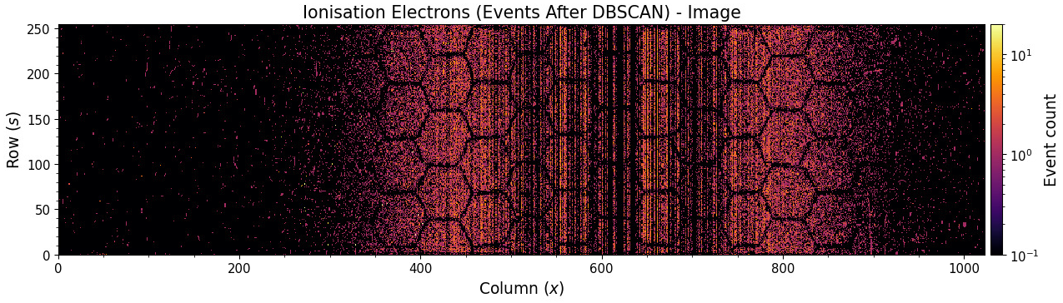
DBSCAN is not always perfect…

Slide 40
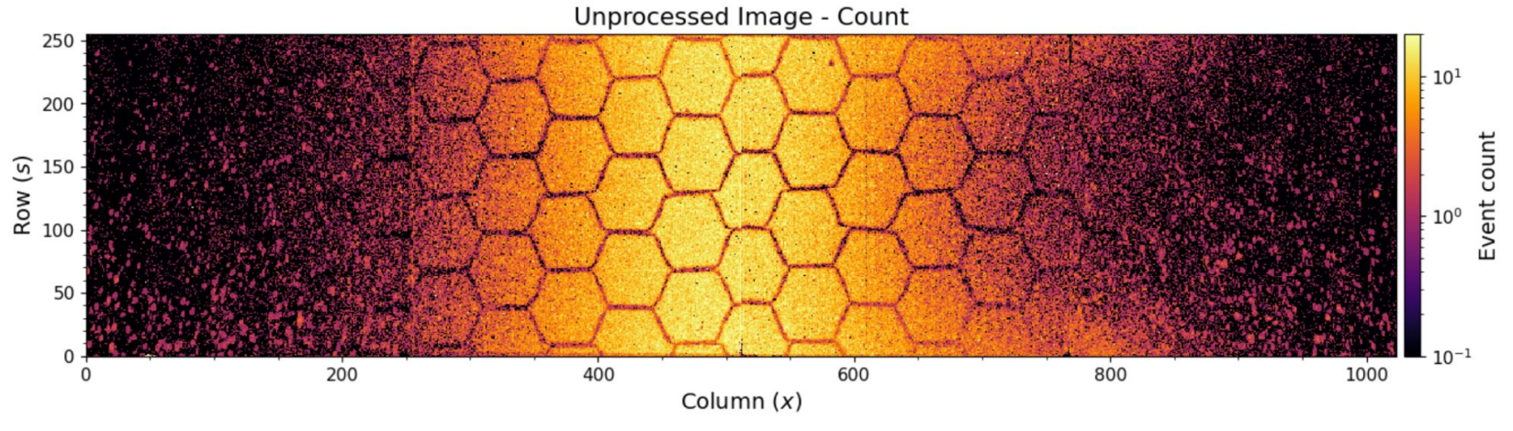
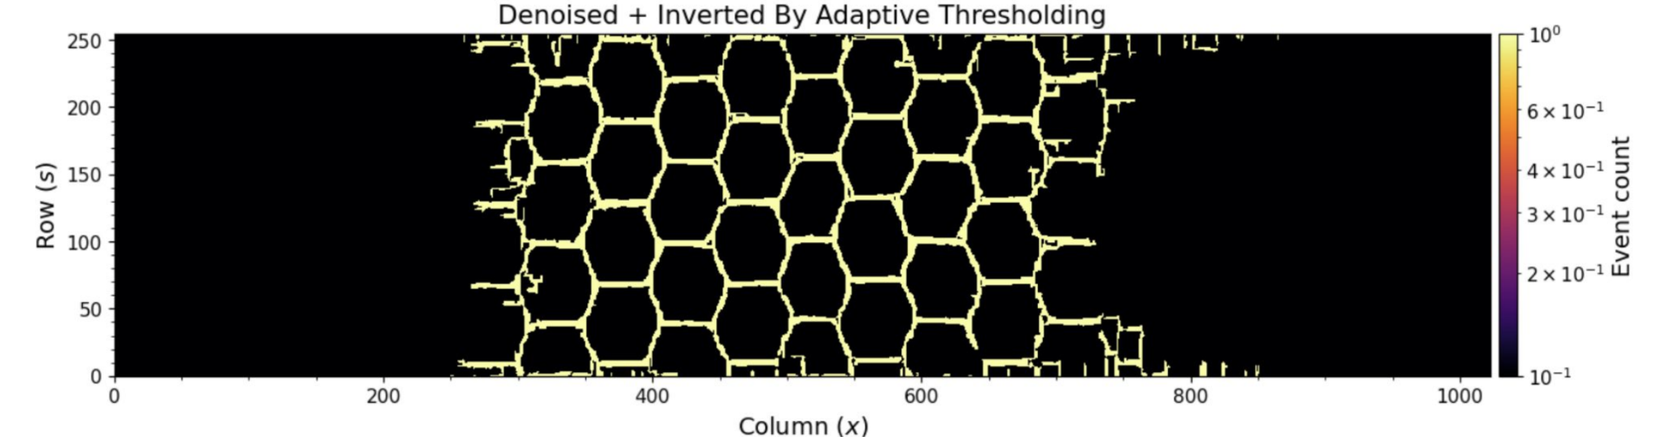
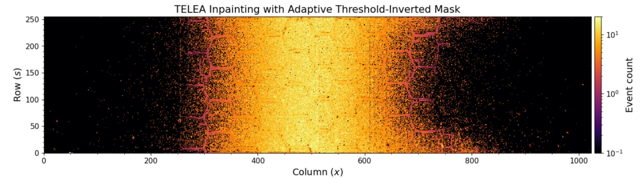
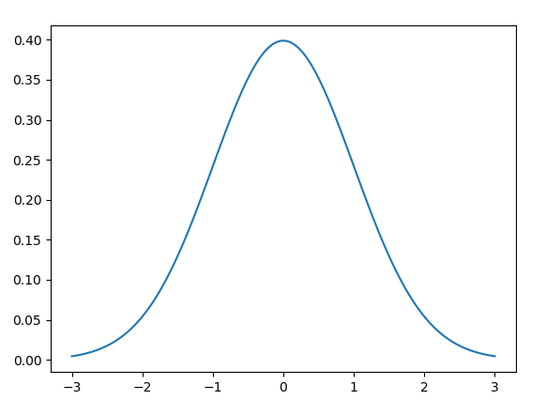
Extra #3: RF Shield Correction
We can also interpolate the honeycomb using TELEA¹ inpainting!
Noisy Image
RF Shield
Denoised and Inpainted
Improves the beam profile
1. Telea, Alexandru (2004). An Image Inpainting Technique Based on the Fast Marching Method. Journal of Graphics Tools. 9.10.1080/10867651.2004.10487596.
Slide courtesy of Glenn Anta

Slide 41
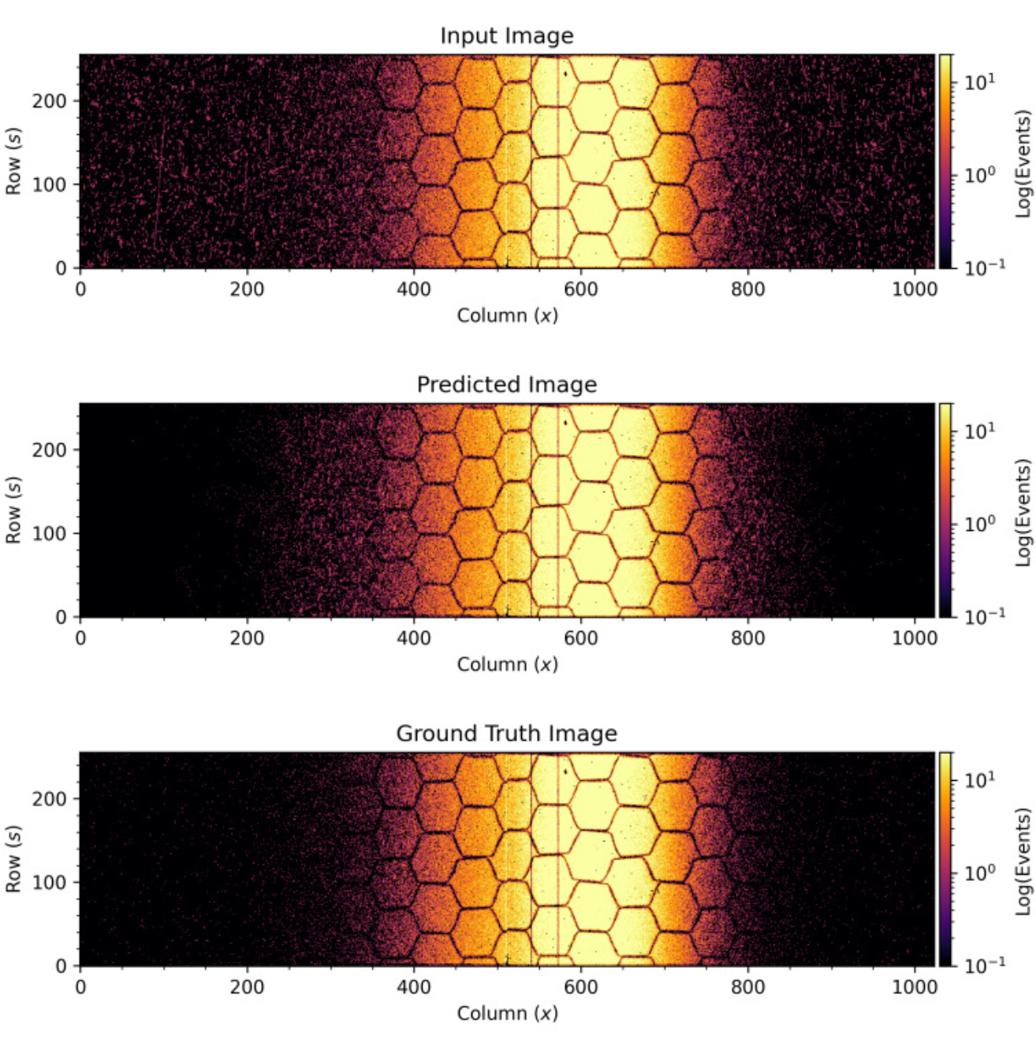
Prediction Example

Slide 42
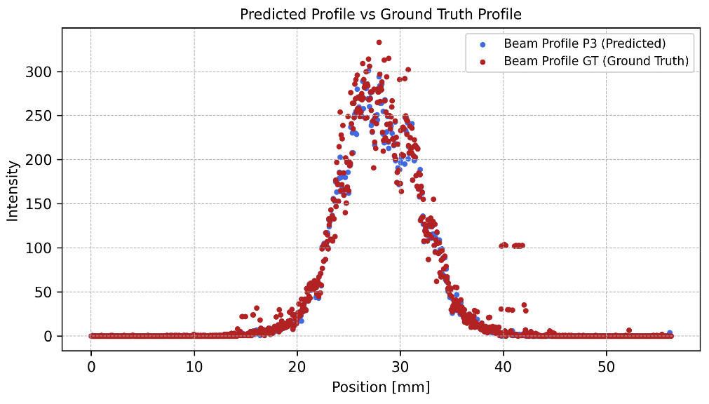
Predicted vs Ground Truth Errors (Test Set on LHC3, MD5, MD6 & MD7)
P3 vs GT
Predicted Profile vs Ground Truth Profile
Error Metric | Value
MSE (Mean) | 47.78
MSE (Median) | 6.37
R² (Mean) | 0.969
R² (Median) | 0.994

Slide 43
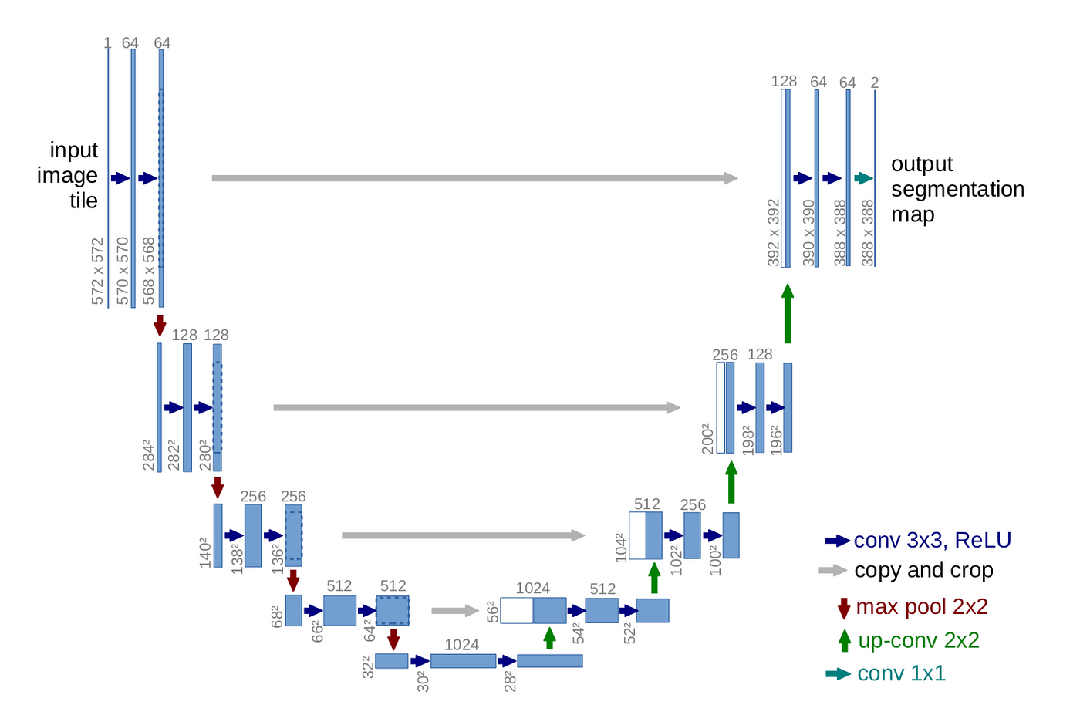
Chosen Architecture: U-NET
4 up-conv blocks
4 down-conv blocks
skip connections
Source: U-Net: Convolutional Networks for Biomedical Image Segmentation
Notes:
Basic - simple and works well in many domains - good starting point. Mature. Bullet points. Encoder/Decoder.

Slide 44

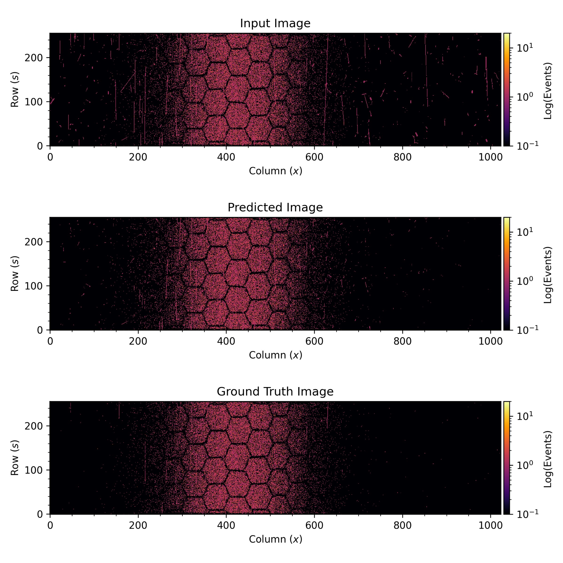
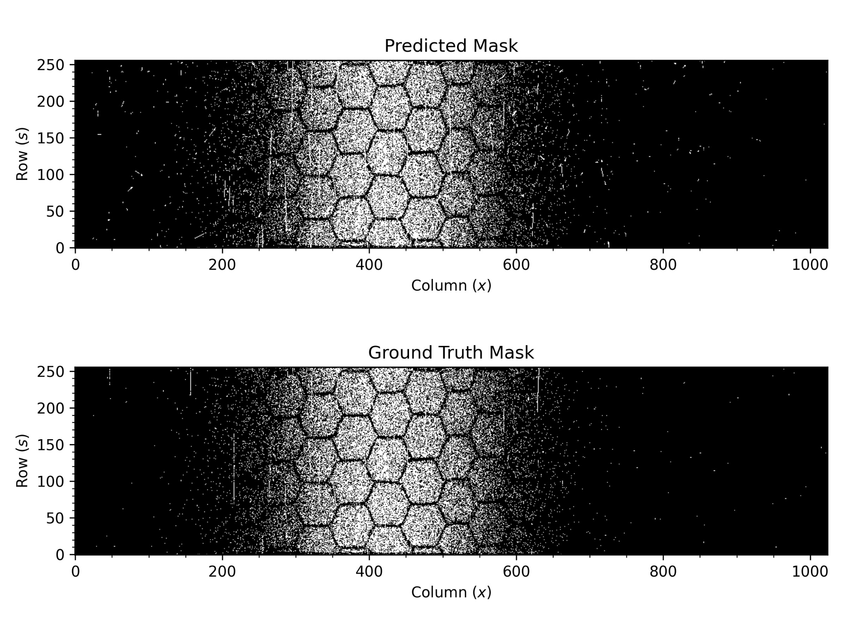
Training Stage
BEAM LOSS REMOVAL USING DBSCAN (SLOW)
DBSCAN OUTPUT
U-NET ARCHITECTURE
binarize
NOISY IMAGE
CLEAN BINARY IMAGE
Notes:
We need many images. It looks like we train with only 1 image. Remove mask.

Slide 45
Inference
NOISY IMAGE
FINAL CLEAN OUTPUT IMAGE
Our trained U-NET model
X
Notes:
Zooms.

