Slide 1
Development of electron gun & collector for the new AD-CONS electron cooler
G. Khatri | SY-BI-XEI
14 Dec. 2023 | for BI Day

Slide 2
Outline
Intro
Test bench
New collector tests
New gun tests
Future tests and plans

Slide 3

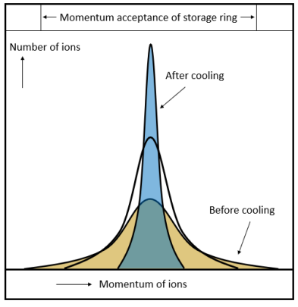
Why do we need Electron Cooling?
Deceleration process has some “side effects’’:
Increase of beam emittance
➔ results in beam loss & poor-quality beam
Electron Cooling compensates this blow-up!
It shrinks the size, divergence and energy spread of a stored charged particle beam without the loss of intensity.
Crucial for experiments: high anti-proton capture efficiencies and high luminosity!
First proposed by G. Budker at INP, Novosibirsk in 1966
First tested at NAP-M storage ring at INP in 1974
slide by Elisabeth-Sena Welker

Slide 4
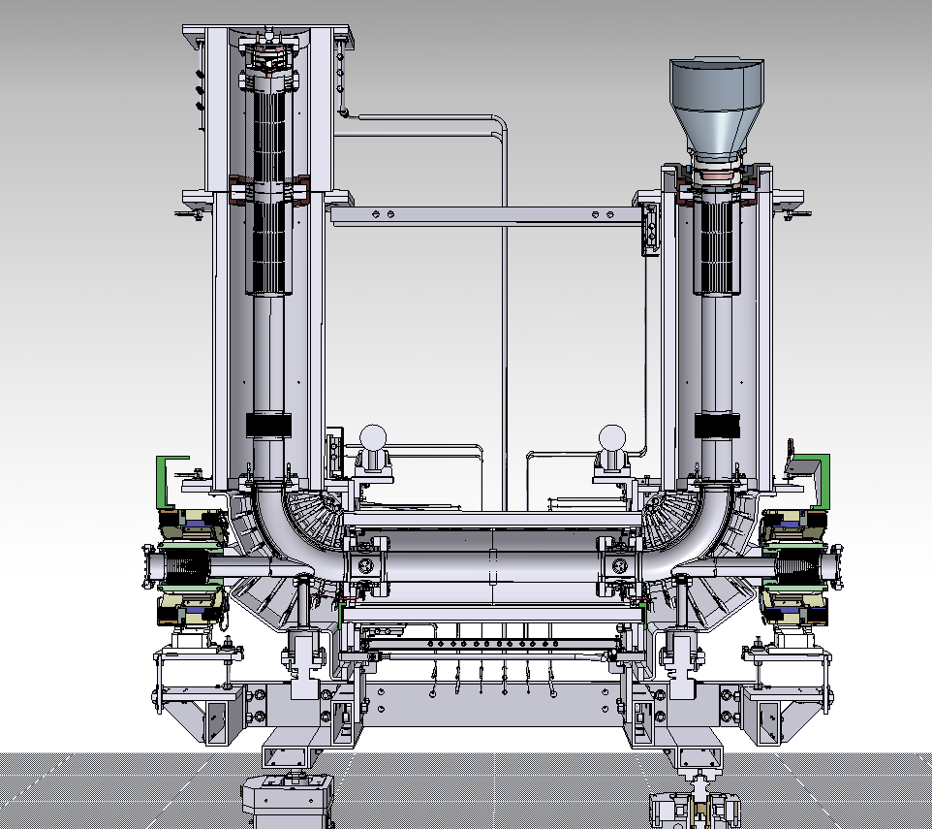
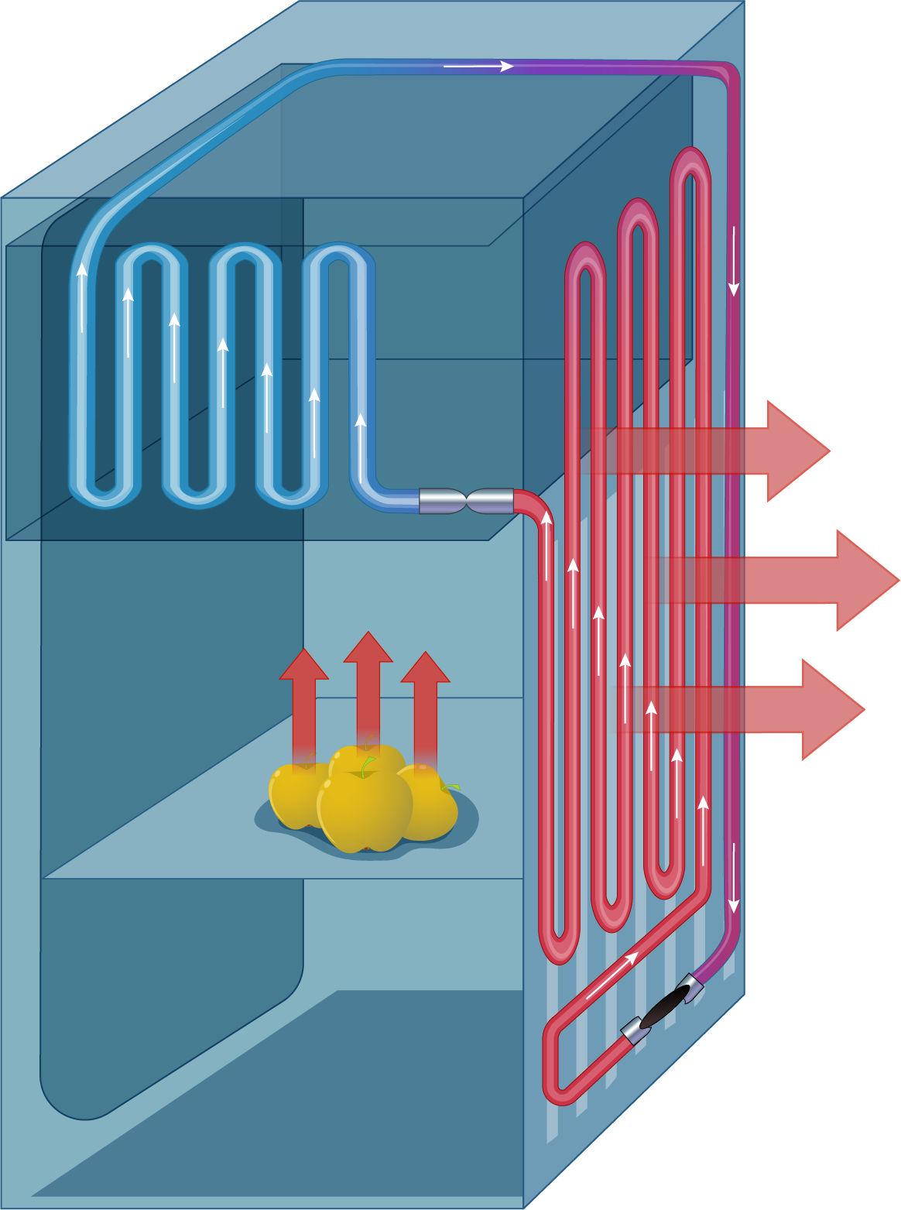



How does electron cooling work ?
E-Gun
Electrons are constantly renewed → Energy is removed from system: “Cooling ”
Collector
Cooling Liquid = Cold Electrons $T_{2}$
1 m overlap
Cooled Ion Beam
Hot Ions$T_{1}$
Uncooled, Circulating Ion Beam
Magnet system
Heat exchange => Ions will assume $T_{2}$
slide by Elisabeth-Sena Welker

Slide 5
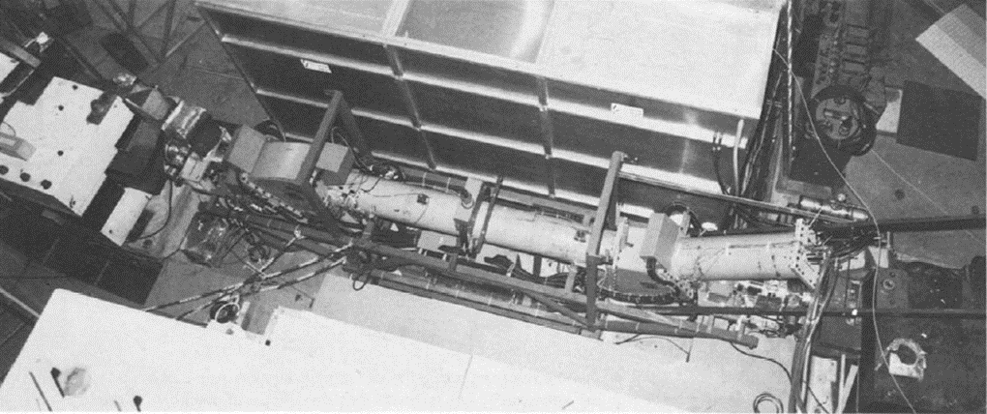
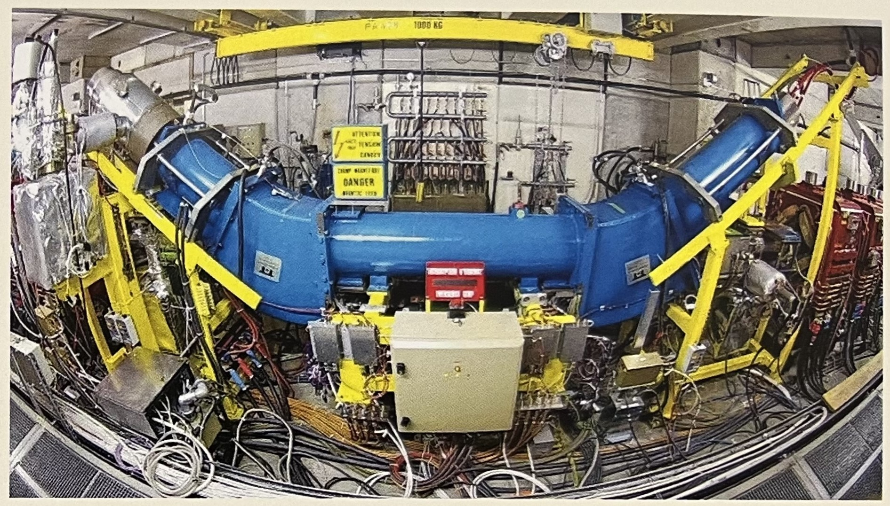
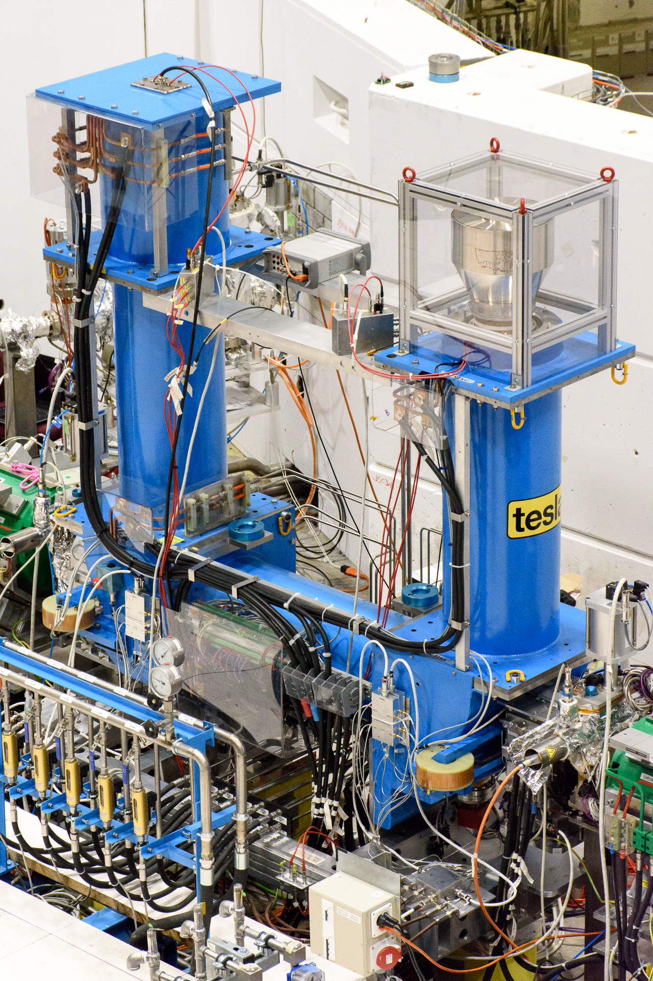
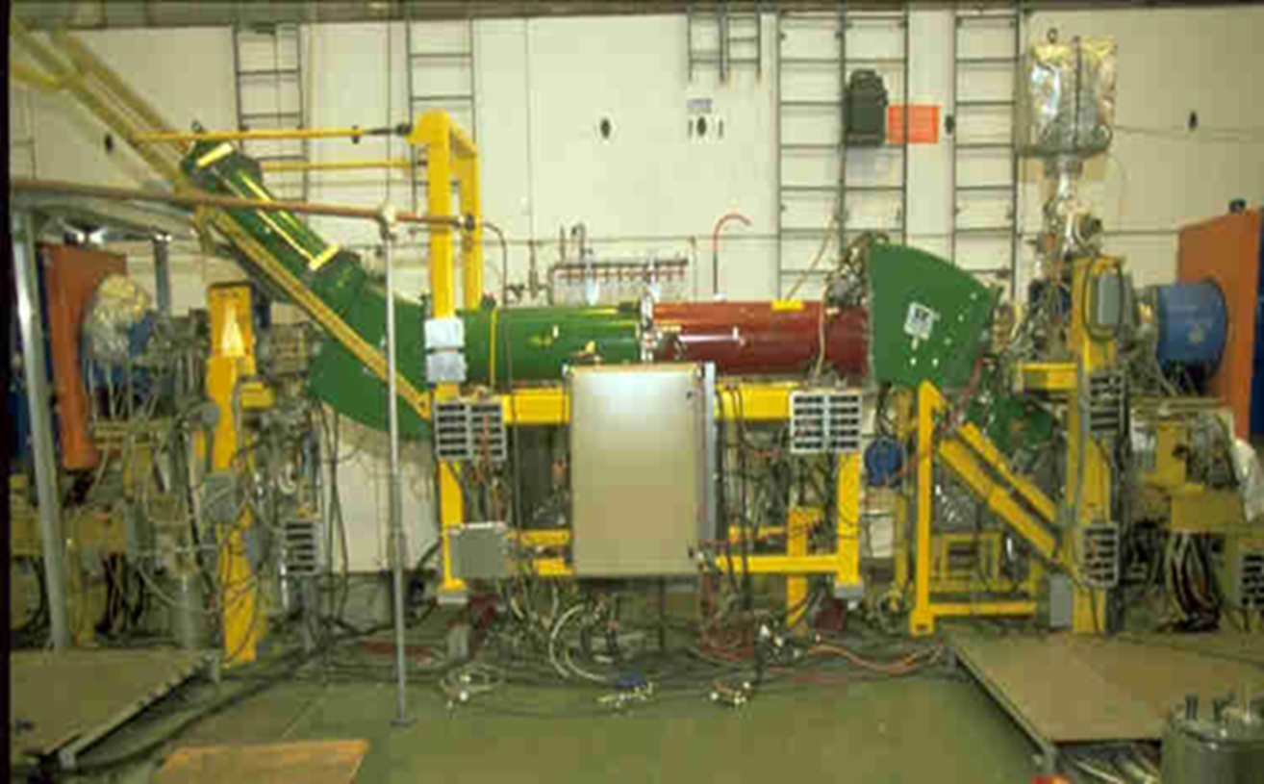
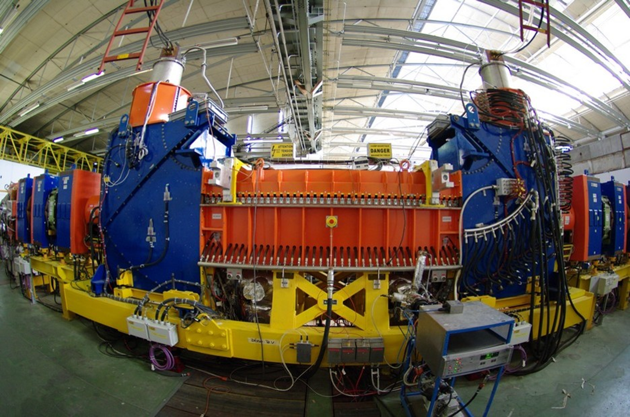
Electron cooling at CERN
1977-1980: ICE
1999 - : AD (to be replaced in LS3)
2018 - :ELENA
1982-1997: LEAR
2005 - : LEIR
See for more detail: https://indico.cern.ch/event/1149090/ and https://indico.cern.ch/event/961114/

Slide 6
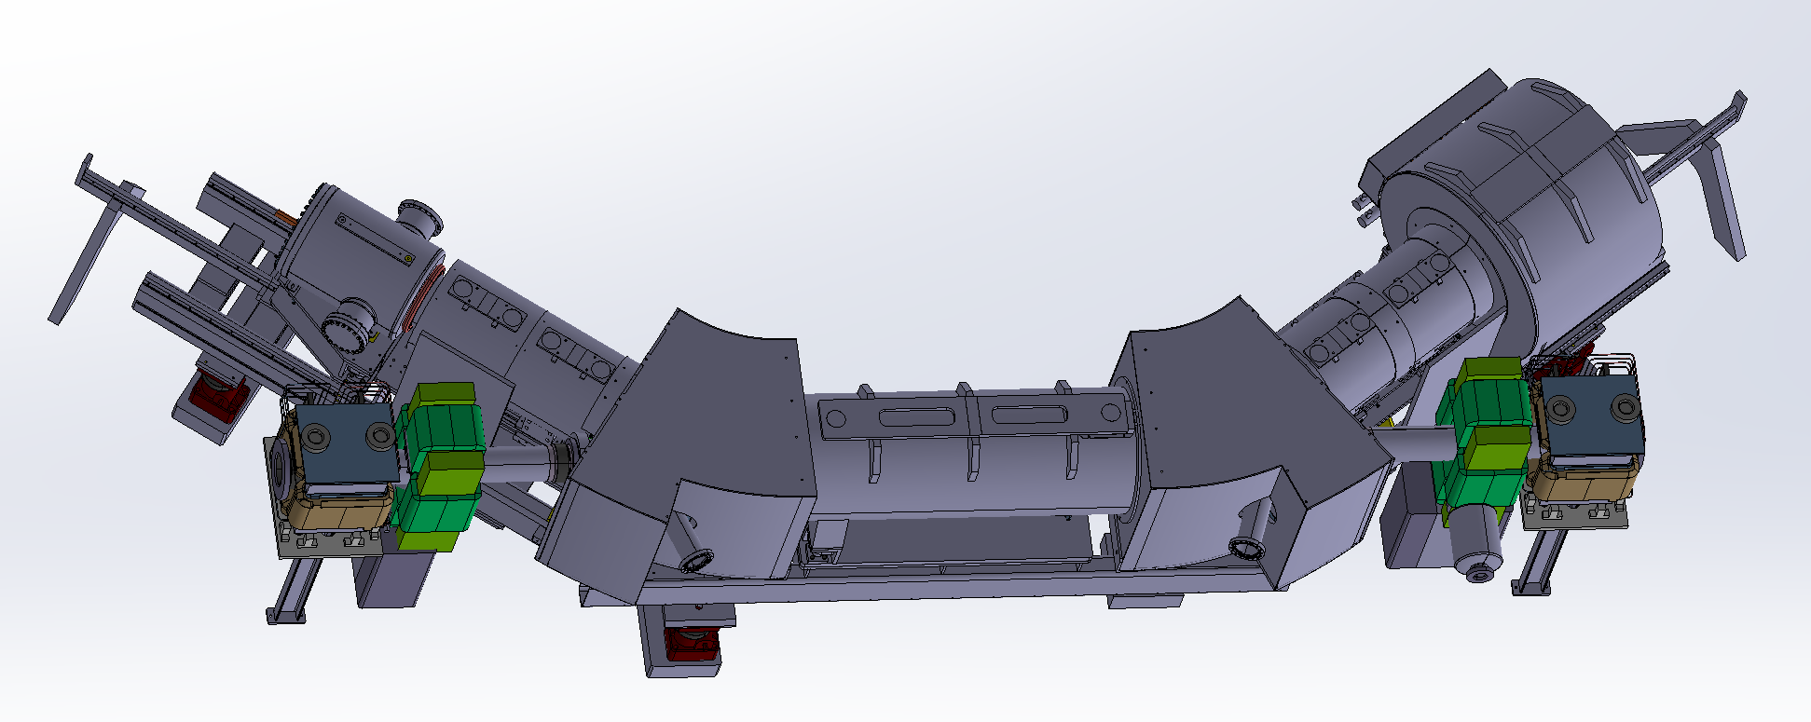
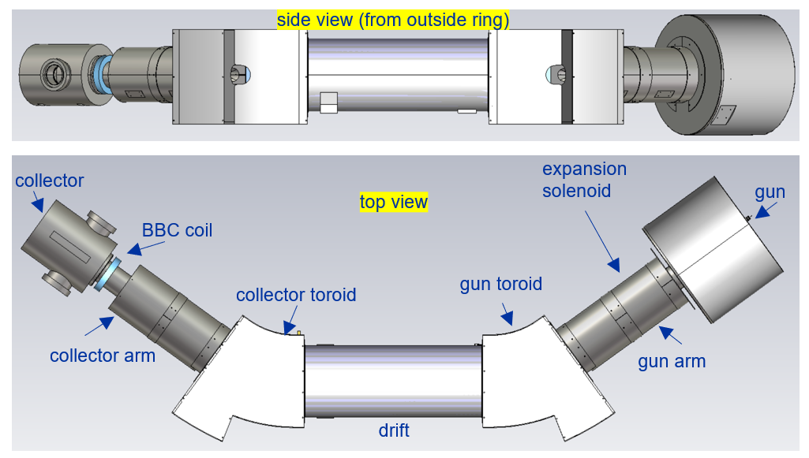
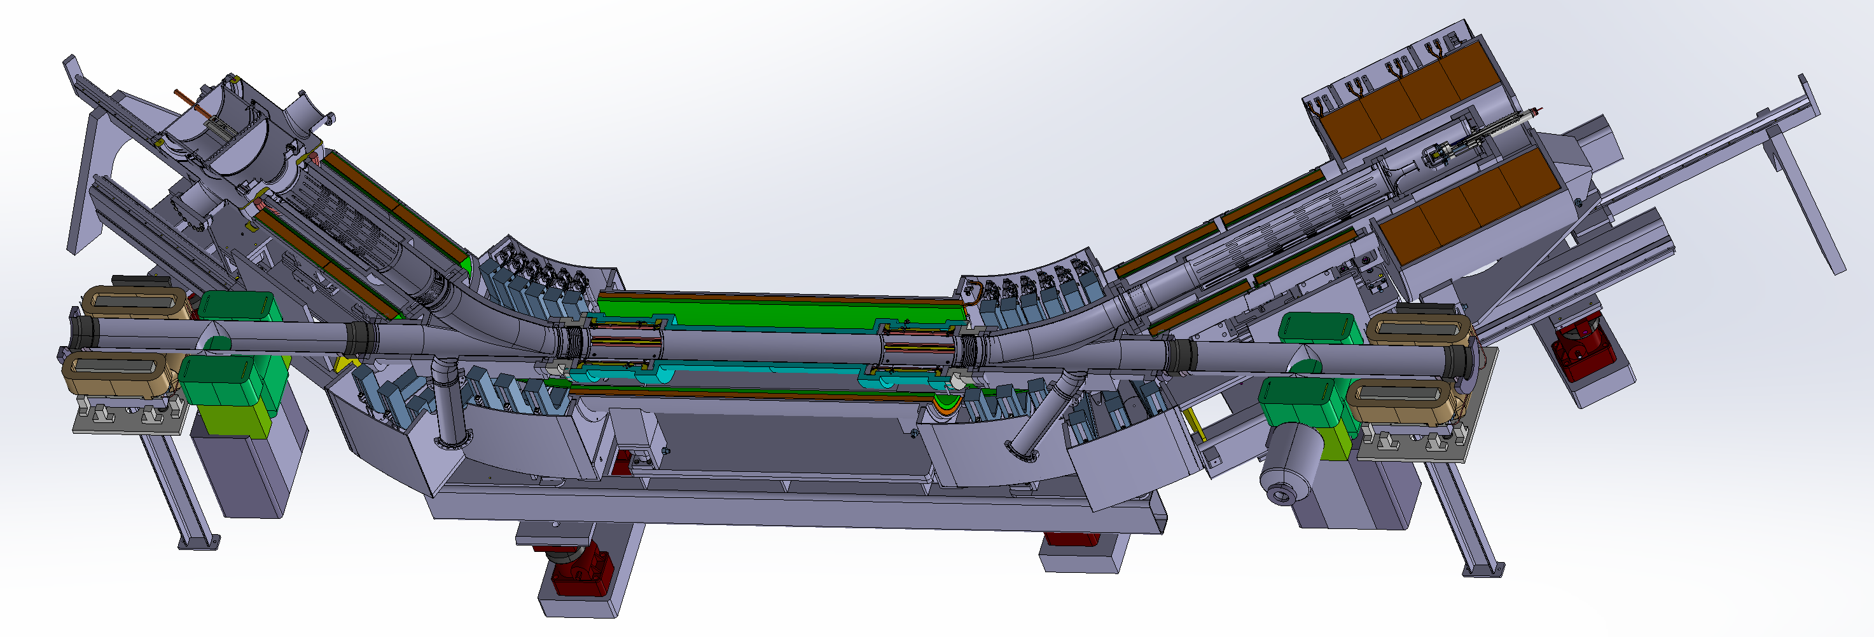
New AD electron cooler
Parts 40+ years old and lack spares
Decision was made to make a new AD electron cooler – to be installed in LS3
3D model from N. Chritin

Slide 7
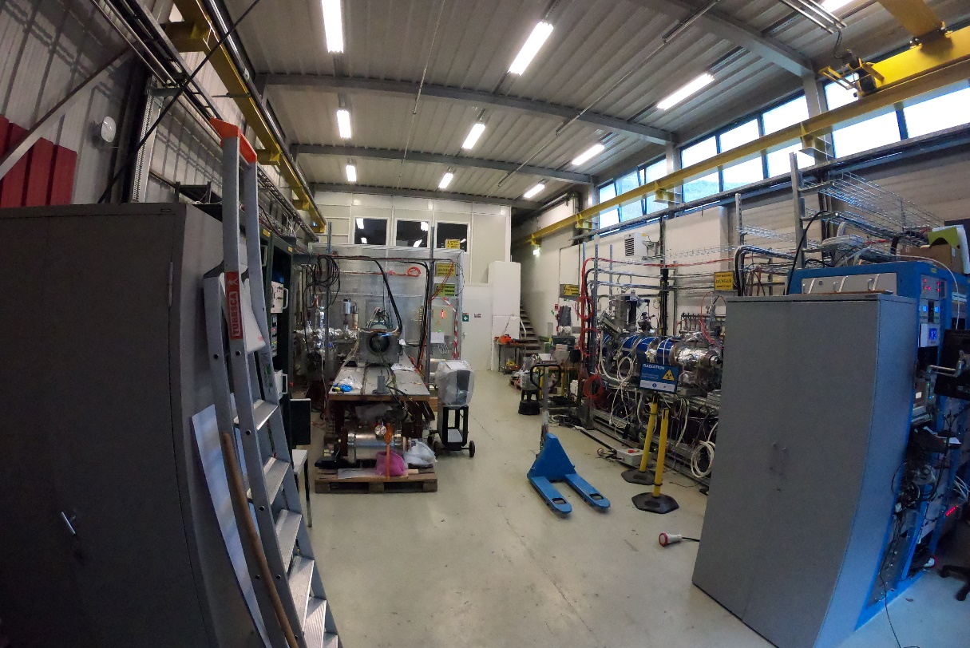
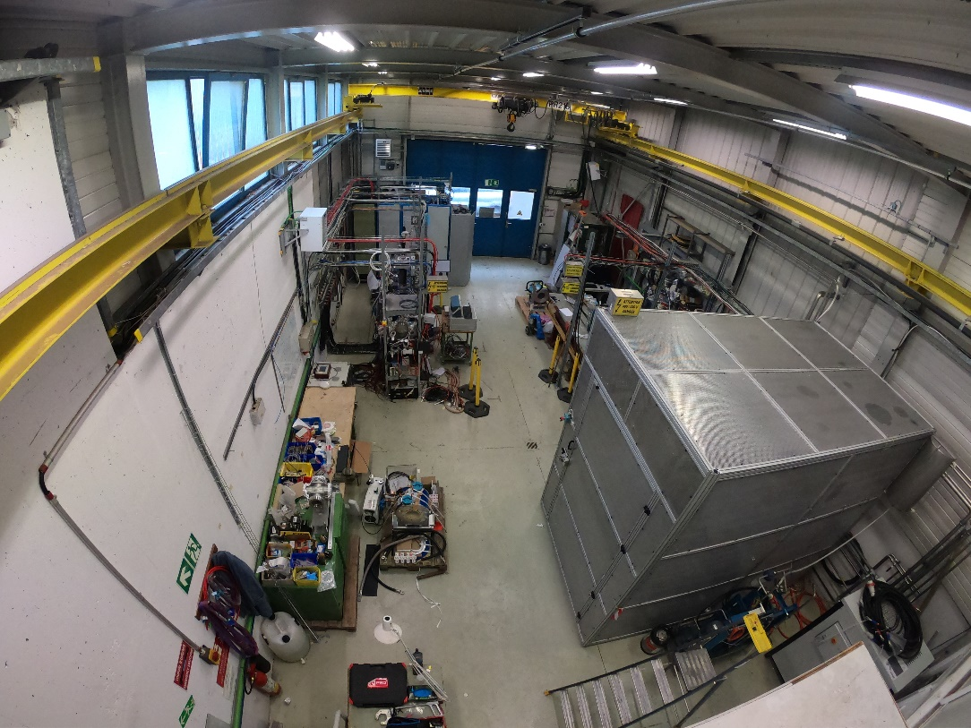
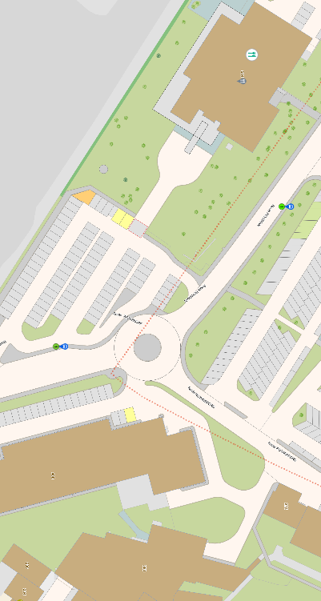
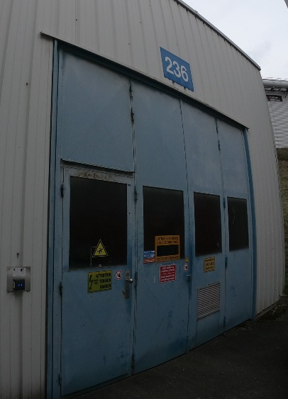
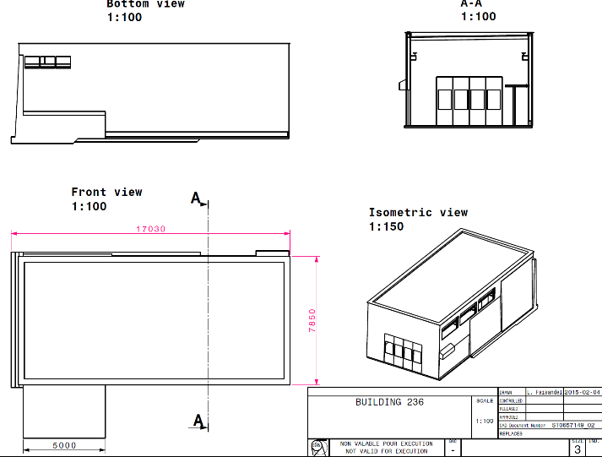
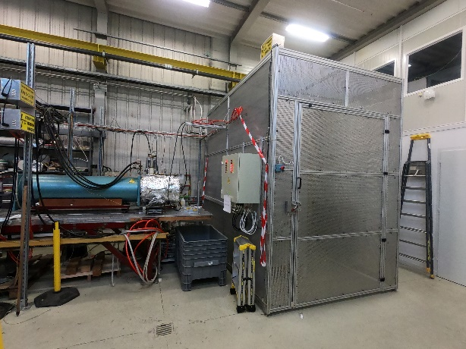
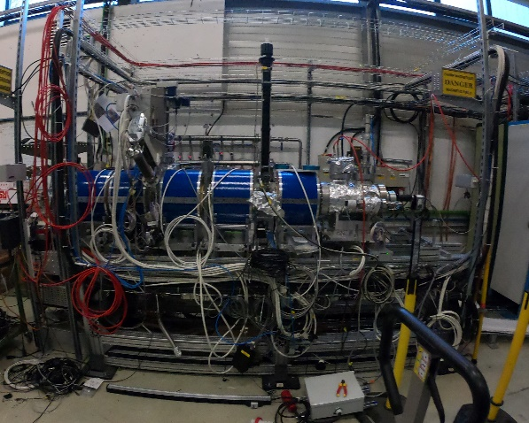
Bat. 236 layout (EBTS and ECTS)
See BI day 2022 talk by Sameed on EBTS
b.236 view from entrance
b.236 view from the back
Restaurant 2
EBTS
ECTS
HV Cage
LINAC4
Water cooler
for magnets
Water cooler
for collector
ECTS- Electron Cooler Test Stand
EBTS- Electron Beam Test Stand
Known history of b.236:
- Storage for e-cooler spares
- Laser ion source (BE-ABP-HSL)
- e-cooler test stand
CAD ref: ST0657149_02
(J. Cenede)

Slide 8
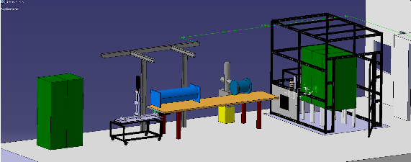
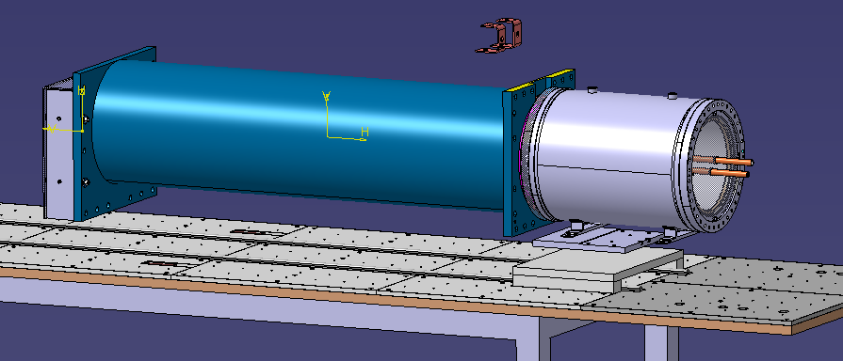
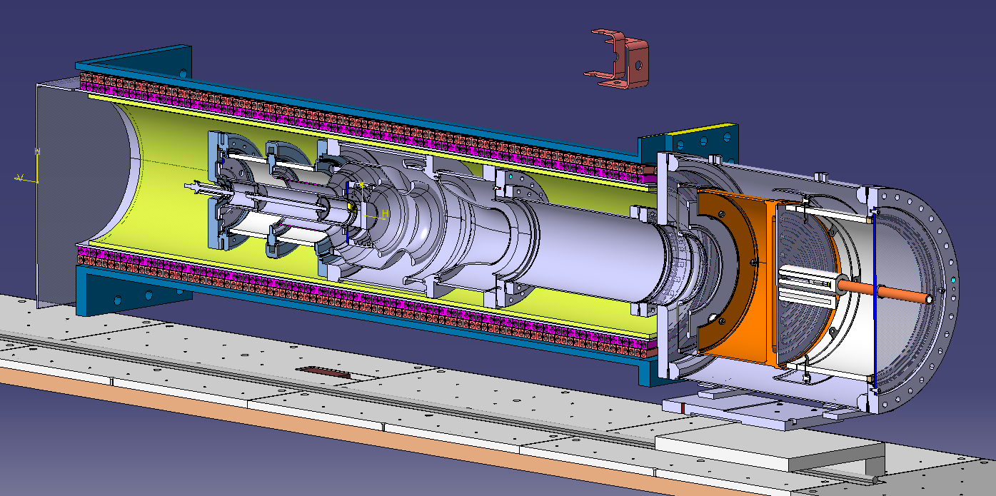
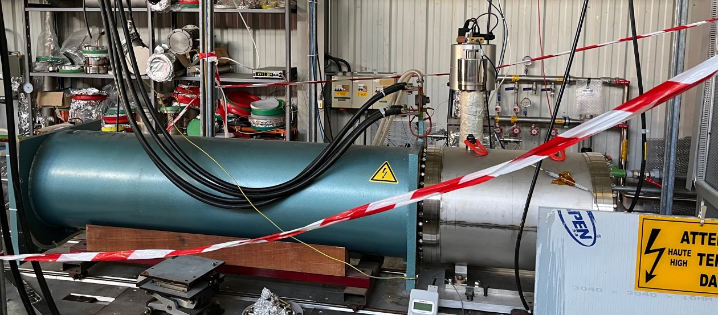
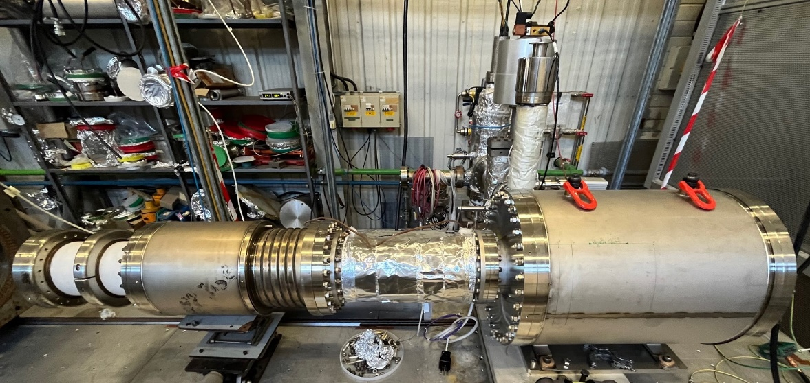
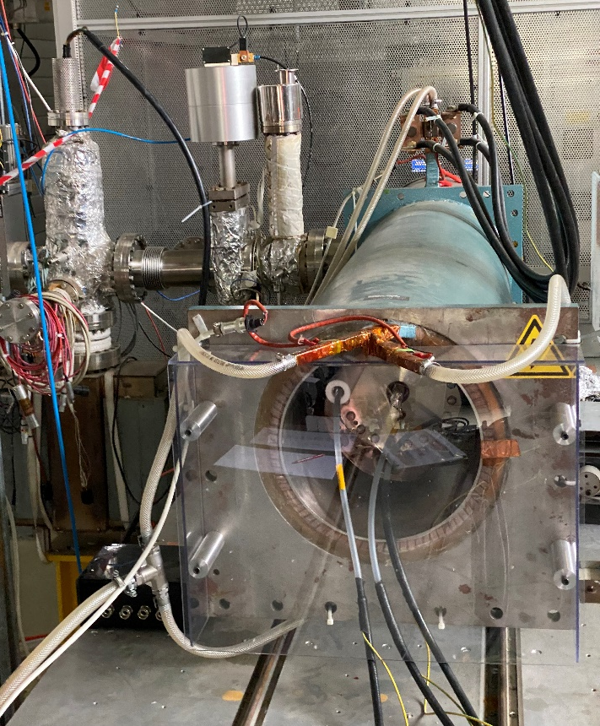
ECTS – Electron Cooler Test Stand
by J. Cenede
A linear test stand for test/characterization e-cooler components
Use spare AD gun and spare drift solenoid for testing the collector
by J. Cenede
by J. Cenede
spare drift solenoid (AD e-cooler )
spare e-gun (AD e-cooler )
new collector
can slide the solenoid on the rails

Slide 9
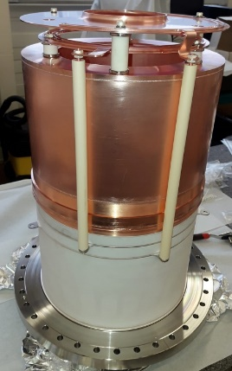
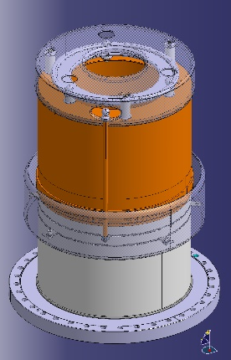

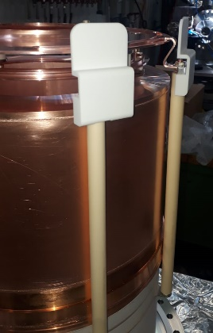
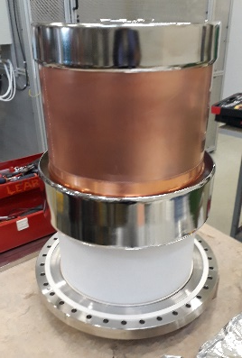
AD collector timeline
2018 July, AD e-cooler collector failure (vacuum leak)
2018, months later the spare fails, put back in the original after repair
2020, new collector (v1) designed and manufactured, HV sparks in vacuum
2021, modification #1 (v2), didn’t help
2022, modification #2 (v3), vacuum spikes only when B-field (link)
2022, systematic tests, found ExB magnetron discharge (EDMS: 2823714)
2023 Jan, passed static E (35 kV DC) and B (650 Gauss) tests (link)
2023 Jun, confirmed need for compression coil at collector (link)
2023 Sept, demonstrated 1.8 A DC e-beam @ 27 keV for 72 hours (link)
2023 Dec, gun cathode replaced, ready for more tests to reach 2.4 A / 27 keV (link)
Version 1
Version 2
Version 3
images: J. Cenede / A. Frassier

Slide 10
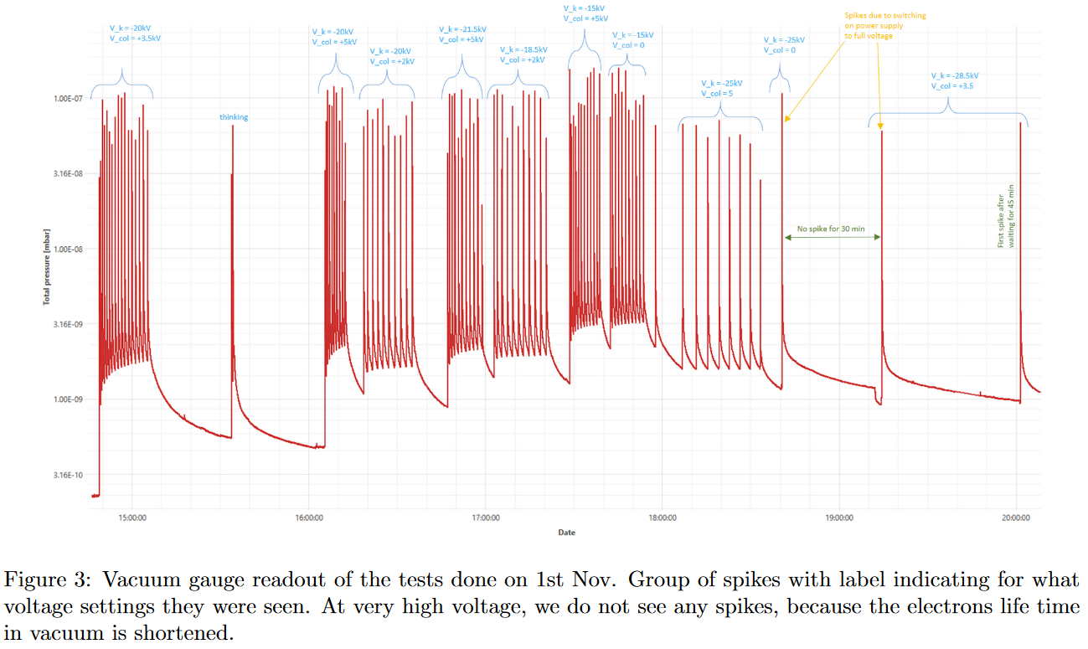
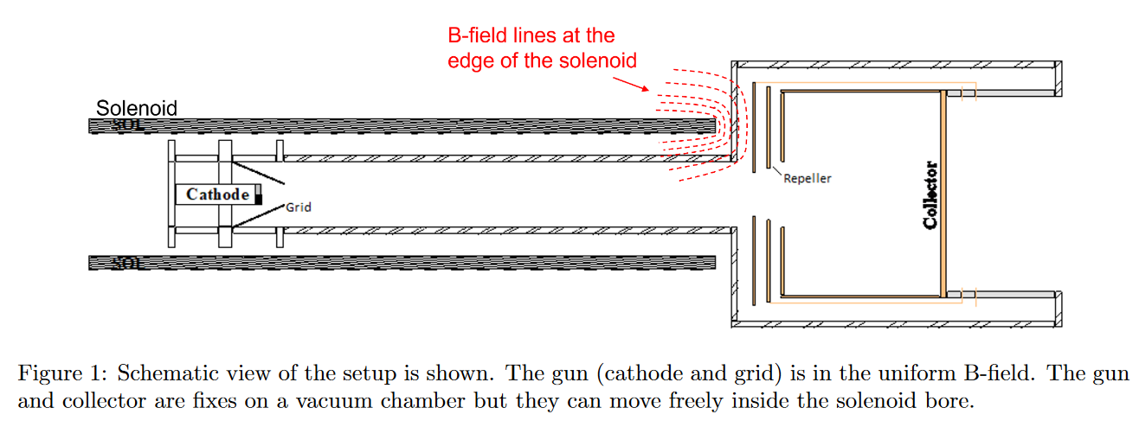
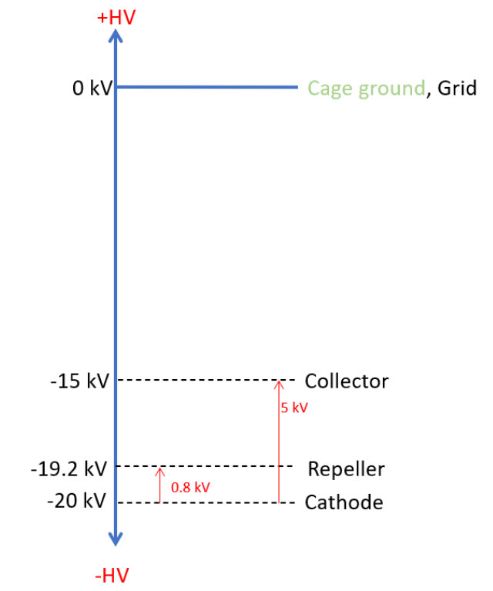
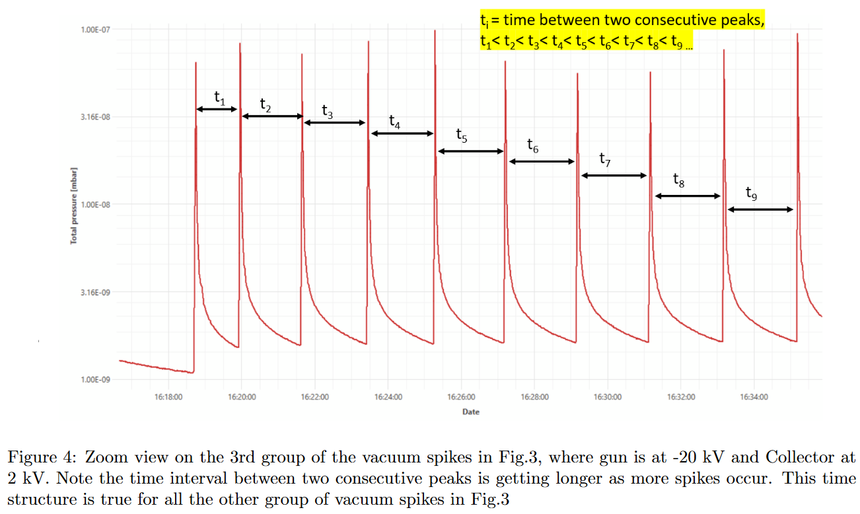
Collector tests: ExB magnetron discharges
Details about the tests and results are given in EDMS: 2823714)
What tests done?
Grounding electrodes
Shorting …
Varying voltages
Varying B-field
Waiting long enough (0.5-4h) for each test
Mu-metal shielding
Pick-up fast BCT
E-loss on PSU
…
Documented on the e-logbook (link)

Slide 11
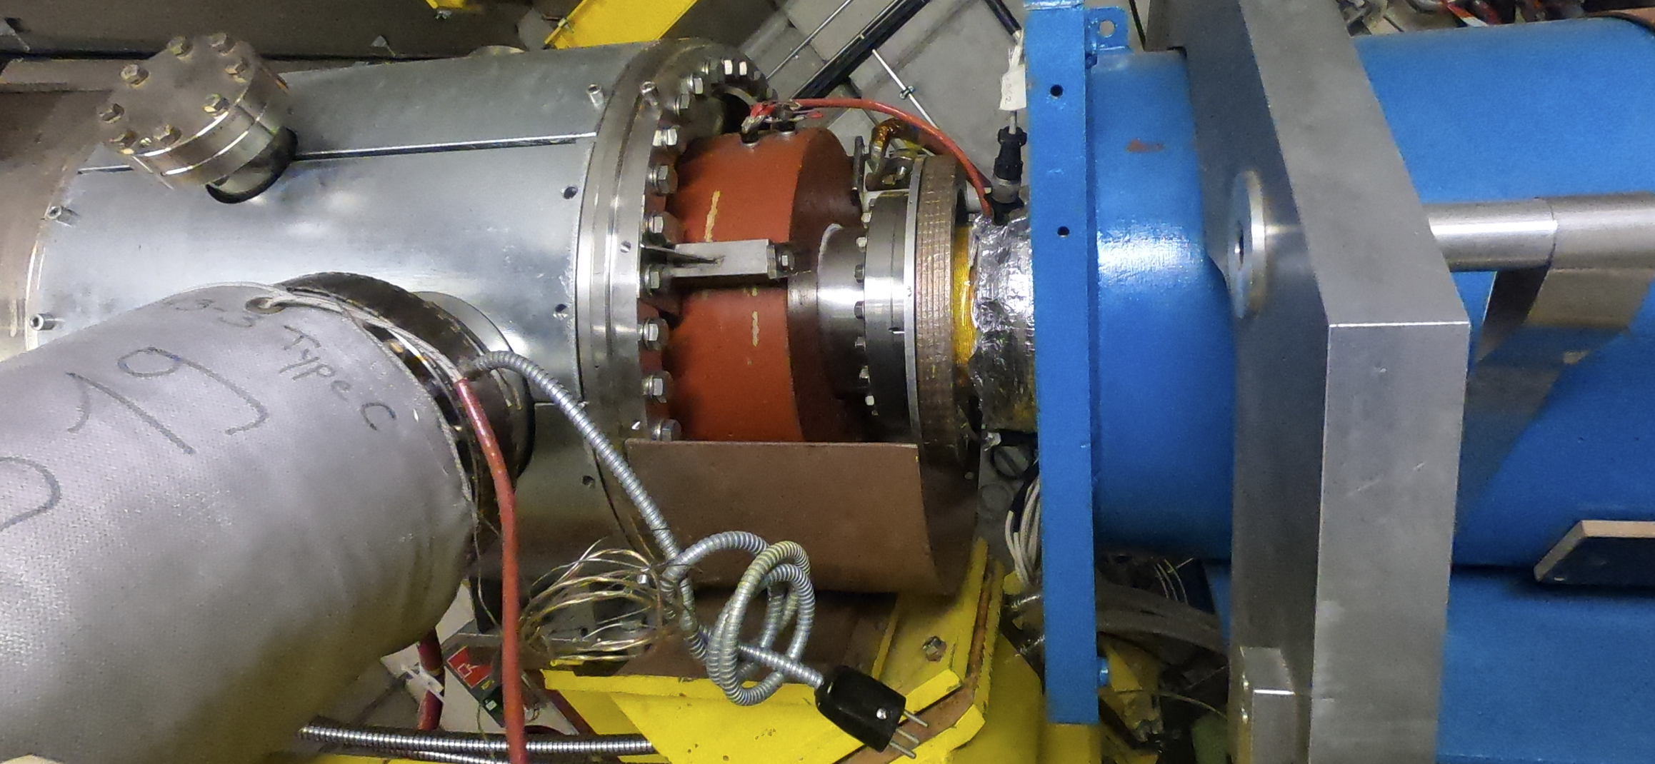
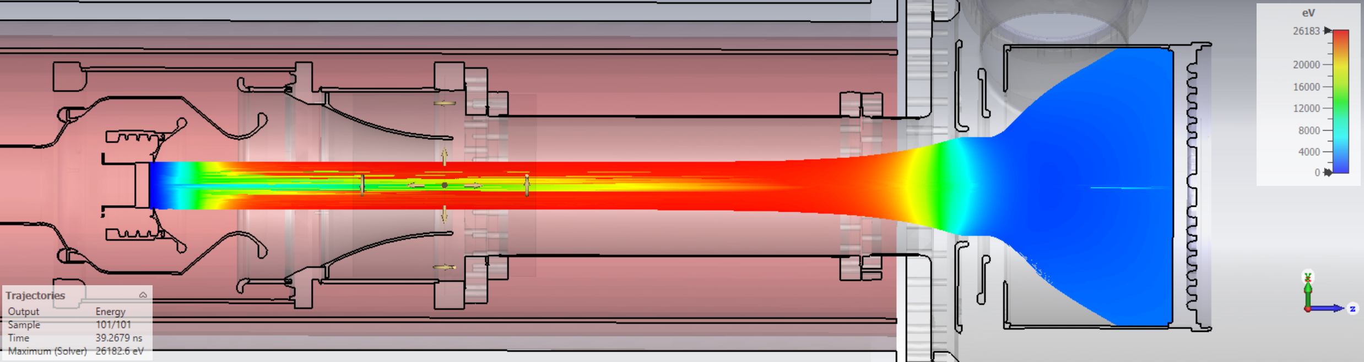
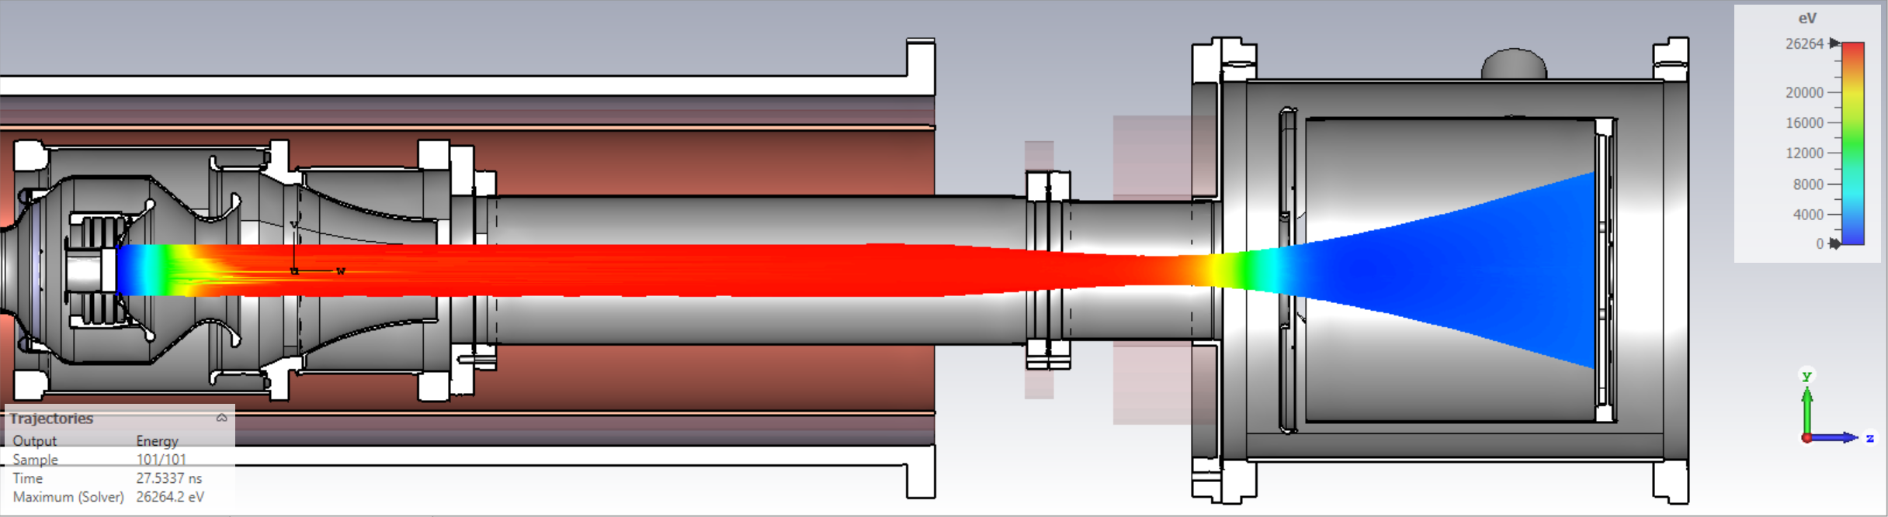
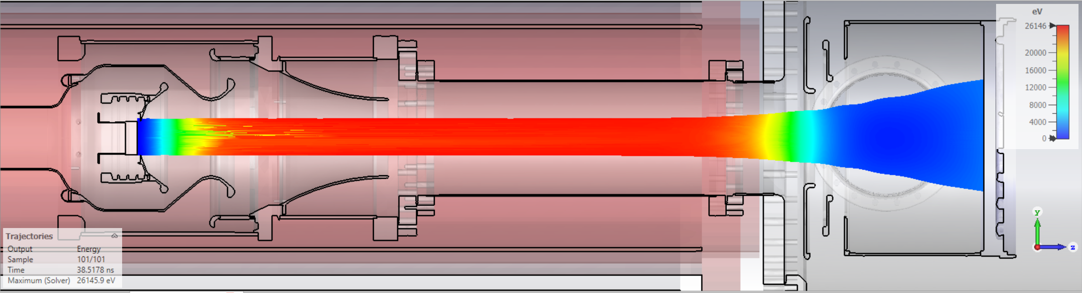
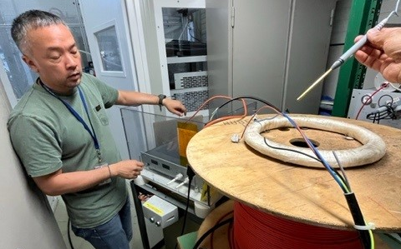
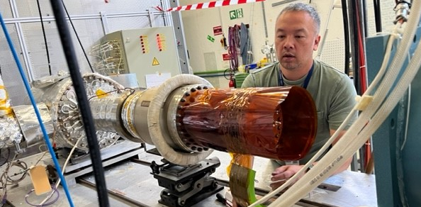
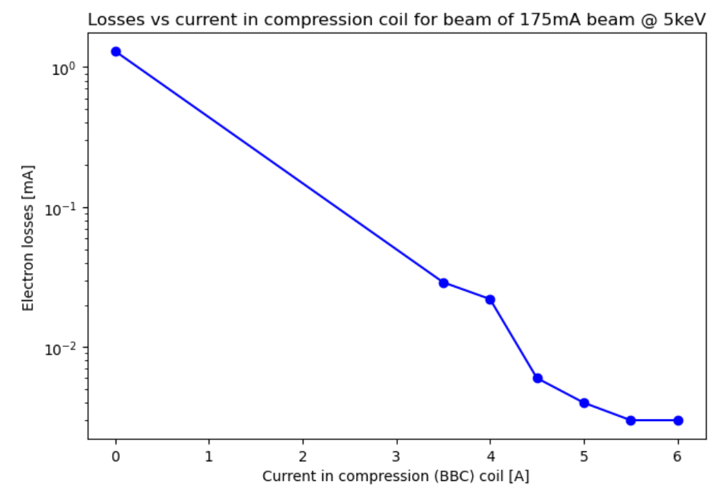
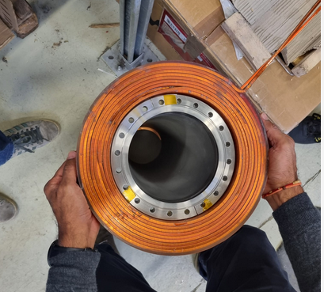
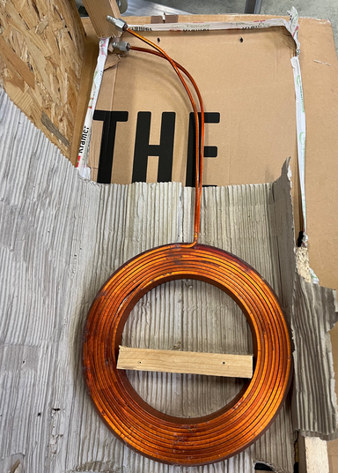
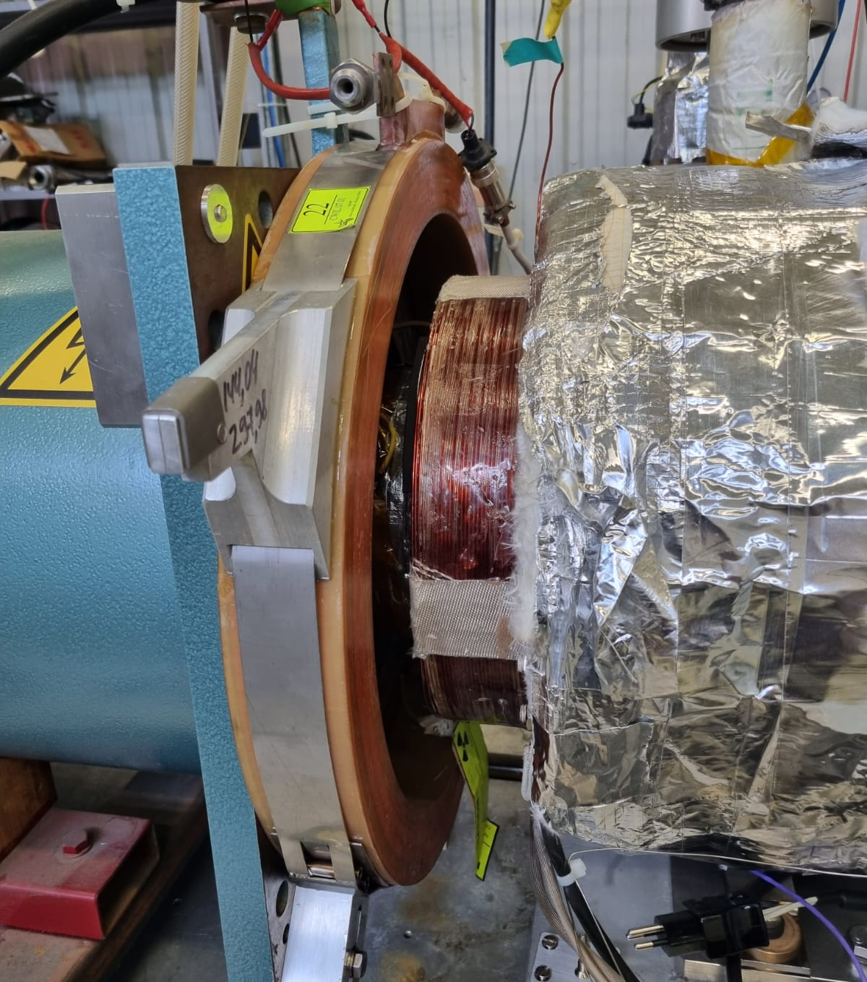
Collector tests: BBC compression coil
present cooler has two BBC coils
Iron shield
No BBC coil
Issues:
e-beam hits side wall of collector (water cooling only at back)
beam hits entrance of the collector and cause e-losses
e-beam
BBC1
BBC2
old collector
That’s how it is in AD today !
LEIR pancake coil used as BBC (+ extra coil from Canada, former colleague sent)
E-beam with BBC coil:
Compress at collector entrance
Focus at back of collector
Magnetic bottle for 2ndaries/ions
LEIR BBC
Canada BBC
New (stronger) BBC coil arrived last week for tests
Message:
CST simulations very helpful in understanding and allowing progress on the test bench !
That’s how new collector got to 1.75 A DC@ 27keV
Vacuum and ESD: need better pumping
BBC = big bobbin compression (historic name)

Slide 12
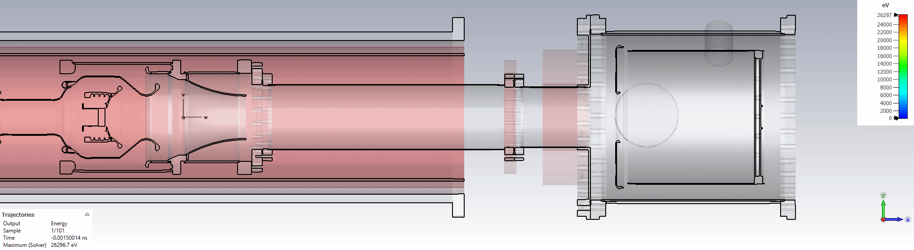
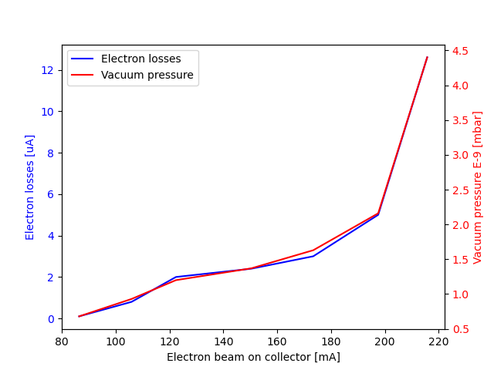
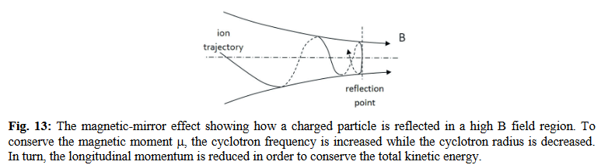
Collector tests: secondary electrons and ESD outgassing
ESD: electron stimulated desorption
Outgassing due to electron dump in collector metal surface
Vacuum degrades -> e-loss increases
Solution: higher pumping speed or condition the surface for months
Magnetic bottle (formed due to compression coil) helps trap low energy secondary electrons/ions

Slide 13
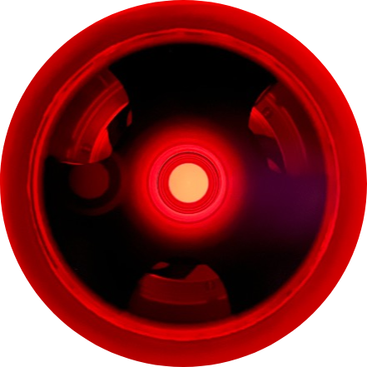
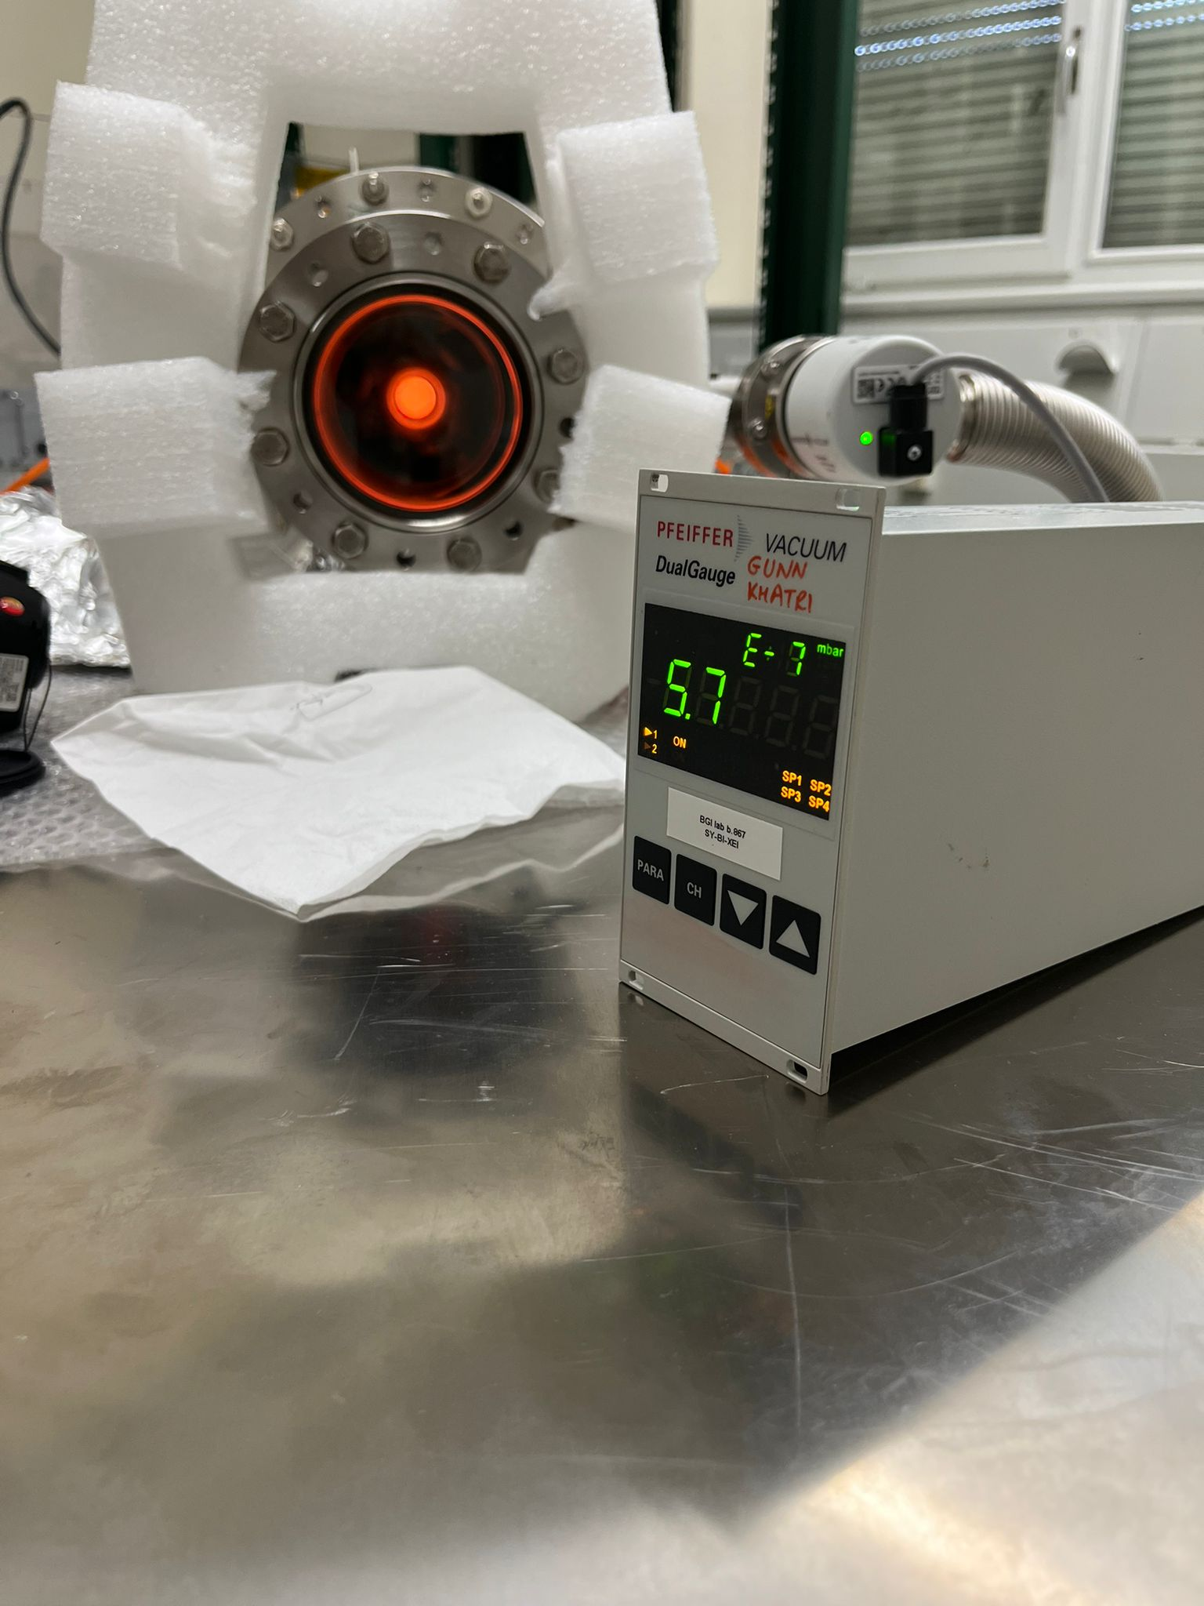
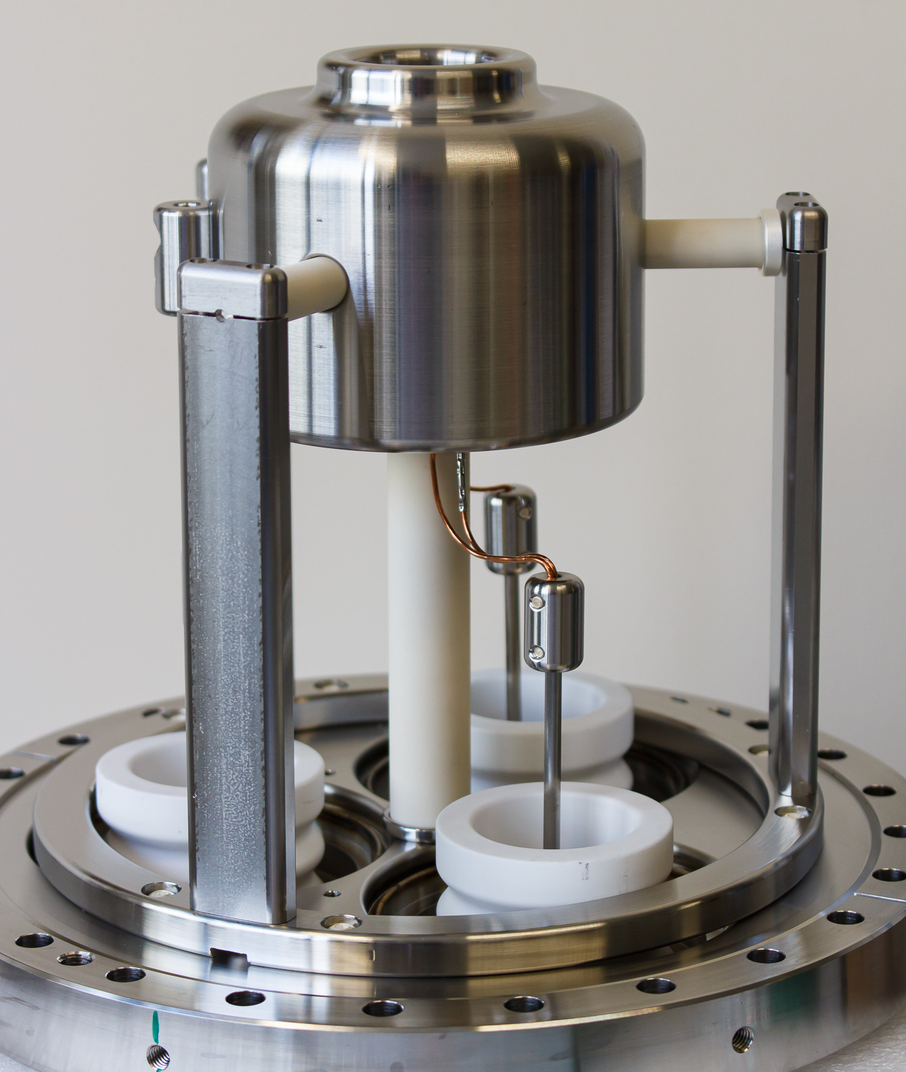
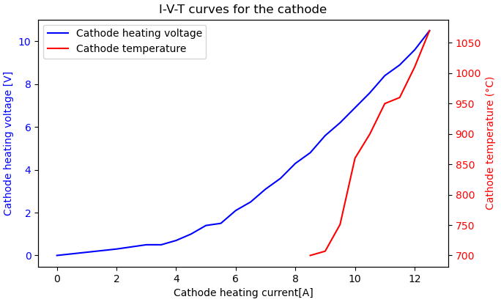
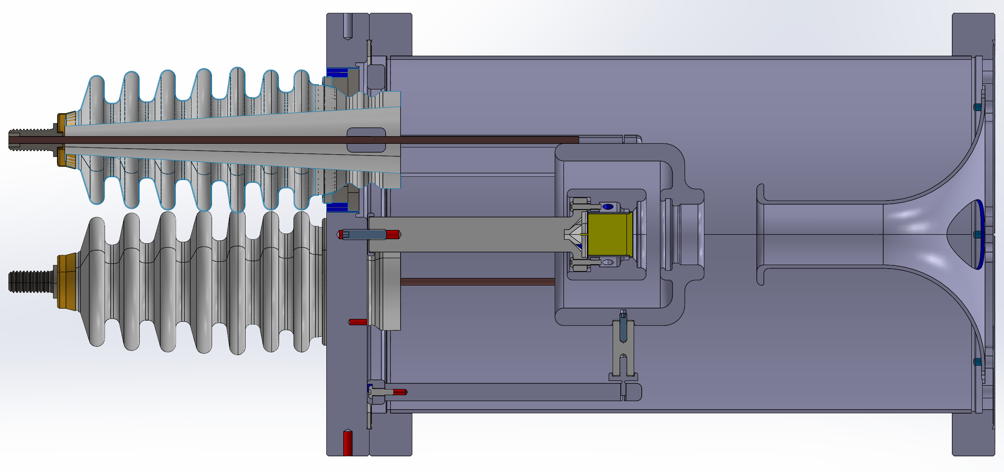

New gun: HV and thermal tests
High perveance (P ~ 2.2 uP), variation of design by A. Pikin
Designed/assembled by J. Cenede (modular design)
1 inch cathode, 311 type from SPECTRAMAT INC.
To be operated under 2400 Gauss
Beam expansion by adiabatic transition to 600 Gauss
1000 degree C OK for 3 heating cycles
HV holding at 30 kV DC OK for cold filament

Slide 14




New gun: first beam extraction
“quick & dirty” test with poor vacuum, that’s why only 5 kV
Scalloping reduces with increase in the B-field see Sameed’s work for more detail (link)
Experimentally observed as reduction in the electron losses
On test bench
(Oct. 2023)
gun @600 gauss
gun @900 gauss

Slide 15

Future tests: expansion solenoid, profile monitor
Beam induced fluorescent (BIF):
Demonstrated in cool23 workshop by T. Beiser et al. (Mainz Uni.)
1 A / 27 keV e-beam, but much smaller cathode compared to ours
Mainz uni. folks willing to come to CERN with their setup/camera to check feasibility
Use the BGC imaging setup from EBTS
Gap to be used for diagnostics
CST simulation: e-beam 2.4 A / 27 keV
Test exp. Solenoid (cheap, fast, 2400 Gauss)
new gun
drift solenoid (1.5m, 600 Gauss)
new collector
compression coil
Test expansion solenoid:
One quote received, waiting for two more.
Kramer Engineering: 20 weeks, 22 kEUR
?
?
Issue: cathode’s bright light will be reflected in vacuum chamber
Solution 1: put wavelength filter before camera (BGC setup)
Solution 2: locally coat the vacuum chamber with black paint (Aquadag)

Slide 16



CST simulations of e-beam transport in the new AD cooler
more details on: https://indico.cern.ch/event/1339640/
beam dump centered on
The back wall of the collector
TF steering coils
TF steering coils
reference
horizontal line
gif video: see extra slides for screenshot in case you are looking at PDF of this presentation

Slide 17
Future plans
12/2023 – demonstrate 2.4 A / 27 keV beam on the new collector (Spare for AD operation)
01/2024 – finish vacuum upgrade
02/2024 – start proto gun testing @ 900 Gauss ( > 5kV)
04/2024 – 2nd copy of the new collector assemble and start testing
07/2024 – start proto gun test @ 2400 Gauss (6 months for test expansion solenoid)
12/2024 – deliver minimum requirement 2.4 A / 27 keV on new gun & collector
01/2025 – start tests to see how high beam current can go (wish up to 4.8 A)
Other activities in 2024: improve control system, BIF profile monitor, mimic pulsed AD cycle (pulsed/ramp)….
Possible design optimization
Collector: triple junction covers, higher cooling-water power @ 4.8 A
Gun: HV feedthroughs, e-losses on grid/anode, thermal effects on ceramic etc …

Slide 19

Acknowledgement
I would like to thank:
- Luke, Sameed, Volodymyr and Niek for help in improving my simulations skills.
- Fred, Sasha, Gerard, Davide, Adriana and Hannes for helpful discussions on e-beam physics.
- Alex and Jean for significant progress on new Gun/Collector tests in b.236.
- Ondrej and Abhishek for their help in b.236
- W. Devauchelle, S. Deschamps for technical support
- D. Steyaert and Y. Coutron for collector design
- AD CONS e-cooler project members for their collaboration

Slide 20



Extra slide: Vacuum upgrade proposal for ECTS
Ready to start ordering, waiting for green light and budget code.
Spreadsheet can be found in: \\eosproject-smb\eos\project\s\sy-bi-xei\operations\electron-beams\ECTS test stand in b.236

Slide 21

Extra slide: Old vs new collector

Slide 22


Extra slide: high voltage referencing
e-
e-
Collector
e-Gun
e-
e-
Pbar
Pbar
Toroid
Drift
Toroid

Slide 23

Extra slide: Vacuum for discussion
Ceramic absorb large amount of water (thus heavy outgassing) – both the gun and collector
Distance from gun to pumps is long and restrictive
KF seal, oil from oil pump, borrowed pump from AEGIS
The reason the bakeout was avoided in the first place is due to risk of breaking ceramics.
The systematic tests done to understand nature of the vacuum spikes and how they change with changing E or B fields. It was not known beforehand as ExB discharge, the tests were necessary. And so to convince to go for bakeout. YETS started so people were occupied, we had to do it ourselves.

Slide 24

Extra slide: New AD e-cooler backward planning
~1.5 years
Lab assembly
& tests
Installation and commissioning
Lab & machine
Powering
Collector
Gun
Integration
Vacuum
Correctors
Magnets
F. specs
Specs
Procurement
Current spare tests
Design & construction
Tests
Gun Proto
Tests
Final design & construction
Tests
Integration
Design validation
Construction and coating
Tests
Design & construction
Magnet validat
Specs and design
Magnet mat procurement and construction
Tests
Funct. specs

Slide 25



Extra slide: Basic assumptions and input for the simulation
side view (from outside ring)
3D model (ST1715187_01) from N. Chritin,14 Sept 2023
Magnets: current, turns from Luke
Toroid steering coils: 3D, current, turns from Luke (50 turns, 10A max)
No H/V arm steering coils are considered yet (waiting for Luke to finalise on his end)
Voltages configuration for most simulations (unless explicitly specified different):
Beam current ~2.4 A (2.2 uPerveance, confirmed with Sameed’s results and b.236 test bench)
The beam transport doesn’t depend on source type (space charge or fixed gun), but it does consider space charge along transport path
Full AD simulations with SCL gun, ECTS simulations with fixed source
collector
expansion
solenoid
gun
top view
BBC coil
collector toroid
gun toroid
collector arm
gun arm
drift
Coil name | Current (A) | # of turns
expansion solenoid | 87.4 | 1440
2+2 arm solenoids | 250 | 83
6+6 toroid pancake coils | 90 | 64
drift solenoid | 250 | 300
bbc compression coil | 250 | 81
2+2 TF steering racetrack coils | 10 | 50

Slide 26


Extra slide: B-field for discssion
Rough measurement of the B-field of the solenoid to see nothing is unexpected. See e-logbook (link)

Slide 27

Extra slide: Complete test b.236 (pros. & cons.)
Pros
Services (electricity/water etc…) ok
Independent of AD activities (flexible time)
More open space compared to AD ring
Confidence building and operational experience
Dry assembly before final installation
If break vacuum, only bake the e-cooler
Cons
Cabling, control system and EPC supplies need
Time and resource consuming
May not be ready for installing in LS3
B.236 hot in summer, affect power converters

Slide 28


Extra slide: Complete test AD (pros. & cons.)
Pros
Services (electricity/water etc…) ok
Saving on time and manpower
EPC power convertors delay acceptable
Gun/collector are already tested in b.236
Concrete shielding above e-cooler will stay open
Cons
Once removed, old e-cooler is gone, no choice but make it work
Space constraints in AD ring
If break vacuum, need baking sector 3 of AD ring
6-month stop of cooling water (can be adapted)
Ring needs to be locally fenced when e-cooler ON
282 cm
Distance to left and right from beam axis
118 cm

