Slide 1


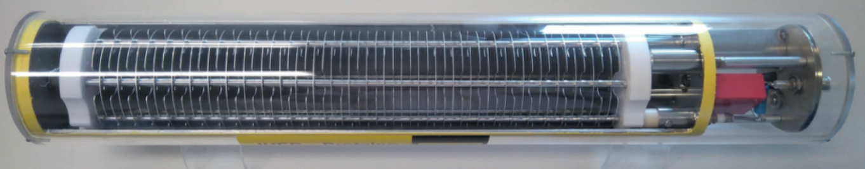

BLM IC Production
Gerhard Schneider for the BLM IC team with slides from Christos Zamantzas and Dmitry Gudkov
14.12.2023 11h50

Slide 2
Contents
What is the Beam Loss Monitor system?
What is the Beam Loss Monitor Ionisation Chamber (BLM IC) ?
Production of the BLM ICs

Slide 3
What is the BLM system for?
LHC Beam Energy per Beam: 362 MJ
Energy to heat and melt 1 kg of copper: 700 kJ
Mathematics: 362 MJ / 700 kJ/kg ≈ 500 kg
→ Machine protection is useful

Slide 4
BLM Specifications
USE OF THE BLM’S FOR MACHINE PROTECTION
• protection against beam losses that could lead to damage of equipment
• protection against beam losses that could lead to a quench of a magnet.
Reasons: Loss of beam vacuum, object in the beam pipe, beam missteering….

Slide 5
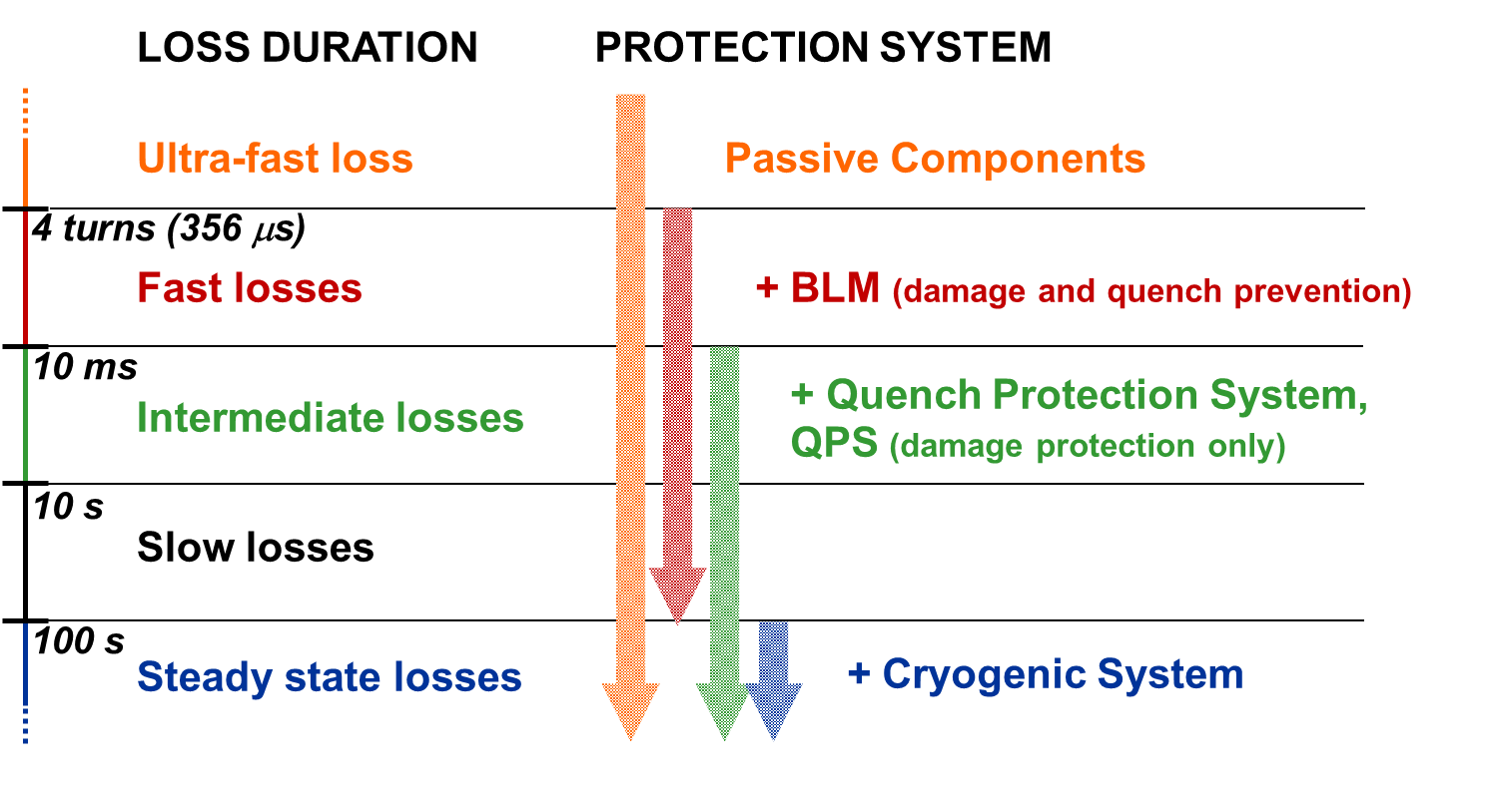
Beam Loss Duration and Protection Systems
50 – 150 μs
Achieved
by BLM LHC
100 s
Impossible to have active protection from ultra-fast losses
No real redundancy for fast losses; later additions of beam and magnet current change monitoring
Courtesy: C. Zamantzas

Slide 6
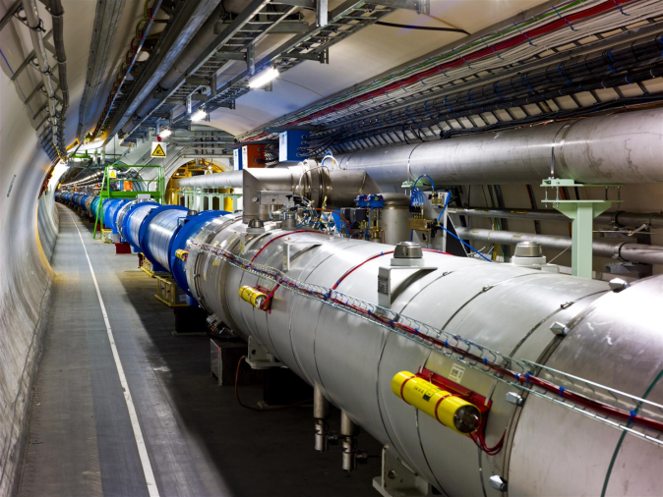

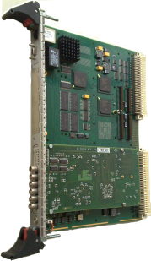

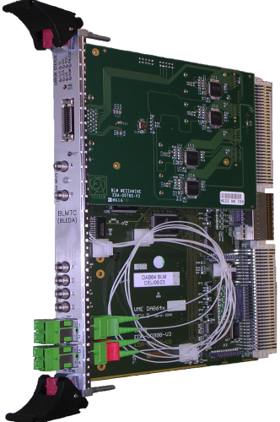
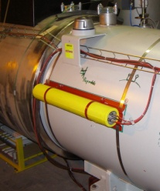
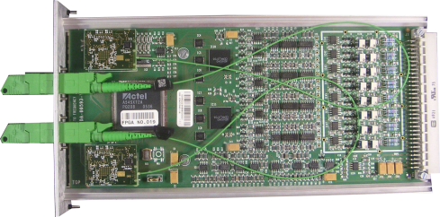
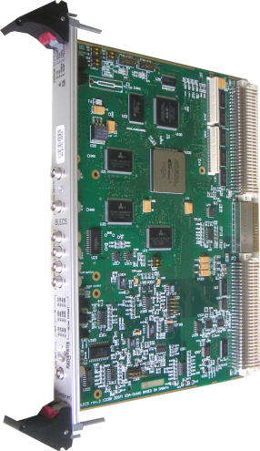
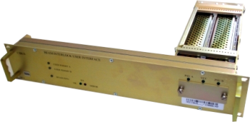
LHC BLM System Overview
Highly critical system for the protection of LHC
Deployed all around the 27 km of the tunnel
Speed, Reliability, Fail-safety is required
Large amount of measurement data are published continuously
Settings and Thresholds
Front-end CPU
Databases, fixed displays…
Processing, Analysis & Decision Modules
BLM IC
x27
Acquisition Modules
Combiner and Survey
Beam Interlock Interfaces
x400
x4000
x800
x27
around the LHC ring
x16
Tunnel
Surface
Courtesy: C. Zamantzas

Slide 7
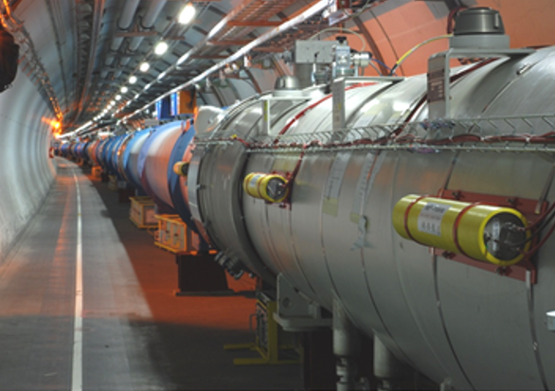

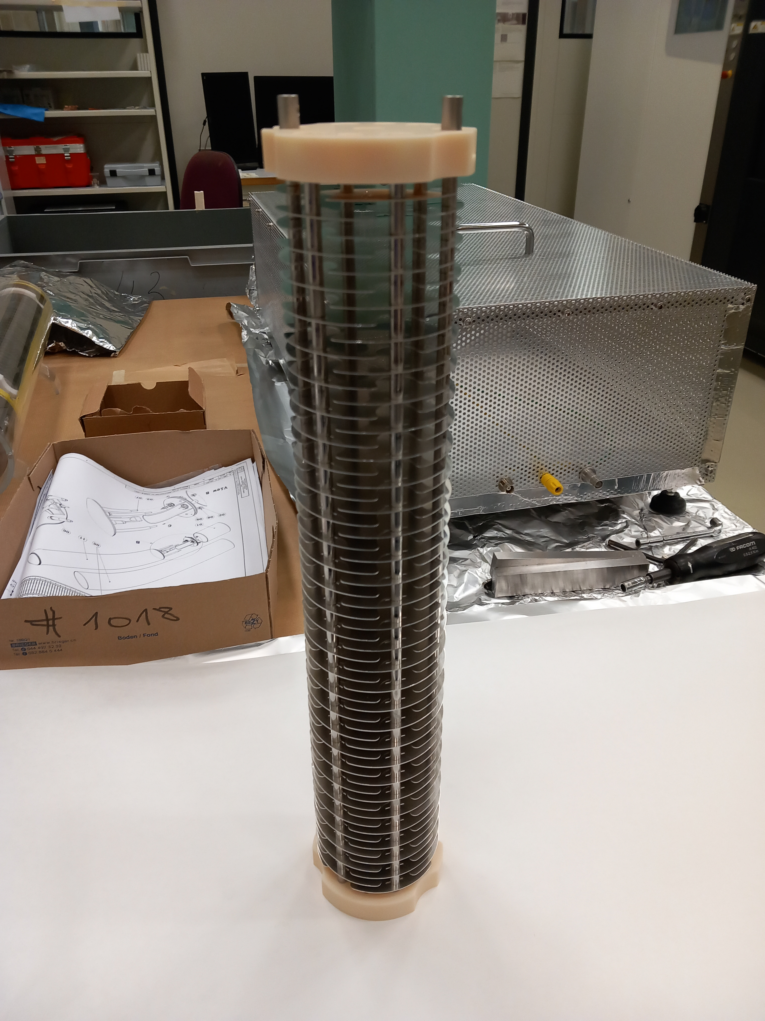
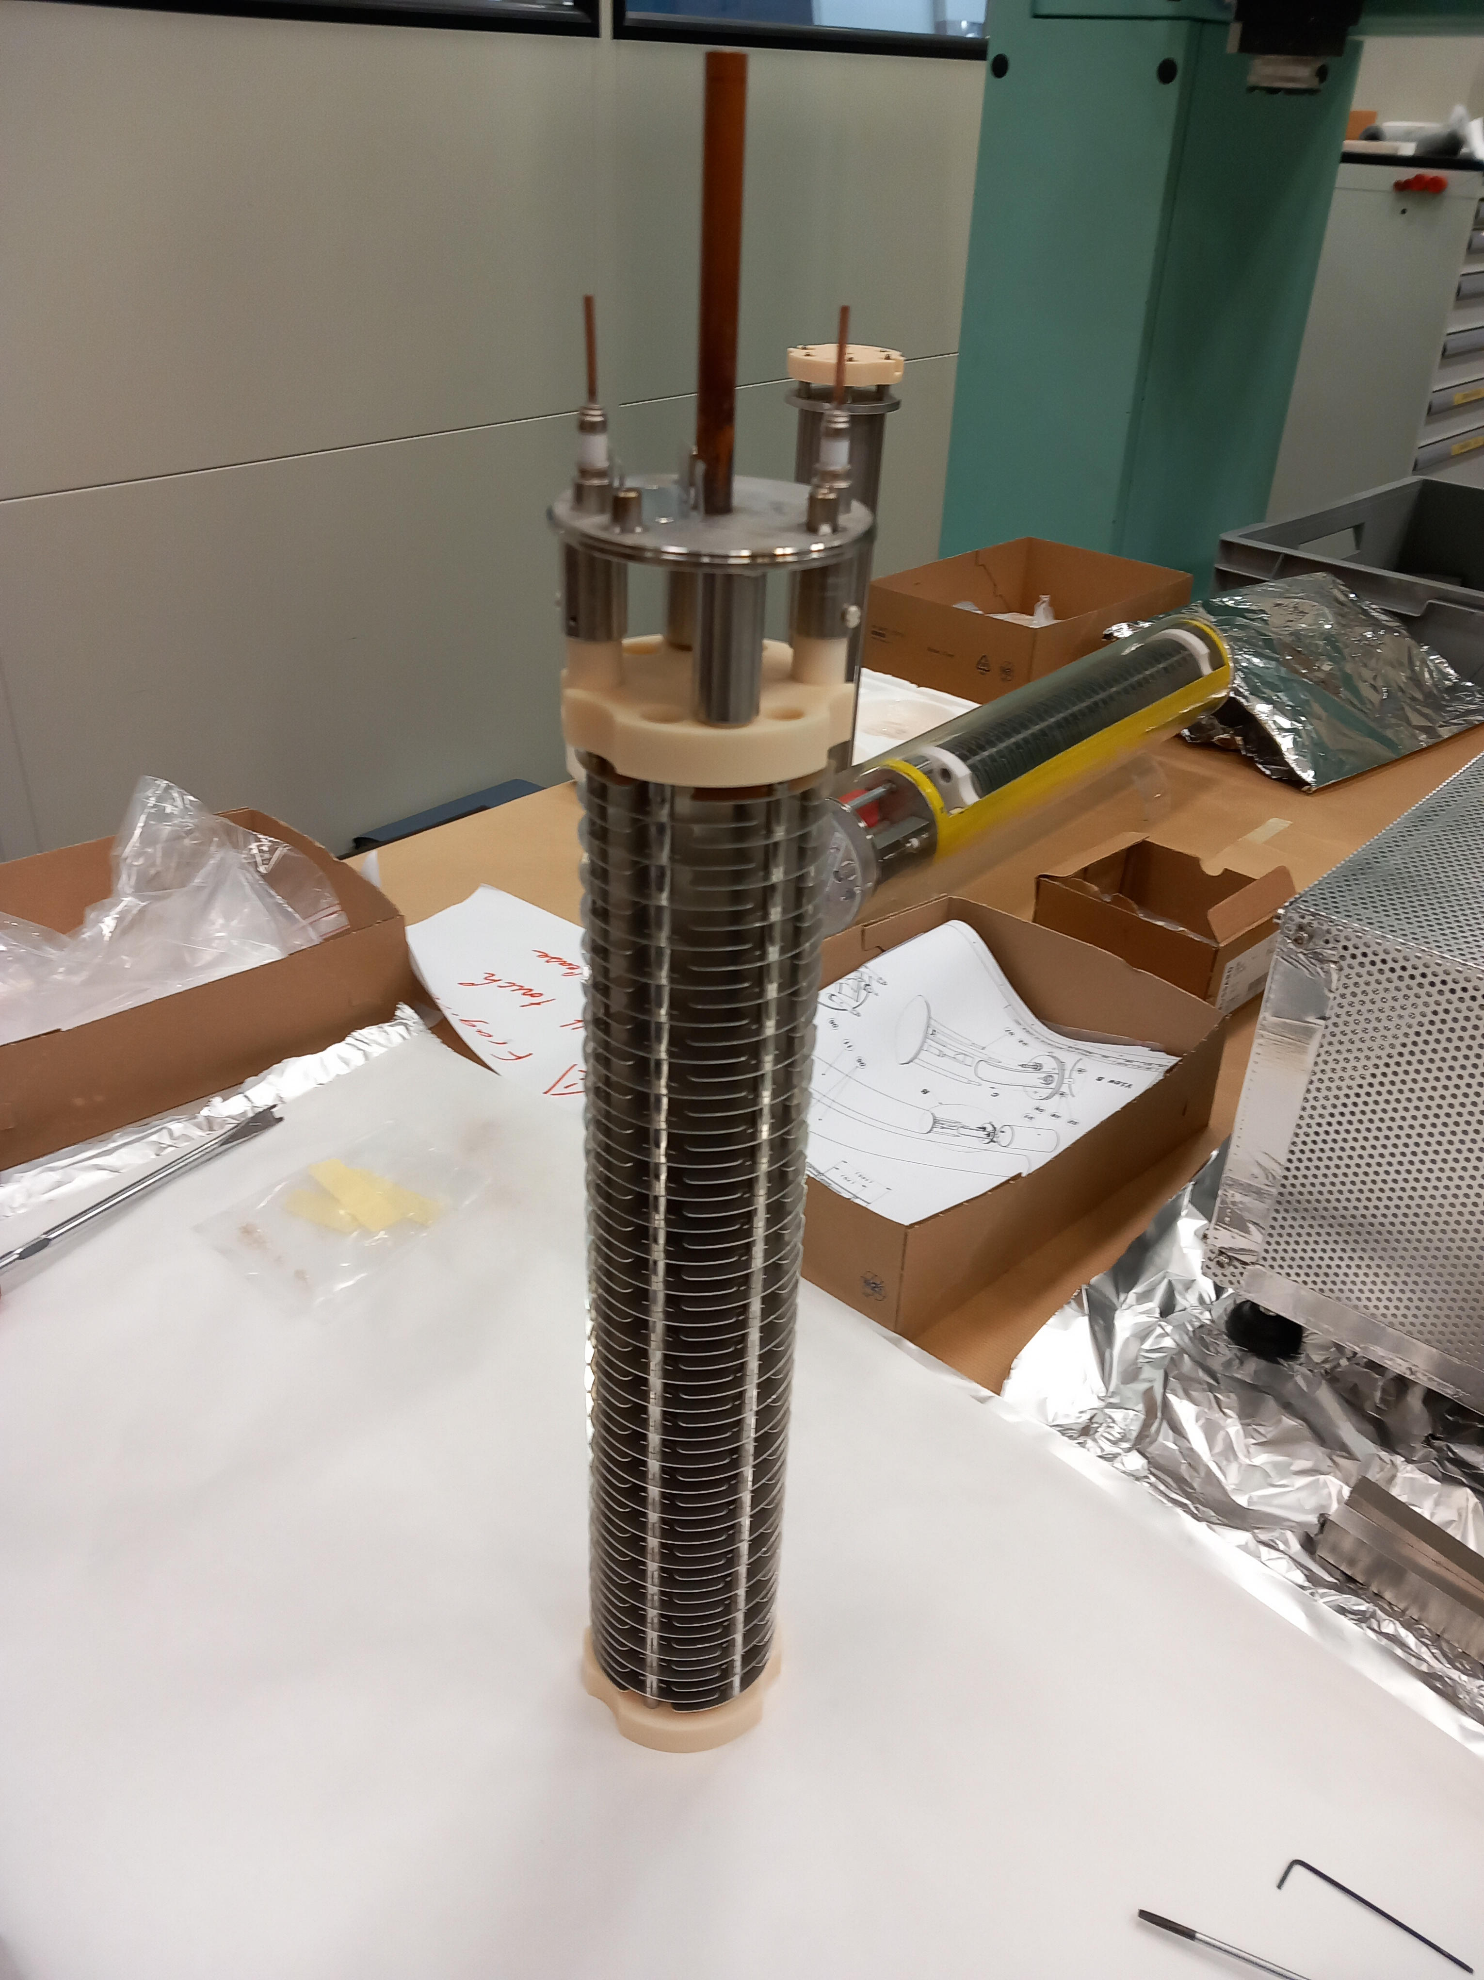
BLM IC
Voltage 1500 V
1.1 bar Nitrogen Gas
61 Electrodes
Particle Ionising Gas
Measure Current

Slide 8
Previous Experience and know-how
Total 4000+ produced by CERN and IHEP (Russian Collaboration) since 2005
Experience lost or faded since last production, but mostly re-gained in 2023
Know-how to be documented in Engineering Specifications- started

Slide 9
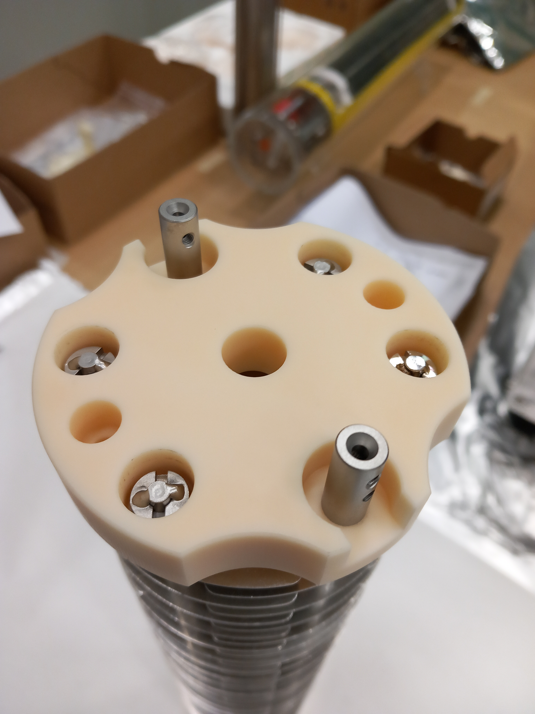

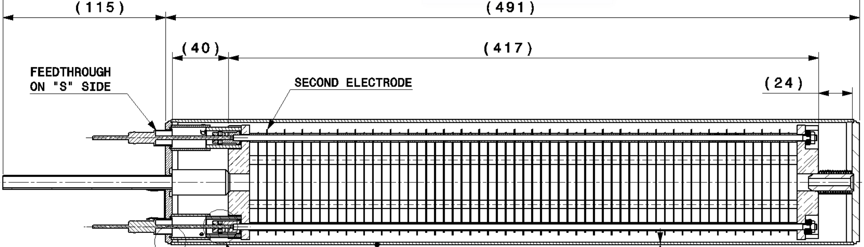
BLM IC Elements General Assembly
Ceramics Al₂O₃ with very low conductance 2x
Electrodes Al EN6082 61x
Ceramic Feedthroughs
Vacuum container
Welded cover, all vacuum welds TIG
Many others…

Slide 10
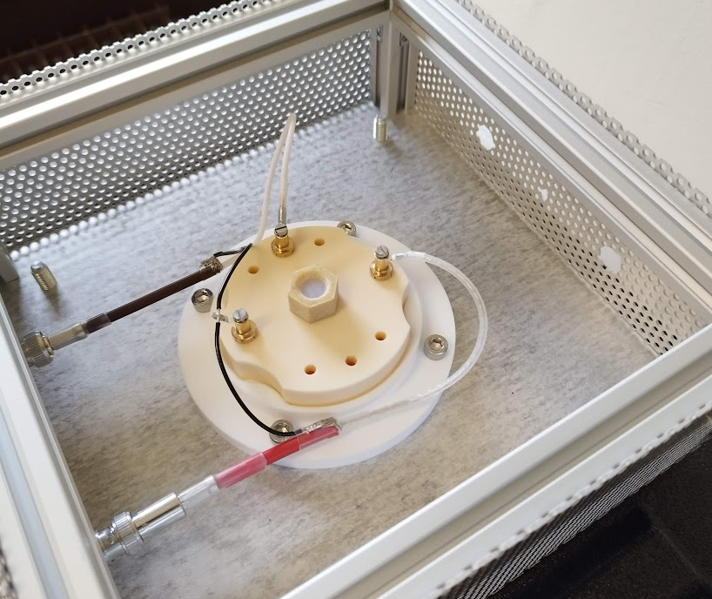
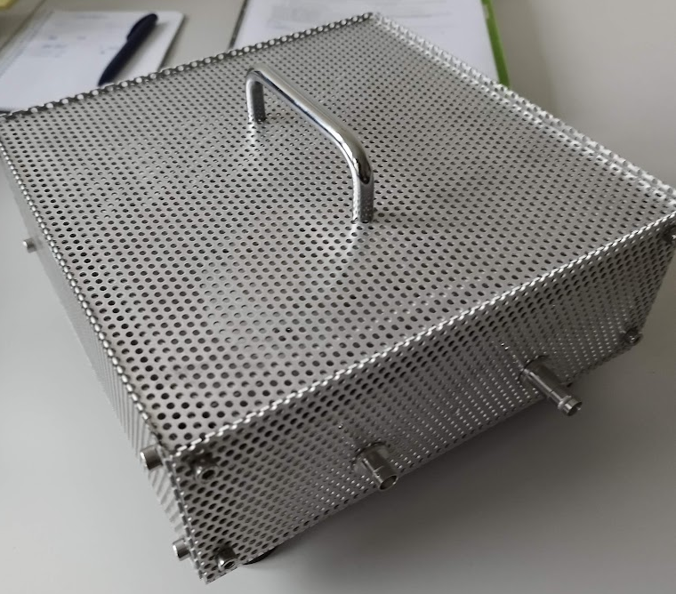
Critical Component: Ceramic Insulator
  Very stringent insulation requirements
    <1pA current leakage
  Some insulators have much higher current leakage (out of spec., not acceptable)
  Current leakage can be measured on the dedicated insulator test bench
  Ceramic parts must be ready for installation after manufacturing; cleaning difficult and risky
  Test campaign ongoing to check the quality of the stored ceramics

Slide 11
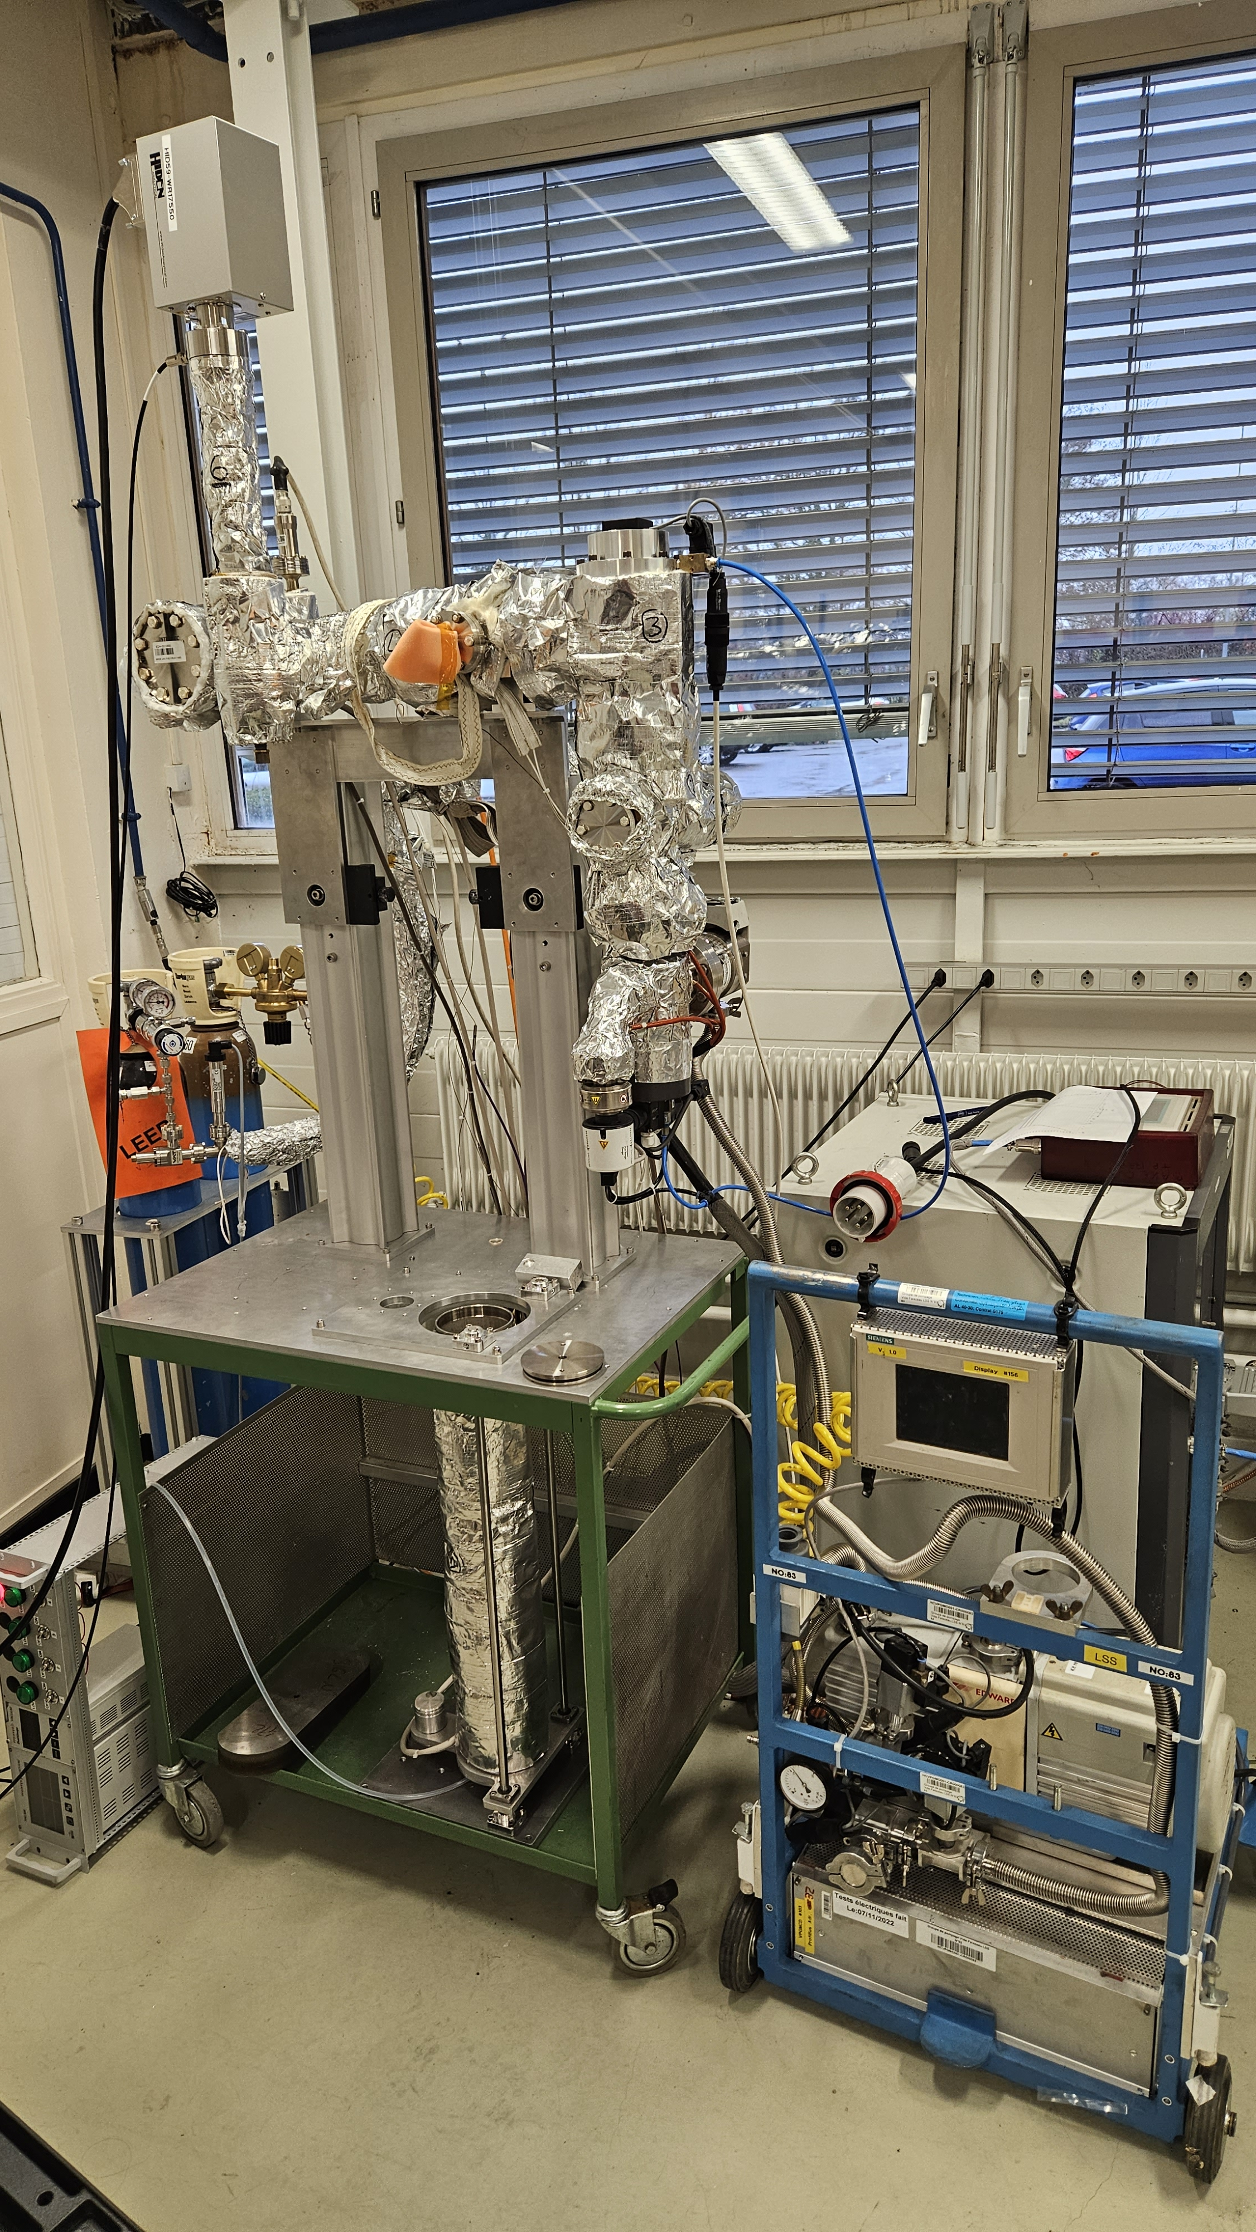
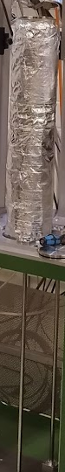
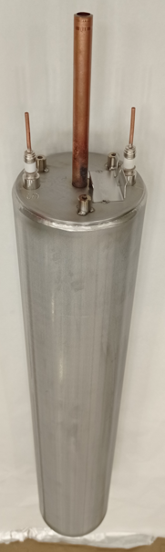
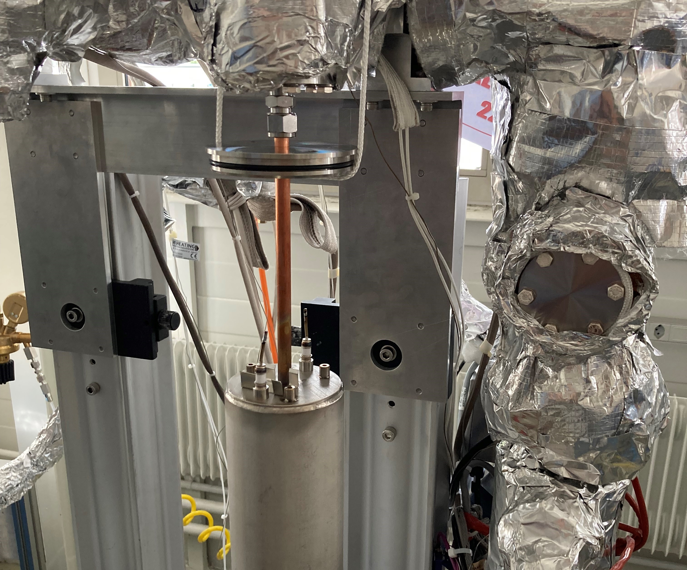
Vacuum Test Stand Build in 2023
  BLM bakeout and leak check housing
  Pumping station
  Bakeout equipment
  Residual gas analyser
  Gas refill

Slide 12
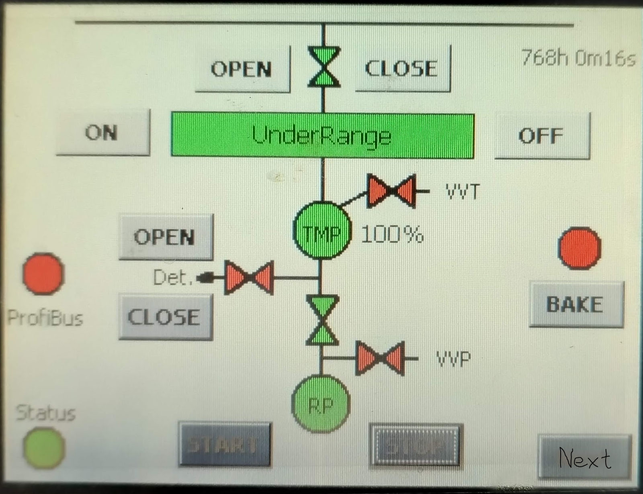
Vacuum Test Stand Synoptic
Vacuum controls
Procedure for BLM IC leak tightness tests, bake-out, N2 filling and RGA with use of vacuum stand EDMS 2916501

Slide 13
Vacuum Test Stand capacity increase
  Go from 1 by 1 bakeout to batch process 10 to 30 BLMs
  Trade-off between minimising the bakeout numbers by increasing the places on the bench the risk to start all over again in case one of the BLM leaks or fails the vacuum acceptance test.
  Space + cost constraints

Slide 14
BLM IC Menu (1/3)
2023: Les amuse-bouches
  Re-design and check that the recipe is successful
  Check how many ingredients we have in-house stored from previous productions and what we need to order
  2 BLM IC full in-house production, followed by electrical tests and full functional test in HiRadMat.
  Production of vacuum test stand

Slide 15
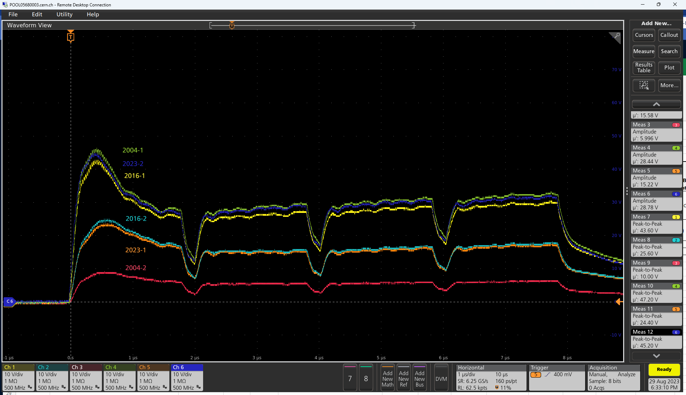
HiRadMat Test in 2023-1
Done with a beam of 288b (4x42b)
Similar Trend as previous measurements
Further details → ask BLM colleagues
Courtesy: C. Zamantzas

Slide 16
BLM IC Menu (2/3)
2024: The starter
  Produce in-house 10+ BLM in-house to assure all chefs and sous-chefs know all steps by heart and optimise the recipts https://en.wikipedia.org/wiki/Brigade_de_cuisine
  Buy all ingredients (Total 10 orders > 50 kCHF, 1 between 0.5 and 1 MCHF)
  Agree all contracts, documentation, increase capacity of vacuum test stand

Slide 17
BLM IC Menu (3/3)
2025: Main Menu
  Assure for minimum production 400 BLM IC fully tested
    Need capacity of CERN in-house production, test, Quality Assurance (QA)
    Ramp-up production in industry or collaboration
  Follow-up production and quality assurance and documentation
2026: La suite
  Assure for a further production of 600+ BLMs
Total 1000 BLM ICs to be produced of which are 200 for HL-LHC

Slide 18
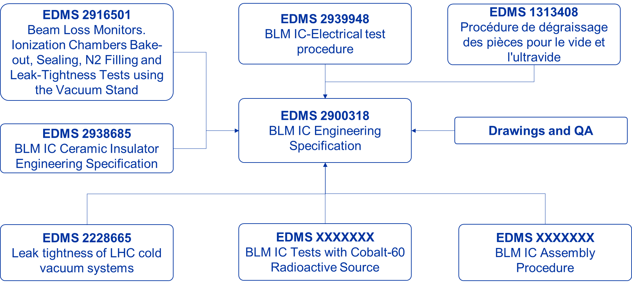
Present Situation –
Engineering Specifications

Slide 19
Production options for assembly, vacuum test and documentation
Full in-house production
  - Space, Manpower, tooling, QA…
Full external production
Collaboration in-house and institute (or company)
  - Overhead, travel, off-site, technology transfer, …
  → In all cases, CERN will procure all components

Slide 20
Summary
1000 BLM ICs to be produced of which 400 by end 2025
Full CERN in-house know-how to build and test gained
Work on engineering specifications and procurement
Put in place Asset Management and Quality Assurance
All components procured by CERN
Assembly, vacuum test and QA in company or collaboration, some at CERN
→ Further information in EDMS BLM IC

Slide 21
Questions
or

Slide 22
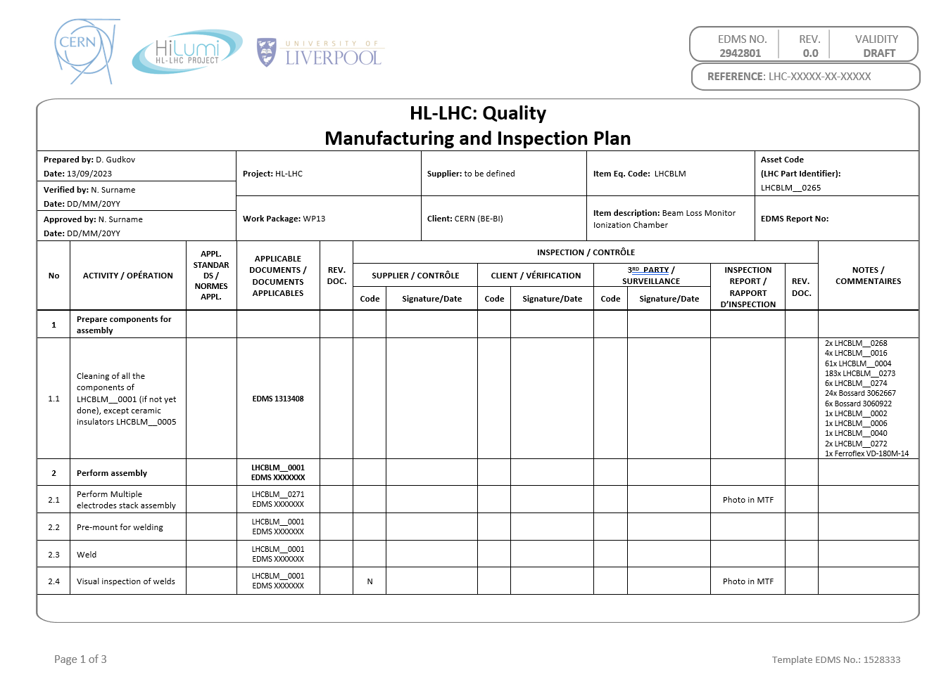
Manufacturing and Inspection Plan (MIP)

Slide 23
Production Procurement Proposal
Procurement of all material by CERN
  Gain time to agree on production route
  Control of parts to be assembled
  No obvious reason that we would lose money
Build second Test Stand in institute/company if no in-house production

Slide 24
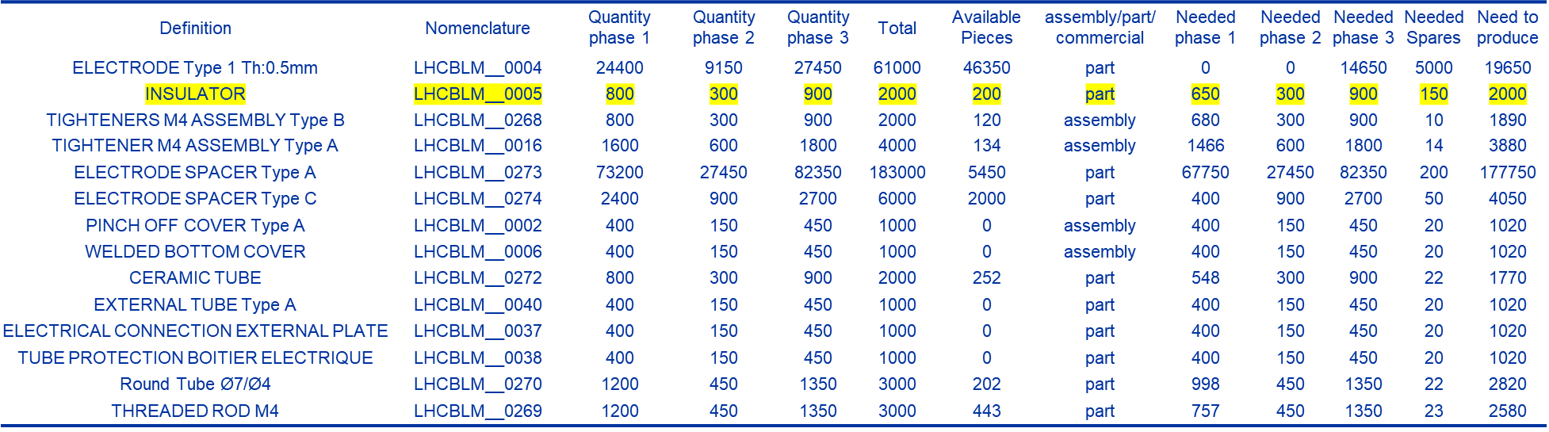
Present Situation – Material on Stock at CERN
(and to be procured)

Slide 25
Procurement values
Most expensive and critical single order expected to be the ceramic spacer
  Friatec price in 2016: 44.40 EUR/piece
  We calculate with 90 CHF/piece and we need 2000 → below 200 kCHF
Industry assembly
  Assume 4h*100 CHf/h*1000 BLM
  200 CHF/bakeout piece

Slide 26
HRM
This is with a beam of 288b (4x42b)
  Not ideal conditions for this measurement
  Scope and detector saturated
The top three trends are for three different productions
  Installed at the same location
  Prototype (blue) shows behaviour similar to the first production (2006/green) and 2016 production (yellow)

Slide 27
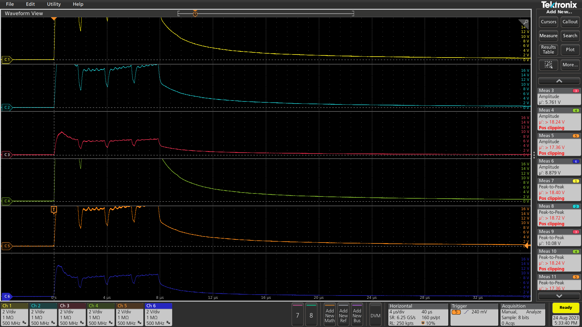
Saturation of inputs

Slide 28
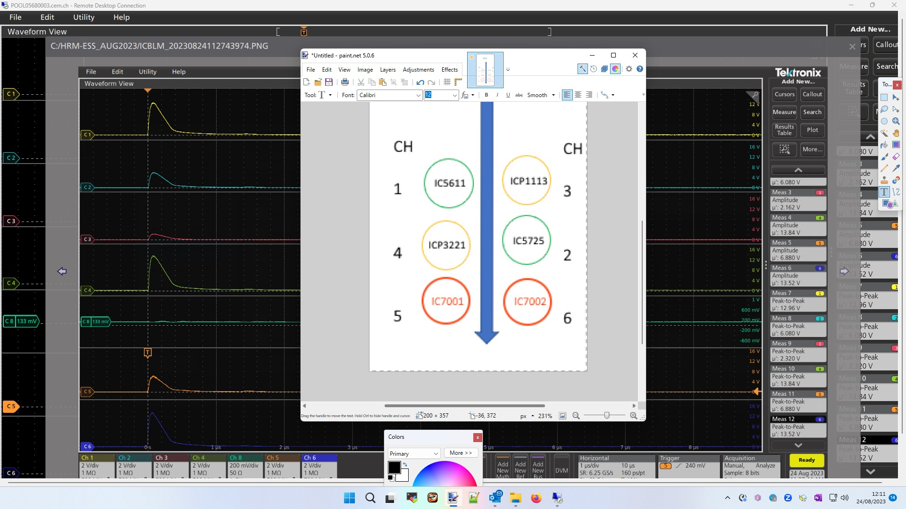
Channel Organisation

Slide 29
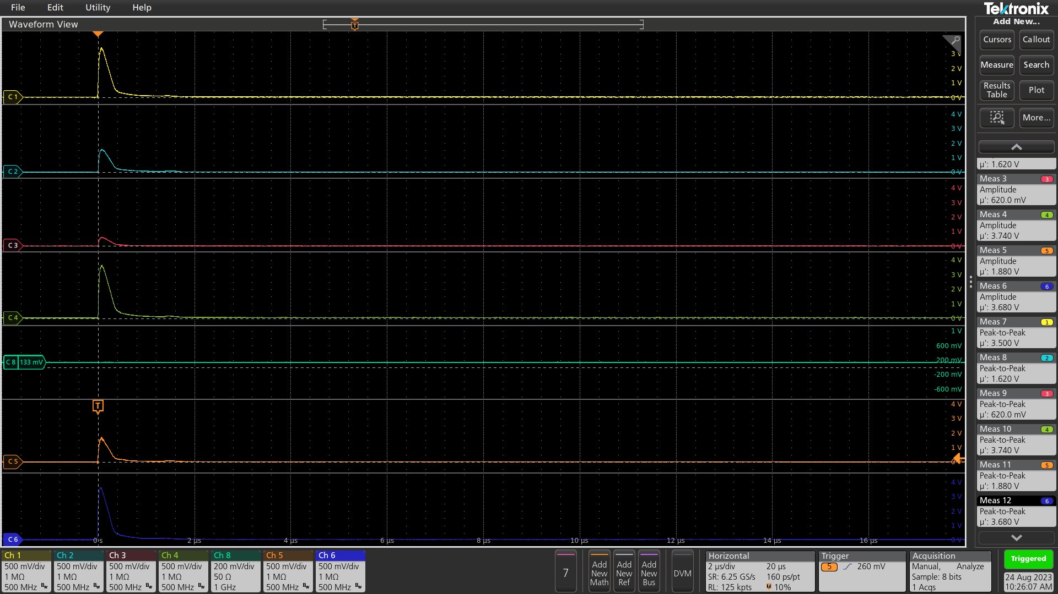
Channel 6 uncertainty 1/2

Slide 30
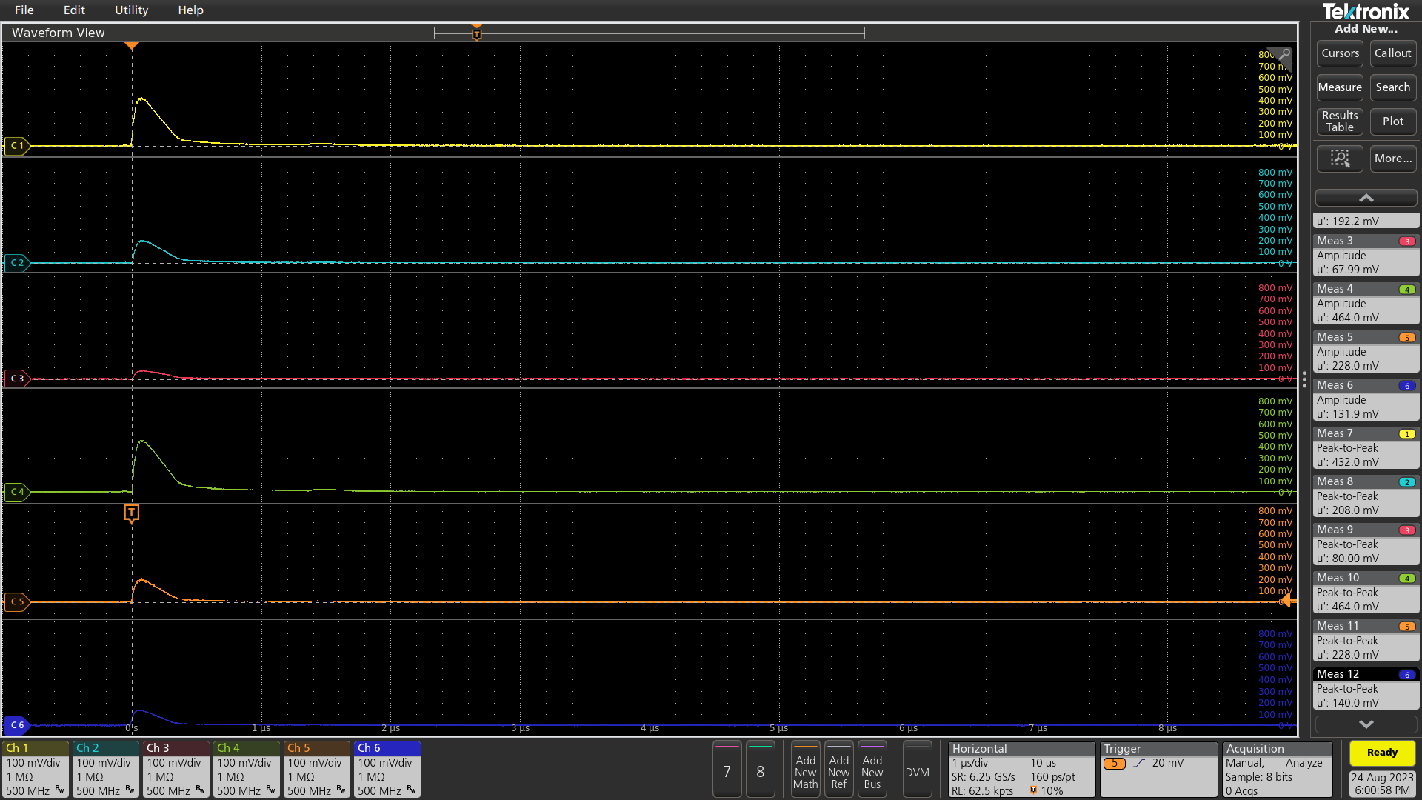
Channel 6 uncertainty 2/2

Slide 31
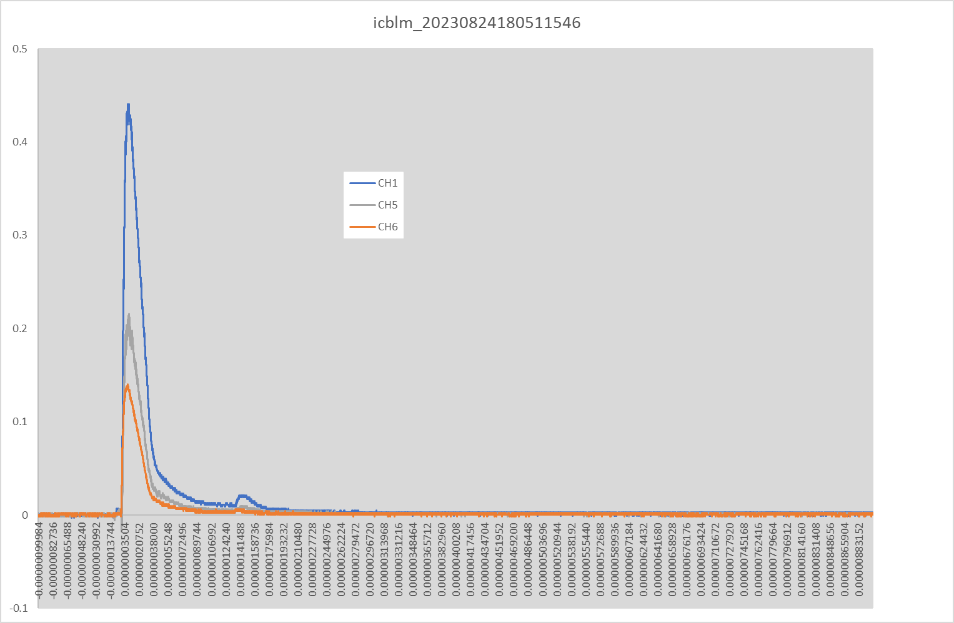
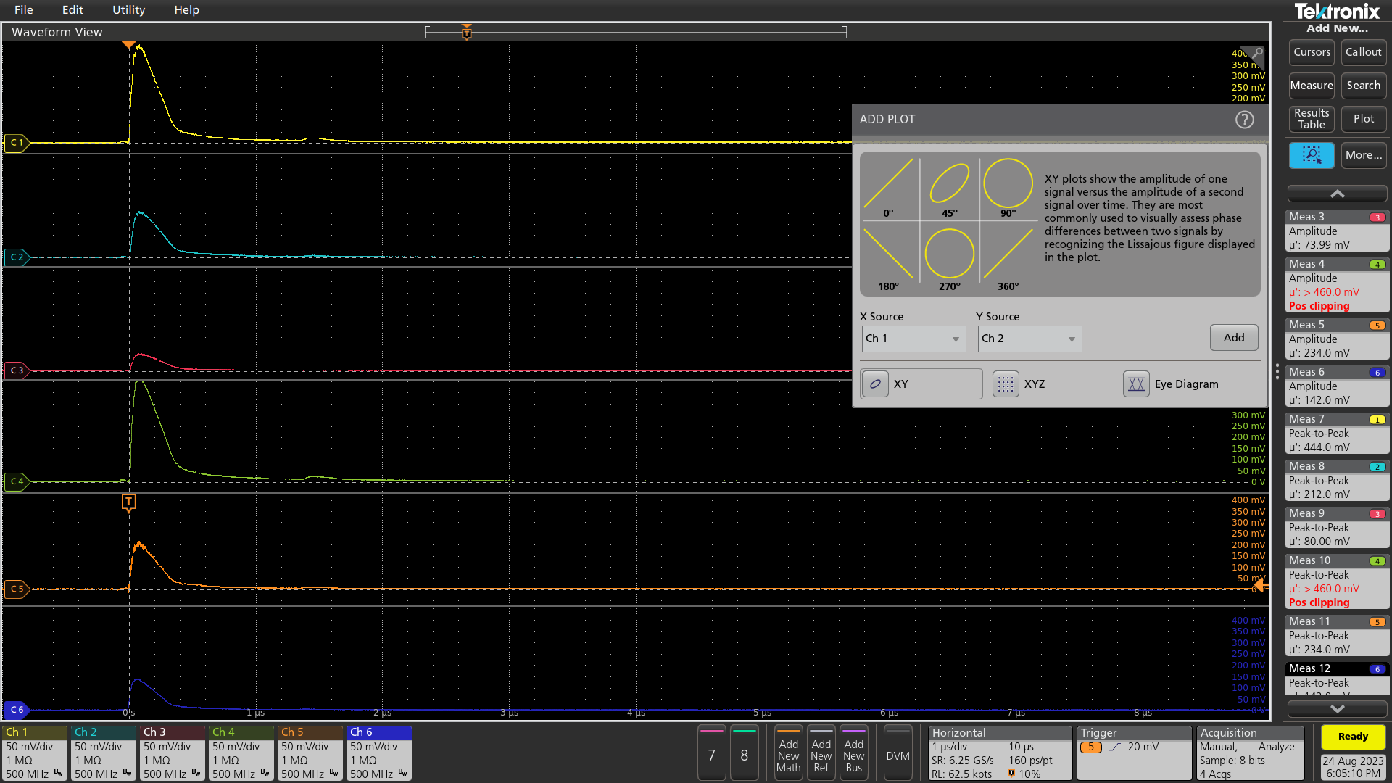
icblm_2023-08-24 18:05:115.46

