Slide 1
HL-LHC Beam Position Monitor Mechanics
Emma Quinn
SY-BI-ML
14/12/2023
Working alongside: M. Krupa, G. Schneider, L. Havart

Slide 2
Contents
BPM Background
HL-LHC
Warm BPMs
Cryogenic BPMs
Summary

Slide 3
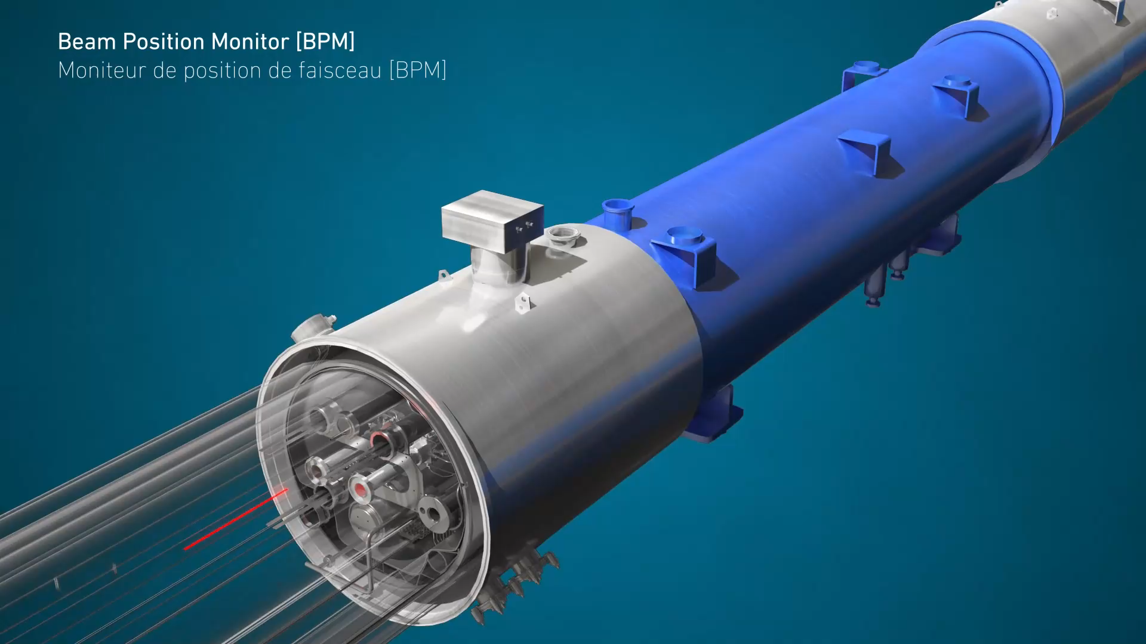
What is a BPM
Beam Position Monitor
(Video: https://videos.cern.ch/record/2697283)

Slide 4
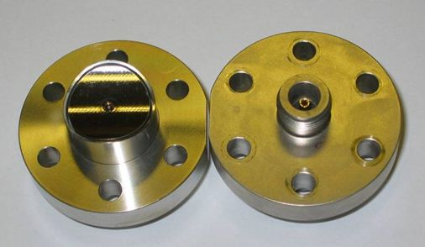
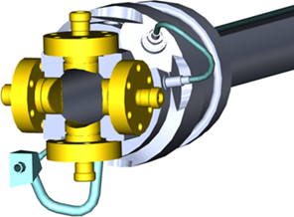
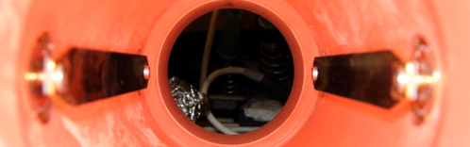
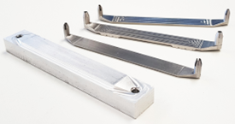

Electrodes
Button Electrodes
Stripline Electrodes
Complex, fragile mechanics
Frequency response defined by the electrode length
Specialised measurement
It is possible to distinguish between the directions of beam propagation and to record only the position from one beam
“Default” choice for most BPMs
Simple mechanical design
Small size
Commercially procured component
Cost effective

Slide 5
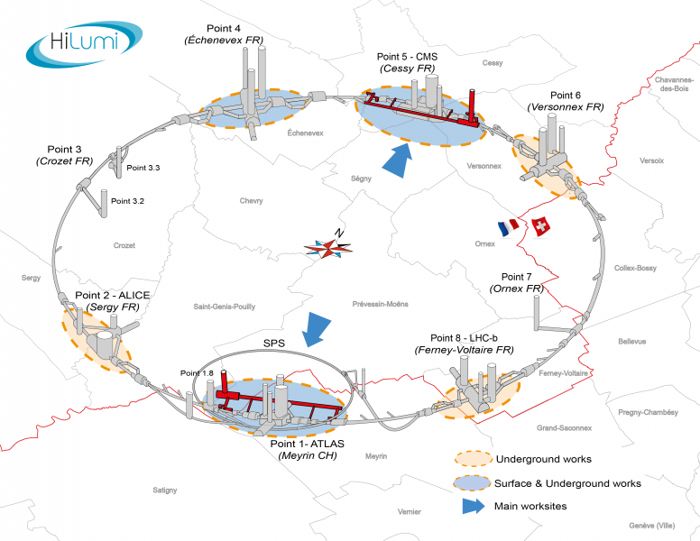
HL-LHC
High-Luminosity Large Hadron Collider
Project aiming to upgrade the performance (luminosity) of the LHC to increase the potential for discoveries
Luminosity = no. of potential collisions per surface unit in given period of time
Higher luminosity = increase of experimental data = more observations
Aim for operation from the beginning of 2029

Slide 6
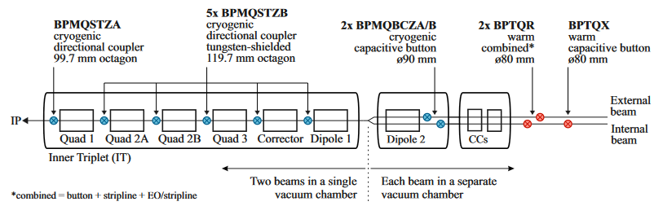
A
5x B
2x D2
2x BPTQR
Upgrades to magnets at IP1 and IP5
32 Cryogenic BPMs
4 A type
20 B type
8 D2 type
+2 Spare per type
8 Warm (BPTQR) BPMs
+ 2 spares

Slide 7
Warm BPMs

Slide 8
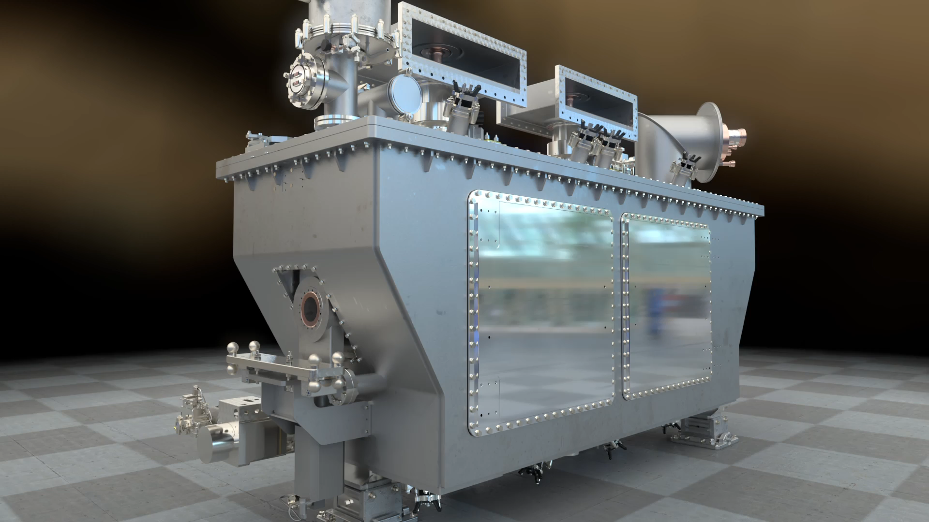
Crab Cavity (CC)
Monitoring of the beam current close to the CC location to correct the crabbing phase.
Monitoring of the beam current close to the CC location as an antenna generates a signal used to regulated the CC field to remove undesired coupling through Adaptive Noise Cancelling techniques.
Excessive CC noise results in an additional bunch tilt outside of the crabbing region
(Video: https://videos.cern.ch/record/2697283)

Slide 9
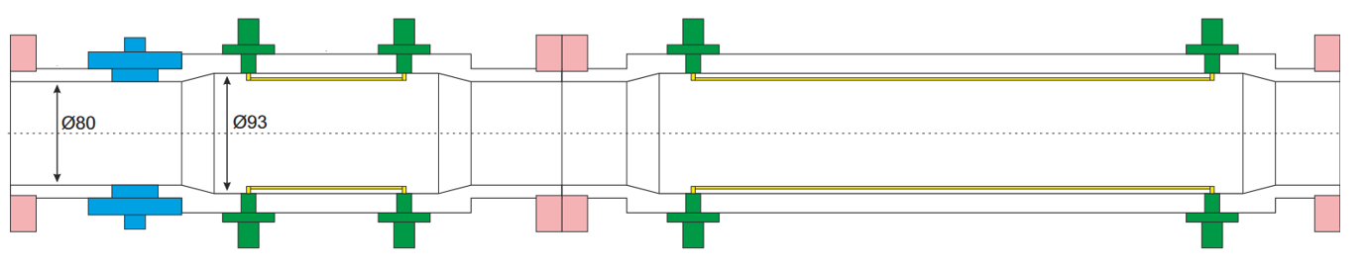
Warm BPMs – preliminary design
New BPM pick-ups for the HL-LHC crab cavities.
Button
Stripline
Stripline
BPTQR pickup
Stripline BPW
BPTQR BPM
BPTQR BPM consists of 2 different pickups that are rigidly attached to each other.
BPTQR pick-up
BPW pick-up
L. Harvart Warm BPM Presentation: https://indico.cern.ch/event/1348175/contributions/5674900/attachments/2763676/4813838/BPTQR%20design%2001.12.2023%20.pdf

Slide 10
Warm BPM design requirements
Vacuum Requirements
Alignment Requirements
BPM interface
Large Radial Movement bellows modules on both sides as it is a Full Remote Alignment System (FRAS) baseline.
Bellows allowing radial displacement up to 2.5 mm in each direction.
Interaction to bellow using CF DN100 flanges → Same flanges on the BPM
Coating
Due to the large length, most likely need to be NEG coated
Bakeout
Bakeout jackets will be place over the BPM
Universal Alignment Platform (UAP) - work in progress
Full Remote Alignment System (FRAS) specification:
The BPTQR BPM will be align on a “Manual standardized adjustment platform” for realignment during Long Stop and YETS.
Beam instrumentation strategy is to use a Universal Alignment Platform (UAP).
L. Harvart Warm BPM Presentation: https://indico.cern.ch/event/1348175/contributions/5674900/attachments/2763676/4813838/BPTQR%20design%2001.12.2023%20.pdf

Slide 11
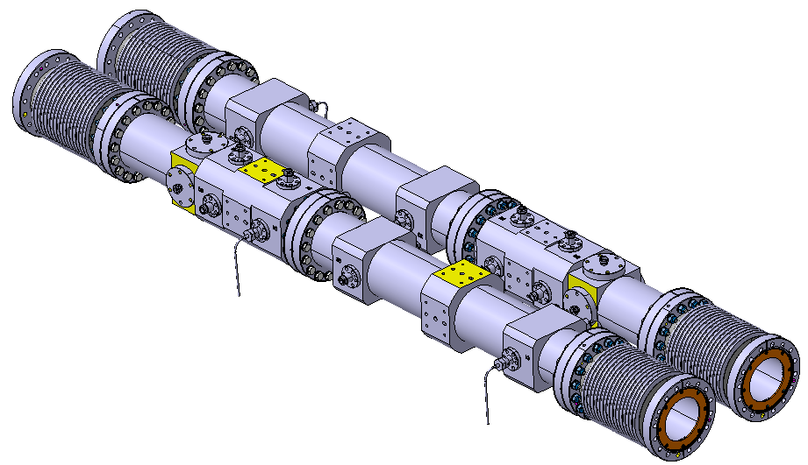
Current design
1150 mm long pick-up
Ø80mm to Ø93mm
Weight: 120 Kg for Beam 1 and Beam 2 BPM + 4 bellows.
BPTQR: 4 x button electrode + 4 x 120 mm stripline electrode.
BPW: 2 x 400 mm stripline electrode.
CF DN100 flange with bolts and nuts
Stainless steel EN 1.4429 (316LN).
Beam is entering through the same pick-up in both lines.
Large Radial Movement bellows on each side .
CF DN100 flange with bolts and nuts.
L. Harvart Warm BPM Presentation: https://indico.cern.ch/event/1348175/contributions/5674900/attachments/2763676/4813838/BPTQR%20design%2001.12.2023%20.pdf

Slide 12
Cryogenic BPMs

Slide 13
A
5x B
2x D2

Slide 14
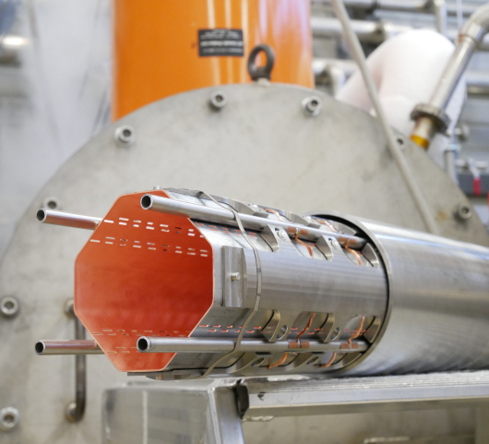
Beam Screen
Shields for the cold bore of the superconducting magnets from synchrotron radiation power and power dissipation to keep magnets cold
New beam screens will be installed in the Inner Triplet (IT) quadrupole magnets and dipoles
Different aperture to previous beam screens, therefore new cryogenic BPMs must be designed and manufactured

Slide 15
Cryogenic BPMs
A (Q1 “BPMQSTZA”)
B (Q2A-D1 “BPMQSTZB”)
D2 (“BPMQBCZA/B”)

Slide 16
A
Octagonal Aperture Shape
Directional Coupler (stripline electrodes)
D99.5XL270.6
60-80K
Body
Cooling tube (x4)
Cooling tube support
Octagonal-octagonal transition
Electrode (x4)
Electrical feedthrough
Octagonal-round transition

Slide 17
B
Octagonal Aperture Shape
Directional Coupler (stripline electrodes)
D125.1XL270.6
60-80K
Cooling tube (x4)
Body
Thermal link
Octagonal-round transition
Cooling tube support
Tungsten Absorber (x4)
Electrode (x4)
Electrical feedthrough
Octagonal-octagonal transition

Slide 18
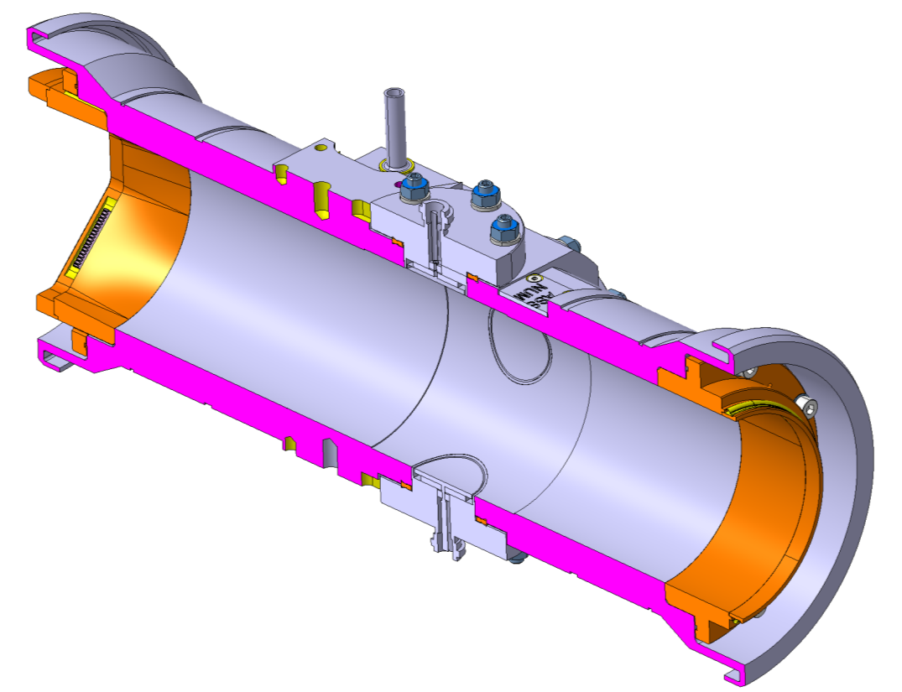
D2
Circular Aperture Shape
Internal cooling tube channel
Button electrodes
D90XL398.4
4.5-20K
Body
Cooling tube (x4)
Round-octagonal transition
Electrode (x4)
Electrical feedthrough
Round-Round transition

Slide 19
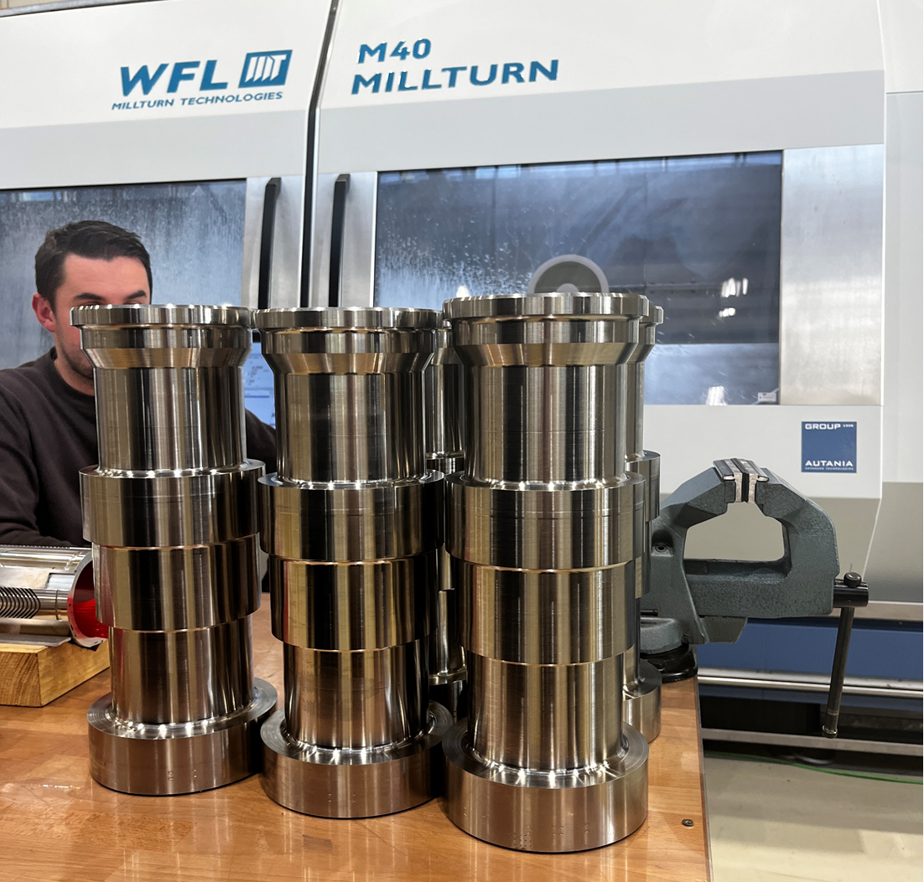
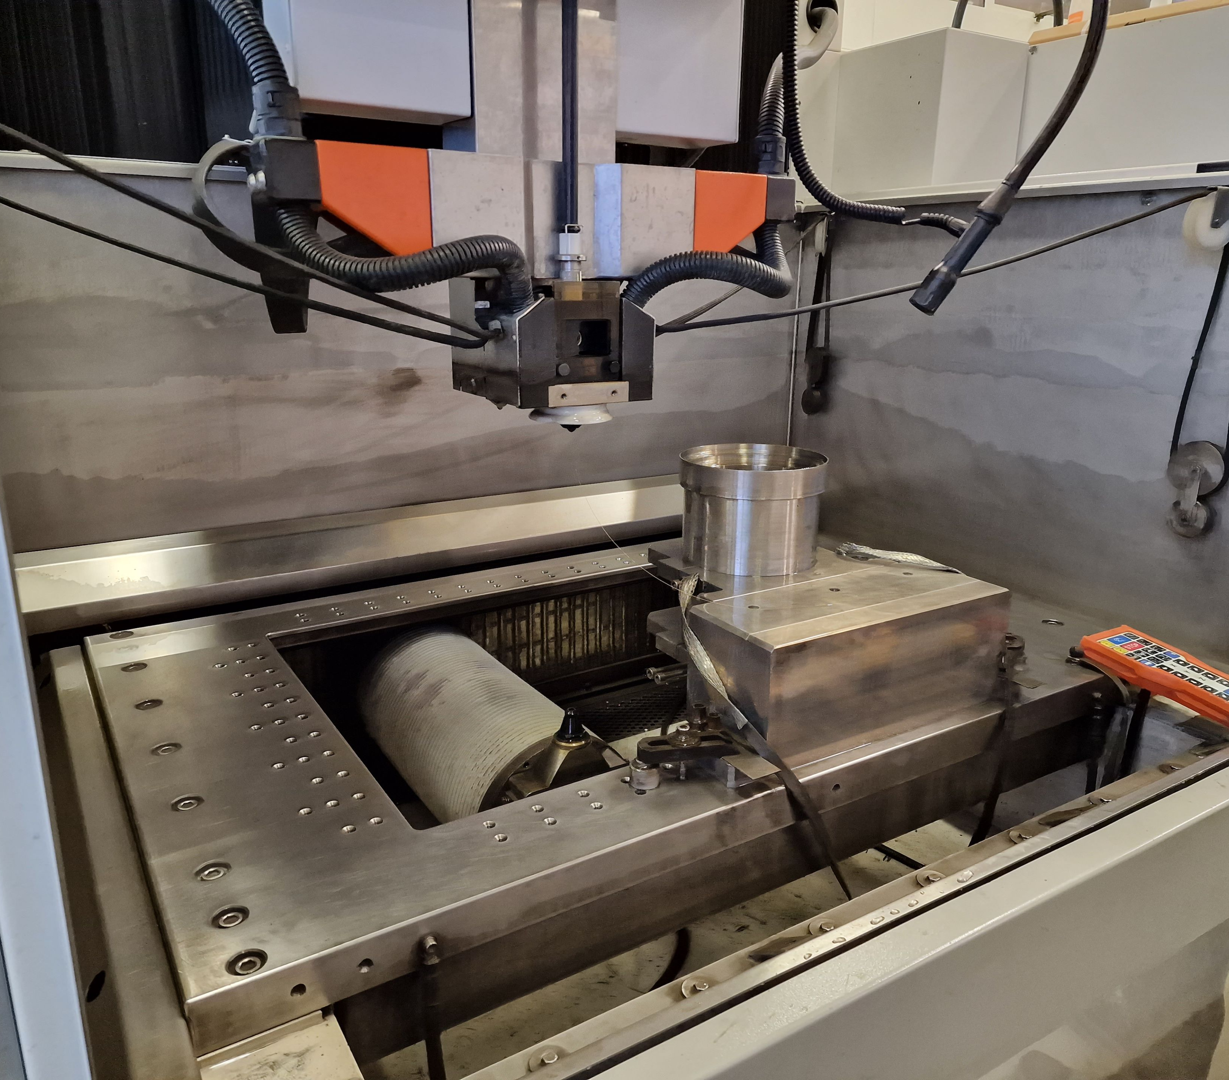
Manufacturing Process
Machining work, coatings and assembly all performed at CERN
Electroerosion Wire Cutting
Machining
Stainless Steel 316LN

Slide 20
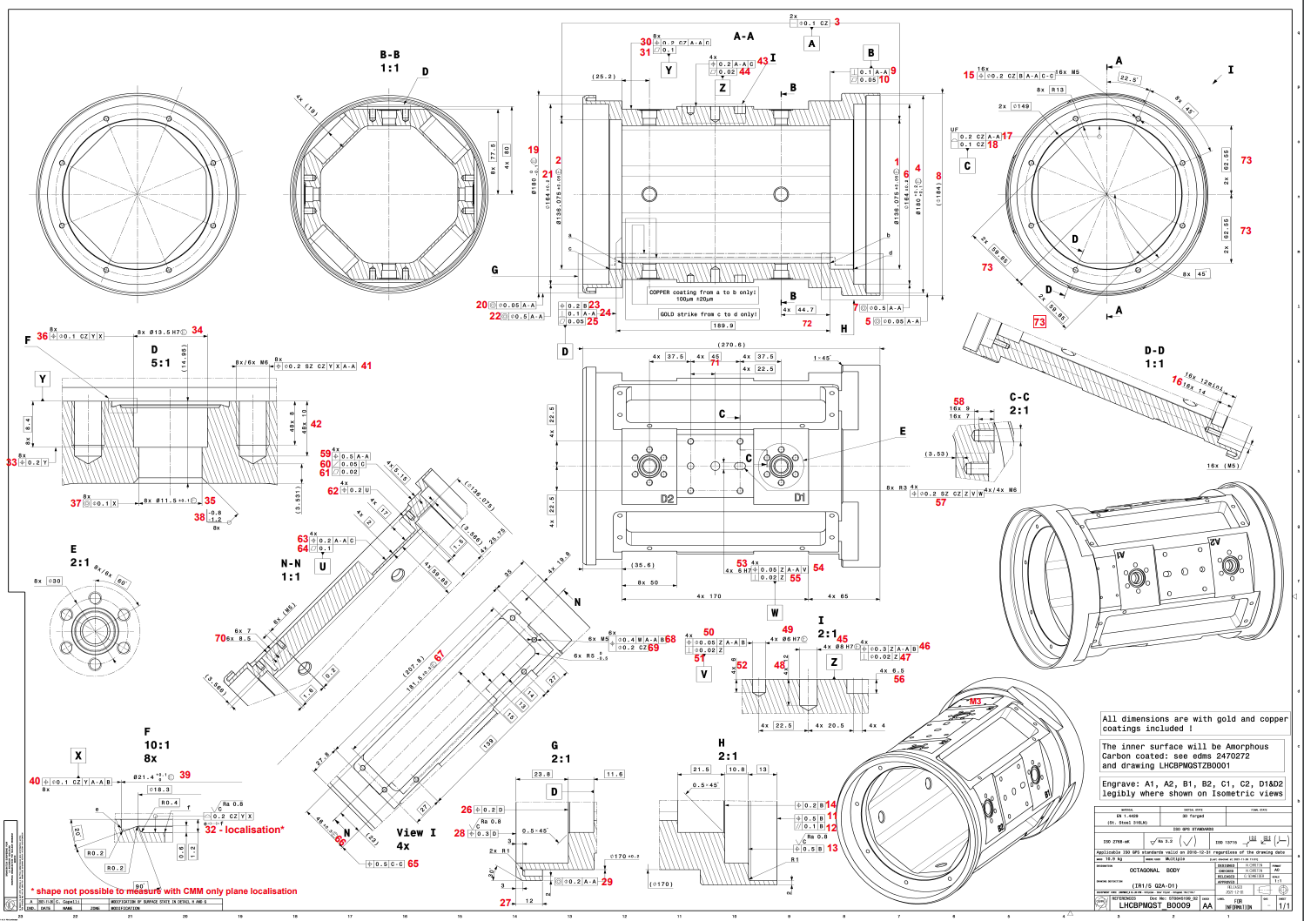
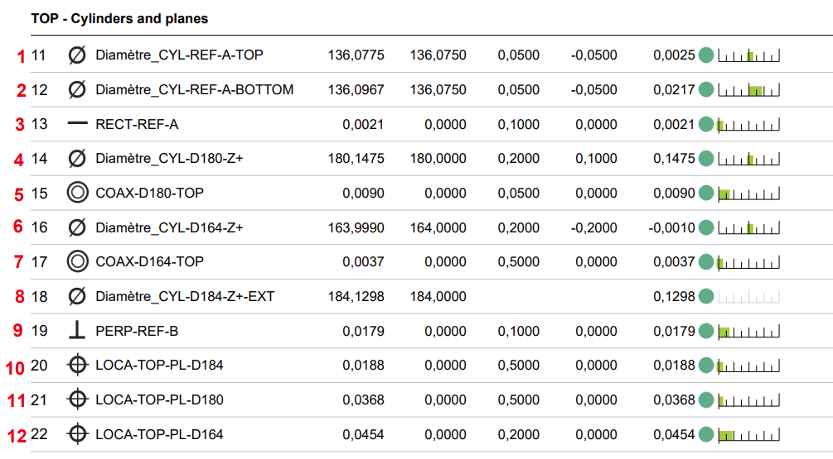
Testing
Metrology Reports
Metrology dimensional checks in EN-MME in b.72 CERN
Dimensional control of bodies to CAD, tolerance checks, thread checks

Slide 21
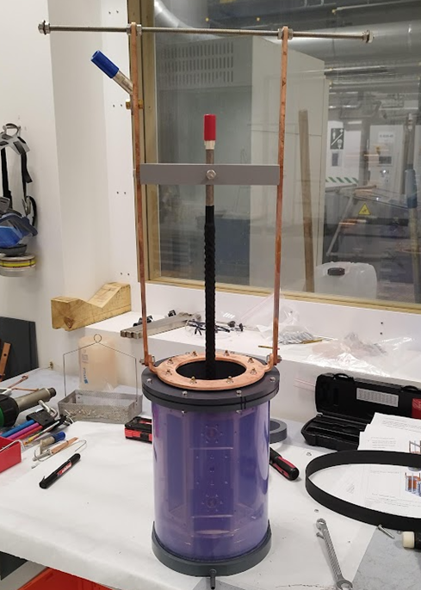
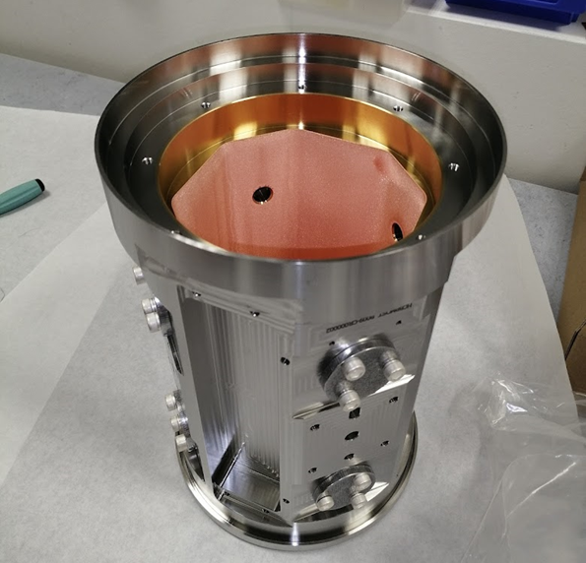
Thickness = 0.1±0.02 mm
Cu Coating
Electroplating
with Au flash to adhesion

Slide 22
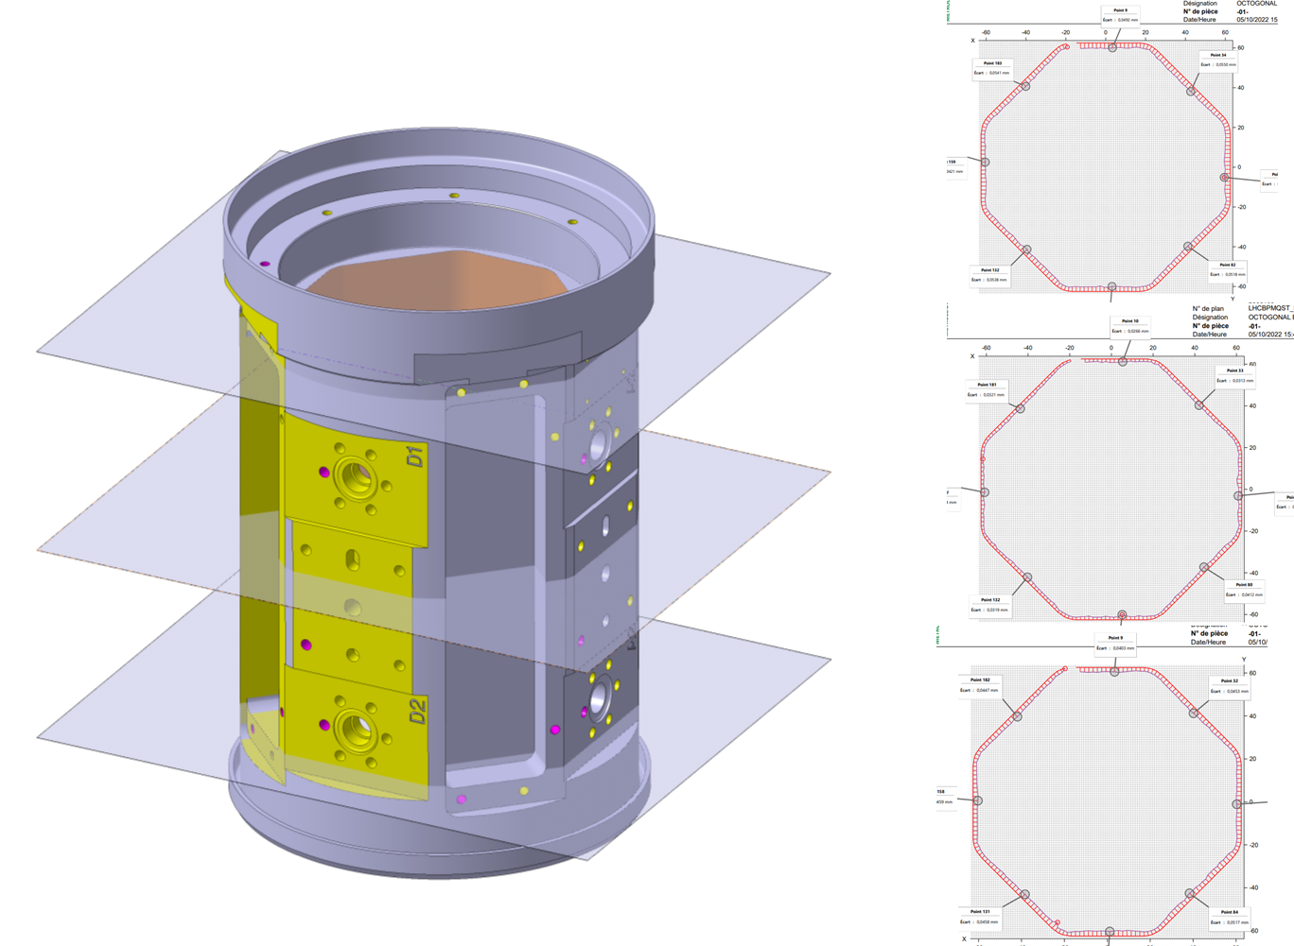
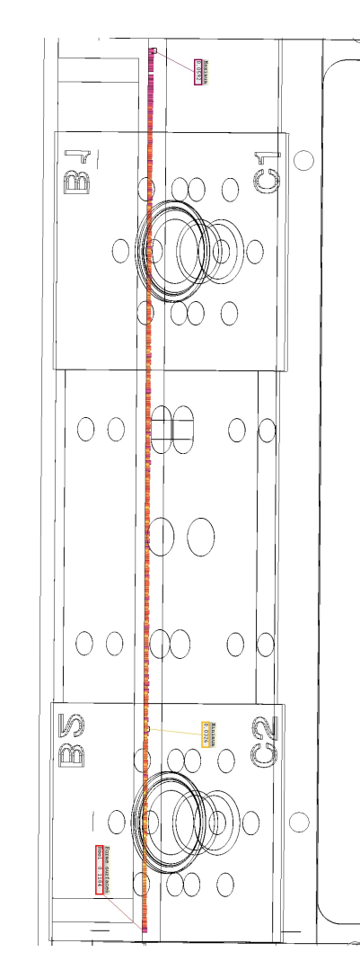
Testing
Metrology
Au/Cu thickness check, tolerance check

Slide 23
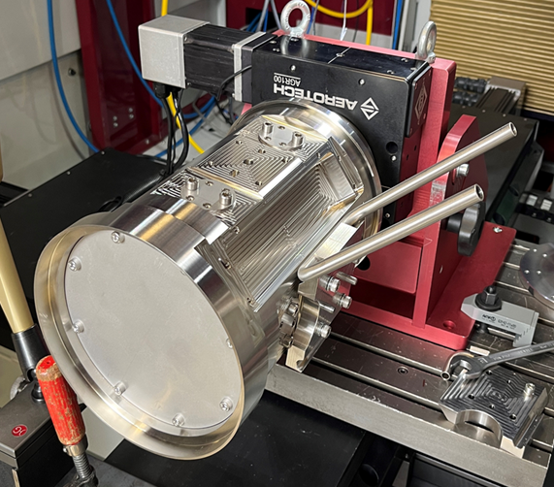
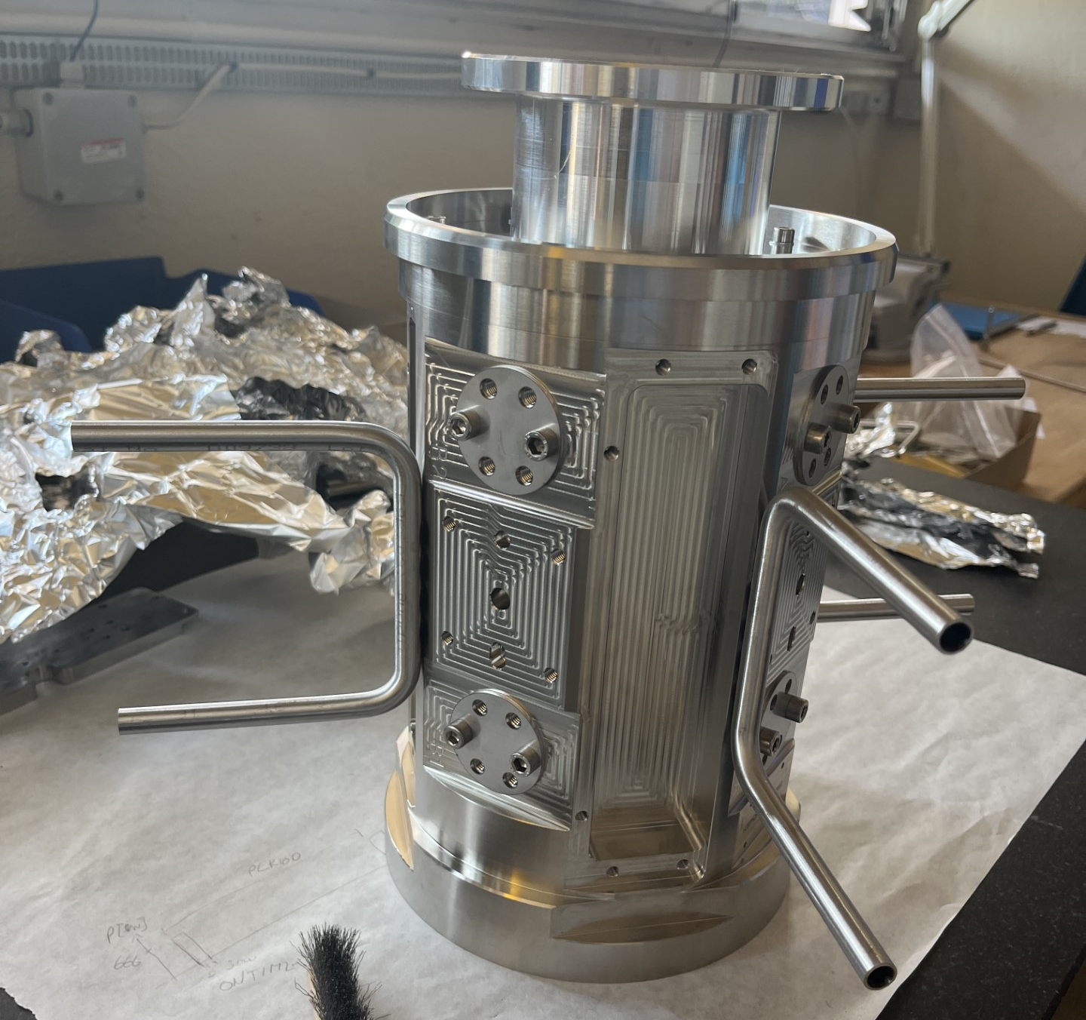
(excluding D2 – cooling tubes will be TIG welded)
Laser Welding

Slide 24
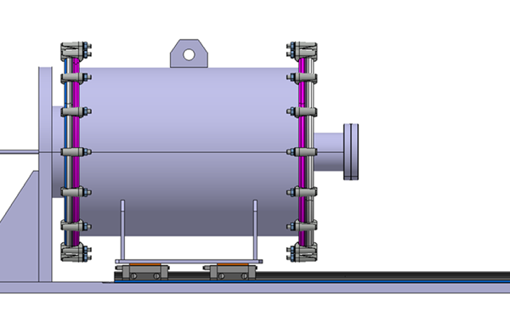
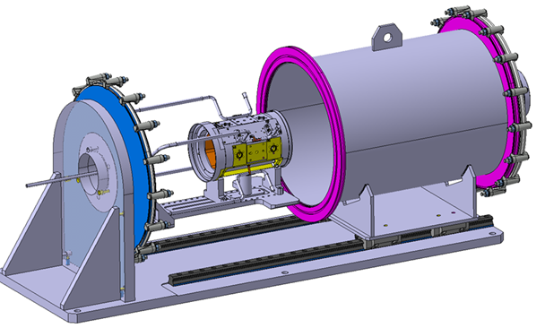
Testing
Leak/Pressure Test – work in progress
perform simultaneous leak test BPM external cooling tubes and pressure test vessel
elements and structures are robust; leak-tightness of the welds
Cooling tube tested with pumped He through a spider connection to 28bar
Vacuum chamber will pump down to 0.5bar
Leak/Pressure Test Tooling

Slide 25
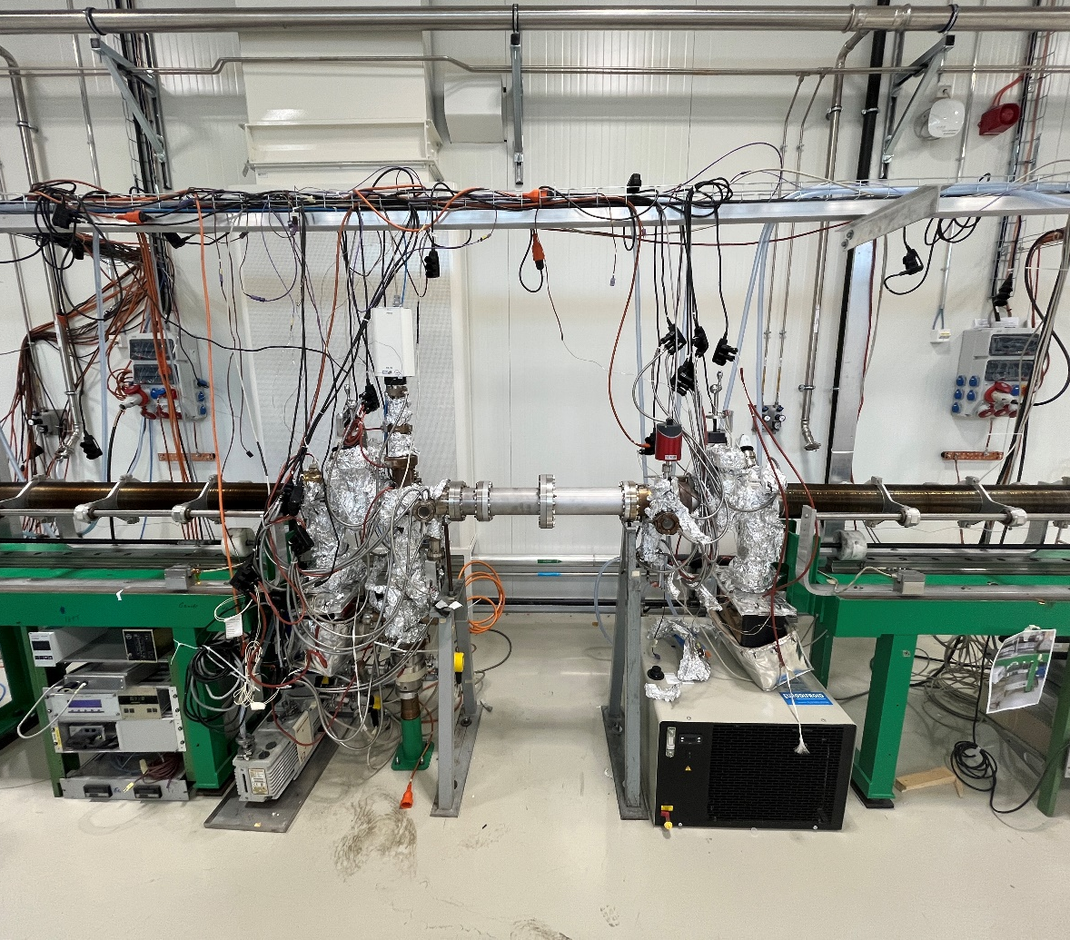
Amorphous Carbon Coating
(aCc)

Slide 26

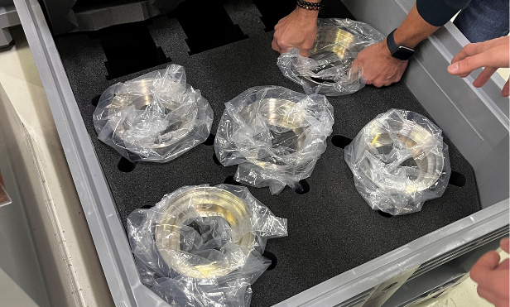
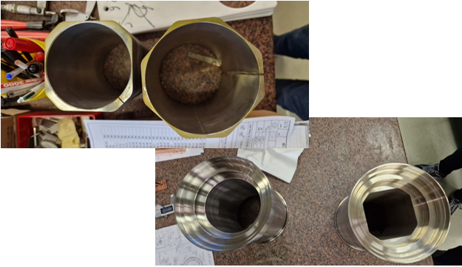
BPM Series Production Update
All A type BPMs are completed in Electroerosion wire cutting – moving onto B type BPM
D type will commence in 2024,
Bodies currently on machine
All copper components of the BPMs will be finished by end of year
All small parts of BPMs (brackets, Tungsten blocks etc) are finished

Slide 27
After Manufacturing Production
Storing the BPM in N
Assembly of electrodes
Cold testing of assembly
BPM to Beam Screen cooling tube integration
Welding BPM to Beam Screens
Integration into cryostat

Slide 28
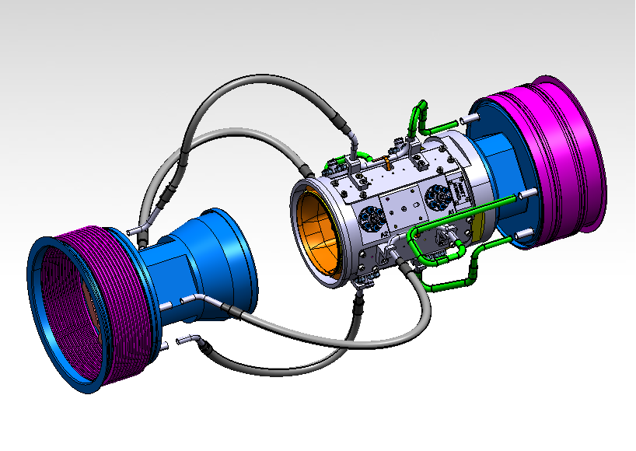
BPM/Beam Screen Alignment

Slide 29
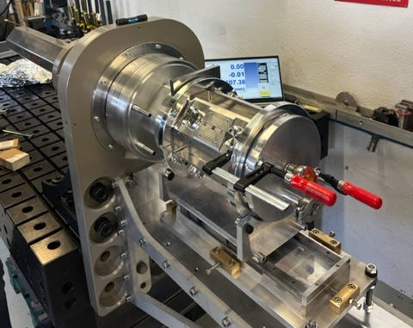
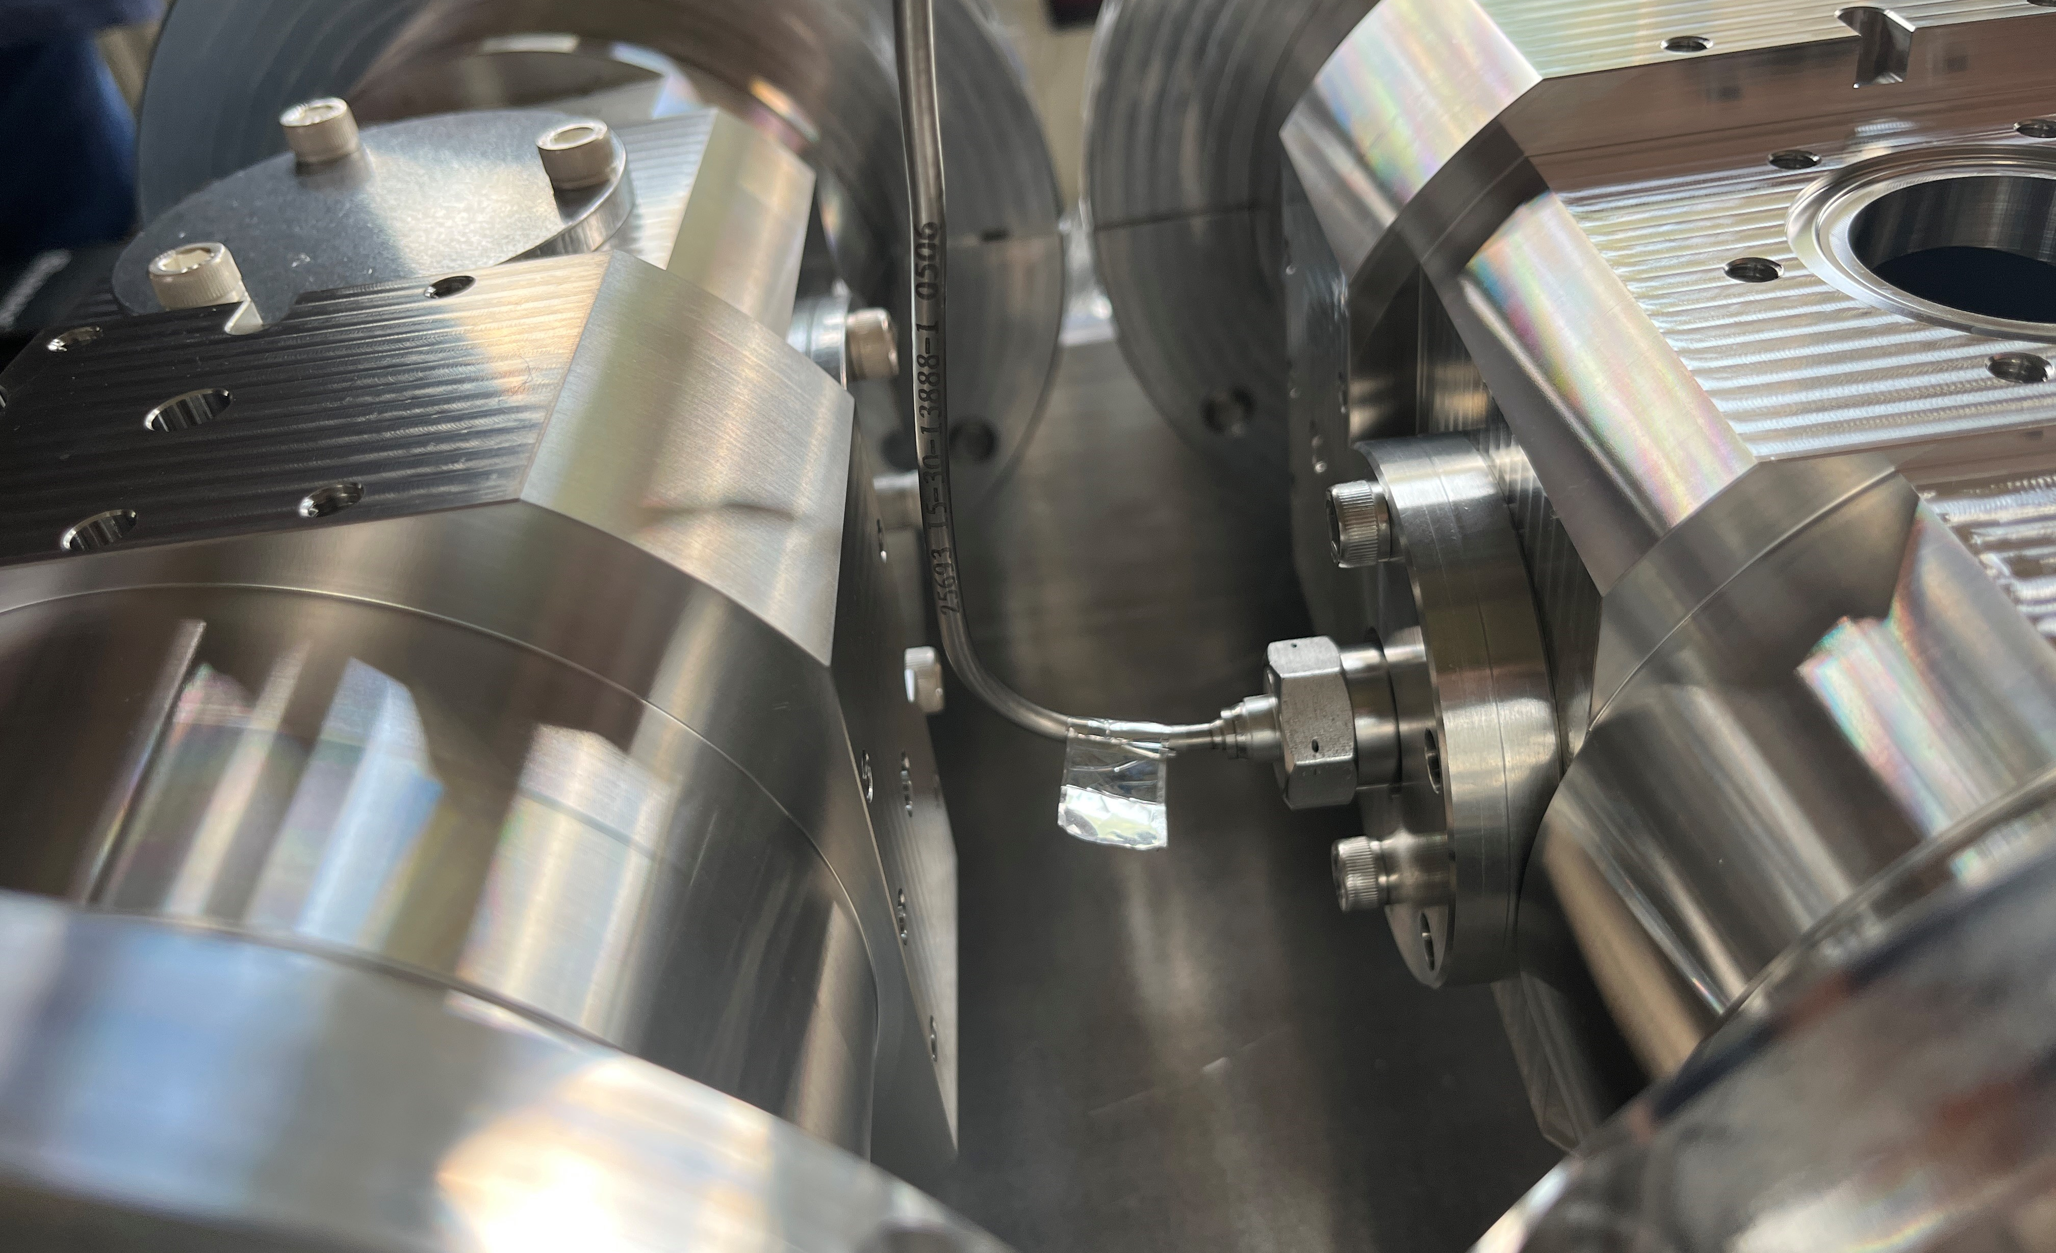
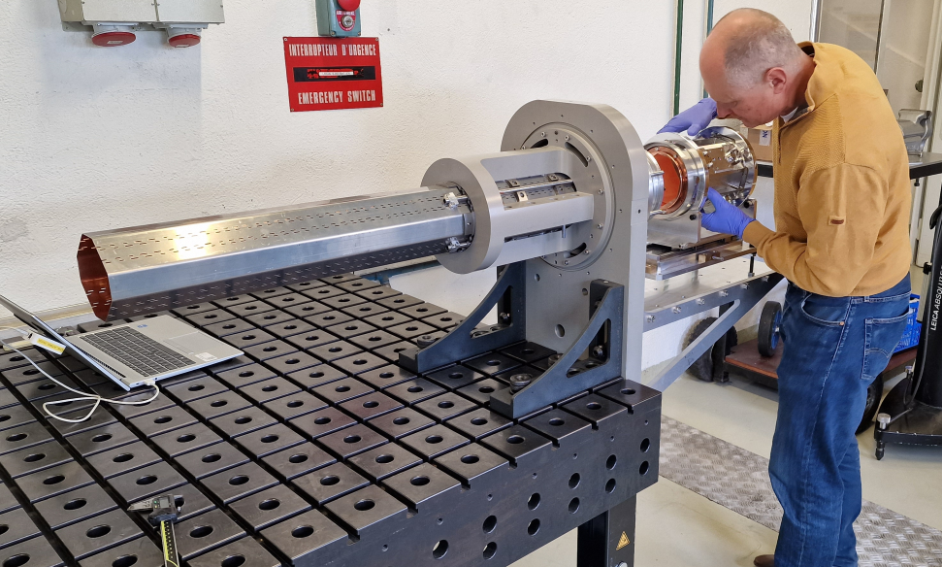
Testing
Alignment Checks
D2 Cable Alignment test
Check the accessibility on semi-rigid cables for D2 BPMs during their alignment in the tunnel with mockup alignment platform and electrode
Resulted in groove being designed in body to accommodate for extra space
Beam Screen/BPM alignment test
Validate the two interfaces, aligning ideally below 0.1mm, with roll angle of 0.1mrad to beam screen aligned within 0.1mrad
HL-LHC BPM/Beam screen assembly was tested on the TE-VSC mock-up in b.376, checked with BE-GM, validated by laser tracker geometer alignment tools
BPM/Beam Screen Alignment
D2 Cable Alignment

Slide 30
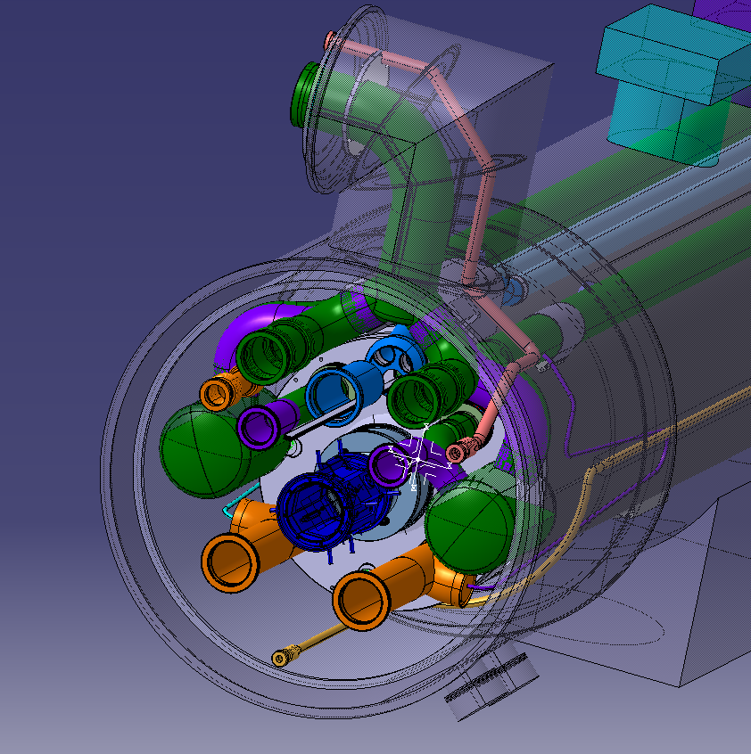
Integration into the cryostat

Slide 31
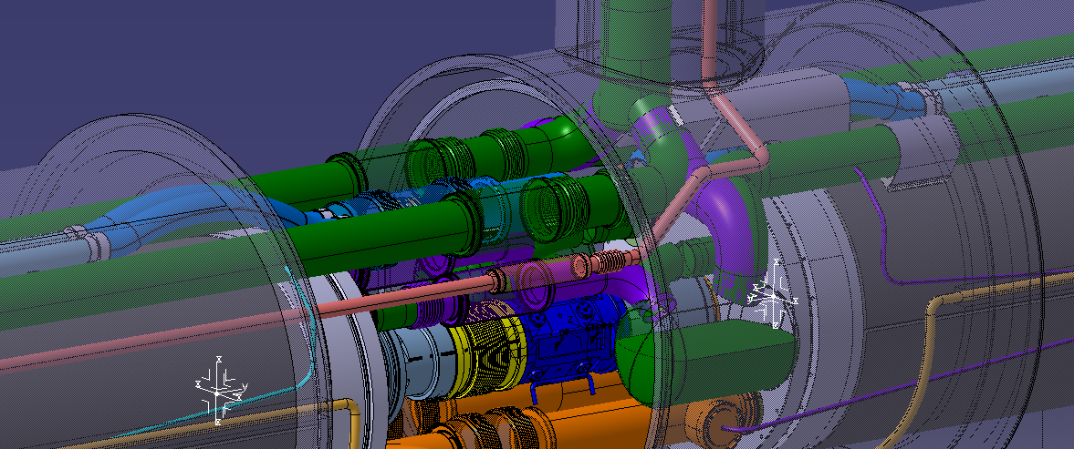

“Gaining invisibility”

Slide 32
Next Steps
Warm HL-BPMs
Cryogenic BPMs
Find a way to fix the electrode’s semi-rigid cable.
Confirm the electrodes selected for the stripline BPW pick-up.
Electro-optical (EO-BPM) transducer technology or the traditional stripline transducer
Deliver the 3D model to the integration team.
Thermal analysis of the body and the electrodes during bakeout.
Tolerance stack analysis of the BPTQR and BPW assemblies
What is the acceptable limit → what is the lowest tolerance achievable from a mechanical assembly point of view.
Leak and Pressure testing for the cooling tubes and body in SMA18
Copper Coating RRR testing of the baths for the series production
aCc for the pre-series production
Electrode position
Beam 1
Beam 2
BPTQR
BPW
Assembly coaxiality defect.

Slide 33
Summary
Warm HL-BPMs
Cryogenic BPMs
Installation of Crab Cavities require the new BPM for Crab Cavities diagnostic is called BPTQR and it consists of 2 different pickups.
Further input from the Crab Cavities and RF group concerning the electrode technology chosen for this BPM
All technical requirements have been considered.
3D Model is ready to be presented to the integration team for space reservation update.
3 types of cryogenic BPMs
A, B, D2
Pre-series starting to go into final stages of production-
leak testing of cooling tubes, aCc, and storing under N to be finalised
Series production ongoing
Bodies to be machined in early 2024
Testing and quality control ongoing at all stages – all will be available with project MTF on EDMS

Slide 34
Thank you for listening!
Thanks to all who I’ve worked with on the project so far:
SY-BI: G. Schneider, M. Krupa, L. Harvart, M. Hamani, A. Rinaldi, L. Hanson, B. Moser
EN-MME: E. Rigutto, J. Geisser, and everyone at B.100 workshop, D. Pugnat, A. Cherif, C. Fahy, C. Garion
TE/VSC: M. Thiebert, F. Fesquet, F. Santangelo, A. Vidal, W. Vollenberg, P. Pinto

Slide 35
References
BPMs:
https://cds.cern.ch/record/1213277/files/p187.pdf
https://accelconf.web.cern.ch/d09/papers/mopd09.pdf
https://indico.cern.ch/event/965501/contributions/4063097/attachments/2145257/3615954/HL-LHC%20BPM%20Final%20Design%20Review%20-%20Mechanical%20design,%20integration%20and%20tooling.pdf
https://cas.web.cern.ch/sites/default/files/lectures/tuusula-2018/bpmsystems1.pdf
Beam Screens:
https://home.cern/news/news/accelerators/brand-new-beam-screen-cope-high-luminosity
https://accelconf.web.cern.ch/e94/PDF/EPAC1994_0208.PDF
Au/Cu Coating: https://indico.cern.ch/event/1287205/contributions/5409102/attachments/2658896/4605303/Development%20of%20the%20Coating%20Process%20for%20HL-LHC%20BPMs.pdf
Videos: https://videos.cern.ch/record/2697283
BPM/Beam Screen Alignment: https://edms.cern.ch/ui/#!master/navigator/document?D:101287309:101287309:subDocs
Warm BPMs: https://indico.cern.ch/event/1348175/contributions/5674900/attachments/2763676/4813838/BPTQR%20design%2001.12.2023%20.pdf

Slide 36
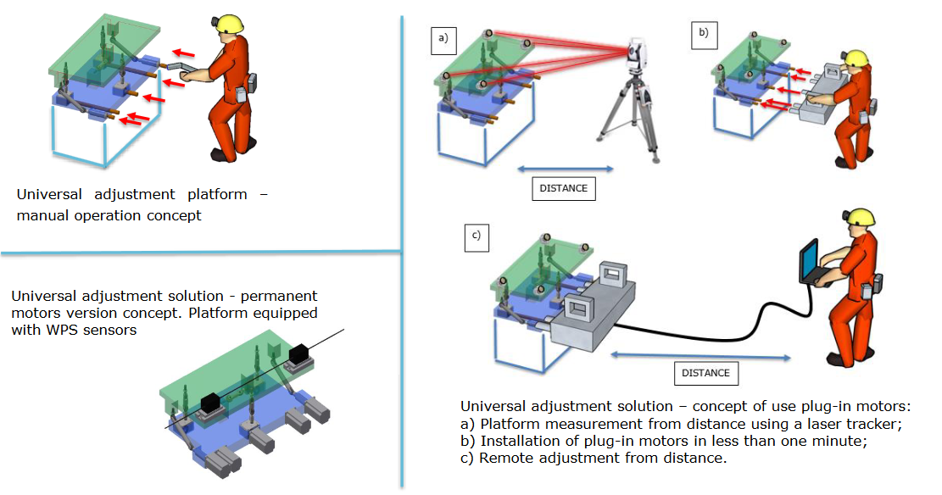
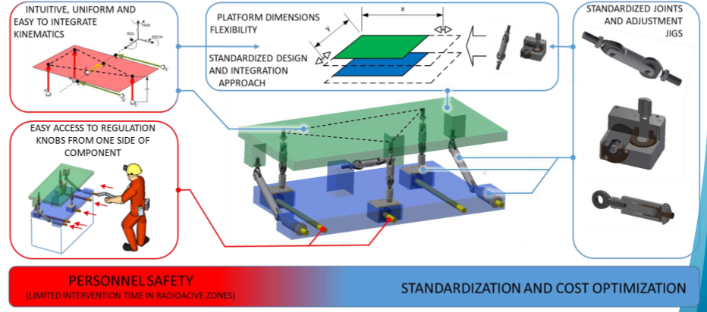
Geometer requirements
Universal Alignment Platform (UAP) work in progress
Full Remote Alignment System (FRAS) specification:
The BPTQR BPM will be align on a “Manual standardized adjustment platform” for realignment during Long Stop and YETS.
Beam instrumentation strategy is to use a Universal Alignment Platform (UAP).
“Half” remote alignment techniques where all joints and adjustment jigs are in the tunnel, but the motors are on a plug-in interface.
2 sizes of UAP assumed: Small UAP for small components < 300kg and Big UAP for bigger components 300 < …< 2000 kg.
Figure 11 — UAP general information
(Pictures: https://indico.cern.ch/event/806637/contributions/3487466/attachments/1925359/3186588/FRAS_MG.pdf ).

Slide 37
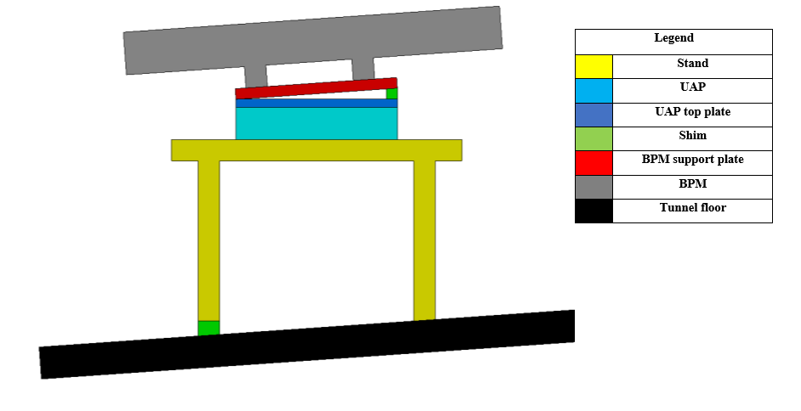
Geometer requirements
Universal Alignment Platform (UAP) positioning
The UAP is required to be horizontal and therefore the supporting structure must be designed to accommodate the slope of the tunnel ground.
Shim between the floor and the stand.
The plate containing the target and the inclinometer must be tilted to follow the beam line → Shim between BPM support plate and the UAP top plate.
Rigid connection between BPM support plate and the UAP top plate (No adjustable height setting).
In the nominal UAP position the BPM must be already tilted.
Figure 12 — UAP positioning requirements.

Slide 38
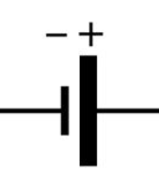
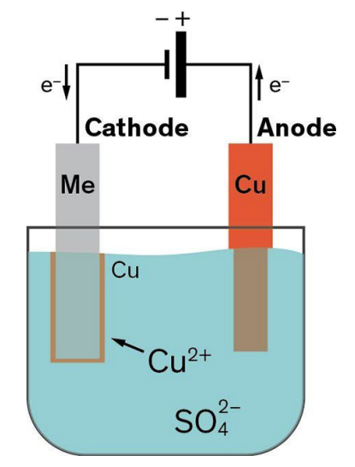
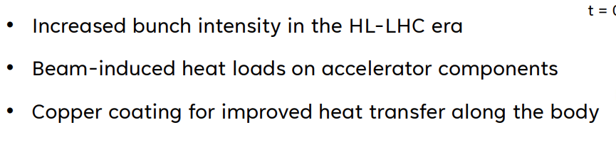
Electroplating
Set Up
Impedance
ensure the beam stability it is important to reduce the impedance at the frequencies relevant for the intra-bunch dynamics - achieved by coating with a thin layer of low resistivity coating
https://cds.cern.ch/record/2652401/files/2018-12-11_HL-LHC-Project-Report-impedance.pdf
Impedance in Vacuum:
https://indico.cern.ch/event/565314/contributions/2285748/attachments/1467498/2280257/Vacuum_for_Particle_Accelerators_b.pdf

Slide 39
aCc
Set Up
Electron Clouds
BPM is vacuum sealed.
Plasma is created in vacuum and via electrolysis, Titanium rod is input to layer over copper coating – titanium is used as adhesive layer for carbon.
A magnet is pushed up the rod, to encourage the adhesion and magnify the magnetic field – only ran up once. The titanium rod is removed after ~30min and then the amorphous carbon coating can proceed.
Same process as titanium, apart from it is input from the other end of the BPM.
This is beneficial as it means the vacuum seal cannot be broken during application of the two coats and so there is a minimum risk of oxidisation and impurities in the process. The amorphous carbon coating takes ~3 hours.
Due to the constraints in size of the machine, only one BPM can be coated at a time.
https://home.cern/news/news/engineering/remedy-against-electron-clouds-inside-particle-colliders
stray electrons in a vacuum chamber stirred by a proton beam, bounce off the walls of the BPM, multiplying and whizzing around the beam.
can lead to a heat load being deposited on the cryogenic circuit and to a significant decrease in the beam quality
carbon layer that is fine enough to preserve the resistivity properties of the copper surface without disturbing the fragile environment of the LHC magnet

Slide 40
Leak Test Tooling
316L SS material for UHV clean test
28bar chosen: Design pressure for the cryogenic distribution lines (reference https://edms.cern.ch/document/2436668/1.0 page 26)
0.5 Bar chosen: General Safety Instruction GSI-M-2 “Standard pressure equipment”, relating to pressure vessels used at CERN that are subject to or could be subject to a maximum allowable pressure of PS > 0.5 bar
https://hse.cern/safety-rule/ssi-m-2-1
https://hse.cern/content/mechanical-hazards-m
PS - the design pressure and is the maximum pressure the equipment is allowed to operate at

Slide 41
Tungsten Blocks
The tungsten shielding reduces the radiation dose deposited into the downstream cryogenic magnet.
This is particularly important for the Q2 magnet for which the BPM tungsten shielding reduces the deposited dose by ~30%.
As the Q2 BPM uses the B type design, we decided that it would be cheaper to equip all B type BPMs with tungsten rather than have a special design just for the Q2.
On the other hand, A type BPM attached to the Q1 magnet is not shielded as the simulations shown that including tungsten there has no additional effect.
Tungsten Absorber (x4)
https://indico.cern.ch/event/559125/contributions/2268948/attachments/1330179/1998614/IT_BPM_shielding_Tsinganis.pdf
https://indico.cern.ch/event/559125/attachments/1336362/2010278/HL-LHC-TCC-14-01092016_minutes.pdf

