Slide 1
HL-ZDC Sarcophagus Design
Mark Stockham
Scott Voigt
Allen Hase
University of Kansas

Slide 2
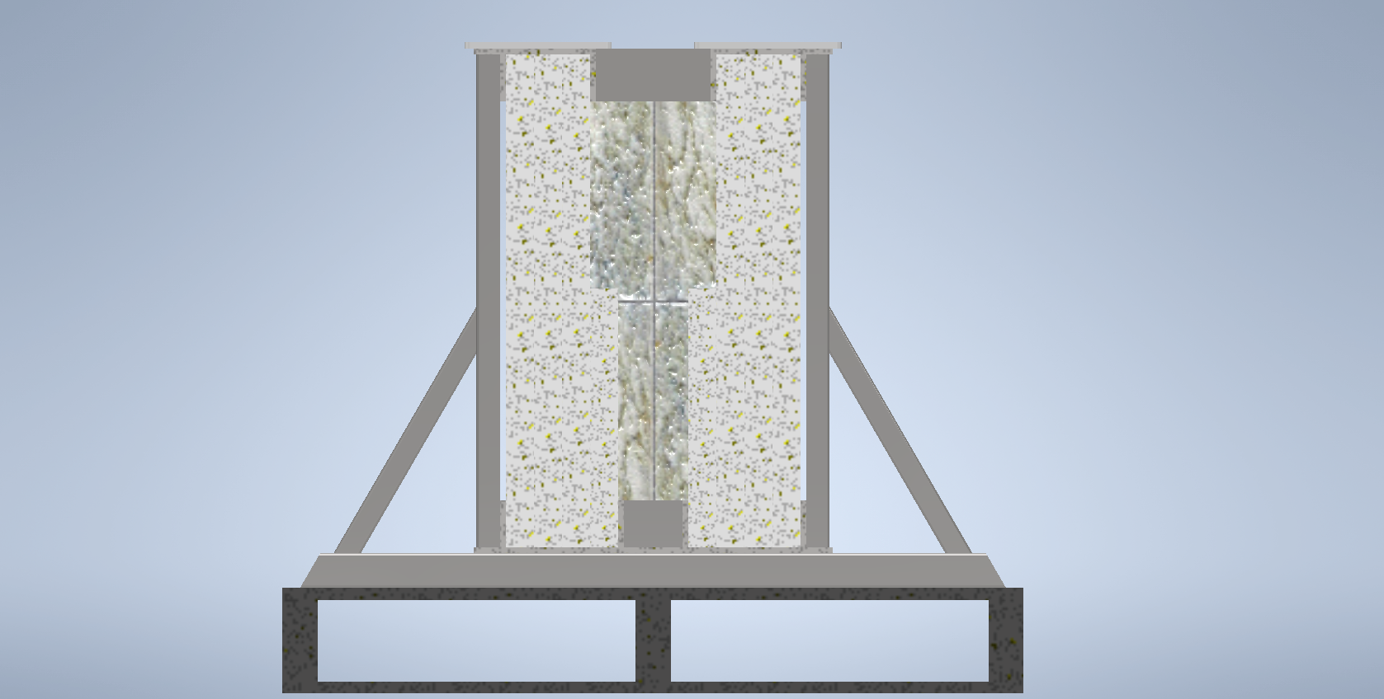
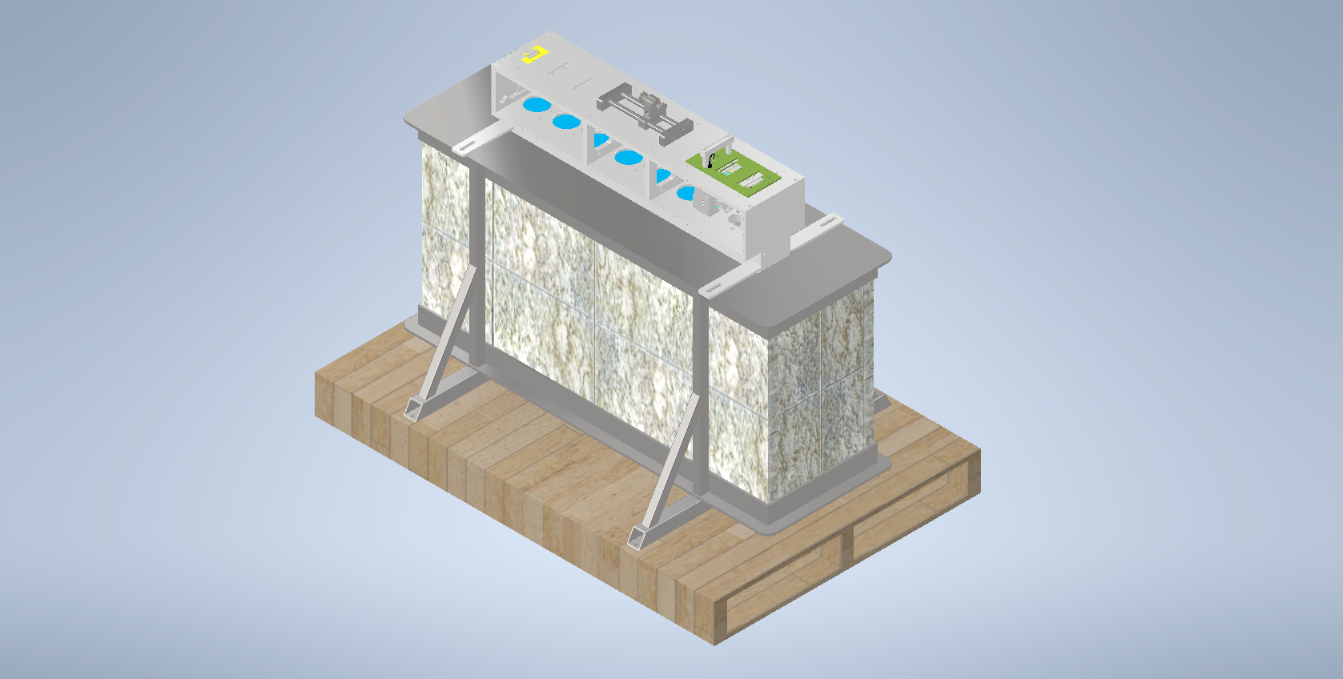
Previous Design
Pallet-based construction
Four layers of ~3cm thick marble
1”-1.5” steel square tubing and ¼” steel plate welded frame
Designed to be lifted, not suspended
~1000 lbs[455 kg]

Slide 3
Proposed Changes
Wood is not suitable, change pallet to steel construction
  Repeated structural units are now 4” x 1.72” x 0.32” C-channel
Make the design hoist-friendly (see next slide)
  Having suspension points be on the bottom of the frame allows for suspension with similar loads to lifting with forks, the design is strong in this direction

Slide 4
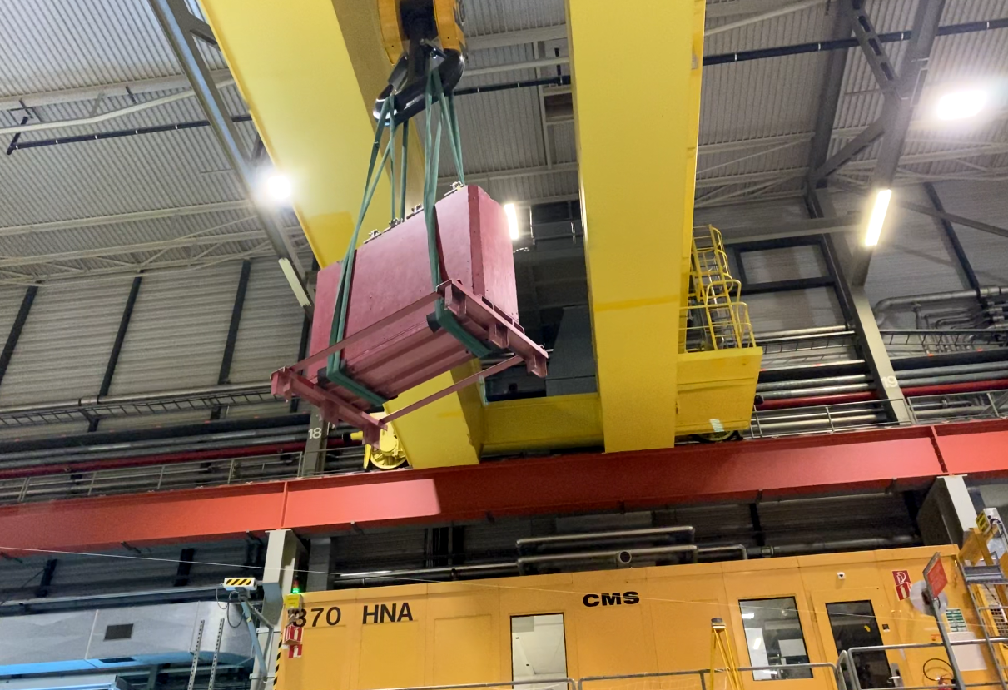

Slide 5
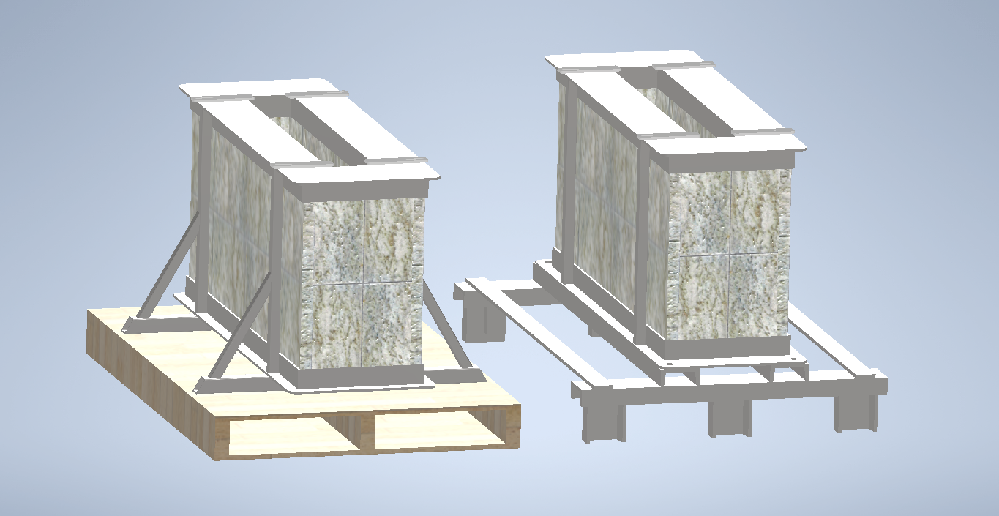
~1000 lbs, 455kg
~1100 lbs, 500kg
Current sarcophagi are ~650kg
Additional layer of marble, perhaps 275lbs (125kg)

Slide 6
Open Questions
Does the structure need lifting ears on top? This would require significant redesign, as the current design is not meant to be suspended from the top
Is there a preliminary design for the lids? What are the lid design requirements?
Do we need to simulate this design’s performance via FLUKA?

Slide 7
Extras – old drawings

Slide 8
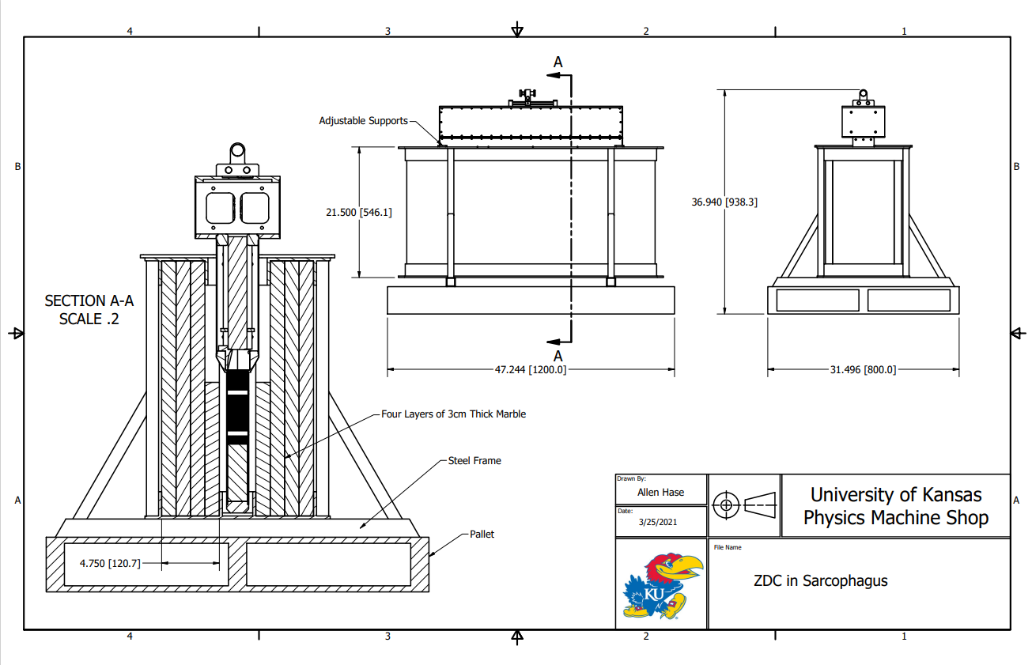

Slide 9
