Slide 1
M. Hamani
SPS EYETS 23/24

Slide 2
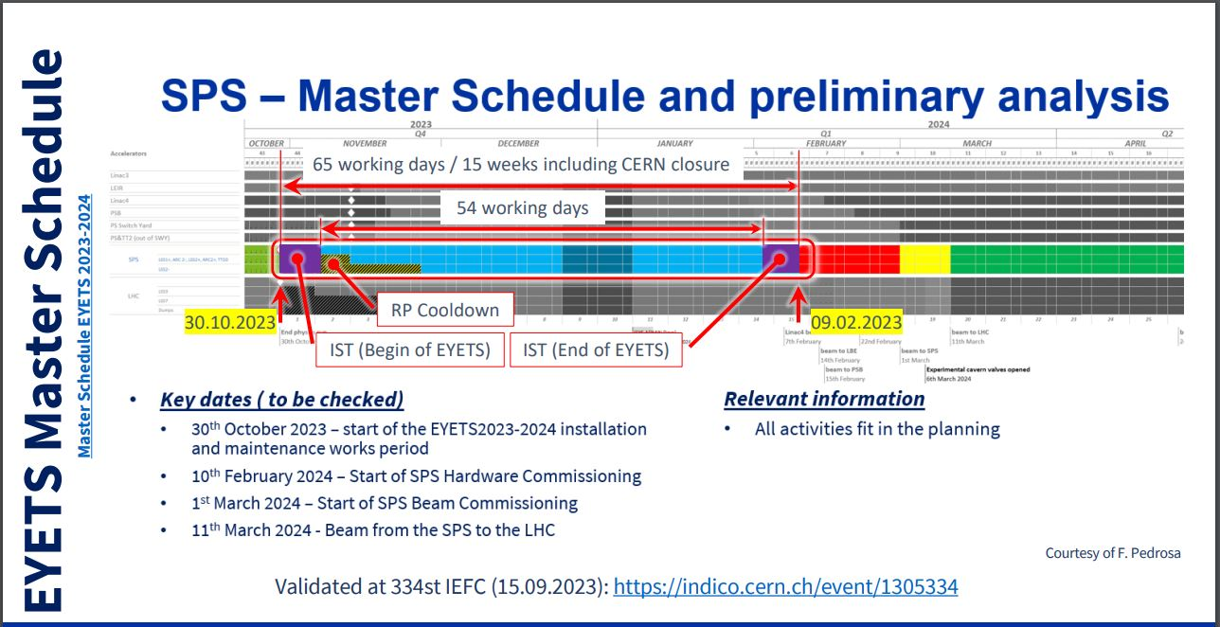

Slide 3
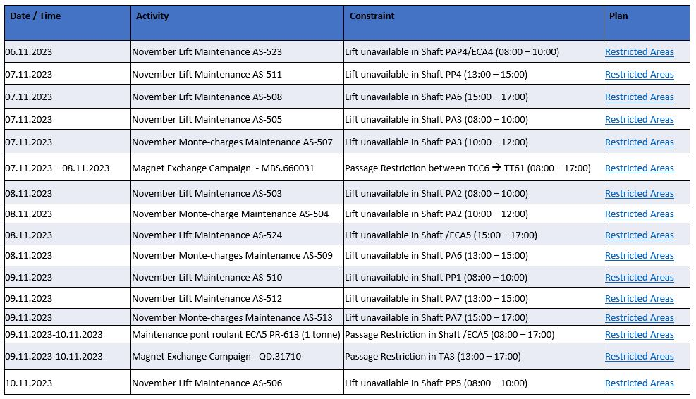
Constraints

Slide 4
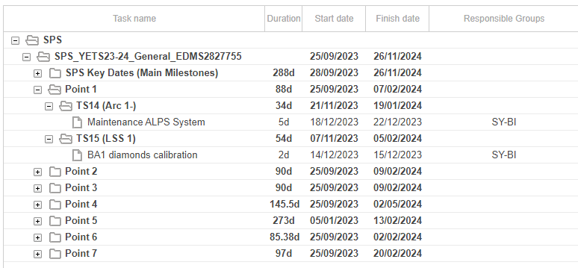
Activities SY-BI SPS Point 1
21.11.23
11.01.24

Slide 5
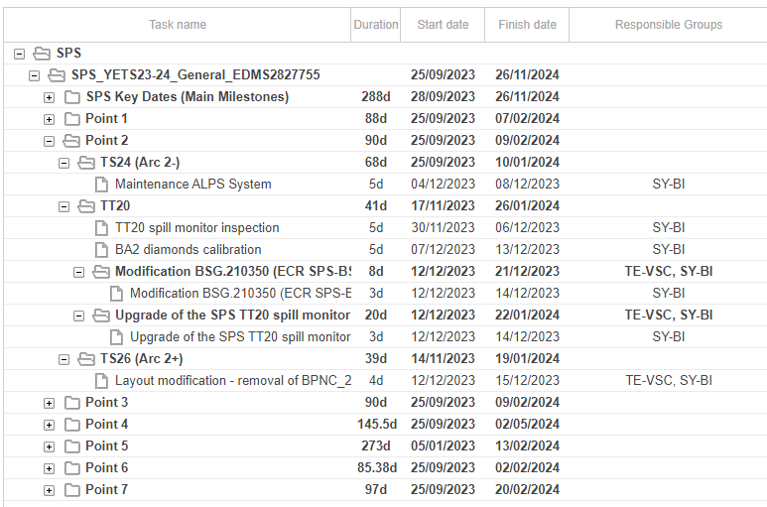
Activities SY-BI SPS Point 2

Slide 6
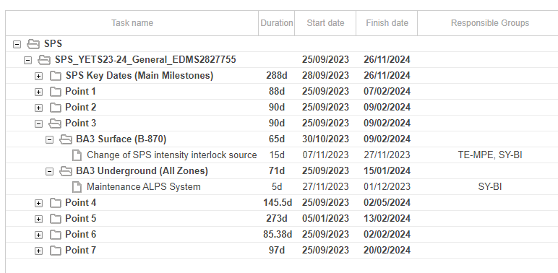
Activities SY-BI SPS Point 3

Slide 7
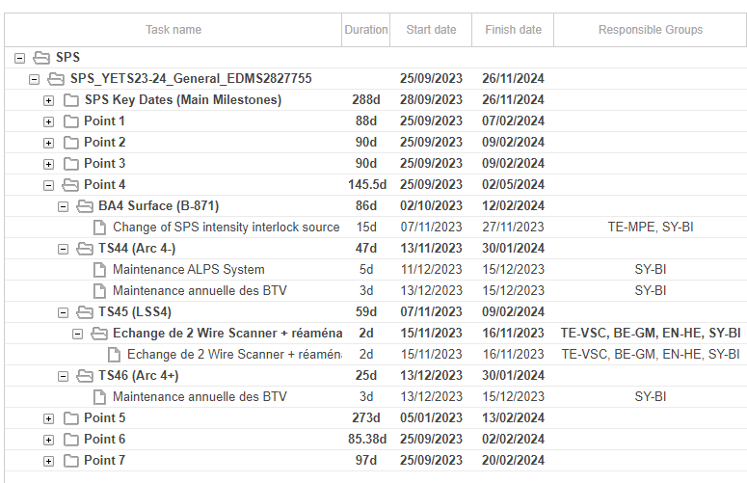
Activities SY-BI SPS Point 4

Slide 8
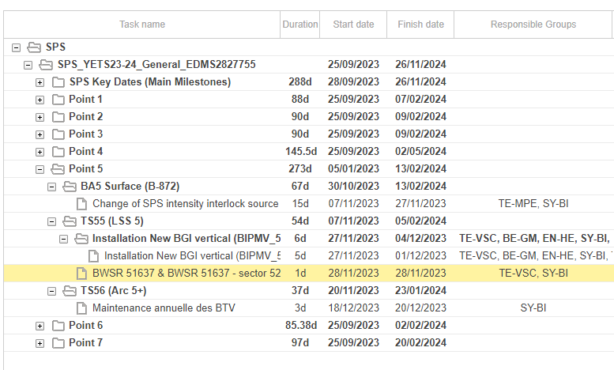
Activities SY-BI SPS Point 5

Slide 9
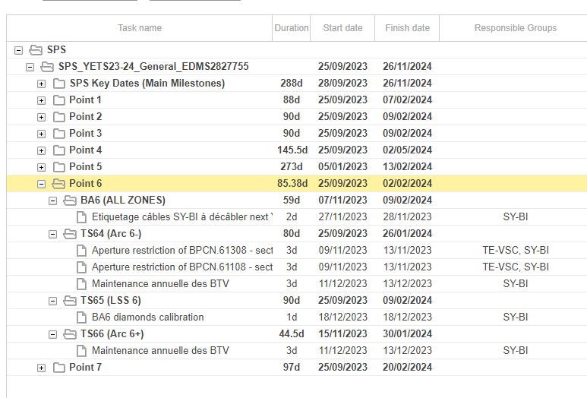
Activities SY-BI SPS Point 6

Slide 10
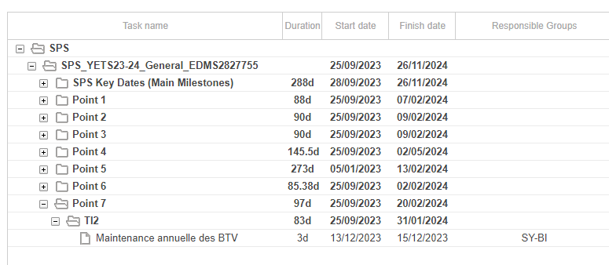
Activities SY-BI SPS Point 7

Slide 11
