Slide 1
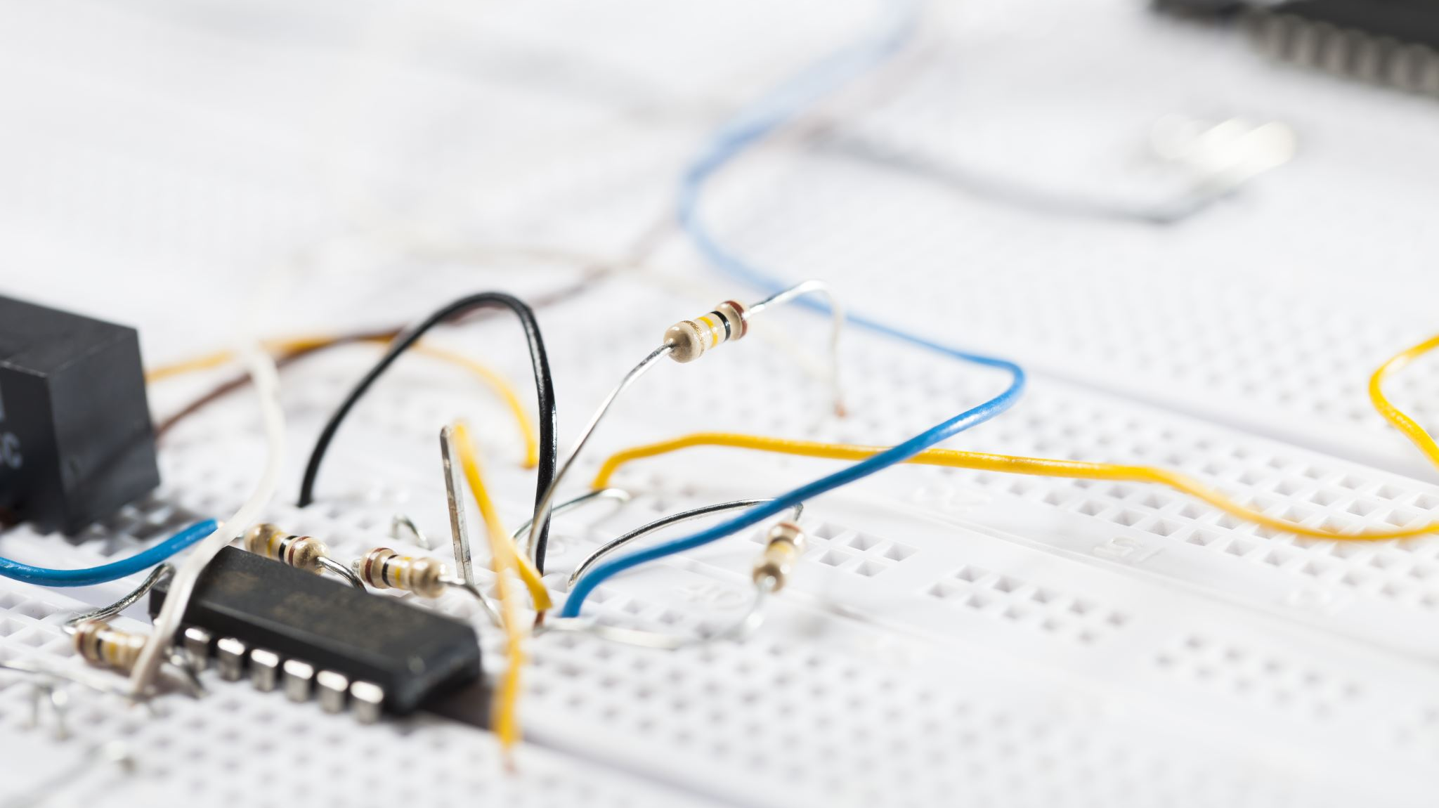
BI technical board: SoM
Standardise less to standardise for more

Slide 2
Why this meeting
VFC successor required for projects beyond LS3
New projects in BI with clear synergies
Desire to continue and increase the standardisation in the group and open to others in the sector and beyond
§ SoM: standardise less to standardise for more (systems)

Slide 3
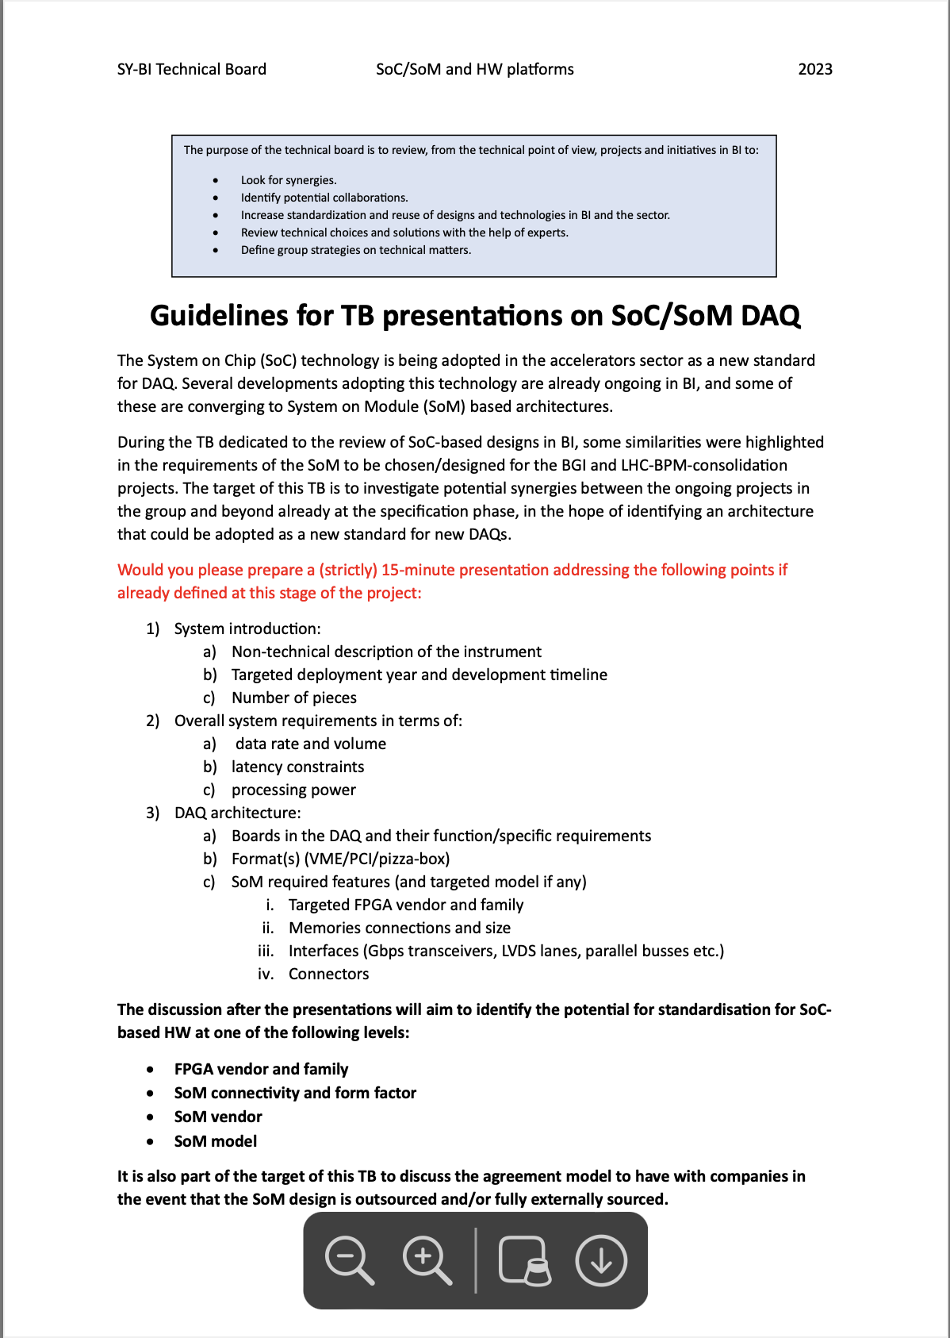
Why this meeting
VFC successor required for projects beyond LS3
New projects in BI with clear synergies
Desire to continue and increase the standardisation in the group and open to others in the sector and beyond
§ SoM: standardise less to standardise for more (systems)

Slide 4
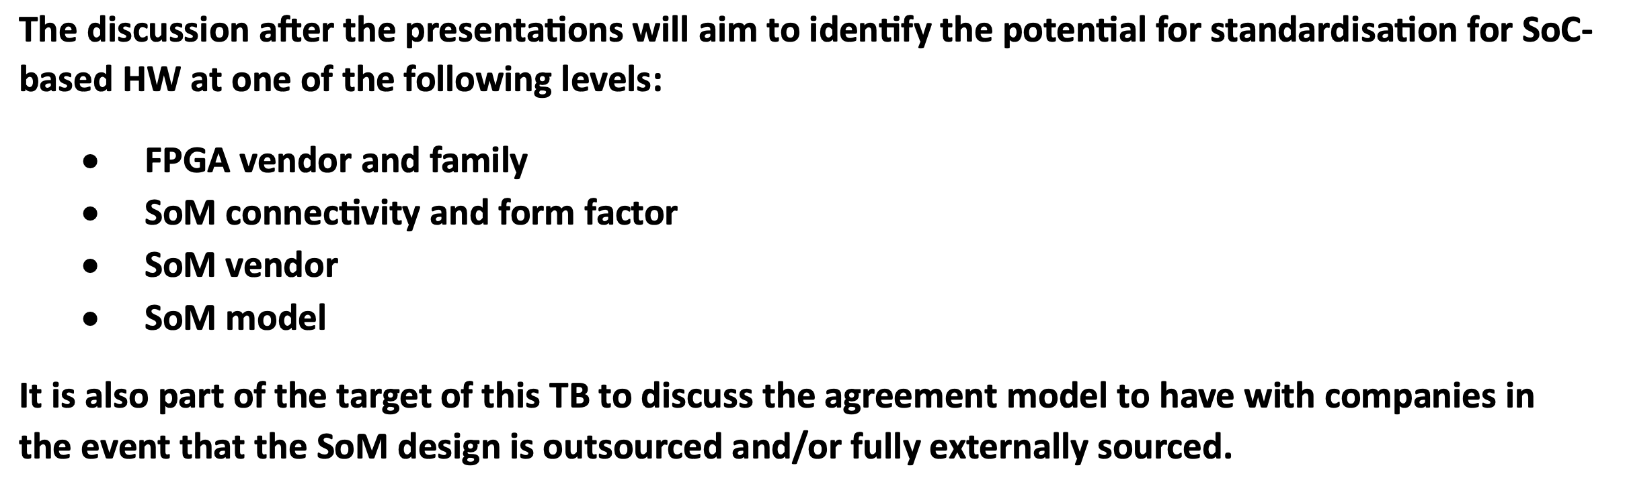
Why this meeting
VFC successor required for projects beyond LS3
New projects in BI with clear synergies
Desire to continue and increase the standardisation in the group and open to others in the sector and beyond
§ SoM: standardise less to standardise for more (systems)

Slide 5
Why this meeting
VFC successor required for projects beyond LS3
New projects in BI with clear synergies
Desire to continue and increase the standardisation in the group and open to others in the sector and beyond
§ SoM: standardise less to standardise for more (systems)
§ Possibility of the creation of a HW ecosystem around it

Slide 6
Why this meeting
VFC successor required for projects beyond LS3
New projects in BI with clear synergies
Desire to continue and increase the standardisation in the group and open to others in the sector and beyond
§ SoM: standardise less to standardise for more (systems)
§ Possibility of the creation of a HW ecosystem around it
NOT in competition with DI/OT but a way to COMPLEMENT it

