Slide 1
BIPXL System-on-Module needs
Mark McLean, BI-TB, 9th Nov 2023

Slide 2
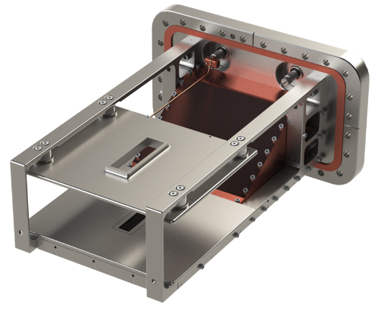
The BIPXL projects
PS & SPS BGI
LHC BGI
Timepix4 Telescope
Timepix4 BLM

Slide 3
PS & SPS BGIs
These use four Timepix3 detectors
A radiation hard Front-End box contains four GBTx Tx/Rx devices
For this application the SoM needs just 4 GTH Tx/Rx channels connected to the PL

Slide 4
LHC BGI
This will use one Timepix4 detector
A radiation hard Front-End box will contain one LpGBTx for slow control, and 16 5Gbit/s single-mode VTx transmitters
For this application the SoM will need 1 GTH transmitter and 17 GTH receivers, connected to the PL
In truth, 15 receivers would be OK.

Slide 5
Timepix4 Telescope
This will use four Timepix4 detectors
Each Telescope plane will have an LpGBT transceiver
For this application the SoM will need 4 GTH transmitters and 4 GTH receivers, connected to the PL
A few more could be useful, some Telescopes have six or more planes

Slide 6
Timepix4 BLM
This will use one Timepix4 detector
One LpGBT will be used for slow-control, and two 5Gbit/s single-mode VTx transmitters will be used for the data
For this application the SoM will need 1 GTH transmitters and 3 GTH receivers, connected to the PL
More channels would allow multiple BLMs to be connected to a single Back-End

Slide 7
Other requirements
We are currently using the MPSoC XCZU9EG-2FFVB1156
We need at least 1GB of DDR4 connected to the PL, plus 4GB connected to the PS
We need a single Ethernet port connected to the PS
We currently use a SFP connected to the PL for readout of raw data by IP-Bus. The future comms protocols for SoC are not yet clear, but we might want to keep this functionality.
We need a few I/Os for timing and triggering.
A SATA or NVMe port for an SSD for logging could be useful, or an RS232 port

Slide 8
Summary of requirements
Application | #Tx | #Rx | Qty
PS & SPS BGI | 4 | 4 | 4
LHC BGI | 1 | 17 | 4
Telescope | 4 | 4 | 1
BLM | 1 | 3 | ?
XCZU9EG-2FFVB1156
DDR4 on PL and PS

Slide 9
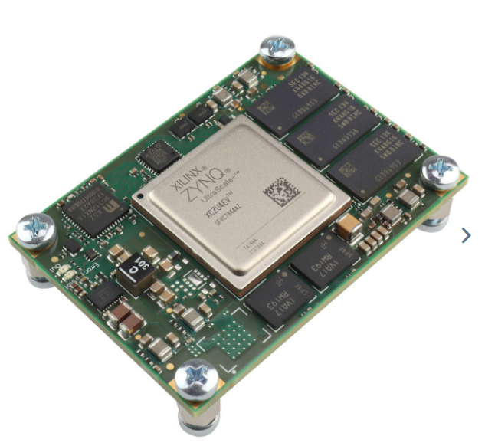
Suggestions
We could continue to use the ZCU102 for all projects except the LHC-BGI. But if other projects chose a suitable SoM then we would be happy to consider it for new production.
For the LHC-BGI the requirement for at least 15 (pref. 17) Rx GTH channels and PL DDR4 narrows our choice a lot.
  Trenz plan an MPSoC version of the AM0070,
  or there is the TE0806
  Enclustra make a module called Andromeda
  XZU90 which has 44 GTH channels

