Slide 2
S220/IT contract – Annual Meeting
30th Nov 2023
Speaker: Fabio Trevisani
With inputs from the CERN service managers

Slide 3
Agenda
Introduction
DCS presentation
CERN presentation
Discussion / AOB
  Follow-up

Slide 4
Agenda
Introduction
DCS presentation
CERN presentation
Discussion / AOB
  Follow-up

Slide 5
Introduction
Goal of the annual meeting:
  Recap on the contractual obligations
  Review of the period 1st Oct 2022 to 30th Sep 2023
  Identify issues and potential enhancements
  Make announcements

Slide 6
Recap contractual obligations
Contract started on 1st Oct 2018
  Duration is 3 years +1+1+1+1 (4x one year)
  Entering its 6th year, but only for 6 months;
    Then incorporated in a new contract
Delivery of the contractual documents:
  Annual template reviewed (minor changes)
  DCS Annual presentation submitted in due time
  Prevention Plan updated in August (staff movements)
  Service Handbooks reviewed in May and June
    Tapes handbook still dated Sep. 2022
    Reminder: review must be spontaneous every quarter (TS § 8.4.2)

Slide 7
Agenda
Introduction
DCS presentation / report review
CERN presentation
Discussion / AOB
  Follow-up

Slide 9
Agenda
Introduction
DCS presentation
CERN presentation
Discussion / AOB
  Follow-up

Slide 10
CERN Annual Review
Changes occurred
Safety & Compliance
Contract evolution
Key Performance Indicators (KPI)
    ⇒ DCS report: OLA summaries, Quality monitoring and Failures
  Other measurements
  Decisions taken
Feedbacks from CERN Service Managers

Slide 11
Changes occurred (CERN side)
Working conditions on CERN sites
  New edition March 2023
Transfer of CERN responsibility
  None during the period under review
    But Christian Boissat stepping down as Repair Service Manager
    Guillaume Métral (inventory matters) and Hervé Rousseau (DC tech. 3rd level expert) will take over

Slide 12
Safety & Compliance
On the 26th of January, one DCS employee fell down the stairs outside of building 513. Incident declared in EDH (ref: 9622683)
Reminder issued in April about wearing EPI (gloves/shoes)
Some spare parts have been lost and charged to the contractor
  2 disks for a total of less than 400 CHF

Slide 13
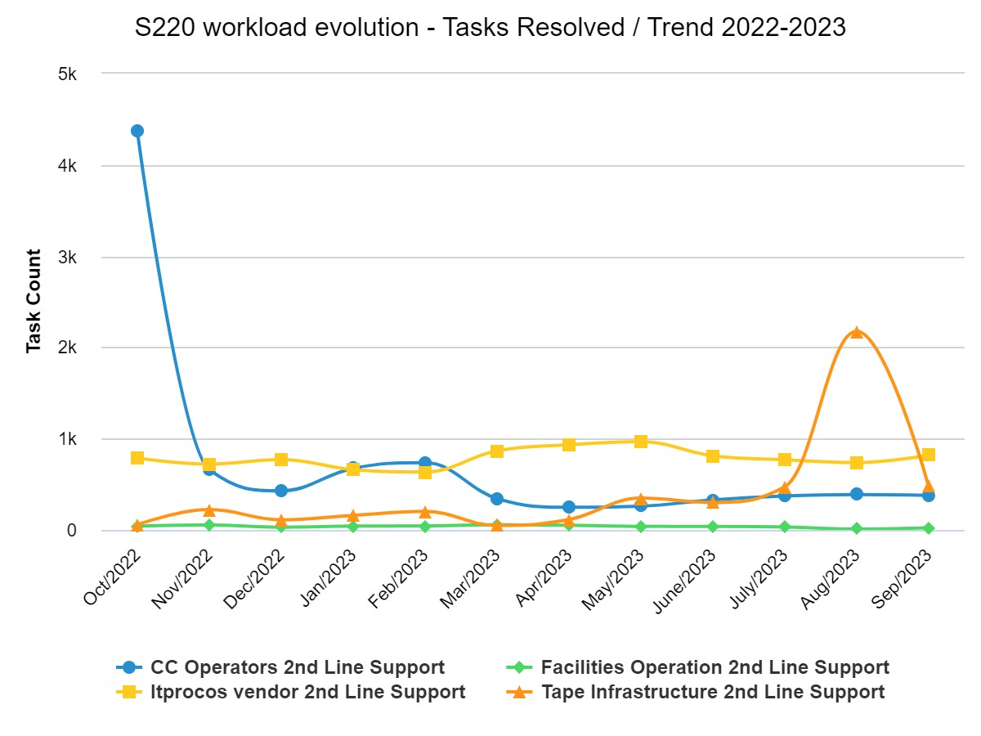
Contract evolution
Tape & Console Operations had peaks
  LHCb containers issue (Oct 2022)
  (tickets resolved in bulk)
  Tape incidents caused by a bug in the CTA software in Aug
  (but no impact on workload)
Sustained trend, slightly positive
for Repair and Tape
Decreasing trend for Console and Installation
Overall number of tickets stable around 21k

Slide 14
Contract evolution (cont.)
Console Operations
  Tasks passed to TI Operators (CCC)
  In view of activity reduction for this service (end of night shift Oct. 2023)
Install Operations service:
  Lack of deliveries = less installation work
    Team reduced to one person from July to September
  First “contact” with the new Prévessin DC (B.775)
Repair Operations service:
  Repair archives are now digitized (+2000 PDF files with OCR)
  New procedures setup for ‘complex’ units returned to suppliers
    But still hoping in improvements in providers repairs registration portals
  The backlog always kept under control at low level

Slide 15
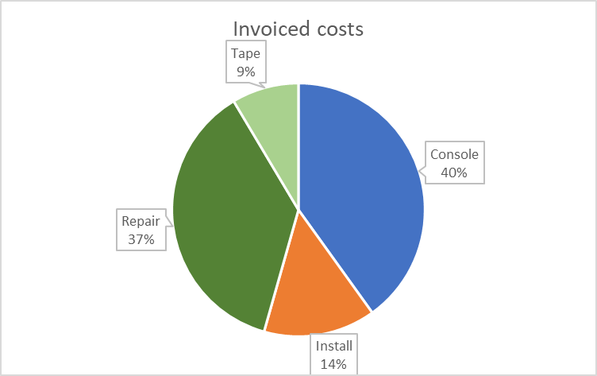
Contract evolution (finance)
Billing conformed to the requirements:
  By service and profile; overview ⇒
Invoices in line with budgets
  Overall and by service
  -2% Install only one person (3 months)
Contractual revision
  Reminder: revised prices for the 4th year (2021-2022): +0.3%
  New revised prices for the 5th year (2022-2023): +1.3%
  The turnover KPI will deduct 2 arrivals and 2 departures for 2023

Slide 16
OLA and KPI (summary & decisions)
Details in DCS presentation
Summary of CERN decisions on non-compliant tickets, per service
  Console Operations : one case (Jan.) CC Operator failed to apply KB0002120 (Piquet, Rota or Best-Effort calls)
  Installation Operations: one case (Jan.), installation in wrong position
    During the same period, three other cases were classified “Corrective Action Accepted”
    Classified as “Problem to follow instructions”, but promptly corrected by contractor
All other KPIs were good
  For all services

Slide 17

Other measurements (summary)
No task achieved outside priority scheme
No spare parts or consumables below minimum stock levels
100% Console shift work coverage
Cumulated value of penalties during the preceding 12 months
Personnel turnover
  Agreement reminder: no penalty applied for 2 arrivals and 2 departures (CVI not fully compensated)
  Total staff considered: 17 people as of June, two replacements becoming regular operators
    To cope with summer time absences
    This change is in favour of the contractor, even though very limited (1.4%)
    End September value: 2.94%

Slide 18
CERN: Feedback from SrvMgr
Console Operations:
  Delivered quality:
    Excellent performance reported
    Consistently exceeded Service Responsible expectations
    Even though expected quality is well-defined in operational procedures, the team members frequently go above and beyond what is required
  No training provided and none planned
  Future workload (till contract end): no fluctuation foreseen
    But service will be stopped as of 1st-Apr. 2024

Slide 19
CERN: Feedback from SrvMgr (cont.)
Installation Operations:
  Delivered quality:
    Difficult period end of year 2022, early 2023, causing issues (cf. slide #16), but…
    the delivered quality drastically improved with recently provided technicians
    Thank you DCS for the flexibility in adapting the size of the team during summertime
  Training:
    New personnel always needs to be trained by CERN to be fully operational
    No extra training is foreseen for next year
  Future workload:
    4Q2023 1H2024, installations in new data centre at Prévessin site
    Visibility on (effective) deliveries, hence workload, not easy
    May need to request again flexibility in adapting the size of the team

Slide 20
CERN: Feedback from SrvMgr (cont.)
Repair Operations:
  Delivered quality:
    Quality and time to resolve incidents and requests considered satisfactory through the year
    Minor issues:
      During the annual closure, some parts were not returned in a timely fashion to suppliers
      Two hard disk drives have been lost in May (DCS charged for this)
  Training:
    No training needed during the year
  Future workload:
    Stable volume of tickets foreseen for the current and next quarter
    Interventions at the PDC will take place on a weekly basis starting in January 2024

Slide 21
CERN: Feedback from SrvMgr (cont.)
Magnetic Tapes Operations:
  Delivered quality is generally good, including by replacement people
    Communication satisfactory
    Always agreements on timeframes which satisfies both parties
  Training:
    No training provided CERN
    DCS Tape Operations operator is well experienced and provided training to colleagues who replace him from time to time
    CERN particularly appreciate that such person:
      often provides refresh training in advance / prior to his absences as the tools change
      keeps the relevant documentation up-to-date.
  Future workload:
    Gradual increase with more equipment to install (as the LHC experiments take more data)
    Slightly more issues to handle, but no need for additional personnel

Slide 22
Agenda
Introduction
DCS presentation
CERN presentation
Discussion / AOB
  Follow-up

Slide 23
AOB - Follow up
Handbooks
  All updated at least once in 2023
  Not all recently:
    Installation service (06/06)
    Repair (10/10)
    Tape (30/10)
    Console (09/11)
  Must be reviewed spontaneously every quarter (TS § 8.4.2)

Slide 24
AOB – Follow up (cont.)
Contractual obligations
  Documents to update:
    PP (staff movements) – update received (21/08)
    QAP (certification renewals) – see DCS report
  Documents to review:
    Templates (annual meeting)
    Handbooks ; quarterly review !
    Procedures (regularly)
  All documents, except procedures, available at:
      https://contract-s220-it.web.cern.ch/

Slide 25
AOB
Enhancement proposals?
Please let me know!
Only a few months before contract termination
Counting on YOU to remain motivated
Thank you for your interest in contract renewal!
  Hope to be able to share decision by end of year

