Slide 1

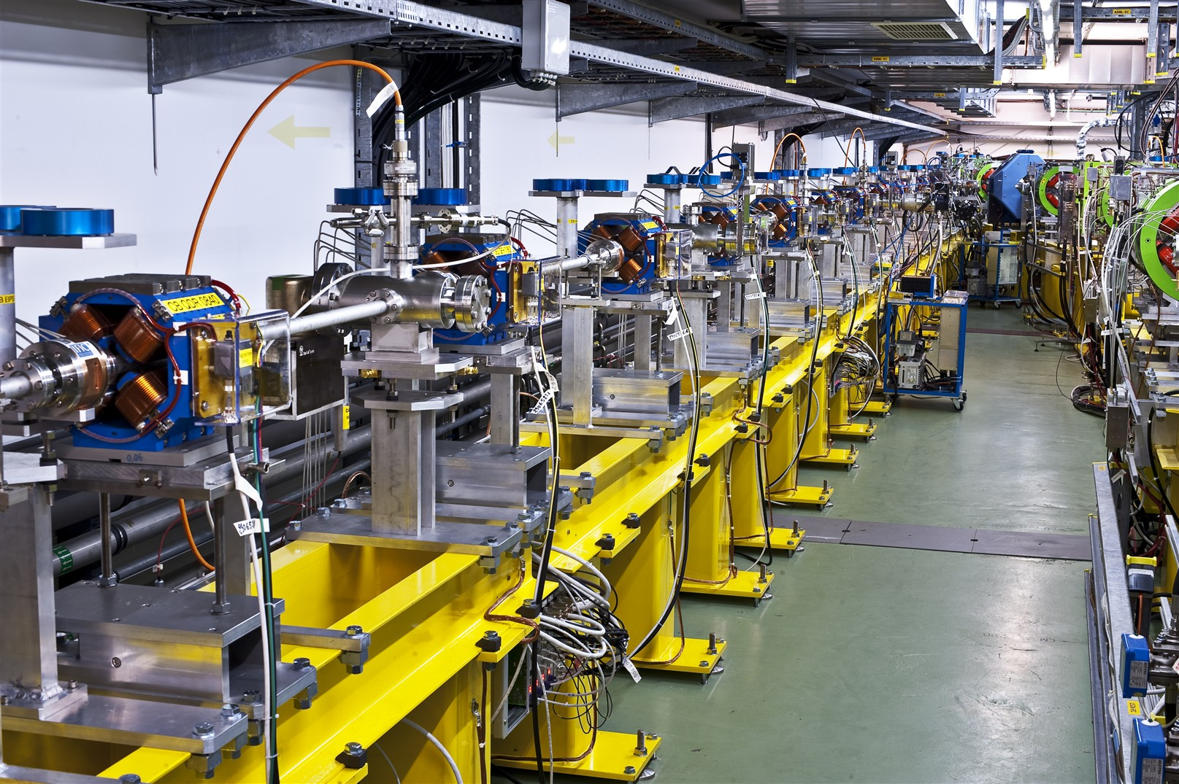
CTF3
WP: CTF3-000 Completion of feasibility program in CTF3 |  | Purpose/Objectives/Goals: Complete the experimental program on feasibility issues (feasibility) |  |  |  | Deliverables |  |  | Schedule
Completion of drive beam generation benchmarks |  | Demonstrate production and transport to CLEX of 28 A beam, 150 π mm mrad rms norm. emittance, 1 mm rms bunch length. |  |  |  | Report on tests |  |  | 2011 – 4Q
Completion of two-beam acceleration benchmarks |  | Demonstrate 100 MV/m acceleration at nominal pulse length. Breakdown kick measurements. Control of RF pulse shape. |  |  |  | Report on tests |  |  | 2011 – 4Q
PETS ON/OFF |  | Demonstrate operation of PETS on/off mechanism with beam. |  |  |  | One PETS equipped with on/off mechanism installed in TBTS Report on beam operation of PETS on/off |  |  | 2011 – 3Q 2011 – 4Q
TBL deceleration |  | Demonstrate deceleration of 28 A drive beam to 70% (50%) of initial energy in a string of 12 (16) PETS. |  |  |  | 12 (16) PETS tanks installed in CLEX TBL line Reports on beam deceleration esperiments |  |  | 8 tanks 2011 – 3Q 12 tanks 2012 – 2Q (16 tanks 2012 – 4Q) Intermed. report 2012 – 4Q (Final report 2013 – 2Q)
Link to other WPs/activities: This WP is linked to CTF3-003. Resources to increase the number of PETS tanks from 12 to 16 are included in CTF3-003.
Lead collaborator(s): CIEMAT, IFIC-Valencia, Univ. Catalunya (Spain), CERN: BE/RF, BE/BI, BE/ABP, BE/OP, …
Resources: | 2011 |  | 2012 | 2013 | 2014 |  | 2015 | 2016 |  | Total
Material (kCHF): | ~ 3000 (CERN only)
Personnel (FTE): | ~ 40
Resources comment: First 12 tanks and PETS on/off already budgeted in 2010-2011(~ 2 MCHF) FTEs in 2011: CERN: 24 staff, 6 fellows (APT data)
Other comments: The critical issue is the deceleration test.

Slide 2
CTF3
WP: CTF3-001 CTF3 consolidation & upgrades |  | Purpose/Objectives/Goals: Enable CTF3 continued operation until 2016 with performances compatible with the experimental program (system performance) |  |  |  | Deliverables |  |  | Schedule
Energy upgrade |  | Required for long string of modules. Useful for TBL deceleration demonstration, TBL+ high power testing, drive beam transport in modules, beam tests. |  |  |  | 2 new modulators/klystrons (3GHz, 45 MW) and associated infrastructure. M budget: 2.5 MCHF |  |  | 1st MDK: 2012 – 2Q 2nd MDK: 2013 – 1Q
Repetition rate upgrade |  | Required for TBL+ high power testing. Useful for operation. |  |  |  | Additional shielding, pulsed charge power supplies for MKS, interlocks. M budget: 3.5 MCHF |  |  | Interlocks: 2011 – 3Q MKS PS: 2012 – 1Q Shielding 2013 – 1Q
Consolidation, stability, operation |  | Required for continued CTF3 operation 2012-2016. |  |  |  | Consumables (klystrons), spares (TWTs), feed-backs, diagnostics and control system maintenance and improvements, operating support. M budget: 9 MCHF |  |  | Distributed 2012-2016
Effect of beam-loading on breakdown |  | Assess the break-down rate behaviour in beam-loaded X-band structures |  |  |  | Re-furbish CTF3 dog-leg, RF network Report on experiment |  |  | 2012 – 1Q 2013 – 1Q
Link to other WPs/activities: This WP is integrated to WPs CTF3-002, CTF3-003 and CTF3-004 (see above)
Lead collaborator(s): CERN: BE/RF, BE/BI, BE/ABP, BE/OP
Resources: | 2011 |  | 2012 | 2013 | 2014 |  | 2015 | 2016 |  | Total
Material (kCHF): |  |  | 4000 | 4000 | 2500 |  | 2500 | 2000 |  | 15000
Personnel (FTE): |  |  | 20 | 20 | 15 |  | 15 | 15 |  | 85
Resources comment: First new MKS (girder 14), klystron spares and spare TWT delayed from 2011 to 2012 for budget reasons.
Other comments:
Critical parameters are …

Slide 3
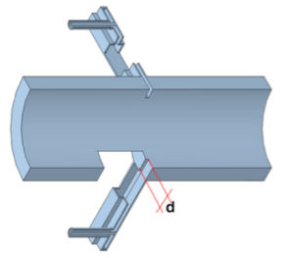
CTF3
WP: CTF3-002 Drive Beam phase feed-forward and feedbacks |  | Purpose/Objectives/Goals: Understand sources of drive beam phase jitter, develop and test feed-forward system to stabilize drive beam phase (performance, risk) |  |  |  | Deliverables |  |  | Schedule
Drive Beam phase monitors |  | Understand sources of drive beam phase jitter. Used in feedbacks and feed-forward test. |  |  |  | Drive Beam phase monitor prototype, phase monitor small series (2-3), electronics and acquisition. M budget: 0.5 MCHF |  |  | Monitor proto: 2011 – 4Q Monitor series: 2013 – 2Q
Feed-forward kickers |  | Required to demonstrate feed-forward performance. |  |  |  | Two strip-line kickers. M budget: 0.75 MCHF |  |  | 2012 – 4Q
Feed-forward pulsers |  | Required to demonstrate feed-forward performance. |  |  |  | Fast pulser amplifiers for the two kickers. Fast electronics. M budget: 1.25 MCHF |  |  | 2013 – 4Q ?
Infrastructure and operation |  | Required for testing. |  |  |  | Cabling, infrastructure, controls, operational support. M budget: 0.5 MCHF |  |  | Distributed 2012-2016
Link to other WPs/activities: This WP depends on WP CTF3-001
Lead collaborator(s): INFN/LNF, Oxford Un./J. Addams, CERN: BE/RF, BE/BI, BE/ABP, BE/OP…
Resources: | 2011 |  | 2012 | 2013 | 2014 |  | 2015 | 2016 |  | Total
Material (kCHF): |  |  | 1300 | 1400 | 100 |  | 100 | 100 |  | 3000
Personnel (FTE): |  |  | 4 | 4 | 4 |  | 4 | 4 |  | 20
Resources comment: to be reviewed with INFN-Frascati & Oxford.
Other comments:
Critical parameters are …

Slide 4
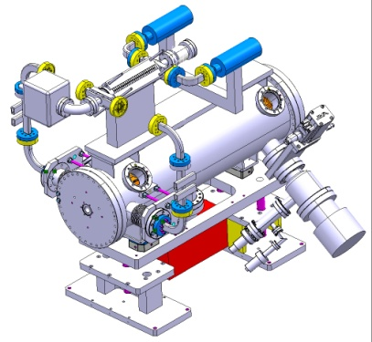
CTF3
WP: CTF3-003 TBL+ |  | Purpose/Objectives/Goals: Contribute to high-power testing program of accelerating structures, understand break down behaviour of PETS-structure system and conditioning scenarios (performance, cost) |  |  |  | Deliverables |  |  | Schedule
Upgrade of TBL drive beam line |  | Provide high-power slots for testing. |  |  |  | 4 (8) PETS in mini-tanks with input couplers, waveguide network, supports and cables. M budget: 750 kCHF (+ 750) kCHF |  |  | First 4 PETS: 2012 – 2Q Addit. 4 PETS: 2013 – 2 Q
RF Test stands |  | RF conditioning and high-power testing of structures. |  |  |  | waveguide network, supports and cables, instrumentation and control for 4 (8) slots M budget: 750 (+750 ) kCHF |  |  | First 4 slots: 2012 – 2Q Addit. 4 slots: 2013 – 2 Q
Operation |  | Support testing. |  |  |  | Maintenance, operating support. Annual reports on testing results. M budget: 1 MCHF |  |  | Distributed 2012-2016
Link to other WPs/activities: This WP is partly overlapping with WPs CTF3-000
Lead collaborator(s): CERN: BE/RF, BE/BI, BE/ABP, BE/OP
Resources: | 2011 |  | 2012 | 2013 | 2014 |  | 2015 | 2016 |  | Total
Material (kCHF): |  |  | 1700 | 1700 | 200 |  | 200 | 200 |  | 4000
Personnel (FTE): |  |  | 4 | 4 | 2 |  | 2 | 2 |  | 14
Resources comment: …
Other comments:
Critical parameters are …

Slide 5
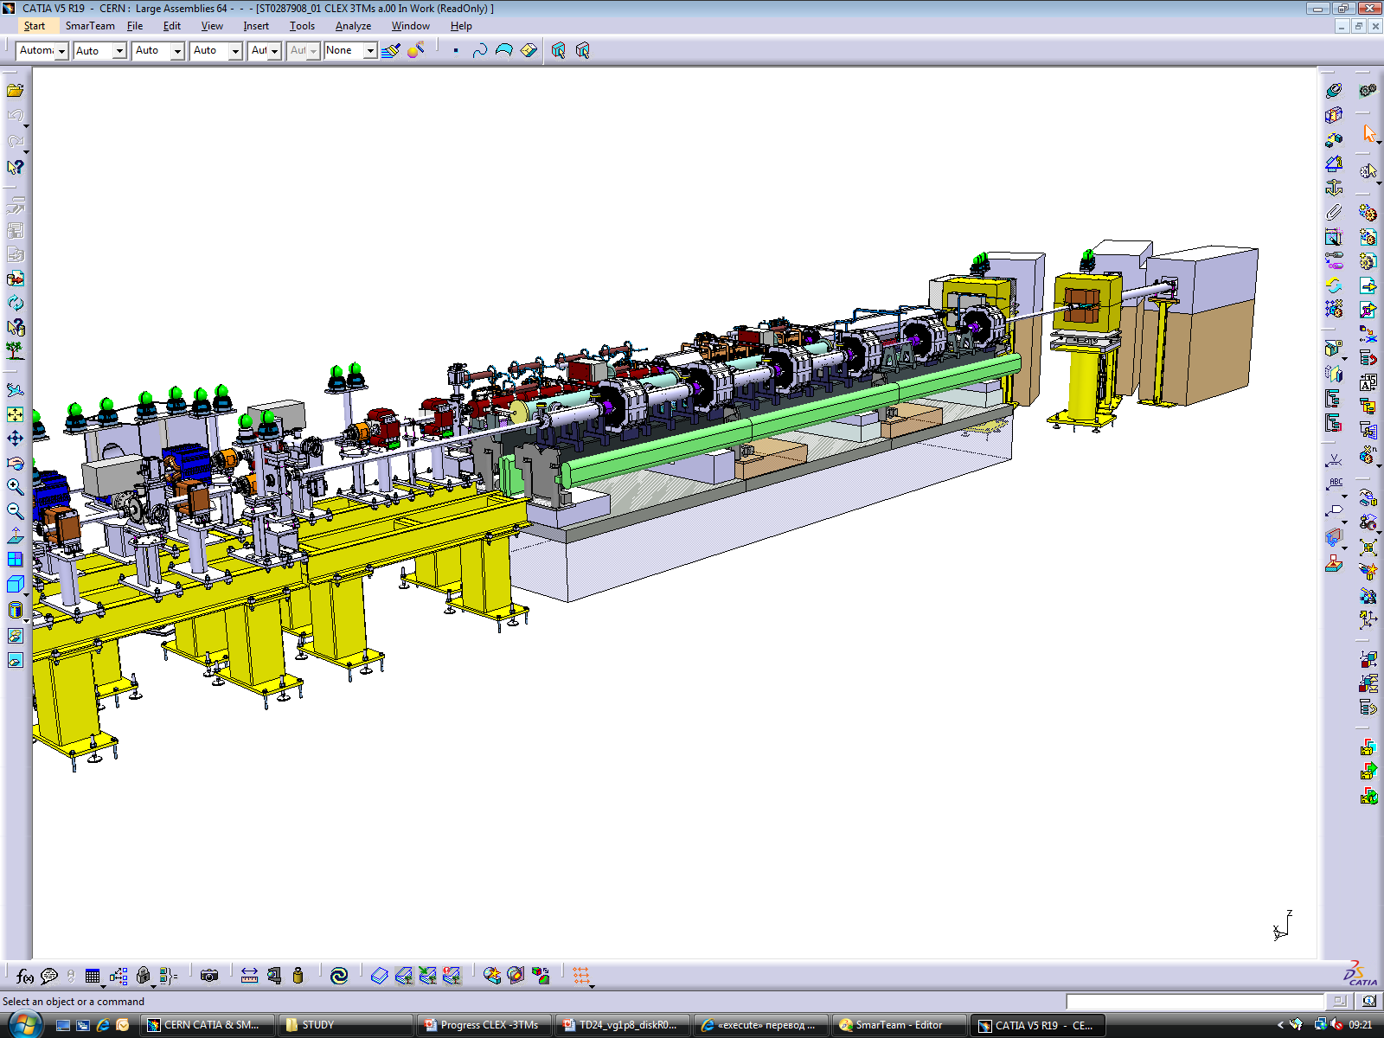
CTF3
WP: CTF3-004 Two-Beam module string |  | Purpose/Objectives/Goals: Understand behaviour and limitations of a few generations of CLIC two-beam modules in a real accelerator environment testing them with beam (performance, cost) |  |  |  | Deliverables |  |  | Schedule
First phase |  | Test behaviour of a single complete Two-Beam Module. |  |  |  | One Two-Beam Module type 1 installed and tested in CTF3 M budget: 0.5 MCHF |  |  | 2012 – 2Q
Second phase |  | Test behaviour of a module string with a minimum number of interconnects. |  |  |  | Two-Beam Module string (type 101) installed and tested in CTF3 M budget: 0.75 MCHF |  |  | 2013 – 2Q
Third phase |  | Test behaviour of a module string, new generation. |  |  |  | Two-Beam Module string, new generation (3 modules) M budget: 0.75 MCHF |  |  | Modules: 2016 – 2Q
Operation |  | Provide operational support |  |  |  | Provide operational support M budget: 1 MCHF |  |  | 2012 to 2016
Link to other WPs/activities: This WP is linked to WP CTC-004 – only installation/operation budget foreseen
Lead collaborator(s): Uppsala, IRFU/Saclay, CERN: BE/RF, BE/BI, BE/ABP, BE/OP
Resources: | 2011 |  | 2012 | 2013 | 2014 |  | 2015 | 2016 |  | Total
Material (kCHF): |  |  | 700 | 700 | 500 |  | 700 | 400 |  | 3000
Personnel (FTE): |  |  | 3 | 3 | 3 |  | 3 | 3 |  | 15
Resources comment: …
Other comments:
Critical parameters are …

