Slide 1
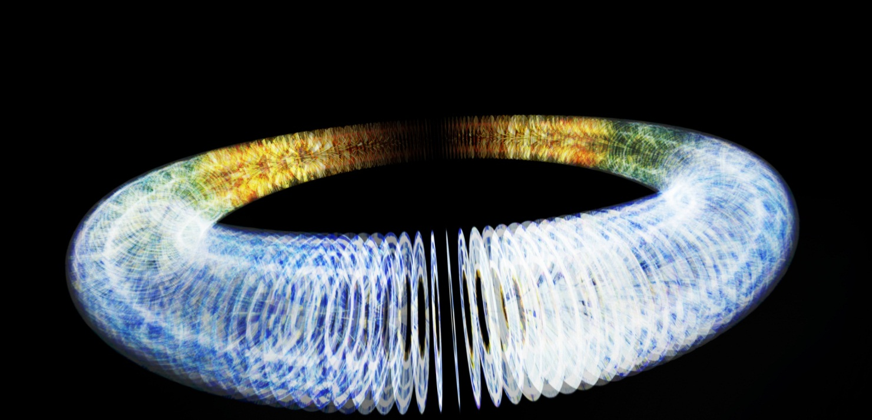
CLIC – ACAS Collaboration
Damping Ring Studies
Supervisors:
Roger Rassool
Mark Boland
Ioannis Papaphilippou
Kent Wootton
12th April 2011
Notes:
Good morning!
My name is Kent Wootton and I am a PhD student at the University of Melbourne
Where I am supervised by
Roger Rassool in the Experimental Particle Physics Group
My Co supervisors are
Mark Boland at the Australian Synchrotron and Ioannis Papaphilippou at CERN
Today I am presenting to you my confirmation talk entitled “Design of the CLIC Main Damping Ring lattice for low emittance”

Slide 2
Outline
AIM: To demonstrate the feasibility of an ultra low emittance damping ring for CLIC
ASLS SR experimental work
  Frequency map analysis
  Beam profile and emittance measurements
  Low emittance tuning study
  Precision beam energy measurement
CLIC DR modelling
  MADX alignment sensitivities
  Dynamic aperture mapping
Notes:
The aim of my research is to demonstrate the feasibility of an ultra-low emittance damping ring for the CLIC linear accelerator. In this talk I will outline my progress so far and the plans for the next year of my PhD research.
In order to demonstrate the feasibility of the 1 pm vertical emittance called for in the CLIC design, I have embarked on an experimental and modelling program at the Australian Synchrotron.
Using the 3 GeV electron storage ring as a test bed, I have conducted experiments to measure the beam profile to determine the vertical emittance as part of a low emittance tuning study. I also made a precise measurement of the beam energy which allowed me to calibrate the lattice model.
In parallel to the experimental program I have been developing the skills to modelling a damping ring lattice using MADX and related software tools. Building on the existing lattice from the CLIC damping ring working group I have modelled the alignment tolerances and identified the magnets to which the vertical emittance is most sensitive. I have also started to look at the effect of misalignments on the dynamic aperture of the damping ring. My goal is to get these modelling results to a stage that they can be included in the CDR due later this year.

Slide 3
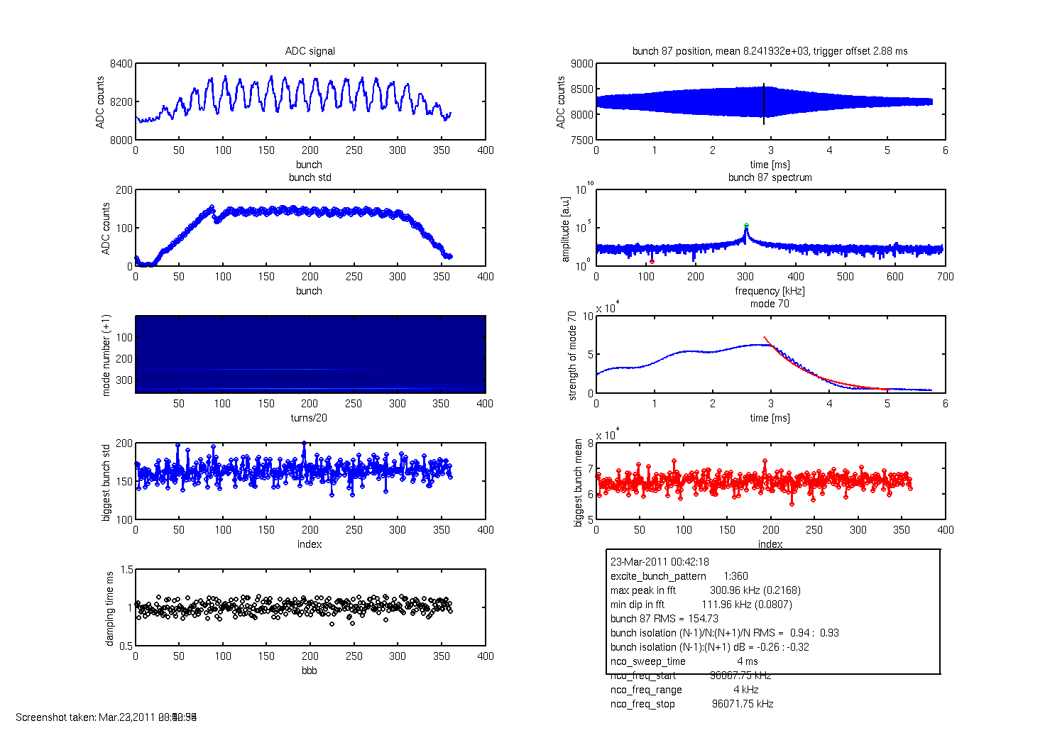
Bunch-by-Bunch transverse feedback
D. Peake, M. Boland, R. Rassool

Slide 4
Synchrotron Radiation Interferometer
σy, ρ
R0
a
Slit 2
bandpass
linear polariser
Slit 1
a
R1
R₁
R₀
Notes:
Measurements of the Australian Synchrotron storage ring emittance have been made using a synchrotron radiation interferometer. The interferometer is based on Mitsuhashi’s synchrotron radiation interferometer, after Michelson’s double slit stellar interferometer.
Illustrated here is the interferometer I designed for my honours project. This arrangement shows two single slits, each mounted on separate linear translation stages for independent motion. The interferogram resulting from illumination of the double slits by an extended, thermal source is shown in the left plots, with a cross-section illustrated. A high-coherence wavefield results on propagation from a narrow source at a long distance, giving a fringe visibility approaching unity.

Slide 5
XDB calibration with SRI
Notes:
I have made measurements with the interferometer in the calibration of the X-ray diagnostic pinhole camera. Shown here is the measured electron beam source size, with variation in the emittance ratio.
It can be seen that the resolution of the pinhole camera is about 5 um, compared with approximately 2 um resolution of the interferometer
A minimum vertical beam size of approximately 40 microns is possible with the interferometer. For the X-ray pinhole camera, the measured vertical beamsize is the electron beam size convolved with the point-spread function of the finite dimension pinhole. This limits the minimum measurable beam size, as we see on the next slide.

Slide 6
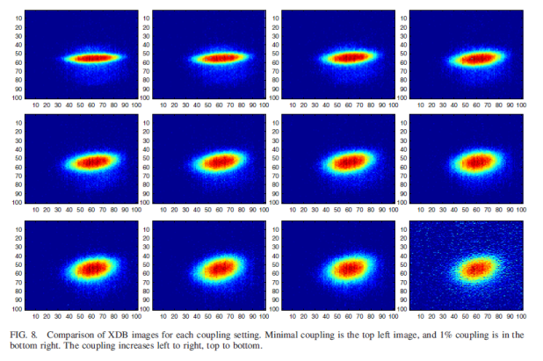
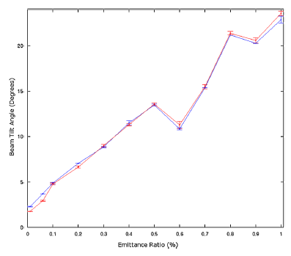
Q-LOVE and Intra-Beam Scattering
Dowd, R. et al., PRST:AB, 14:012804, 2011.
Notes:
The original motivation for measurement of the storage ring minimum vertical emittance was the Quantum-LOVE prize: the quantum limit of vertical emittance. While the convolution of the electron beam size and diffractive pinhole prevented an accurate measurement of the electron beam source size, the XDB pinhole camera was reliably used in the measurement of the rotation of the beam ellipse. Shown here is the rotation of the beam ellipse over a range of emittance ratios. The measured data is shown in blue, the LOCO model in red, with lines to guide the eye.
This shows the zero-bunch current limit of vertical emittance. I have made preliminary measurements using the interferometer of the increase in beam size of a single bunch, with increasing bunch population, for high chromaticity settings (blue) and low chromaticity settings (red). The interferometer is useful at a low stored current of 10mA. The interpretation of these results is that the emittance volume is increasing in dimensions that were unmeasured, including the horizontal and longitudinal.
As the RF voltage cannot be further increased, achieving high IBS bunch densities requires operation of the storage ring at energies below 3 GeV. Eugene and I have developed ramp tables for the storage ring, allowing us to ramp the storage ring from 3.0 down to 1.5 GeV. In this way, the bunch length will be decreased.
But how do you measure the energy?

Slide 7
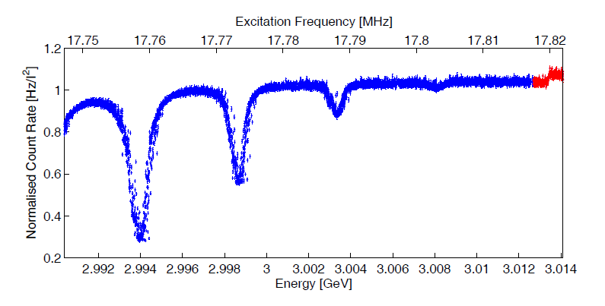
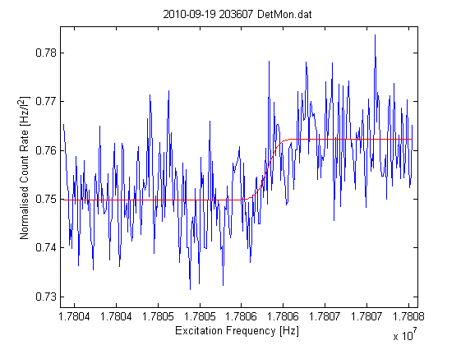
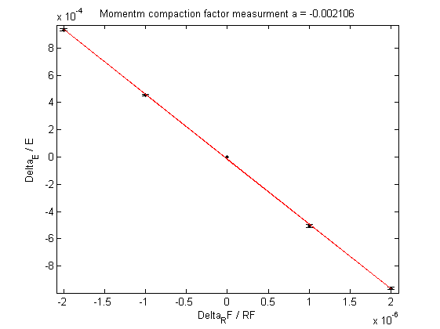
Resonant Spin Depolarisation → α_{c}
E = 3.013408(8) GeV
α_{c} = 0.00211(5)
Notes:
And using this technique, the beam energy was measured accurate to the sixth significant figure.
Shown here is the first resonant depolarisation, where the increase in counts highlighted in red, indicates the loss in polarisation of the beam.
By varying the RF frequency, we were able to measure the momentum compaction factor, accurate to three significant figures.

Slide 8
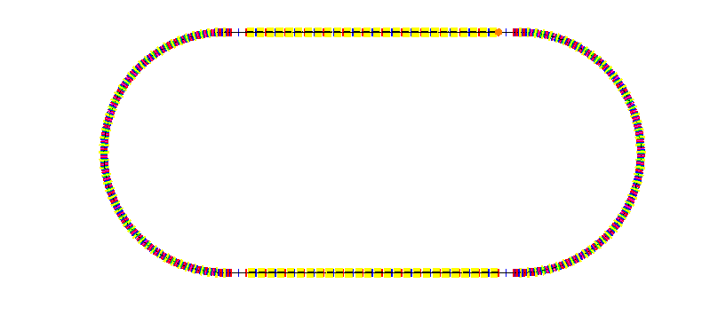
CLIC DR sensitivities
200 seeded machines
Analytical estimate
5%, mean, 95%
Gaussian, 2.5σ

Slide 9
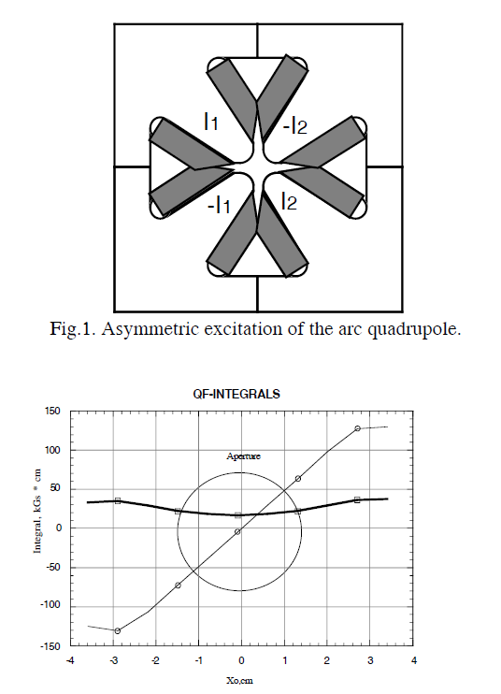
Asymmetric powering of multipoles
Tight everyday alignment tolerances
Asymmetric powering introduces dipole, sextupole moment
Duke SR
  20% →2.25 mm shift
2% →200 μm shift

Slide 10
CLIC Damping Ring - DBA
50 wigglers
Save on photon absorber-quad in wiggler insertions
This ring 345 m
  Add cells for RF
Inj-ext – insertion length difficult
Notes:
I’m also working on my own DBA damping ring lattice. I believe that the benefits of increased symmetry outweigh the cost from the increased equilibrium horizontal emittance.

Slide 11
Experimental Plan
BBB transverse feedback for FMA
E → 1.5 GeV for IBS
Horizontal emittance: bare, wigglers
LOCO coupling
CLIC DR Modelling – further work
Dynamic aperture with misalignments
Corrector/BPM requirements
Asymmetric powering of multipoles
CLIC DR – DBA-TBA-MBA?
Notes:
My plan for experiments during the coming year

