Slide 1

CLIC SURVEY AND ALIGNMENT
ACAS possible participation to alignment studies
12-04-11
BE/ABP/SU

Slide 2
SUMMARY
Introduction: survey and alignment for the CLIC project
Studies concerning active pre-alignment
ACAS possible participation to alignment works

Slide 3
Introduction: survey and alignment
We will need to align all beam components or their associated supports:
  In all the area of the tunnel (main beam injectors, drive beam generation complex, main linac, beam delivery system, return loops,…)
On the ground, on the wall (transfer lines), in loops (return loops, damping rings)
Within various tolerances ranging from 30 microns to more than 300 microns.
  At different stages: fiducialisation of the components in surface laboratories, initial alignment and smoothing (before the first beam), maintenance of alignment (remotely or directly in the tunnels) during the lifetime of the collider
Some priorities have been given concerning the survey and alignment studies:
  Prove the feasibility of the pre-alignment of the components of the main linac within 10 microns (1σ) over a sliding window of 200 m along the whole linac
Propose a global solution of alignment
  Integrate the solution and make it compatible with other services
3

Slide 4
Introduction: why active pre-alignment?
The pre-alignment precision and accuracy on the transverse positions of the components of the CLIC linacs is typically ten microns over distances of 200m.
Factor 10 times smaller than LHC
At a micron scale:
Ground motion
Continuous determination of the position of the components
Re-adjustment when necessary
Noise of accelerator
Temperature dilatations
Considering the number of components supports to be aligned
Considering the resolution of displacement required
Determination of the position of the components in a general coordinate system thanks to alignment systems
=
+
Active pre-alignment
Re-adjustment thanks to actuators

Slide 5
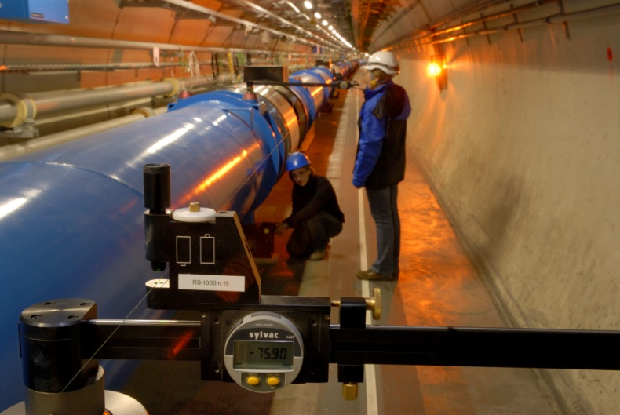
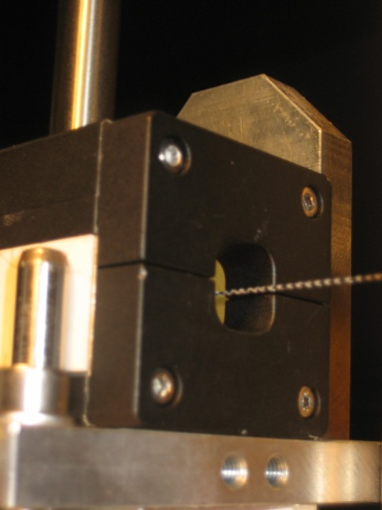
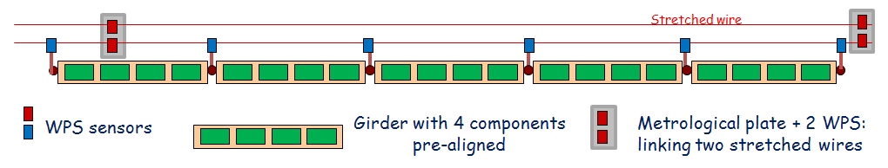
Introduction: status
Studies started 20 years ago
A solution based on stretched wires is proposed for the CDR
Stretched wire in the LHC
Wire Positioning Sensor (WPS)
Stretched wires and WPS proposed for the CDR

Slide 6
Introduction: next steps
But there are some drawbacks:
  Gravity effects
  Cost
  No standard reference precise and accurate enough to validate this solution
Next steps:
  Consolidation of existing solution
  Design of alternative solutions
    Design, manufacturing and qualification of low cost sensors and adjustment solutions
  Monitoring of the last quadrupoles around the detectors
simulations & validation on dedicated mock-ups
6

Slide 7
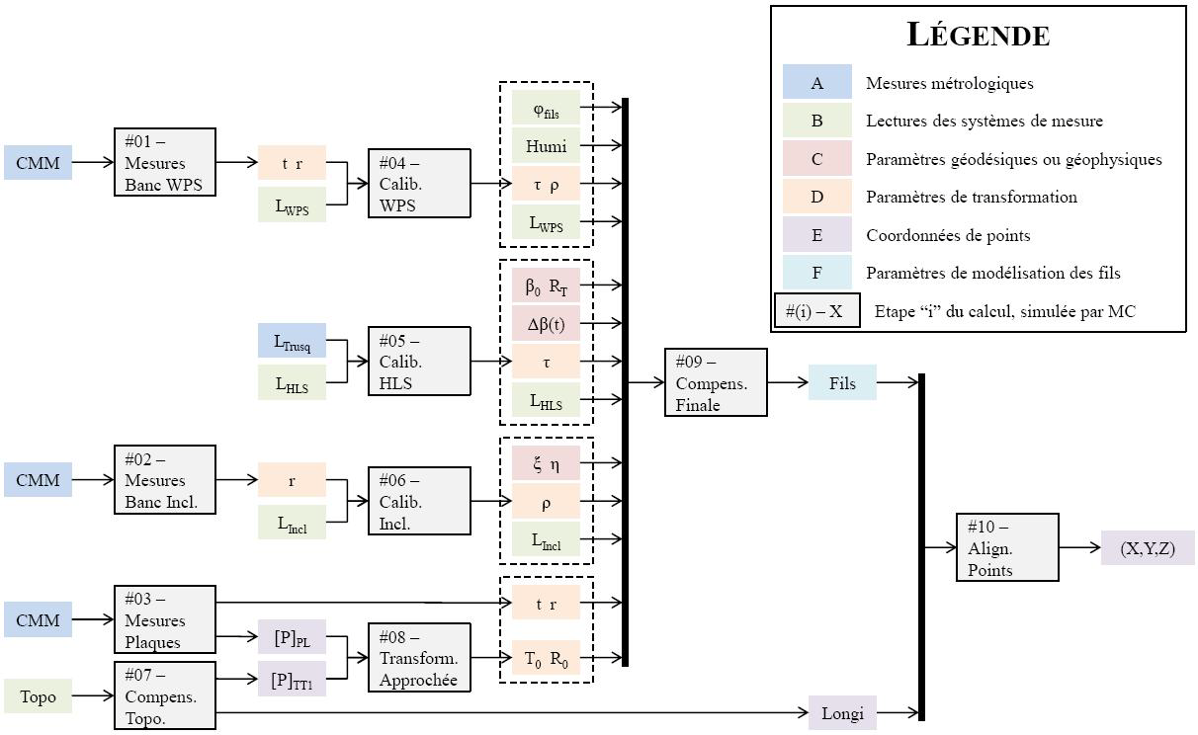
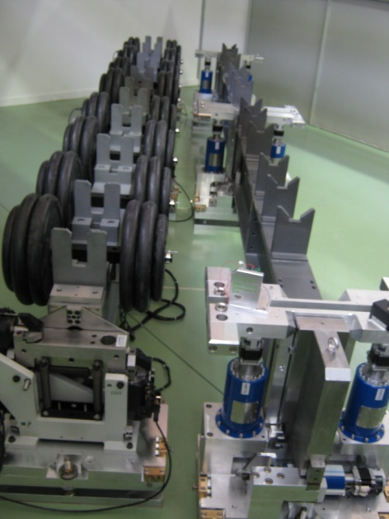
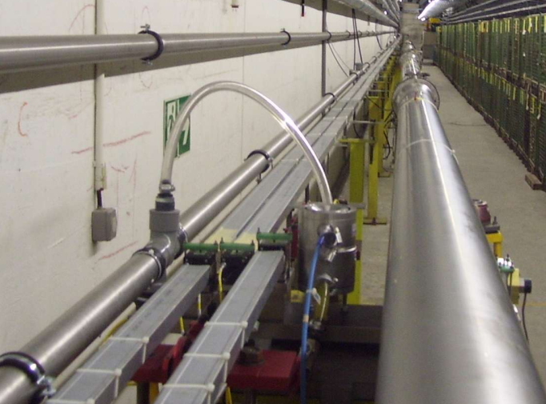
Studies: consolidation & development of alternatives
Consolidation of the existing solution:
  3 PhD subjects:
      «Determination of a precise gravity field for the CLIC feasibility studies”
      «Analysis and modeling of the effect of tides on Hydrostatic Levelling System »
      «Proposal of an alignment method for the CLIC linear accelerator: from the geodetic networks to the active pre-alignment »
  Simulations and facilities:
Example of algorithm structure
2 test modules (4 m)
TT1 facility (140 m)

Slide 8
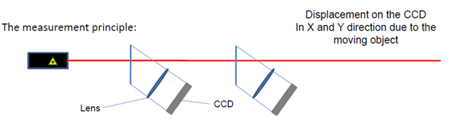
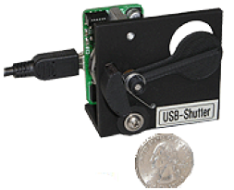
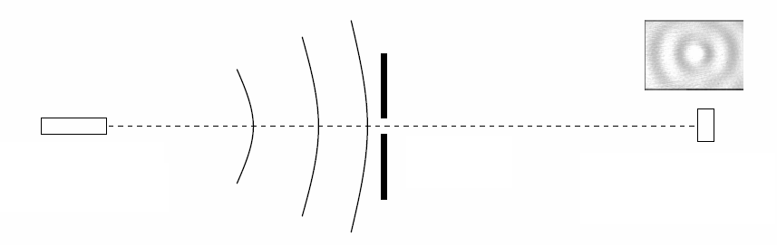
Studies: consolidation & development of alternatives
Development of alternatives:
  “laser based”
  LAMBDA project
    Concept to be validated on short distances ➔ under vacuum over 100 m
  Alignment systems from NIKHEF through a collaboration
laser +
beam expander
diffraction
plate
pixel image
sensor

Slide 9
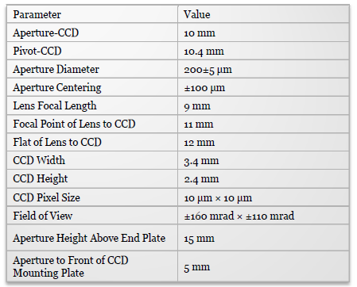
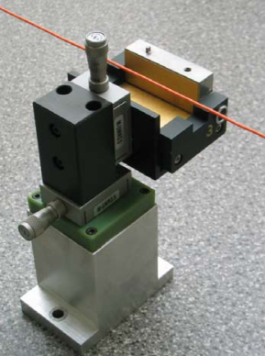
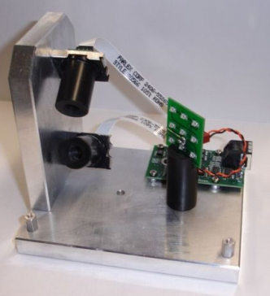
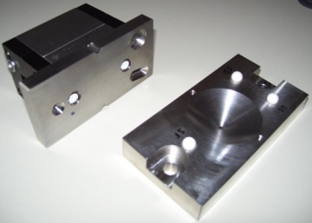
Development of sub-micrometric sensors
WPS sensor fulfilling the requirements
    « absolute measurements » (known zero w.r.t mechanical interface)
    no drift
    sub micrometric measurements
Upgrade of an existing WPS
Development of a new WPS
Capacitive based WPS (cWPS)
Optical based WPS (oWPS)
Resolution: 0.2 µm
Range: 10 x 10 mm
Repeatibility: 1 µm
Bandwidth: 10 Hz
Development of low cost sensors
With increased performance
Working in an accelerator environment

Slide 10
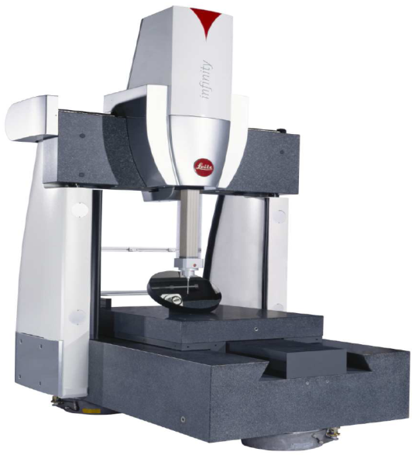

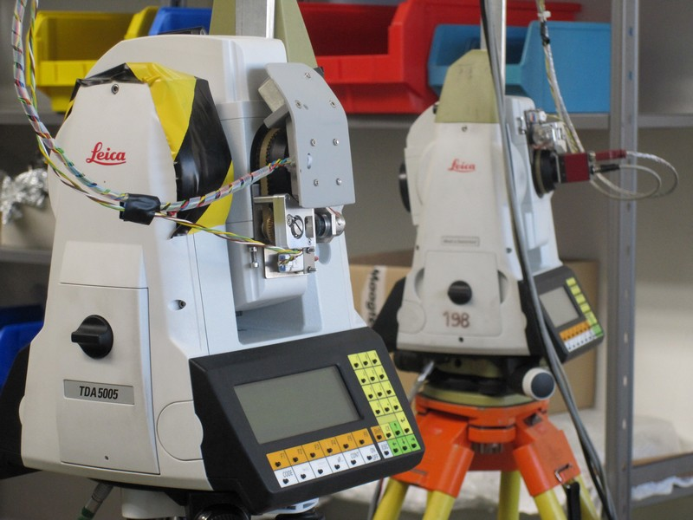
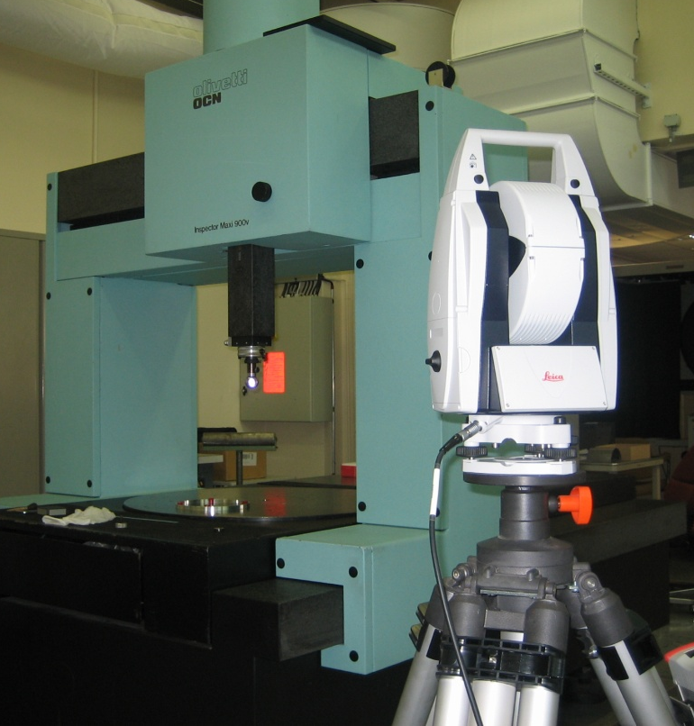
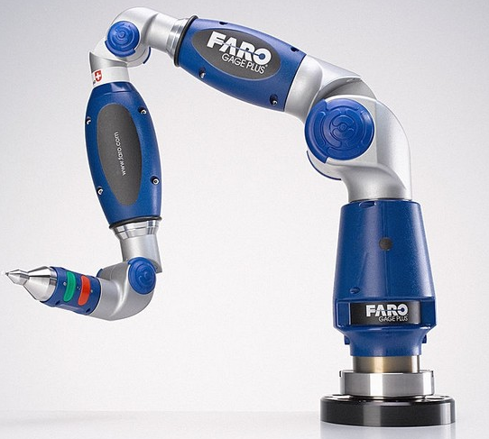
Development of fiducialisation methods
Issue: measure 2 m long objects within a few microns
First solution: CMM measurements (dimensional control, pre-alignment of components on their supports, fiducialisation), but STATIC
  Micro triangulation
MPE = 0.3 µm + L/1000 (L in mm)
  AT 401: maximum offset in the determination of a point in space: ± 15 µm + 6ppm (3σ)
Alternative solution: combination of measurements from Laser Tracker, measurements arm or micro triangulation in lab and tunnels (control after transport, during tests,…)
10
10

Slide 11
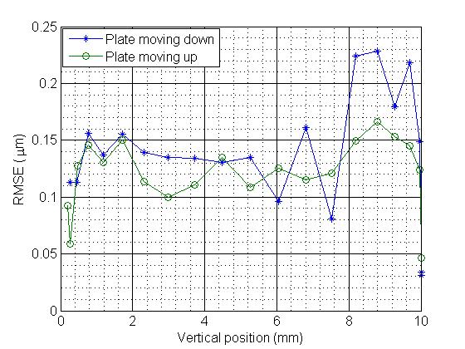
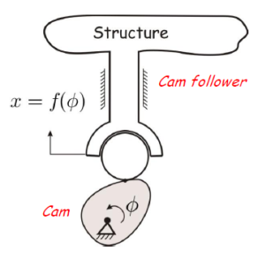
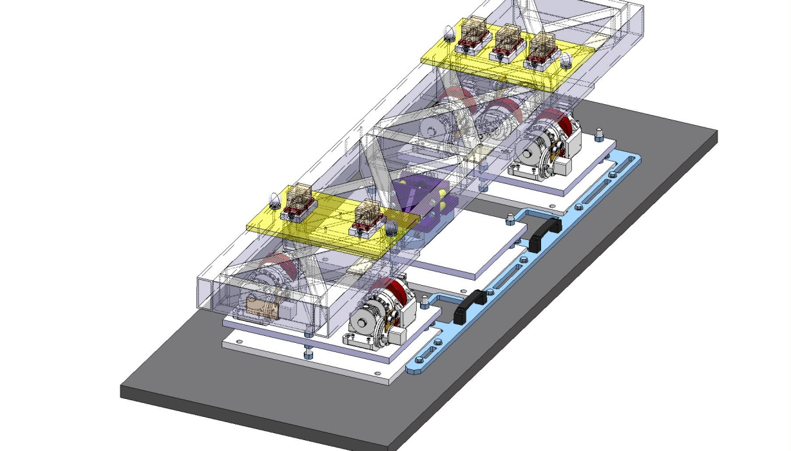
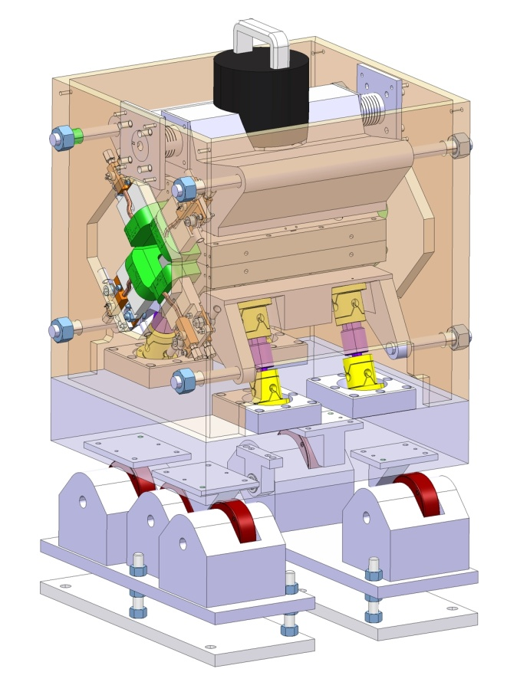
Development of re-adjustment solutions:
Based on cam movers
Eccentric cam mover
Repeatability measurements
5 DOF test bench
Smaller cam movers to be designed

Slide 12

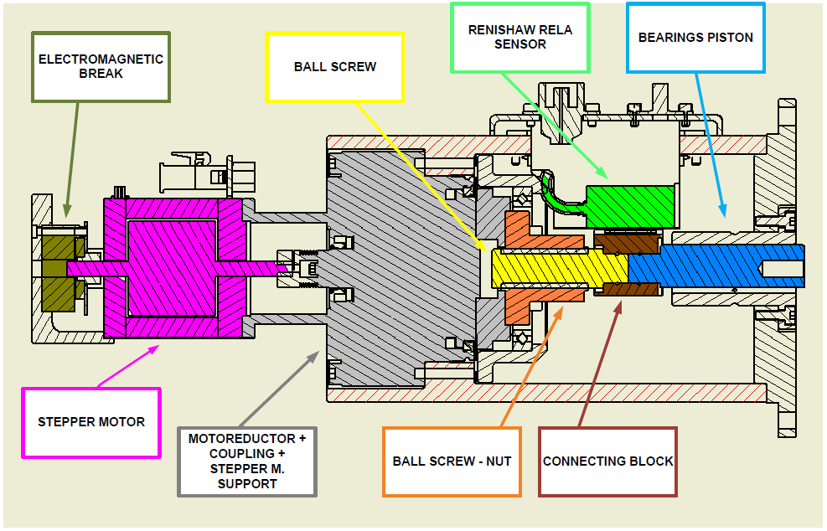
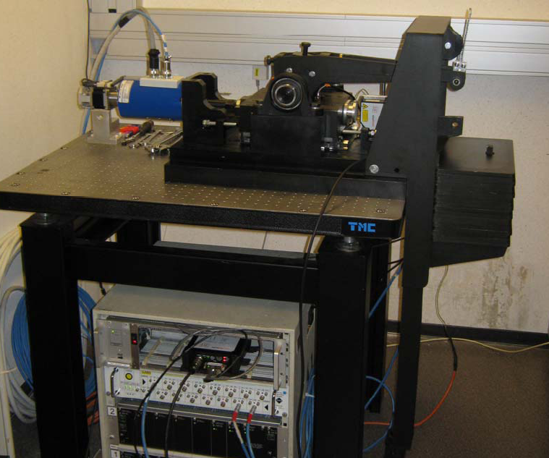
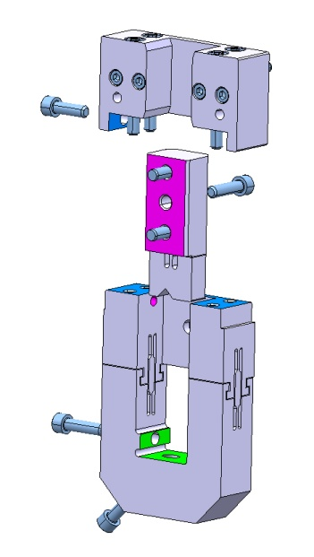
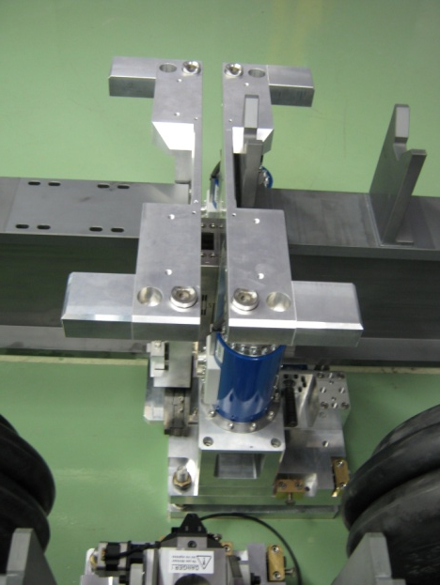
Development of re-adjustment solutions:
Based on Linear actuators
1 DOF test bench
1 DOF test bench

Slide 13
ACAS possible participation to alignment works
Standard alignment works in CTF3
Participation to the studies concerning pre-alignment:
    Contribution to the development of sensors and actuators: irradiation tests, qualification under magnetic fields
    Contribution to mechanical studies : design and manufacturing of calibration/qualification benches, design and manufacturing of smaller cam movers, design of on/off mechanism under vacuum,…
    Additional manpower: Fellow, Doctorate student (Geodesy, optics, mechanics, electronics, mechatronics)

