Slide 1
Instrumentation
Juan Casas
CERN – TE/CRG Group
Technical Training: Cryogenic Engineering for Helium Superconducting devices
CERN, 20-24 November 2023

Slide 2
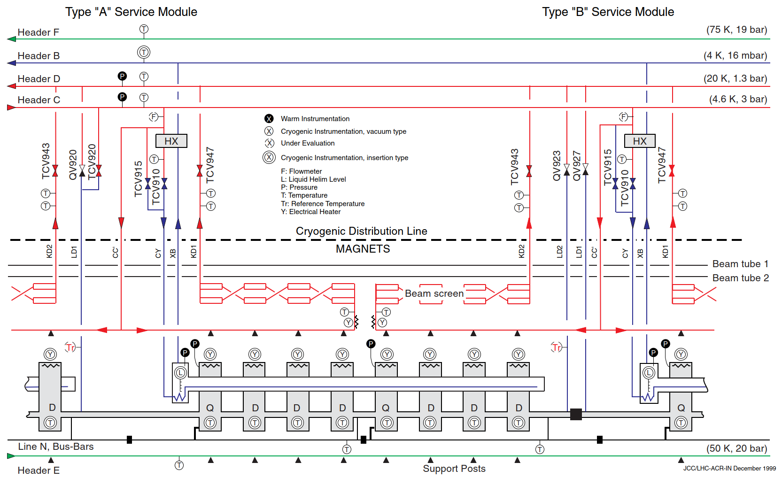
Instrumentation: what is it for?
The instrumentation is “one” of the set of apparatuses that permit the operation, optimization and diagnostics of, in this case, cryogenic equipment.
The components are sensors & actuators with its ancillary components.
The instrumentation is shown on a P&ID (example: LHC cell 1999 version).

Slide 3
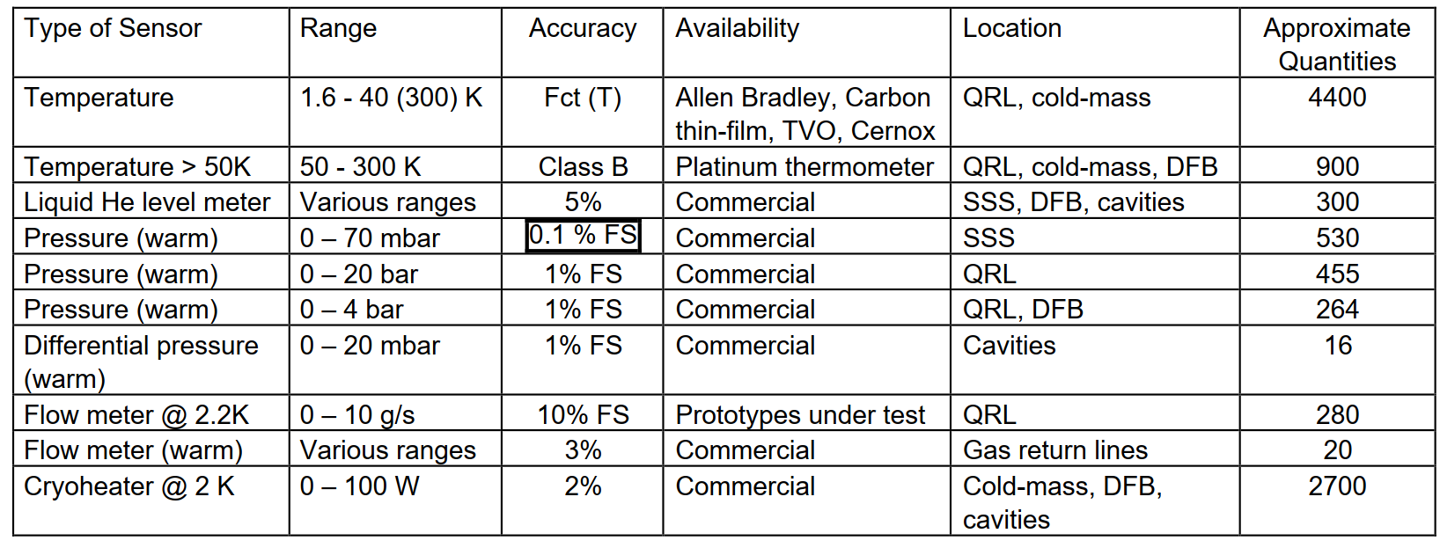
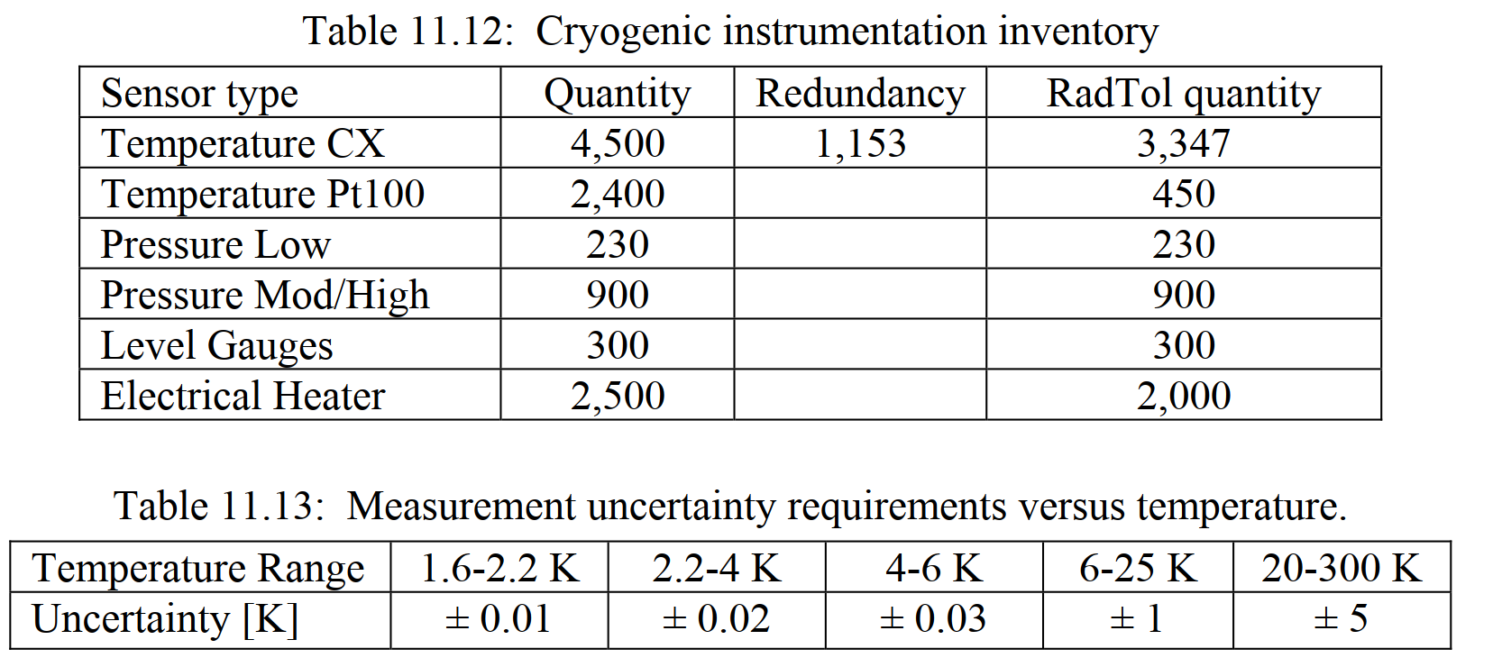
Instrumentation: Requirements then Selection
The ideal workflow is:
Design engineer provides a set of requirements
  Quantity including criticality (redundancy)
  Measurement uncertainty
  Environmental conditions
Instrumentation specialist selects appropriate candidates
  Final selection include qualification for non-standard (commercial) environments
  Acquisition chain is critical and shall be part of the cost optimization
LHC: selected requirements
LHC: preliminary analysis

Slide 4
Instrumentation: Metrology
Measurement is the process of obtaining experimental values attributed to a quantity or property.
The metrological traceability is a property of a measurement
result whereby the result can be related to a reference
through a documented unbroken chain of calibrations.
Primary references are managed by national standards laboratories
Uncertainty defined by the GUM (Guide to the expression
of Uncertainty in Measurement):
Uncertainty: quantification of the doubt about a measurement result
  width of the margin (+/-) and confidence level (%)
Random errors Type A, systematic Type B
Requires mathematical model => seldom used in
practical measurements
Primary Reference Standards
Transfer Standards
Working Standards
Gauges, Instruments and
Equipment used to measure process
and Product Characteristics

Slide 5




Instrumentation: Metrology (Technical)
Objective of a measurement is to determine a value of the measurand, in other words, to sample one value out of a universe of possible values.
Accuracy: agreement of measurement with respect to the true value
Precision: spread of measurements (not related to true value, ~ repeatability)
Reproducibility: results can be attained by a different research team, using the same methods.
Bias: total systematic error as contrasted to random error
Trueness: closeness between the test results and an accepted reference value.
The measure of trueness is normally expressed in terms of bias.
Inaccurate & imprecise
(unrepeatable)
Precise but inaccurate
(repeatable)
Accurate but imprecise
Accurate & precise
Figures from a poster made by NPL

Slide 6
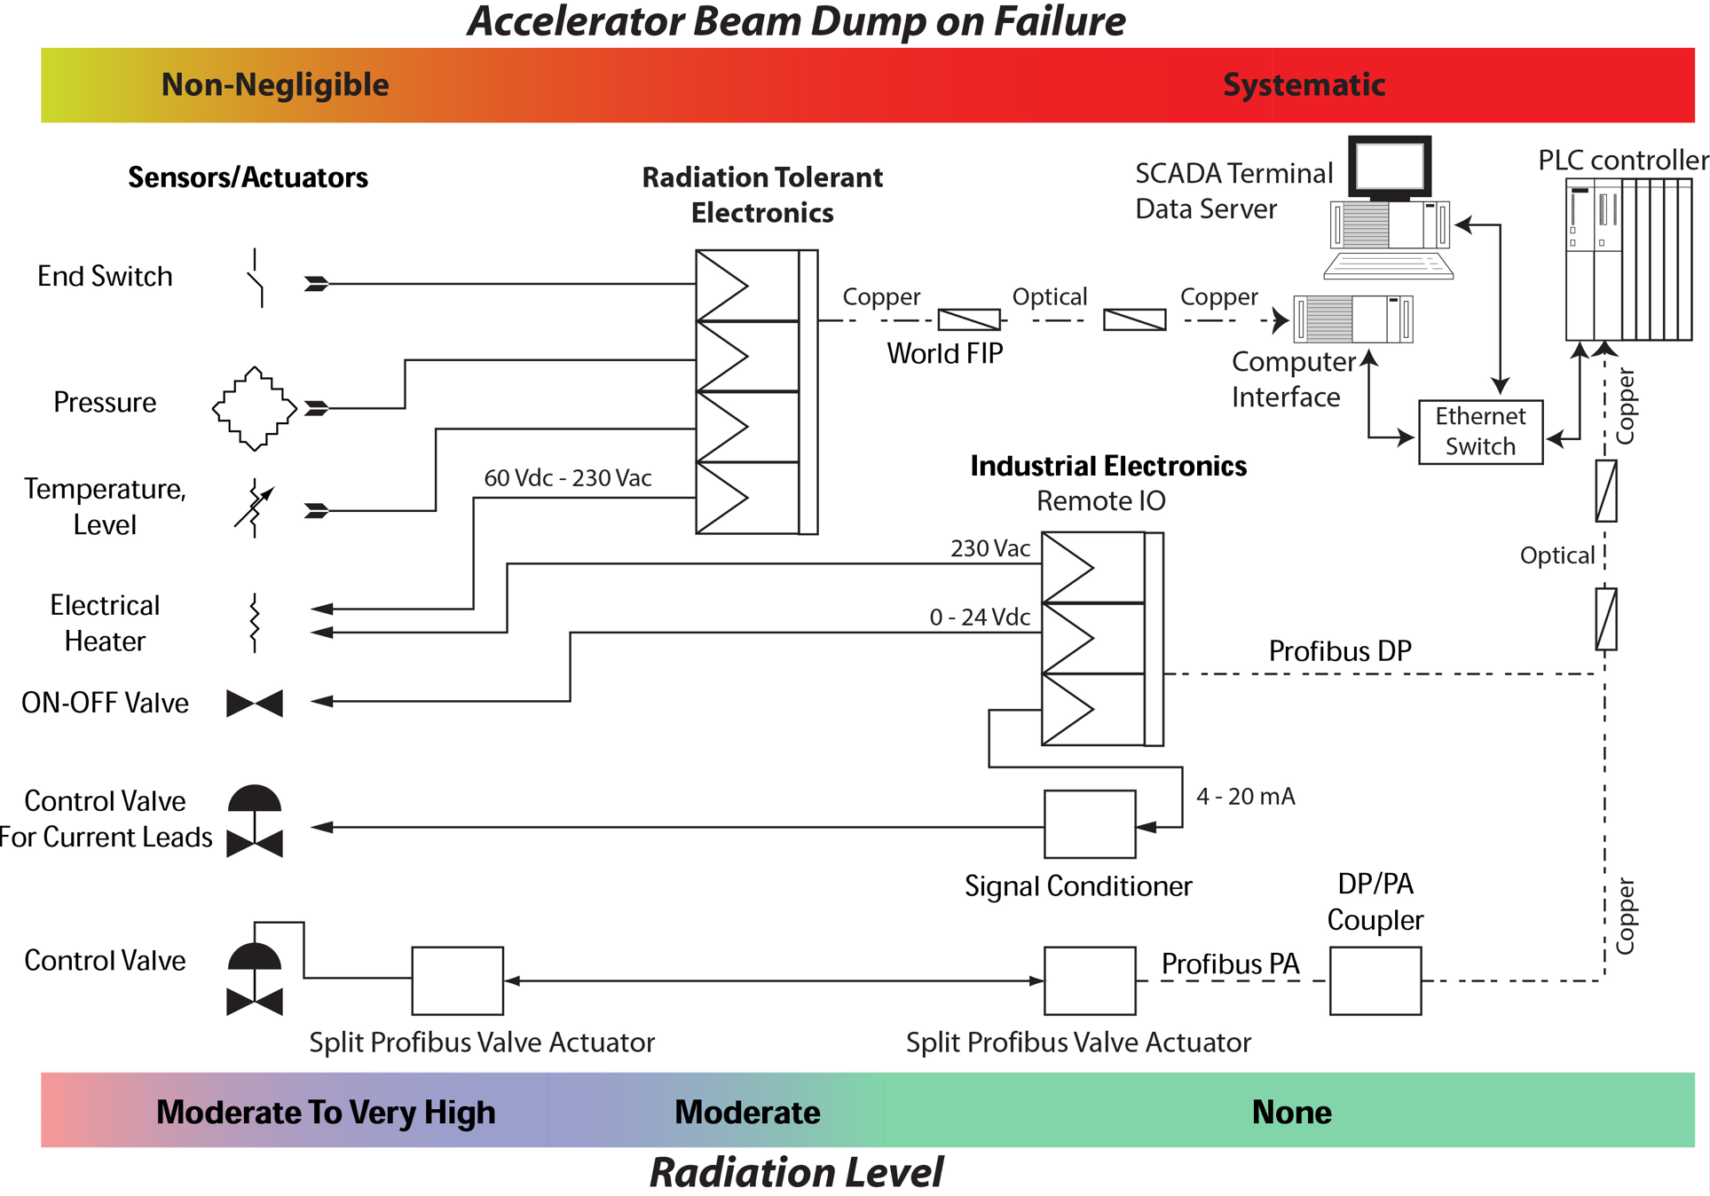
Instrumentation Chain: Particle Accelerator
Particle accelerator usually involve environmental radiation
More challenging than a typical industrial installation
Equipment need to be qualified by the end user
Critical equipment need to be located appropriately & provide adequate redundancy
Long distance require mechanisms to cope with EMI
20+ year operation design
  ¡ obsolescence !
LHC example

Slide 7
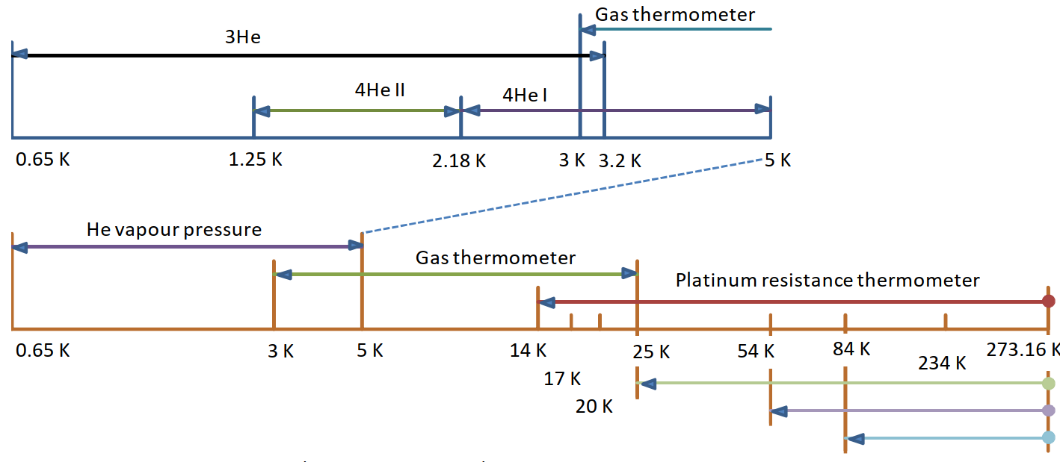
Absolute Temperature Scale (ITS 90)
Temperature (as pressure) is an intensive quantity and its measurement is done via the use of a transducer that provides a temperature dependent value.
An intensive property does not depend on size or mass.
The International Temperature Scale of 1990 extends upwards from 0.65 K
Based on 3ple points: equilibrium between solid, liquid and gas phases (single temperature)
Based on interpolation platinum thermometer
Based on LHe vapor saturation pressure & gas thermometer
Between 0.9 mK & 1 K it exists a provisional temperature scale (PLTS2000)
T [K] | Substance
13.8033 | e-H₂ (T)
17 | e-H₂ (V)
20.3 | e-H₂ (V)
24.5561 | Ne (T)
54.3584 | O₂ (T)
83.8058 | Ar (T)
234.3156 | Hg (T)
273.16 | H₂O (T)
³He, ⁴He from 4.2 K

Slide 8
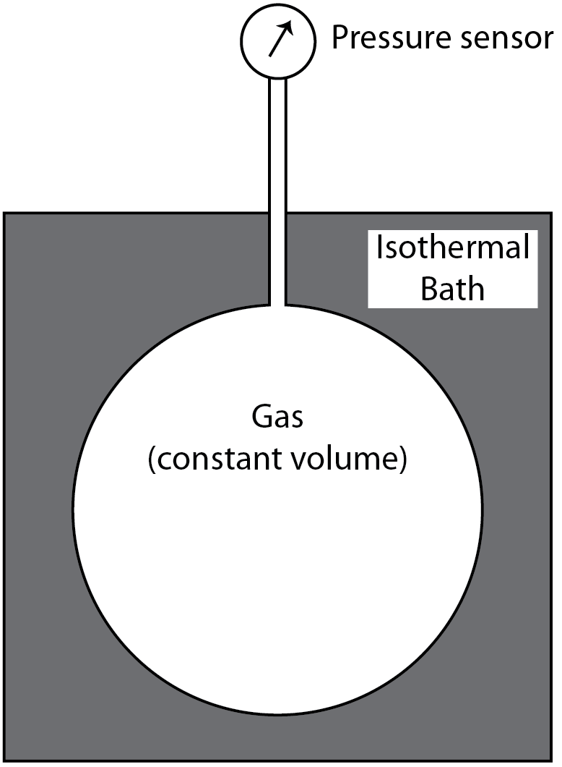
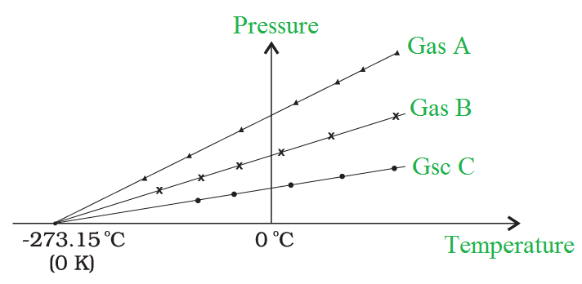
Absolute Temperature Scale
The origin for the value of the lowest attainable temperature is related with:
Freezing (ice point) temperature of water (0 °C)
Boiling temperature of water (100 ºC)
Law of perfect gases & constant volume gas thermometer
  Temperature % Pressure
Vanishing pressure ⬄ lowest temperature
  Non ideal gas ⬄virial coefficients
The SI unit for temperature is K (Kelvin)
  0 ºC = 273.15 K

Slide 9
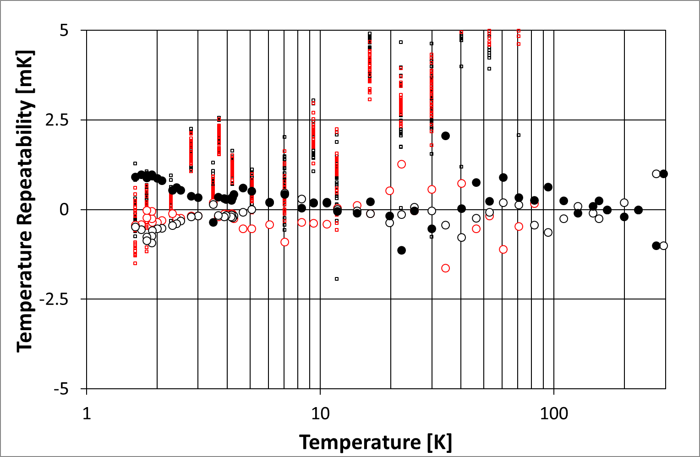

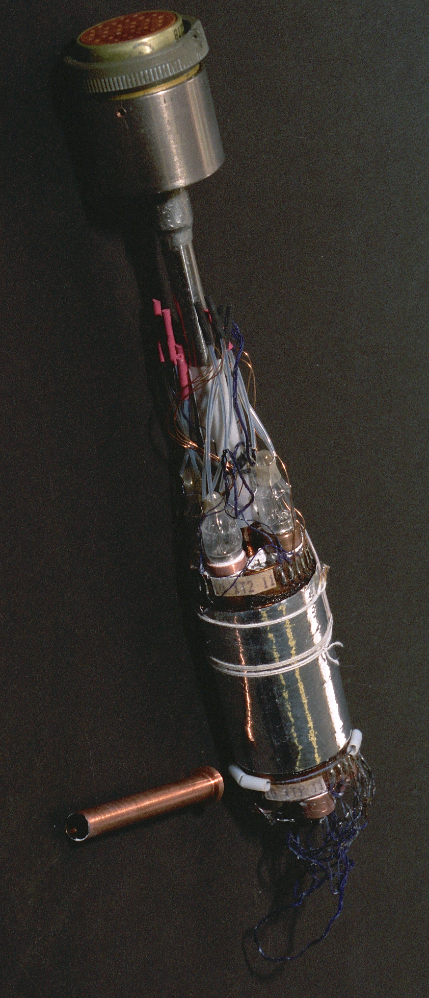
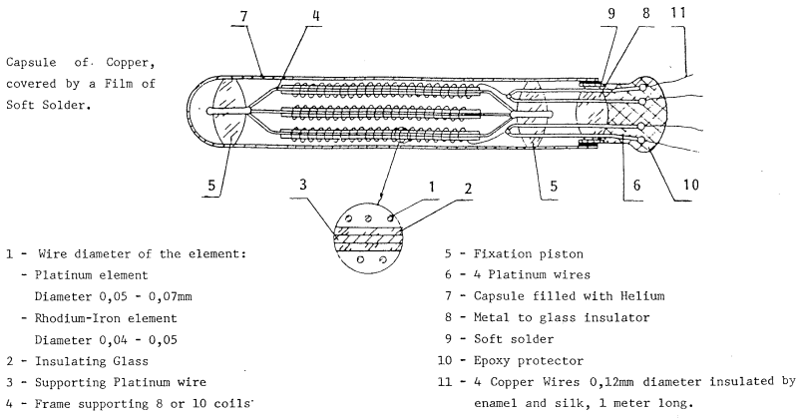
Absolute Temperature Scale: CERN interpolation standards
Primary Reference Standards
Rhodium IRon Thermometers (RIRT): secondary & working standards.
2^{ary} standards are compared to 1^{ary} standards by a reference laboratory.
Working standards are installed in the series calibration insert & compared from time to time (yearly basis) to the secondary standards.
Transfer Standards
Working Standards
Gauges, Instruments and
Equipment used to measure process
and Product Characteristics
RIRT standard made by Tinsley (UK)
RIRT standard made by VNIIFTRI (RUS)
VNIIFTRI standard comparison insert
: RIRTs in CERN calibration insert
: cernox sensors

Slide 10
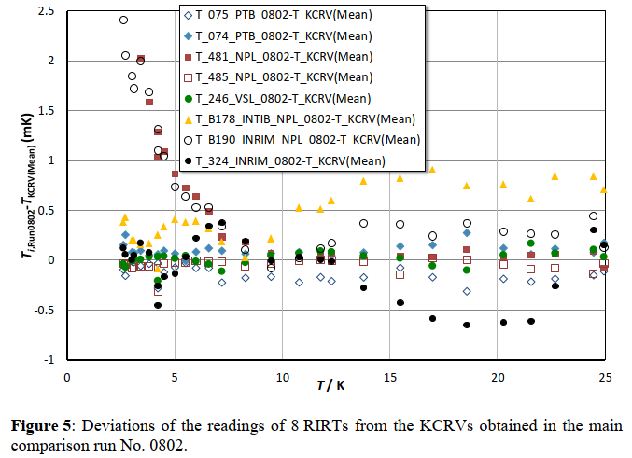
Standards/Calibration Certificates
The LHC requirements for the measurements below 4 K are very tight
Not far off from the national standards laboratories results:
Working & secondary standards are
not required for cryo-CERN for:
Pressure
Voltage
Current
etc.
industrial calibration certificates of
apparatuses is sufficient; these are:
DMM
Portable calibrators
Bench instruments
…..
From <<EURAMET Key Comparison No. EURAMET.T-K1>> (2016)

Slide 11
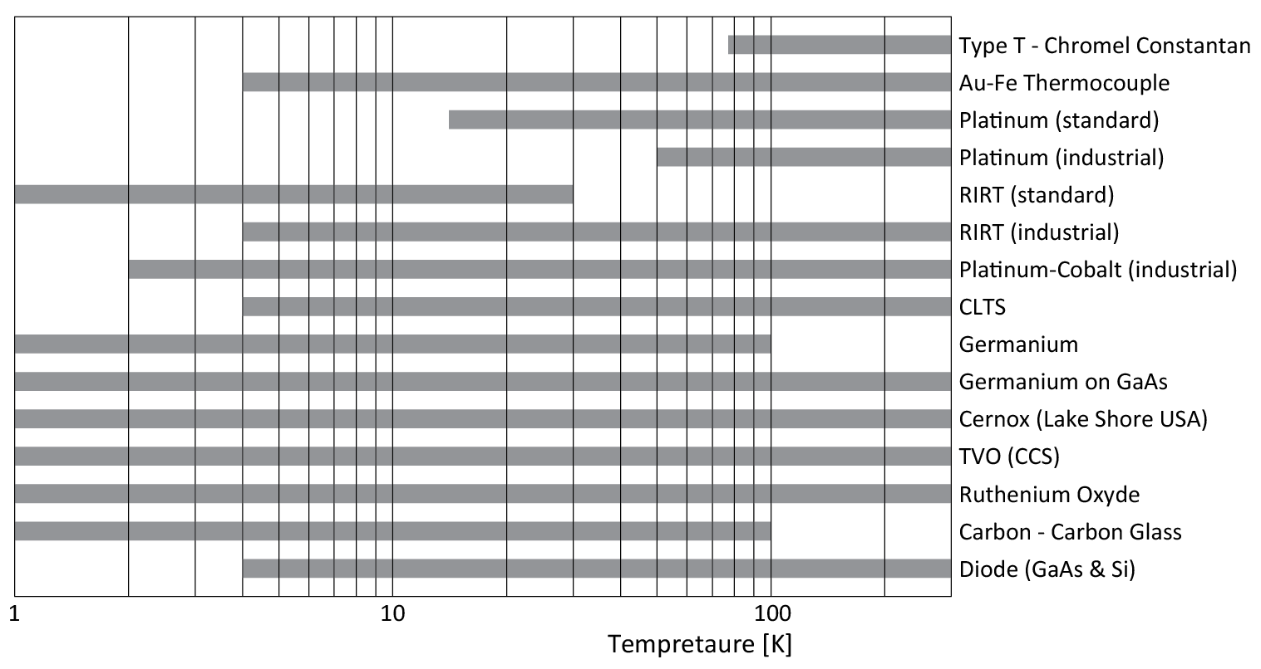
Temperature Measurement: Electrical Sensors
Most of the temperature measurements are based in electrical sensors.
Not a single one fitting all applications.
Many are several decades old and some are becoming obsolete  or difficult to obtain .
✰
Apart measurement range, check for:
- accuracy requirements
- environmental constraints (pressure, radiation, magnetic field, etc.)
- signal conditioning
- thermal anchoring
- …
- overall cost
✰



Slide 12
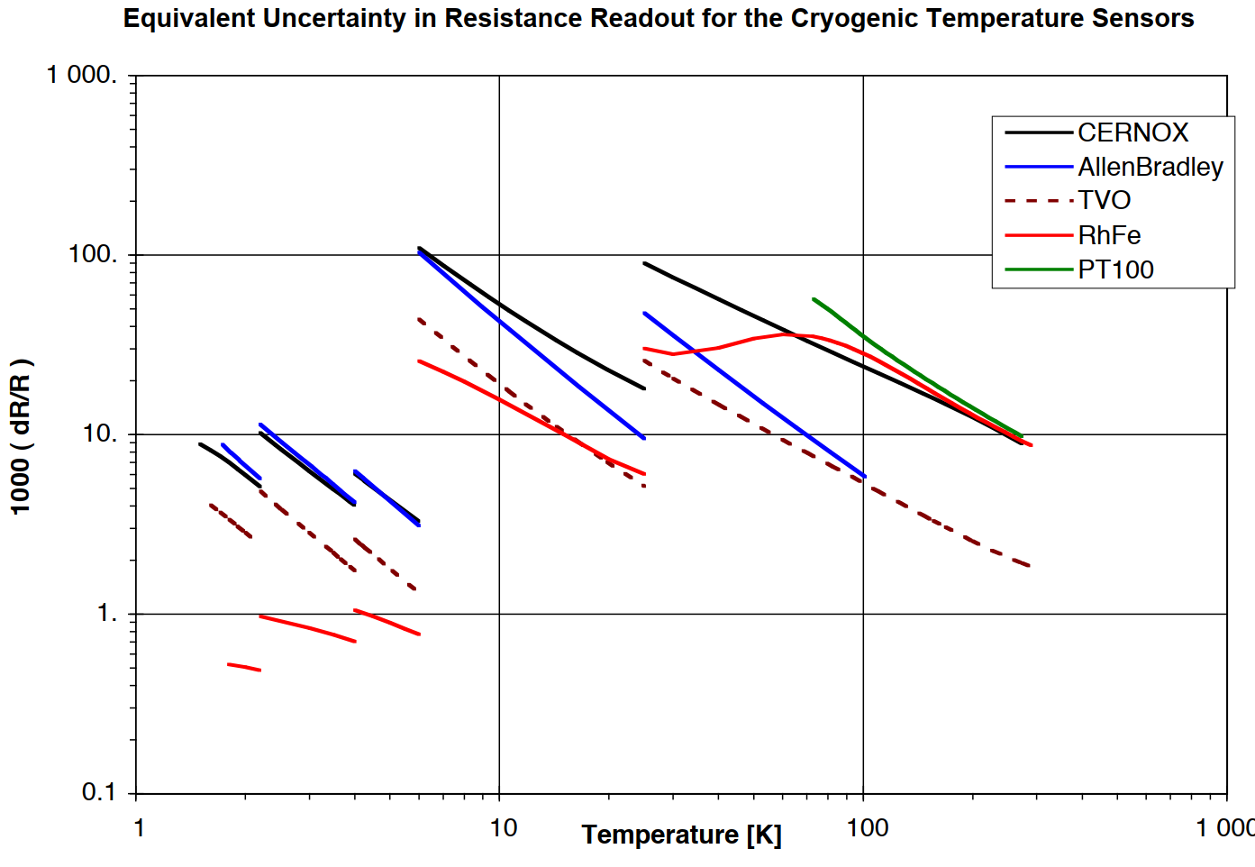
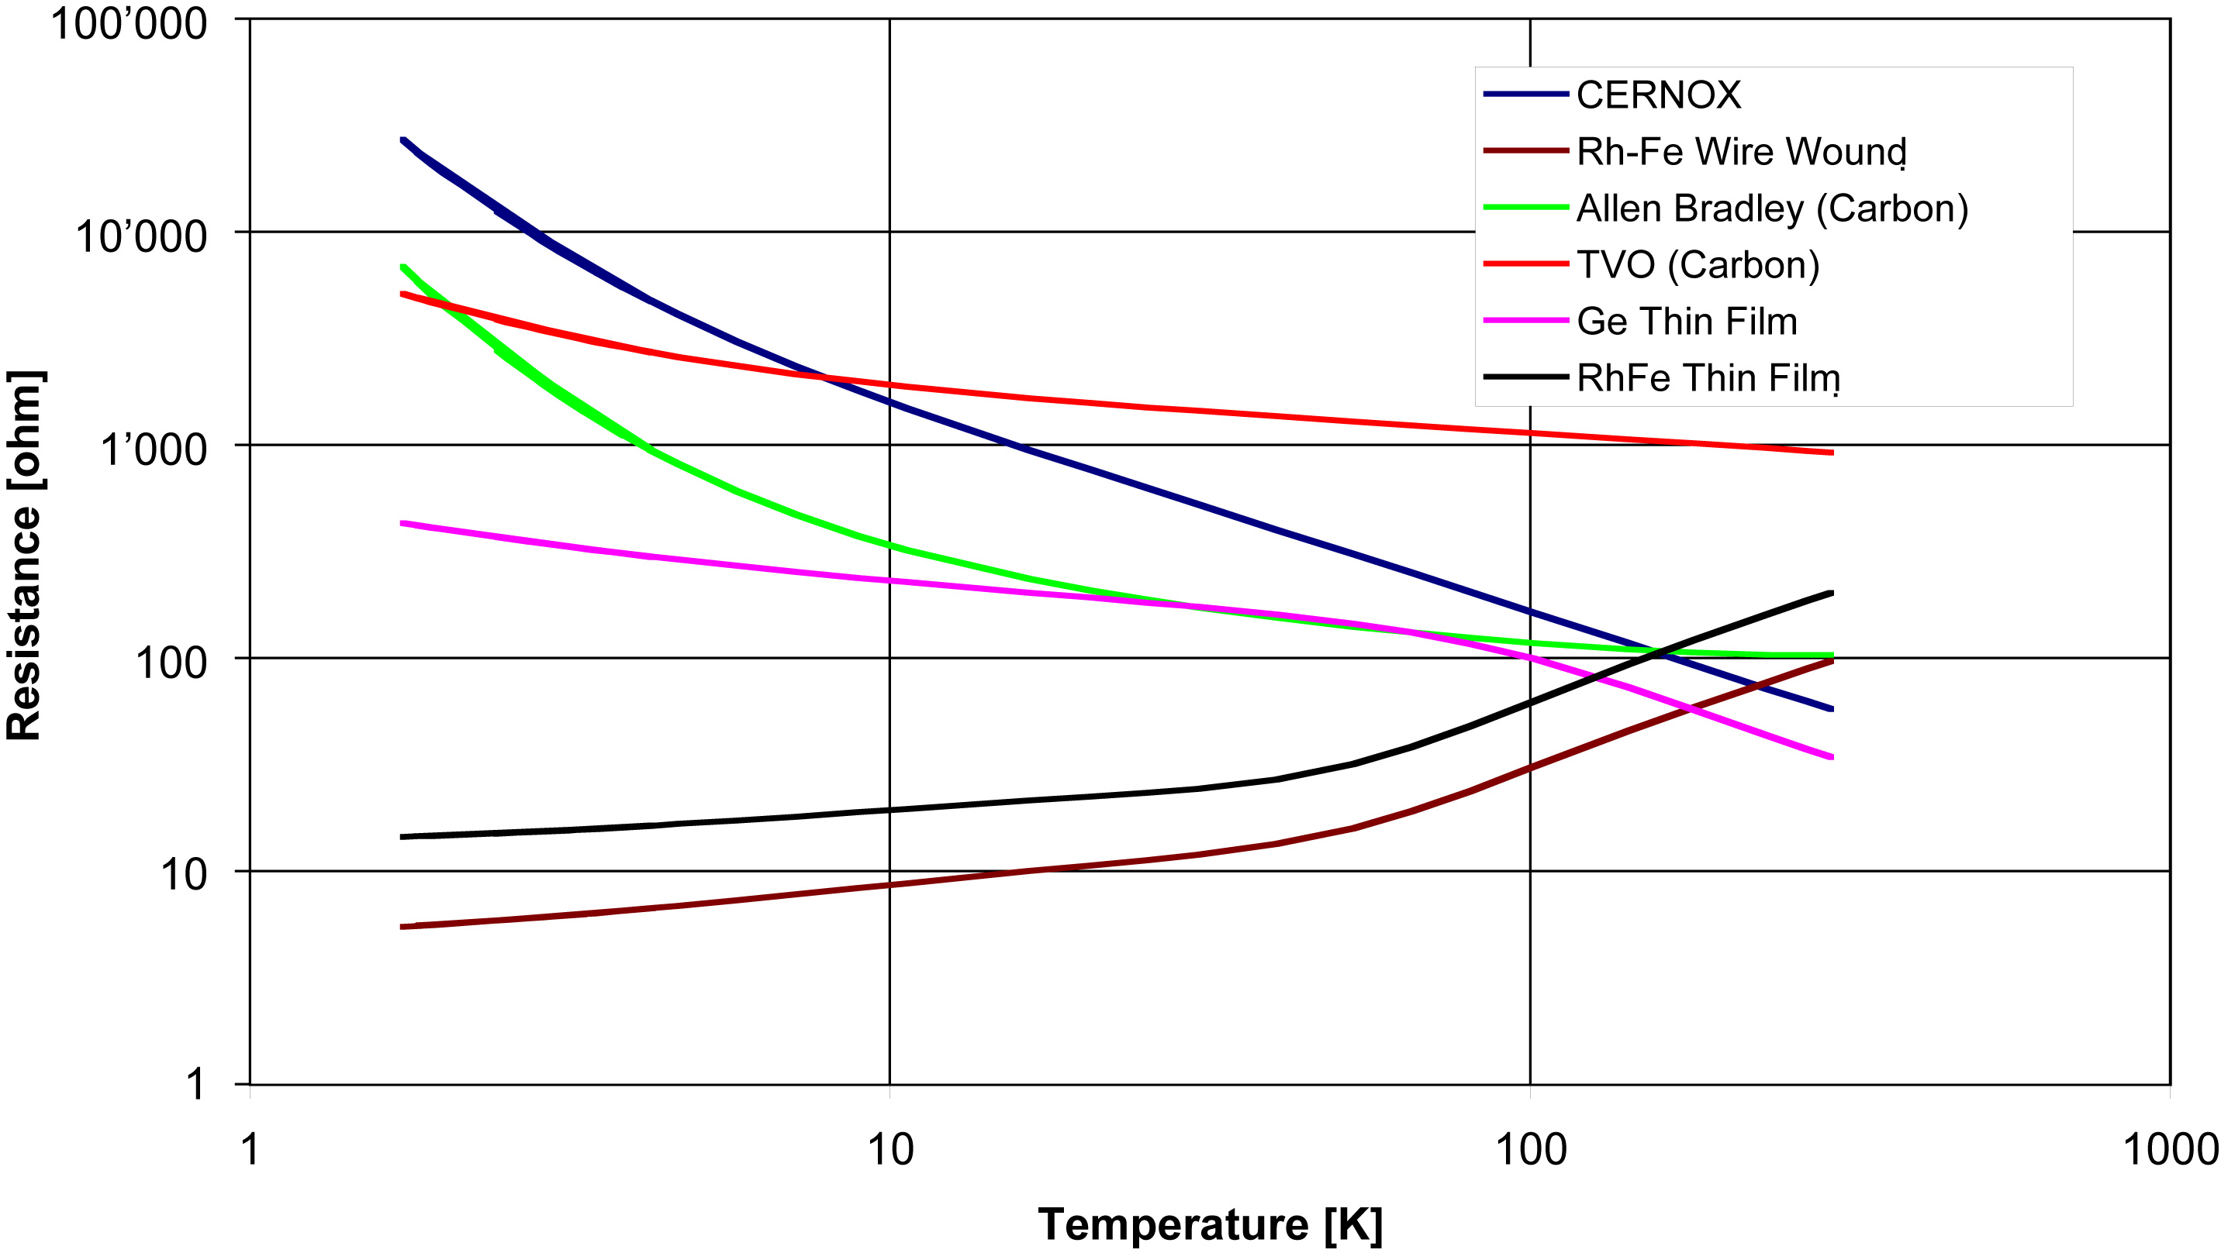
Temperature Measurement: Electronic <-> Sensor Matching (LHC)
The LHC temperature requirement:
The precision budget shared (arbitrarily) in equal parts between the sensor & electronics.
RhFe: demanding signal conditioning
Very small sensitivity => 30 ppm resolution
Industrial Pt100 standard curve is provided
above 73 K; used in LHC down to 50 K.
Higher dR/R simplify measurement
6.0 K
25 K
1.6 K
2.2 K
300 K
4.0 K
0.25 % RDG
CRYO ACQ
Lower dR/R complicate measurement

Slide 13

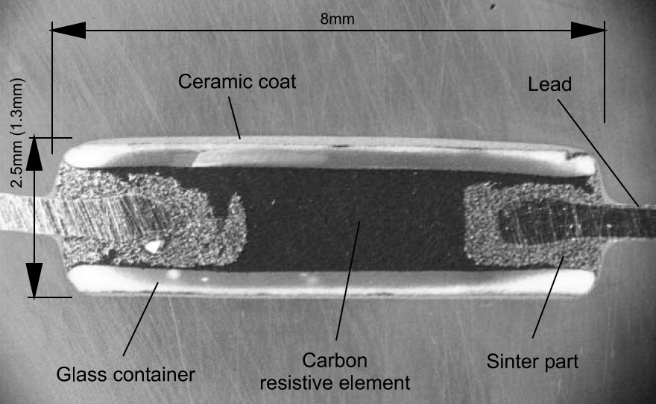
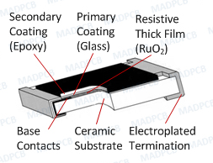
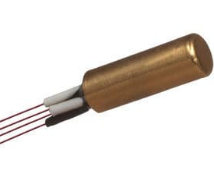
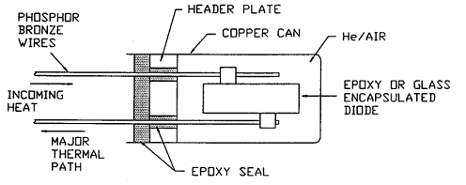
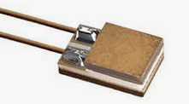
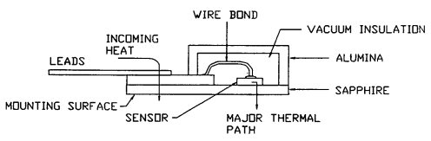
Temperature Measurement: packaging for electrical sensors
“PCB” resistors
TVO, Allen Bradley, Ruthenium oxide
Anchoring via wires & body
Robust package
Canister mounting
Ge, carbon glass, cernox, ..
Anchoring via wires
Canister anchoring quite useless ⬄ vacuum
Fragile package:
epoxy seal damage
=> sensor damaged if not passivated
Proprietary package: SD Lake Shore
Cernox, diode, etc
Anchoring via wires (& body)
Robust package but wires (leads) are fragile
CERN vacuum assembly uses solely the leads as thermal path
TVO
RuO2 (SMD)
Canister
SD
Major thermal path
Probably NOT

Slide 14
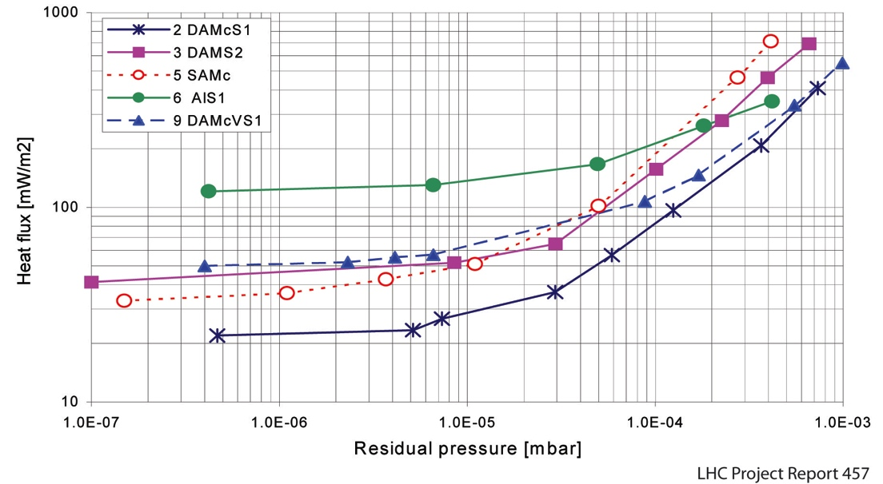
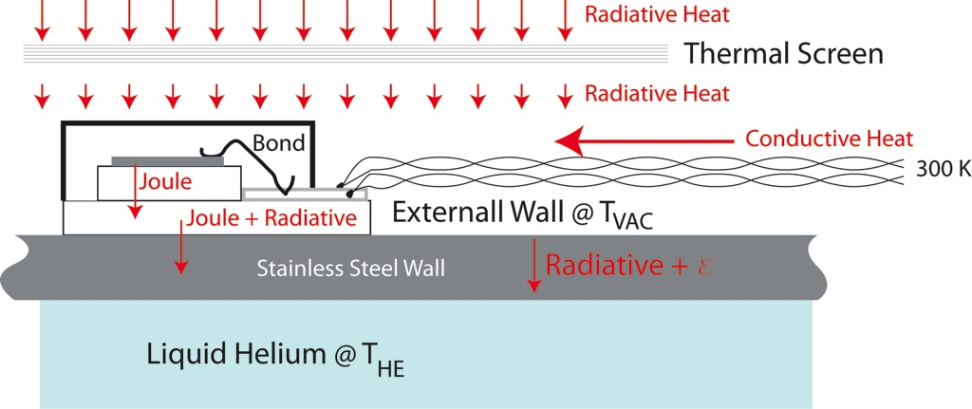
Temperature Measurement: Thermal Anchoring under vacuum
Sensor temperature increases through wires thermal conduction, photon radiation & Joule self-heating
Sensor temperature heat in-leak extracted through wall separating vacuum & cryo-fluid
Radiated Heat Flux In Vacuum envelope
PARAMETER: Type of Superinsulation
Thermal Conductance
Measurement

Slide 15
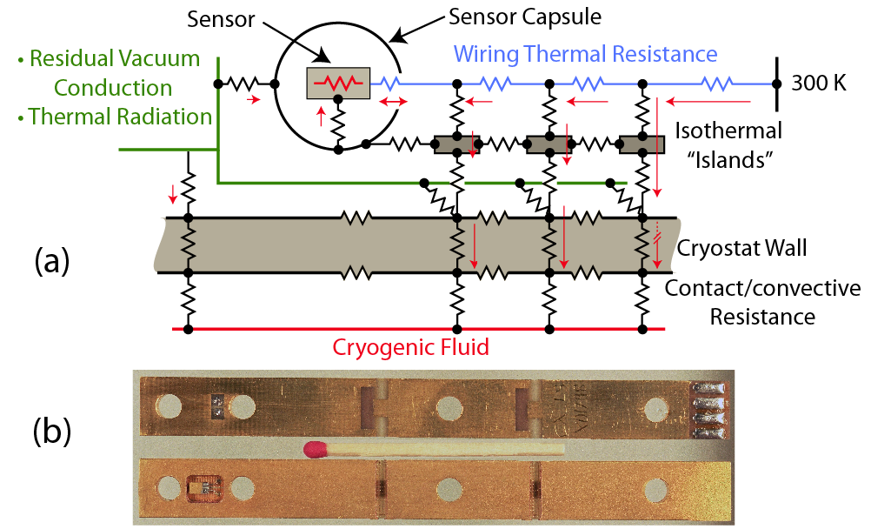
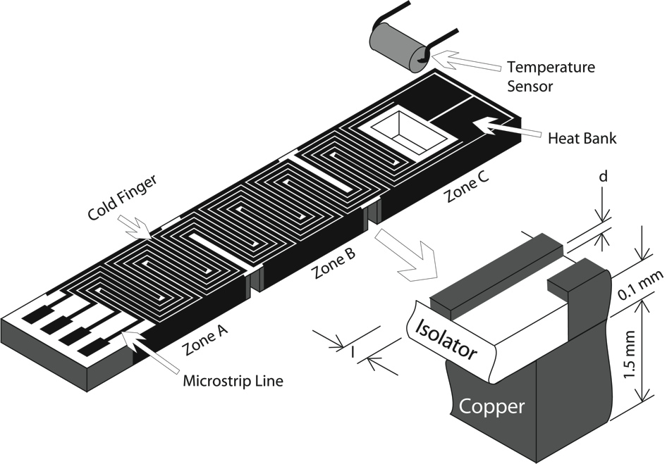
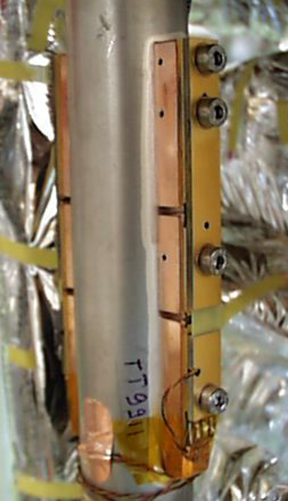
Temperature Measurement: Thermal Anchoring under vacuum
LHC vacuum thermometer based on a triple anchoring support
- increases robustness in case one anchor support is thermally loose
- anchor support intercept receives heat flow and divert most to “cold source”
- anchor supports are thermally decoupled
Good practices still apply => heat flow through wires => long & resistive (non-copper) wires
Calibration performed on full assembly before screwing in final position
=> sensor is never soldered/desoldered/manipulated once it has been calibrated

Slide 16
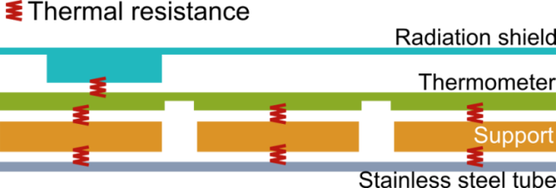
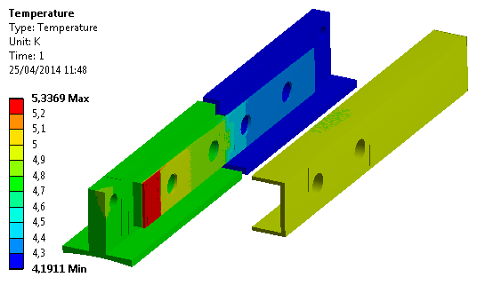
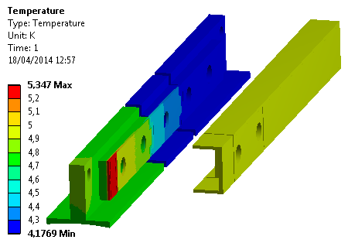
Temperature Measurement: Thermal Anchoring under vacuum
ITER-CEA has adopted the LHC long thermometer block for vacuum applications.
CEA used finite element analysis model to simulate 2 & 3 island configurations:
3 islands provides better accuracy
confirms CERN’s (much) simpler calculations
Main contributors to external wall temperature increase:
  Thickness of stainless steel wall
  Photon radiance
  Thermal transport through wires
Measurand = external wall temperature
Helium
Copper block
Sensor
location
2 Islands
3 Islands
3 islands ->
ΔT = 15 mK
ΔT = 2 mK
2 islands ->
ΔT = 43 mK
ΔT = 8 mK

Slide 17
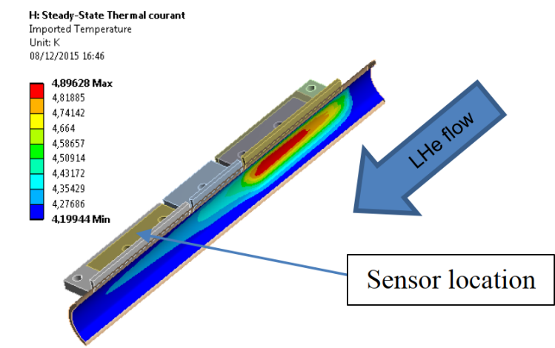
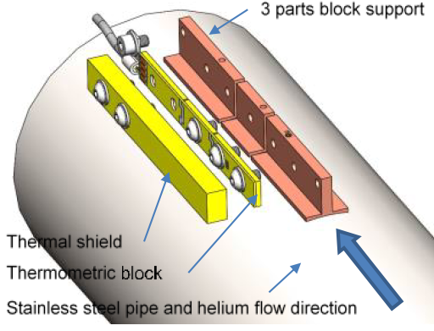
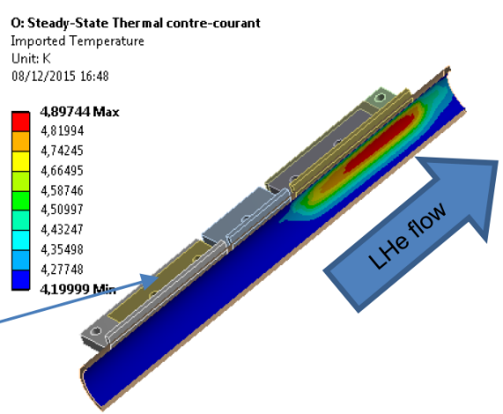
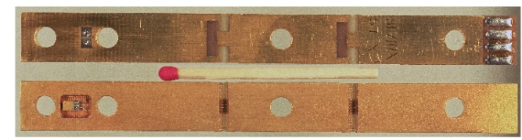
Temperature Measurement: Thermal Anchoring under vacuum
As confirmed by finite element modelling the sensor should be upstream
Wires heat in-leak shall propagate away from sensor on circulating fluid
CERN design is asymmetrical => support structure shall be properly orientated
CEA design is symmetric => orientation has to be checked on assembly or repair

Slide 18
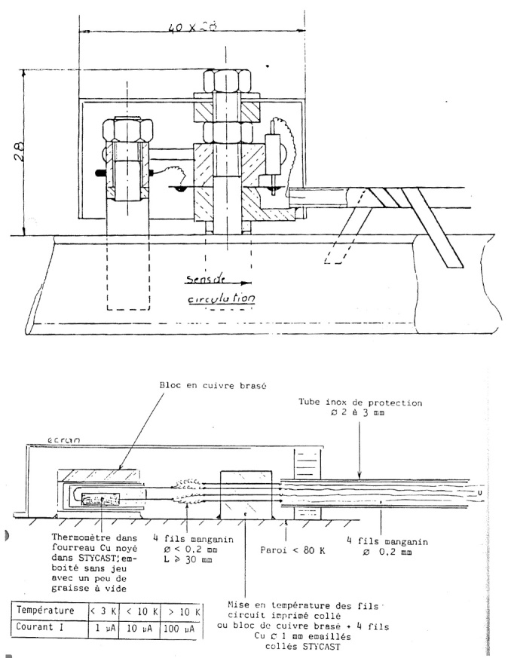
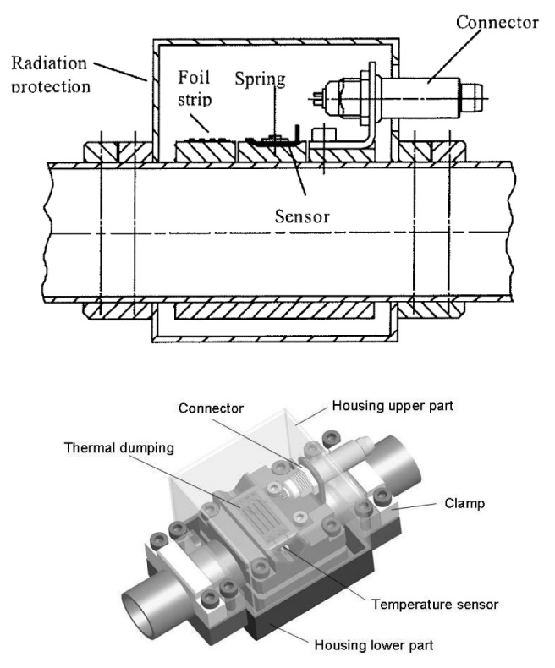
Temperature Measurement: Thermal Anchoring under vacuum-CEA & KFK
Existing industrial approaches, both examples rely on two anchoring “islands”:
1st island anchors the incoming wires to reduce the heat reaching the sensor
2nd island anchors the sensor body and heat incoming from 1st stage
Both designs foresee a thermal screen
Vacuum thermometry
=> large exchange surfaces
=> these are never miniature
CEA – 1998
Independent thermal anchor for sensor & wires
Brazed assembly
KFK - 2010
Independent thermal anchor for sensor & wires
Clamped assembly

Slide 19
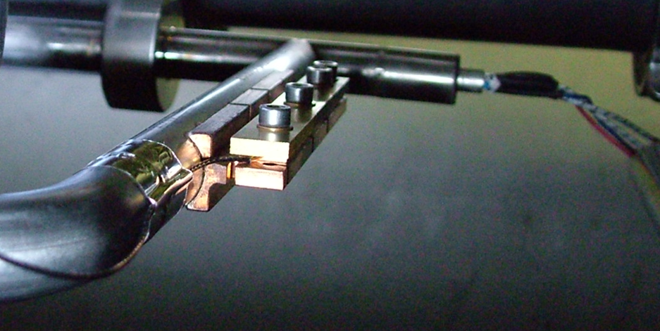
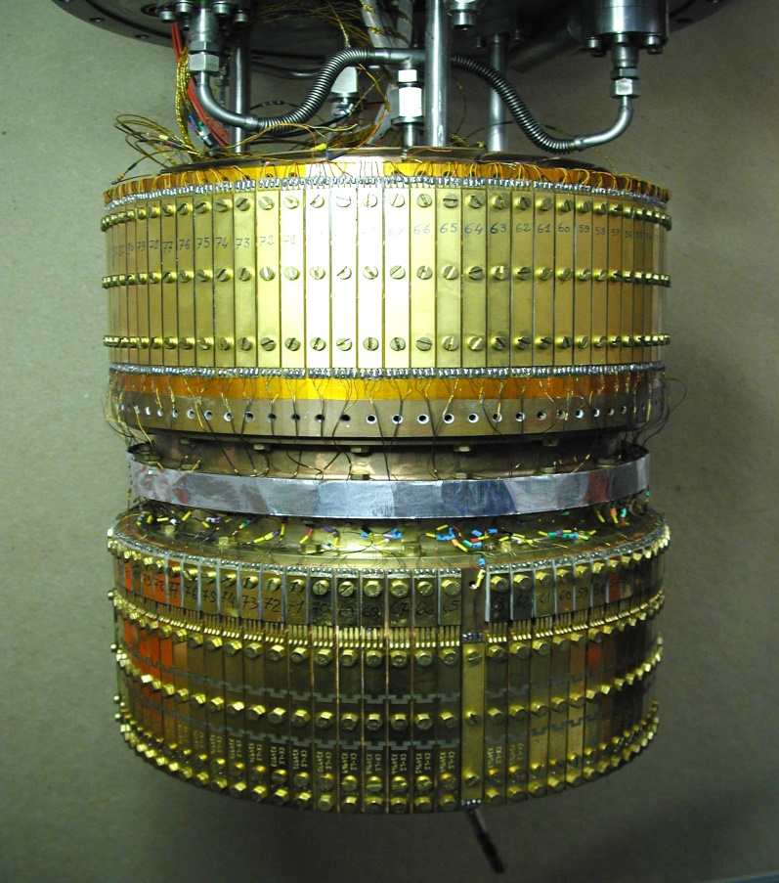
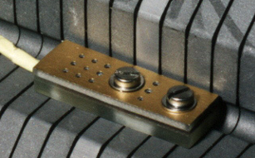
Temperature Measurement: Thermal Anchoring under vacuum
Calibration performed under vacuum with sensors on final holder:
Long block for vacuum applications
Short block for immersion in LHe
Bare sensor for insertion thermometry on “temporary” support
}
<= Sensor never manipulated after calibration
Series calibration insert
Capacity: 74 sensors

Slide 20
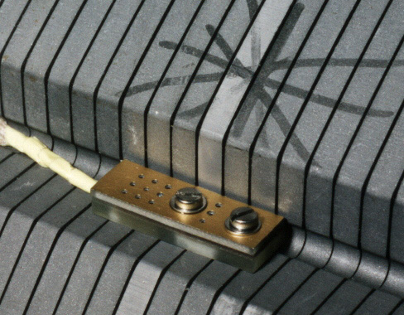
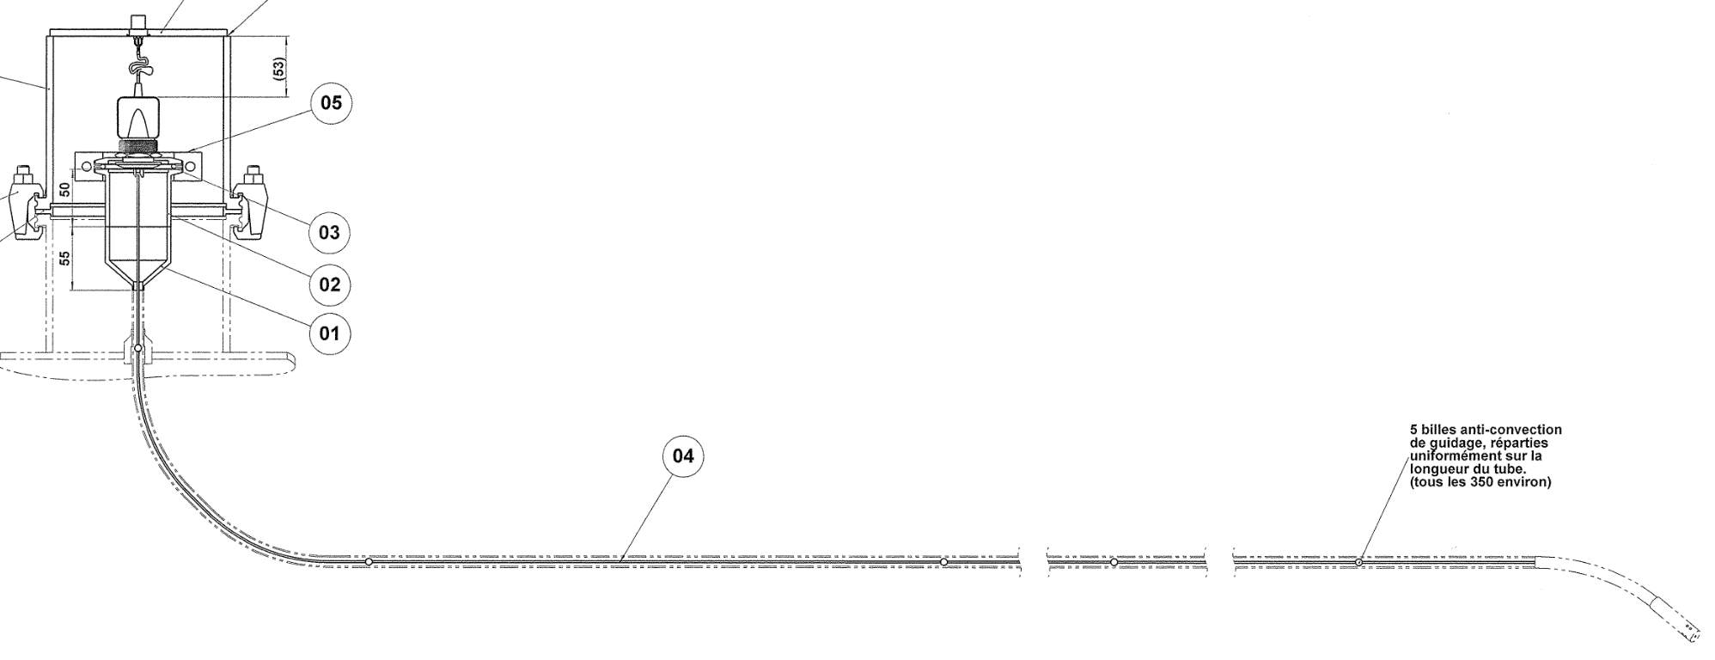
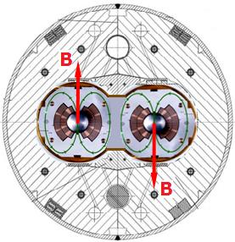
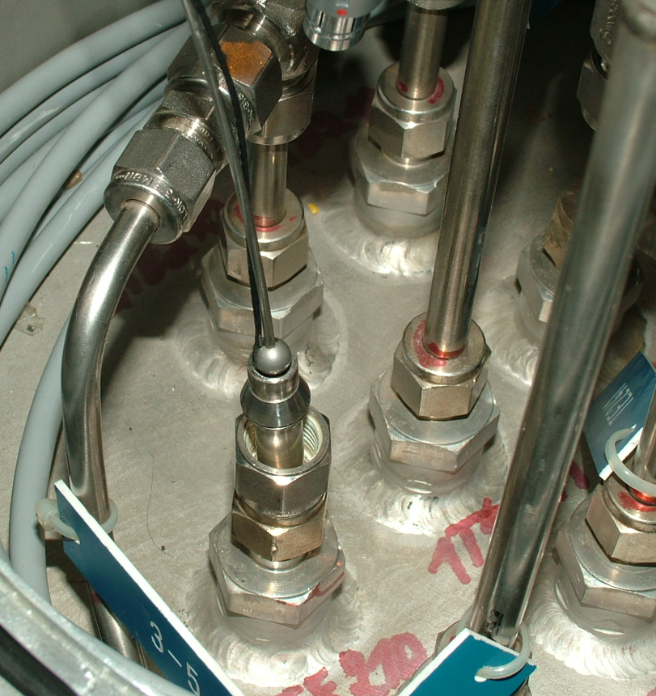
Temperature Measurement: Insertion thermometry
Low pressure gaseous helium => insertion thermometers:
Added advantage: exchangeability
  Require insertion capillary and warm gaseous helium guards that avoid air contamination in case of leaks
Low pressure gaseous fluid has poor heat exchange and hampers vacuum thermometry
Liquid helium thermometers have their cables anchored at the fluid temperature
Possible problem is sensor mechanical protection during fast flow transients
Wires thermalized by LHe.
LHC cold mass thermometer.
Mechanical protection for cable and fast flow
Insertion Thermometer
Example: LHC QURC, wire with alignment balls
Negligible effect
from stray field

Slide 21
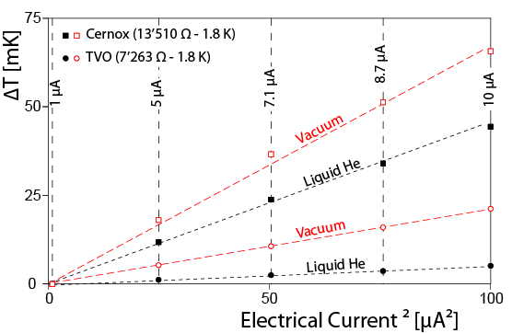
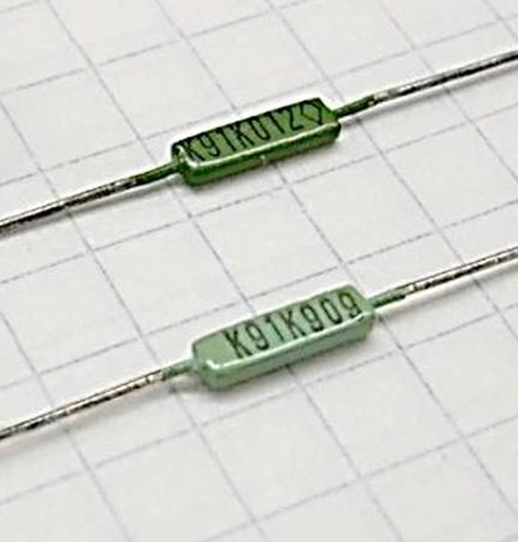
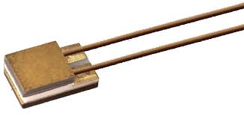
Temperature Measurement: Electrical Perturbances – Joule self-heating
Resistance measurements using a commercial Digital MultiMeter (DMM) is not suitable for cryogenics:
100 µA (or higher) is common for portable and benchtop DMMs
Measurements below 5 K require:
a low current source and a volt-meter.
bipolar excitation current to compensate thermoelectric effects.
TVO leads cross section versus cernox wire-bonds explain the difference in temperature increase due to Joule effect
ca. ~ 10 nW
TVO
Temperature offset due Joule self-heating:
LHC current 1µA
ca. ~ 1 μW
Notes:
1.35 microW for cernox
0.726 microW for TVO

Slide 22
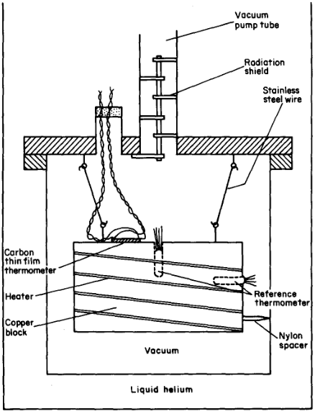
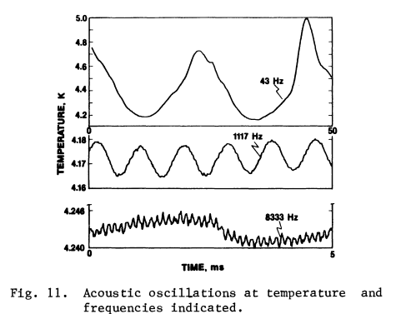
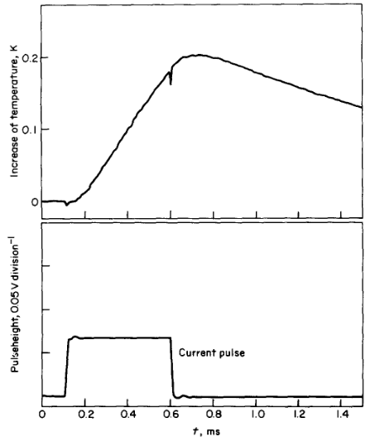
Temperature Measurement: time response
Time responses reported in literature are often difficult to understand:
be careful with comparisons in different experimental conditions.
Temperature response time is dominated by the sensor specific heat.
Lower heat capacity (mass) ⬄ faster thermometer
For electrical sensors stray capacitance or inductance can limit bandwidth.
Some authors do provide experimental data:
Louie: thermo-acoustic temperature oscillations
Bloem: sensor attached to Cu under vacuum
Ph. Roche: exotic very low mass sensors with 70 kHz bandwidth
Louie 1986
Bloem 1984

Slide 23
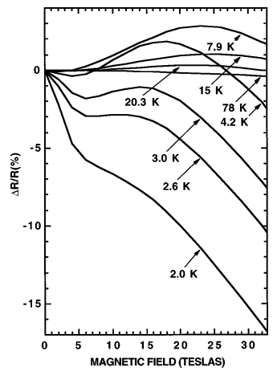
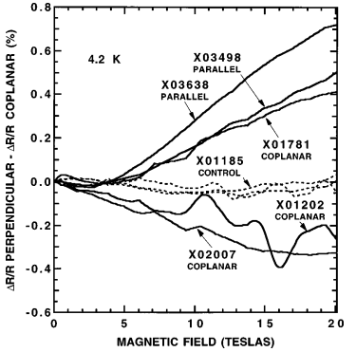
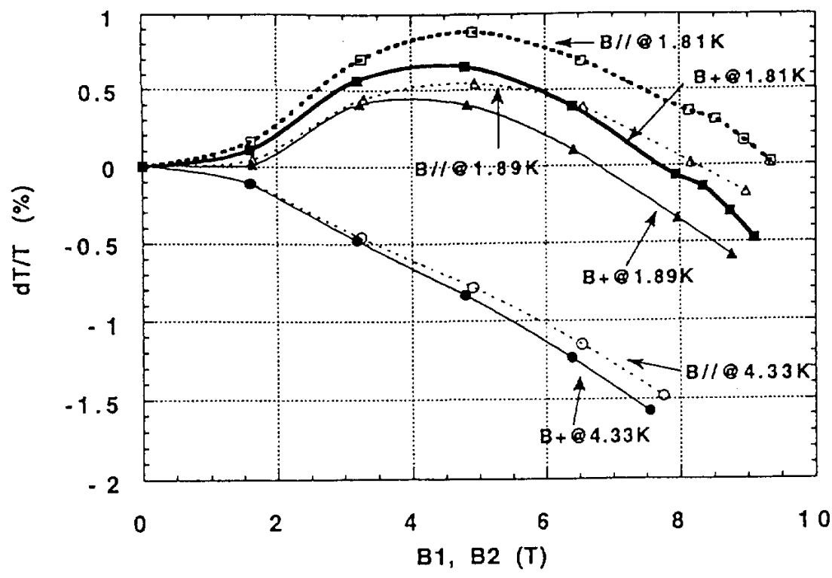



Temperature Measurement: Environmental Perturbances – magnetic field
Variable temperature resistance sensors exhibit magnetoresistance
Capacitance, gas, … thermometers are insensitive to magnetic field
However are less practical thermometers
$\vec{B}$ versus ΔT is in principle
repeatable but depends
on orientation.
Cernox magnetoristance, Brandt et al (1999)
$$\vec{B}$$
Ge magnetoresistance, Haruyama et al (1996)
$$\vec{B}$$
= &  orientations

Slide 24



Temperature Measurement: Environmental Perturbances –Radiation
By early LHC design phase, there was no reliable data for radiation effects at low temperature.
=> The LHC radiation qualification was performed in the SARA and CERI cyclotrons.
Neutron irradiation was selected as it was considered more representative of the LHC.
To reduce the thermal budget and facilitate manipulation, the cryostat was made of aluminum
Density much lower when compared with stainless steel (Gy = J/kg)
  Absorbed radiation % mass => the lower the density the lower the absorbed thermal energy
  shorter radiation decay when comparing with stainless steel => short or no “cooling” time
Operating temperature between 1.6 and 4.2 K (sole radiation campaign in Lhe at this date)
Temperature reference shall be radiation hard => LHe-II saturation pressure
A level gauge was indirectly qualified as RadHard (wire is same material as LHC magnets!)
LHC temperature sensors radiation qualification set-up
Cyclotrons: SARA (Grenoble) or CERI (Orleans)

Slide 25


Temperature Measurement: Environmental Perturbances – Radiation
CERN radiation effects test performed in LHe-II
Maximum neutron dose below requirements of IT (and HiLumi)
Available experimental time limited the TID value
Neutron radiation effects (displacement damage) vary depending on sensor type
Non ordered structures were expected to exhibit less drift
  saturation gives confidence that sensor may still be suitable for IT & HiLumi
As a general rule radiation effects are comparable to temperature or aging effects
LHC CM sensor « protected » by yoke
ARC: 1,5 10¹³ n.cm⁻² over 10 years
DS X 10; IT X 100
Notes:
Displacement damage

Slide 26


Temperature Measurement: Environmental Perturbances – Radiation
Sensor damage/drift not only depends on the Total Integrated Dose (TID)
But also in its history => Thermal annealing of defects present at room temperature
Ge on GaAs (Germanium) was reported @ LN2 to be RadHard; BUT
  1.8 K neutron irradiation provokes a very fast drift of its resistance
  Warm-up from 4.2 K to 273 K completely restores initial characteristics
Thermal annealing not observed for cernox & TVO.
Ge on GaAs could have been adopted for the LHC
Cold test was crucial in this particular case
ΔT [K]
Beam OFF
300 K
Beam ON
1.8 K
Beam ON
1.8 K

Slide 27

Temperature Measurement: Sensor ageing (resistive type)
Cryogenic temperature sensors may change their characteristics over time
Historical data is very important, none was available for cernox or TVO
Thermal cycles is the accepted method for accelerated ageing
  Shall be within the expected range of operation and not create additional constraints
Moisture is a concern in particular for non sealed sensors
  Fast LN2 immersion/extraction is probably not a good idea
Drift for industrial Pt100 sensor is not a concern, the standard curve (ie sensor interchangeability) is adequate for most applications.
CERN thermal cycles qualification
performed in Ghe (+ LHe)
Avoids water ingress
Cernox exhibits better stability
with increasing temperature.
After 100 cycles between 4.5 K & 270 K in GHe

Slide 28



Temperature Measurement: Protection of low level signals
Temperature measurement: very low amplitude & usually low frequency
Electrical signals require EMC cross-talk protection:
Cables shielded (double shielded ideally)
  External shield GND on both sides (HF)
    shield taken on full circumference
    No pigtails, it degrades immunity
  Internal shields GND on only electronic side (LF)
Twisted signal pairs
Cryostat is a Faraday cage ⬄ no need for shields
  Check neighbors for noise emission
  Separate signal from power cables
  Cable routing shall be part of the cryostat design


Slide 29


Temperature Measurement: Environmental Perturbances
LHC case: shared grounds with power converter and quench protection
May result in collateral damage (sensor, electronics, ..)
  Dielectric breakdown can happen during HV tests
Can result in noise (difficult to understand)
Cross-talk observed also in other CERN test areas
Temporary GND connection
Caused voltage offset & fluctuations
a.c. noise => non-linearity => d.c. offset!

Slide 30

Temperature Measurement: Catastrophic Events
Sensors were destroyed during the assembly of LHC magnets:
HV coil tests (capacitive coupling)
  => ground the sensor
LHe vessel longitudinal welding (magnetic coupling)
  => do not ground the sensor
Capacitive Coupling
Magnetic Coupling
=> Appropriate procedure mitigated the problem

Slide 31



Temperature Measurement: Catastrophic Events
Routine high voltage tests on LHC circuits may destroy a temperature sensor. Energy is stored in the magnetic circuit stray capacitance:
Platinum filament is about 2 µgr
2041 K is the melting temperature of platinum
  => 0.45 J required to melt 2 µgr in adiabatic conditions (fast transient)
  Verified experimentally in the lab with 700 nF
  Magnetic circuits stray capacitance: 700 nF up to 50 µF
=> “HOT” lines shall provide adequate voltage insulation
Pt100 sensor from main SC lead
Damaged Filament !

Slide 32



Temperature Measurement: Signal Conditioning
RadTol electronics in the LHC tunnel environment (DS & ARC).
Radiation & temperature compensation: resistance bridge
Thermoelectric effects compensation: current inversion
Comparison bridge permits to sample the sensor resistance within better than 0.1% in spite of temperature induced gain variations exceeding +/- 3%.

Slide 33



Temperature Measurement: Signal Conditioning
Single Event Effects (SEE) happen in digital circuits, may be catastrophic (mainly for power components) or produce soft errors.
Soft errors may provoke anomalous readings on the operator screens.
soft errors can be corrected online (if foreseen).
Soft errors on WFIP memory
Reat temperature
Setpoint 50 K
Setpoint 50 K

Slide 34


Temperature Measurement: The full picture
It is impossible to check or recalibrate the LHC sensors, however for the cold mass they are immersed in superfluid helium:
=> in between plugs the temperature is ~ isothermal
=> Most 1600 cernox sensors are within +/- 5 mK
Quality Assurance is essential to track individual sensors (serial number, calibration, location, ..)
QRL He supercritical supply line
Magnets temperature-LHe2

Slide 35
Temperature Measurement: The full picture
What is the best sensor for a given application?
As shown for the LHC temperature measurement chain, it is a complex iteration that starts with the engineering requirements followed by the instrumentation engineer that selects a pool of candidates taking into account the environmental constraints, integration aspects, availability of electronic signal conditioning units compatible with industrial controls, etc.
Cost wise, the sensor is a fraction of the overall cost, example for electrical type:
- sensor (Pt100: 50.- , TVO calibrated: 300.-, cernox calibrated: 900.-)
- sensor protection & fastening (100.-)
- wiring in the cryostat (100.- plus manpower)
- single or dual electrical feedthroughs + associated connectors (300.- per set)
- warm wiring (20.-/meter laid)
- electronic signal conditioning (500.-)
Whatever sensor is selected it will measure always its own temperature
=> quality of installation is crucial

Slide 36



Temperature Measurement: Optical fiber Sensors
“Bare” optical Fiber Sensing (OFS) technologies measure temperature above 50-80 K.
Distributed optical sensors is a mature technology used to measure
stress and temperature in civil engineering, oil & gas, marine, etc.
ITER intend to deploy OFS to measure stress (FBG),
displacement (FBG & FP) and temperature (FBG).
Typically requires an interrogator (reading unit that provides the
optical signal (laser) and process the reflected
and/or transmitted light)
Fabry-Perot
coating to enhance
thermal contraction

Slide 37



Liquid level Measurement: Techniques
Hydrostatic head is probably the most robust method for large reservoirs:
Capacitance mainly applicable to liquid nitrogen (gas & liquid He have similar ε)
Liquid shall no go up the bottom capillary!
Design not so trivial.
Assumes density vapor << liquid

Slide 38

LHe level Measurement: superconducting wire
For measuring liquid helium level a NbTi SC wire is used
Typical wire diameter: 50 µm
  Critical field @ 4.2 K is about 8 T => current to quench 800 A!
  Critical current density limit is about 7 A @ 3T, maybe 60 A @ 0T
Typical measurement current is about 50 to 80 mA
  ? How can the wire be quenched????
Heating resistor is absolutely required
  Need to raise temperature above 10 K (NbTi T_{c})
  Wire resistance in the normal state: typ 0.3 Ω/mm
  Quench is propagated by exceeding a certain heat flux

Slide 39

LHe level Measurement: superconducting wire
The level gauge operates as long as:
Current is high enough to propagate the normal state in the vapor part
Current cannot exceed the critical film boiling heat flux in the liquid
  it is about 1 W/cm² (0.01 W/mm²)
  Above this heat flux a gas blanket may form along the wire
  For a 50 µm diameter wire & 0.3 Ω/mm => 72 mA
  Coherent with excitation current usually being used

Slide 40


LHe level Measurement: superconducting wire
In superfluid LHe the position of the SC-normal interface depends on the power density (peak flux).
Gaseous blanket when density exceeds peak flux.

Slide 41





LHe level Measurement: Perturbations
Thermo-acoustic oscillations induce heat and then evaporation: observed in LHC SAMs
LHC: sensor connected @ top/bottom with pipes
TOP one too long & too narrow => evaporation flow + constriction => pushes level down
=> Required consolidation!

Slide 42

Pressure Measurement: Basics
Cryogenic facilities require to measure:
insulation vacuum in the range
10⁻⁹ (ie 10⁻⁶ mbar) till 1 bar
  Based mostly on thermal &
  ionization effects
Cryogenic fluids in the range
0.01 till 25 bar
  Based mostly on mechanical displacement
  No radiation
    Commercial sensors adequate
Accelerator beam vacuum
10⁻⁹ mbar & lower
Out of scope.
Pressure range for cryostats
www.omega.com

Slide 43


Pressure Measurement: Vacuum
Pirani gauges:
Measurement range: 10⁻⁴ till 1000 mbar
Heat loss: conduction + radiation + convection
Filament temperature set @ 293 K
Radiation hardness 10⁷ Gy with remote electronics
Cable is part of the sensor => calibration for lengths exceeding 20 m
Accuracy: +/- 30 % of read value
Enclosure
Support
Qconv
Qrad
Support
Filament
Qend
Qgas = f(p)
Qend
Controller
Twisted pairs single shielding
VOUT
~ 500m
-
+
Gauge
Vacuum
VFIL
Courtesy N. Chatzigeorgiou (CERN)

Slide 44

Pressure Measurement: Vacuum
HV triaxial cable
~ 500m
Penning gauges:
Measurement range: 10⁻⁵ till 10⁻¹¹ mbar
Ionization of gas molecules ⬄ discharge current
current range 10⁻⁶ - 10⁻¹² A (impedance !)
Cable is part of the sensor => calibration for lengths exceeding 20 m
Accuracy: +/- 50 % of read value
Original Penning cell
Inverted magnetron (higher sensitivity)
Cylindrical anode
3 kV
3 kV
Cathode
Magnet
+
+
-
-
N
N
N
S
B
A
B
A
S
S
Cathodes
Anode
Magnet
Courtesy N. Chatzigeorgiou (CERN)

Slide 45



Pressure Measurement: Fluid range
0.01 to 25 bar (or more) measurements are typically based on:
Elastic deformation of a “thin” membrane/diaphragm
Elastic displacement is measured through:
  Strain gauges
  Capacitive or inductive displacement sensors
Excessive pressure across membrane
  Inelastic displacement => permanent damage
  Burst => membrane destruction => loss of containment
  Pressure limits examples:
    LHC HiLumi 60 mbar => 1.3 bar overpressure
    LHC 4 bar => 5 bar overpressure & 10 bar burst
    LHC 20 bar => 32 bar overpressure & 64 bar burst
    Pressure tests easily damage sensors!
      Isolation valve is required
Sensor Type | Side 1 of membrane | Side 2 of membrane
Gauge | Process pressure | Ambient pressure
Differential | Process pressure 1 | Process pressure 2
Absolute | Process pressure | Vacuum

Slide 46





Pressure Measurement: passive types – strain gauge based
Operation in cryogenic conditions or in radiation => passive sensor.
Passive sensors are becoming a rarity, most manufacturers embed electronics.
Smart sensors embed temperature corrections to improve accuracy:
Passive sensor + temperature + correction formulae ~ smart sensor
Strain Wheatstone bridge based sensor
VACUUM
Metallic strain gauge
Process Inlet

Slide 47



Pressure Measurement: passive types – variable reluctance
Variable reluctance sensors use comparatively larger membranes
=> better to measure lower pressures when comparing to strain gauge
However: lower overpressure limit (1.4 bar)
Sensors selected for LHC-HiLumi are based on magnetic components
=> rad-hard by design
However the connecting cable is part of the sensor via stray cable capacitance & inductance
⇨ calibration in-situ or with “final” cable
Sensor made by NICHE
Validyne sensors

Slide 48



Pressure Measurement: passive types – Cryogenic conditions
Cryogenic pressure measurements required for measuring fast transitions
avoids capillary hydrostatic head and time response reduction.
For some strange reason, (low cost) sensors reported to operate in cryo conditions (Fujikura, Siemens, etc.) cease to be commercially available.
Unfortunately, qualifying new sensors for cryogenic operation is very tedious.
Constant voltage excitation
290 K
77 K
4.2 K
Merit strain gauge based sensor
1 GΩ impedance @ 4.2 K
=> Stray capacitance limits bandwidth (1/(R.C))
Constant current excitation

Slide 49


Pressure Measurement: peculiarities in cryogenic conditions
⇨most applications install warm conventional sensors and the process pressure is connected via sensing capillaries with a wide temperature gradient.
The sensing capillary introduce artifacts due to:
Hydrostatic head (depends on temperature/density profile)
Thermoacoustic oscillations
Pressure drop due to fluid flow
Additional dynamic pressure if it looks like a Pitot tube
Limits the measurement frequency bandwidth

Slide 50
Mass Flow Measurement: Basics
Flow measurement is an essential tool for many industries and public utilities.
In cryogenic facilities flow metering is used for
the assessment of cryogenic loads
process monitoring and control
detection of faults and wear on pumping machinery
Apart from oil contamination in the ambient temperature circuits, most of the gaseous fluids used in cryogenics are pure, clean and are well described by the ideal gas law.
Oil contamination can be a problem for hot wire anemometers.
However when a fluid rate is to be measured at cryogenic temperatures care is necessary in order to avoid the presence of two-phase flow or cavitation.
The main fluid properties for gas flow rate meters are: temperature, pressure, density and viscosity

Slide 51
Mass Flow Measurement: Techniques
There is a variety of techniques, some suitable for cryogenic conditions ():
Positive displacement (accumulated volumetric flow)
Variable area or rotameter
Thermal 
Differential pressure 
Vortex
Coriolis 
Turbine 
…

Slide 52



Mass Flow Measurement: Basics
The transport of fluid through a pipe is described by the equation of continuity (1), Bernoulli's theorem (2) and the Reynolds number Re (3).
(1): $\frac{∂ρ}{∂t}+∇\left(ρ.\vec{v}\right)=0$
ρ and v are respectively the fluid density and velocity.
$$\left(2\right): ρ\frac{v^{2}}{2}+p+ρ.g.z=constant$$
p, g & z are respectively the pressure, gravity and
vertical distance
The Reynolds number R_{e} defines the flow regime:
$${\left(3\right): R}_{e}={\tilde{v}.D}/ν$$
D & $ν$ are respective the pipe diameter &
kinematic viscosity. Flow regimes are laminar,
intermediate and turbulent.
non compressible => volumetric flow conservation
non compressible & no viscocity

Slide 53





Mass Flow Measurement: Basics
Most flow measurements often require non-perturbed flow
Requirement for minimum length of upstream & downstream piping
Straight piping shall be smooth (it means no valves)
Cost of piping need to be taken into account, in particular for large diameters.
From ABB: industrial flow measurement

Slide 54




Mass Flow Measurement: Differential pressure
Differential pressure flow meters are widely used in both ambient and cryogenic conditions.
The volumetric flow is:
$$\dot{Q}=C\frac{π}{4}D_{2}^{2}\frac{\sqrt{2(p_{1}−p_{2})}}{\sqrt{δ\left[1−{\left(\frac{D_{1}}{D_{2}}\right)}^{4}\right]}}$$
The flow is overestimated because non-reversible
processes are ignored.
The discharge coefficient factor C (it is a multiplying
factor) is added to improve accuracy. It is an empirical
term that corrects for friction, geometrical contraction or
imperfections, etc.
ITER venturi flowmeters
discharge coefficient =>
Varin et al (2019)
Venturi for LHe metrology.
Manufactured by Colonetti (IT)

Slide 55




Mass Flow Measurement: Thermal
There are two main types of thermal flowmeters:
heat loss from a heated element (resistance wire, thermocouple, etc.) to the flow stream
$q=∆T\left[k+2\sqrt{kC_{v}ρπdv}\right]$
k,d and v are the fluid thermal conductivity, wire diameter and fluid average velocity
temperature rise of a fluid passing over a heated element
$\dot{m}=\frac{W}{∆H}$
Thermal flowmeters are widely used to measure gases above 273 K.
Heaters, temperature and pressure sensors permit to estimate flow along cryogenic lines.
King equation
= power / enthalpy difference

Slide 56




Mass Flow Measurement: Thermal
Output signal depends on gas characteristics.
For most application GN2 is an adequate surrogate calibration fluid for GHe applications.
Conversion factor depends slightly on vendor or model.
Exist also as thermal mass flow controller.
From Teledyne-Hastings

Slide 57







Mass Flow Measurement: Coriolis
As it is indicated by its name the Coriolis flowmeters are based in:
$$\vec{F_{c}}=−2 m \vec{ω}×\vec{v}$$
ω and v are the tube angular motion and the flow velocity.
The Coriolis forces (flow) are of opposite directions
⇨arm twist amplitude depends on mass flow
Excitation coil induces vibration at natural frequency
Left and right pick-up coils measure twist
Phase shift is proportional to flow rate
Signal conditioner (it is a computer) makes correction for:
Changes of elasticity (Young modulus)
Dimensional variations
Corrections rely on a temperature sensor
⇨temperature sensor saturates @ about 70 K
⇨CRYO =>replace with “fixed” value and perform corrections down
to Lhe temperatures.
Coriolis force

Slide 58



Mass Flow Measurement: Coriolis
Mass flow rate is not affected by the tube vibration frequency.
However vibrating at the natural frequency has two advantages:
Least amount of energy to keep the tube vibrating (as a tuning fork)
Natural frequency depends on the mass contained within the tube
  Fluid density ρ can be measured
  $Natural Frequency∝1/{\sqrt{M_{tube}+ρ.Volume}}$
Coriolis flowmeters are best suited for dense fluids, they measure
the mass flow rate directly and have a turn down ratio better than 100 x.
For warm helium service Coriolis flowmeters are limited to high pressure (> 100 bar) applications due to the relatively large pressure drop.
It is the sole flowmeter that measures directly mass flow

Slide 59



Mass Flow Measurement: Coriolis
Coriolis flowmeters can be used for liquid and supercritical helium.
Calibration is performed with water as surrogate fluid.
Cryo applications require remote electronics:
10, 300, 700 or 1’000m cable length have been shown to not affect the reading
Suitable for accelerator applications => deployed in the LHC
  Flow measurements on some beam screen circuits and QURCs
CMF 010 used in the LHC beam screen circuits
Range 27 g/s
LHC cryogenic range 1.5 g/s
Cryogenic range due to pressure drop

Slide 60
Adding Heat: Electrical Resistors
Electrical heaters: evaporate liquid helium, perform calorimetry tests, etc.
It is often assumed that heat is only transferred from the heater body; however:
Wires are required and have contradictory requirements:
  Cross section as small as possible to reduce conduction heat transfer
  Cross section large enough to avoid burn-out due to Joule heating
4-wire configuration permits to measure exactly the power dissipated by the immersed electrical heater, however:
wires add heating leaks
4 wire provides a better “electrical” measurement but heat inleak through 2 additional conductors

Slide 61


Adding Heat: Electrical Resistors –wire current capacity
The electrical current-carrying capacity of a wire is the amount of current the wire can carry in its operating environment without exceeding its rating.
Wires are used in bundles, space applications propose a derating factor
r: conductor radius
Δ: insulation thickness
i: electrical current
ρ: electrical resistivity, fct(T)
k: thermal conductance, fct(T)
ε: emissivity
σ: Stefan-Boltzmann
5.67.10⁻⁸ W.m⁻².K⁻⁴
Assumes that all radiated heat is intercepted on the vessel at ambient temperature (T_{o})
Worst conditions @ warm (before cooldown or end of warm-up)

Slide 62



Adding Heat: Electrical Resistors – Wire Current Capacity
LONG wire temperature increase from 22 ºC depending on bare wire size and current in vacuum:
$$2.π.r.dl.ε. σ. \left(T_{wire}^{4}−T_{backgnd}^{4}\right)=\frac{ρ\left(T_{wire}\right){.i}^{2}.dl}{ {π.r}^{2}}$$
ε: emissivity (0.9)
σ: 5.67 10⁻⁸ [W/(m² K⁴]
r: wire diameter
Assume infinite long wire
Insulation neglected:
- not stated in NASA document
- decreases temperature rise
NASA TM-102179
Thermal Radiation

Slide 63


Adding Heat: Electrical Resistors – Wire Current Capacity
Wire temperature increase from 20 ºC depending on wire size and current
in vacuum:
$$2.π.\left(r+insulation thickness\right).dl.ε. σ.$$
$$\left(T_{wire}^{4}−T_{backgnd}^{4}\right)=\frac{ρ\left(T_{wire}\right){.i}^{2}.dl}{ {π.r}^{2}}$$
ε: emissivity (0.9)
σ: 5.67 10⁻⁸ [W/(m² K⁴]
r: wire diameter
Assume infinite long wire
Junkosha rule of thumb:
Vacuum temperature rise is about 2 to 3 times the value under normal atmospheric pressure.
Domestic 230 Vac application ⬄ 10 A temperature
rise in free air -> 1/3 or 1/2 that in vacuum:
1.0 mm2 (Dia 1.13 mm) vacuum T rise 56.3 K
=> free air T rise between 18.8 K & 28.2 K
1.5 mm2 (Dia 1.38 mm) vacuum T rise 34.1 K
=> free air T rise between 11.4 K & 17.0 K
Junkosha website
Thermal Radiation

Slide 64




Adding Heat: Electrical Resistors – Wire Current Capacity
For short wires is there a risk of burnout?
What is the distance to reach the maximum desired temperature?
Higher risk: ambient temperature <= accidental powering
$$−k\left(T\right).π.r^{2}.\frac{dT}{dx}=\left(\frac{ρ\left(T\right).i^{2}}{π.r^{2}}−2.π.(r+∆).ε.σ.\left(T^{4}−{T_{o}}^{4}\right)\right)dx$$

Slide 65


Adding Heat: Electrical Resistors – Wire Current Capacity
Assume copper resistivity and thermal conductance constant
OK for calculating the temperature profile for a wire in vacuum carrying 2 A with the feedthrough temperature @ 293 K and 50 K temperature increase
$$−k\left(T\right).π.r^{2}.\frac{dT}{dx}=\left(\frac{ρ\left(T\right).i^{2}}{π.r^{2}}−2.π.(r+∆).ε.σ.\left(T^{4}−{T_{o}}^{4}\right)\right)dx$$
90% of the temperature rise done within 17 cm that is well below typical wire lengths inside the cryostat vacuum vessels.
Wire Temperature [K]
Distance from feedthrough [m]

Slide 66


Adding Heat: Electrical Resistors – Wire Current Capacity
Electrical wiring is mostly used in bundles.
Bundles reduce the current carrying capacity => derate by at least 30%
Overheating is catastrophic:
Sputters plastic or metal
Damages turbo-molecular pumps,..
Current [A]
50 K temperature increase
30 K temperature increase
From: “Derating Standards and Thermal Modelling Tools for Space Harness Designs” ICES-2015-59
Single Wire Cross section [mm2]

Slide 67

Adding Heat: Electrical Resistors – Voltage rating
Voltage breakdown in Vacuum or liquid helium environments are generally not an issue for electrical heaters.
However gaseous helium breakdown voltage can be relatively low and produce an arc capable of transporting very large currents => fuse required
Depends on closest distance between bare conductors
Check warm electrical feedthrough!
Gaseous helium pressure
Best is to not exceed 100 V
Remember 100 Vac =>141 Vdc p-p
GHe will catch the peak!
Electric arcs protection require
extremely fast fuses.

Slide 68
Adding Heat: Electrical Resistors – Heat Transfer Density
Transfer of heat to liquid is done through (increasing heat flux density):
Convective heat transfer
Nucleate pool boiling
Film boiling
Heat will always be extracted:
If heater surface is too small
Very large temperature rise
burnout
For a heater immersed in LHe do not exceed the heat density of 1 W /cm².

Slide 69
Reading Material
- J. Casas, "LHC thermometry: laboratory precision on an industrial scale in a hostile environment: tutorial 52," in IEEE Instrumentation & Measurement Magazine, vol. 17, no. 1, pp. 57-64, February 2014, doi: 10.1109/MIM.2014.6782999.
- F. Pavese, Lessons learnt in 50 years of cryogenic thermometry, Chapter in “Cryogenic Engineering: Fifty Years of Progress”, Timmerhaus and Ross eds., Springer, New York, 2006, ch.10, pp. 179-221.

