Slide 1

Computing
for
Astroparticle Physics
1st Workshop
Lyon 7-8 Oct.

Slide 2

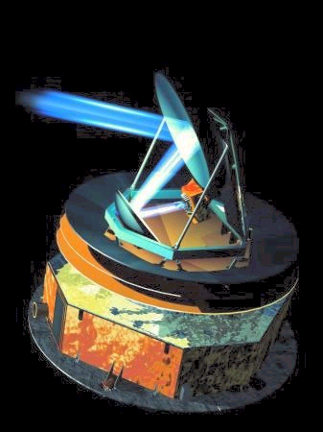

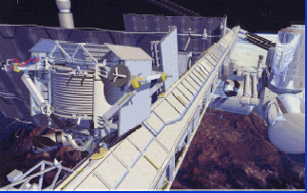
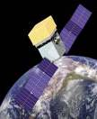
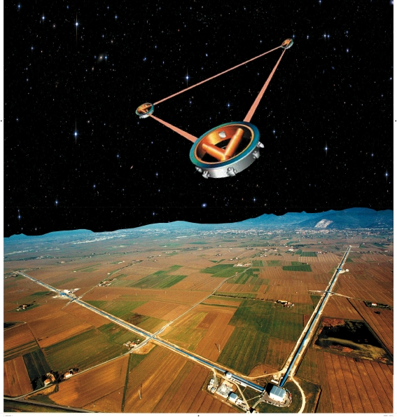
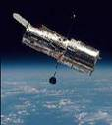

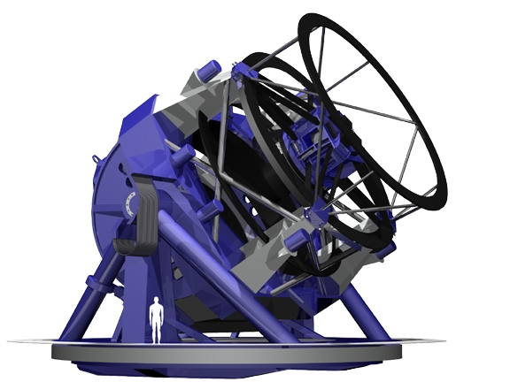
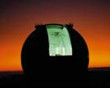
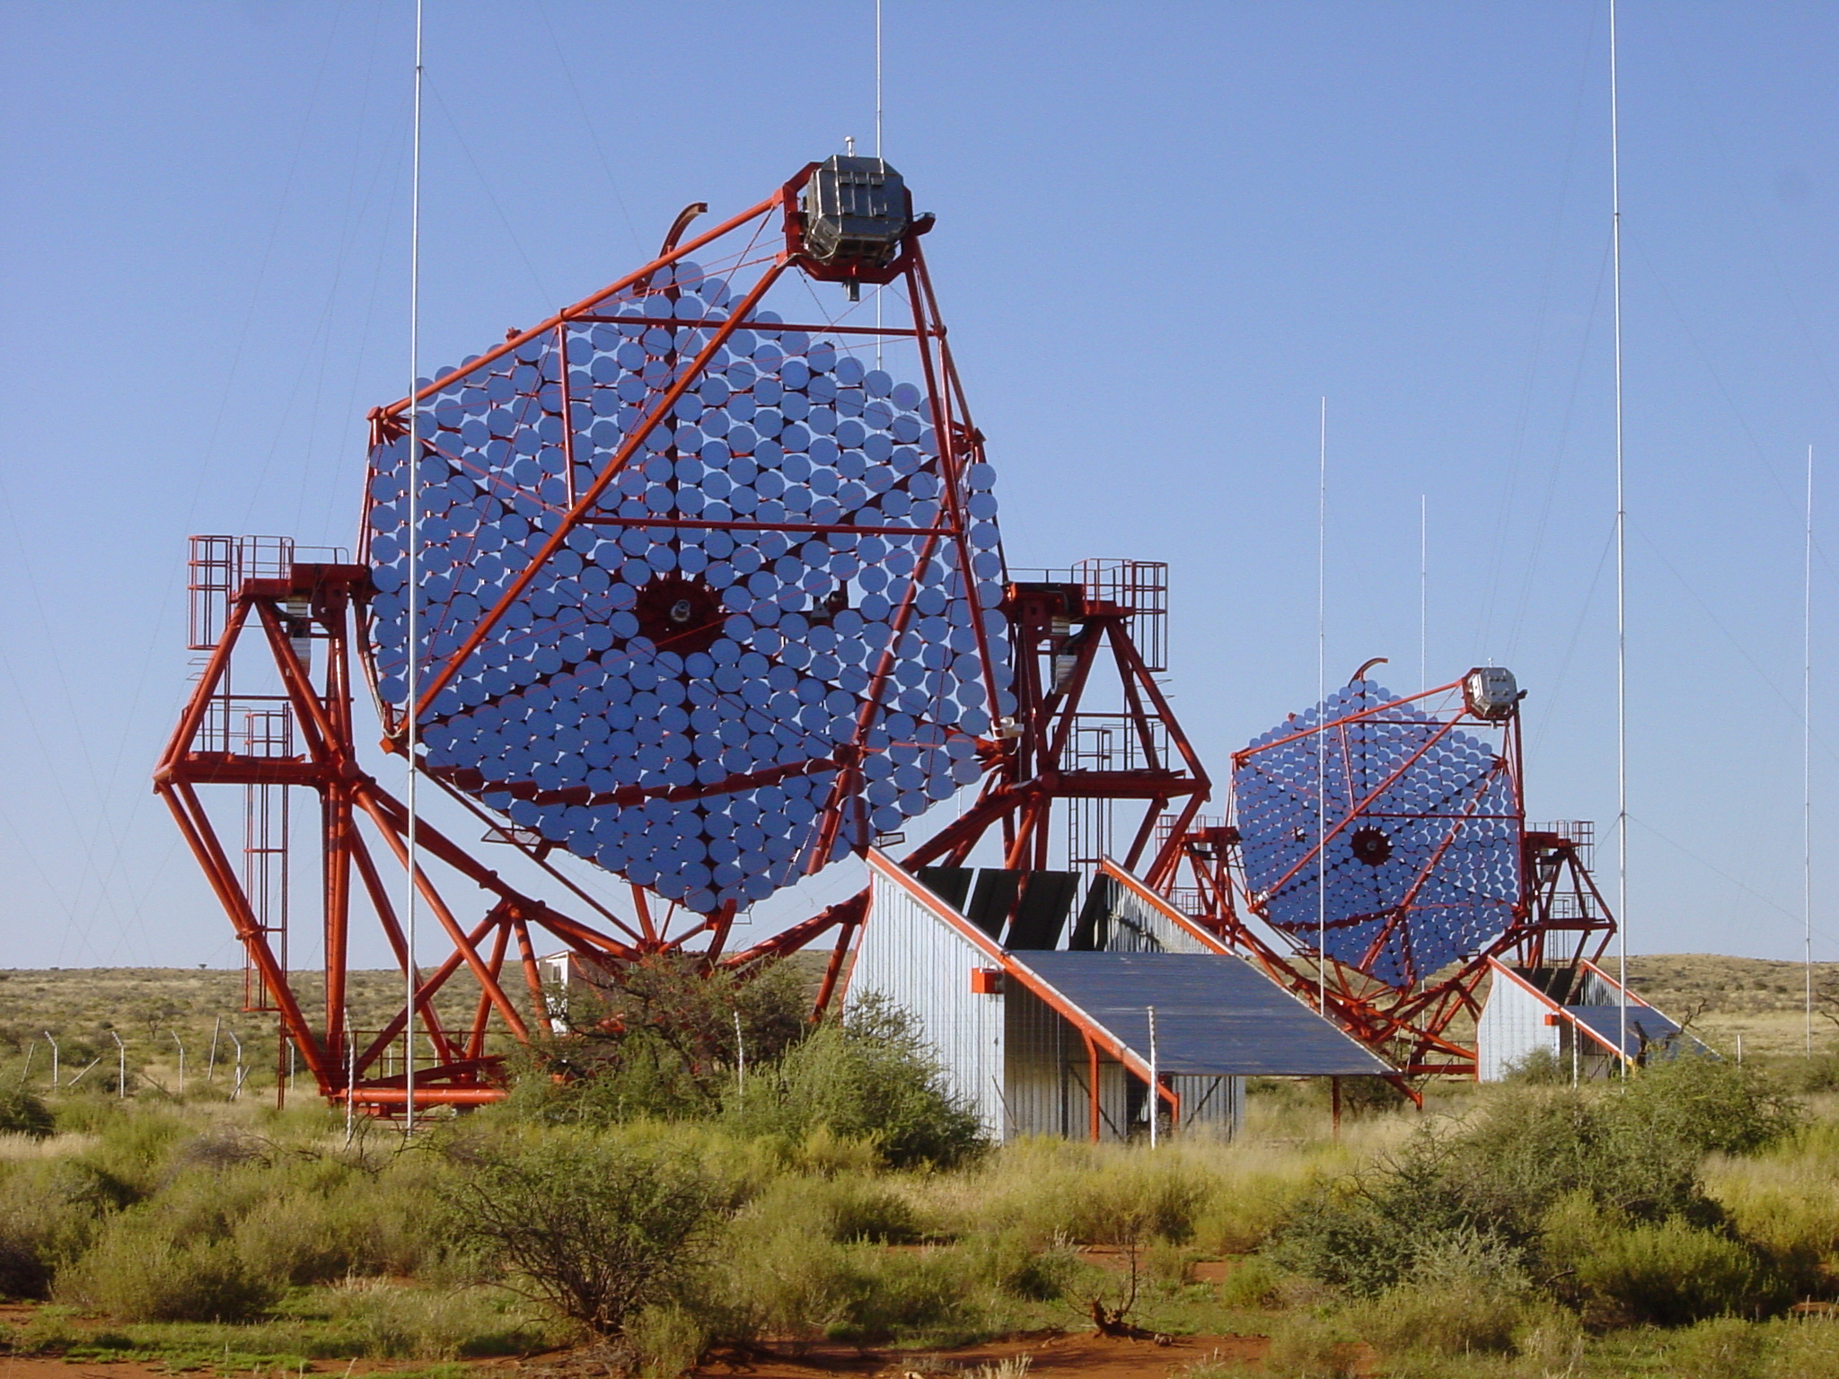

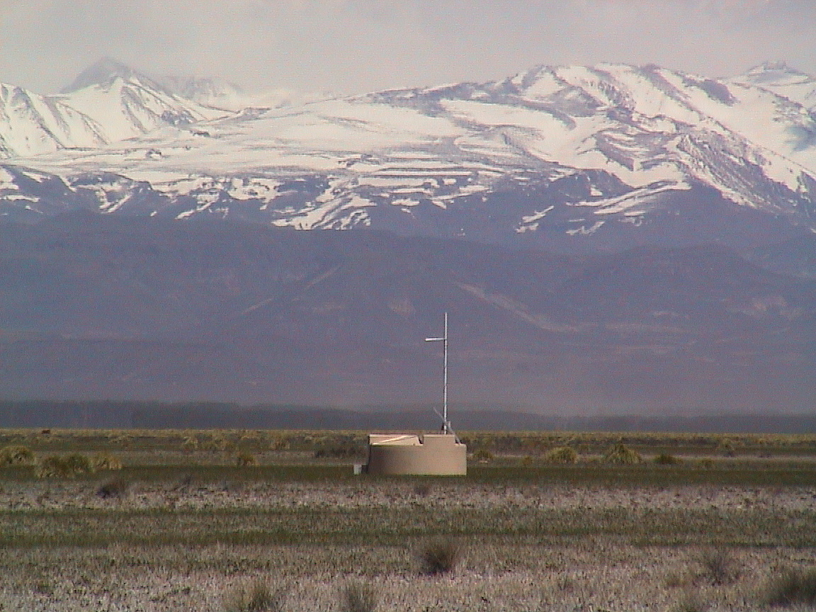
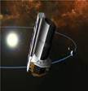
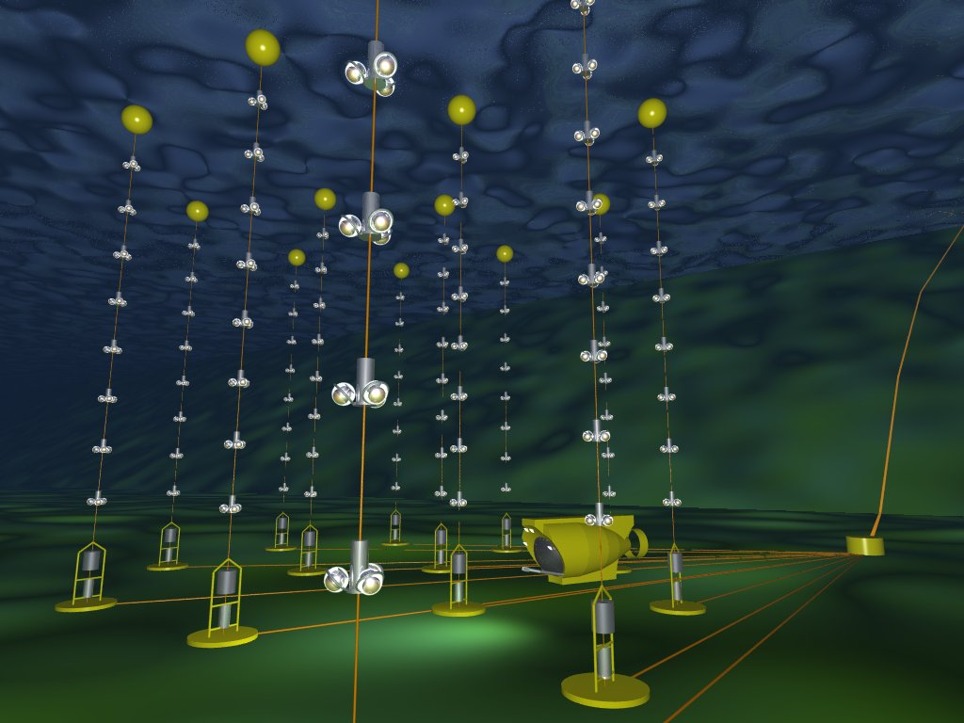
Computing intensity
Access intensity (image I/O)
Signal processing methods (gravitational wave antennas)
Fusion of heterogeneous data (multi-messenger)
Data-quality/type for public access (noisy picture)
Insertion in EGI, Virtual observatories
Distributed data capture (smart grids)
Remote monitoring and control
Environmental/geoscience data availability
Outreach
Some issues

Slide 3
What would we like to obtain from this workshop:
Identify problems
Assess opportunities
Explore possibilities of European (global?) scale coordination
On the practical side:
We would like to aim a written document
  20 page document exists.
:

Slide 4
Findings, ACTION LIST 1st workshop
  Hardware: Impact of GPU
Middleware: Grid and/or Cloud? (theme for next workshop)
  3 types of computing examples: Event, Survey, Signal processing
  4 types of communities we need to interface with Astroparticle Computing in an organised way
    EGI, ACTION: ASPERA meetings Tier1/Projects
    IVOA, ACTION: ASPERA meetings Tier1/Projects
  Invent a computing model for astroparticle… (Theme for next workshop)
  Two examples of regional centres, HEAVENS, ARAGO.
    How do we network them, nationally and internationally?
    How do we interface to the teams ? (Simlabs ?)
  Monitoring and control through the grid…. (Theme for next workshop?).
What was missing:
  Software optimality considerations, databases , software frameworks?
  More examples from other fields? (Neptune, outreach)
Astroparticle and Computing in Lyon the first of a meeting:
  2 more to come:
    First in Barcelona March 2011
    Second in Hannover March 2012
  10-15 pages summary with pictures.

Slide 5
Not a summary, but the Dog/Cat test:
Or what an agency person understands when technologists and modellers discuss

Slide 6
Mode/Technology l challenges
Astroparticle experiments in a verys short time enter from medium scale to large scale, need to adapt, specific scientific constrains but also « budgetary » constraints
How precise are the models and the set of requirements? Storage amount? ,CPU? distribution level?, I/O problems?, concurrent jobs? These have to be more precise.
  ACTION : Template and census for next workshop
    First the projects then sent to Tier1 for their comments
    Use the 2005 LHC projections to renormalize
Current database usage is quite different among experiments but traditional.
  Can we go towards the merging of database and a file system DBFS?
  What are the extra constraints of the public access?
  « Intelligent » and distributed databases?
Which hierarchy for computing?
  Centralised or distributed ?
  Hardware specific (eg GPU) or Virtual ?
  A MESSAGE FROM THE SPONSOR: Distributed system important for funding …(LSST, GRID)
PUBLIC ACCES need to understand the constraints on the models .
  ACTION : Working group ?

Slide 7
Mode/Technology Il challenges
In the distributed case is the GRID usefull for astroparticle ?
  Against what ? Need to define. GRID 10 years old technology but alternative depends on our horizon projects claim new data for 2015 .
  Commercial cloud still too expensive no I/O
  Virtualisation looks quite promising
  GRID as a Cloud hypervisor ?
  Portals for common GRID submission?
Software side, is there a commonality ? A CERN library ? Can we have one for astroparticle.? HEAPNET.
  Do we need a common set of professionals to create repository (along the 3 axes)
  Classification of applications need to be developped
  Need accumulation of debugged software (20 years in LHC)
  ACTION: More detailed discussion for next workshop ?
Hardware side: How should we model thinking about new technology, GPUs, multicore type of computing, 86 cores, etc, new computing models, massive parallel scale,
  ACTION: More detailed discussion next workshop

Slide 8
The small group organizing the workshop will prepare a document for 2012 (after the Hannover workshop, a few pages from workshop 1 already exist)
They should poke, help the projects to enter in the definition of needs mode and concrete and coordinated propositions towards the agencies

Slide 9
Thank you :
Manuel and collaborators and attendants for a very lively workshop
See you next year (May 2012?) In Hannover

