Slide 1
CernVM - a virtual software appliance for LHC applications
2nd ASPERA Workshop
30-31 May 2011, Barcelona, Spain
P. Mato /CERN

Slide 2

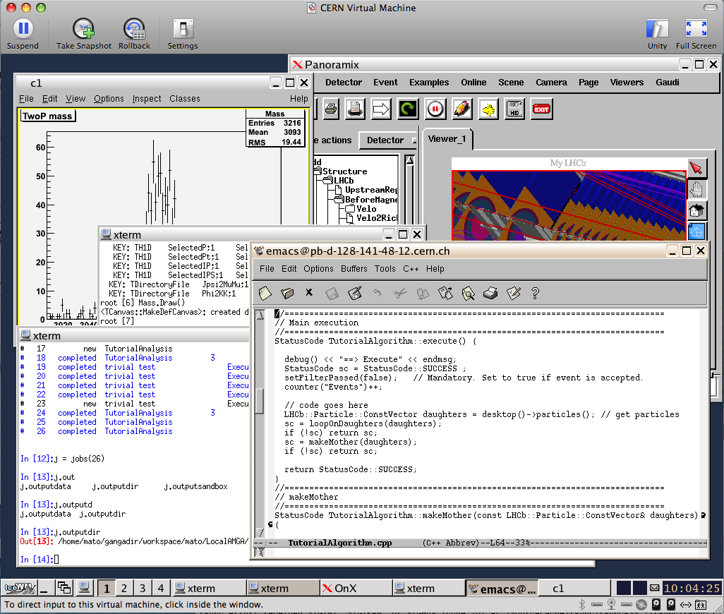
CernVM R&D Project
Aims to provide a complete, portable and easy to configure user environment for developing and running LHC data analysis locally and on the Grid independent of physical software and hardware platform (Linux, Windows, MacOS)
  Code check-out, edition, compilation,
  local small test, debugging,…
  Grid submission, data access…
  Event displays, interactive data analysis, …
  Suspend, resume…
Decouple application lifecycle
from evolution of system infrastructure
Reduce effort to install, maintain and keep up to date the experiment software
http://cernvm.cern.ch

Slide 3
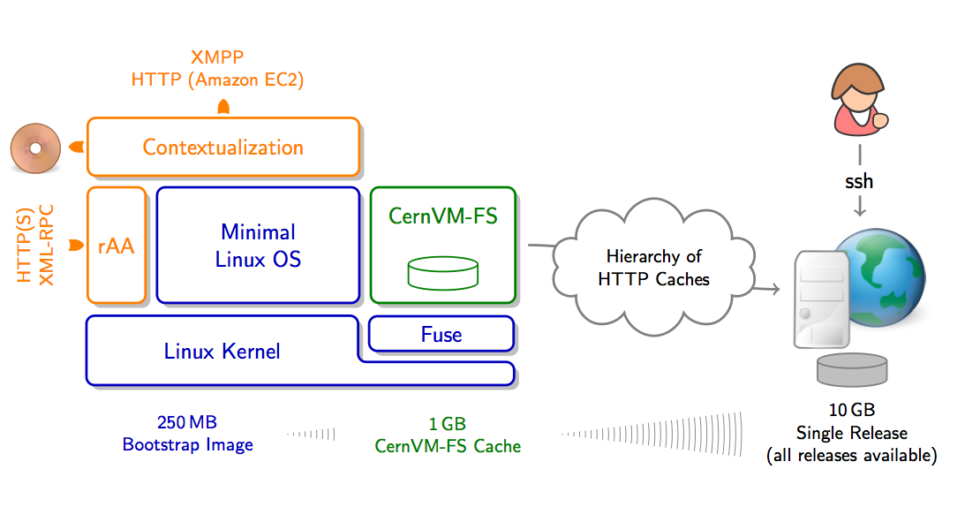
CernVM Elements
  Minimal Linux OS (SL5)
  CernVM-FS - HTTP network file system optimized for jus in time delivery of experiment software
  Flexible configuration and contextualization mechanism based on public Cloud API

Slide 4

Initial Scope
Checkout
Submit to Grid
Display results
Suspend
Test
Compile
Resume
Debug
Notes:
4

Slide 5
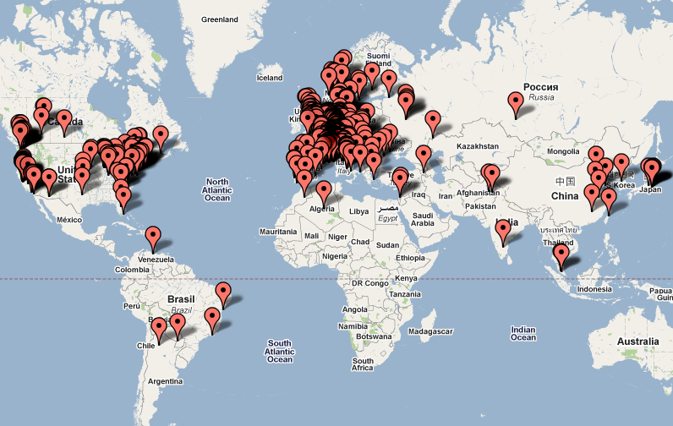
Where are our end-users?
~1000 different IP addresses
~2000 different IP addresses

Slide 6
Is CernVM suitable for deployment on Grid and Cloud infrastructure?
What are the benefits of going CernVM way comparing to more traditional¹⁾ approach to batch node virtualization?
Traditional approach:
  Take “standard” batch node [2GB] and add experiment software [10GB] and generate VM image. Have experiment and security team certify the image, deploy it to all sites and worker nodes. Repeat this procedure 1-2 times per week and per experiment.

Slide 7
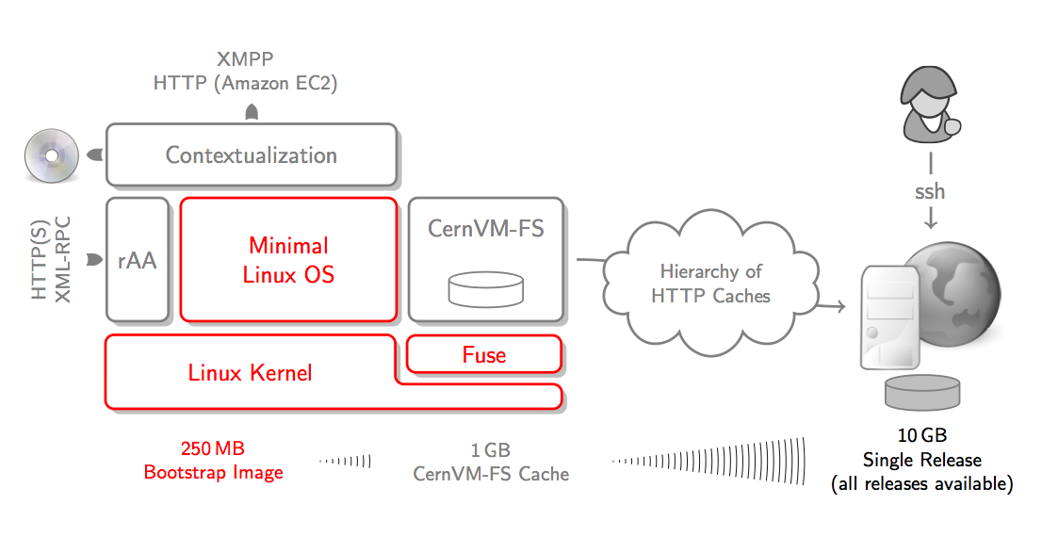
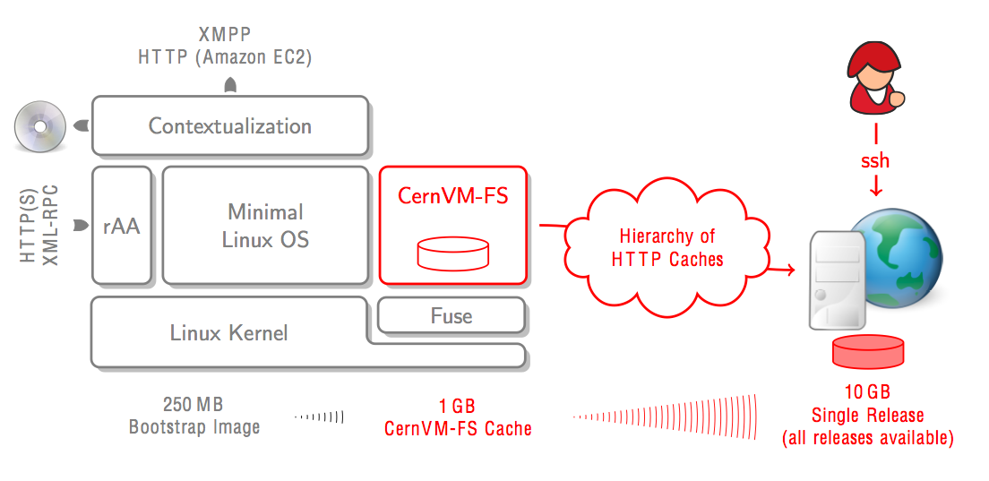
Part #1: Minimal OS image
Just enough OS to run LHC applications
Built using commercial tool (rBuilder by rPath)
  Top-down approach - starting from application and automatically discovering dependencies
Small images (250MB), easy to move around
Just enough OS to run LHC applications
Built using commercial tool (rBuilder by rPath)
  Top-down approach - starting from application and automatically discovering dependencies
Small images (250MB), easy to move around

Slide 8

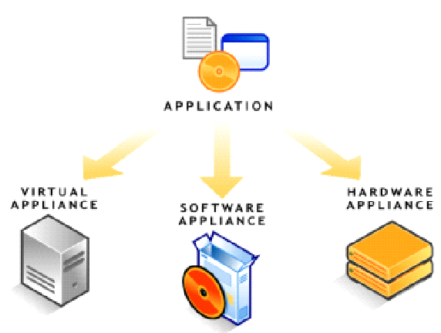
Appliance Builder
Starting from experiment software…
  Installable CD/DVD
  Stub Image
  Raw Filesystem Image
  Netboot Image
  Compressed Tar File
  Demo CD/DVD (Live CD/DVD)
  Raw Hard Disk Image
  Vmware ® Virtual Appliance
  Vmware ® ESX Server Virtual Appliance
  Microsoft ® VHD Virtual Apliance
  Xen Enterprise Virtual Appliance
  Virtual Iron Virtual Appliance
  Parallels Virtual Appliance
  Amazon Machine Image
  Update CD/DVD
  Appliance Installable ISO
…ending with a custom Linux specialised for a given task

Slide 9


Conary Package Manager
Every build and every file installed on the system
is automatically versioned and accounted for in a database

Slide 10
Part #2: CernVM-FS
  Experiment software is changing frequently and we want to avoid need to frequently update, certify and redistribute VM images with every release
  Only a small fraction of software release is really used
  Demonstrated scalability and reliability
  Now being deployed on across all Grid sites as the channel for software distributions
Experiment software is changing frequently and we want to avoid need to frequently update, certify and redistribute VM images with every release
Only a small fraction of software release is really used
Demonstrated scalability and reliability
Now being deployed on across all Grid sites as the channel for software distributions

Slide 11
Application Software Delivery
CernVM comes with the read-only file system (CernVM-FS) optimized for software distribution
  Very little fraction of the experiment software is actually used (~10%)
  Very aggressive local caching, web proxy cache (squids)
  Transparent file compression
  Integrity checks using checksums, signed file catalog
  Operational in off-line mode
No need to install any experiment software
  ‘Virtually’ all versions of all applications are already installed
  The user just needs to start using it to trigger the download

Slide 12
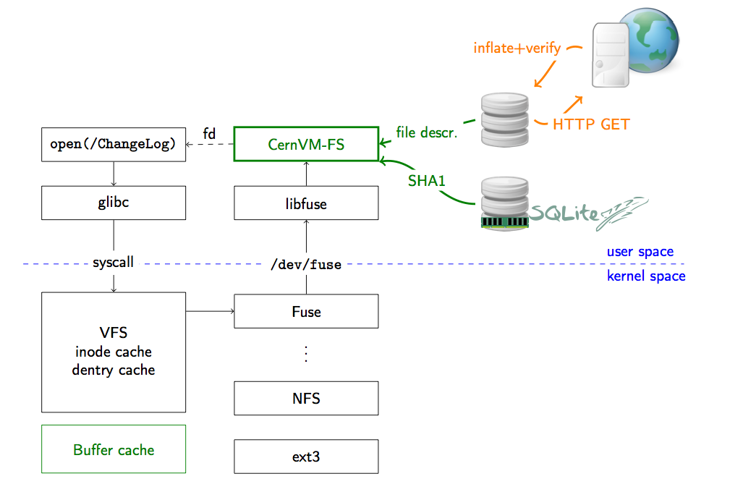
Fuse Module

Slide 13
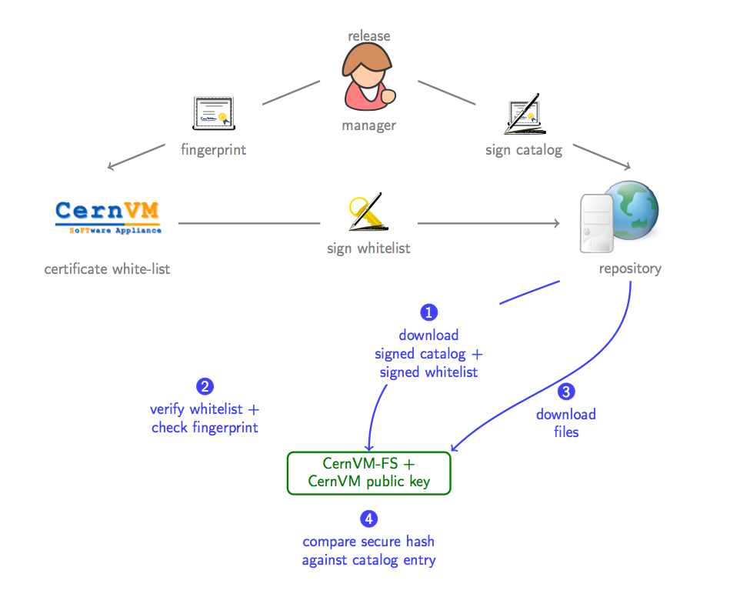
Integrity and Authenticity
Principle: Digitally signed repositories with certificate white-list

Slide 14
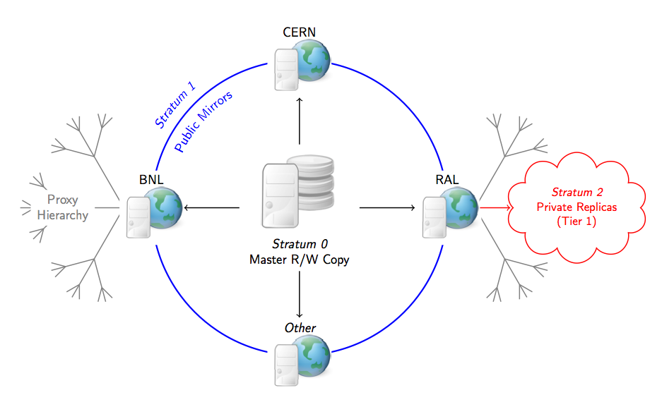
Content Distribution
Stratum Model
  + Fast and Scalable
  + No single point of failure
  - Complex hierarchy

Slide 15
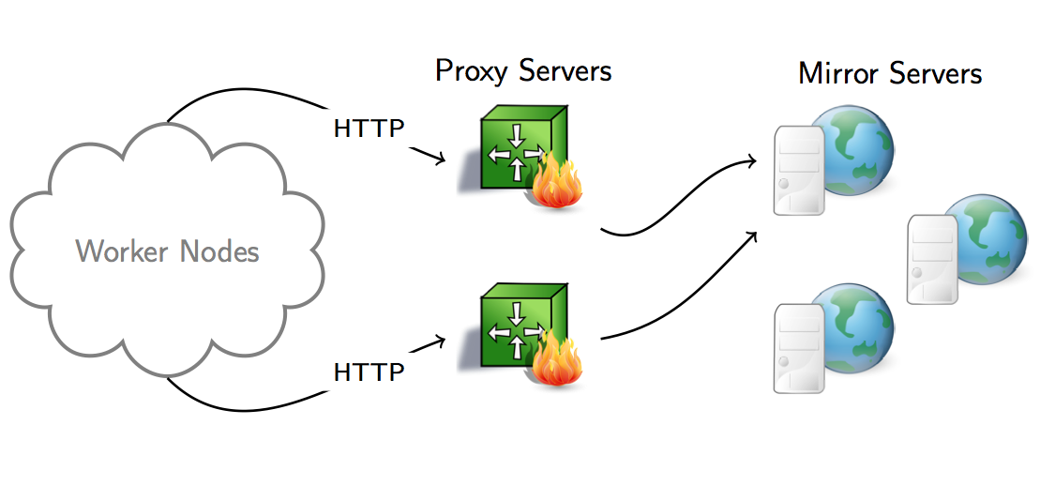
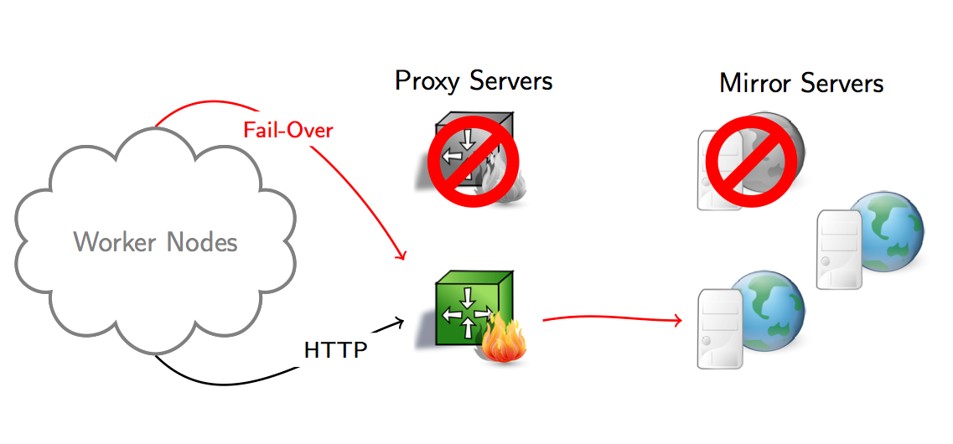
Client-Side Fail-Over
Proxies
  SL5 Squid, load-balancing + fail-over
  e. g. CVMFS_HTTP_PROXY="A|B|C"
Mirrors
  Fail-over mirrors at CERN, RAL, BNL
  For roaming users automatic ordering based on RTT

Slide 16
CernVM-FS within WLCG
CernVM-FS is set to replace current software installation methods
Current method
  Run <VO>sgm job via grid
  Write files within job to some shared storage
  Validate software
  Publish tag in BDII
  Process has to be repeated (an debugged) at every site
Being deployed at Tier-1s, Tier-2s and Tier-3s
  ATLAS and LHCb running productions with it

Slide 17
Advantages for WLCG Grid
Install once (on stratum zero)
  Files appear everywhere across WLCG
This can be many days faster
Hopefully less variation across sites
  Common path /cvmfs/…
  Very few variables: Cache size, Squid QOS
  Same install bugs every where – fix once
Some sites are struggling to provide scalable
NFS/AFS
  One shared area read by every batch worker
  It scales better than NFS/AFS

Slide 18
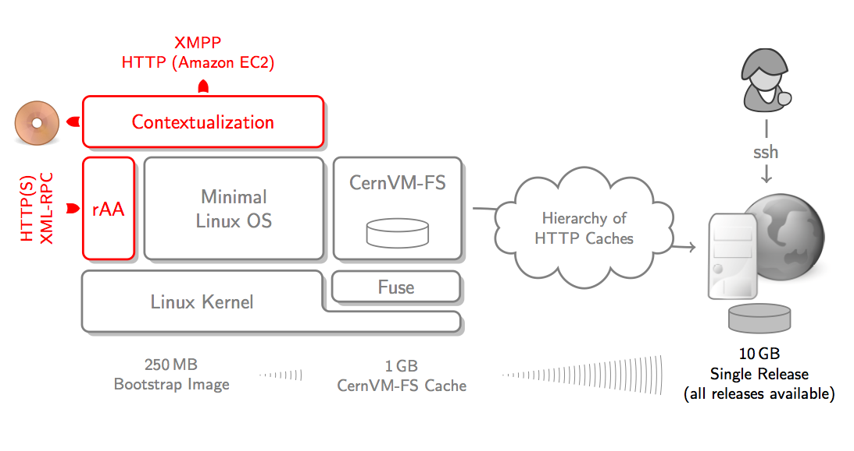
Part #3: Contextualization
There are several ways to contextualize CernVM
  Web UI (for individual user)
  CernVM Contextualization Agent
  Hepix CDROM method
  Amazon EC2 API user_data method
There are several ways to contextualize CernVM
  Web UI (for individual user)
  CernVM Contextualization Agent
  Hepix CDROM method
  Amazon EC2 API user_data method

Slide 19
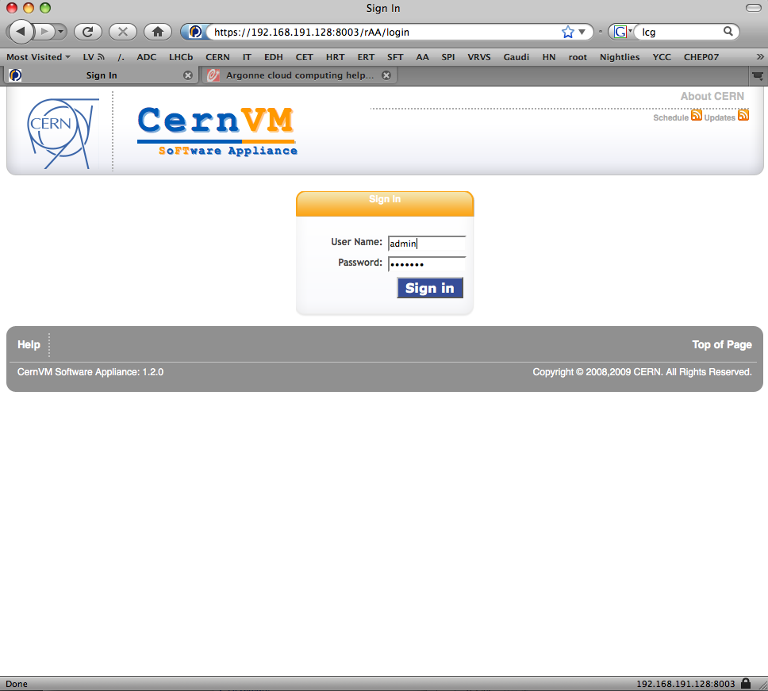
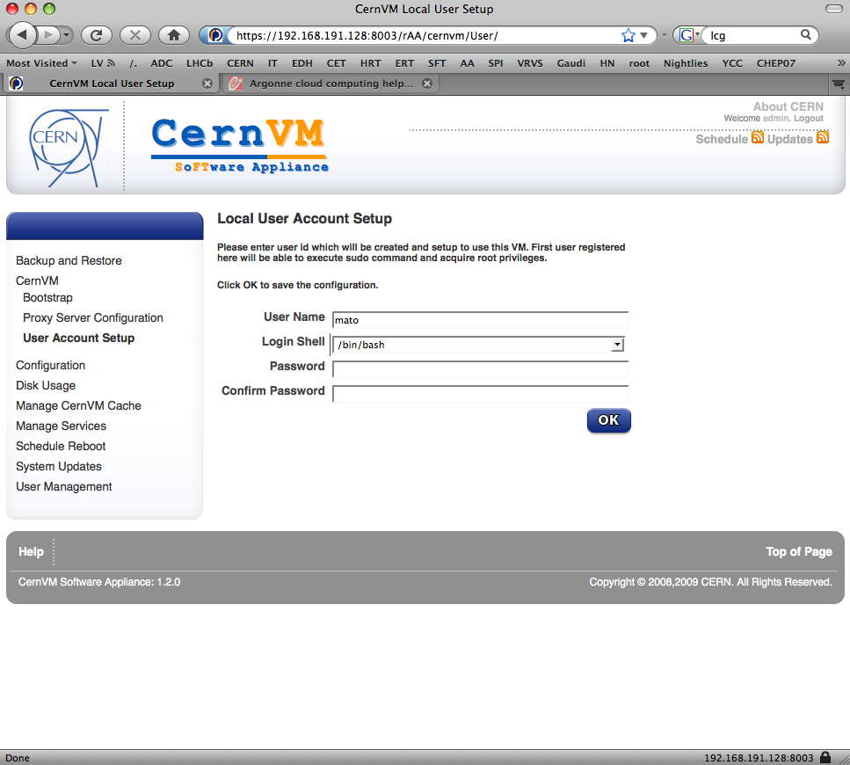
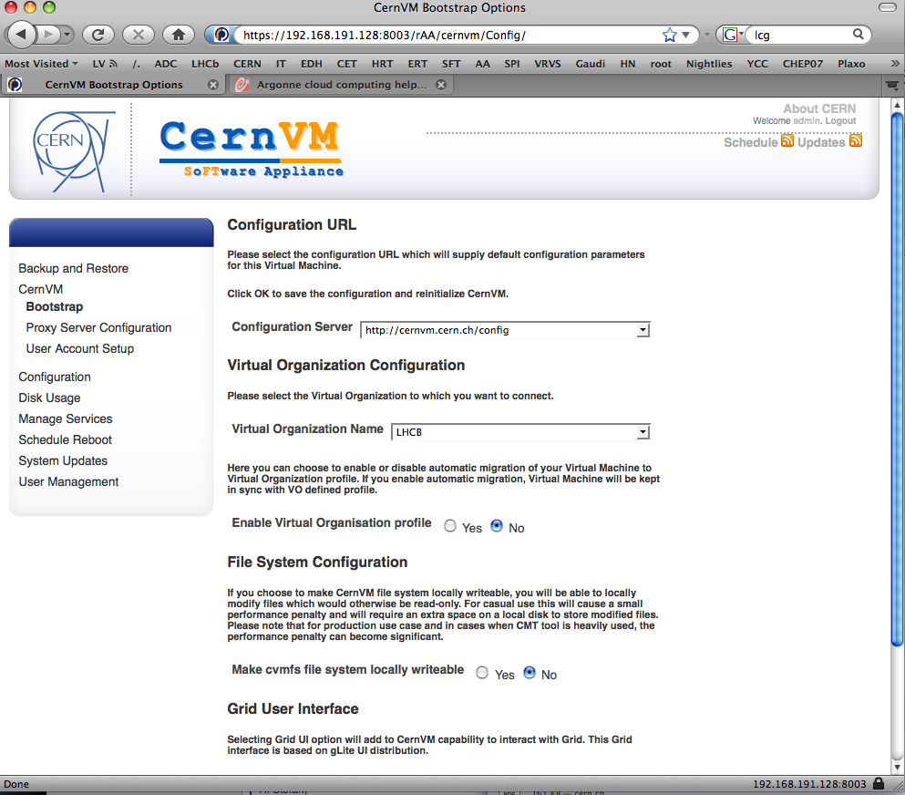
As easy as 1,2,3
Login to Web interface
Create user account
Select experiment, appliance flavor and preferences
Notes:
19

Slide 20
EC2 Contextualization
Basic principles:
  Owner of CernVM instance can contextualize and configure it to run arbitrary service as unprivileged user
  Site can use HEPIX method to inject monitoring and accounting hooks without functionally modifying the image
The contextualization is based on rPath amiconfig package extended with CernVM plugin
  This tool will execute at boot time (before network services are available), parse user data and look for python style configuration blocks.
  If match is found the corresponding plugin will process the options and execute configuration steps if needed.
For more info on CernVM contextualization using EC2 API, see:https://cernvm.cern.ch/project/trac/cernvm/wiki/EC2Contextualization

Slide 21
user_data example
[cernvm]
# list of ',' separated organizations/experiments (lowercase)
organisations = cms
# list of ',' separated repositories (lowercase)
repositories = cms,grid
# list of ',' separated user accounts to create <user:group:[password]>
users = cms:cms:
# CVMFS HTTP proxy
proxy = http://<host>:<port>;DIRECT
# install extra conary group
group_profile = group-cms
# script to be executed as given user: <user>:/path/to/script.sh
contextualization_command = cms:/path/to/script.sh
# list of ',' seperated services to start
services = <list>
# extra environment variables to define
environment = CMS_SITECONFIG=EC2,CMS_ROOT=/opt/cms

Slide 22
Now we have CernVM OS, FS, Contextualization, Cloud API, …
What’s next?

Slide 23









Run PanDA (ATLAS) in
CernVM on the Clouds
Private/Academic Clouds
PanDA Server
EC2 API
Store results
Public/Commercial Clouds

Slide 24


EOS: Scalable Service Architecture
Clients
XROOT client & FUSE
KRB5 + X509 authenticated
FUSE
bash# df /eos
eosatlas.cern.ch 3.8P 39G 3.8P 1% /eos
XrdClient
Management Server
Pluggable Namespace, Quota, ACLs,HA
Strong Authentication
Capability Engine
File Placement
File Location
Implemented as plugins in xrootd
xrootd
server
MGM
Plugin
MGM
Failover
NS
NS
async
MQ
xrootd
server
MQ
Plugin
Message Queue
Service State Messages
File Transaction Reports
sync
File Storage
File & File Meta Data Store
Capability Authorization
File & Block Disk Error Detection (Scrubbing)
Layout Plugins [ currently Raid-1(n) ]
async
xrootd
server
FST
Plugin
FST
Andreas Peters IT/DM
[root@vmbsq090700 ~]# df /eos
Filesystem 1K-blocks Used Available Use% Mounted on
eos 3413376370848 23790724 3413352580124 1% /eos

Slide 25
Using cernvm-tools
Listing available images:
[pbuncic@localhost ~]$ cvm --region CERN -H ls -i
AMI LOCATION STATE VISIBILITY ARCH TYPE
ami-00000008 hepix_sl55_x86_64_kvm available Public i386 machine
ami-00000002 cernvm232_head_slc5_x86_64_kvm available Public i386 machine
ami-00000004 cernvm231_slc5_x86_64_kvm available Public i386 machine
ami-00000003 cernvm232_batch_slc5_x86_64_kvm available Public i386 machine
ami-00000010 lxdev_slc6_quattor_slc6_x86_64_kvm available Public i386 machine
Support for multiple regions:
[pbuncic@localhost ~]$ cvm --region EC2 -H ls -i ami-5c3ec235
AMI LOCATION STATE VISIBILITY ARCH TYPE
ami-5c3ec235 download.cernvm.cern.ch.s3.amazonaws.com/cernvm-2.3.1-x86_64_1899.img.manifest.xml available Public x86_64 machine

Slide 26
Initializing Credentials
Proxy certificate
[pbuncic@localhost ~]$ lcg grid-proxy-init
Your identity: /DC=ch/DC=cern/OU=computers/CN=pilot/copilot.cern.ch
Creating proxy ................................................ Done
Your proxy is valid until: Thu May 19 06:43:50 2011
[pbuncic@localhost ~]$ lcg grid-proxy-info
subject : /DC=ch/DC=cern/OU=computers/CN=pilot/copilot.cern.ch/CN=1766683191
issuer : /DC=ch/DC=cern/OU=computers/CN=pilot/copilot.cern.ch
identity : /DC=ch/DC=cern/OU=computers/CN=pilot/copilot.cern.ch
type : Proxy draft (pre-RFC) compliant impersonation proxy
strength : 512 bits
path : /tmp/x509up_u500
timeleft : 11:59:56
This proxy certificate is time limited and authorized only to
  Request jobs from dedicated PanDA queue
  Write (but not delete) files in a given EOS directory

Slide 27
LXCloud
Starting contextualized CernVM images on lxCloud:
[pbuncic@localhost ~]$ cvm --region CERN run ami-00000003 --proxy --template panda-wn:1
r-47a5402e predrag default i-195 ami-00000003 128.142.192.62 128.142.192.62 pending default 0 m1.small 1970-01-01T01:00:00+01:00 default
[pbuncic@localhost ~]$ cvm --region CERN -H ls
ID RID OWNER GROUP DNS STATE KEY TYPE
i-195 default predrag default 128.142.192.62 running default m1.small
[pbuncic@localhost ~]$ cvm --region CERN -H ls
ID RID OWNER GROUP DNS STATE KEY TYPE
i-195 default predrag default 128.142.192.62 running default m1.small
i-196 default predrag default 128.142.192.63 running default m1.small
i-197 default predrag default 128.142.192.64 running default m1.small
i-198 default predrag default 128.142.192.65 running default m1.small
i-199 default predrag default 128.142.192.66 pending default m1.small
i-200 default predrag default 128.142.192.67 pending default m1.small
i-201 default predrag default 128.142.192.52 pending default m1.small
i-202 default predrag default 128.142.192.53 pending default m1.small
i-203 default predrag default 128.142.192.54 pending default m1.small
i-204 default predrag default 128.142.192.55 pending default m1.small
i-205 default predrag default 128.142.192.56 pending default m1.small
i-206 default predrag default 128.142.192.57 pending default m1.small

Slide 28
Amazon EC2
Starting more contextualized CernVM images on EC2:
[pbuncic@localhost ~]$ cvm run ami-5c3ec235 -g default -t m1.large --kernel aki-9800e5f1 --key ami --proxy --template panda-wn:10
r-ad962dc1 392941794136 default i-f3b04a9d ami-5c3ec235 pending ami 0 m1.large
r-ad962dc1 392941794136 default i-f1b04a9f ami-5c3ec235 pending ami 1 m1.large
r-ad962dc1 392941794136 default i-cfb04aa1 ami-5c3ec235 pending ami 2 m1.large
r-ad962dc1 392941794136 default i-cdb04aa3 ami-5c3ec235 pending ami 3 m1.large
....
[pbuncic@localhost ~]$ cvm --region EC2 -H ls
ID RID OWNER GROUP DNS STATE KEY TYPE
i-f3b04a9d r-ad962dc1 392941794136 default ec2-50-16-144-41 running ami m1.large
i-f1b04a9f r-ad962dc1 392941794136 default ec2-75-101-214-247 running ami m1.large
i-cfb04aa1 r-ad962dc1 392941794136 default ec2-184-72-183-26 running ami m1.large
i-cdb04aa3 r-ad962dc1 392941794136 default ec2-184-73-56-72 running ami m1.large
i-cbb04aa5 r-ad962dc1 392941794136 default ec2-50-16-32-51 running ami m1.large
i-c9b04aa7 r-ad962dc1 392941794136 default ec2-75-101-184-46 running ami m1.large
i-c7b04aa9 r-ad962dc1 392941794136 default ec2-50-19-38-225 running ami m1.large
i-c5b04aab r-ad962dc1 392941794136 default ec2-50-16-105-241 running ami m1.large
i-c3b04aad r-ad962dc1 392941794136 default ec2-174-129-86-61 running ami m1.large
i-c1b04aaf r-ad962dc1 392941794136 default ec2-50-19-9-47 running ami m1.large

Slide 29
PanDA Monitor

Slide 30
Summary
Described the three elements that constitutes the CernVM image
  Minimal Linux OS (SL5)
  CernVM-FS - HTTP network file system optimized for jus in time delivery of experiment software
  → Can also be used independently of CernVM
  Flexible configuration and contextualization mechanism based on public Cloud API
User environment petty well understood, evolving towards a job hosting environment (grid, cloud, volunteering computing)
Testing CernVM on Amazon-EC2 and LXCloud
  A way to simplify software deployment and jump on the Cloud-wagon

