Slide 1
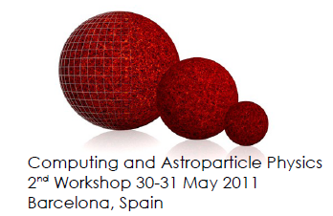
Overview of Database Technologies
Computing and Astroparticle Physics
2nd ASPERA Workshop
Eric Grancher
eric.grancher@cern.ch
CERN IT department
https://edms.cern.ch/document/1146858/1

Slide 2
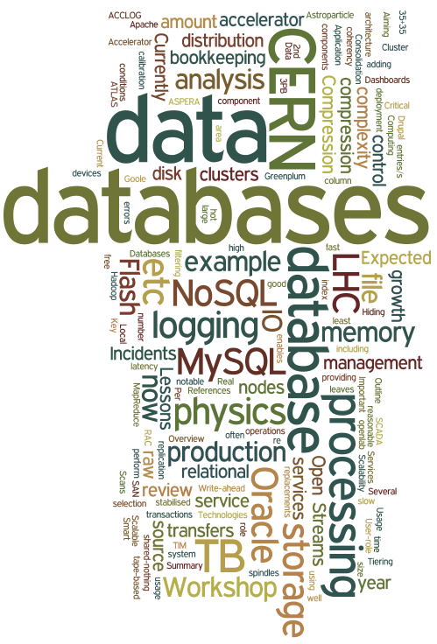
Outline
Experience at CERN
  Current usage and
  deployment
  Replication
  Lessons from last 15 years
Oracle and MySQL
Trends
  Flash
  Compression
  Open source “relational”
  databases
  NoSQL databases
http://www.wordle.net/

Slide 3
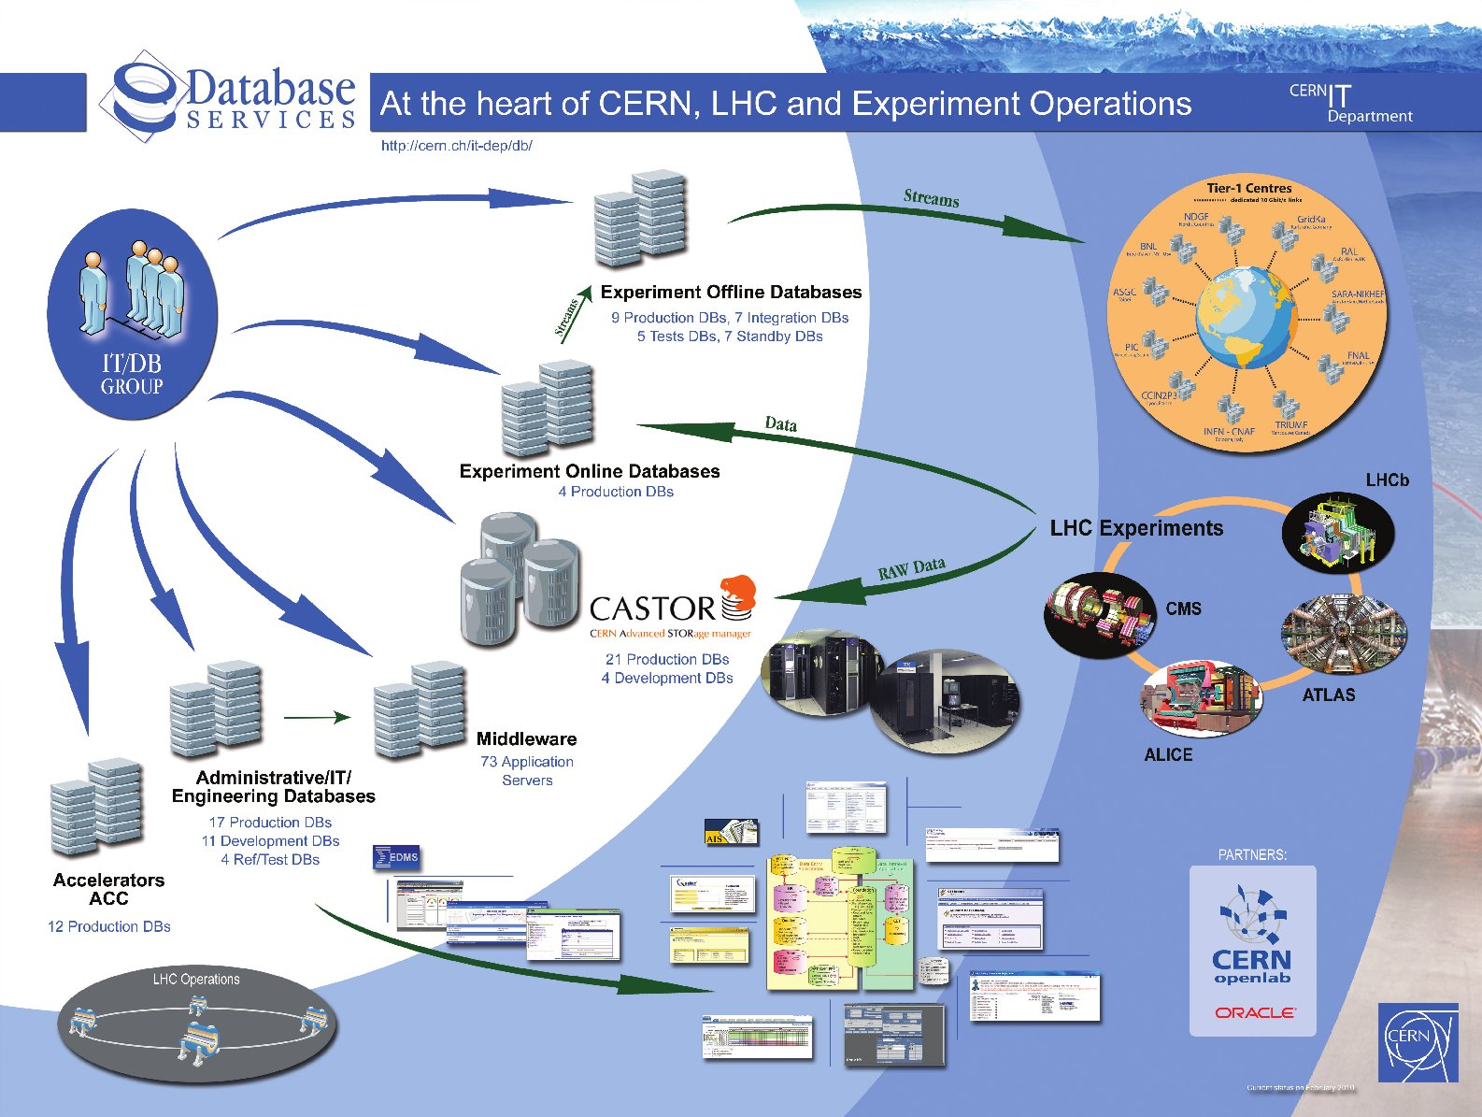
Notes:
Databases at CERN

Slide 4
CERN databases in numbers
original slide by Luca Canali
CERN databases services
  ~130 databases, most of them database clusters
  (Oracle RAC technology RAC, 2 – 6 nodes)
  Currently over 3000 disk spindles providing more than ~3PB raw disk space (NAS and SAN)
  MySQL service started (for Drupal)
Some notable databases at CERN
  Experiments’ databases – 14 production databases
    Currently between 1 and 12 TB in size
    Expected growth between 1 and 10 TB / year
  LHC accelerator logging database (ACCLOG) – ~70 TB, >2.10¹² rows, expected growth up to 35(+35) TB / year
  ... Several more DBs in the 1-2 TB range

Slide 5
Key role for LHC physics data processing
Online acquisition, offline production, data (re)processing, data distribution, analysis
    SCADA, conditions, geometry, alignment, calibration, file bookkeeping, file transfers, etc..
Grid Infrastructure and Operation services
    Monitoring, Dashboards, User-role management, ..
Data Management Services
    File catalogues, file transfers and storage management, …
Metadata and transaction processing for custom tape-based storage system of physics data
Accelerator control and logging systems
AMS as well: data/mc production bookkeeping and slow control data
original slide by Luca Canali

Slide 6
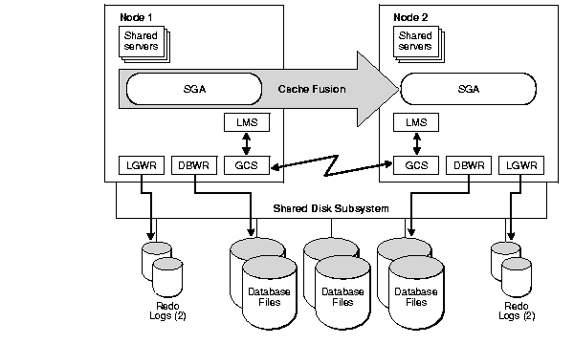
Oracle Real Application Cluster
from Oracle9i Real Application Clusters Deployment and Performance

Slide 7
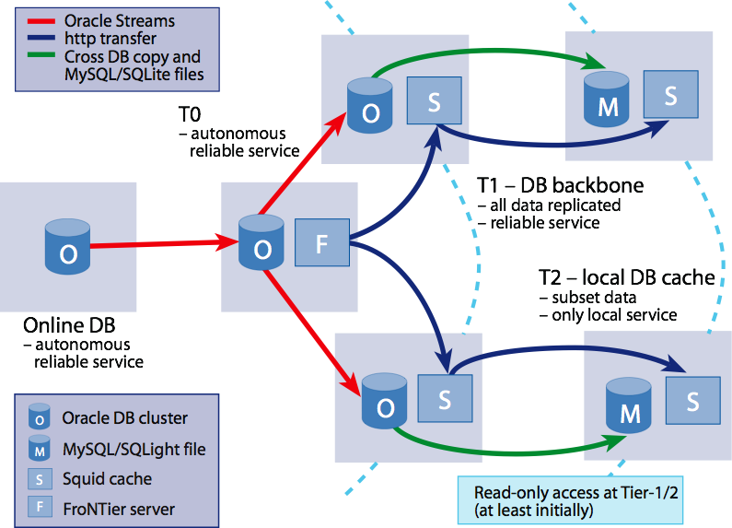
CERN openlab and Oracle Streams
Worldwide distribution of experimental physics data using Oracle Streams
Huge effort, successful outcome
slide by Eva Dafonte Pérez

Slide 8
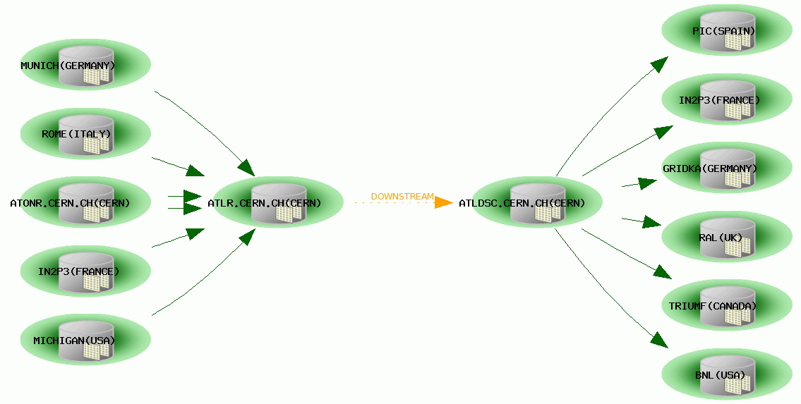
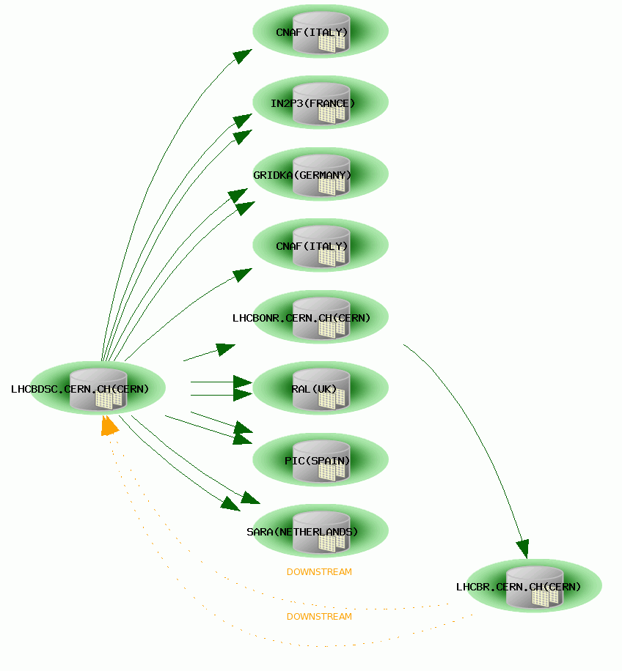



ATLAS
LHCb
CMS
ALICE
COMPASS
slide by Eva Dafonte Pérez

Slide 9
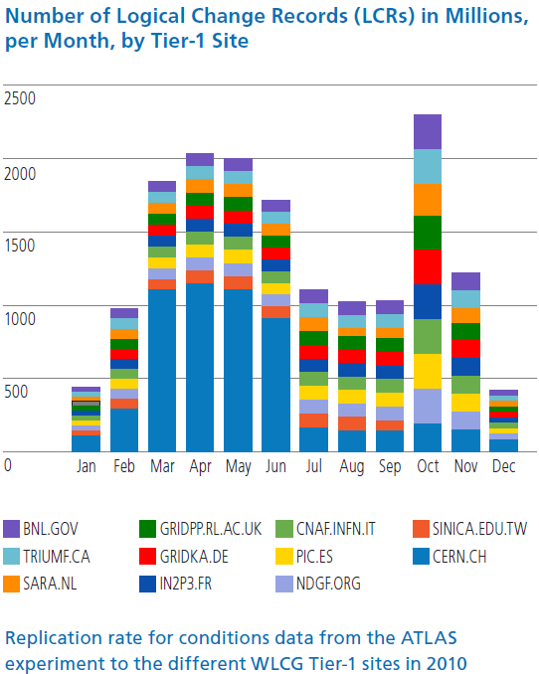

Slide 10
Lessons learnt
Aiming for high-availability is (often) adding complexity… and complexity is the enemy of availability
Scalability can be achieved with Oracle Real Application Cluster (150k entries/s for PVSS)
Database / application instrumentation is key for understanding/improving performance
NFS/D-NFS/pNFS are solutions to be considered for stability and scalability (very positive experience with NetApp, snapshots, scrubbing, etc.)
Database independence is very complex if performance is required
Hiding IO errors from the database leaves the database handle what it is best at (transactions, query optimisation, coherency, etc.)

Slide 11
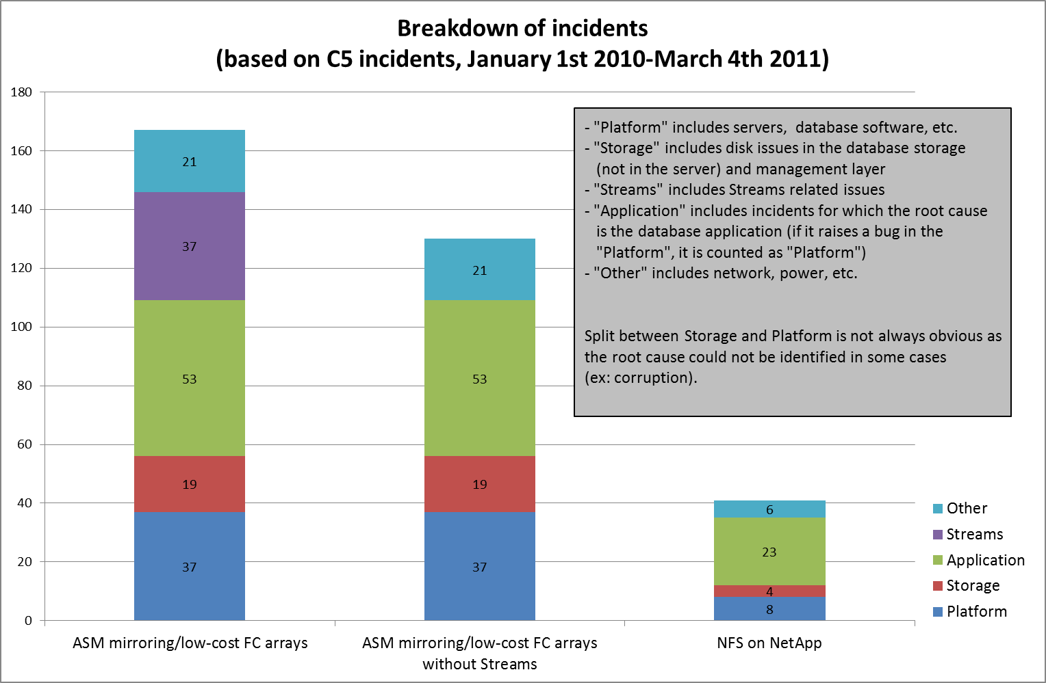
Incidents review

Slide 12
Evolution
Flash
Large memory systems
Compression
Open source “relational” databases
NoSQL databases

Slide 13
Flash, memory and compression
Flash changes the picture in the database area IO
  Sizing for IO Operations Per Second
  Usage of fast disks for high number of IOPS and latency
Large amount of memory
  Enables consolidation and virtualisation (less nodes)
  Some databases fully in memory
Compression is gaining momentum for databases
  For example Oracle’s hybrid columnar compression
  Tiering of storage

Slide 14
Exadata Hybrid Columnar Compression on Oracle 11gR2
Compression factor
slide by Svetozar Kapusta
Notes:
Compass PVSS columns: 6 number, 4 TS(9) , 5 varchar2 , 3 binary_double
LCG SERVICESTATUS columns: 5 number
LCG TESTDATA 2007 columns: 6 number(38), 1 varchar2, 1 CLOB
ATLAS PANDA FILESTABLE columns: 3 number, 12 varchar2, 2 date, 2 char
LCG MESSAGES columns: 5 number, 7 varchar2, 1 TS

Slide 15
Local analysis of data
“Big Data”, analysis of large amount of data in reasonable of time
Goole MapReduce, Apache Hadoop implementation
Oracle Exadata
  Storage cells perform some of the operations locally (Smart Scans, storage index, column filtering, etc.)
Greenplum
  shared-nothing massively parallel processing architecture for Business Intelligence and analytical processing
Important direction for at least the first level of selection

Slide 16
Open source relational databases
MySQL and PostgreSQL
Some components are not “free”, replacements exist (for example for hot backup Percona XtraBackup)
MySQL default for many applications (OpenNebula, Drupal, etc.)
PostgreSQL has a strong backend with Oracle-like features (stored procedures, write-ahead logging, “standby”, etc.)

Slide 17
NoSQL databases 1/2
Not about SQL limitations/issues
  about scalability
  Big Data scale-out
Feature-rich SQL engines are complex, lead to some unpredictability
Workshop at CERN (needs and experience)
ATLAS Computing Technical Interchange Meeting

Slide 18
NoSQL databases 2/2
Lot of differences
  Data models (Key-Value, Column Family, Key-Document, Graph, etc.)
  Schema free storage
  Queries complexity
  Mostly not ACID (Atomicity, Consistency, Isolation and Durability), data durability relaxed compared to traditional SQL engines
  Performance with sharding
  Compromise on consistency to keep availability and partition tolerance
-> application is at the core, evolution?

Slide 19
Summary
Oracle
  Critical component for LHC accelerator and physics data processing
  Scalable and stable, including data replication
CERN central services run on Oracle, for which we have components and experience to build high availability, guaranteed data, scalability
MySQL is being introduced
  Nice features and light, lacks some scalability and High-Availability features for solid service
NoSQL is being considered
  Ecosystem still in infancy (architecture, designs and interfaces subject to change!)

Slide 20
Oracle
EU director for research, Monica Marinucci
Strong collaboration with CERN and universities
Well known solution, easy to find database administrators and developers, training available
Support and licensing

Slide 21
References
NoSQL ecosystem, http://www.aosabook.org/en/nosql.html
Database workshop at CERN https://indico.cern.ch/conferenceDisplay.py?confId=130874 and ATLAS Computing Technical Interchange Meeting https://indico.cern.ch/event/132486
Eva Dafonte Pérez, UKOUG 2009 “Worldwide distribution of experimental physics data using Oracle Streams”
Luca Canali, CERN IT-DB Deployment, Status, Outlook http://canali.web.cern.ch/canali/docs/CERN_IT-DB_deployment_GAIA_Workshop_March2011.pptx
CERN openlab, http://cern.ch/openlab/
CAP theorem, http://portal.acm.org/citation.cfm?id=564601
ACID, http://portal.acm.org/citation.cfm?id=291

Slide 22
Backup slides

Slide 23
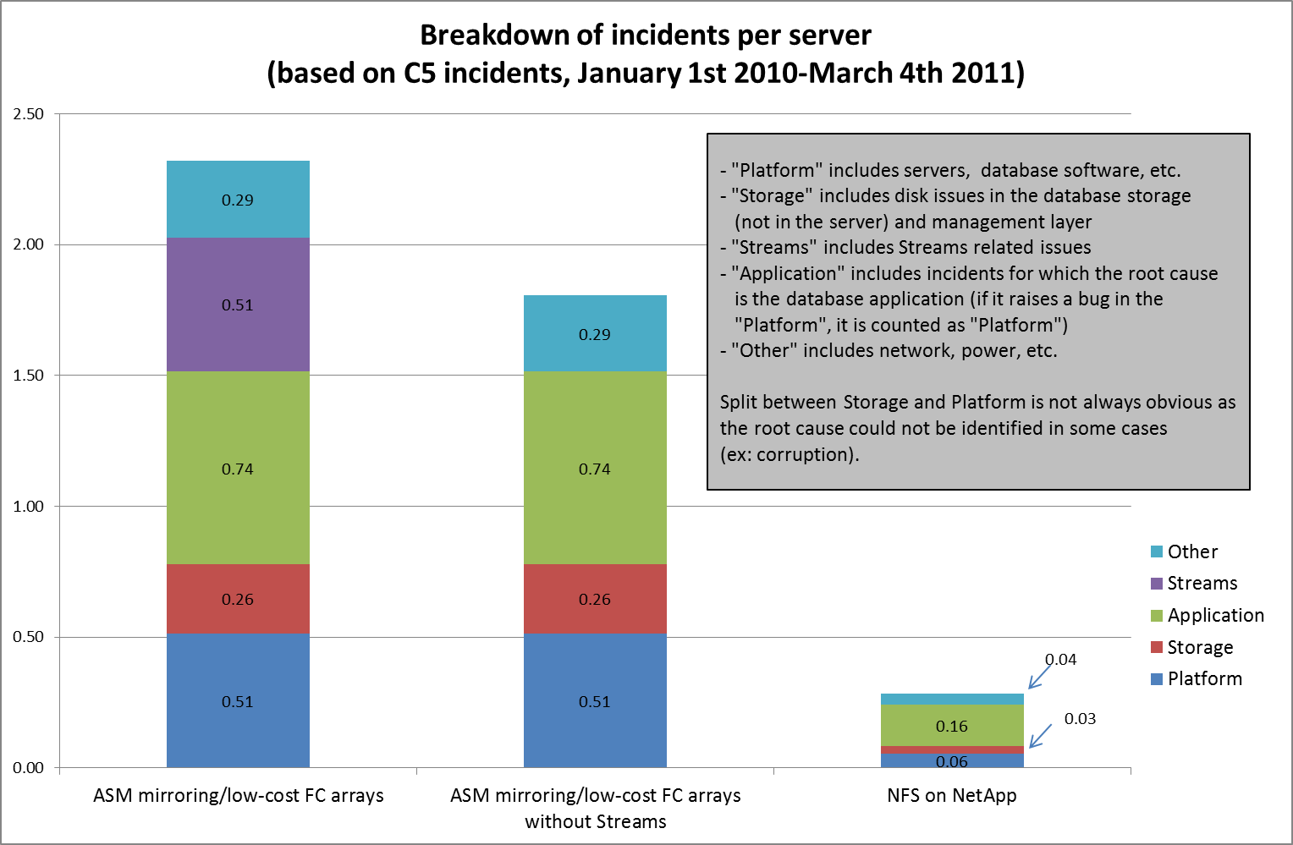
Incidents review

Slide 24
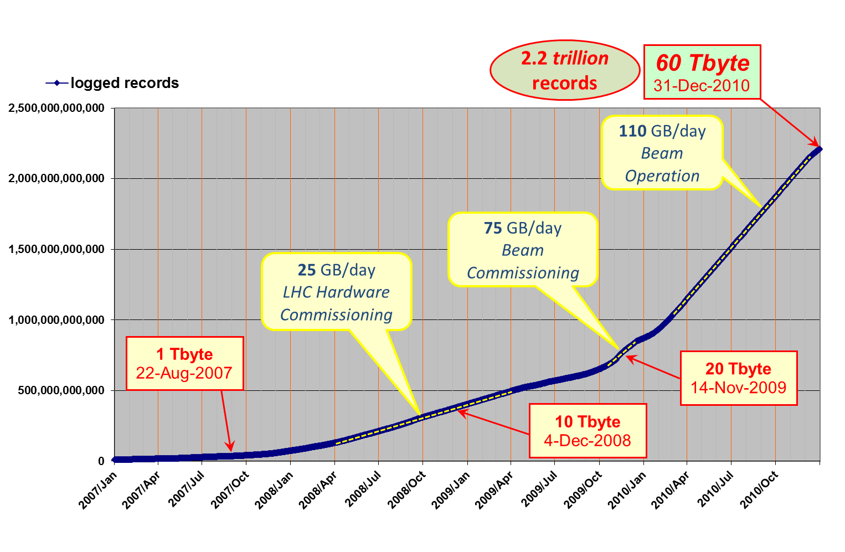
LHC logging service, >2.10¹²
graph by Ronny Billen

