Slide 1



The KATRIN Analysis Framework
2nd ASPERA Workshop on Computing and Astroparticle Physics
Barcelona 2011

Slide 2
Outline
The KATRIN Experiment
Data Taking and Experiment Control
The Analysis Software Framework
Implementation Details
Conclusion & Outlook

Slide 3
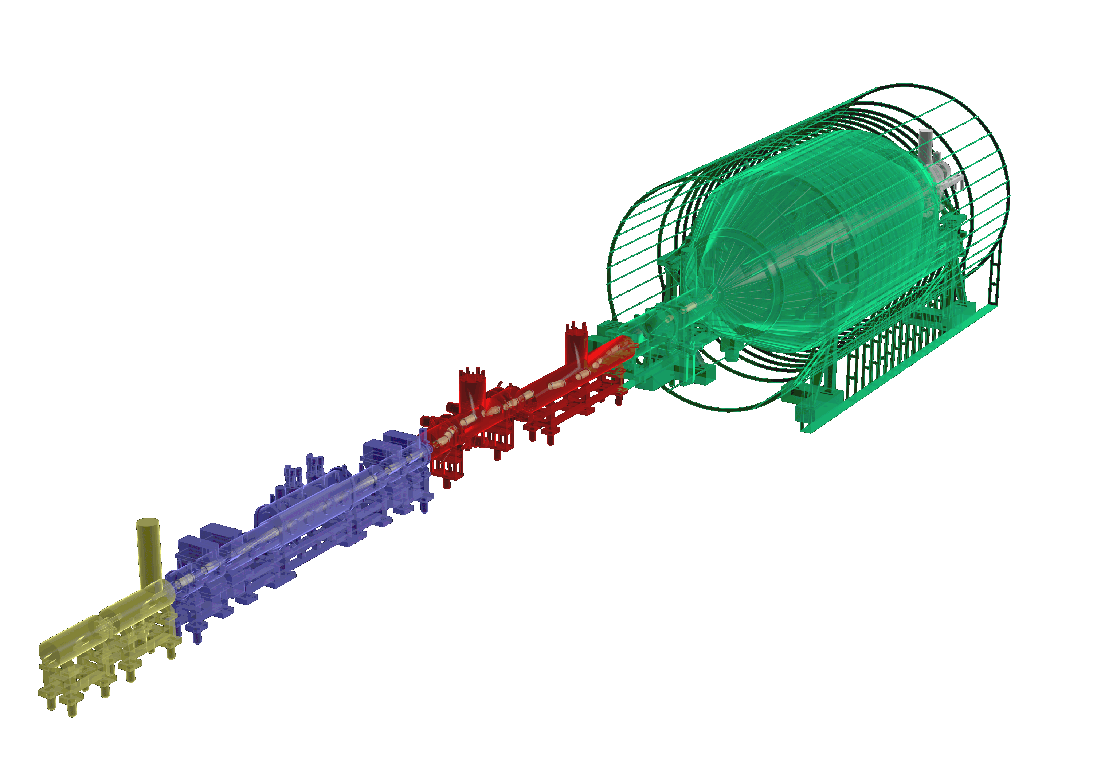















The Karlsruhe TRItium Neutrino (KATRIN) Experiment
Experimental objective:
model-independent measurement of the absolute neutrino mass scale
sensitivity: 0.2 eV/c² (90% C.L.)
source: gaseous tritium (ß-decay)
Collaboration
130 scientists
5 countries
13 institutions

Slide 4
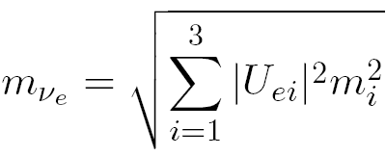
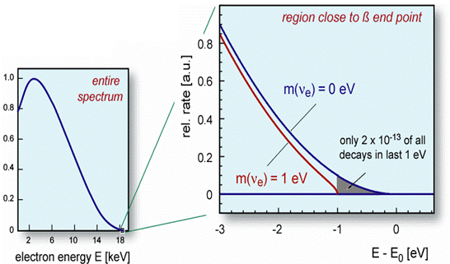
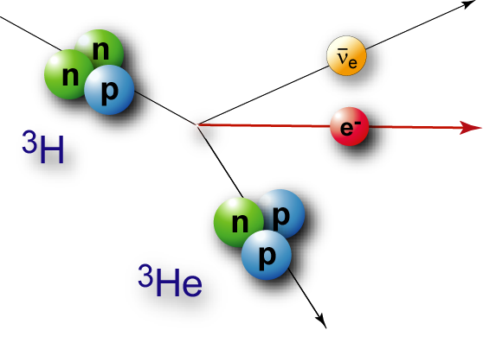
β-decay and neutrino mass
Direct kinematic measurement of the effective neutrino mass
Tritium as β-emitter
MAC-E filter (electrostatic filter with magnetic adibatic collimation) as spectrometer
Data rate: mHz - kHz

Slide 5
Experiment Control & Data Taking

Slide 6
Requirements
DAQ: around 1 GB per day
SlowControl: Large number of heterogenously distributed sensors,
ca. 10.000 channels
Calibration, geometry information, simulation results, …
Constant monitoring is necessary to maintain highly stable operating conditions over years.
The neutrino mass sensitivity goal of 0.2 eV/c² demands many parameters to be reliably known on the ppm (10⁻⁶) level.
Data has to be restructured, calibrated and merged from many different sources, even for simple analysis tasks.

Slide 7
Conventional file-based data access is not feasable:

Slide 9
Service Oriented Architecture at KATRIN
ADEI (Advanced Data Extraction Interface)
SlowControl data processing and caching
PHP based web platform for online data access

Slide 10
Service Oriented Architecture at KATRIN
KATRIN Data Manager
C++ WebService (Apache Webserver / FastCGI)
RPC (remote procedure call) interface and
XML Binding with gSOAP 2.8
Widget-centric C++ WebToolkit Wt for interactive web development
SQL database access through ORM (object relational mapping) abstraction layer Wt::Dbo

Slide 11
Service Oriented Architecture at KATRIN
Client C++ KATRIN Library KALI
Basic utility functions (XML binding, exception handling, logging, …)
Data retrieval and upload through
RPC programming interface
Common constants and data types
ROOT (CERN) support

Slide 12
Service Oriented Architecture at KATRIN

Slide 13
The Benefits of a Service Oriented Approach
Well defined data flow and server-side processing
(unnecessary data transfer is minimized)
Automated data quality and integrity checks
Central version and user access control
Reliable transaction handling
Data access through intuitive and consistent programming interfaces
Standardized code, common constants and data formats
Server-side data processing is performed by only few maintainable services
Consistent set of client applications (analysis and simulation) speaking a „similar language“

Slide 14
Offline Analysis

Slide 15
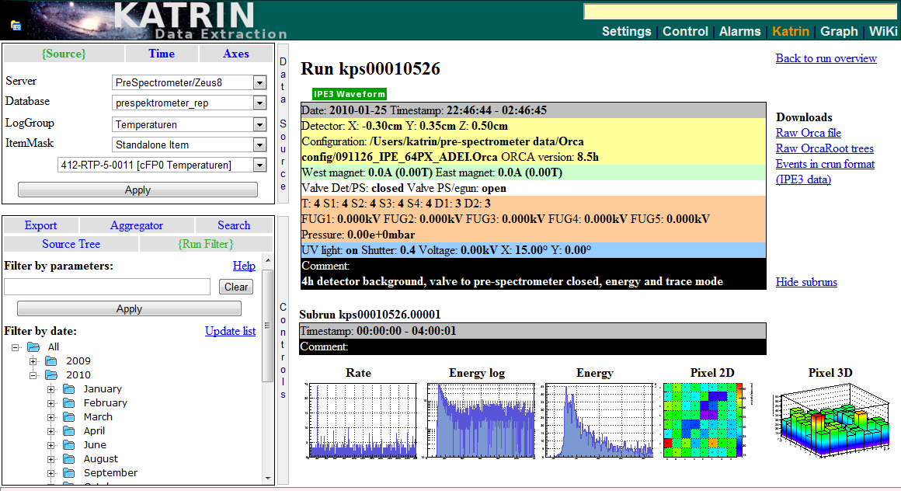
Online Analysis (Browser Screenshot)
External PHP application (ADEI) accessing KATRIN DAQ data through PHP-SOAP.
(Plugin developed by Sebastian Vöcking, University of Münster)

Slide 16
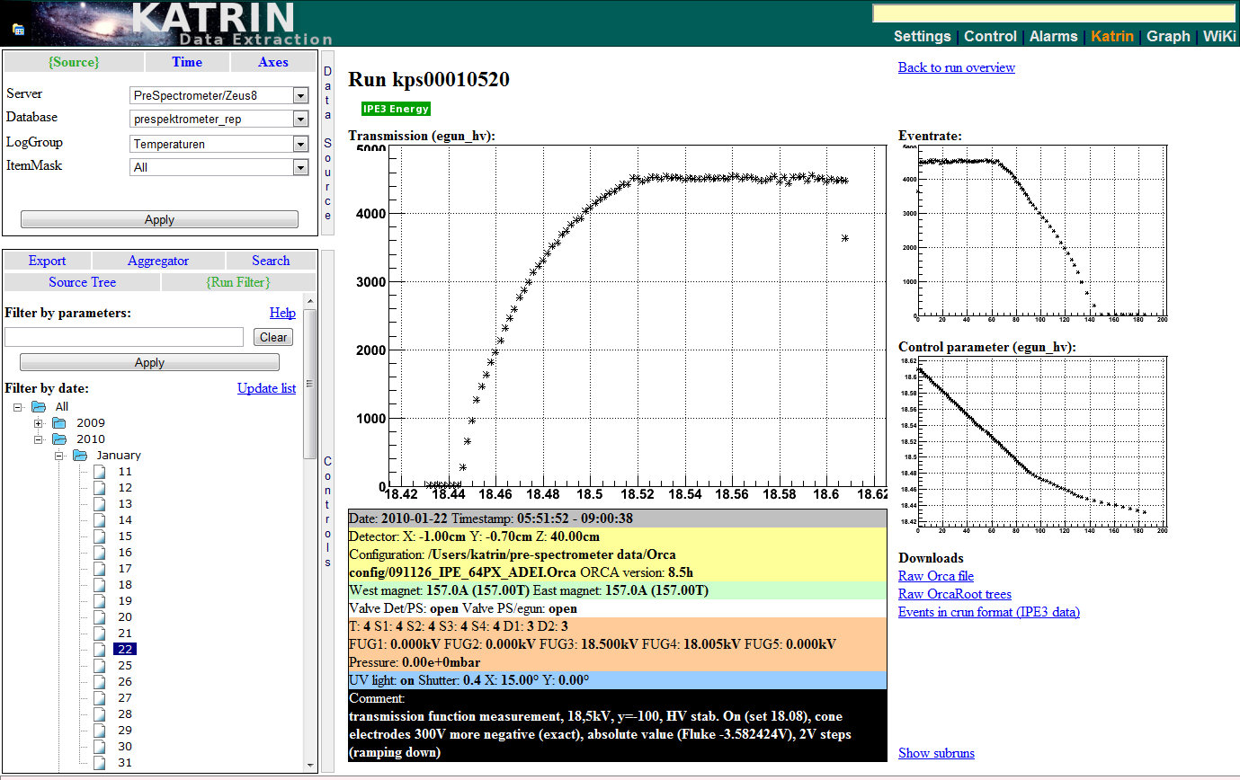
Online Analysis (Browser Screenshot)
Combined SlowControl and DAQ data:
Pixel detector hit rate over electron gun voltage.

Slide 17
Summary & Conclusion
C++ web service with SOAP interfaces for client applications implemented and tested
Standardized RPC interfaces (remote function calls) now allow intuitive access to heterogeneously distributed and structured data
Automated data processing and caching established
First stability and performance test look very promising
Preliminary online analysis tools available
Deployable C++ client library for offline analyses of main spectrometer commissioning measurements by the end of 2011

Slide 18

Thank you for your attention.
ν
ν
ν
ν
ν
ν
ν

Slide 19
References and URLs
The KATRIN Experiment:
http://www-ik.fzk.de/tritium
ADEI:
http://dside.dyndns.org/adei
Orca:
http://orca.physics.unc.edu/~markhowe/Orca_Help
gSoap:
http://www.cs.fsu.edu/~engelen/soap.html
Wt:
http://www.webtoolkit.eu

Slide 20
Implementation
KATRIN Data Manager
  C++ WebService (Apache Webserver / FastCGI)
  RPC (remote procedure call) interface and XML Binding with gSOAP 2.8
  Widget-centric C++ WebToolkit Wt for interactive web development
  SQL database access through ORM (object relational mapping) abstraction layer Wt::Dbo
Client C++ KATRIN Library KALI
  Basic utility functions (XML binding, exception handling, logging, …)
  Data retrieval and upload through RPC programming interface
  Common constants and data types
  ROOT (CERN) support
ADEI (Advanced Data Extraction Interface)
  SlowControl data processing and caching
  PHP based web platform for online data access

Slide 21
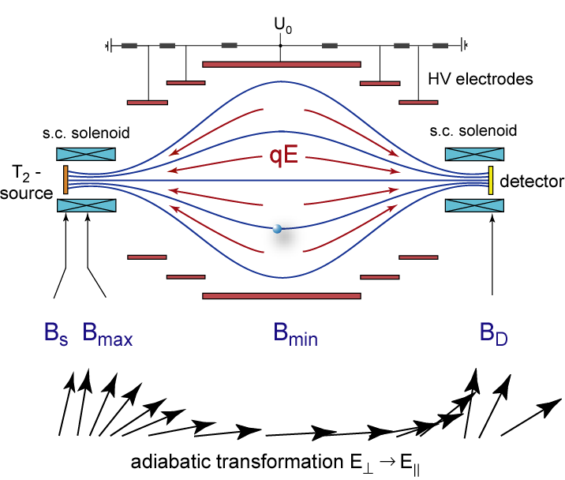
Magnetic Adiabatic Collimation with Electrostatic Filter (MAC-E)

Slide 22
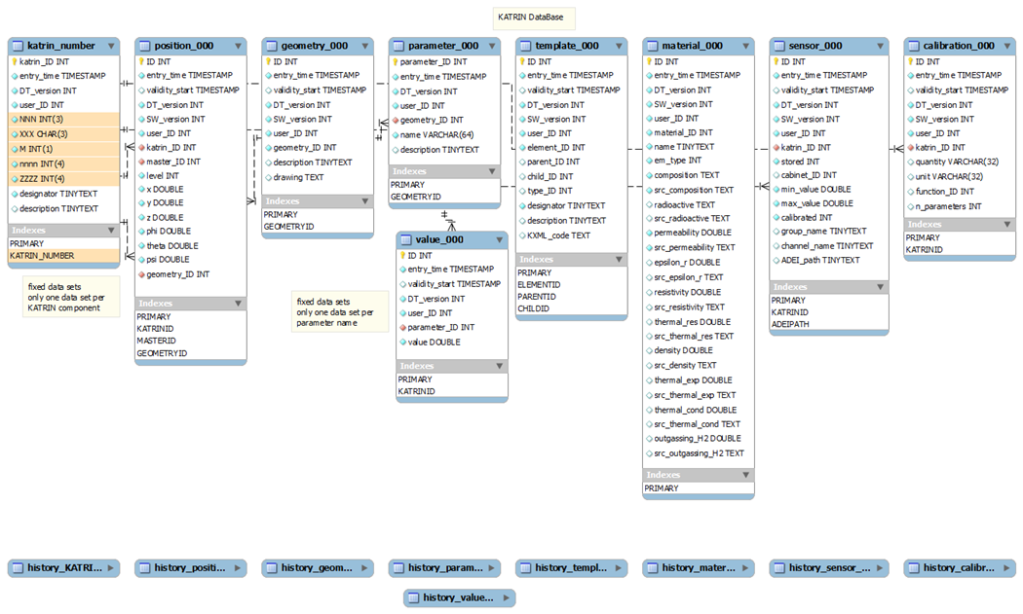
KATRIN number / sensor / geometry catalogue

Slide 23
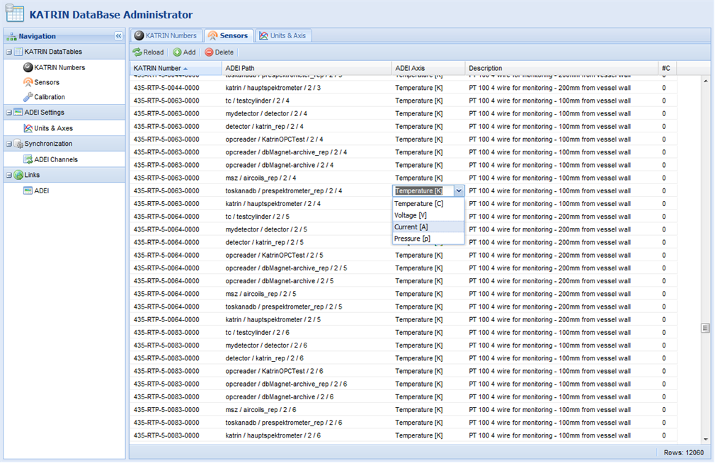
KATRIN DataBase Administrator

