Slide 1
The CERN Accelerator School turns 40
19.1.2024

Slide 2
A BIG Thank You!!! to our lecturers
Celebrate the occasion of 40th CAS Anniversary
First CAS Course October 1983 “Antiprotons for Colliding Beam Facilities”
About 90 CAS courses held so far
Would never be possible without your dedication and engagement as high-level expert CAS lecturers
Many things have changed over the last 40 years in accelerator physics and technology and the CAS courses
One thing stays:
CAS lives from the active participation of our lecturers!
Thank You!!!

Slide 3
Group Photo

Slide 4
Speech of the Director of Accelerators and Technology
Mike Lamont

Slide 5
CAS in the landscape of European training in accelerator science and technology
Phil Burrows

Slide 6
Residential CAS courses forever
Hermann Schmickler

Slide 7
History and memories of the CERN Accelerator School
Maurizio Vretenar

Slide 8
CAS Alumni: "CAS participants are advancing!”
Video by Noemi Caraban

Slide 9
CAS - special recognition - awards

Slide 10
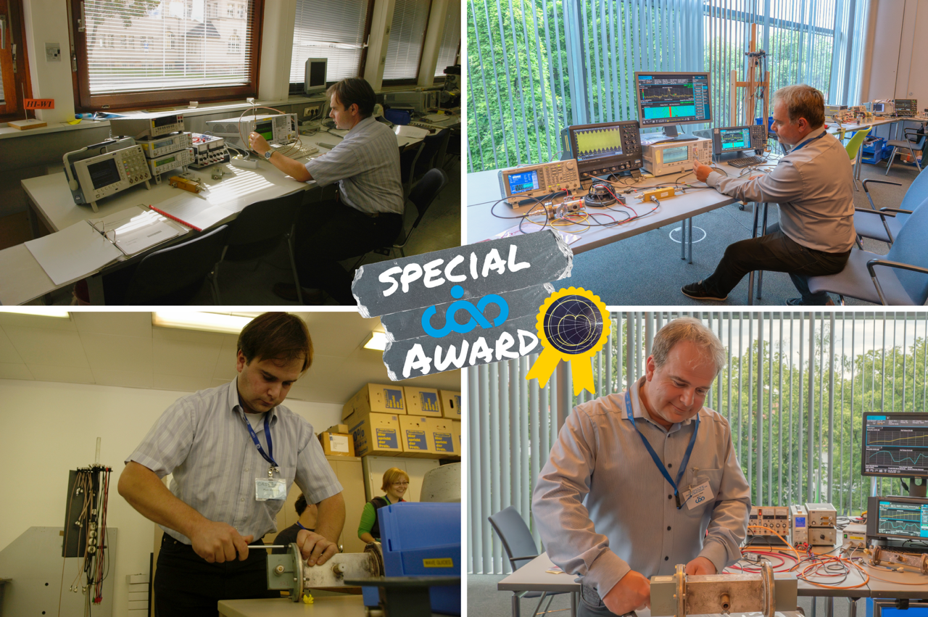
Piotr Kowina

Slide 11
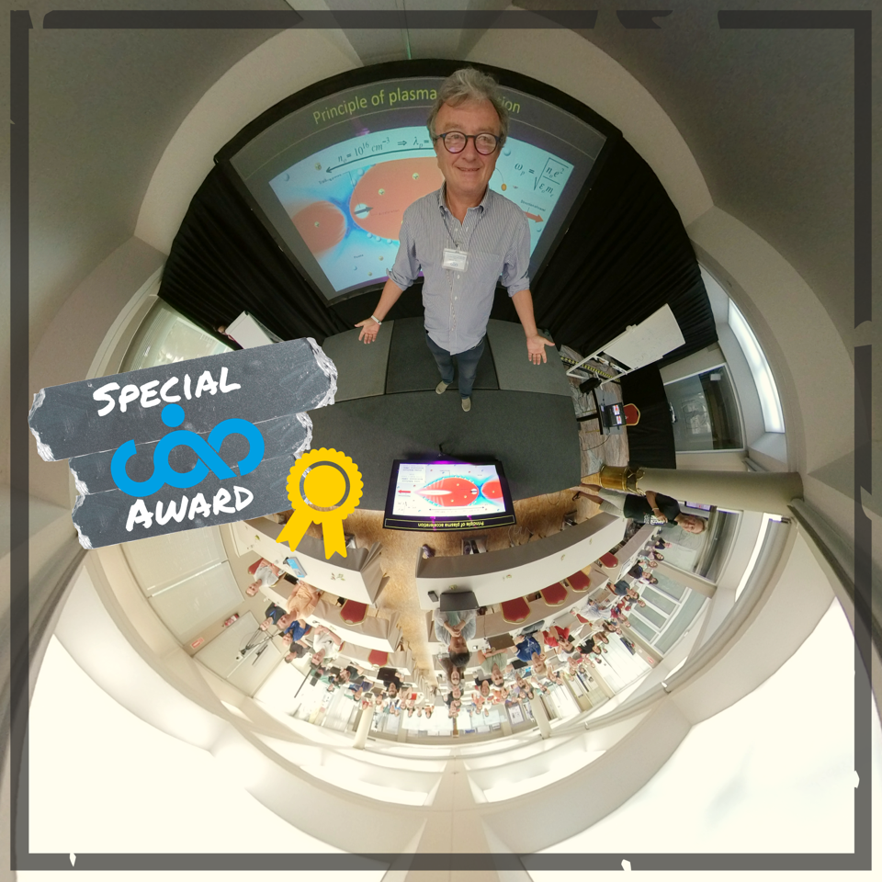
Massimo Ferrario

Slide 12
Closing

Slide 13
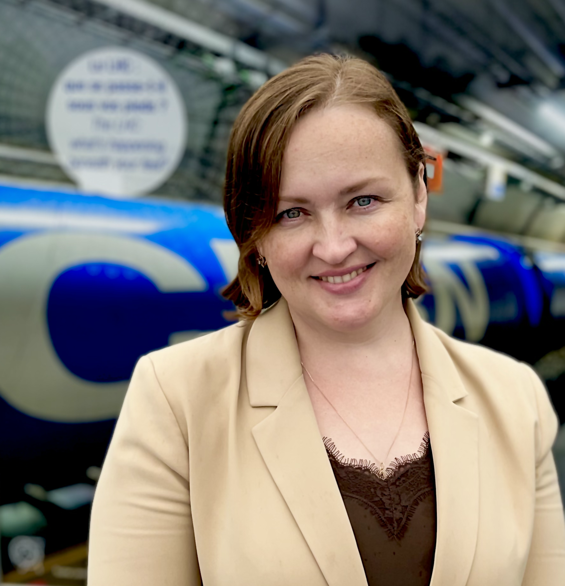
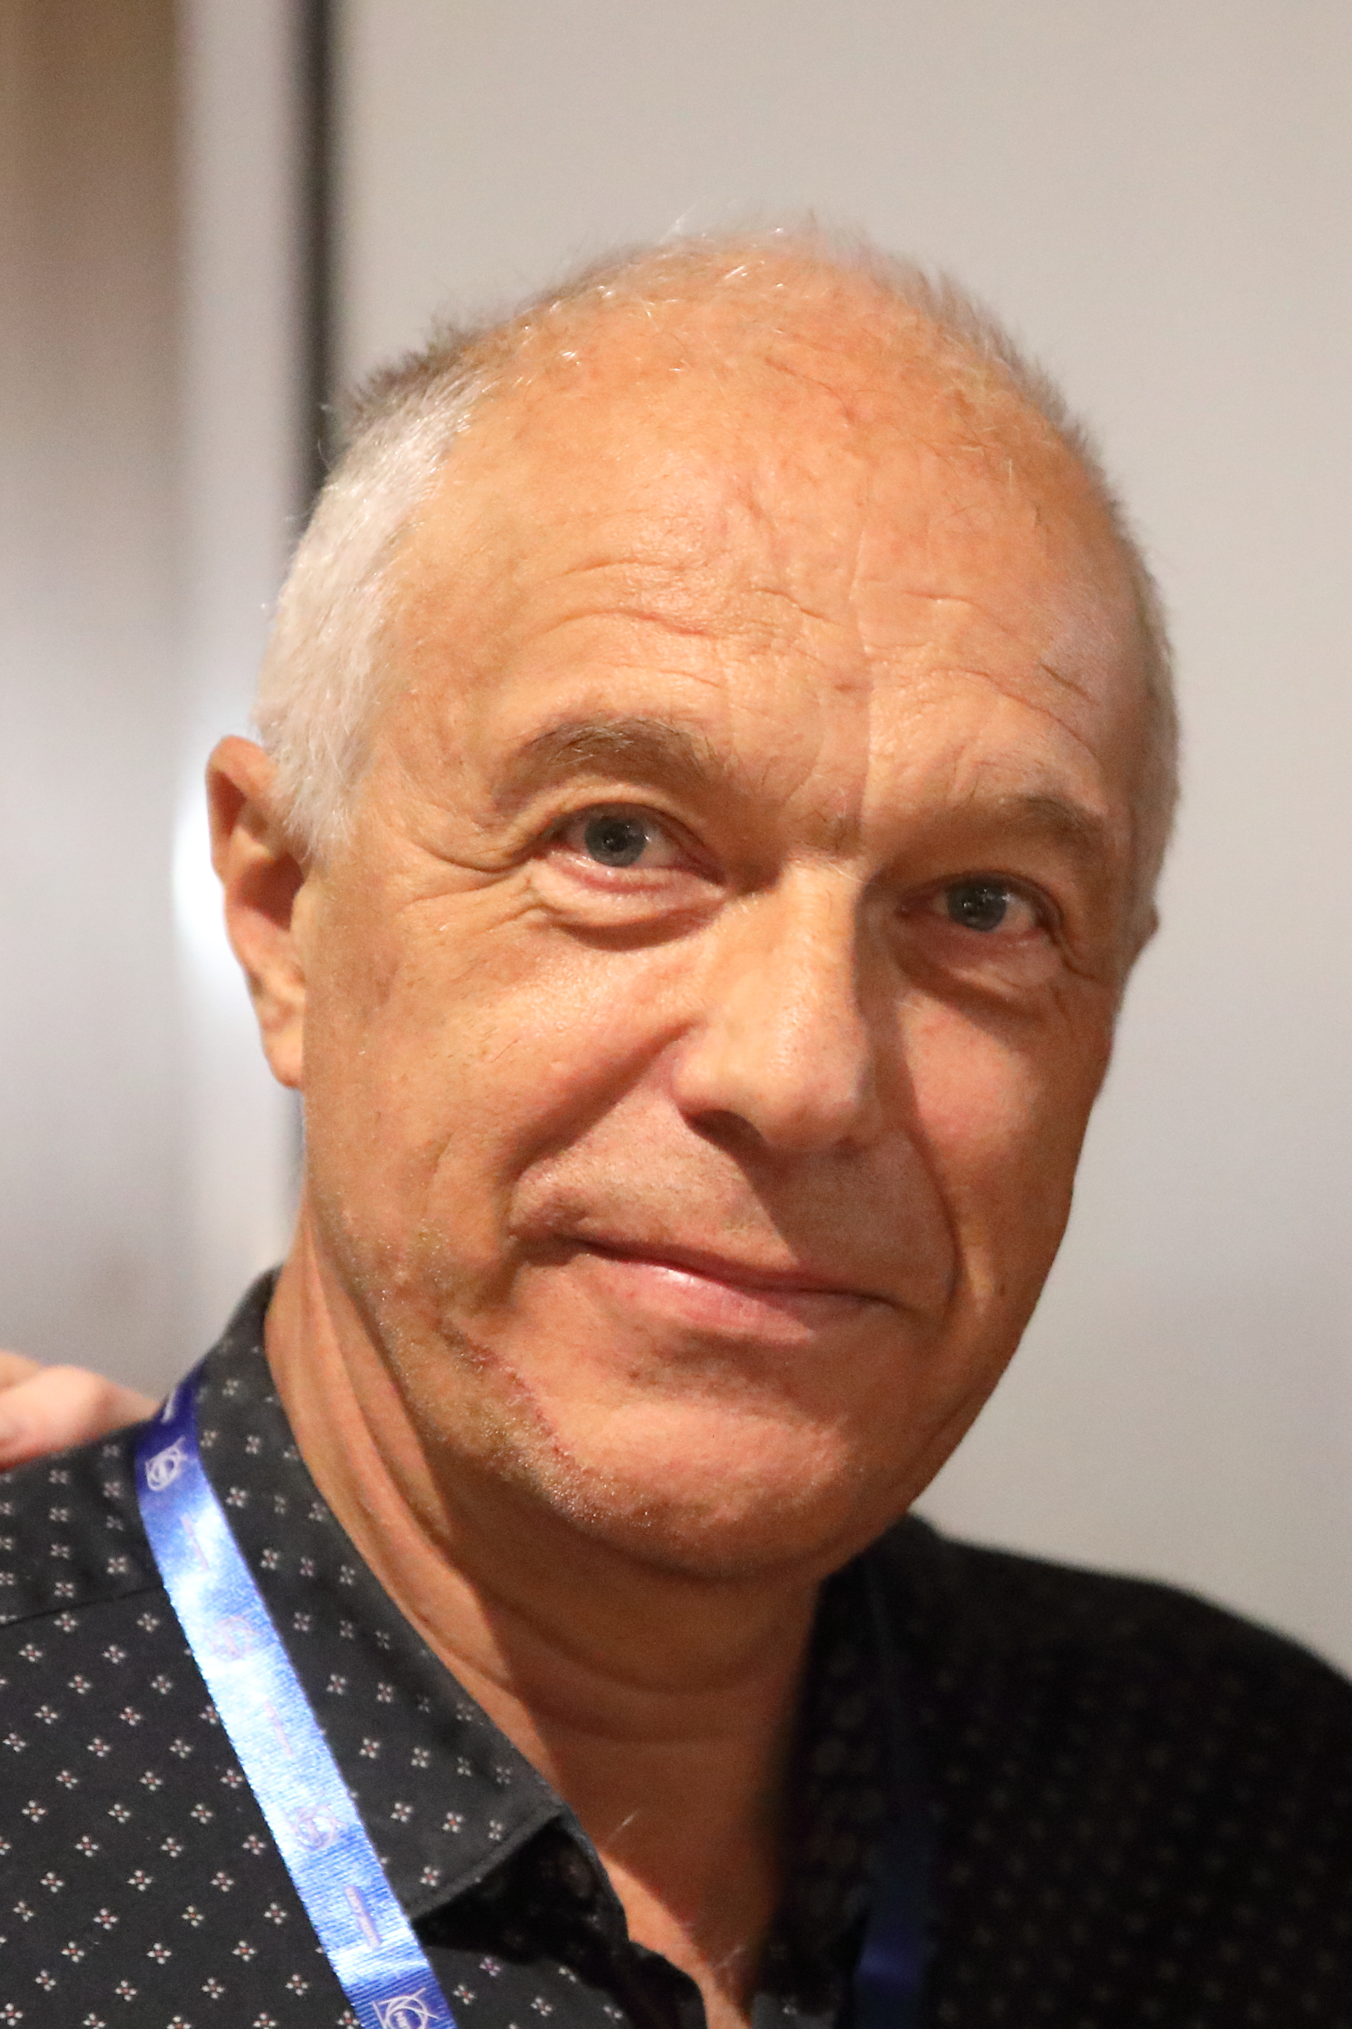
Thank you again in the name of the CAS Team
Noemi Caraban Gonzalez
CASopedia, Social media
Noemi Caraban Gonzalez
CASopedia, Social media
Christine Völlinger
Deputy Director
Maria Filippova
Administrative Assistant
Frank Tecker
Director
Delphine Rivoiron
Administrative Manager
Hermann Schmickler
previous Director

Slide 14
Social Mingle
Little present when you go out from here
Feel free to keep the CAS 40 cups as a souvenir of today
Enjoy the drinks, snacks, and the cake

