Slide 1
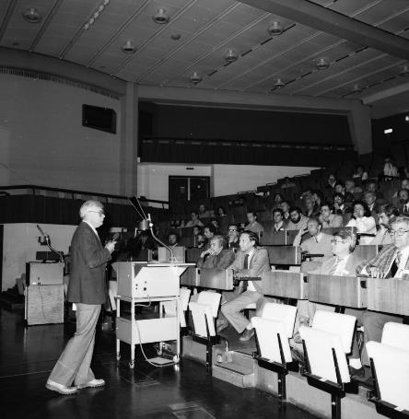
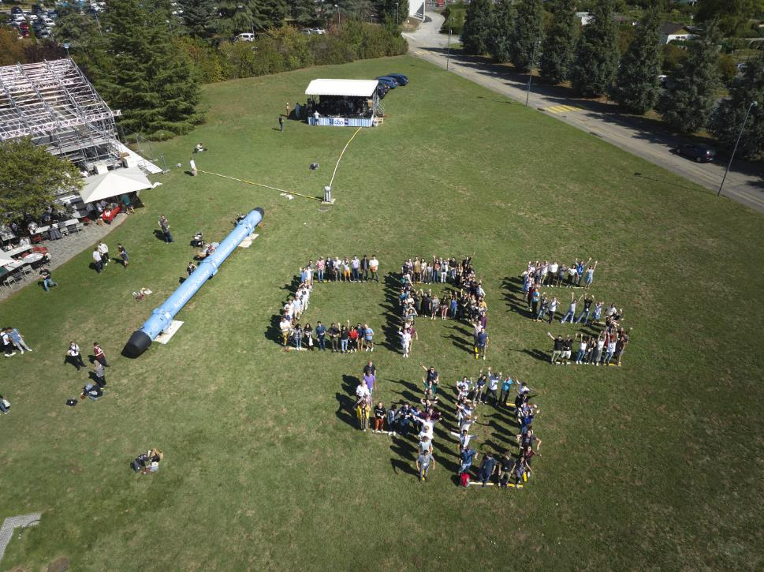
History and memories of the first 40 years of CAS
CAS 1
Maurizio Vretenar CERN ATS-DO
CAS student, 1988-1993
CAS lecturer, 1998-2014
CAS admirer and supporter, all my career

Slide 2
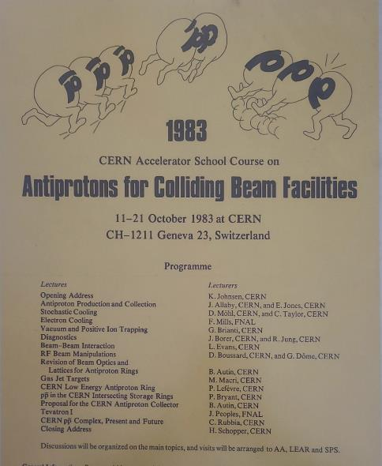
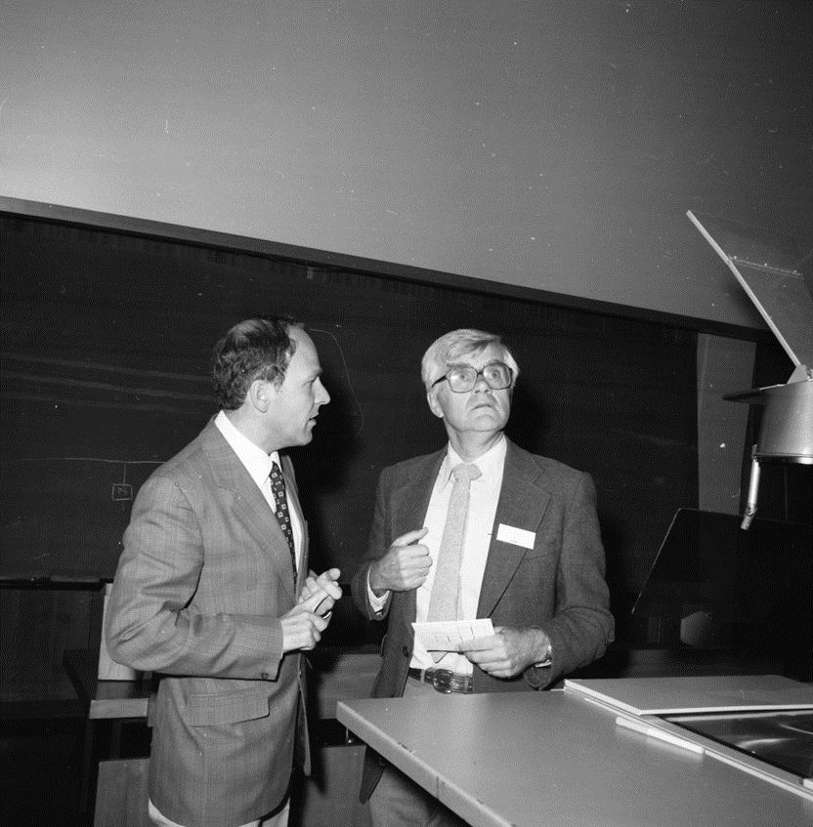
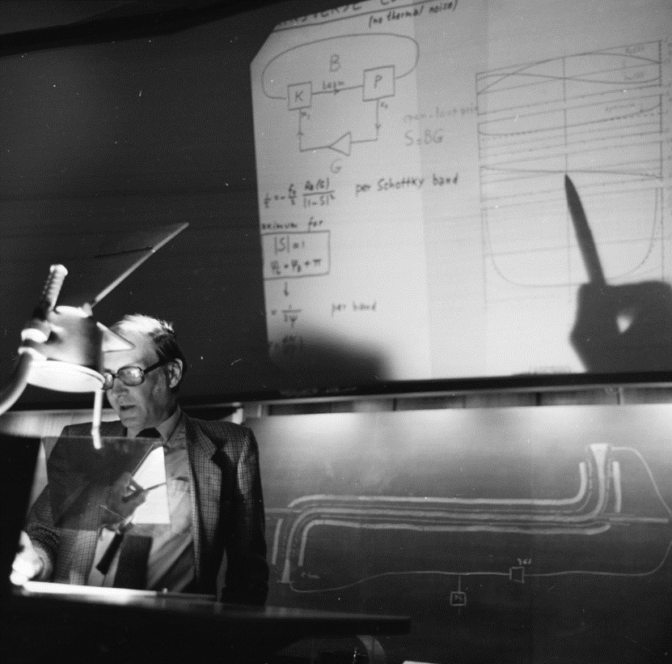
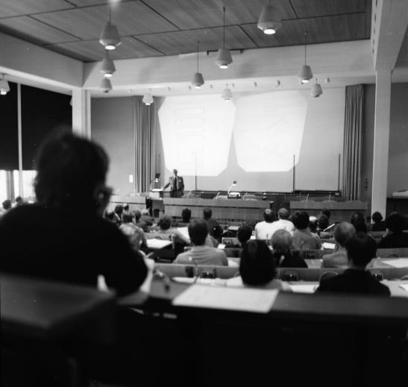
The 1st CAS: October 1983
Antiprotons for colliding beam facilities
Organised by K. Johnsen and P. Bryant
The times:
- discovery of W+/- announced in January 1983
- huge success of pbar complex and SPS collider
- excitement at CERN and outside
- Nobel to Rubbia and Van der Meer in 1984
The needs:
- No high-level education on accelerators
- Experts are recycled physicists or engineers
- Need to transmit large amount of knowledge
- Connect HEP accelerators with other applications
The original format:
- 2 weeks of lectures by top experts from CERN
- At CERN Council Chamber
- Workshop-style (only few social events)
Wide success, >100 participants

Slide 3
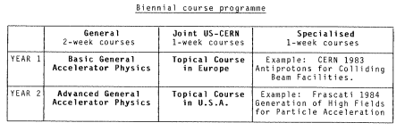
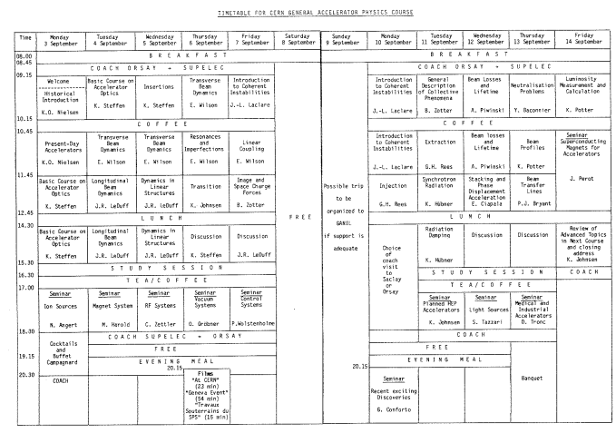
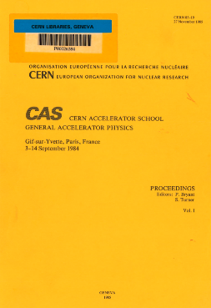
Changing format: the 1st Introductory CAS, 1984
1984: the first Introductory CAS at Gif-sur-Yvette, part of a bi-annual course programme
New format:
- residential, with study sessions, evening events and excursions
- outside of CERN, with visits to local laboratories
- lecturers from many European laboratories
- target: staff in accelerator laboratories, university departments and companies involved in accelerators
Huge success: 148 participants!
Bonus: the CAS proceedings!
The 44 Yellow Reports published so far became a reference for all students approaching accelerator science.

Slide 4
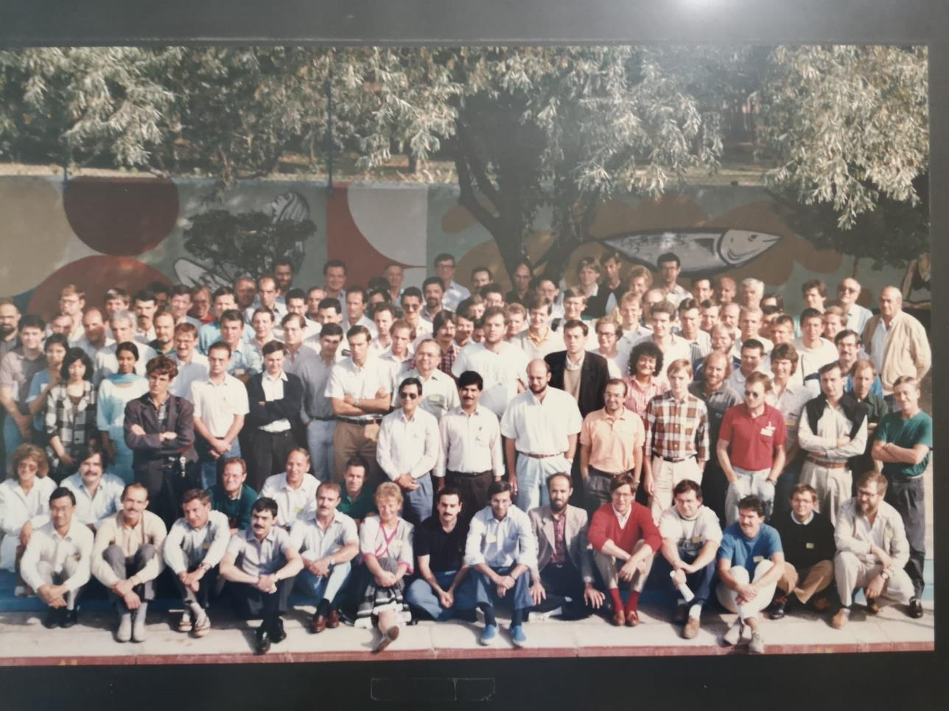
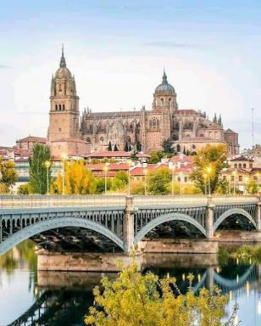
My first CAS: Salamanca, 1988
Organised in a resort close to Salamanca, Spain (in the monastic style of education coming from the British roots of the first two heads of school)
107 participants
2 important side effects:
Networking (students and lecturers)
Engaging new EU countries without accelerator traditions
The first group photos!

Slide 5
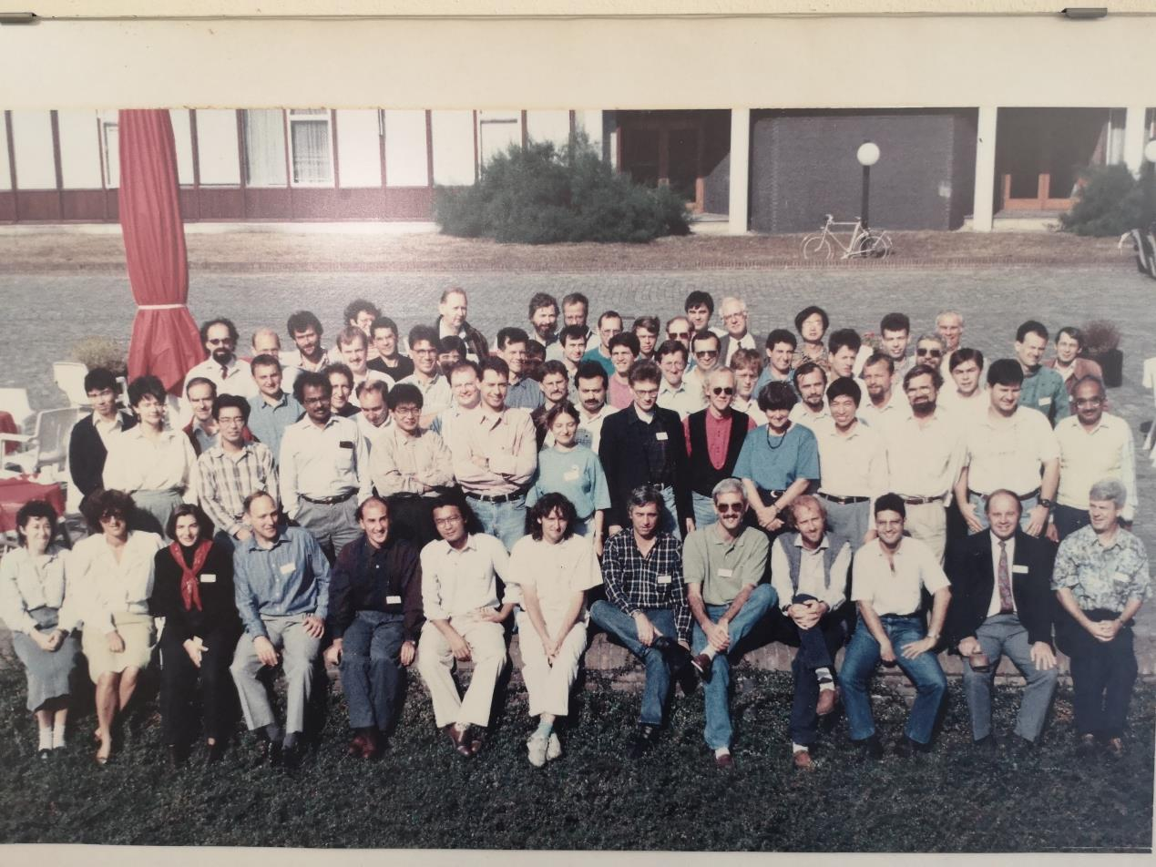
My second CAS: Advanced CAS School, Nordwijkerhout, 1990
More effective seclusion (a religious training centre in the Dutch countryside…).
Same networking results & training of the future European leadership in particle accelerators.

Slide 6
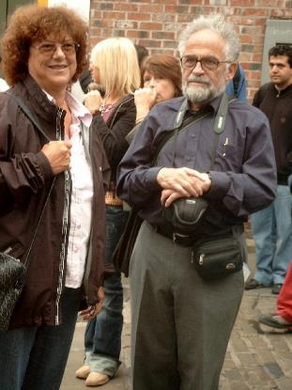
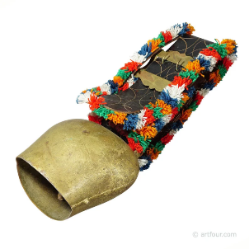
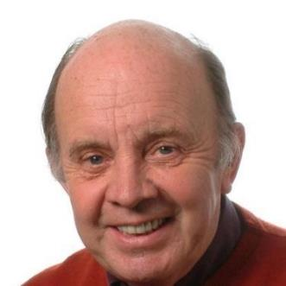
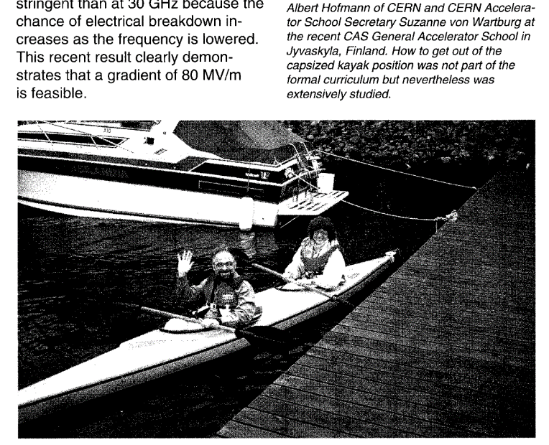
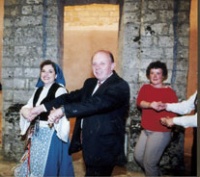
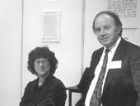
Some memories from CAS golden years
Ted Wilson becomes Head of CAS in 1992. He will remain in charge for 10 years, marking the school with his characteristic Oxford style, supported by the omnipresent Suzanne Von Wartburg.
Swiss cowbell, used to call students after coffee breaks and to mark transformations of coordinates during lectures!
(from CERN Courier)
Dancing at Loutraki, 2000

Slide 7
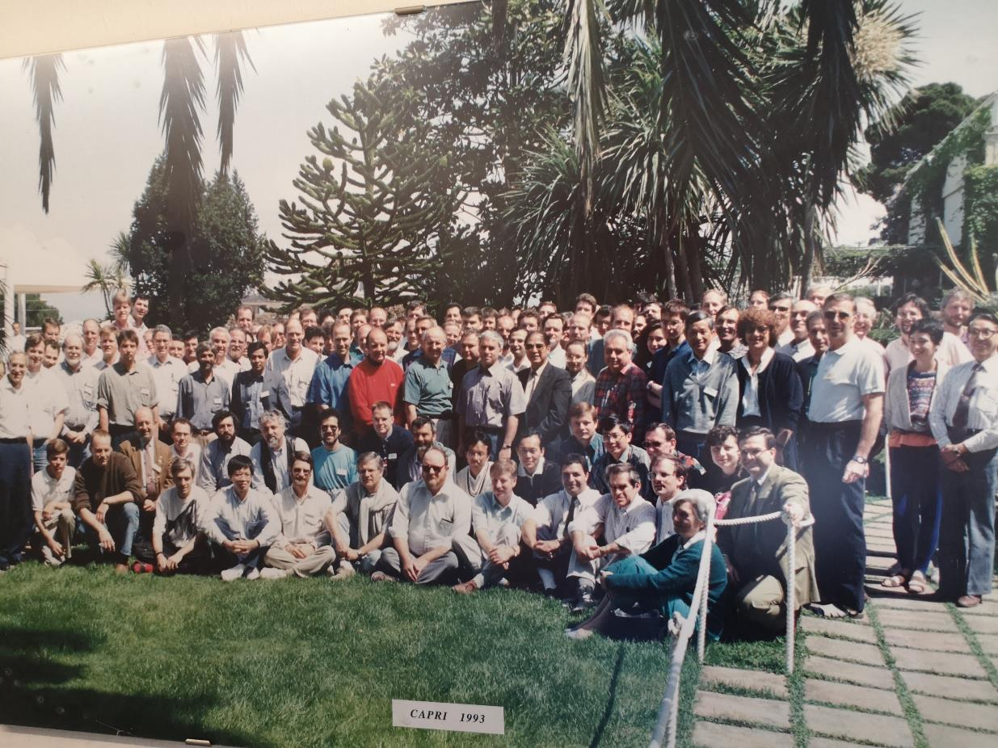
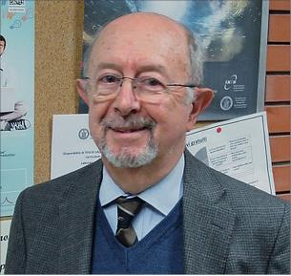
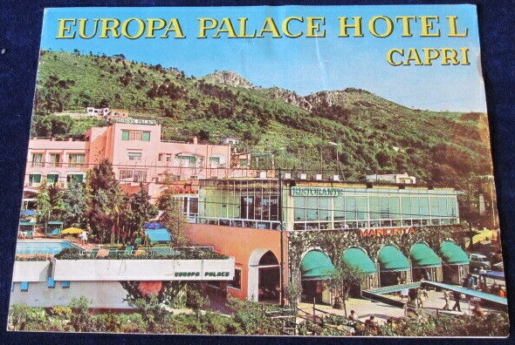
Superior locations: Capri (1993 and 1997)
Vittorio Giorgio Vaccaro
Radio-Frequency school, Capri 1993

Slide 8
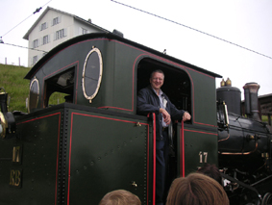
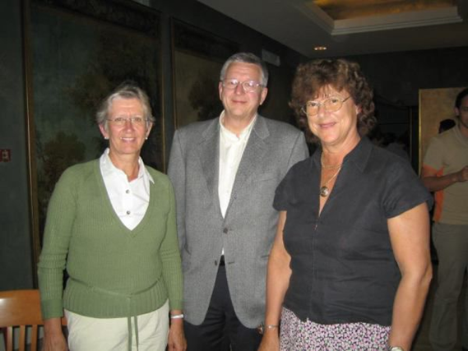
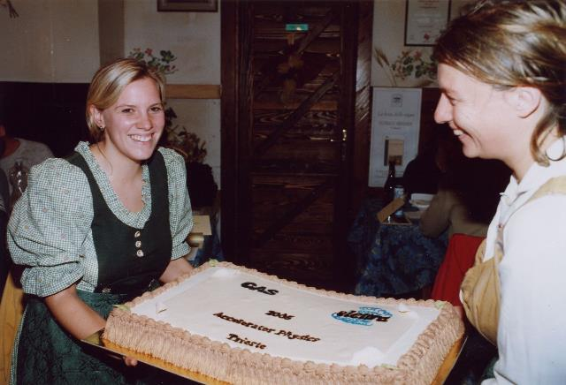
CAS going global and progressing full steam!
Daniel Brandt inherits in 2002 the CAS School under the severe constraints of the LHC financial crisis (less lecturers, less schools,…). He brings it out of the troubles, in the open spirit of the past and opening to new countries:
Czech Rep., Portugal, Poland, Bulgaria, Slovakia. Following demand, specialised courses go up to 2/year.
2003 synchrotron radiation school, Brunnen
Celebrating the CAS in Trieste, 2005

Slide 9
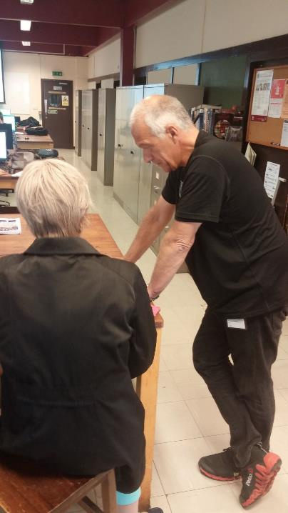
The CAS roll of honour
CAS going into the modern age
Head of CAS
Kjell Johnsen | 1983 | 1985
Philip Bryant | 1985 | 1991
Edmund Wilson | 1992 | 2002
Daniel Brandt | 2003 | 2010
Roger Bailey | 2011 | 2017
Hermann Schmickler | 2018 | 2021
Frank Tecker | 2022
In 2018 Hermann Schmickler takes over the school and launches an ambitious programme to revitalize the school addressing the request for more courses and more accelerator training in Europe (within the limits of available budgets):
- more schools, with introductory every year, advanced less frequent (and with less theory).
- more topical courses.
- new curriculum with hands-on learning and practical applications.
- more lecturers and students not from CERN, more focus on industry.
CAS Secretary
Suzanne Von Wartburg | 1985 | 2005
Barbara Strasser | 2005 | 2017
Delphine Rivoiron | 2017

Slide 10
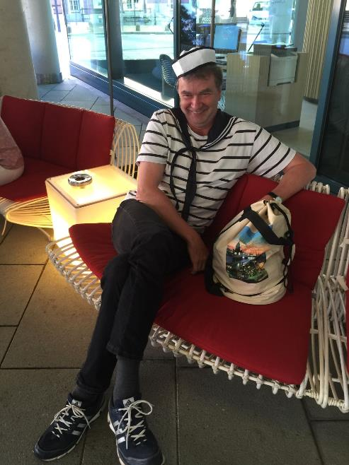
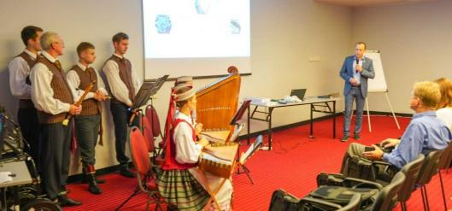
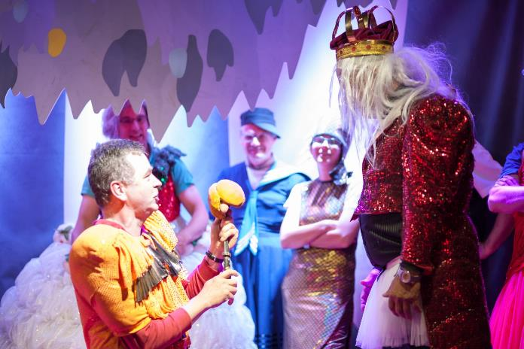
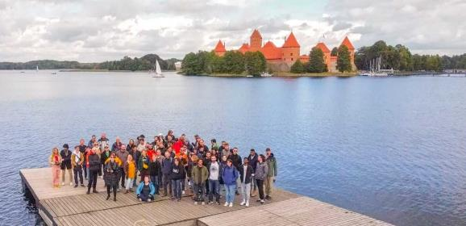
Some nice moments from recent schools
Kaunas 2022
Helsinki 2018
Disclaimers and acknowledgement:
- (most of) photos shown were taken before the European Data Protection regulation of 2018
- I warmly thank Kai Wittenburg who provided some of the photos of social events, and Noemi Caraban who has taken many photographs of recent schools

Slide 11
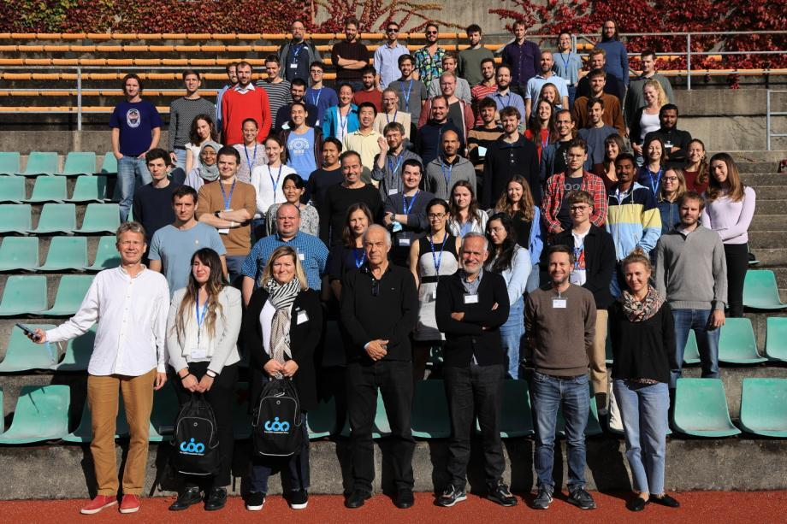
And the rest is the present!
https://cds.cern.ch/record/2886692
Thanks to Frank and his team for organising this event, to Noemi for collecting all old CAS group photos on CDS, and…
long life the CAS!

