Slide 1
Status of the Magnet Station Simulation
Cesar da Silva: Los Alamos National Lab. Reporting the work from :
Michal Kazanecki : IFJ (Krakow)
Jakub Malczewski : IFJ (Krakow).

Slide 2
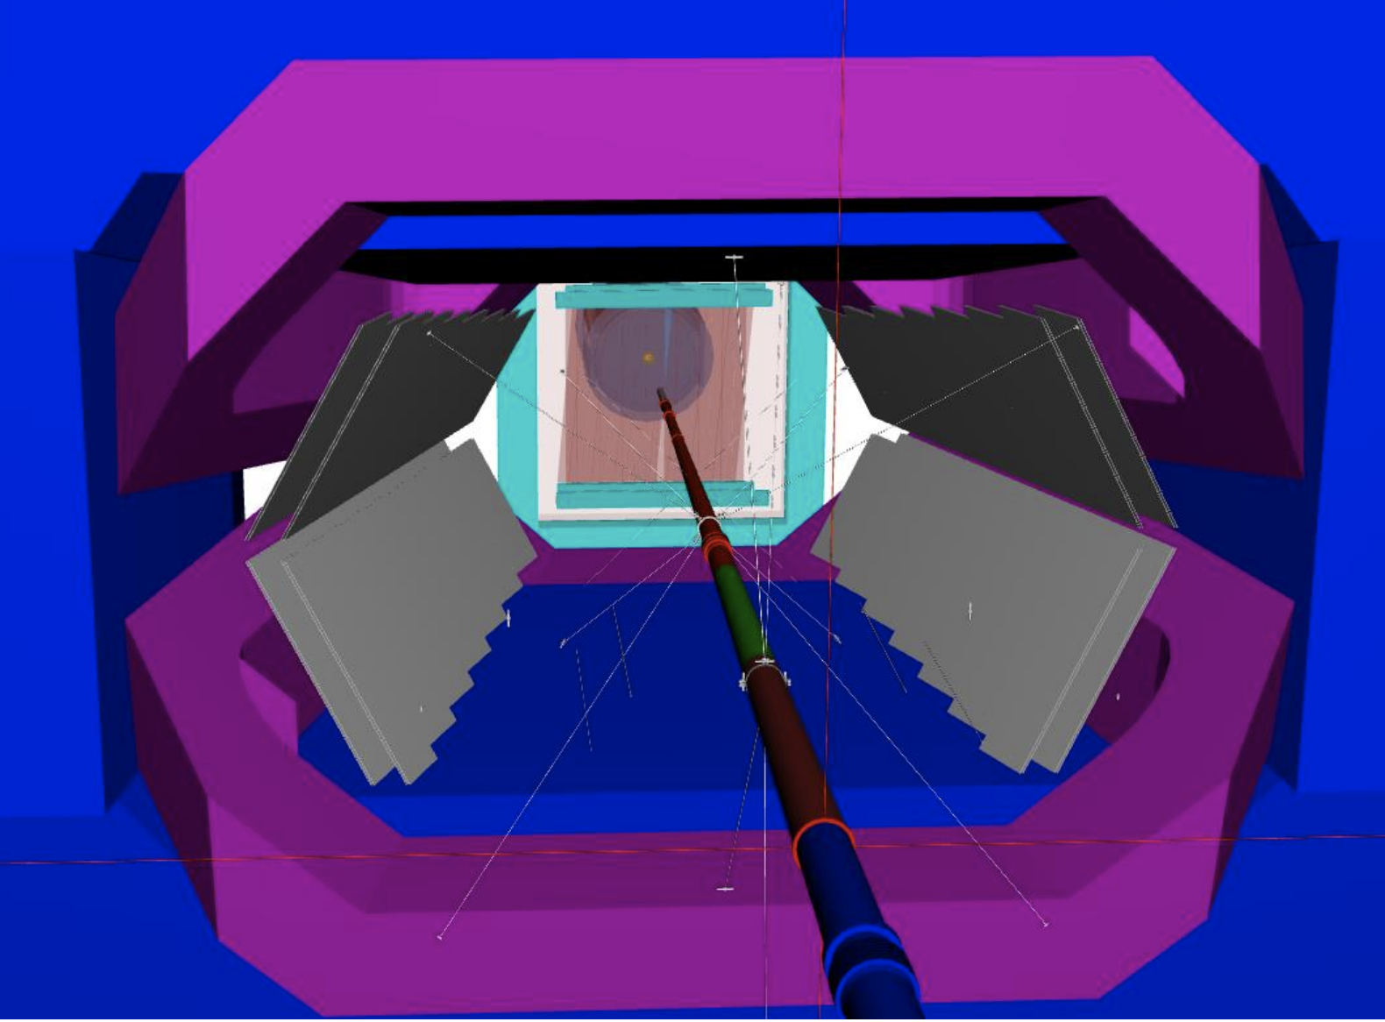
Magnet Station in DD4EP

Slide 3
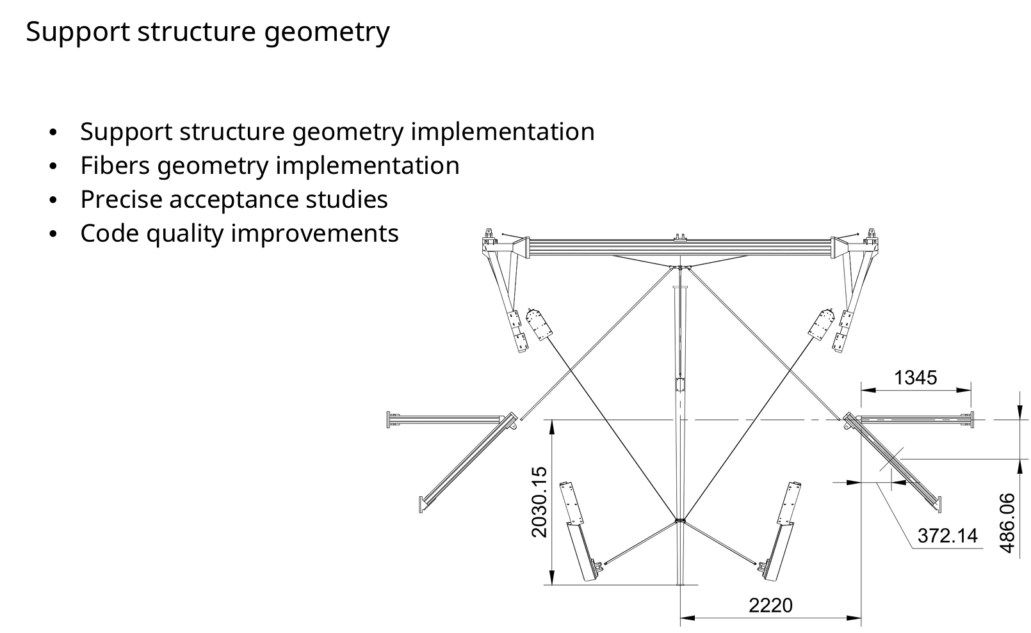

Slide 4
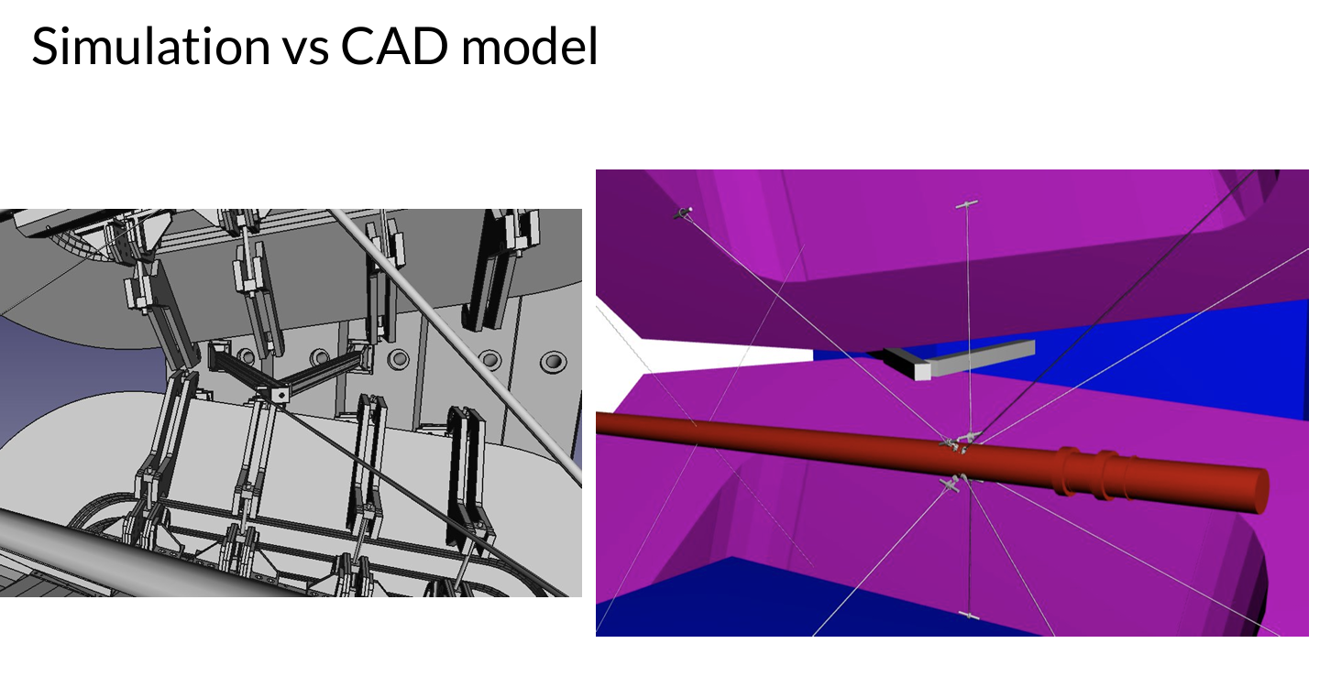

Slide 5
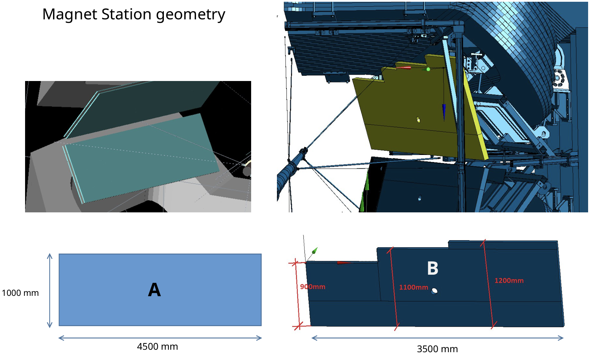

Slide 6
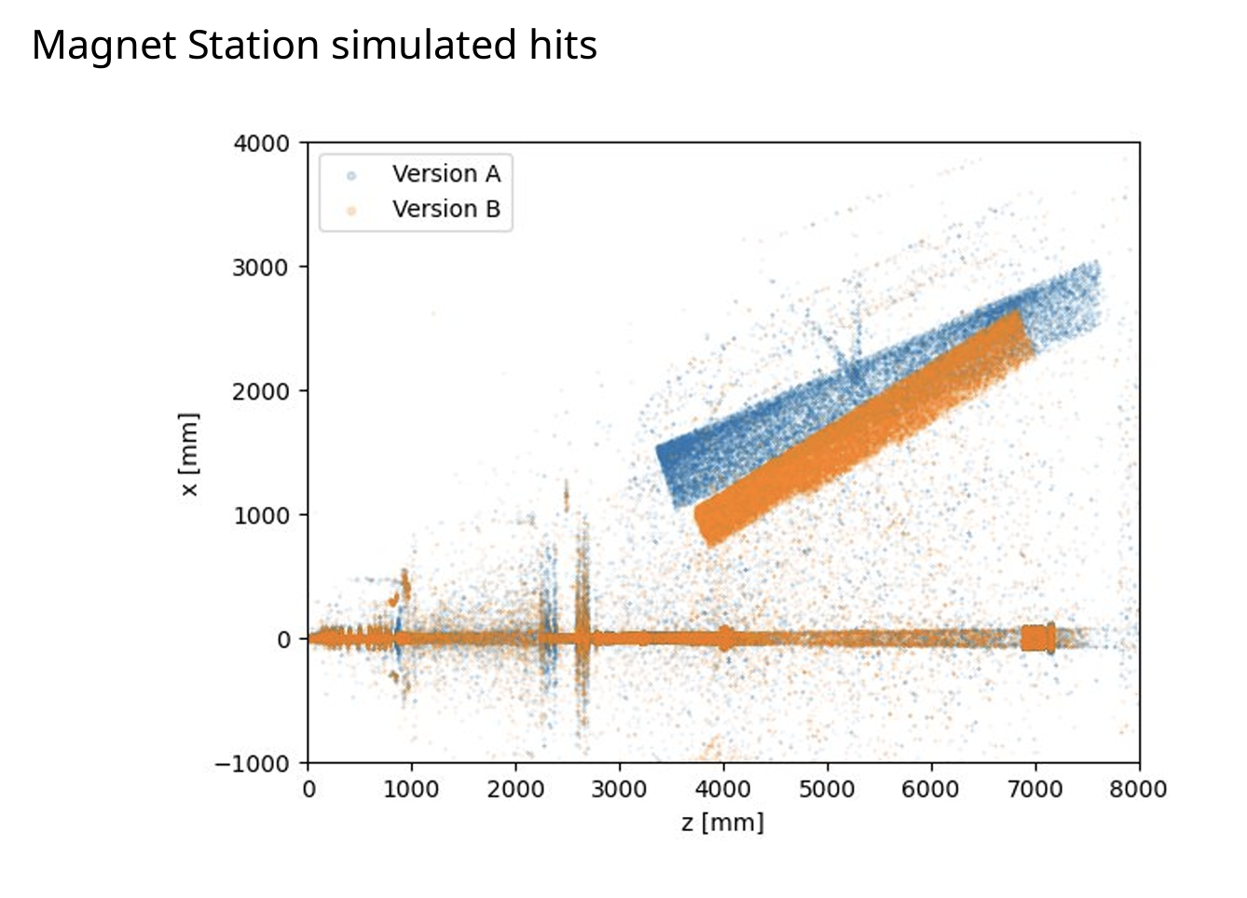
Most recent changes on the angle of the panels in order to avoid any mechanical conflict with the spider web or internal magnet structure
Every change in CAD has been monitored by simulation to study tracking and physics impact of the CAD model changes

Slide 7
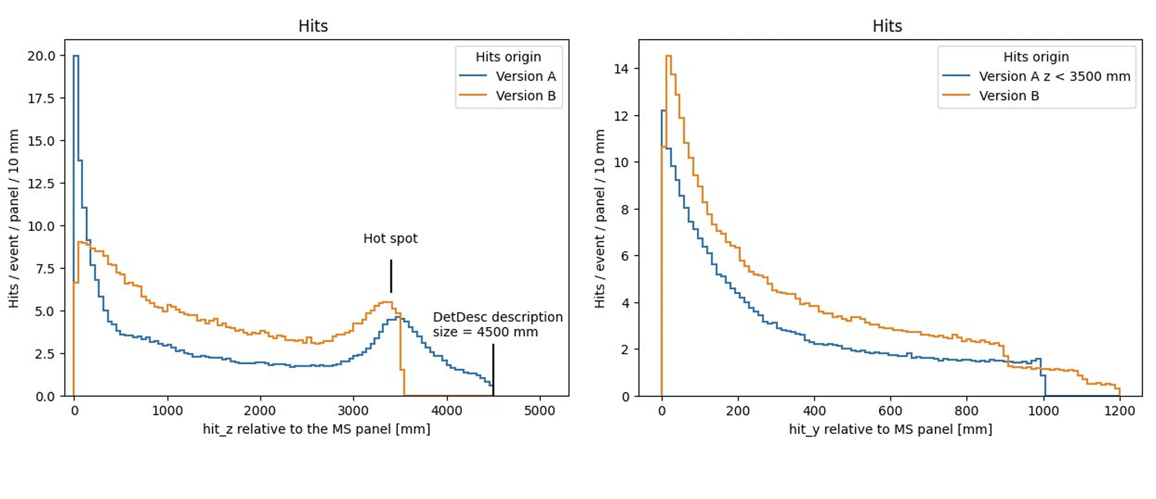

Slide 8
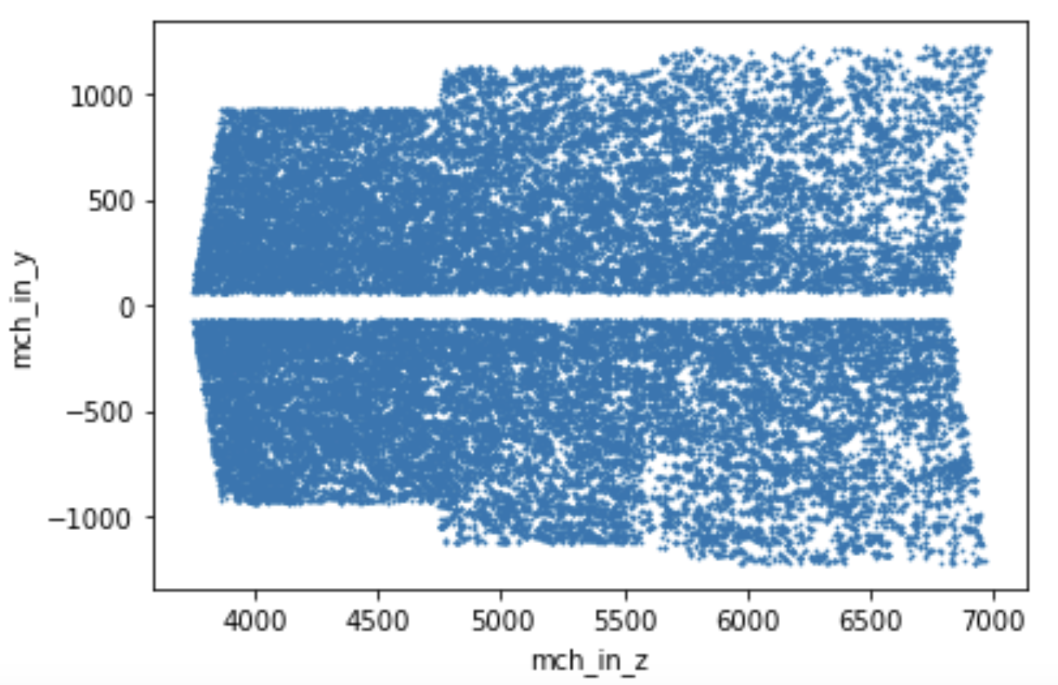

Slide 9
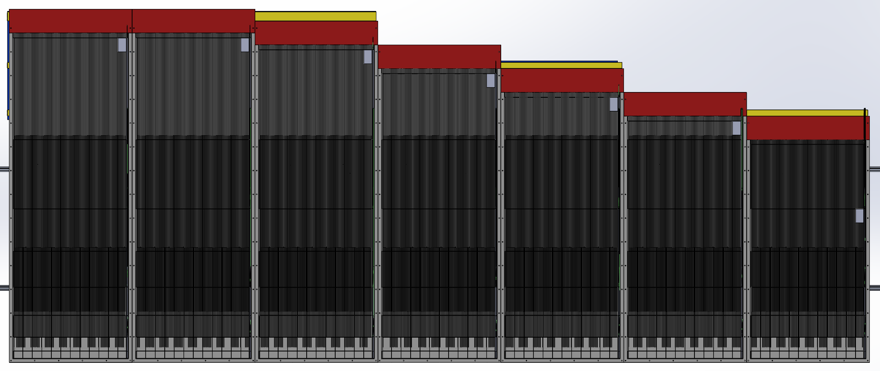
Segmentation in the CAD model
Ongoing work to implement bar segments in DD4HEP

Slide 10
Next Steps
Fully functioning MS simulation in current LHCb framework
  Detector in dd4hep : xml description and C++ builder
  Gauss-on-Gaussino
code is still maintained in a separate repository, but regularly checked against recent modifications in the core LHCb simulation
Needs to decide if we want to keep the MS simulation this way or integrate with the general LHCb packaged. Important for UT studies
MCHit packer requires a new class
Digitalization : using private classes which convert hit information to bar index
UT+VELO stepwise track projection to MS already coded as a private library

