Slide 1
CERN Consolidation program
CERN SCE / EPFL
Alejandro Martínez Sellés
10/11/2021

Slide 2
Outline
Budget profile
CONSOLIDATION programme organization
Technical assessment – STRATUS tool
Exemple B36 renovation
Full CONSOLIDATION programme
Questions

Slide 3
Budget Profile (confirmed projects)
Funding sources:
Site consolidation programme: building renovations and site improvements
MTP allocations to large construction projects as per Masterplan 2040
Project-driven transformations and new constructions

Slide 4
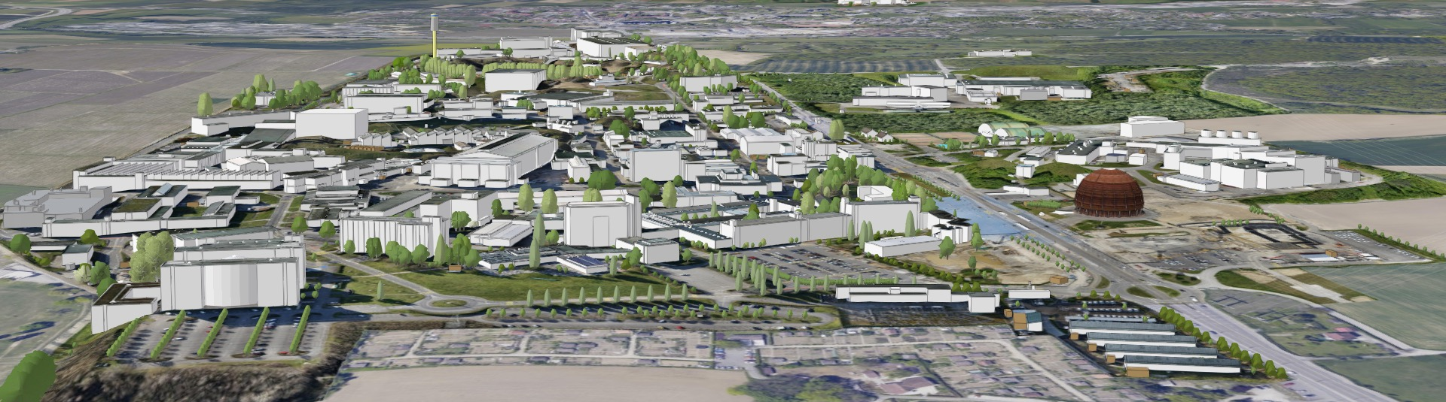
CERN site key figures
590 ha (220 fenced)
2 main sites and 15 satellite sites
670 building from 10 m² to 20.000 m²
65% built before the 70s
70 km tunnels and 80 caverns
30 km roads
1000 km technical galleries and trenches
9000 persons/daily
490 hostel rooms
8500 working places
>5000 parking places
25000 daily movements to- and inter-sites
Public transport links in CH, not in FR

Slide 5
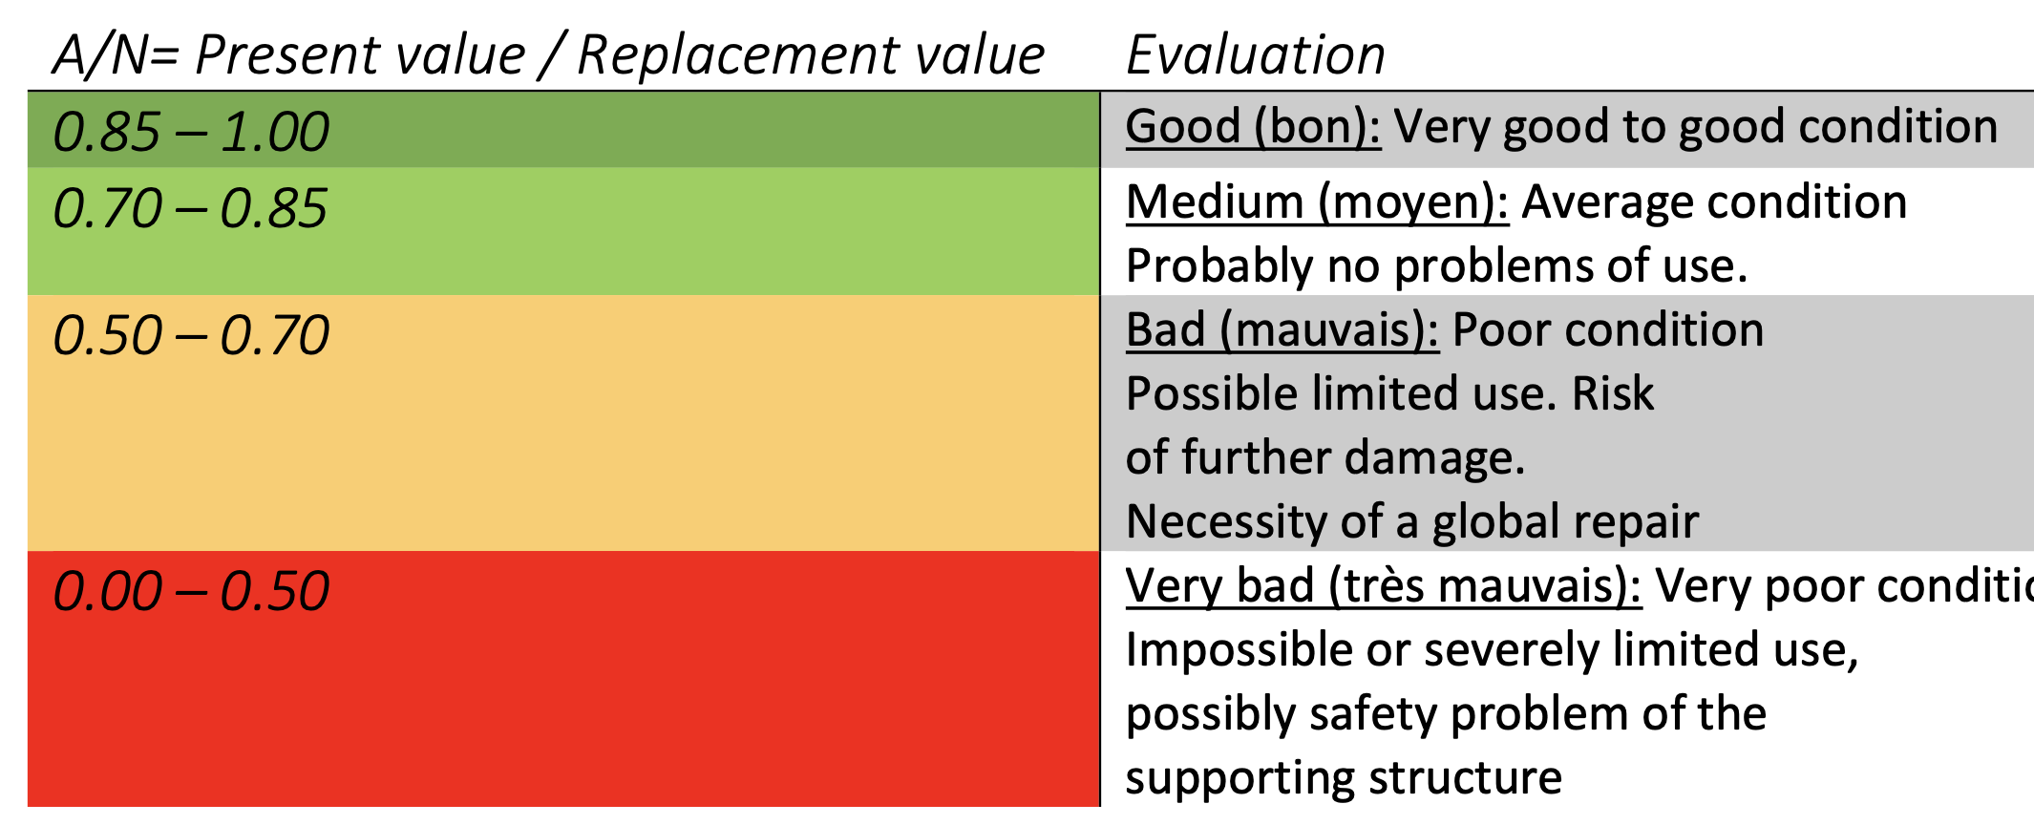
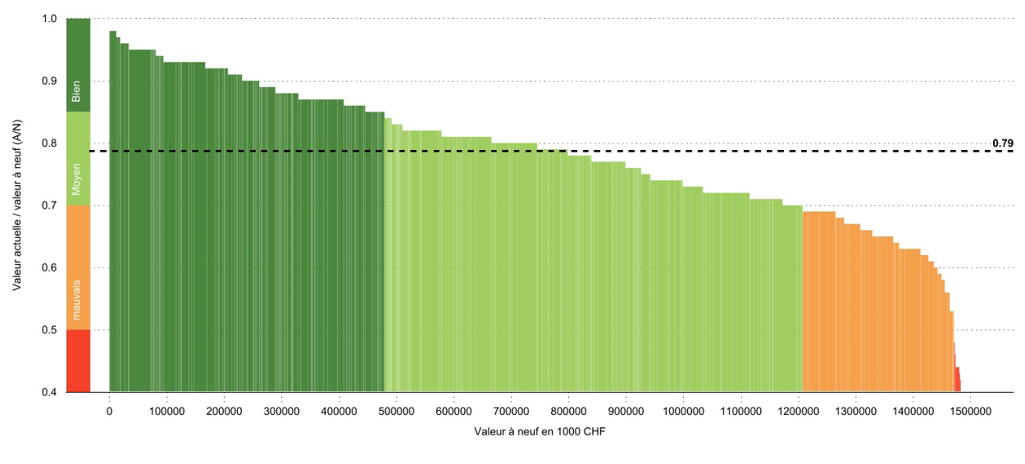
Site consolidation
Mission & Priorities
Specifications
Process
Plan capital investments and carry out, in a rolling time window of 10 years, the corrective and pre-emptive repairs and improvement of infrastructure assets that are essential for CERN’s scientific programme.
Data-driven decisions
Standardization of requirements definition according to Masterplan, IRP approval process for execution
5 and 10 year views
Global renovations
Regulations compliance
Energy efficiency improvement: > 60%
Monitoring heating, electrical and lighting consumption
Operation of HVAC, Heating and lighting consumption according to the outdoor temperature, occupation of the premises, eco-mode
Favor centralized networks
PRIORITIES
Safety
Strategic value with respect to scientific goals
Sustainability: durability, environmental impact, energy performance

Slide 6
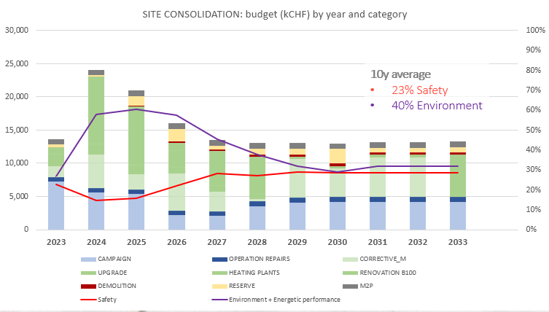
Site consolidation
Strategy
Capital investment plan
Entry into the SITE CONS programme
Stratus outcome (<0.8) x 3S Factorization:
Strategy
Safety
Sustainability
Quarterly Steering committee – Decision gate
Plan proposal
Steering committee
Plan update
Production follow-up
Prioritization
(Workshops)
Nb of buildings renovated: 2/year
Nb of fluo-tubes changed: 2000 u/year
Nb of lights changed: 2500 m2/year
Nb of WC changed: 20 u/year
Nb of sink changed: 20 u/year
Nb of urinals changed: 10 u/year
Nb of WMC changed: 5 u/year
Nb of heating sub-station: 2/year
Nb of compressed air stations : 2/year
Roof insulation: 3000 m2 /year

Slide 7
Technical assessment – STRATUS tool
STRATUS tool - input for each building
Base data
Quantities and cost-per-element evaluation sheet
GIS-STRATUS data comparison (SCRIPT)
STRATUS renovation costs compared to CERN past renovation costs - adjustment coefficient

Slide 8
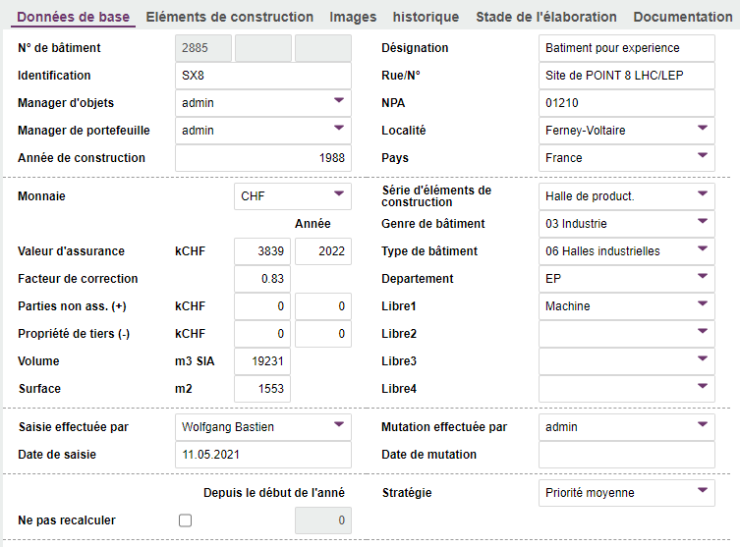
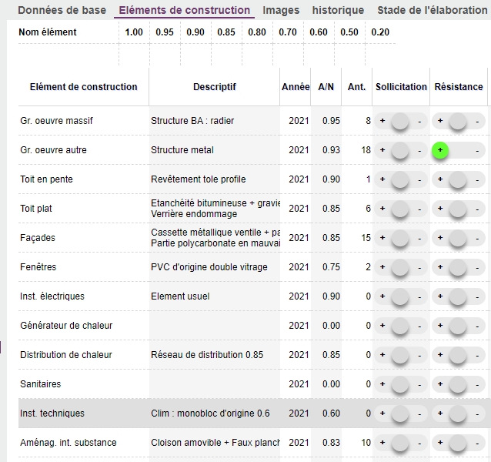
Technical assessment – STRATUS tool
STRATUS tool - input for each building

Slide 9
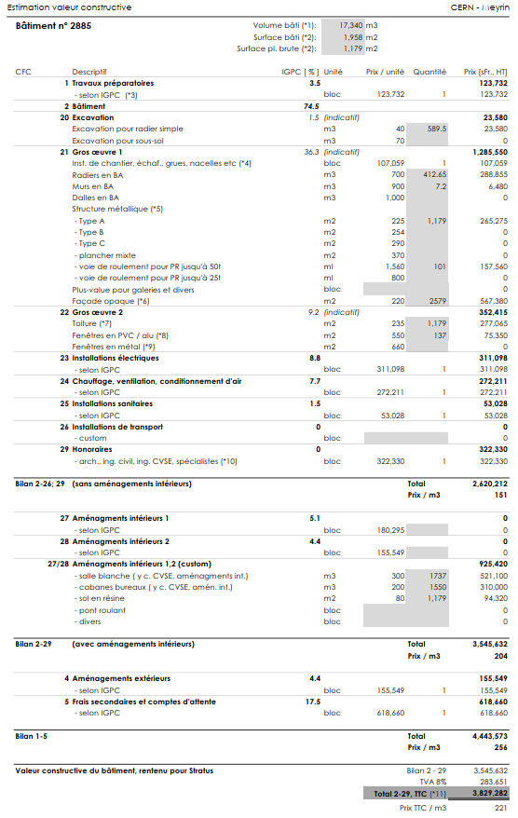
Technical assessment – STRATUS tool
STRATUS tool - input for each building

Slide 10
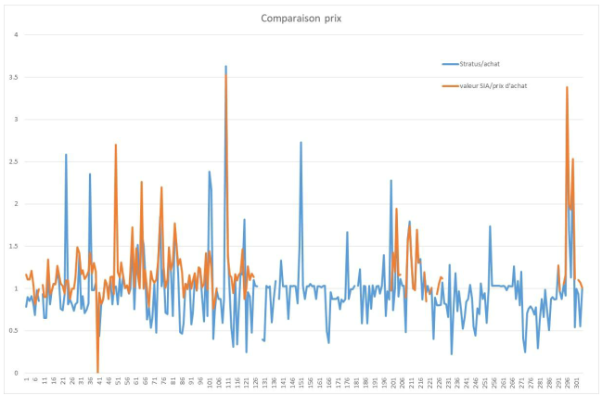
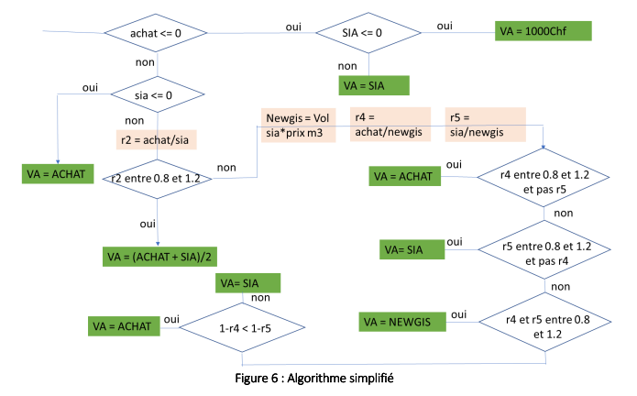
Technical assessment – STRATUS tool
STRATUS tool - input for each building

Slide 11
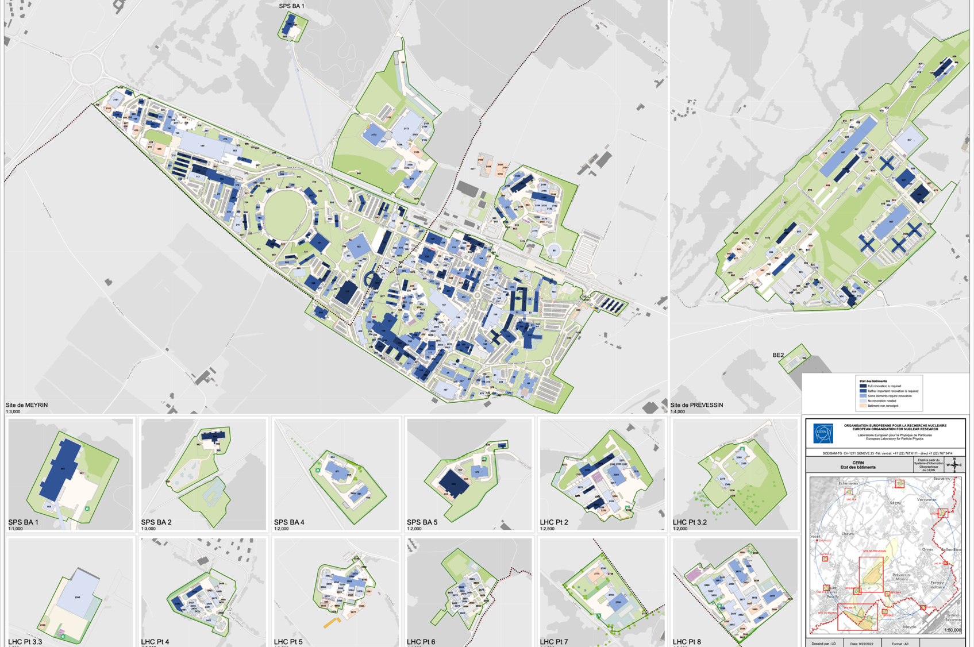
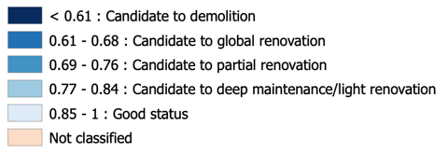
Site Consolidation
Condition of Assets
Stratus Update 2023
451 buildings

Slide 12
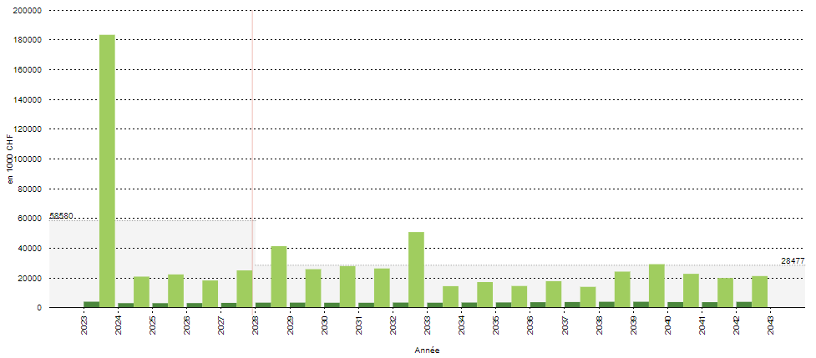
Technical assessment – STRATUS tool
STRATUS tool – outcome – investment needs

Slide 13
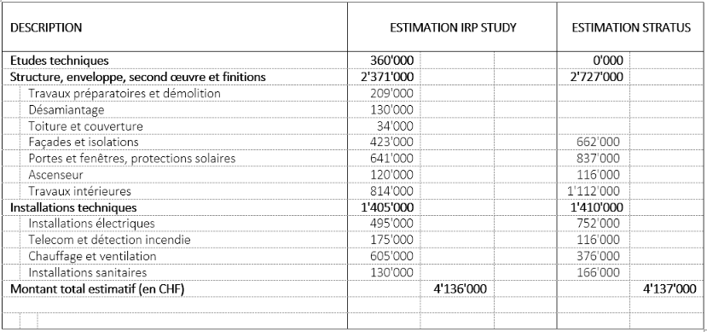
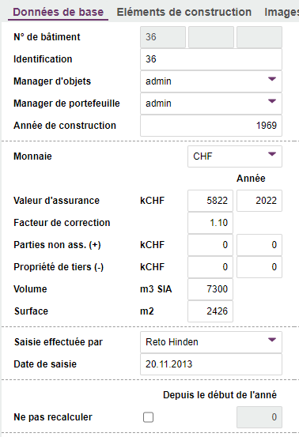
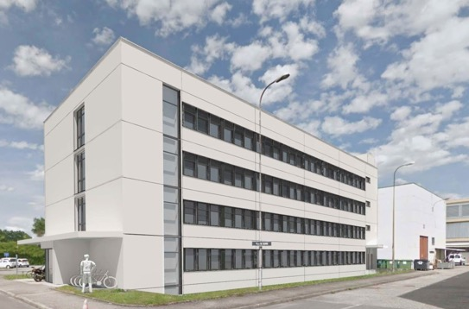
Example B36 full renovation

Slide 14
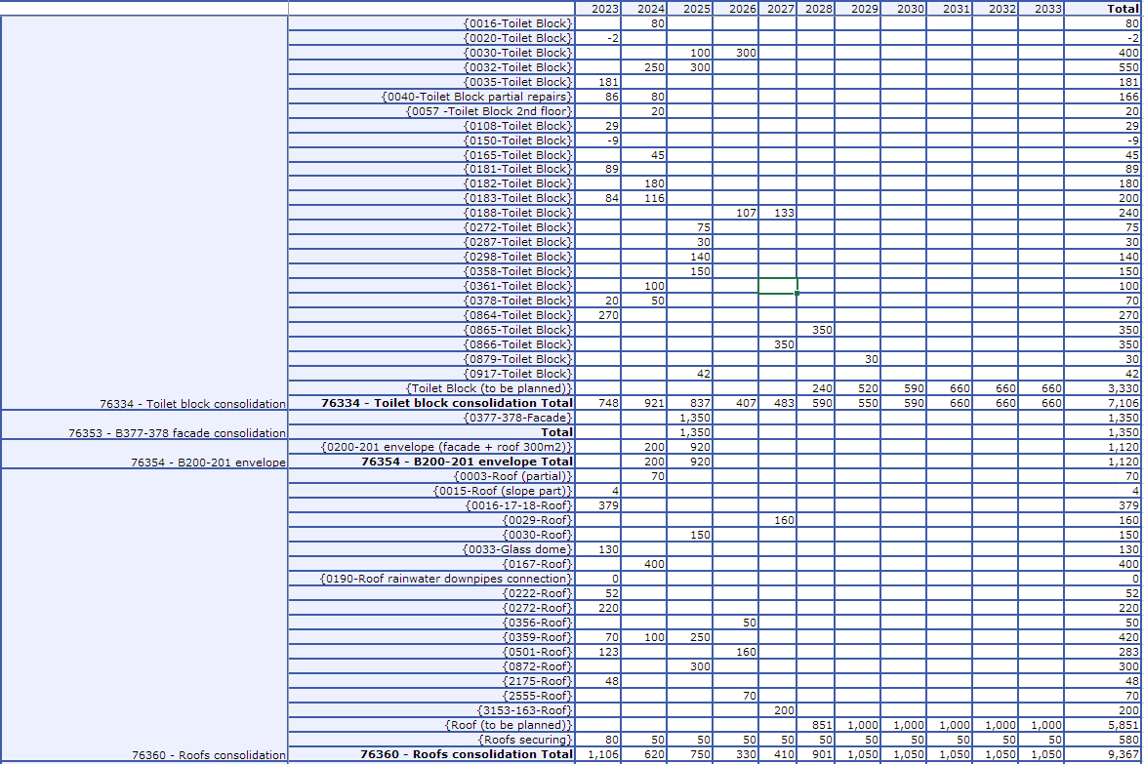
Full consolidation plan

Slide 15
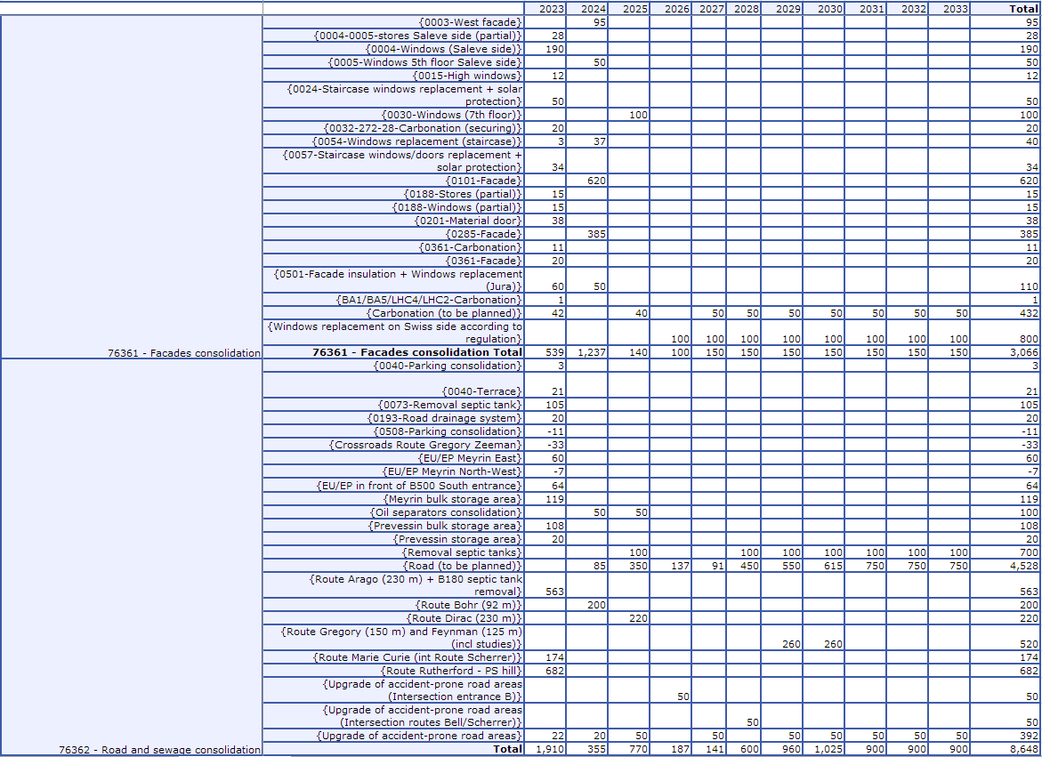
Full consolidation plan

Slide 16
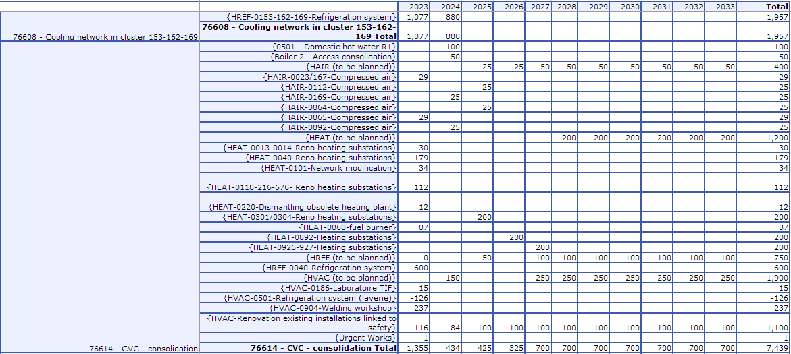
Full consolidation plan

Slide 17
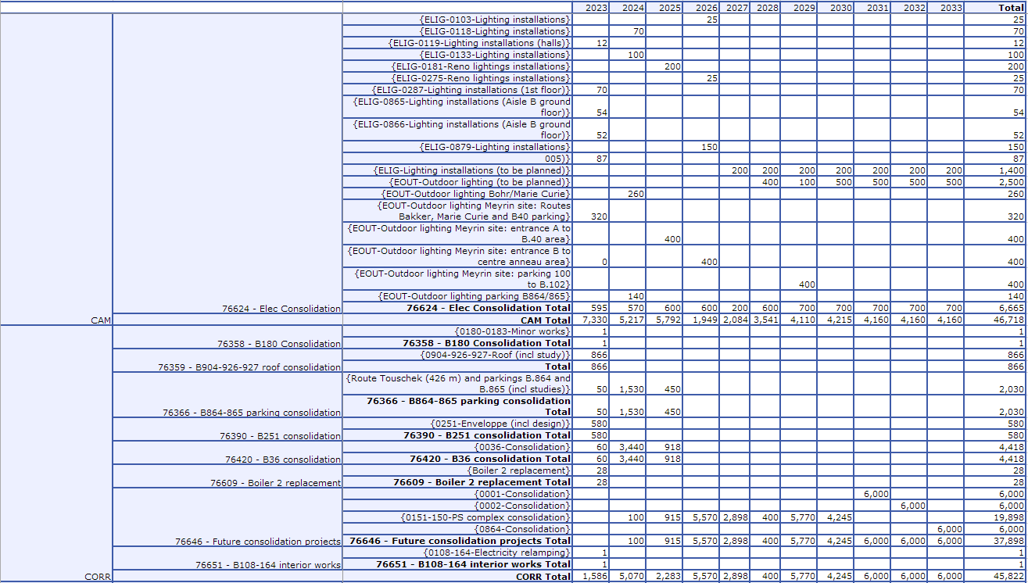
Full consolidation plan

Slide 18
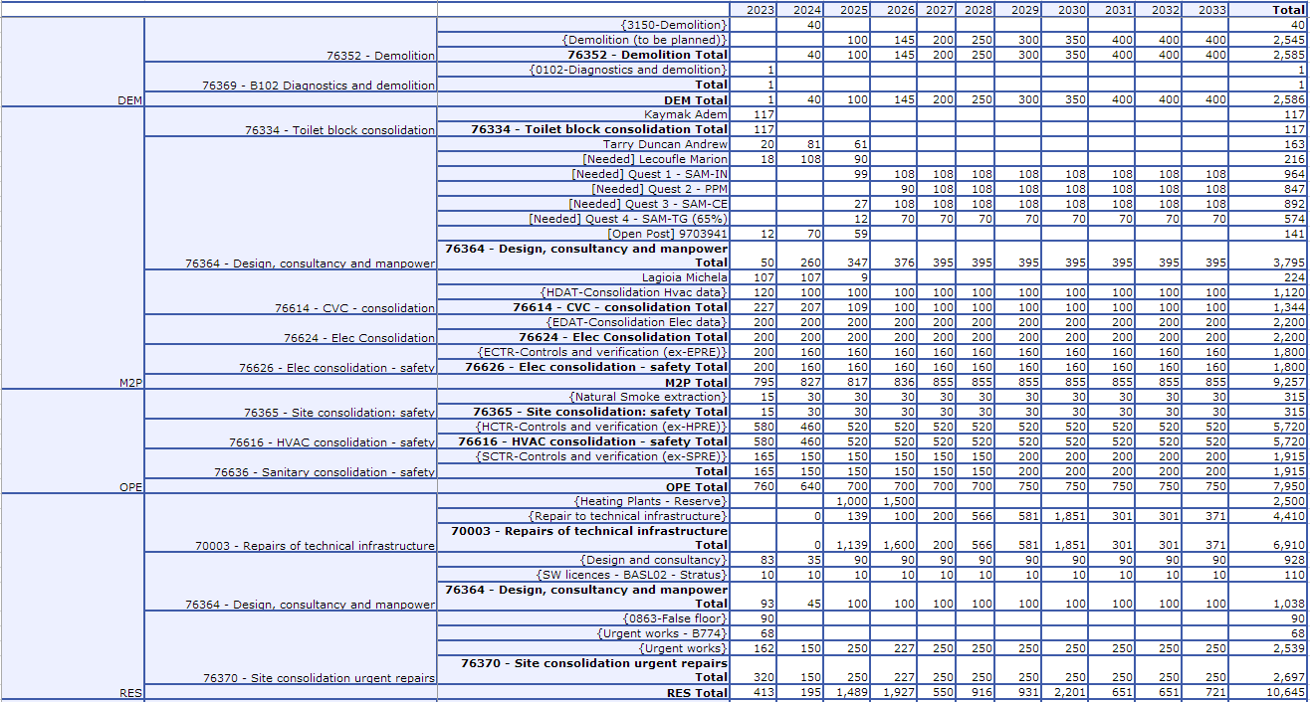
Full consolidation plan

Slide 19
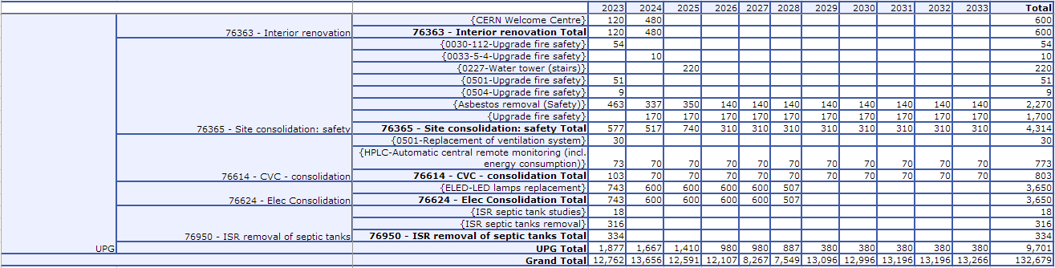
Full consolidation plan

Slide 20
Questions?
When you were about to start a renovation project, what was the cost estimate given by STRATUS, for the elements you decided to renovate, and what was the actual renovation cost?
Are there elements in STRATUS that were really off when you actually made the renovations, which ones, and could you see why ?
How did you set the renovation cut-off years in order to make your financial plans? For example did you change all the windows when the STRATUS value was still 0.6 and budgeted based on a total change (STRATUS grade=0)?
Did you add any margin for additional transformation (and not just renovation 1:1)? And if so, was that for a change in planned use, or for other upgrades?
In your experience, does STRATUS also cover the cost of the studies that preceded your renovations?

Slide 21


