Slide 1
Tape and Disk evolution for the exabyte era
Hugo Gonzalez Labrador
Storage Engineer
CERN IT
7th Rucio Workshop, SDSC, 30/09/2024

Slide 2
Outline
Storage media
  HDD (Hard Disk Drives)
  SSD (Solid State Drives)
  Magnetic Tapes
Storage at CERN
Market evolution and forecast
Challenges for CERN

Slide 3
HDDs

Slide 4
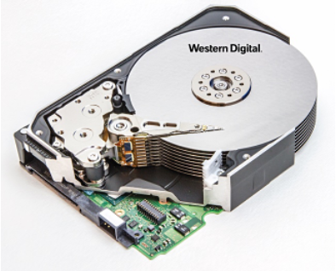
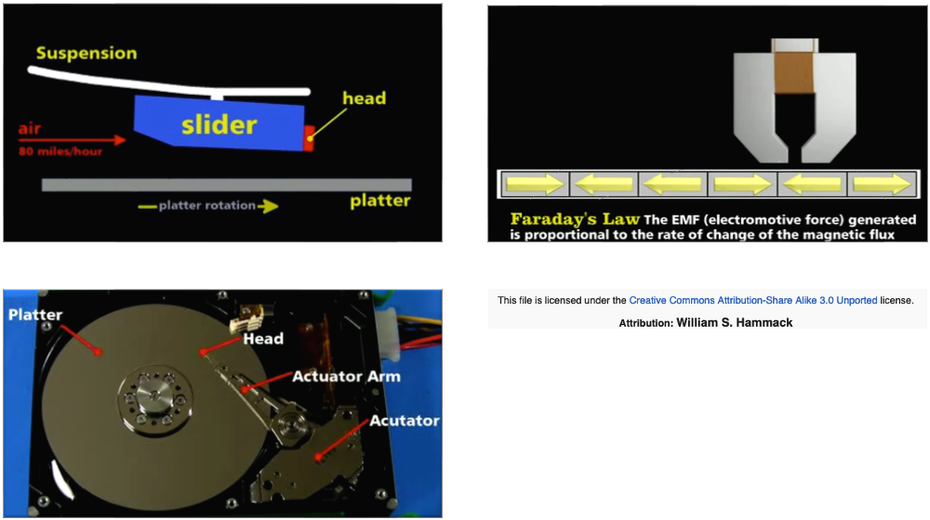
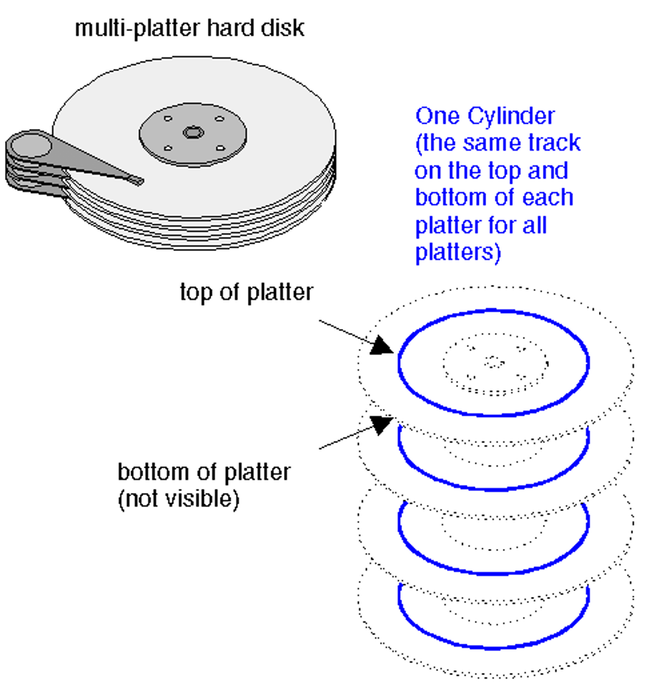
Hard Disk Drives
Basics
Changes in the polarization of the disk platter sections will create voltage spikes, which gets encoded to sequences of 0s and 1s: 01000111...

Slide 5
Hard Disk Drives
Driving factors
Market vendors optimize on two aspects with different efforts
Increase performance (throughput, GB/s) -> little effort put
Increase capacity -> most effort put

Slide 6
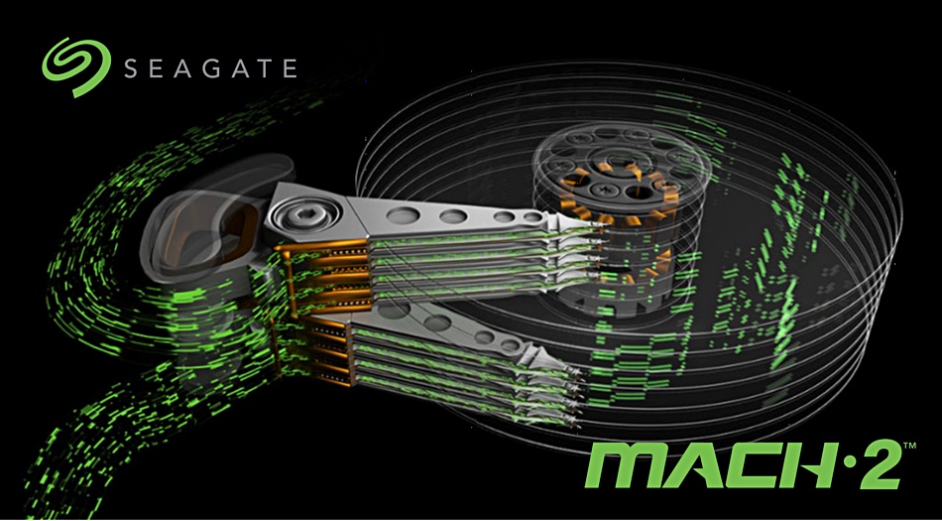
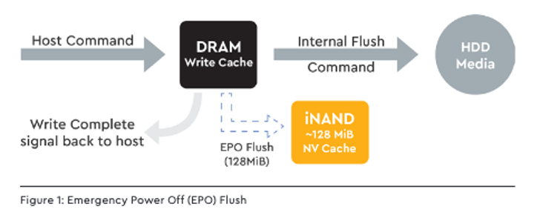
Hard Disk Drives
Driving factors: Performance
Doble actuators
1 actuator -> ~250 MB/s
2 actuators -> 500 MB/s
Niche market
Source: Seagate
Write cache enabled
Allows to cache writes to the media and transfer them in bulk to optimize performance
Data loss on power outages
Alternatives: Emergy Power Off Flush
Flash memory is used to write to the media
TODO
Source: WD

Slide 7
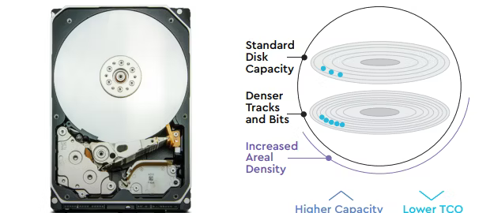
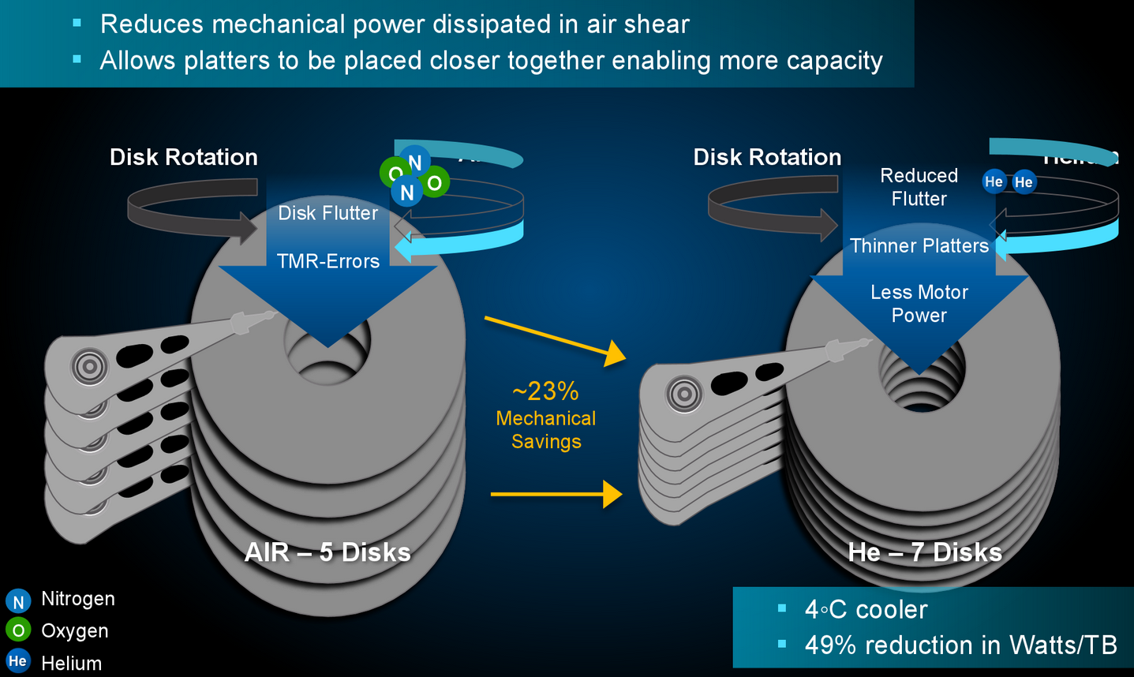
Hard Disk Drives
Driving factors: Capacity
Helium drives
Replacing air with Helium
Reduces friction between platters
Cooler temperatures
Less power consumption
Thinner platters -> More platters
Today: 10 platters
Areal density
Number of bits you can store per square inch, usually measured in Tb/inch2
Source: WD
Source: Annandtech

Slide 8
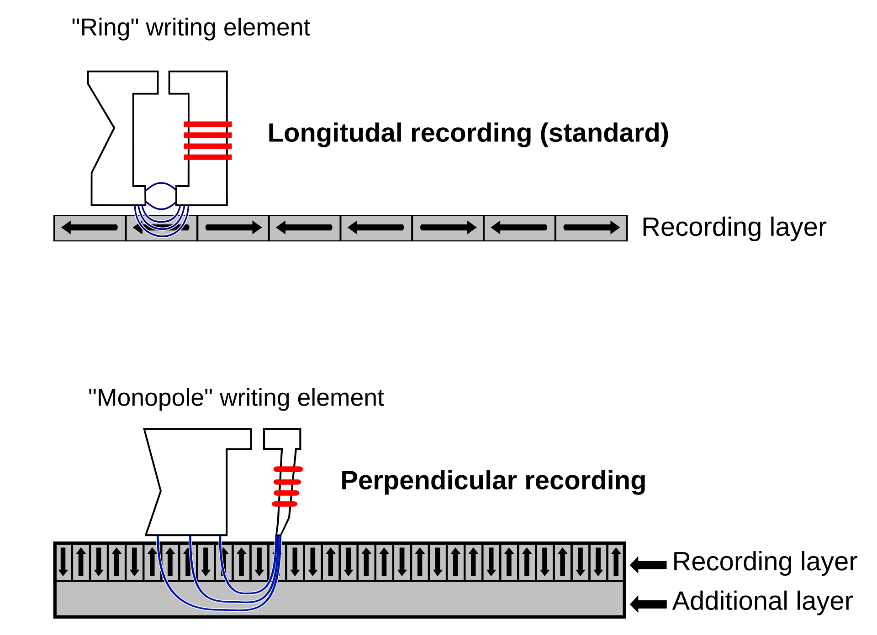
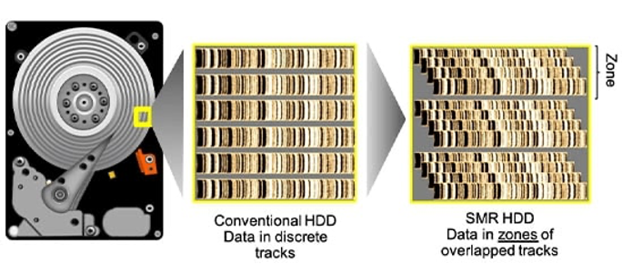
Hard Disk Drives
Driving factors: Capacity: Areal Density: PMR and SMR
PMR (Perpendicular Magnetic Recording)
SMR (Shingled Magnetic Recording)
Tracks overlap like tiles in a roof
Increases density but reduces performance for random writes (zone overwrite)
By TyIzaeL - http://commons.wikimedia.org/w/index.php?title=File:Perpendicular-eng.jpg, Public Domain, https://commons.wikimedia.org/w/index.php?curid=5734076

Slide 9
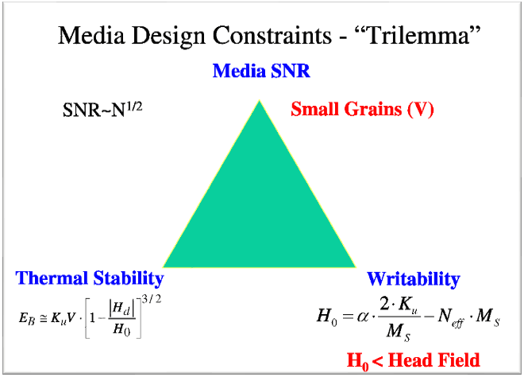
Hard Disk Drives
Driving factors: Capacity: Areal Density: Paramagnetic trilemma
To increase density we need smaller grains (less ferromagnetic molecules)
The head becomes smaller to be more precise, means head generates weaker magnetic field
As grains become smaller, they are susceptible to thermal agitation (bitflip)
To increase immunity to thermal agitation, the grains need to “hold” to each other stronger, requiring a stronger magnetic field, requiring a bigger head
What tricks do vendors use to avoid these constraints?
Use another source of energy to “ease” writing in the media grain so the electromagnetic field can be weaker
These techniques are called Energy Assisted Magnetic Recording (EAMR or ePMR)

Slide 10
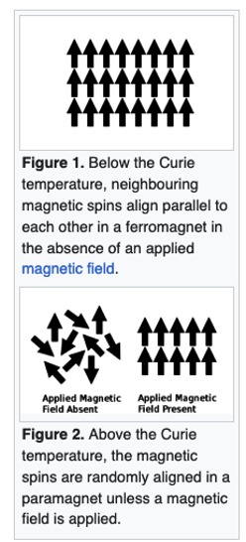
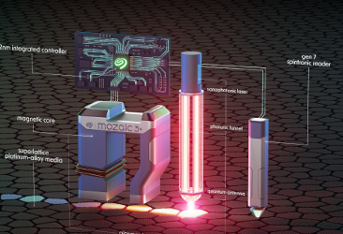
Hard Disk Drives
Driving factors: Capacity: Areal Density: HAMR
HAMR (Heat Assisted Magnetic Recording)
Uses a laser to heat media grains to Curie Point to the ferromagnetic grain loses magnetic polarisation
When reaching Curie point, a small electromagnetic field is induced to change polarisation
Heat/Write/Cool cycle is less than 1 ns
Reduces energy of required electromagnetic field to almost zero
Source: Wikipedia
Source: Seagate

Slide 11
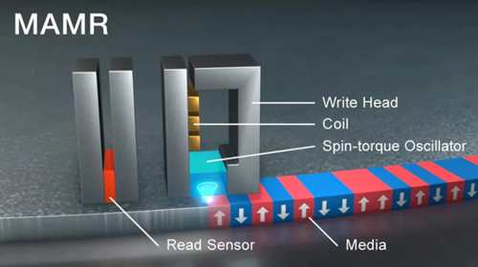
Hard Disk Drives
Driving factors: Capacity: Areal Density: MAMR
MAMR (Microwave Assisted Magnetic Recording)
Uses a microwave to “ease” the polarization of the media grains
Potentially reducing required magnetic field to ⅓
Source: storagenewsletter.com

Slide 12
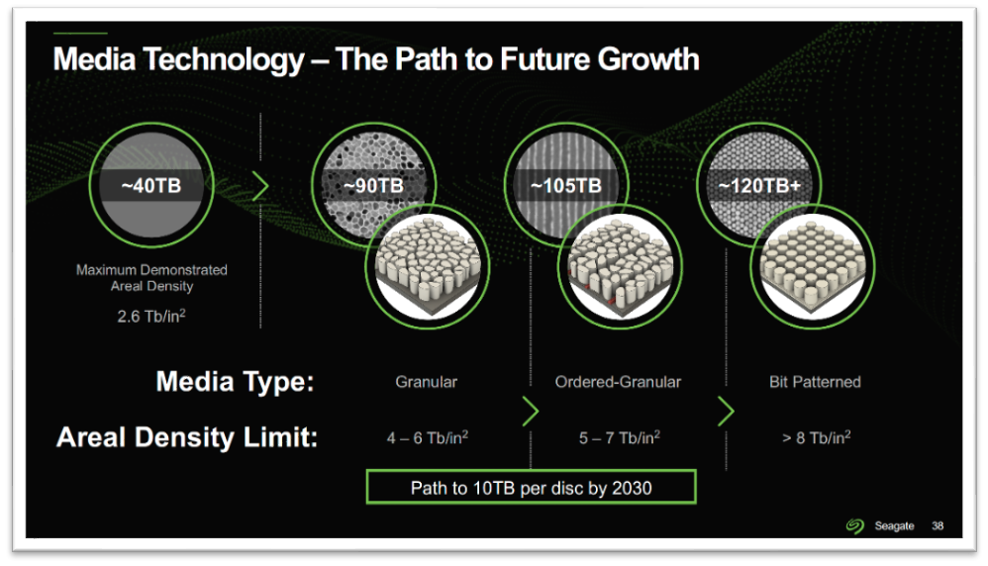
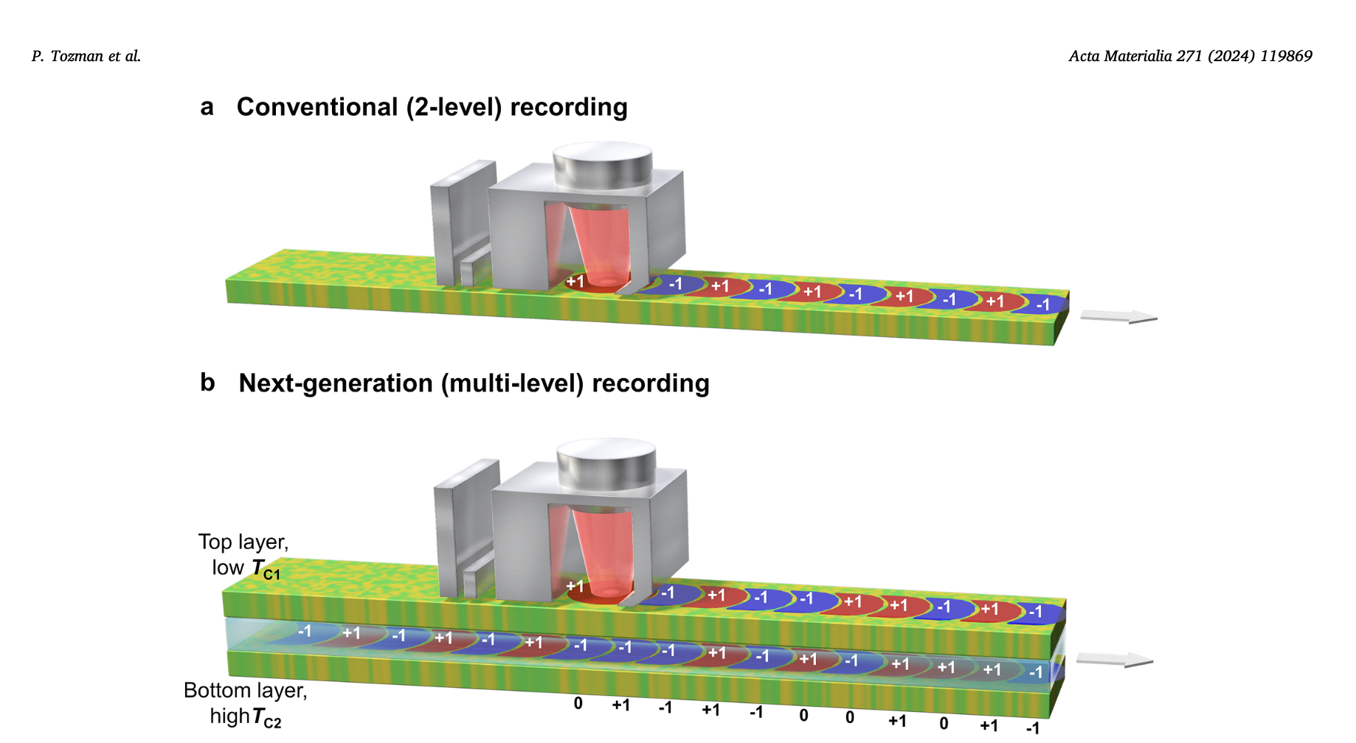
Hard Disk Drives
Driving factors: Capacity: Areal Density:
Future: BPM and ML-HAMR
BPM (Bit Patterned Media)
Multi-Layer HAMR
Source: Seagate
Source: Paper, Acta Materialia 271 (2024) 119869

Slide 13
Magnetic tapes

Slide 14
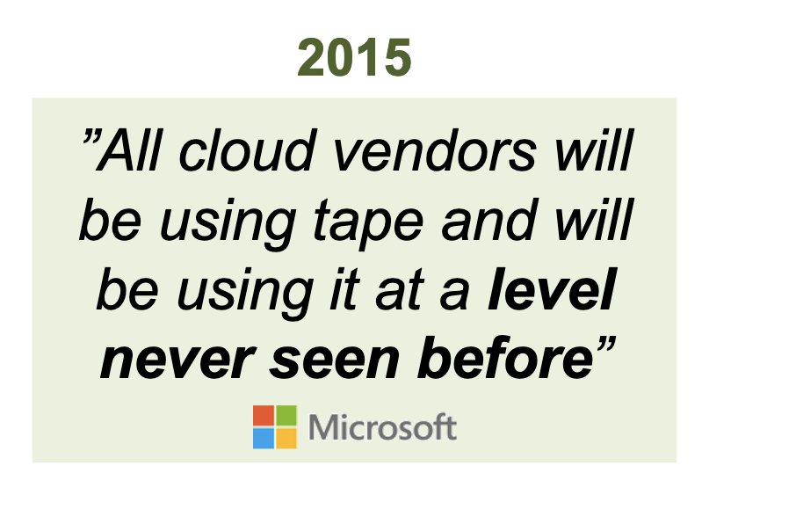
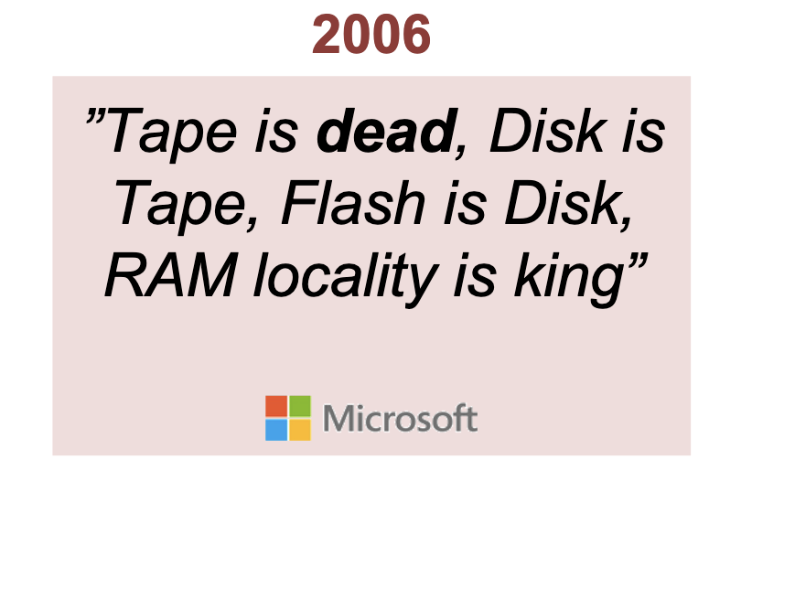
Magnetic tapes
https://indico.cern.ch/event/1353243/contributions/5846917/attachments/2821388/4927105/Lantz_Future_of_Tape_CERN_18032024.pdf

Slide 15
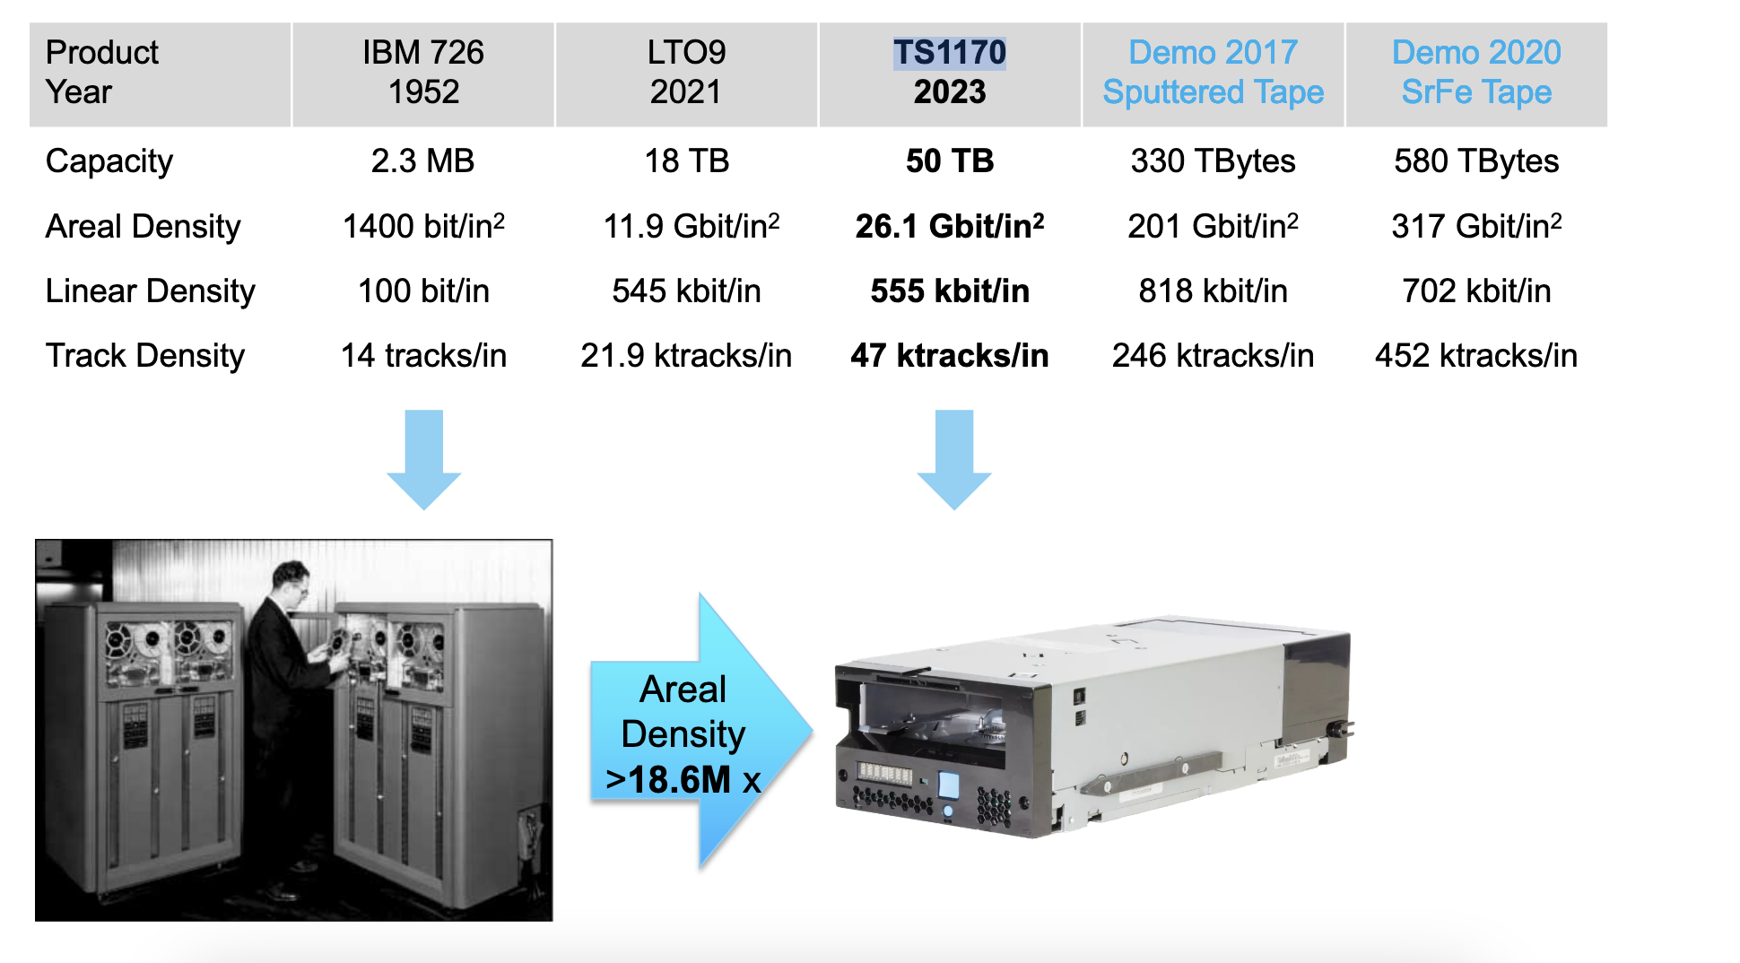
Magnetic tapes
Scaling
https://indico.cern.ch/event/1353243/contributions/5846917/attachments/2821388/4927105/Lantz_Future_of_Tape_CERN_18032024.pdf

Slide 16
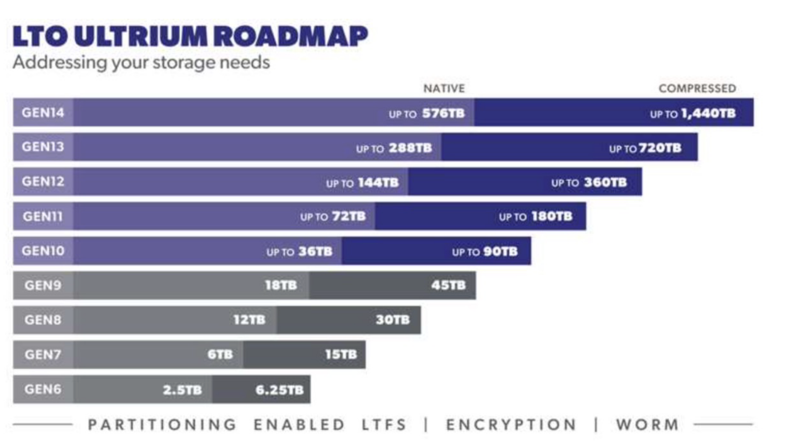
Magnetic tapes

Slide 17
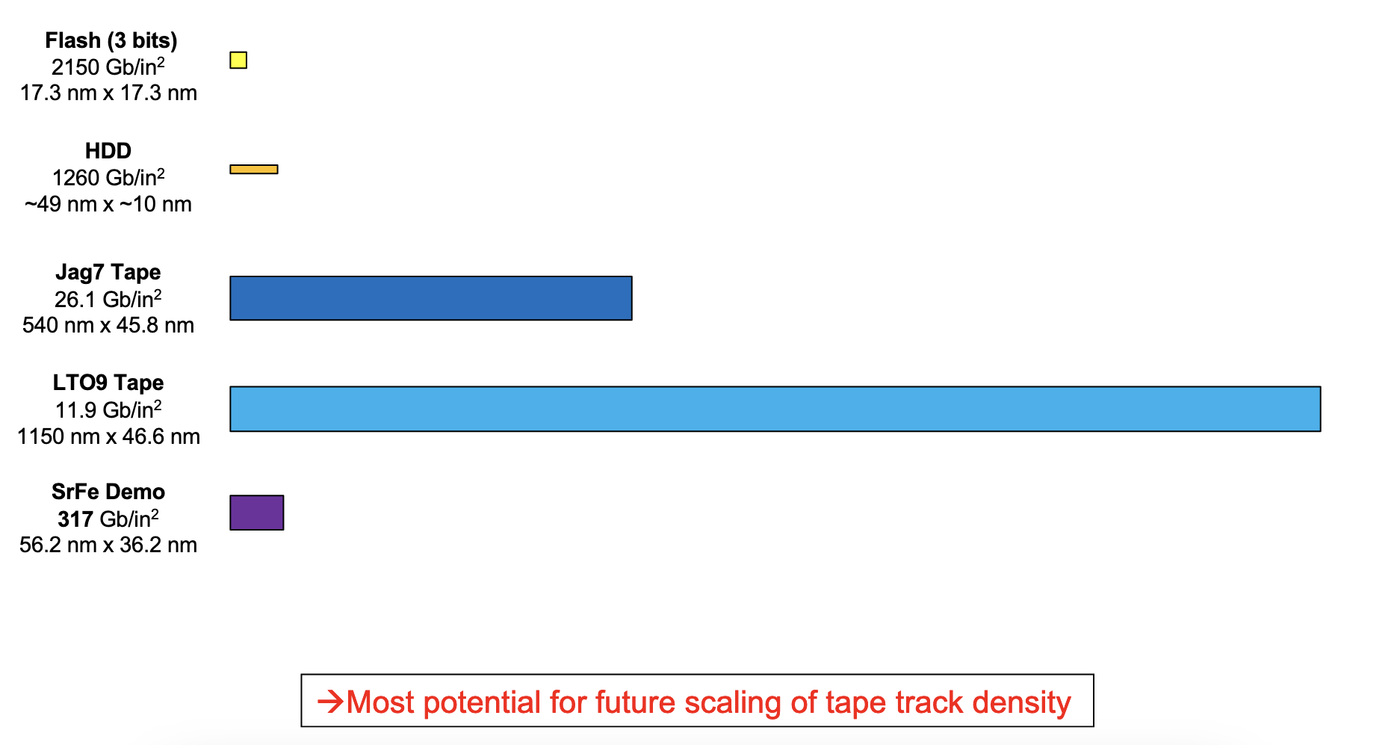
Density comparison across media
Extrapolating current HDD areal density techniques on tape can potentially deliver 2PB tape cartridges!
https://indico.cern.ch/event/1353243/contributions/5846917/attachments/2821388/4927105/Lantz_Future_of_Tape_CERN_18032024.pdf

Slide 18
Flash: SSD and arrays

Slide 19
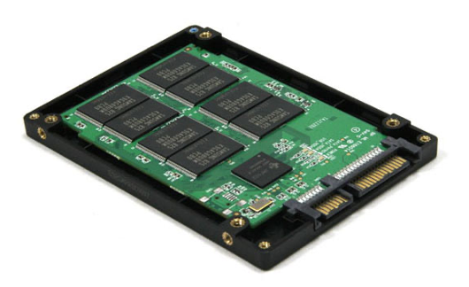
Solid State Disks
Basics
SSDs are made of non-volatile flash memory (NAND cells)
NAND cells can be electrically erased and reprogrammed, known as Program/Erase (P/E) cycles. Number of these cycles determines endurance of the device

Slide 20
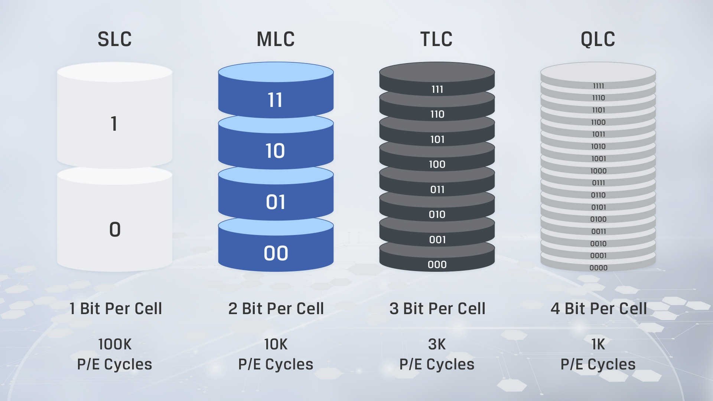
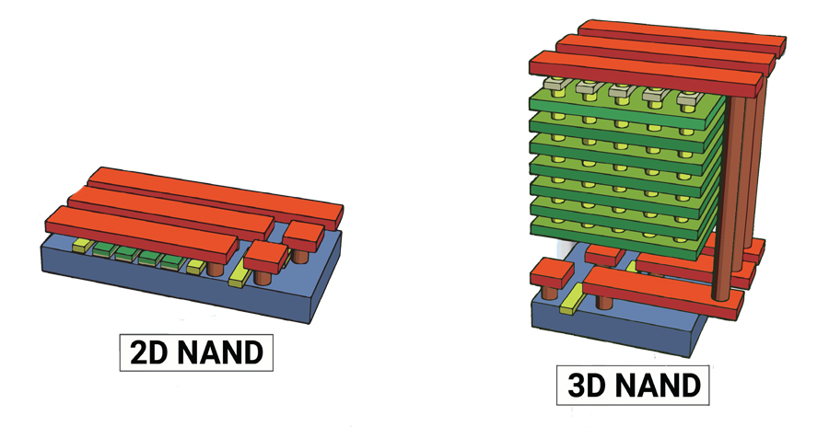
Solid State Disks
Basics
NAND cell types
NAND layout
Source: Kingston
Source: theicttrends.com

Slide 21
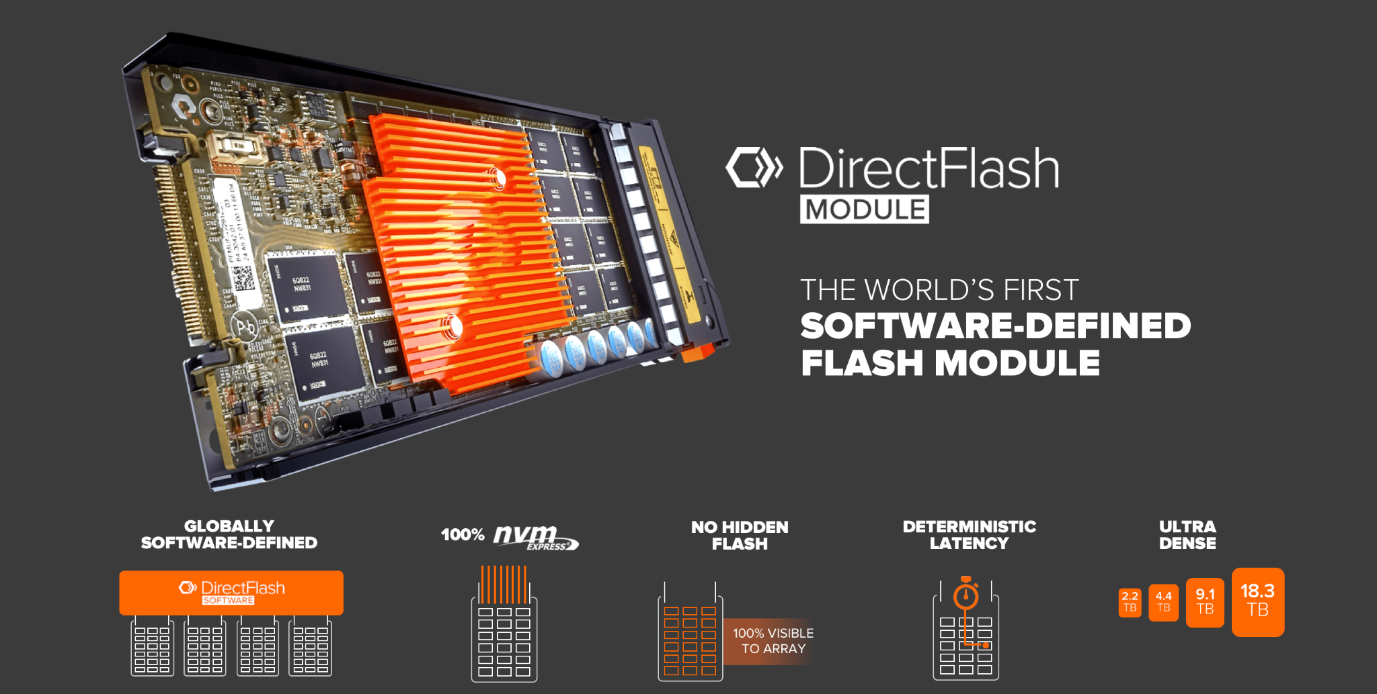
Solid State Disks
Flash Arrays
Flash arrays abstract the complexity of flash devices (the FTL, the leveling functions) to software, providing maximum flexibility for use-cases:
Maximise performance (SLC)
Maximise throughput (QLC)
Mix
https://www.purestorage.com/knowledge/what-is-directflash-and-how-does-it-work.html?shareVideo=6330700995112

Slide 22
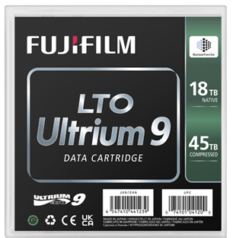
Comparison
Throughput
IOPS
Latency to 1st byte
Capacity
Price
~250 MB/s
Hundreds
< 5 ms
Up to 32 TB
$$
400MB/s
-
Minutes
~ 20/45 TB (compressed)
$
3-12 GB/s
Thousands
< 0.5ms
Up to 100 TB
$$$

Slide 23
Disk and Tape Storage at CERN

Slide 24
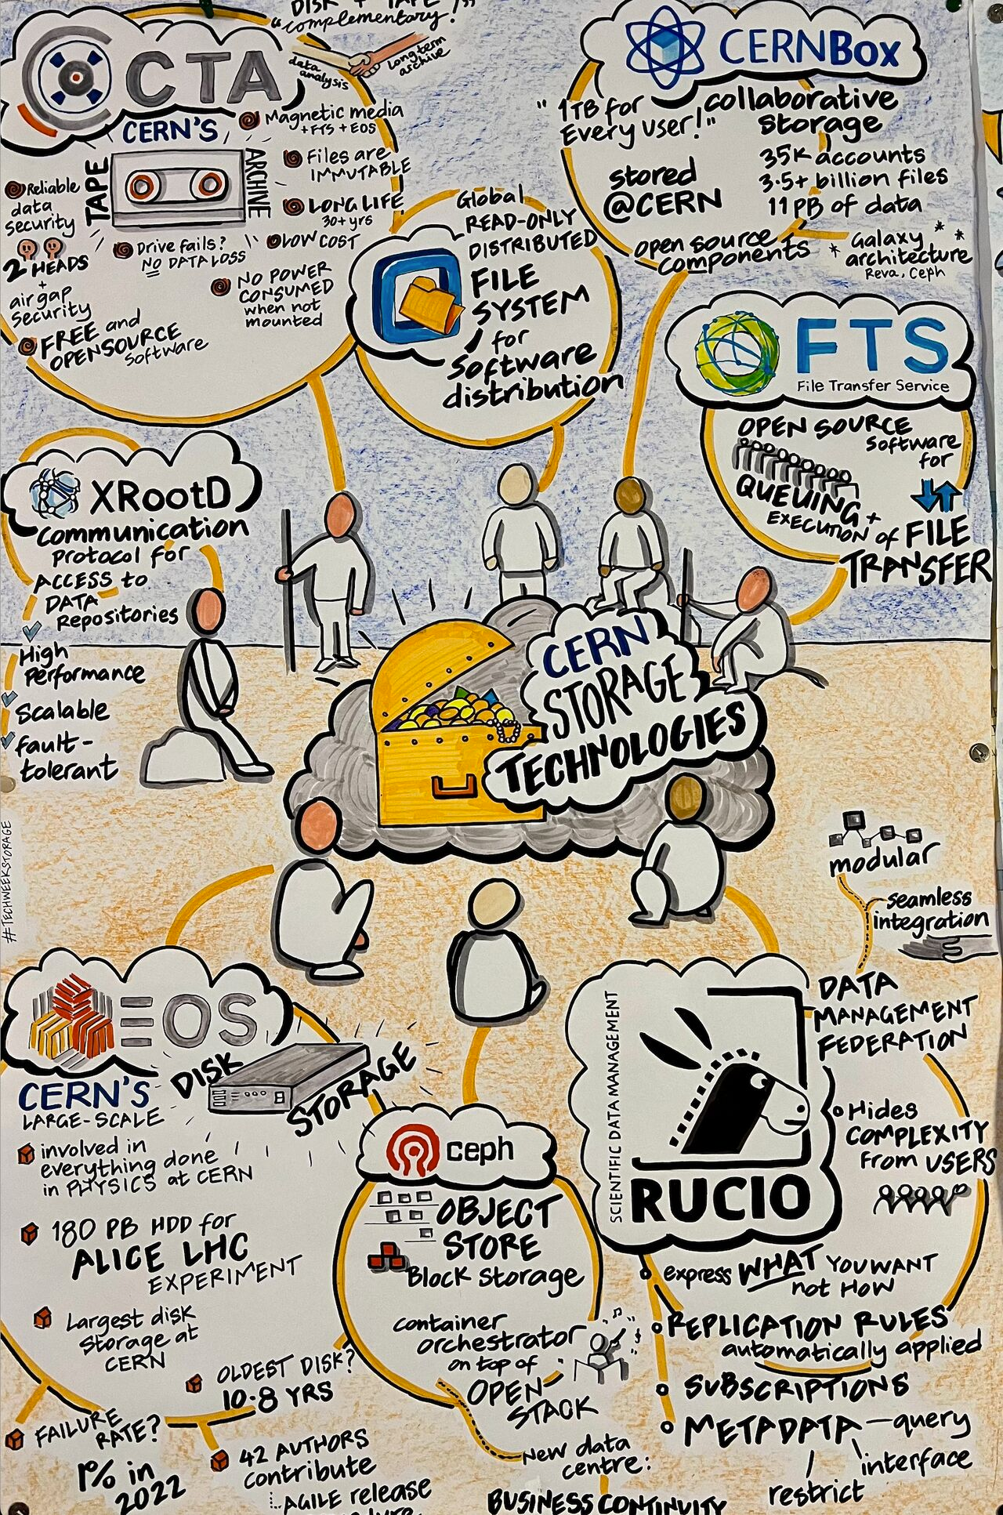
The CERN IT Storage group mission is to ensure coherent design, development, operation and evolution of storage and data management services at CERN for all aspects of physics, user and project data and general needs of the Laboratory.
For this presentation, we’ll focus only on the two major open source systems developed in-house and used worldwide: EOS and CTA

Slide 25
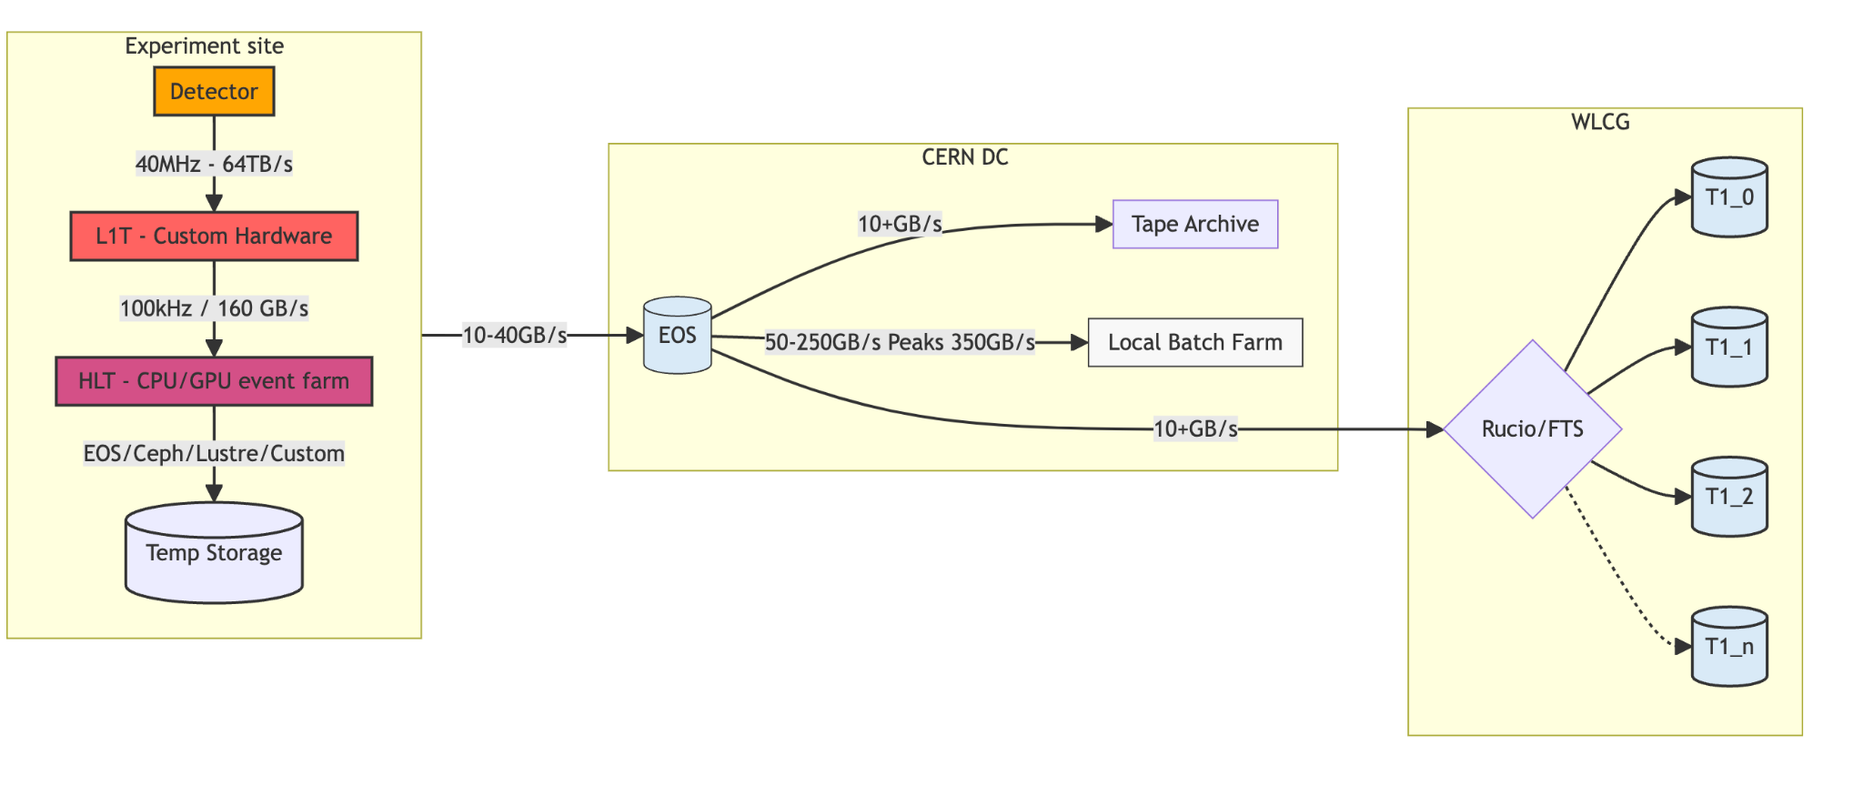
Data access patterns
Example for only one experiment!
Archiving
Analysis
Data Taking
Source: https://storagelecture24.web.cern.ch/#/5/1

Slide 26


EOS and CTA
Disk-based system with dedicated “storage pools” with defined QoS Experiments’ Data Management frameworks manage the transitions to tape
Low-Latency namespace
POSIX-like file access
From RAID to RAIN
Tape-based system with fast (flash) disk buffer
Tape-backend of EOS
Supports PostgreSQL as namespace (used to be Oracle only)
Evolution of CASTOR (30+ years of tape experience)

Slide 27
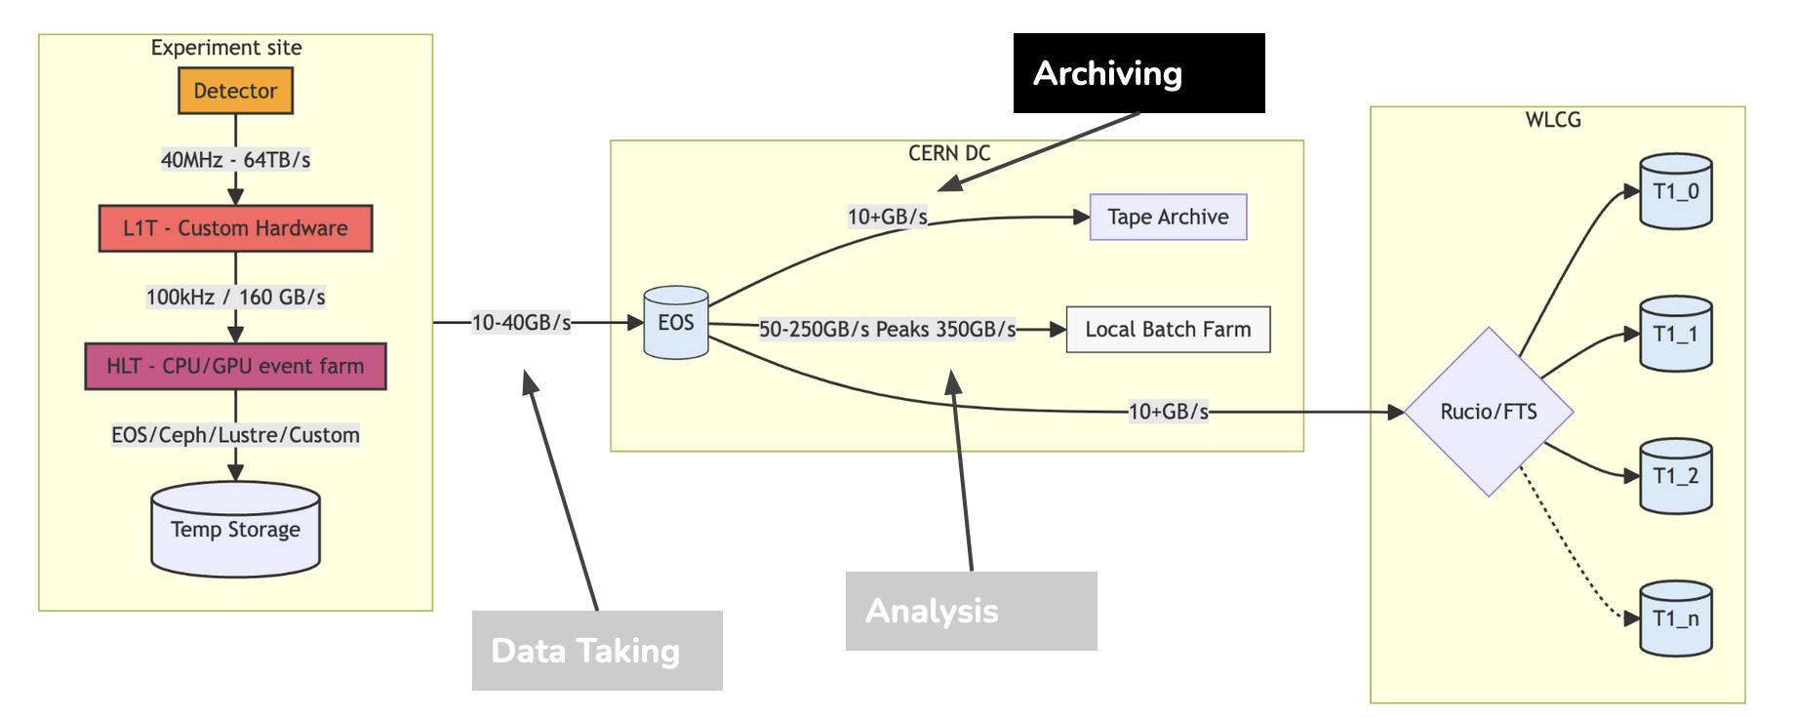
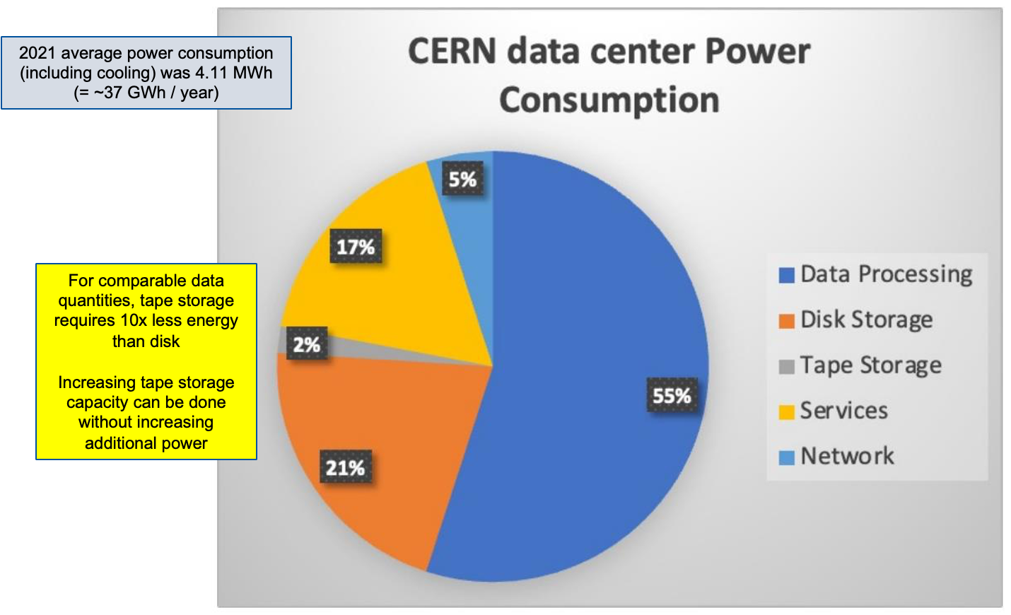
Why Tape?
Good fit for archiving use-cases
Reliability
Uncorrectable Bit Error Rate: LTO-9 tape cartridge (10⁻²⁰) is 10 000x more reliable
than typical 18 TB hard disk drive (10⁻¹⁵)
Annual failures at CERN: 1% hard disks vs. 0.005% tape cartridges (~200x less)
Separation of media and data access device: No data loss if the drive fails
Long media lifetime (30+ years)
Energy efficiency

Slide 28
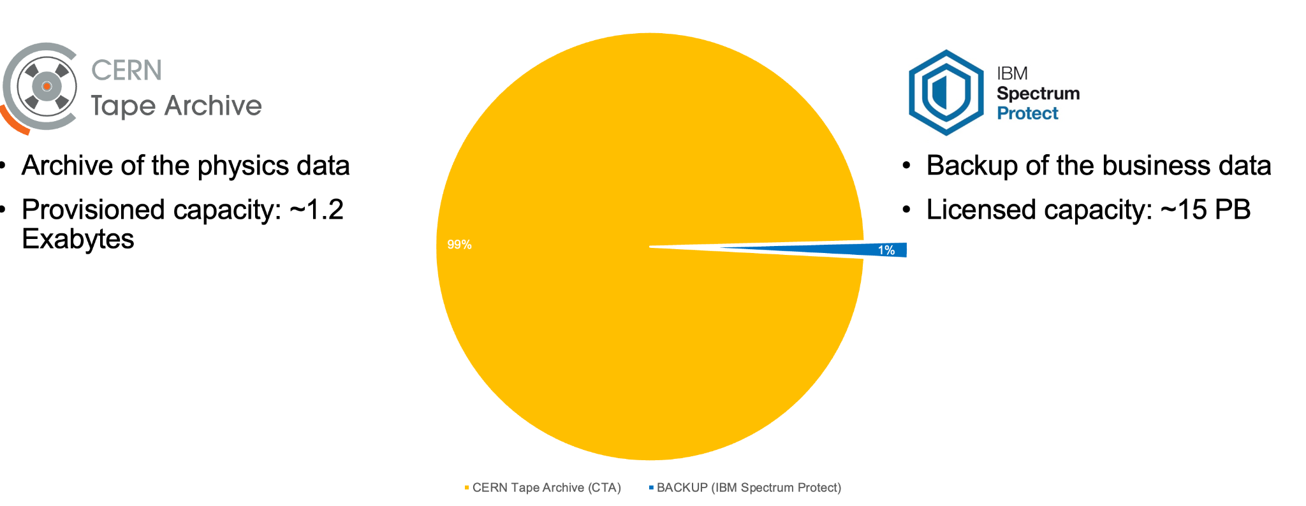
Tape use-cases

Slide 29
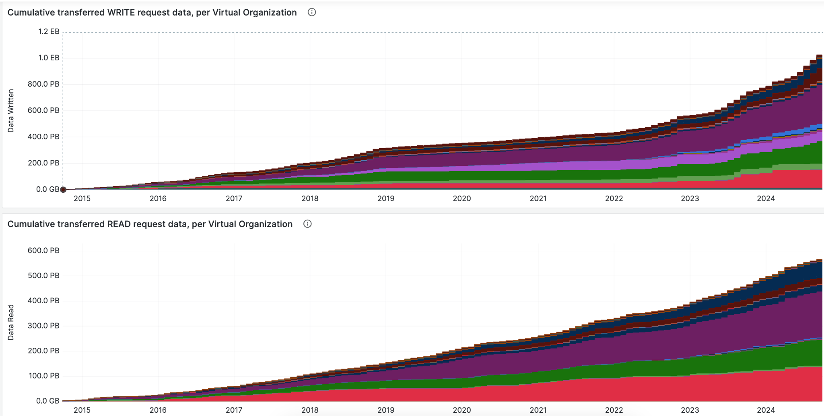
Cumulative writes and reads to tape

Slide 30
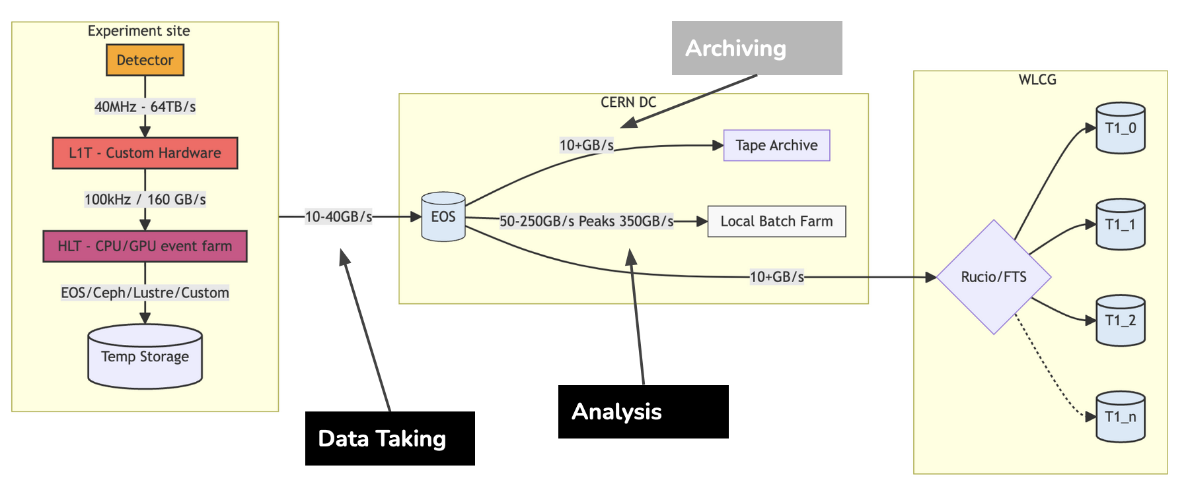
Why Disk?
Analysis use-case
100K clients streaming data from over 100k disks.
1-150MB/s throughput per stream
“Similar to having 100K people watching Netflix and skipping the boring parts”
Data taking use-case
100s of clients streaming as fast as possible
0.5-1GB/s per stream

Slide 31
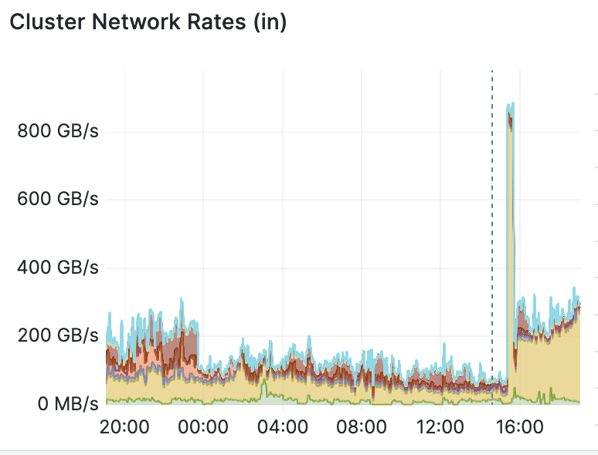
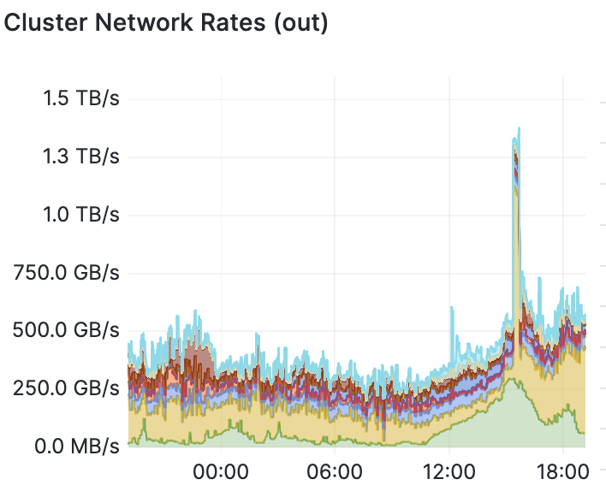
WRITES
READS
EOS data rates last 24h

Slide 32
CERN’s approach
For Tape: Introduce the latest tape technology as it becomes available
For Disk: Purchase the cheapest $/TB hard disk drives
Outcomes (rough estimates):
tape storage is ~3x cheaper than disk
50% disk capacity and 50% tape capacity
Tape: 0.6 reads per 1 write
Disk: 5 reads per 1 write

Slide 33
Market

Slide 34
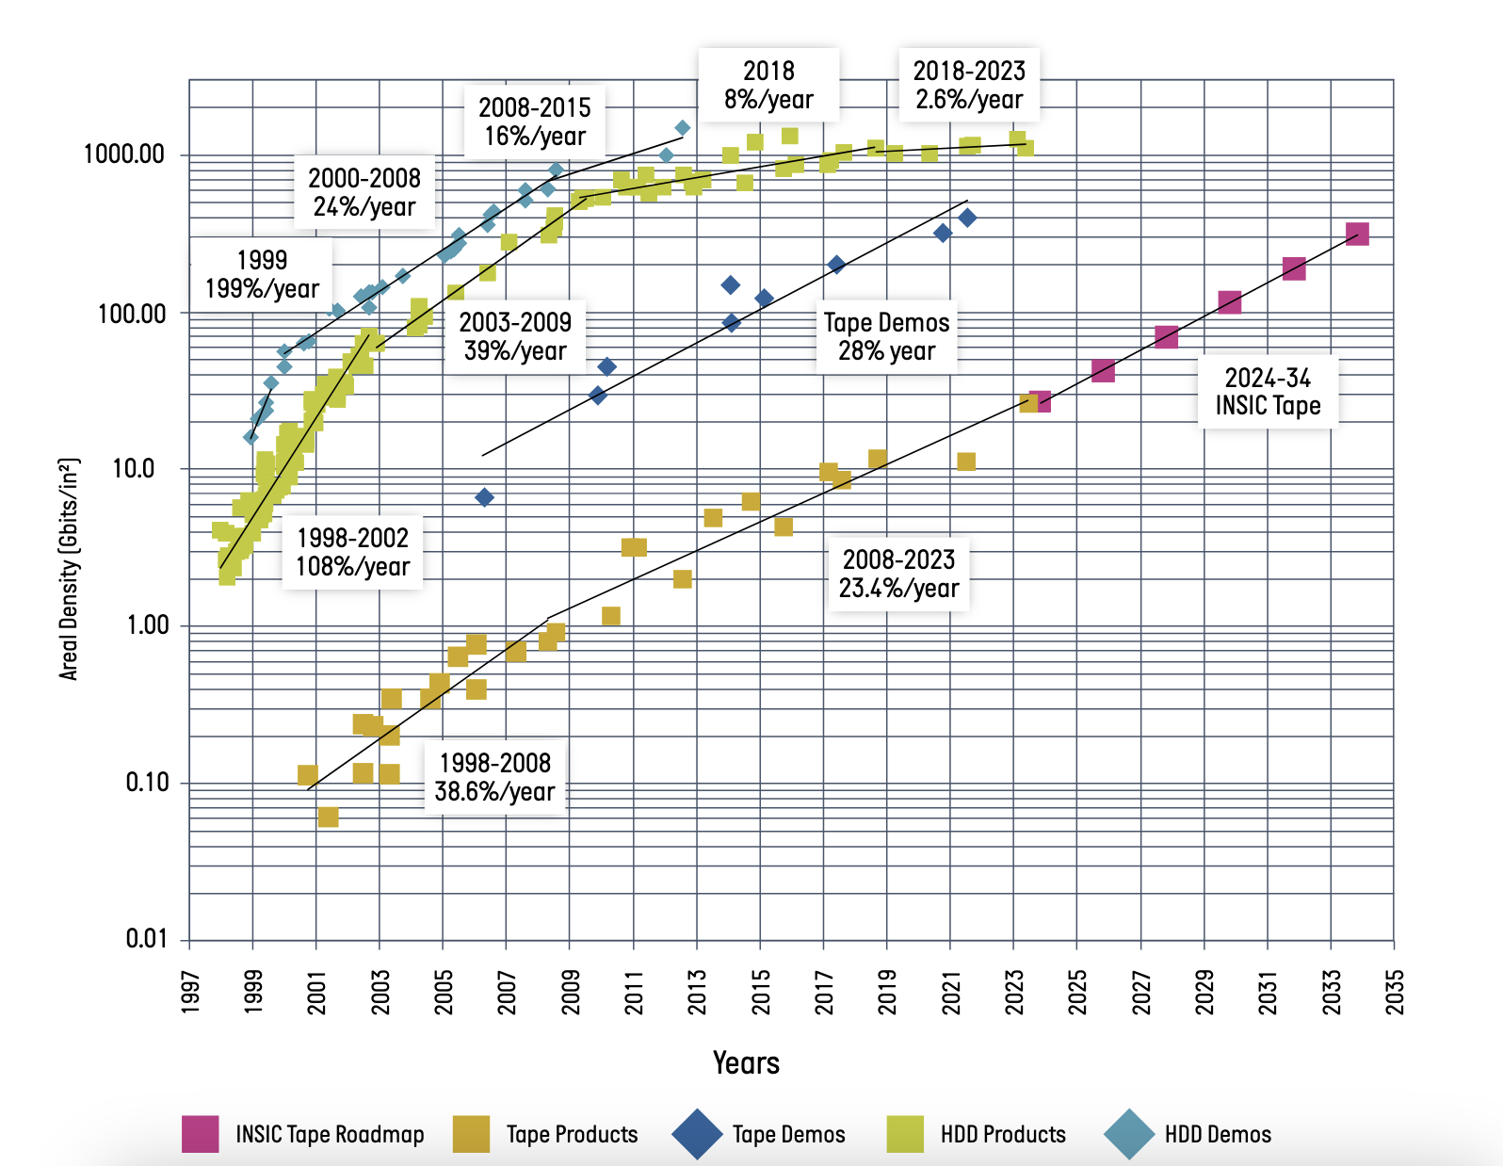
Source: https://www.lto.org/wp-content/uploads/2024/07/INSIC-International-Magnetic-Tape-Storage-Technology-Roadmap-2024.pdf

Slide 35
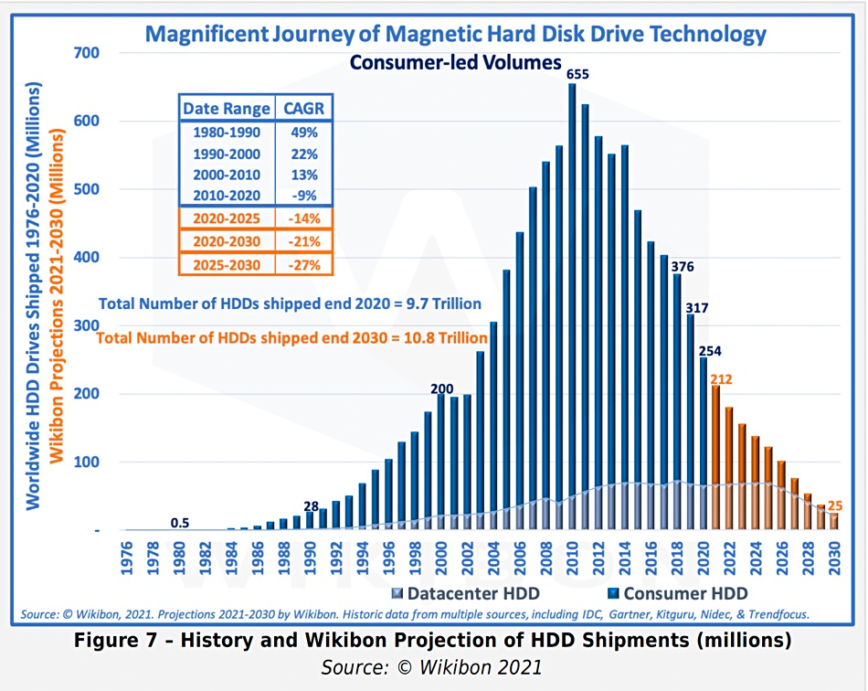

Slide 36
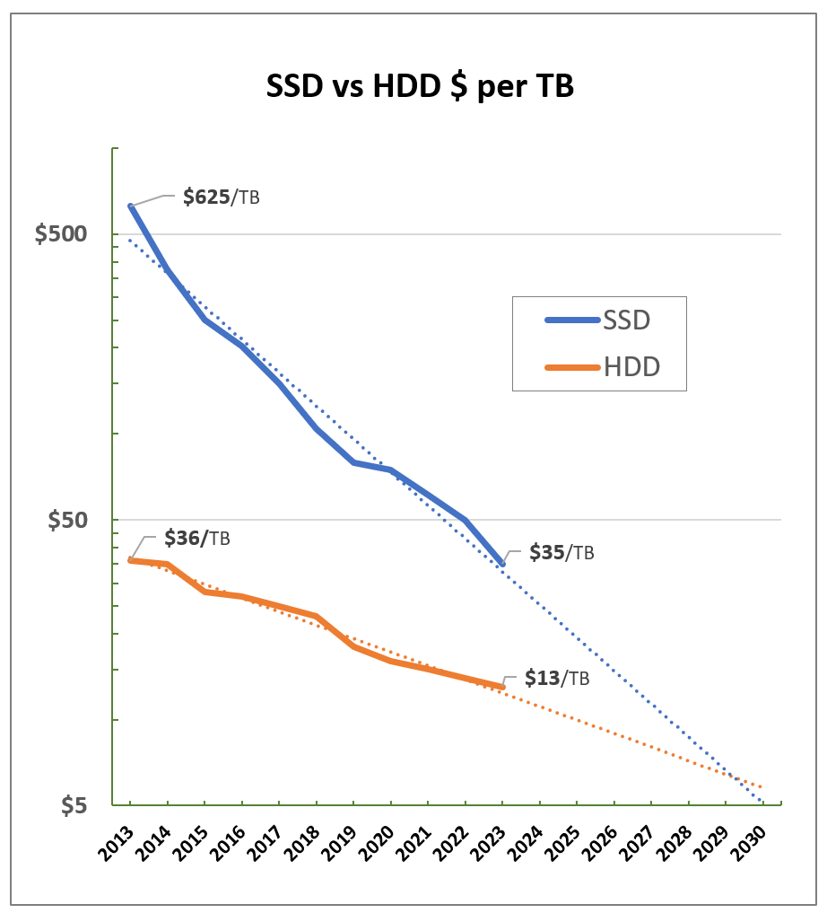
Some experts forecast there will a crossing point where flash will be more cost-effective than HDD around 2030
Other experts coincide that this point will not be reached by that time
Some experts coindice that HDD market will be very small and that existing companies will create a consortium to still benefit from this market. For example: WD created two new companies: one for HDD and one for flash
Wrights’ Law: “the more efficient vendors are making flash, the cheaper it will be”
Some companies will probably jump before the crosspoint is met (compounded costs, including power,cooling, … are less for flash)
Source: DataHoarder

Slide 37
Challenges

Slide 38
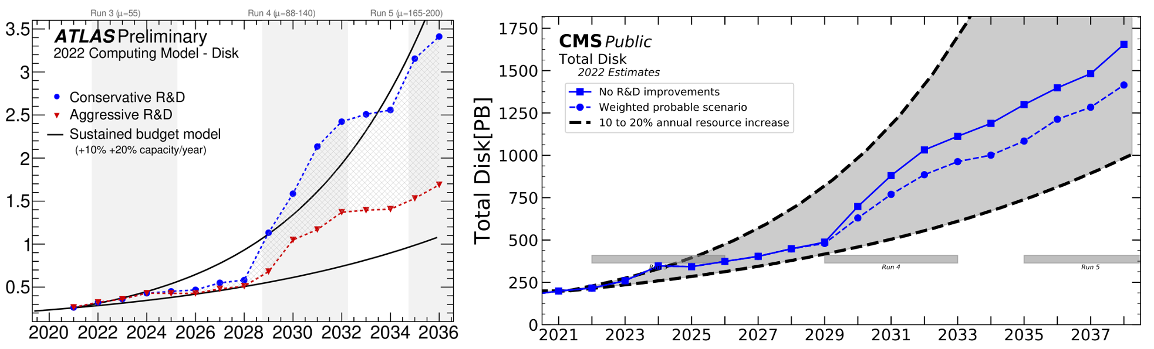
ATLAS and CMS storage predictions

Slide 39
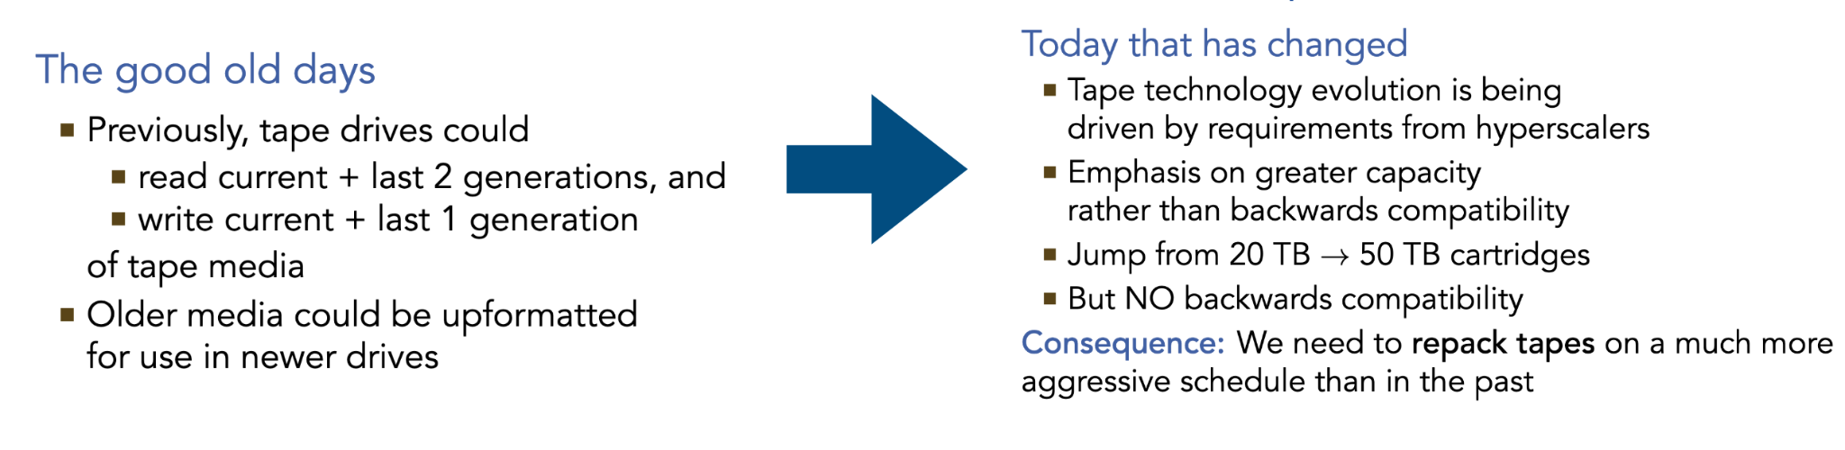
Challenges for tape

Slide 40
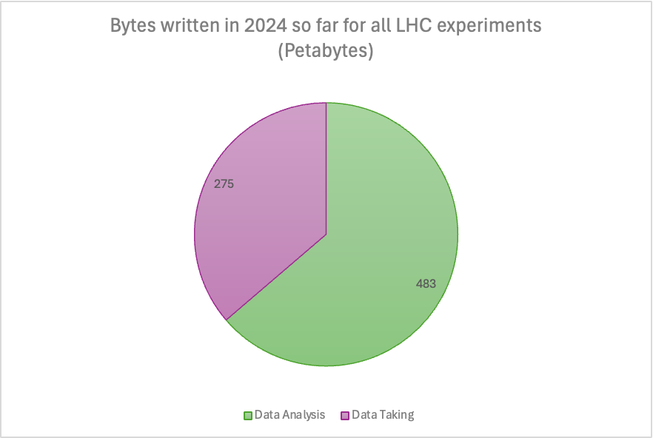
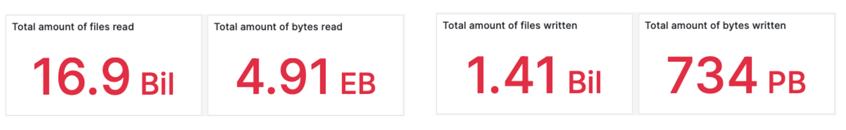
Challenges for disk
Data taking account for roughly 36% of all data the written and only for 5% of the write streams into the system
Data taking rates are predictable, analysis is not

Slide 41
Challenges for disk
Experiments pledges are on capacity, performance is provided for “free”, however the disk market driven towards high density disks, which have a significant penalty in performance (throughput, IOPS).
HDD throughput is stale at 250MB/s and is not going to change any time soon
CERN disk infrastructure runs with ~1K disk servers accounting for 100K disks.
The number of parallel streams per disk is ~2 -> 220K parallel streams across whole cluster
With new disk servers (2024): 120disks x 24TB drives with 100Gb interfaces, Hyper-optimized $/TB, it will result in:
~ 300 disk servers (replica) -> 36K disks-> 72K parallel streams -> 3x times load per HDD
~ 185 disk servers (EC 10+2) -> 22K disks -> 44K parallel streams -> 5x times more load per disk

Slide 42
How to increase disk capacity without losing performance with linear budget?

