Slide 1


Creating a rucio service for km3net
7th Rucio Community Workshop
Contact Persons
Bouwe Andela
Senior Research Software Engineer
b.andela@esciencecenter.nl
Victor Azizi
Research Software Engineer
v.azizi@esciencecenter.nl

Slide 2
Overview
What is KM3NeT?
  How does KM3NET want to use rucio
Set up of rucio for KM3NeT
Future work for rucio with KM3NeT
Questions

Slide 3
What is KM3NeT

Slide 4
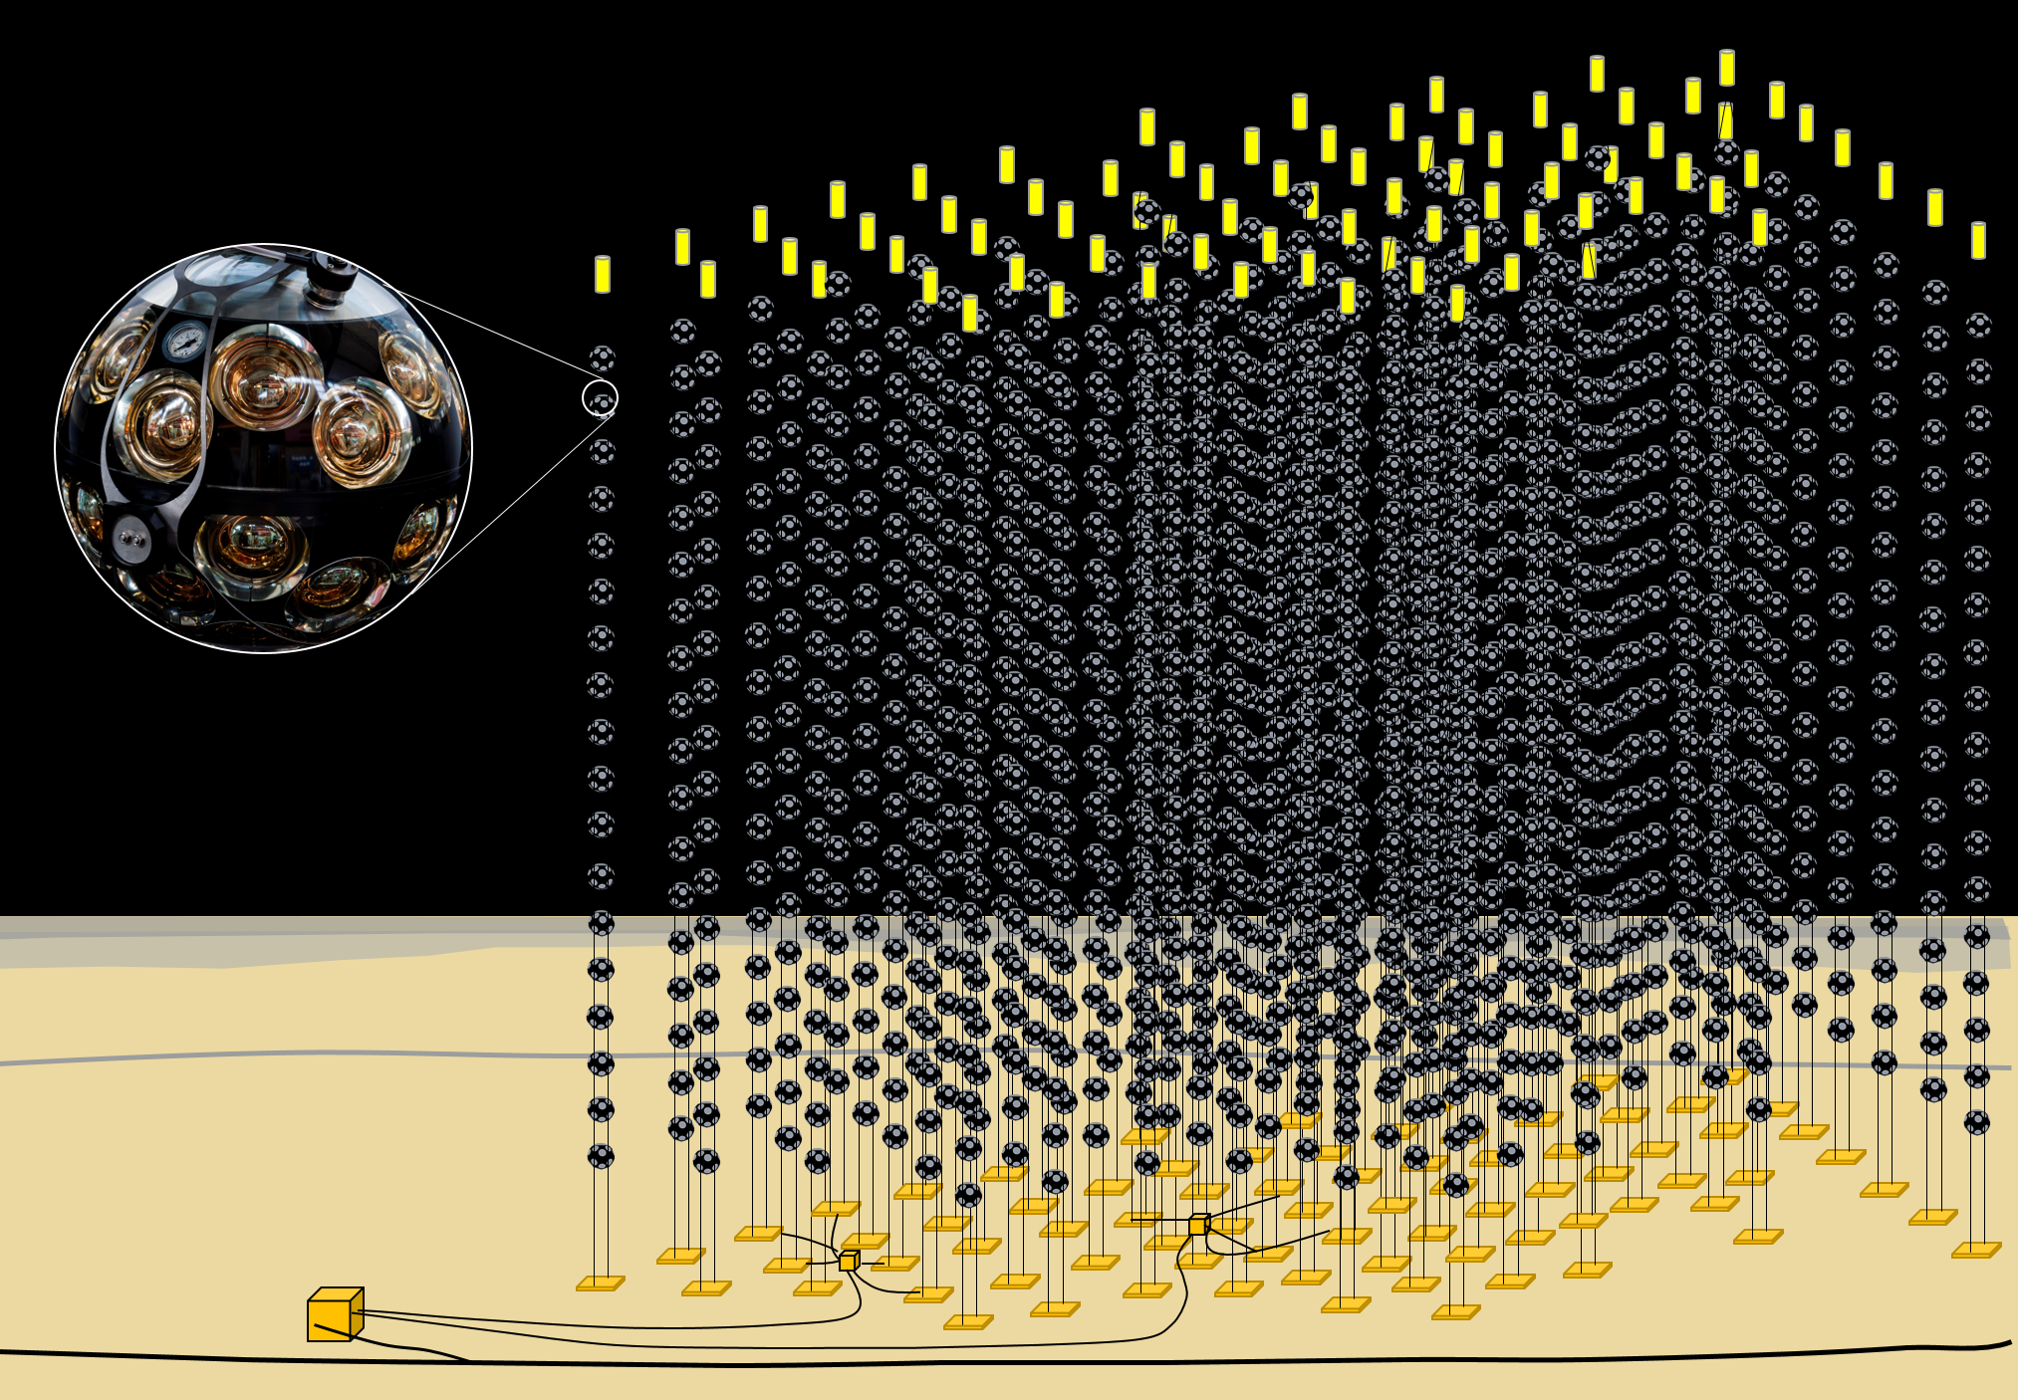
The KM3NeT Neutrino Telescope
Distributed infrastructure in the Mediterranean Sea
  FR: 10⁷ m³
  IT: 1 km³
Modular telescope array
  345 vertical strings
  200.000 light-sensitive photo-multiplier tubes
Today:
  FR: 10% operational
  IT: 5% operational

Slide 5
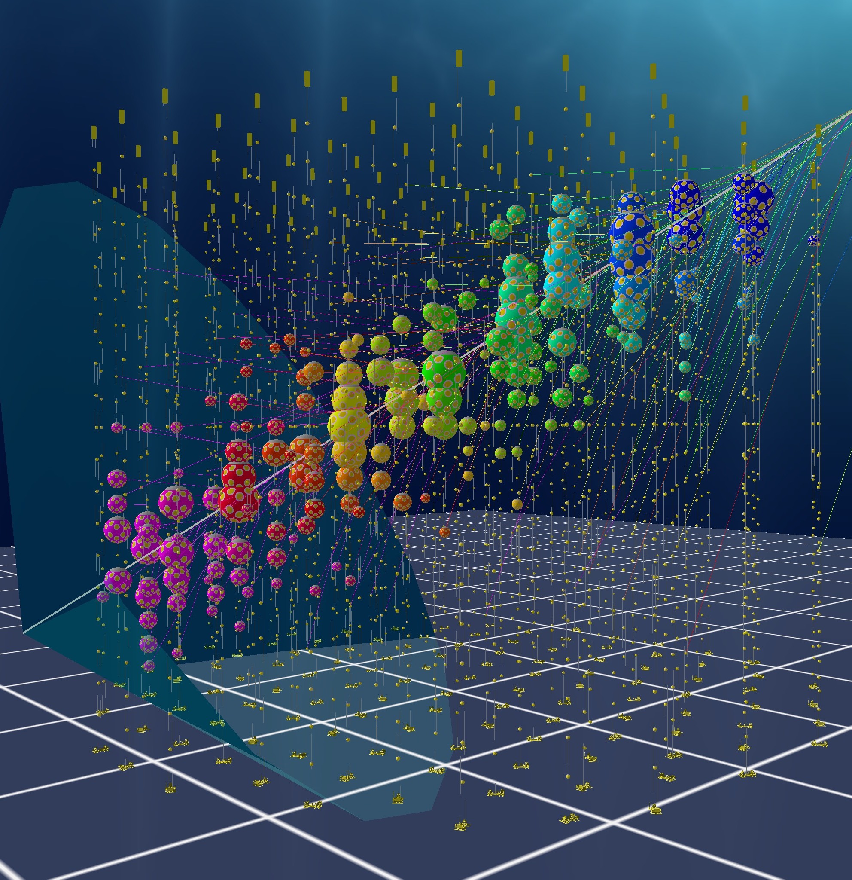
Simulations in KM3NeT
Events are
  Atmospheric muons 200 Hz
  Atmospheric neutrinos 10-100 day⁻¹
  Cosmic neutrinos 10-100 year⁻¹
Expected "raw" data volume 0.5PB year⁻¹
Simulations 10x data volume
  Expected data volume of 2PB year⁻¹
Rucio will be used for data management of real data and simulated data on the grid

Slide 6
Some More Numbers
Once detector is fully built, computing needs expected to grow into an average of 1-2k cores / jobs running simultaneously, with peaks when doing mass-reprocessings of data.
The new version of the data processing, which uses snakemake as a workflow manager, is integrated with Rucio for input and output handling on the Grid.

Slide 7
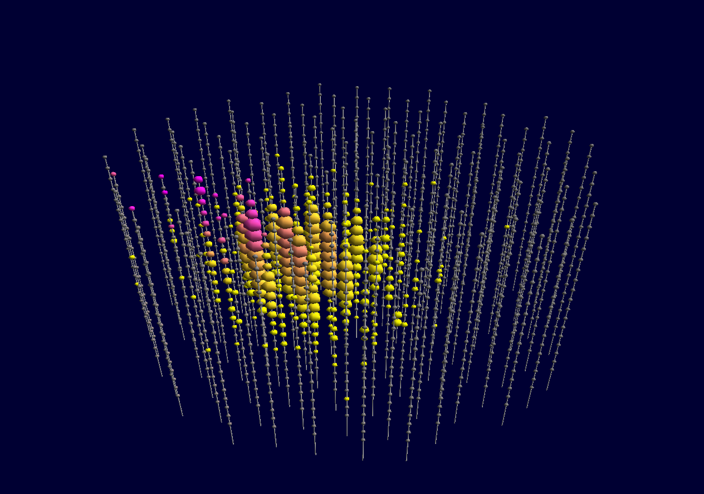


The KM3NeT Computing Model
Tier-2
Local computing resources
data
analysis
Tier-1
data
processing
Computer Centre IT
Computer Centre PL
Computer Centre NL
Computer Centre FR
Computer Centre …
CC-FR
CC-IT
data
storage
CC-FR
CC-IT
Tier-0
FR
IT
data
acquisition
onshore computing
onshore computing

Slide 8

KM3NeT Tier-1 Level
Calibration of raw events
“Reconstruction” of calibrated events
Rucio should handle storage of calibrated and reconstructed data
  Accessible to all KM3NeT partners
  Distribution of the data processing
  Organization in data sets
raw
events
reconstructed
events

Slide 9
The role of the eScience Center
Set up a data management service
Help with integration into their processing workflows
Develop training material and deliver user trainings
Project runs until end of 2025

Slide 10
Set up of rucio for KM3NeT

Slide 11
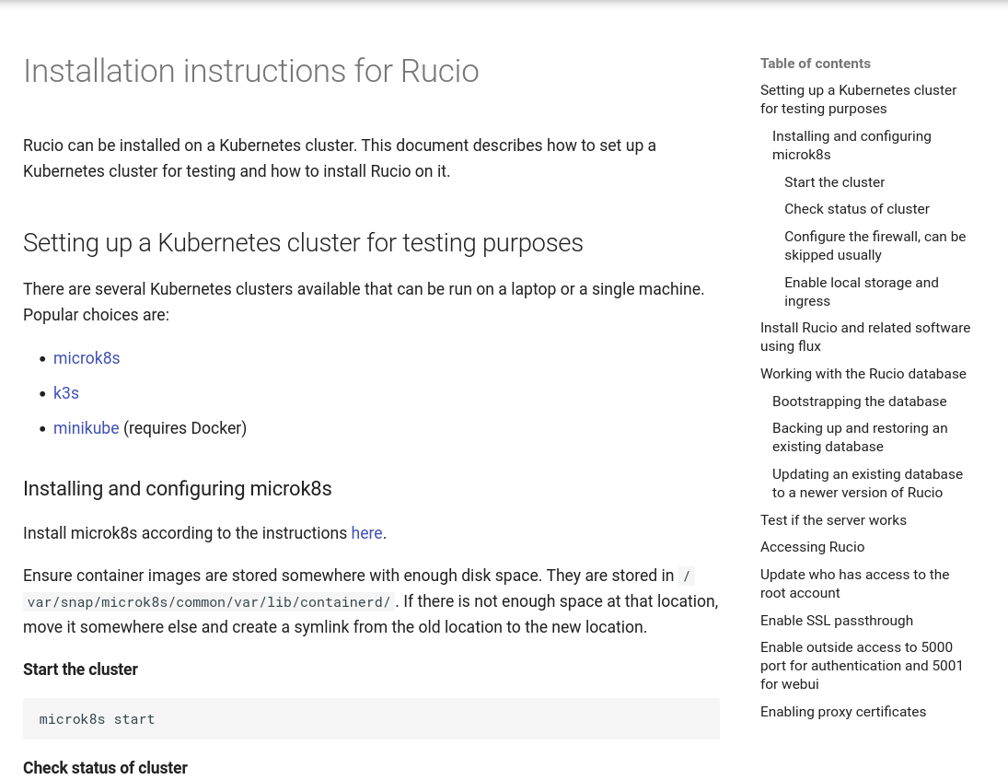
Document everything
https://rucio.pages.km3net.de/rucio-documentation/

Slide 12
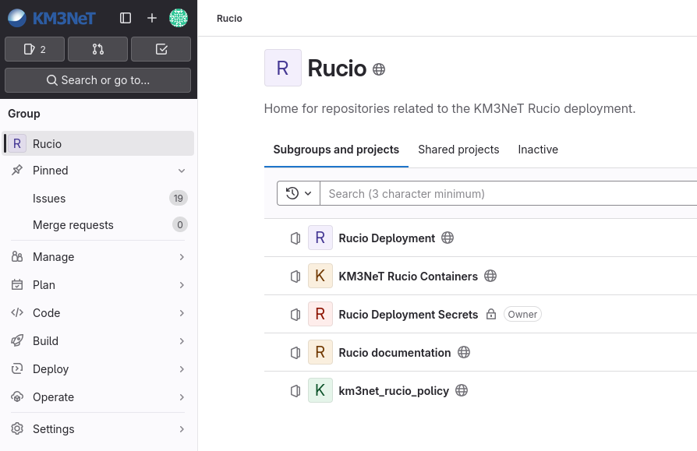
Repositories
https://git.km3net.de/rucio
Everything is publicly accessible, except the Secrets repository.

Slide 13



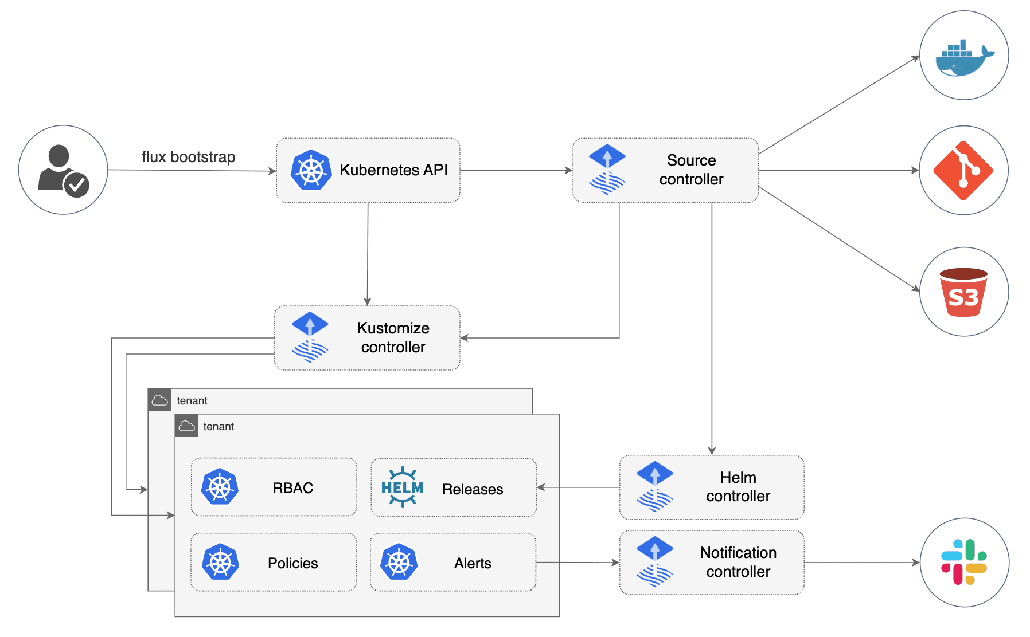
Setting up the data management service
We got 2 very nice (virtual) servers from Nikhef
  One for testing, one for production
On these servers we installed with
We auto update this cluster from a public gitlab repository with flux

Slide 14
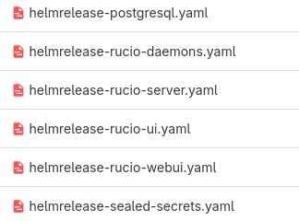
Using rucio helm charts to get started
Update the documentation to include easy database generation
How to manage the helm charts?
  There are many helm charts that need the same values
Solution: Just put the helm charts in a helm chart!
We created a helm chart that generates all our rucio helmcharts
(and everything else we need)

Slide 15
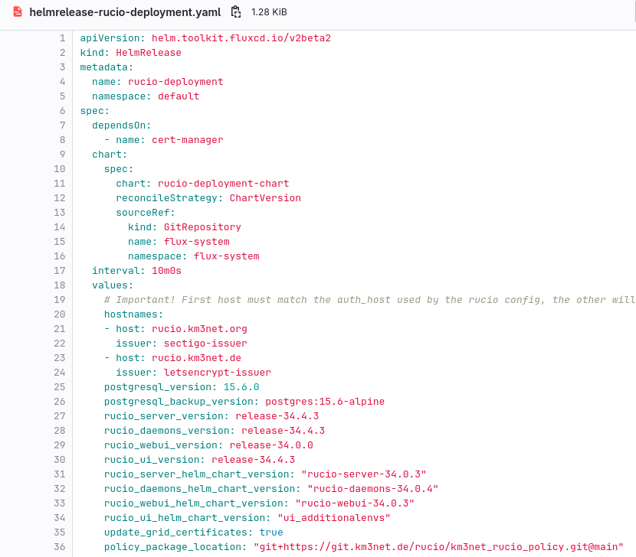
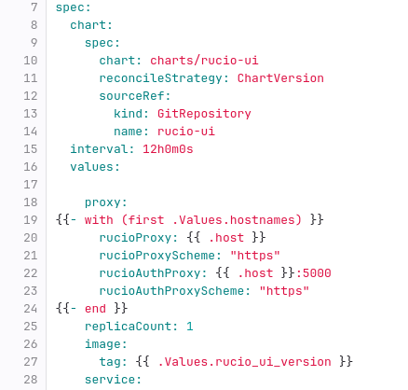
Our rucio helmcharts chart values
ui helm-chart as template:
Notes:
Left picture shows how we define the values for our custom helm chart (rucio-deployment-chart)
Right picture shows the template of the ui helm chart as defined in rucio-deployment-chart

Slide 16
What about automatic deployments
Candidates:
gitlab actions (push approach)
via flux (pull approach)

Slide 17
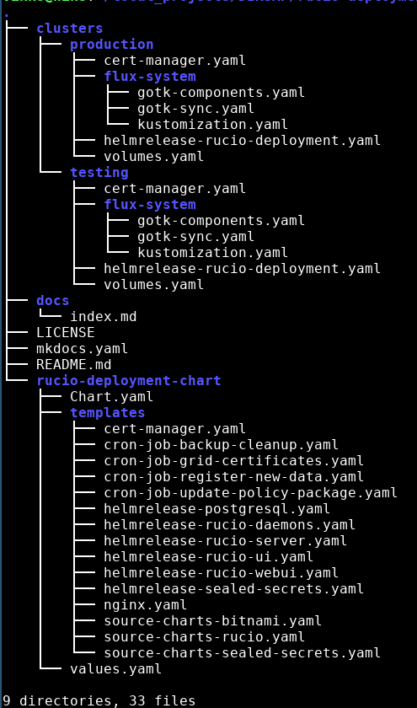
Setting up flux
Run flux bootstrap to install flux in the cluster
Flux will apply our helmrelease and check for updates every 5 minutes
Our helmrelease installs all our services, including rucio
Benefits
If we push to our deployment repository, the cluster tries to update
If the upgrade fails, the cluster stays at the latest working version
We can easily create multiple deployments in the same git repository
Flux can follow a specific branch,
  We can test on a develop branch and a test deployment before merging to main

Slide 18
Secrets management
Separate private repository with all sensitive information.
  FTS certificate
  SSL certificate renewal credentials
  Database passwords
  Etc ...
Script to push these secrets to the kubernetes cluster, separate from flux.

Slide 19
Development flow
Make changes to the development branch
Test cluster updates itself
Verify and test changes
Merge changes to the main branch
Production cluster updates itself

Slide 20
Future work

Slide 21
(possible) Integration with DIRAC
DIRAC (the grid) will be used to distribute compute necessary for KM3NeT
Currently there is a workflow to make data available on the grid via rucio, but not necessarily on the compute site!
Benefit: Easy to implement
Drawback: Extra file transfers between compute sites. Extra energy and time spent.
Solution: Make DIRAC rucio-aware. But we have no DIRAC access, so must be done by DIRAC owner (currently EGI)

Slide 22
Learn more
Documentation available: https://rucio.pages.km3net.de/rucio-documentation/
Send us an email: v.azizi@esciencenter.nl & b.andela@esciencecenter.nl

Slide 23
Questions?

Slide 24
“Empowering
researchers across
all disciplines
through innovative
research software”
Contact Persons
Bouwe Andela
Senior Research Software Engineer
b.andela@esciencecenter.nl
Victor Azizi
Research Software Engineer
v.azizi@esciencecenter.nl

