Slide 1

Task3 of the mmWG:
Proposal for next studies
F. Boattini
11.December.23

Slide 2
Proposal for ext steps for TUD university
Run calculations for MAP dipole at 1.5T and 1.8T
Run calculations for H-type dipole at 1.8T with hollow conductors
Consider materials without Co and high saturation
Check both solutions thermally
Meet again to discuss results
Start coupled magneto-dynamic simulations on the selected layout with the two resonance circuits (and different dimensioning of them)

Slide 3
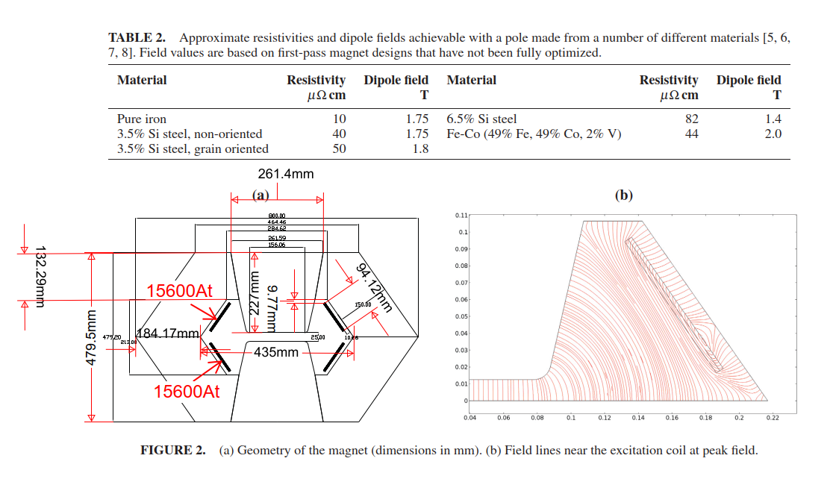
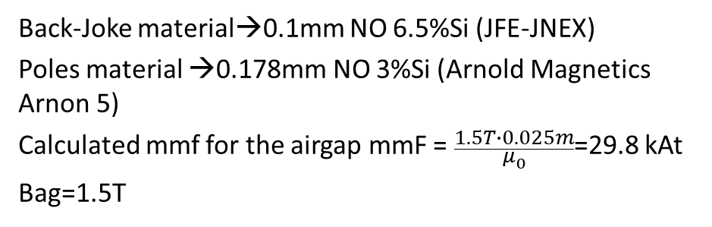
MAP dipole study (https://doi.org/10.1063/1.4965683)
Back-Joke material→0.1mm NO 6.5%Si (JFE-JNEX)
Poles material →0.178mm NO 3%Si (Arnold Magnetics Arnon 5)
Calculated mmf for the airgap mmF = $\frac{1.5T∙0.025m}{μ_{0}}$=29.8 kAt
Bag=1.5T
Map Dipole | MAP | CERN (Maxwell2D)
External Dimensions [mm x mm] | 800 X 480 | 800 X 480
Bgap [T] | 1.5 | 1.5
Gap size [mmxmm] | 156 x 25 | 156 x 25
Mmf [kAt] | 31.2 | 31.2
Iron losses (joke) [J/cycle-m] (*) | ≅1.1E6/(2200x15)=33 | 59085x2x0.001=59 (pole and Joke have the same material M235-35A)
Iron losses (pole) [J/cycle-m] (*) | ≅2.1E6/(2200x15)=63 | 61167x2x0.001=61
Coil Losses [J/cycle-m] (*) | ≅0.55E6/(2200x15)=16 | 4*(3174+5106)x0.001=33
Total losses [J/cycle-m] (*) | 112 | 153
Stored energy (total / gap) [J/m] | 4200 / 3490 | 4900 / 3490
(*) with 1kHz sinus

Slide 4
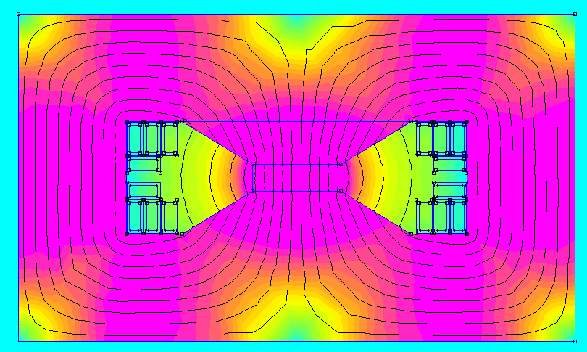
Ideas for the full power-converters/magnets system
0.64m
0.019m
Just an example not the one to consider for the calculaitons
0.039m
Sc=0.003m
Sigmarms=5A/mm2
Sigmapk=18A/mm2
0.37m
Hollow water-cooled conductors
Single turn with straight conductors connecting magnet to magnet via the power cell (or directly)
Map Dipole | MAP | UNIBO HM | Hollow conductors
External Dimensions [mm x mm] | 800 X 480 | 500 x 380 | 640 x 370
Bgap [T] | 1.5 | 2 (1.8 is the design value) | 1.8
Gap size [mmxmm] | 156 x 25 | 100 x 30 | 100 x 30
Mmf [kAt] | 31.2 | 47.8 | 44.9
Iron losses [J/cycle-m] | ≅1.1E6/(2200x15)=96 @1kHz | 128 @ 500Hz | 133 @454Hz
Coil Losses [J/cycle-m] | ≅0.55E6/(2200x15)=16 @1kHz | 295 @ 500Hz | 125 @ (Fourier of current)
Total losses [J/cycle-m] | 112 | 423 | 258
Stored energy (total / gap) [J/m] | 4200 / 3490 (1.2) | 5740 / 4775 (1.2) | 7630 / 3867 (1.97)

Slide 5
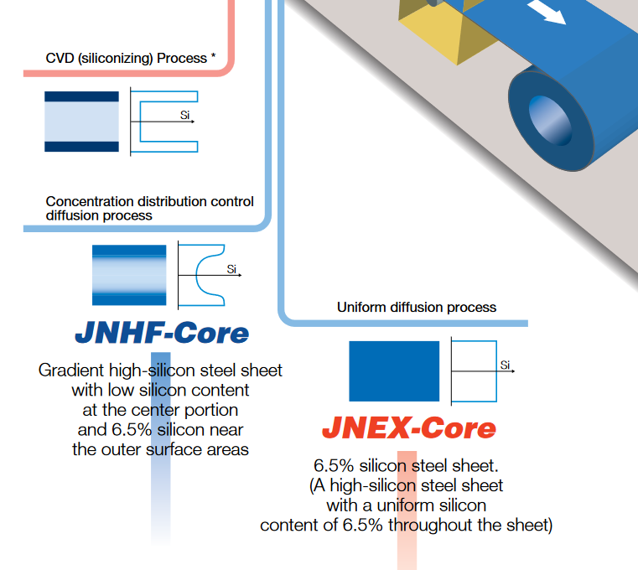
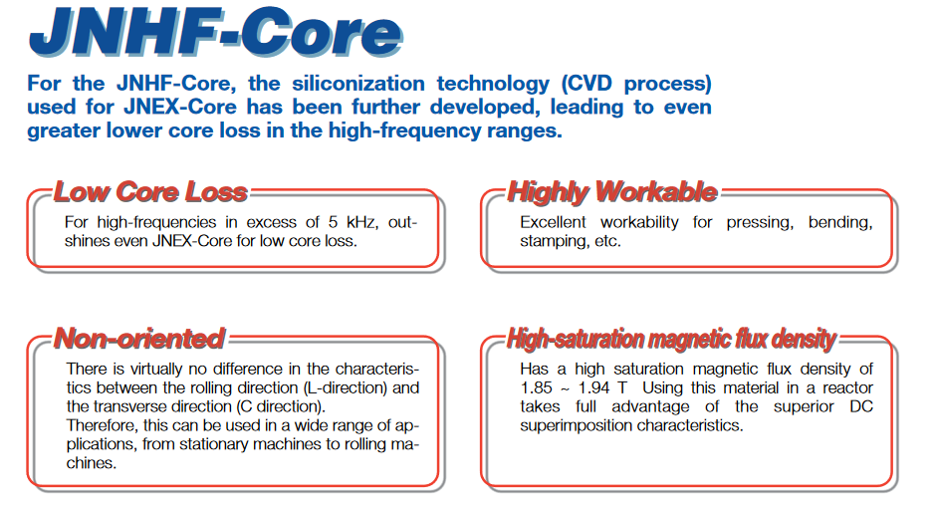
High-saturation magnetic flux density steels
No cobalt content- Non oriented
https://www.jfe-steel.co.jp/en/products/electrical/catalog/f2e-001.pdf

Slide 6
Thank you for your attention

