Slide 1
DUNE –HWDB APP
Subhiksha Paulraj
University of Texas at Arlington

Slide 2
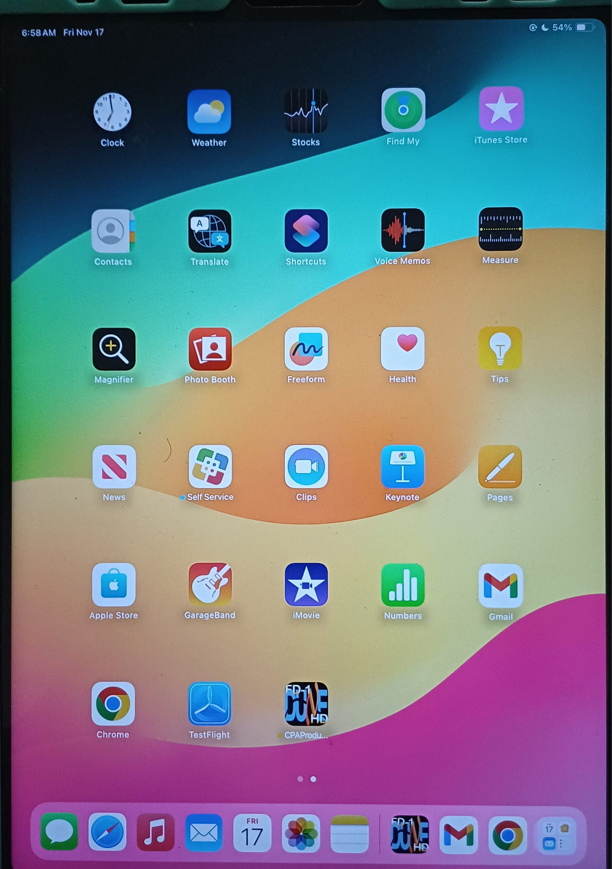
THE APP
USED TO DOCUMENT PROFILES
(All profiles processed at UTA needs
to be updated to the HWDB app)

Slide 3
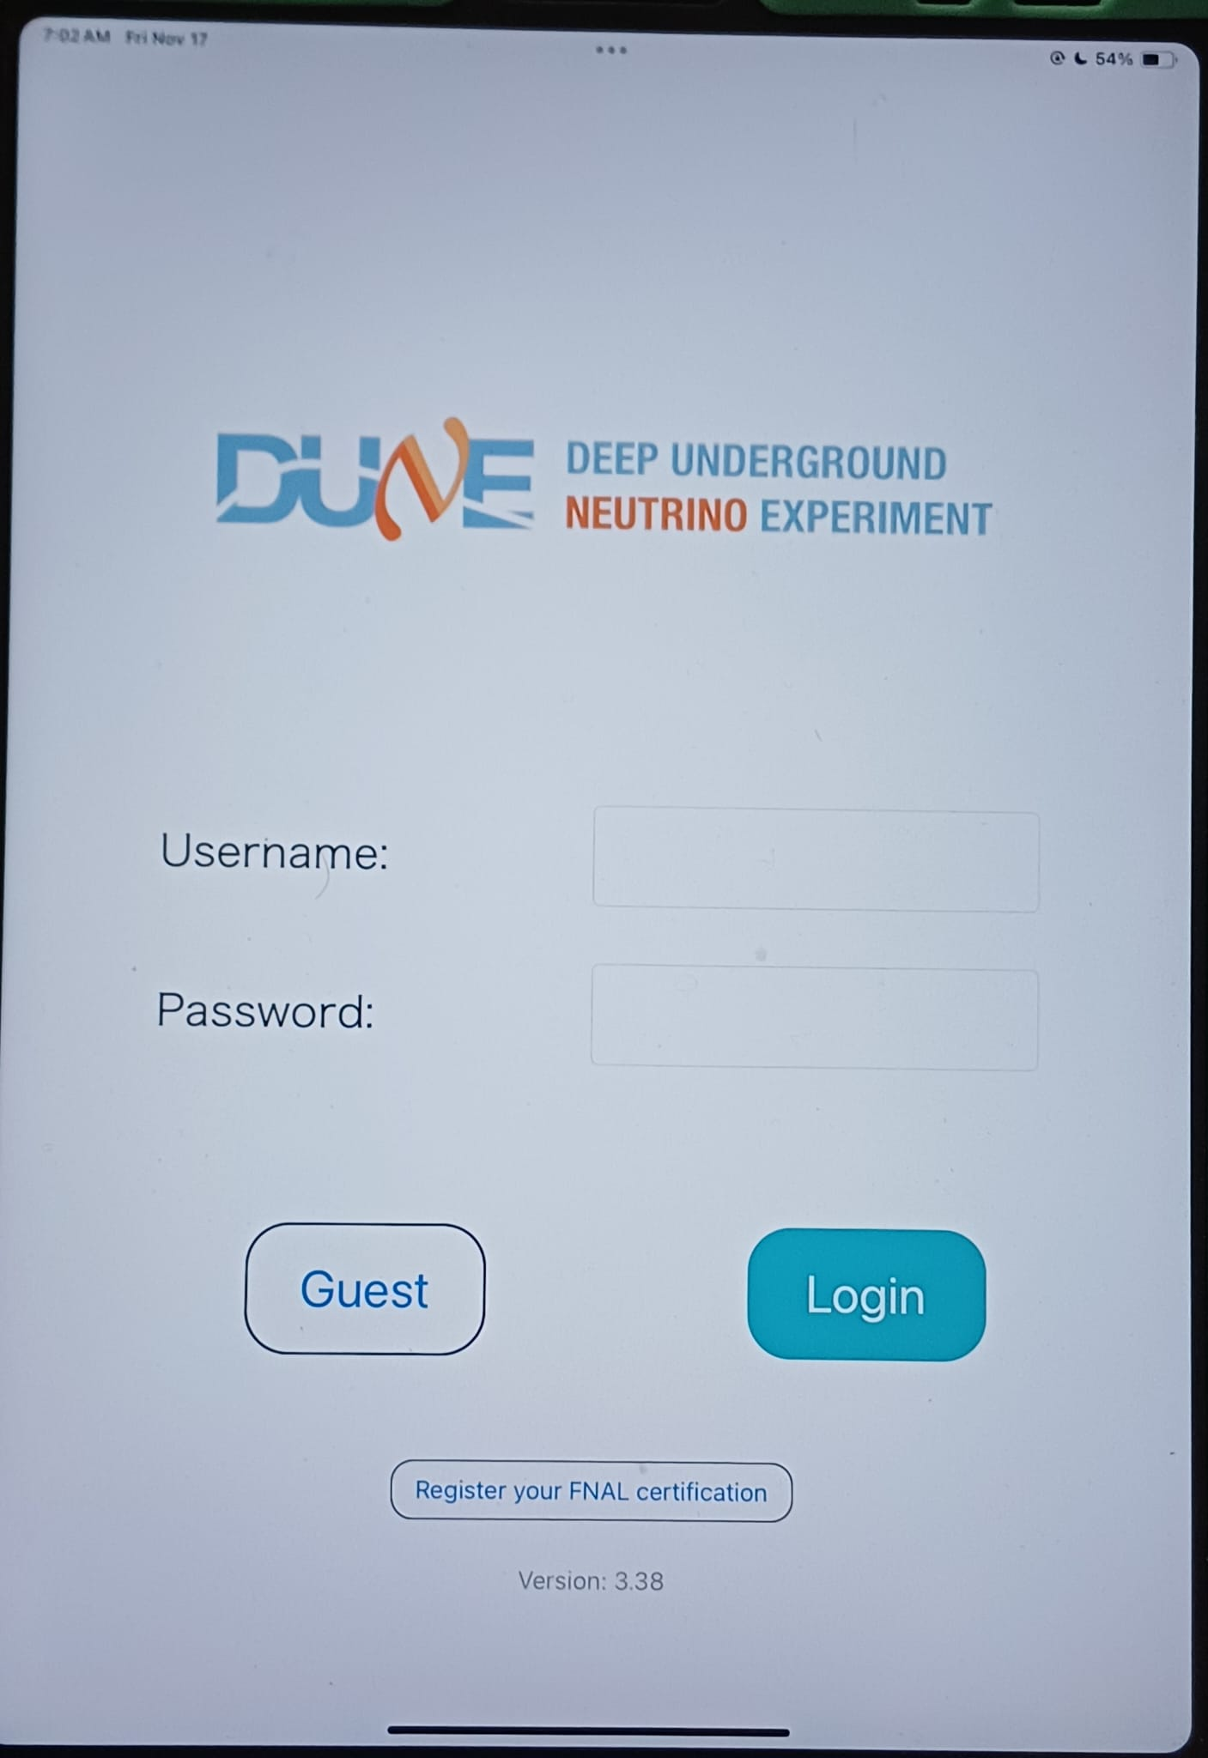
LOGIN
Login using your username and password
  To create login- FNAL account required
or
Login via guest account

Slide 4
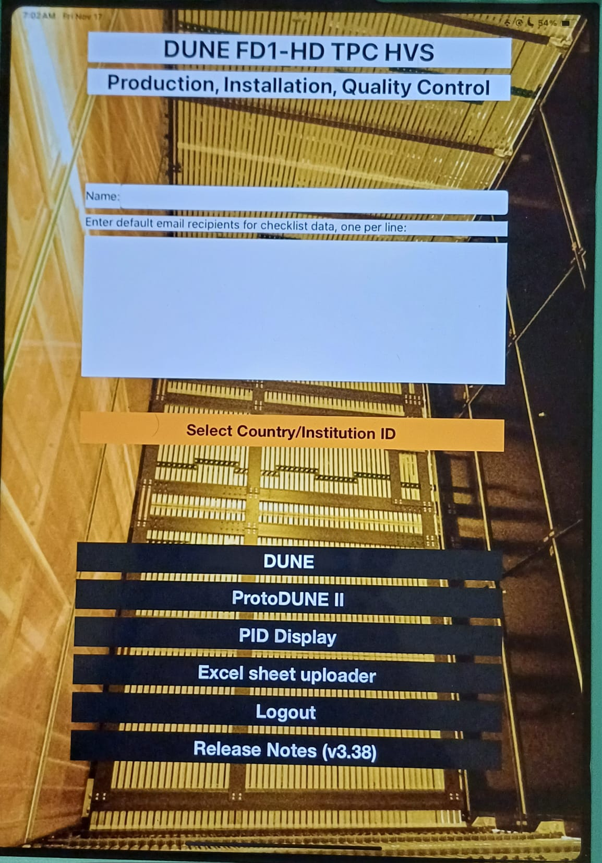
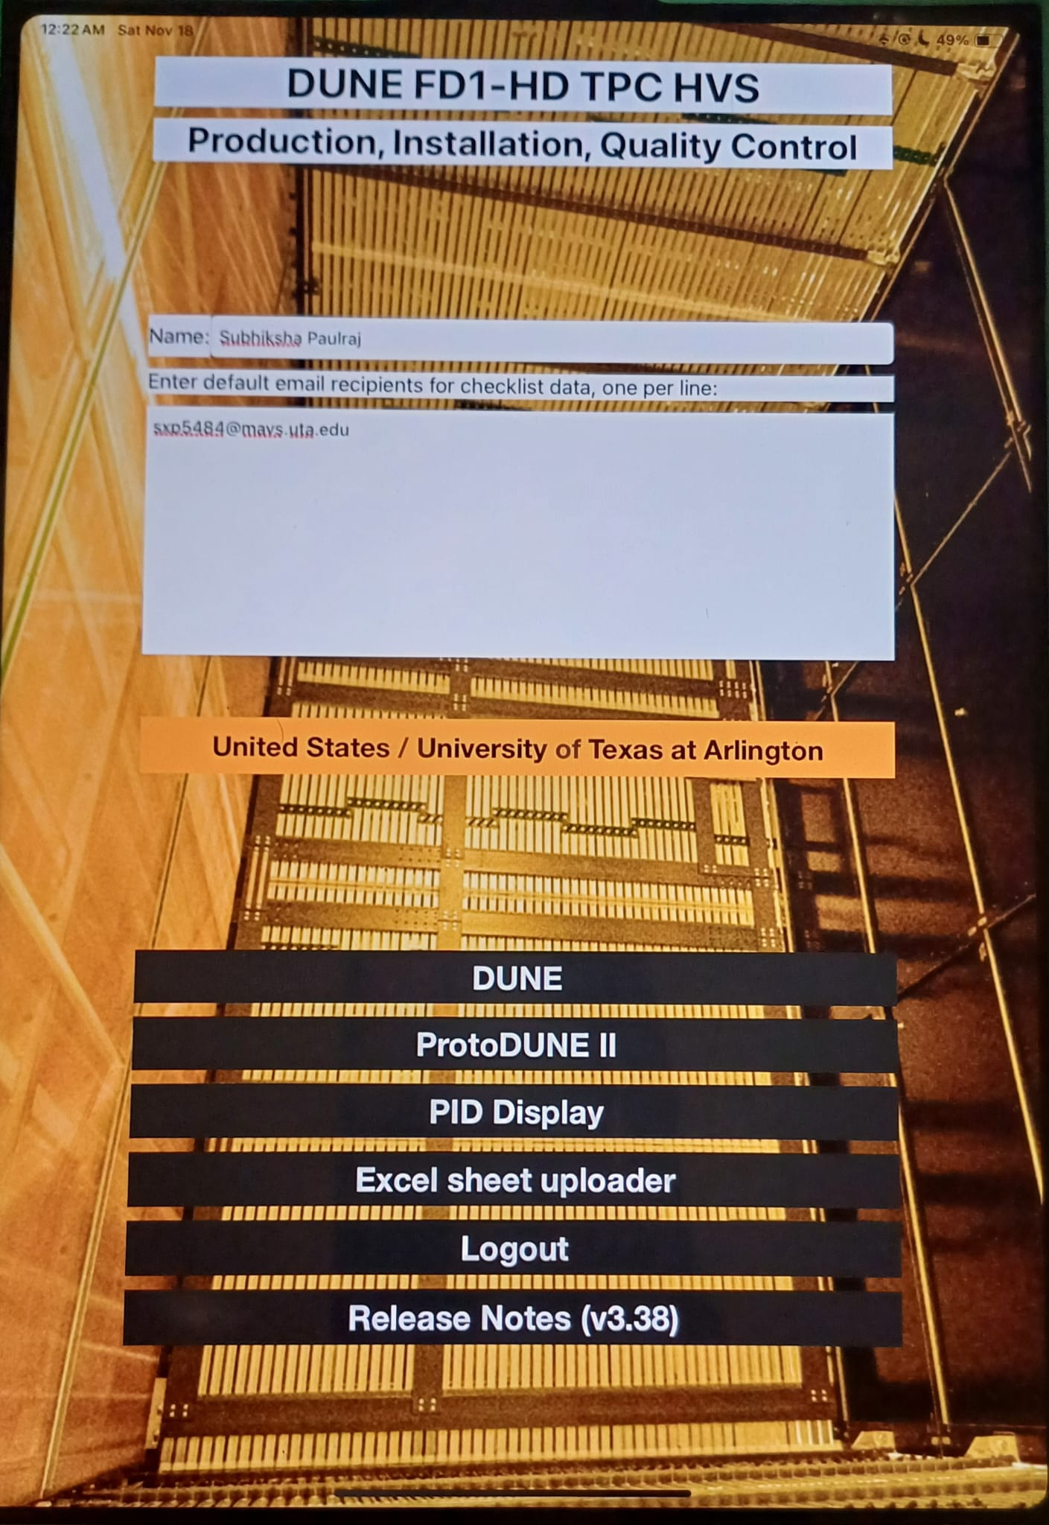
INTERFACE OF HWDB
After we login
Select
University of Texas at Arlington
Enter your name
and email

Slide 5
Field Cage -> Parts

Slide 6
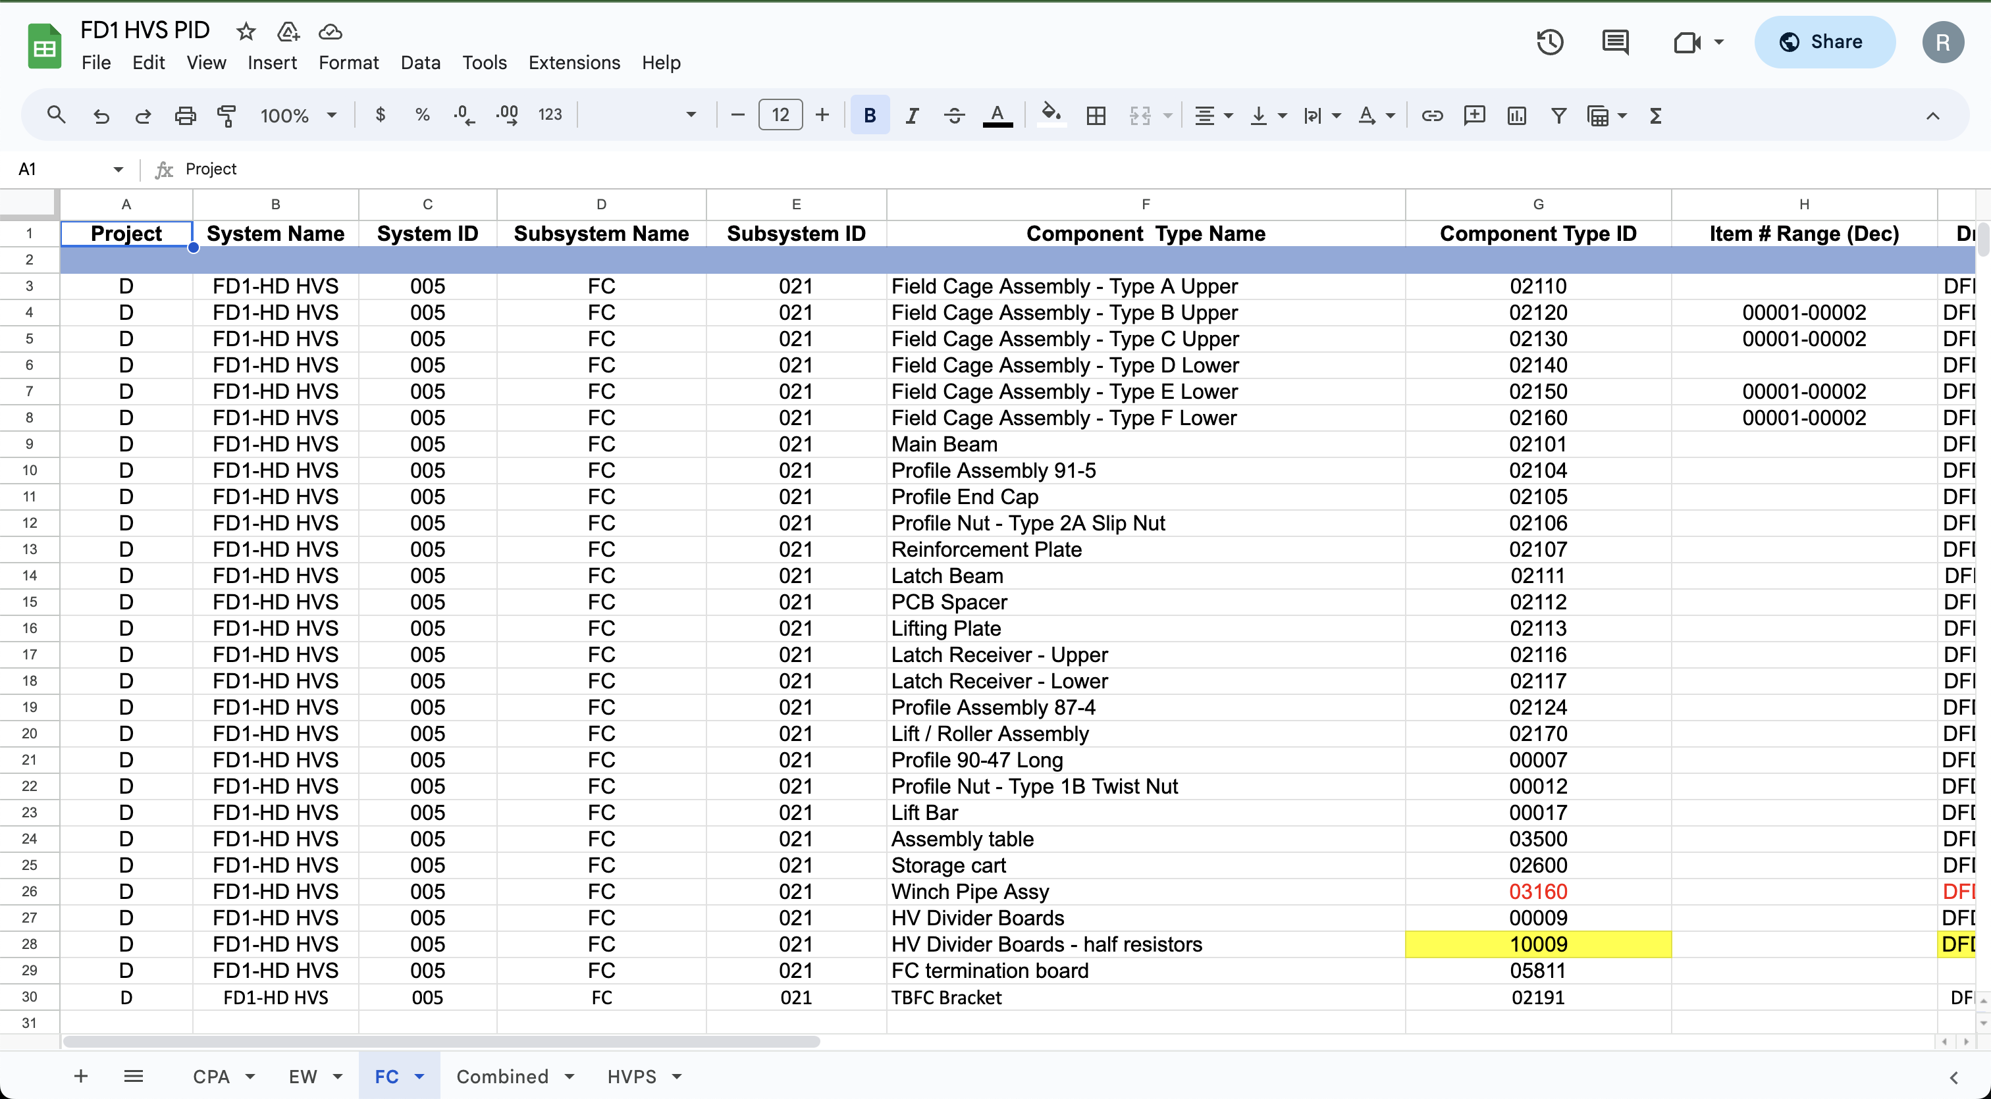
Visual Inspection and Part Id
Visual Inspection, check for all the possible damages, depending on the experience. No rigorous process.
Make comments, if the profile disqualify inspection.
Each parts processed have their own unique part id.

Slide 7
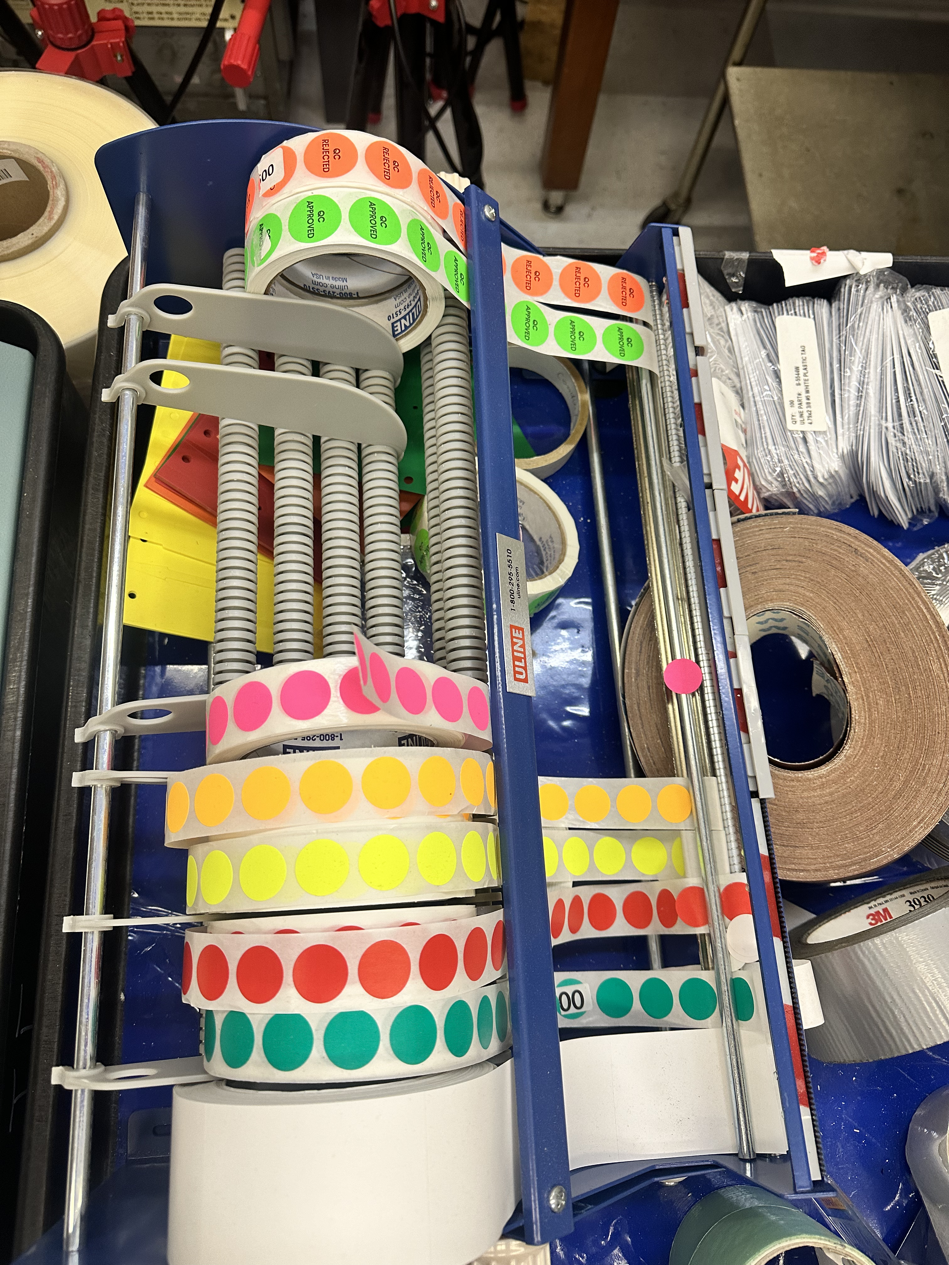
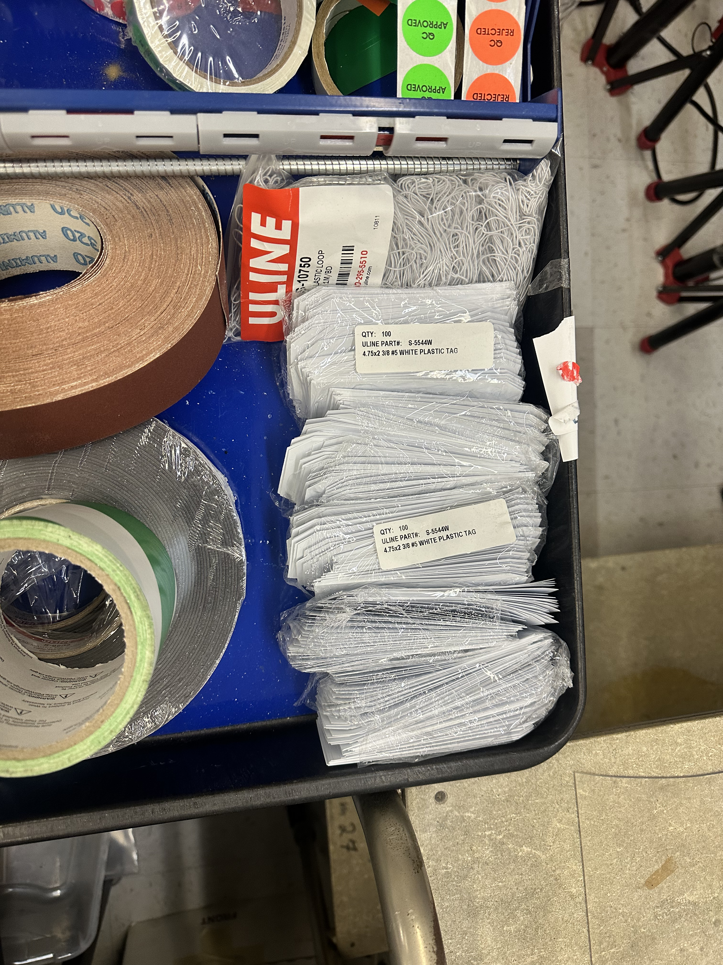
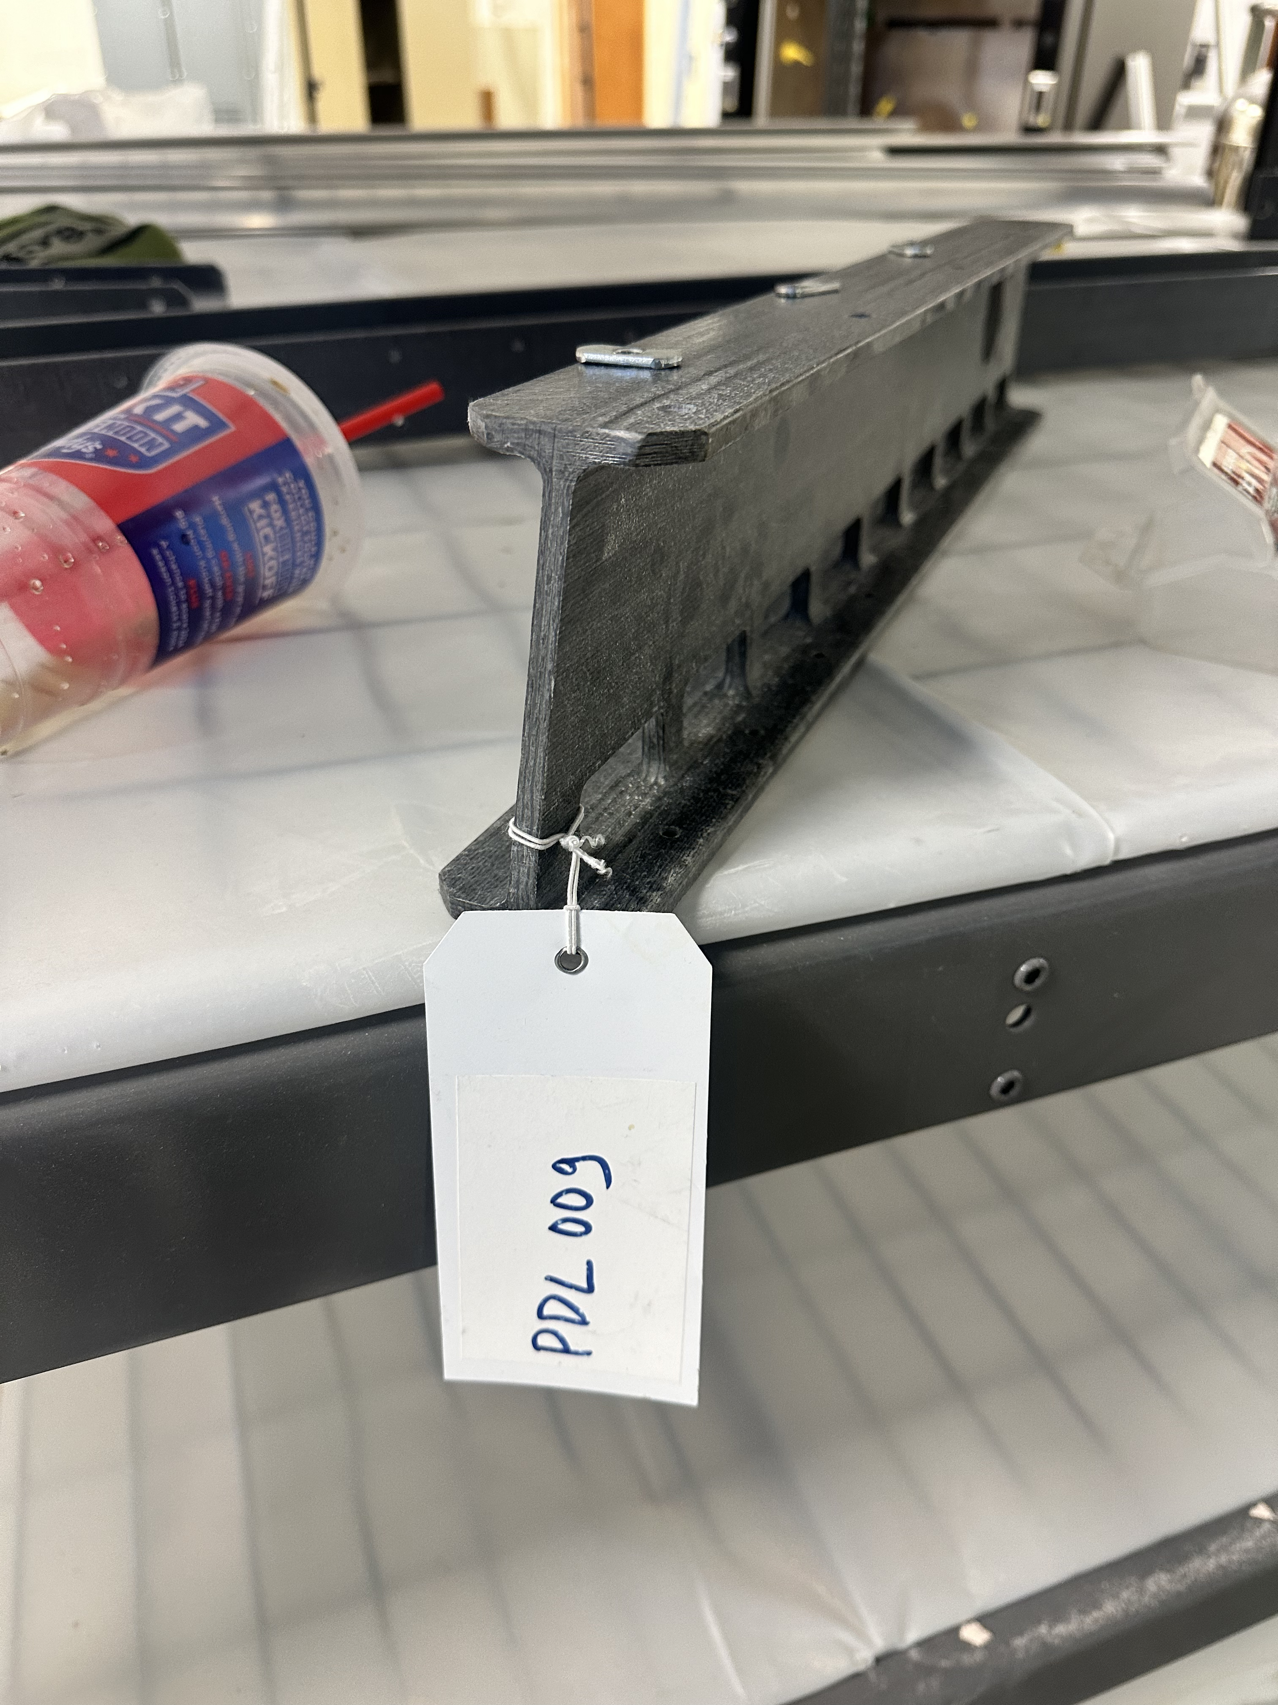
Quality Control (QC)
Once Parts qualify visual Inspection, each sticker is used to unique track.

Slide 8
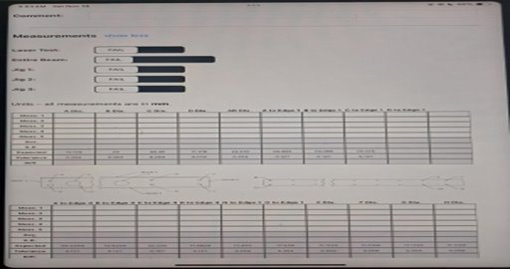
Measurement
Measurement is taken at the measurement section of app.
Measurement should be within the tolerance limit.

Slide 9
UPDATING THE DATA
Once data is entered, it can be saved locally or
directly uploaded to the app.
(To upload them to database all the data
Needs to be inserted in the first place)
sending email
Uploading to database
Saving locally
Loading DB

