Slide 1
14 T: Model status
Susana Izquierdo Bermudez
November 2023

Slide 2
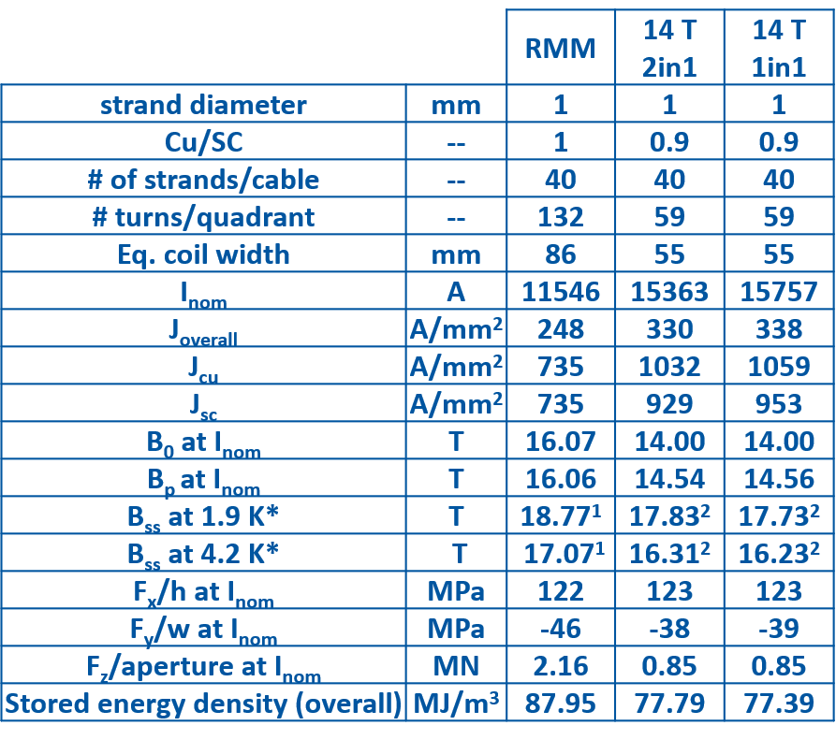
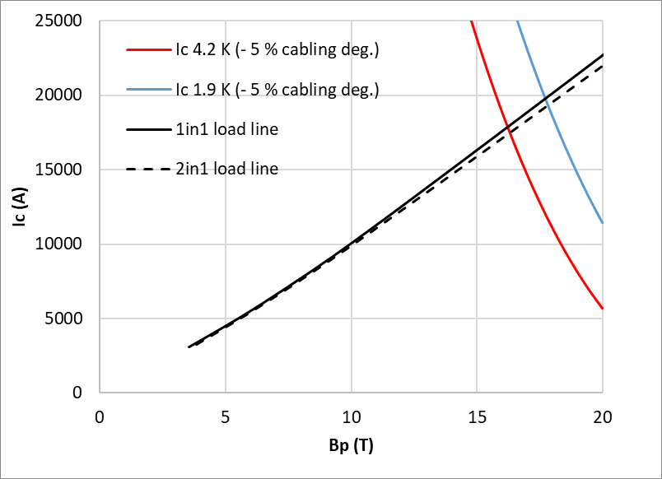
Reference design
Reference design: 40 strands ‘available’ cable
¹ Based on extracted samples reacted with the coil
₂ Reference HFM Jc, including 5 % cabling degradation

Slide 3
Working principle
A copy of the models I developed so far is available here:
  \\CERN\dfs\Workspaces\m\MDT_Mechanics\14T\SIB
Typically, in my folders:
  you will always find a *.history text file to follow the evolution of the design/studies
  a ‘Reference’ file with the latest reference model
  Note:
    the reference file is verified, if you go through the full history, you can find models with errors/modifications that are not ok, so be careful!
    if you have a doubt or find something wrong, please ask!

Slide 4
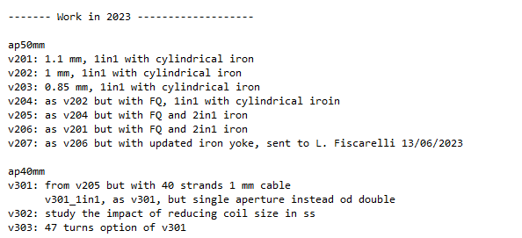
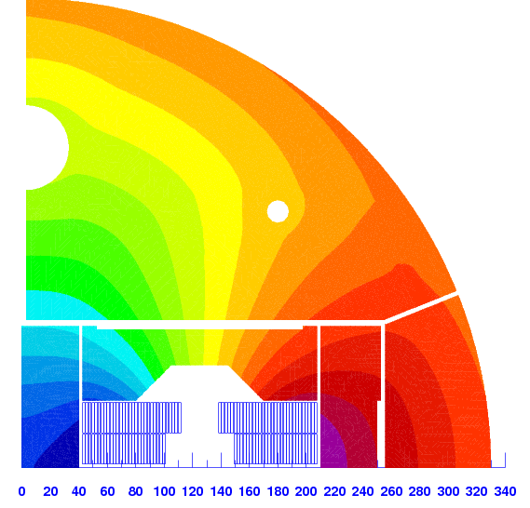
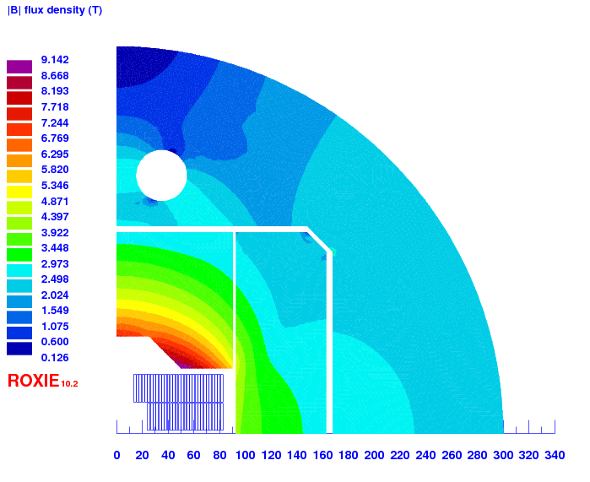
Electromagnetic design
Reference
Studies performed so far (all in 2D):
  Geometric coil field quality optimization
  The role of the iron (https://indico.cern.ch/event/1299122/)
Next step:
  Update coil geometry based on winding tests
  Fine tuning of the iron geometry close to the pole in the 1in1
  For the 2in1, the geometry of the iron needs to be updated once we have an idea of the mechanical design

Slide 5
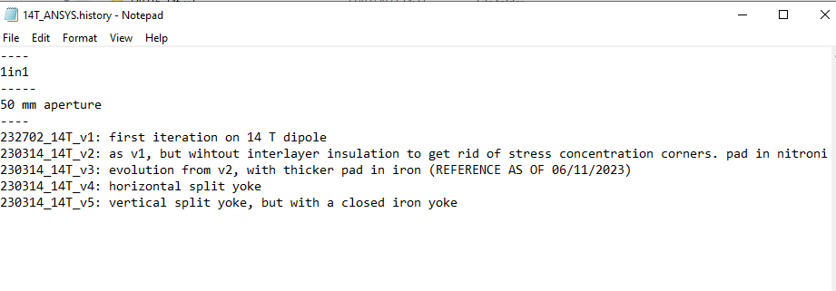
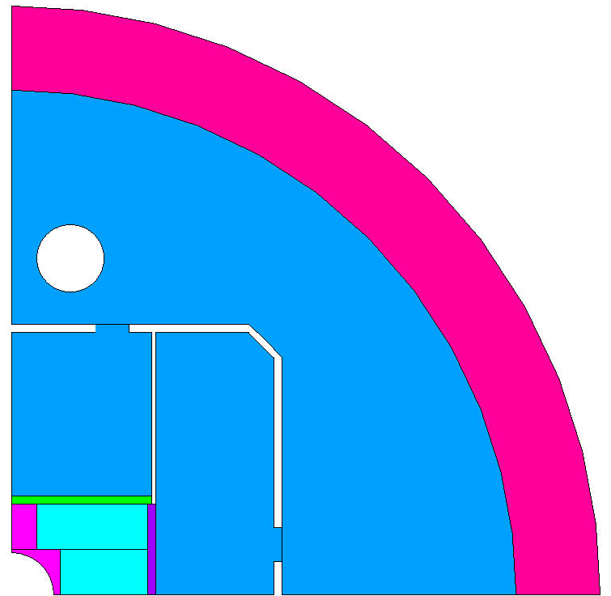
Mechanical design – ANSYS models
Reference
Studies performed so far (1in1):
  Main structural components optimization
  Vertical vs horizontal split yoke, closed vs open yoke
Next step (1in1):
  Reduce the aperture and update the coil geometry from the reference 1in1 magnetic design (now it is 50 mm)
  Implement the detailed iron geometry (vpad is missing the ‘insert’)
For the 2in1, we need to see with Emma once she is back

