Slide 1
EMWSD / Wakis
Electromagnetic and Wake Solver Development
Meeting #18
Elena de la Fuente
Carlo Zannini, Lorenzo Giacomel, Giovanni Iadarola

Slide 2
1. Where are we?
2. Main improvements
3. Some (fun) examples
4. Feedback from University
5. Conclusions & Next steps
Outline

Slide 3
PhD roadmap
  2023: Jul – Ago (2 months):
    Physics review FIT
    3D Eqs in python
    Test in cube (PEC BCs not working!)
  2023: Sep-Dic (4 months):
    PEC BCs
    Embedded boundaries
    Add PML/CPML
    First taste of materials
  2024: Jan–April (4 months):
    UNIT TEST
    (…)
We are here !

Slide 4
1. Where are we?
2. Main improvements
3. Some (fun) examples
4. Feedback from University
5. Conclusions & Next steps
Outline

Slide 5











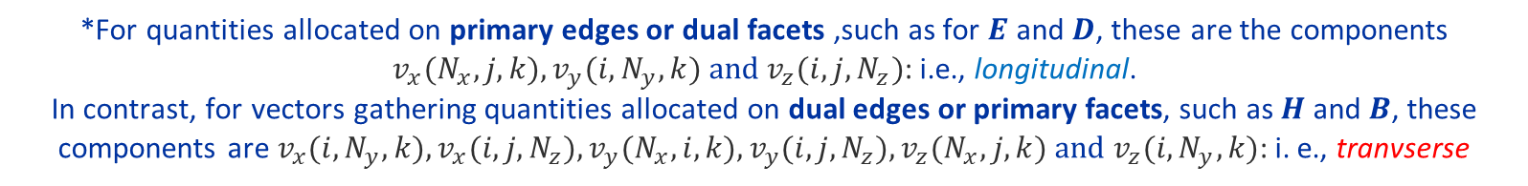
















































Primal grid $G$ vs tilde grid $\tilde{G}$
*For quantities allocated on primary edges or dual facets ,such as for $E$ and $D$, these are the components $v_{x}(N_{x},j,k),v_{y}(i,N_{y},k) and v_{z}(i,j,N_{z})$: i.e., longitudinal.
In contrast, for vectors gathering quantities allocated on dual edges or primary facets, such as $H$ and $B$, these components are $v_{x}(i,N_{y},k), v_{x}(i,j,N_{z}), v_{y}(N_{x},i,k), v_{y}(i,j,N_{z}), v_{z}(N_{x},j,k) and v_{z}(i,N_{y},k)$: i. e., tranvserse
x
$$n_{1.1}$$
$$E_{x, 1,1}$$
$$E_{x, 2,1}$$
$$E_{x, 3,1}$$
$$E_{x, 4,1}$$
$$n_{1,1}$$
$$n_{2,1}$$
$$n_{3,1}$$
$$n_{4,1}$$
$$G$$
$$G$$
$$H_{z, 1,1}$$
$$H_{z, 2,1}$$
$$H_{z, 3,1}$$
$$H_{z, 4,1}$$
y
$$E_{y, 1,1}$$
$$E_{y, 2,1}$$
$$E_{y, 3,1}$$
$$E_{y, 4,1}$$
$$\tilde{G}$$
$$E_{x, 1,2}$$
$$E_{x, 2,2}$$
$$E_{x, 3,2}$$
$$E_{x, 4,2}$$
“Ghost cells”
$$H_{z, 1,2}$$
$$H_{z, 2,2}$$
$$H_{z, 3,2}$$
$$H_{z, 4,2}$$
$$E_{y, 1,2}$$
$$E_{y, 2,2}$$
$$E_{y, 3,2}$$
$$E_{y, 4,2}$$
$$E_{x, 1,3}$$
$$E_{x, 2,3}$$
$$E_{x, 3,3}$$
$$E_{x, 4,3}$$
$$H_{z, 1,3}$$
$$H_{z, 2,3}$$
$$H_{z, 3,3}$$
$$H_{z, 4,3}$$
$$E_{y, 1,3}$$
$$E_{y, 2,3}$$
$$E_{y, 3,3}$$
$$E_{y, 4,3}$$
$$E_{x, 1,4}$$
$$E_{x, 2,4}$$
$$E_{x, 3,4}$$
$$n_{4,4}$$
$$E_{x, 4,4}$$
$$H_{z, 1,4}$$
$$H_{z, 2,4}$$
$$H_{z, 3,4}$$
$$H_{z, 4,4}$$
$$E_{y, 1,4}$$
$$E_{y, 2,4}$$
$$E_{y, 3,4}$$
$$E_{y, 4,4}$$
*Source: Klaus Klopfer PhD thesis [2014]

Slide 6
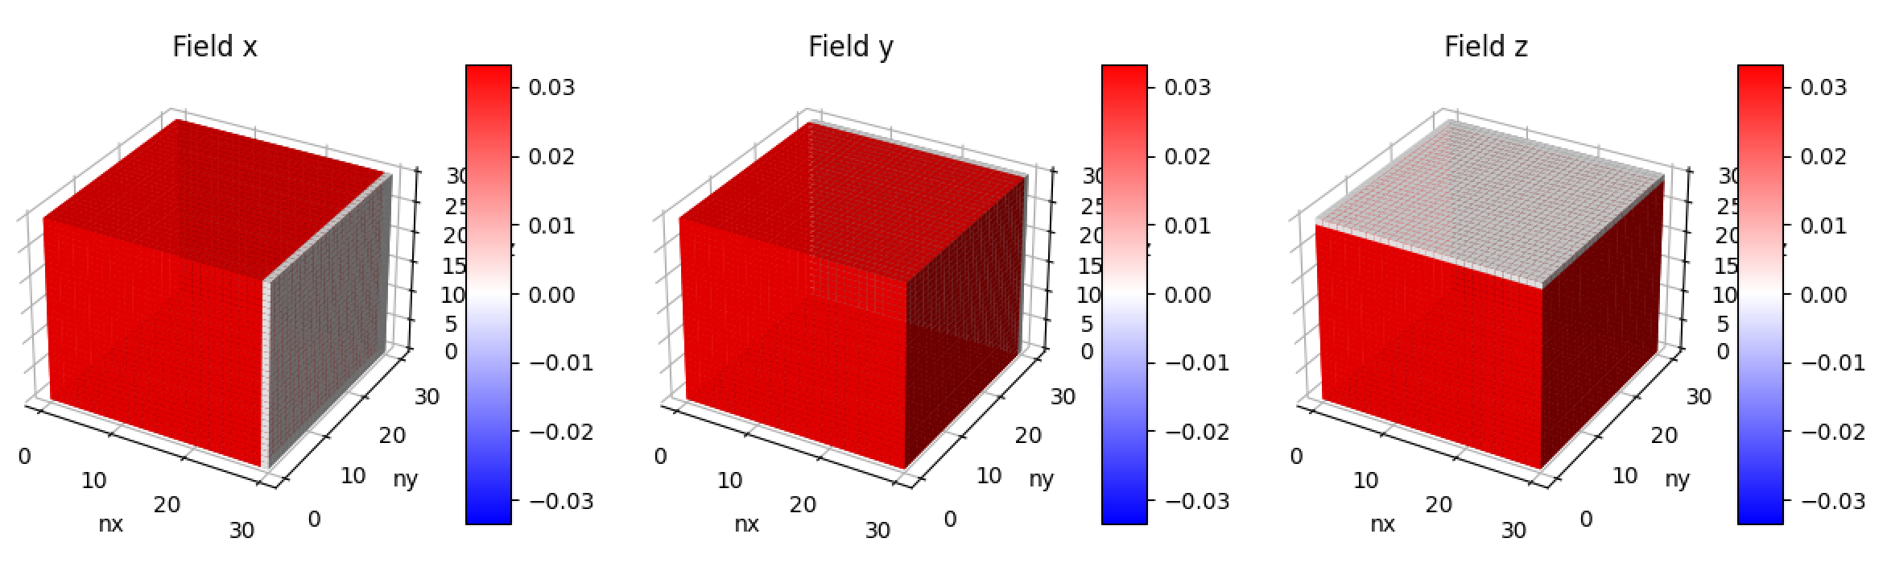
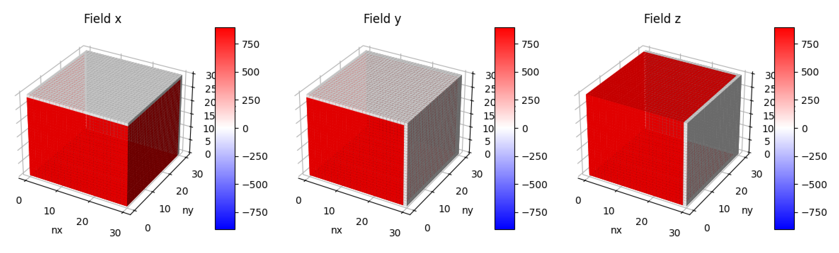
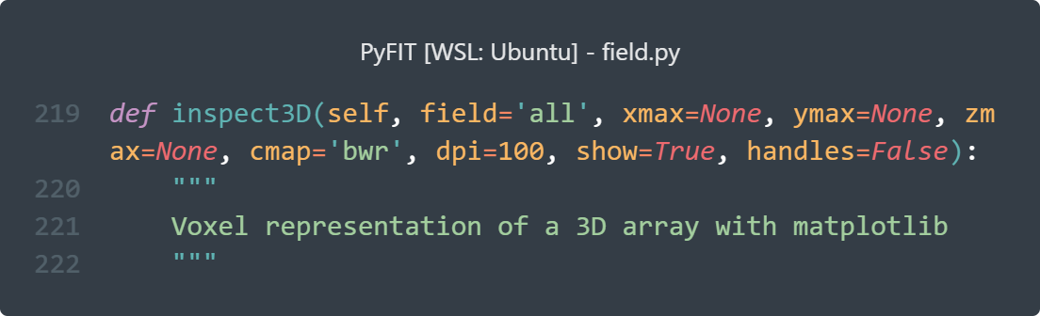

Primal grid $G$ vs tilde grid $\tilde{G}$ (II)
We can enforce the quantities at the ghost cells to be zero using the lengths and areas diagonal matrices ${\tilde{D}}_{L}$, ${\tilde{D}}_{A}$
By definition, ${\tilde{x}}_{N_{x}}={\tilde{x}}_{N_{x}−1}$, ${\tilde{y}}_{N_{y}}={\tilde{y}}_{N_{y}−1}$ , ${\tilde{z}}_{N_{z}}={\tilde{z}}_{N_{z}−1}$.
This gives the following lengths ${\tilde{L}}_{x}={\tilde{x}}_{N_{x}}−{\tilde{x}}_{N_{x}−1}$and areas ${\tilde{A}}_{x}={\tilde{L}}_{y}⋅{\tilde{L}}_{z}$
$${\tilde{D}}_{L}=diag({\tilde{L}}_{x,0,0,0,}…,{\tilde{L}}_{x N_{x}, N_{y}, N_{z}}, …,{\tilde{L}}_{z, N_{x}, N_{y}, N_{z}})$$
3N x 3N
$${\tilde{D}}_{A}=diag({\tilde{A}}_{x,0,0,0,}…,{\tilde{A}}_{x N_{x}, N_{y}, N_{z}}, …,{\tilde{A}}_{z, N_{x}, N_{y}, N_{z}})$$
3N x 3N
**used built-in 3D plotting method

Slide 7
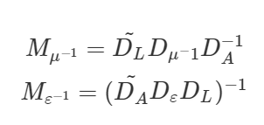

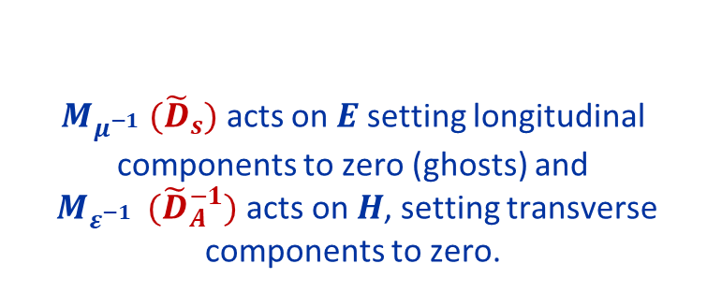
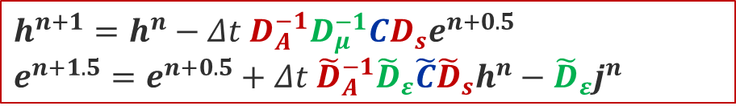

Primal grid $G$ vs tilde grid $\tilde{G}$ (III)
To use ${\tilde{D}}_{L}$, ${\tilde{D}}_{A}$ correctly, we need to change the update equations:
New update equations agree with the definition of the Material matrices given in [1]:
$$h^{n+1}=h^{n}−Δt{ D}_{A}^{−1}D_{μ}^{−1}CD_{s}e^{n+0.5}$$
$$e^{n+1.5}=e^{n+0.5}+Δt {\tilde{D}}_{A}^{−1}{\tilde{D}}_{ε}\tilde{C}{\tilde{D}}_{s}h^{n}−{\tilde{D}}_{ε}j^{n}$$
$M_{μ^{−1}}{ (\tilde{D}}_{s})$ acts on $E$ setting longitudinal components to zero (ghosts) and
$M_{ε^{−1}}$ ${ (\tilde{D}}_{A}^{−1})$acts on $H$, setting transverse components to zero.
$$h^{n+1}=h^{n}−Δt{ {\tilde{D}}_{s}D_{μ}^{−1}D}_{A}^{−1}Ce^{n+0.5}$$
$$e^{n+1.5}=e^{n+0.5}+ΔtD_{s}{\tilde{D}}_{ε}{\tilde{D}}_{A}^{−1}\tilde{C}h^{n}−{\tilde{D}}_{ε}j^{n}$$
*[1]: Klaus Klopfer PhD thesis [2014]

Slide 8
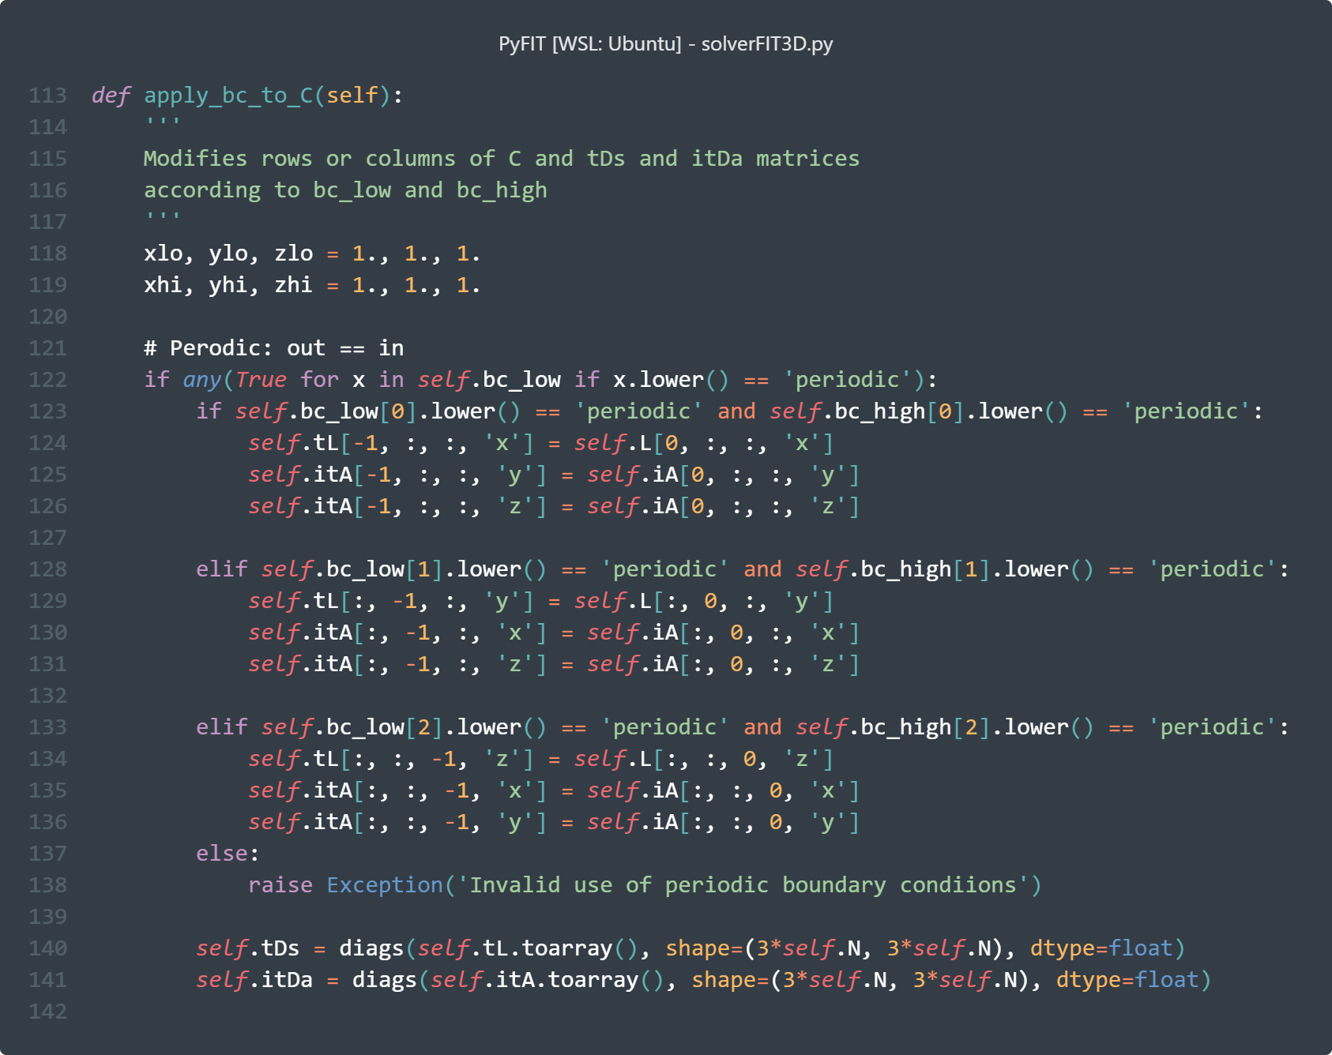
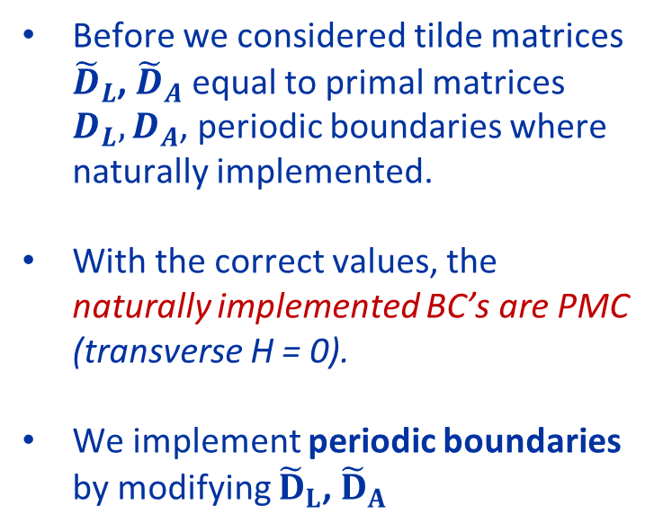
PEC, PMC & Periodic boundaries (I)
PERIODIC BCs
Before we considered tilde matrices ${\tilde{D}}_{L}$, ${\tilde{D}}_{A}$ equal to primal matrices $D_{L}, D_{A}$, periodic boundaries where naturally implemented.
With the correct values, the naturally implemented BC’s are PMC (transverse H = 0).
We implement periodic boundaries by modifying ${\tilde{D}}_{L}$, ${\tilde{D}}_{A}$

Slide 9
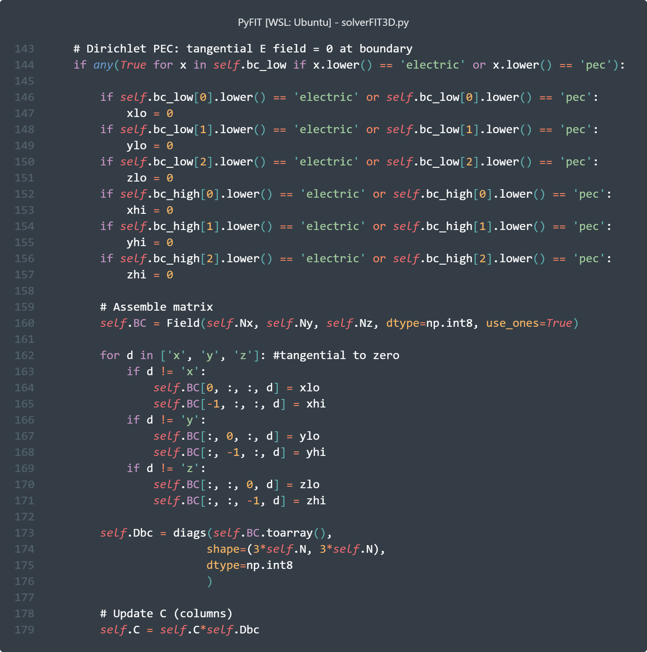
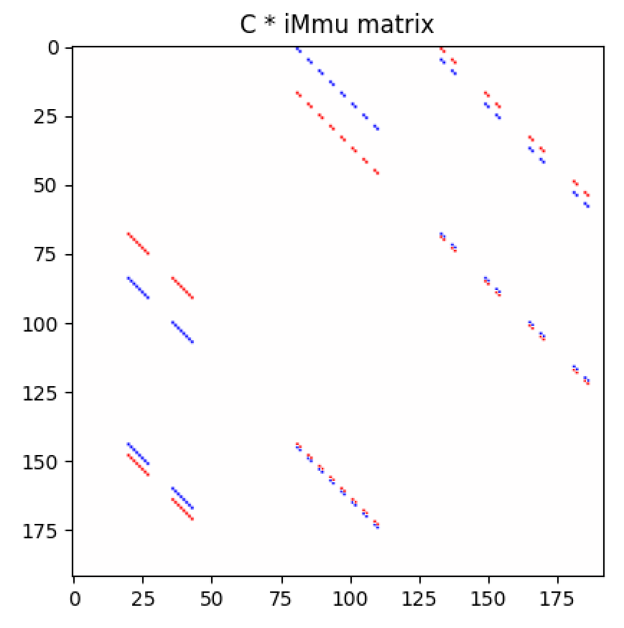
PEC, PMC & Periodic boundaries (II)
PEC BCs
We modify the columns of matrix C by constructing an auxiliary diagonal matrix Dbc that will contain zeros where the transverse components of the E field should be zero.
To modify the columns, we multiply this matrix Dbc after C
Sparsity of the C matrix after applying PEC BC’s in all directions.
Domain with N = 4x4x4. Size of C = 3N x 3N

Slide 10
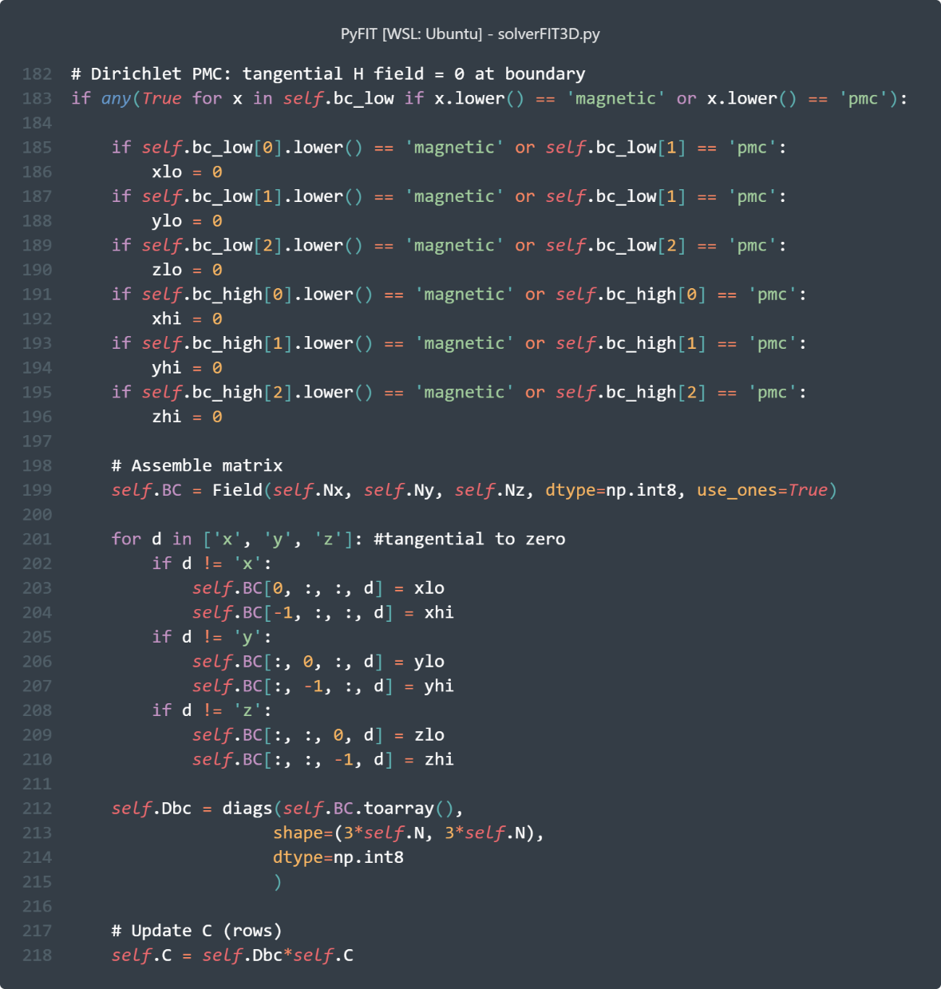
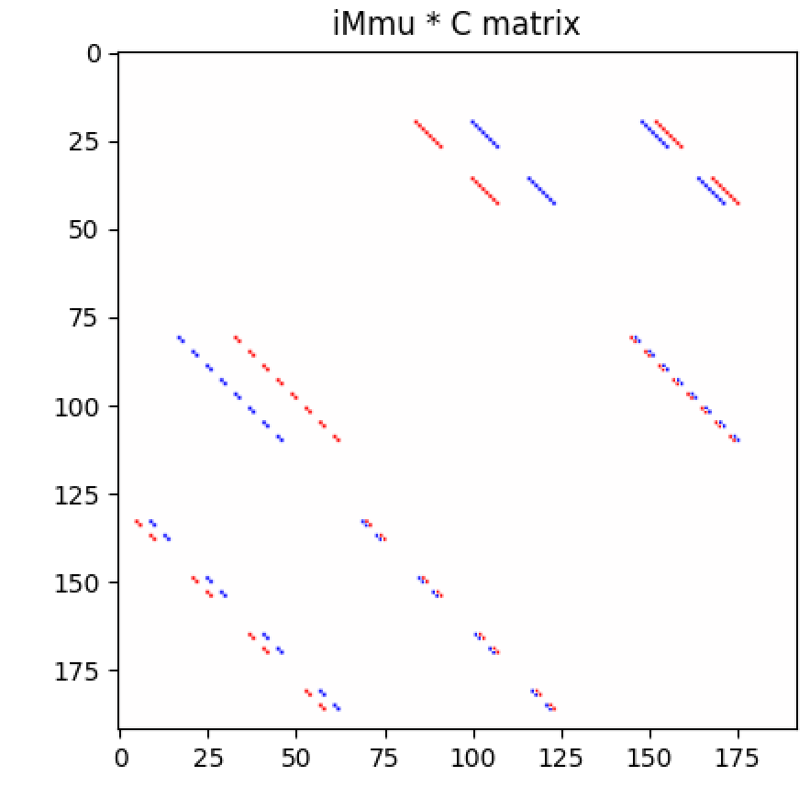
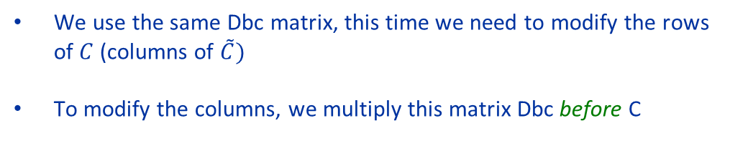
PEC, PMC & Periodic boundaries (III)
PMC BCs
We use the same Dbc matrix, this time we need to modify the rows of $C$ (columns of $\tilde{C})$
To modify the columns, we multiply this matrix Dbc before C
Sparsity of the C matrix after applying PMC BC’s in all directions.
Domain with N = 4x4x4. Size of C = 3N x 3N

Slide 11
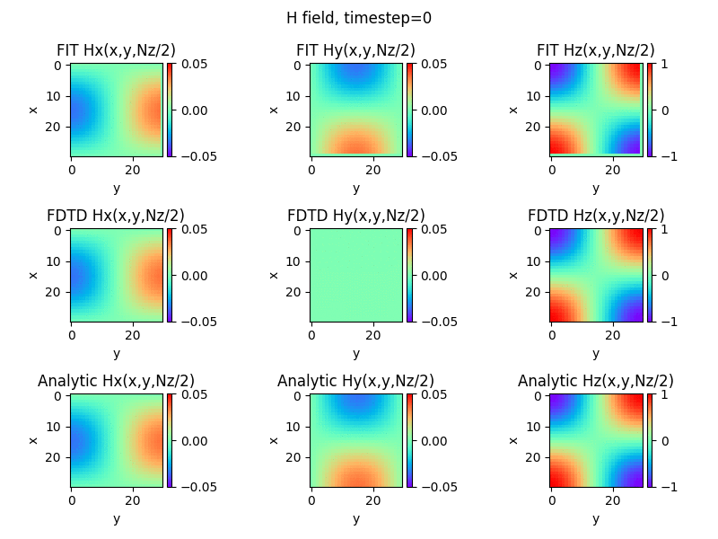
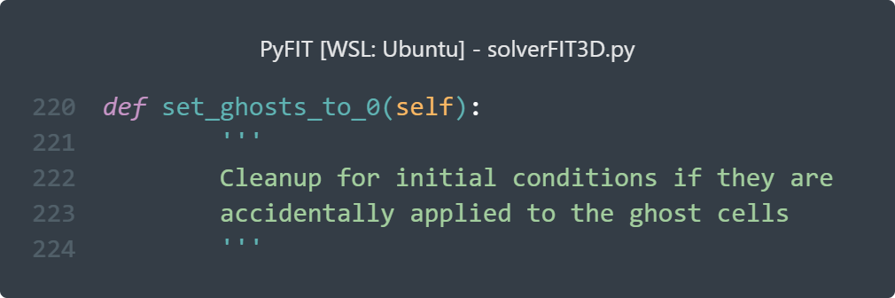

Resonator test: PEC BC’s
All PEC BCs
Vacuum
y
x
z
TE111
Plane XY
Initial condition: the 3D analytic solution of a cubic resonator mode TE111 for $H_{x}, H_{y}, H_{z}$
**special routine created for 3D IC, applied before 1st timestep

Slide 12
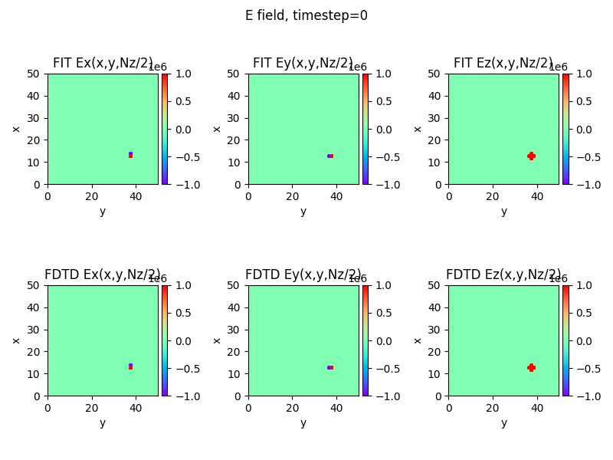

Perturbation test: Periodic BC’s
All Periodic BCs
Vacuum
Perturbation
Plane XY
***FDTD does not have Periodic implemented
Perturbation at $\frac{3}{4}N_{x}$, $\frac{3}{4}N_{y}$, $\frac{1}{2}N_{z}$

Slide 13
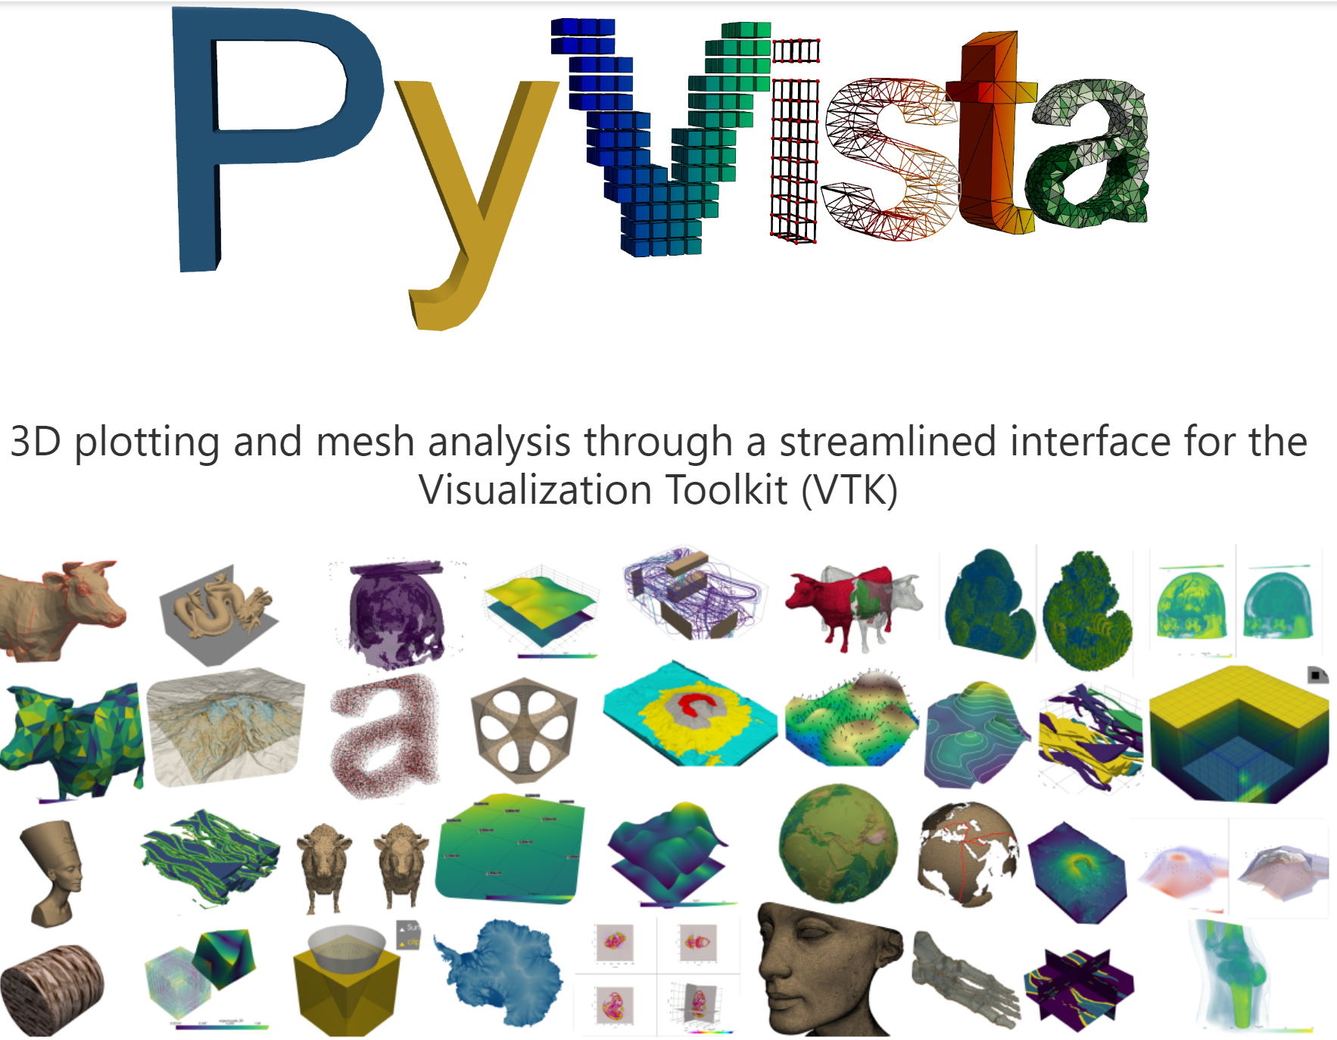
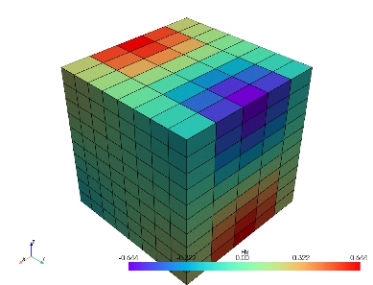
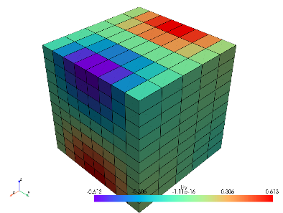
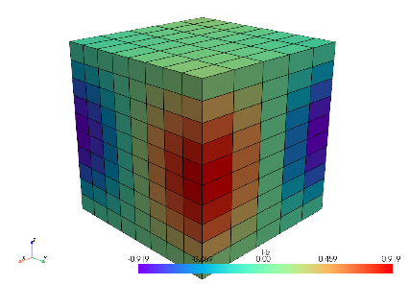
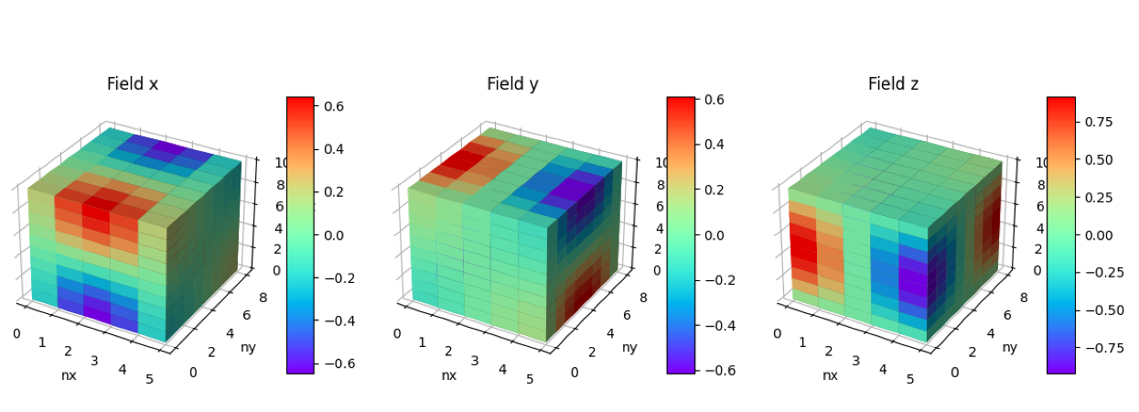
STL importer with PyVista
https://pyvista.org/
Docs: https://docs.pyvista.org/version/stable/#status
Vtk is x1000 faster than matplotlib for 3D plotting
PyVista (0s) for 400 cells
Matplotlib voxel (2’ 30s) for 400 cells

Slide 14
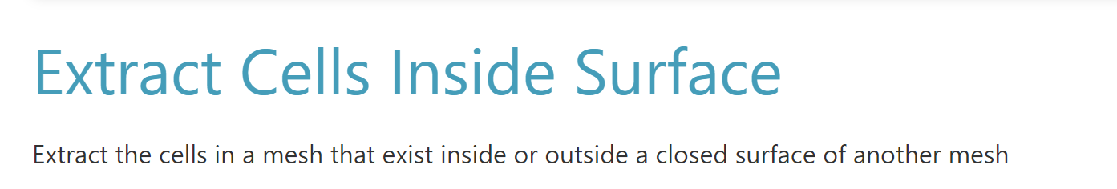
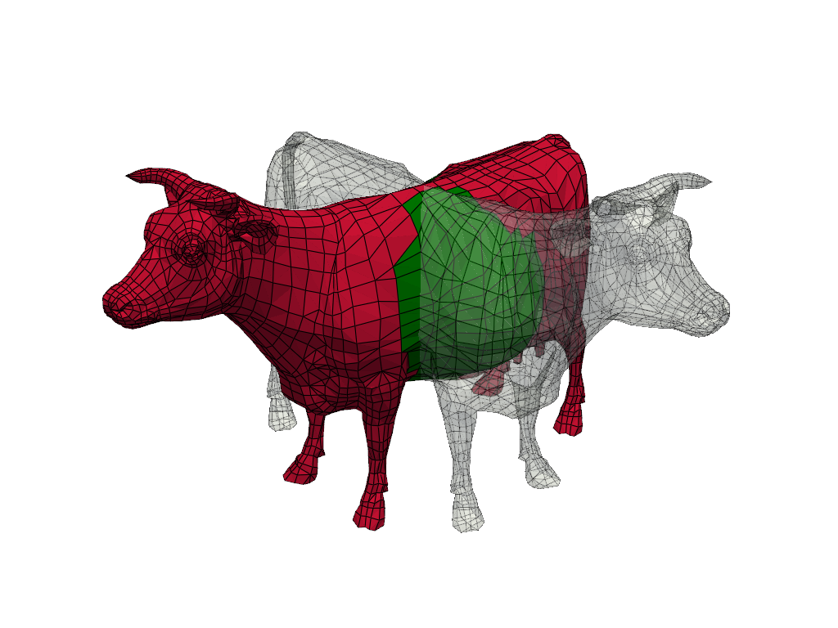
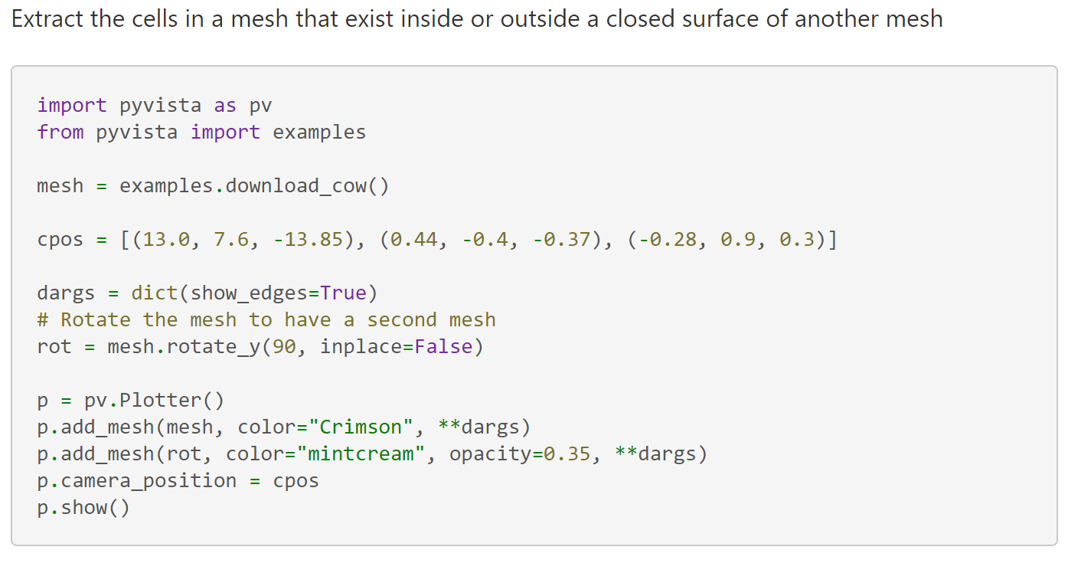
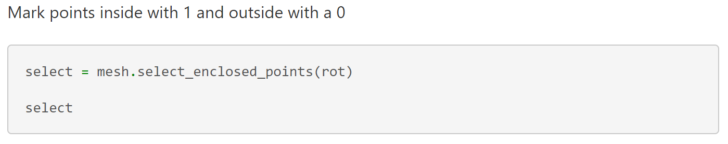
STL importer with PyVista (II)

Slide 15
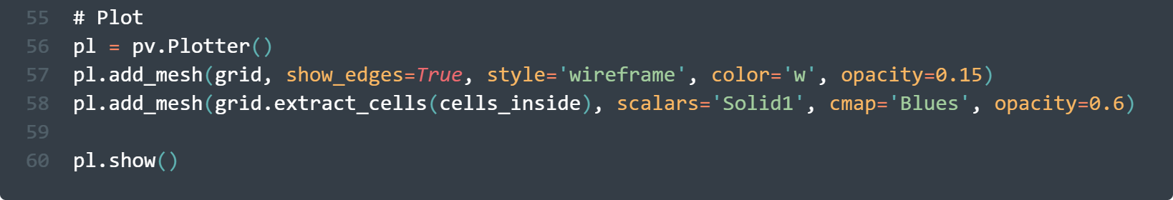
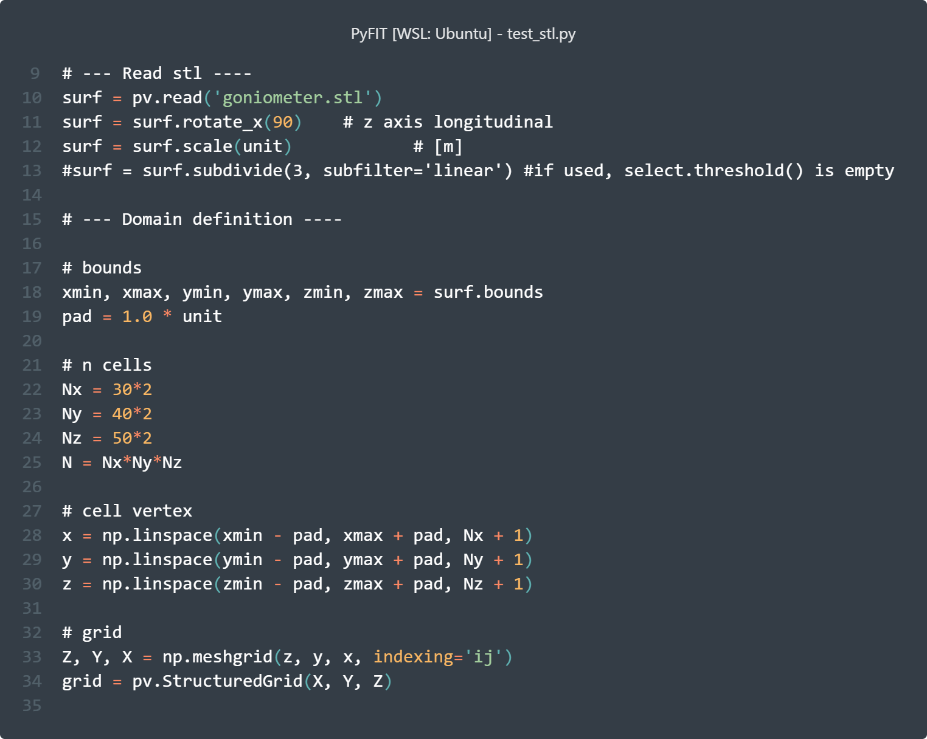
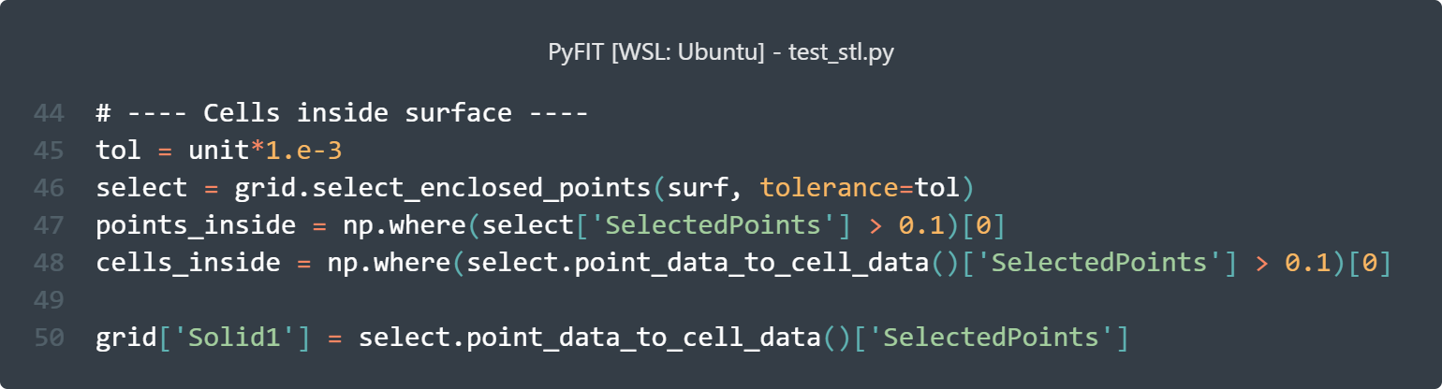
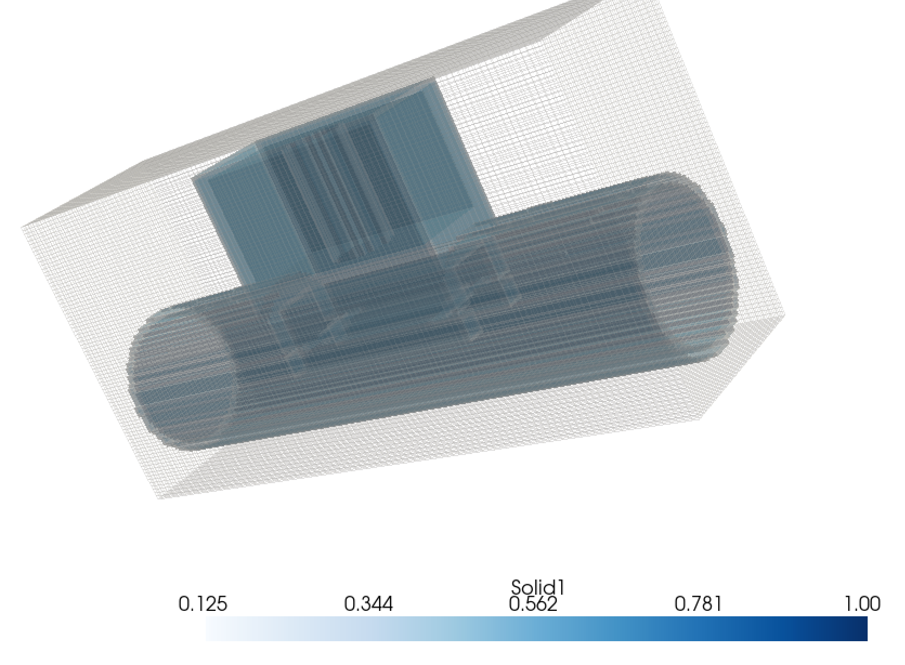
STL importer with PyVista (III)
Import Goniometer stl
Runtime (2s) for 480.000 cells, included plotting

Slide 16

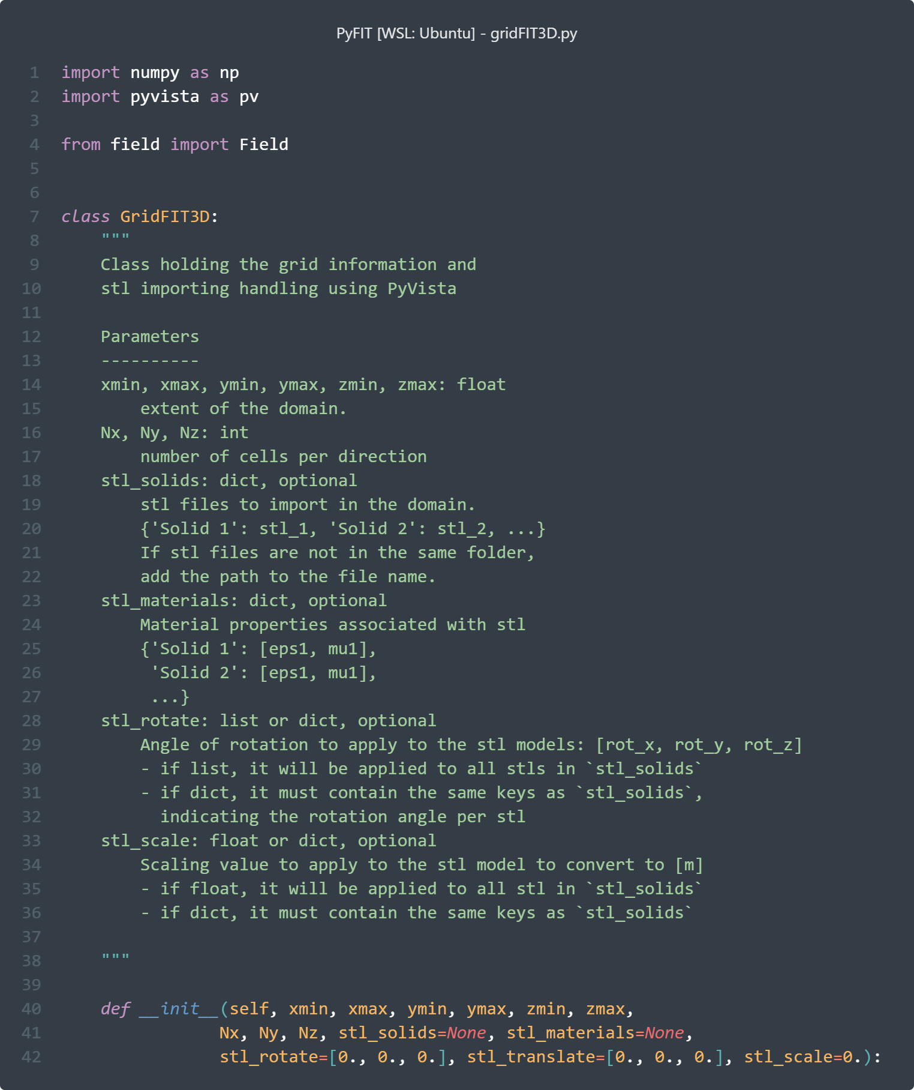
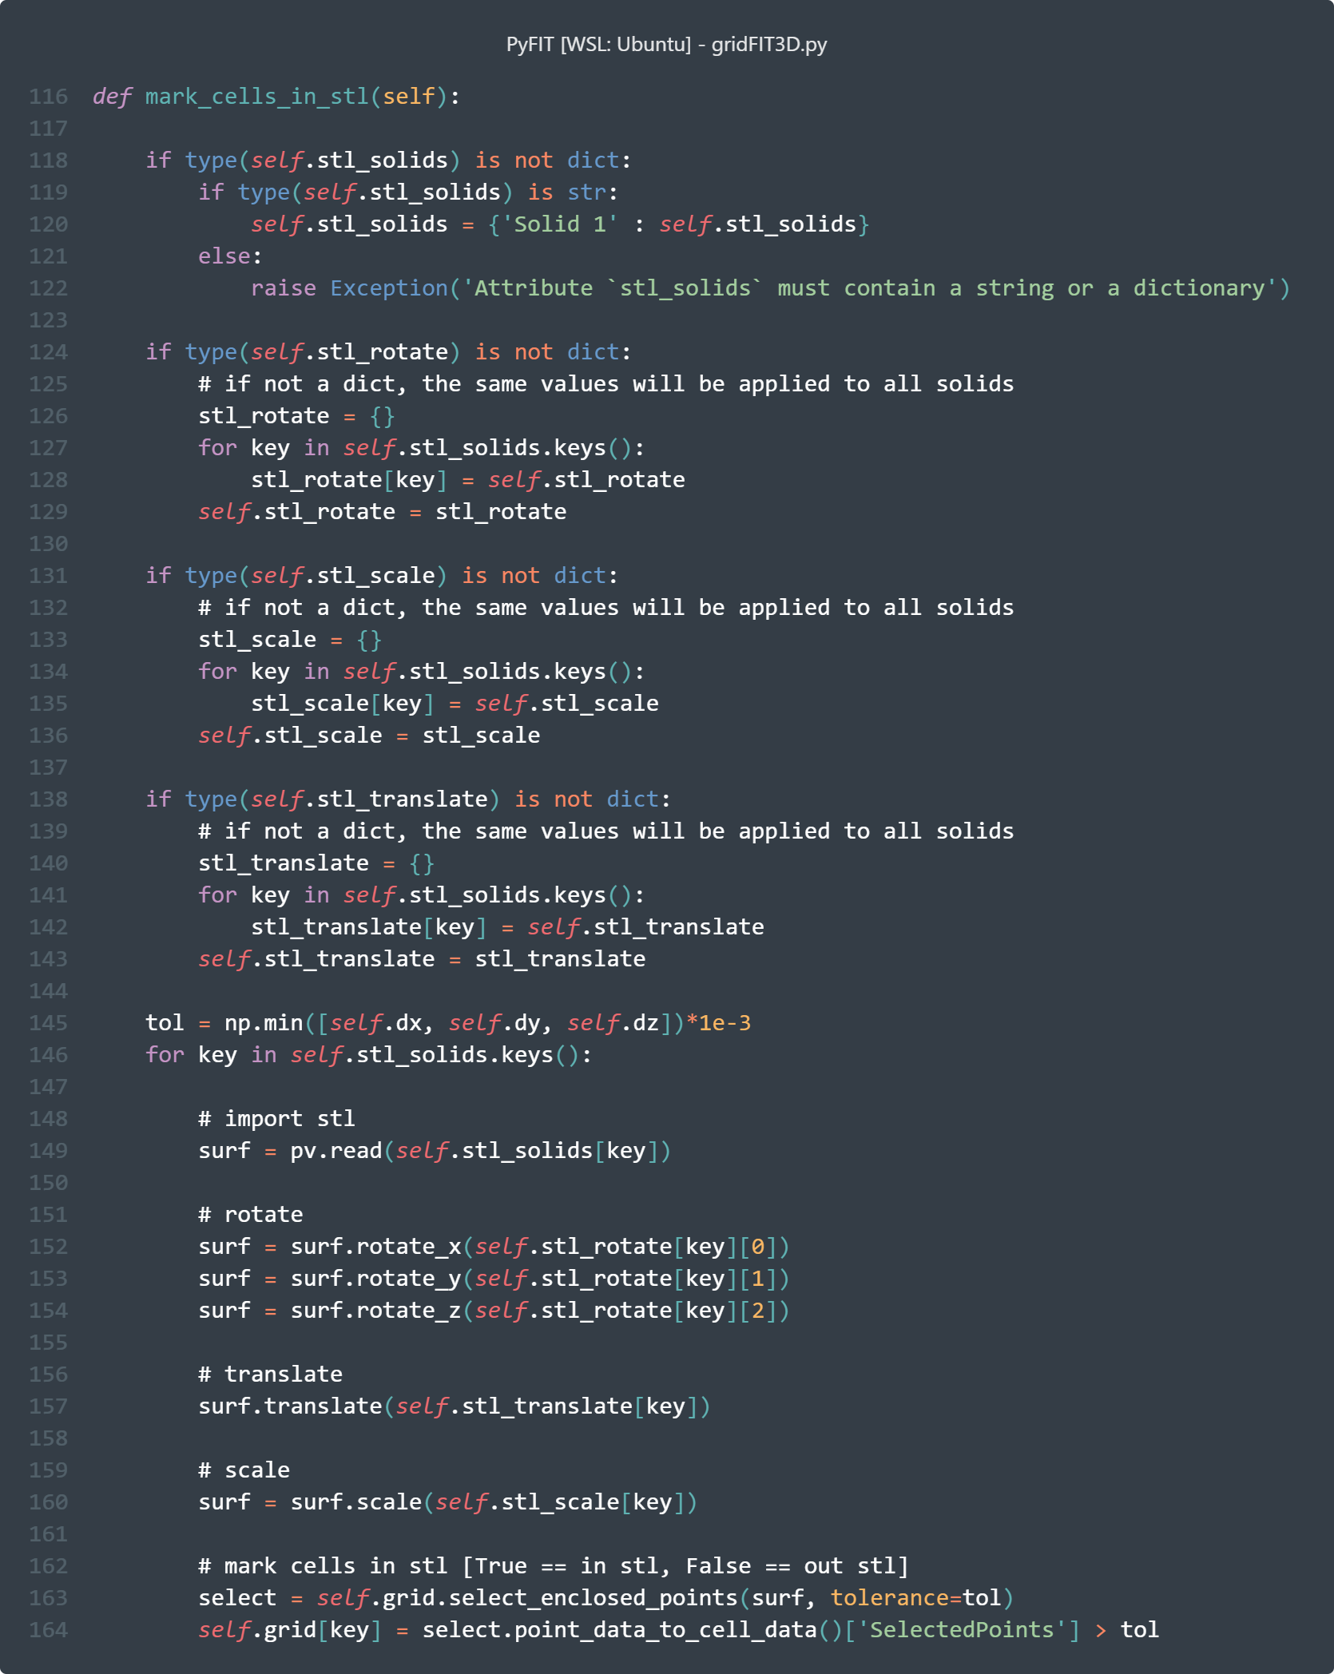
Adding STL and materials to FIT
New grid ‘GridFIT3D’ class:
Creates grid with a PyVista Structured Grid object
Computes lengths and areas for primal and tilde grid diagonal matrices
Imports stl by marking the cells inside the (closed) surface (True/False)
Staircased for now, but potential for pixel smoothing!

Slide 17
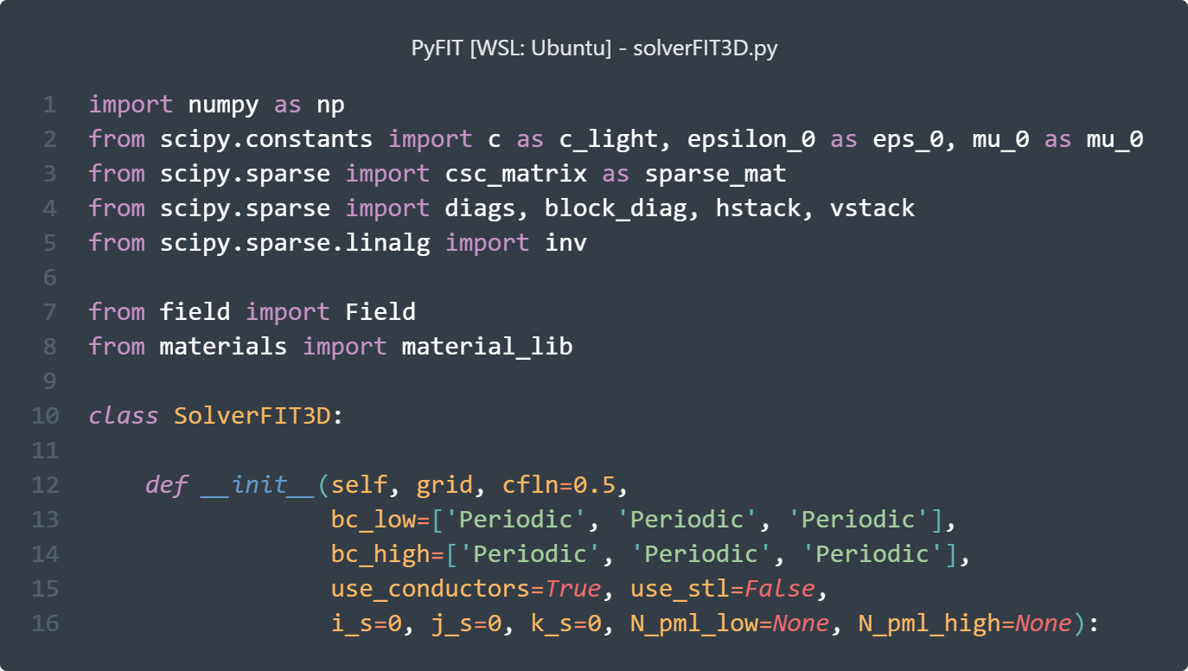
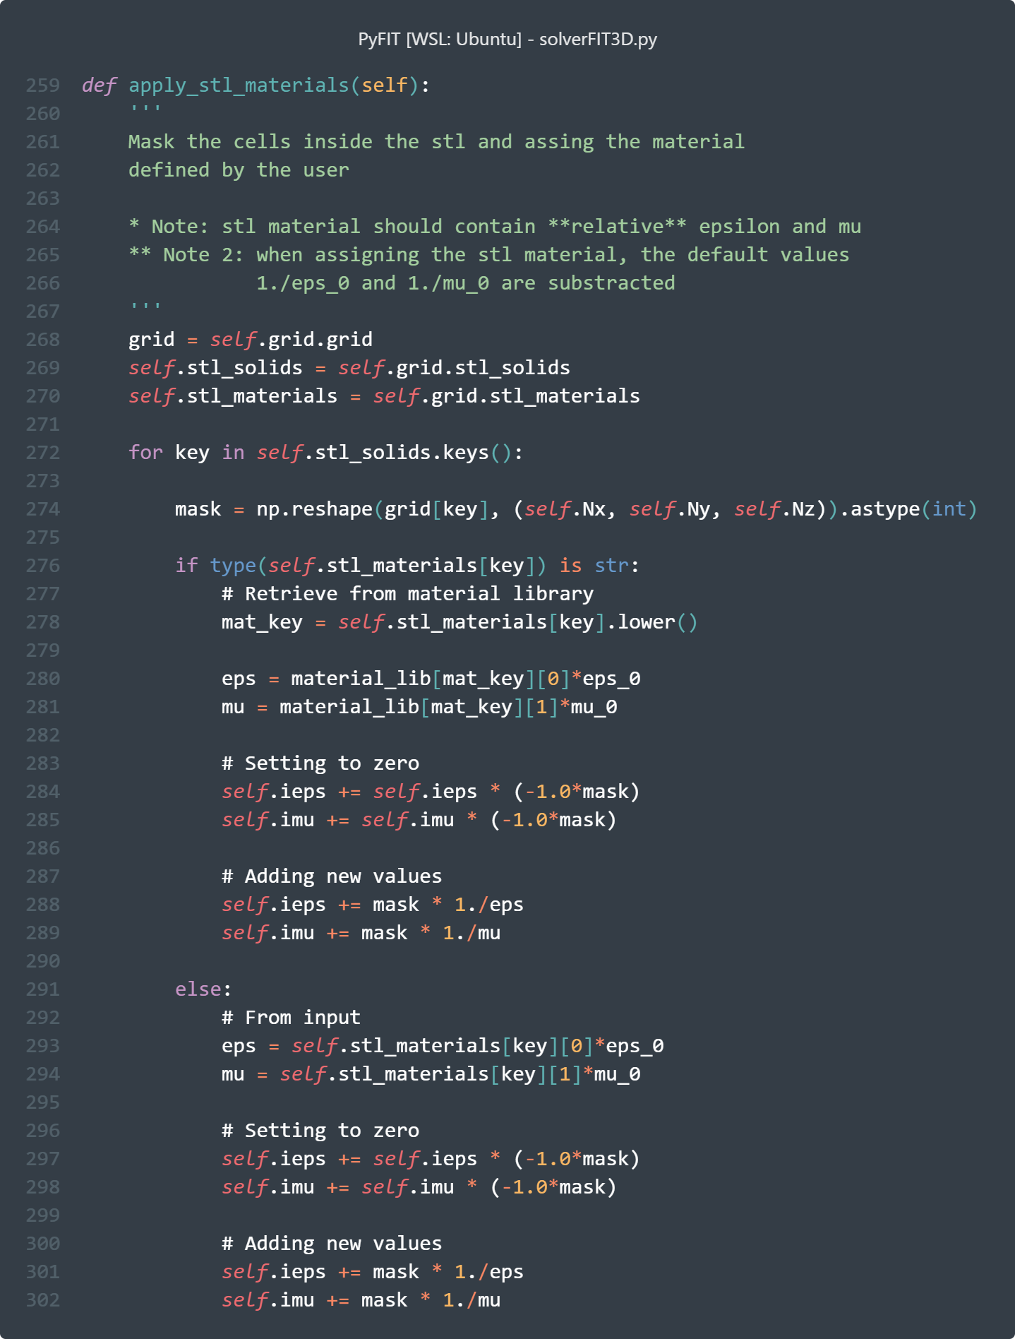
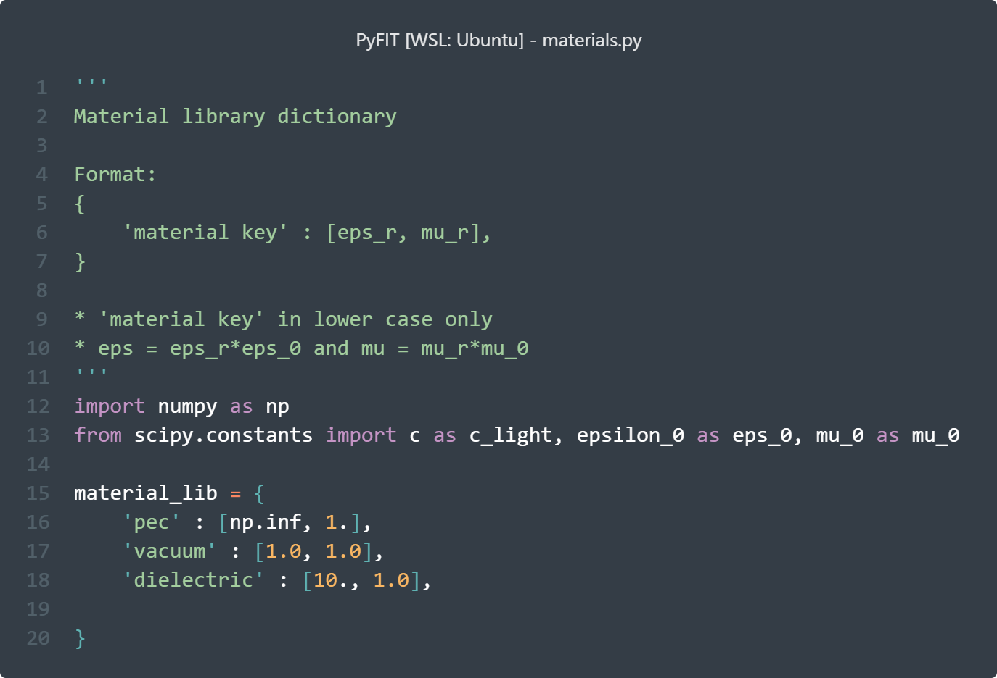
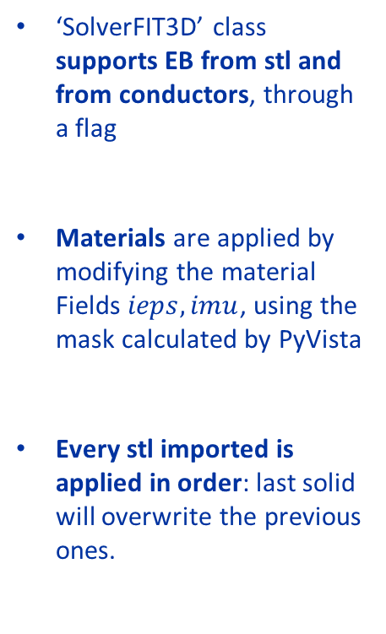
Adding STL and materials to FIT (II)
‘SolverFIT3D’ class supports EB from stl and from conductors, through a flag
Materials are applied by modifying the material Fields $ieps, imu$, using the mask calculated by PyVista
Every stl imported is applied in order: last solid will overwrite the previous ones.

Slide 18
1. Where are we?
2. Main improvements
3. Some (fun) examples
4. Feedback from University
5. Conclusions & Next steps
Outline

Slide 19
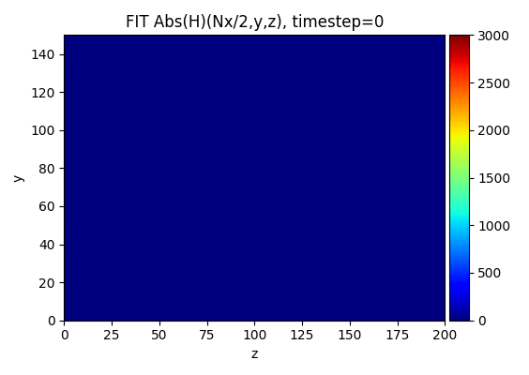

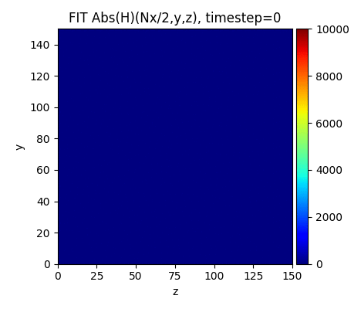
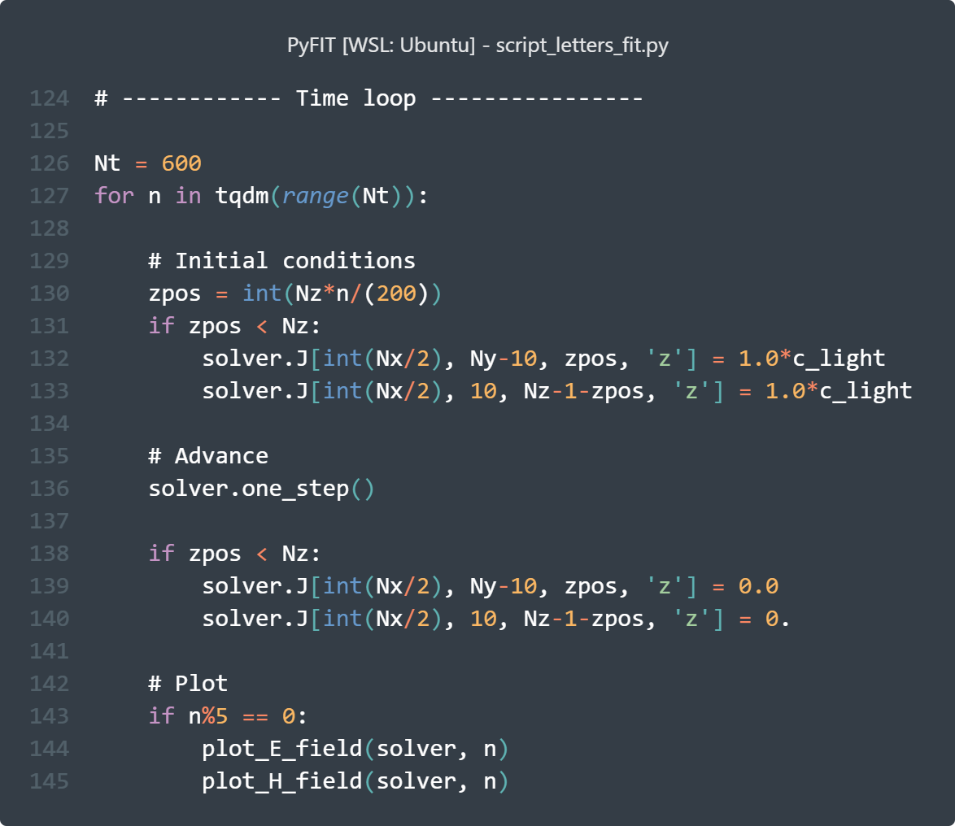





Example(s) I: 1 stl solids made of different materials
All PEC BCs
PEC $ε_{r}=∞$
Vacuum
y
z
x
PEC $ε_{r}=∞$
or dielectric $ε_{r}=11$
Plane YZ
PEC $ε_{r}=∞$
dielectric $ε_{r}=11$
‘Moving’ perturbations
**Letters STL models generated with: https://text2stl.mestres.fr/en-us

Slide 20
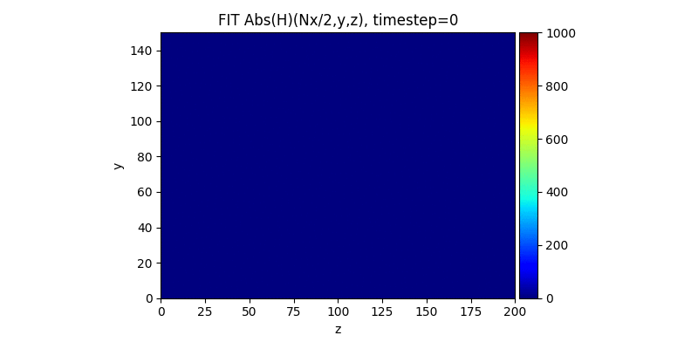




Example II: 2 stl solids made of different materials
All PEC BCs
Vacuum
Dielectric $ε_{r}=10$
PEC $ε_{r}=∞$
Plane YZ
Perturbations
solver.J[int(Nx/2), int(Ny/2), 0, 'z'] = 1.0*c_light
solver.J[int(Nx/2), int(Ny/2), Nz-2, 'z'] = 1.0*c_light
solver.J[int(Nx/2), 1, int(Nz/2), 'z'] = 1.0*c_light
solver.J[int(Nx/2), Ny-2, int(Nz/2), 'z'] = 1.0*c_light
https://github.com/elenafuengar/PyFIT/blob/main/examples/script_2solids_fit.py
Ncells = 900,000
Runtime on 8Gb Intel i5-8500 single core: 8 timesteps/s: 2’ 24’’

Slide 21
1. Where are we?
2. Main improvements
3. Some (fun) examples
4. Feedback from University
5. Conclusions & Next steps
Outline

Slide 22
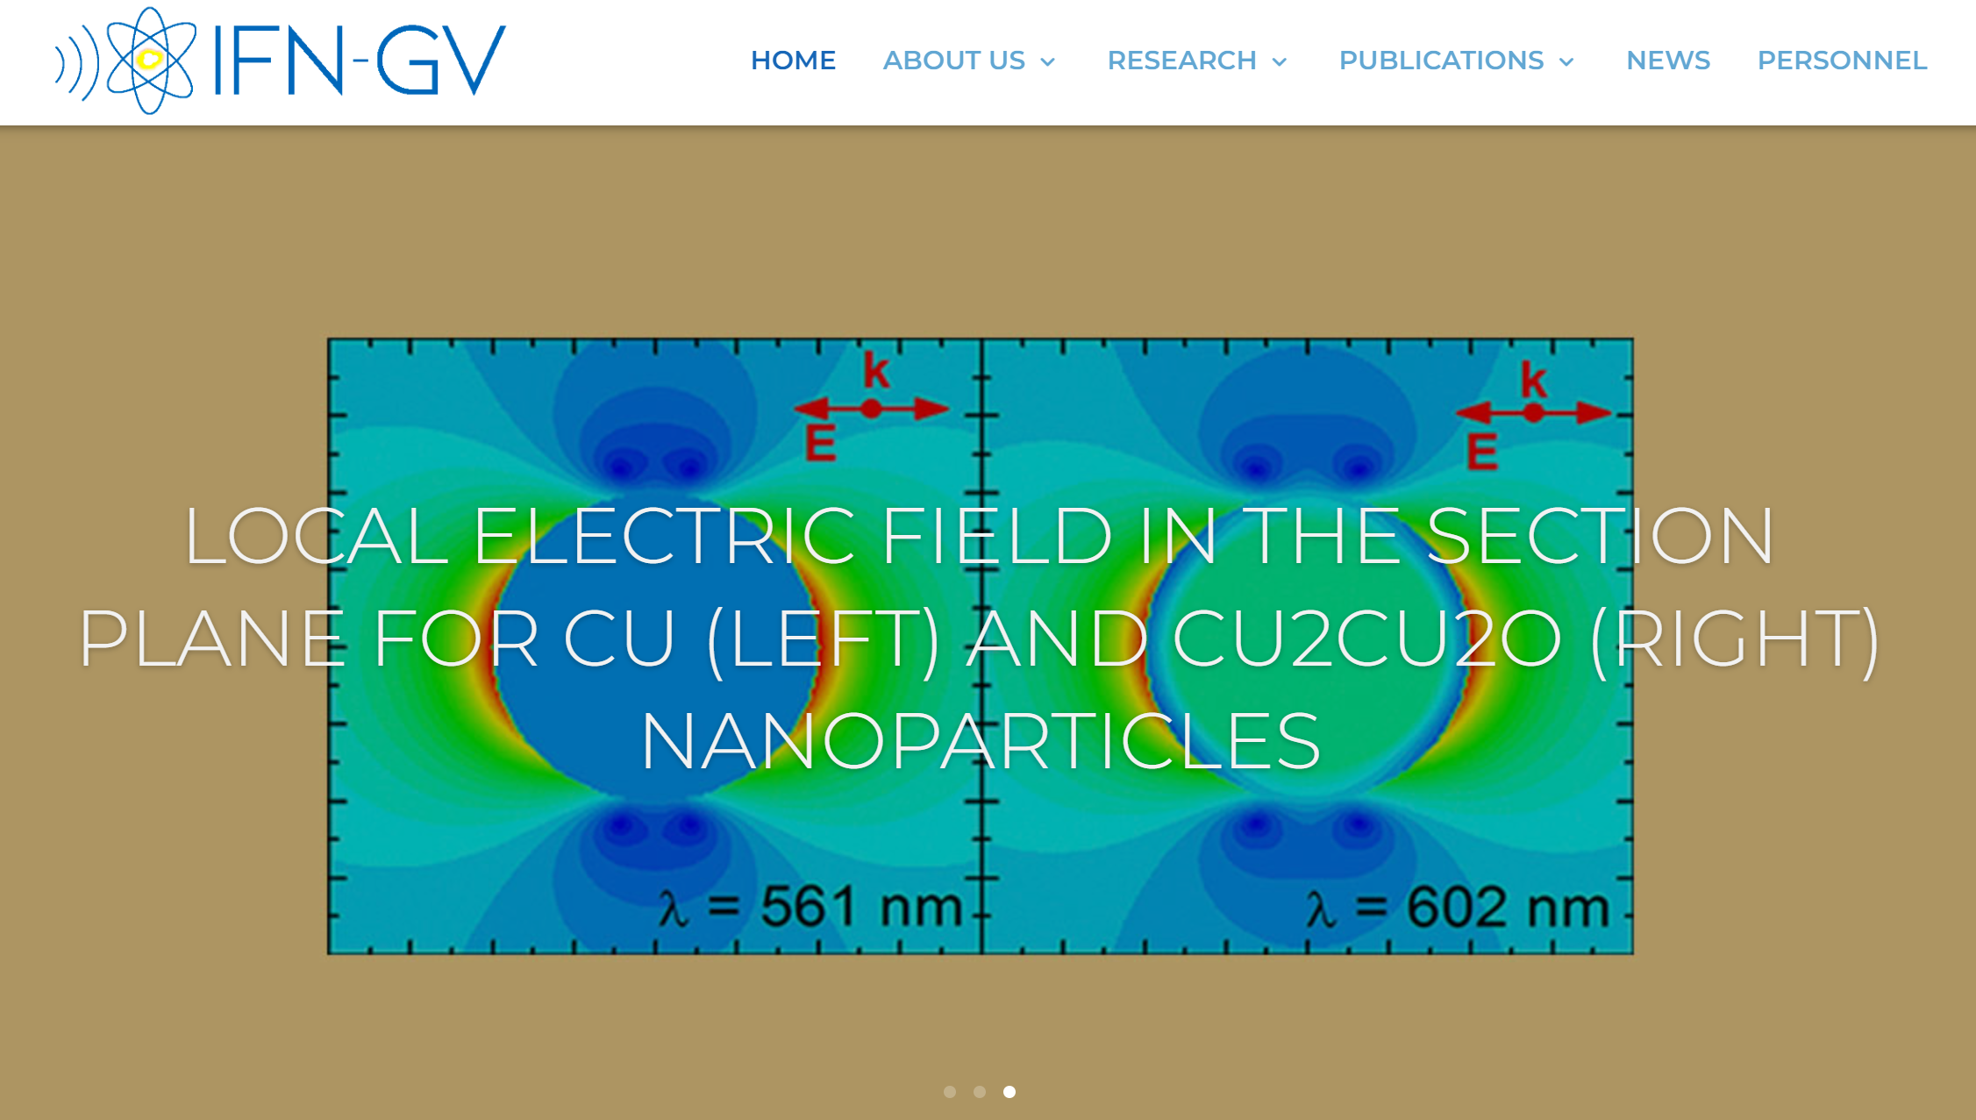

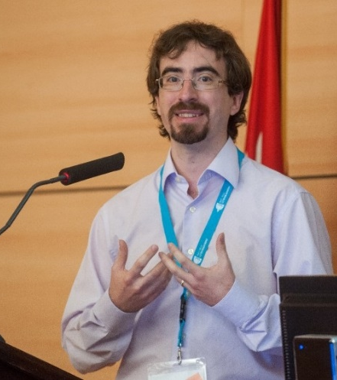
Polytechnic University of Madrid (UPM)
PhD Supervisors: Manuel Cotelo, Eduardo Oliva
Department name: Instituto de Fusion Nuclear Guillermo-Velarde*
Department director: Pedro Velarde
Manuel Cotelo
Eduardo Oliva
*http://www.denim.upm.es/es/inicio/

Slide 23
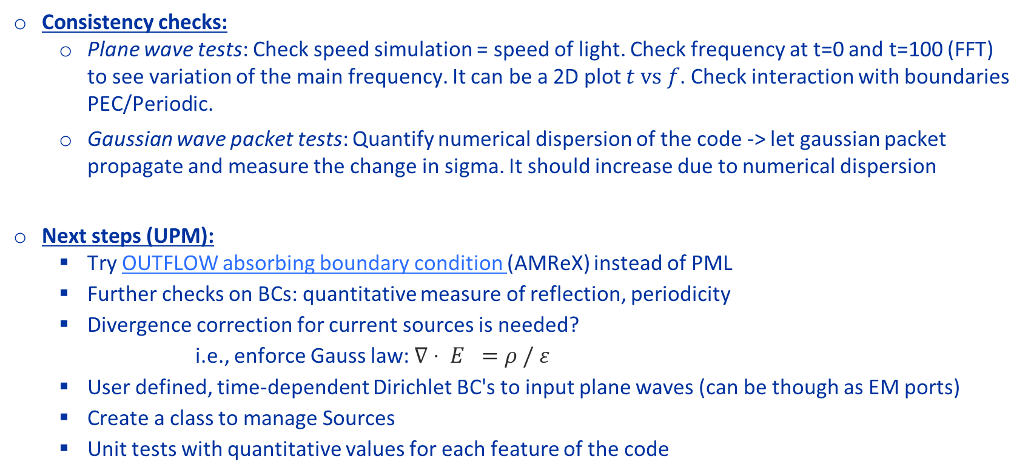
Feedback: roadmap until next visit
Consistency checks:
  Plane wave tests: Check speed simulation = speed of light. Check frequency at t=0 and t=100 (FFT) to see variation of the main frequency. It can be a 2D plot $t vs f$. Check interaction with boundaries PEC/Periodic.
  Gaussian wave packet tests: Quantify numerical dispersion of the code -> let gaussian packet propagate and measure the change in sigma. It should increase due to numerical dispersion
Next steps (UPM):
  Try OUTFLOW absorbing boundary condition (AMReX) instead of PML
  Further checks on BCs: quantitative measure of reflection, periodicity
  Divergence correction for current sources is needed?
    i.e., enforce Gauss law: $∇⋅ E =ρ / ε$
  User defined, time-dependent Dirichlet BC's to input plane waves (can be though as EM ports)
  Create a class to manage Sources
  Unit tests with quantitative values for each feature of the code

Slide 24
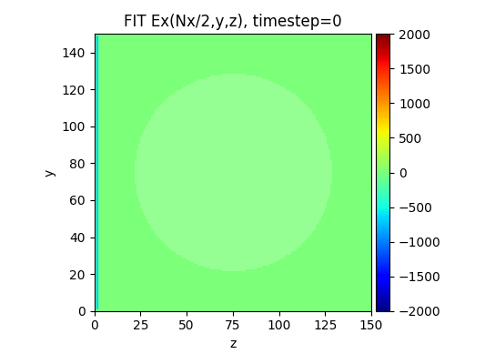
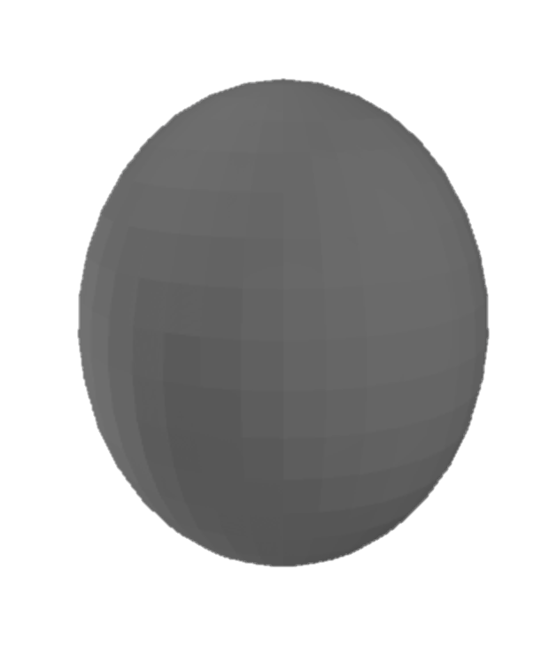
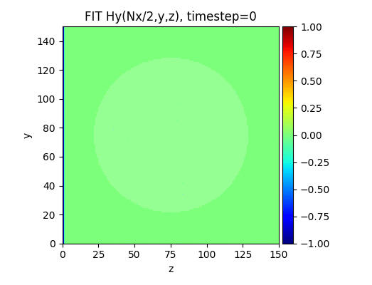
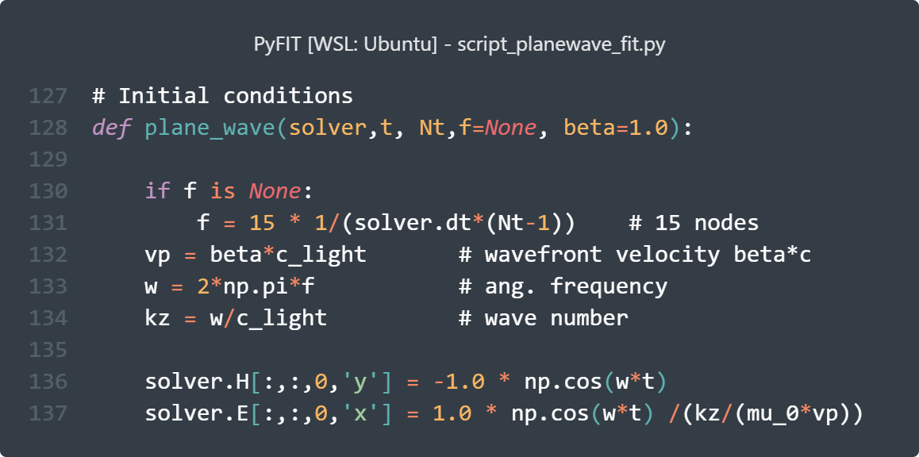

First attempts with Plane wave
All PEC BCs
Vacuum
Plane
wave
port
PEC $ε_{r}=∞$
Plane YZ

Slide 25

First attempts with Plane wave (II)
All PEC BCs
Vacuum
Plane
wave
port
Dielectric $ε_{r}=10$
Plane YZ

Slide 26
1. Where are we?
2. Main improvements
3. Some (fun) examples
4. Feedback from University
5. Conclusions & Next steps
Outline

Slide 27
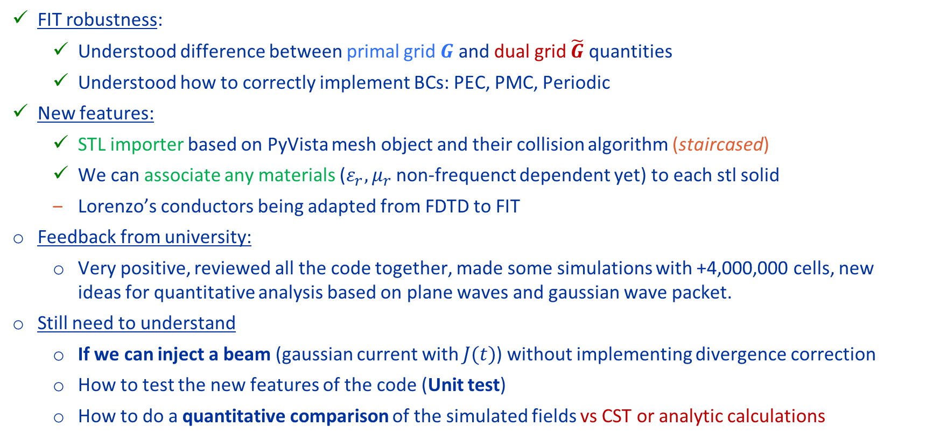
Conclusions & Next steps
FIT robustness:
  Understood difference between primal grid $G$ and dual grid $\tilde{G}$ quantities
  Understood how to correctly implement BCs: PEC, PMC, Periodic
New features:
  STL importer based on PyVista mesh object and their collision algorithm (staircased)
  We can associate any materials ($ε_{r}, μ_{r}$ non-frequenct dependent yet) to each stl solid
  Lorenzo’s conductors being adapted from FDTD to FIT
Feedback from university:
  Very positive, reviewed all the code together, made some simulations with +4,000,000 cells, new ideas for quantitative analysis based on plane waves and gaussian wave packet.
Still need to understand
  If we can inject a beam (gaussian current with $J(t)$) without implementing divergence correction
  How to test the new features of the code (Unit test)
  How to do a quantitative comparison of the simulated fields vs CST or analytic calculations

Slide 28
PhD roadmap updated
  2023: Jul – Ago (2 months):
    Physics review FIT
    3D Eqs in python
    Test in cube (PEC BCs not working!)
  2023: Sep-Dic (4 months):
    PEC BCs
    Embedded boundaries
    Add PML/CPML (feasible??)
    First taste of materials
  2024: Jan–April (4 months):
    UNIT TEST
    University roadmap
      (next visit ~April 24)
    (…)
We are here !

Slide 29
Thank you ☺ !!!
Electromagnetic and Wake Solver Development
meeting #18
Elena de la Fuente García (BE–ABP–CEI)

Slide 30
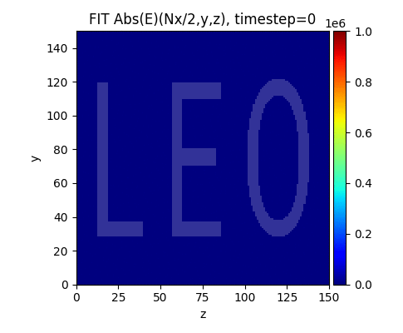
Divergence correction for charges
Image charges appearing in E field due to violation of gauss law (continuity eq)
Could be solved applying divergence correction (electrostatic poisson solve)

Slide 31
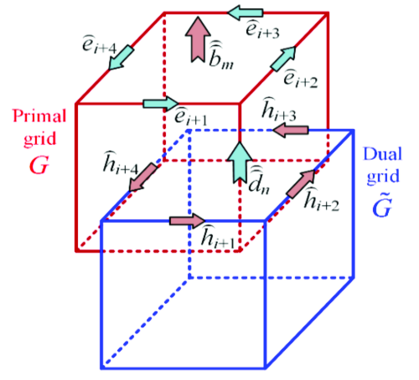



FIT theory: Grid Maxwell Equations
FIT
Grid Maxwell Equations
$$\oint_{∂A}^{ }{E⋅ds=−\iint_{A}^{ }{\frac{∂B}{∂t}⋅dA}}$$
$$\oint_{∂A}^{ }{H⋅ds=−\iint_{A}^{ }{\left(\frac{∂D}{∂t}+J\right)⋅dA}}$$
$$∯_{∂V}^{ }{B⋅dA}=0$$
$$∯_{∂V}^{ }{D⋅dA=\iiint_{V}^{ }{ρ dV}}$$
$D=\underline{\underline{ε}}E$, $B=\underline{\underline{μ}}H$, $J=\underline{\underline{σ}}E+ρv$
$$CD_{s}e=−D_{A}\frac{∂b}{∂t}$$
$$\tilde{C}{\tilde{D}}_{s}h={\tilde{D}}_{A}\left(\frac{∂d}{∂t}+j\right)$$
$$SD_{A}b=0$$
$${\tilde{S}\tilde{D}}_{A}\left(\frac{∂d}{∂t}+j\right)=0$$
$d={\tilde{D}}_{ε}e$, $b=D_{μ}h$, $j={\tilde{D}}_{σ}e+D_{ρ}v$ $ε={(ε}_{r}+\frac{σ}{jω})ε_{0}$
Operators
Spatial matrixes
Material properties
$$h^{n+1}=h^{n}−Δt{ {\tilde{D}}_{s}D_{μ}^{−1}D}_{A}^{−1}Ce^{n+0.5}$$
$$e^{n+1.5}=e^{n+0.5}+ΔtD_{s}{\tilde{D}}_{ε}{\tilde{D}}_{A}^{−1}\tilde{C}h^{n}−{\tilde{D}}_{ε}j^{n}$$
We need to build all these matrices and then apply these equations every timestep !
What we care about:
Update equations

Slide 32

Bibliography used:
- Wakefields and Impedances [T. Weiland, 1991]
- TE/TM FIT for accelerators [I. Zarg, 2005]
- Open boundaries for FIT [MC. Balk, 2005]
- 2D expansion [I. Zarg, 2015]
- 2D freq. domain [R. SChumann, 2000]
- Frequency domain FIT and FEM Uwe Niedermayer PhD thesis [2015]
- Eigenmode + MPI + Gyrotropic materials Klaus Klopfer PhD thesis [2014]
- Vlasov solver PIC Lukas Hanichen PhD thesis [2016]

