Slide 1

Layout version 1.7 - Approval Closure
J. Oliveira, S. Chemli
EN-ACE
HL-LHC Integration Meeting #241 10/11/2023

Slide 2
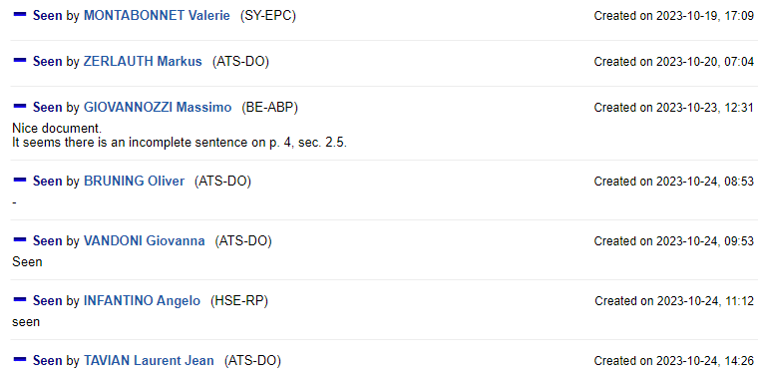
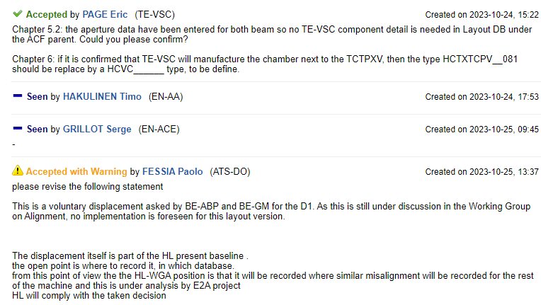
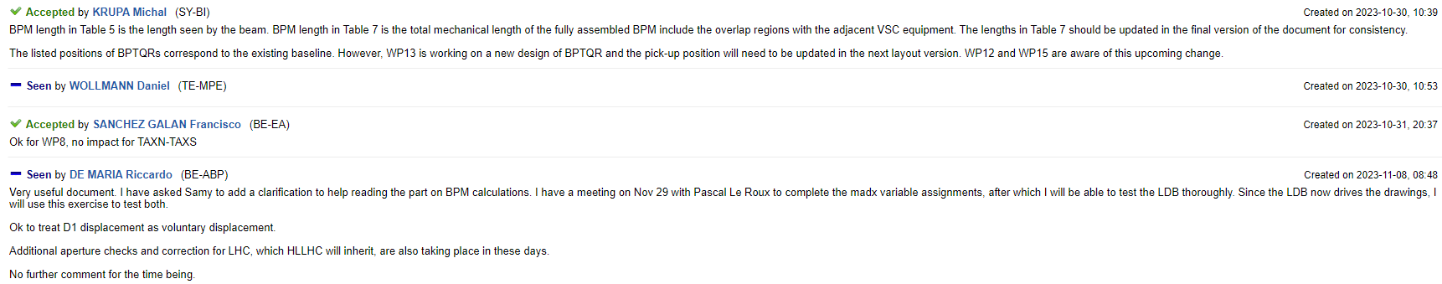
Layout version LS3 1.7 Changes to the mechanical layout
Release Notes | EDMS 2953058 v.0.1 | LHC-LJ-ER-0002 v.0.1

Slide 3
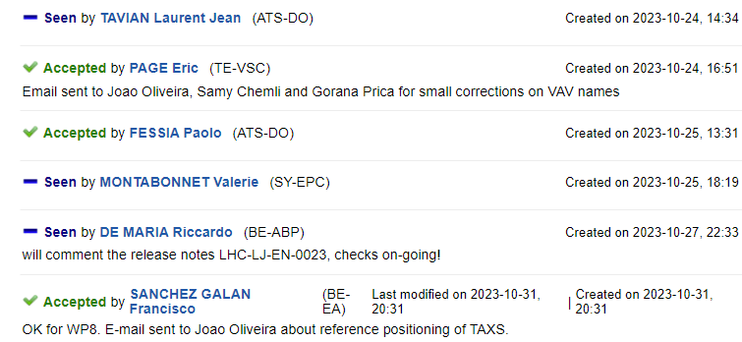
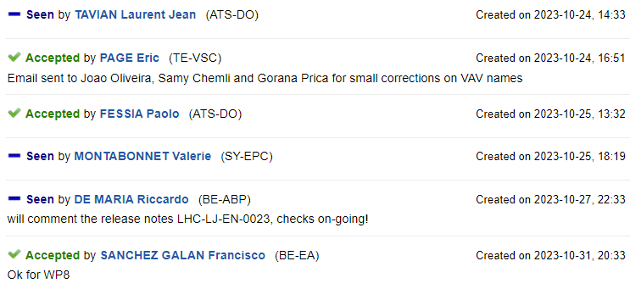
Layout Drawings
LHCLSXH_0009/10 P5
LHCLSXH_0001/2 P1

Slide 4

Thank you for your time.
“If I have seen further, it is by standing on the shoulders of Giants.”
From a letter to Robert Hooke in 1675, Sir Isaac Newton PRS.
And a very special thanks to all the colleagues that contributed to this presentation.

Slide 5
Extra Slides

