Slide 1
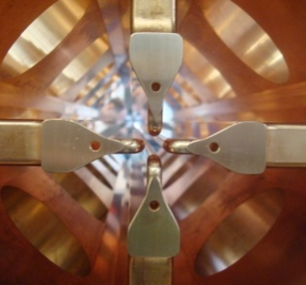
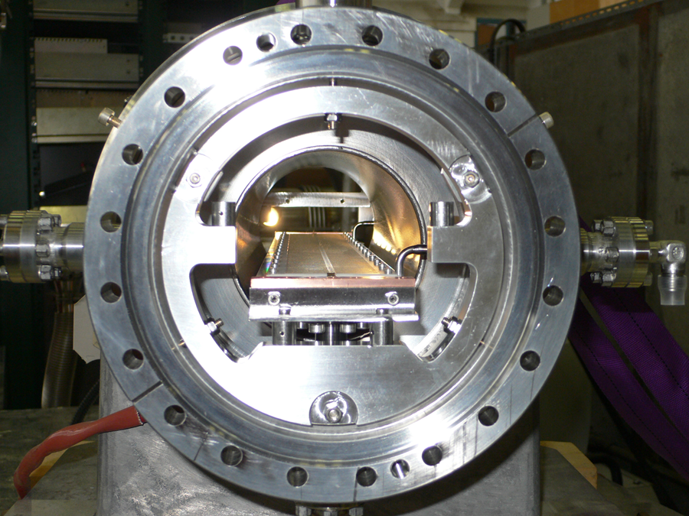
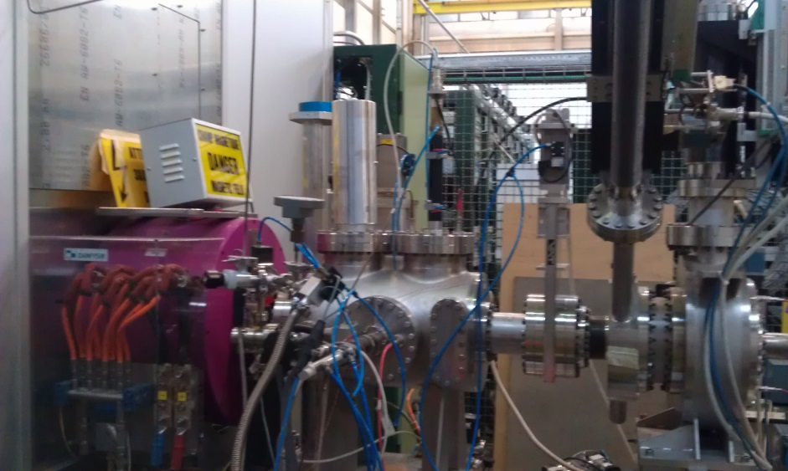

LINAC Activities at CERN- contribution to WP3 coordinated by N. Milas
source
Solenoid
Emittance metre
Radio Frequency Quadrupole 352MHz
Fast Chopper – 1MHz
Source test stand
Alessandra Lombardi and the Hadron Sources and Linac team
The Superconducting Proton Linac (SPL)
Achievements with LINAC4
Activities on source upgrade and RFQ redesign
Conclusions and outlook

Slide 2
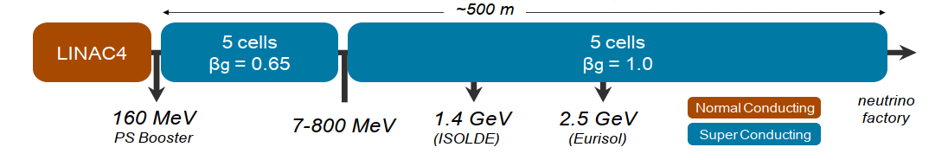

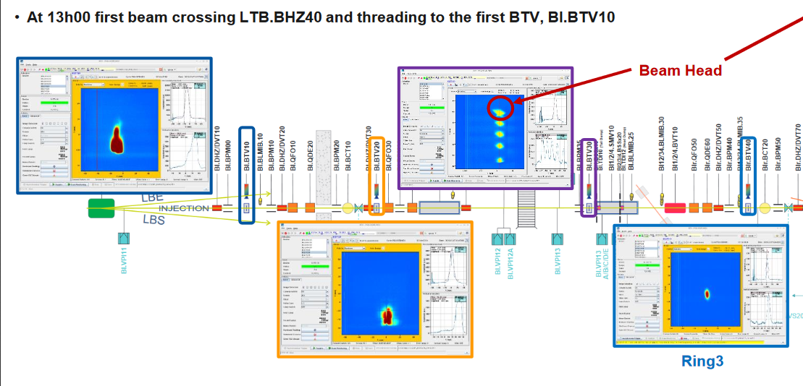
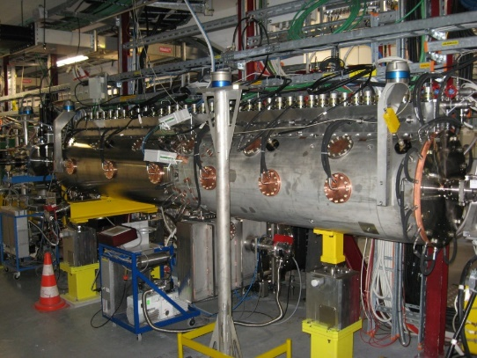
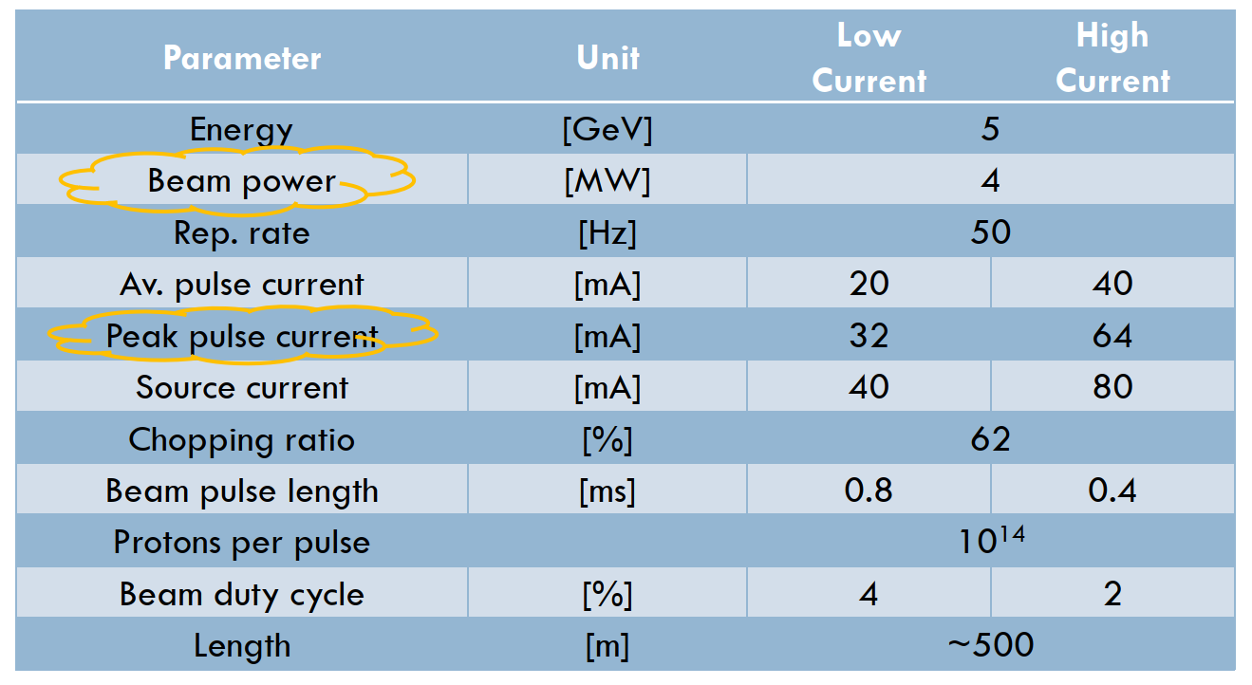

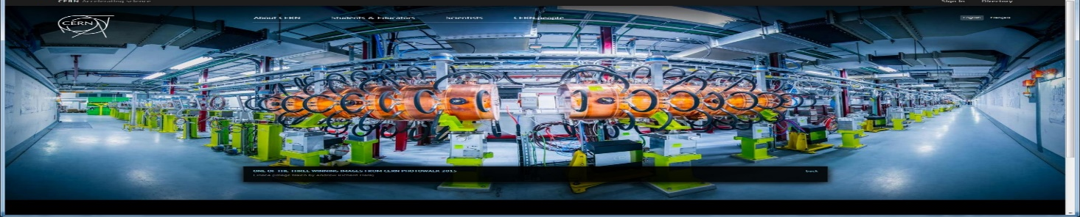
LINACs for ν-fact or µ-collider – CERN 2010
352MHz
704 MHz
SPL parameters
7 Dec 2020

Slide 3
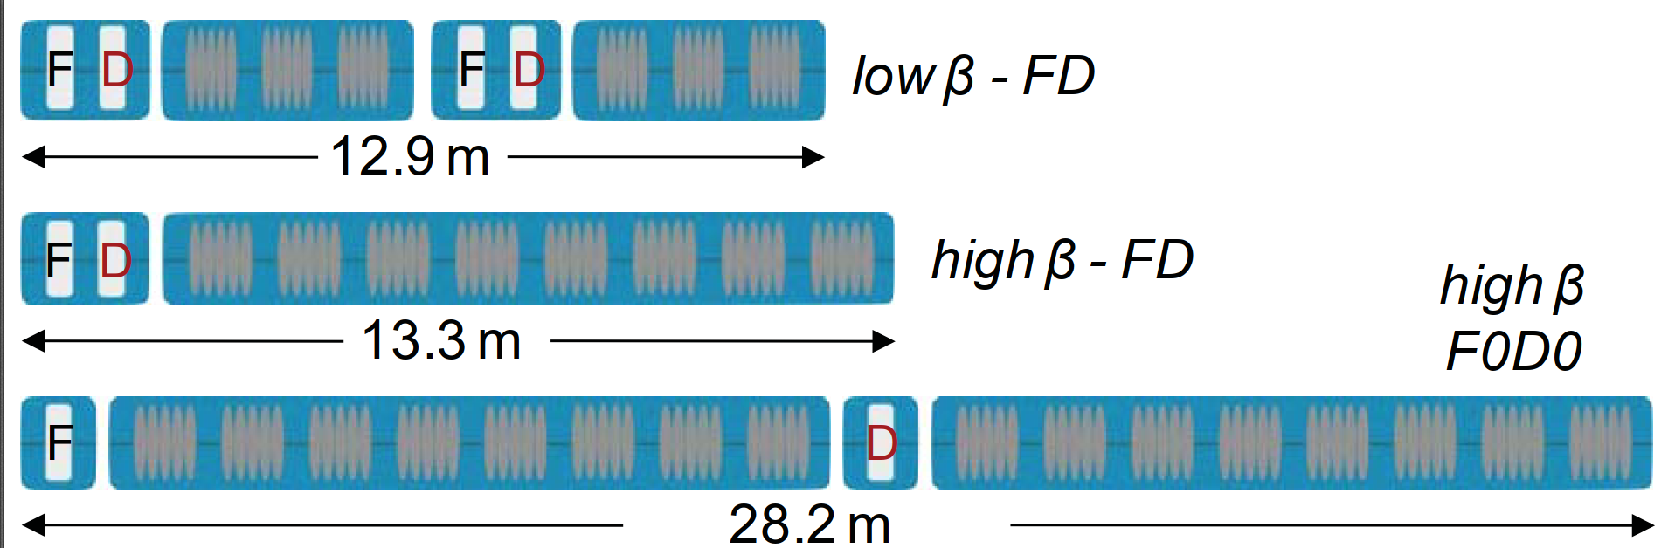
Building blocks of the superconducting part

Slide 4
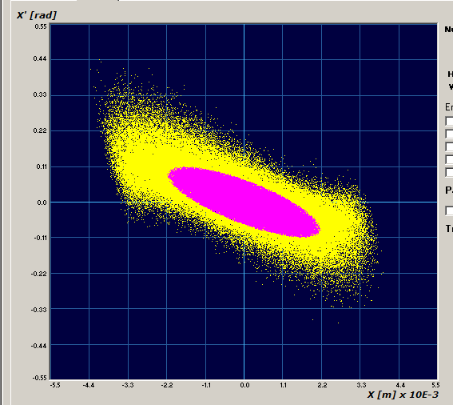
CERN 2013 : pre-injector challenge
IS-O2
(25mA in RFQ acceptance)
IS-04
(50mA in RFQ acceptance)
IS-O3
(35mA in RFQ acceptance)
Source redesign
16mA
3m high-field (2018)
RFQ3
2021
2013: Comparison of measured emittance (yellow) and RFQ acceptance (pink). The expected transmission thru the RFQ is 75%. (PARMTEQ + TOUTATIS).
RFQ redesign

Slide 5
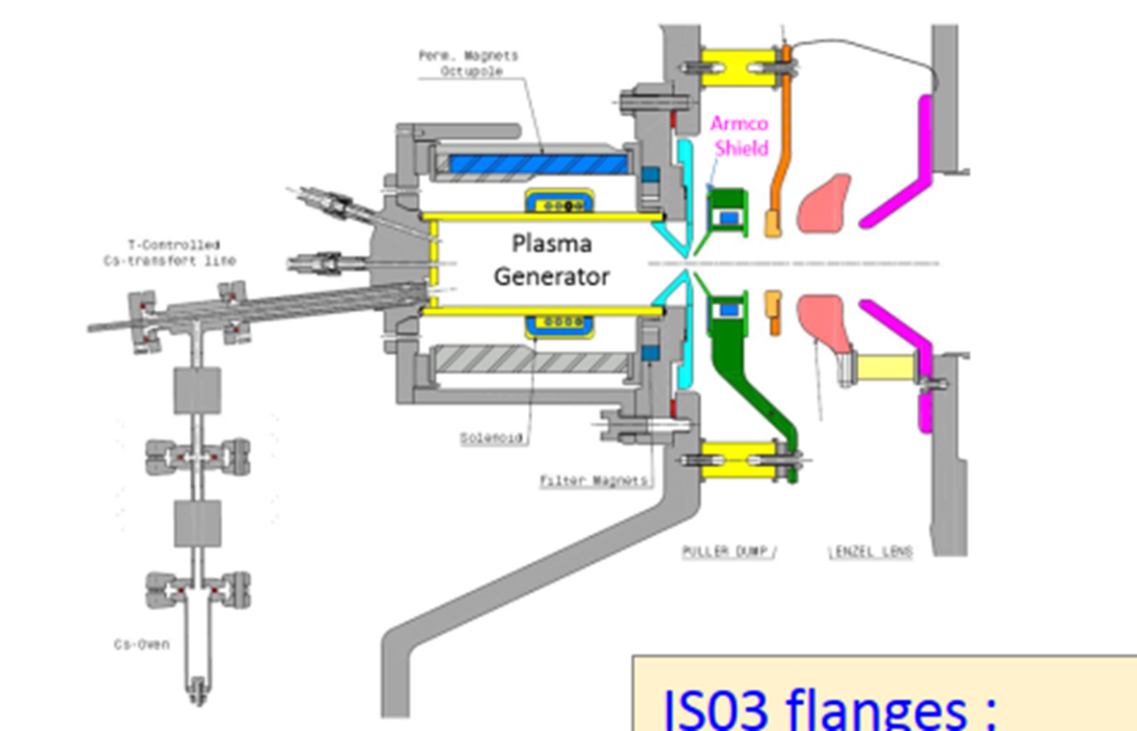
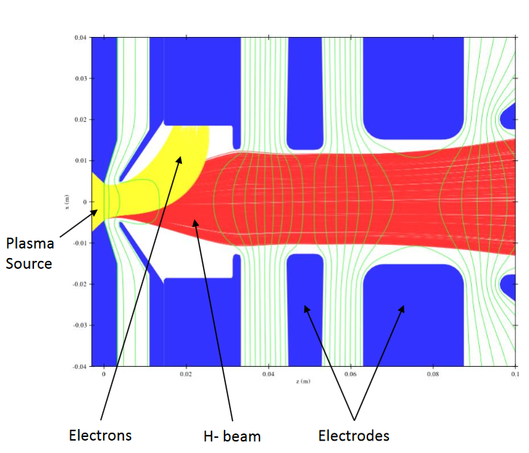
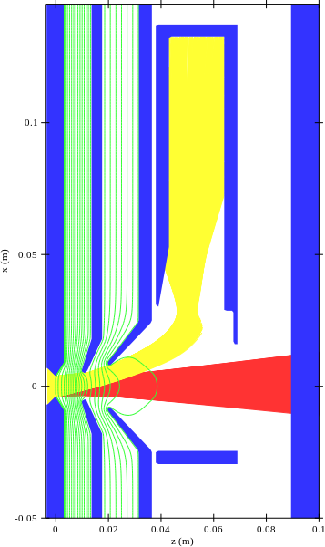
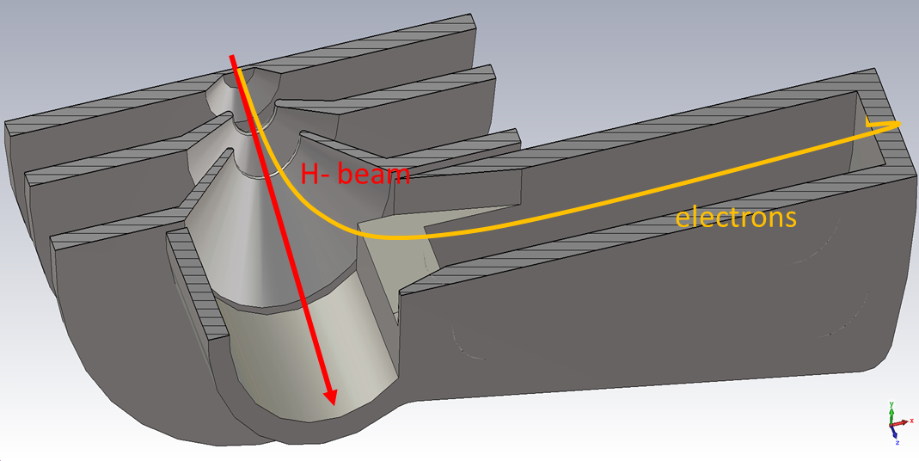
IS04 vs IS03: What’s new?
Emittance: It’s all in the extraction
IS03 and IS04 have identical plasma generators:
  Plasma chamber.
  RF system (amplifier and antenna).
  Gas injection system.
  Cesiation system.
IS03 and IS04 have different extraction and electron dumping schemes
IS04 vs. IS03
Simplified design with only plasma, puller and ground electrodes: Eliminated puller-dump and Einzel lens causing emittance growth.
6 cm shorter.
Co-extracted 45 keV e⁻ onto a dedicated dump.
IS03 – Dumping 10 keV e⁻
IS04 – Dumping 45 keV e⁻
-45 kV
-35 kV
0 kV
30 kV
0 kV
-45 kV
-22 kV
0 kV

Slide 6
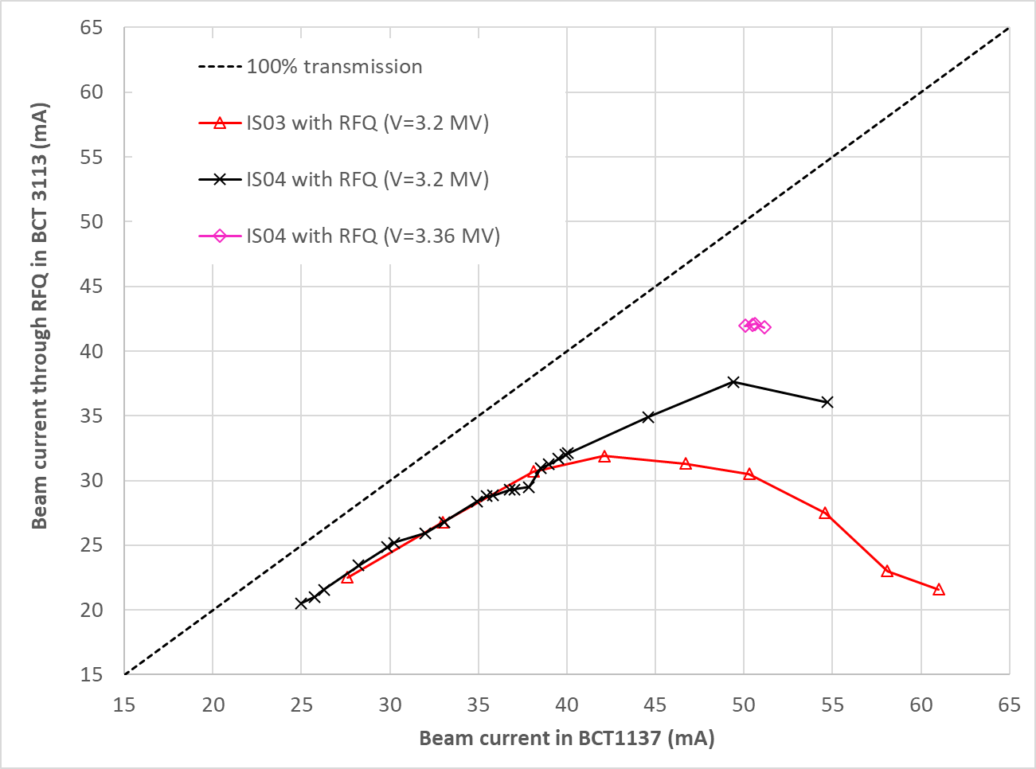
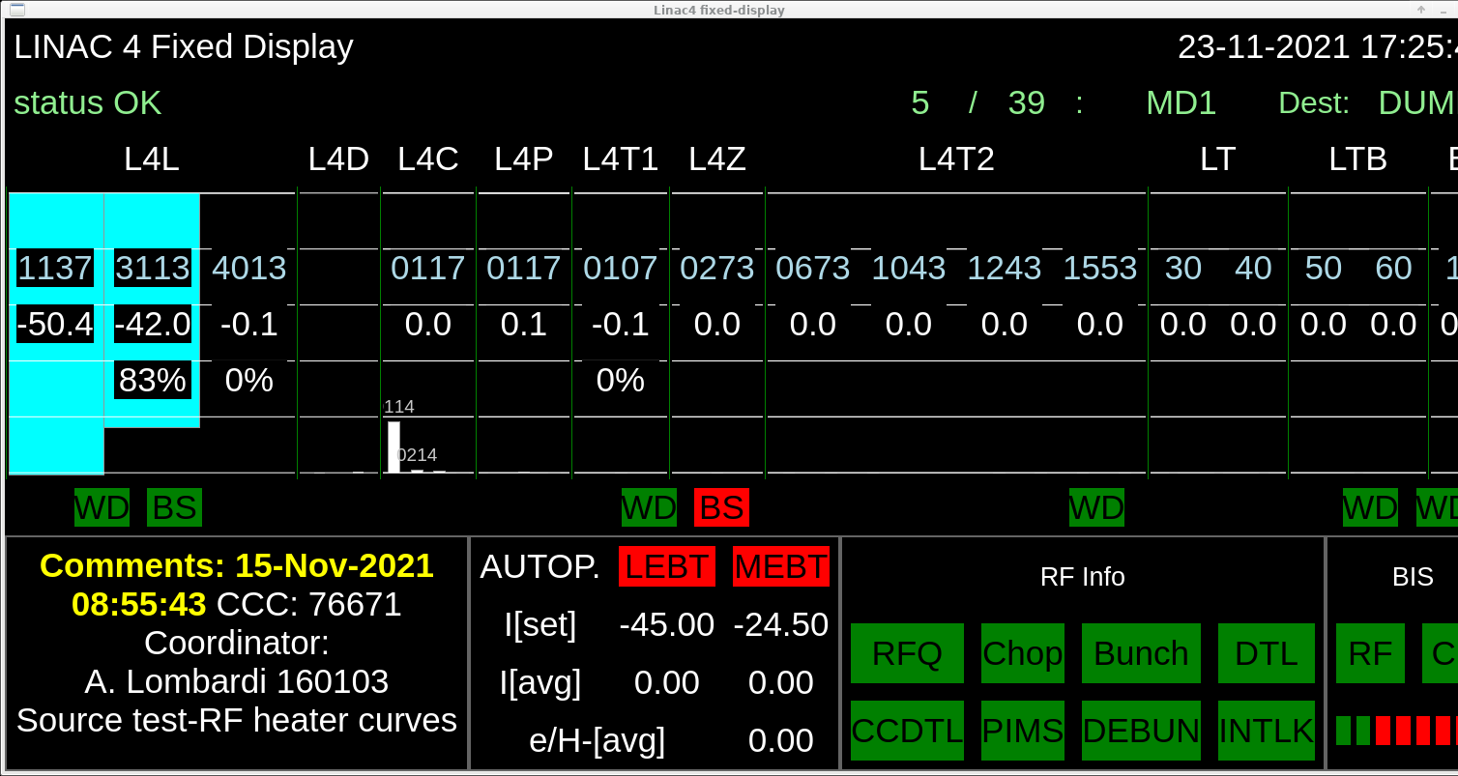
Confirmed at LINAC4 19-23 November 2021
RFQ V=3.36 MV: 42 mA out of the RFQ for 50.4 mA input – RECORD
RFQ V=3.2 MV (operational): Comparable performance (and potentially better with further optimization) for beam current <40 mA but considerably better above that.

Slide 7
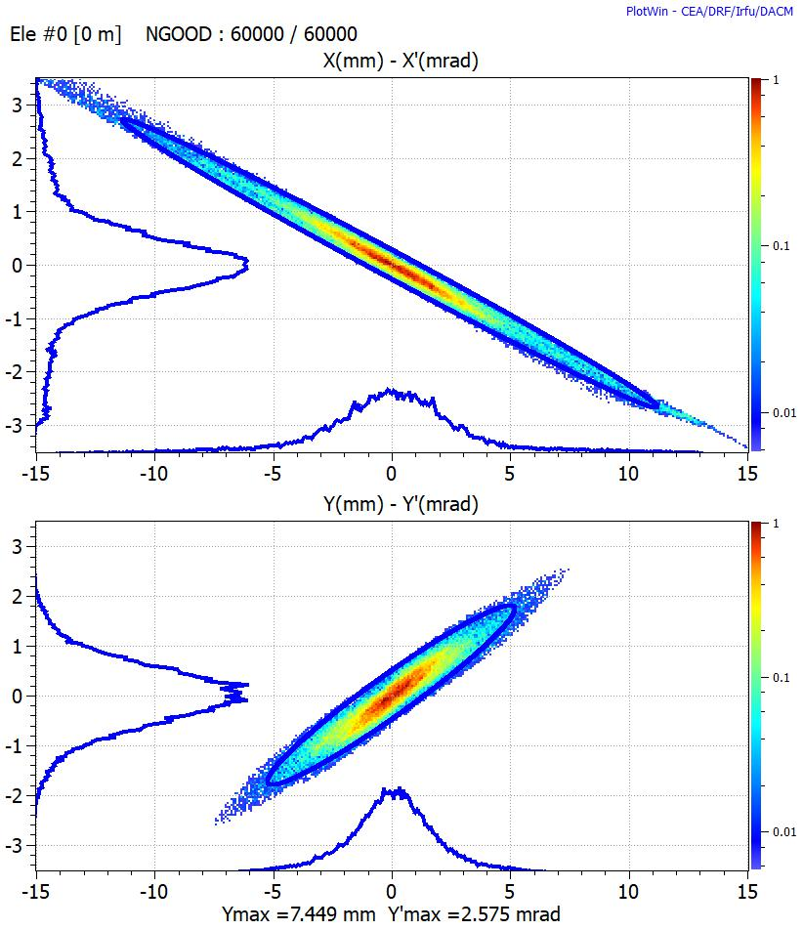
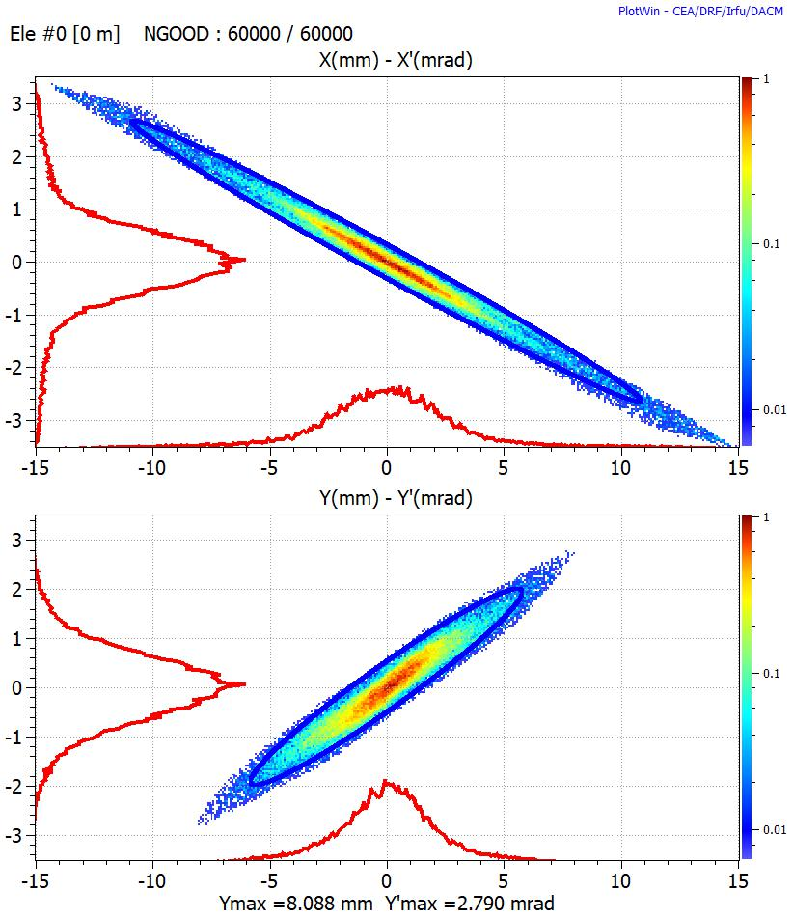
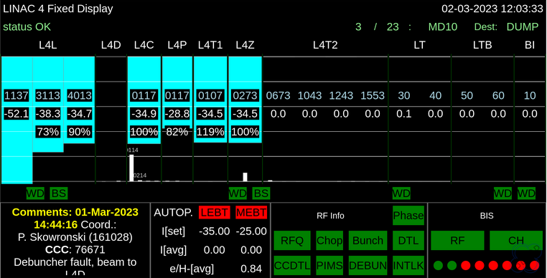
IS04 installed as operational source 2023
Allows for Machine Developments at higher current
On 02/03/2023 we increased the source current in steps to 50 mA.
  35 mA at 160 MeV in the L4Z and in the LBE.
  Reaching the limit of cavities available RF power. 3 MeV chopping needed.
  Small difference on L4Z transverse emittance comparable to what found with 30 mA.
  352 MHz bunch length ? No clear conclusion as our diagnostic suddenly gave larger phase spread even for the nominal.
  35 mA transverse emittance measured at the LBE…
25 mA
35 mA

Slide 8
35 mA at the PS Booster
H and V emittances very similar.
  Well within PSB matching tolerances
  Space charge effects are understood.
25 mA
35 mA
We control the space charge effects all along the linac

Slide 9
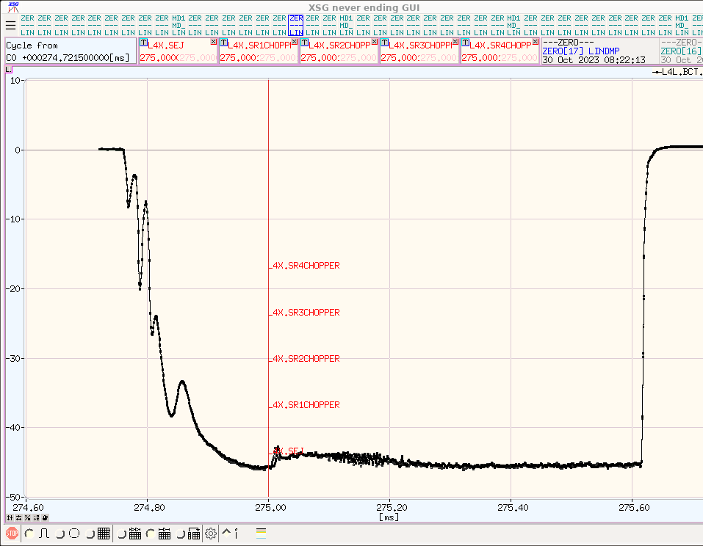
Linac4/PSB high intensity MD, 30/10/2023
48mA beam with 40kW RF power
Gas start moved later to stabilize pulse current but e/H goes up to 2.7
Moved gas start earlier along, so the unstable part is displaced before the usable beam pulse. Flatness is better and e/H is back to 1.4.
48mA beam - 600µsec 1 Hz

Slide 10
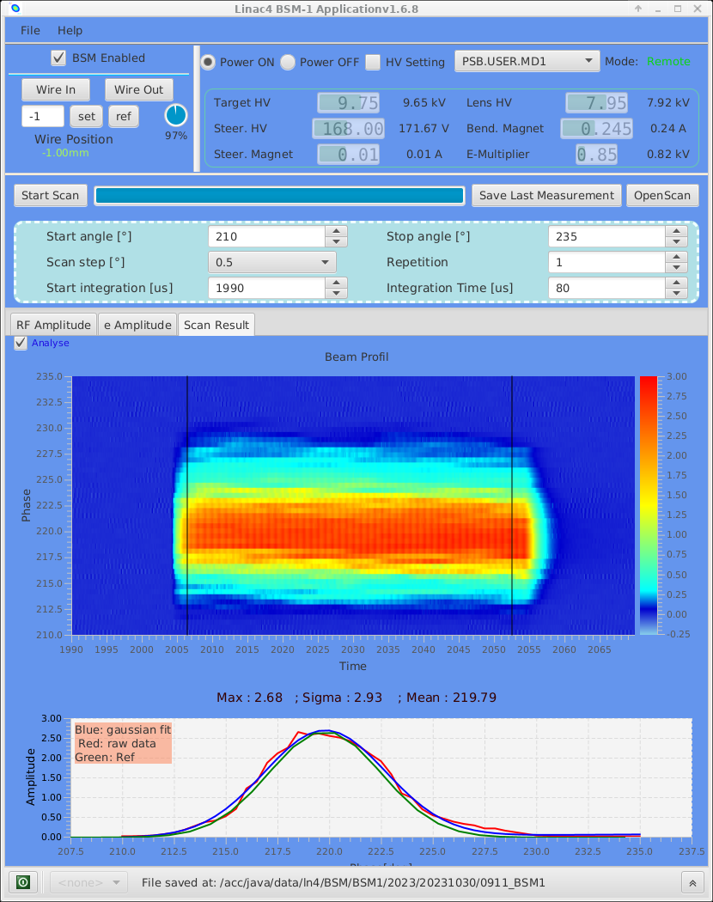
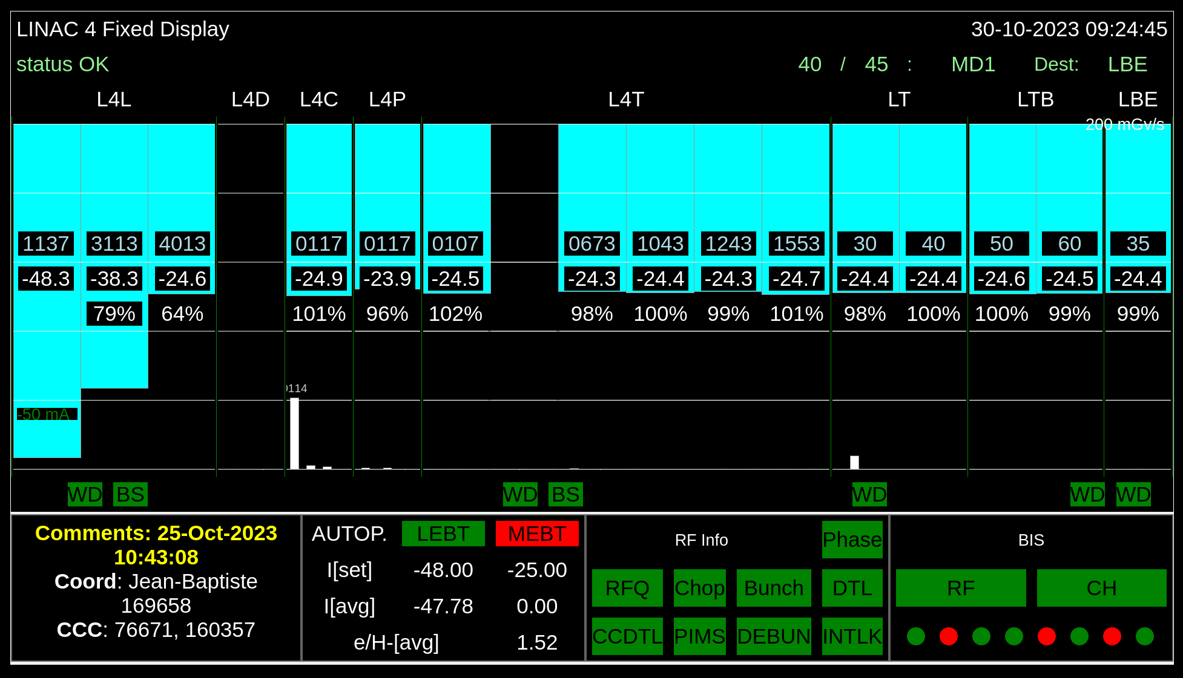
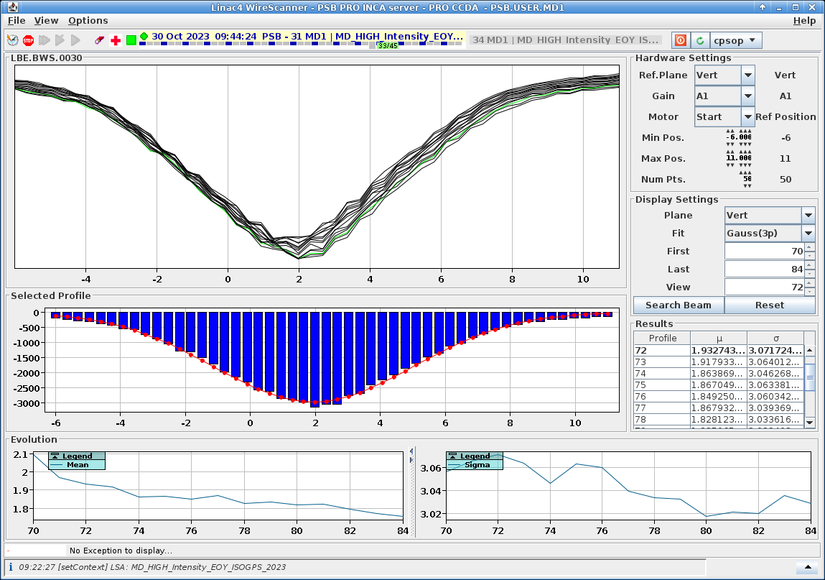
25mA average beam to LBE – klystron limitation
38.3 peak current

Slide 11
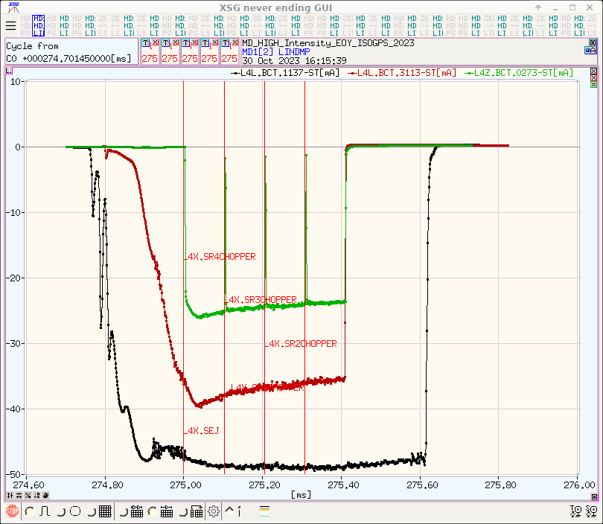
Source stable overnight and until the end of the MD 28 hours later, no oscillations

Slide 12
Stability is good on LINAC4 repetition rate
28 hours of linac4 = 34 minutes of muon collider
Column1
Mean | -47.7437
Standard Error | 0.016696
Median | -47.8159
Mode | #N/A
Standard Deviation | 0.660919
Sample Variance | 0.436814
Kurtosis | 151.5617
Skewness | 11.1744
Range | 11.99044
Minimum | -48.3582
Maximum | -36.3678
Sum | -74814.4
Count | 1567
-47.7+-0.66 mA
BCT1137

Slide 13
Source summary and outlook
38 mA peak current at 160 MeV.
  With a reasonable RFQ voltage…
  Chopping pattern needed to relax on the RF power side.
  Transverse emittances look under control, with NO re-matching in the Linac4 above 3 MeV.
What’s next – experimentally
  Explore continuous gas injection that is more suited to 50Hz
  Look at a different MEBT optics – Could request some iterations…
  Optimise also …
    RFQ level.
    Source and LEBT.
    MEBT quad settings.
What’s next – calculations and R&D
  Optimise extraction and low energy
  Study direct injection into the RFQ

Slide 14
IS-O2
(25mA in RFQ acceptance)
IS-04
(50mA in RFQ acceptance)
IS-O3
(35mA in RFQ acceptance)
Source redesign
16mA
3m high-field (2018)
RFQ3
2021
2013: Comparison of measured emittance (yellow) and RFQ acceptance (pink). The expected transmission thru the RFQ is 75%. (PARMTEQ + TOUTATIS).
RFQ redesign

Slide 15
Common design guidelines
Input/output energy : 45 keV/3MeV;
a two-term potential vane profile, a constant average aperture radius and a constant transverse radius of curvature for an easier tuning and the possibility of machining with a 2D cutter;
Constant voltage profile;
Transmission higher than 90% for emit=0.5µm rms normalised I=70mA

Slide 16
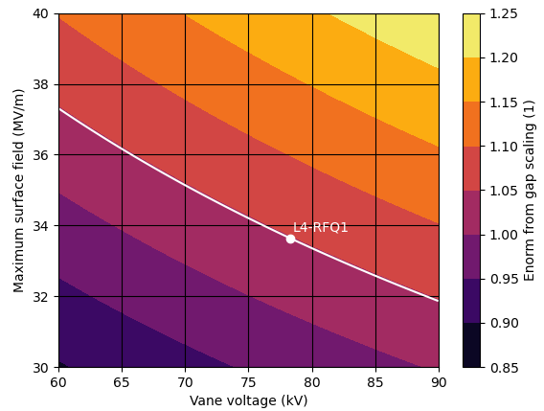
RFQ design – copper
General Guidelines:
Stay below the RFQ1 line
Transmission>90 for emit=0.5 mm mrad and I=70mA
rho/ro=0.7 -1
Two versions
  L=4.5 m to avoid dipole rods
  L=as short as possible.

Slide 17
4.5 m
RFQ parameters
Length m | 4.5
Vane voltage kV | 79
Max electric field (MV/m) | 33
Peak RF power kW | 750
Average aperture (r0) mm | 3.2
Transverse radius (ρ) | 2.7
Maximum modulation | 1.5
Minimum aperture mm | 2.5
Focusing parameter (B) | 5.87
Phase at gentle buncher deg | -35
Transmission % (70mA , 0.5 mm mrad) | 93.2

Slide 18
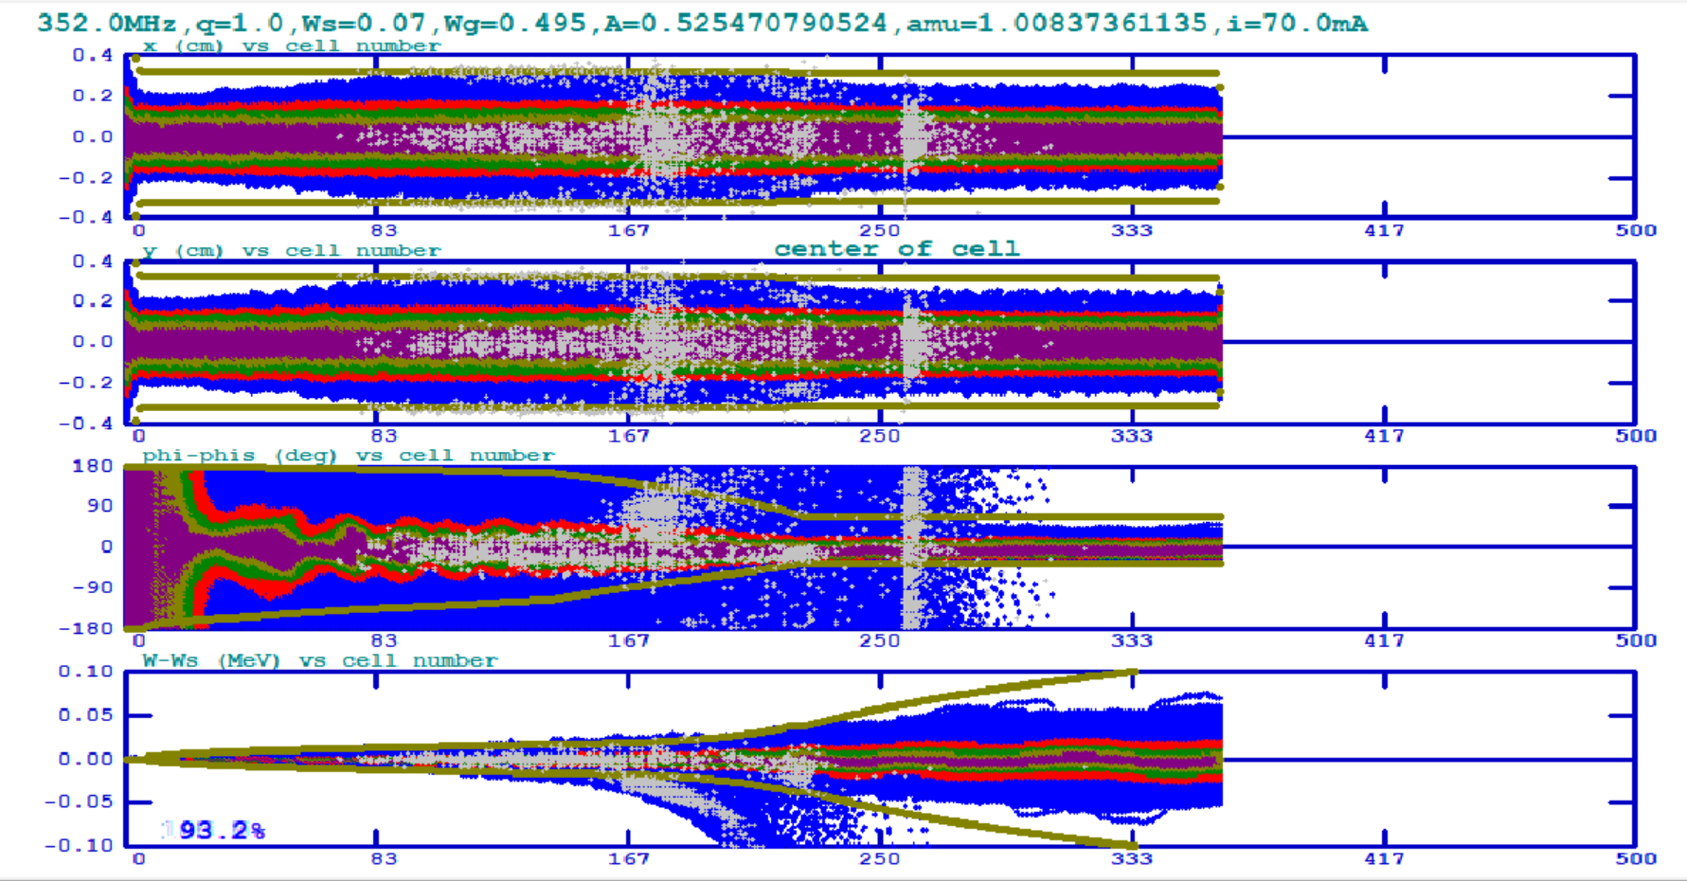
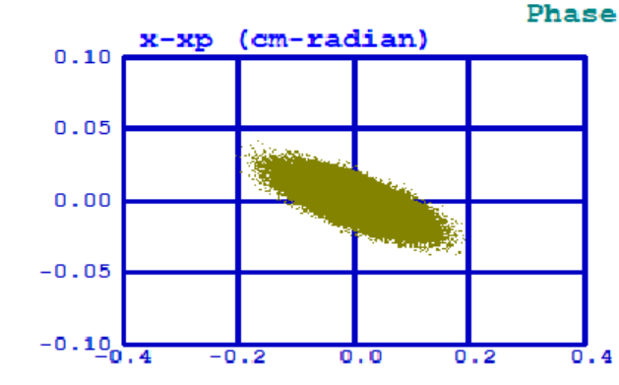
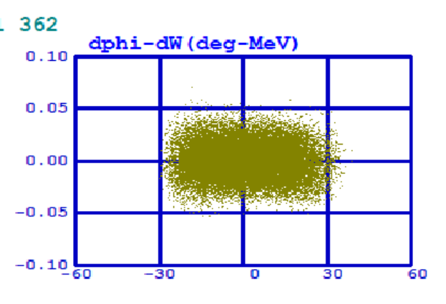
Beam dynamics – 70mA emit =0.5mm mrad
Transverse (x, y top) and longitudinal planes (phase, energy spread) along the RFQ
Beam at the RFQ output plane

Slide 19
3.9 m
RFQ parameters
Length m | 3.9
Vane voltage kV | 79
Max electric field (MV/m) | 33
Peak RF power kW | 650
Average aperture (r0) mm | 3.2
Transverse radius (ρ) | 2.2
Maximum modulation | 1.8
Minimum aperture mm | 2.2
Focusing parameter (B) | 5.76
Phase at gentle buncher deg | -32
Transmission % (70mA , 0.5 mm mrad) | 95.4

Slide 20
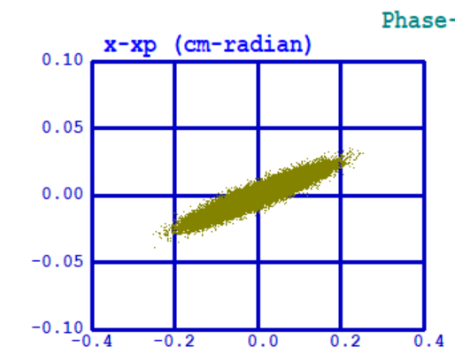
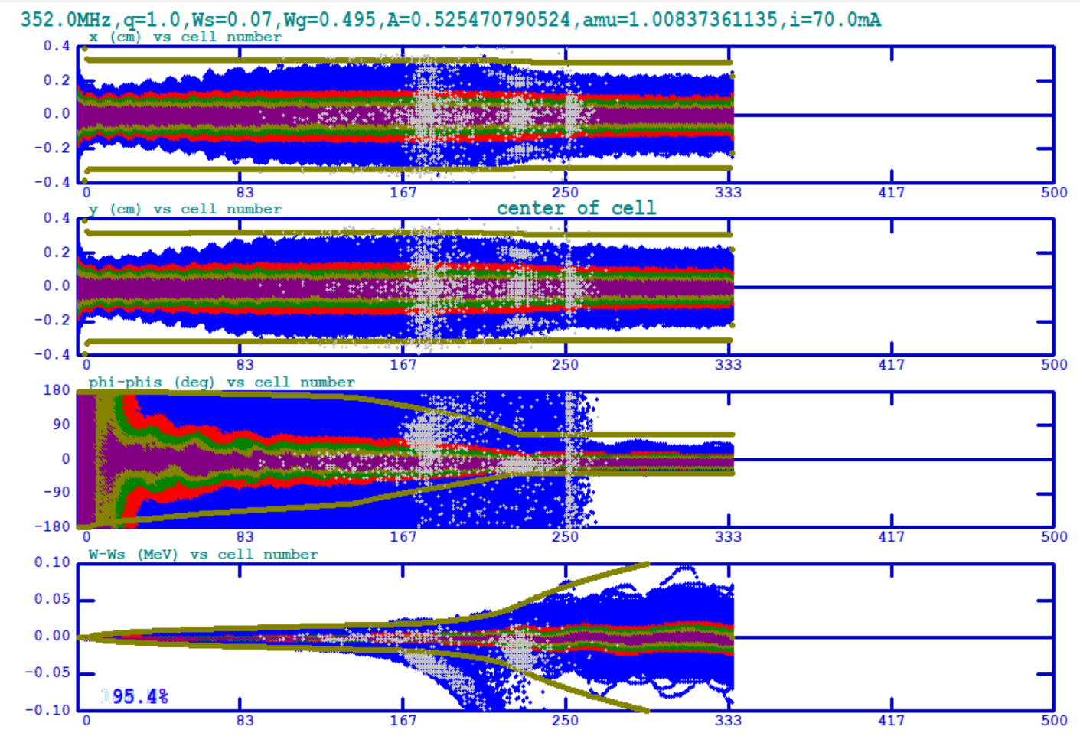
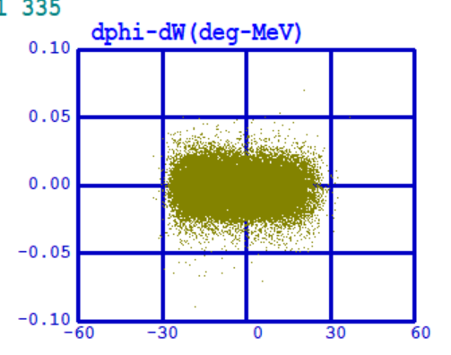
Beam dynamics – 70mA emit =0.5mm mrad
Transverse (x, y top) and longitudinal planes (phase, energy spread) along the RFQ
Beam at the RFQ output plane

Slide 21
RFQ design – new material
General Guidelines:
Field up to 50MV/m for 78 kV (cryo-copper)
Respect scaling –
  120kV and 42.3 MV/m
  140kV and 39.3 MV/m
Transmission > 90% for emit=0.5 mm mrad and I=70mA
rho/ro=0.7 -1
L as short as possible
Best beam quality

Slide 22
2.5 m 120 kV
RFQ parameters
Length m | 2.5
Vane voltage kV | 120
Max electric field (MV/m) | 44
Peak RF power kW | 960
Average aperture (r0) mm | 4.1
Transverse radius (ρ) | 4.1
Maximum modulation | 2.2
Minimum aperture mm | 2.4
Focusing parameter (B) | 5.54
Phase at gentle buncher deg | -32
Transmission % (70mA , 0.5 mm mrad) | 91.2

Slide 23
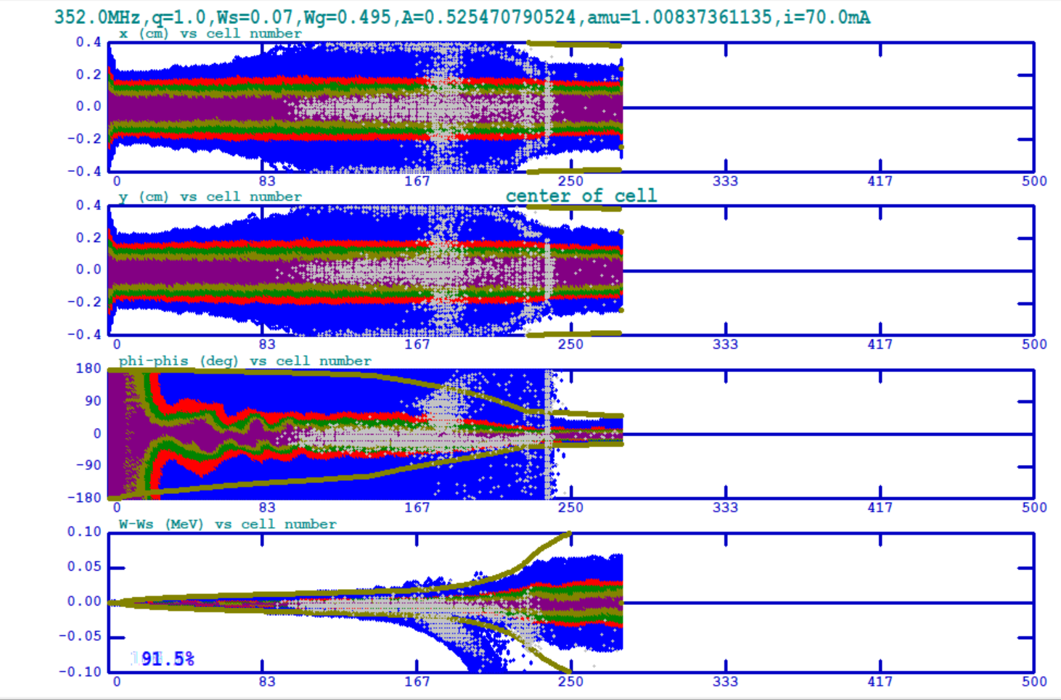
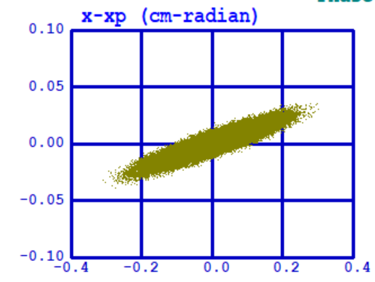
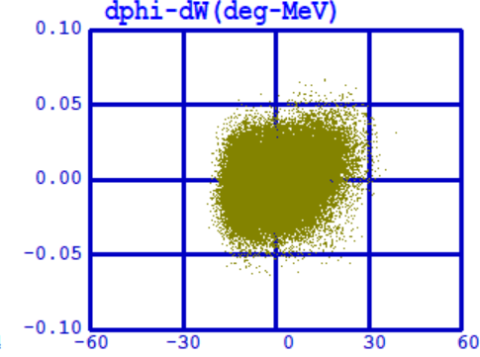
Beam dynamics – 70mA emit =0.5mm mrad
Transverse (x, y top) and longitudinal planes (phase, energy spread) along the RFQ
Beam at the RFQ output plane

Slide 24
Comparison of performance-method
Comparison of performance
    Simulations
    Current through the RFQ
Parameters :
  emittance at the RFQ input plane : 0.2 to 0.9 µm
  Matching :
  Transverse beam distribution : uniform, parabolic, gaussian
  Current : range 0-60mA
  Energy dispersion

Slide 25
Comparison of performance – results
Current of 60 mA needs to fit in an emittance of 0.4 for RFQ1 vs in an emittance of 0.8 for RFQ3 to give 48mA out of the RFQ

Slide 26
Summary
The SPL design of 2010 still holds
Substantial progress on the source brightness and more avenue to explore
  low current target is met
  R&D for high-rep rate includes study of the gas injection.
Chopping should be upgraded to faster rep rate
There are 3 designs for an RFQ that fits the specifications of LINAC4 at higher beam current and emittance. All designs have a transmission of more than 90% for a beam of 70mA with rms emittance 0.5 mm mrad. Two of the RFQ designs are based on RF parameters similar to RFQ1 whereas a very short RFQ is based on a surface field higher than what is attainable with room temperature copper.
3Mev test stand is equipped with diagnostics that can address questions related to beam quality for

Slide 27
EXTRAS

Slide 28
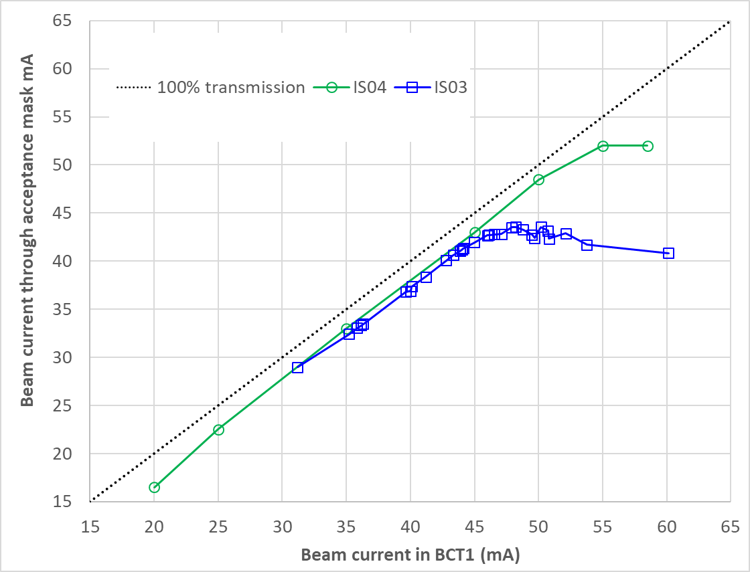
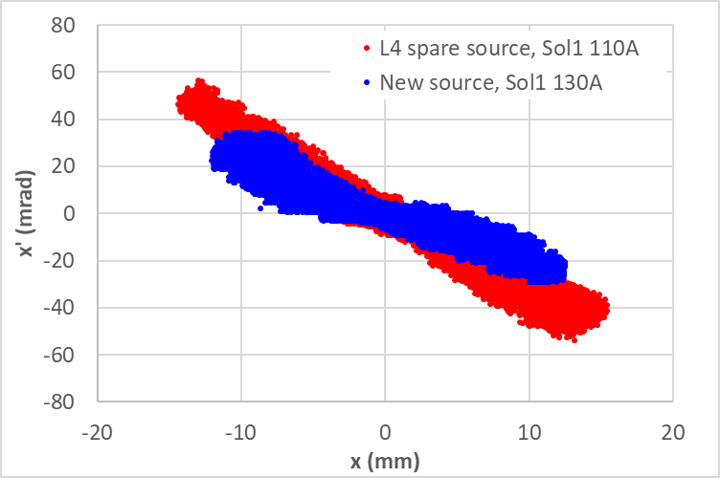
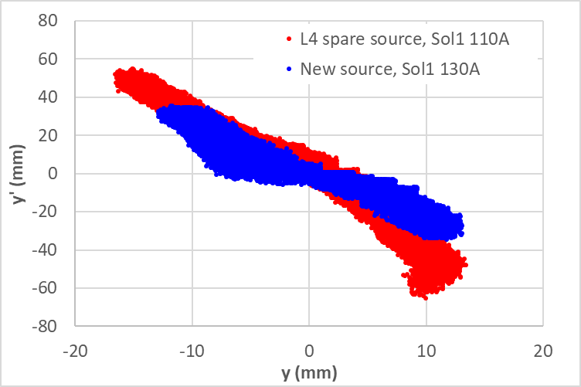
Test Stand results
With IS04 better quality beam at the test stand during 2021 (run for 20 weeks total)
Emittance at 35 mA | IS03 | IS04 | Δ (%)
XX’ norm. RMS emittance (π.mm.mrad) | 0.34 | 0.26 | -23.5
YY’ norm. RMS emittance (π.mm.mrad) | 0.40 | 0.32 | -20.0
Stability at 35 mA | IS03 | IS04 | factor
Sigma (%) over 24 h | 0.81% | 0.41% | 2
Sigma (%) over a week | 1.1% | 0.61% | 1.8

Slide 29
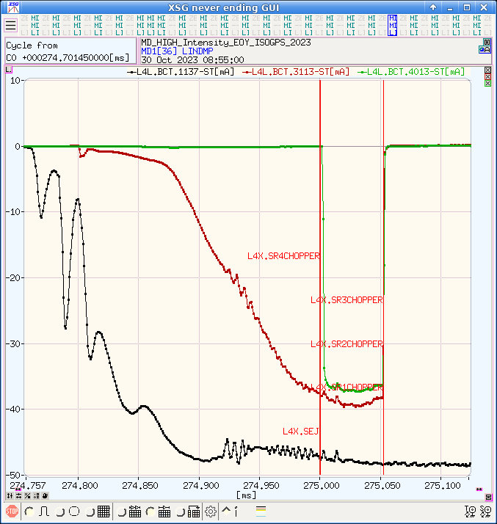
LEBT settings re-optimized for higher current (lower solenoids currents)
37mA in the dump with no chopping
~80% RFQ transmission
Increasing the RFQ power from 3.2 to 3.25MV increases the transmission from 81.5% to 82.5%

