Slide 1
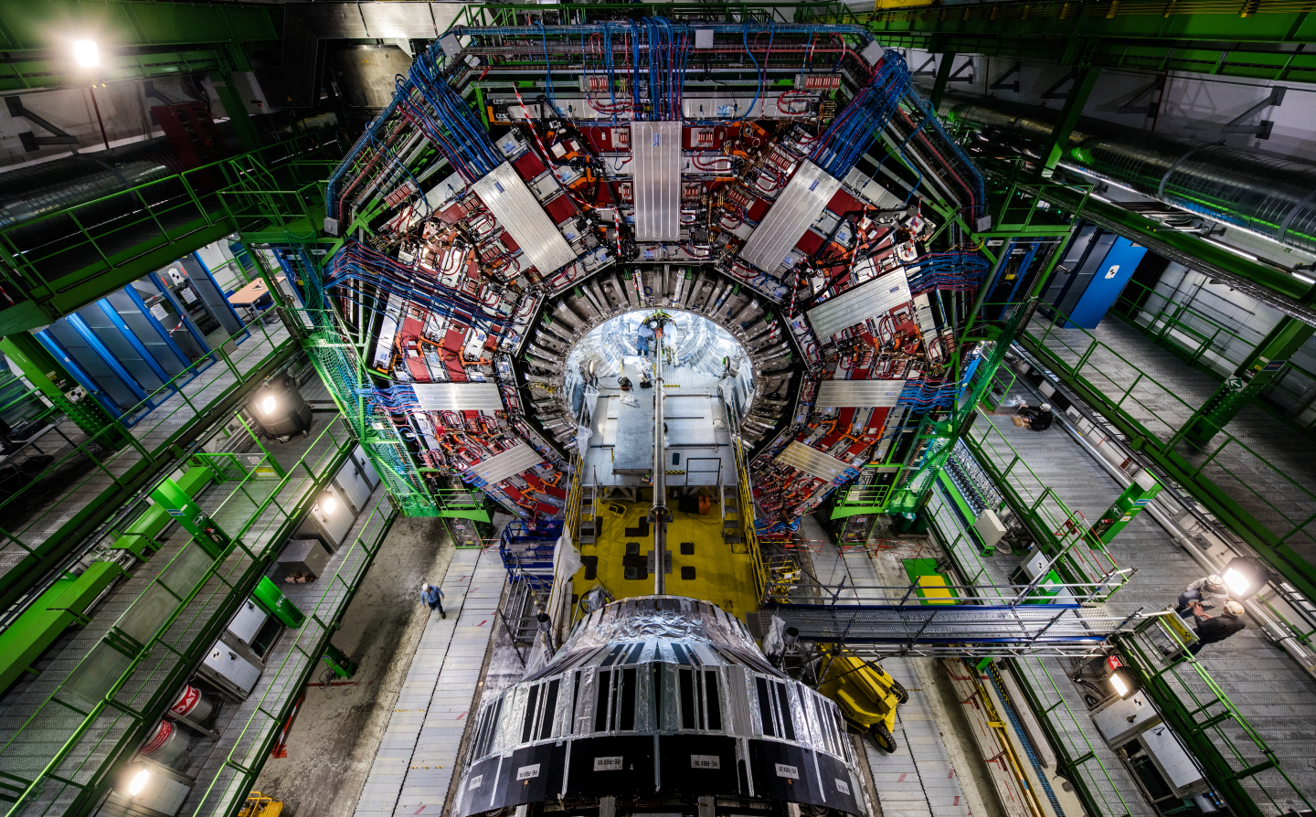
Theoretical physics
Aleksi Kurkela

Slide 2
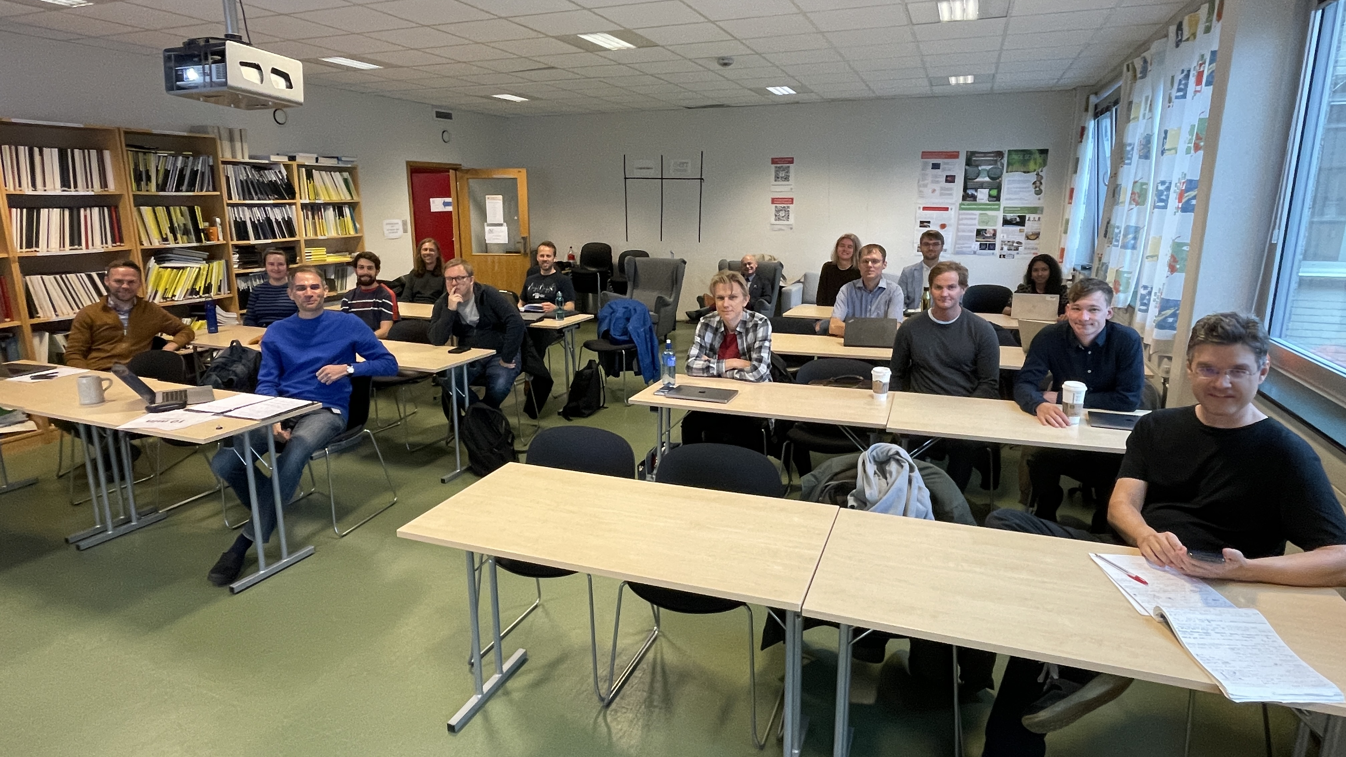
Who am I
Theoretial particle physicist:
  PhD in Helsinki Finland, 2008
  ETH Zurich, 2008-2010
  McGill Montreal, 2010-2013
  CERN, 2013-2020
  Stavanger, 2015 –
Research: particle physics, nuclear physics, astrophysics,…

Slide 3
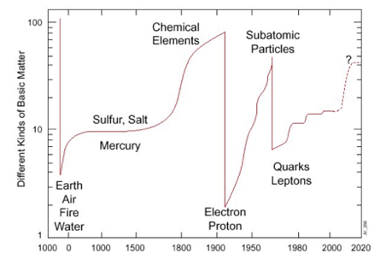

Slide 4
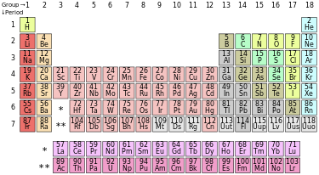

Slide 5
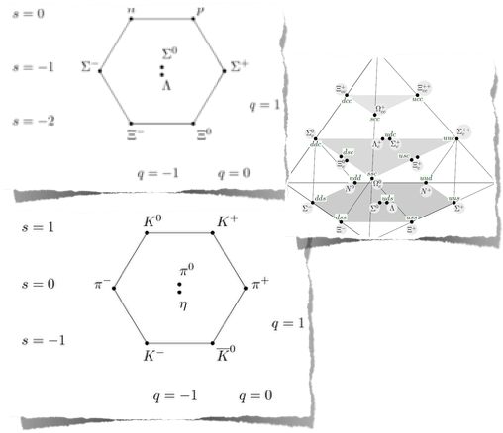

Slide 6
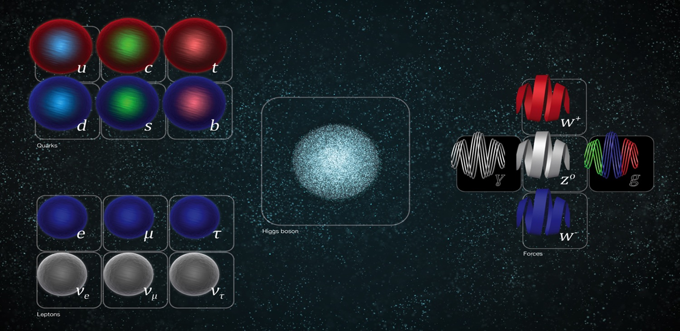

Slide 7
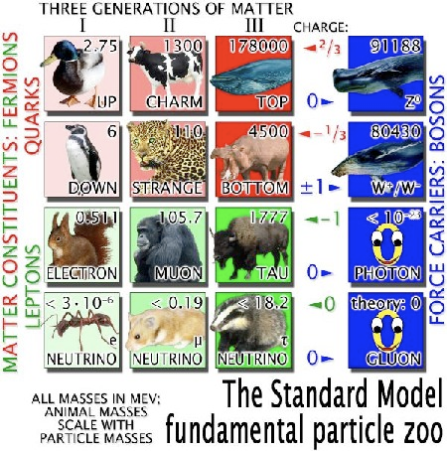
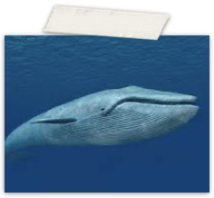
Periodic table of particle physics:
Higgs 125 GeV

Slide 8
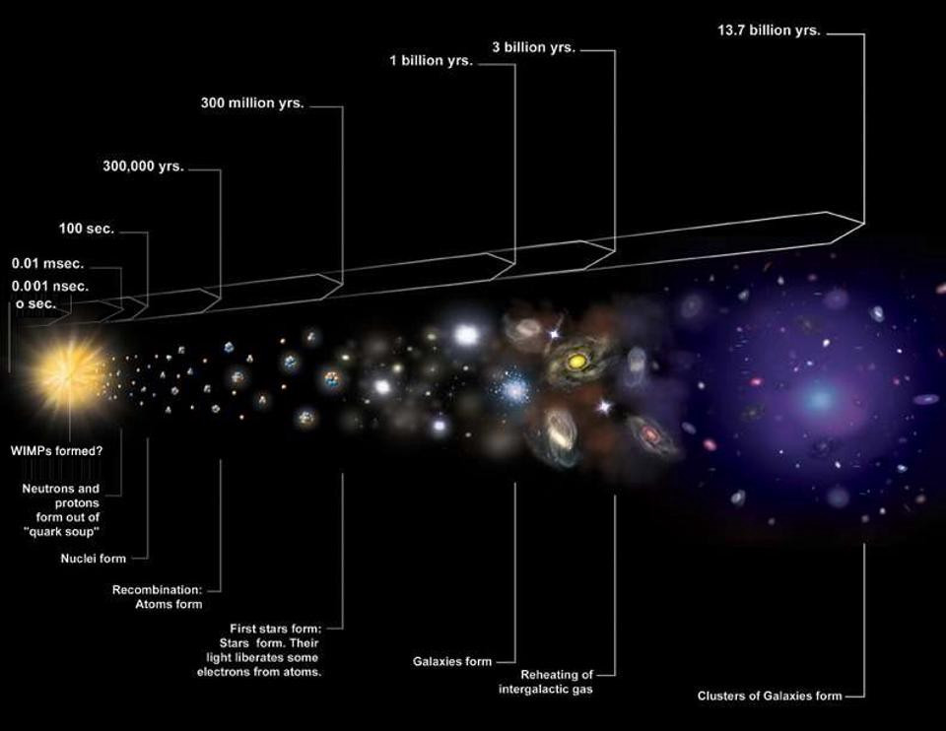

Slide 9
The standard model is incomplete!
Why the “periodic table”?
How do the elementary particle behave?
Why universe has a lot of matter and no anti-matter?
How does gravity fit in all this?
Something is missing!

Slide 10
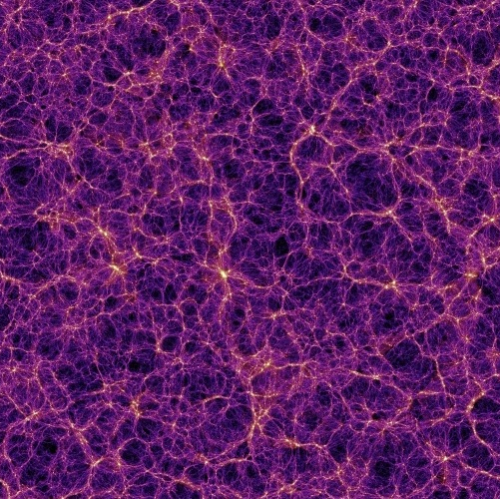
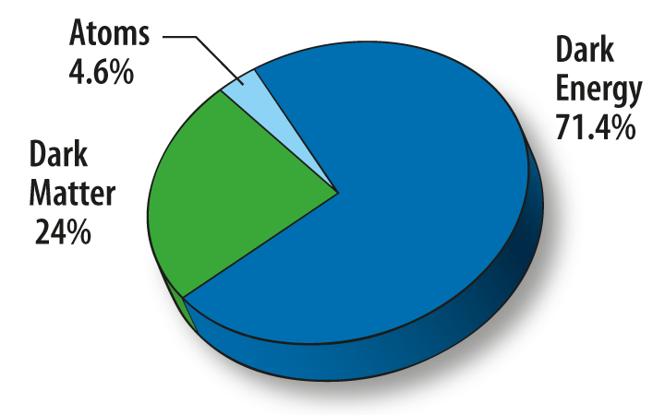
Dark universe:

Slide 11
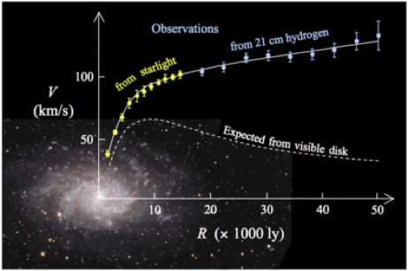
Dark universe:

Slide 12
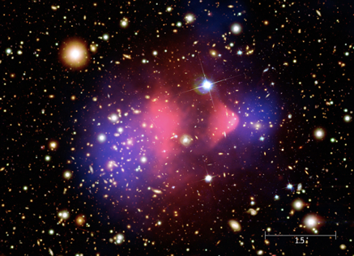
Dark universe

Slide 13
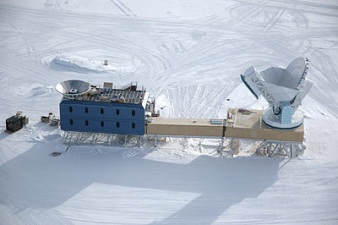
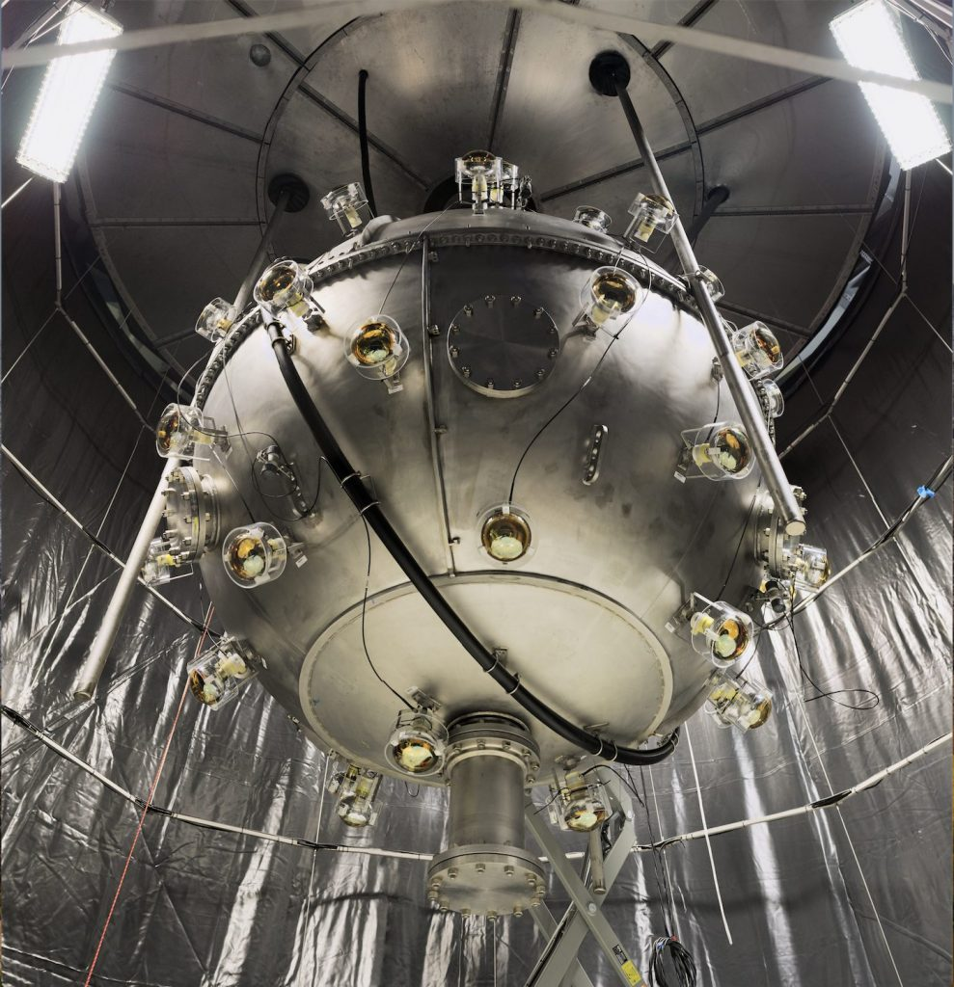
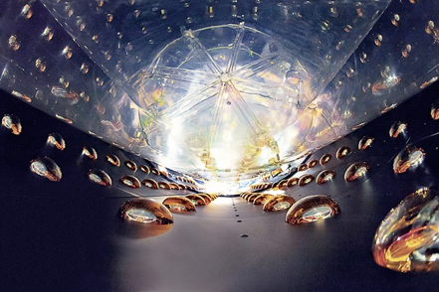
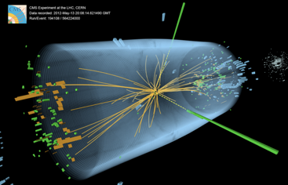
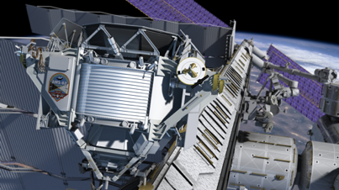
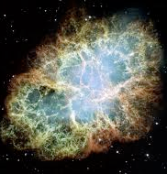
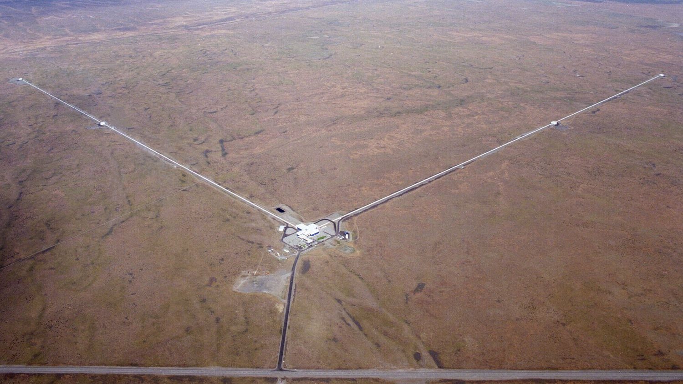

Slide 14
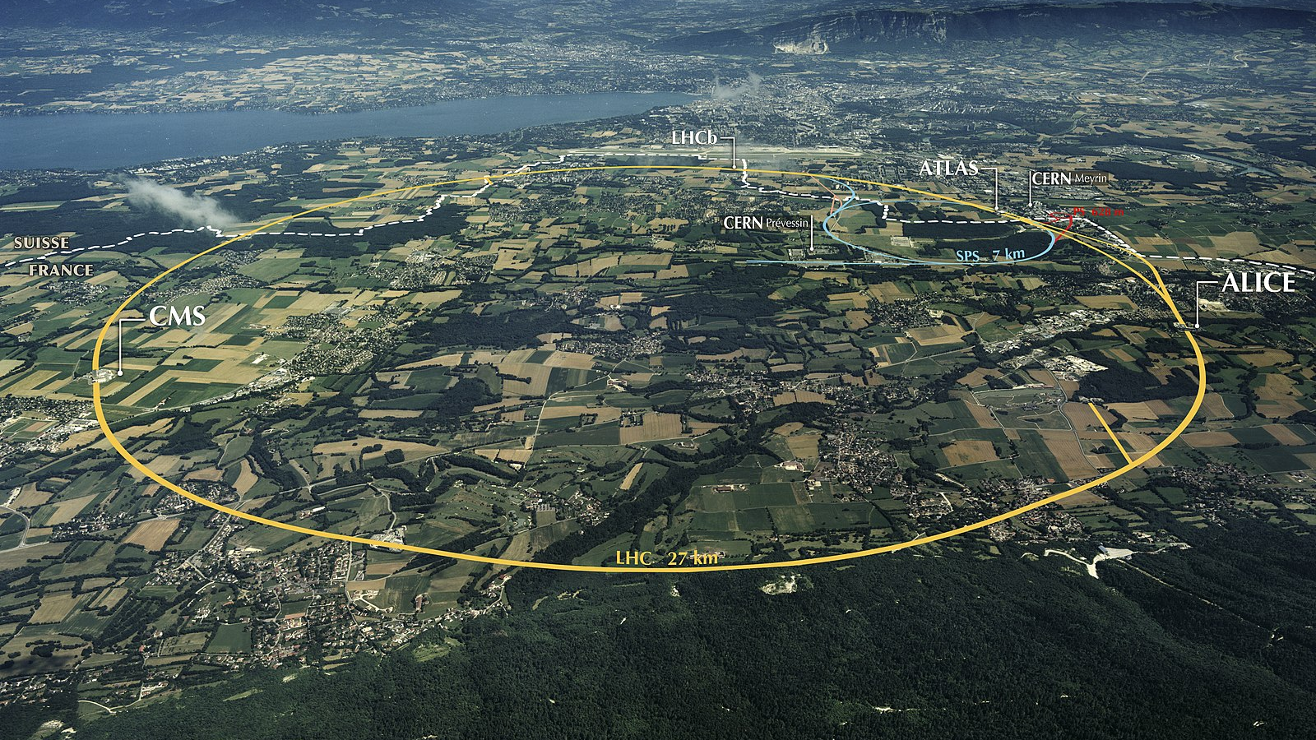

Slide 15
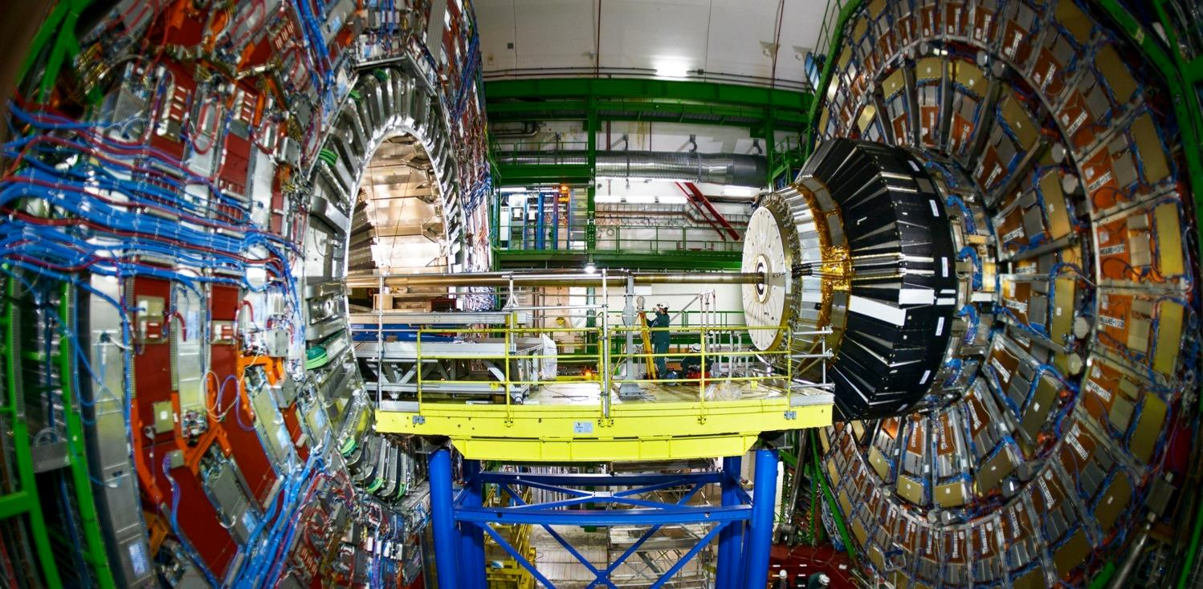

Slide 16
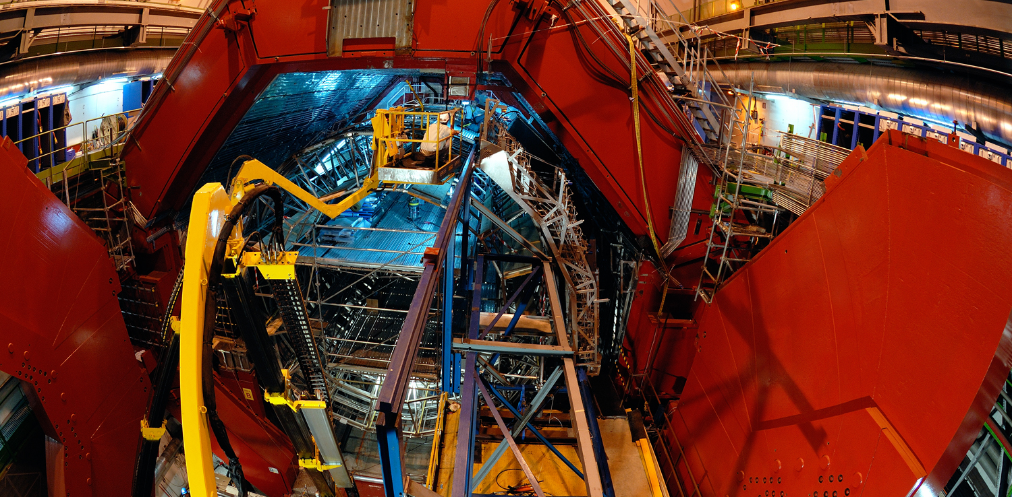

Slide 17
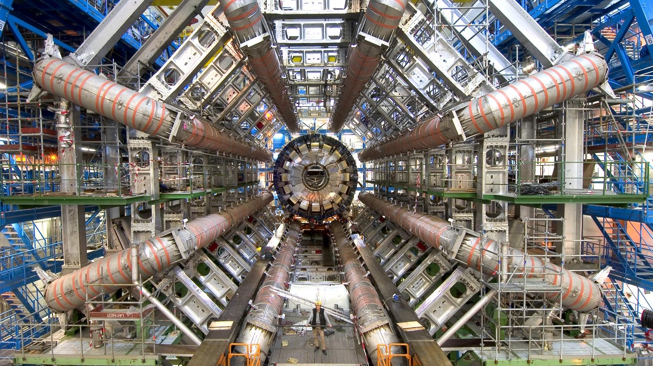

Slide 18
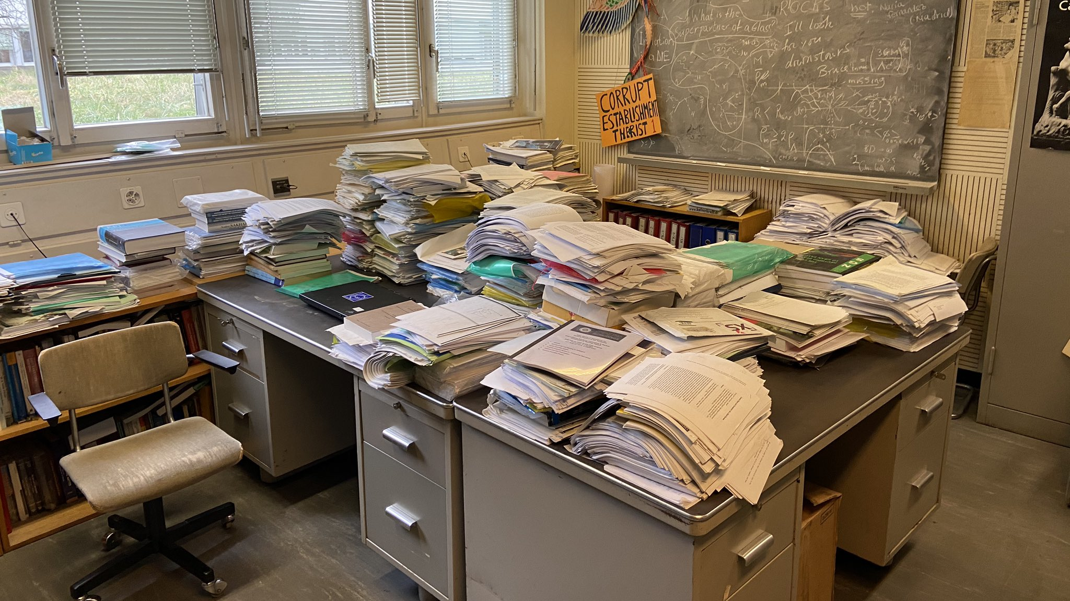

Slide 19
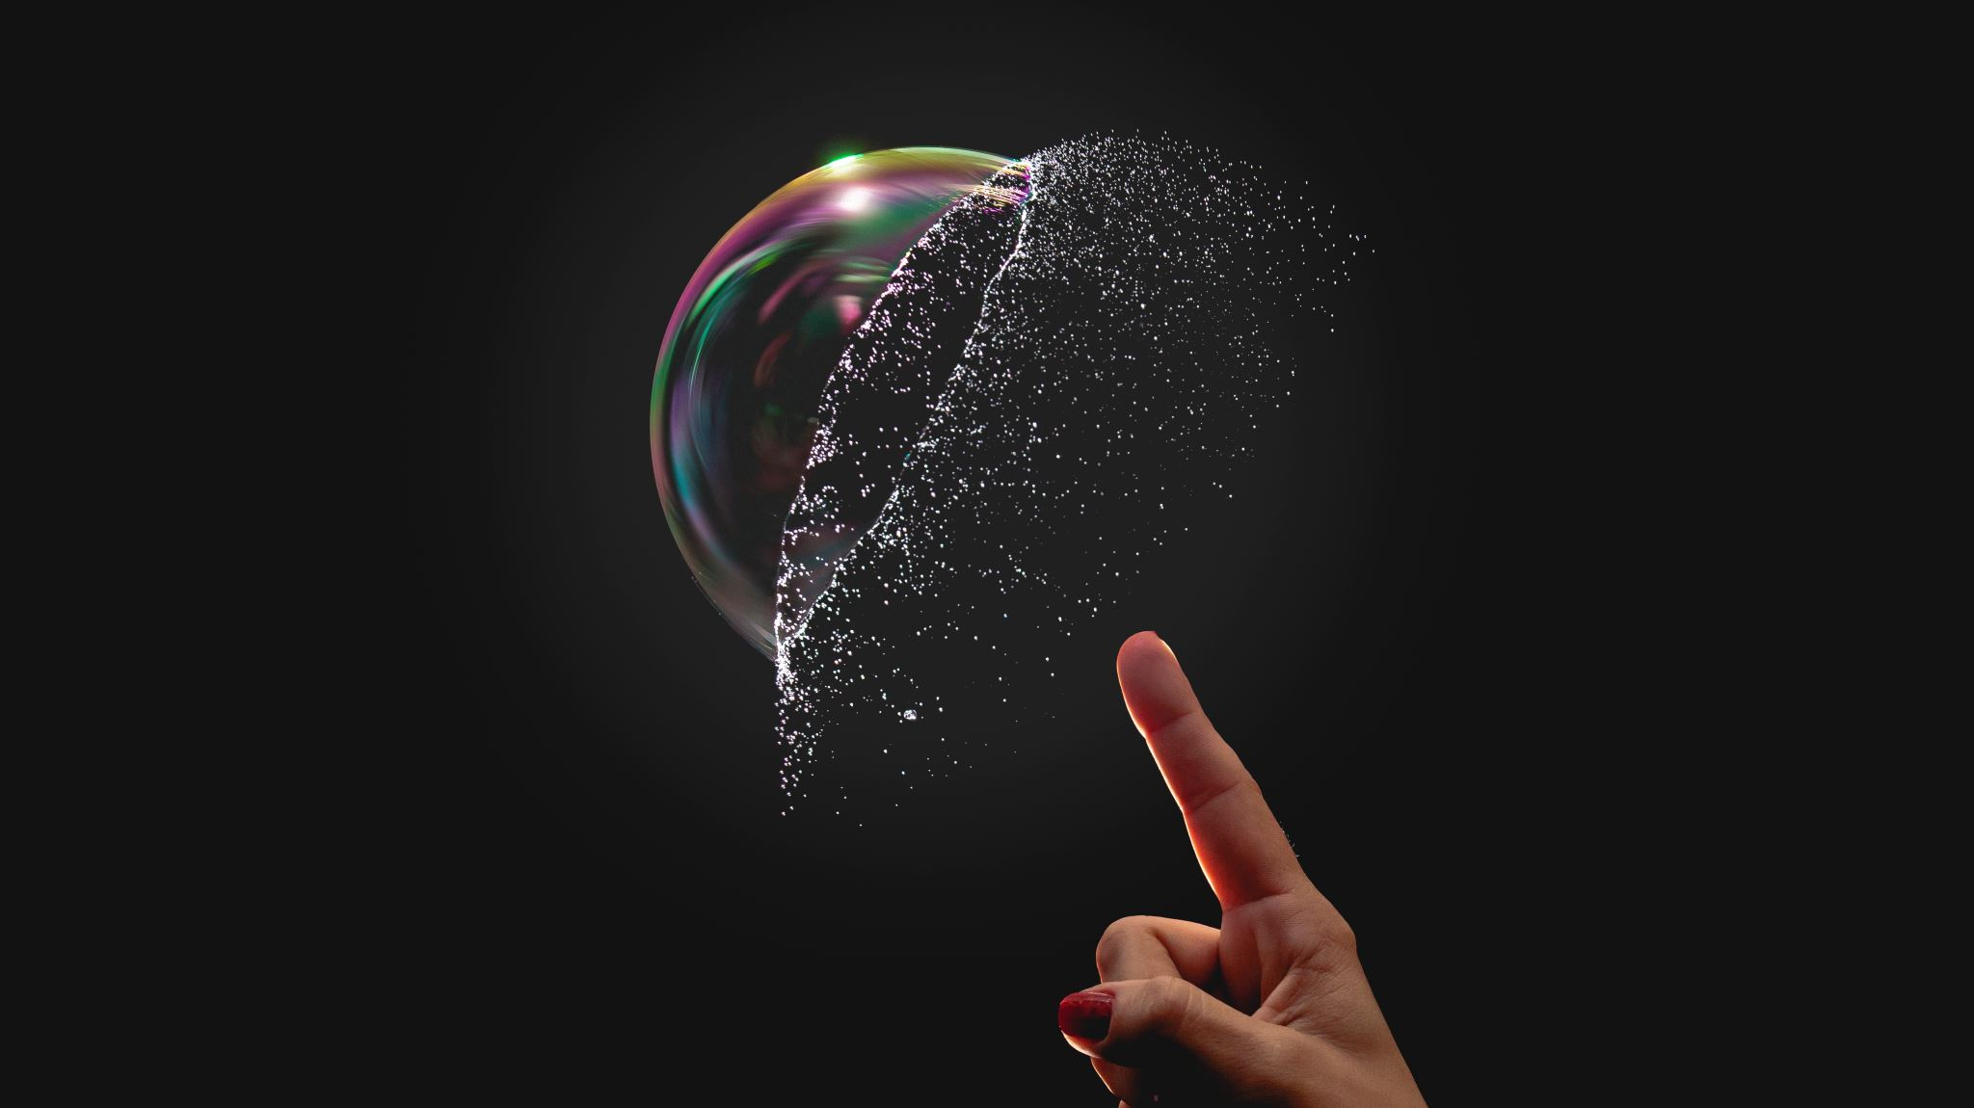
What does it mean to discover a particle?

Slide 20
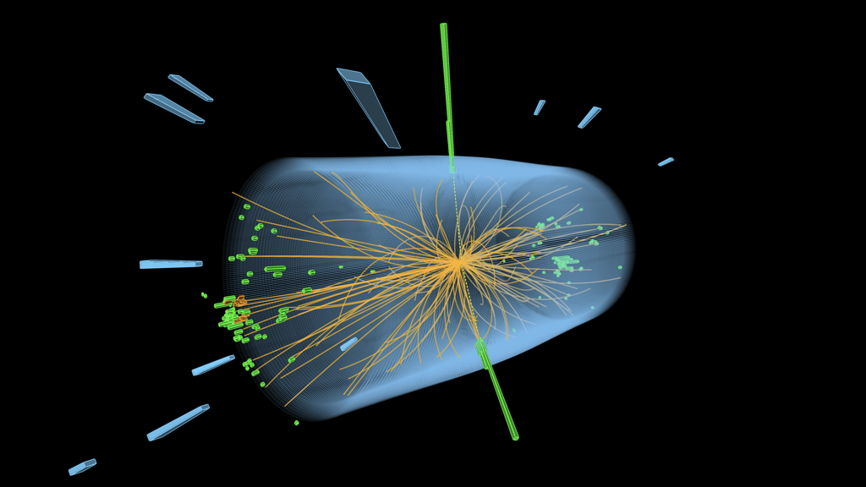

A billion collisions per second
EKinetci
The energy of the particles in collision is converted into new particles.
$$E=m c^{2}$$

Slide 21
A billion collisions per second
EKinetci
The energy of the particles in collision is converted into new particles.
$$E=m c^{2}$$
13TeV

Slide 22

A billion collisions per second
EKinetci
The energy of the particles in collision is converted into new particles.
$$E=m c^{2}$$
13TeV = 2 $μ$J

Slide 23

A billion collisions per second
EKinetci
The energy of the particles in collision is converted into new particles.
$$E=m c^{2}$$
13TeV = 2 $μ$J
E_{k} = ½ m·v² ⇒ E_{k} = ½ (0.1g)·(0,2m/s) ² ~ 13 TeV

Slide 24

A billion collisions per second
EKinetci
The energy of the particles in collision is converted into new particles.
$$E=m c^{2}$$
13TeV = 2 $μ$J
2 $μ$J/ $c^{2}=2.3$·${10}^{−23}$kg

Slide 25

A billion collisions per second
EKinetci
The energy of the particles in collision is converted into new particles.
$$E=m c^{2}$$
13TeV = 2 $μ$J
2 $μ$J/ $c^{2}=2.3$·${10}^{−23}$kg
$m_{higgs}=2$·${10}^{−25}$kg

Slide 26
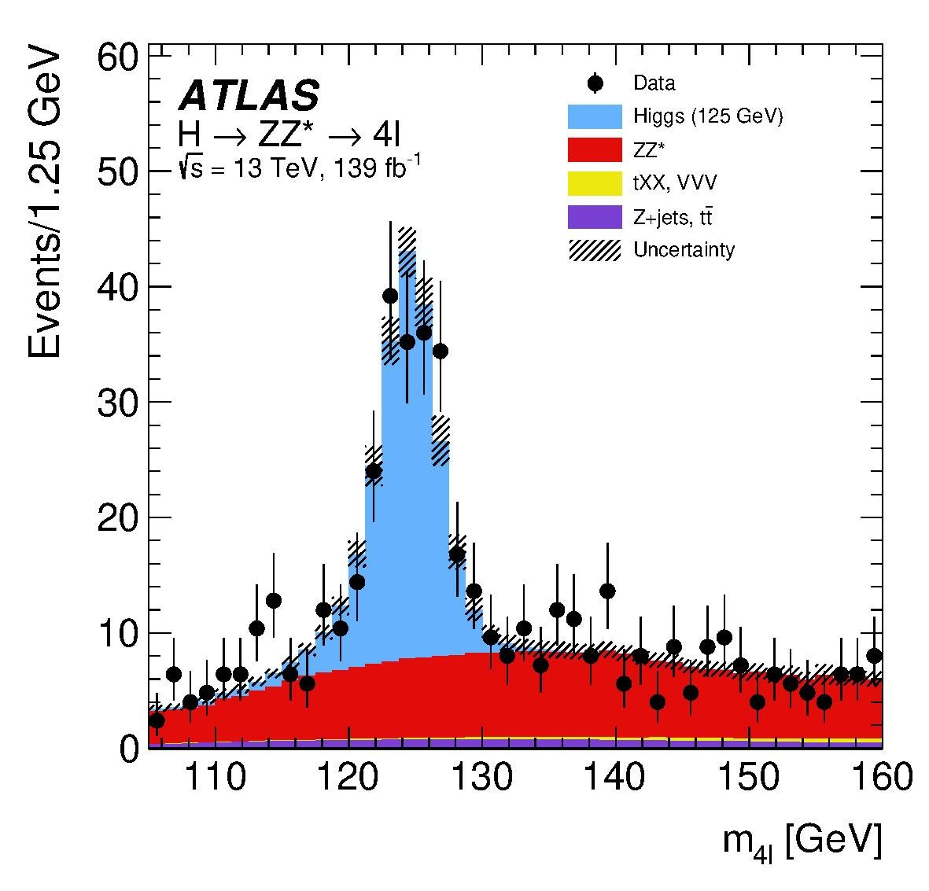

How to find a particle?

Slide 27
How to find a particle?

Slide 28



How to find a particle?
$$E_{1}$$
$$E_{2}$$
$$E_{1 }+E_{2}$$

Slide 29
How to find a particle?

Slide 30
How to find a particle?
m_{H} = 125 GeV

Slide 31
How to find a particle?
E₁ + E₂ = 125 GeV

Slide 32
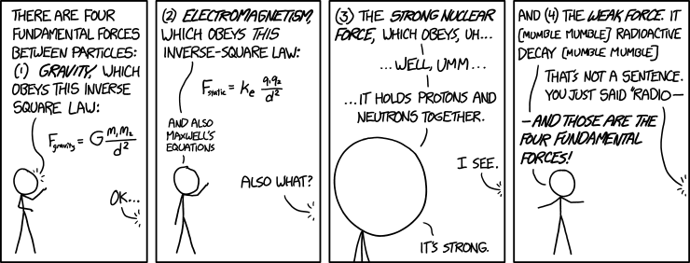
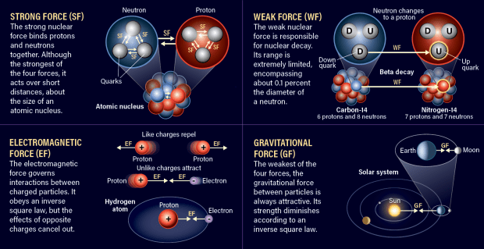
Forces of Nature
Gravity
Electromagnetism
Strong nuclear force
Weak nuclear force

Slide 33
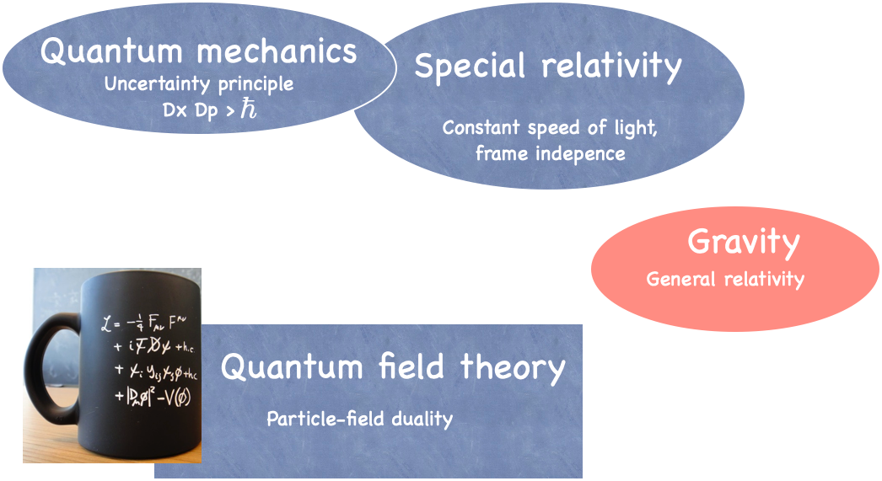

Slide 34
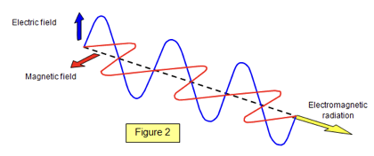
Fields are particles too:
Light is oscillations in electric and magnetic fields
The smallest possible vibration: Photon

Slide 35
Fields are particles too:
Electric and
Magnetic fields
Chromoelectric and
Chromomagnetic field
+ gravitational field
and graviton?
SU(2) fields

Slide 36
Strong force: Quantum Chromodynamics

Slide 37

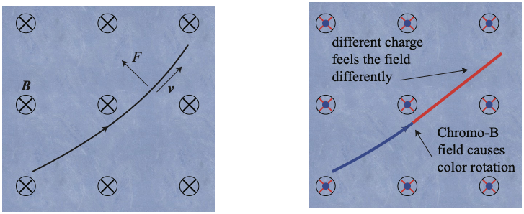
Strong force: Quantum Chromodynamics
Three colors of quarks
Chromoelectric and –magnetic fields like electric and magnetic fields but see color instead of electric charge
Chromo fields change not only momentum but also color

Slide 38
Strong force: Quantum Chromodynamics
Three colors of quarks
Chromoelectric and –magnetic fields like electric and magnetic fields but see color instead of electric charge
Chromo fields change not only momentum but also color
Chromo fields have colors too -> Self interaction!

Slide 39
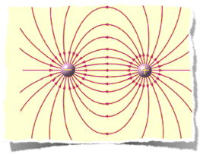
Strong force: Quantum Chromodynamics
Inverse square law for
electric charges

Slide 40
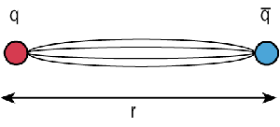

Strong force: Quantum Chromodynamics
Inverse square law for
electric charges
Constant string force between quarks
$$F={\left(400 MeV\right)}^{2}$$

Slide 41

Strong force: Quantum Chromodynamics
$$F={\left(400 MeV\right)}^{2}=130 kN$$
Color confinement
Millennium Prize 1M$

Slide 42

Quarks are confined into hadrons:

Slide 43
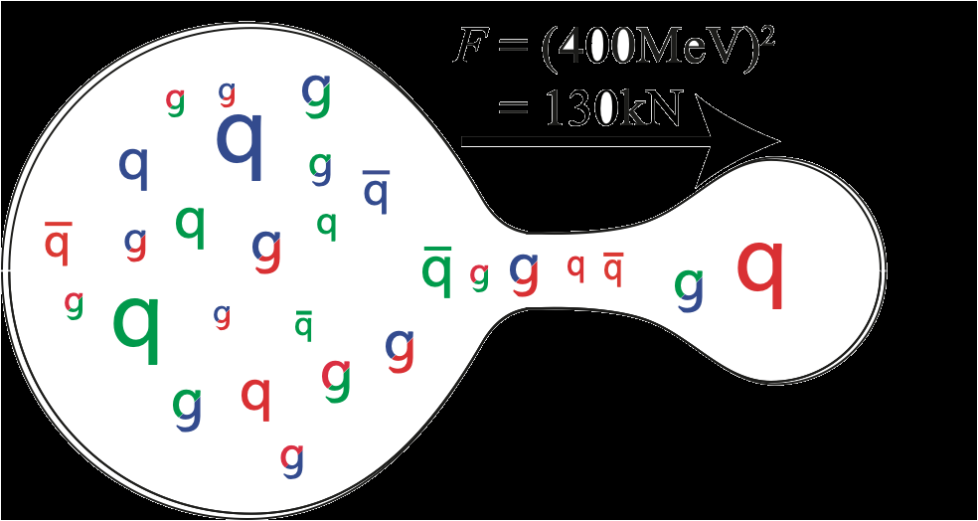
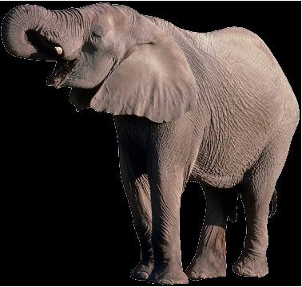


Quarks are confined into hadrons:
$$F={\left(400 MeV\right)}^{2}=130 kN$$
$$W=F.dx$$
$=130 kN × {10}^{−15}$m
$$={1.3⋅10}^{−10}J$$
$$m=E/c^{2}$$
$$=1.5⋅{10}^{−27}kg$$
$=$ mass of a pion
Quarks and gluons are confined into hadrons

Slide 44
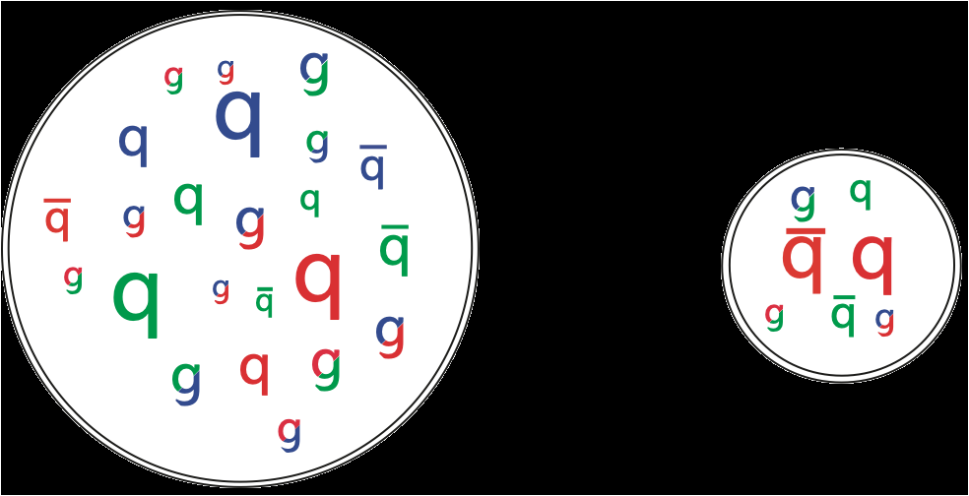
Nuclear substructure
Quarks are confined into hadrons:
$$W=F.dx$$
$=130 kN × {10}^{−15}$m
$$={1.3⋅10}^{−10}J$$
$$m=E/c^{2}$$
$$=1.5⋅{10}^{−27}kg$$
$=$ mass of a pion
s

Slide 45
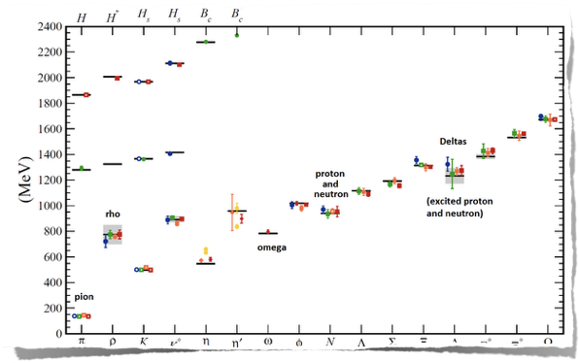
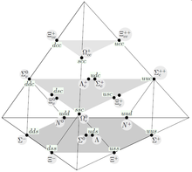
Nuclear substructure:

Slide 46
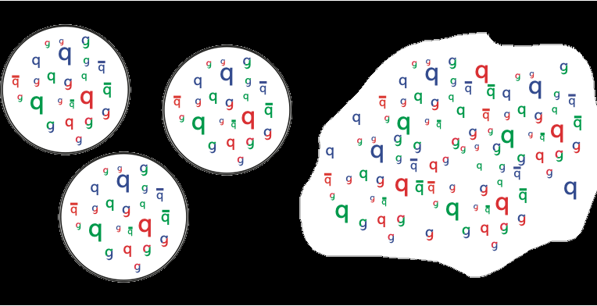
Quark matter:

Slide 47
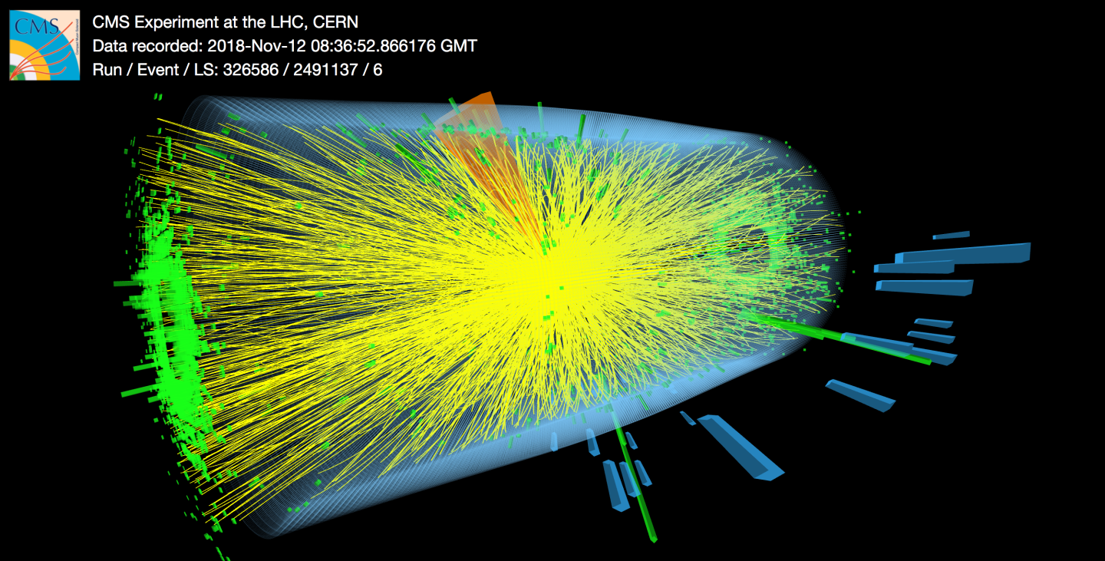
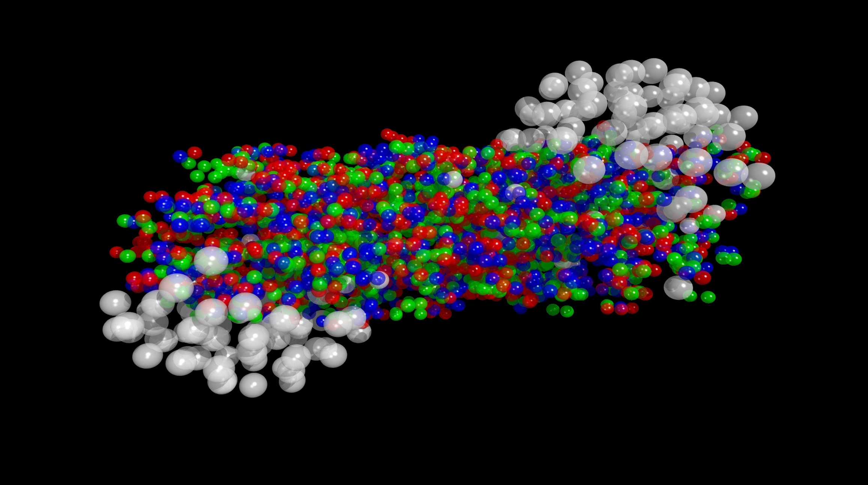
Heavy-ion collisions

Slide 48
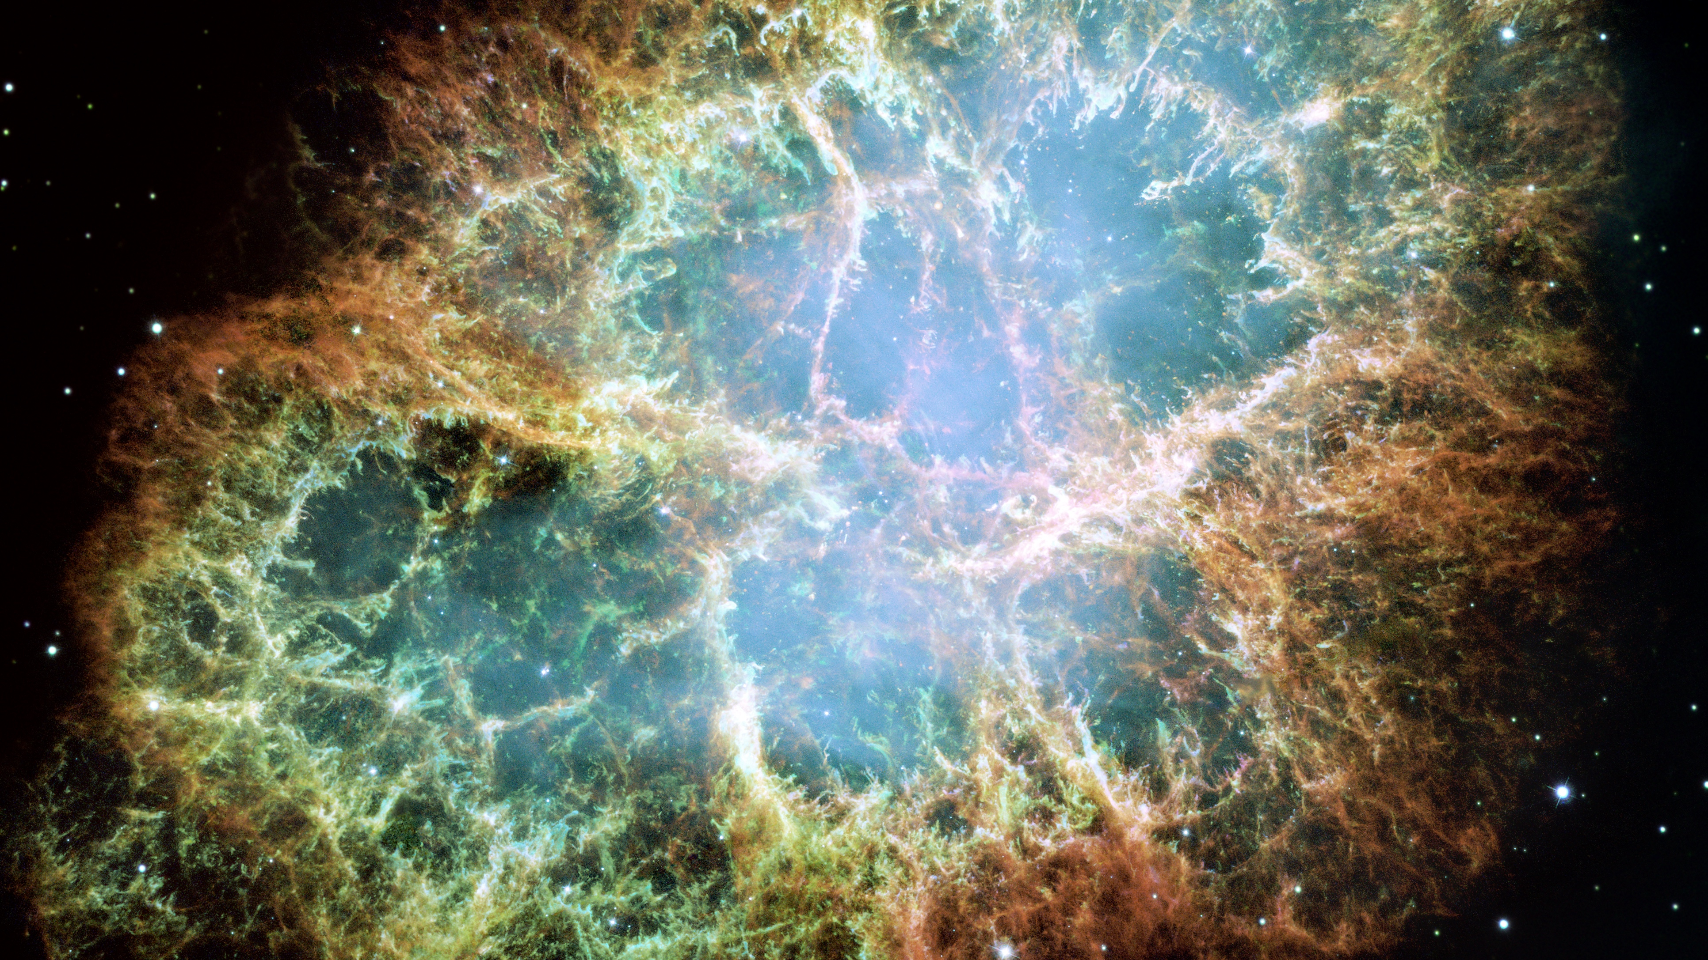

Slide 49
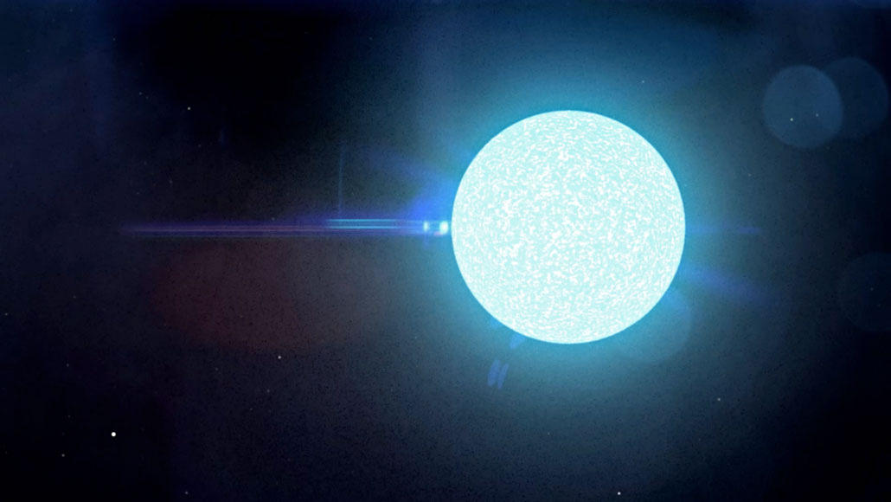

Slide 50
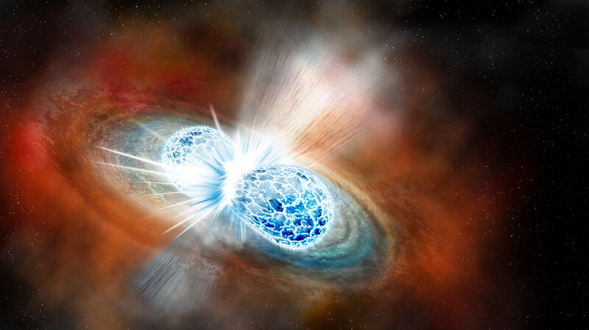

Slide 51
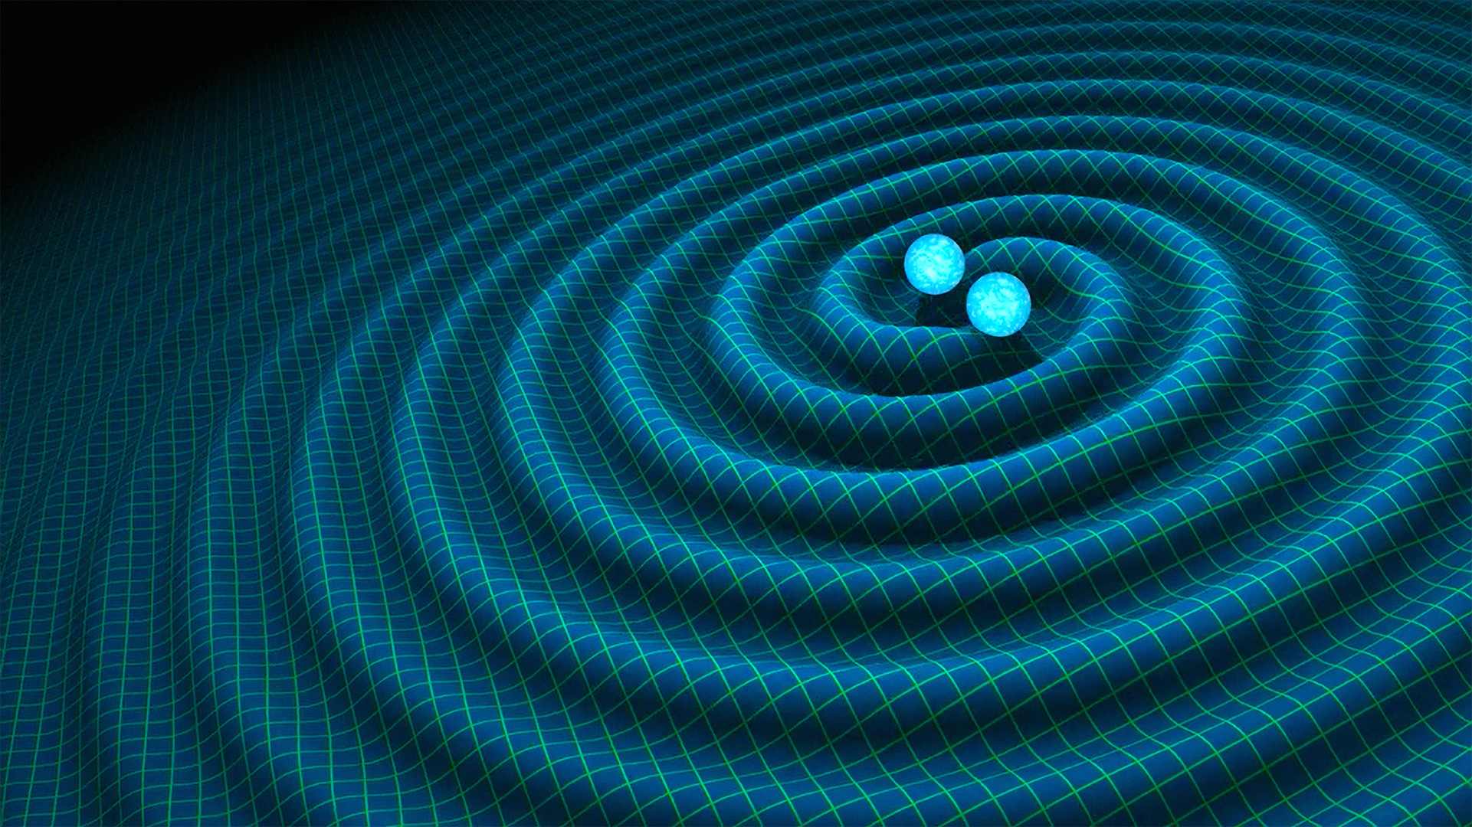

Slide 53
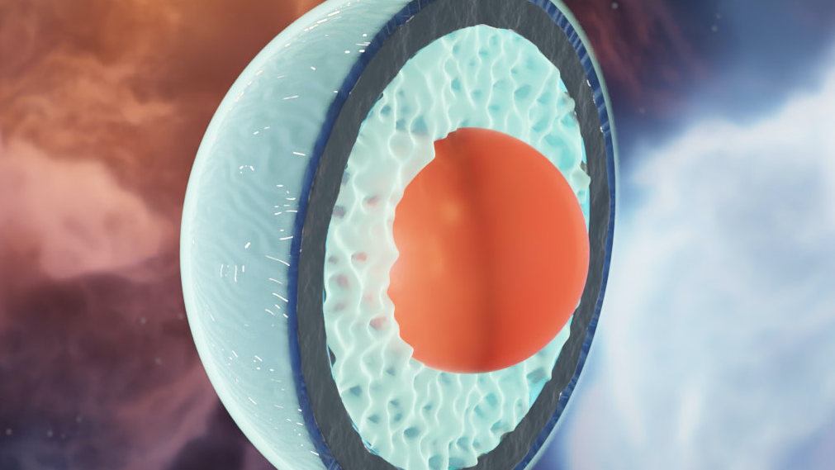
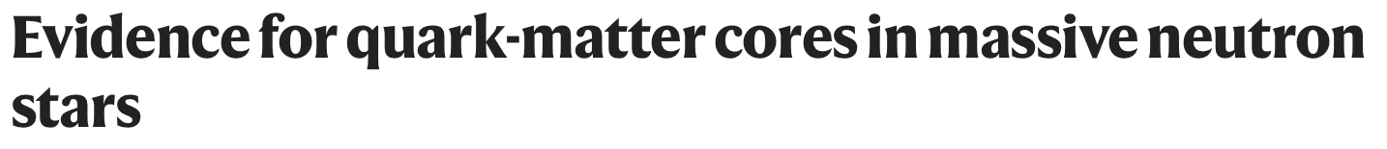

Quark
Matter !

Slide 54
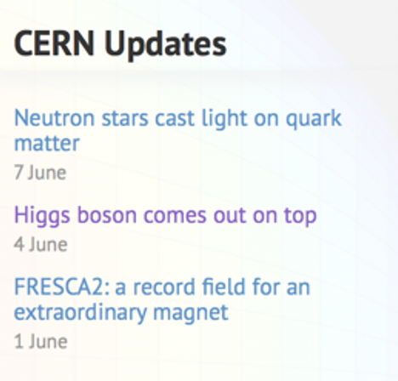





Quark
Matter !

Slide 55
UiT:
David McNutt
N-PACT 2023
Norwegian Particle, Astroparticle and
Cosmology Theory community.
NTNU:
Jens Oluf Andersen,
Michael Kachelriess,
Foteini Oikonomou
Marius Solberg,
Ben David Normann
Jonas Tjemsland,
Robin Plantey,
Domenik Ehlert.
UiS:
Tomas Brauner,
Aleksi Kurkela,
Anders Tranberg,
Alexander Rothkopf,
Germano Nardini,
Alex Nielsen,
Paul de Medeiros,
Sigbjørn Hervik,
Eirik Svanes,
Helena Kolesova,
Rasmus Larsen,
Jahed Abedi,
Daniel Alvestad,
Gaurang Parkar,
Paolo Marcoccia,
Divyarani Chandrababu Geetha,
Gerhard Ungersbäck,
Jonas El Gammal,
Oleg Komoltsev,
Magdalena Eriksson,
Vegard Undheim.
HVL:
Odd Magne Øgreid.
UiB:
Jörn Kersten,
Konrad Tywoniuk,
Per Osland (emer.),
Alexandre Falcao,
Adam Takacs,
Johannes Isaksen.
UiO:
Are Raklev,
Larissa Bravina,
Torsten Bringmann,
David Mota,
Anders Kvellestad,
Jake Gordin,
Lasse Lorentz Braseth,
Tore Klungland
HiØ:
Mikjel Thorsrud.
UiA:
Nils-Erik Bomark.

Slide 57
Dark universe:

Slide 58
Dark universe

Slide 59
Dark universe

Slide 60

Fields are particles too:

