Slide 1



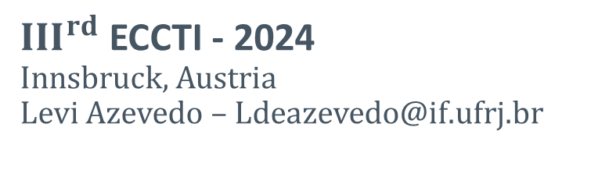
Adaptable platform for trapped cold electrons hydrogen and lithium anions and cations
Matrix Isolation Sublimation Technique as a low energy ion source
$III^{rd}$ ECCTI - 2024
Innsbruck, Austria
Levi Azevedo – Ldeazevedo@if.ufrj.br
L. O. A. Azevedo*, R. J. S. Costa, W. Wolff, A. N. Oliveira*,
R.L. Sacramento*, D.M. Silveira*, C. L. Cesar*
*ALPHA Collaboration - CERN
Ref: "Adaptable platform for trapped cold electrons, hydrogen and lithium anions and cations”. Commun Phys 6, 112 (2023).

Slide 2
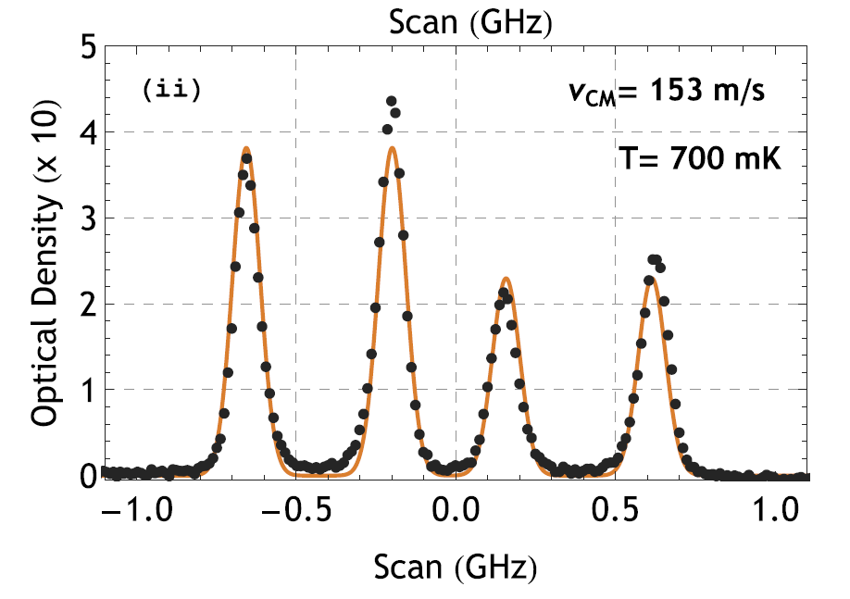
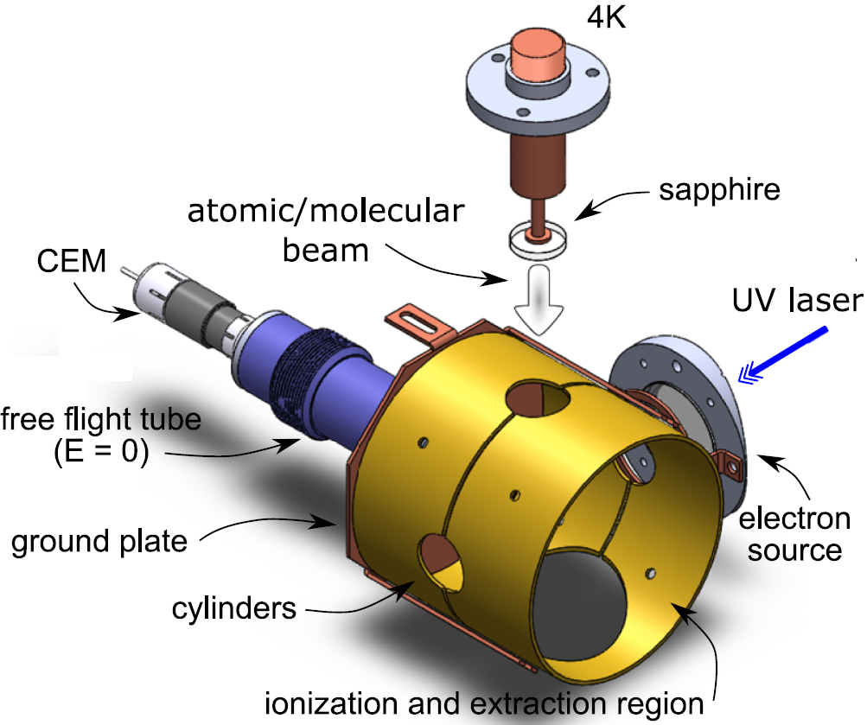
Matrix Isolation Sublimation (MISu)
1
Cold beams of Atoms and Molecules
    Doopler Sensitive Laser spectroscopy
    Magnetic trapping of atoms
  Ground-state molecular beams (rho-vibrational ground-state)
  Molecular formation inside matrices at 4 K
  Charged Particles beams – Ions & electrons
Versatile to diferente species
  Simple atomic systems to molecules/clusters
Adaptable Technique
  Laser Spectroscopy
  Time of Flight Mass Spectrometer
  Traps for confining cold particles
    Penning-Malmberg trap
    Two magnetic trap for hydrogen (H) in a near future
R. L. Sacramento, et al., Matrix Isolation Sublimation: an apparatus for producing cryogenic beams of atoms and molecules, Rev. Sci. Instrum. 86, 073109 (2015)
A. N. Oliveira, et al., Heteronuclear molecules from matrix isolation sublimation and atomic diffusion, J. Chem. Phys. 149, 084201 (2018)

Slide 3
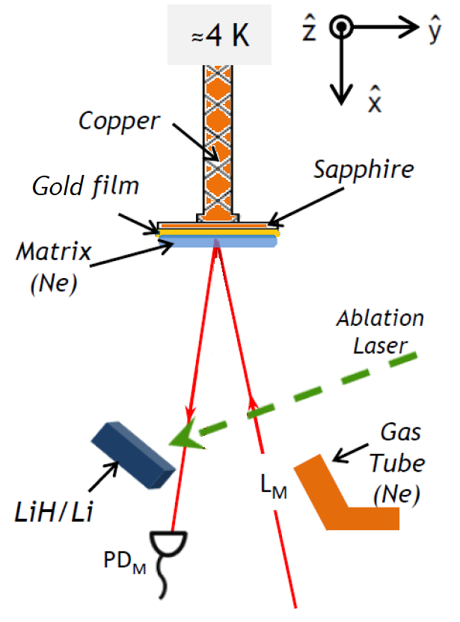
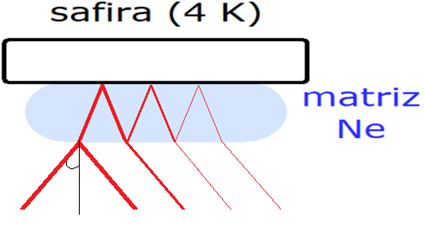
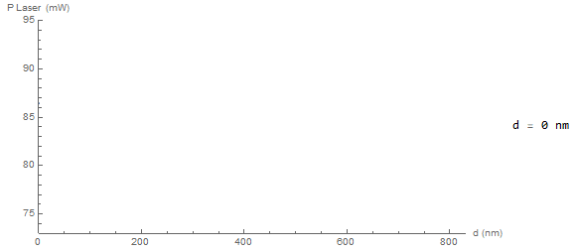

2
MISu - Steps
Growth of the Matrix
  Inert Gas (Ne or $H_{2}$)
  Flow Rate: 1 – 10 mmol/h
  Solid matrices
  Interference
  fringes signal as
  matrix grows
NiCr

Slide 4
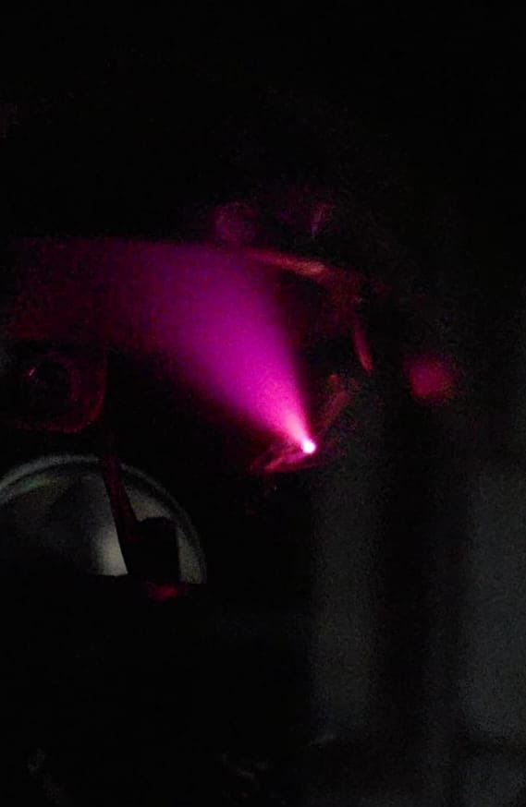
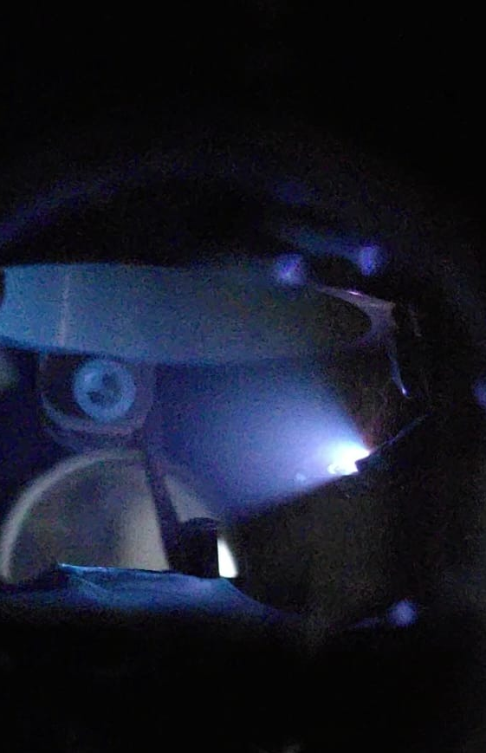
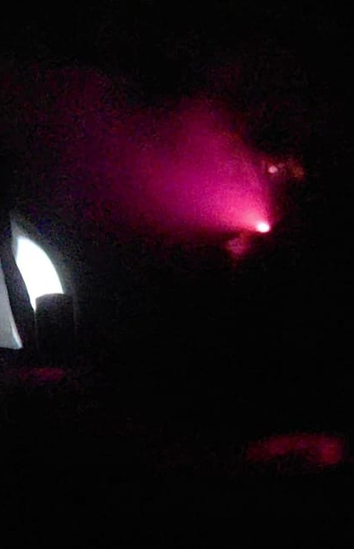

MISu - Steps
3
s
Laser Ablation
  Pulsed Laser of 5 ns pulses
  Typical energy: 1 mJ
  $ND:YAG$ (1064 nm or 532 nm)
  Solid Targets ($LiH$, $TiH_{2}$ and $Li$ – Applicable to other targes)
NiCr

Slide 5

MISu - Steps
S
s
Sublimation
  Heat pulse to the Sapphire
    Sublimation plume
    Cold beams
  Spectroscopy
    Longitudinal Laser ($L_{M}$)
4
NiCr

Slide 6
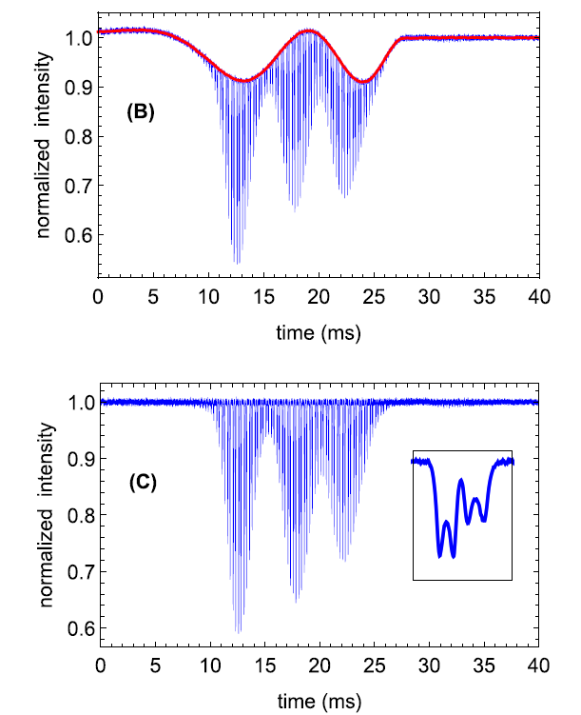
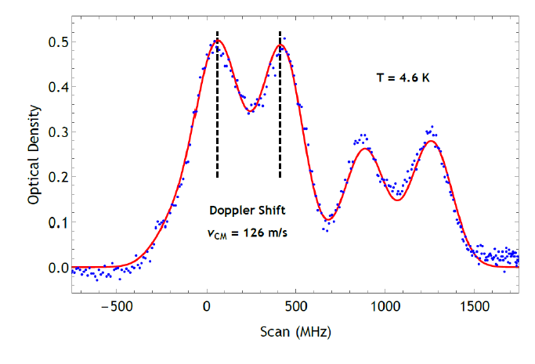


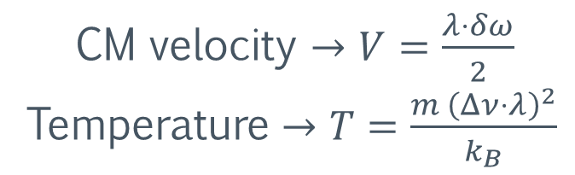
Absorption spectroscopy – Longitudinal signal
5
Typical velocities: 70 – 200 m/s
Typical temperatures: 0.2 – 20 K
CM velocity $→V=\frac{λ⋅δω}{2}$
Temperature $→T=\frac{m {\left(Δν⋅λ\right)}^{2}}{k_{B}}$
$$δω$$
$$Δν$$

Slide 7
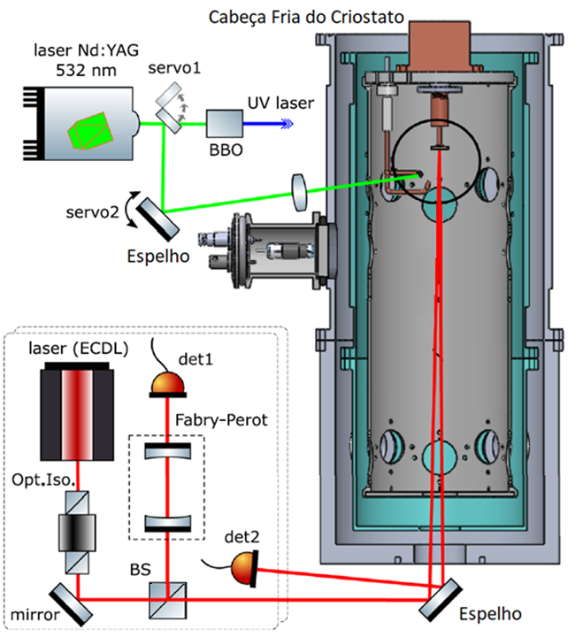
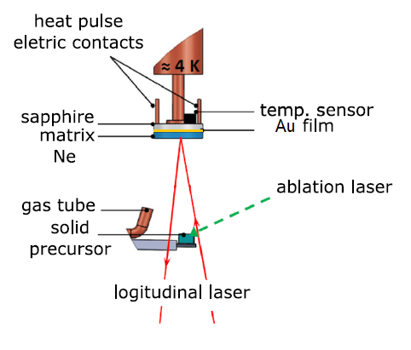
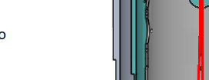
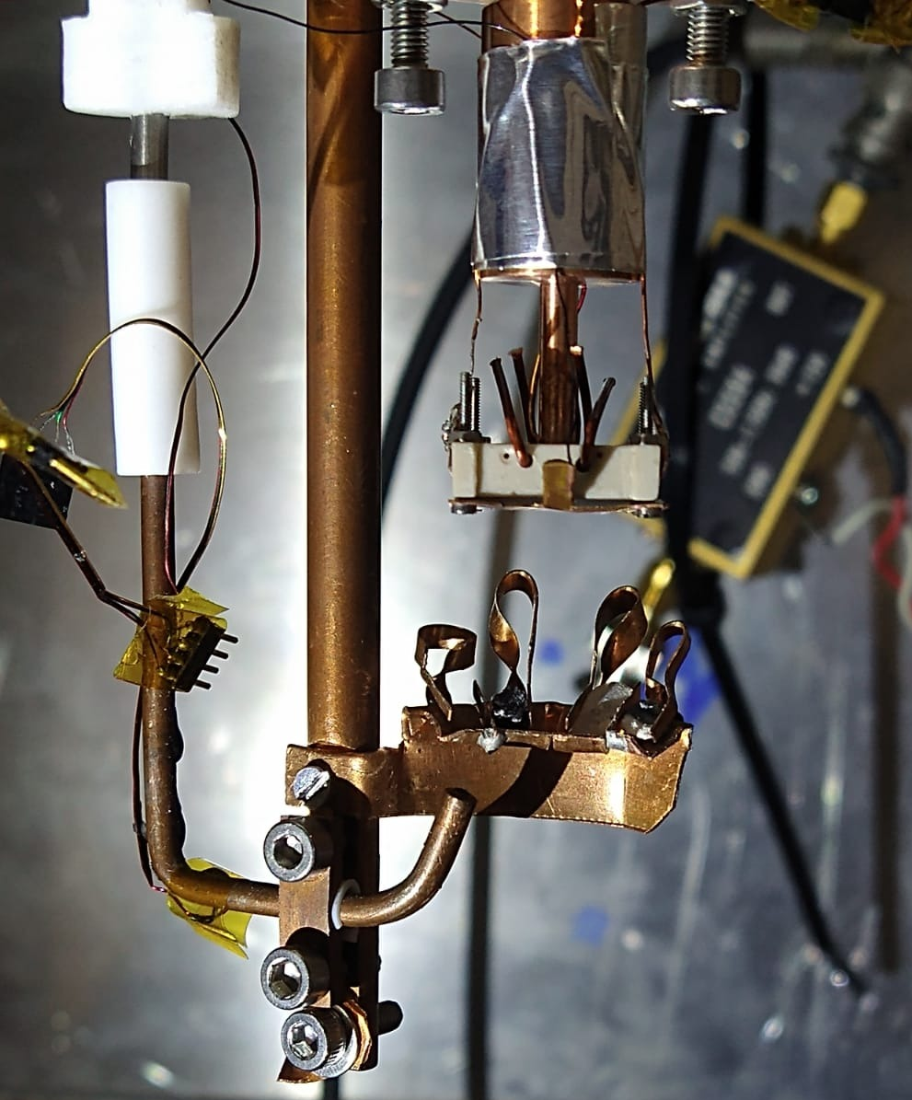
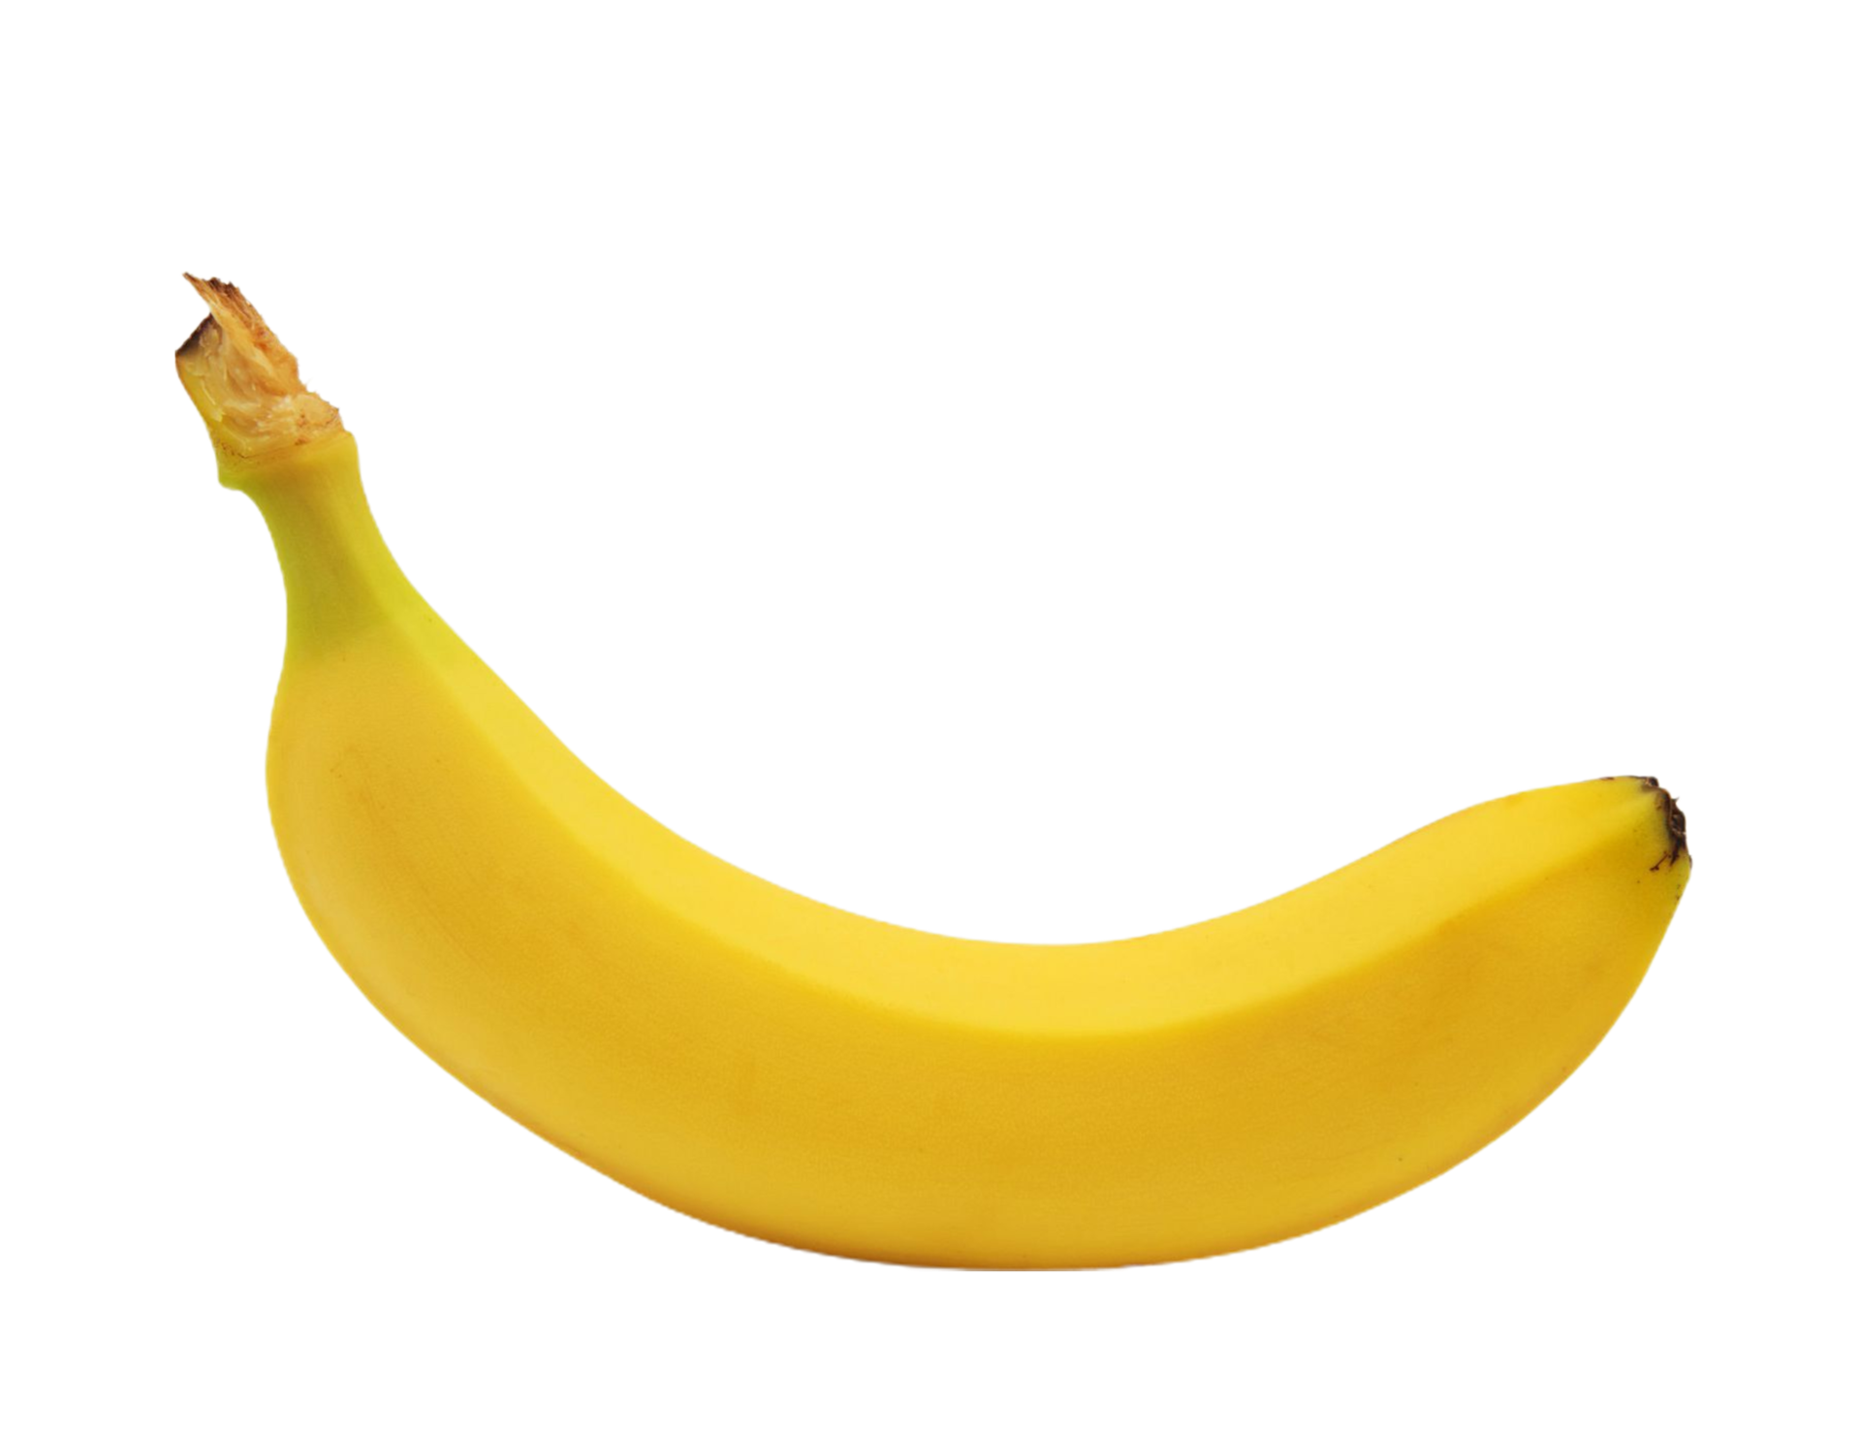
MISu - Main setup
6
5 cm
NiCr film
Banana for scale
10 mm

Slide 8
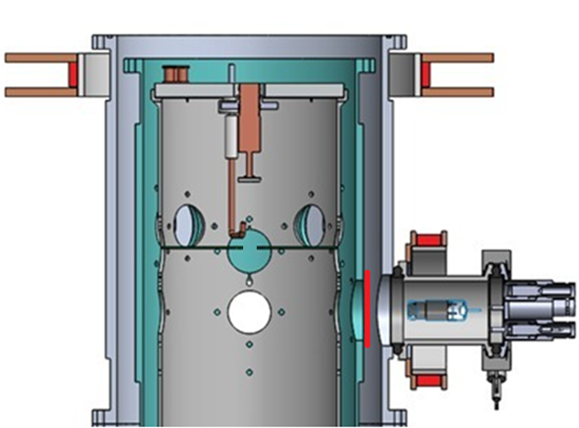
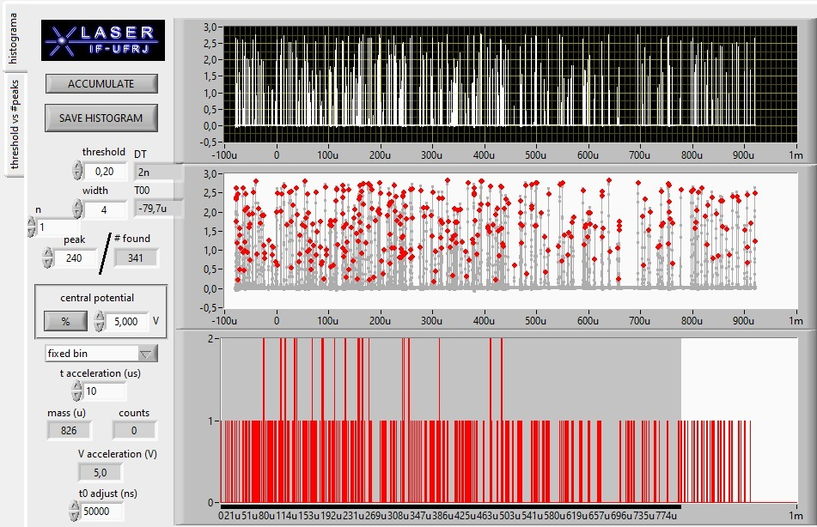
7

Slide 9
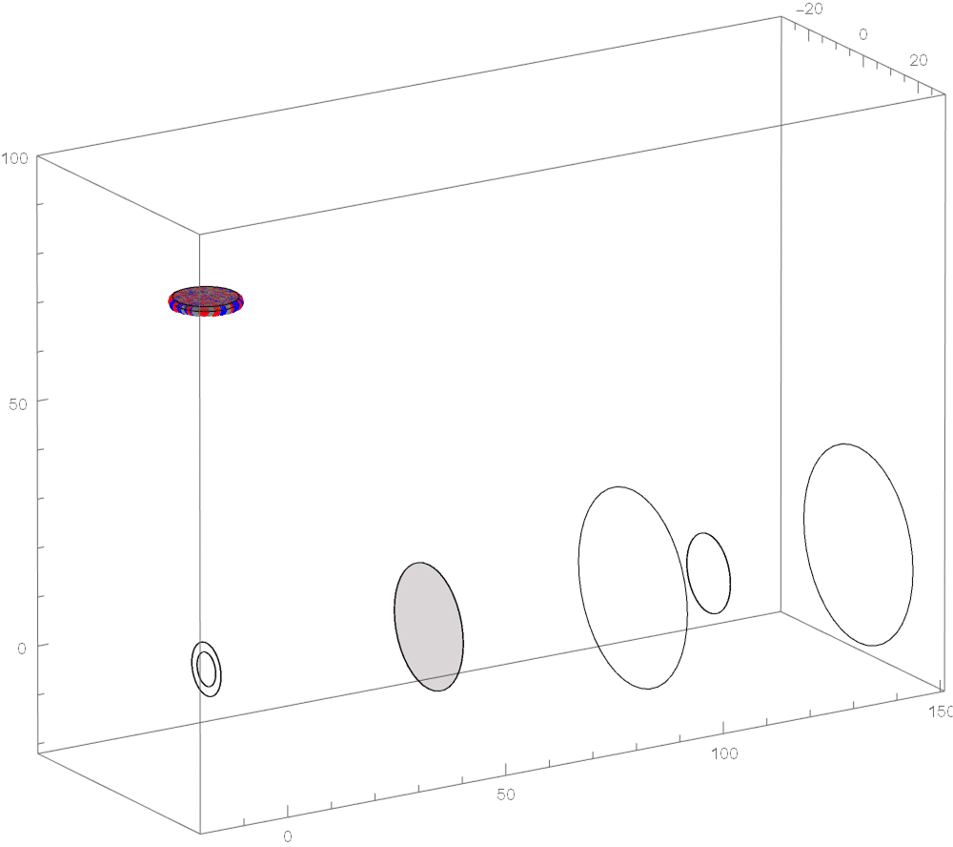
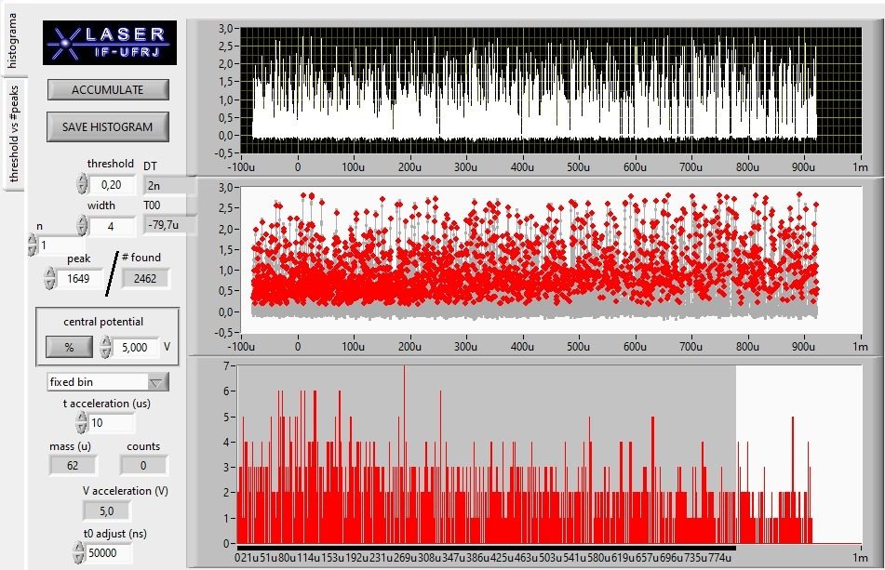
7

Slide 10
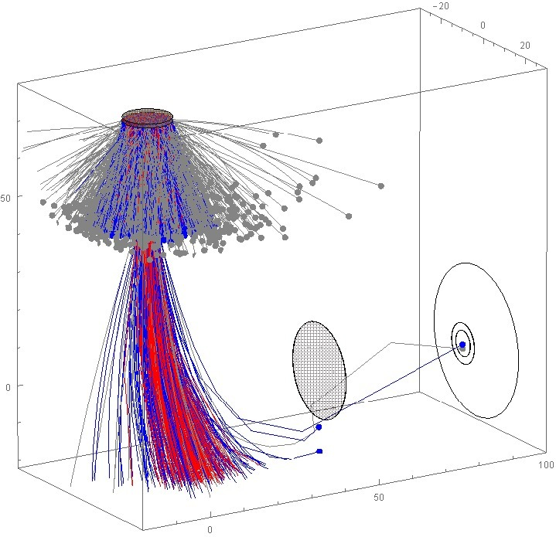
Simulations and some results
8
Simulation (particle tracing – B-field guiding particles) for a 80 K sample

Slide 11
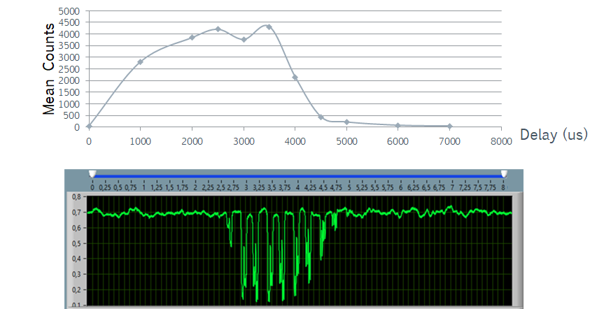
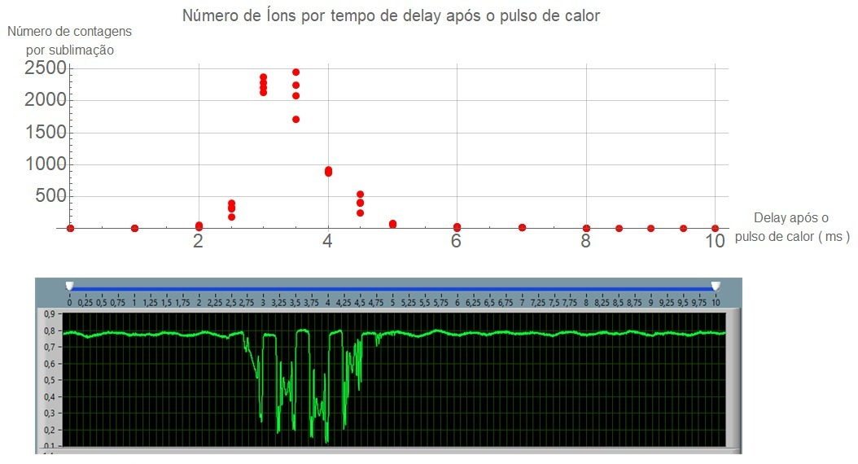

Simulations and some results
8
Simulation (particle tracing – B-field guiding particles) for a 80 K sample
Negative charge particles detection
It works!
Now we want $H^{−}$

Slide 12
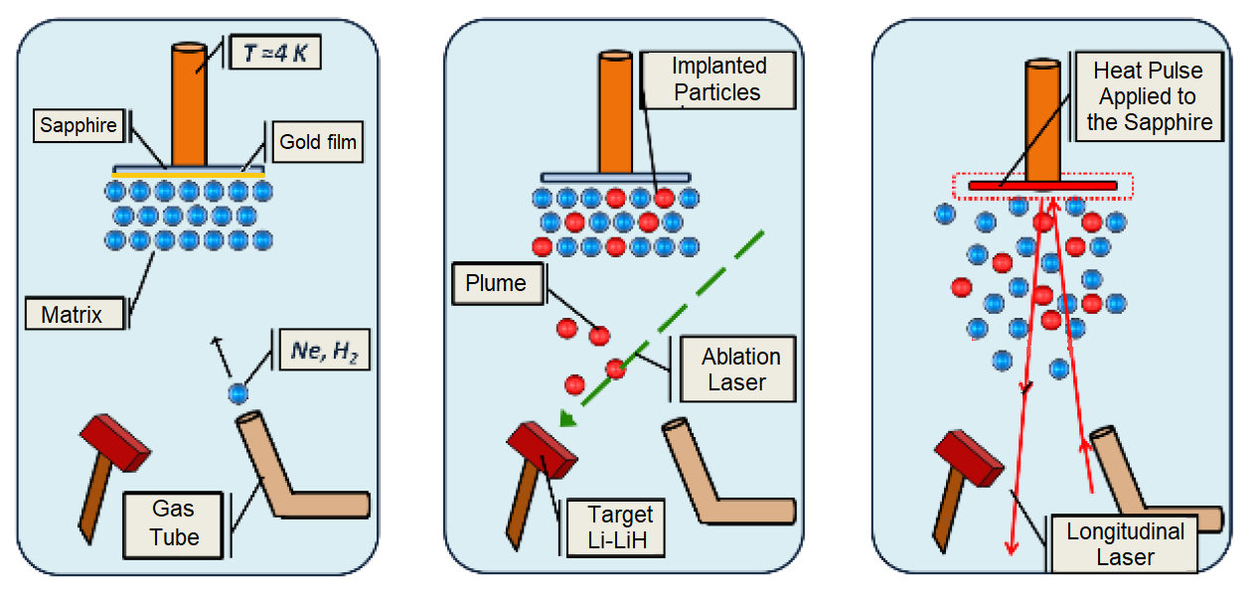
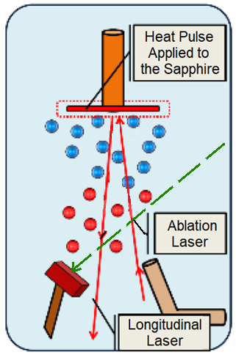
MISu - Variant
9
Typical MISu cycle
  Growth
  Ablation during or after growth
  Sublimation
MISu variant (New-MISu)
  Growth
  Ablation followed by a partial or total sublimation
  Produced particles stay shorter times inside matrix
  Depending on delay – Ions are “deflected” by the
  sublimation cloud

Slide 13
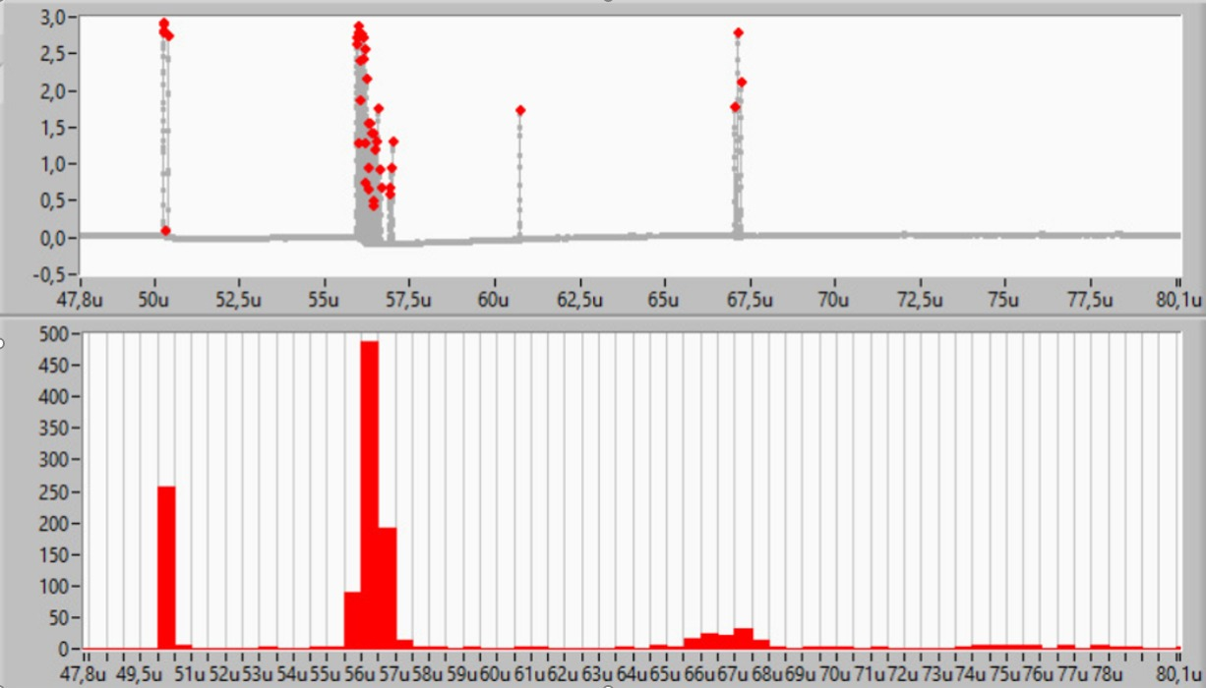
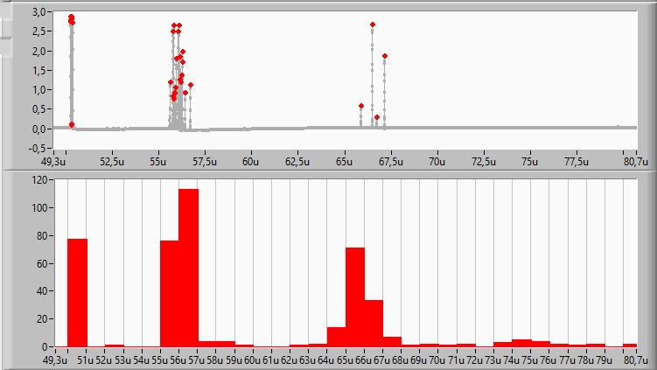
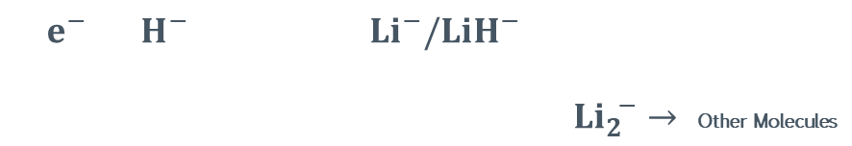
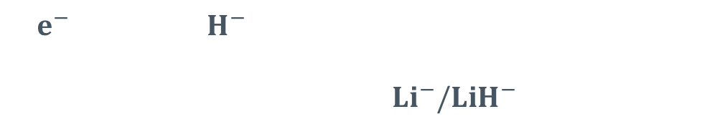
10
Time of Flight – Anions produced with MISu
(s)
$e^{−}$ $H^{−}$
$Li^{−}/LiH^{−}$
$e^{−}$ $H^{−}$ $Li^{−}/LiH^{−}$
$Li_{2}^{ −}→$ Other Molecules

Slide 14
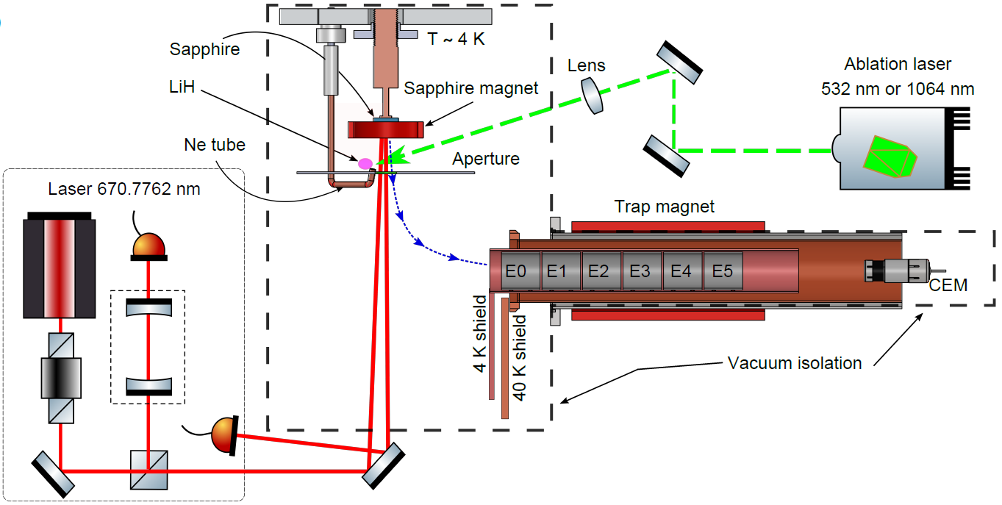
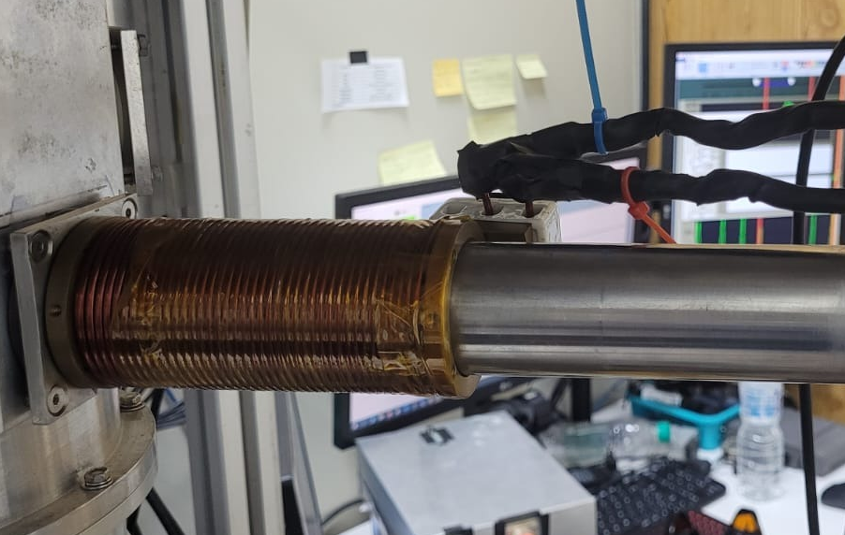
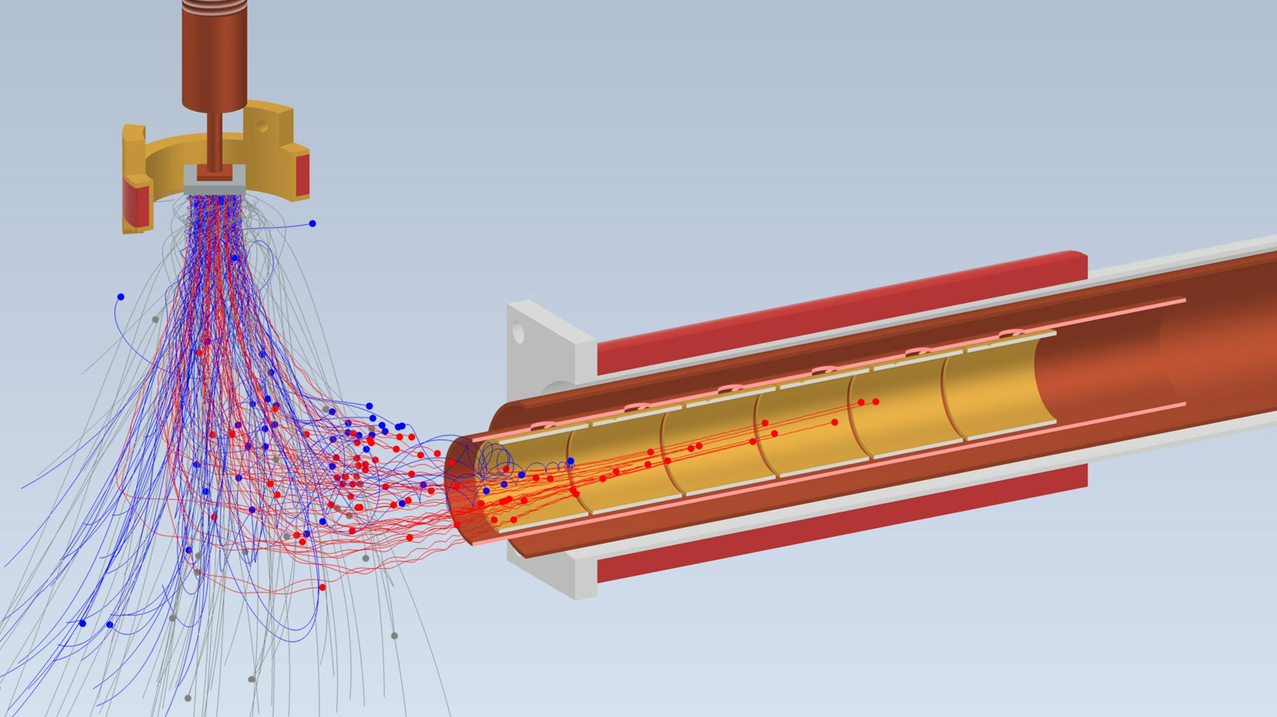
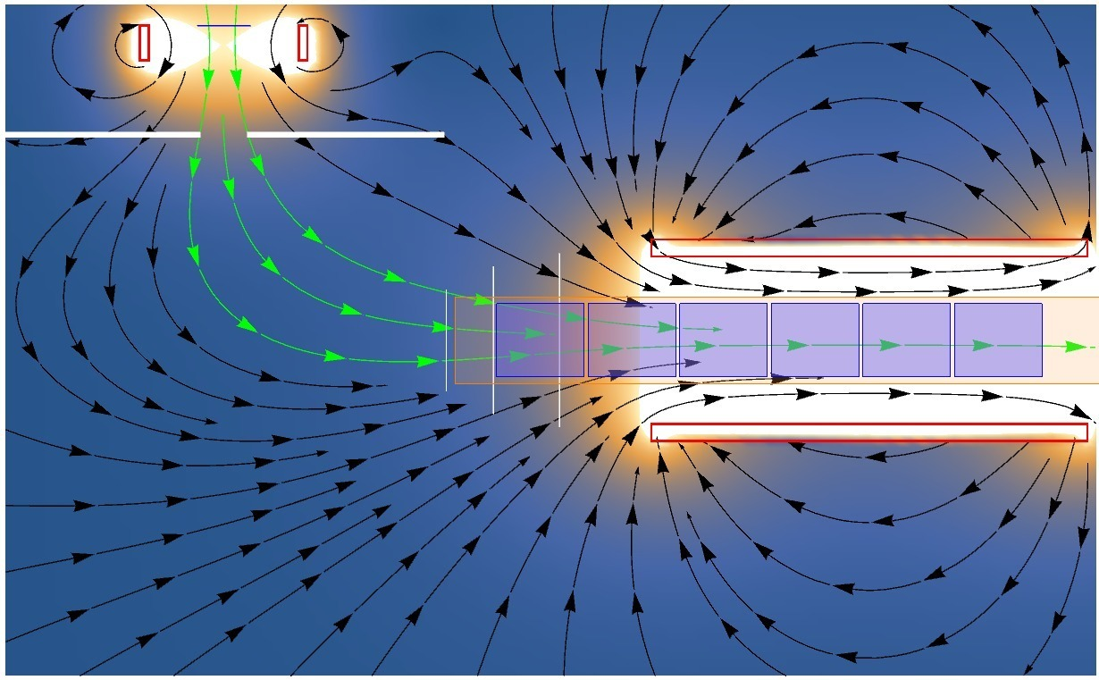
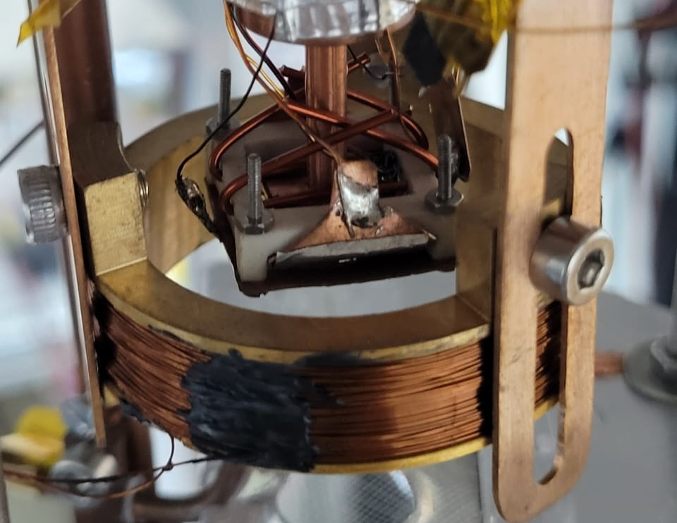
MISu Setup – With Penning-Malmberg Trap
11
100 mm
40 K
~0.3 T
~0.09 T

Slide 15
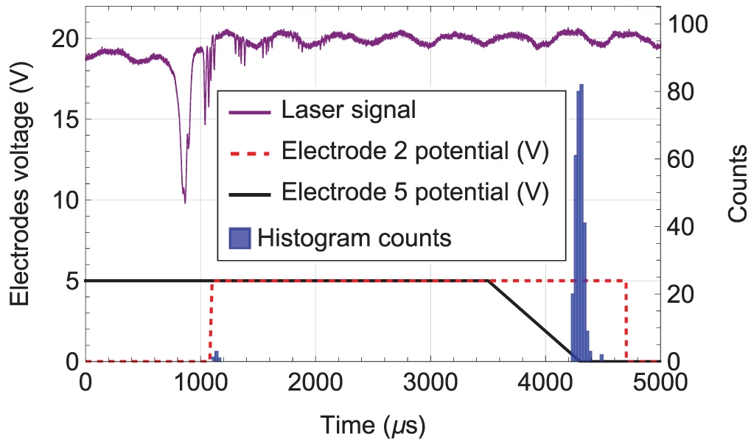
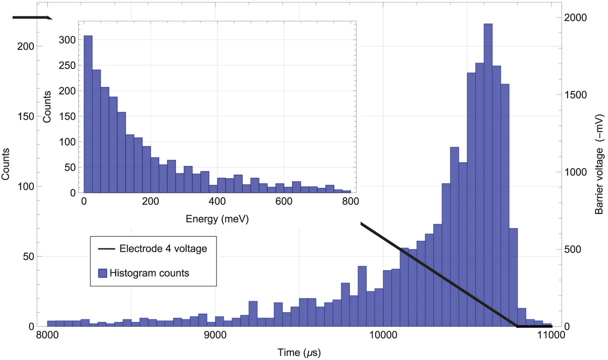
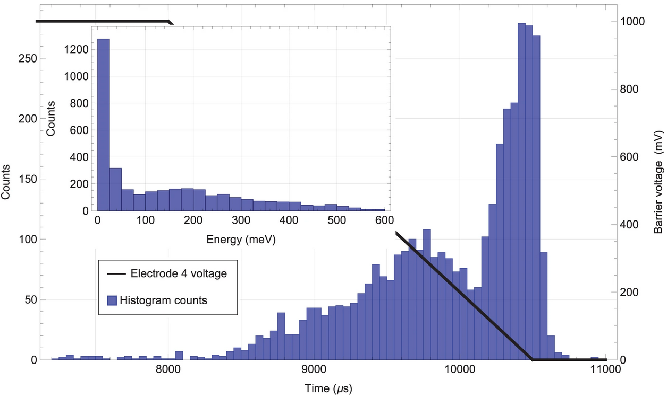
Experimental cycle
12
Few seconds production cycle
+5000 of particles trapped per pulse
  Can be improved
    Higher ablation energy
    Stronger guiding magnetic field
    Adding more coils for guiding charged particles
    Stronger trapping magnetic field
    Increasing the size of aperture
    Trapping on axis (Sapphire axis)
Negative charges
Positive charges

Slide 16
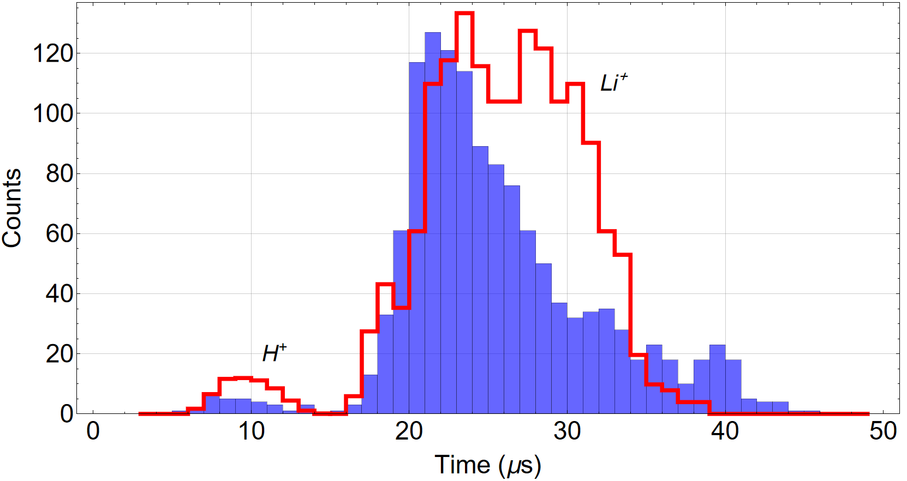
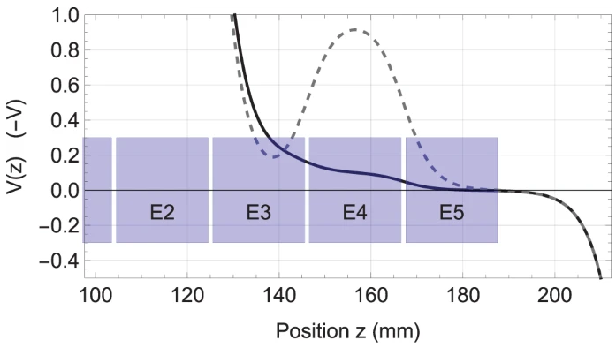
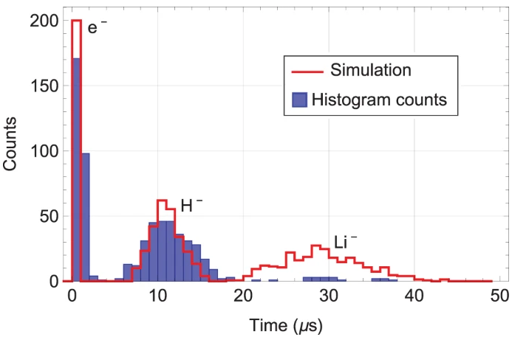
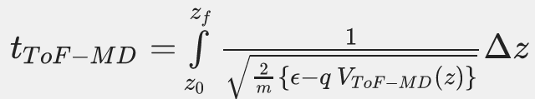
Time of Flight Mass Discriminator (ToF-MD)
13
Simulation
Experiment

Slide 17
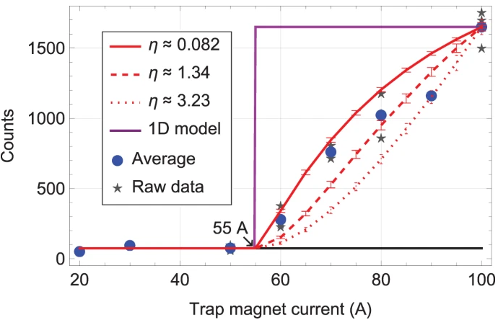

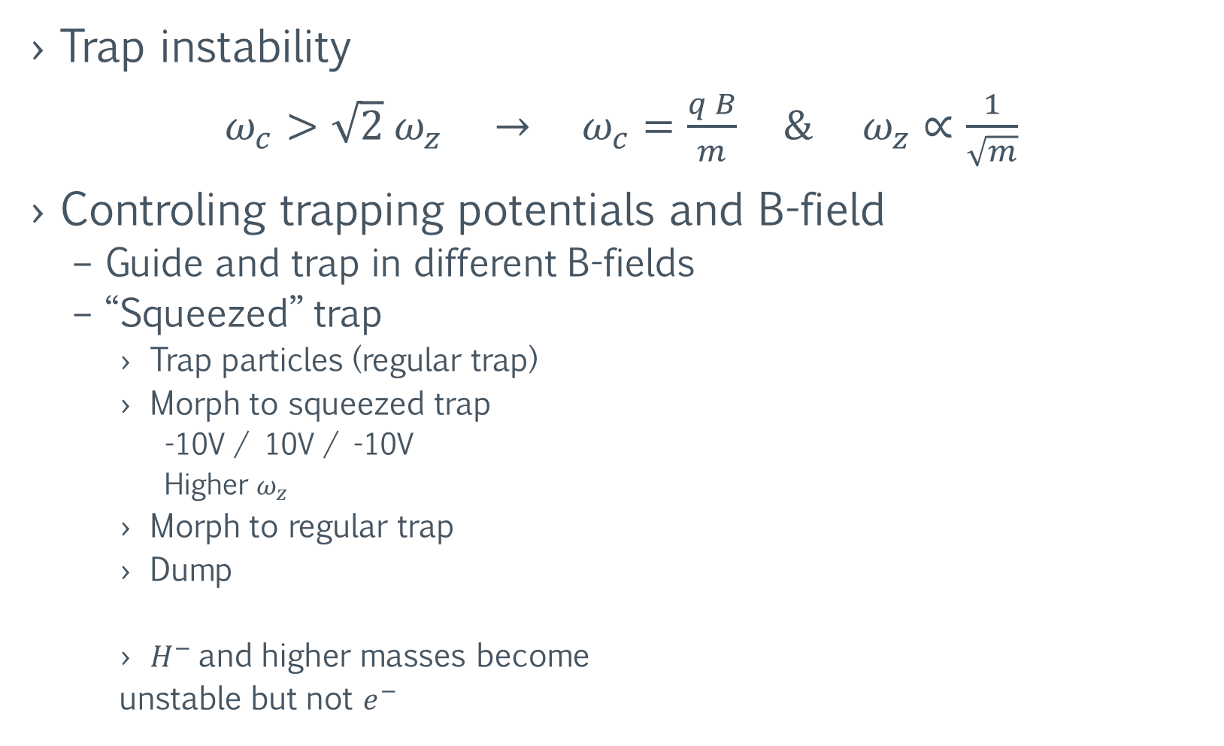
$H^{−}$ to $e^{−}$ proportion
14
Trap instability
$ω_{c}>\sqrt{2} ω_{z} → ω_{c}=\frac{q B}{m} \& ω_{z}∝\frac{1}{\sqrt{m}}$
Controling trapping potentials and B-field
  Guide and trap in different B-fields
  “Squeezed” trap
    Trap particles (regular trap)
    Morph to squeezed trap
      -10V / 10V / -10V
      Higher $ω_{z}$
    Morph to regular trap
    Dump
    $H^{−}$and higher masses become
    unstable but not $e^{−}$
100 A $→0.092$ T at trap center

Slide 18
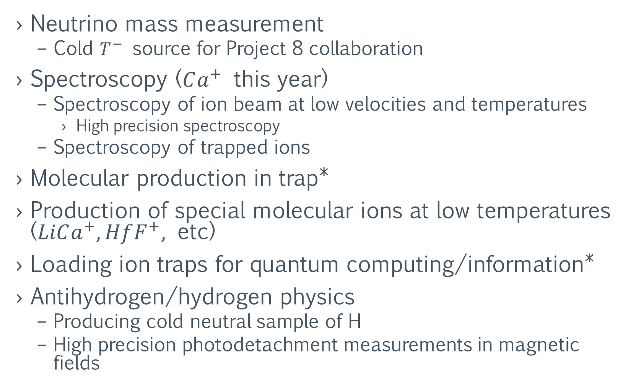
Possible applications (some of them)
15
Neutrino mass measurement
  Cold $T^{−}$ source for Project 8 collaboration
Spectroscopy ($Ca^{+}$ this year)
  Spectroscopy of ion beam at low velocities and temperatures
    High precision spectroscopy
  Spectroscopy of trapped ions
Molecular production in trap*
Production of special molecular ions at low temperatures ($LiCa^{+}, HfF^{+},$ etc)
Loading ion traps for quantum computing/information*
Antihydrogen/hydrogen physics
  Producing cold neutral sample of H
  High precision photodetachment measurements in magnetic fields

Slide 19
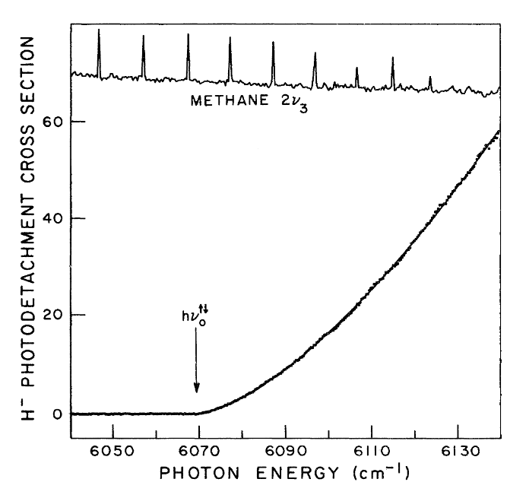
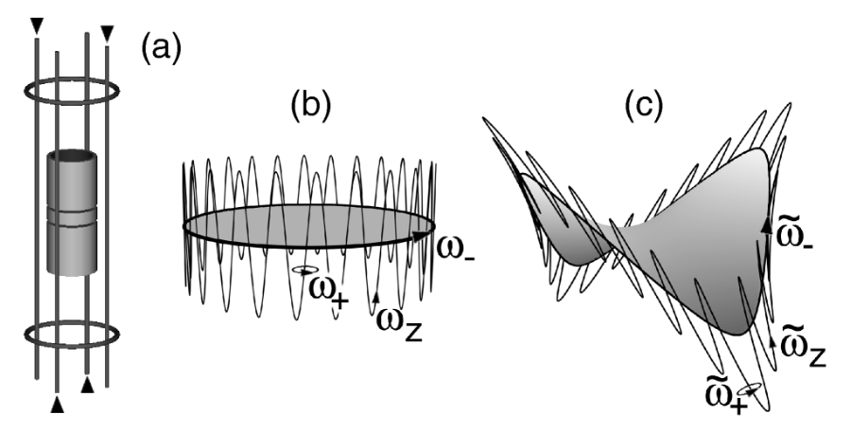



Loading a neutral trap with hydrogen
16
Trapping the $H^{−}$ and $e^{−}$ in a Penning-Ioffe-Pritchard*
  Cyclotron cooling of $e^{−}$- Sympathetic cooling of $H^{−}$
  Near threshold Photodetachment of $H^{−}$
    Low recoil energy given to the remaining $H$
$$754.20±0.02 meV$$
$$1644.10±0.04 nm$$
Squires, T. M., Yesley, P., & Gabrielse, G. (2001). Stability of a Charged Particle in a Combined Penning-Ioffe Trap. Physical Review Letters, 86(23), 5266–5269.
Wigner, E. P. (1948). On the Behavior of Cross Sections Near Thresholds. Physical Review, 73(9), 1002–1009.
Lykke, K. R., Murray, K. K., & Lineberger, W. C. (1991). Threshold photodetachment ofH−. Physical Review A, 43(11), 6104–6107.

Slide 20




ALPHA - CERN
17
ALPHA experiment apparatus
PRELIMINARY
Physics-driven
Lineshape theory
Levi Azevedo
& Claudio Lenz
Ahmadi, M., Alves, B.X.R., Baker, C.J. et al. Characterization of the 1S–2S transition in antihydrogen. Nature 557, 71–75 (2018)
Includes AC-Stark shift
and ionization effects
Baker, C.J., Bertsche, W., Capra, A. et al. Laser cooling of antihydrogen atoms. Nature 592, 35–42 (2021)

Slide 21



ALPHA - CERN
17
ALPHA experiment apparatus
Adapted MISu Source
Ahmadi, M., Alves, B.X.R., Baker, C.J. et al. Characterization of the 1S–2S transition in antihydrogen. Nature 557, 71–75 (2018)
Electron cooling
Near threshold photodetachment
Hydrogen laser cooling (Lyman-$α$ source)
1s-2s spectroscopy on Hydrogen
  Detection: Ion recapture / Lyman-$α$ detection
Claudio Lenz Cesar 2016 J. Phys. B: At. Mol. Opt. Phys. 49 074001

Slide 22


18
New version of LASER-CPT
CEM for positive charged particles
CEM for negative charged particles
More electrodes (possible to trap both positive and
negatively charged particles)
  Possible to stack from different pulses
  Molecular production
Two CEM for simultaneous detection
More uniform magnetic field (yet still ~0.1 T)
Optical access on axis for spectroscopy

Slide 23

Conclusions
19
Azevedo, L.O.A. et al. Adaptable platform for trapped cold electrons, hydrogen and lithium anions and cations. Commun Phys 6, 112 (2023).
Low energy $H^{−}$ production
    Other sources produce it at energies $>5$ keV
  Scalability
    Improving B-fields and ablation power
    Possible to stack
  Electron cyclotron sympathetic cooling
  Evaporative cooling
Production of H
  Near threshold photodetachment
    Low recoil energy
    Trappable Hydrogen production
  Spectroscopy of magnetically trapped Hydrogen
Antimatter research
  Spectroscopy in same Gravitational&Magnetic enviroment
    Reduce of systematic uncertainties
    Possibility of reaching precision in the comparision of ${10}^{−16}$ (Relative precision)

Slide 24






20

Slide 25


Slide 26


Slide 27


Slide 28



Versão 1.5

Slide 29


CEM_Transverse_Holder
CEM_Transverse_Holder
40K_Tube
40K_Tube
40K_T_Connection
40K_T_Connection
Acesso óptico
axial
CEM_Transverse_Holder
CEM_Transverse_Holder

Slide 30



Vista do Acesso óptico
CEM preso da mesma forma como é hoje
Possível diminuir diâmetro do copo do CEM

Slide 31



Slide 32


Trap Coil V1.5
2 camadas e 60 voltas - Correção – 6 voltas em uma camada extra apenas nas bordas
Fio 2.3 mm (condutor) – 2.4 mm (condutor+isolamento)
Diâmetro interno do tubo de 300 K – 37 mm (atual é 36.1 mm)
Diâmetro externo – 41 mm (parede de 2 mm – Alumínio)
Precisa disso tudo?

Slide 33





New Sapp Holder

Slide 34




Channeltron - CEM
Funcionamento do Channeltron [6]

Slide 35



Slide 36




Slide 37
Molecules

Slide 38




-3.1 meV
$ΔE_{01}=12.7 meV≈146 K≪4 K$
-15.8 meV
Neon can accommodate a 2D electron gas with a density
over ${10}^{10}cm^{−2}$

Slide 39



Slide 40

22
$Li_{3}$
$Li_{4}$
$Li_{5}$
$Li_{6}$
$Li_{7}$
$Li_{2}$ $Li_{8}$
.$Li$

Slide 41

23
$Ne$
$Ca$ $Ca_{2}O$
$$Ca_{2}$$

Slide 42



25

Slide 43
26

Slide 44


