Slide 1


Studies of highly charged ions formed using antiprotons at AEgIS
Valts Krūmiņš
On behalf of the AEgIS Collaboration
9-July-2024
ECCTI2024

Slide 2
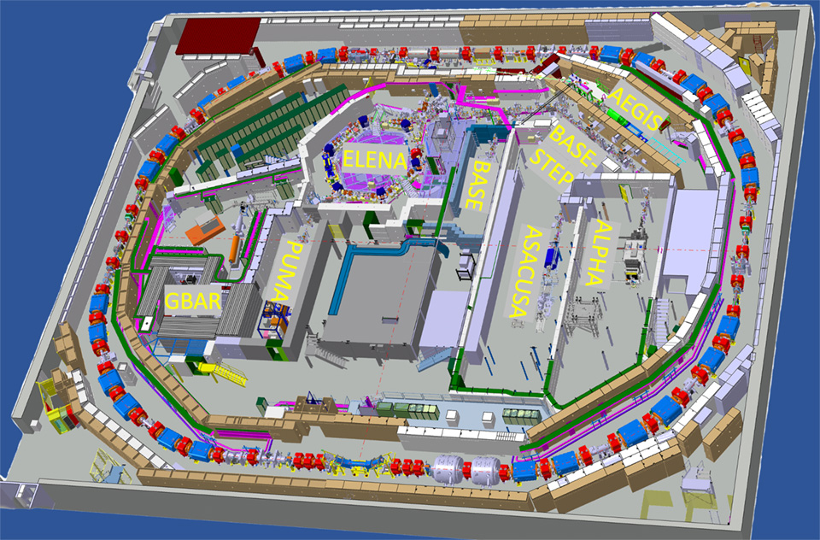
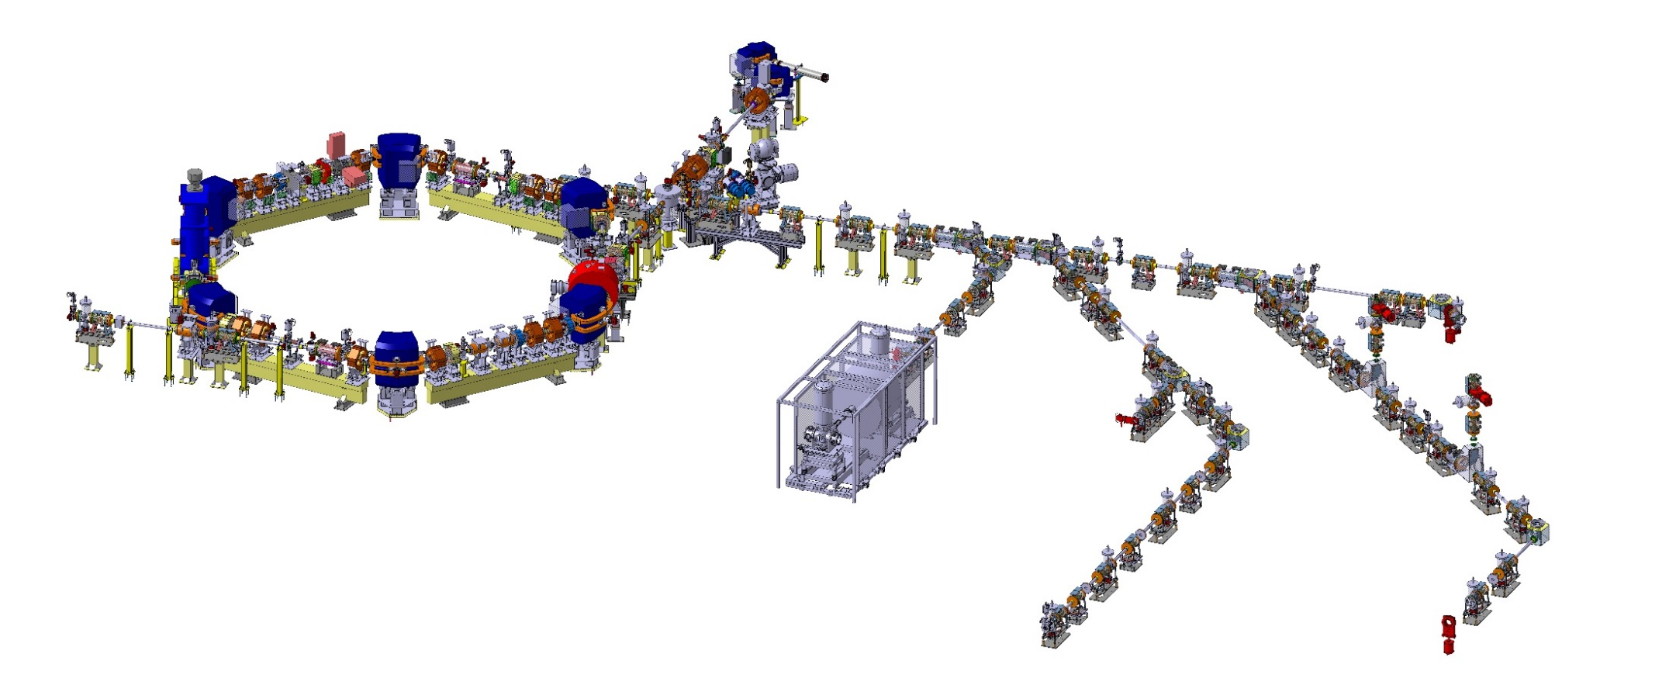





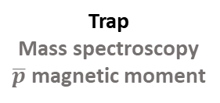
Experiments at the Antimatter factory
Antiprotons @1 MeV
Antiprotons @ 0.1 MeV
ELENA
Antiprotons for experiments
ALPHA ASACUSA AEGIS BASE GBAR PUMA
Beam
Pulsed production
of antihydrogen
Gravity
Positronium
Trap
Antihydrogen trapping
Spectroscopy
Gravity
Beam
Antiprotonic atoms
Collisions
Antihydrogen
Spectroscopy
Trap
Mass spectroscopy
$\overline{p}$ magnetic moment
Trap
Antimatter gravity
Lamb-shift
Movable trap
for antiprotons
Study of exotic nuclei
Antiprotonic atoms+HCIs

Slide 3

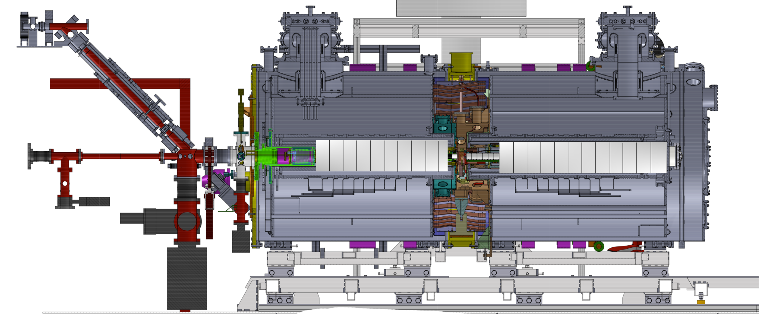
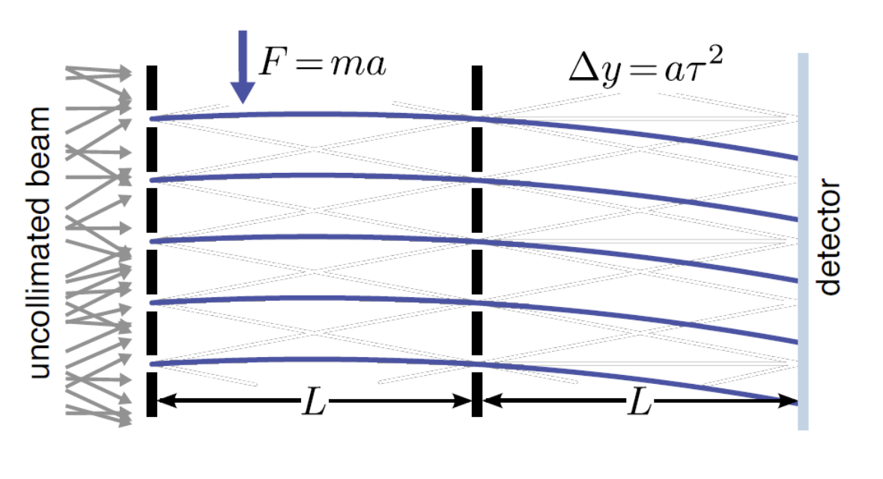





e+
Goal: Forming a cold beam of $\overline{H}$ and measure its trajectory in a gravitational field to <1% accuracy.
Pulsed production of $\overline{H}$ achieved using laser excited Rydberg positronium ($σ∝ n^{4}$)
Record antiproton catching efficiency.
1T
5T
$\overline{p}$ From ELENA
$\overline{p}$
Charge exchange reaction:
$${Ps}^{∗}+\overline{p}→{\overline{H}}^{∗}+e^{−}$$
Laser excitation to Rydberg state
e+
Ps*
Ps converter
High resolution
CMOS Sensor
$${\overline{H}}^{∗}$$
antiprotons

Slide 4


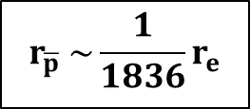

The antiprotonic atom
Bohr radius
$$r_{\overline{p}}$$
$$\overline{p}$$
Antiproton is a stable negatively charged hadron 1836x heavier than the electron.
Antiprotonic atoms form deeply bound states near the nucleus.
Sensitive laboratory for benchmarking both QED and QCD.
$$r_{\overline{p}} \sim {\frac{1}{1836}r}_{e}$$
$$e^{−}$$
$$r_{e}$$
Electric field
Notes:
Tests for new forces etc.
Orbits overlapping with nucleus rapidly annihilate. Resulting in broadening and shifts of lines. Test of nuclear structure
Formation with low energy antiprotons stopping in target materals, gas, liquids etc.
Normally short-lived us lifetimes only few systems have longer lived states He P.

Slide 5

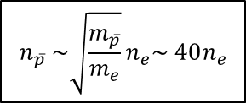





The life of an antiprotonic atom
$$e^{−}$$
$$\overline{p}$$
$$n_{\overline{p}} \sim \sqrt{\frac{m_{\overline{p}}}{m_{e}}}n_{e}\sim 40n_{e}$$
Capture of the antiproton in a high-n Rydberg state.
$$\overline{p}$$
$$e^{−}$$
Cascade emitting x-rays and Auger electrons.
$$e^{−}$$
Antiproton approaching stripped nucleus, strong interaction influences orbitals. Resonance effects can take place.
Linebroadening caused by annihilation with nuclear perifery.
Annihilation on nucleus
Notes:
The antiproton will decay through transitions, emitting auger electrons, followed by radiative emission of x-ray photons.
Energy levels shifted by strong interaction (benchmark for QCD)
Nuclear resonances resulting from antiproton decay.
Annihilation occur once the wavefunction overlap the with the nucleus.

Slide 6
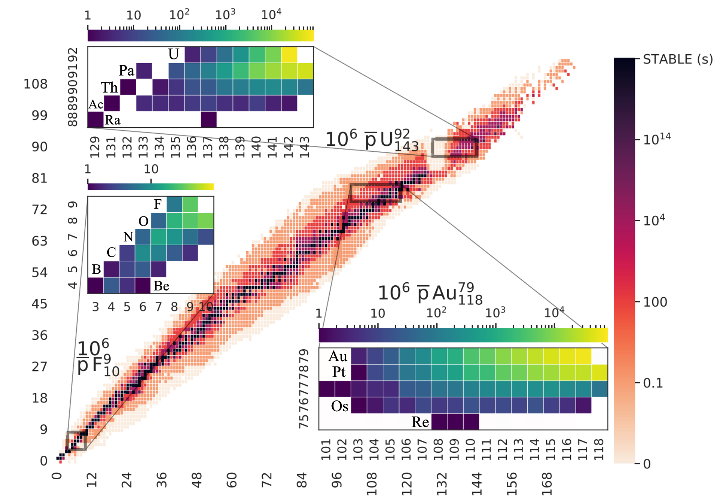


What about the resulting nuclear fragments?
$$π$$
G. Kornakov et al., PRC 107, 034314 (2023)
?
$$π$$
Nuclear fragments are (often) radioactive Highly Charged Ions (HCI)
Sensitive probes for:
- QED
- Weak interaction
- Nuclear structure
GEANT4/FLUKA simulations of fragments formed from 1 million Pbar annihilations:

Slide 7
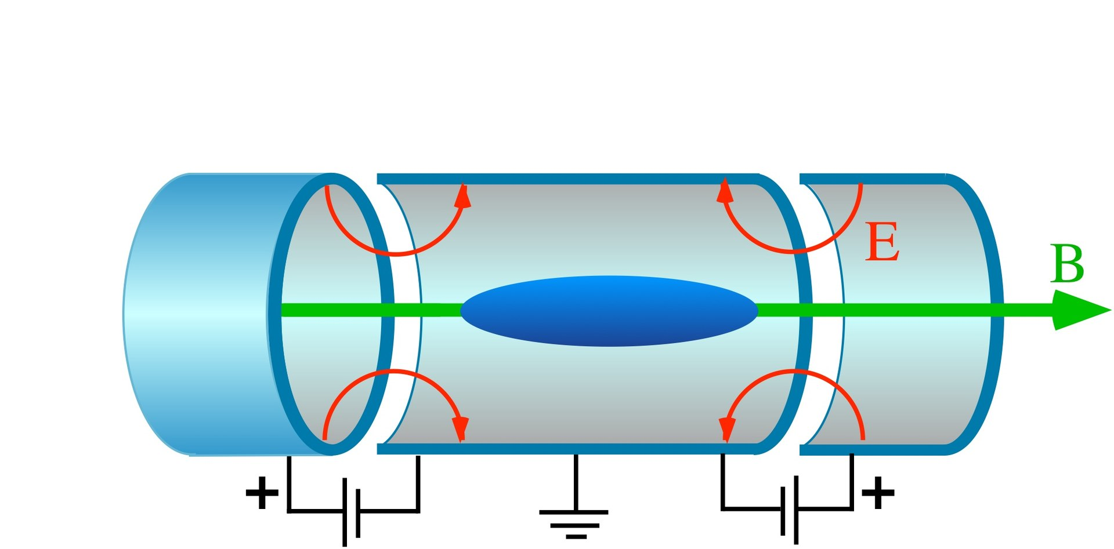
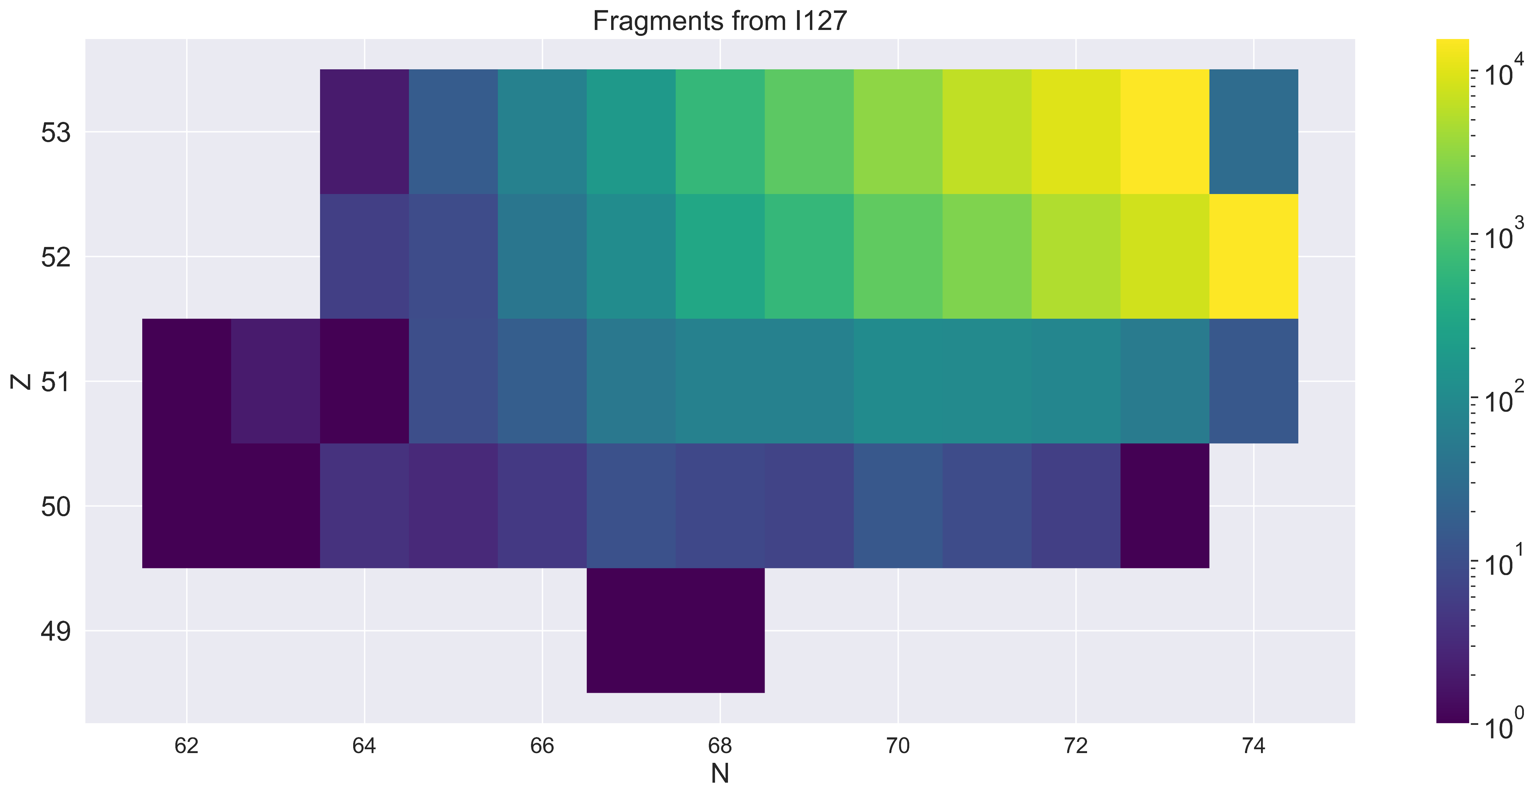
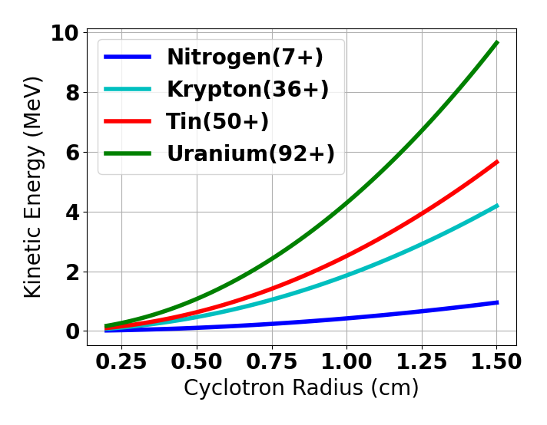
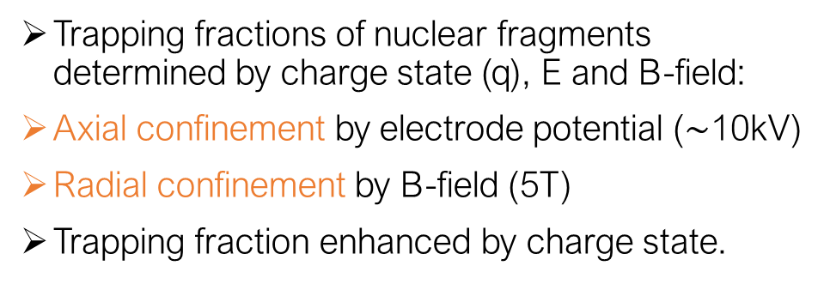
Can we trap fragments in a Penning-Malmberg trap?
Trapping fractions of nuclear fragments determined by charge state (q), E and B-field:
Axial confinement by electrode potential ($\sim$10kV)
Radial confinement by B-field (5T)
Trapping fraction enhanced by charge state.
>50% trapped at 10 keV/q
¹²⁷I
Radial confinement

Slide 8











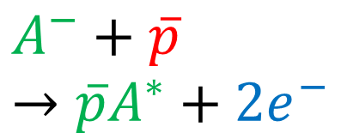



Controlled synthesis of antiprotonic atoms using charge-exchange
Charge-exchange with Rydberg atom
Charge exchange reaction:
Rydberg atom
antiproton
$${Ps}^{∗}+\overline{p}→{\overline{H}}^{∗}+e^{−}$$
$$e^{−}$$
$$\overline{p}$$
positronium
antiproton
+
$$e^{+}$$
$${Ps}^{∗}$$
+
$$\overline{p}$$
$$A^{−}+\overline{p}→{\overline{p}A}^{∗}+{2e}^{−}$$
$$e^{−}$$
$$σ∝ n^{4}$$
antiprotonic atom
antihydrogen (${\overline{H}}^{∗}$)
$$\overline{p}$$
$$e^{+}$$
electron
$$e^{−}$$
+
$$e^{−}$$
+
$$\overline{p}$$

Slide 9
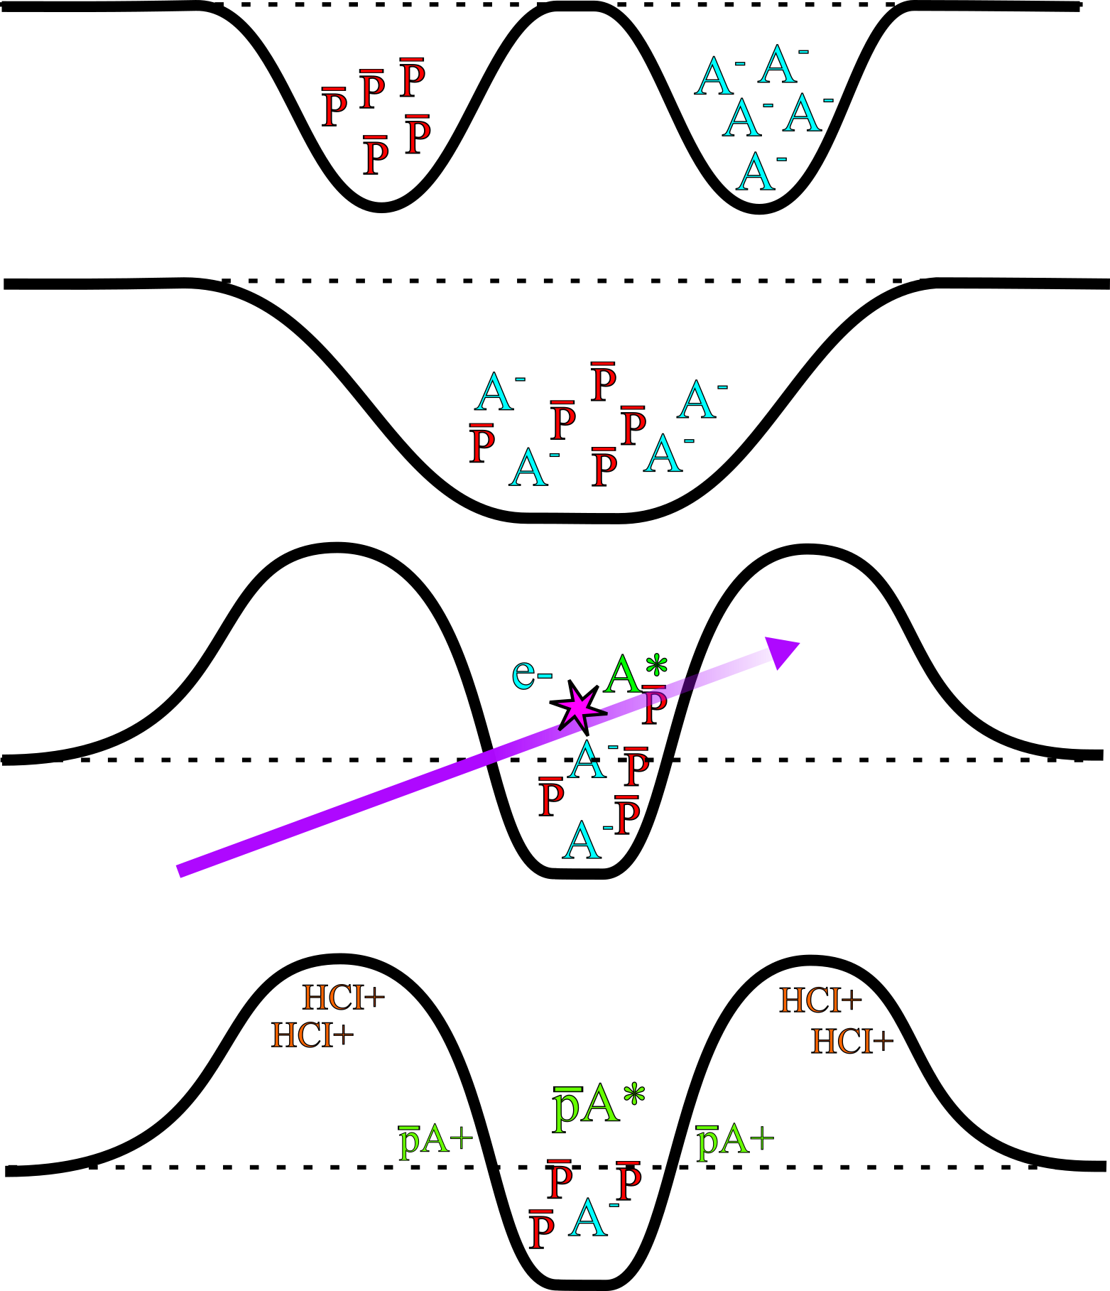
Controlled synthesis of antiprotonic atoms
Nested trap is created.
(1)
(3)
Cotrapping of anions and antiprotons cooled using electrons.
I⁺
I*
4xx nm
206 nm
206 nm
Laser photodetachment and excitation to Rydberg state.
I⁻
EA=3.1 eV
(2)
Mixing anions with antiprotons.
Capture of HCI fragments after annihilation.
(4)
$$A^{∗}+\overline{p}→\overline{p}A^{∗}+e^{−}$$

Slide 10
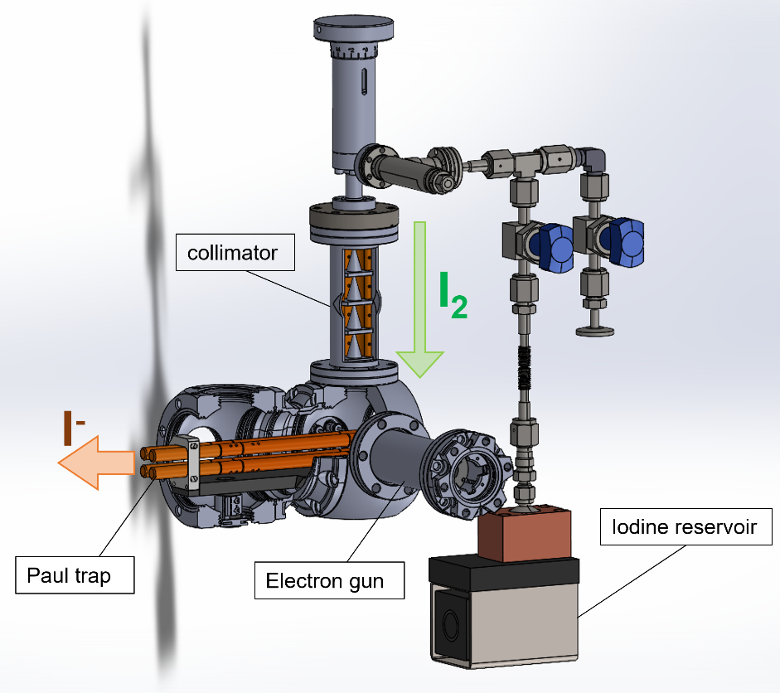
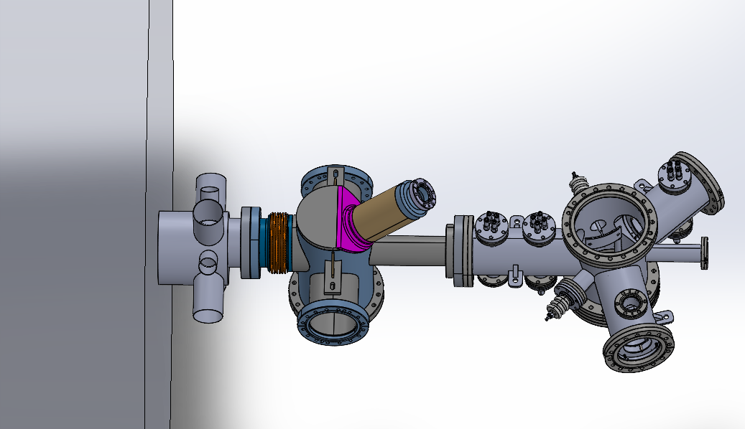
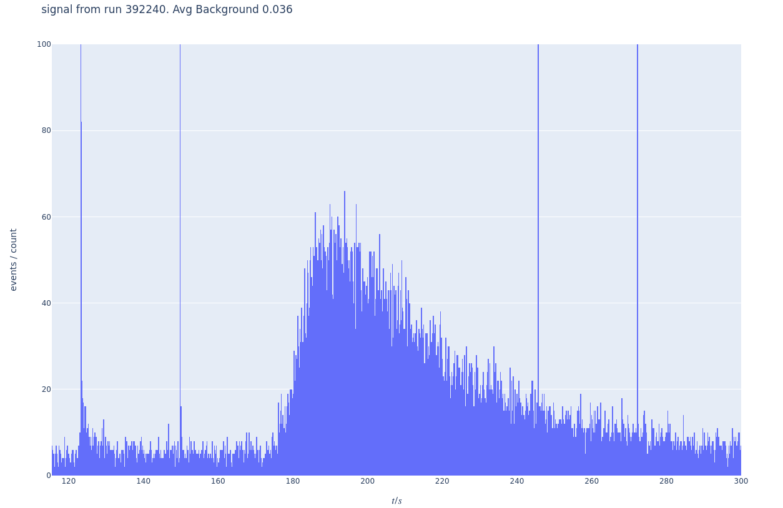







Towards the synthesis of antiprotonic atoms
$\overline{p}$ From ELENA
$\overline{p}$
Gas injection
$$A^{−}$$
$$π$$
$$e^{+}$$
Scintillator signal
$$π$$
$\overline{p}$
Studying positive ions formed from annihilations with nitrogen in UHV (<1e-8 mbar)

Slide 11
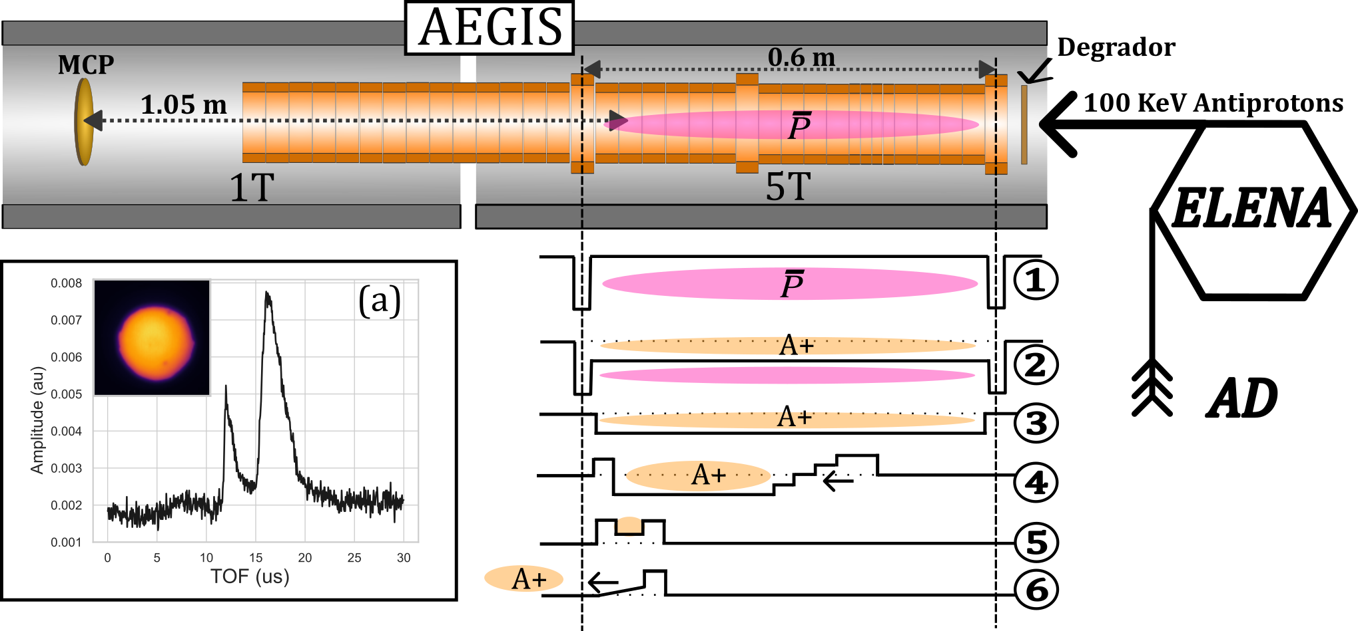
Overview of the ion capture and TOF procedure
(b)

Slide 12
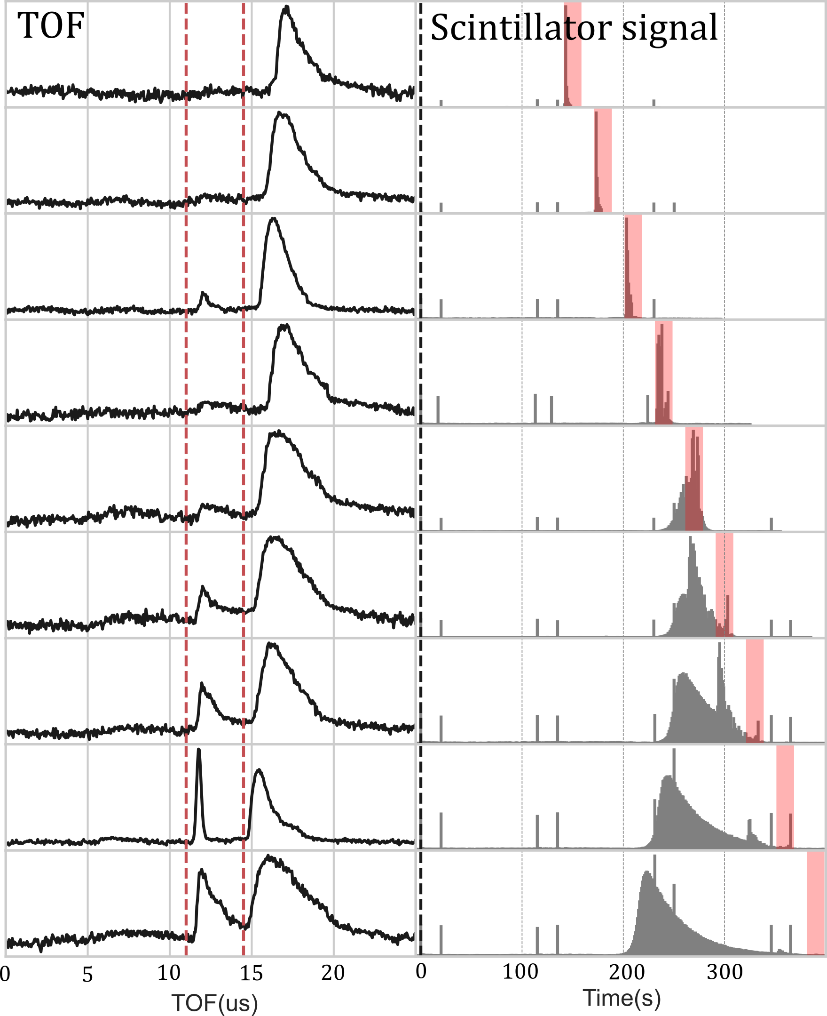
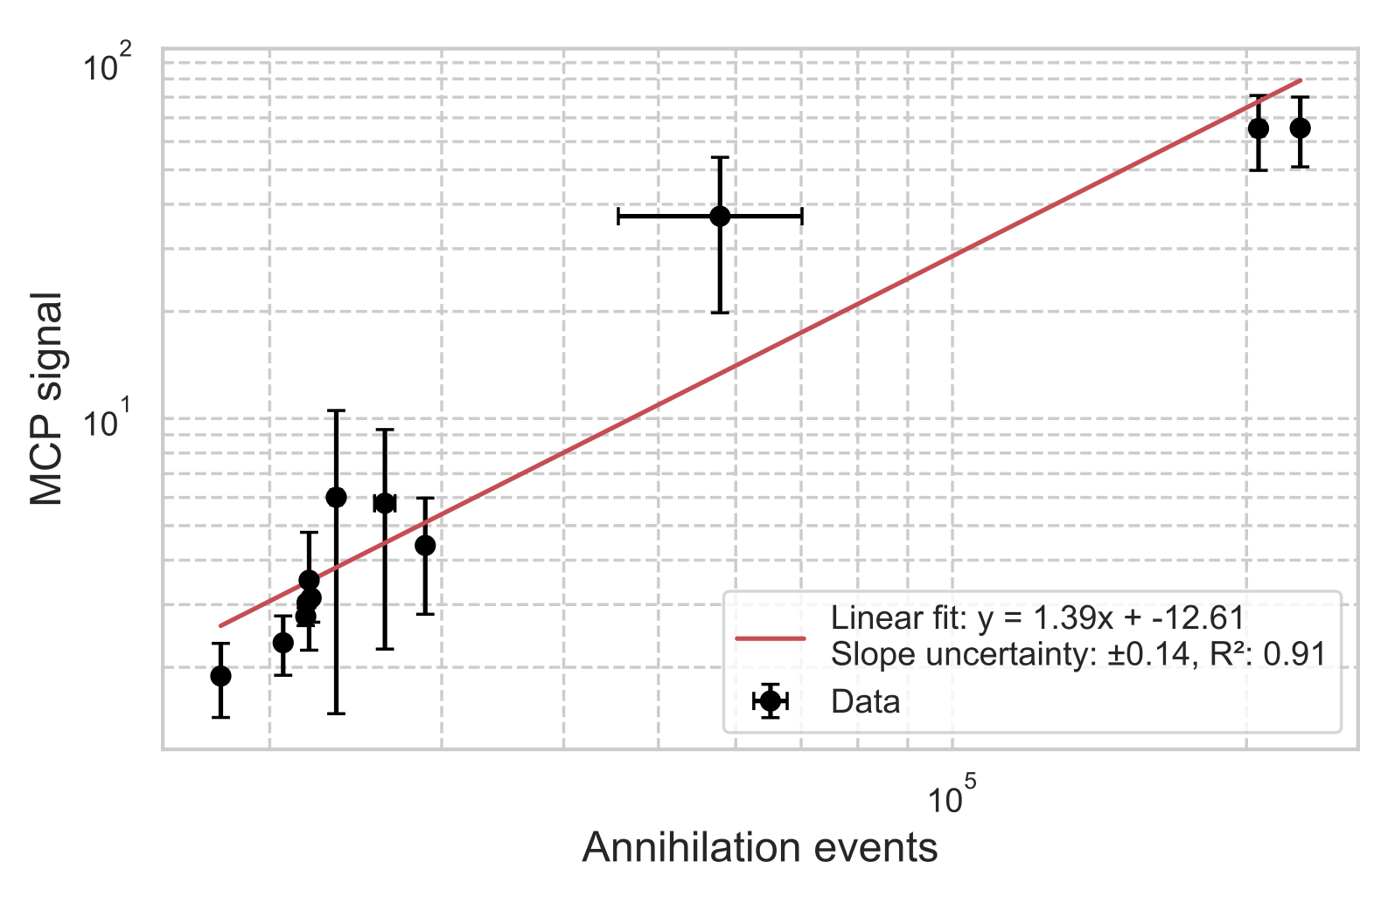
TOF spectrum vs scintillator signal
Observation of a TOF signal formed from antiproton annihilation with nitrogen.
Signal observed for low energy antiprotons <1 keV.
Preliminary

Slide 13
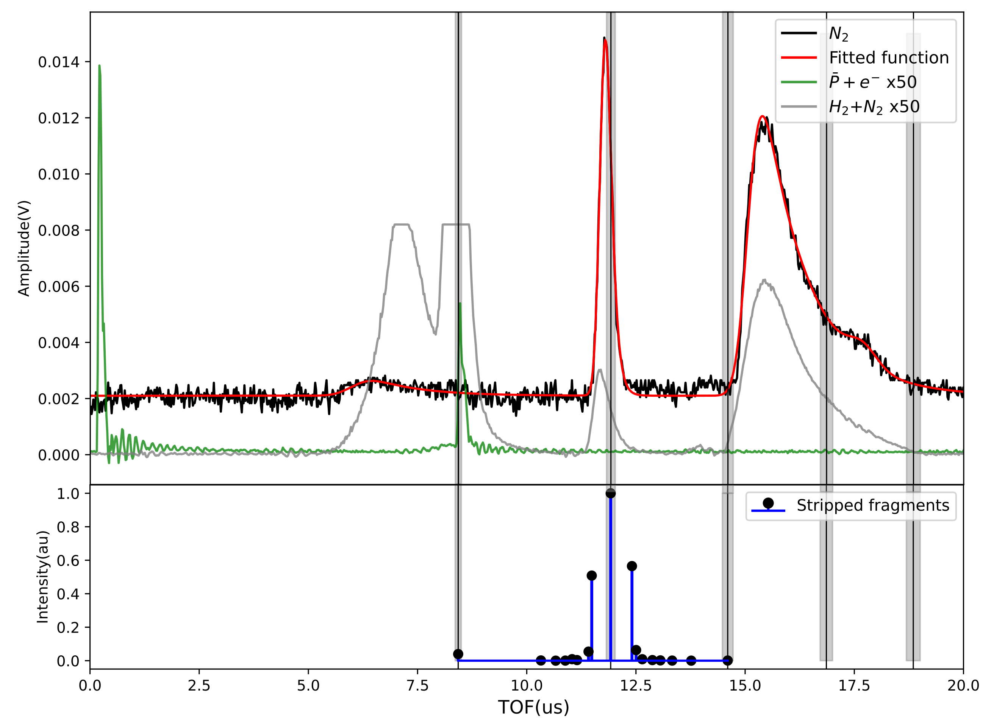
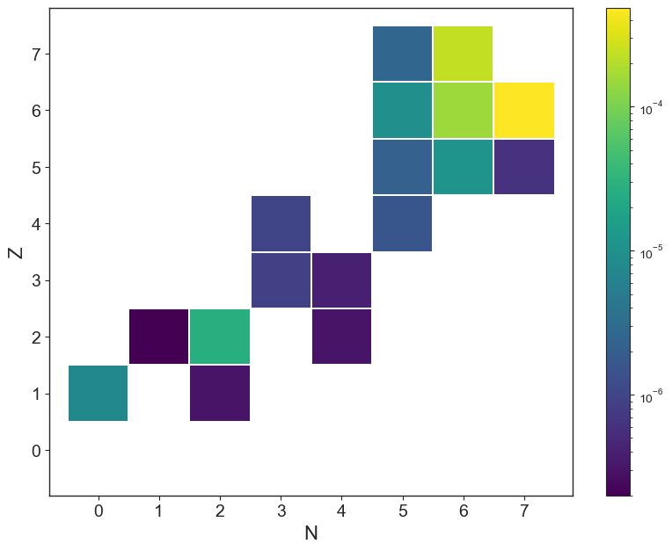
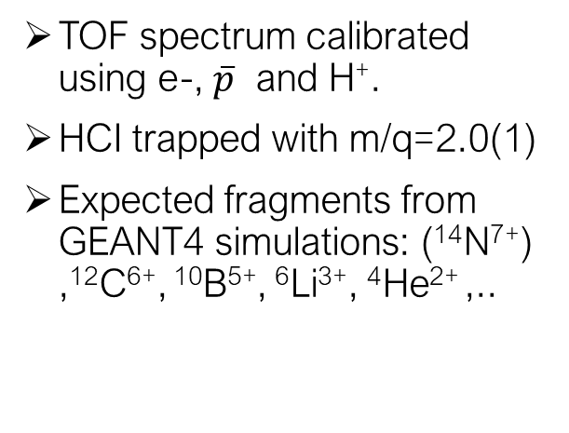
Identification of trapped HCIs formed from antiproton annihilation
TOF spectrum calibrated using e-, $\overline{p}$ and H⁺.
HCI trapped with m/q=2.0(1)
Expected fragments from GEANT4 simulations: (¹⁴N⁷⁺) ,¹²C⁶⁺, ¹⁰B⁵⁺, ⁶Li³⁺, ⁴He²⁺ ,..
m/q=1
2
3
e-
H+
_
P
Preliminary

Slide 14
Summary and outlook
New program at AEgIS focusing on the controlled synthesis and study of antiprotonic atoms and HCIs.
Procedure developed at AEgIS for trapping and identifying HCIs formed from annihilation with antiprotons on atoms in UHV.
Simulations ongoing to better understand formation mechanism.
Planned study of HCI fragments formed from noble gases (Ar, Kr...).
Antiprotonic atom
spectroscopy
Antiprotonic atoms
In AEgIS
TOF spectroscopy of captured fragments from gas injection
Cooling and mixing of anions with antiprotons
(QED/QCD/BSM)
Nuclear structure
Dark matter?
Anion source installation:
Co-trapping anions
with antiprotons
Laser installation:
Laser triggered synthesis of antiprotonic atoms
Novel synthesis of radioactive HCIs
Notes:
Continued development of trapping procedure and identification of HCI fragments from antiproton-atom interaction using gas injection (the dirty method).
Aim to laser triggered formation of antiprotonic atoms Antiprotonic atom spectroscopy: Auger electron, X-ray, visible etc.
Trapping and cooling of exotic radioactive HCIs (positron cooling, sympathetic laser cooling)
Multiple-step process: Antiproton annihilation on cooled HCIs.

Slide 15
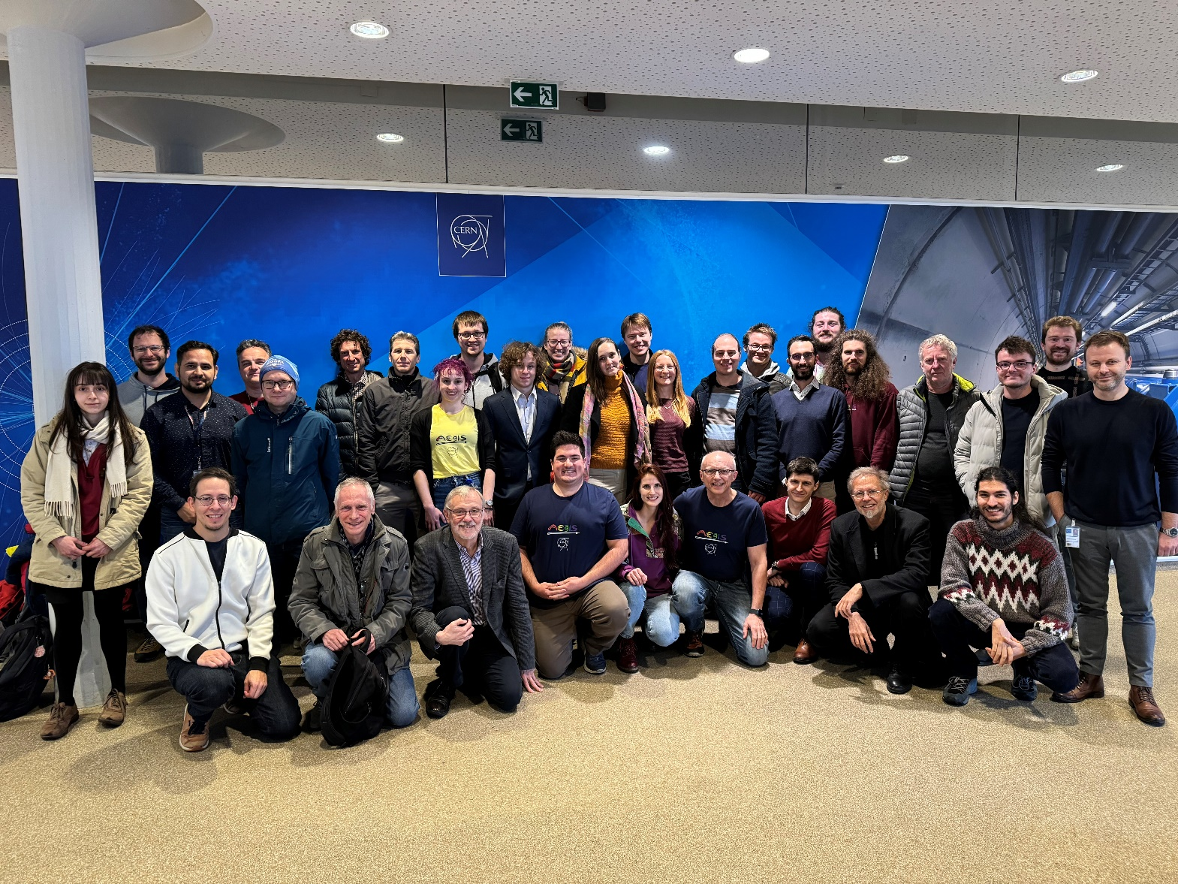

Thank you for your attention
On behalf of the AEGIS collaboration

Slide 16
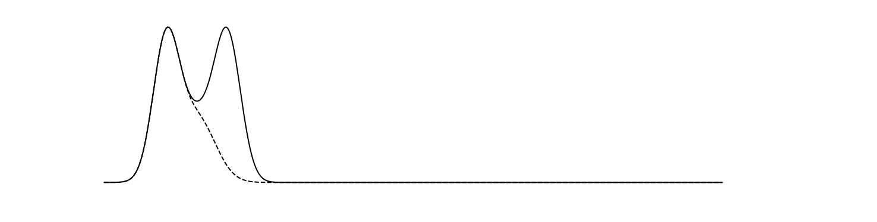
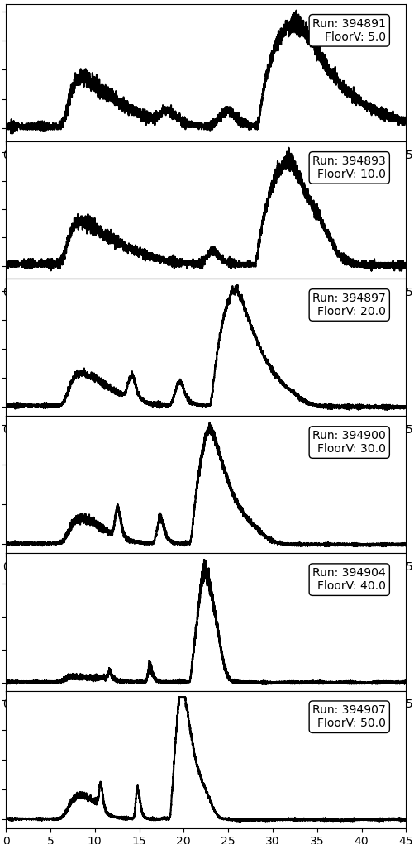
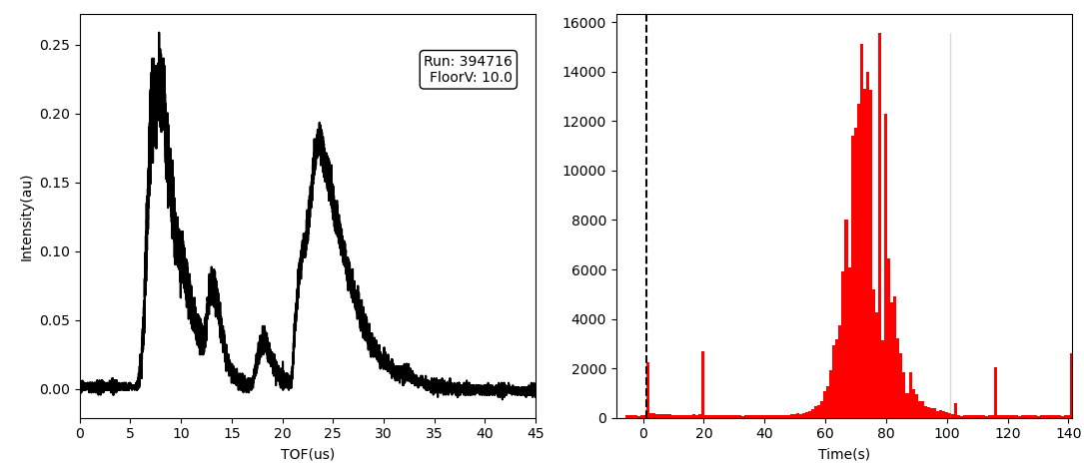
Sample data during campaign
+160V
A+
Floor Voltage
A+
MCP
MCP TOF signal
Scintillator signal (SC21)
Negative charges
Cold ions
Hot ions

Slide 17
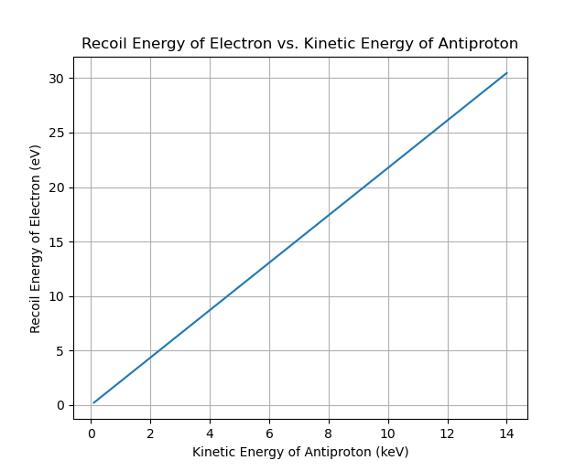
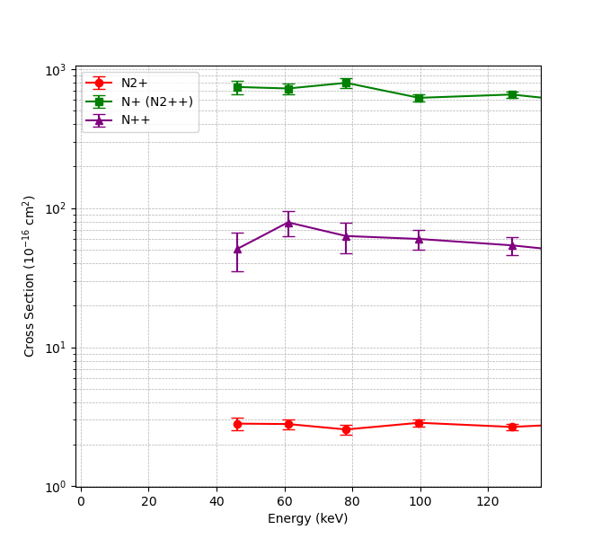
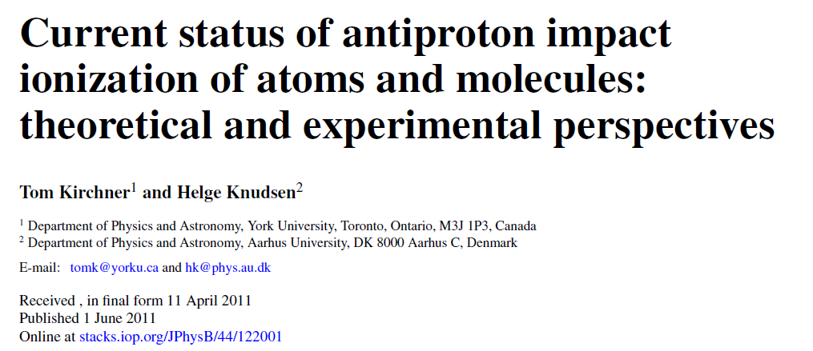

Collissional ionization with antiprotons?
3000 eV is required to form N⁷⁺ from the N₂ molecule
20 eV
$$\overline{P}$$
e-
10 KeV

Slide 18
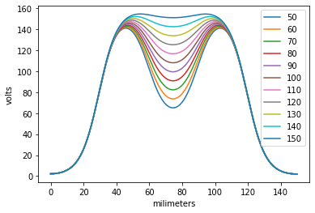
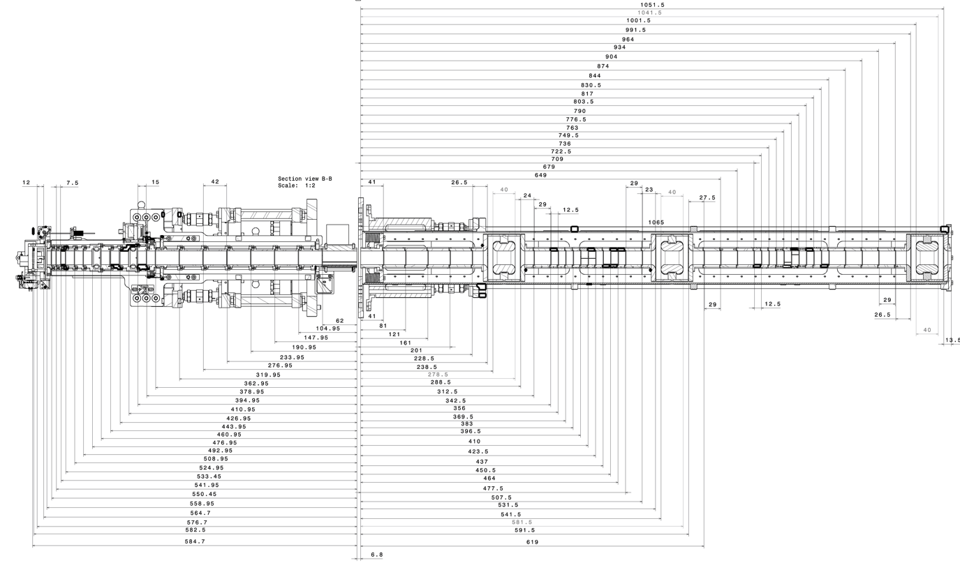
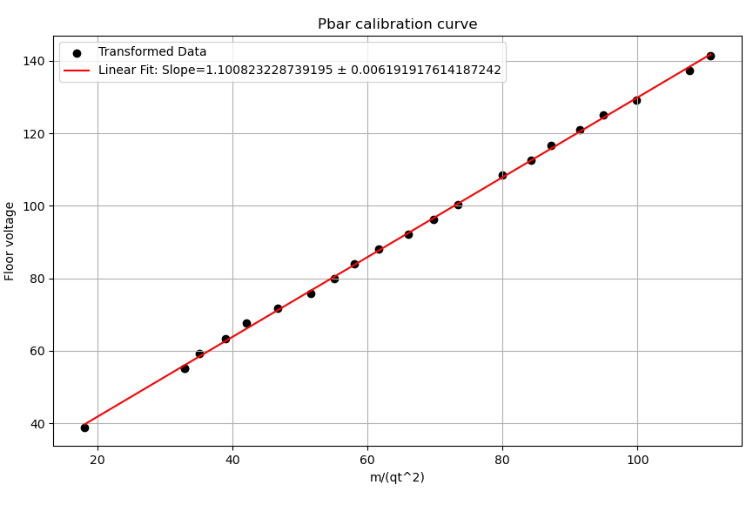
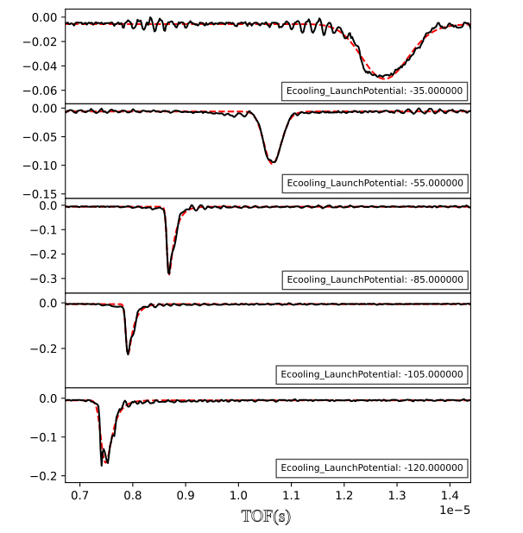
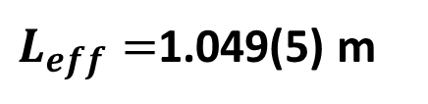
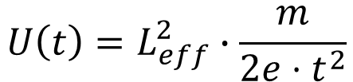
Pbar TOF calibration
1.035 m
0.545m
MCP
$L_{eff}=$1.049(5) m
$$U\left(t\right)=L_{eff}^{2}∙\frac{m}{{2e⋅t}^{2}}$$

Slide 19
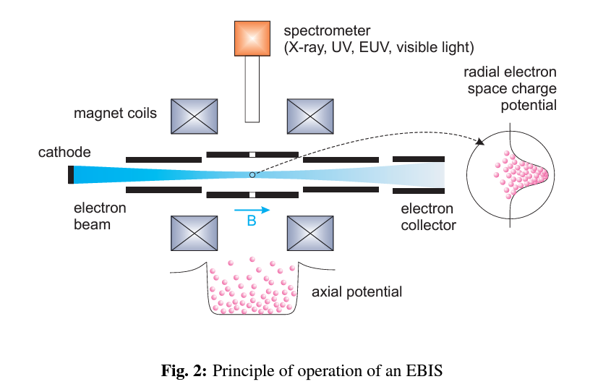
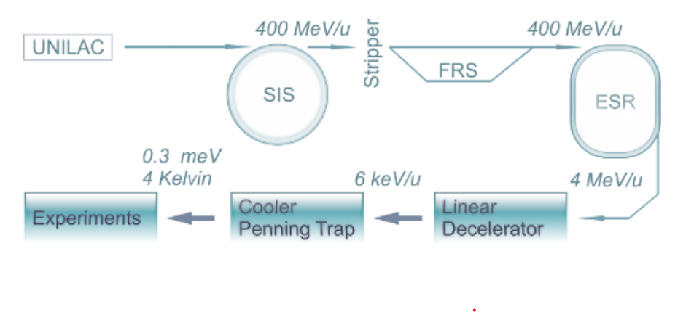
Traditional HCI formation at radioactive beam facilities:
Electron beam ionization:
High energy beam through stripper foil:
Zschornacka, G., M. Schmidt, and A. Thorn. "Electron beam ion

Slide 20
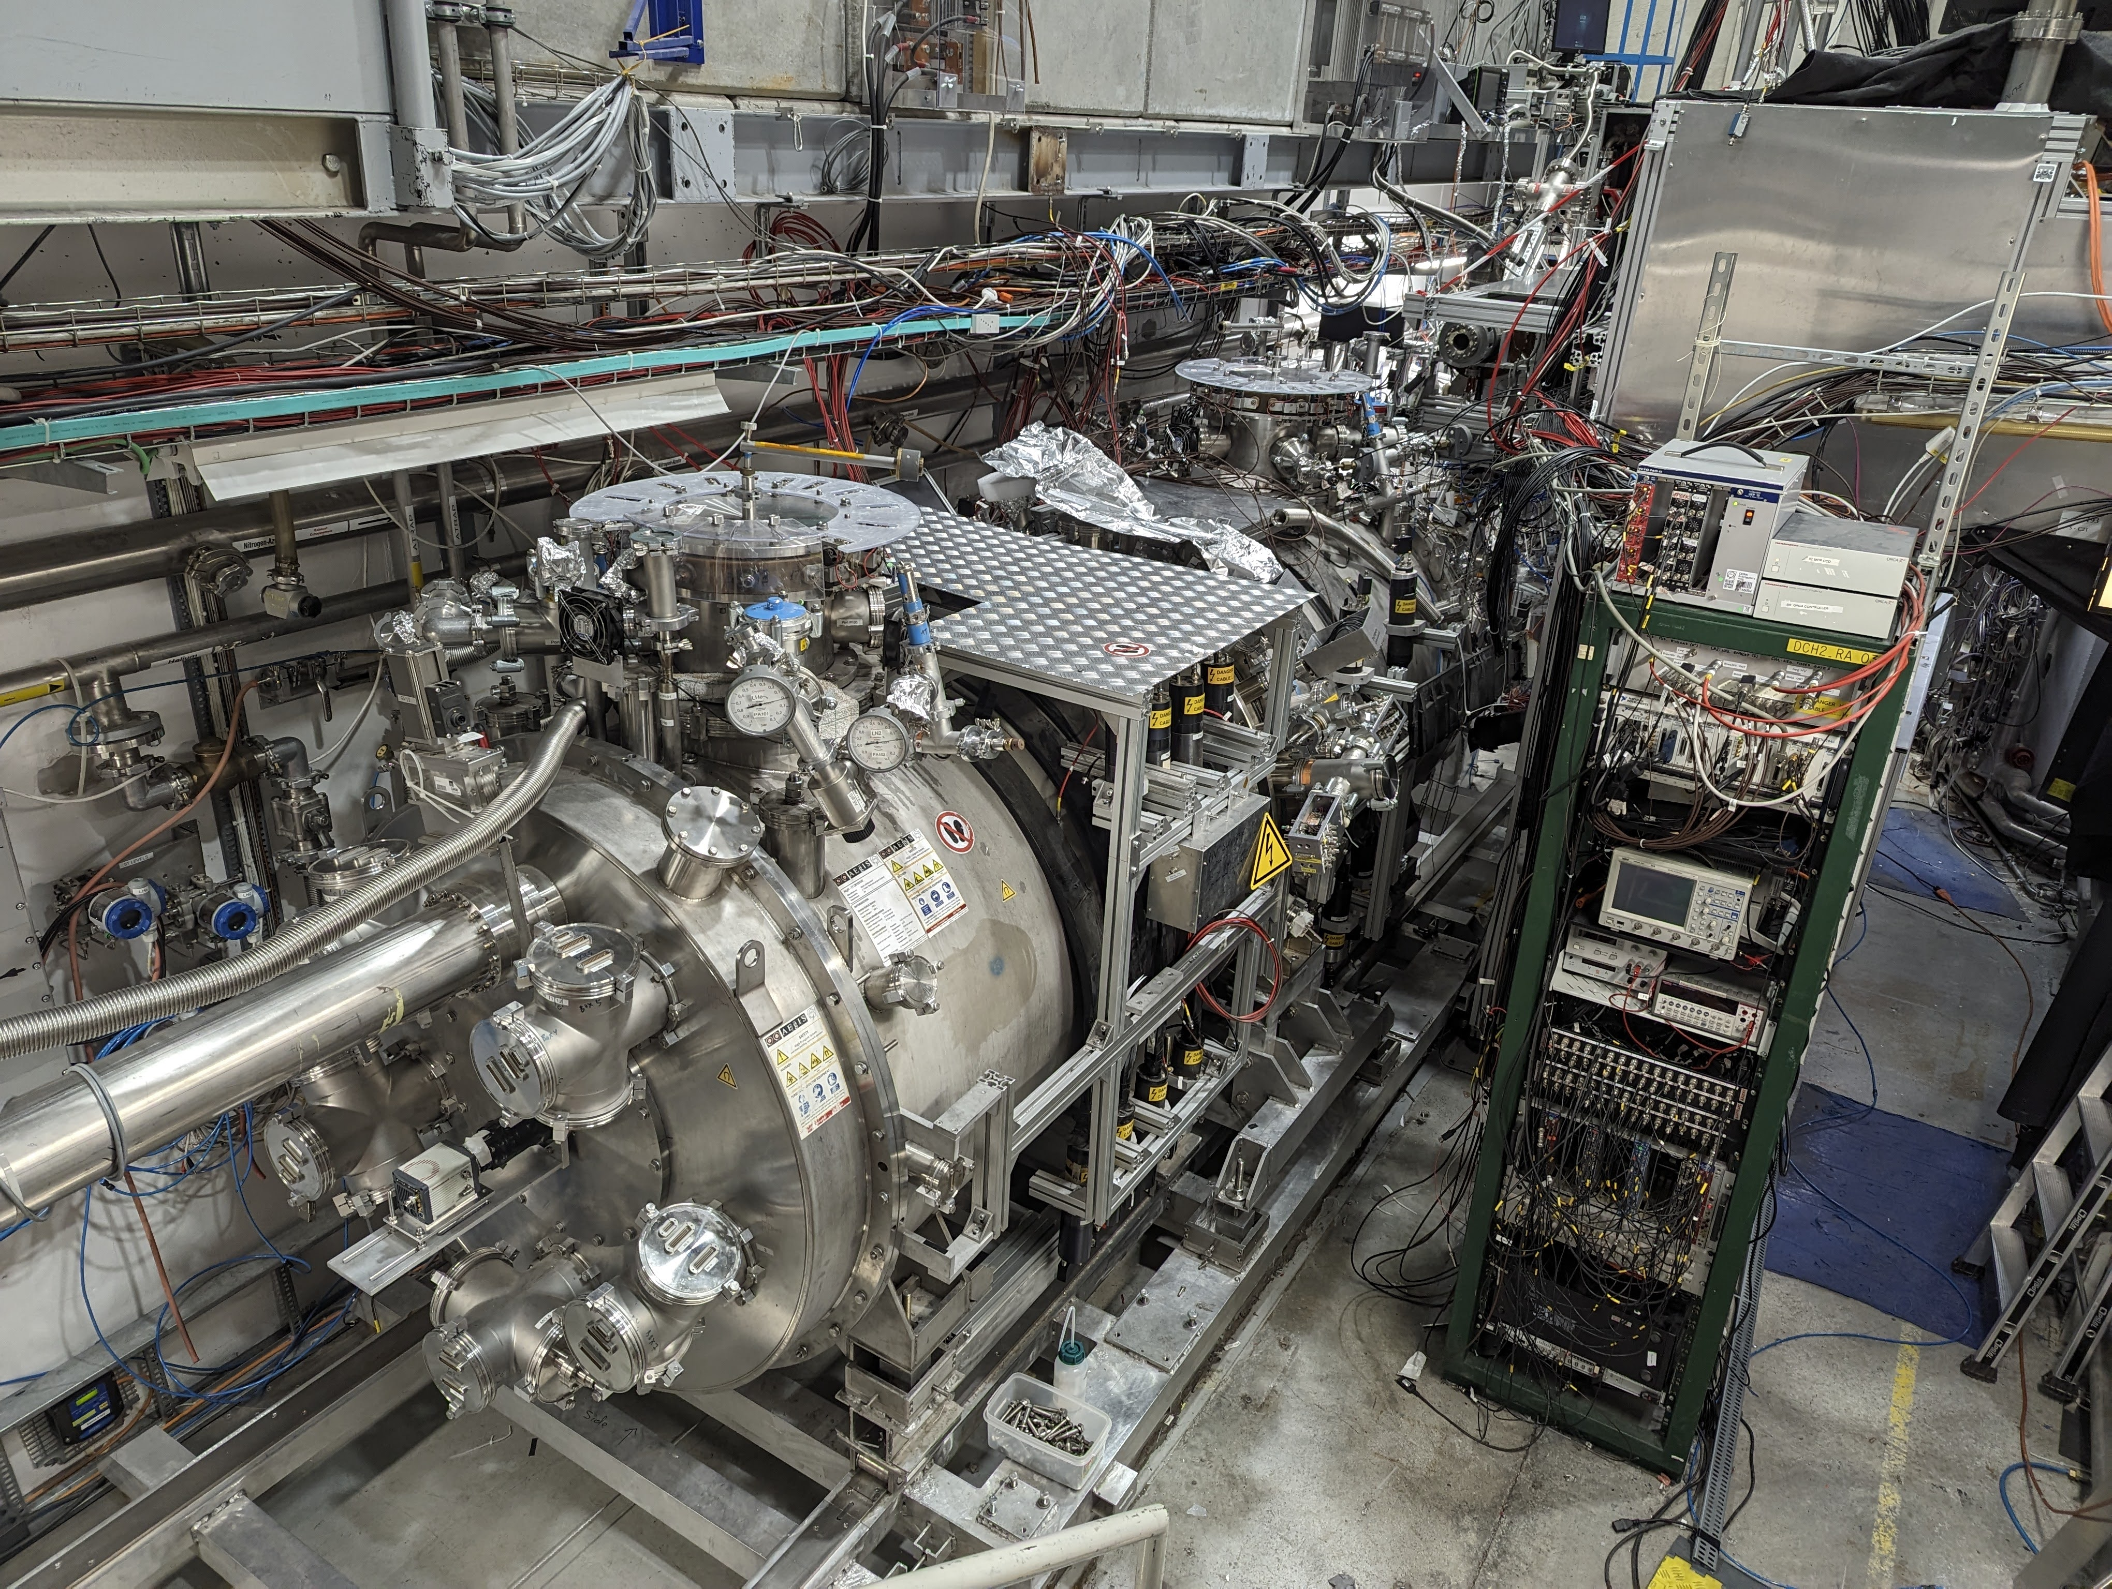

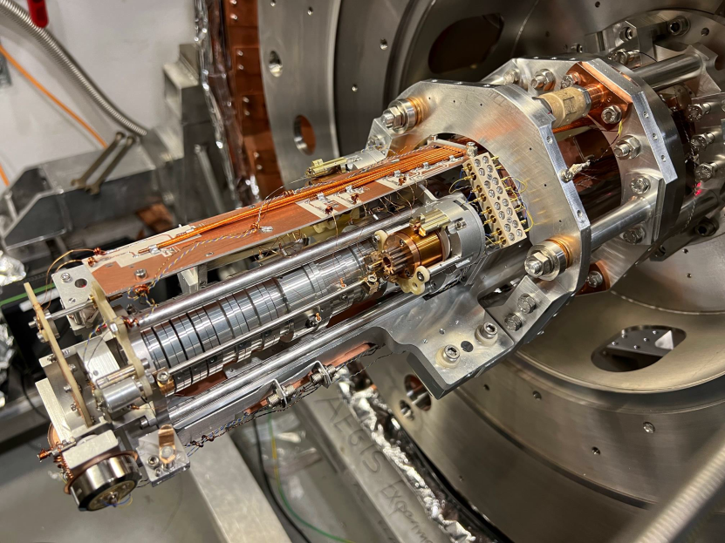
The AEGIS experiment

Slide 21
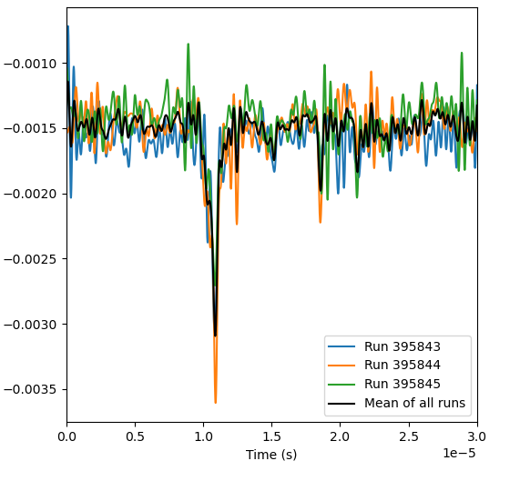
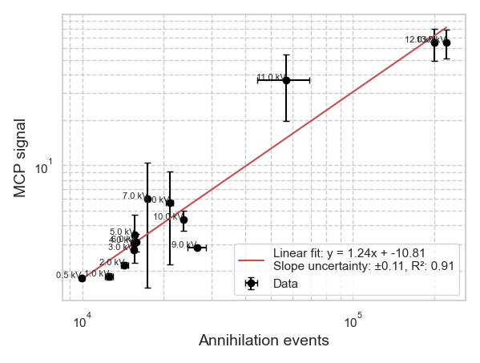
Low energy antiproton interactions
<1 keV trapped pbars
2kV
Signal of m/q=2 peak vs annihilation event:
What could result in the formation of m/q=2 from nitrogen?

Slide 22
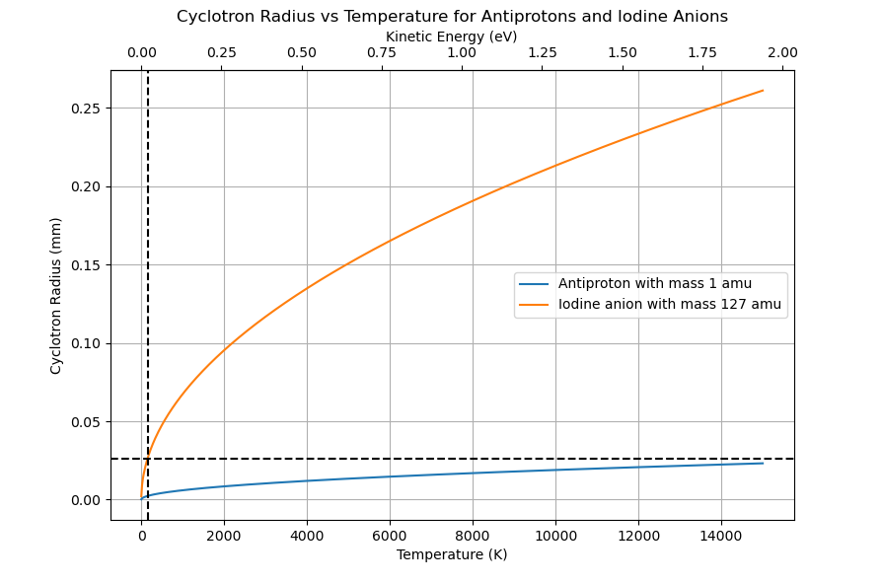

Slide 23
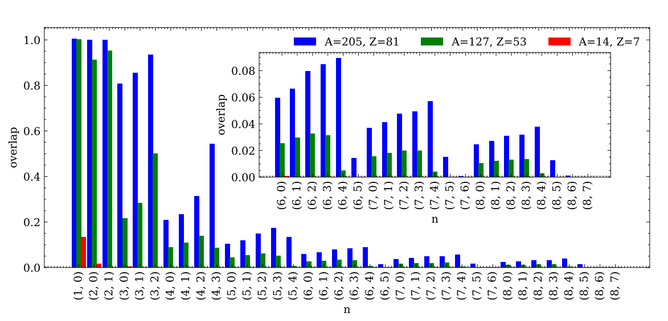
Antiproton overlap with nucleus
Mercury
Iodine
Nitrogen

Slide 24
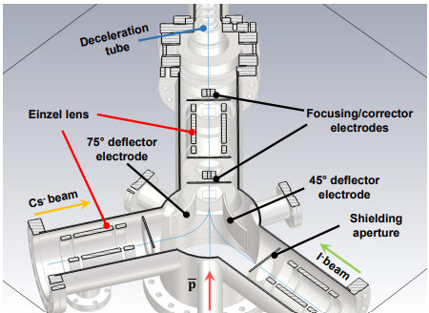
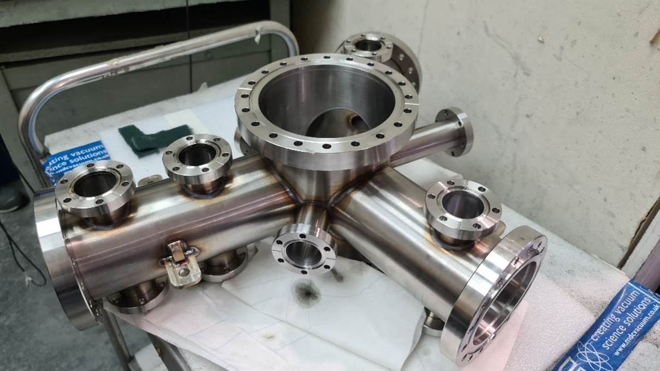
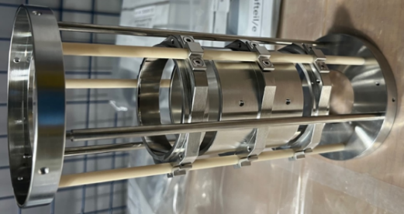
Antiprotonic atoms: setup of the ion injection beamline
Goal of the R&D: establish the techniques to form antiprotonic bound states.
On track for 2023

Slide 25
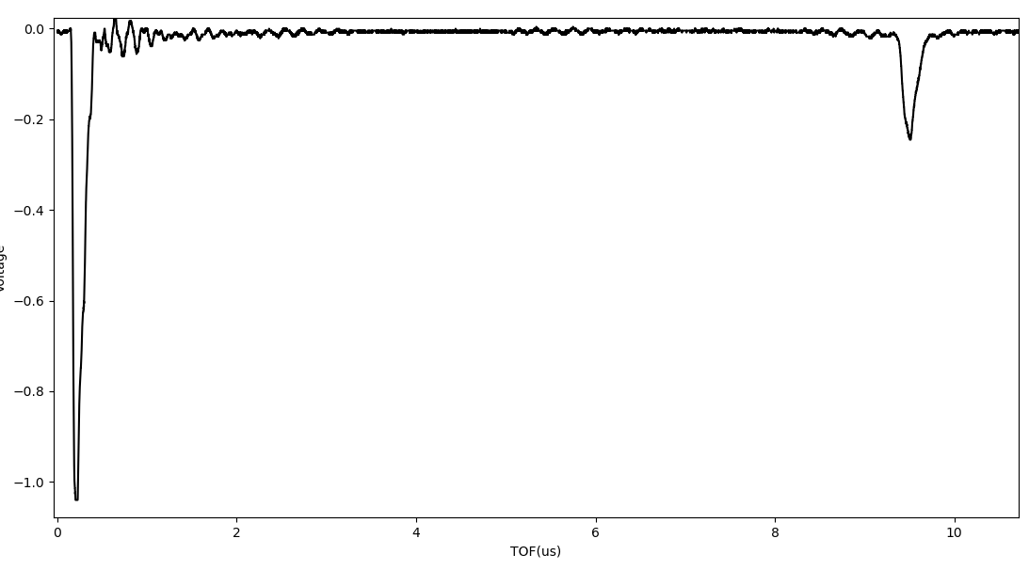
TOF calibration using Pbars and electrons
1.035m
0.533m
0V
Electrons
Pbar
TOF=200(50)ns
-70(1)eV → 1.0(2)m
TOF=9.5(1)us
-70(1)eV → 1.10(1)m

Slide 26
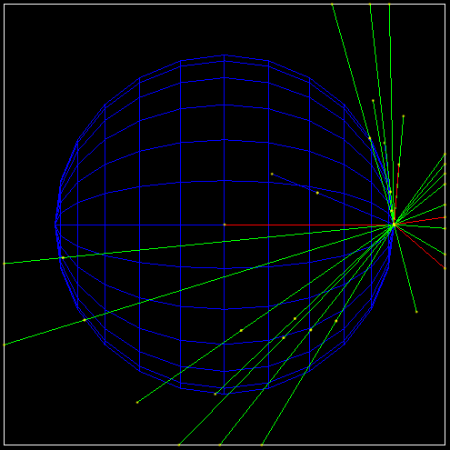
Simulation – Geant4 set up
Antiproton is created inside a hollow sphere of 500 nm thickness of target material
Target defined according to data from a config file (N,Z, density)
  Simulation ran for different isotopes (over 3000 isotopes)
1M antiprotons with E=1 keV
Physics List:
  FTFP_BERT_HP

