Slide 1










Towards a 10-fold improved measurement of the antiproton magnetic moment
Bela Peter Arndt
Institutes: MPIK, GSI, RIKEN
2024 / 07 / 09

Slide 2
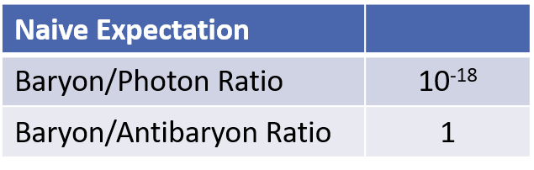
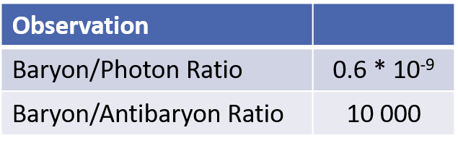
Matter-Antimatter Asymmetry
Sakharov conditions
1.) B-violation (plausible)
2.) CP-violation (observed / too small)
3.) Arrow of time (less motivated)
[2]
Alternative Source: CPT violation – adjusts matter/antimatter asymmetry by natural inversion given the effective chemical potential.
[1]
[1] Peplow, Mark. "Planck telescope peers into primordial Universe." Nature (2013).
[2] Charlton, Michael, Stefan Eriksson, and Graham M. Shore. Antihydrogen and fundamental physics. Cham: Springer, 2020.
Notes:
Make a nice slide:
CPT invariance with precise measurements

Slide 3
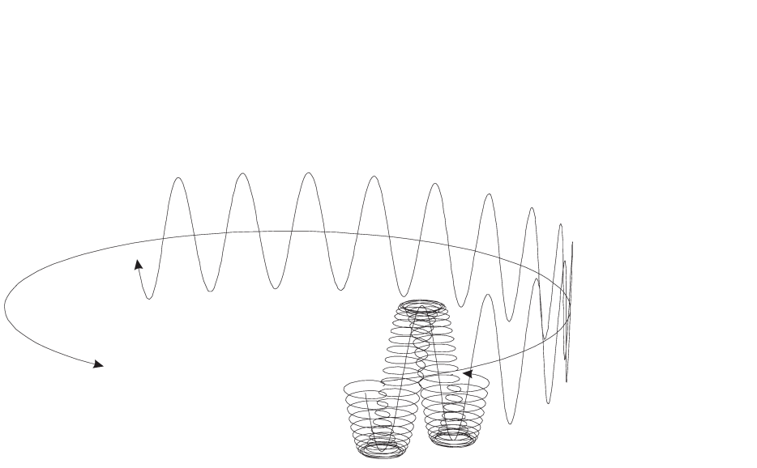
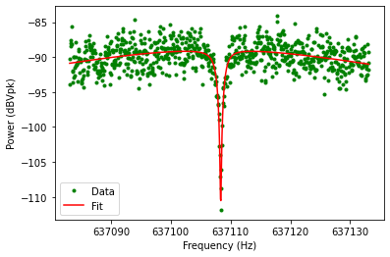
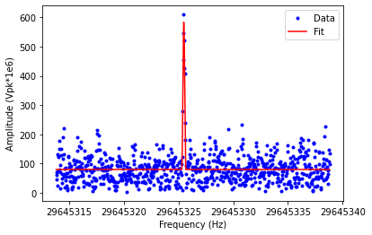


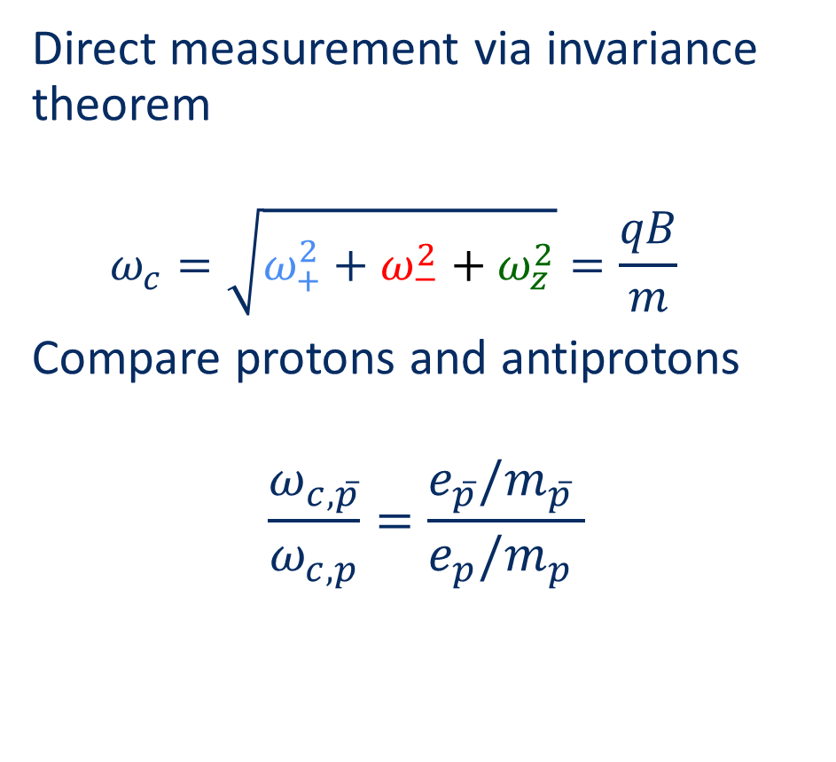


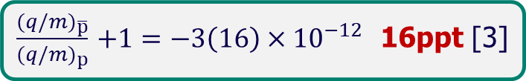


Charge-to-mass Ratio
Particle in a Penning trap
Direct measurement via invariance theorem
  $$ω_{c}=\sqrt{ω_{+}^{2}+ω_{−}^{2}+ω_{z}^{2}}=\frac{qB}{m}$$
Compare protons and antiprotons
$$\frac{ω_{c,\overline{p}}}{ω_{c,p}}=\frac{e_{\overline{p}}/m_{\overline{p}} }{e_{p}/m_{p} }$$
$$ω_{z}$$
$$ω_{+}$$
$$ω_{−}$$
$ω_{c}$via image current detection
Dip at $ω_{z}$
Peak at $ω_{+}$
$\frac{{(q/m)}_{\overline{p}}}{{(q/m)}_{p}}$ $+1=−3\left(16\right)×{10}^{−12}$ 16ppt [3]
3 Ulmer, Stefan, et al. "High-precision comparison of the antiproton-to-proton charge-to-mass ratio." Nature 524.7564 (2015): 196-199.
Notes:
2 measurements
Compare proton and antiproton with cyclotron motion
Cyclotron -> + , - , z
Magnetic moment in units of the nuclear magnetron
Measure spin procession and cyclotron

Slide 4
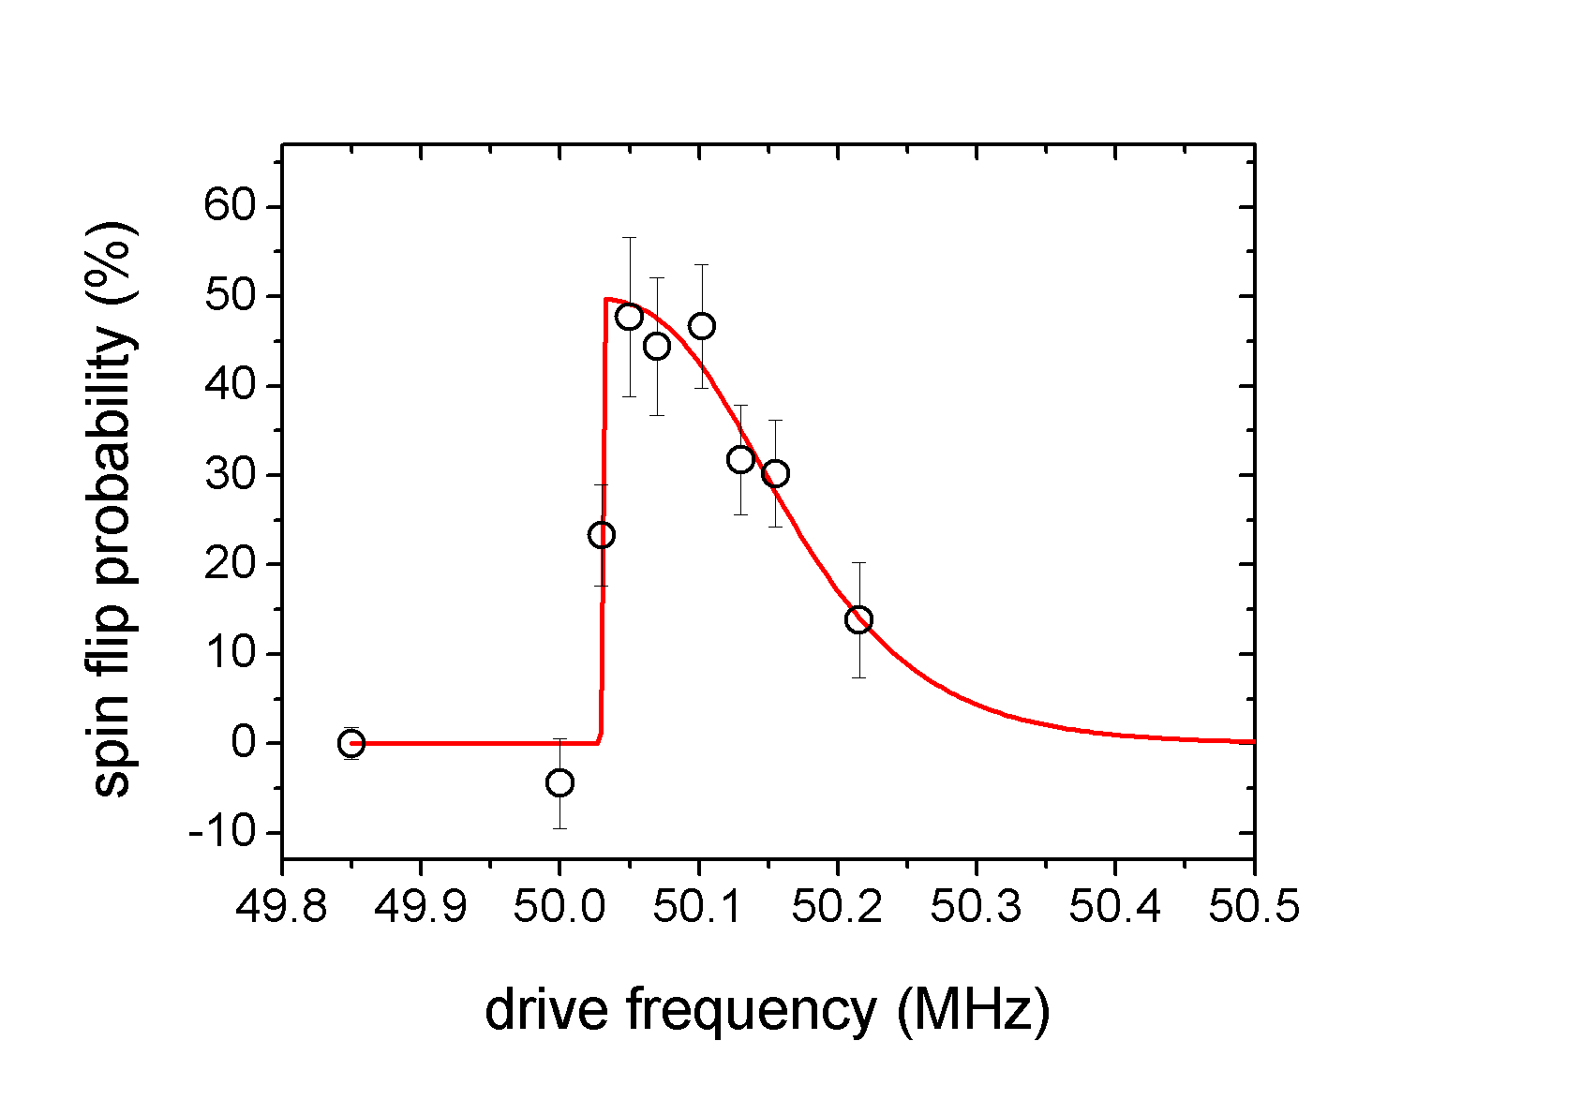
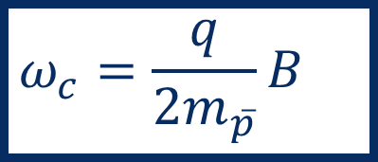
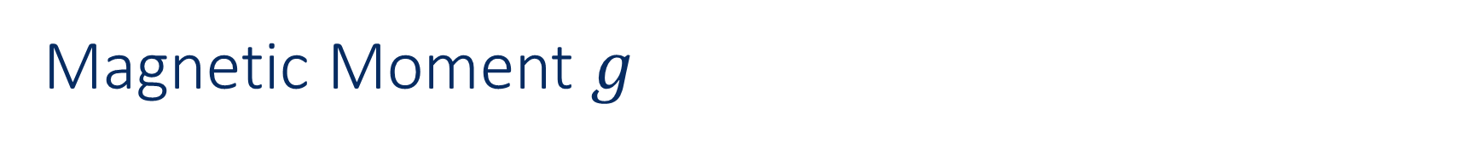
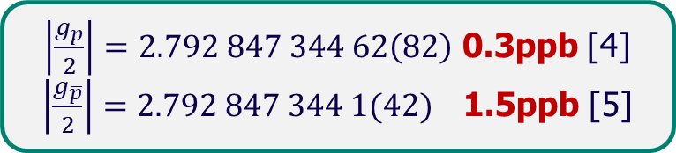
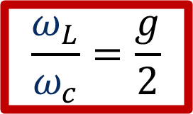
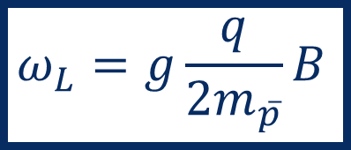
Magnetic Moment $g$
No image current detection possible
Cyclotron frequency
Larmor frequency
Continuous Stern-Gerlach effect
$$ω_{c}=\frac{q}{{2m}_{\overline{p}}}B$$
$$ω_{L}=g\frac{q}{{2m}_{\overline{p}}}B$$
$$\frac{ω_{L}}{ω_{c}}=\frac{g}{2}$$
Decoherent: random spin state (time independent, 50% sf )
Coherent: rabi oscillations (time dependent, 100% sf )
$\left|\frac{g_{p}}{2}\right|=2.792 847 344 62\left(82\right)$ 0.3ppb [4]
$\left|\frac{g_{\overline{p}}}{2}\right|=2.792 847 344 1(42)$ 1.5ppb [5]
4 Schneider, Georg, et al. "Double-trap measurement of the proton magnetic moment at 0.3 parts per billion precision." Science 358.6366 (2017): 1081-1084.
5 Smorra, Ch, et al. "A parts-per-billion measurement of the antiproton magnetic moment." Nature 550.7676 (2017): 371-374.
Notes:
2 measurements
Compare proton and antiproton with cyclotron motion
Cyclotron -> + , - , z
Magnetic moment in units of the nuclear magnetron
Measure spin procession and cyclotron

Slide 5
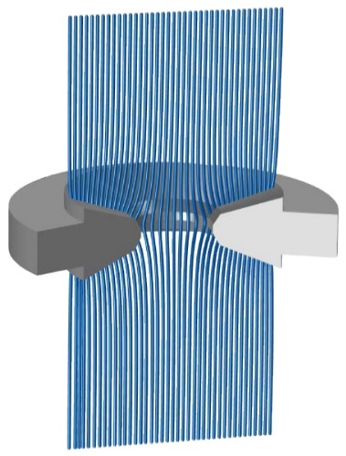
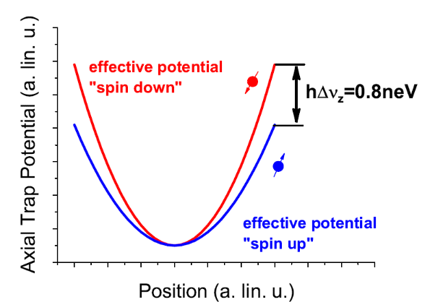
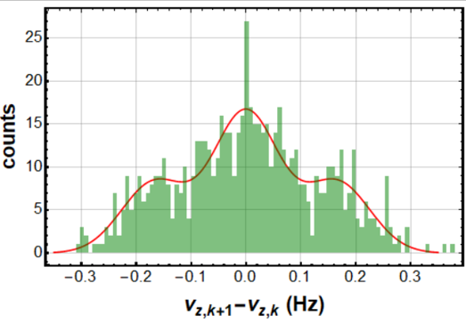
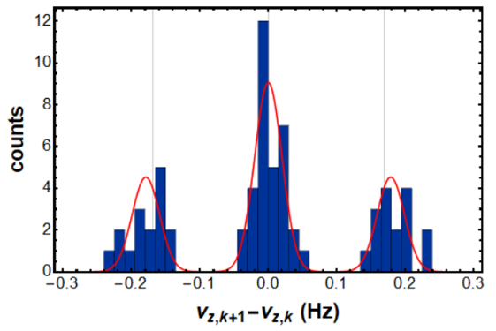
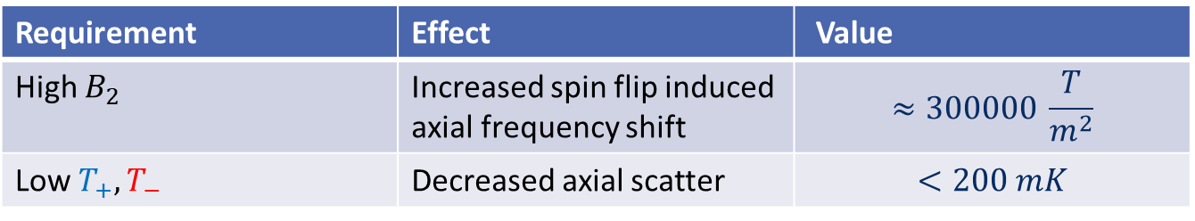

Challenges of Spin Flip determination
Resolve spin shift
$$Δν_{z}\sim \frac{μ_{p}B_{2}}{m_{p}ν_{z}} ≈170 mHz$$
Resolve spin shift
Δν_𝑧~(μ_𝑝 𝐵_2)/(𝑚_𝑝 ν_𝑧 ) ≈170 𝑚𝐻𝑧
Small axial scatter
best reached under 30 mHz
Strong magnetic bottle
$B_{2}$ = $300000 \frac{T}{m^{2}}$
Strong magnetic bottle
𝐵_2 = 300000 𝑇/𝑚^2
2016
B-field expansion
$$B\left(z\right)=\int_{k=0}^{∞}{B_{k}z^{k}}$$
Analog for potential
$$V\left(z\right)=V_{0}\int_{k=0}^{∞}{C_{k}z^{k}}$$
2023
Requirement | Effect | Value
High $B_{2}$ | Increased spin flip induced axial frequency shift | $$≈300000 \frac{T}{m^{2}}$$
Low $T_{+},T_{−}$ | Decreased axial scatter | $$<200 mK$$
Notes:
Decrease axial scatter from other sources
Increase the the magnetic bottle B2

Slide 6
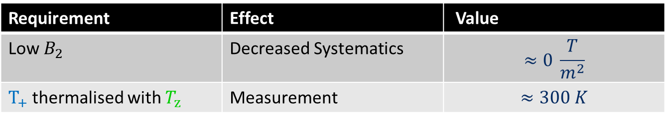


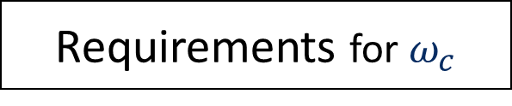
Challenges of Spin Flip determination
Resolve spin shift
$$Δν_{z}\sim \frac{μ_{p}B_{2}}{m_{p}ν_{z}} ≈170 mHz$$
Resolve spin shift
Δν_𝑧~(μ_𝑝 𝐵_2)/(𝑚_𝑝 ν_𝑧 ) ≈170 𝑚𝐻𝑧
Small axial scatter
best reached under 30 mHz
Strong magnetic bottle
$B_{2}$ = $300000 \frac{T}{m^{2}}$
Strong magnetic bottle
𝐵_2 = 300000 𝑇/𝑚^2
2016
Requirements for $ω_{c}$
B-field expansion
$$B\left(z\right)=\int_{k=0}^{∞}{B_{k}z^{k}}$$
Analog for potential
$$V\left(z\right)=V_{0}\int_{k=0}^{∞}{C_{k}z^{k}}$$
2023
Requirement | Effect | Value
Low $B_{2}$ | Decreased Systematics | $$≈0 \frac{T}{m^{2}}$$
$T_{+}$thermalised with $T_{z}$ | Measurement | $$≈300 K$$
Requirement | Effect | Value
High $B_{2}$ | Increased spin flip induced axial frequency shift | $$≈300000 \frac{T}{m^{2}}$$
Low $T_{+},T_{−}$ | Decreased axial scatter | $$<200 mK$$
Notes:
Decrease axial scatter from other sources
Increase the the magnetic bottle B2

Slide 7
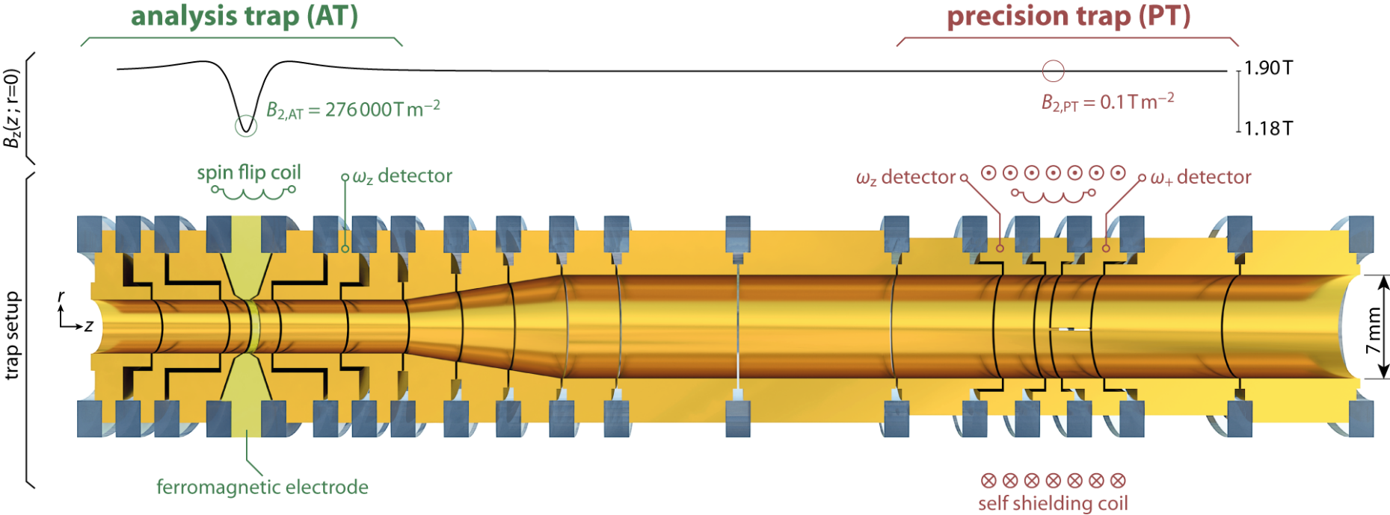
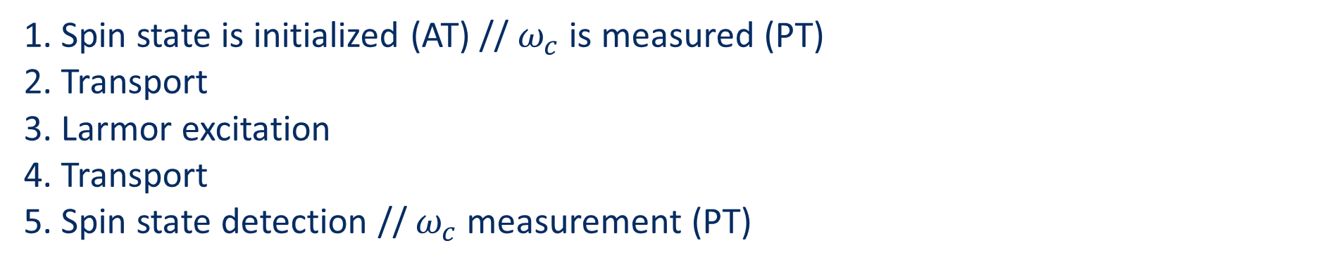
The Two-trap Method
RF- drive
1. Spin state is initialized (AT) // $ω_{c}$is measured (PT)
2. Transport
3. Larmor excitation
4. Transport
5. Spin state detection // $ω_{c}$measurement (PT)

Slide 8
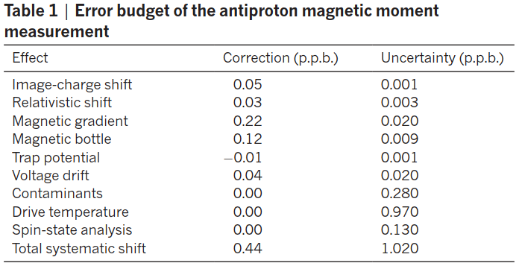


Understanding Systematic Errors
Shift related to:
$$B_{1}=71.2(4) \frac{mT}{m^{2}}$$
Shift related to:
$B_{2}=2740\left(220\right) \frac{mT}{m^{2}}$
Dominant error contribution!
[5]
Decoherence due to line width parameter $ω_{c}=\frac{q}{m}B_{0}\left(1+\frac{B_{2}E_{z}}{B_{0}mω_{z}^{2}}\right)$
5 Smorra, Ch, et al. "A parts-per-billion measurement of the antiproton magnetic moment." Nature 550.7676 (2017): 371-374.

Slide 9
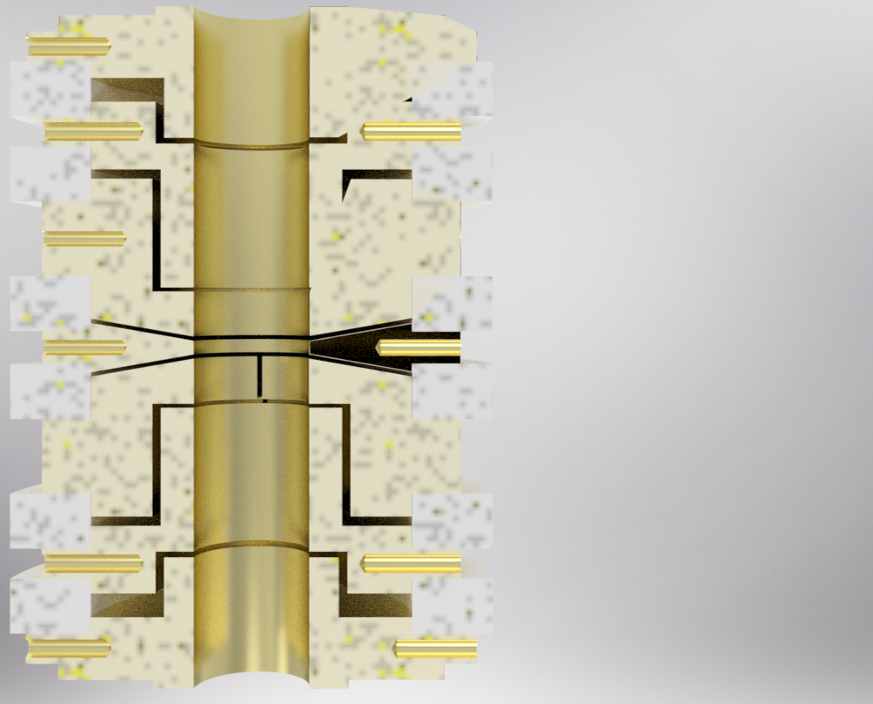
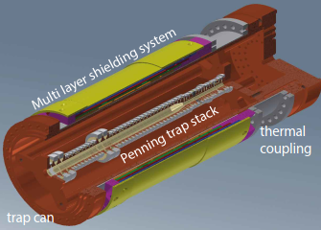
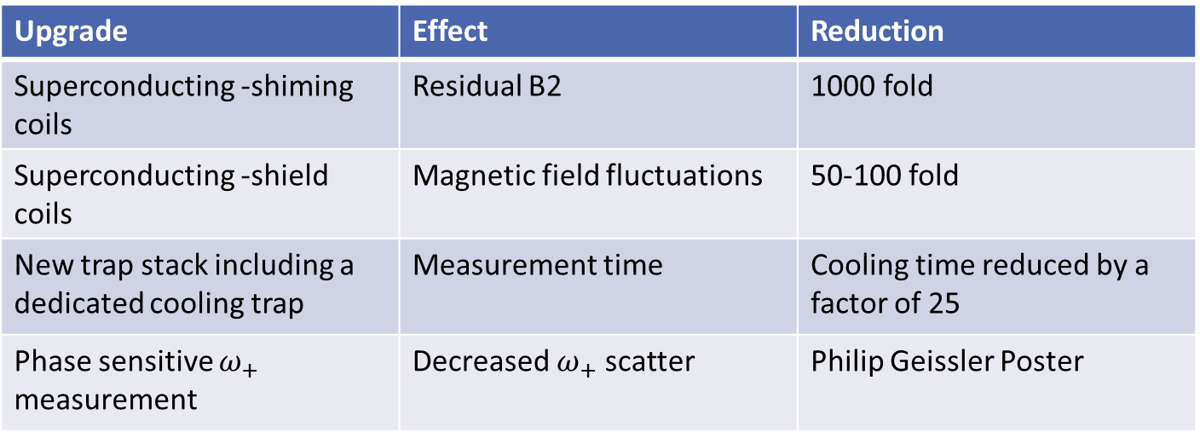
Hardware Upgrades
Cooling Trap
Upgrade | Effect | Reduction
Superconducting -shiming coils | Residual B2 | 1000 fold
Superconducting -shield coils | Magnetic field fluctuations | 50-100 fold
New trap stack including a dedicated cooling trap | Measurement time | Cooling time reduced by a factor of 25
Phase sensitive $ω_{+}$ measurement | Decreased $ω_{+}$ scatter | Philip Geissler Poster
Outer layer:
Self shielding coils
Inner layer:
Shiming coils for B2 and B1

Slide 10
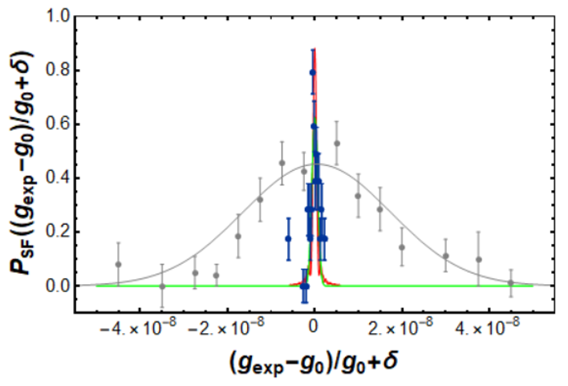
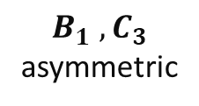
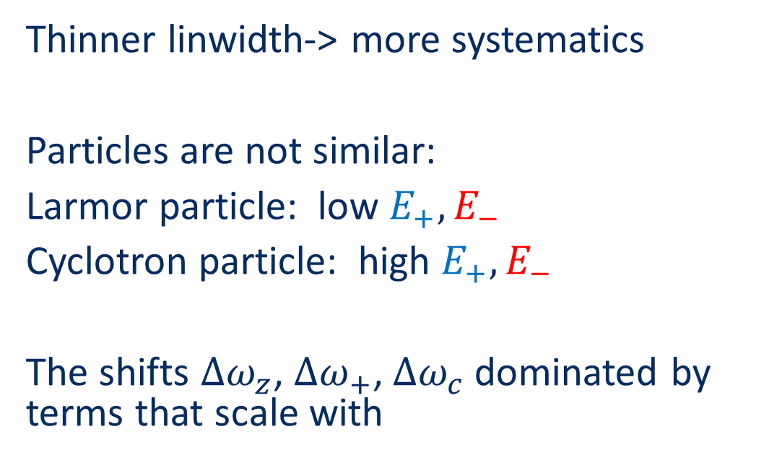



Reduction of the Resonance Linewidth
Proton resonance
Preliminary
Thinner linwidth-> more systematics
Particles are not similar:
Larmor particle: low $E_{+},E_{−}$
Cyclotron particle: high $E_{+},E_{−}$
The shifts ${∆ω}_{z}$, ${∆ω}_{+}$, ${∆ω}_{c}$dominated by terms that scale with
relativistic
B-field contributions
Potential contributions
Mixing term
and more
$v_{+}\left(E_{+}\right)=v_{+}\left(0\right)\left\{1+\left(−\frac{1}{mc^{2}}−\frac{1}{4π^{2}mv_{z}^{2}}\left[{\left(\frac{B_{1}}{B_{0}}\right)}^{2}+{\left(\frac{v_{z}}{v_{+}}\right)}^{4}\left(\frac{B_{2}}{B_{0}}\right)\right]+\frac{3}{4qV_{0}}\frac{C_{4}}{C_{2}^{2}}{\left(\frac{v_{z}}{v_{+}}\right)}^{4}−\frac{9v_{z}^{2}}{16π^{2}mv_{+}^{4}}\frac{C_{3}^{2}}{C_{2}^{2}}+\frac{3}{4qV_{0}}\frac{2C_{3}B_{1}}{C_{2}^{2}B_{0}}{\left(\frac{v_{z}}{v_{+}}\right)}^{2}\right)…\right\}$ $E_{+}$
$$B_{1} ,B_{2}$$
$$C_{4}$$
$$C_{3}$$
$B_{1}$ $,C_{3}$
asymmetric

Slide 11
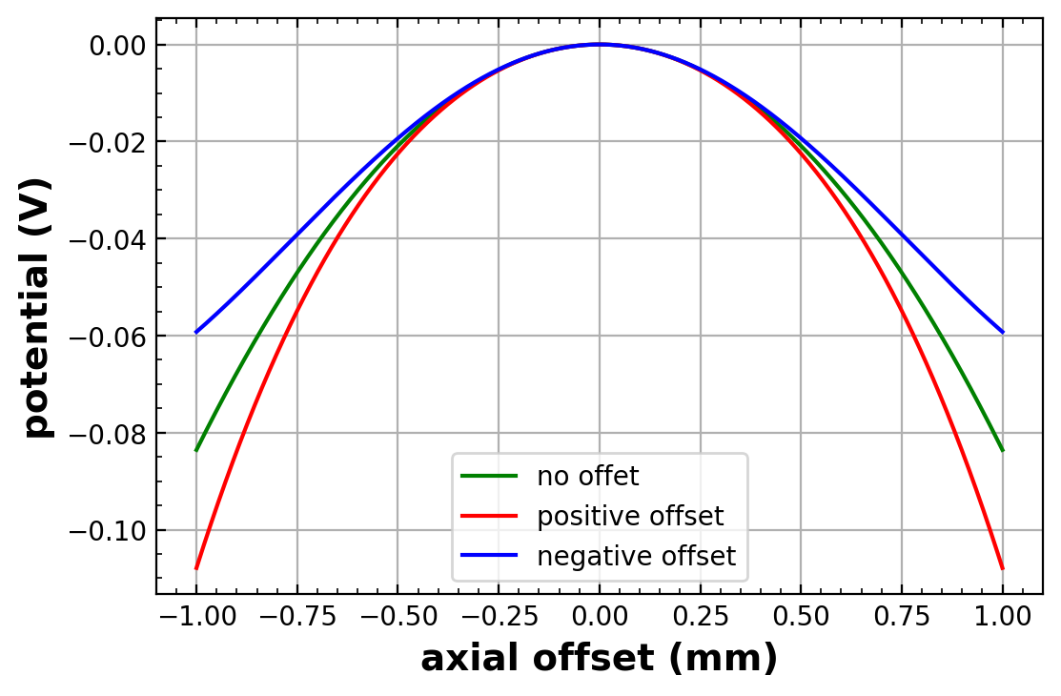
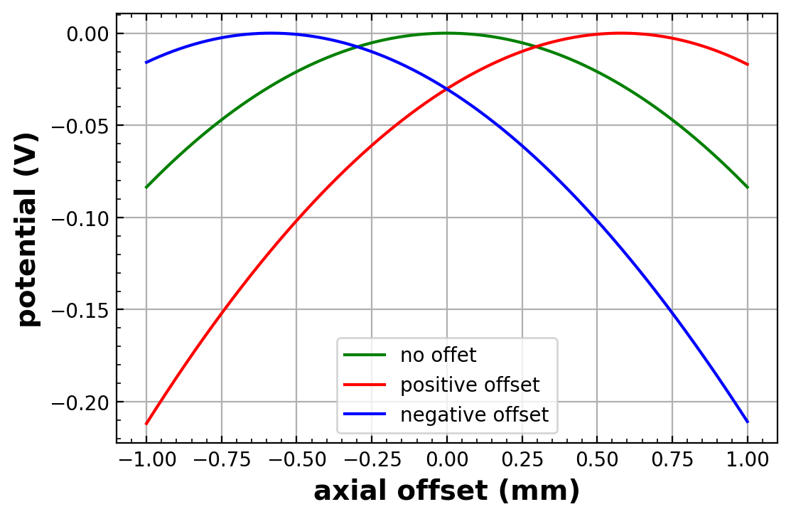

Manipulate Potentials
Open-endcap Penning trap
Vary correction electrodes
Both electrodes:
changes $C_{4}$
tuning ratio optimisation
One electrode:
changes $C_{3}$
changes axial position
Endcap up
Correction up
Ring
Correction low
Endcap low

Slide 12
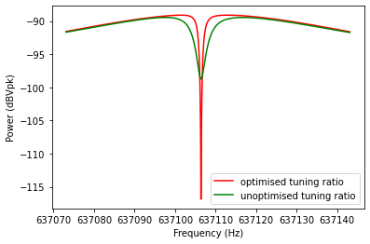
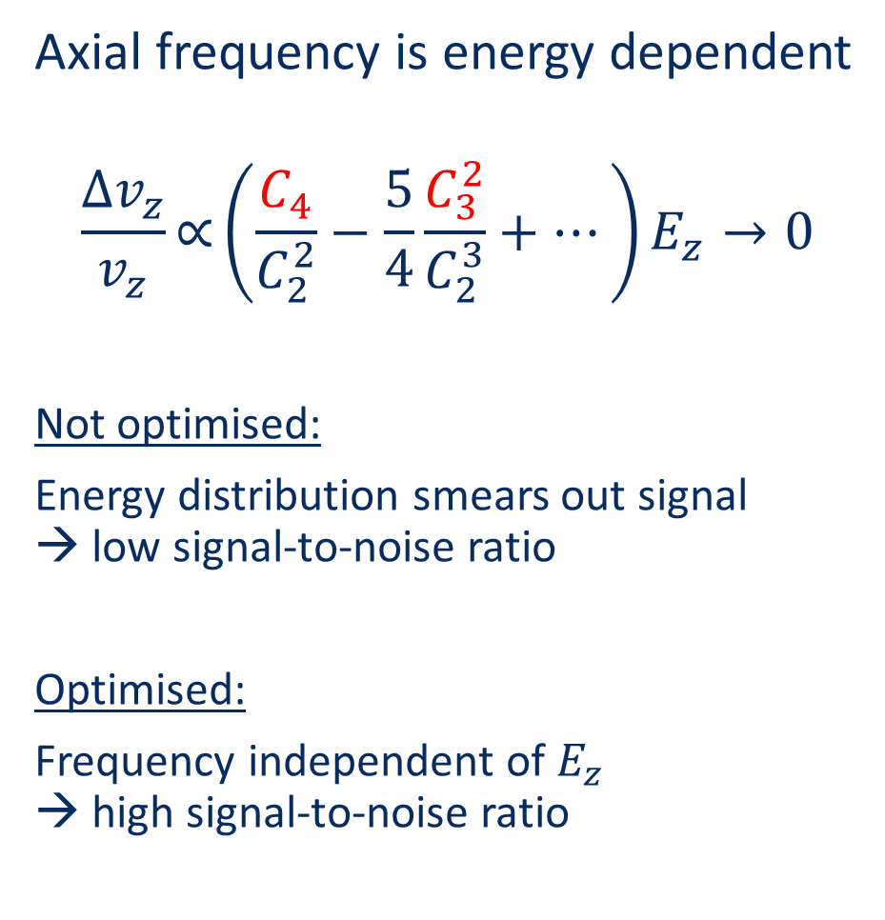
Tuning Ratio Optimisation
Axial frequency is energy dependent
$$\frac{∆v_{z}}{v_{z}}\text{∝}\left(\frac{C_{4}}{C_{2}^{2}}−\frac{5}{4}\frac{C_{3}^{2}}{C_{2}^{3}}+…\right)E_{z}→0$$
Not optimised:
Energy distribution smears out signal → low signal-to-noise ratio
Optimised:
Frequency independent of $E_{z}$ → high signal-to-noise ratio
SNR low
SNR high

Slide 13
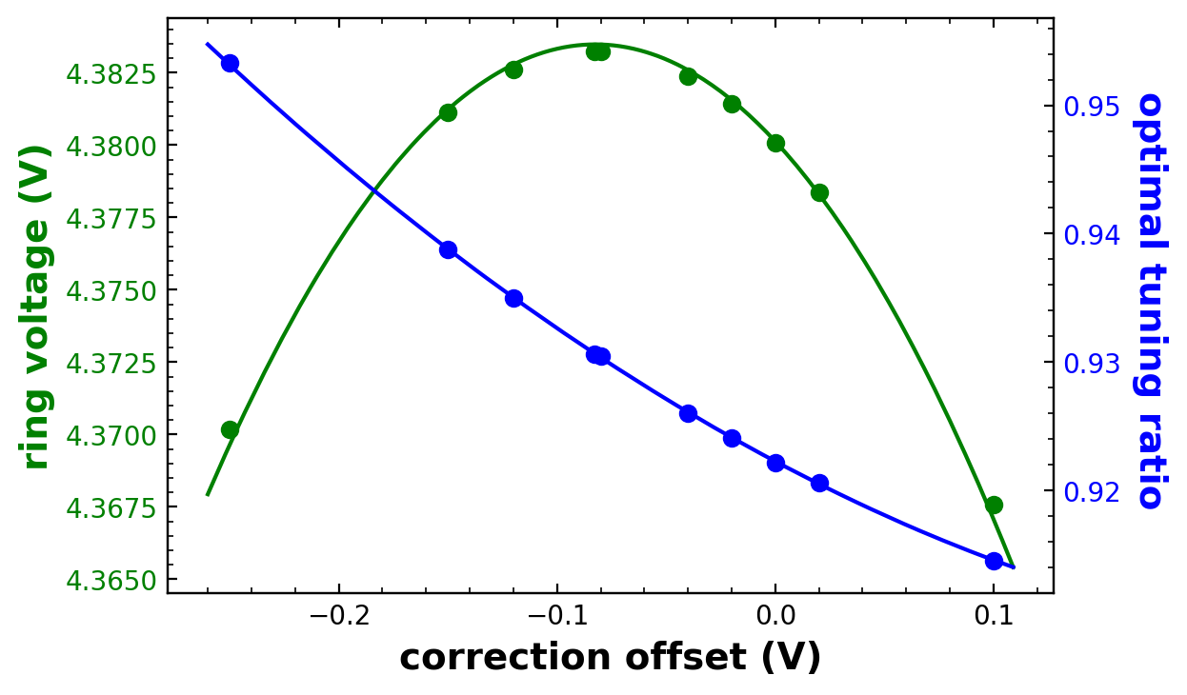
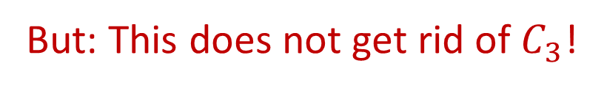
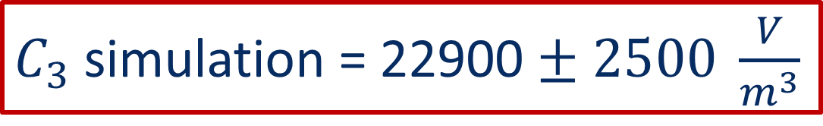
Centering the Particle
Vary a correction electrode
Optimise tuning ratio
Find the trap center at ring voltage maximum
Simulate and fit different endcap offset to the data:
But: This does not get rid of $C_{3}$!
$C_{3}$ simulation = 22900 $± 2500 \frac{V}{m^{3}}$

Slide 14
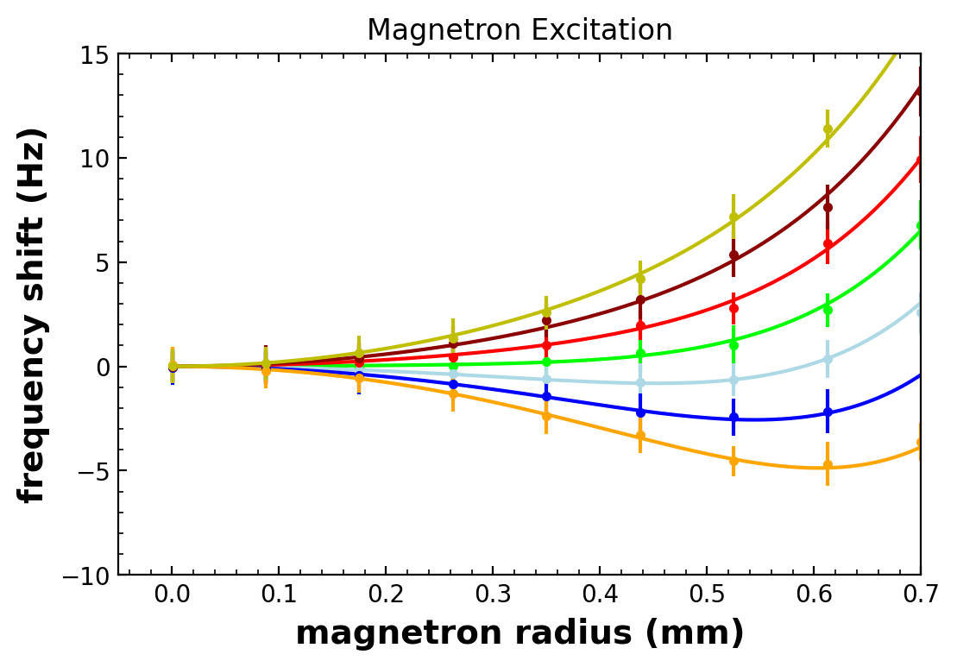


Direct Measurement of C3
Recall: $E_{z }$ axial shift optimisation:
Vary tuning ratio→
Optimise the SNR
$\frac{∆v_{z}}{v_{z}} \text{∝} \left(\frac{C_{4}}{C_{2}^{2}}−\frac{5}{4}\frac{C_{3}^{2}}{C_{2}^{3}}+…\right)E_{z}→0$
$E_{−}$ axial shift optimisation:
Excite magnetron mode externally →
Measure energy dependent shift $∆v_{z}$
$$\frac{∆v_{z}}{v_{z}} \text{∝} \left(\frac{C_{4}}{C_{2}^{2}}−\frac{3}{4}\frac{C_{3}^{2}}{C_{2}^{3}}+…\right)E_{−}→0$$
Colour coded:
different TR
SNR low
SNR High
higher order effects
Both measurements cannot cannot distinguish between $C_{3}$ and $C_{4}$

Slide 15
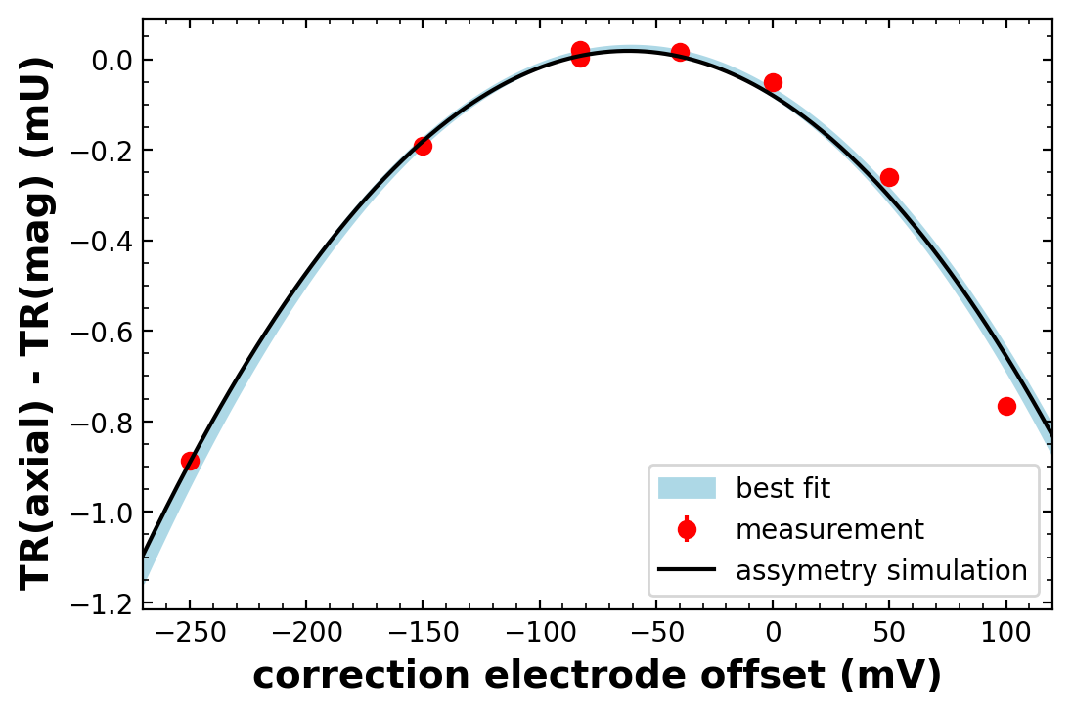
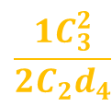

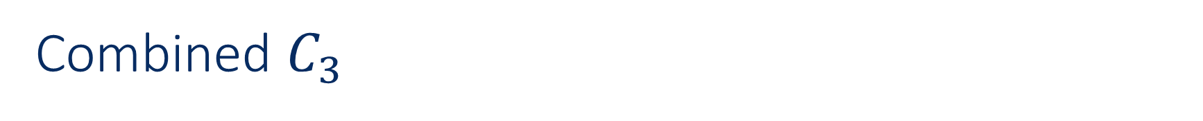



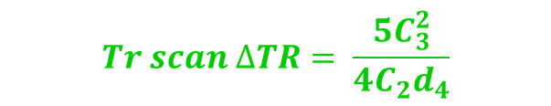
Combined $C_{3}$
Combine measurements to get $C_{3}$ independent of $C_{4}$
$$Magnetron ∆TR= \frac{3{ C}_{3}^{2}}{4C_{2}d_{4}}$$
$$\frac{1C_{3}^{2}}{2C_{2}d_{4}}$$
$$Tr scan ∆TR= \frac{5C_{3}^{2}}{4C_{2}d_{4}}$$
real $C_{4}=0$
$E_{−}$shift
$E_{z}$ shift
Resulting offset $C_{3}$ in the Base 2024 g-factor run: $22500 ±2200 V/m^{3}$

Slide 16
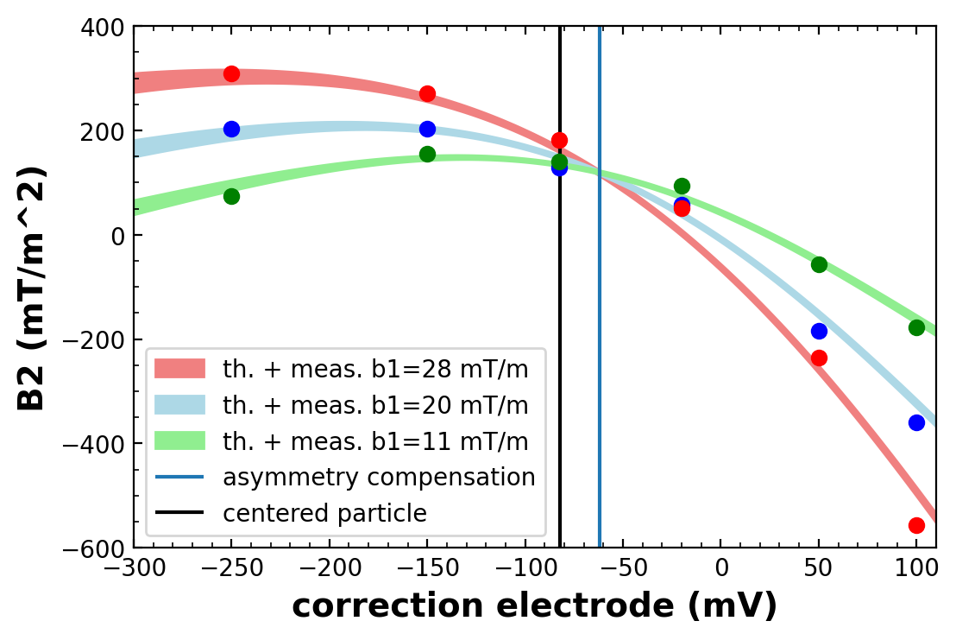
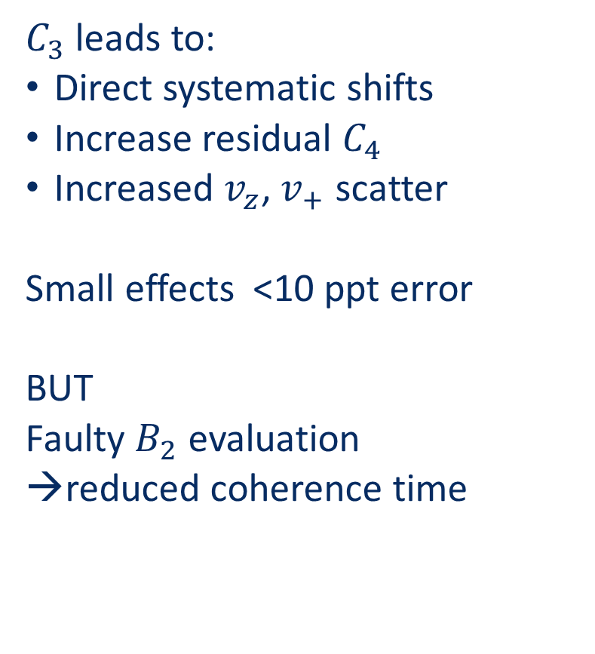



Systematic Errors
$C_{3}$ leads to:
Direct systematic shifts
Increase residual $C_{4}$
Increased $v_{z}$, $v_{+}$ scatter
Small effects <10 ppt error
BUT
Faulty $B_{2}$ evaluation
reduced coherence time
real $B_{2}$
Uncorrected $B_{2} (mT/m^{2})$
$$correction electronde offset (mV)$$
Controlling assymetry is crucial to perform sub 100 ppt g-factor experiments!

Slide 17










Thanks for your attention

Slide 18



Axial scatter from $E_{+}$
Std. scatter$=\left|X_{0}\left(B_{2}\right)+X_{1}\left(B1\right)c_{3}+{X_{3}c}_{3}^{2}\right|$
Background gaussian scatter axial : 33.5 mHz
Resonator temperature: 48 K
$$v_{z}\left(E_{+}\right)=v_{z}\left(0\right)∗\left\{1+\left(−\frac{1}{2mc^{2}}+\frac{1}{4π^{2}mv_{z}^{2}}\frac{b_{2}}{b_{0}}+\frac{3}{4qV_{0}}\left[−\frac{c_{4}}{c_{2}^{2}}{\left(\frac{v_{z}}{v_{+}}\right)}^{2}+\frac{3}{2}\frac{c_{3}^{2}}{c_{2}^{3}}{\left(\frac{v_{z}}{v_{+}}\right)}^{2}−\frac{c_{3}b_{1}}{c_{2}^{2}b_{0}}\right]\right)…\right\} E_{+}$$

Slide 19

Full BASE trap stack
Analysis trap
(spin state analysis)
Precision trap
(antiproton catching)
Reservoir trap
(antiproton catching)
Cooling trap
Elongated transport section
(gradient supression)

Slide 20





Potential simulation
Solve Laplace with given geometry
  $$∆ϕ\left(ρ,z\right)=\frac{1}{ρ}\frac{∂}{∂ρ}\left(ρ\frac{∂}{∂ρ}φ\left(ρ,z\right)\right)+\frac{∂^{2}}{{∂z}^{2}}φ\left(ρ,z\right)=0$$
Calculate potential coefficient of each electrode
Optimise for different endcap offsets
[1]
Positive lower endcap offset
Negative lower endcap offset
Fit residuals (arb. Unit)
Endcap Offset (mV)
[1] Ulmer, Stefan. First observation of spin flips with a single proton stored in a cryogenic Penning trap. Diss. Ruprecht-Karls-Universität Heidelberg, Germany, 2011.

Slide 21
To do mayor
Update plots
First slide money hierarchy
Physics scope
Align presentation: capital letters/slide nr etc
Additional slides

