Slide 1
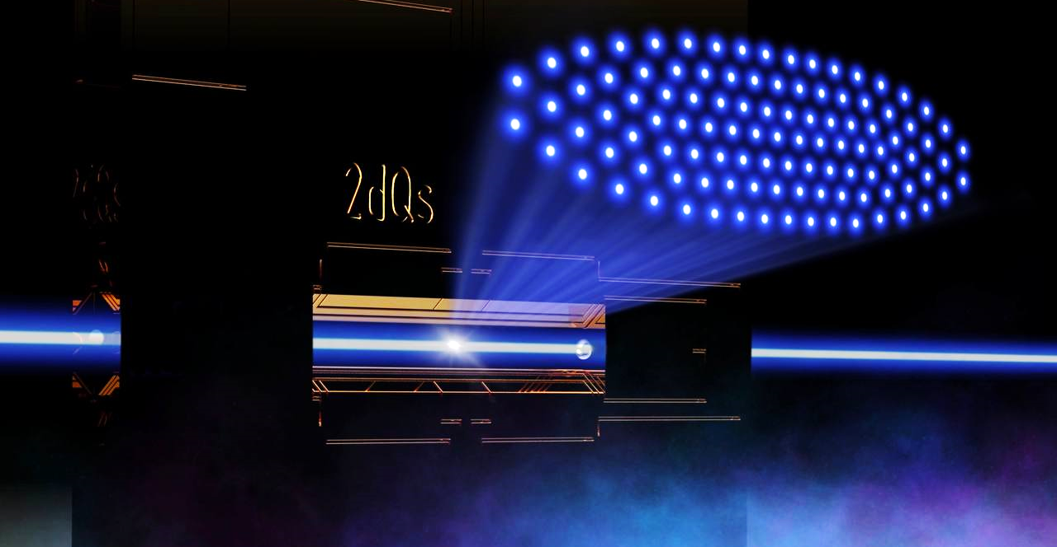
Entanglement generation in 2D ion crystals
Artem Zhdanov,
Institute for Experimental Physics,
University of Innsbruck, Austria

Slide 2

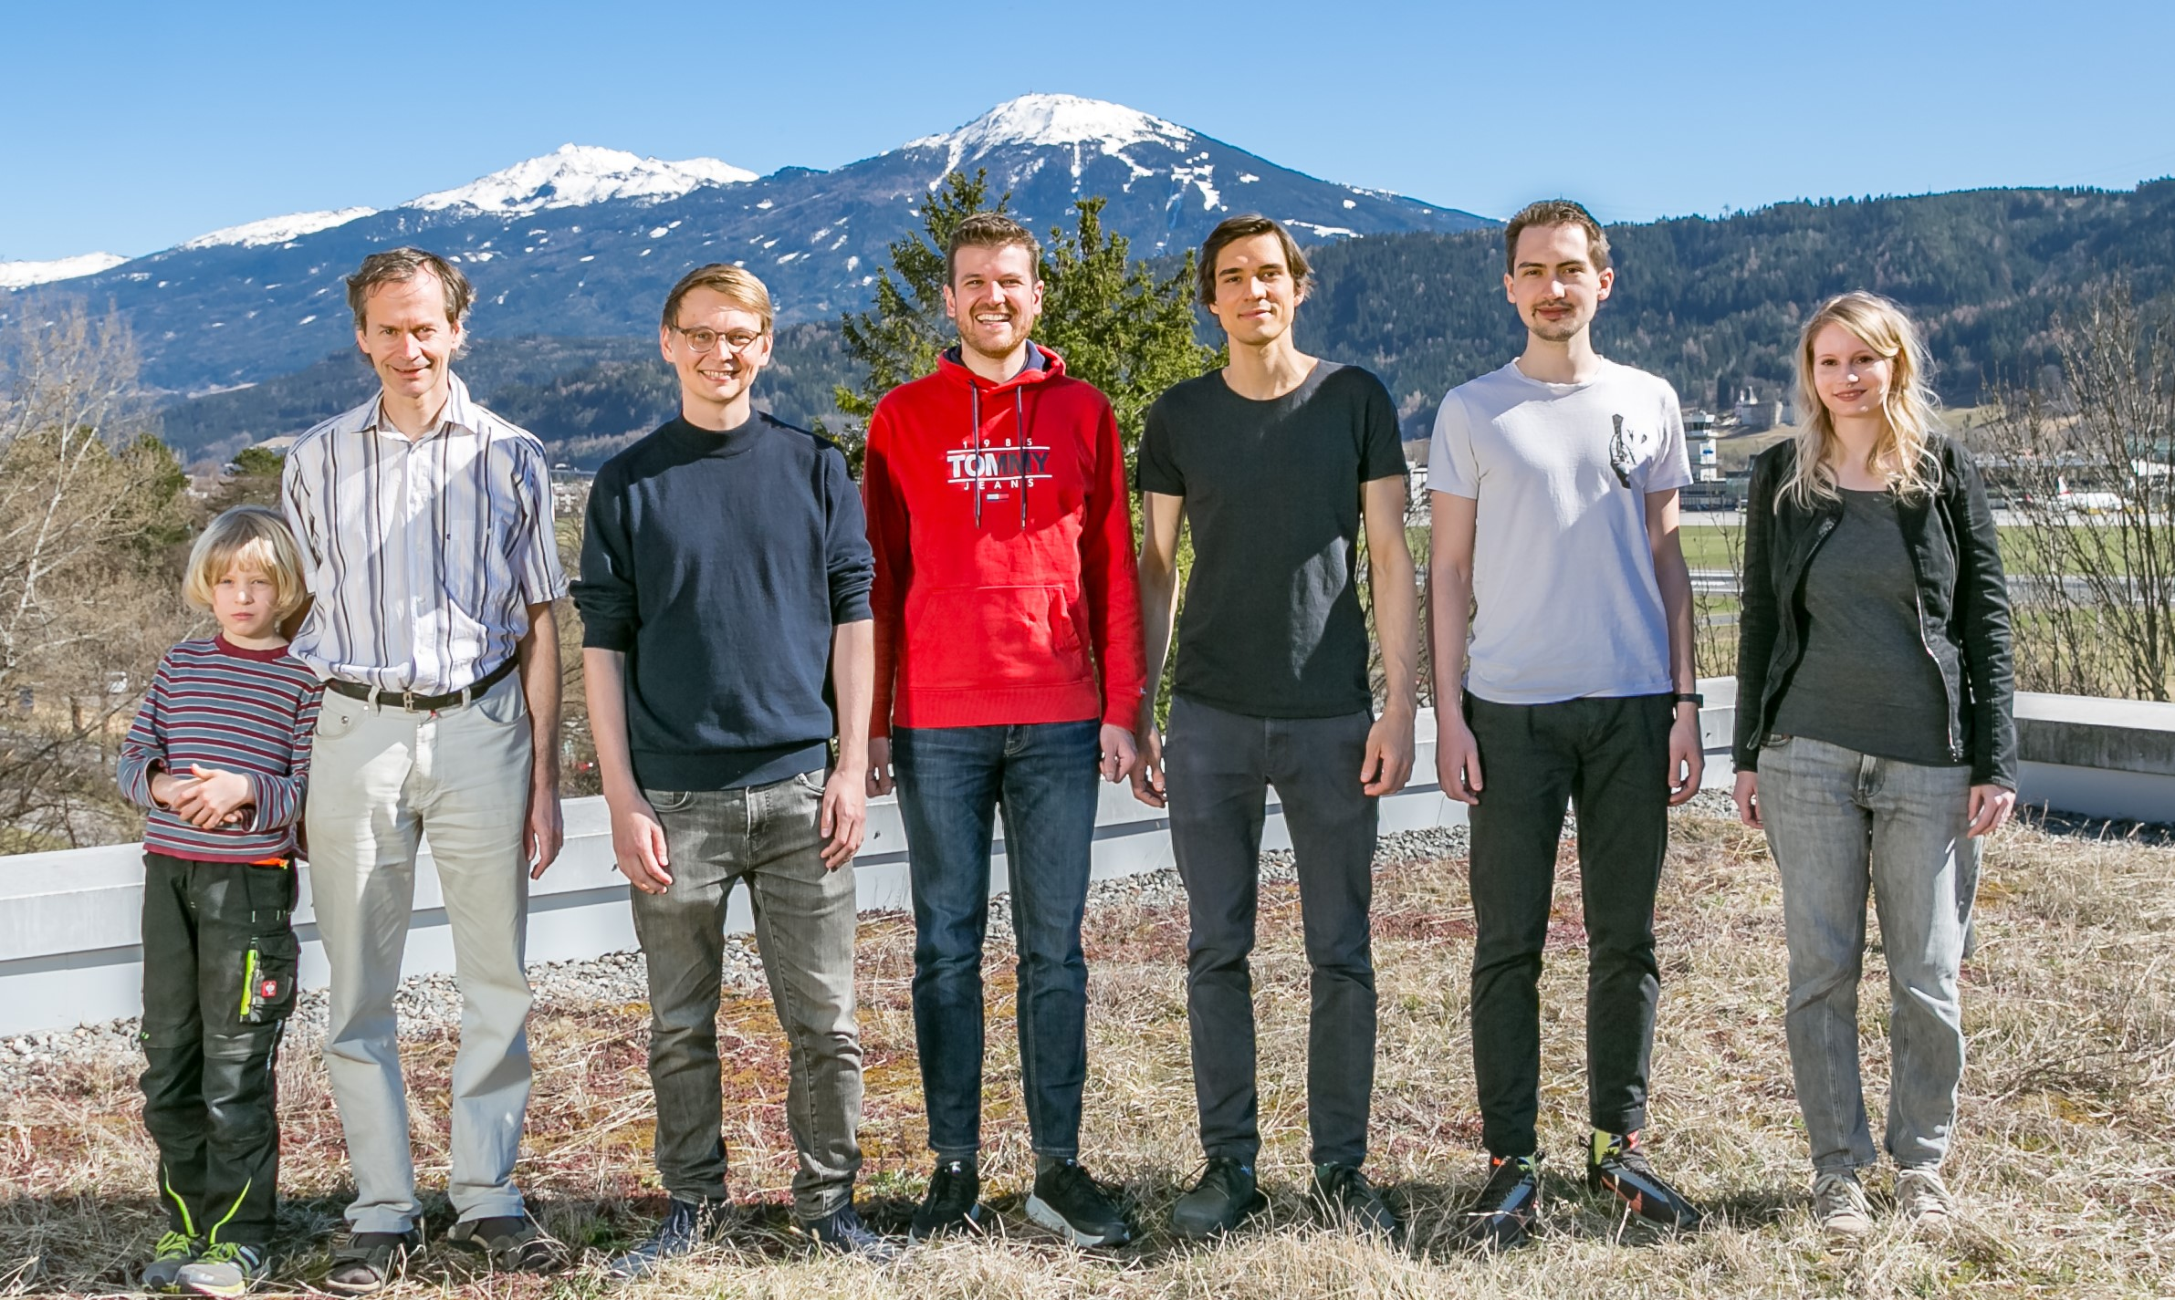
Team leader
Christian Roos
Postdocs
Tuomas Ollikainen✈️
Matthias Bock
PhDs
Dominik Kiesenhofer👨🏻‍💻
Artem Zhdanov
Helene Hainzer🚂

Slide 3
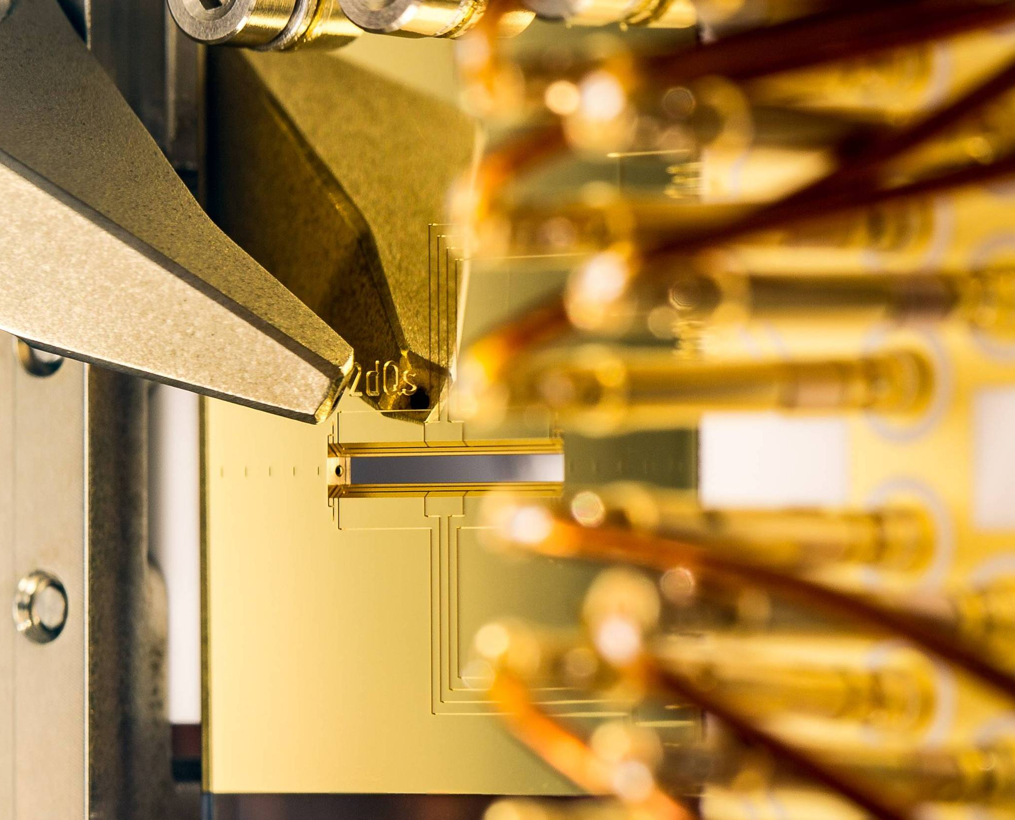
Talk structure
Motivation
Toolset
  2D ion crystals
  Individual ion state control
  Spin-spin interaction
Entanglement generation
  Spin squeezing
  Spin excitation spread
Outlook

Slide 4
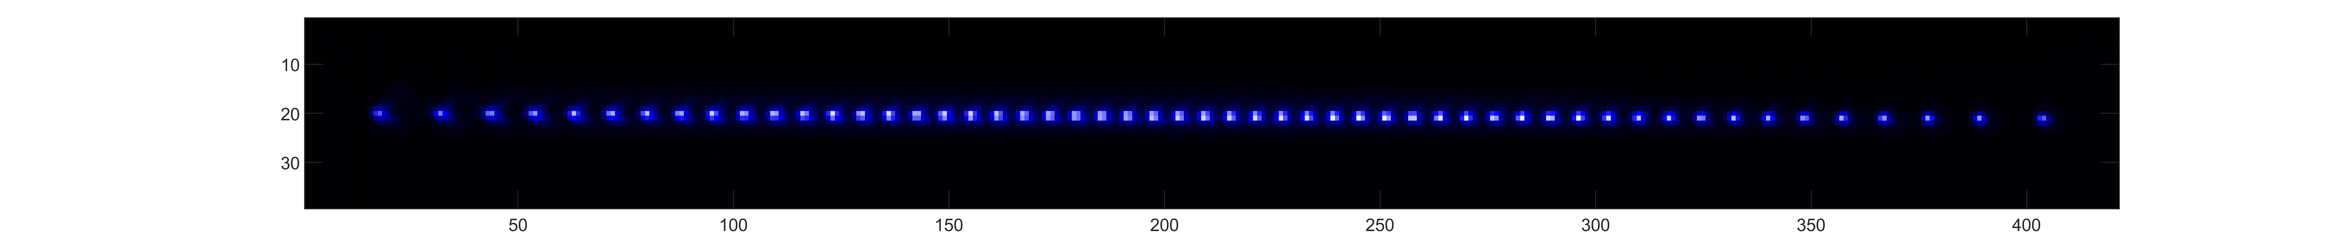
Trapped ion quantum simulators
Typically, an ion chain stored in a linear Paul trap
No “gates”:
Local and global single particle Hamiltonians and spin-spin interaction models instead
Electronic states of ions don’t interact with each other directly
  Good for quantum information storage
  “Bad” for making entanglement

Slide 5
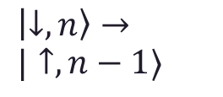


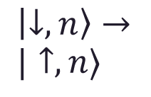
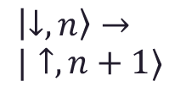
Trapped ion quantum simulators
Two-tone laser field
$$\vec{k}$$
Couples ions’ electronic state to collective motion via state dependent forces
Mølmer–Sørensen interaction
Red sidebands
$$ν_{o}$$
Blue sidebands
Δ
Δ
δ
δ
$\left|↓,n\right\rangle →$
$|↑,n−1⟩$
$\left|↓,n\right\rangle →$
$|↑,n⟩$
$\left|↓,n\right\rangle →$
$|↑,n+1⟩$
Tone 1
Tone 2

Slide 6
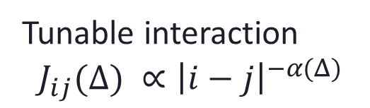
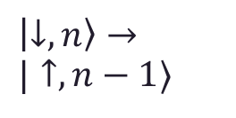
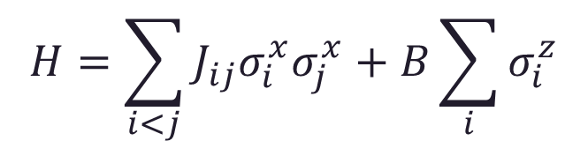
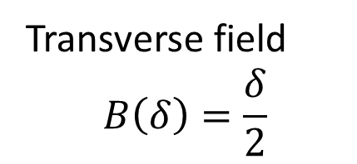
Trapped ion quantum simulators
Transverse field
$$B\left(δ\right)=\frac{δ}{2}$$
Transverse field Ising Hamiltonian
Tunable interaction
$$J_{ij}(Δ) ∝{\left|i−j\right|}^{−α(Δ)}$$
$$H=\sum_{i<j}{J_{ij}σ_{i}^{x}σ_{j}^{x}}+B\sum_{i}{σ_{i}^{z}}$$
Red sidebands
$$ν_{o}$$
Blue sidebands
Δ
Δ
δ
δ
$\left|↓,n\right\rangle →$
$|↑,n−1⟩$
$\left|↓,n\right\rangle →$
$|↑,n⟩$
$\left|↓,n\right\rangle →$
$|↑,n+1⟩$
Tone 1
Tone 2

Slide 7
Why 2D?
Model of interest
More ions:
Scalability of linear chains faces problems such as
  high axial heating rates
  single-ion addressing
Possibility to (natively) investigate 2D spin models
Linear chain of spins
2D spin lattice

Slide 8

The qubit of choice
40Ca⁺
Qubit is defined as two levels of 4S_{1/2} Zeeman splitting
Qubits are all driven simultaneously via Raman interaction
Individual qubit state is controlled with an addressed beam driving quadrupole transition
Readout state shelving is also done on quadrupole transition
4P_{1/2}
3D_{5/2}
396 nm
Raman transition
729 nm
Addressing
Readout shelving
4S_{1/2}
Ground state qubit
$$ν_{0}=11.6MHz$$
Coherence time ~1s in a spin-echo experiment (1/e)

Slide 9
Basic set of operations
Ion-resolved single qubit rotations and shelving
Global single qubit rotations and spin model interactions
Global shelving for state readout

Slide 10
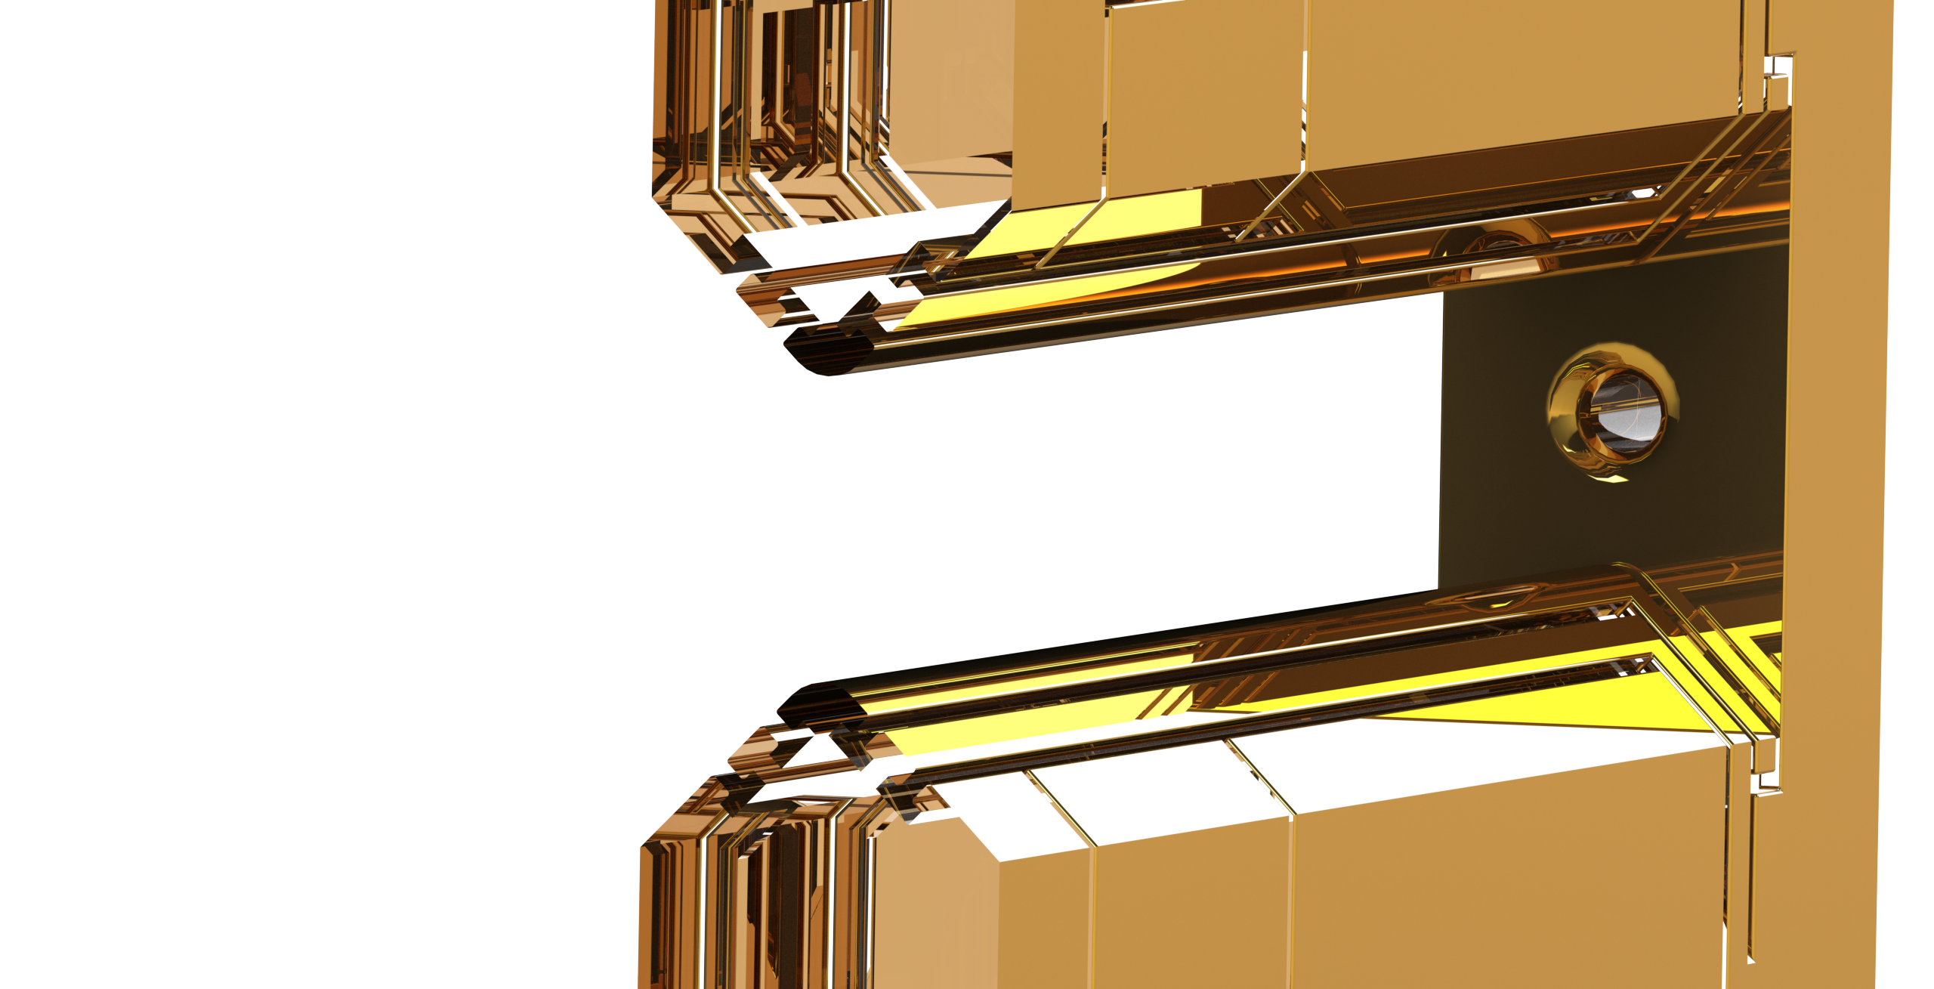
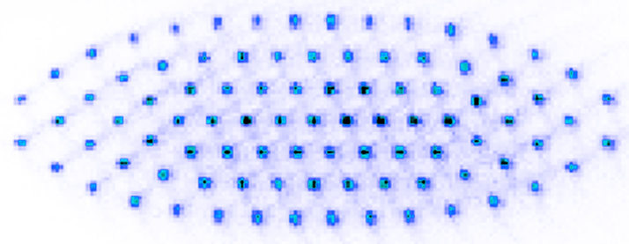

Trapping 2D ion crystals
Stationary crystals of up to
105 ions
Heating Rate of Transverse COM mode 0.5 ph/s/ion
Motional ground state cooling of all transverse modes using EIT technique
Crystal plane
0.8 mm
700 kHz
350 kHz
2.2 MHz
Technical paper on PRX

Slide 11
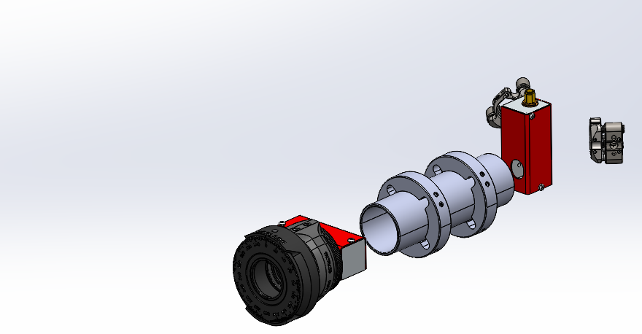
Single ion control
Addressing setup – two crossed AODs
Steering of a single beam anywhere on the crystal plane
A few us

Slide 12
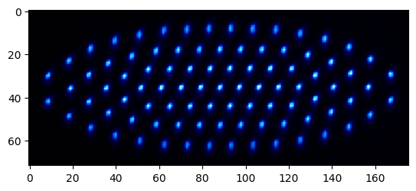
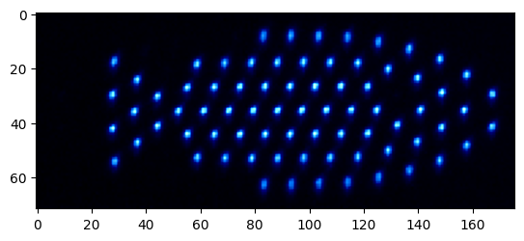
Single ion control
This way we can convert an ion crystal into a…
Fish!
But why?

Slide 13
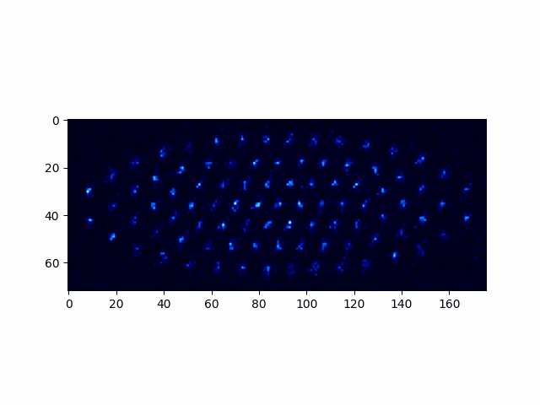
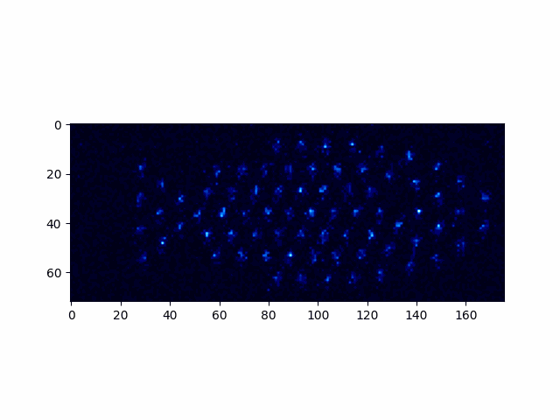
Single ion control
Single shot fish is also a fish
~70% Fish state fidelity
Which is ~98% fidelity per addressed pulse
Expected to get better with new 729nm laser

Slide 14
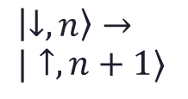
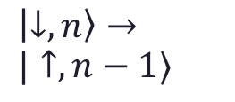
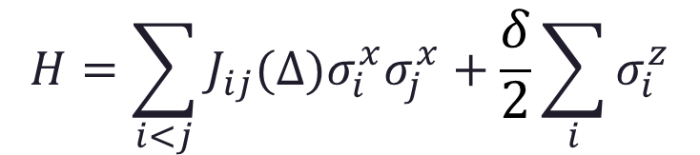

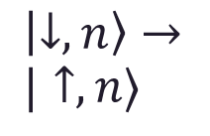
Spin-spin interaction
Raman π
4P_{1/2}
Raman σ
$$H=\sum_{i<j}{J_{ij}(Δ)σ_{i}^{x}σ_{j}^{x}}+\frac{δ}{2}\sum_{i}{σ_{i}^{z}}$$
396 nm
Raman transition
$$ν_{o}$$
4S_{1/2}
Red sidebands
Blue sidebands
Δ
Δ
δ
δ
$\left|↓,n\right\rangle →$
$|↑,n−1⟩$
$\left|↓,n\right\rangle →$
$|↑,n⟩$
$\left|↓,n\right\rangle →$
$|↑,n+1⟩$
Tone 1
Tone 2

Slide 15
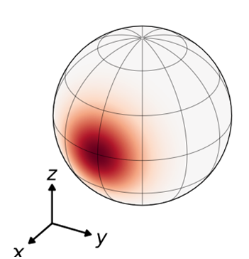
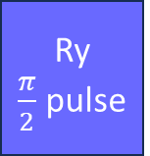
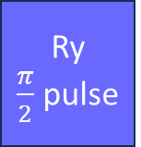


Spin squeezing
$$σ^{2}=N$$
Sensing state preparation
Phase readout
Ry
$\frac{π}{2}$ pulse
Phase accumulation
Ry
$\frac{π}{2}$ pulse
$$t$$
Wineland et al.,
Phys. Rev. A 46, 6797 (1992)
Franke, J. et al. Nature (2023). https://doi.org/10.1038/s41586-023-06472-z

Slide 16
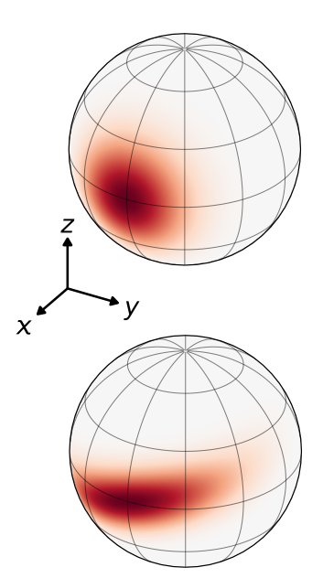
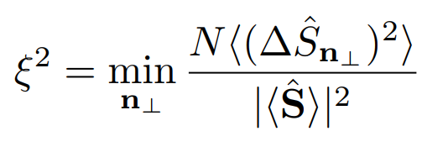
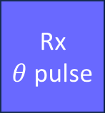


Spin squeezing
Wineland squeezing parameter to quantify metrological gain
Total magnetization on a Bloch sphere
for coherent spin state (CSS)
and squeezed spin state (SSS)
Simple binomial distribution for uncorrelated particles (CSS)
One of two orthogonal variances is suppressed below SQL
$$σ^{2}=N$$
Sensing state preparation sequence
$$σ^{2}<N$$
Ry
$\frac{π}{2}$ pulse
Spin-spin interaction
Rx
$θ$ pulse
$$t$$
Wineland et al.,
Phys. Rev. A 46, 6797 (1992)
Franke, J. et al. Nature (2023). https://doi.org/10.1038/s41586-023-06472-z

Slide 17
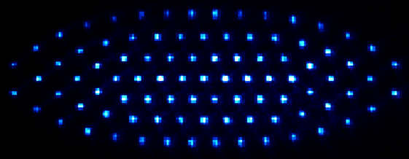
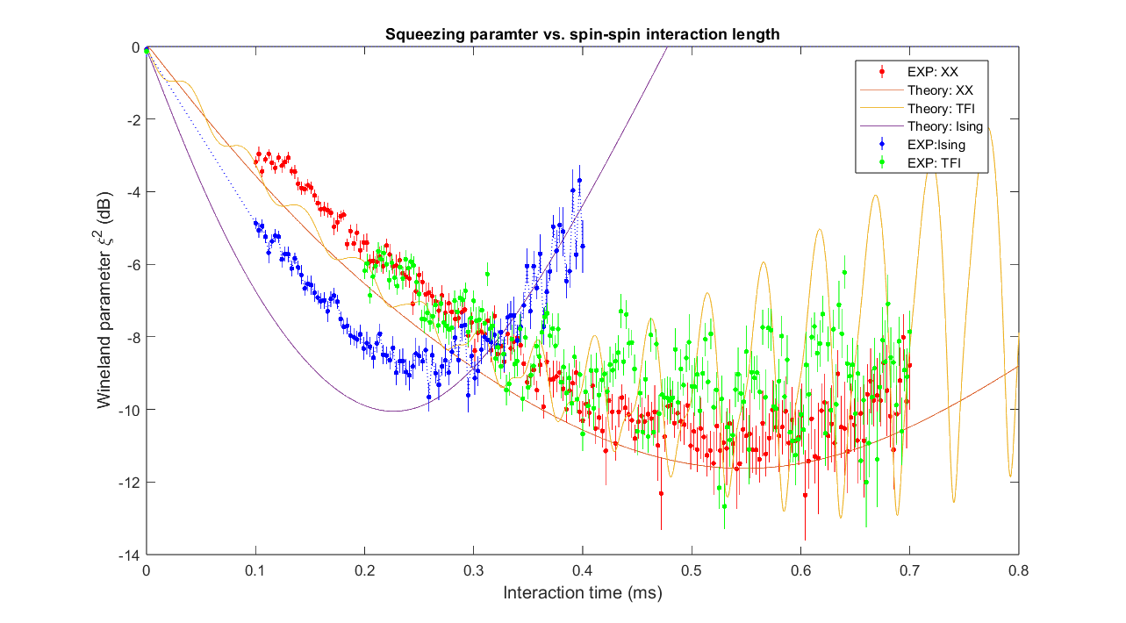
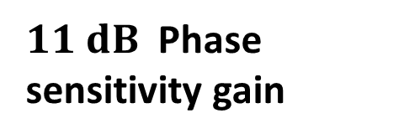
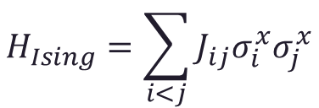
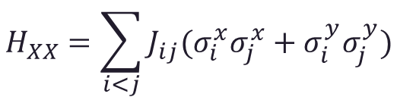
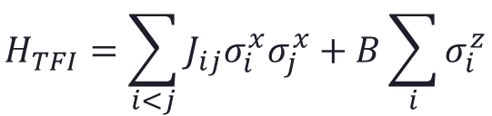
Spin squeezing
$$H_{Ising}=\sum_{i<j}{J_{ij}σ_{i}^{x}σ_{j}^{x}}$$
$$H_{TFI}=\sum_{i<j}{J_{ij}σ_{i}^{x}σ_{j}^{x}}+B\sum_{i}{σ_{i}^{z}}$$
$$H_{XX}=\sum_{i<j}{J_{ij}{(σ}_{i}^{x}σ_{j}^{x}+σ_{i}^{y}σ_{j}^{y})}$$
$11 dB$ Phase sensitivity gain

Slide 18
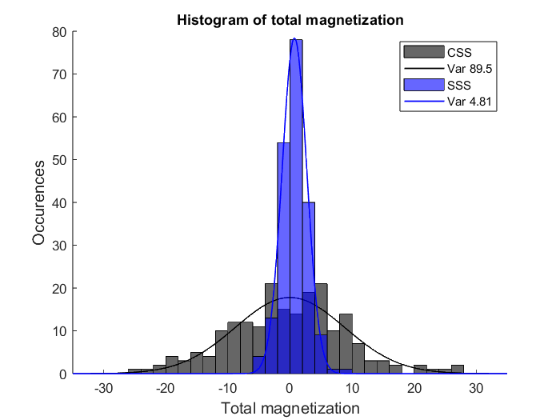
Spin squeezing
Variance ~18 times lower than SQL
$$H_{Ising}=\sum_{i<j}{J_{ij}σ_{i}^{x}σ_{j}^{x}}$$
$$H_{TFI}=\sum_{i<j}{J_{ij}σ_{i}^{x}σ_{j}^{x}}+B\sum_{i}{σ_{i}^{z}}$$
$$H_{XX}=\sum_{i<j}{J_{ij}{(σ}_{i}^{x}σ_{j}^{x}+σ_{i}^{y}σ_{j}^{y})}$$
$11 dB$ Phase sensitivity gain

Slide 19
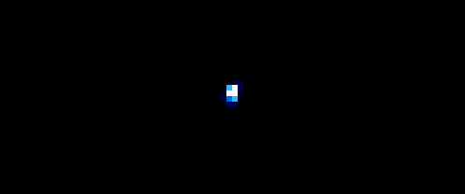
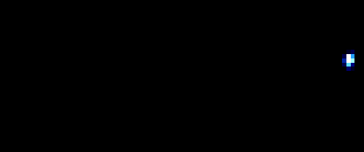
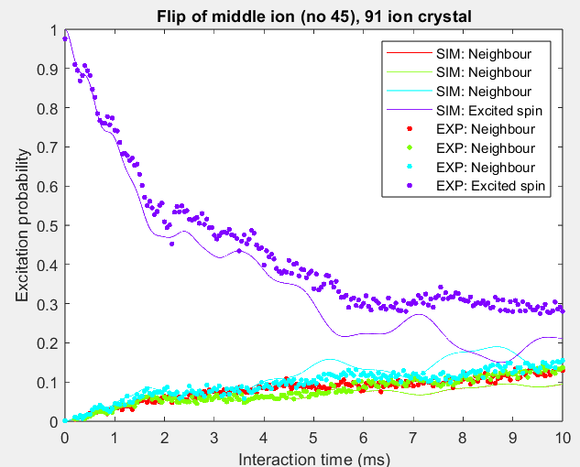
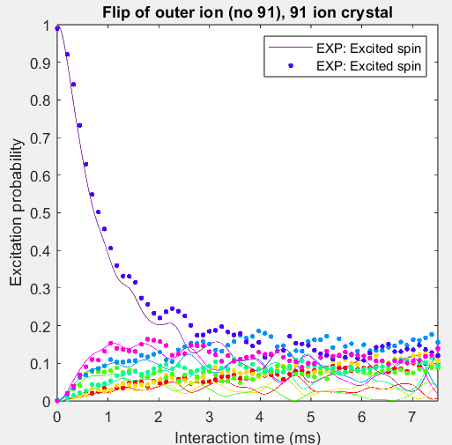
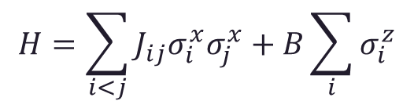
Excitation spread
Average excitation for 0-10ms interaction time
Average excitation for 0-7.5ms interaction time
Model: Transverse Field Ising
$$H=\sum_{i<j}{J_{ij}σ_{i}^{x}σ_{j}^{x}}+B\sum_{i}{σ_{i}^{z}}$$
Excited middle spin
Excited outer spin
Already different from linear chains!

Slide 20

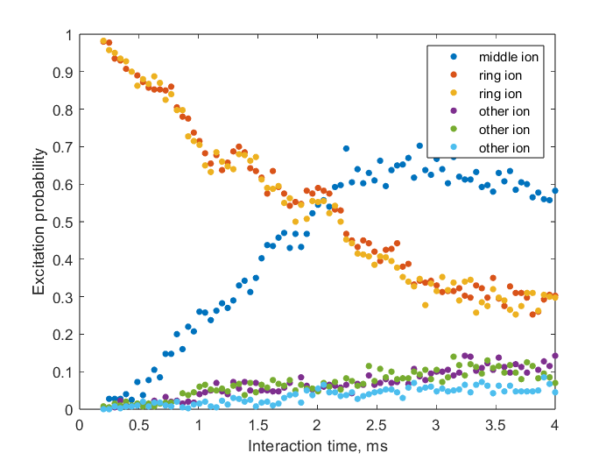
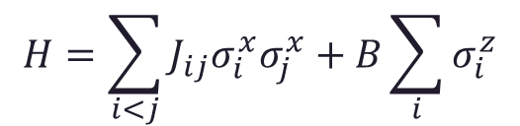
Bonus data
Initial state – Excited ring of ions
$$H=\sum_{i<j}{J_{ij}σ_{i}^{x}σ_{j}^{x}}+B\sum_{i}{σ_{i}^{z}}$$

Slide 21
Outlook
What do we have
Trapping ~100 ions in stationary 2D ion crystals
Cooling all transverse motional modes to ground state
Implementing addressed qubit state control
Realization of Ising, Transverse Field Ising and XX spin-spin interaction models in 91 ions crystal
What is next
Other interaction models (e.g. XY model via Trotterization)
More complex sequences for variational optimization
Explore 2D spin models, different phases of matter, large scale entanglement

Slide 22




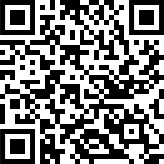
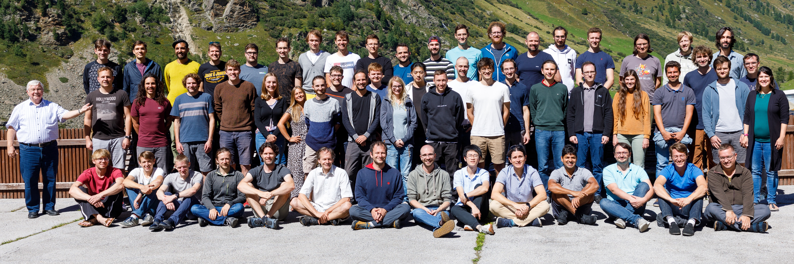
Quantum Optics and Spectroscopy Group

Slide 23
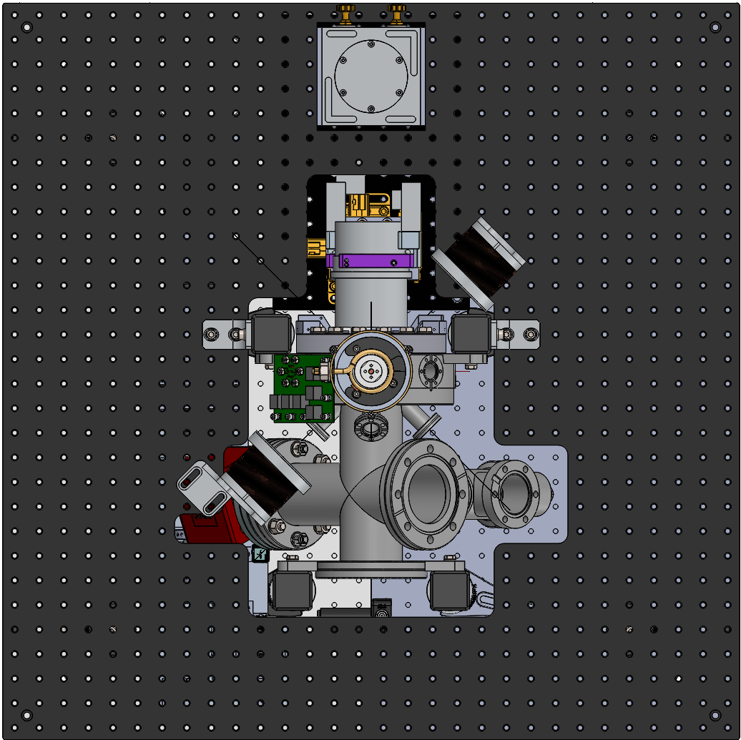
Basic set of operations
Ion-resolved single qubit rotations and shelving
Global single qubit rotations and spin model interactions
Global shelving for state readout
Raman σ
Single ion addressing and readout
B₀
Ions’ plane
Quantization
axis
Raman π
Global Shelving

Slide 24
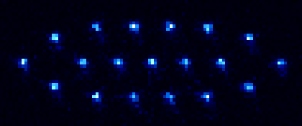
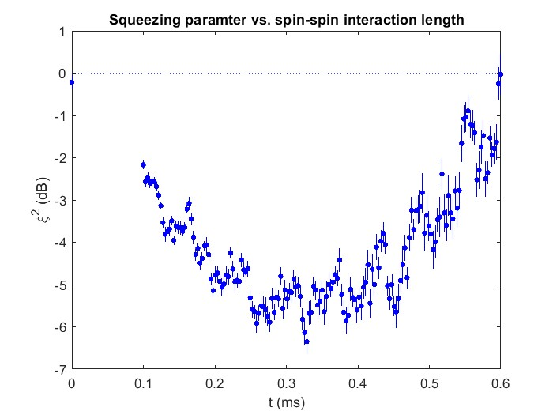
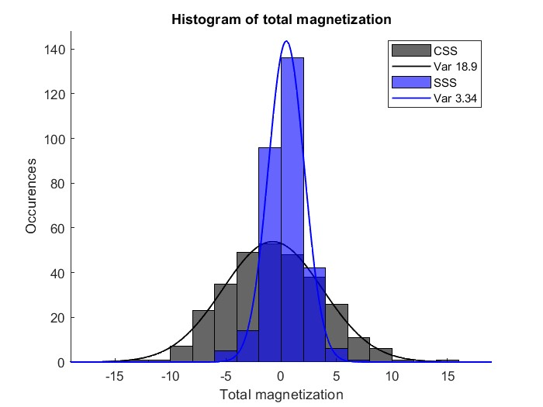
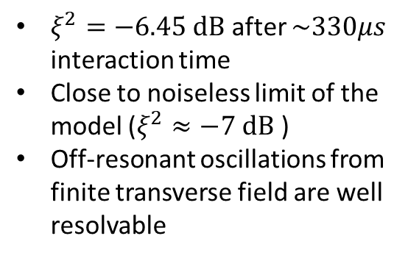
Spin squeezing
19 ions crystal
Variance >5 times lower than SQL
$ξ^{2}=−6.45 dB$ after $\sim 330μs$ interaction time
Close to noiseless limit of the model ($ξ^{2}≈−7 dB$ )
Off-resonant oscillations from finite transverse field are well resolvable

Slide 25
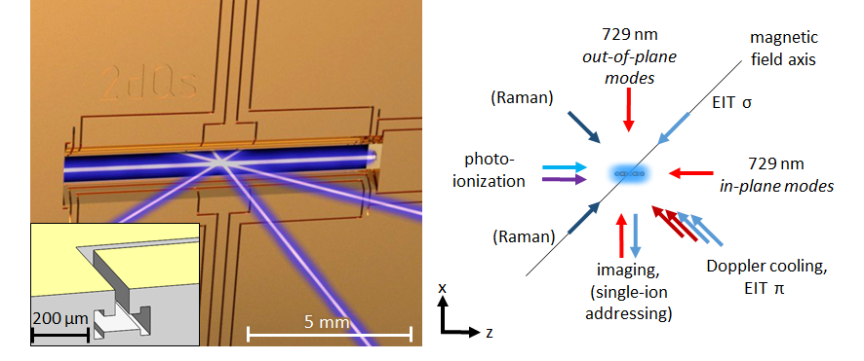

Cooling an controlling 2D crystals
Beam geometry
Most of the beams are arranged in the micromotion-free plane
Similar cooling and recrystallization properties as in linear chains!
Kiesenhofer et al., PRX Quantum 4, 020317 (2023)

Slide 26

Analog quantum simulation with trapped ions
Linear chain analog quantum simulator with up to 50 spins @ IQOQI Innsbruck
Large-Scale Entanglement, arXiv:2306.00057, accepted in Nature
Scalable spin squeezing, arXiv:2303.10688, accepted in Nature
Observation of Magnon Bound States, Phys. Rev. X 13, 031017
Thermalisation with noncommuting charges, PRX Quantum 4, 020318
Observing emergent hydrodynamics, Science 376, 720-724, (2022)
Quantum information scrambling, Phys. Rev. Lett. 124, 240505 (2020)
Cross-Platform Verification, Phys. Rev. Lett. 124, 10504 (2020)
Self-verifying variational quantum simulation, Nature 569, 355 (2019)
Measuring Rényi entanglement entropy, Science 364, 260 (2019)
Environment-assisted quantum transport, Phys. Rev. Lett. 122, 050501 (2019)
Quantum chemistry calculations, Phys. Rev. X, 8, 031022 (2018)
Entangled States in a 20-Qubit System, Phys. Rev. X, 8, 021012 (2018)
Efficient tomography, Nature Phys. 13, 1158 (2017)
Dynamical quantum phase transitions, Phys. Rev. Lett. 119, 080501 (2017)
Spectroscopy of interacting quasiparticles, Phys. Rev. Lett. 115, 100501 (2015)
Quasiparticle engineering and entanglement prop.n, Nature 511, 202 (2014)

Slide 27


Slide 28

Vacuum Setup
RF feedthrough and
helical resonator
Multipin DC feedthrough with filterboard
729
Photoionisation
Titanium frame
EIT
Magnetic field axis
Optical pumping
Raman 1
Ca target
Interposer
(wirebonding)
Ablation
729
Addressing
Imaging
Doppler cooling
EIT

Slide 29


Addressing characterization
FWHM (intensity) 1x1.6 um in this measurement
Probably better currently

Slide 30

Addressing characterization
Resonant cross-talk of addressing setup
  0.2% averaged over the crystal
  0.5% averaged over nearest neighbors
  2% with some selected next nn (in red)

Slide 31



EIT cooling
Strong σ-polarized 397nm beam with detuning $∆$ from the excited state creates dressed states $\left.|\tilde{g}\right\rangle$ and $\left.|\tilde{e}\right\rangle$
Light shift δ equals out-of-plane mode frequency
Weak probe beam creates EIT window with Fano-type feature
Absorption on the carrier and blue sideband is suppressed due to EIT, red sideband is driven
Fast multi-mode cooling technique
Asymmetric absorption profile → driving red sidebands
Detuning Δ (typ. ~100 MHz)
Strong dressing beam (σ) +
weak „probe“ beam (π)
4P_{1/2}
397 nm
σ
π
4S_{1/2}
m=+1/2
m=-1/2
Original paper:
Morigi, G., Eschner, J., & Keitel, C. H. (2000). Ground state laser cooling using electromagnetically induced transparency. Physical review letters, 85(21), 4458.
PhD thesis, Regina Lechner

Slide 32
EIT ground-state cooling of all transverse modes
Red sideband spectra:
N = 8
N = 105
Transverse mode spectrum after Doppler cooling
Absence of red-sideband absorption after EIT cooling!

Slide 33


Driving ground state transition
Raman manipulation with motion-sensitive beams
Coil drive VS Raman drive coherence
Carrier oscillations (one ion out of 19)
Time (μs)
Doppler-cooled
EIT-cooled
Notes:
carrier raman: one ion out of a 91-ion crystal, 93%: comparison of extremal values

Slide 34


Qubit implementation and coherent operations
Raman transitions:
Carrier Rabi frequencies up to 270kHz
High-fidelity global rotations using composite pulses and ground-state cooling
Larger k-vector enables faster spin-spin interactions!
The coherence time does not depend on the spectral properties of the laser
Performance limited by spontaneous scattering
91 ions
Std Pi pulse Composite Pi pulse

Slide 35



Crystal configurations analysis
1
2
3
4
Image series
~ 5000 images
Projection onto
„eigenpictures“
Cluster algorithm
N Eigenpictures
5000 images
N coefficients
Projection coefficient
matrix C_ij
time
…
Principal component analysis (PCA) → SVD of covariance matrix
Projection of individual images onto eigenpictures
DBSCAN algorithm
→ clusters of coefficients

Slide 36



Trap optimization
Occurence of main configuration in %
%
Variation of RF voltage
> 99 % in main configuration!

Slide 37







Configurations postselection
State readout
Crystal configuration readout (all-bright)
Possible configurations
Cooling
Prepare state
Manipulation
a₁
a₂
a₃
State picture
Crystal picture
a₄
$$a_{1}>a_{i}?$$
Keep
Redo
a₅

Slide 38












Setup: Chamber side
$$σ^{+}$$
Raman 2
Raman 3
$$σ^{−}$$
Raman 2
Directional characteristics of dipole emission/absorption
Raman 1+2 differential $\vec{k}$
B₀
$$Δm=+1$$
Ions’ plane
$$Δm=−1$$
Quantization
axis
$$Δm=0$$
Raman 1
Raman 1, 3
$$π$$

Slide 39











Variational optimization
Ry
$\frac{π}{2}$ pulse
Interaction + rotation layer $τ,θ$
Example: one-layer variational optimization
Reproduces usual spin squeezing experiment, but faster
$$t$$
Bichromatic pulse $τ$
Rx
$θ$ pulse
Next step: more squeezing layers
Ry
$$\frac{π}{2}$$
$$τ,θ$$
$$τ,θ$$
$$τ,θ$$
$$t$$

Slide 40














Raman effect
Qubit frame based on GPS clock
Less strict requirements for the laser
Spontaneous scattering from Raman transition
Why Raman
Use of ground state qubit
Unlimited excited state lifetime
No need for ultra narrow linewidth laser
Unlimited coherence of reference frame
Stronger coupling to the motional modes
$396nm$ Raman transition has $3.68⋅\cos{θ}$ larger k-vector compared to $729nm$ transition
Stronger coupling to motional modes
Stimulated
Raman Scattering
Raman Scattering
$$ω_{1},{\vec{k}}_{1}$$
$$ω_{2},{\vec{k}}_{2}$$
$$ℏ(ω+ω_{0})$$
$$\vec{k}={\vec{k}}_{2}−{\vec{k}}_{1}$$
$$ℏω$$
$$ℏω$$
$$2×ℏ(ω+ω_{0})$$
$$ℏ(ω+ω_{0})$$
$$ω=ω_{2}−ω_{1}$$
$$\left|\vec{k}\right|=2\cos{θ}⋅\frac{2π}{λ}$$
$$ℏω_{0}$$
$$ℏω_{0}$$
Unlimited excited state lifetime
Higher magnetic noise sensitivity

Slide 41








Raman effect
Stimulated Scattering
Stokes
Anti-Stokes
$$ℏ(ω−ω_{0})$$
$$ℏ(ω+ω_{0})$$
$$ℏ(ω+ω_{0})$$
$$ℏω$$
$$ℏω$$
$$ℏω$$
$$2×ℏ(ω+ω_{0})$$
$$ℏω_{0}$$

Slide 42





Important equations
Lower
$$Δ$$
Bigger
Raman Rabi frequency:
$Ω_{R}=\frac{Ω_{1}Ω_{2}}{2Δ}$
Off-resonant scattering rate:
$R_{scatt}=\frac{Γ\left(Ω_{1}^{2}+Ω_{2}^{2}\right)}{Δ^{2}}$
Drive/Scattering ratio:
$\frac{Ω_{R}}{R_{scatt}}\sim \frac{1}{2Δ}$
Better Drive / Scattering ratio
Easier power requirements
$$Δ$$
Detuning
$$Ω_{1}$$
Dipole transition Rabi frequencies
$$Ω_{2}$$

Slide 43





















Balancing AC Stark shifts
Both beams are linearly polarized to compensate AC Stark shifts
$$m_{j}=+\frac{1}{2}$$
$$m_{j}=+\frac{3}{2}$$
$$m_{j}=−\frac{3}{2}$$
$$m_{j}=−\frac{1}{2}$$
4P_{3/2}
$$393nm$$
$$δ_{π}^{m=−\frac{1}{2}}=δ_{π}^{m=+\frac{1}{2}}$$
$$m_{j}=−\frac{1}{2}$$
$$m_{j}=+\frac{1}{2}$$
4P_{1/2}
$$397nm$$
$$δ_{σ^{+}}^{m=−\frac{1}{2}}≠δ_{σ^{+}}^{m=+\frac{1}{2}}$$
$$σ^{−}$$
$$π$$
$$σ^{−}$$
$$σ^{+}$$
$$π$$
$$σ^{+}$$
$$δ_{σ^{+}+σ^{−}}^{m=−\frac{1}{2}}=δ_{σ^{+}+σ^{−}}^{m=+\frac{1}{2}}$$
$$δ_{σ^{−}}^{m=−\frac{1}{2}}≠δ_{σ^{−}}^{m=+\frac{1}{2}}$$
4S_{1/2}
$$ν_{0}=11.5MHz$$
$$m_{j}=−\frac{1}{2}$$
$$m_{j}=+\frac{1}{2}$$
Interaction
path
Unavoidable
shift
Compensation
shift

Slide 44








Other sources of frequency shifts
Off-resonant Raman paths
Imbalance between components of bichromatic interaction
4P_{3/2}
Resonant drive:
$\sim 40Hz$for $t_{π}≈9μs$
Not a problem
carrier
$$Ω_{R}$$
$$Ω_{B}$$
4P_{1/2}
MS interaction:
$\sim 400Hz$for $t_{int}\sim 500μs$
Might be a problem
Frequency
$\sim 100Hz$per 2% power imbalance
Can be both signs
$$−23 MHz$$
Solution: Imbalance bichro components to cope with off-resonant Raman paths
4S_{1/2}
$$ν_{0}=11.5MHz$$
$$+23 MHz$$

Slide 45



Setup: Table side
TOPTICA TA-SHG pro
Frequency-doubled diode laser 1.5W@396nm
AOMs in single pass
Crystalline Quartz, High Power
To the trap$→$
Fiber couplers
Self-made, dust-tight

