Slide 1

Investigating interference with phononic bright and dark states in a trapped ion
Robin Thomm

Slide 2
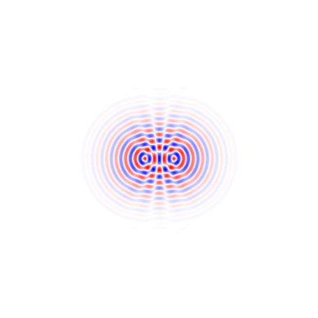
What makes stuff interfere?
Classical
$\left\langle n | \hat{E} | n\right\rangle =0$ but coupling is present
⟨𝑛│𝐸 ̂│𝑛⟩=0 but coupling is present
Variances and/or higher moments?
Two electric fields: $E=\left(1+e^{i δφ}\right)E_{0}$
Two electric fields: E=(1+𝑒^(𝑖 𝛿𝜑) ) 𝐸_0
→ relative phase
Quantum
→ Not so clear

Slide 3
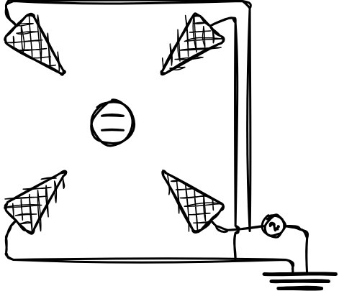
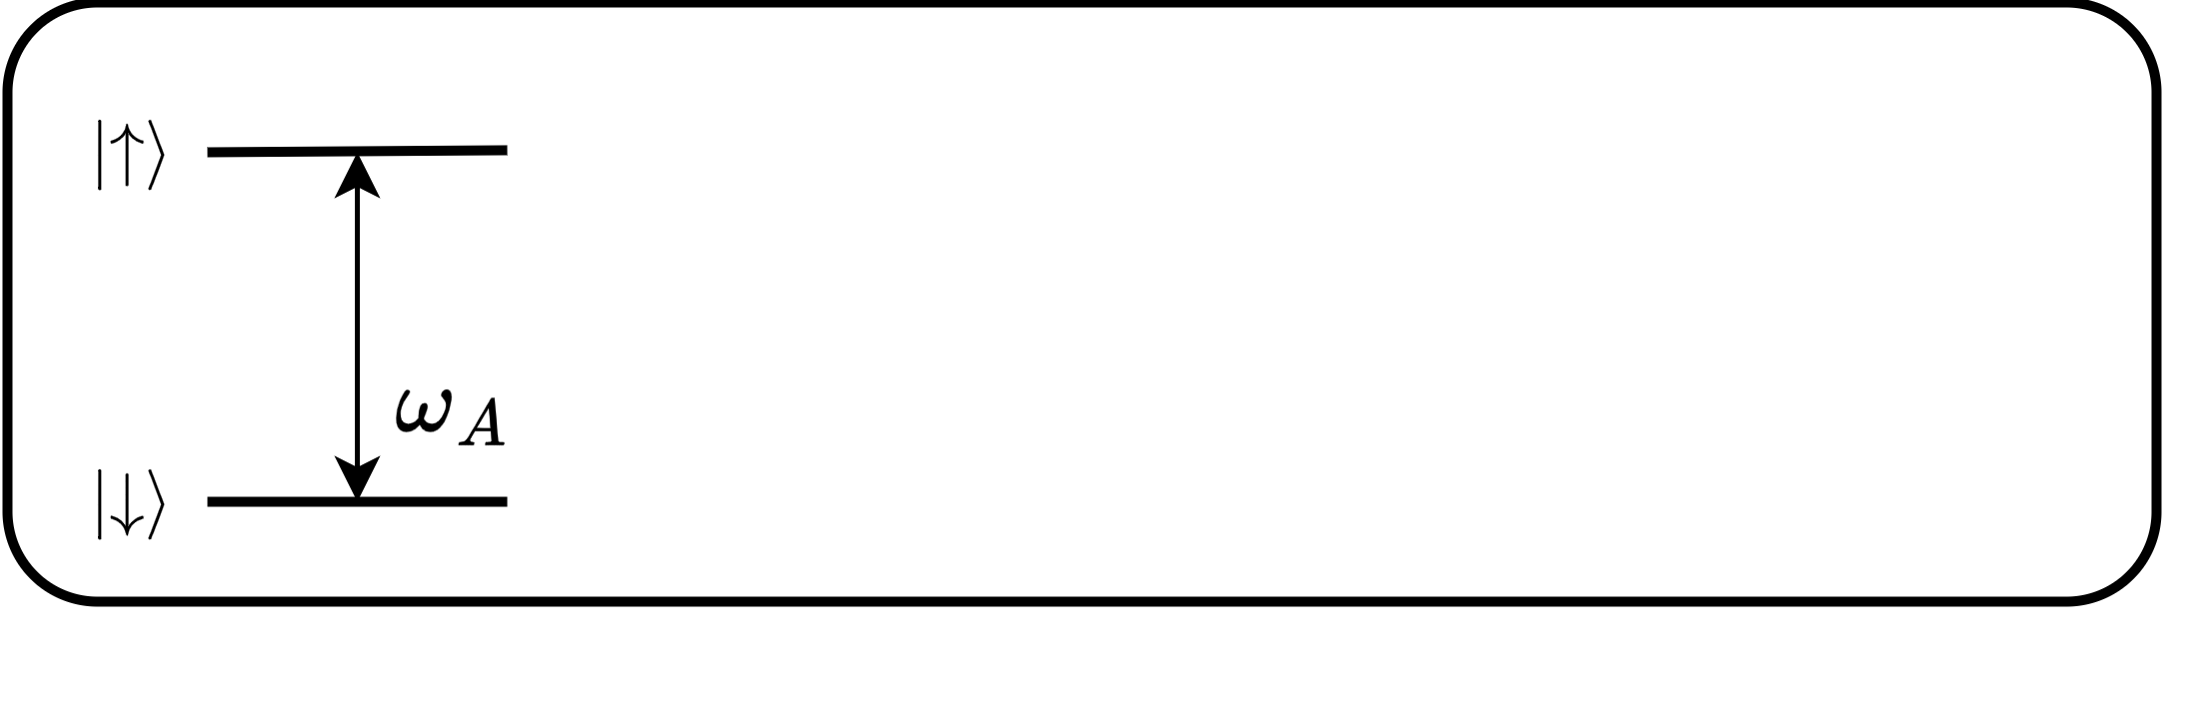

System

Slide 4

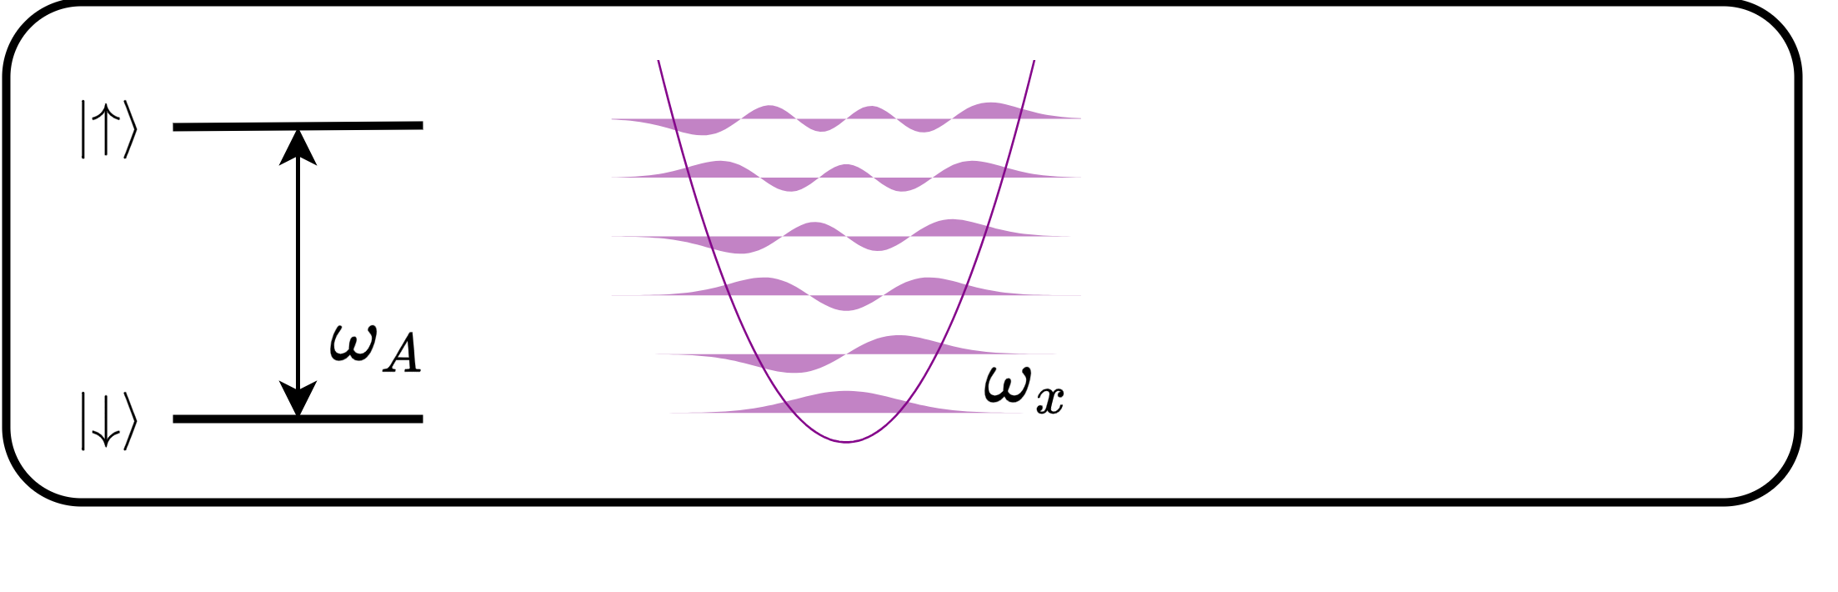
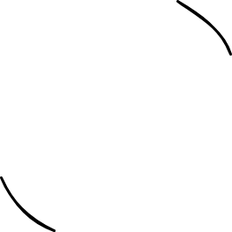

System

Slide 5

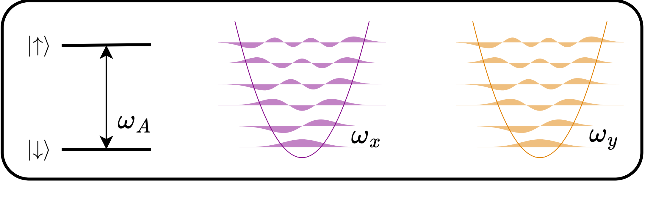
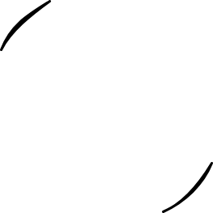

System

Slide 6

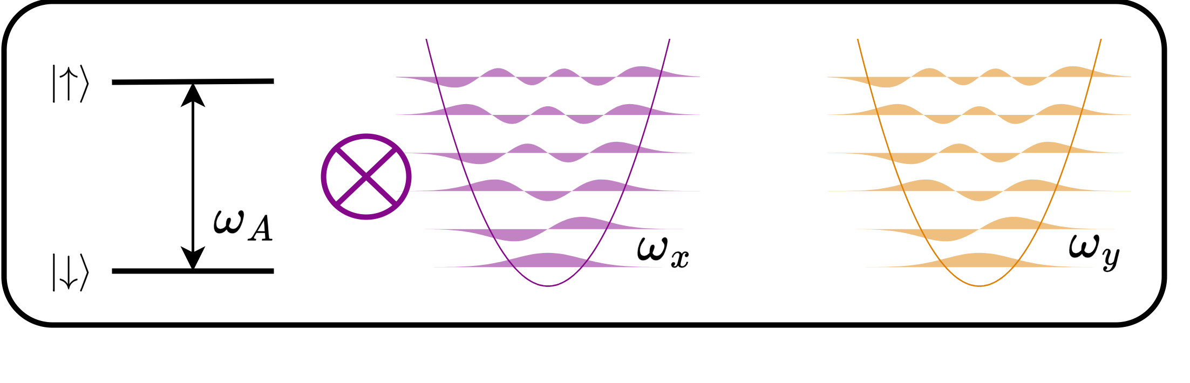
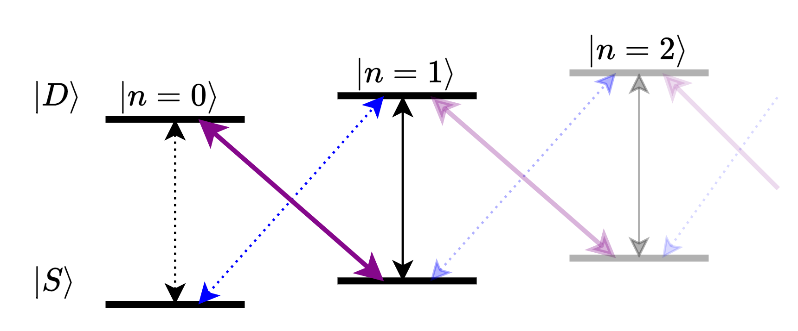
System

Slide 7

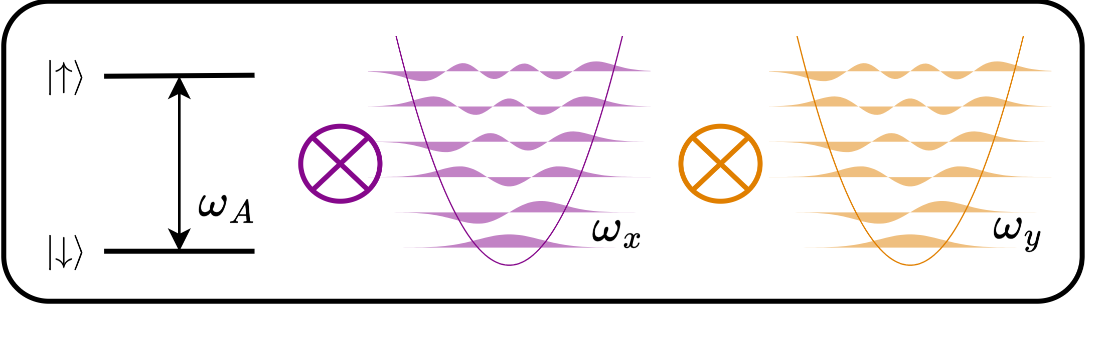
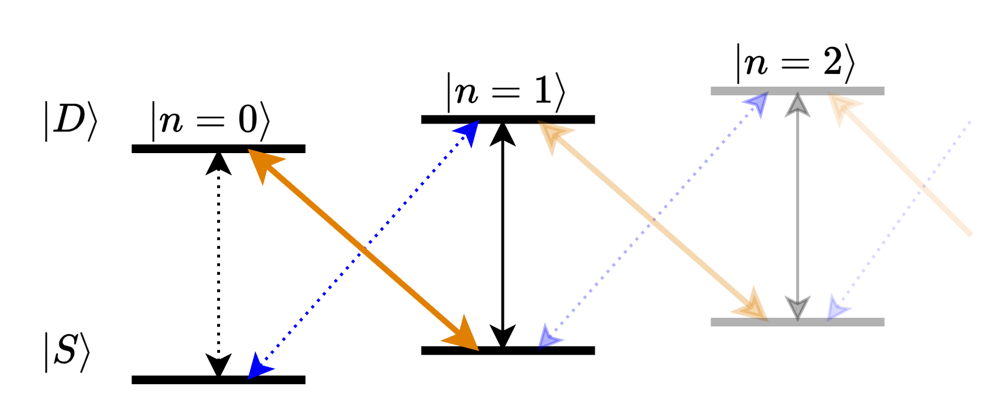
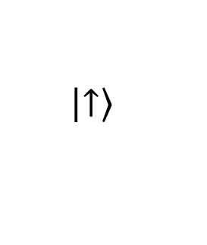
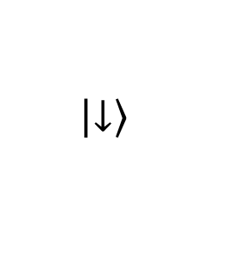
System
$$\left|\left.↑\right\rangle \right.$$
$$\left|\left.↓\right\rangle \right.$$

Slide 8
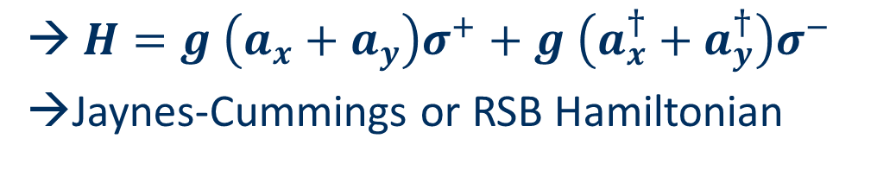
System
$H=g \left(a_{x}+a_{y}\right)σ^{+}+g \left(a_{x}^{†}+a_{y}^{†}\right)σ^{−}$
Jaynes-Cummings or RSB Hamiltonian

Slide 9
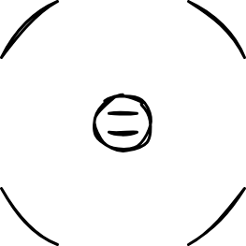

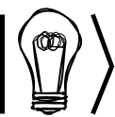







Theory
Bright
Dark
$H=g \left(a_{x}+a_{y}\right)σ^{+}+g \left(a_{x}^{†}+a_{y}^{†}\right)σ^{−}$
Reference
$\left.\left|1, 0\right.\right\rangle$
Time evolution
$H\left|\left.↓\right\rangle \right.\left.\left|n, 0\right.\right\rangle =g\sqrt{n}\left|\left.↑\right\rangle \right.\left.\left|n−1, 0\right.\right\rangle$
  → Rabi oscillations
Coherent state
  $$\left|\left.α, 0\right\rangle \right.= \sum{c_{n}\left.\left|n, 0\right.\right\rangle }$$
Constr. Interference
$\left.\left|ψ_{+}^{1}\right.\right\rangle = \frac{1}{\sqrt{2}} \left(\left|\left.1, 0\right\rangle \right.+ \left|\left.0, 1\right\rangle \right.\right)$
Time evolution
$H\left|\left.↓\right\rangle \right.\left.\left|ψ_{+}^{n}\right.\right\rangle =g\sqrt{2n}\left|\left.↑\right\rangle \right.\left.\left|ψ_{+}^{n−1}\right.\right\rangle$
  → $\sqrt{2}$ faster
Coherent state
  $\left.\left|ψ_{+}^{α}\right.\right\rangle =\left|\left.α, α\right\rangle \right.= \sum{c_{n}\left.\left|ψ_{+}^{n}\right.\right\rangle }$
Destr. Interference
$\left.\left|ψ_{−}^{1}\right.\right\rangle = \frac{1}{\sqrt{2}} \left(\left|\left.1, 0\right\rangle \right.− \left|\left.0, 1\right\rangle \right.\right)$
Time evolution
$H\left|\left.↓\right\rangle \right.\left.\left|ψ_{−}^{n}\right.\right\rangle =0$
  → No population transfer
Coherent state
  $\left.\left|ψ_{−}^{α}\right.\right\rangle =\left|\left.α, −α\right\rangle \right.= \sum{c_{n}\left.\left|ψ_{−}^{n}\right.\right\rangle }$
Villas-Boas, C. J. et al. Bright and dark states of light: The quantum origin of classical interference arxiv 2021

Slide 10
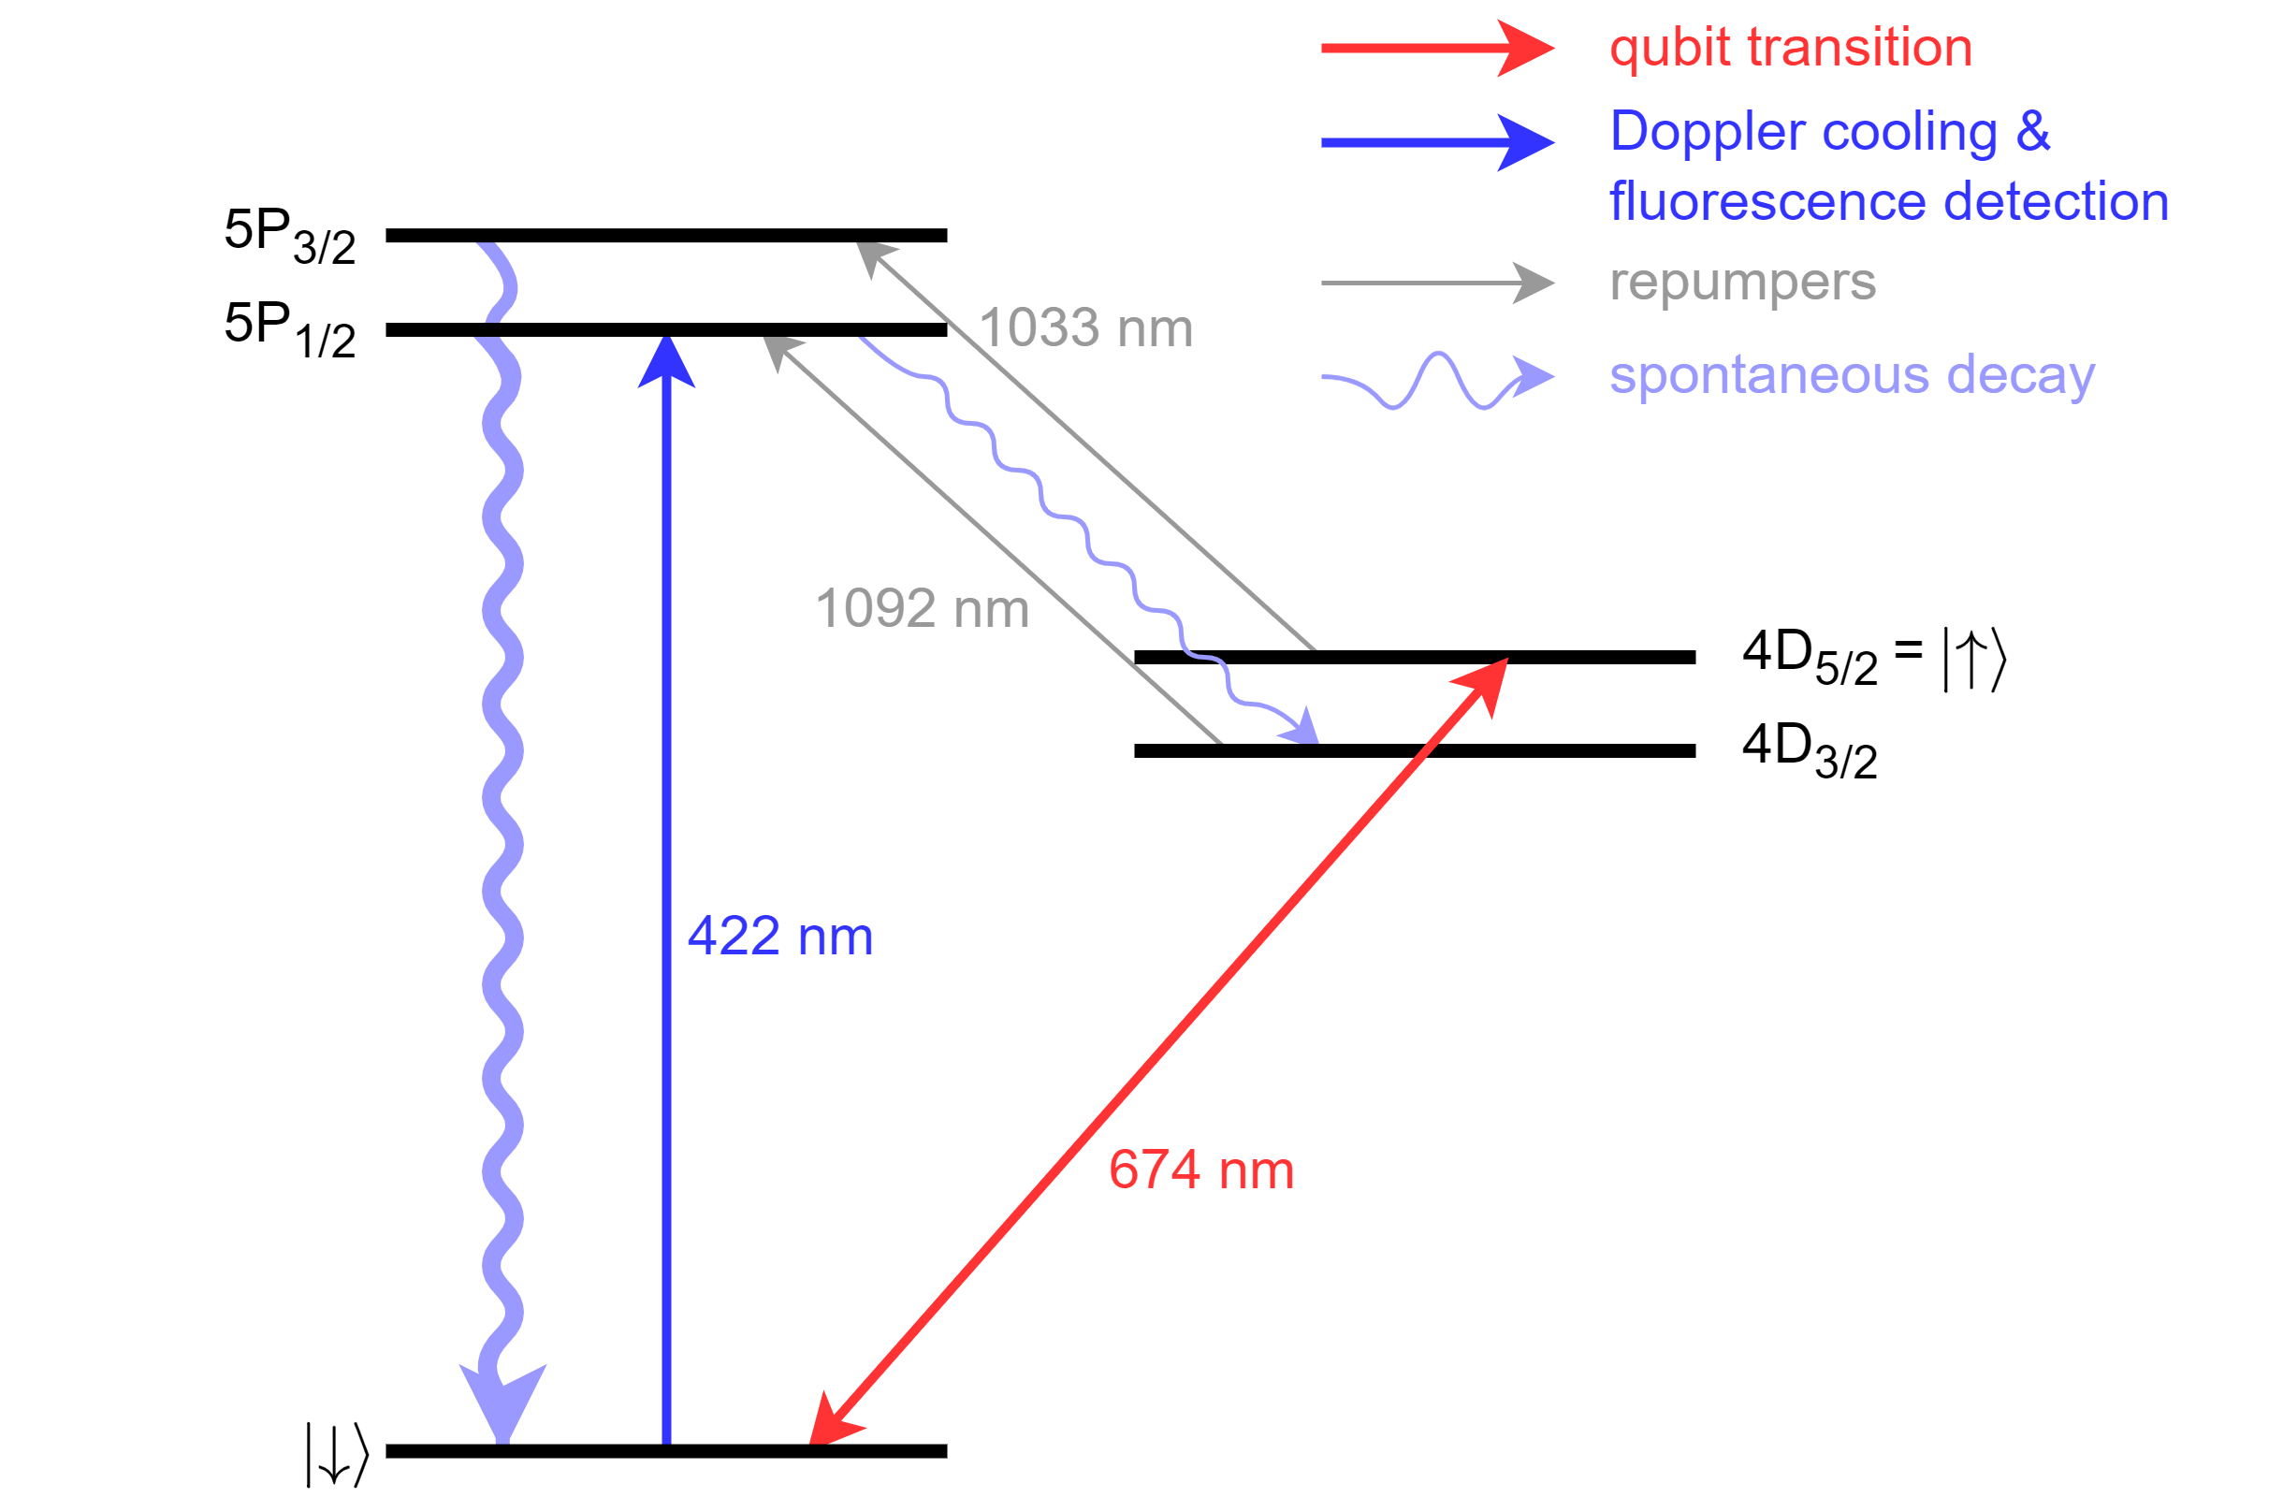
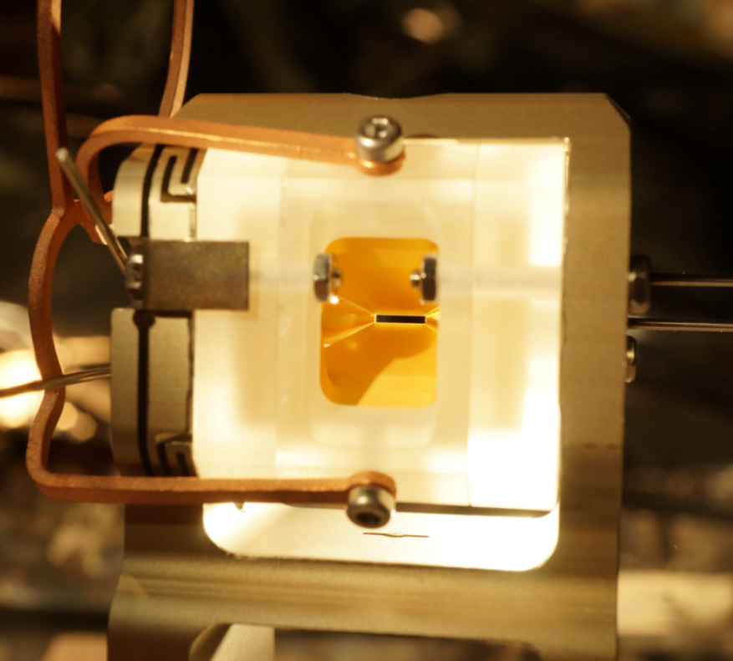
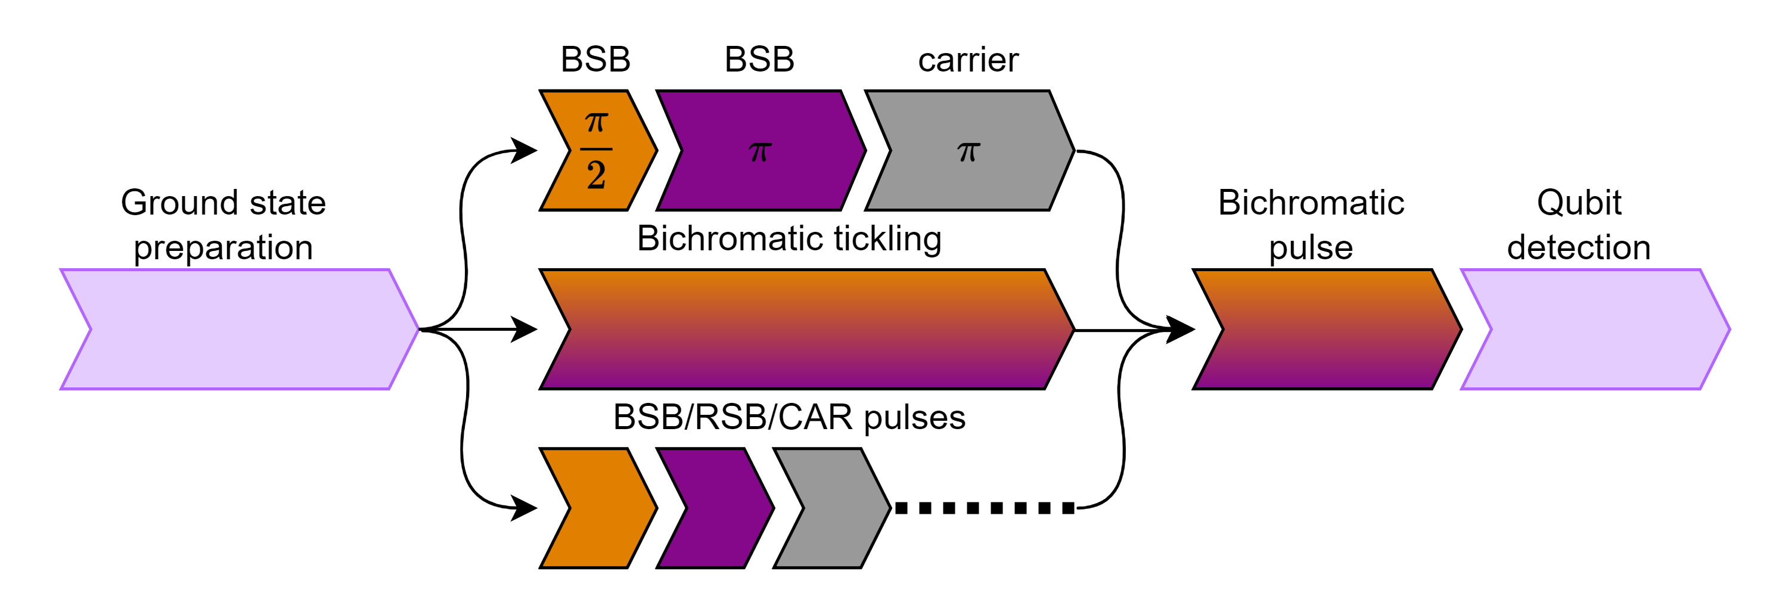

Experimental setup
The ion
A single ⁸⁸Sr⁺ ion
Qubit: $\left|\left.S\right\rangle \right.$ and $\left|\left.D\right\rangle \right.$, initially in $\left|\left.S\right\rangle \right.$
Qubit: |├ 𝑆⟩┤ and |├ 𝐷⟩┤, initially in |├ 𝑆⟩┤
The trap
Linear Paul trap
Use both radial modes
State preparation
Ground state preparation ($\overline{n}<0.1$)
Ground state preparation (𝑛 ̅<0.1)
Tickling or BSB & RSB pulses
Coupling
Driving both RSBs simultaneously
Bichromatic laser with 45° overlapp with both modes

Slide 11
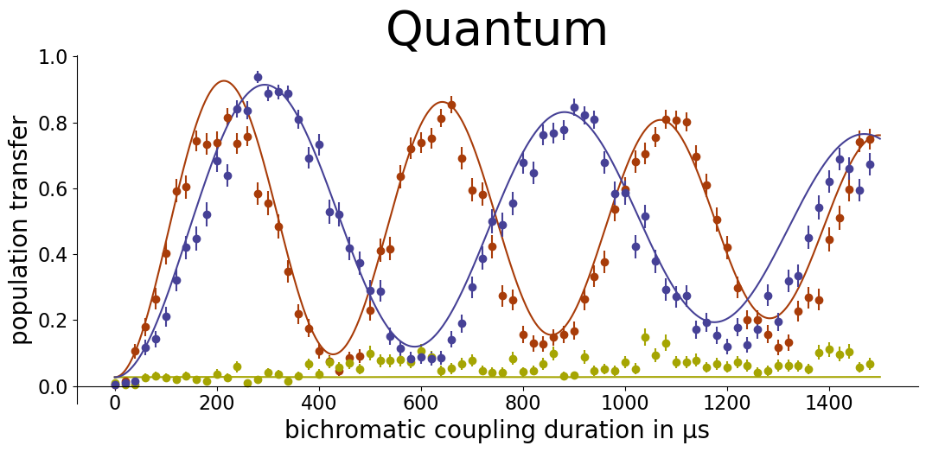
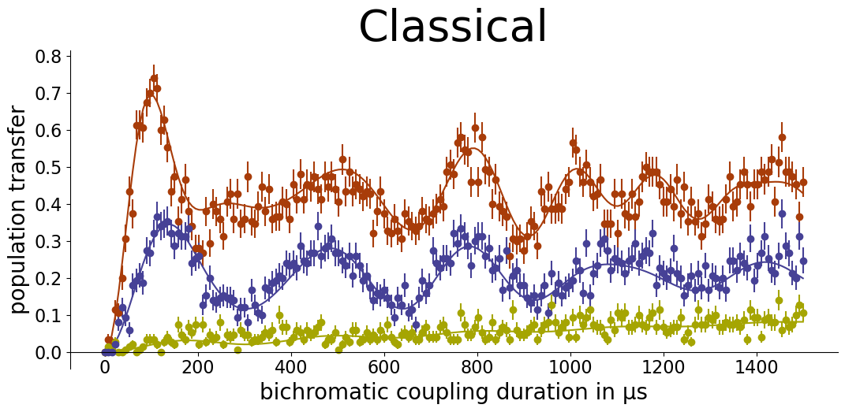
Results
Quantum
$$\frac{1}{\sqrt{2}} \left(\left|\left.1, 0\right\rangle \right.+ \left|\left.0, 1\right\rangle \right.\right)$$
𝟏/√𝟐 (├|├ 𝟏, 𝟎⟩┤+ ├|├ 𝟎, 𝟏⟩┤)
$$\frac{1}{\sqrt{2}} \left(\left|\left.1, 0\right\rangle \right. − \left|\left.0, 1\right\rangle \right.\right)$$
𝟏/√𝟐 (├|├ 𝟏, 𝟎⟩┤ − ├|├ 𝟎, 𝟏⟩┤)
$$\left|\left.1, 0\right\rangle \right.$$
|├ 𝟏, 𝟎⟩┤
$$\left|\left.α, α\right\rangle \right.$$
|├ 𝜶, 𝜶⟩┤
$$\left|\left.α, −α\right\rangle \right.$$
|├ 𝜶, −𝜶⟩┤
Classical
$$\left|\left.α, 0\right\rangle \right.$$
|├ 𝜶, 𝟎⟩┤

Slide 12
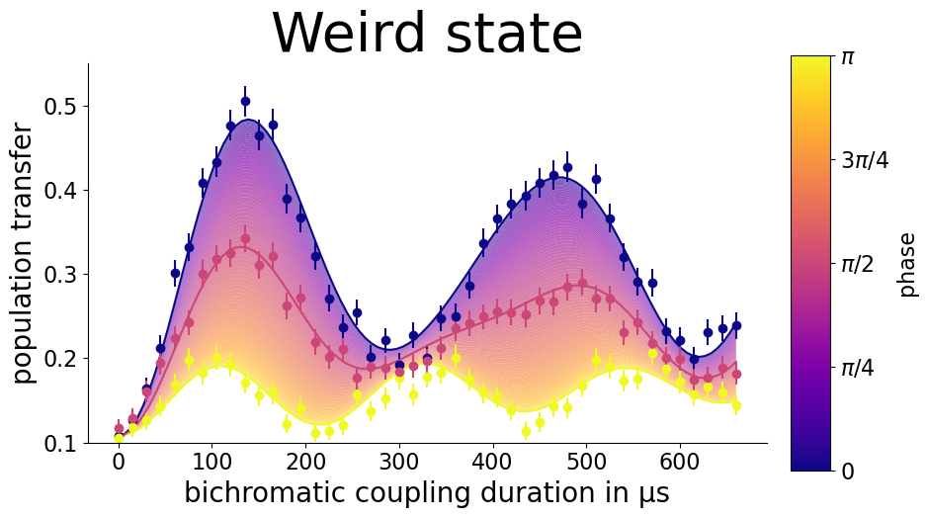
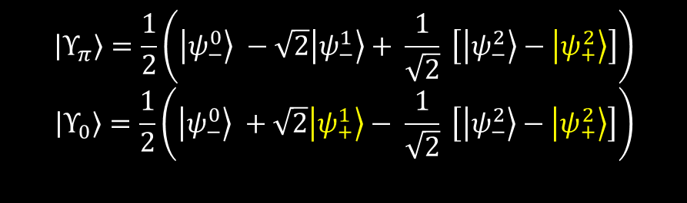
Product state
$\left|\left.Υ_{φ}\right\rangle \right.=\frac{1}{2}\left(\left|\left.0\right\rangle \right.+\left|\left.1\right\rangle \right.\right)\left(\left|\left.0\right\rangle \right.+e^{iφ}\left|\left.1\right\rangle \right.\right)$
|├ Υ_𝜑 ⟩┤=1/2 (├|├ 0⟩┤+├|├ 1⟩┤)(├|├ 0⟩┤+𝑒^𝑖𝜑 ├|├ 1⟩┤)
$\left|\left.Υ_{π}\right\rangle \right.$: $\left\langle \left.E\right\rangle \right.=0$ and ${\left\langle \left.∆E\right\rangle \right.}^{2}=2$
same as for the dark coherent state
|├ Υ_𝜋 ⟩┤: ⟨├ 𝐸⟩┤=0 and ⟨├ ∆𝐸⟩┤^2=2
same as for the dark coherent state
$$\left|\left.Υ_{π}\right\rangle \right.=\frac{1}{2}\left(\left.\left|ψ_{−}^{0}\right.\right\rangle −\sqrt{2}\left.\left|ψ_{−}^{1}\right.\right\rangle + \frac{1}{\sqrt{2}} \left[\left.\left|ψ_{−}^{2}\right.\right\rangle −\left.\left|ψ_{+}^{2}\right.\right\rangle \right]\right)$$
$$\left|\left.Υ_{0}\right\rangle \right.=\frac{1}{2}\left(\left.\left|ψ_{−}^{0}\right.\right\rangle +\sqrt{2}\left.\left|ψ_{+}^{1}\right.\right\rangle − \frac{1}{\sqrt{2}} \left[\left.\left|ψ_{−}^{2}\right.\right\rangle −\left.\left|ψ_{+}^{2}\right.\right\rangle \right]\right)$$

Slide 13
Conclusions
Observed constructive and destructive interference
Two mode basis:
  Intuitive description of the interference
What makes stuff interfere?
  Not just expectation values and variances

Slide 14
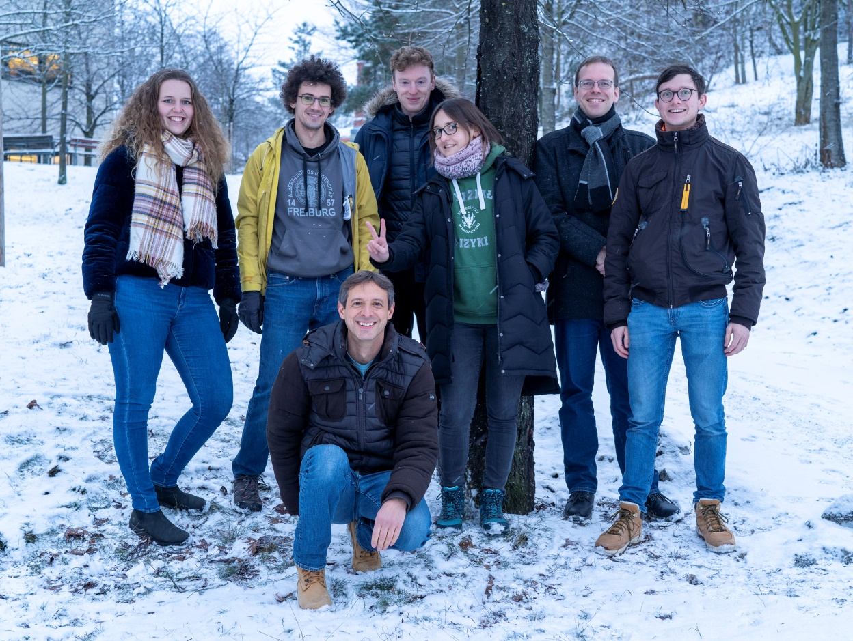








The Team
https://qtech.fysik.su.se
Experiment
Theory
Alan C. Santos
André Cidrim
Celso
Villas-Boas
Romain
Bachelard
Funding

Slide 15
THE END
Thank you

Slide 16
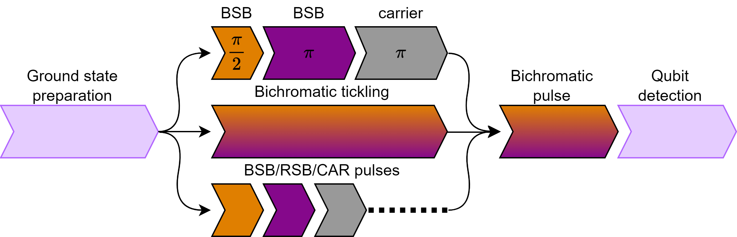
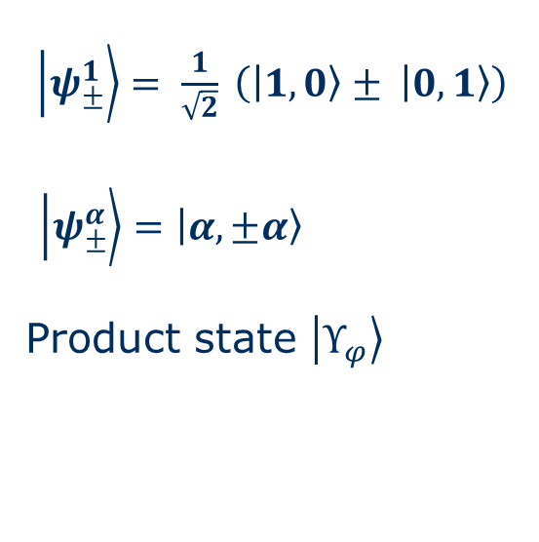
Pulse sequence
$\left.\left|ψ_{±}^{1}\right.\right\rangle = \frac{1}{\sqrt{2}} \left(\left|\left.1, 0\right\rangle \right.± \left|\left.0, 1\right\rangle \right.\right)$
$\left.\left|ψ_{±}^{α}\right.\right\rangle =\left|\left.α, ±α\right\rangle \right.$
Product state $\left|\left.Υ_{φ}\right\rangle \right.$

Slide 17
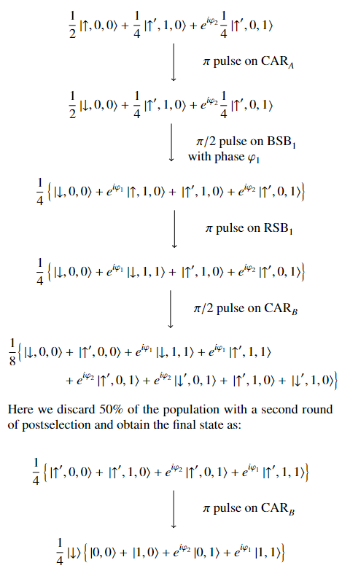
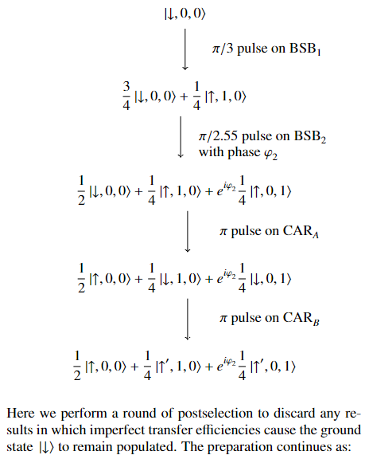
Creation of the weird state

Slide 18
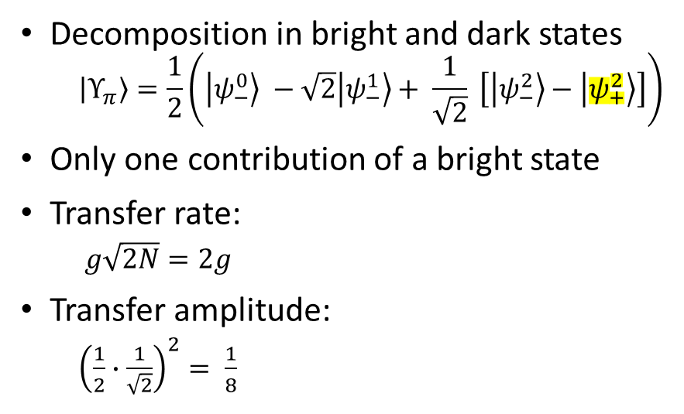
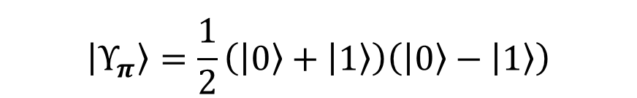
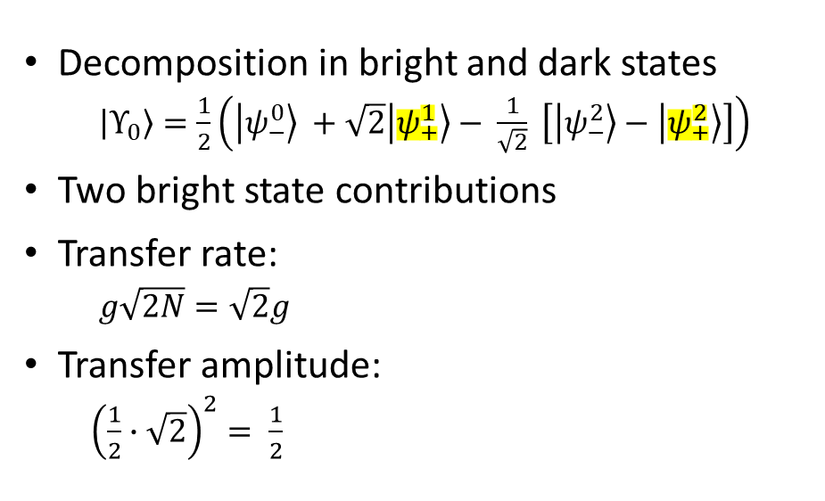
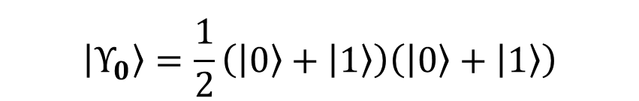
The product state
$$\left|\left.Υ_{π}\right\rangle \right.=\frac{1}{2}\left(\left|\left.0\right\rangle \right.+\left|\left.1\right\rangle \right.\right)\left(\left|\left.0\right\rangle \right.−\left|\left.1\right\rangle \right.\right)$$
$$\left|\left.Υ_{0}\right\rangle \right.=\frac{1}{2}\left(\left|\left.0\right\rangle \right.+\left|\left.1\right\rangle \right.\right)\left(\left|\left.0\right\rangle \right.+\left|\left.1\right\rangle \right.\right)$$
Decomposition in bright and dark states
  $$\left|\left.Υ_{π}\right\rangle \right.=\frac{1}{2}\left(\left.\left|ψ_{−}^{0}\right.\right\rangle −\sqrt{2}\left.\left|ψ_{−}^{1}\right.\right\rangle + \frac{1}{\sqrt{2}} \left[\left.\left|ψ_{−}^{2}\right.\right\rangle −\left.\left|ψ_{+}^{2}\right.\right\rangle \right]\right)$$
Only one contribution of a bright state
Transfer rate:
  $g\sqrt{2N}=2g$
Transfer amplitude:
  ${\left(\frac{1}{2}∙\frac{1}{\sqrt{2}}\right)}^{2}= \frac{1}{8}$
Decomposition in bright and dark states
  $\left|\left.Υ_{0}\right\rangle \right.=\frac{1}{2}\left(\left.\left|ψ_{−}^{0}\right.\right\rangle +\sqrt{2}\left.\left|ψ_{+}^{1}\right.\right\rangle − \frac{1}{\sqrt{2}} \left[\left.\left|ψ_{−}^{2}\right.\right\rangle −\left.\left|ψ_{+}^{2}\right.\right\rangle \right]\right)$
Two bright state contributions
Transfer rate:
  $g\sqrt{2N}=\sqrt{2}g$
Transfer amplitude:
  ${\left(\frac{1}{2}∙\sqrt{2}\right)}^{2}= \frac{1}{2}$

Slide 19

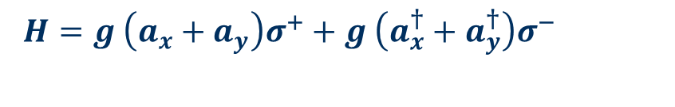
Theory
$H=g \left(a_{x}+a_{y}\right)σ^{+}+g \left(a_{x}^{†}+a_{y}^{†}\right)σ^{−}$
Two-mode basis
$$\left.\left|ψ_{n}^{N}\right.\right\rangle = \sum_{m=0}^{N}{C_{n}^{N} } \left|\left.m, N−m\right\rangle \right.$$
├ ├|𝜓_𝑛^𝑁 ┤⟩= ∑_(𝑚=0)^𝑁▒〖𝐶_𝑛^𝑁 〗 |├ 𝑚, 𝑁−𝑚⟩┤
Bright and dark states
$\left.\left|ψ_{±}^{N}\right.\right\rangle =\sqrt{\frac{N!}{2^{N}}} \sum_{m=0}^{N}{\frac{{(±1)}^{m}}{\sqrt{m!\left(N−m\right)!}} } \left|\left.m, N−m\right\rangle \right.$
├ ├|𝜓_±^𝑁 ┤⟩=√(𝑁!/2^𝑁 ) ∑_(𝑚=0)^𝑁▒〖〖(±1)〗^𝑚/√(𝑚!(𝑁−𝑚)!) 〗 |├ 𝑚, 𝑁−𝑚⟩┤
$$n=0, N$$
Villas-Boas, C. J. et al. Bright and dark states of light: The quantum origin of classical interference arxiv 2021

