Slide 1


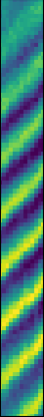
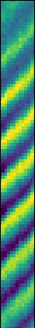
Single-ion dynamics in a phase-stable polarization gradient
Notes:
Share with you how we use trap-integrated photonics to probe single-ion dynamics in a phase-stable polarization gradient

Slide 2


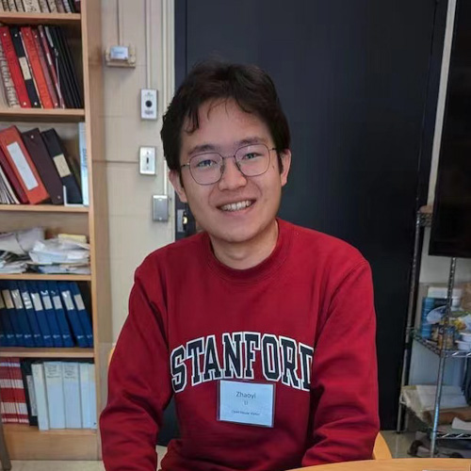





Team
MIT:
Photonics design and testing
Experiments with ions
MIT-Lincoln Laboratory:
Photonics design and testing
Ion trap fabrication
Key contributors:
FWK (photonics and experiment)
Sabrina Corsetti (photonics and experiment)
Ethan Clements (experiment and theory)
Zhaoyi Li (theory)
PIs: John Chiaverini, Isaac Chuang, Jelena Notaros
Funding:
Notes:
This work is a collaborative effort between MIT and MIT-LL
The design and testing of integrated photonics was conducted at both locations
The experiments with ions were done at MIT while traps were fabricated at LL
Among the key contributors, I planned the experiments, tested photonic devices and set up the ion experiments
Sabrina is a grad student at MIT and did it all, design and testing of photonics as well as ion experiments
Ethan is a postdoc and ran experiments with ions as well as developing the numerical theory
Zhaoyi is a grad student at MIT and set up an analytical theory calculation
John at LL
Ike at MIT
Jelena at MIT
Now to the meat of the matter

Slide 3
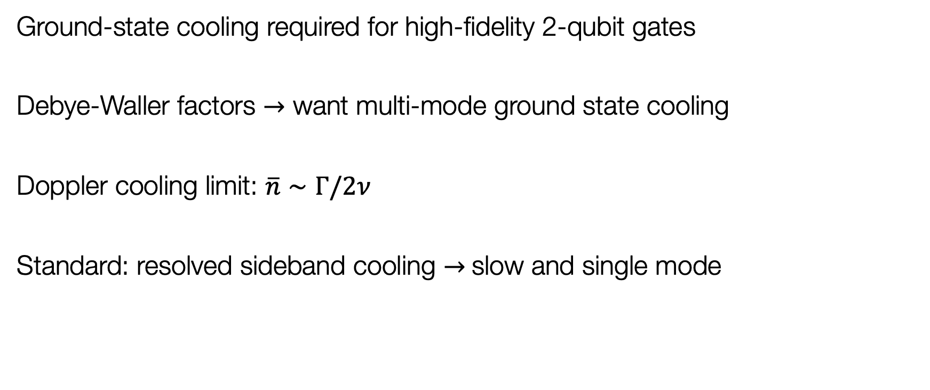
So, you want your ions in the ground state?
Ground-state cooling required for high-fidelity 2-qubit gates
Debye-Waller factors $→$ want multi-mode ground state cooling
Doppler cooling limit: $\overline{n}∼Γ/2ν$
Standard: resolved sideband cooling $→$slow and single mode
Notes:
As you have heard in previous talks, most experiments start with ground state cooling. This is the most convenient starting point for generating arbitrary states of motion and is often required for high fidelity 2-qubit gates
In fact, due to the Debye-Waller factors from spectator modes correcting the sideband Rabi frequencies, you likely want to cool all of your modes to close to the ground state
Doppler cooling limit set by the transition linewidth and mode frequency. For the dipole transitions we use, this generally does not cool us to the ground state
As you heard in many talks, the standard solution is to use resolved sideband cooling, but this method is rather slow since using a narrow line transition and sideband Rabi frequency is reduced by the Lamb-Dicke factor. It also only cools a single mode.
So how do you cool many modes to the ground state simultaneously?

Slide 4
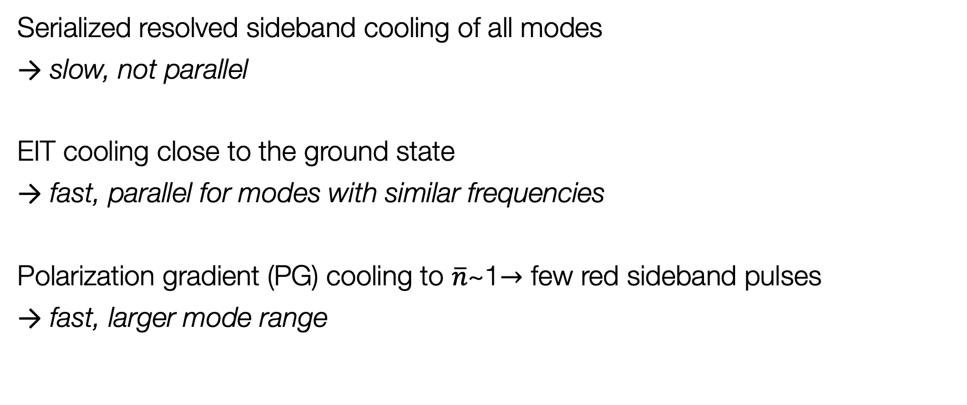
How do you cool many motional modes to the ground state simultaneously?
Serialized resolved sideband cooling of all modes
slow, not parallel
EIT cooling close to the ground state
fast, parallel for modes with similar frequencies
Polarization gradient (PG) cooling to $\overline{n}$~1$→$ few red sideband pulses
fast, larger mode range
Notes:
Well, it’s obvious, right? Just sideband cool one mode, then the next, then the next. You see where I am going, with 3N modes this gets a bit tedious.
Several talks have mentioned EIT cooling, which is a wonderful technique that is both fairly fast because it uses a dipole allowed transition and can cool several modes in parallel as long as they lie within the fano resonance feature.
A third method is Sisyphus cooling, which we heard about from Bas on Monday. A version of this is called polarization gradient cooling, which can cool to well-below the Doppler limit and is fast and multi-mode. This method can be combined with a few red sideband pulses on the modes of interest to prepare fully in the ground state

Slide 5
Outline
Polarization gradient cooling: how to manual
  What is the classic picture?
  How does it change when you look at a trapped ion?
  What has previously been done?
Phase-stable polarization gradient from integrated photonic devices
Polarization gradient cooling dynamics

Slide 6
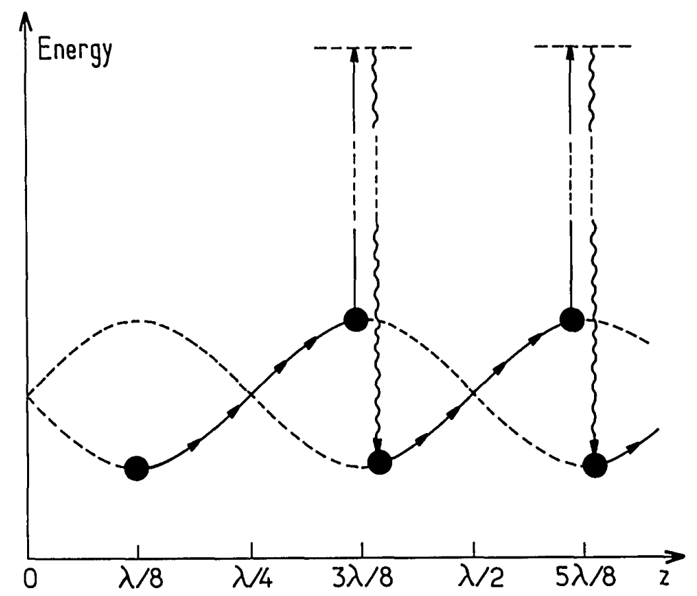
PGC, don’t neutrals people do that?
Position (polarization) dependent light shifts
Sisyphus cooling
Key: optical pumping into the lower energy level
Velocity selective based on pumping time
Vol. 6, No. 11/November 1989/J. Opt. Soc. Am. B
Notes:
You might be wondering, I’ve heard of polarization gradient cooling, don’t neutrals people do that?
And yes! You’ll see I’ve borrowed this figure from Dalibard and Cohen-Tannoudji in there 1989 paper where they explained that polarization gradient cooling was the mechanism behind early MOT trappers mysteriously cold atoms.
The technique relies on state-dependent potential landscape caused by position (polarization) dependent light shifts
This is a Sisyphus cooling technique, which means that kinetic energy is dissipated by the atom running up the potential hill but then being preferentially optically pumped to the lower energy ground state, where the process repeats itself
The optical pumping lag time determines how far up the potential hill the atom climbs and is velocity selective
But how do we make sure our Greek atom is only climbing?

Slide 7
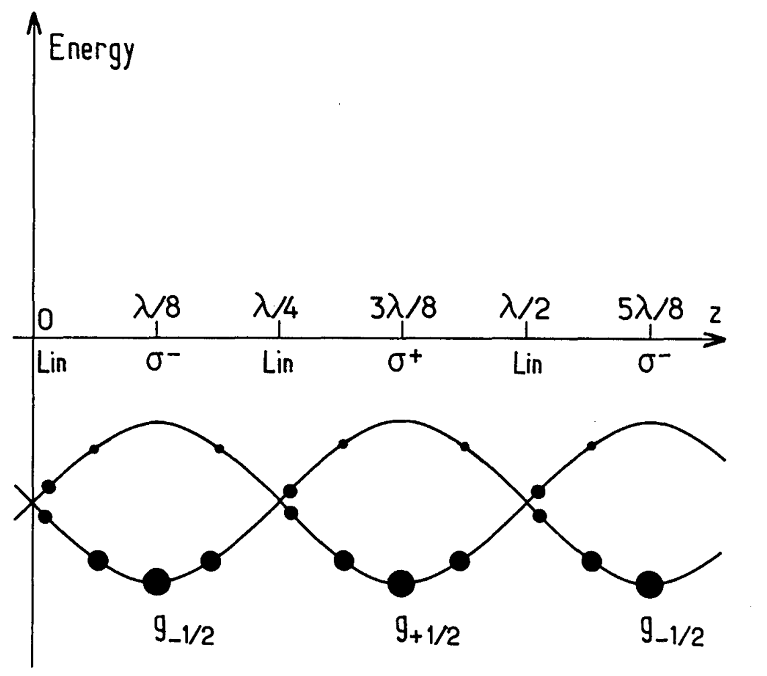



Why’s the Greek only climbing?
S_{1/2}$→$ P_{1/2} case:
Blue detuning for pumping to lower state
P_{1/2}
$$σ_{− }$$
$$σ_{+}$$
S_{1/2}
Vol. 6, No. 11/November 1989/J. Opt. Soc. Am. B
Notes:
Determined by the polarizations and detuning.
Let’s go through it for the S1/2 to P1/2 case, which we use in our demonstration.
In the lin perp lin configuration where the polarization switches between sigma-, sigma+ and a combination of the two
Blue detuning gives us optical pumping into the lower energy state
For sigma+ light …

Slide 8
Why’s the Greek only climbing?
S_{1/2}$→$ P_{1/2} case:
Blue detuning for pumping to lower state
P_{1/2}
$$σ_{+}$$
S_{1/2}
Vol. 6, No. 11/November 1989/J. Opt. Soc. Am. B
Notes:
The -1/2 ground state is light shifted up, while optical pumping into the unshifted and thus lower energy +1/2 ground state

Slide 9
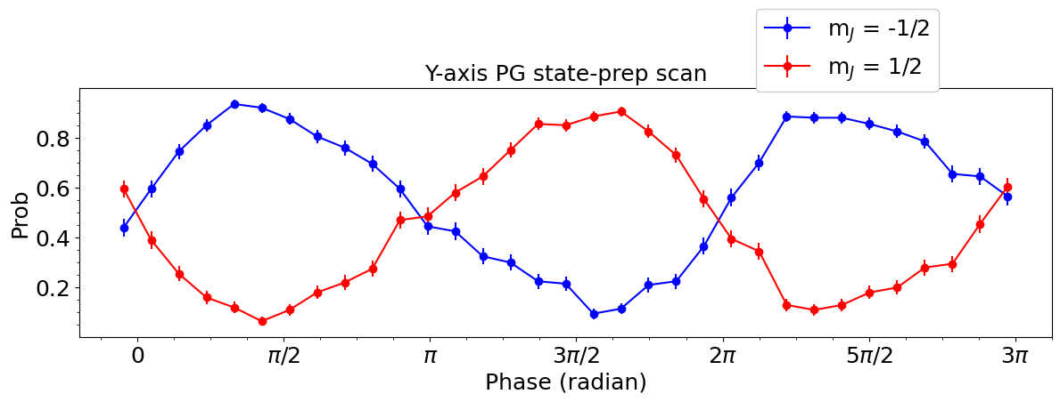
Why’s the Greek only climbing?
S_{1/2}$→$ P_{1/2} case:
Blue detuning for pumping to lower state
P_{1/2}
$$σ_{− }$$
S_{1/2}
Vol. 6, No. 11/November 1989/J. Opt. Soc. Am. B
Notes:
For sigma- this is reversed with the same effect
Now for a taste of experimental results. The population imbalance as a function of polarization gradient phase was neatly drawn by Dalibard in 1989 with the little circles, but as far as we know, we are the first to directly observe it experimentally. Here the two colors represent the probability of finding the ion in the +1/2 or -1/2 ground state after pulsing on the polarization gradient as a function of the ions position in the gradient.
You might be thinking…

Slide 10
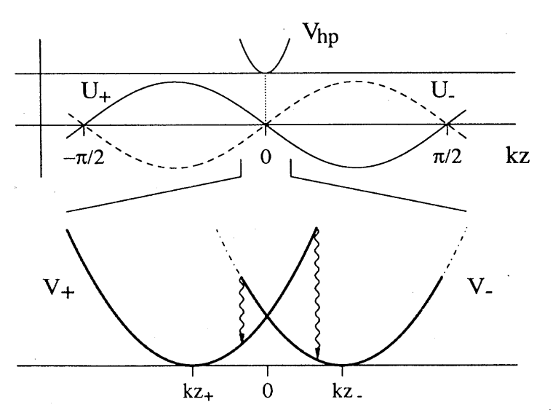


But my ion is tightly trapped. It cannot run up that long hill...
Combine harmonic trap and light-shift potential
Different potentials for each ground state
Still pumping between different potential landscapes
Can also average over polarization phase (running wave)
$$S_{1/2}, m=−1/2$$
$$S_{1/2}, m=1/2$$
https://doi.org/10.1103/PhysRevA.48.1434
Notes:
I can see how this mechanism works for neutral atoms, but our ion is tightly trapped compared to the scale of an optical wavelength
Indeed, but when you combine the harmonic trapping potential and the light shift, you get a state-dependent net potential and you can still get optical pumping between the two potential landscapes
One can also average over the polarization gradient phase. We’ll call that running wave PGC. This still results in cooling, but results in a higher steady state temperature

Slide 11
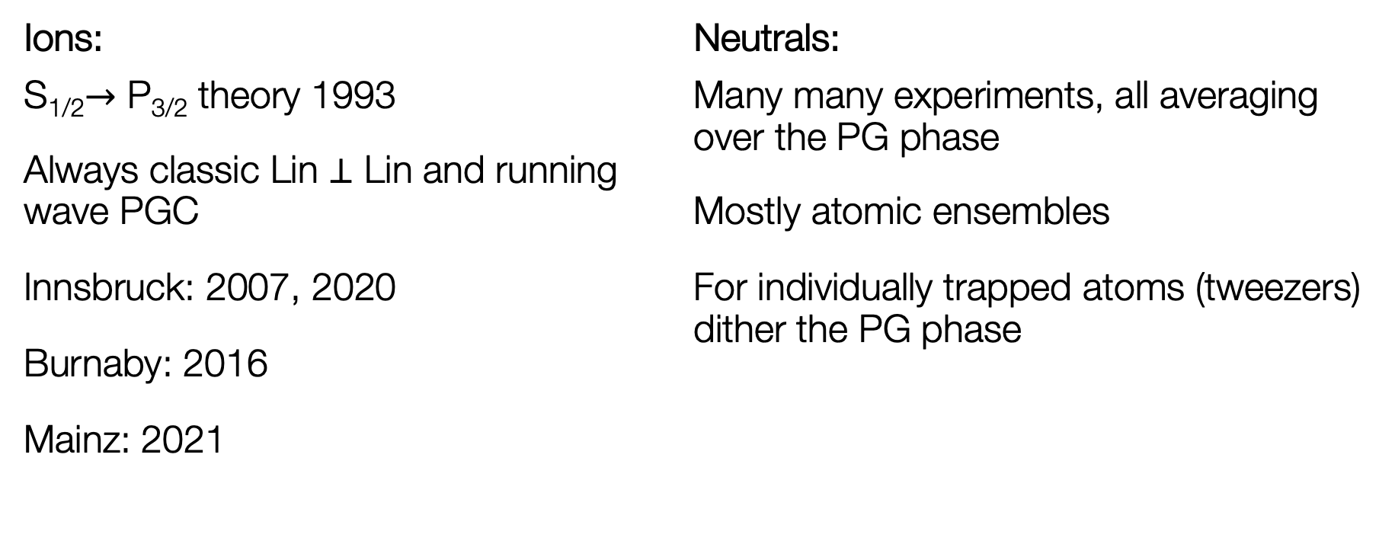
Someone’s done this, right?
Ions:
S_{1/2}$→$ P_{3/2} theory 1993
Always classic Lin $⊥$ Lin and running wave PGC
Innsbruck: 2007, 2020
Burnaby: 2016
Mainz: 2021
Neutrals:
Many many experiments, all averaging over the PG phase
Mostly atomic ensembles
For individually trapped atoms (tweezers) dither the PG phase
Phys. Rev. Lett. 119, 043001 (2017)
M K Joshi et al 2020 New J. Phys. 22 103013
Wenbing Li et al 2022 New J. Phys. 24 043028
Phys. Rev. A 96, 033406 (2017)
Notes:
When we started we were asking ourselves, someone has done this right?
After all, the first proposal and theoretical description was published in 1993 with well-known authors including Rainer.
Innsbruck, Burnaby, mainz
In neutral atoms, PGC is a standard part of many experiments. These also all average over the polarization gradient. Mostly this is because they work with large ensembles of atoms. But implementations with atoms in tweezers have dithered over the phase similarly to experiments with ions.
This is because it is not straightforward to stabilize the phase relative to the trapped atom
Now I will show you how integrated photonics can inherently deliver this phase stability.
What is difference in cooling rate for running vs phase stable?
Min nbar difference is around factor of 2
As far as we can tell all experimental implementations have used Lin perp Lin and running wave polarization gradient cooling.
PGC of axial mode for crystals and “free” motion along axis (Innsbruck, Ca)
PGC of axial mode (Burnaby Yb)
PGC of all modes (Mainz, Ca)
2007, 2016 (Yb+), 2020 Innsbruck, 2021 Mainz
Always running mode

Slide 12
Polarization gradient cooling how to manual
Phase-stable polarization gradient from integrated photonic devices:
  Integrated photonics structures
  Robustness to fab imperfections
  Determining phase-stability
Polarization gradient cooling dynamics
Notes:
Now I will show you how integrated photonics can inherently deliver this phase stability.
Removed:
Saturation parameter measurement

Slide 13
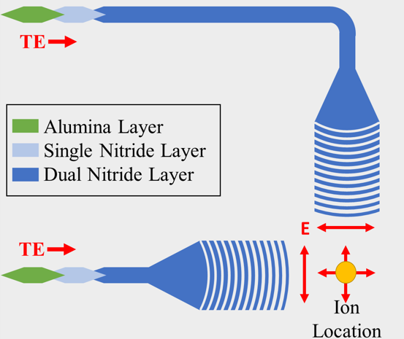
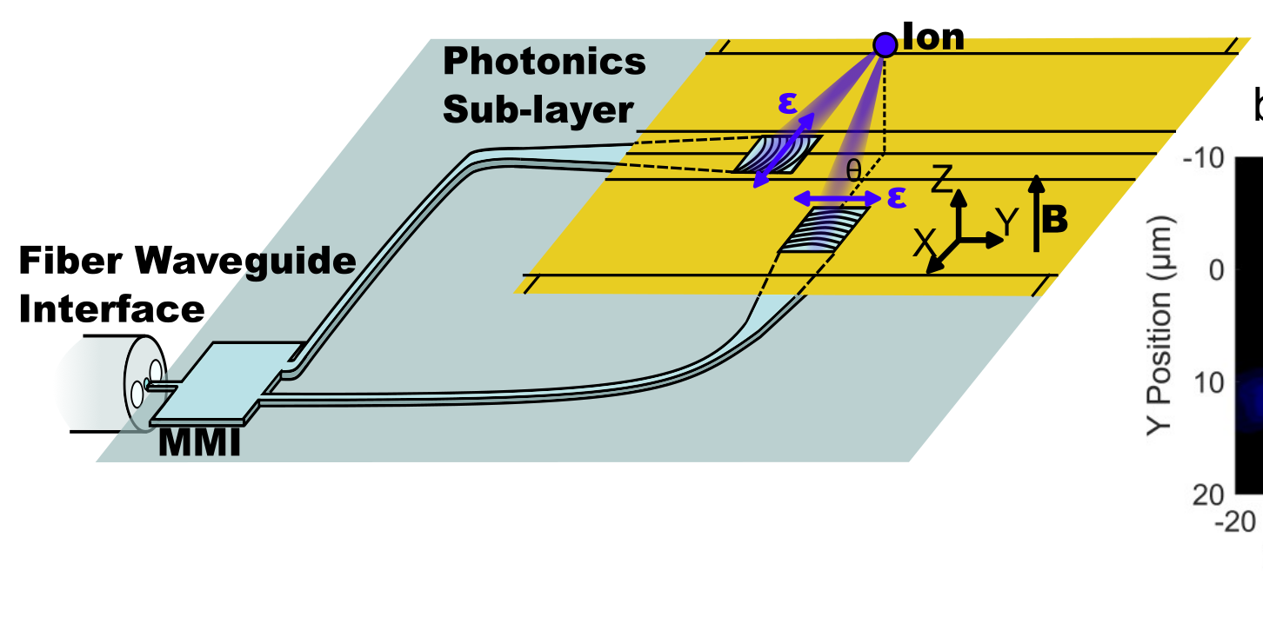





Integrated PGC structures
B-field
$$ε_{1}$$
$$k_{2}$$
Mutually $⊥$ B-field and polarizations (lin $⊥$ lin)
Single fiber input split on-chip $→$ perpendicular TE gratings
$$k_{1}$$
$$ε_{2}$$
Notes:
I’ve mentioned the lin perp lin configuration. This is understood to mean counterpropagating lasers with orthogonal linear polarizations and the magnetic field oriented along the direction of propagation.
Our chip has a single input for the PGC light in the transverse electric mode, it is split on chip and then emitted by perpendicular diffraction gratings. You can see that with emission out of the chip we cannot get counterpropagating beams. However, if you pay attention to the polarization and B-field vectors, you will notice that they are still all mutually orthogonal which results in the same sigma+ and sigma- polarization gradient.
Because the two paths of our interferometer are very short (millimeters) and are monolithic with the trapping electrodes the relative phase at the ion location is inherently stable
For any waveguide experts in the room, we route the light in alumina waveguide to minimize transmission loss, then switch to double layer silicon nitride for the higher index contrast and to break the vertical symmetry for more efficient emission

Slide 14
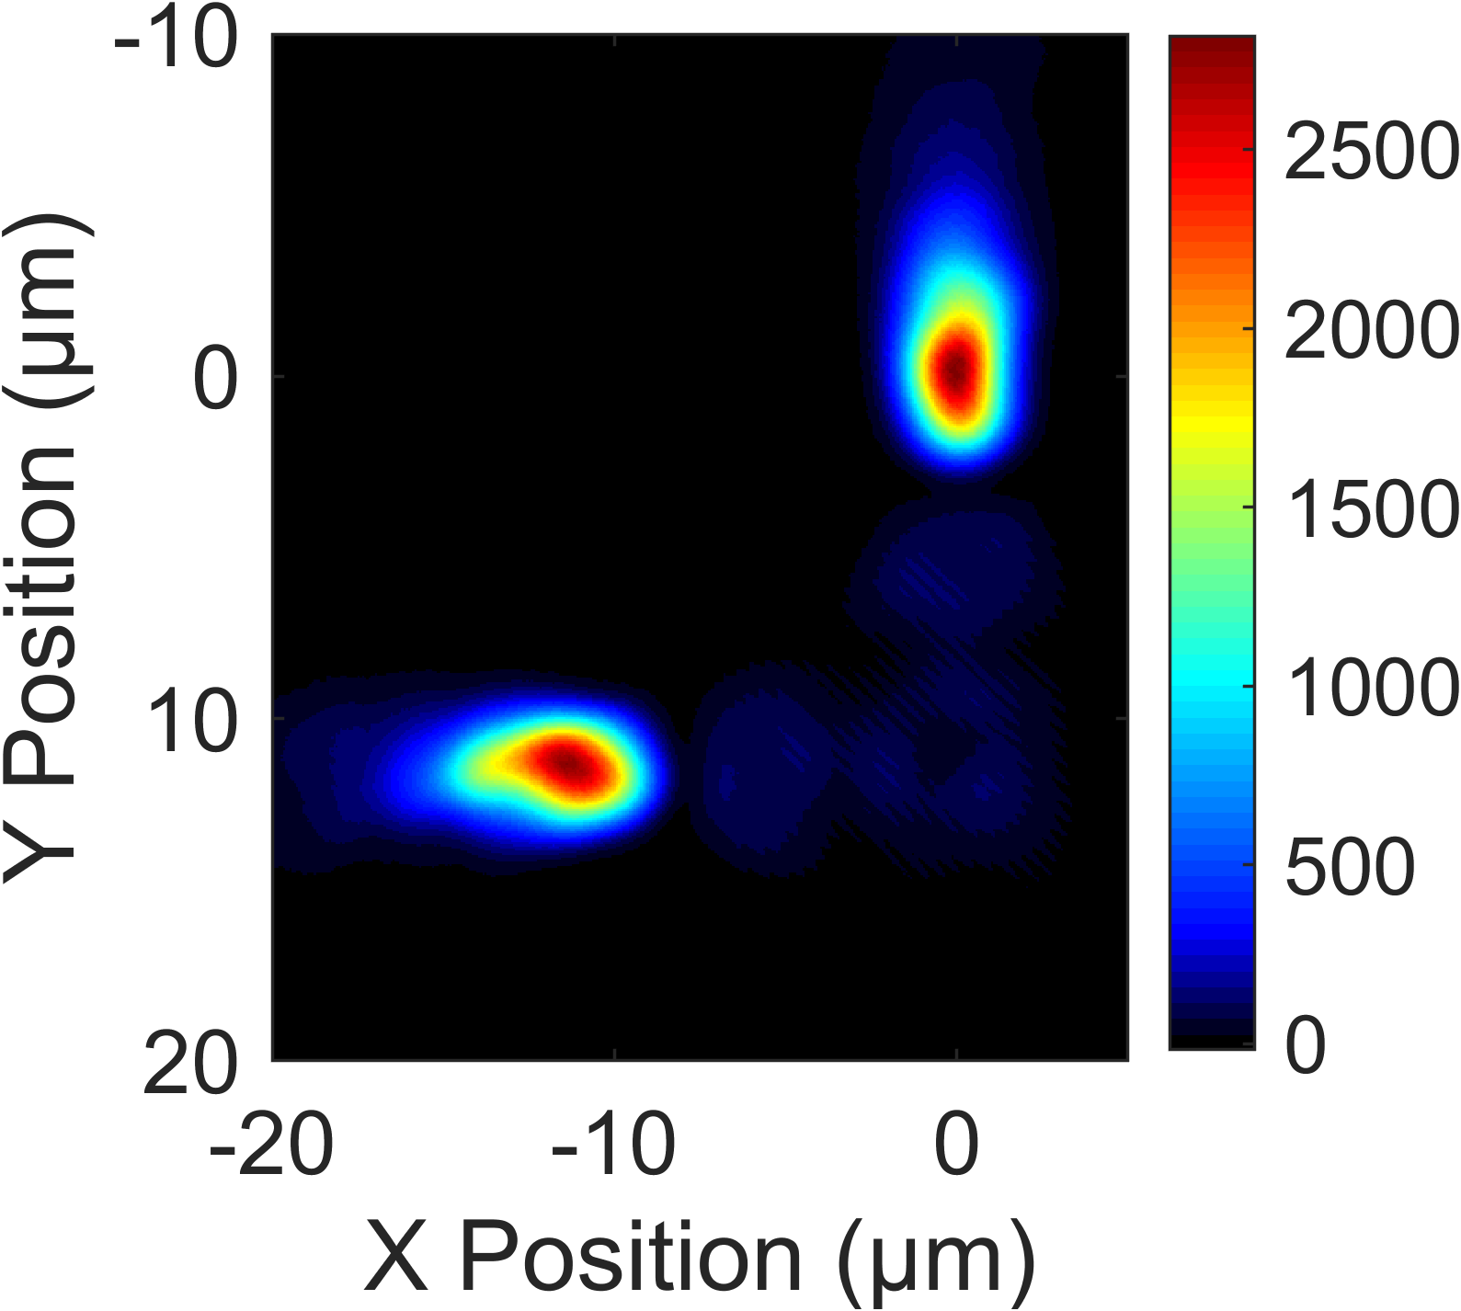

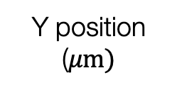
PG is robust to fab imperfections
Integrated beams entirely missing the ion
Beam intensity in the ion plane
(autoprober data)
0
Y position
($μm)$
10
-10
0
X position ($μm)$
Notes:
However, fabrication is not always perfect.
Here I am showing you the beam profiles measured ex-situ at the ion height. You see two relatively nice spots from the two gratings. However, the beams are entirely missing the ion, who’s location I’ve marked in red. When we saw this, we thought “that was fun, guess we try again next time”
But if we zoom in

Slide 15
PG is robust to fab imperfections
Integrated beams entirely missing the ion
Beam intensity in the ion plane
(autoprober data)
Notes:
We see these faint side lobes and low and behold, you can actually see some interference fringes, so there is light that is overlapping from the two grating emissions!

Slide 16
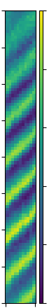
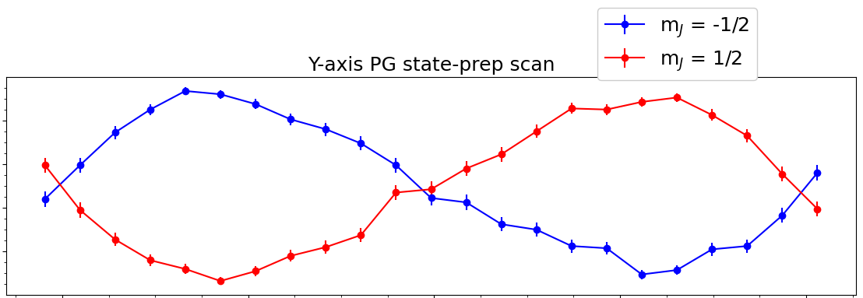

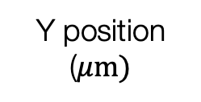



PG is robust to fab imperfections
4
1
Y position
($μm)$
Prob. bright
Integrated beams entirely missing the ion
Polarization purity is imperfect
Polarization purity is non-uniform
Low power: 2 nW in 5 $μ$m beam
Beam intensity in the ion plane
(autoprober data)
2
0
Y position
($μm)$
Ground state population vs PG Phase
1
10
Prob.
bright
0
0
-10
0
-0.2
0.2
0
X position ($μm)$
X position ($μm)$
0
$$π$$
$2π$
Notes:
However, the polarization purity is far from perfect, the power is negligible and the polarization purity is non-uniform. If you take a close look at the map we’ve made of the polarization gradient, you’ll see the contrast is non-uniform and the peaks and troughs are not quite symmetrically spaced.
We are doing our cooling experiments with a power equivalent to 2 nW in 5 um beam.
Regardless, let’s take a look at the phase stability

Slide 17
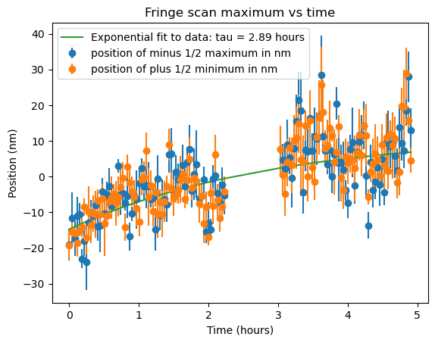
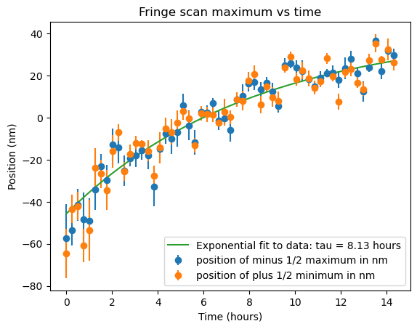
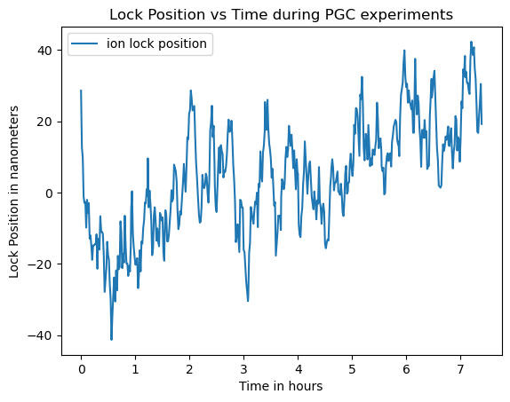

How stable is that phase?
Relative position of PG using ion scan
30
Stability dominated by ion position drift
Drift of PG < 8 nm per hour (<$\frac{λ}{50}$ per hour)
Variance at short times < 10 nm, lock to PG
0
0
5
Relative position of PG using lock
80
60
Position
(nm)
Position
(nm)
0
0
0
Time (hours)
7
0
Time (hours)
14
Notes:
We’ve determined that our measurements of the phase stability are dominated by ion position drift by deliberately displacing the ion using the photoionization beams to charge up the trap. If you take a look at the extrema of the polarization gradient, which we can fit precisely by scanning the ion position, you can see that their relative position to the ion is relaxing exponentially as the electric field environment relaxes.
When we are not drastically charging up the trap, the drift of the polarization gradient is less than 8 nm per hour. At short times, the variance is around 10 nm, which is consistent with our uncertainty in determining the ion location relative to the PG and is similar to the ion wavepacket extent.
This stability allows us to run a very simple, low duty cycle lock that lets us perform experiments at known relative phase of the PG. In blue you see a trace of the relative position the ion is locked at over a 7 hour run of PGC data collection.
At this point I’m sure you are all thinking: phase stability and integrated photonics are great, but Felix, didn’t you say you cooled these ions?

Slide 18
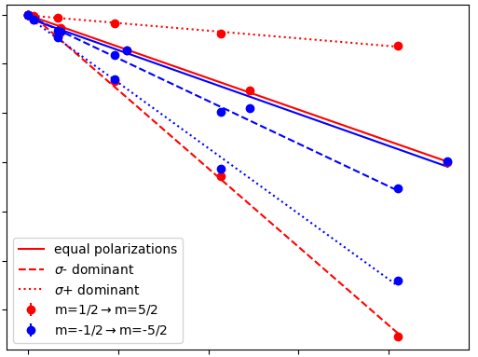
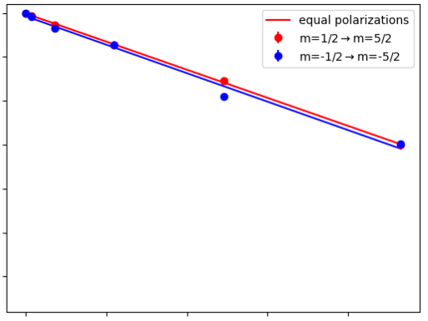
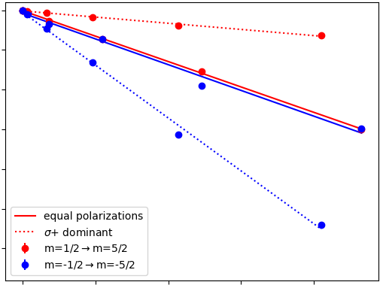





Saturation parameter and power required
Cooling well below saturation intensity
s = 0.0075 (+/-0.001)
On resonance s₀ = 1(+/-0.2)
Operating intensity equivalent to
2 nW in a 5 $μ$m waist beam
AC Stark Shift vs power into chamber
0 kHz
-150 kHz
1
Prob.
bright
$$σ_{−}$$
$$σ_{+}$$
0
0 $μ$W
40 $μ$W
0
$$π$$
$2π$
PG Phase

Slide 19
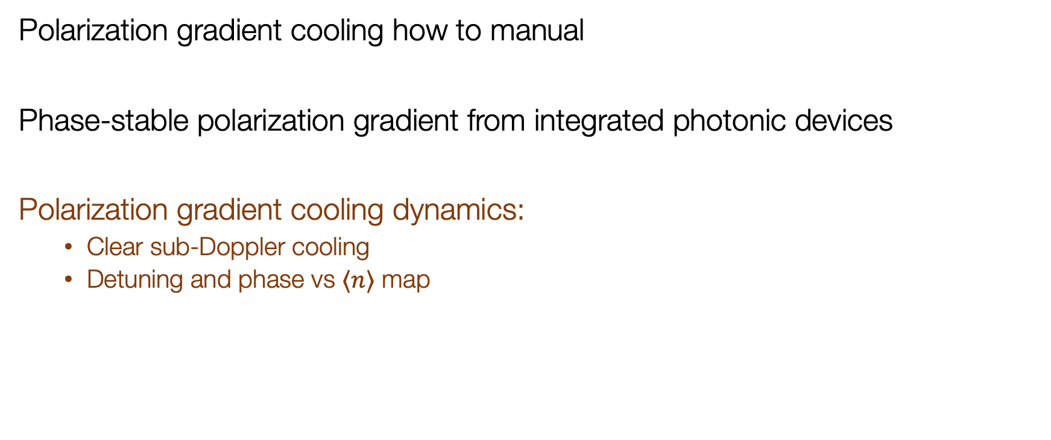
Polarization gradient cooling how to manual
Phase-stable polarization gradient from integrated photonic devices
Polarization gradient cooling dynamics:
  Clear sub-Doppler cooling
  Detuning and phase vs $⟨n⟩$ map
Notes:
At this point I’m sure you are all thinking:
phase stability and integrated photonics are great, but Felix, didn’t you say you cooled these ions?
Removed: Detuning and phase dependence of cooling rate $\frac{dn}{dt}$
Removed: Multi-mode cooling

Slide 20
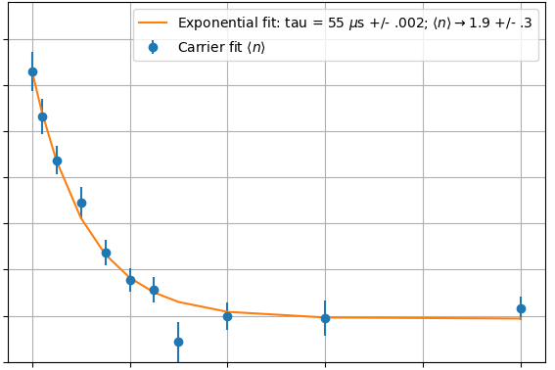



Didn’t you say you cooled these ions?
Axial mode cooling; detuning = 140 MHz
Doppler limit of 1 MHz axial mode:
$⟨n⟩∼12$
Steady state $⟨n⟩=1.9±0.3$
Cooling rate at Doppler limit:
$∼3{∗10}^{5}$ q/s
12
$$\left\langle n\right\rangle$$
2
0
55
500
Time ($μs$)
Notes:
Yes, we did cool some ions!
The Doppler limit of the 1 MHz axial mode was around 12 quanta for our parameters and we were able to cool down to around 2 quanta using the polarization gradient. At the Doppler limit, the cooling rate was several hundred thousand quanta per second.
We can cool faster using higher intensities or closer detuning, but there are trade-offs with the steady state temperature
Analytically, the cooling rate can be understood simply by hiding the cooling and heating effects in this W and setting a steady state temperature that the system ends up in.
Cooling rate: $\frac{d⟨n⟩}{dt}=W\left(⟨n⟩−{\left\langle n\right\rangle }_{0}\right)$

Slide 21
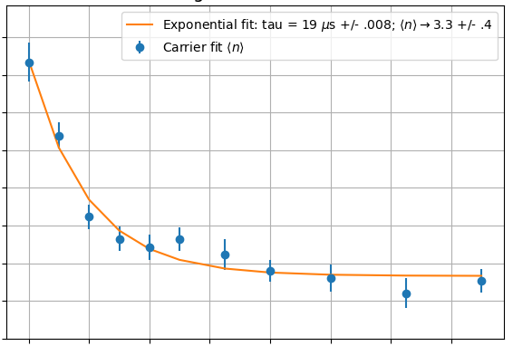


Didn’t you say you cooled these ions?
Axial mode cooling; detuning = 86 MHz
Doppler limit of 1 MHz axial mode:
$⟨n⟩∼12$
Steady state $⟨n⟩=1.9±0.3$
Cooling rate at Doppler limit:
$∼3{∗10}^{5}$ q/s
14
$$\left\langle n\right\rangle$$
2
0
20
140
Time ($μs$)
Notes:
As you can see here where we are closer detuned and have a cooling time constant of 19 us instead of 55 us, but a higher final nbar.
We can map out this steady state temperature at different detunings and phases of the polarization gradient

Slide 22
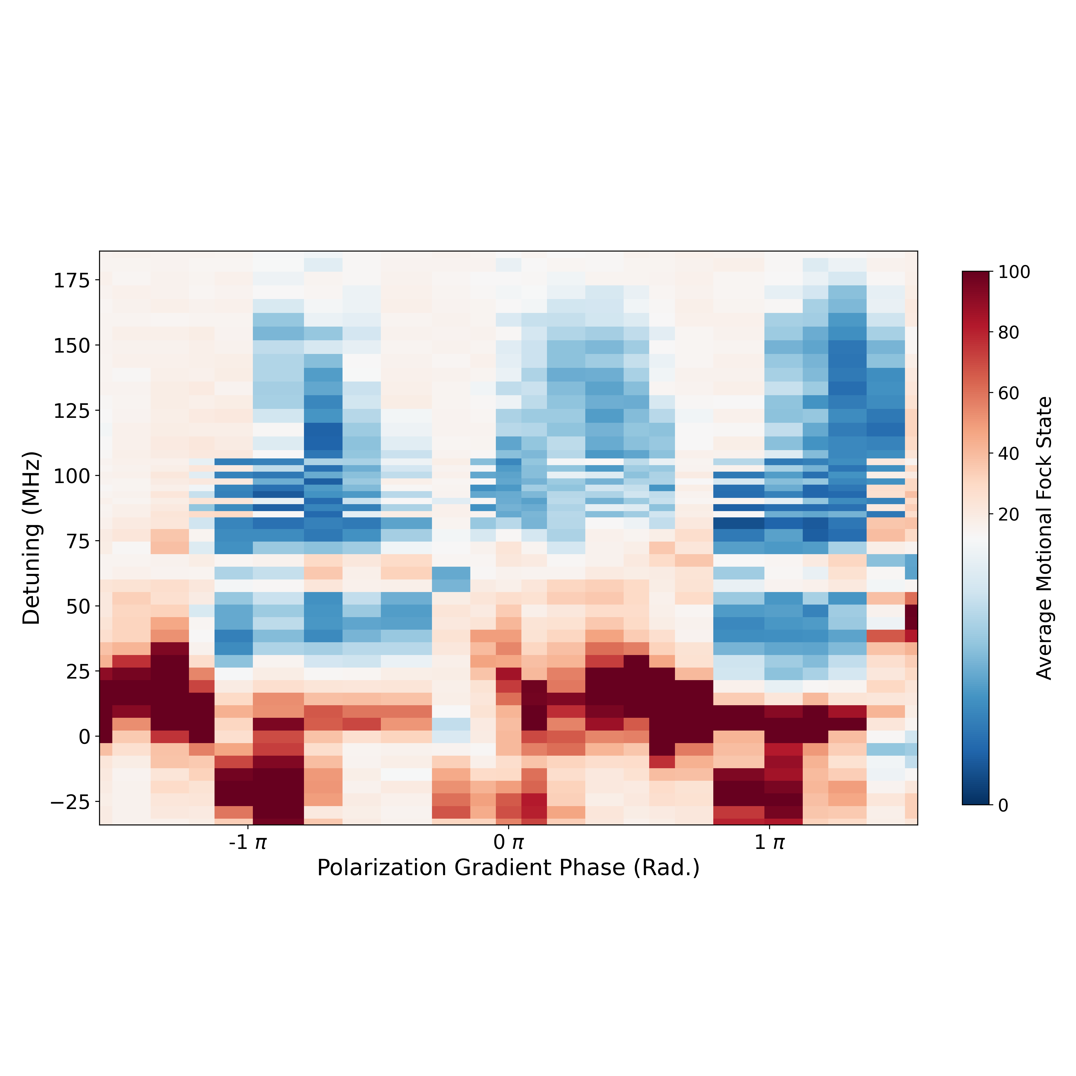
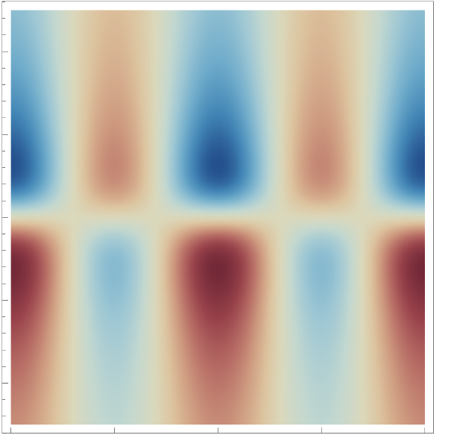




Cooling and heating is periodic
Experimental results
Analytical theory
Detuning (MHz)
$$\left\langle n\right\rangle$$
100
100
100
20
0
0
0
-$π$
0
$$π$$
-$π$
0
$$π$$
Polarization gradient
phase (rad.)
Notes:
We can map out this steady state temperature at different detunings and phases of the polarization gradient
The experimental results show structure with the expected periodicity and general shape with cooling for positive detunings.
An analytical model captures the far-detuned behavior, but not the behavior for detunings <85 MHz or so
Stark shift

Slide 23
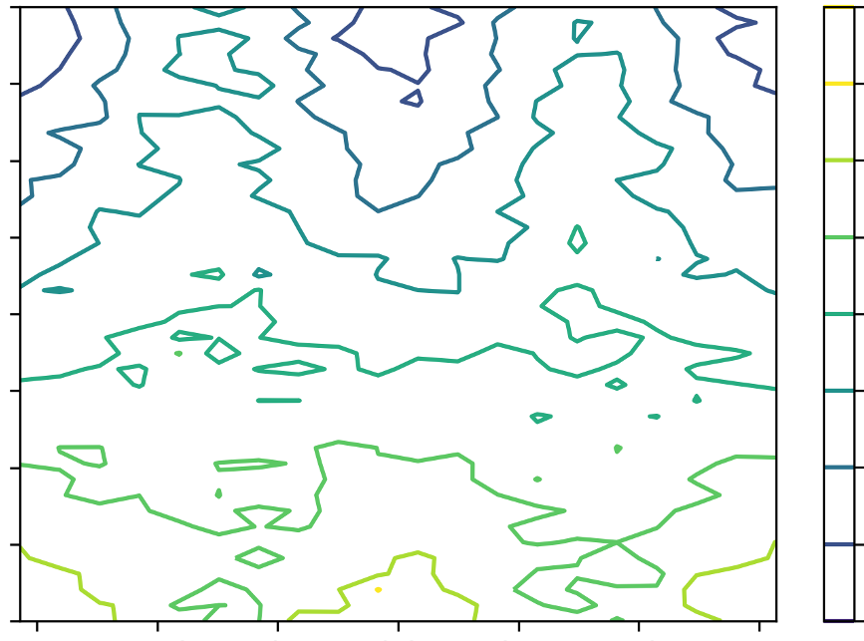

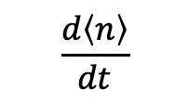

Cooling and heating is periodic
Experimental results
Numerical theory
Detuning (MHz)
$$\left\langle n\right\rangle$$
$$\frac{d\left\langle n\right\rangle }{dt}$$
100
1.5e5
100
100
20
0
0
-9e4
0
-$π$
0
$$π$$
0
-$π$
0
$$π$$
Polarization gradient
phase (rad.)
Notes:
A numerical model of the cooling or heating rate starts to capture more of the structure we see.
If we take a cut along this line and measure the instantaneous heating and cooling rate at the Doppler limit
Assume start at fock state 12 and resonant sat param of 4

Slide 24
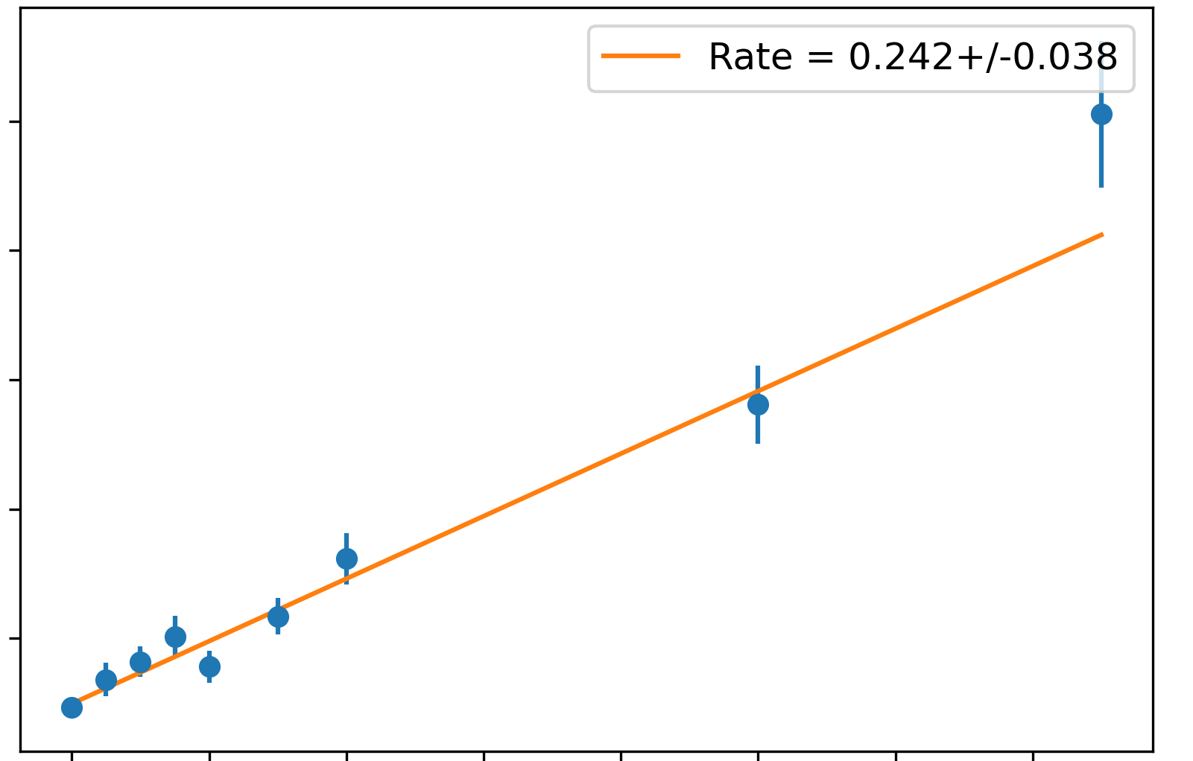
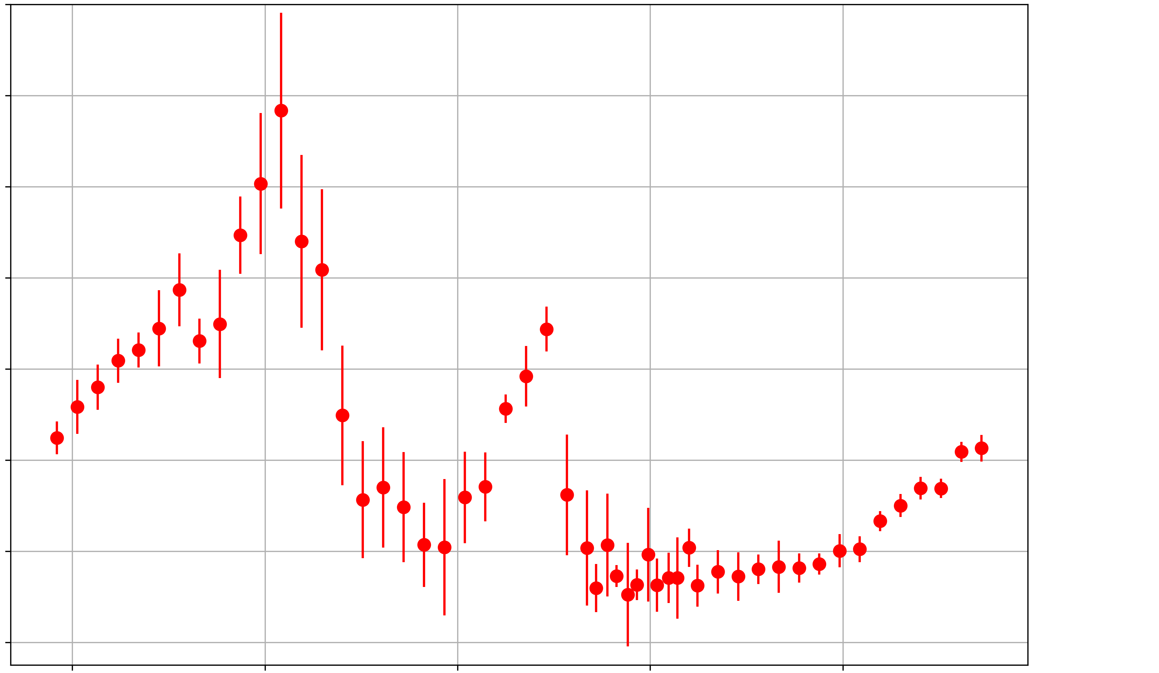
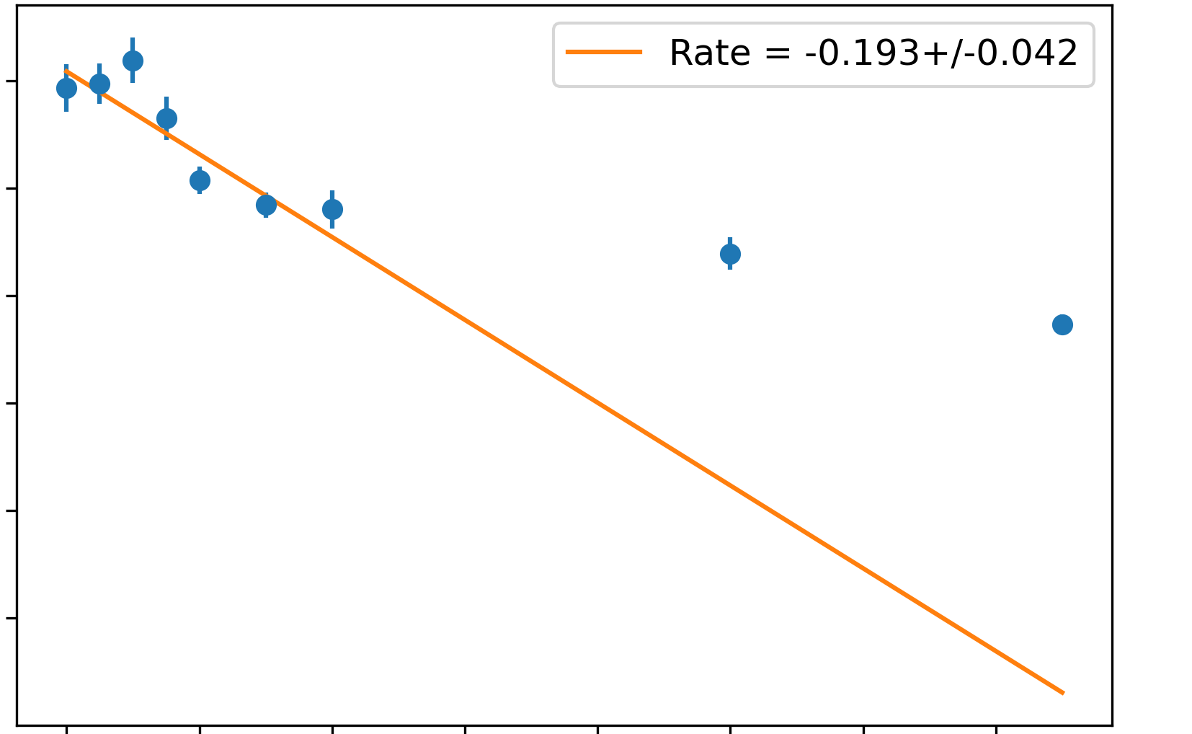


Studying the cooling rate vs. detuning
Detuning dependent instantaneous rate at Doppler limit
60
1e6
20
$\frac{d\left\langle n\right\rangle }{dt}$
0
140
15
0
0
-0.4e6
-50
0
100
Detuning (MHz)
0
Time ($μs$)
140
Notes:
We see heating on and below resonance and then a band of cooling interrupted by a heating peak.
To get the instantaneous cooling/heating rate at the Doppler limit, we take many points at low PG pulse times to get a relatively precise linear fit.
Taking a step back, what have we shown?

Slide 25
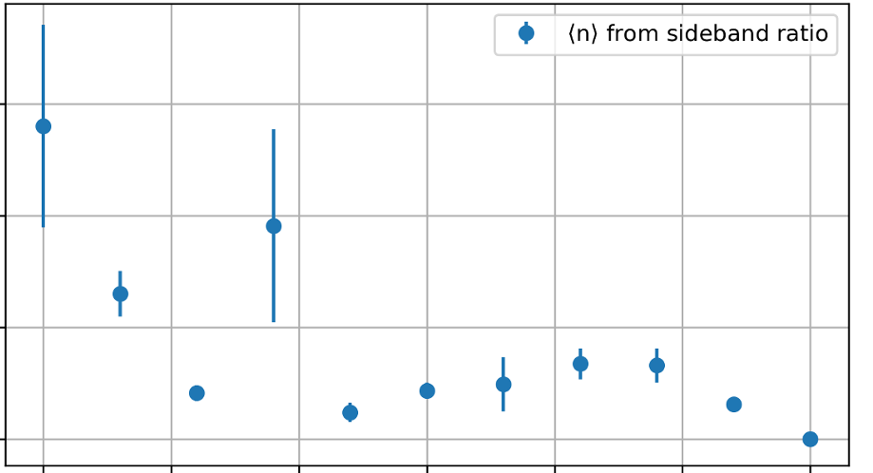
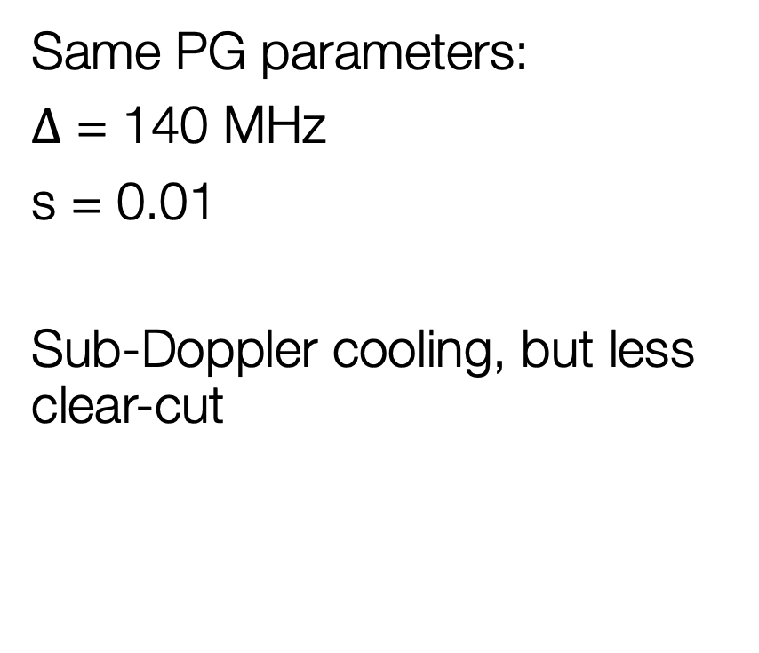


Radial modes
Same PG parameters:
$Δ$ = 140 MHz
s = 0.01
Sub-Doppler cooling, but less clear-cut
Radial mode cooling; detuning = 140 MHz; $ν=2π∗$1.5 MHz
8
$$\left\langle n\right\rangle$$
2
0
100
300
Time ($μs$)
Notes:
Change the plot to just have 1 method of measuring?

Slide 26
What have we shown?
First experimental realization of ions in a phase-stable polarization gradient
Experimental and theoretical mapping of the cooling rate and final temperature vs. PG phase
Fast, power efficient, sub-Doppler cooling
Notes:
We have trapped ions in a phase-stable polarization gradient for the first time
We experimentally and theoretically mapped out the cooling vs. detuning and polarization gradient phase
We demonstrated fast, power-efficient sub-Doppler cooling
Looking towards the future,

Slide 27
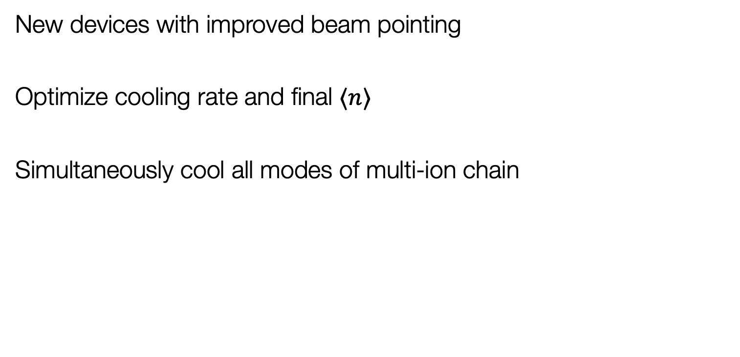
Outlook
New devices with improved beam pointing
Optimize cooling rate and final $⟨n⟩$
Simultaneously cool all modes of multi-ion chain
Notes:
Looking to the future,
We are currently fabricating new devices with improved beam pointing.
With these we hope to optimize the cooling rate and final nbar using higher intensity and higher polarization purity
Finally, we aim to simultaneously cool all modes of multiple ion chains!

Slide 28





End
Optical pumping vs PG phase
1
Prob.
bright
0
Detuning (MHz)
PGC vs phase and detuning
0
$$π$$
$2π$
$$\left\langle n\right\rangle$$
PG Phase
100
Axial mode cooling; detuning = 140 MHz
100
12
20
$$\left\langle n\right\rangle$$
0
2
0
0
100
500
0
$$π$$
2$π$
Polarization gradient
phase (rad.)

Slide 29
Extra slides…

Slide 30

Saturation parameter and power required
Cooling well below saturation intensity
s = 0.0075 (+/-0.001)
On resonance s₀ = 1(+/-0.2)
Operating intensity equivalent to
2 nW in a 5 $μ$m waist beam
AC Stark Shift vs power into chamber
0 kHz
-150 kHz
1
Prob.
bright
$$σ_{−}$$
$$σ_{+}$$
0
0 $μ$W
40 $μ$W
0
$$π$$
$2π$
PG Phase

Slide 31
Radial modes
Same PG parameters:
$Δ$ = 140 MHz
s = 0.01
Sub-Doppler cooling, but less clear-cut
Radial mode cooling; detuning = 140 MHz; $ν=2π∗$1.5 MHz
8
$$\left\langle n\right\rangle$$
2
0
100
300
Time ($μs$)
Notes:
Change the plot to just have 1 method of measuring?

Slide 32
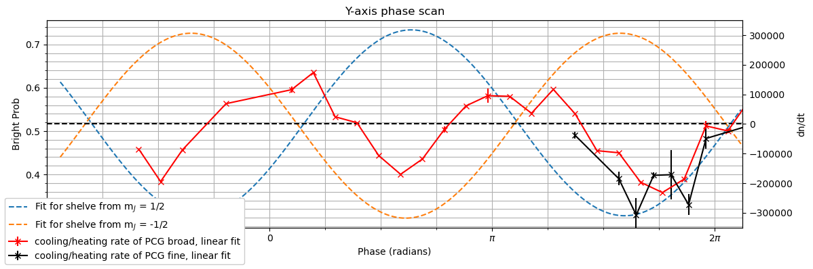

Cooling rate vs phase
Detuning: 86 MHz; saturation param: 0.02
Cooling rate at Doppler limit ($\overline{n}∼12$)
Cooling at “non-intuitive phases”
Notes:
Max cooling rate ~300000 q/s at 12 quanta
Phase dependent cooling rate at Doppler limit for two detunings (86 MHz and 140 MHz) and equal intensity

Slide 33
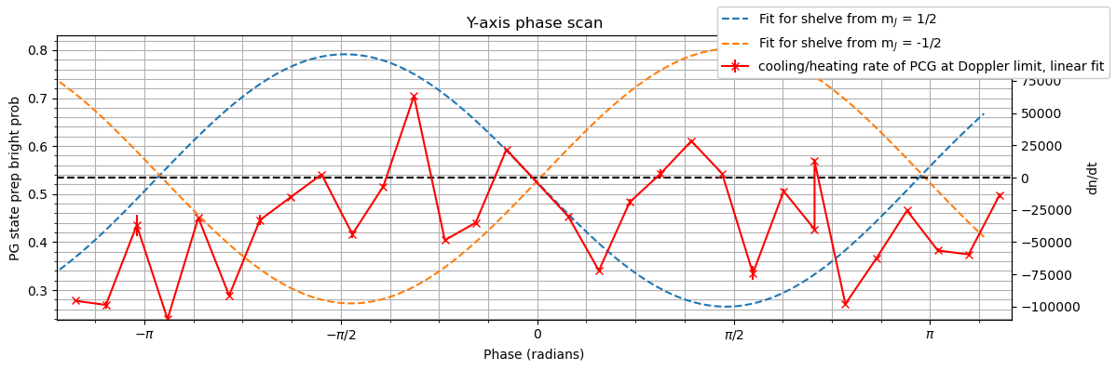

Cooling rate vs phase
Detuning: 140 MHz; saturation param: 0.01
Cooling rate at Doppler limit ($\overline{n}∼12$)
Cooling at “intuitive” phases
Notes:
Max cooling rate ~300000 q/s at 12 quanta
Phase dependent cooling rate at Doppler limit for two detunings (86 MHz and 140 MHz) and equal intensity
Still figuring out the appropriate error handling. Current errorbars are too small

Slide 34
Team
Photonics design:
Sabrina Corsetti
Reuel Swint
Jelena Notaros
Ashton Hattori
Tal Sneh
Patrick Callahan
Milica Notaros
Photonics fab:
LL foundry
Dave Kharas
Thomas Mahony
Photonics testing:
Sabrina Corsetti
Alex Medeiros
Felix Knollmann
Gavin West
Ions experiment:
Ethan Clements
Felix Knollmann
Sabrina Corsetti
PGC Theory:
Zhaoyi Li
Helpful guidance:
May, Cheri, Robert
PI power: John + Ike + Jelena

Slide 35
Team
Photonics design:
Sabrina Corsetti
Reuel Swint
Jelena Notaros
Ashton Hattori
Tal Sneh
Patrick Callahan
Milica Notaros
Photonics fab:
LL foundry
Dave Kharas
Thomas Mahony
Photonics testing:
Sabrina Corsetti
Alex Medeiros
Felix Knollmann
Gavin West
Ions experiment:
Ethan Clements
Felix Knollmann
Sabrina Corsetti
PGC Theory:
Zhaoyi Li
Helpful guidance:
May, Cheri, Robert
PI power: John + Ike + Jelena

Slide 36
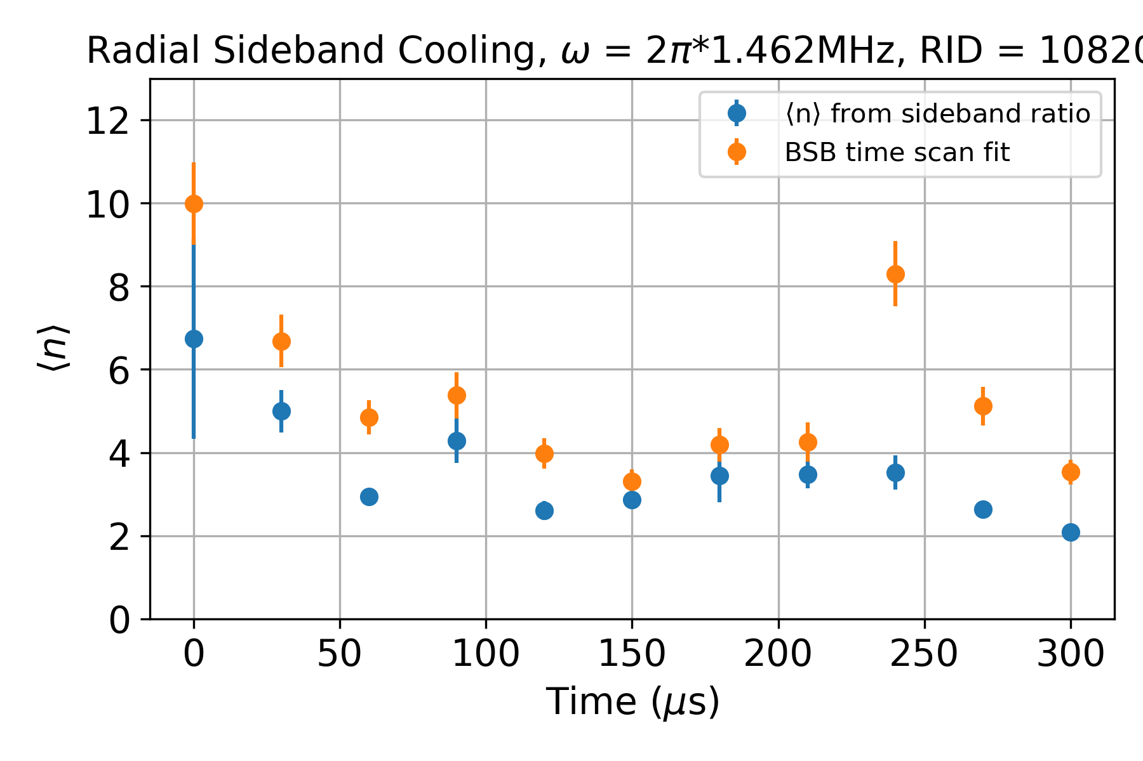
Radial modes
Same PG parameters:
$Δ$ = 140 MHz
s = 0.01
Sub-Doppler cooling, but less clear-cut

Slide 37





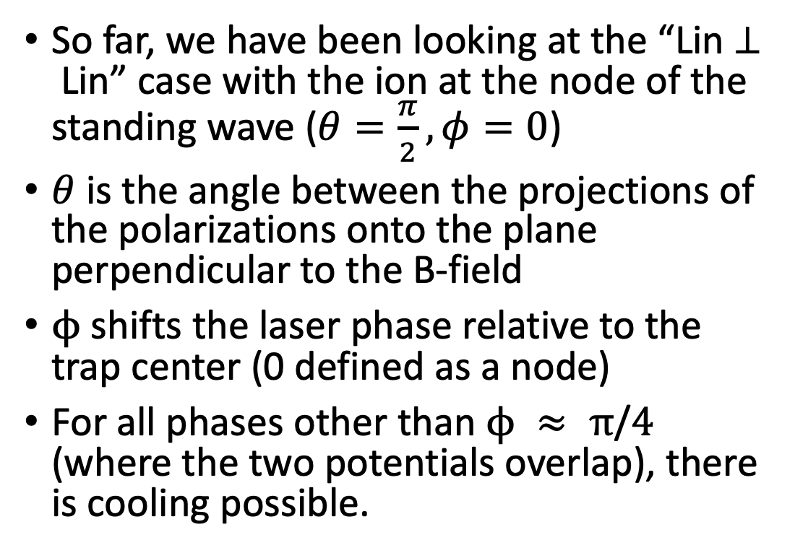



What beam configurations are we looking at?
B-field
So far, we have been looking at the “Lin$⊥$Lin” case with the ion at the node of the standing wave ($θ=\frac{π}{2},φ=0$)
$θ$ is the angle between the projections of the polarizations onto the plane perpendicular to the B-field
$ϕ$ shifts the laser phase relative to the trap center (0 defined as a node)
For all phases other than $ϕ ≈ π\text{/}4$ (where the two potentials overlap), there is cooling possible.
$$ε_{1}$$
$$k_{2}$$
$$θ$$
$$ε_{1}$$
$$k_{1}$$
$$ε_{2}$$
$$ε_{2}$$
$$ϕ$$
Notes:
draw b-field, fix phi line

Slide 38
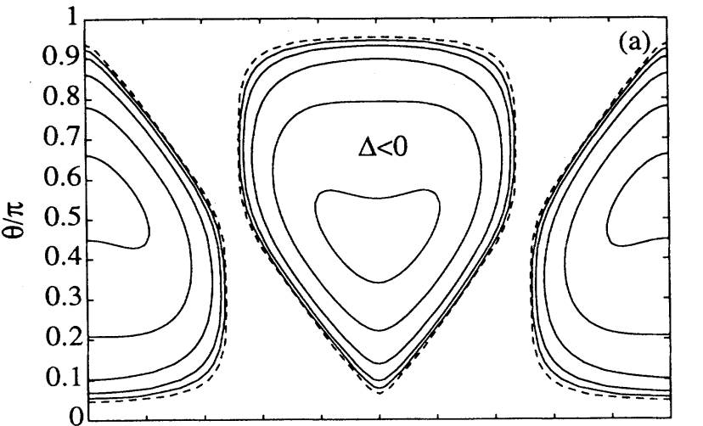










Theory for S_{1/2}$→$ P_{3/2}
$$\left\langle n\right\rangle =1$$
Further-detuned
(10 $Γ$)
Cooling and heating
as a function of $φ$
$$\left\langle n\right\rangle ∼21$$
$$\left\langle n\right\rangle ∼21$$
Closer-detuned
(6 $Γ$)
$$ϕ$$
$$\left\langle n\right\rangle =1$$
Phys. Rev. A 48, 1434 – Published 1 August 1993
Notes:
Working on similar plots for the J=1/2 states Ethan/ Zhaoy
Note theta is angle between polarizations, which is fixed for us
fix animations!!!

Slide 39






Why the hills? Why’s the Greek only climbing?
S_{1/2}$→$ P_{1/2} case:
Blue detuning for pumping to lower state
P_{1/2}
$$σ_{+}\frac{2}{3}$$
$$π\frac{1}{3}$$
$$π \frac{1}{3}$$
$$σ_{− }\frac{2}{3}$$
S_{1/2}
Vol. 6, No. 11/November 1989/J. Opt. Soc. Am. B
Notes:
change schematic, no pi transitions, make blue detuned, animate
-1/2 ground state prob. instead of bright prob

Slide 40




Relaxation of PI induced charging
Repeatable displacement direction (~minute $→$~100 nm or ~4 V/m)
Time constant and amplitude stochastic, but proportional to PI beam time
Notes:
1e-19 N or 3.6 V/m causes a 100 nm displacement axially.

Slide 41





Integrated PGC structures
Z$:\vec{B}$
Single fiber input split on-chip $→$ perpendicular TE gratings
Mutually $⊥$ B-field and polarizations
Y$:\vec{ε_{2}}$
$$x:\vec{ε_{1}}$$
Notes:
replace pics, hide irrelevant info
hide left pic at first
talk about lin perp lin (add pic)
-> TE TE

Slide 42

PGC structures

Slide 43




From Doppler cooled to sub-Doppler cooled
Doppler cooling limited by scattering rate and recoil from emitted photon
A position dependent energy difference to cool the ion
  Created using an AC stark shift on the electronic groundstate manifold
E
E
Wenbing Li et al New J. Phys. 24 043028 (2022)
Joshi, M. K., et al New J. Phys. 22 103013 (2020)

Slide 44



From Doppler cooled to sub-Doppler cooled
Doppler cooling limited by scattering rate and recoil from emitted photon
A position dependent energy difference to cool the ion
  Created using an AC stark shift on the electronic groundstate manifold
Drive position dependent Raman transitions between energy shifted groundstates
Wenbing Li et al New J. Phys. 24 043028 (2022)
Joshi, M. K., et al New J. Phys. 22 103013 (2020)

Slide 45
From Doppler cooled to sub-Doppler cooled
Polarization Gradient cooling:
Very multi-mode, very fast, can cool from highly excited state
Phase stability from integrated photonics offers an advantage
Grating emitters for cooling
Top view
E
E
ion
Polarization gradient
axis
TE
ion
Side view
TE
TE
TE
Hattori, Ashton, et al. Frontiers in Optics (pp. FM4B-3). Optica Publishing Group, 2022.
Notes:
One of the first sub-doppler cooling methods we plan to implement with integrated photonics is polarization gradient cooling
Polarization gradient cooling uses interfering counter propagating laser beams to create a periodically varying polarization gradient which is used for Sisyphus cooling.
It has been demonstrated to cool many modes very quickly from high motional occupation where the capture range is set by the laser intensity
One limitation is that it often will only cool to a motional occupation of a few so the amount of sideband cooling needed would be reduced but it would still be necessary
This technique is more commonly used in the neutral atom community to cool atoms to sub-doppler temperature but has also been demonstrate in trapped ion systems
For polarization gradient cooling you require relative phase stability between the two counter propagating beams
This can often be a challenge in freespace beams but could possibly be simplified by splitting the light for the counter propagating beams on chip which would ensure relative phase stability
One potential grating layout for generating the periodic polarization gradient is shown here where we would use two grating emitters one which allows the TM mode to propagate and the other which allows the TE mode
this will result in a periodic polarization gradient parallel to the trap surface and oriented 45 degrees with respect to the trap axis
There will be a k vector component in the vertical direction but we expect this will not limit the cooling when the laser detuning is properly set.
(1 min 40s) 7min 40s

Slide 46

Automating photonic device validation
Automated measurement of integrated photonics
Testing trap wafers designed for light collection and polarization gradient cooling

Slide 47


Automating photonic device validation
Automated measurement of integrated photonics
Testing trap wafers designed for light collection and polarization gradient cooling
Polarization Gradient Gratings
Ion
Location

Slide 48






Integrated photonics for cooling
EIT cooling:
Requirements: crossed circular polarization and linear polarization
  Lambda system: strongly driven transition with $σ$-polarization (circular) crossed by $π$-polarization (linear)
PG cooling:
Requirements: counter-propagating linear polarizations
Needs crossed linear polarizations.
Phase stability from integrated photonics offers an advantage in achievable base temperature
TE
TE
TM
TM
TM
Top view
TM
Top view
$\frac{π}{2}$ phase shift
25µm
TE
ion
ion
Side view
Side view
$σ$+
$$π$$
TM
TE
Notes:
To achieve these polarization and beam configurations we plane to use integrated photonics following these orientations
The pink sections are the output grating couplers and the blue sections are the electrodes.
The pink triangles in the center of the gratings marks the ion location
For eit cooling we plan to use the interference of two crossed linear polarizations to generate the sigma plus light require for EIT cooling
For the polarization gradient cooling we plan to use counter propagating light with crossed polarizations to generated the standing wave
An advantage of using integrated photonics for these experiments is the relative phase stability from the gratings being integrated into the trapping structure
Zoomed in cutout

Slide 49

EIT cooling structures

Slide 50




Integrated optics for cooling multiple ions
  Context:
  All-to-all connectivity of N ion chain stems from 3N modes of motion
  → many modes used as quantum bus
  The fidelity of trapped ion gates improves when all modes used as a quantum bus are cooled close to the ground-state¹
  → sub-doppler cooling
  Need:
  Fast, multi-mode cooling of all collective modes of motion
  Prior work:
  Already demonstrated with integrated photonics:^{2,3}
  doppler cooling (not cold enough)
  sideband cooling (only single-mode at a time)
¹Sørensen, Anders and Mølmer, Klaus, PRA 62 022311
² R., Niffenegger, et al. Nature 586 538-542
³K., Mehta, et al. Nature 586 533-537.
From Ref. 2
Notes:
Cooling the trapped ion motional modes is important for trapped ion based quantum information processing because the quantized coupled motion of co trapped ions is used as a bus to transfer quantum info between qubits
For coulomb crystals there are 3N modes of motion which all need to be independently cooled
It is important to cool these motional modes to prevent motional dephasing or errors in the information bus connecting the ions
Systems have already demonstrated Doppler cooling and sideband cooling of trapped ions using integrated photonics
These two cooling methods are either not cooling the ion enough or require significant amounts of time to individually cool the 3N modes off motion
Because of this we are interested in developing the ability to use sub doppler cooling techniques that are broadband enough the cool ion motional modes in parallel

Slide 51



Fast sub-doppler cooling
Electromagnetically Induced Transparency (EIT) cooling:
Pros: fast and multi-mode, can cool into ground state
Con: needs circular polarization (hard to integrate)
Polarization Gradient (PG) cooling:
Pros: very multi-mode, very fast, can cool from highly excited state (also uses doppler cooling effect)
Con: does not cool all the way to the ground state
x
From: L. Feng, et al. Phys. Rev. Lett.125 053001
From: Wenbing Li et al 2022 New J. Phys. 24 043028
Notes:
EIT
The two sub-doppler cooling techniques we are interested in studying are EIT and polarization gradient cooling
EIT cooling works by using coherences between states coupled in a three level systems to generate sharp resonances that when overlapped with the motional modes allows for sub-doppler cooling.
To employ this in our system we require lasers with projections along each motional direction as well as circular and linear polarizations
Eit cooling results in fast cooling that can cool many motional modes to their motional groundstates
However it has the design difficulty of needing circular polarization which is hard to generated with integrated photonics
PGC
Polarization gradient cooling uses interfering laser beams to create a lattice which is used for Sisyphus cooling
This is a technique used in the neutral atom community to cool neutral atoms to sub doppler temperatures in an optical lattice
In trapped ion systems the spatially varying polarization gradient allows for cooling to occur as the ion is displaced in the harmonic potential
This technique require counter propagating linear polarizations to work
It is more multimode than EIT cooling and has been demonstrated to cool ions that are far outside of the lamb-dicke regime.
However the one downside to this technique is that it won’t cool ions as close to the motional groundstate as EIT cooling
Cut words and animate points

Slide 52

How stable is that phase?
30
Stability dominated by ion position drift
Drift of PG < 8 nm per hour (<$\frac{λ}{50}$ per hour)
Variance at short times < 10 nm
0
60
0
Notes:
Change axes labels, switch everything to nm
Variance consistent with uncertainty of determining ion location and ion wavepacket extent

Slide 53

Detuning vs. polarization gradient phase
Numerical theory plot
Notes:
Change this for newer versions, especially of theory plot
change location of line
Periodic, complex.
The analytical model captures the far-detuned behavior, but not the behavior for detunings <85 MHz or so
Stark shift

Slide 54

PGC: now in a phase-stable PG!
All prior demonstrations of PGC averaged over the PG phase
Phase stability $→$ ion at maximum cooling rate and lowest $\overline{n}$
First experimental exploration of detuning, saturation parameter, phase landscape
Notes:
Phase stability allows the ion to sit at the location of maximum cooling rate and lowest $\overline{n}$ (win through integrated photonics)

