Slide 1


Towards Sideband Cooling and Thermometry on an X-Junction Surface Trap with Integrated Current Carrying Wires
Sahra Ahmed Kulmiya
July 9, 2024

Slide 2
Overview
01. Introduction
02. The X-Junction Chip
The blueprint concept, the QCCD architecture.
The experimental setup, the x junction chip and its electrical testing.
03. Experimental Results 1
04. Experimental Results 2
05. Outlook
Preparing qubits, measuring the gradients generated, measuring coherence times.
Demonstrating single ion entanglement, large spin-motion coupling parameter
Review the next steps for the experiment.

Slide 3
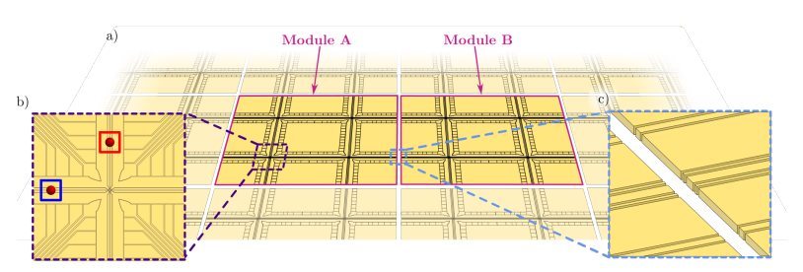
Introduction
A key requirement of a quantum computing architecture is the ability to scale to millions of qubits. If lasers are used to address each individual qubit, then it is required to have a high level of precision over millions of individual laser beams. This high level of precision is not required for qubits manipulated using long wavelength global radiation.
The blueprint paper [1] outlines an array-based design, like a QCCD type architecture.
[1] B. Lekitsch, S. Weidt, A. G. Fowler, K. Mølmer, S. J. Devitt, C. Wunderlich, and W. K. Hensinger, Blueprint for a microwave trapped ion quantum computer, Science Advances, 3 (2017), p. e1601540
Notes:
ions can be trapped in multiple confinement regions on the surface of a micro-fabricated trap, with each region having a different purpose, such as ion storage for memory, or a detection zone for readout. This allows a clear route into scalability.

Slide 4
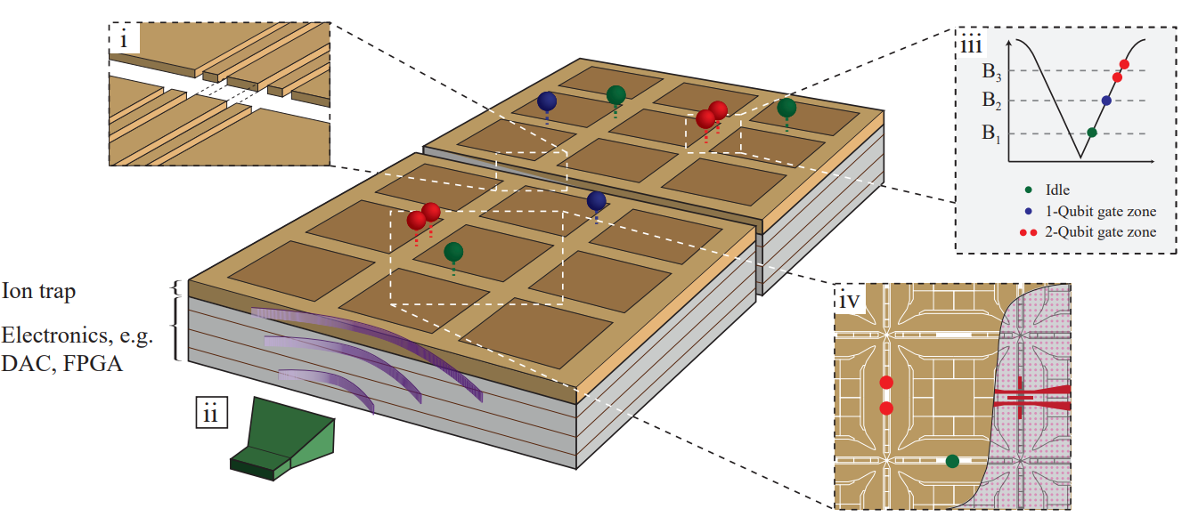
Introduction
Local Static Magnetic Gradient
Ions can then be transported between these different regions [4] to perform a quantum algorithm.
One major challenge of this approach, however, was that the number of radiation fields required increased with the number of ions.
Global Radiation Fields
Integrated CCWs
[2] S. Weidt, J. Randall, S. C. Webster, K. Lake, A. E. Webb, I. Cohen, T. Navickas, B. Lekitsch, A. Retzker, and W. K. Hensinger, Trapped-Ion Quantum Logic with Global Radiation Fields, (2016).
[3] F. Mintert and C. Wunderlich, Ion-Trap Quantum Logic Using Long-Wavelength Radiation, Physical Review Letters, 87 (2001), p. 257904.
[4] Akhtar, M., Bonus, F., Lebrun-Gallagher, F.R. et al. A high-fidelity quantum matter-link between ion-trap microchip modules. Nat Commun 14, 531 (2023)
Notes:
Ions are trapped across arrays of microfabricated X-junctions. The control electronics are placed directly under the ion trap. Similar to the QCCD proposal, ions are transported along the surface to various zones for e.g. trapping, readout or gates. (i) Inter-module networking involves transporting the ions over a potential barrier after careful alignment of the electrodes. (ii) Global microwave fields are broadcast over every region across the ion trap. (iii) Gate zones contain a static magnetic field gradient. Qubits interact with a global radiation field by positioning them within the gradient to bring their transition frequency into resonance. Here, three positions are represented (B1, B2 and B3), corresponding to an idle zone and a 1 (2) Qubit gate zone. (iv) The modules are composed of arrays of X-junctions. Gate zones contain current carrying wires embedded under the electrodes which produce the static magnetic field gradient.

Slide 5
Introduction
Local Static Magnetic Gradient
This requirement was removed when in 2016 [2], high-fidelity quantum logic using long wavelength radiation was successfully demonstrated for the first time, following the scheme proposed by Mintert et. Al. [3] in 2001.
Global Radiation Fields
Integrated CCWs
[2] S. Weidt, J. Randall, S. C. Webster, K. Lake, A. E. Webb, I. Cohen, T. Navickas, B. Lekitsch, A. Retzker, and W. K. Hensinger, Trapped-Ion Quantum Logic with Global Radiation Fields, (2016).
[3] F. Mintert and C. Wunderlich, Ion-Trap Quantum Logic Using Long-Wavelength Radiation, Physical Review Letters, 87 (2001), p. 257904.
Notes:
Ions are trapped across arrays of microfabricated X-junctions. The control electronics are placed directly under the ion trap. Similar to the QCCD proposal, ions are transported along the surface to various zones for e.g. trapping, readout or gates. (i) Inter-module networking involves transporting the ions over a potential barrier after careful alignment of the electrodes. (ii) Global microwave fields are broadcast over every region across the ion trap. (iii) Gate zones contain a static magnetic field gradient. Qubits interact with a global radiation field by positioning them within the gradient to bring their transition frequency into resonance. Here, three positions are represented (B1, B2 and B3), corresponding to an idle zone and a 1 (2) Qubit gate zone. (iv) The modules are composed of arrays of X-junctions. Gate zones contain current carrying wires embedded under the electrodes which produce the static magnetic field gradient.

Slide 6
Introduction
Local Static Magnetic Gradient
In conjunction with a local static magnetic gradient generated at specific positions on the chip, the ions are separated in frequency space, a single global microwave field can be used to address each ion and perform quantum logic.
Global Radiation Fields
Integrated CCWs
[2] S. Weidt, J. Randall, S. C. Webster, K. Lake, A. E. Webb, I. Cohen, T. Navickas, B. Lekitsch, A. Retzker, and W. K. Hensinger, Trapped-Ion Quantum Logic with Global Radiation Fields, (2016).
[3] F. Mintert and C. Wunderlich, Ion-Trap Quantum Logic Using Long-Wavelength Radiation, Physical Review Letters, 87 (2001), p. 257904.
Notes:
Ions are trapped across arrays of microfabricated X-junctions. The control electronics are placed directly under the ion trap. Similar to the QCCD proposal, ions are transported along the surface to various zones for e.g. trapping, readout or gates. (i) Inter-module networking involves transporting the ions over a potential barrier after careful alignment of the electrodes. (ii) Global microwave fields are broadcast over every region across the ion trap. (iii) Gate zones contain a static magnetic field gradient. Qubits interact with a global radiation field by positioning them within the gradient to bring their transition frequency into resonance. Here, three positions are represented (B1, B2 and B3), corresponding to an idle zone and a 1 (2) Qubit gate zone. (iv) The modules are composed of arrays of X-junctions. Gate zones contain current carrying wires embedded under the electrodes which produce the static magnetic field gradient.

Slide 7
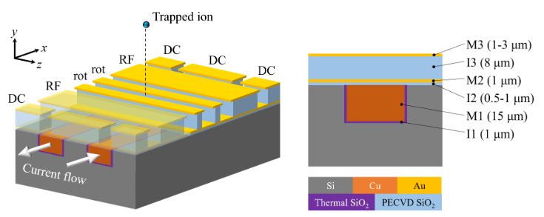
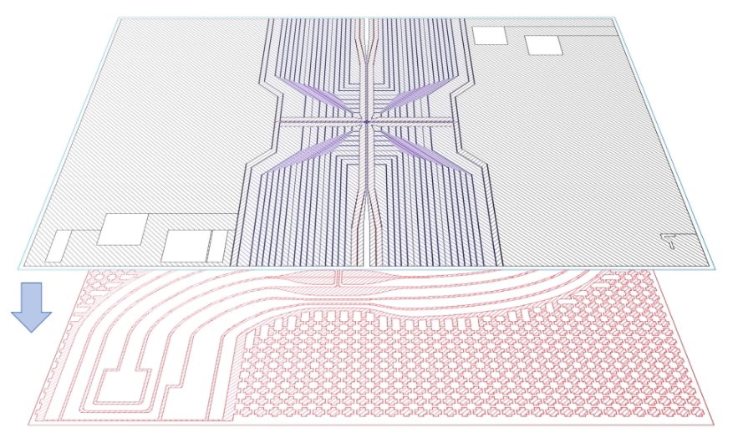
The X-Junction Chip
To demonstrate a unit cell of the blueprint, a surface ion trap is designed [4] with integrated current carrying wires embedded underneath the RF and DC trapping electrodes.
Ion traps with CCWs in the top layer have demonstrated static axial magnetic gradients up to 23 T/m [5]. Oscillating radial magnetic gradients of up to 152 T/m [6] have also been demonstrated at ion heights of 30 um.
RF/DC electrodes
Integrated CCWs
[4] M. Siegele-Brown, S. Hong, F. Raphael Lebrun-Gallagher, S. James Hile, ¨ S. Weidt, and W. Karl Hensinger, Fabrication of surface ion traps with integrated current carrying wires enabling high magnetic field gradients, (2022)
[5] Kunert P, Georgen D, Bogunia L, Baig M, Baggash M, Johanning M and Wunderlich C 2014
Applied Physics B 114 27–36
[6] Srinivas R, Burd S, Knaack H, Sutherland R, Kwiatkowski A, Glancy S, Knill E, Wineland D,
Leibfried D, Wilson A C et al. 2021 Nature 597 209–213

Slide 8
The X-Junction Chip
In this concept:
the design of the CCWs is completely independent from the design of the top electrode layer.
The CCWs are not moved significantly further away from the ion.
Low sheet resistance copper is utilised for the wires to allow management of thermal dissipation.
Therefore, currents up to 10 A can be applied, generating static axial magnetic gradients of up to 100 T/m at ion heights of 125 um [4].
RF/DC electrodes
Integrated CCWs
[4] M. Siegele-Brown, S. Hong, F. Raphael Lebrun-Gallagher, S. James Hile, ¨ S. Weidt, and W. Karl Hensinger, Fabrication of surface ion traps with integrated current carrying wires enabling high magnetic field gradients, (2022)

Slide 9
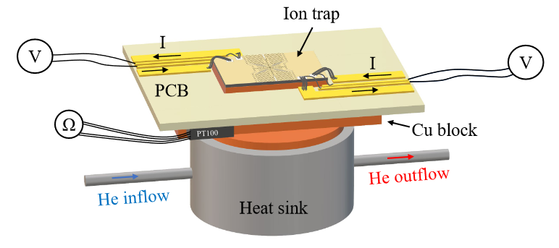
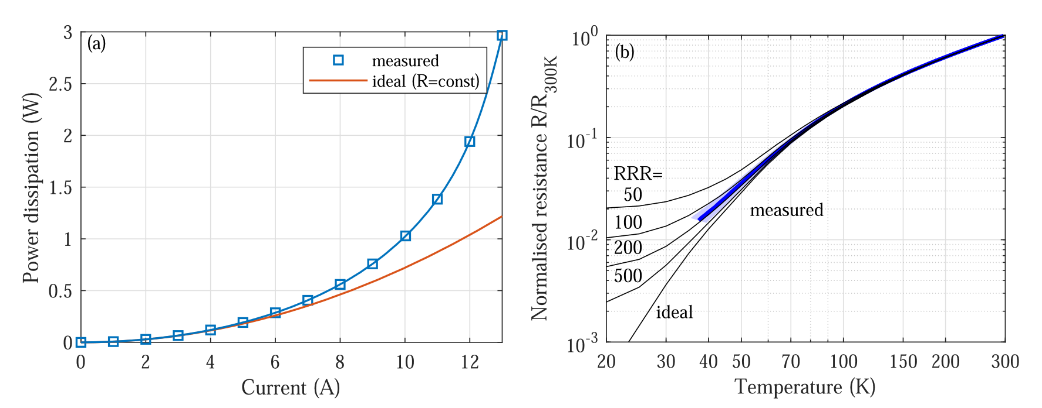
Testing the X-Junction Chip
The following UHV experiment was set up to evaluate the chip's electrical performance. The device was mounted on a heatsink supplied by a custom closed-loop cryogenic system [5].
The power dissipated was measured for continuous currents from 0 A to 8A, and pulsed currents from 10 A to 13 A. The power dissipated reached 20 W, which is well within the cooling power of the cryogenic system [5].
[5] F R Lebrun-Gallagher et al 2022 Quantum Sci. Technol. 7 024002
ECCTI 2024 9 July 2024
Notes:
For continuous currents at 8 A, thermal runaway was observed which can be improved with better thermal anchoring. However, in the pulsed regime, thermal runaway occurred at higher applied currents. The resistance was also measured which agreed with simulation to within 1%. The power

Slide 10
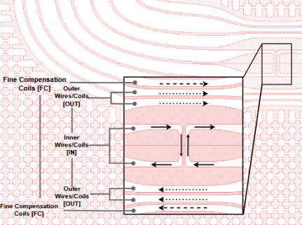
Simulating the X-Junction Chip
We now take a closer look at the design of the CCWs. In our CCW geometry, there are multiple wires, as labelled in the figure on the left. They were designed and optimised to generate the highest axial magnetic gradient.
In total there are 10 wires that have been optimised in an anti-parallel wire pair geometry [6]. The inner wire pair, in combination with the outer wire pair generates a magnetic quadrupole nil at the desired ion height, with the fine compensation coils allowing finer resolution adjustment to the position of the quadrupole nil in one axis.
[6] F R Lebrun-Gallagher PhD Thesis (2022)
Notes:
For continuous currents at 8 A, thermal runaway was observed which can be improved with better thermal anchoring. However, in the pulsed regime, thermal runaway occurred at higher applied currents. The resistance was also measured which agreed with simulation to within 1%. The power

Slide 11
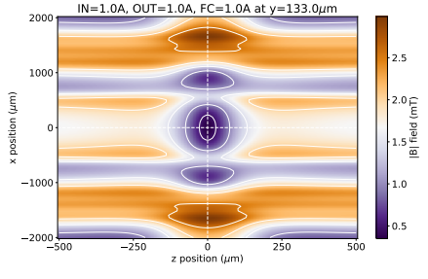
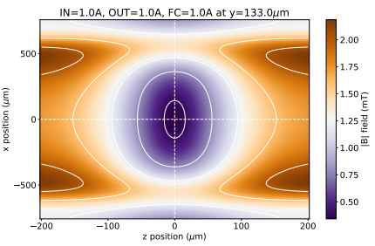

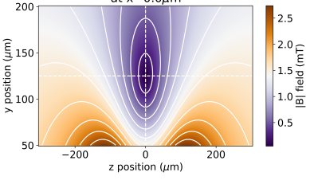
Simulating the X-Junction Chip
In this scheme utilising global microwave radiation, only the gradient of the magnetic field magnitude is of interest [3].
This parameter is directly proportional to the strength of the effective Lamb Dicke parameter which defines the strength of the spin-motion coupling in our qubits.
[3] F. Mintert and C. Wunderlich, Ion-Trap Quantum Logic Using Long-Wavelength Radiation, Physical Review Letters, 87 (2001), p. 257904.
ECCTI 2024 9 July 2024
Notes:
We therefore develop simulations of the wire geometry to predict the strength and orientation of the magnetic fields generated by such a configuration.

Slide 12
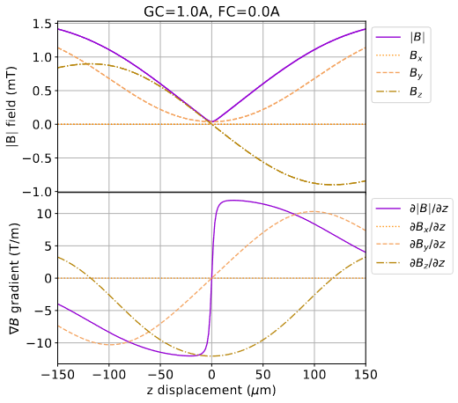
Simulating the X-Junction Chip
At 1A on the gradient coils we should generate approx. 11T/m along the axial direction, and approx. 5T/m along the radial y direction.
There is no magnetic field or magnetic field gradient from the x-axis at all. This is a consequence of the design geometry [5].
The ion should not sit at the centre but displaced some amount from the zero of the magnetic field, allowing a small zeeman splitting, but a large gradient.
[5] F R Lebrun-Gallagher et al 2022 Quantum Sci. Technol. 7 024002
ECCTI 2024 9 July 2024
Notes:
For continuous currents at 8 A, thermal runaway was observed which can be improved with better thermal anchoring. However, in the pulsed regime, thermal runaway occurred at higher applied currents. The resistance was also measured which agreed with simulation to within 1%. The power

Slide 13
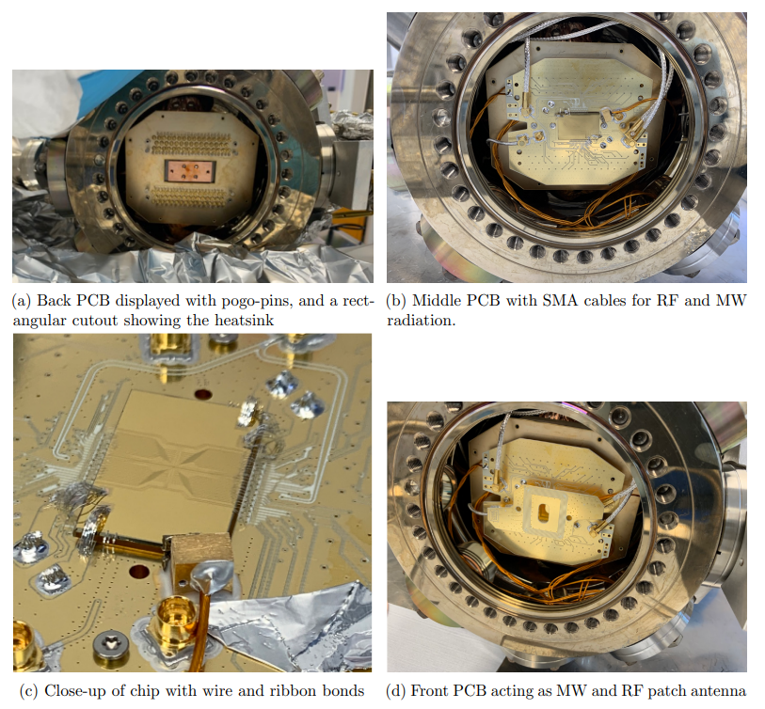
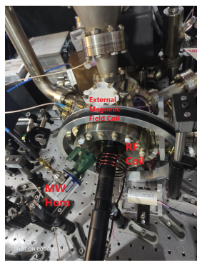
The Experimental Setup
The results and data shown in this presentation were taken using an ultra-high vacuum chamber containing electrical equipment to provide the relevant signals and fields at the ion. An FPGA using the ARTIQ framework is used to perform almost all experimental work.
The microfabricated surface chip shown is glued to a heatsink, and mounted inside the UHV chamber.
BONDED X JUNCTION TRAP
INSIDE VACUUM CHAMBER
UHV CHAMBER
ECCTI 2024 9 July 2024

Slide 14
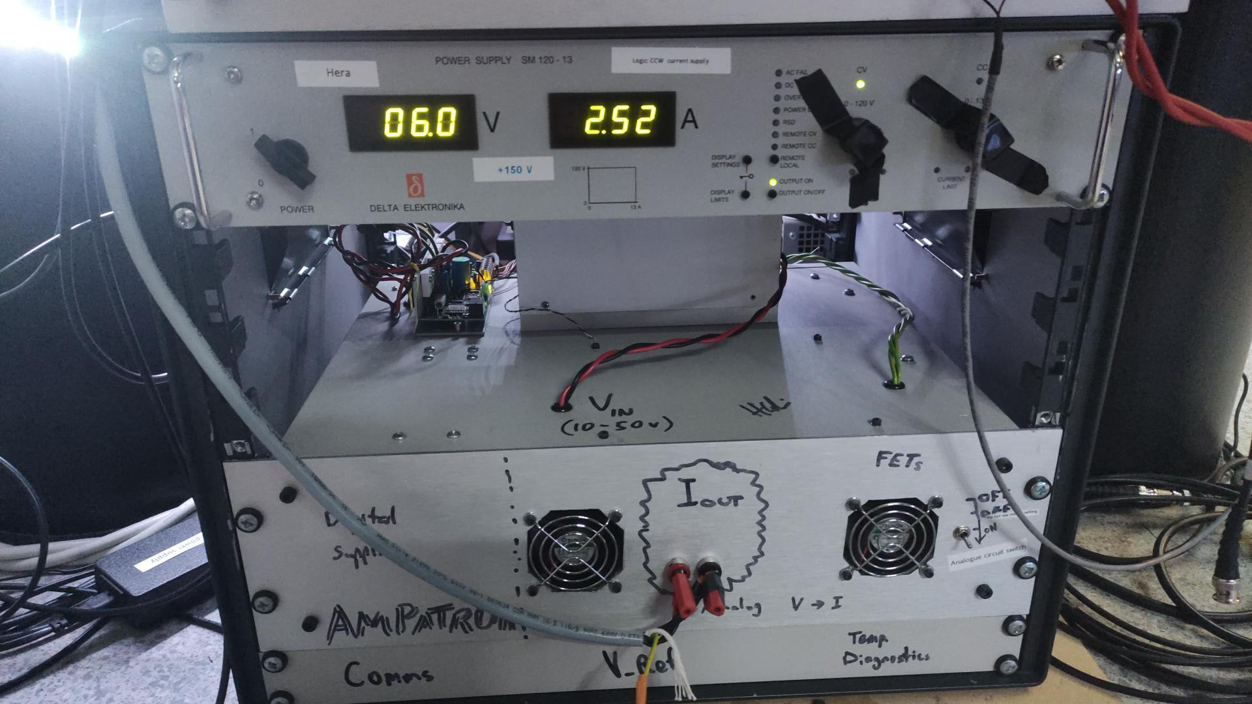
The Experimental Setup
INSIDE VACUUM CHAMBER
We utilise a home-built ultra-low noise current source to power the CCWs. It can go up to 10A.
Builf for very low current noise.
Can switch on and off very quickly in order to interleave ion transport operations for scalable architecture.
System built by Harry Godwin [Universal Quantum] et. Al.
ECCTI 2024 9 July 2024
Notes:
. It consists of a standard power supply shown at the top, whose output is ‘filtered’ for noise when switching on and off via. a complex internal DAC system.
The output is transferred into the grey cables which go into the CCW feedthrough of the vacuum system. It has a measured maximum drift of 99.8 uA over 6 hours, and has been measured to switch from 0 to 10 A in 50 ns.

Slide 15
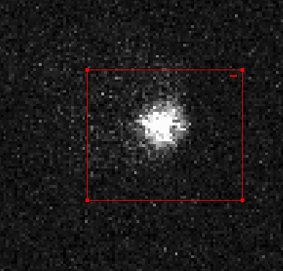
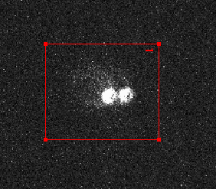
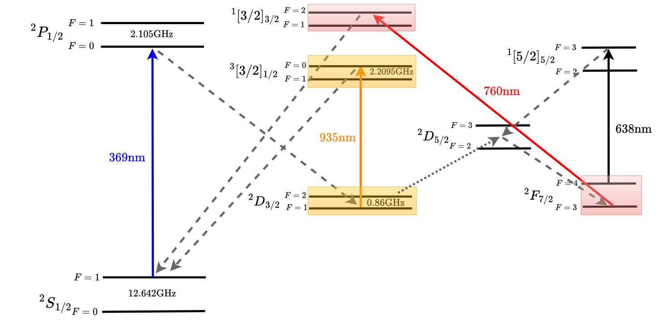
Initial Trapping
A single Yb ion, and multiple Yb ions taken using an EMCCD camera.
Initial experimental characterisation of the chip starts by trapping a single Yb 171+ ion. The experiment temperature is 130 K, and sits at a base pressure of 2.8e-11 mbar. Ion lifetimes are over 30 hours on average.
A magnetic field of approximately 1 mT is typically applied to the ion trap. The transition frequencies of the 2S[1/2] sub-manifold were then measured.
ECCTI 2024 9 July 2024

Slide 16
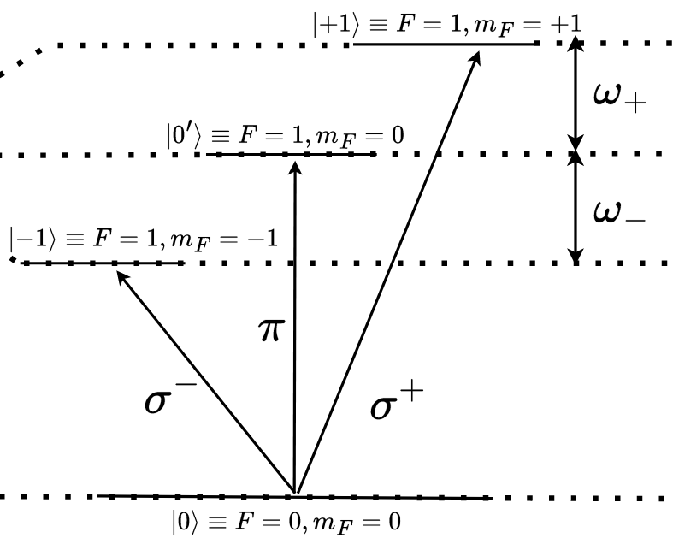
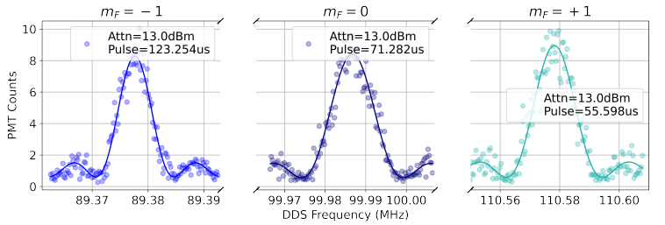
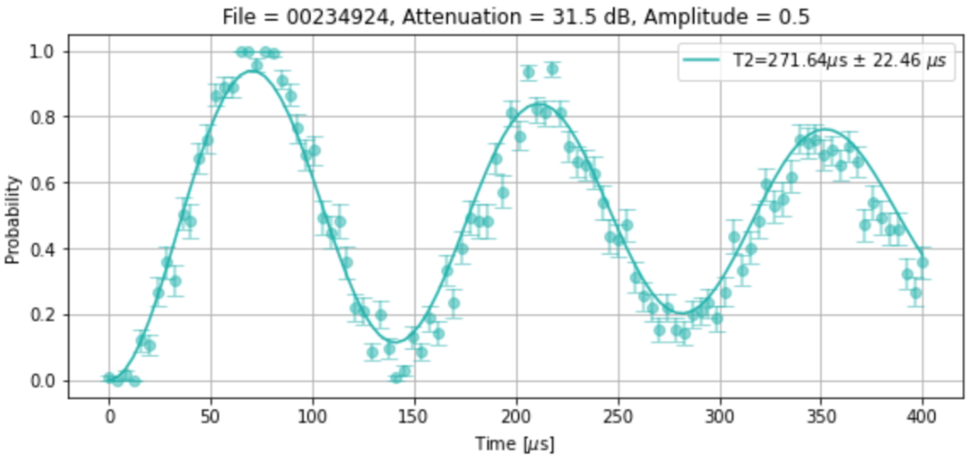
Experimental Results 01
By preparing the ion in the ground state, a microwave pulse with either a fixed duration or fixed frequency can be applied, measuring the centre frequencies and rabi frequencies of each transition.
Qubits can be encoded in bare hyperfine ground states by applying pulses to prepare either ground, excited or superposition states.
ECCTI 2024 9 July 2024
Notes:
However, the bare states are sensitive to dephasing from magnetic field noise, and demonstrate low coherence times.

Slide 17
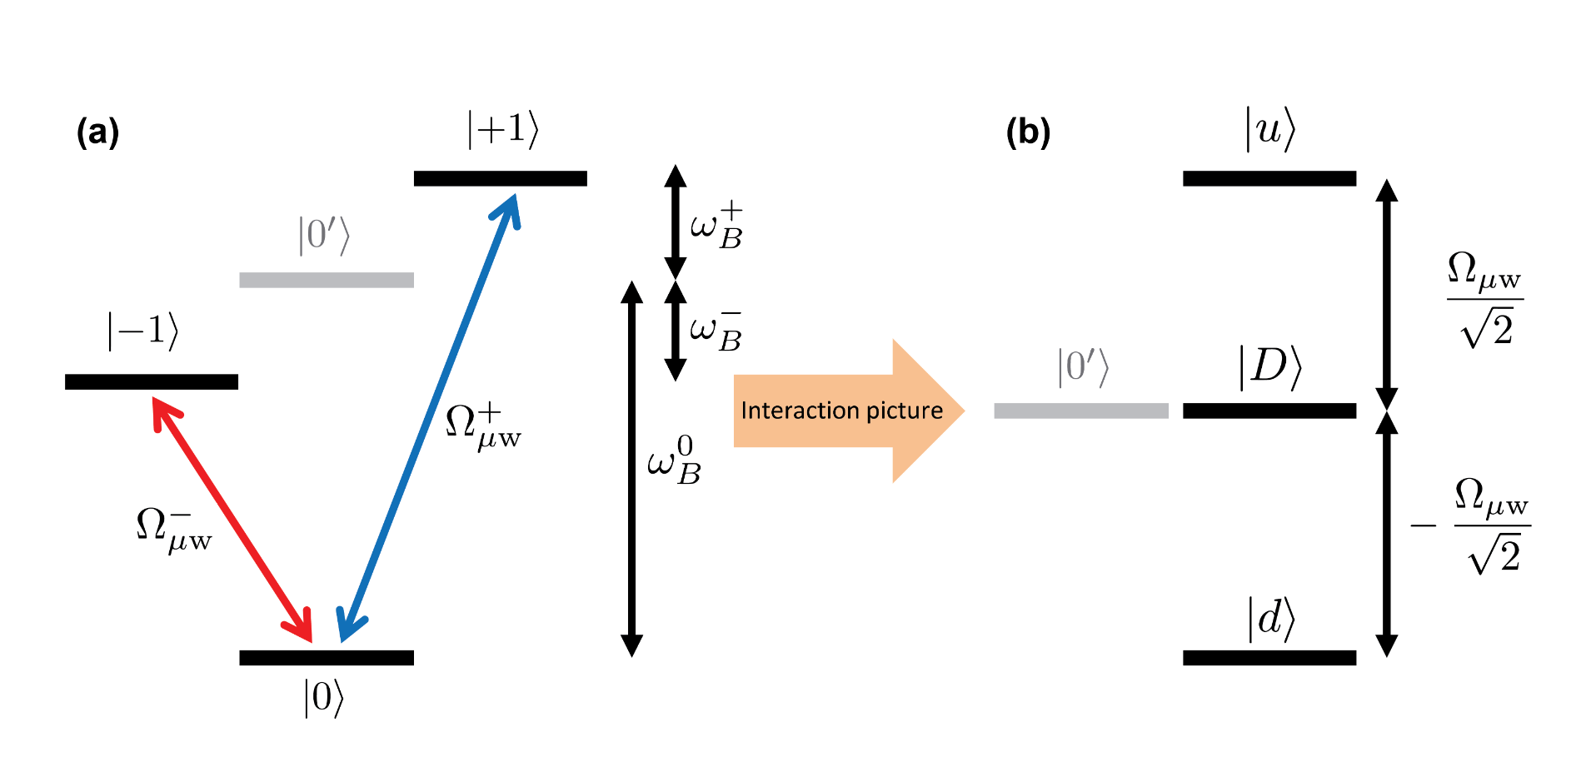
Moving into the Dressed State Picture
Instead of encoding the qubit in the bare atomic transitions, it can be advantageous to instead encode quantum information in the states formed when the ion is dressed by continuous application of a microwave or laser field, known as dressed states [6].
[6] N. Timoney, I. Baumgart, M. Johanning, A. F. Varon, M. B. Plenio, A. Retzker, and C. Wunderlich, Nature 476, 185 (2011).
ECCTI 2024 9 July 2024
Notes:
These states have been shown to be less sensitive to dephasing from magnetic field noise and can increase the coherence time of the system by several orders of magnitude. By applying two continuous microwave fields, a pulsed RF field can be applied to manipulate and detect your new clock qubit.

Slide 18
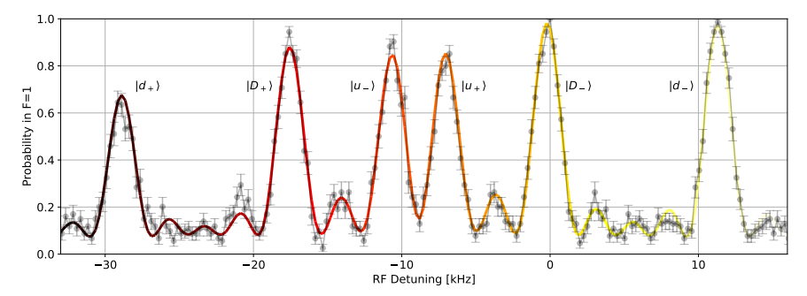
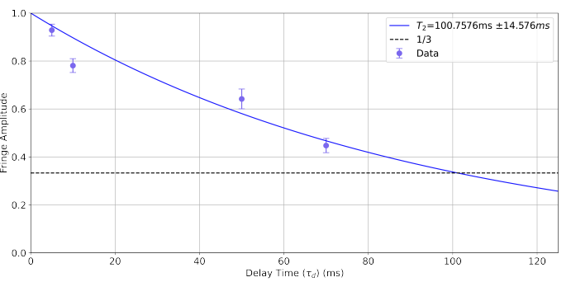
Experimental Results 02
We prepared a dressed state qubit over both zeeman sensitive transitions in Yb171.
The |D⟩ state transitions are utilised as it is protected from both magnetic field noise and any microwave amplitude noise in the dressing fields. Coherence time was measured to be approx. 100 ms at 20 kHz dressing field rabi frequencies.
Spin Echo (T_2) Measure |0’⟩ -> |D+⟩
ECCTI 2024 9 July 2024

Slide 19
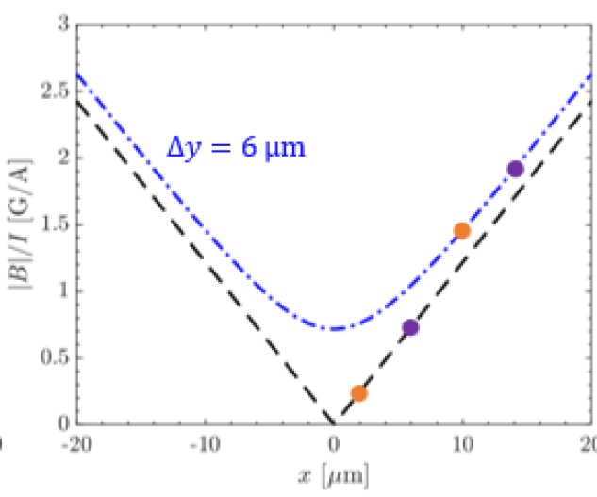
Mapping the Magnetic Gradient using Transport
To demonstrate the design and behaviour of the CCWs, we study how the magnetic field changes at different positions. Depending on the overlap of the nil with the PS nil, we get a different shape of the magnetic field.
ECCTI 2024 9 July 2024
Notes:
This cancelled the out-of plane offset magnetic field, and demonstrated the absence of any magnetic field in x. We measured close to the predicted 22 T/m at the ion position. This demonstrated the integrated CCWs work exactly as expected.

Slide 20
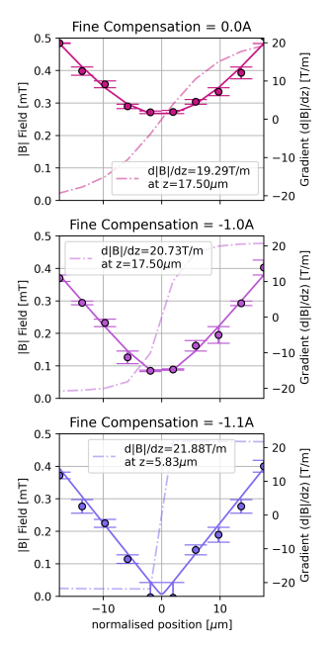
Experimental Results 03
BEFORE COMPENSATION
The ion was transported +- 20 um either side of the simulated nil, and the +1 transition was measured at 10 points, with a current of 2A applied to the coils.
By utilising the fine compensation coils, we are able to overlap the ions position with the quadrupole nil, optimising the gradient, and demonstrating full y-axis compensation, and absence of x-axis magnetic field
AFTER COMPENSATION
ECCTI 2024 9 July 2024
Notes:
This cancelled the out-of plane offset magnetic field, and demonstrated the absence of any magnetic field in x. We measured close to the predicted 22 T/m at the ion position. This demonstrated the integrated CCWs work exactly as expected.

Slide 21
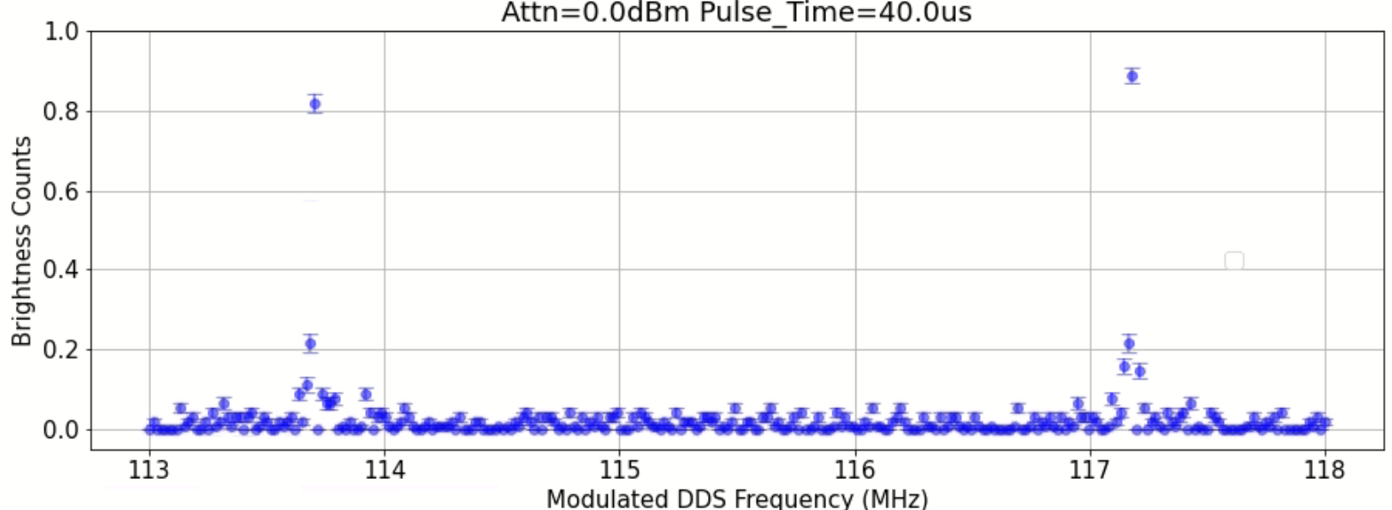
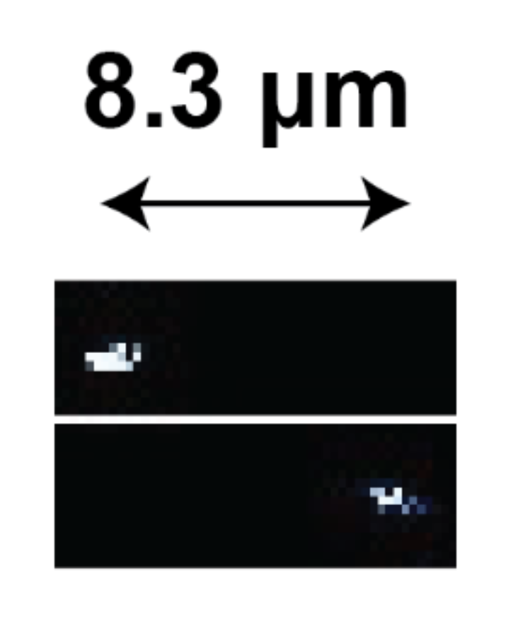
Experimental Results 04
We perform a frequency scan over the +1 zeeman state, with two ions present in the system, allowing us to distinguish each chosen transition.
We can also use this to verify the previous gradient measured. At 2.5A on the CCWs, and an axial secular frequency of 230 kHz, we find the expected 3.5MHz splitting indicating a gradient of 27.5T/m.
ECCTI 2024 9 July 2024

Slide 22
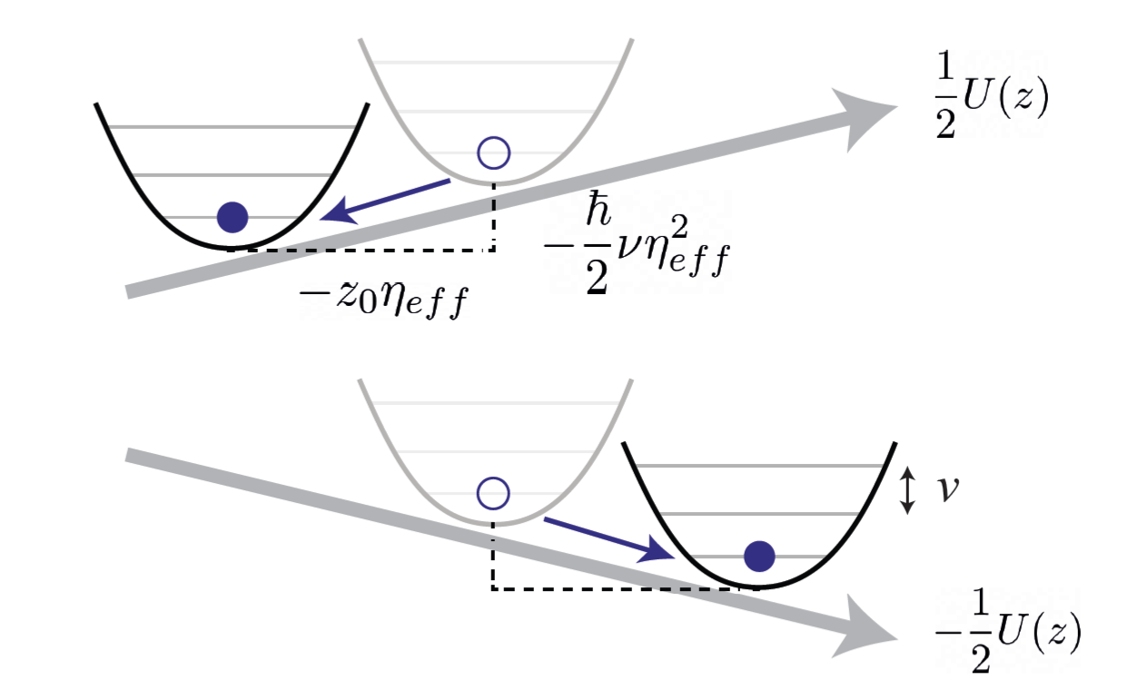
Spin-Motion Coupling
A magnetic-field gradient at the position of the ions can create a state dependent force which increases the coupling of the radiation to the ion’s motional state. Coupling of the spin states to the motional states allow us to address transitions to the motional state which allow ground state cooling, and the implementation of multiple gate schemes [8].
We can also address ions in a chain using frequency space.
[8] K. Lake, S. Weidt, J. Randall, E. D. Standing, S. C. Webster, and W. K. Hensinger
Phys. Rev. A 91, 012319
ECCTI 2024 9 July 2024

Slide 23
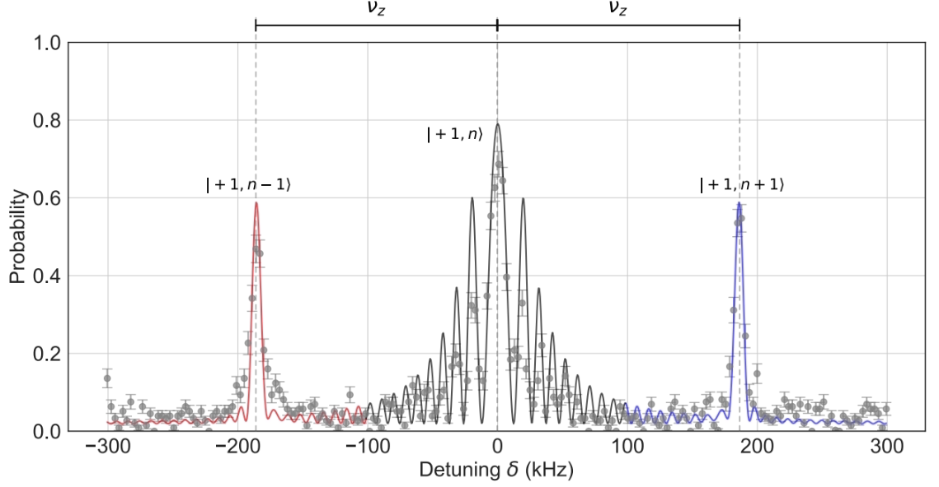
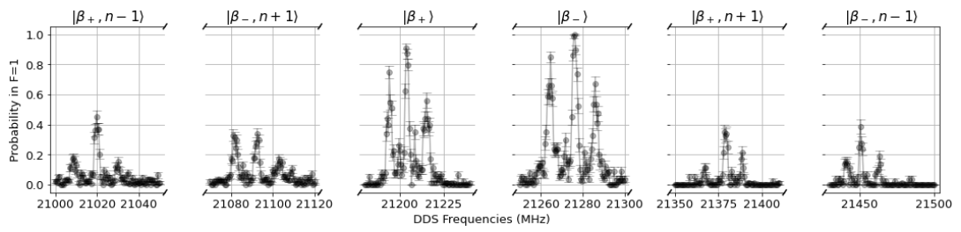
Experimental Results 05
In order to demonstrate spin-motion coupling we also perform a frequency scan over the range encompassing the axial secular frequency of the |0⟩ -> |+1⟩ , we can address transitions to the motional states.
A similar experiment is performed for our dressed state qubits as well.
[8] K. Lake, S. Weidt, J. Randall, E. D. Standing, S. C. Webster, and W. K. Hensinger
Phys. Rev. A 91, 012319
ECCTI 2024 9 July 2024
Notes:
The motional sidebands remain when transforming to the dressed basis, allowing the dressed spin states to be coupled to the motional states also.

Slide 24
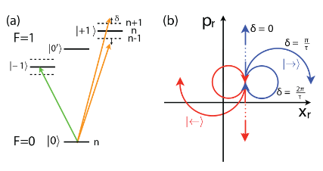
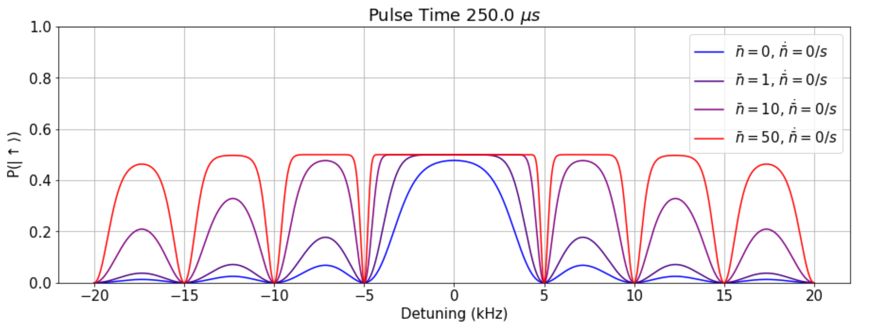
Single Ion Entanglement (CAT State)
By using microwave radiation in conjunction with a large static magnetic-field gradient, we can generate a coupling between the internal and motional states of a trapped ion to demonstrate spin-motion entanglement [8].
We demonstrate this coupling by using it to produce entanglement between the internal spin state of a single trapped ion and its external motional state (a Schrodinger cat state), a single-ion version of the multi-ion Mølmer-Sørensen gate.
[8] K. Lake, S. Weidt, J. Randall, E. D. Standing, S. C. Webster, and W. K. Hensinger
Phys. Rev. A 91, 012319
ECCTI 2024 9 July 2024
Notes:
These detunings correspond to the zero resultant microwave-induced displacements after the application of the pulses, the spin states having undergone j complete loops in phase space resulting in no residual entanglement between spin and motion.

Slide 25
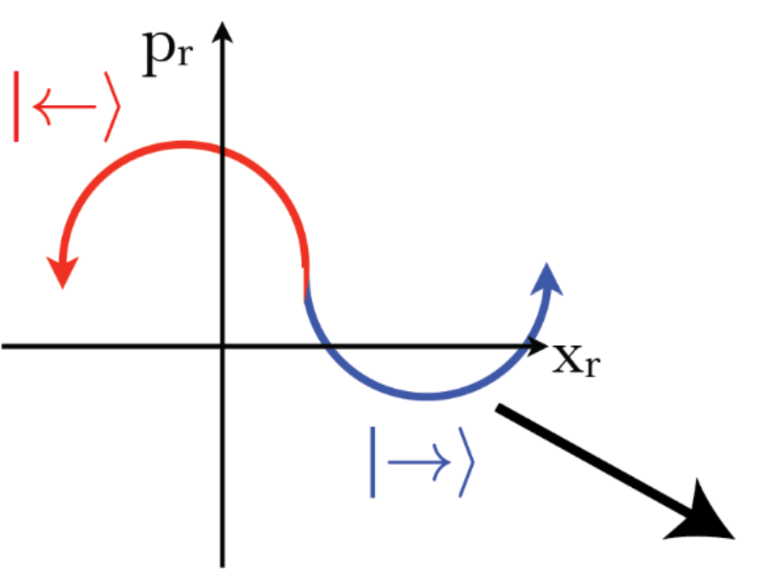
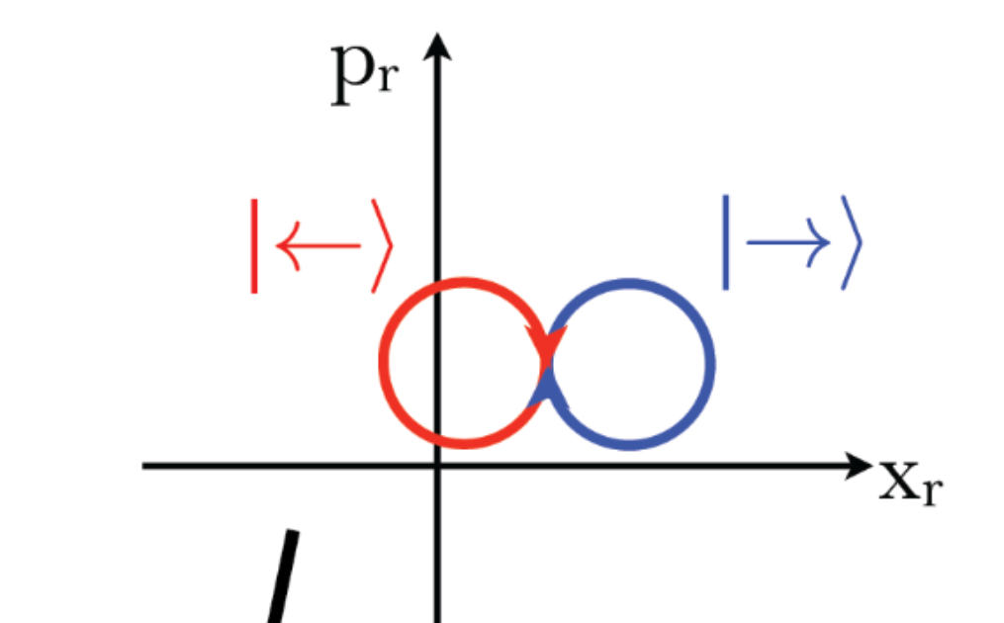
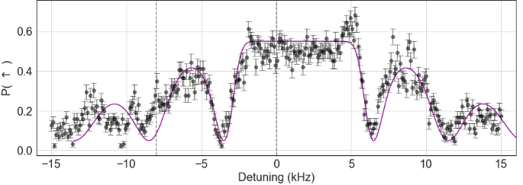
Experimental Results 06
Pulse Time = 200us,
Initial nbar = 58
We perform a frequency scan with two fields oppositely detuned from the red and blue motional sidebands of a single ion, with a pulse time of 200us, and initial nbar of 58.
The maximum distance between the two motional states in phase space occurs when δ = 2 kHz, and the minimum at δ = +-6 kHz.
ECCTI 2024 9 July 2024
Notes:
These detunings correspond to the zero resultant microwave-induced displacements after the application of the pulses, the spin states having undergone j complete loops in phase space resulting in no residual entanglement between spin and motion.

Slide 26
Summary and Outlook
Designed and fabricated a surface trap that can generate a high gradient with a relatively large ion height.
Trapped and characterise the static magnetic gradient and addressed two ions in frequency space.
Utilised the high magnetic gradient to demonstrate a large spin motion coupling parameter with global microwave fields and created a single ion entangled state (CAT) state.
OUTLOOK:
Uitlised the dressed state motional sidebands to cool to the motional ground state using microwaves.
Test two qubit entangling gates such as the Molmer Sorenson Gate.
ECCTI 2024 9 July 2024

Slide 27
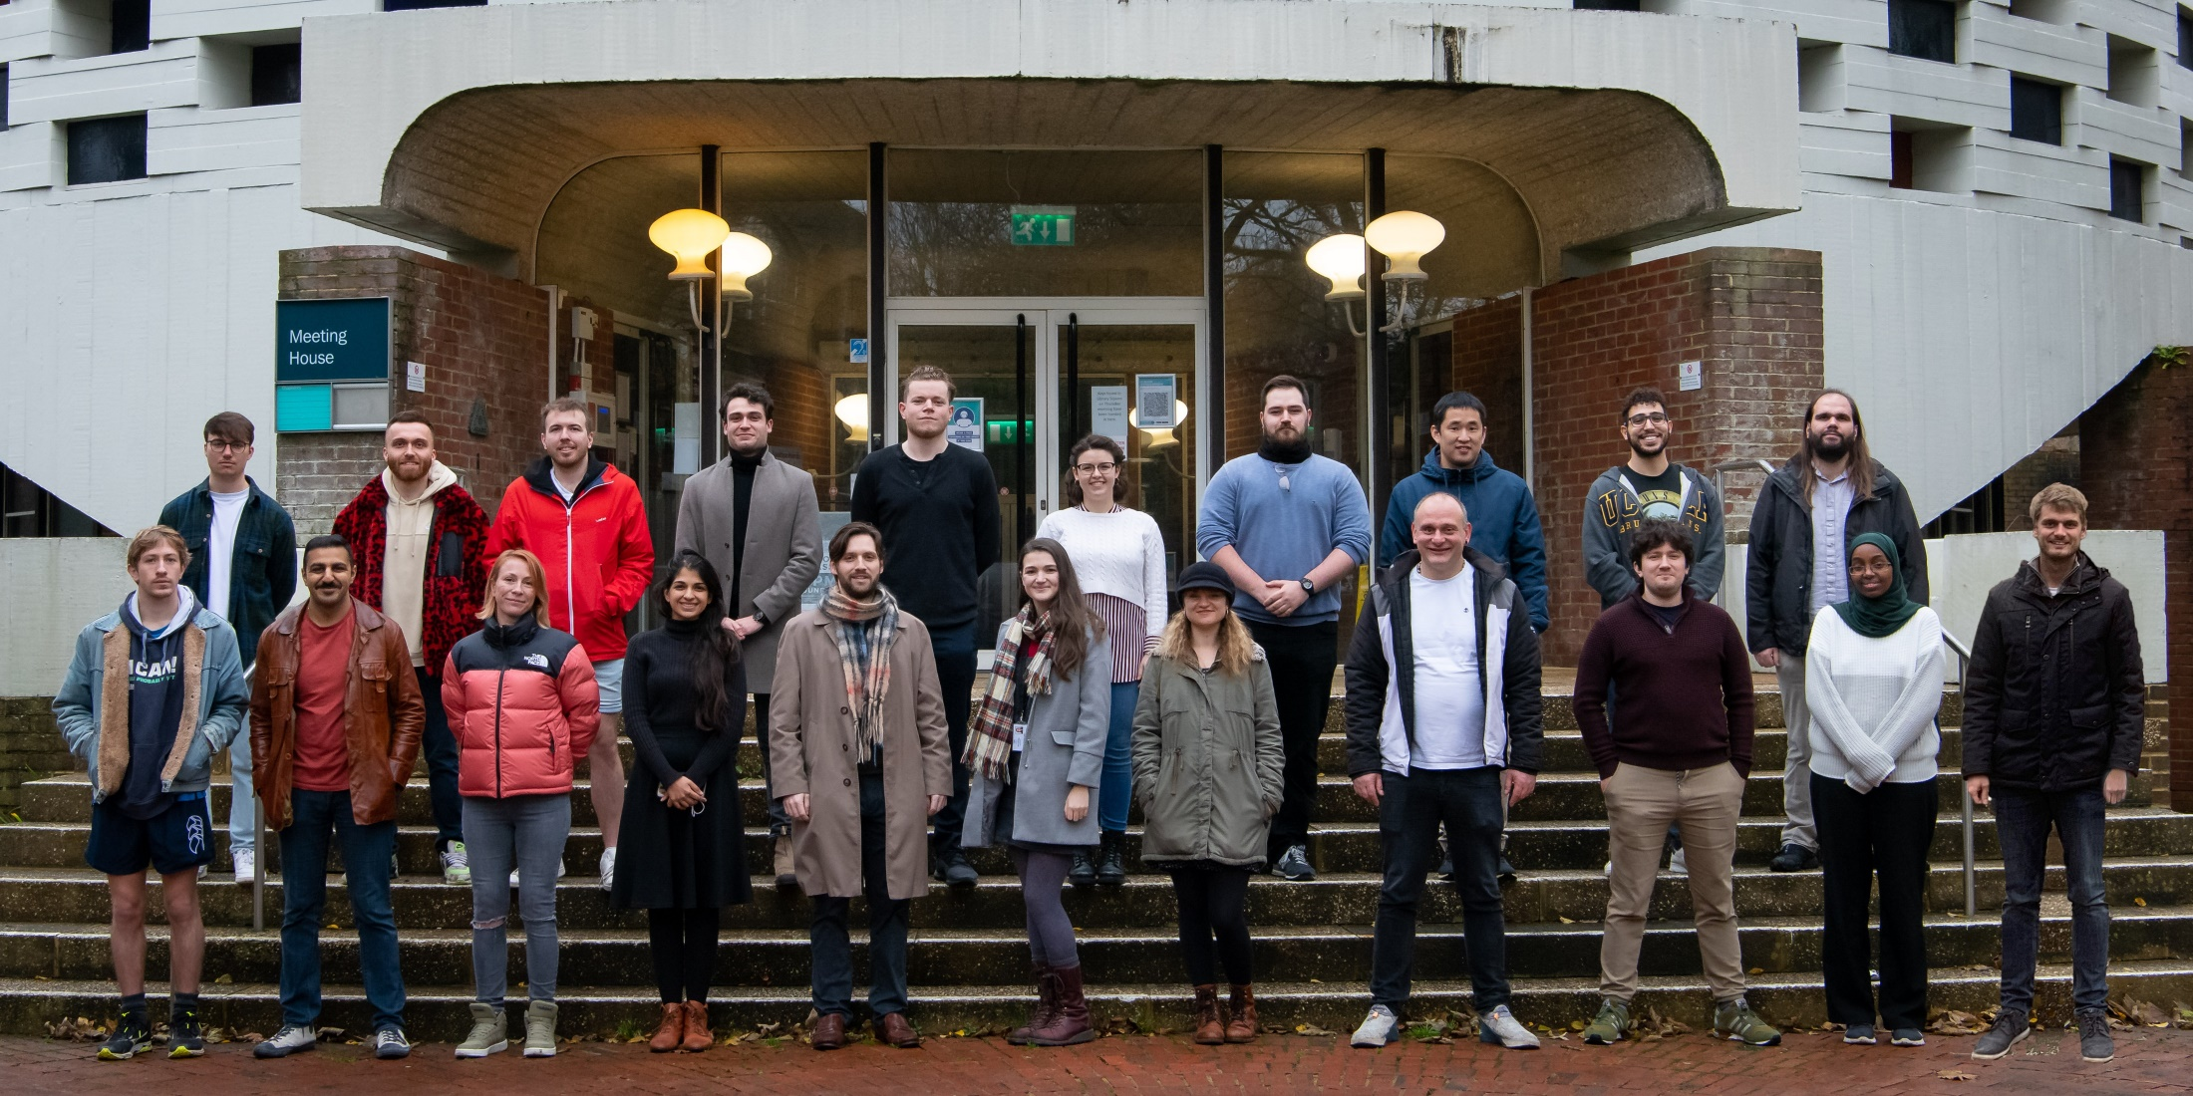















MSc/UG:
Joe Swainston
Suraj Lokesh
Wallace Collins
Head of group:
Prof. Winfried Hensinger
Senior Scientist:
Dr Sebastian Weidt
Administrator:
Emily Crozier
PDRAs/ENGINEERS:
Dr Sam Hile
Dr Foni Raphaël Lebrun- Gallagher
Dr Martin Siegele
Dr Pedro Taylor-Burdett
Sahra Ahmed Kulmiya
Andrew Betts
PhD Students:
Vijay Kumar
Madalina Mironiuc
Petros Zantis
James Urquhart
Parsa Rahimi
Scott Mason
Toby Maddock
Matthew Aylett
We gratefully acknowledge funding from:

